Slide 1
Niobium RRR and Ta specifications for SRF cavities: a critical review
G. Ciovati, P. Kneisel and G. Myneni
7th SRF Materials Workshop, July 16th 2012
Jefferson Lab

Slide 2
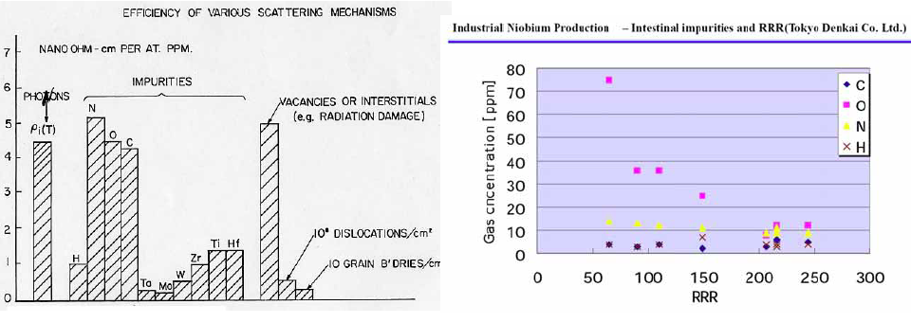
Influence of Impurities on RRR
Contribution of different defects in the scattering mechanism:
Relationship between RRR and nonmetallic impurities measured by Tokyo Denkai
Expected RRR contribution for Nb for 1 wt ppm of impurities

Slide 3
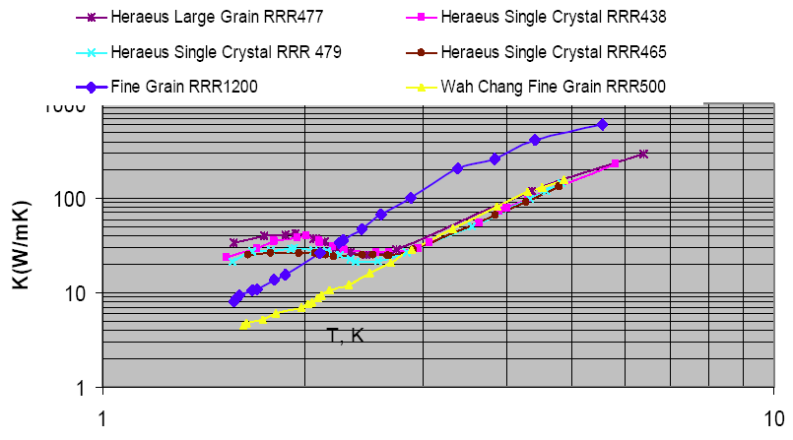
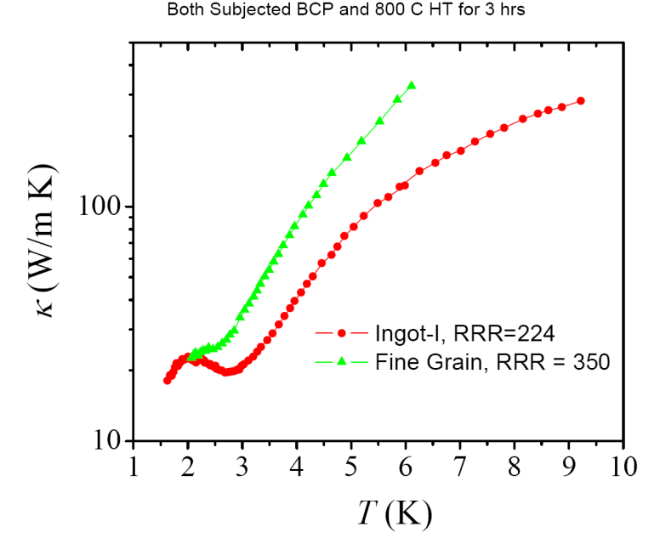
RRR and thermal conductivity
In SRF, RRR is considered a synonymous of thermal conductivity:
Rule of thumb:
κ(4.2K) ≈ 0.25 W/(m K)⋅RRR
BUT most bulk Nb cavities operate at 2.0 K. Phonon peak in large-grain/single-crystal material eliminates the correlation between κ(2.0K) and RRR
P. Dhakal, to be published
W. Singer, DESY

Slide 4
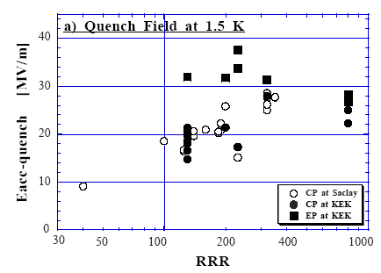
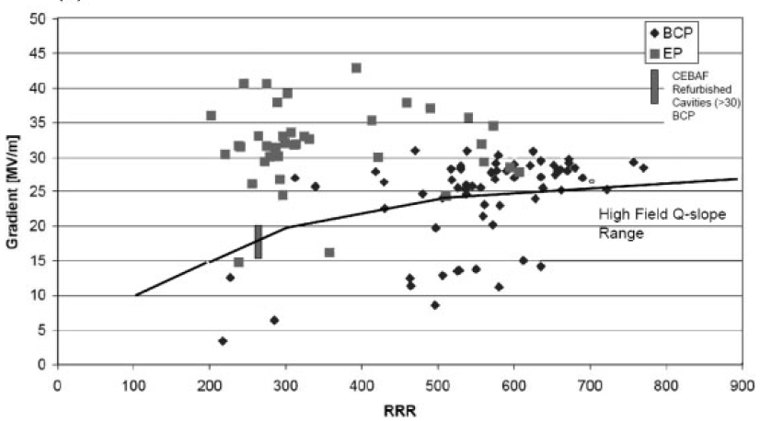
RRR and gradient: data
1.3 GHz single-cell cavities
Fine-grain, BCP vs. EP
E. Kako et al., SRF’99, p. 179
100 μm diameter nc defect
9-cell ILC cavities
H. Padamsee, “RF Superconductivity Science, Technology and Applications”, Wiley-VCH, 2009, p. 199

Slide 5
RRR and gradient: data
BCP, Large-grain vs. Fine-grain
W. Singer et al., Proc. of the SSTIN’10, AIP Conf. Proc. 1352, p. 13

Slide 6
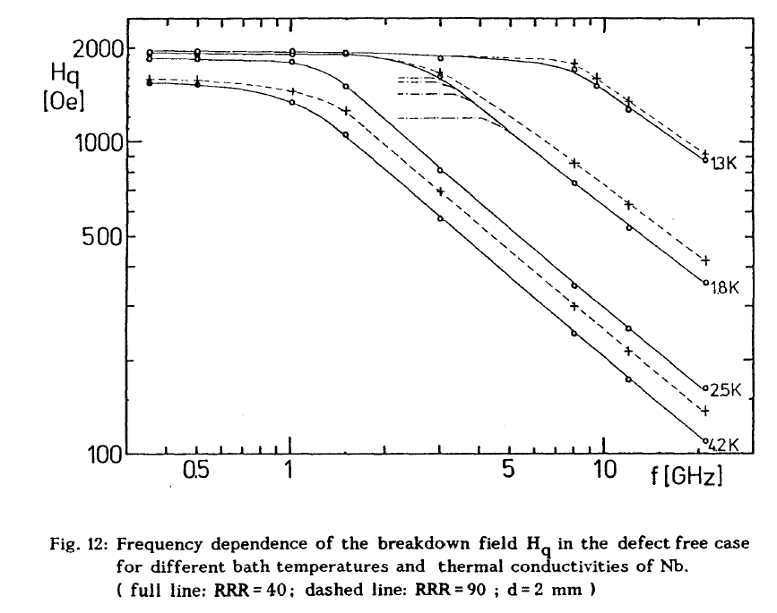
RRR and gradient: models
G. Müller, SRF’87, p. 331
Current and future SRF cavity applications are at f ≤ 1.5 GHz: H_{q} independent of RRR below 2.0 K in case of defect free material

Slide 7
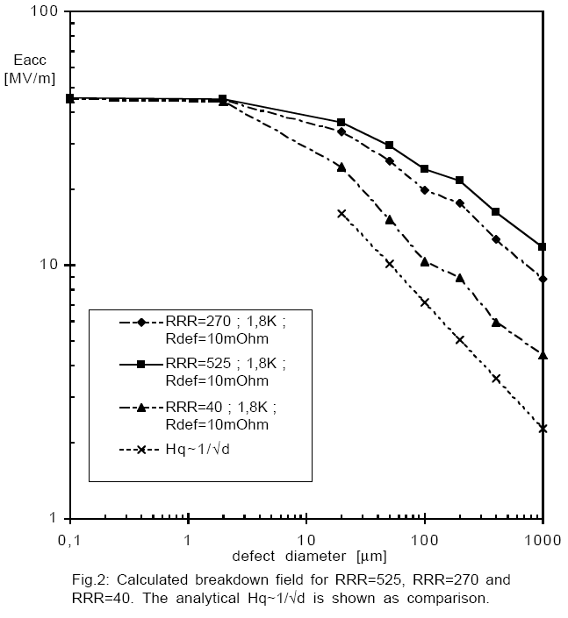
RRR and gradient: models
1.3 GHz, 1.8 K
Eddy current scanning can detect defects with diameter >~50 μm, within ~0.5 μm depth
Data on RRR vs. gradient show defect size <~30 μm
D. Reschke, SRF’97, p. 385

Slide 8
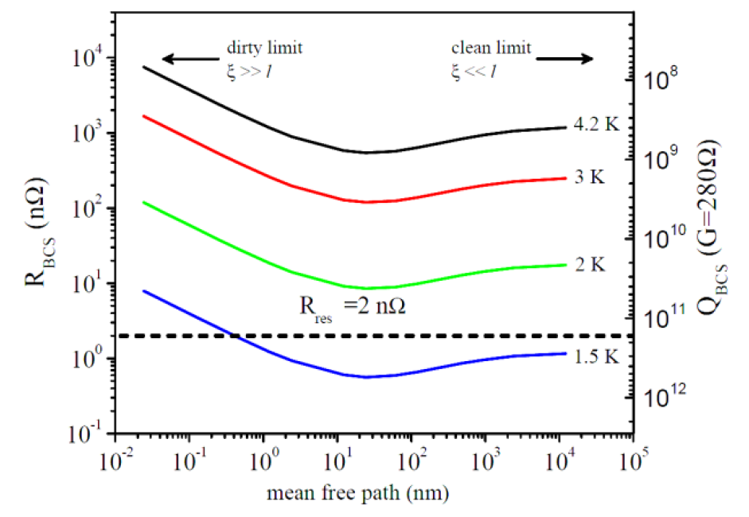
RRR and R_{s}
1.5 GHz
R_{BCS} has a minimum for surface RRR ~ 13
P. Dhakal et al., IPAC’12, paper WEPPC091
We don’t know of any correlation between RRR and RF residual resistance
High RRR is not required for low R_{BCS}

Slide 9
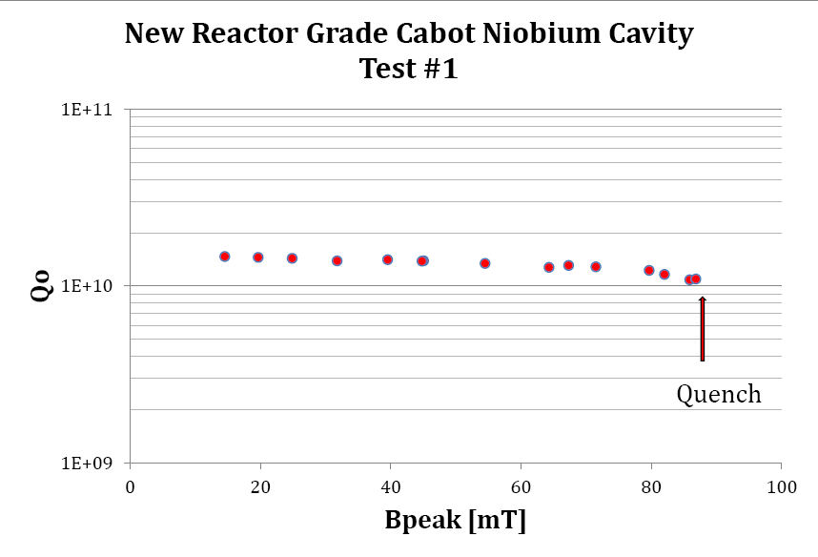
RRR and Q-slopes
RRR ~ 40
E_{acc,quench} ~ 20 MV/m
P. Kneisel, JLAB-TN-12-010
V. Palmieri’s model (SRF’05, p. 162): lower RRR gives higher medium field Q-slope. RRR should be at least ~100.
Gurevich and Lin’s calculation [Phys. Rev. B 85, 054513 (2012)]: lower RRR (~6) gives lower medium and high field Q-slopes.

Slide 10
Ta in Nb: past and current specification
Stanford specification: “Since the relationship between good superconducting Nb cavity RF performance and impurity level is not experimentally demonstrated, the assumption that the Nb should be as pure as possible is made. A compromise must, however, be made between cost and impurity specifications.” [J. P. Turneaure, Proc. of the 1972 Appl. Supercond. Conf., Annapolis, MD, pp. 621-630 ]. Ta was ≤ 500 wt.ppm.
H. Padamsee, RF Superconductivity for Accelerators, J. Wiley & Sons, 1998, p. 106: “Presently the 500-1000 ppm wt impurity level is not perceived to be a problem since tantalum is a substitutional impurity which does not substantially affect the electronic properties.”
Current Ta specification: ≤ 500 wt.ppm
It seems that the Ta content spec. propagated from Stanford as the “best that was commercially available”. No scientific justification was found. There was one documented case of quench at 13 MV/m in a 9-cell cavity due to Ta cluster. (W. Singer et al., SRF’97, p. 850). Rumors say that this cluster was embedded during rolling of the Nb sheets with dirty rollers

Slide 11
SRF cavity results
1.5 GHz single-cell study (P. Kneisel et al., PAC’95, p. 3955)
No significant dependence of quench field on RRR
B_{p,quench} ~ 130 mT (E_{acc}=30.5 MV/m for ILC shape) achieved in a cavity with 1300 wt. ppm Ta
1.3 GHz 9-cell cavity (G. Ciovati et al., SSTIN’10, p. 25):
B_{p,quench} ~ 131 mT (E_{acc}=31 MV/m) achieved in cavity JLab-LG1 with 1300 wt. ppm Ta (Ingot D, CBMM)
Tantalum is “dissolved” in the Nb matrix

Slide 12
Conclusions
Quality control during and post-manufacturing of Nb sheets greatly reduced the likelihood of large (> ~50 μm) defects embedded in the sheets
Thermal model calculations show that the quench field of defect-free Nb is independent of RRR at f ≤ 1.5 GHz and T ≤ 2.0 K
Surface treatment (EP vs BCP) and metallurgy (fine-grain vs. large-grain) influence quench field as much as RRR
Single and multi-cell cavities with 1300 wt.ppm Ta content achieved up to E_{acc}~30 MV/m
The current RRR and Ta specs contribute to high cost of Nb for SRF cavities: is there enough scientific evidence to justify them?

