Slide 1
Laser heating and laser scanning microscopy of SRF cavities
G. Ciovati
7th SRF Materials Workshop, July 16th 2012
Jefferson Lab

Slide 2
Acknowledgements
Design and fabrication of the laser scanning microscope:
  C. Baldwin, G. Cheng, R. Flood, K. Jordan, P. Kneisel, M. Morrone, G. Nemes, L. Turlington, H. Wang, K. Wilson, and S. Zhang (JLab)
  G. Nemes (ASTiGMAT)
Discussions on LSM experiments and data analysis: Steven M. Anlage (Univ. of Maryland)
Discussions on hotspot laser heating: A. Gurevich (Old Dominion Univ.)
Funding: American Recovery and Reinvestment Act (ARRA) through the US Department of Energy, Office of High Energy Physics, Contract No. DE-PS02-09ER09-05

Slide 3
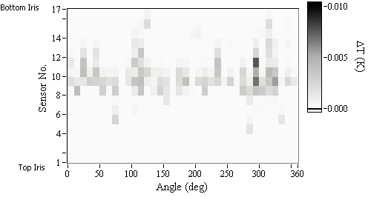
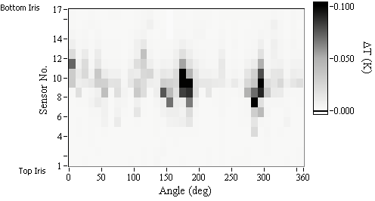
Hotspots in SRF cavities
Temperature mapping reveals that the surface resistance of SRF cavities is:
  spatially non-uniform
  the field dependence is non-linear
Hotspots

Slide 4
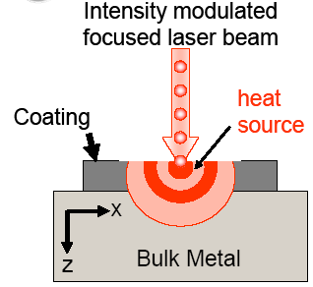
Low Temperature Laser Scanning Microscopy
Nondestructive spatially resolved characterization (optical, structural and electronic properties) of HTS materials
Point-by-point raster scanning of the surface of a sample-under-test with a focused laser beam
Local heating of the SC → perturbation of its electronic system and changes in intensity and polarization of the reflected beam
Photoresponse PR(x,y) → local LSM contrast voltage δV(x,y)
A. P. Zhuravel et al., Low Temp. Phys. 32, 592 (2006)

Slide 5
LTLSM setup for SRF cavity
SRF cavity
Thermometry system
Mirrors’ chamber
Optics
Dimension are in cm
71
G. Ciovati et al., Rev. Sci. Inst. 83, 034704 (2012)

Slide 6
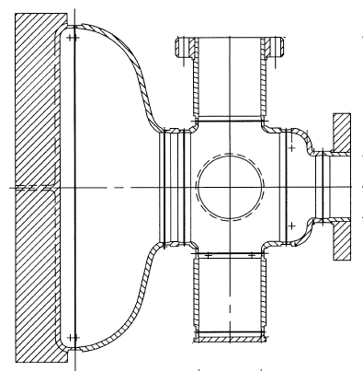
SRF cavity for LSM
Built from ingot Niobium
TESLA half-cell shape
TM₀₁₀ mode: 1.3 GHz
TE₀₁₁ mode: 3.3 GHz
21 cm
H-field in TE₀₁₁ mode
G = Q₀R_{s} = 501 Ω
B_{p}/√U = 76 mT/√J
18 cm

Slide 7
Measurement setup
Assuming R_{s}(T_{f})>>R_{s}(2K) and H_{rf} T-independent
δV_{rms}: voltage measured with lock-in amp
V₀: voltage from crystal diode with laser off
P_{c0}: power dissipated in the cavity with laser off
r_{L}: laser beam radius
Q_{L}: cavity loaded Q
Q_{ext}: external Q of input and pick-up RF antenna
f_{M}: laser modulation frequency

Slide 8
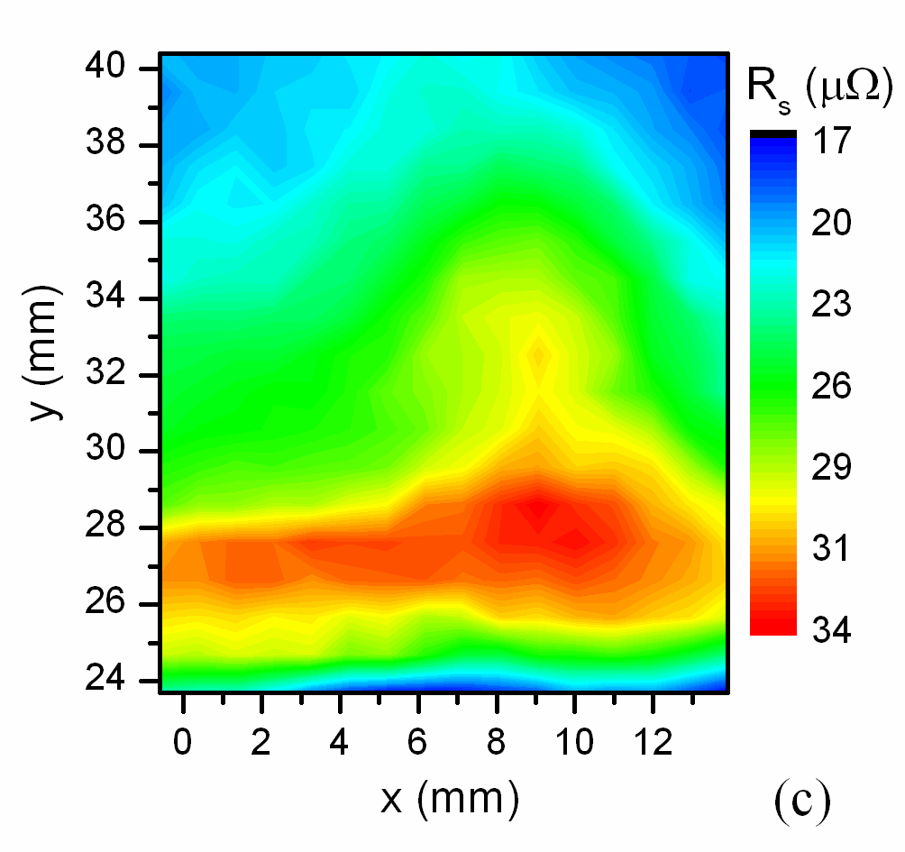
Results: hotspot vs. coldspot
Temperature map of the cavity plate at B_{p} = 13 mT, T_{b} = 2.0 K
P_{abs} = 0.92 W, f_{M} = 10 Hz, r_{L} = 0.435 mm for both scans. T_{in} ~ 8.5 K

Slide 9
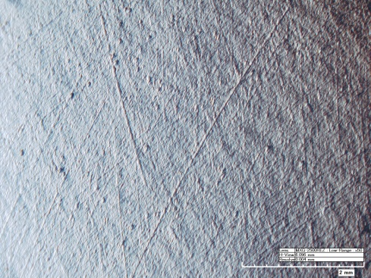
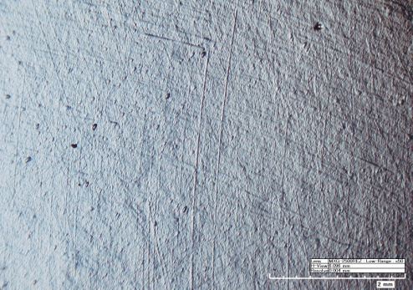
Results: hotspots
Temperature map of the cavity plate at B_{p} = 13 mT, T_{b} = 2.0 K
P_{abs} = 50 mW, f_{M} = 1 Hz, r_{L} = 0.435 mm for both scans. T_{in} ~ 4 K, R_{BCS} ≅ 3.3 μΩ

Slide 10
Comparison with HTS setup
Thermal diffusion length
Thermal response time
κ: thermal conductivity
d: wall thickness
h_{K}: Kapitza conductance
C: specific heat per unit volume
if f_{M}τ >> 1
Spatial resolution =
SRF Cavity: Nb, 2.0 K
HTS, 4.2 K
d_{T} ~ 2.2 mm
τ ~ 0.4 ms, up to ~ 30 ms for T_{out} > 2.17 K
Sample size: tens of cm
Size of apparatus: few meters
d_{T} ~ 1-10 μm
τ ~ 0.1-10 μs
Sample size: few mm
Size of apparatus: tens of cm

Slide 11
Eliminating vortex hotspots by thermal gradients
Thermal force acting on the vortex:
The condition f_{T} > J_{c}Φ₀ gives the critical gradient which can depin vortices:
Taking B_{c1} = 0.17T, J_{c} = 1kA/cm² and T = 2 K for clean Nb yields
|∇T|_{c} ≈ 1.7 K/mm
Vortices in Nb may be moved by moderate thermal gradients
Any change of thermal maps after applying local heaters indicate that some of the hot-spots are due to pinned vortices
A. Gurevich, talk TU104 at SRF’07 Workshop

Slide 12
Laser hotspot annealing
Dissipation due to vortices // surface can be reduced by pushing them into the bulk
ANSYS thermal analysis of Nb plate with a gaussian laser beam 0.87 mm diameter, P_{abs} ~ 0.92 W yields ∇T ~ 8 K/mm

Slide 13
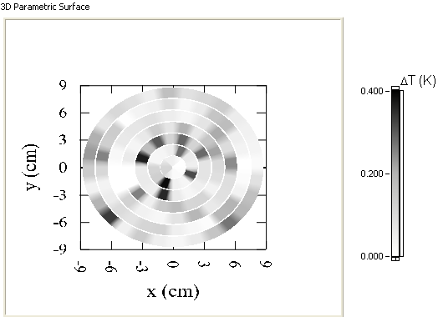
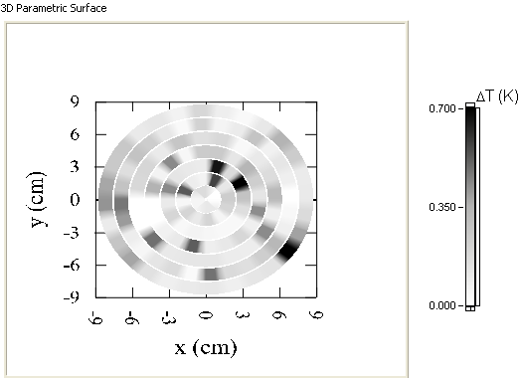
Experimental procedure and results
At 2.0 K:
Baseline cavity RF test: locate RF hotspots by thermometry
RF off, scan laser at hotspot locations (tried different scanning profiles: raster, spiral)
Repeat cavity RF test: locate RF hotspots by thermometry
Top view
Ring 3
Ring 2
T-map before laser heating, 82 mT
T-map after laser heating, 82 mT

Slide 14
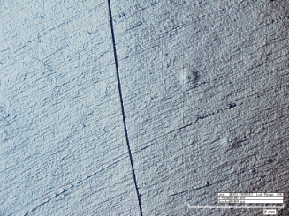
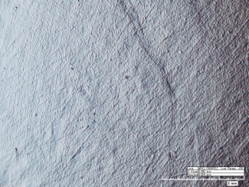
ΔT before and after laser heating
ΔT(B_{p}=82mT, T_{b}=2.0K) along rings 2 & 3 before and after laser heating
Ring 2
Ring 3
Top view
GB
GB
15°
345°
11°
349°
G. Ciovati et al., to be published

Slide 15
Conclusions
A setup to perform LTLSM of an SRF cavity has been designed and built at Jefferson Lab to study “hotspots”
  3D maps of surface resistance with ~ 1 μΩ resolution at 3.3 GHz
  Hotspots can be identified with ~ 2 mm spatial resolution (~ 1 order of magnitude better than thermometry)
The same setup was used to attempt laser “hotspot annealing”
  Pinned vortices are a source of hotspots
  Cannot be easily “eliminated” → improve magnetic shielding of cavities in cryomodule, reduce thermal gradients of cavities in cryomodules during cool-down below T_{c}

