Slide 1
Spin-forming of Seamless cavities
7th Workshop on SRF Materials, July 16-17, 2012, Jlab, Newport News VA
Enzo Palmieri
ISTITUTO NAZIONALE DI FISICA NUCLEARE
Legnro National Laboratories
and University of Padua

Slide 2
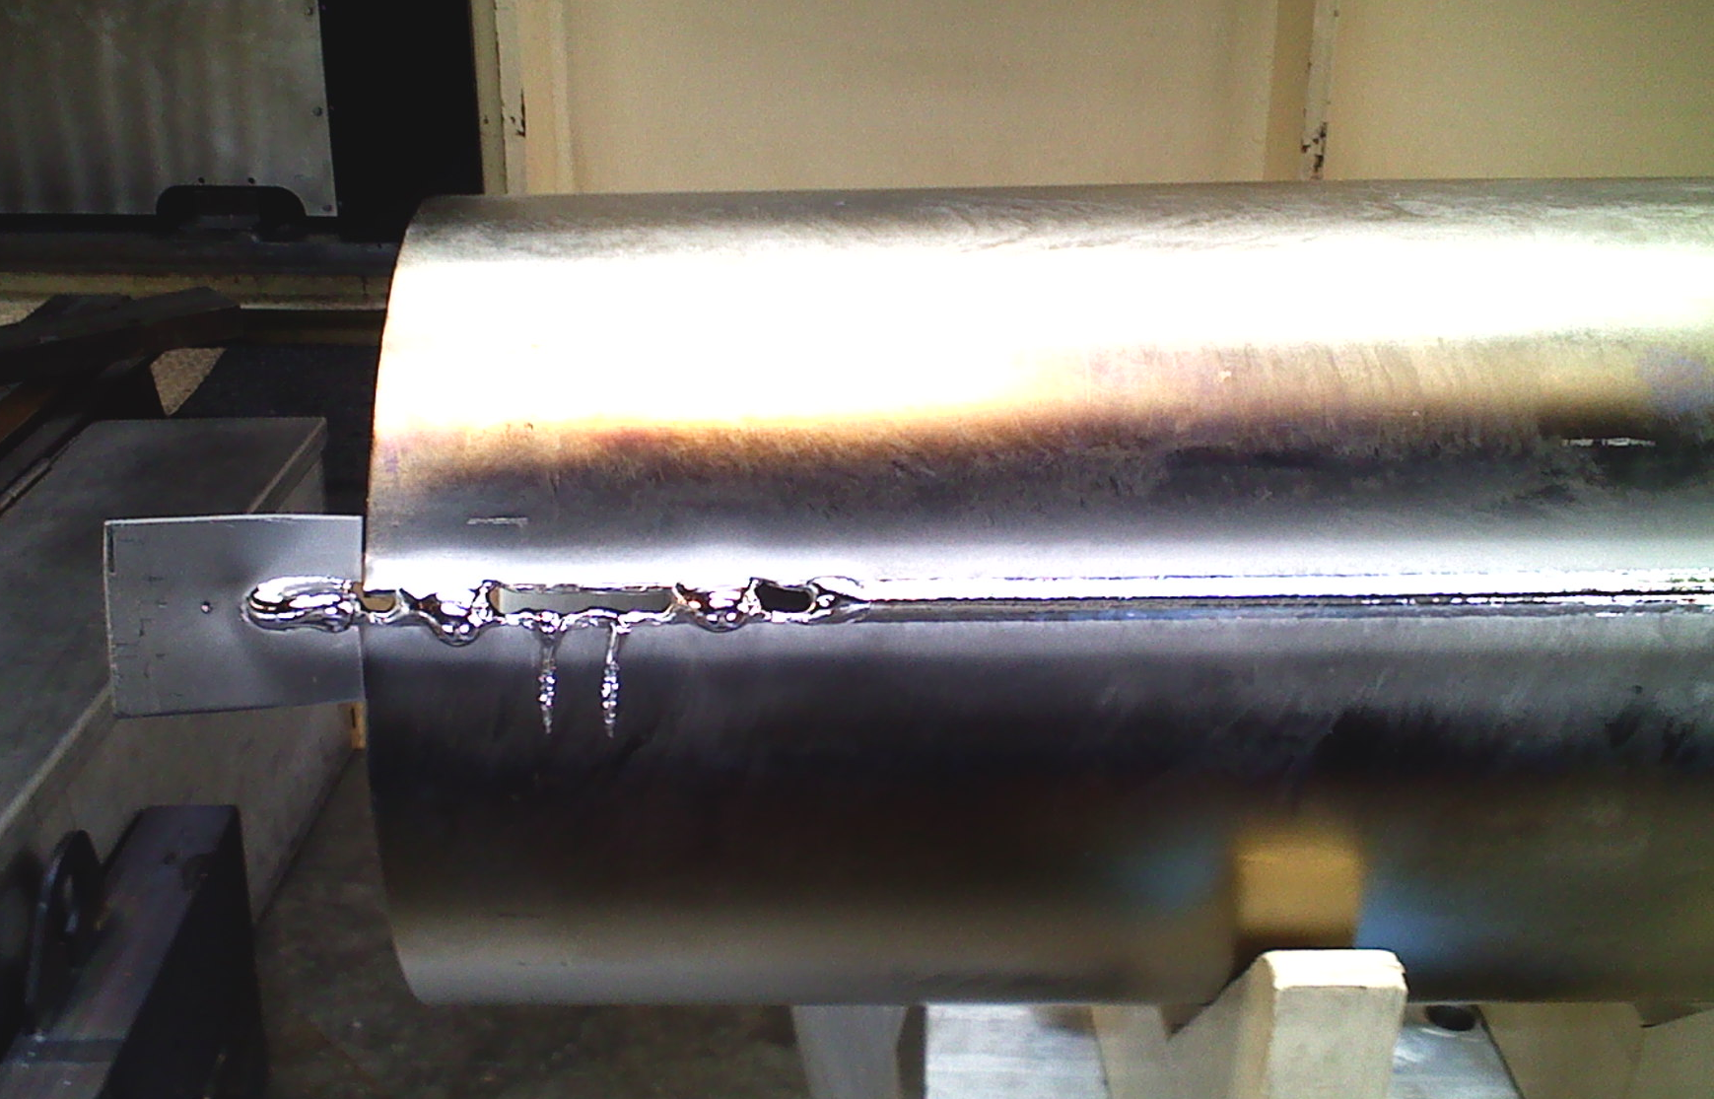
Spin-forming of Seamless cavities
7th SRF materials Workshop. July 16-17, jlab, -Newport News VA
Enzo Palmieri
ISTITUTO NAZIONALE DI FISICA NUCLEARE and University of Padua
ITALY

Slide 3
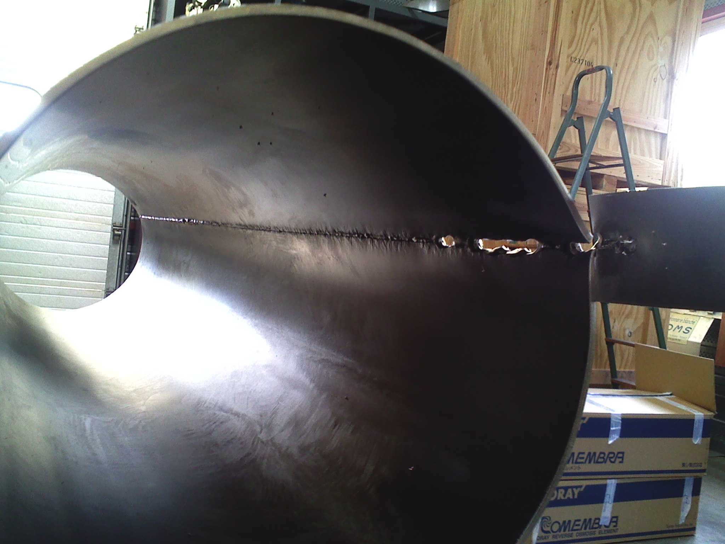

Slide 5
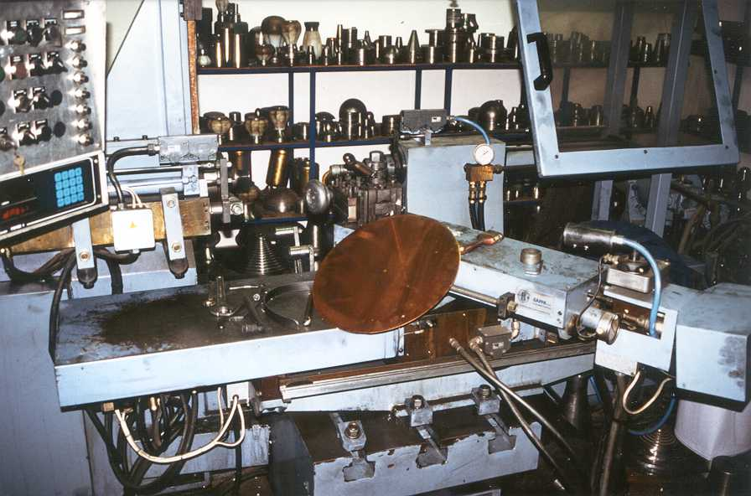

Slide 6
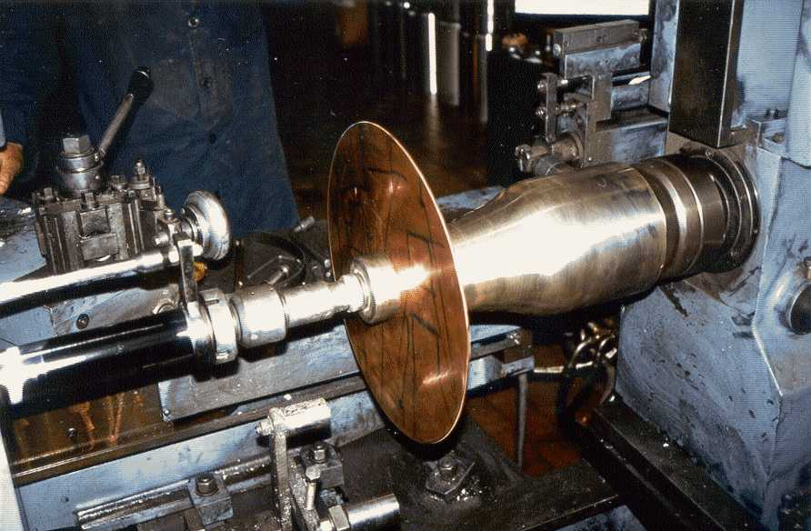

Slide 7
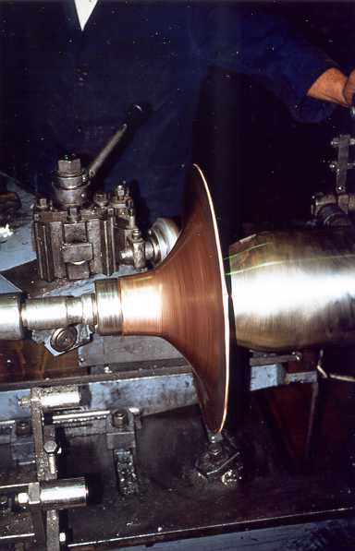

Slide 8
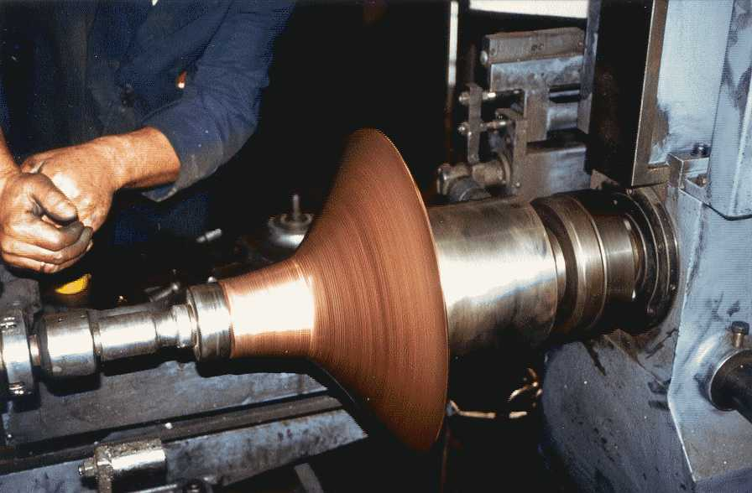

Slide 9
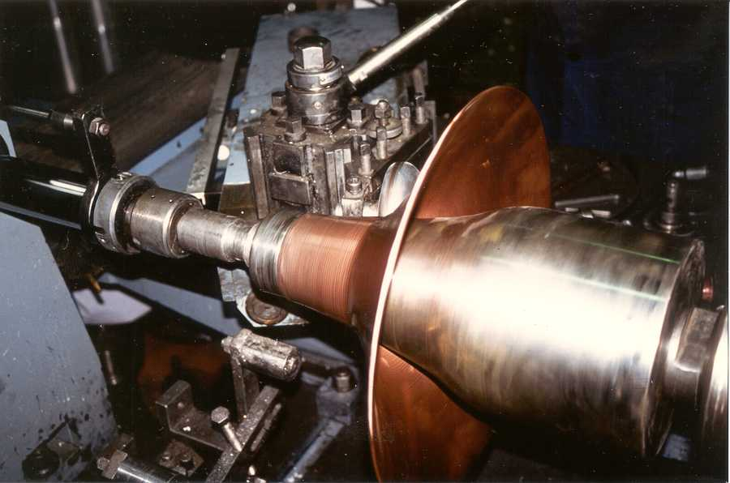

Slide 10
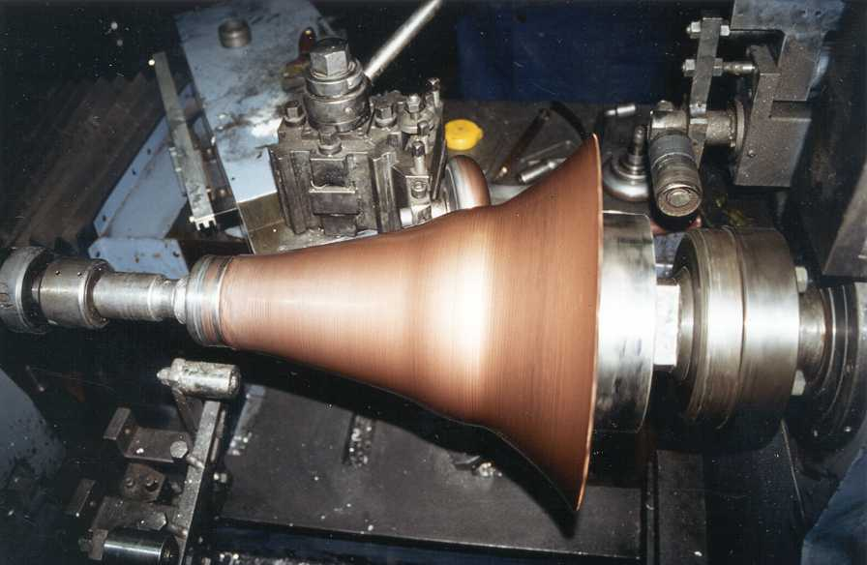

Slide 11
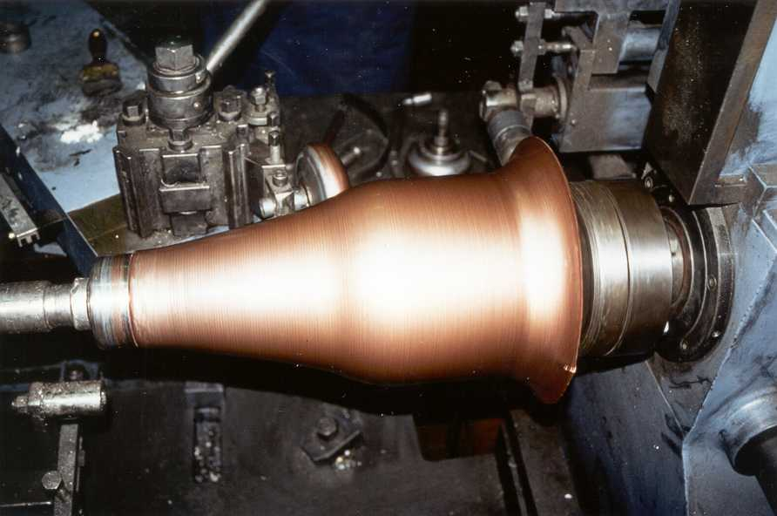

Slide 12
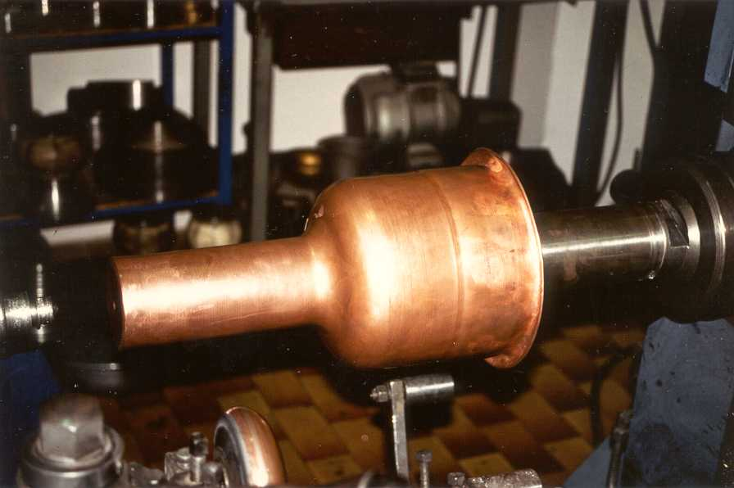

Slide 13
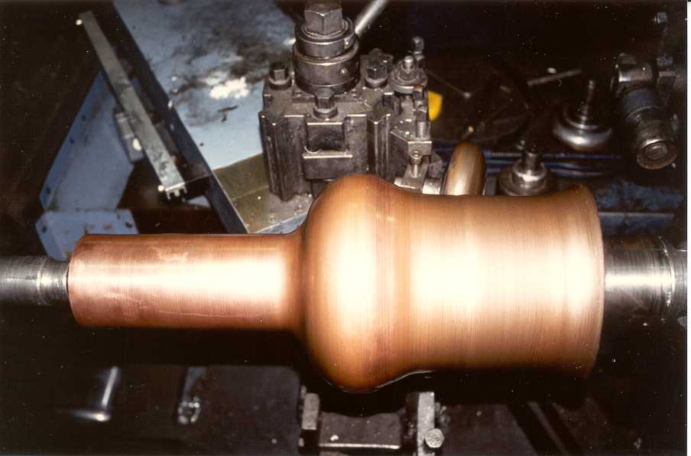

Slide 14
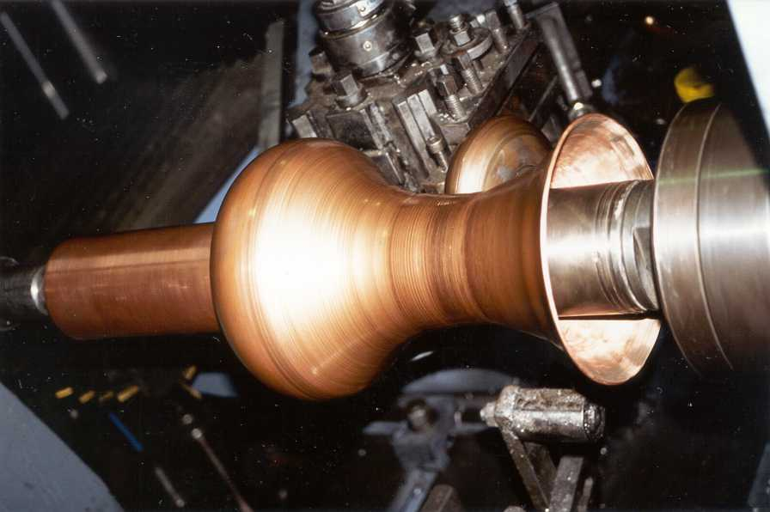

Slide 15
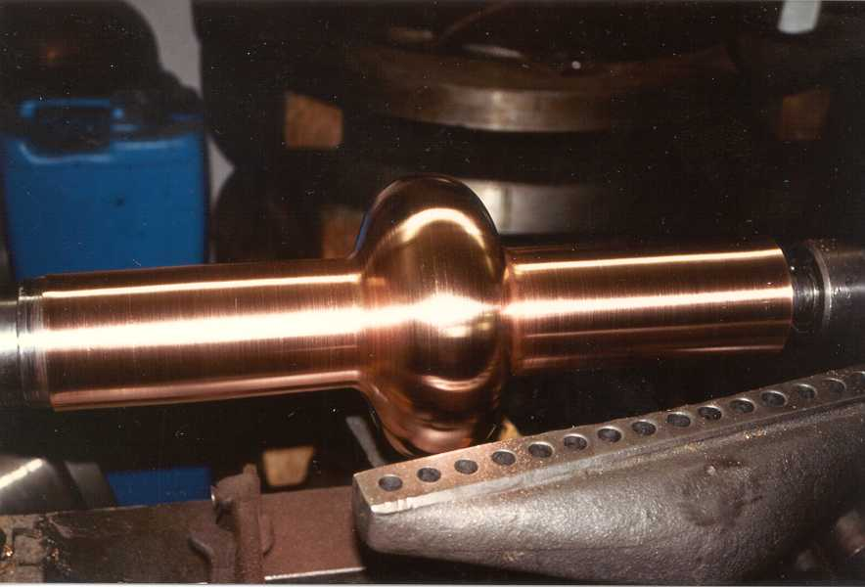

Slide 16
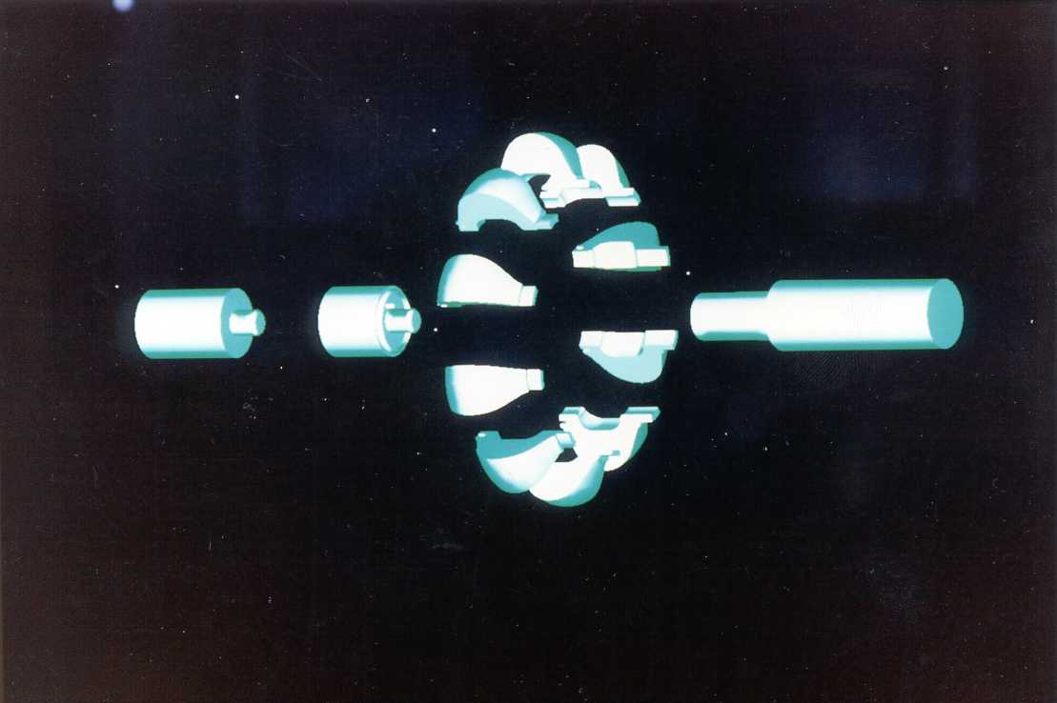

Slide 17
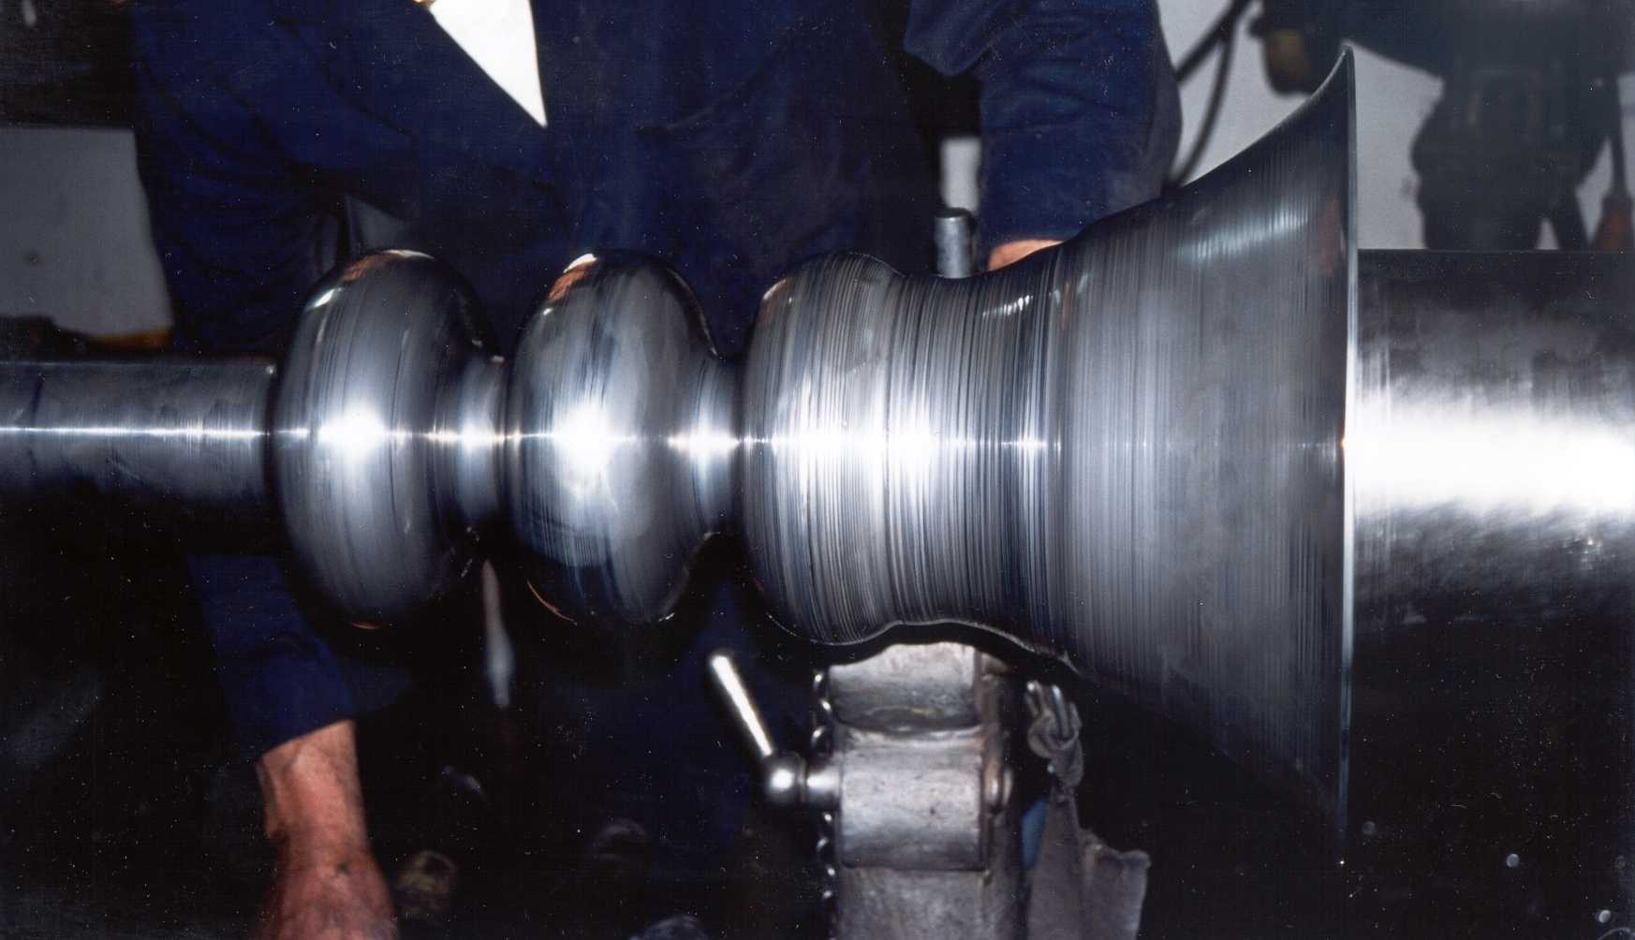

Slide 18
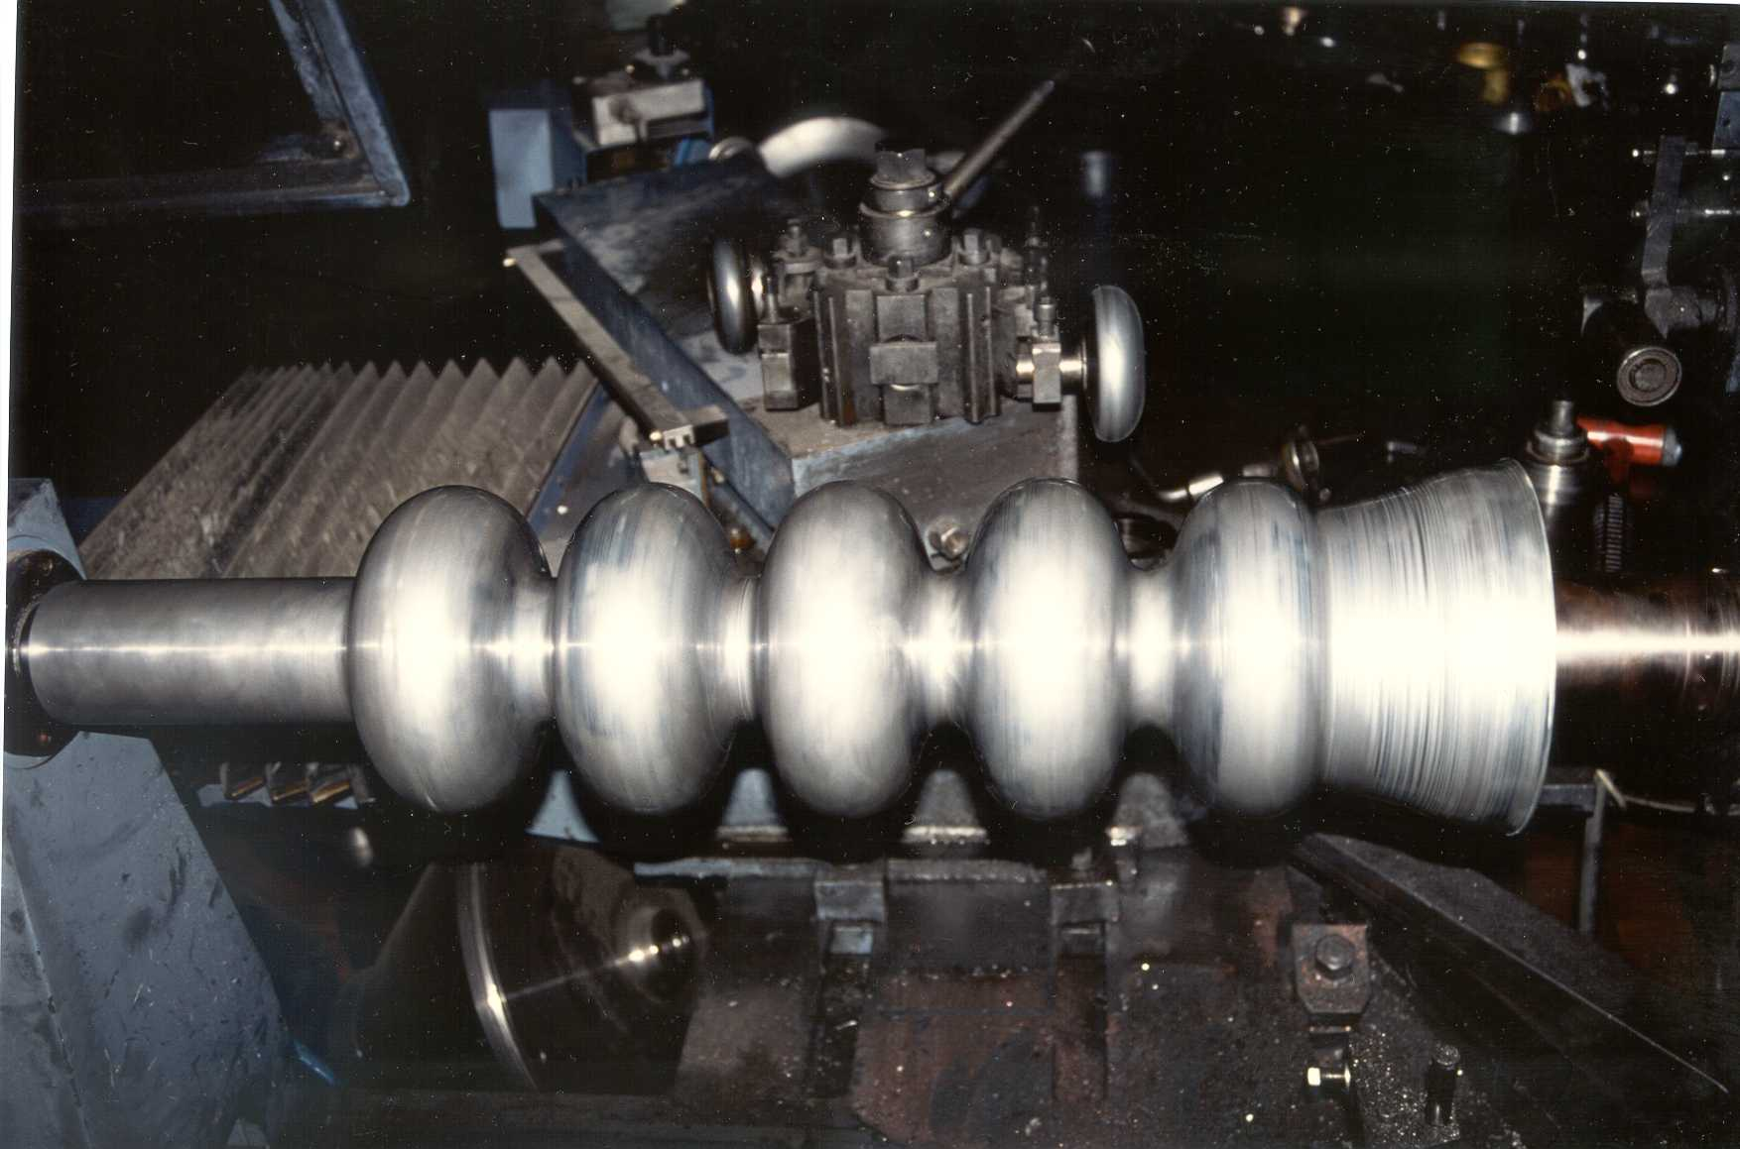

Slide 19
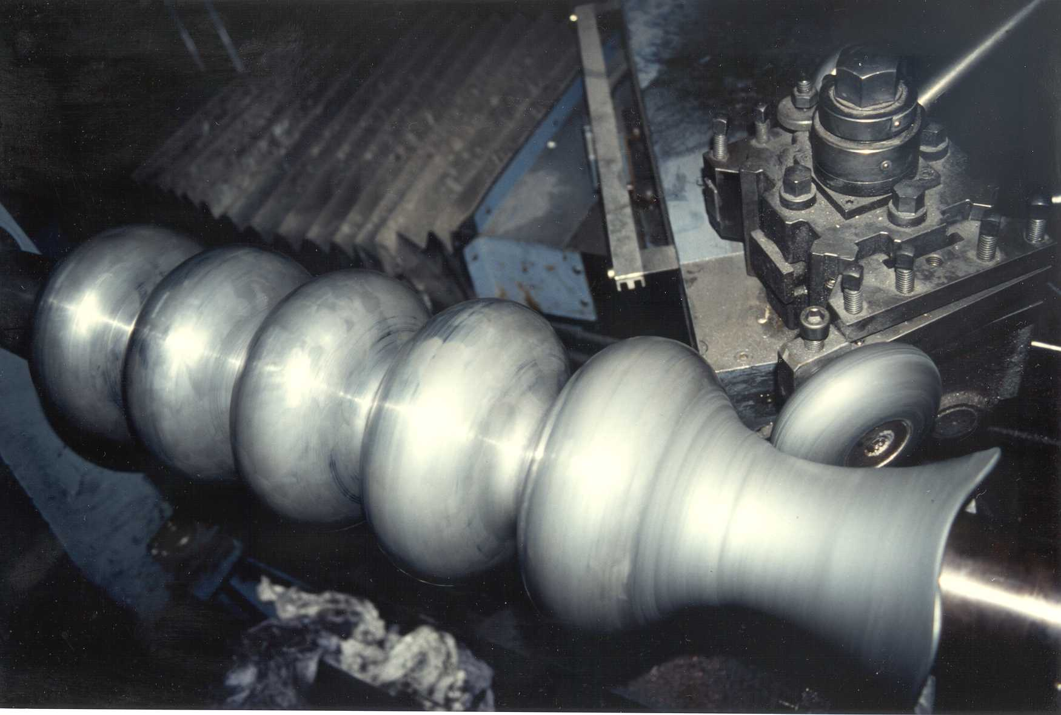

Slide 20
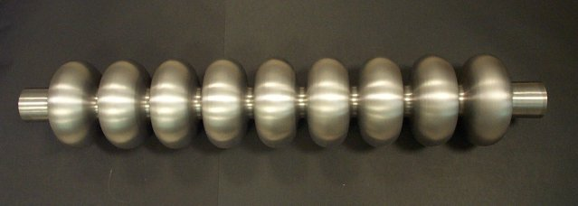

Slide 21
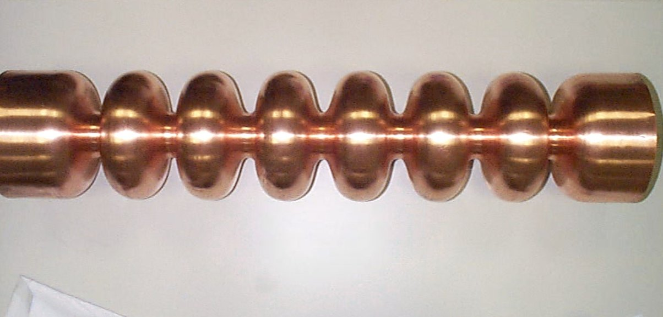

Slide 22
If we loook for a more engineerable process, seamless tubes are mandatory

Slide 23
1. The Deepdrawing Process

Slide 25
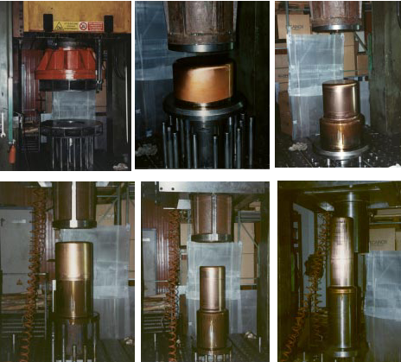

Slide 26
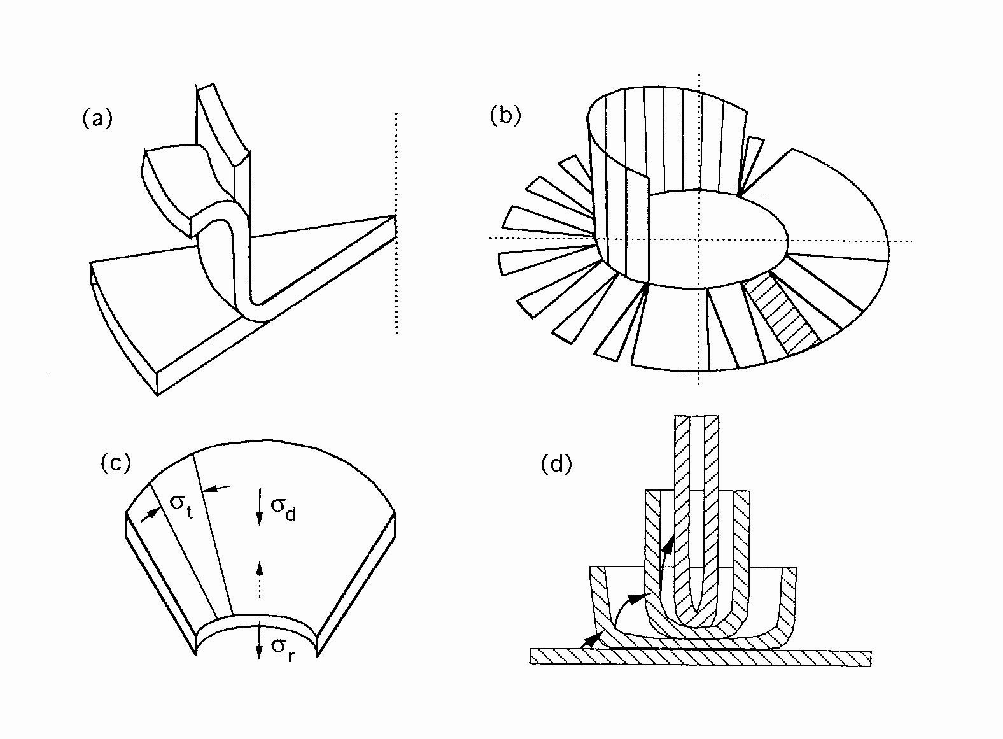

Slide 27
2. The Reversal deepdrawing

Slide 28
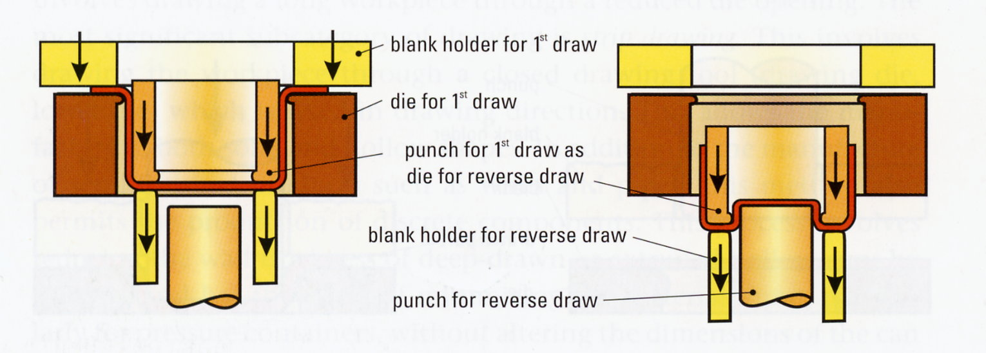

Slide 29
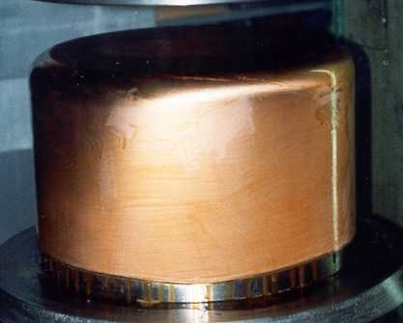

Slide 30
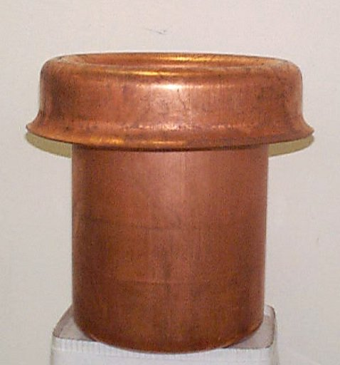

Slide 31
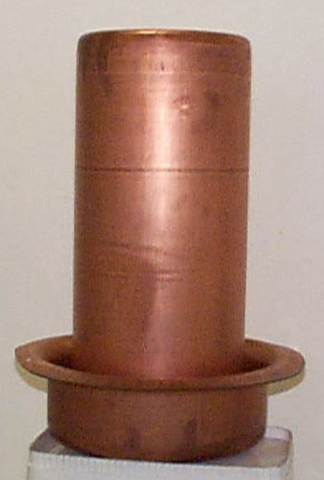

Slide 32
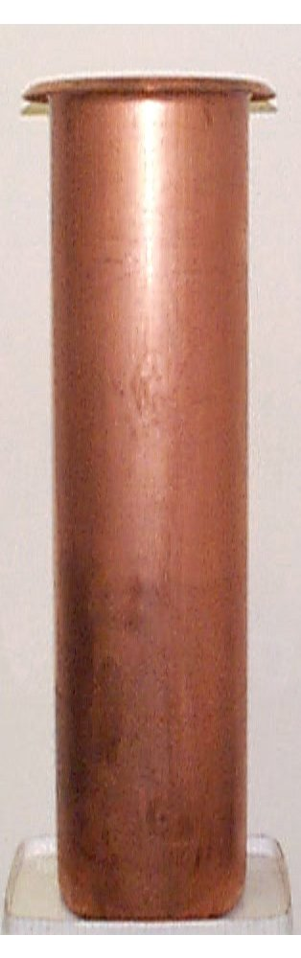

Slide 33
3. The Flowturning Process

Slide 35
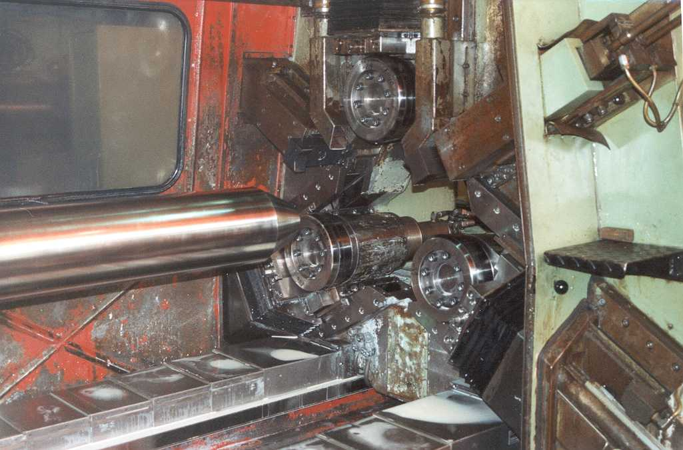

Slide 36
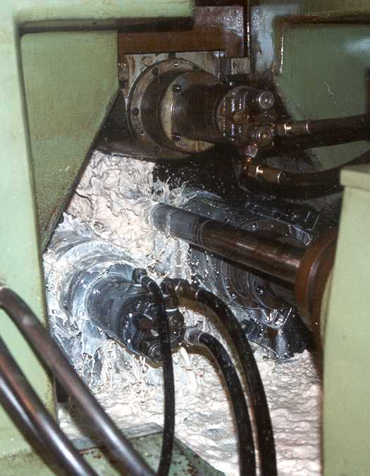

Slide 37
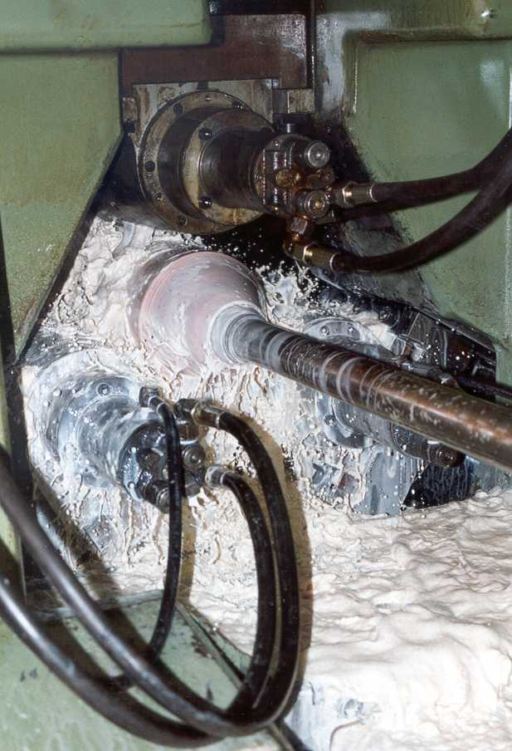

Slide 38
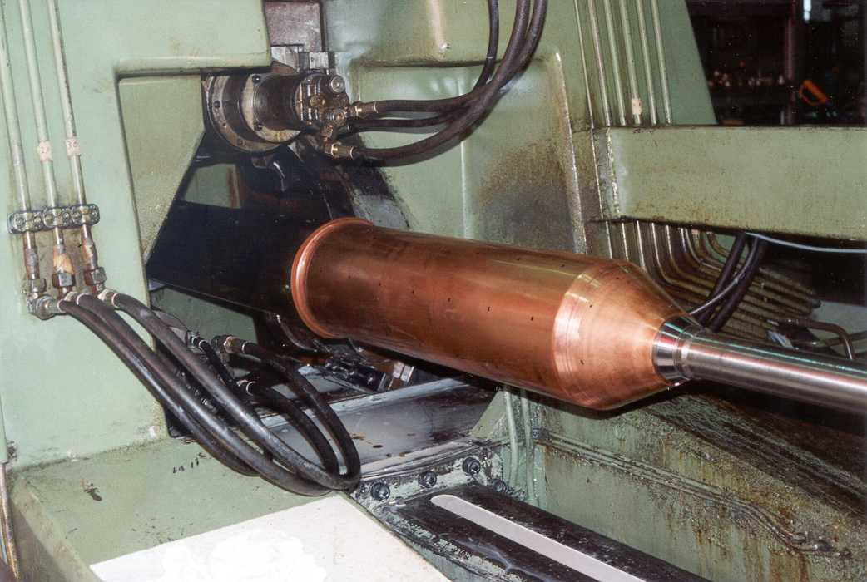

Slide 39
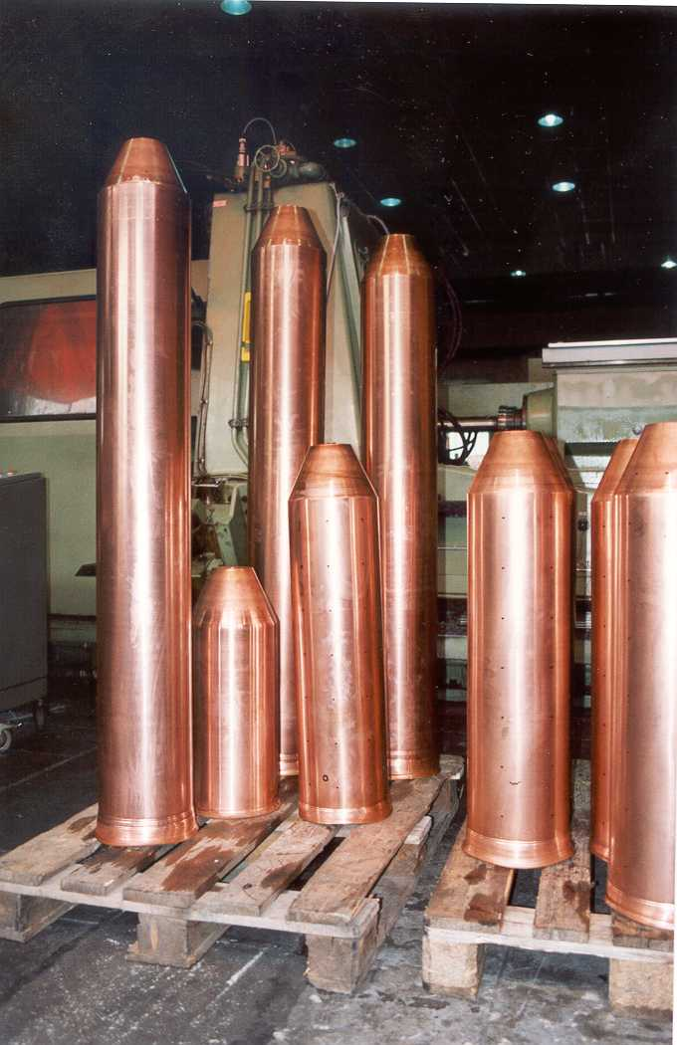

Slide 40
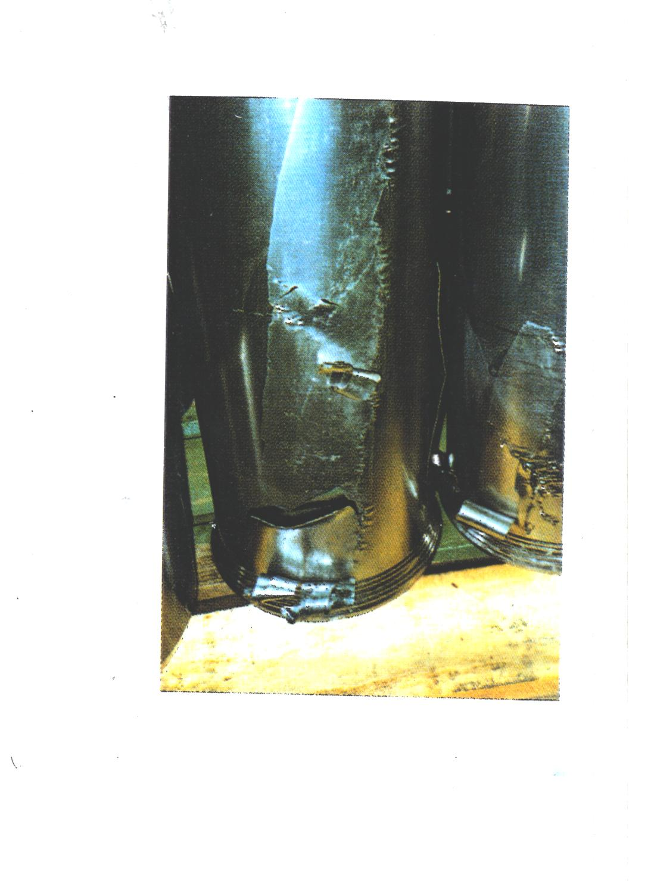

Slide 41
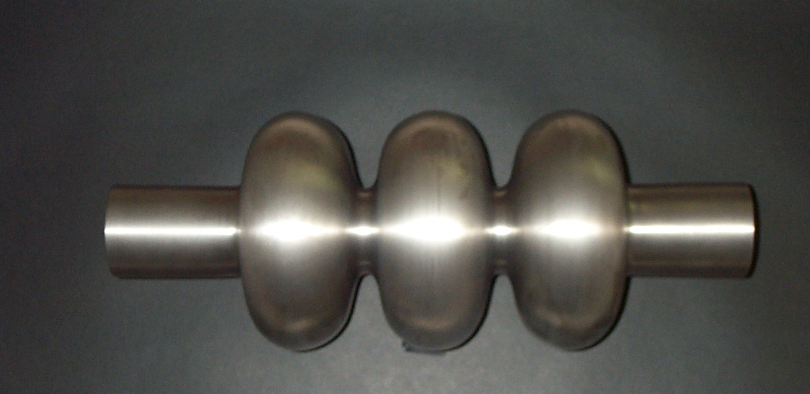

Slide 42
2 Nb ninecells fabricated in 2001 for being measured at KEK

Slide 43
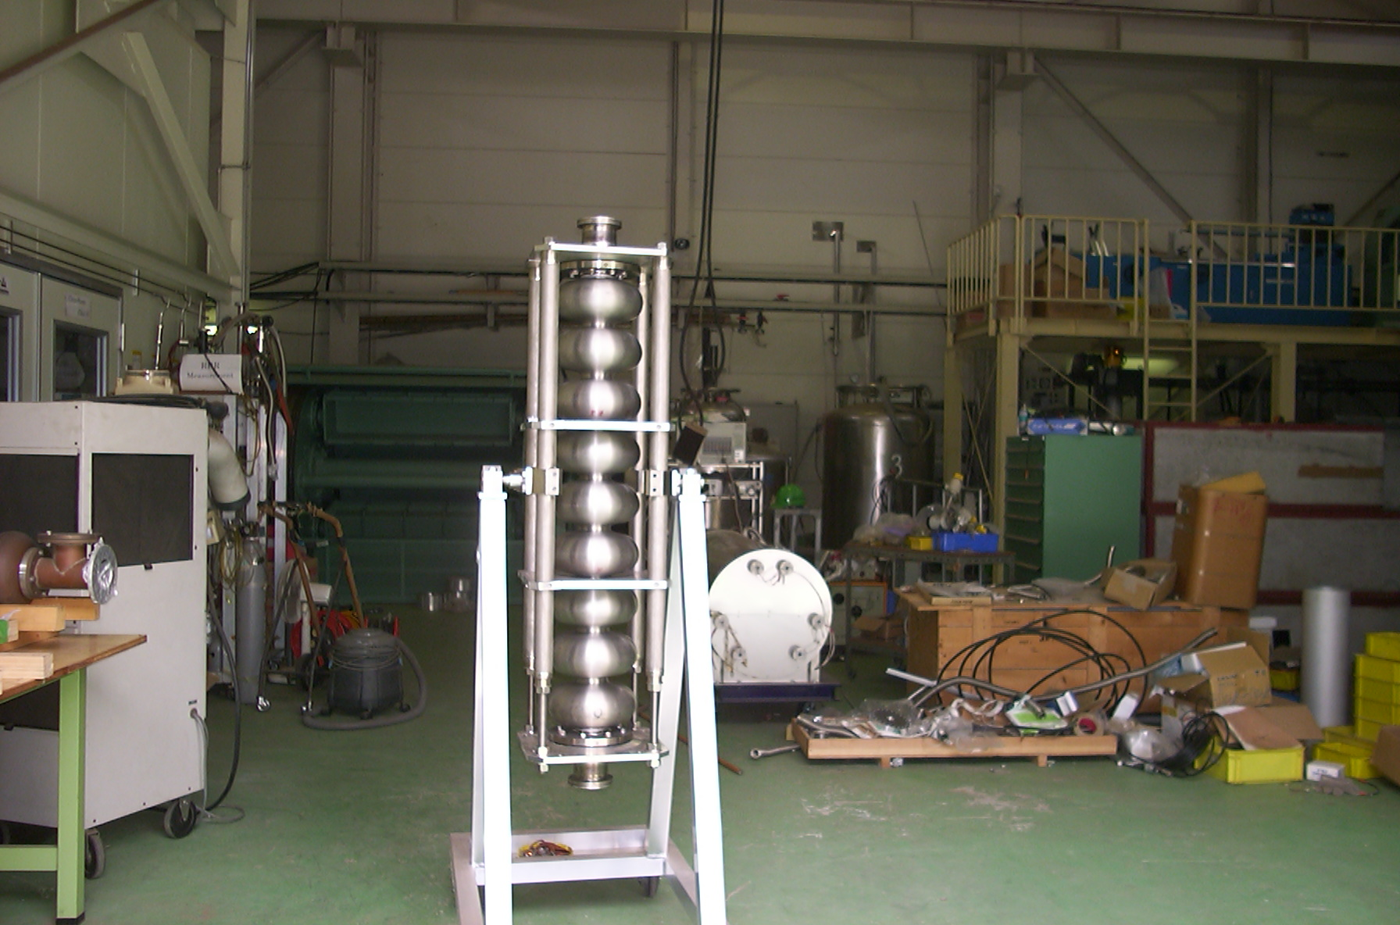

Slide 44
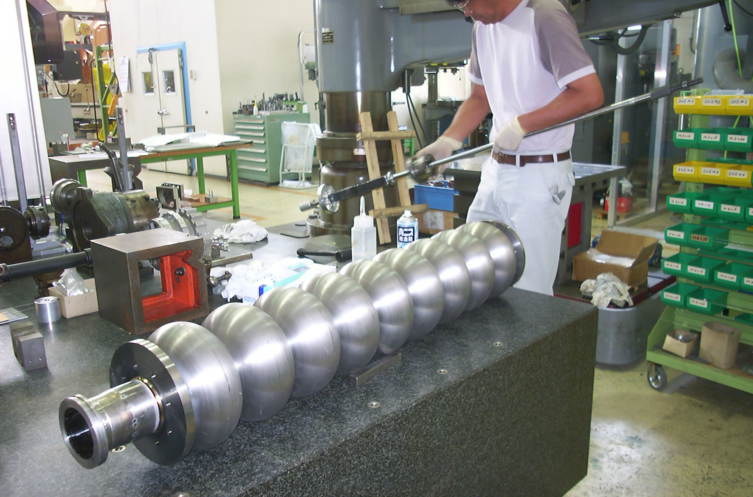

Slide 45
Unfortunately both cavities were broken on last cell during tumbling,
then weld to a standard EB weld monocell in order to have again a 9-cell

Slide 46
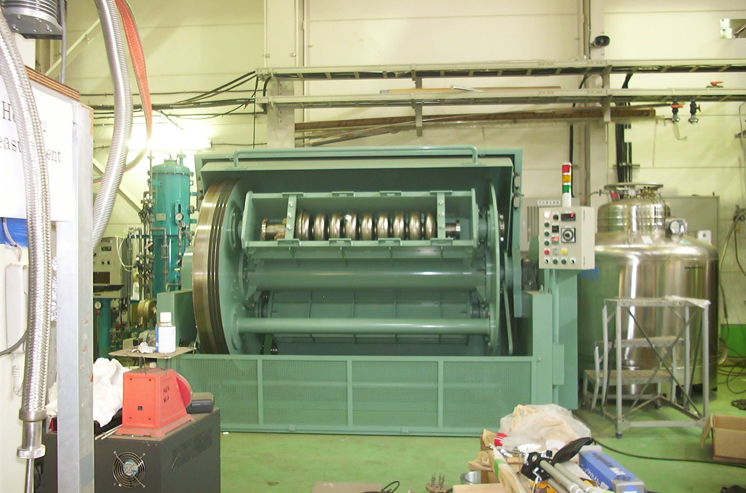

Slide 47
A seamless flange
Cheap alternative to welded Nb-Ti

Slide 48
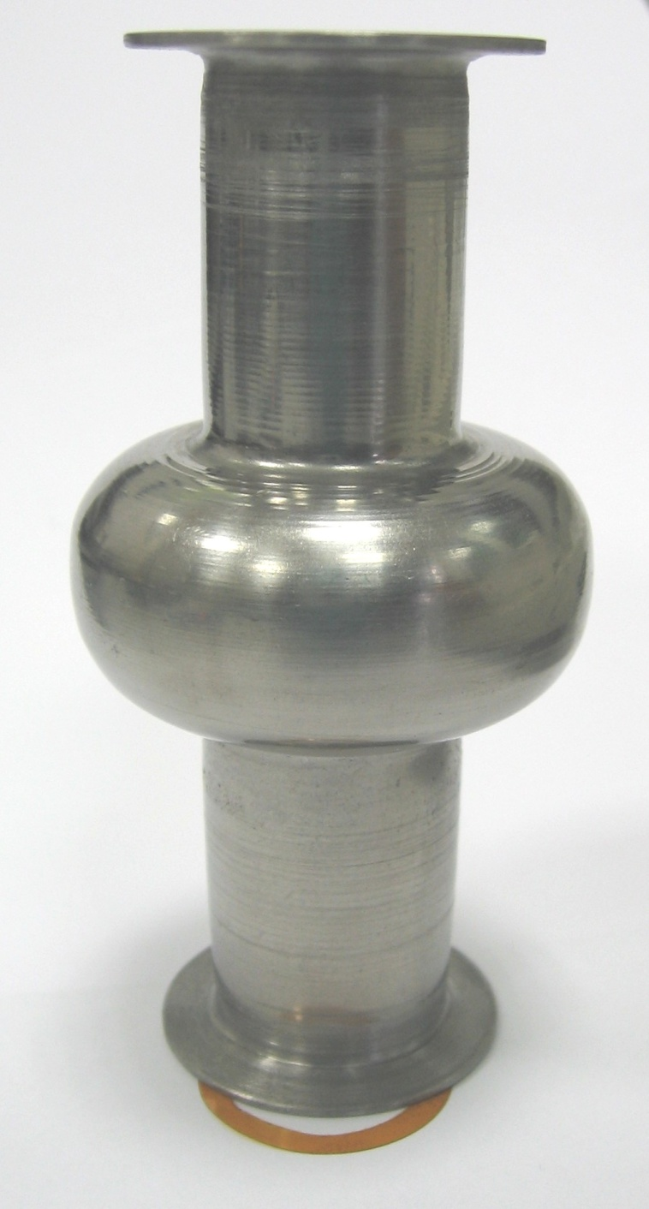
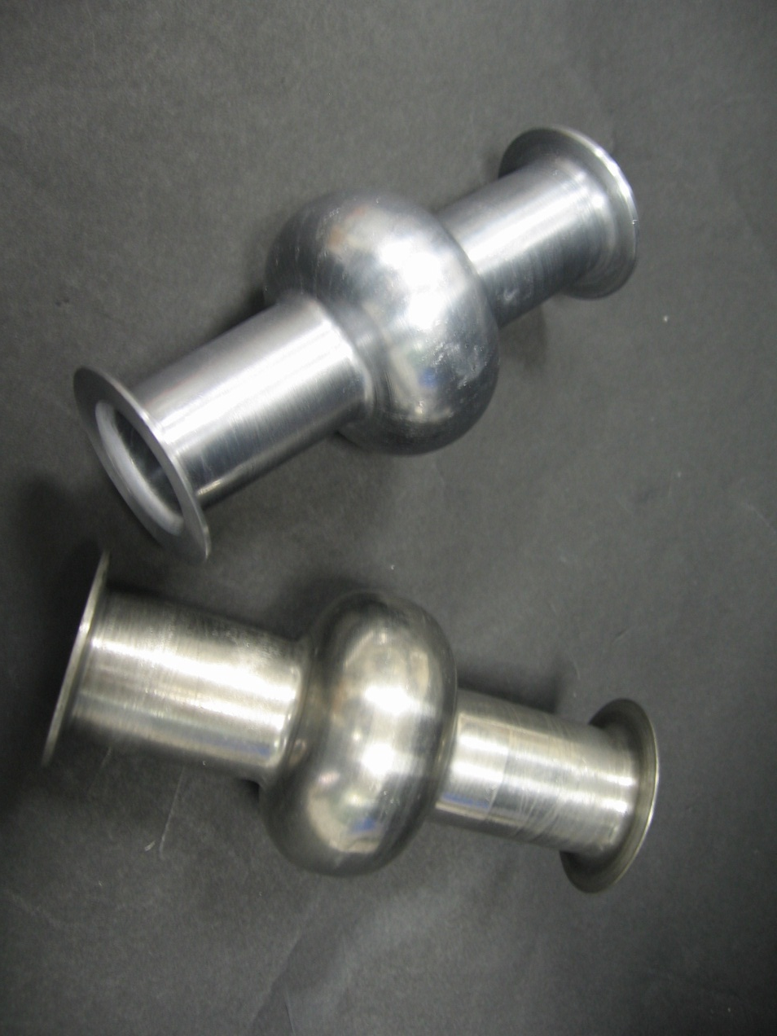
New flange design

Slide 49
Use Kapton Joints for sealing cavities
and …
Life will never be the same!

Slide 50
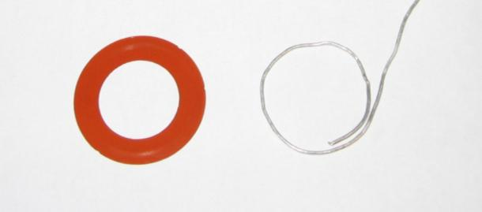
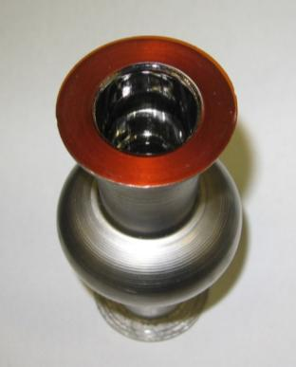
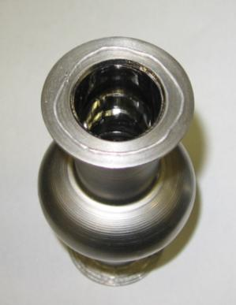

Slide 51
Cavities of any shape and any size

Slide 52
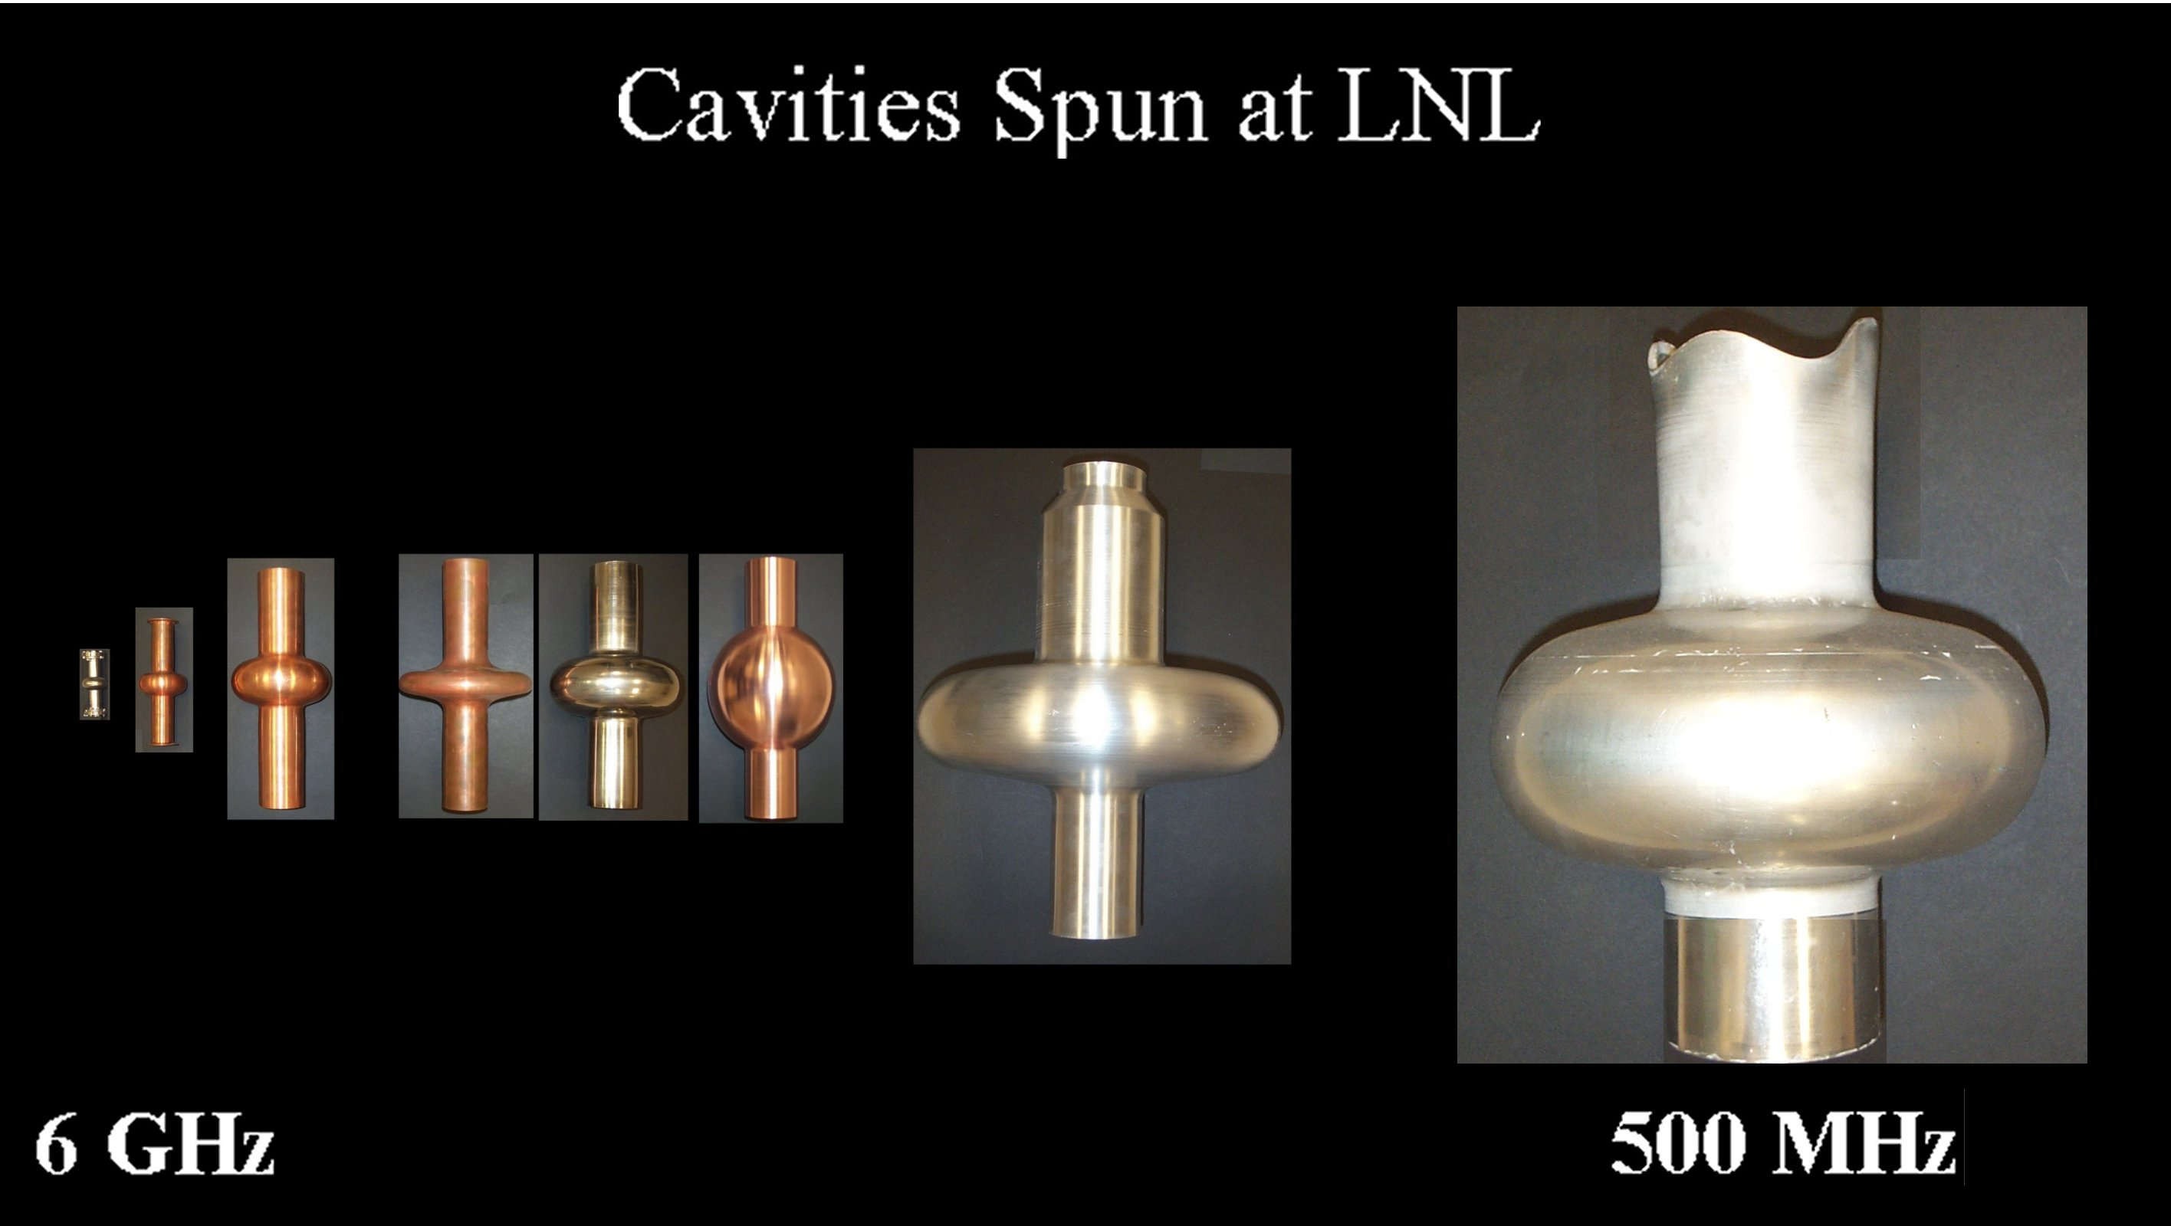

Slide 53
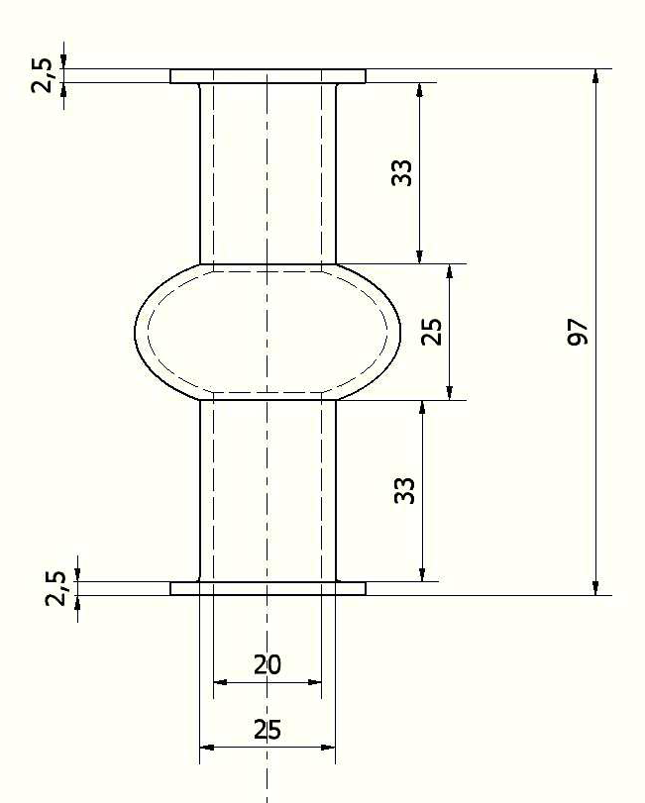
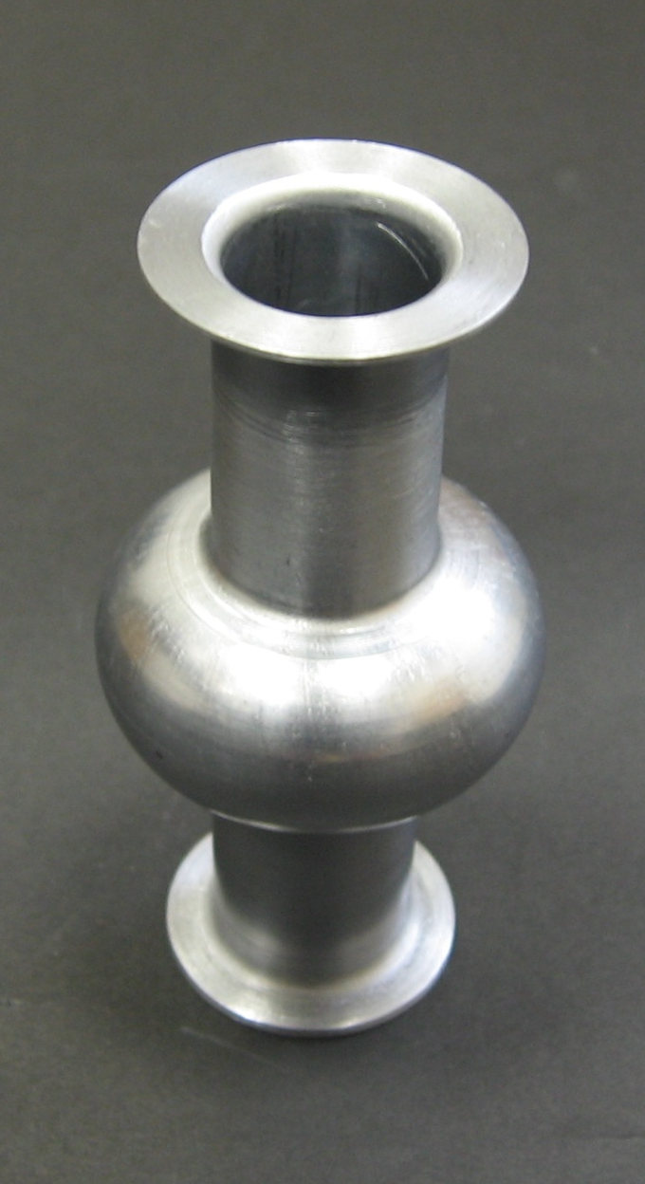
6 GHz cavities
36 mm
Seamless flanges
20 mm
[mm]

Slide 54
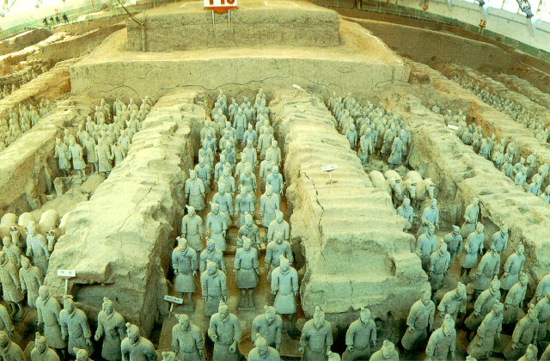
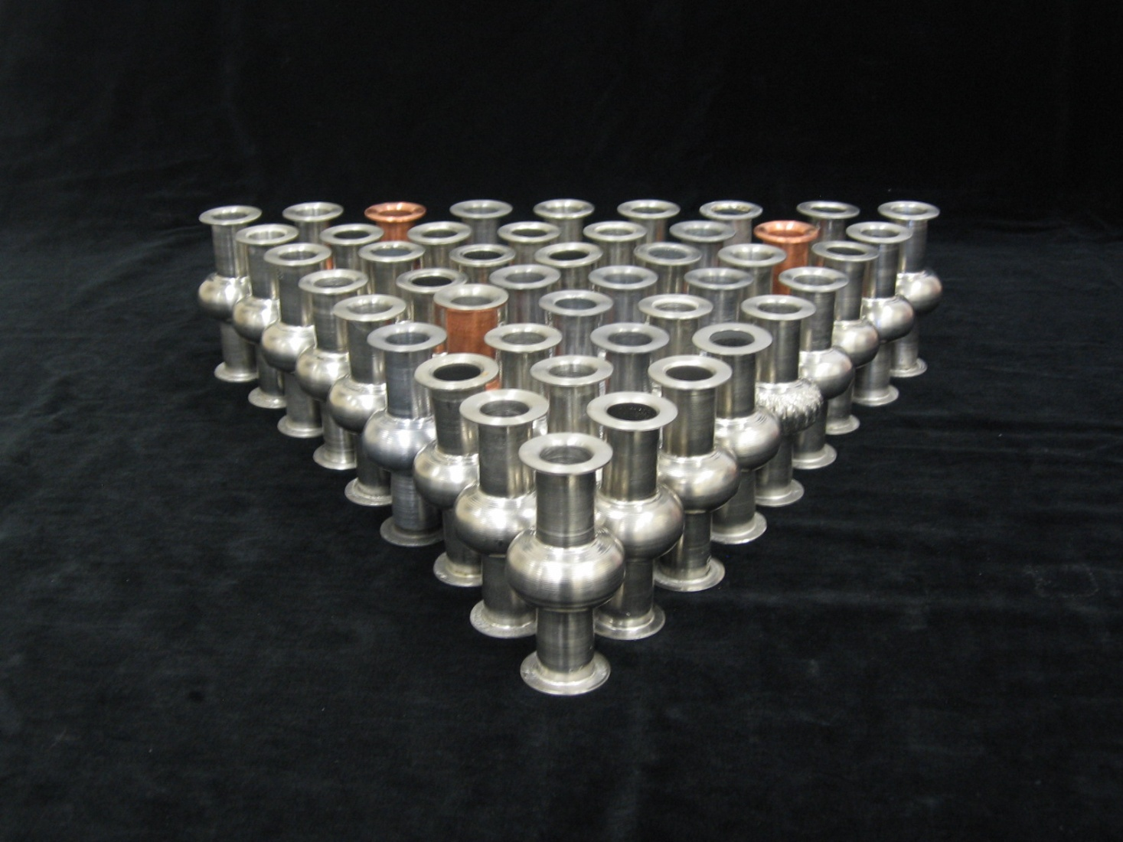
Low research budget → Large amount of cavities
6 GHz

Slide 55
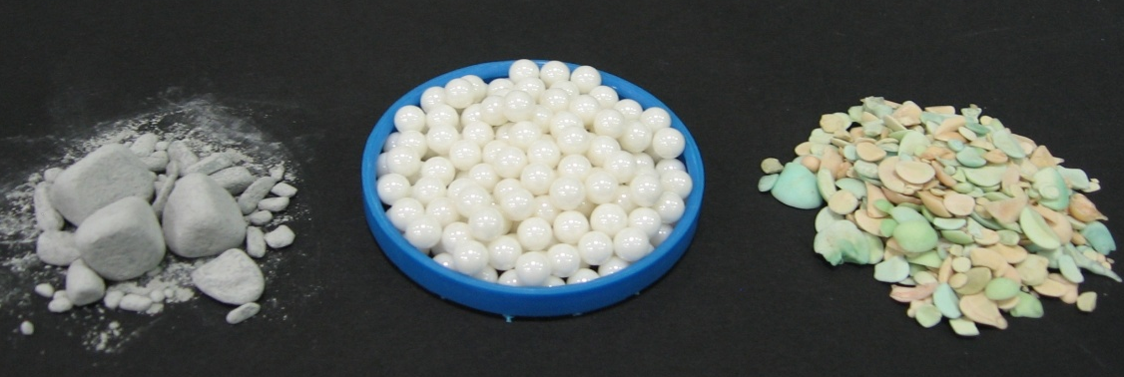
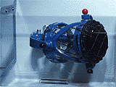
Mechanical
Starting internal surface conditions:
bad finishing
presence of
contaminants
SiC
ZrO₂
Al₂O₃ + SiO₂
Streatments:
Mechanical

Slide 56
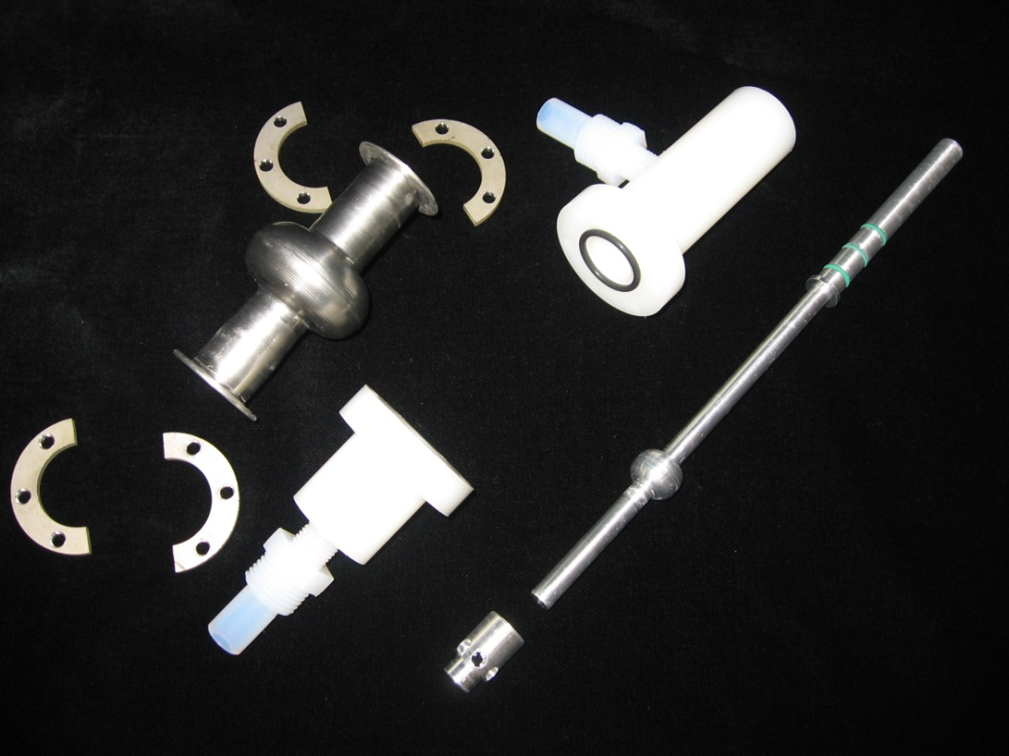
EP
Starting internal surface conditions:
bad finishing
presence of
contaminants
Streatments:
Mechanical
BCP
EP
HF, H₂SO₄
1:9

Slide 57
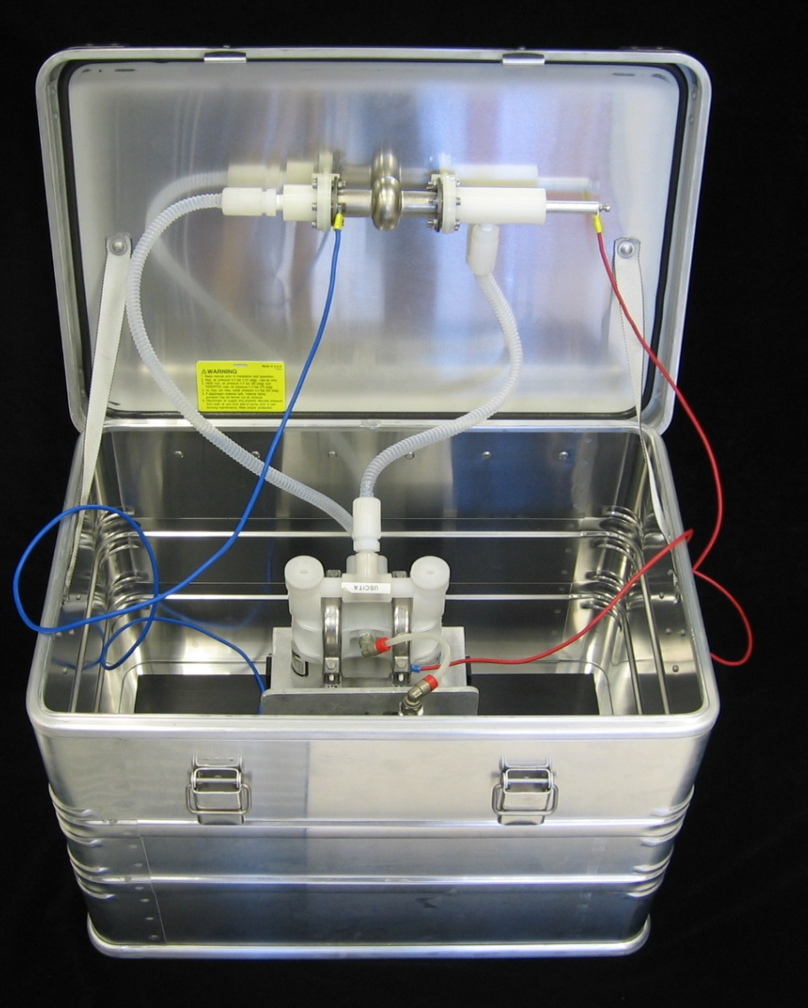
A Mini - Chemical/Electrochemical Lab

Slide 58


Mini-Furnace: Thermal Treatments
Starting internal surface conditions:
bad finishing
presence of
contaminants
Streatments:
Mechanical
BCP
EP
Thermal
Notes:
58

Slide 59

Nb Sputtering
Notes:
59

Slide 60
A dense statistics possibile
  Low cost (material, fabrication, acids, helium… )
  Easy and quick surface treatments
  High number of RF measurements per month
  Possibility to study:
        new surface treatments
          new SC materials
            new cavity shape
              new deposition tecnique (ALD … )

Slide 61


Slide 62
Nb Clad Cu?
No Problem!

Slide 63


Slide 64


Slide 66


Slide 67


Slide 68


Slide 69


Slide 70
Nb Clad Cu is a
well-established technology
Nb HIPPED Cu still
needs to be optimized

Slide 71


Slide 72


Slide 73
The Spinning Proceedure

Slide 74


Slide 75
The initial staus of the blank surfaace
must be defect and scratch free

Slide 76


Slide 77
We produced calibrated holes
in a Cu blank and
we used the crack propagation mechanism in order to find out how to spin

Slide 78


Slide 79


Slide 80


Slide 81


Slide 82
Finding the right parameters by
the Buckingham-PI Theorem
(dimentional analisys):
  D = Blank Diameter
  S= Blank thickness
  v = roller feed velocity
  = Angular velocity
  f = arc of the roller blank contact segment
Reduced parameters are: D/s; ω f / v

Slide 83
What are the advantages of Spinning?

Slide 84
Spinning
is a
3-D forming process

Slide 85


For a standard 2-D forming process
A 40% elongation is a limitation

Slide 86
For Spinning
10,000% elongations are possible wihout annealing

Slide 87
For standard 2-D forming processes,
material parameters, as:
    young Modulus
    Ductility,
    Hardness
are crucial parameters

Slide 88
For spinning
we don’t mind!

Slide 89

For Hydroforming,
the tube thickness uniformity is crucial
Otherwise ….

Slide 90
For spinning we do not mind!
Tube with not uniform thickness will be re-rolled on the machine just before spinning the cavity

Slide 91
Drawbacks of the spin-forming process:
Non-uniform wall thickness of the cavity
Need of internal grinding or tumbling
Still a manual process

Slide 92
Q vs E_{acc} Results

Slide 94


Slide 95


Slide 96
Bulk Nb cavities

Slide 97


Slide 98


Slide 99

The best result on a LNL monocell spun cavity,
measured at KEK by Kenji SAITO

Slide 100


Slide 101
Spinning is mandatory for Nb/Cu Sputtered cavities
Nb film onto hydroformed cavities does not work!

Slide 102
Nb sputtered Cu spun cavity

Slide 103








All last monocells reach 40 MV/m
The 3cell after only a partial grinding reached 25 MV/m

Slide 104
Current Work:
Tube back-extrusion directly from from billets

