Slide 1
7th SRF Materials Workshop
FRIB SRF Cavities
7/16/12
Chris Compton

Slide 2
Outline
FRIB Brief Overview
FRIB Cavities (types, #’s)
FRIB Cavity Fabrication
Niobium requirements for FRIB
FRIB Cavity Performance
FRIB Upgrade

Slide 3
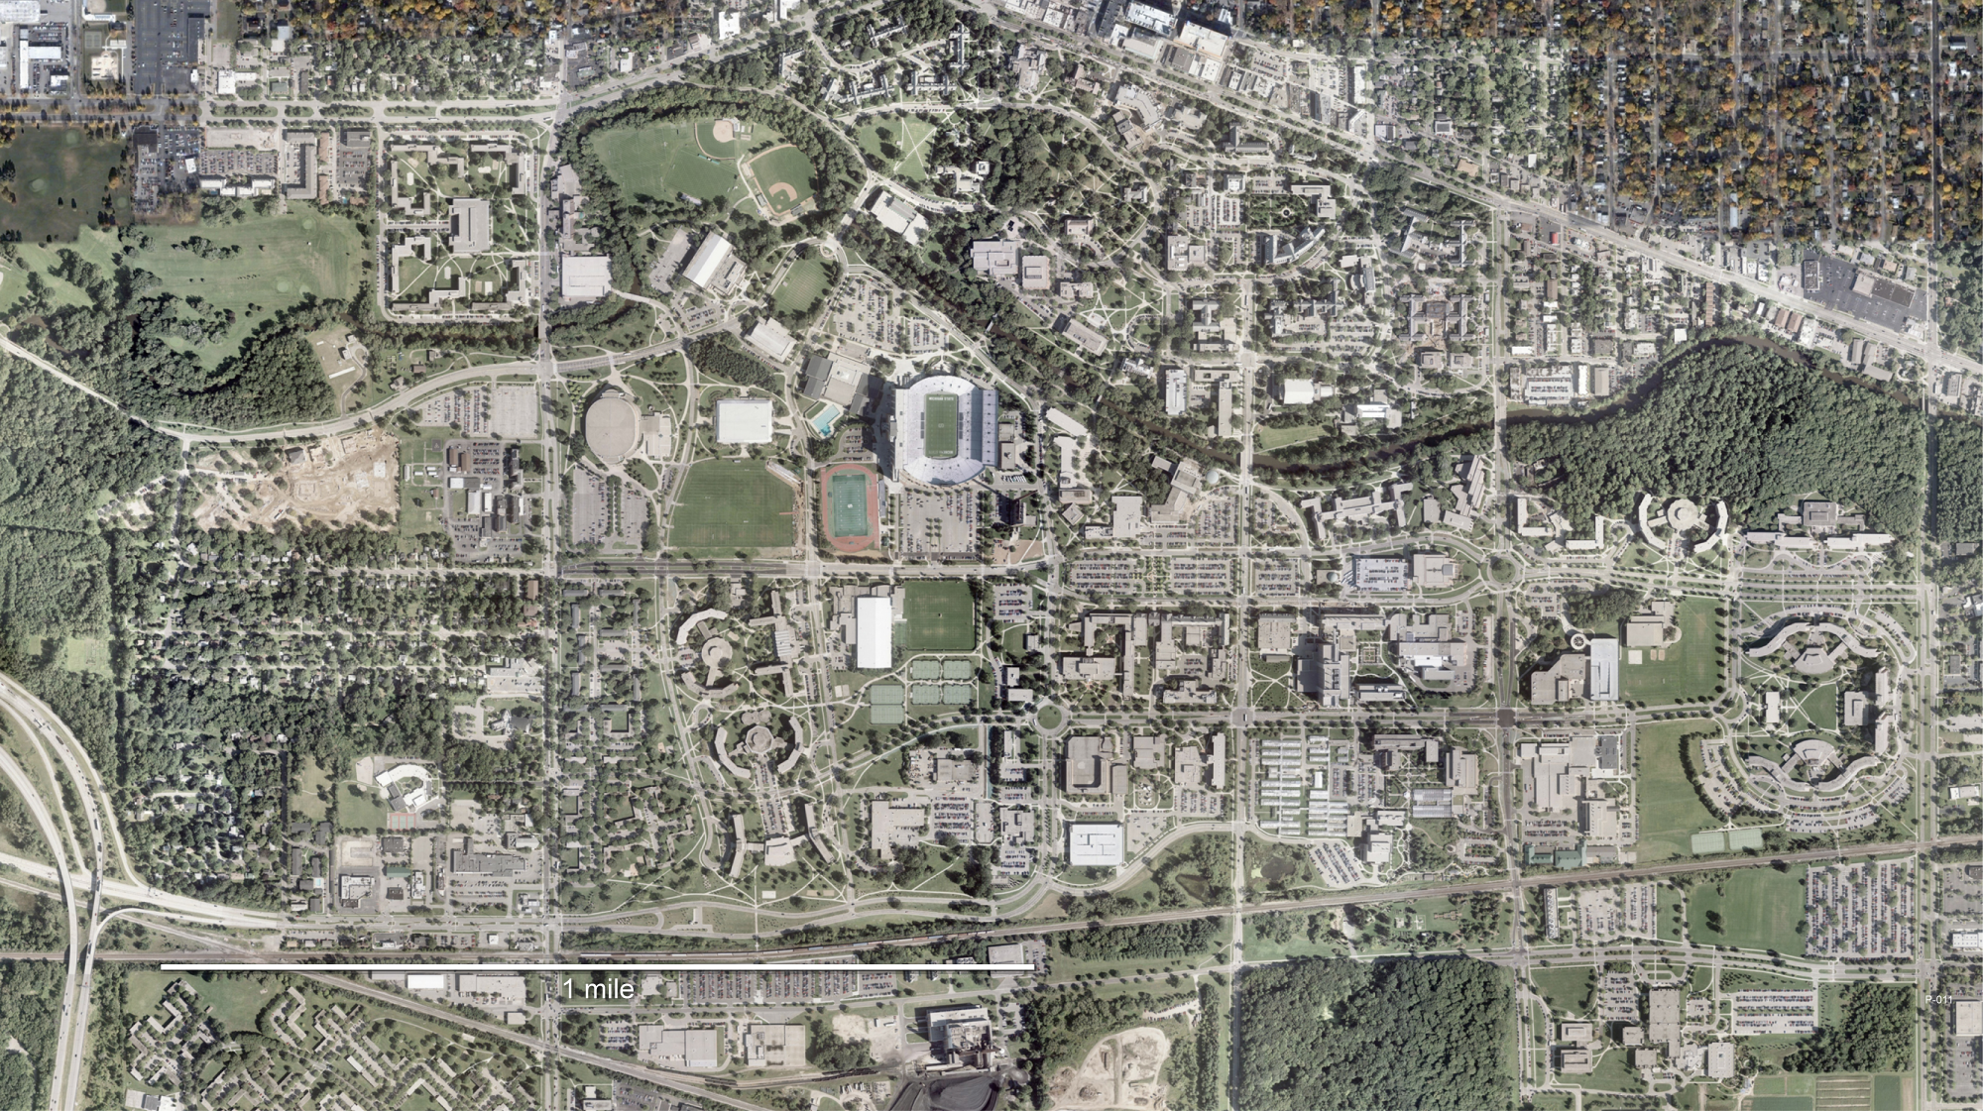
Facility for Rare Isotope Beams (FRIB)
D.O.E funded project, completion 2019
Notes:
5200 acres campus plus 18400 acres throughout Michigan

Slide 4
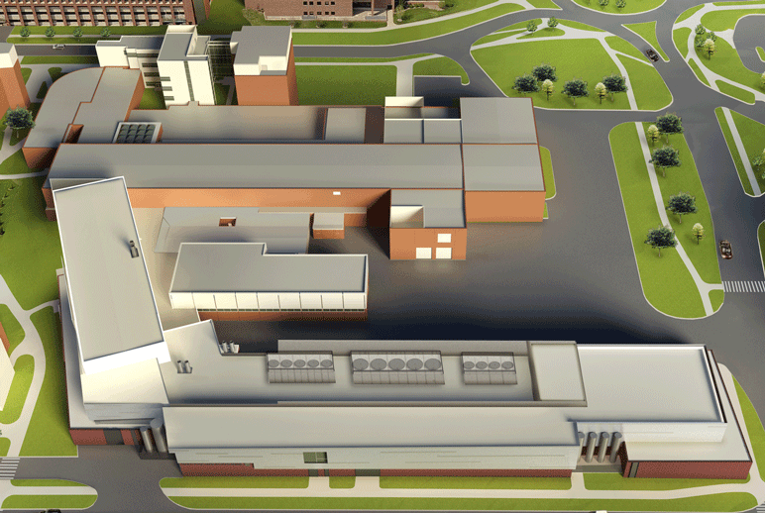
Facility for Rare Isotope Beams (FRIB)
200 MeV/u, 400kW (²³⁸U)
Existing NSCL
FRIB

Slide 5
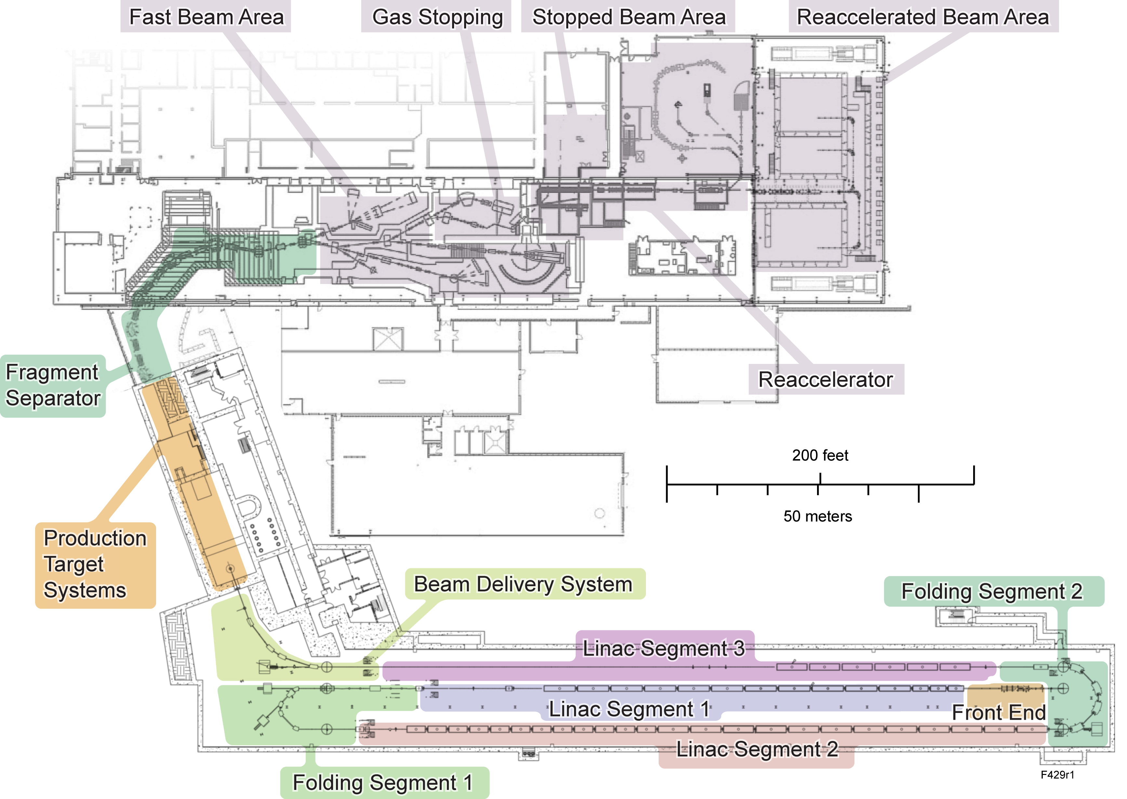
Integrated Technical Design

Slide 6
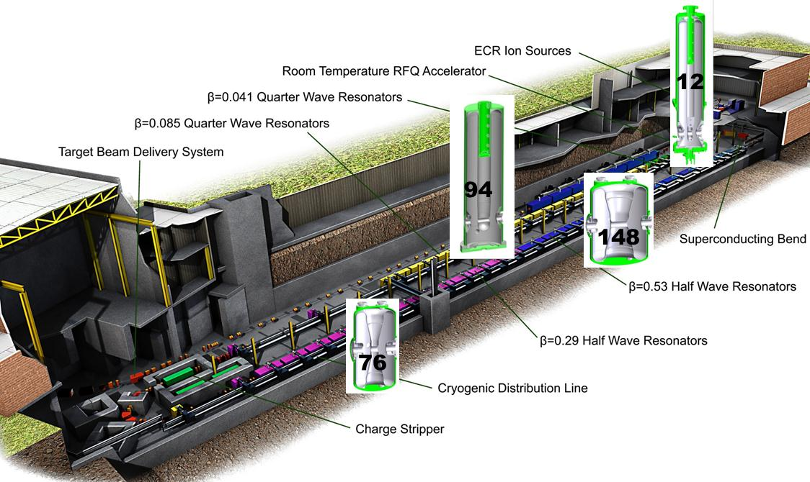
FRIB Driver Accelerator Layout

Slide 7
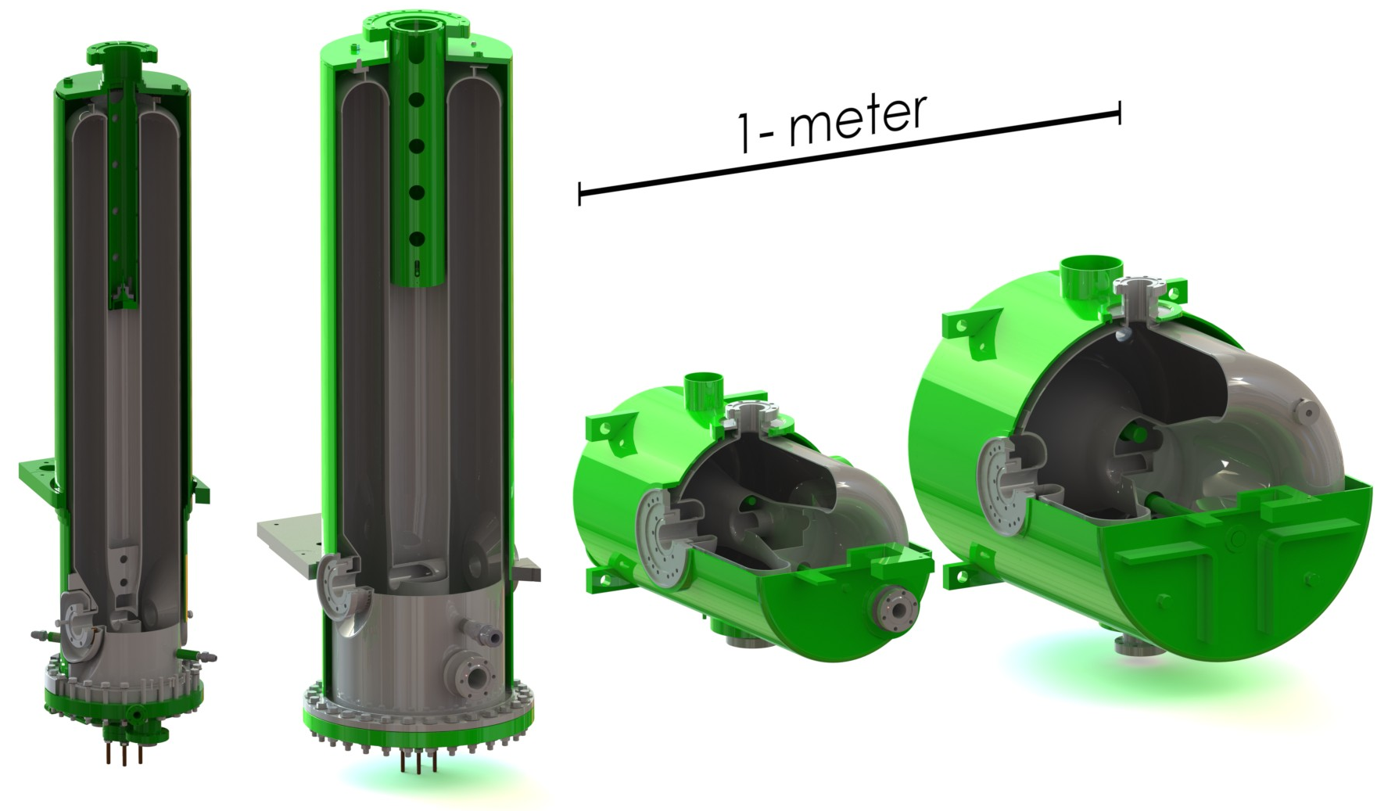
What is required to achieve FRIB (200 MeV/u,
400 kW)
49 cryomodules required for FRIB driver linac
4 main cryomodule types
3 matching cryomodule types
330 cavities required
4 cavity types
69 solenoids
QWR, 80.5 MHz, beta=0.041
QWR, 80.5 MHz, beta=0.085
HWR, 322 MHz, beta=0.29
HWR, 322 MHz, beta=0.53
QWR 80.5 MHz
Beta=0.041
QWR 80.5 MHz
Beta=0.085
HWR 322 MHz
Beta=0.29
HWR 322 MHz
Beta=0.53
β₀ | 0.041 | 0.085 | 0.29 | 0.53
f (MHz) | 80.5 | 80.5 | 322 | 322
V_{a} (MV) | 0.81 | 1.8 | 2.1 | 3.7
E_{p} (MV/m) | 31 | 33 | 33 | 26
B_{p} (mT) | 55 | 70 | 60 | 63
R/Q (Ω) | 402 | 452 | 224 | 230
G (Ω) | 15 | 22 | 78 | 107
Aperture (mm) | 34 | 34 | 40 | 40
L_{eff} ≡ βλ (mm) | 160 | 320 | 270 | 503

Slide 8
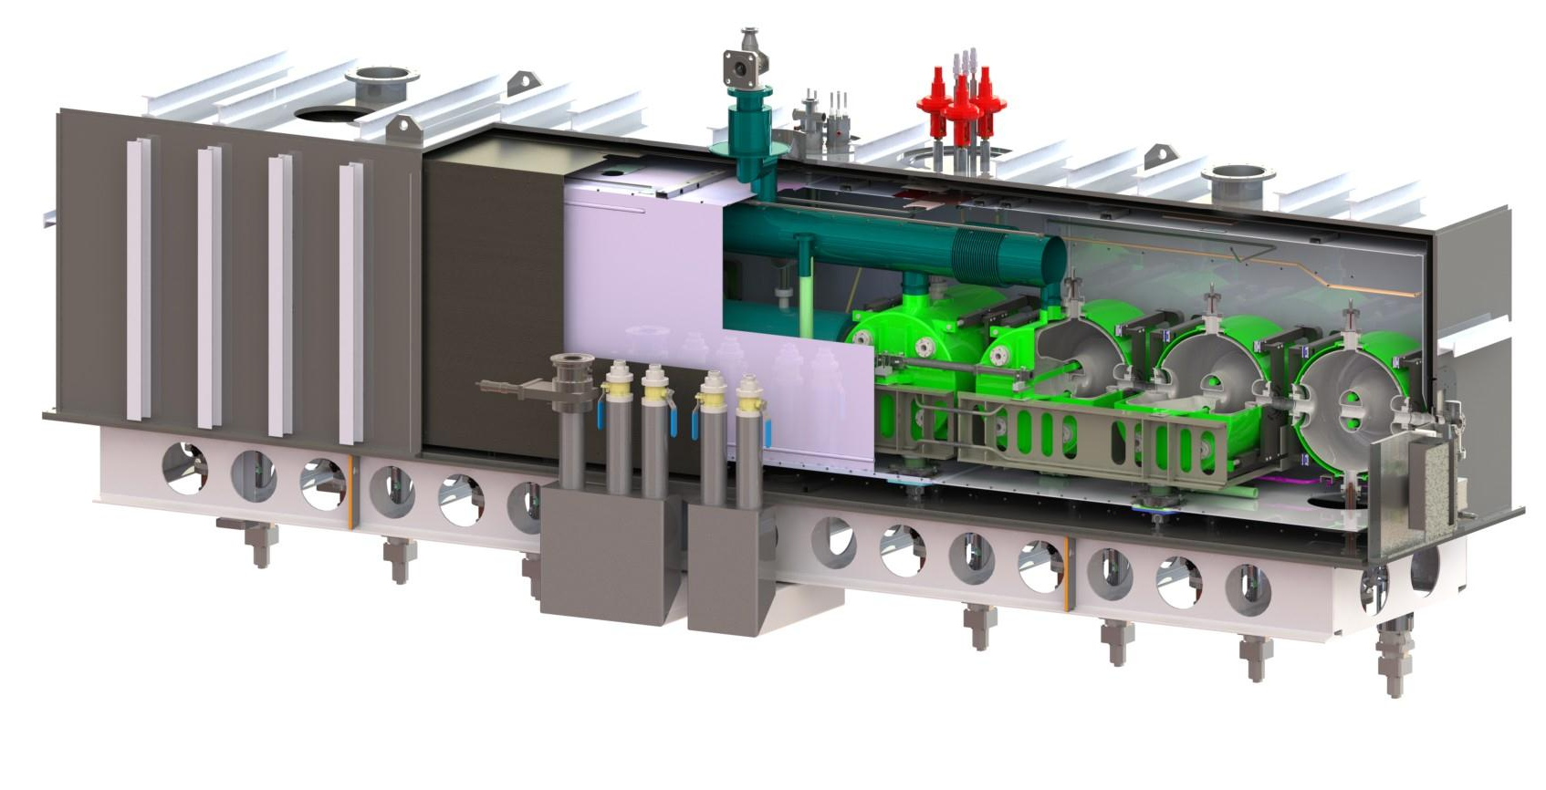
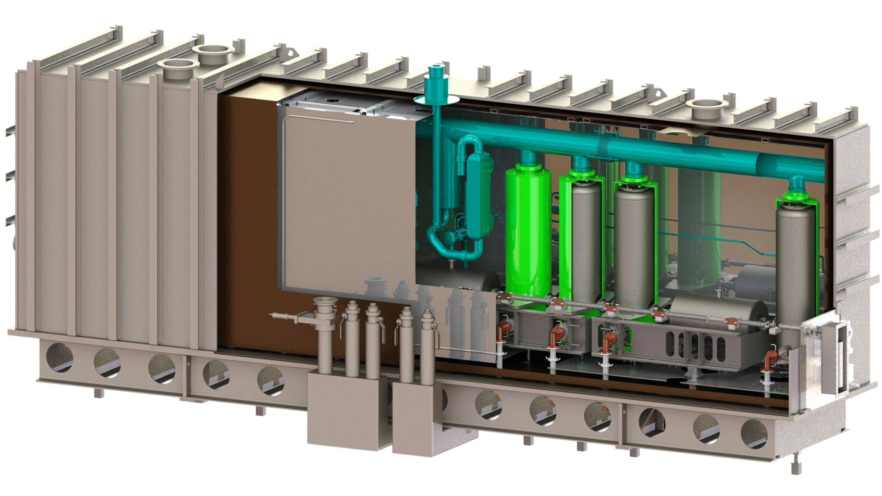
HWR and QWR Cryomodule Designs for FRIB
Modular Design to be Used on All FRIB Resonator Types
322 MHz β = 0.53 HWR Configuration:
Length = 5.82 m
Height = 2.39 m
Width = 1.28 m
Weight = 8,200 kg
322 MHz β = 0.53
8 HWR Resonators x 1 Solenoid
80.5 MHz β = 0.085 QWR Configuration:
Length = 5.99 m
Height = 3 m
Width = 1.28 m
Weight = 9,375 kg
80.5 MHz β = 0.085
8 QWR Resonators x 3 Solenoids

Slide 9
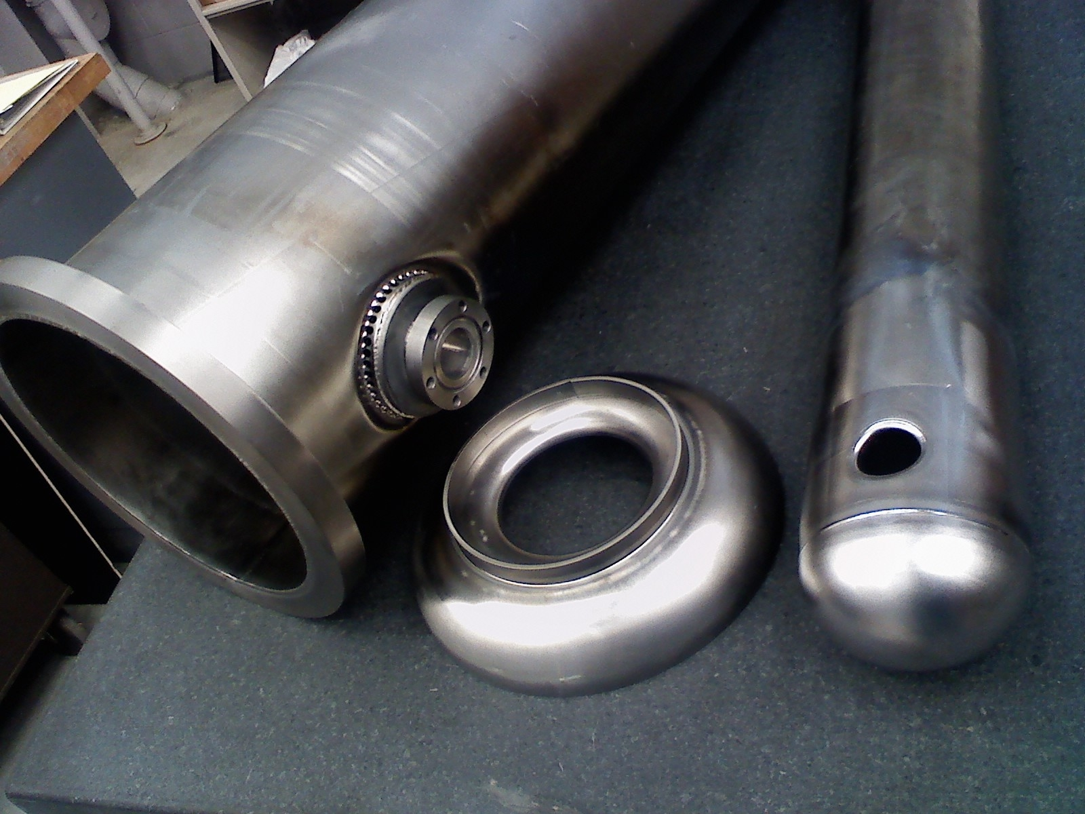
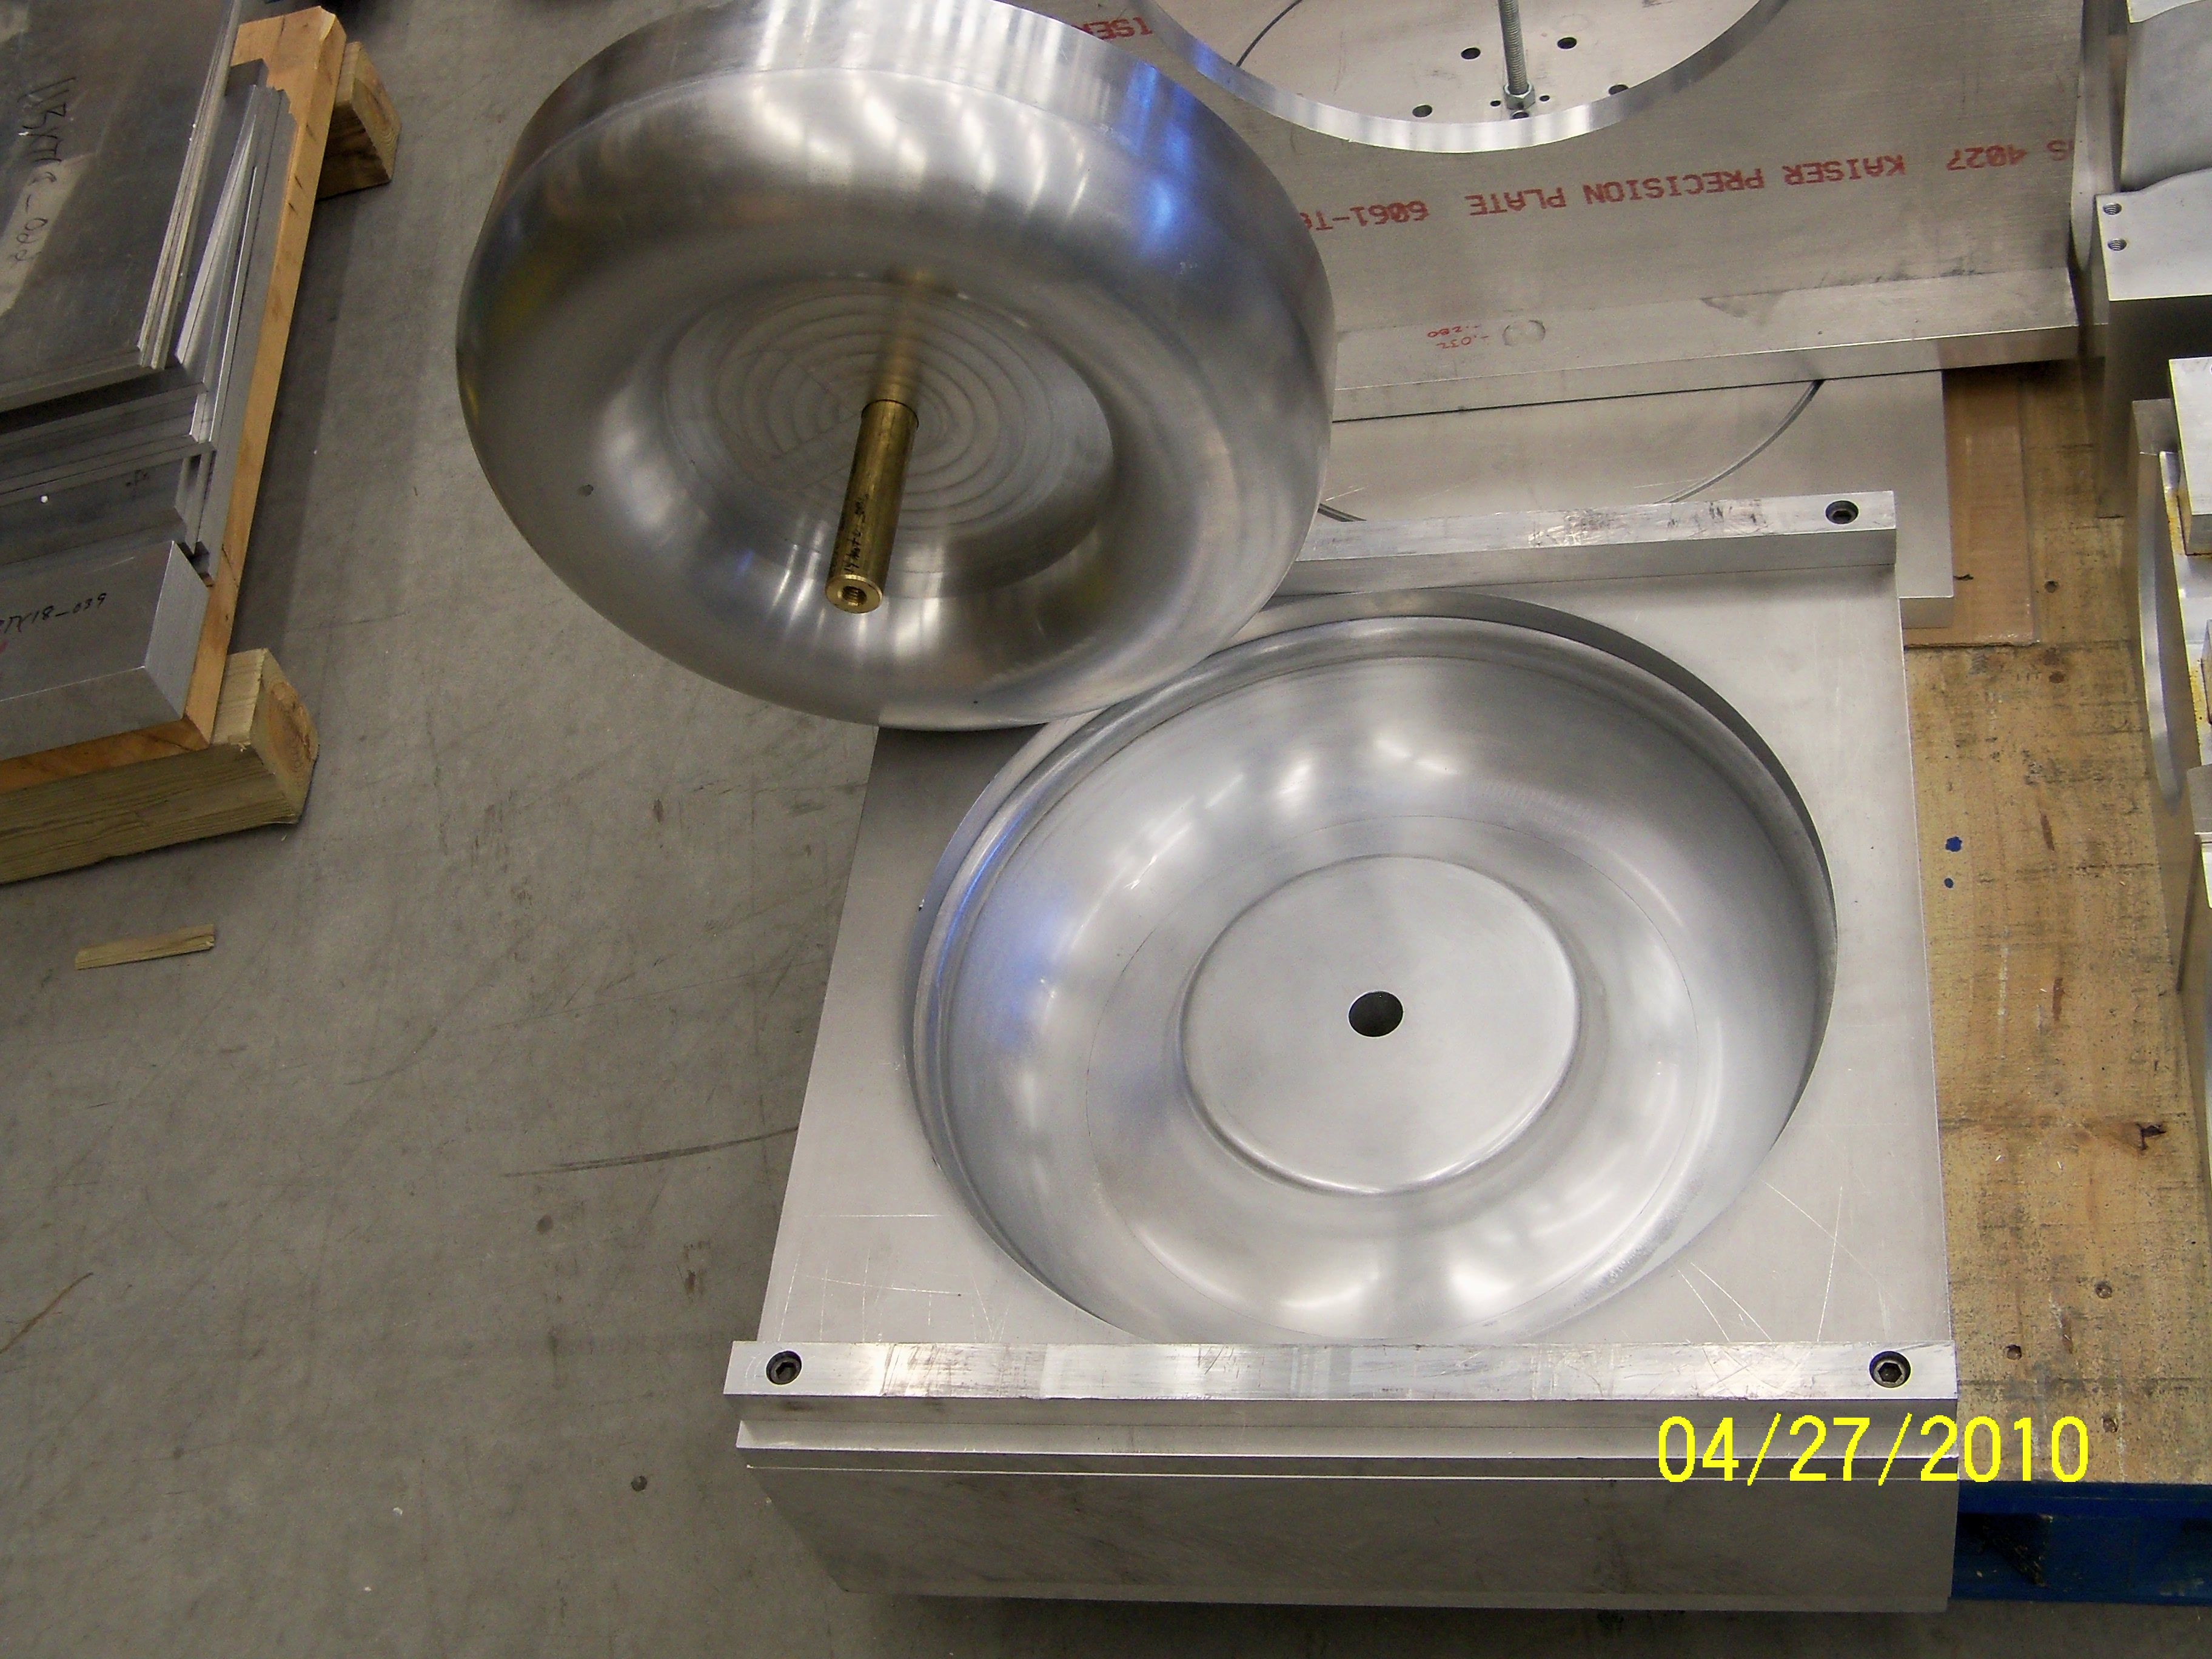
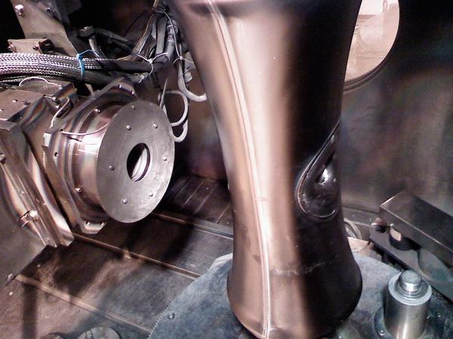
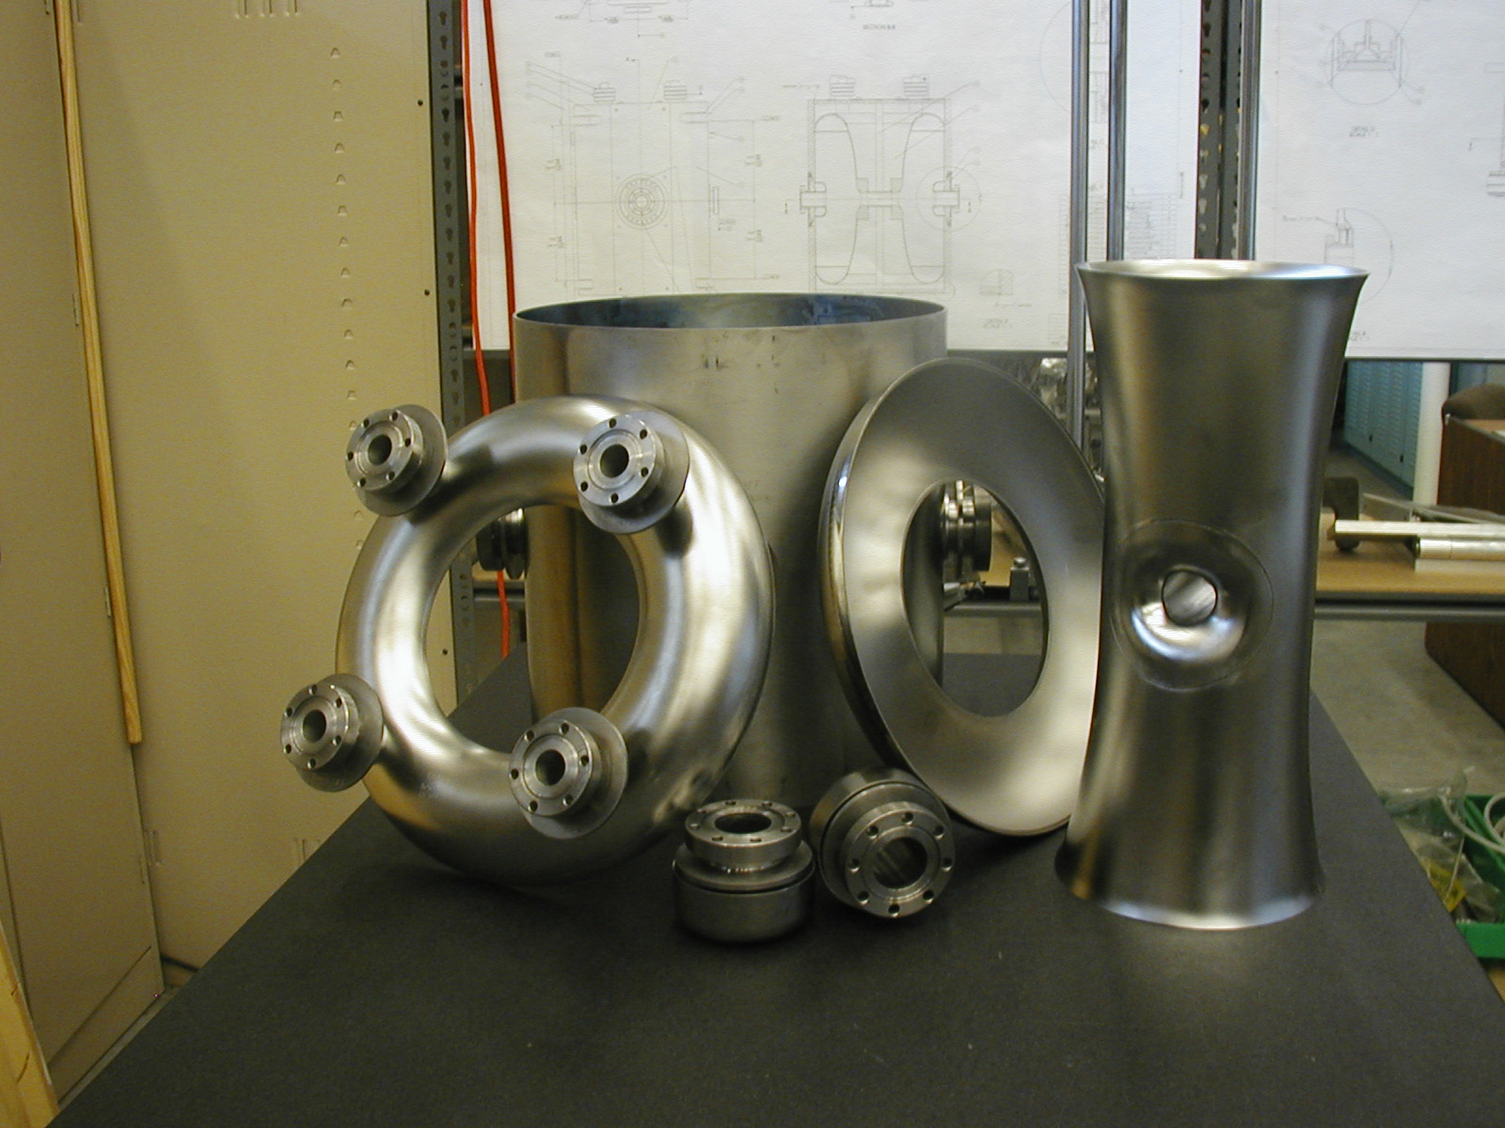
Cavity Fabrication
Cavities fabricated from bulk niobium
Cavity components formed using standard rolling and deep drawing techniques
Cavity components jointed using electron-beam welding technology
Isolated vacuum design using Conflat seal technology
Nb-Ti alloy used for cavity vacuum flanges and interfacing with helium vessel
Helium vessel fabricated from grade 2 titanium, using TIG welding for joining

Slide 10
Cavity Stiffness
Lot of effort goes into E&M and mechanical design for cavity stiffening
  Vacuum integrity
  Frequency tuning
  Tuning sensitivity
  Cavity Control
    Lorentz detuning
    Cryoplant fluctuation
    Mechanical noise (pumps…)

Slide 11
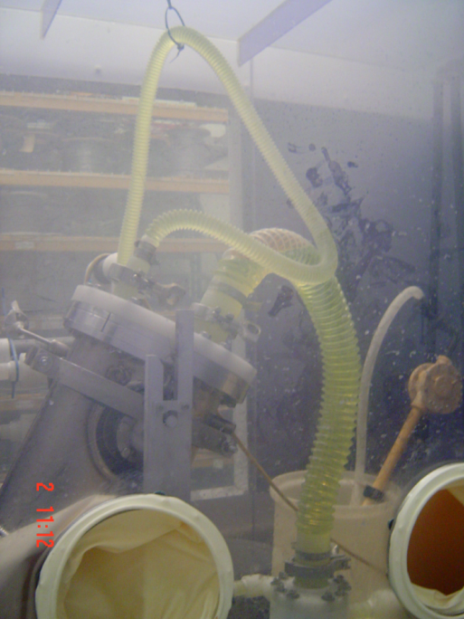
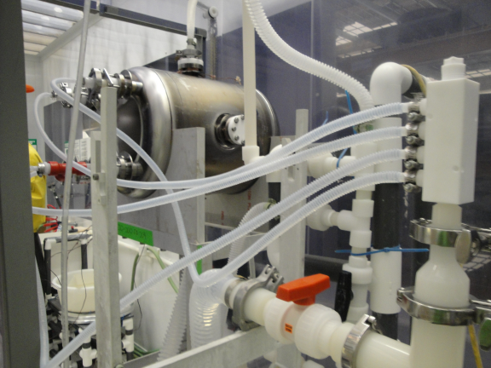
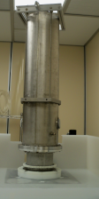
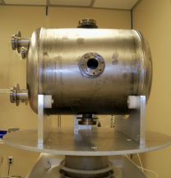
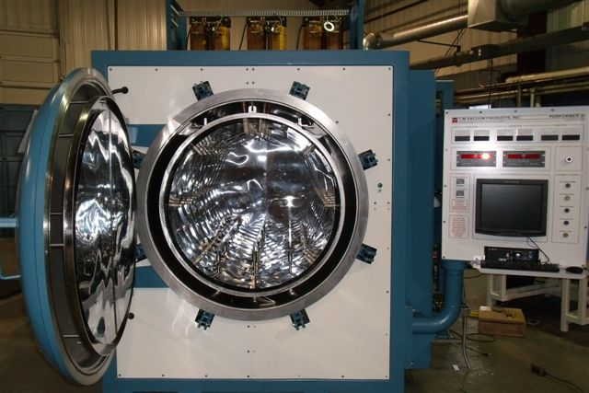
Cavity Processing
FRIB Cavities shall be processed for acceptance testing using the following recipe:
  Cleaned/degreased (outside cleanroom)
  Bulk etch (~150 µm)
  Rinse
  Heat treatment (600C for 10 hours)
  Alignment machining
  Cleaned/degreased (outside cleanroom)
  Cleaned (inside cleanroom)
  Fine etch (20 µm)
  HPR ( 2-3 hours)
  Dry

Slide 12
Niobium Procurement for FRIB
Total niobium materials procurement for FRIB: $13.3M
  Includes
    All RRR niobium sheet, plate, tube, and rod
    All Nb-Ti alloy
    All materials required for pre-production and baseline production
Niobium materials ordered from three companies
  Tokyo Denkai - thin niobium sheet
  Ningxia - niobium tube, rod, and thick niobium sheet
  Wah Chang - Nb-Ti alloy material
Breakdown of delivery schedule
  5% in Feb 2013
  23% in Aug 2013
  5% in Oct 2013
  29% in Jan 2014
  38% in Oct 2014
FRIB cavities require large sheet niobium for inner and outer conductors
  0.085 outer conductor – 870mm x 1050mm x 2mm
  0.53 outer conductor – 480mm x 1570mm x 3mm

Slide 13
Niobium Material Specification
Niobium specification similar to specification used for SNS and 12 GeV upgrade
Niobium materials shall be inspected and tested against FRIB niobium specification both at the vendor and upon receipt at FRIB
Specification verification from vendor
  All niobium shall be supplied with inspection documentation relating piece to every production lot number
  Niobium vendor shall test the following criteria
    Dimensional tolerance (including thickness)
    Mechanical requirements
      Yield strength – 7000 psi (48.2 N/mm2) • Tensile strength – 14000 psi (96.4 N/mm2)
      Elongation – 40% minimum • Hardness – 50 maximum (Hv)
    Metallurgical requirements
      Chemical composition
      Grain size – ASTM #5 (0.064 mm)
      Recrystallization > 90%
    Electrical requirements
      RRR > 250
    Surface finish

Slide 14
Chemical Composition
Element | Max. Parts per Million (weight/ppm)
Ta | 1000
W | 100
Ti | 40
C | 30
O | 40
N | 30
H | 10
Fe | 50
Si | 50
Mo | 50
All other metallic impurities | Less than 50 each

Slide 15
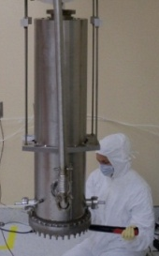
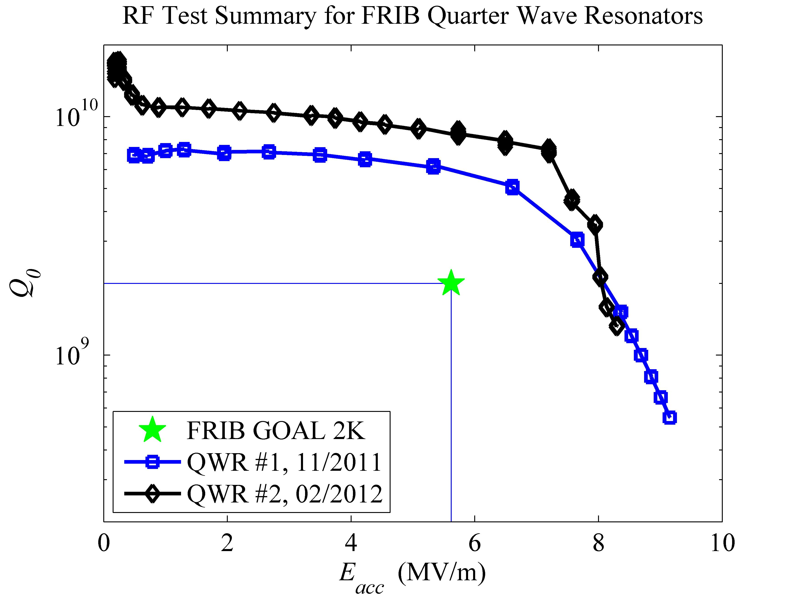
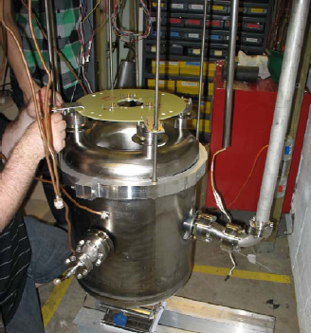
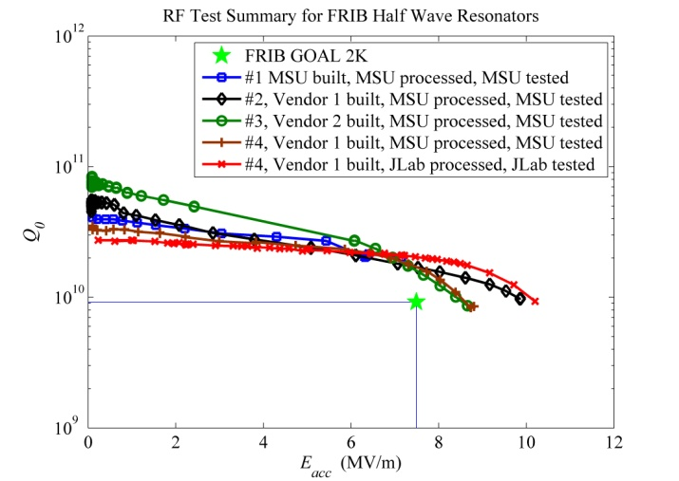
Cavity Performance for FRIB
Several QWR (beta=0.041 and 0.085) built and tested
Several HWR (beta=0.53) built and tested

Slide 16
FRIB Upgrade Considerations
Original design (RIA) was 400 MeV/u
Down scoped to 200 MeV/u (FRIB), but…
FRIB required to have upgrade path to 400 MeV/u
Upgrade plan integrated into the FRIB tunnel design
  space allocated for 12 additional cryomodules
FRIB upgrade to push SRF technology
  Fixed space in tunnel – Increase real estate gradient
  Increase Q – Optimal plan to not increase cryogenic plant, but doable
  Increase B_{peak} - Still provide operational safety factor
²³⁸U beam
Scenario | Charge state | Energy [MeV/u] | Energy [MeV/u] | Energy [MeV/u]
 | (average) | (baseline) | (baseline + | (baseline + 12 C.M.)
 |  |  | + 12 C.M.) | (35% gradient enh. for β=0.29 & 0.53)
Baseline | 78+ | 202 | 306 | 413

Slide 17
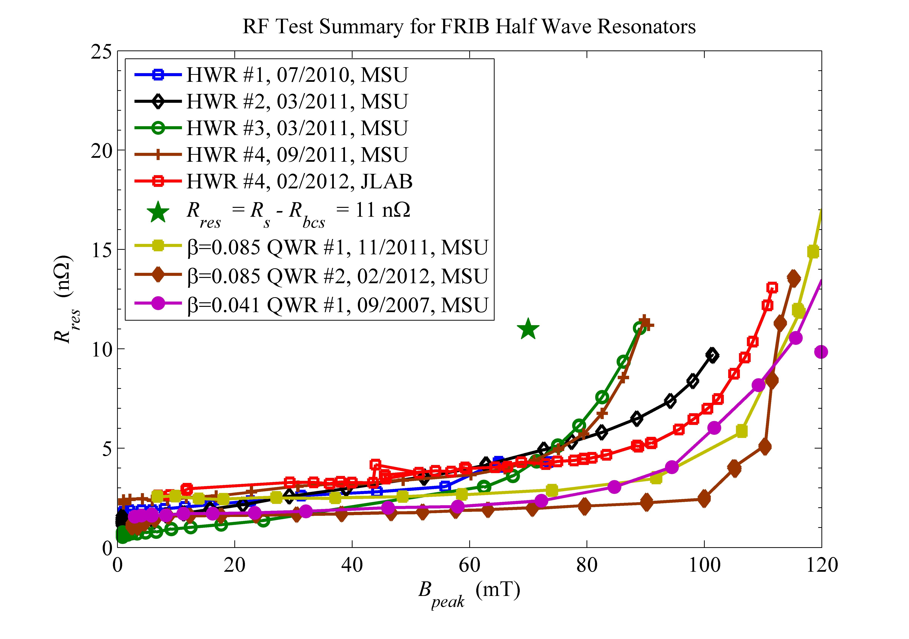
Cavity Performance for Upgrade
FRIB cavities designed to have B_{peak} below 70mT at operating field
Limited by thermal breakdown, field emission free at design gradient

Slide 18
FRIB Upgrade Considerations
A05-Bollen
12 Open Slots

Slide 19
FRIB Upgrade Considerations
What will be the best path forward to 400 MeV/u?
New cavity designs?
New bulk niobium properties?
New surface treatment?
New cavity design using thin film technology?
New design using new materials or acceleration approaches?

