Slide 1

NGLS Outline and
Needs in Superconducting RF Materials Development
John Corlett
SRFMW, July 16, 2012
Office of Science

Slide 2
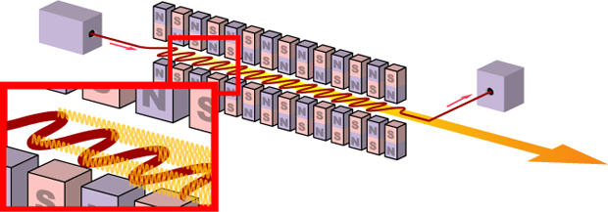
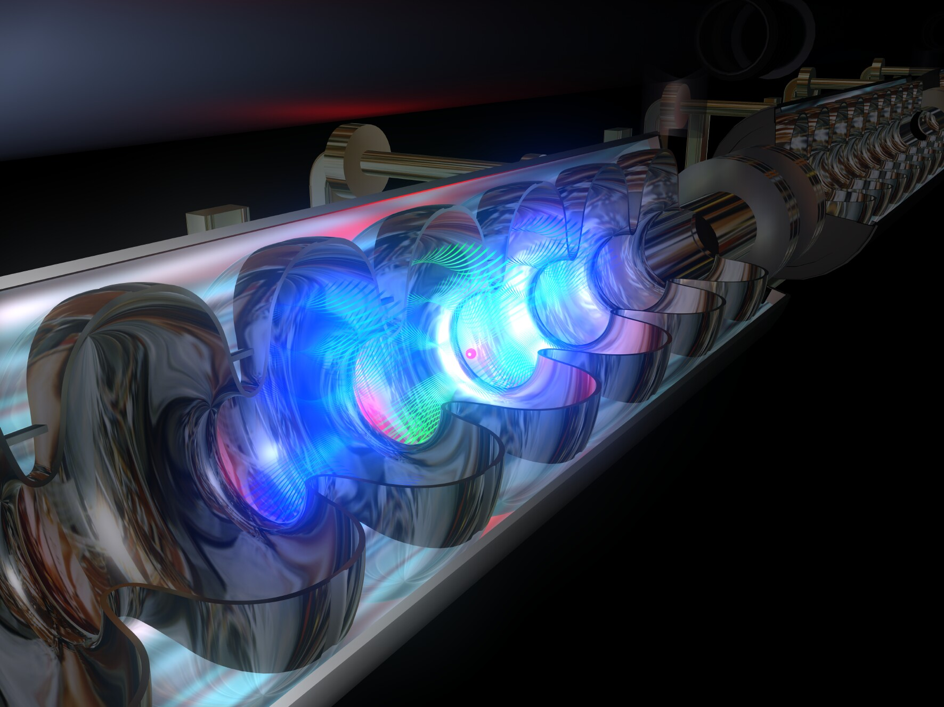
What is the NGLS?
~ 100 microjoule
~ microseconds
≤1 to ~100 femtoseconds
An array of high average power X-ray lasers with intense, ultrafast, coherent X-ray pulses at high repetition-rate
X-rays
time
Free electron lasers (FELs)produce intense, ultrafast, coherent, X-ray pulses
A CW superconducting accelerator with high rep-rate injector provides the high brightness and high-power electron beam
EUXFEL

Slide 3



What is the NGLS?
Comparison with existing light sources
~ microseconds
Intense coherent pulses at high rep rate – high average power
NGLS
~100 microjoule
≤1 to ~100 femtoseconds
Today’s storage ring x-ray sources
Weak pulses at
high rep rate
~ nanoseconds
~nanojoule
~10 to 100 picoseconds
Today’s x-ray laser sources
Intense pulses at
low rep rate
~millijoule
~ milliseconds
…
…
~10 to 100 femtoseconds
Notes:
Storage rings and FELs provide beamlines with about 1 Watt average power (0.1% BW)
Next generation superconducting-linac-driven FELs can provide hundreds of Watts, and with flexibility in X-ray pulse characteristics
Orders of magnitude more average power in coherent beams, with many (10) orders of magnitude greater peak brightness than storage rings

Slide 4
What is the NGLS?
Approach
Beam spreader
High-brightness, high rep-rate gun and injector
CW superconducting linac,
laser heater, bunch compressors
Array of independent FELs
X-ray beamlines and endstations
More energy per unit bandwidth
More photons per second
Shorter pulses
Controlled trade-off between time and energy resolution
CW pulse train

Slide 5
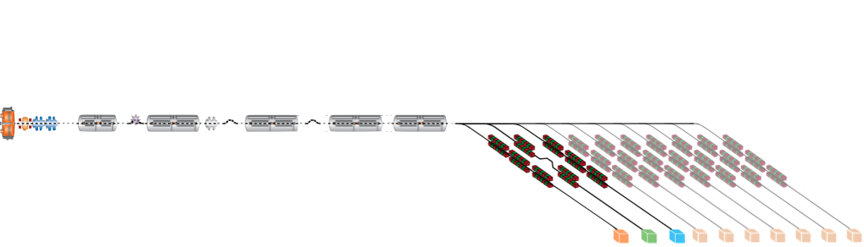
What is the NGLS?
Capabilities
High repetition rate soft X-ray laser array
  Up to 10⁶ pulses per second
  Average coherent power up to ~100 W
Spatially and temporally coherent X-rays (seeded)
  Ultrashort pulses from ≤1 fs to ~100 fs
  Narrow energy bandwidth to 50 meV
Tunable X-rays
  Adjustable photon energy from 270 eV – 1.2 keV
    higher energies in the 3rd and 5th harmonics
  Polarization control
  Moderate to high flux with 10⁸ – 10¹² photons/pulse
Expandable
  Capability
  Capacity

Slide 6
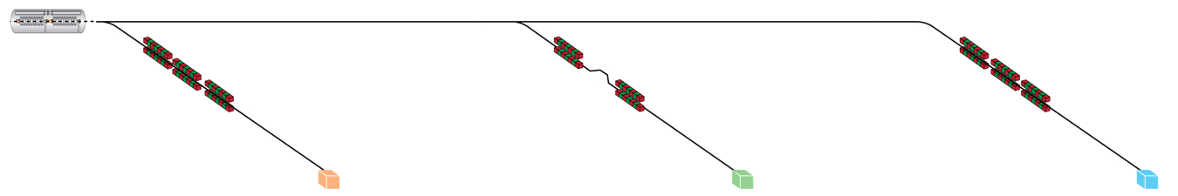
Three nominal initial X-ray lasers
2 color seeded
Self-seeded
Seeded / self-seeded
10 μs
10 μs
≤100 fs
≤1 μs
5 – 250 fs
~1– 25fs
5 – 250 fs
High resolution
Trade-off time/energy resolution
10¹¹ – 10¹² ph/pulse
10⁻³ – 5x10⁻⁵ bandwidth
Ultra-fast
≤ fs pulse capability
2 color
10⁸ ph/pulse
Highest rep rate
High flux
10¹¹ - 10¹² ph/pulse
100 W

Slide 7
Linac schematic layout
L0
I_{pk} = 50 A
L1
I_{pk} = 50 A
L_{harmonic}
L2
I_{pk} = 150 A
L3
I_{pk} = <600 A
CM01
CM2,3
3.9
CM04
CM09
CM10
CM27
GUN
1 MeV
Heater
100 MeV
BC1
210 MeV
BC2
685 MeV
SPRDR
2.4 GeV
~700 m
to spreader end
300 pC bunches
1 MHz rep-rate
2.4 GeV
~16 MV/m gradient
27 ~12-m long cryomodules
7 RF cavities per module
2 bunch compressors
1 laser heater
3 initial identical spreader beamlines

Slide 8
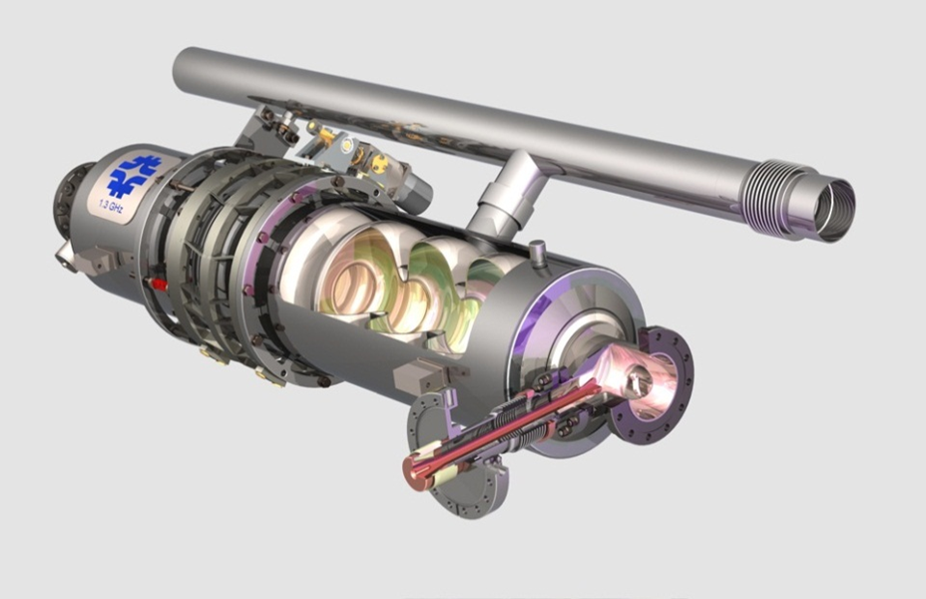
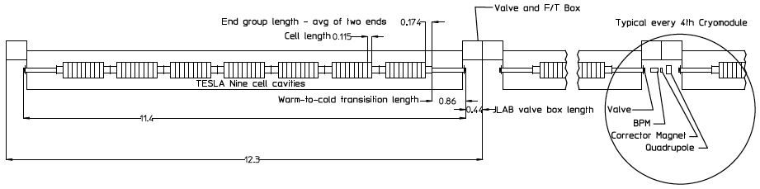
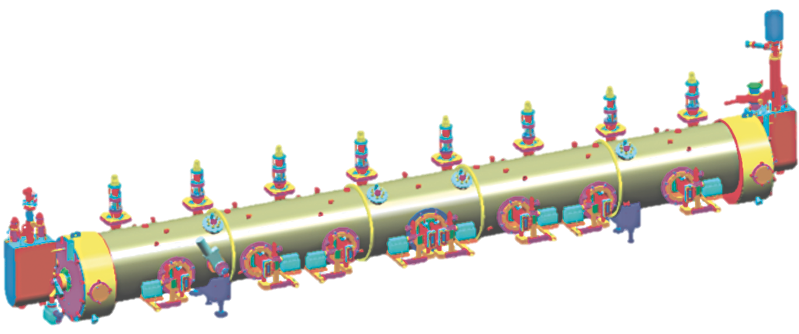




NGLS cryomodule concept
“TESLA” cavities in JLAB-style housing
  Cold/warm transitions on each cryomodule
  Distribute 5 K liquid, cool to 1.8 K at cryomodule
  Warm magnets, diagnostics & HOM absorbers
  RF power distribution options under study
Planning workshop on “CW SCRF Linac for X-ray Lasers” – September

Slide 9
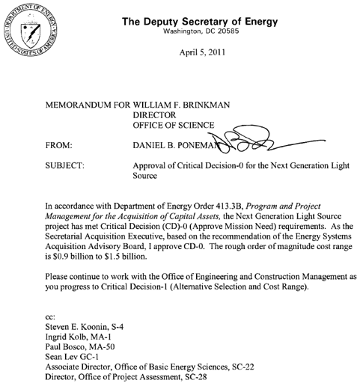
NGLS project status
LBNL submitted a CD-0 proposal in December 2010
DOE approved “Mission Need” for the Next Generation Light Source

Slide 10
Planning assumptions
Today
CD-0
CD-1
CD-2/3a, 3b
CD-4a,b
FY
11
12
13
14
15
16
17
18
19
20
21
22
23
Defining
Refining
Building
Commissioning
We need to define what NGLS “is” in this timeframe
Use existing technology where it works
Develop performance improvements and cost reductions where they have the biggest impact

Slide 11
Charge to this workshop
For a CW accelerator, with modest accelerating field ~15–20 MV/m:
  What materials and fabrication processes could be developed to increase Q_{o} to the highest reliably achievable value?
  What materials and fabrication technique developments might lead to reduced costs and improved production yield?
Notes:
High repetition rate
Injector (APEX)
Spreader
Advanced FEL operation
Seeding
Lasers
Undulators
Instrumentation & diagnostics
Timing & synchronization
High average power
Beam dumps
Superconducting accelerator developments
High Q_{o}
Higher order mode power
Field emission
Harmonic cavity

