Slide 1
Fabrication of Seamless Nb Tube for SRF Cavities
K.T. Hartwig^{1,2}, S. Balachandran¹, R. Elwell², and R.E. Barber²
¹Mechanical Engineering Department, Texas A&M University, College Station, Texas 77843.
²Shear Form Incorporated, Bryan, Texas 77801.
* Work supported by DOE SBIR Grant DE-SC0007601

Slide 2
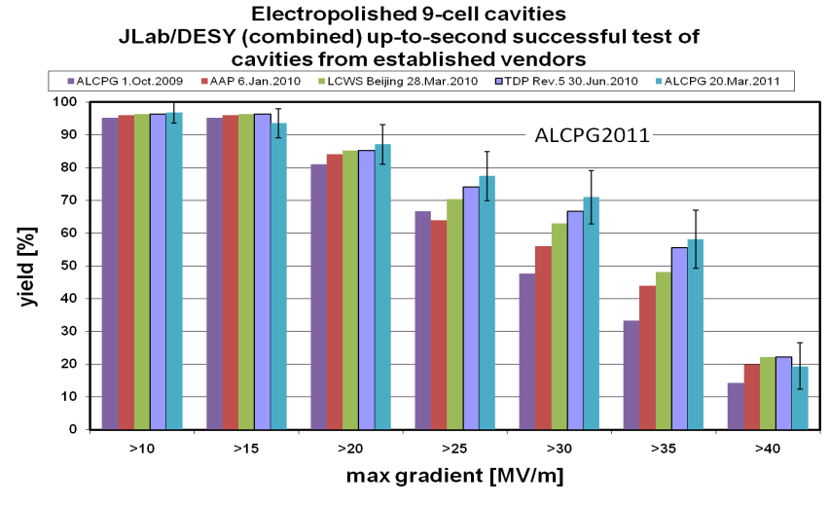
CHALLENGING ISSUES
$$$
SRF2011 Hot Topic Discussion, R. L. Geng
MANUFACTURING ISSUES FOR Nb SRF CAVITIES :
Tube dimensions- OD, wall thickness, and length
Non uniform deformation characteristics
  Non-uniform microstructure
  Inconsistent microstructure (Reproducibility)
Bulk Defects
Limited microstructures given fabrication constraints.
Notes:
Fabrication and manufacturing cavities must focus on possible ways of eliminating the defects, by mechanical design of fabrication equipment and by proper microstructural control of Nb.
Seamless tubes- Eliminates equatorial welds. May reduce some Type I defects.
Singer conclusions on various approaches:
Back extrusion does not work (does not give required mechanical properties)
Spinning: Works for short tubes
Flow forming: In combination with spinning, deepdrawing, extrusion works best for DESY
Concept proven by Black Labs

Slide 3
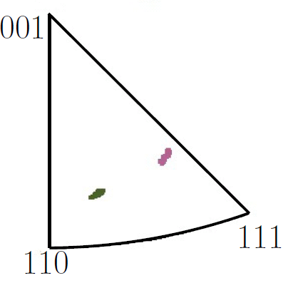
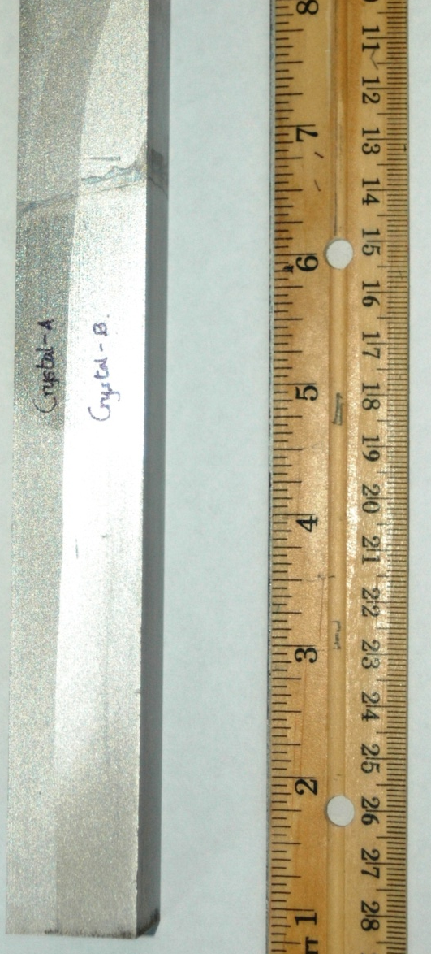
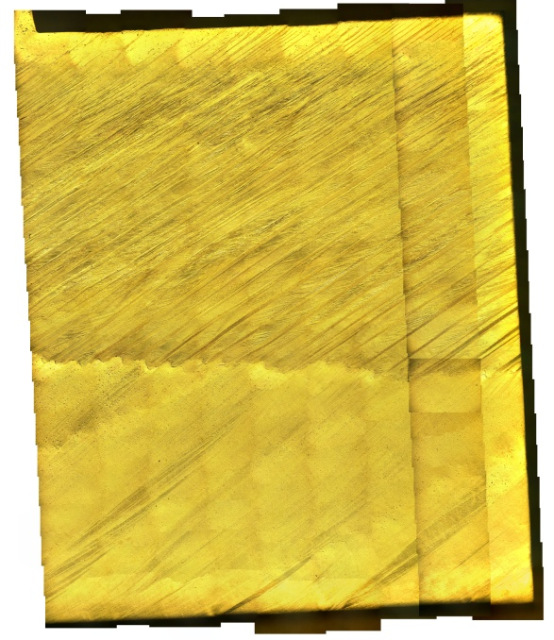
DEFORMATION DEPENDS ON ORIENTATION
EXAMPLE- HIGH STRAIN OF BI- CRYSTAL
A
B
AFTER A SIMPLE SHEAR OF 1.14;
EQUIVALENT ROLLING REDUCTION (67%)
B
A
Notes:
This is found by equivalent work method…

Slide 4
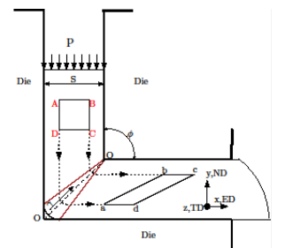
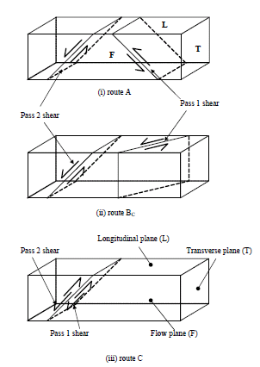
SEVERE PLASTIC DEFORMATION TO NORMALIZE MICROSTRUCTURE
Shear Strain per pass is 1.14
Deformation is confined to a thin region.
Rotations between passes changes the strain path leads to rapid refinement of microstructure.
High strains effectively breakdown the microstructure.
Jae- Tek, Im (PhD thesis)
Notes:
Idea--Increase dislocation density to the limit. Have very high misorientation regions uniformly distributed to promote nucleation..

Slide 5
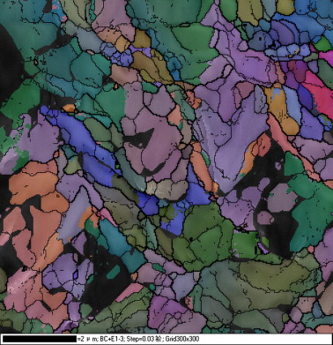
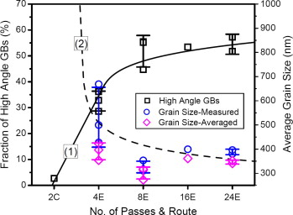
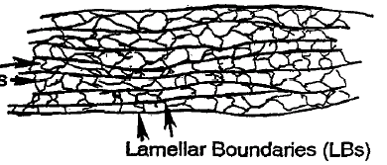
4 pass RG Nb. Scale bar 2µm
High Angle GB’s >15º created.
HAGB’s are nucleation site for recrystallization.
Possibility of lower temperatures for full recrystallization
Cell walls
Z. Pan, S. N. Mathaudhu, K. T. Hartwig, Q. Wei et.al, Acta Mat, 2012.
Hughes, Hansen, Acta Mat, 1995
Notes:
Step size is 30nm.

Slide 6
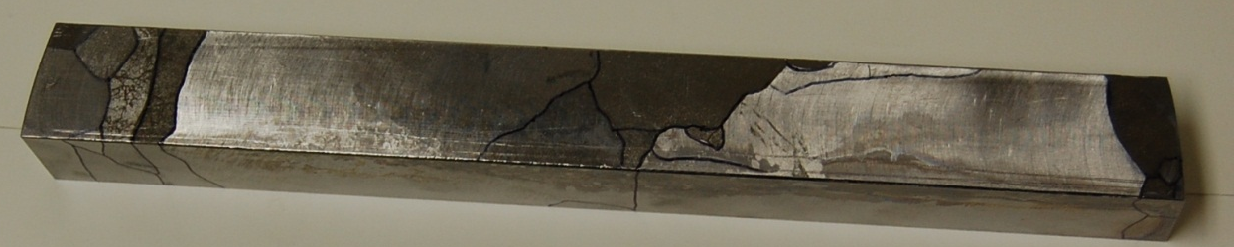
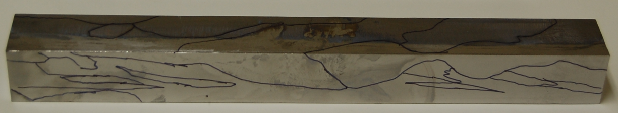
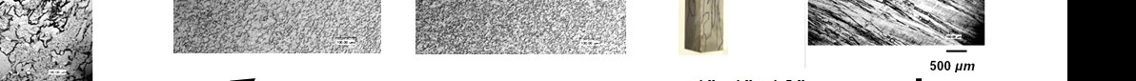
IT IS HARD TO ERASE MICROSTRUCTURAL MEMORY OF Nb
T2
25mm
L2
25mm
CAST RG INGOT
Different starting microstructures, may yield different end results.

Slide 7
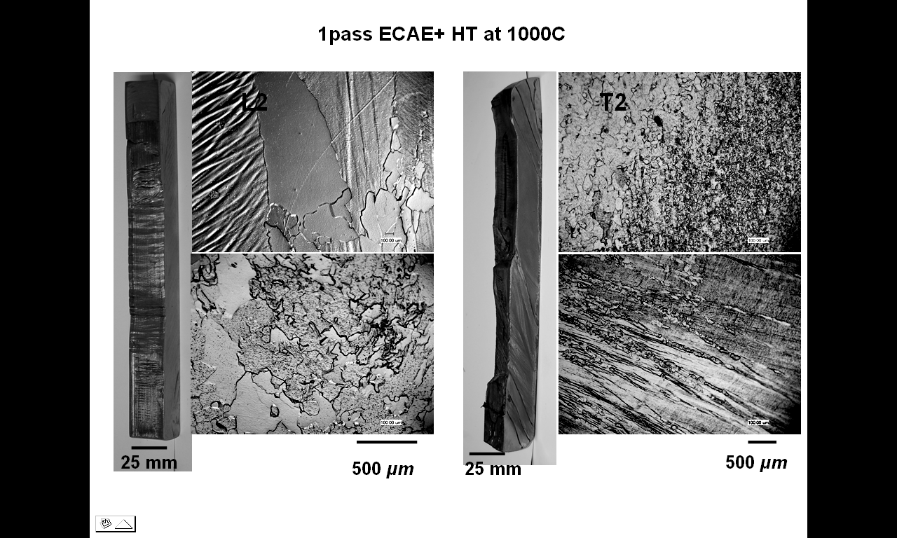
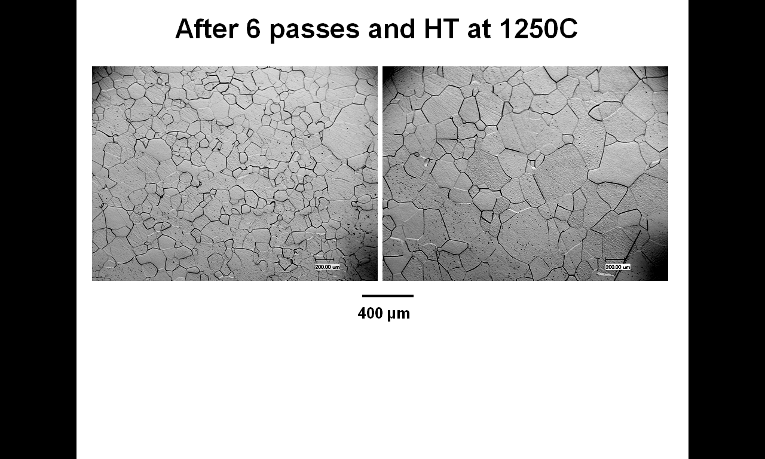
NORMALIZED MICROSTRUCTURE AFTER SEVERAL SPD AND HT CYCLES
After a strain of 2.3 and Heat Treatment of 1100ºC
After a strain of 6.9 and Heat Treatment of 1250ºC
400μm

Slide 8
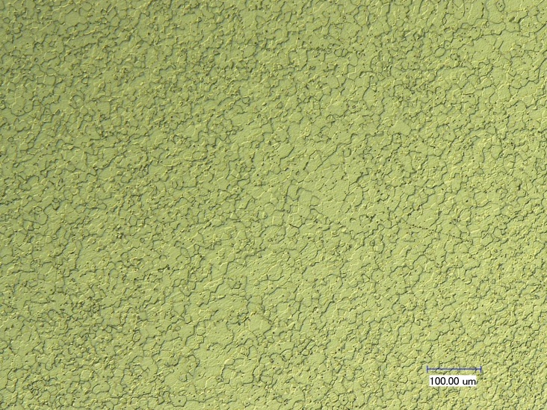
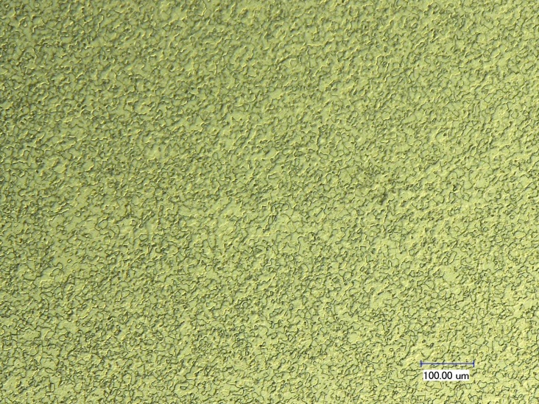
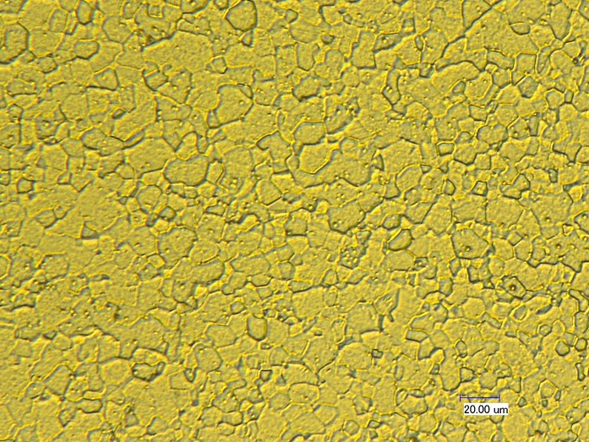
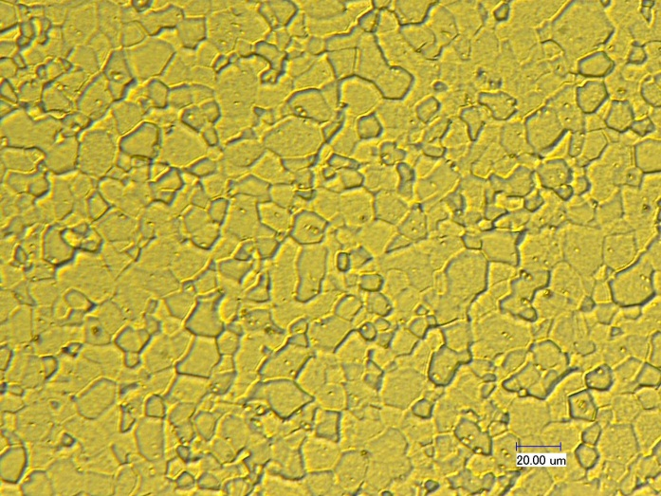
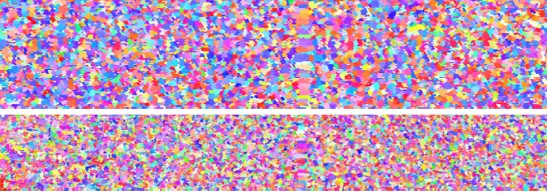
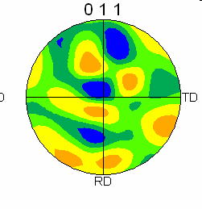
AFTER A TOTAL STRAIN OF ~11 AND THREE HEAT TREATMENTS
L
L2
T2
T
F
Approximately 3” from front end
200 µm
200 µm
Rx=700 C
50 μm
50 μm
T
EBSD by: D. Baars, T.R. Bieler (MSU)
L
Total Length: 1mm
3.2 mrd

Slide 9
APPROACH WITH PROMISE
BULK RRR Nb
GRAIN REFINED BULK Nb
ECAE*
AR* Extrusion
AXIS SYMMETRIC SEAMLESS TUBE
SEAMLESS TUBE
HT**
ECAE
No change in shape
Grain size 10-30 µm
Weak shear textures
* Area reduction
Notes:
The pole figure is a {110} pf with the important fibers marked.
Extruded tubes will have a strong <110> texture in the extrusion direction .Heat treatment will reduce the intensity of this texture. However, the texture will persist. And this is not axis syymetric
SEC is needed to produce axis symmetric texture. Capability to produce equiaxed fine grain structure with low texture
Spinning of the tube also produces axis symmetric properties. From Crooks presentation, the tubes are fine grain size and low texture too.

Slide 10
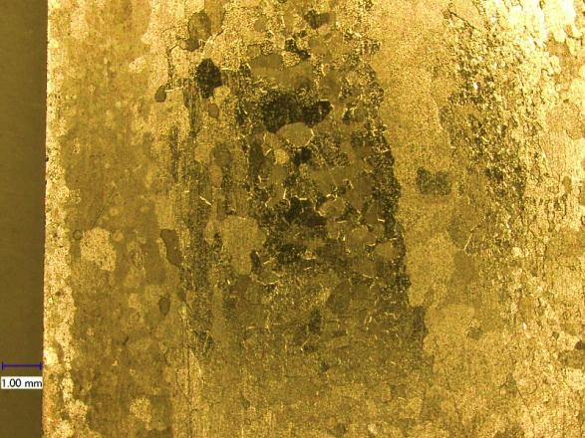
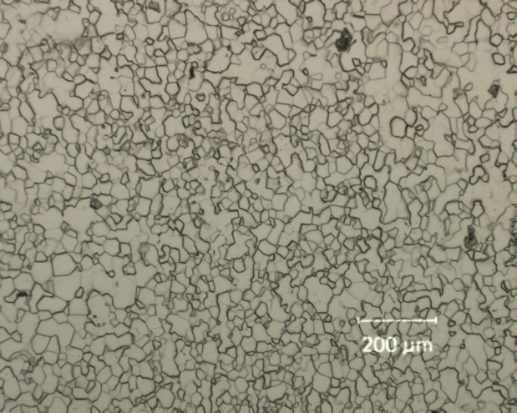
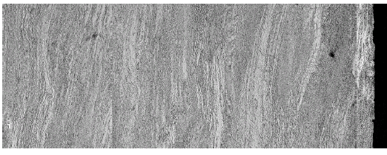
PRELIMINARY RESULTS (RRR Nb tube)
As received (Bulk)
mECAE
Rx
5mm
P.J. Lee
1 µm
500 µm
AR
As worked seamless tube
Rx
t= 1500µm
t=0
500 µm

Slide 11
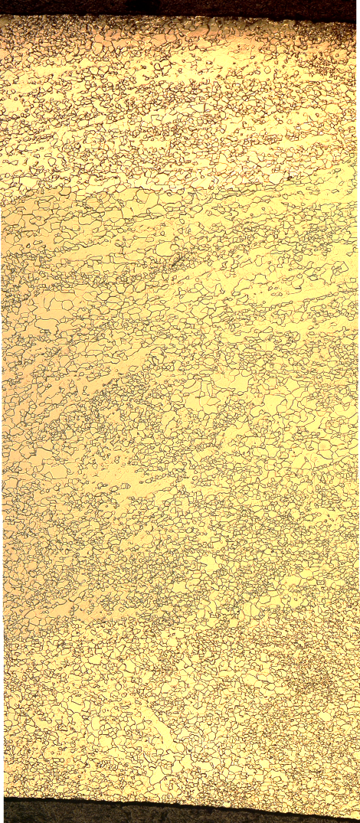
THROUGH THICKNESS TUBE MICROSTRUCTURE: AFTER HEAT TREATMENT
Ramp Rate: 2º C/min
Soak Time: 120min
Vacuum Level: 0.2-4 x 10⁻⁶ torr
600º C
700º C
800º C
900º C
500 µm
Notes:
Banding observed by OM suggets difference in grain growth mechanisms, relations to texture.

Slide 12
Ramp Rate: 2º C/min
Soak Time: 120min
Vacuum Level: 0.2-4 x 10⁻⁶ torr
600ºC
700ºC
800ºC*
Temperature (ºC) | Grain Size (µm) | HV₃₀₀
600 | Bi- Modal 10±3; 30±7 | 51±2
700 | Bi-Modal 12±3; 48±3 | 49±3
800 | Bi-Modal 15±6; 72±4 | 50±2
SCALE BAR 100 µm

Slide 13
CONTINUING WORK…
ECAE processing of seamless tubes
Bulge testing of recrystallized tubes by C. Compton to evaluate hydroformability.
EBSD charcterization of recrystallized material at MSU. Grain orientation spread data, to quantify residual strain….

Slide 14
Questions and Discussion
Fabrication expenses. Does microstructure influence cavity performance?
Why is microstructure important?
Why is a uniform microstructure in RRR Nb difficult to achieve? How can this issue be overcome?
Is it possible to make mechanically consistent seamless RRR Nb tubes? What level of inconsistency is tolerable?
What mechanical and microstructural properties (grain size, texture) are needed for good hydroformability and how are they related to processing?
Scale up?
High uniform strain processing and recrystallization
Directly dependent on the homogeneity of the microstructure.
General criteria: High ductility, moderate- high strain hardening.
Specifics with respect to hydroforming needs to be established.

Slide 15
Thank you for your attention
Comments and Questions…

