Slide 1
Energy (ILC) and Intensity (Project X) SRF Cavity Needs
C.M. Ginsburg (FNAL)
SRF Materials Workshop
Jefferson Lab
July 16-17, 2012

Slide 2
International Linear Collider
ILC RDR
ILC Specifications
Initial center-of-mass energy up to 500 GeV, upgradeable to 1 TeV
Ability to scan in energy between 250 and 500 GeV
Integrated luminosity in the first four years 500 fb-1 at 500 GeV
Peak luminosity 2 x 10³⁴ cm⁻² s⁻¹, 75% duty factor
e- e+
Main Linac
Two 11-km linacs, one for electrons and one for positrons
Accelerate from injected energy of 15 GeV to the final beam energy of 250 GeV
~16000 1.3 GHz superconducting RF cavities, operating at average gradient 31.5 MV/m
Notes:
This design information is from the ILC Reference Design Report which was released last month.

Slide 3
ILC: SRF Cavities
Primary design criteria
Maximum gradient in shortest distance
Minimize cost per cavity (or per cryomodule)
TESLA shape was chosen as baseline
E_{peak}/E_{acc} = 2.0
B_{peak}/E_{acc} = 4.26 mT/(MV/m)
Cavity performance specification
vertical (qualification) test: 35 MV/m and Q₀>0.8E10
operation: 31.5 MV/m and Q₀>1E10
Required cavity processing
Electropolishing, HPR, class-10 cleanroom assembly

Slide 4
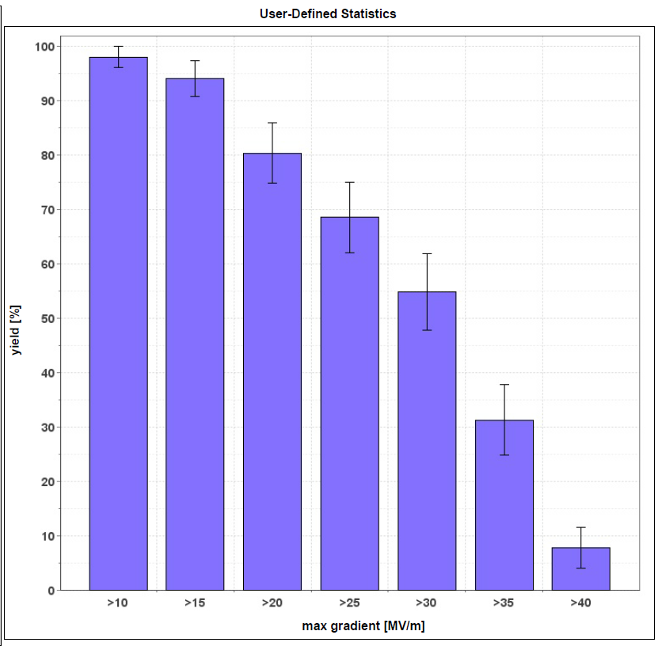
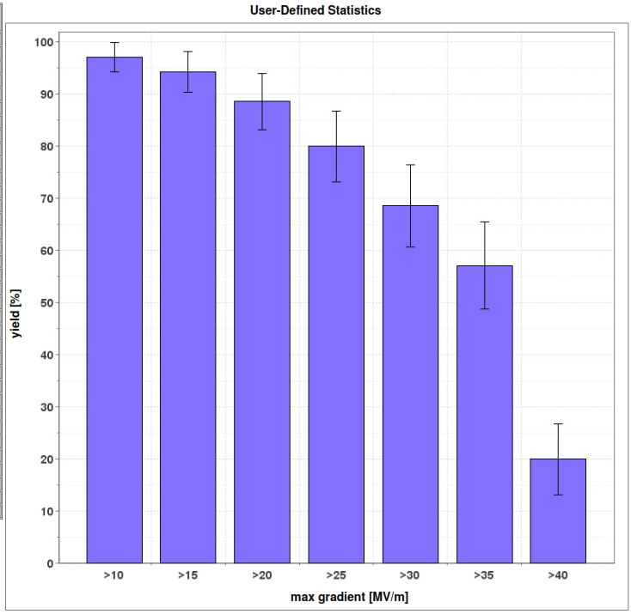
ILC: Production Yields
100
100
KILC 2012
1st pass
KILC 2012
2nd pass
Yield [%]
Yield [%]
0
>25
>30
>35
>25
>30
>35
0
Max gradient [MV/m]
Max gradient [MV/m]
Electropolished 9-cell ILC cavities built by established vendors
Processed by established labs: JLab/DESY/KEK
1st-pass cavity yield at >35 MV/m is (31 +- 7) %
2nd-pass cavity yield at >35 MV/m is (57 +- 8)%

Slide 5
ILC: Beyond the Baseline Studies
50 MV/m
Several instances of this gradient level with different cell shapes
trade off lower B_{peak}/E_{acc} = ~3.5 mT/(MV/m) for higher E_{peak}/E_{acc} ~2.2
Avoiding field emission (even) more important
Reduce cost
Hydroformed cavities? (shapability, Nb properties)
Large grain material? (surface roughness, earing, BCP only)
Looser material specs? (tantalum content, targeted inspection)
Better performance after first pass (Tumbling? Better diagnostic tools?)

Slide 6
Project X at Fermilab
High-power proton beam with flexible beam formats delivered simultaneously to multiple users
3 MW at 3 GeV
Rare process experiments with kaons, muons, nuclei
Extraction of up to 0.5 mA at 1 GeV is possible
0.080-0.200 MW at 8 GeV
Rare process experiments, neutrinos
2 MW at 60-120 GeV
Long-baseline neutrino experiments
Path toward neutrino factory or muon collider

Slide 7
Project X Linac SRF Cavities
ILC
H⁻
β=0.11
β=0.22
β=0.4
β=0.61
β=0.9
β=1.0
CW
Pulsed
162.5 MHz
2.1-10 MeV
325 MHz
10-160 MeV
650 MHz
0.16-3 GeV
1.3 GHz
3-8 GeV
Section | Freq | Energy (MeV) | Cav/mag/CM | Type
HWR (β_{G}=0.11) | 162.5 | 2.1-10 | 9 /6/1 | Half Wave, solenoid
SSR1 (β_{G}=0.22) | 325 | 10-42 | 16/8/ 2 | Single Spoke, solenoid
SSR2 (β_{G}=0.47) | 325 | 42-160 | 36/20/4 | Single Spoke, solenoid
LB 650 (β_{G}=0.61) | 650 | 160-460 | 42 /14/7 | 5-cell elliptical, doublet
HB 650 (β_{G}=0.9) | 650 | 460-3000 | 152/19/19 | 5-cell elliptical, doublet
ILC 1.3 (β_{G}=1.0) | 1300 | 3000-8000 | 224 /28 /28 | 9-cell elliptical, quad
Notes:
6 cavities/CM for low-beta 650’s
8 cavities/CM for high-beta 650’s

Slide 8
Project X: SRF Cavities
Primary design criteria
Minimize power dissipation (esp. 650 MHz β=0.9)
Performance challenges
Requirements for E_{peak} and B_{peak} are modest
Multipacting is an issue for the complex shapes: cleanliness
Power dissipation requirement on 650 MHz cavities must be optimized
JLab design for β=0.61 achieved proof-of-principle Q₀ in single-cells using BCP
No data for β=0.9 yet, but Q₀ ~2E10 in the 15-20 MV/m range, in operation, may be challenging
How to optimize Q₀

Slide 9
General Materials Issues
For any of our projects…

Slide 10
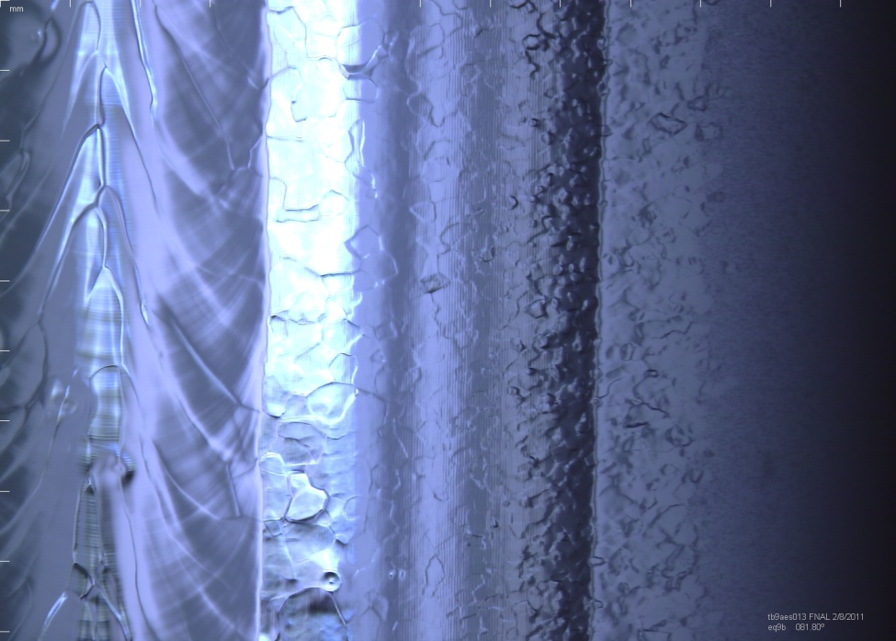
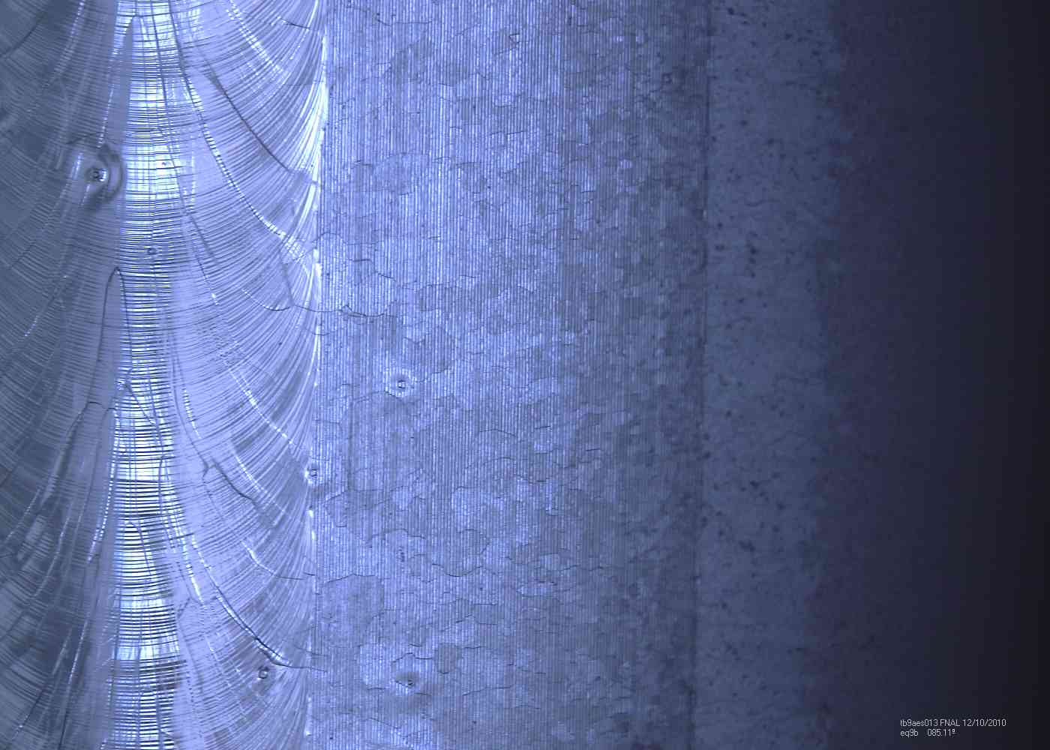
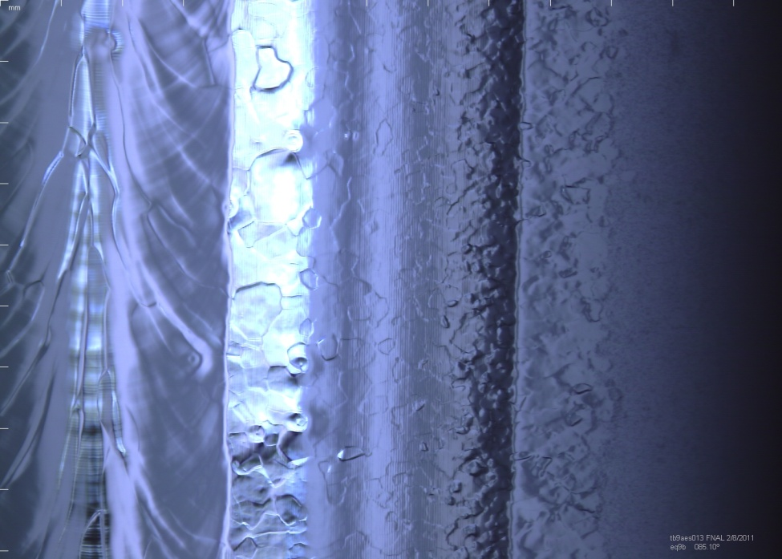
Features seen on an ILC cavity
Cavity was light BCP’d (10-15 um) at AES
1mm
before bulk EP
after bulk EP at ANL/FNAL
TB9AES013

Slide 11
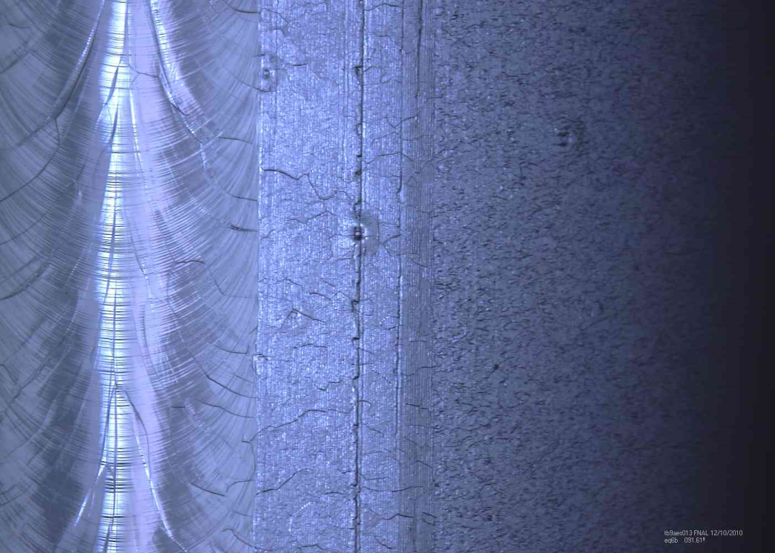
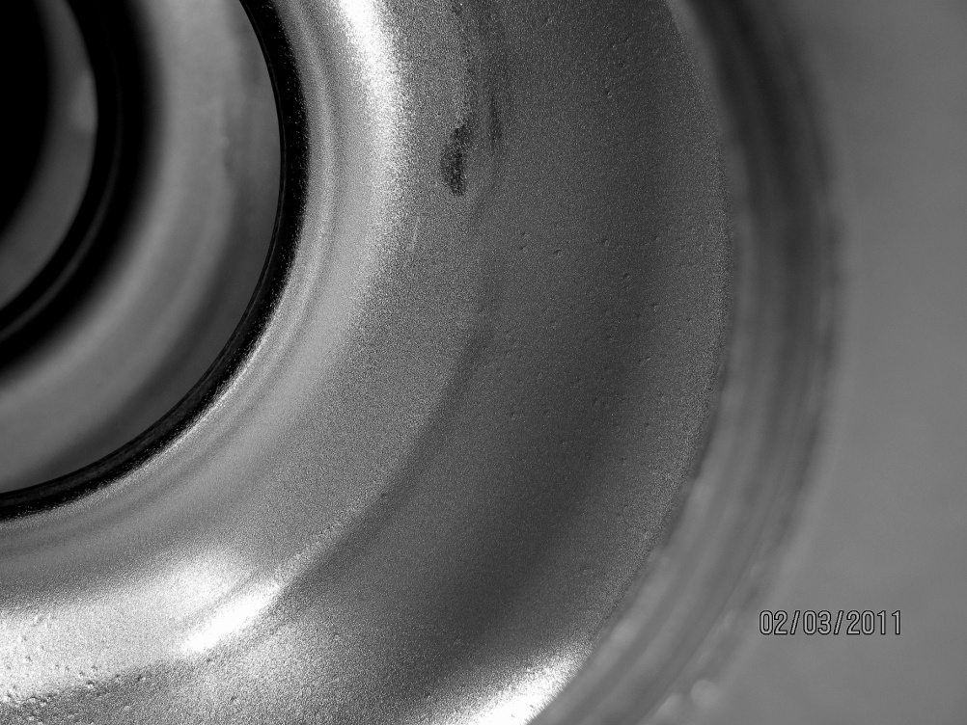
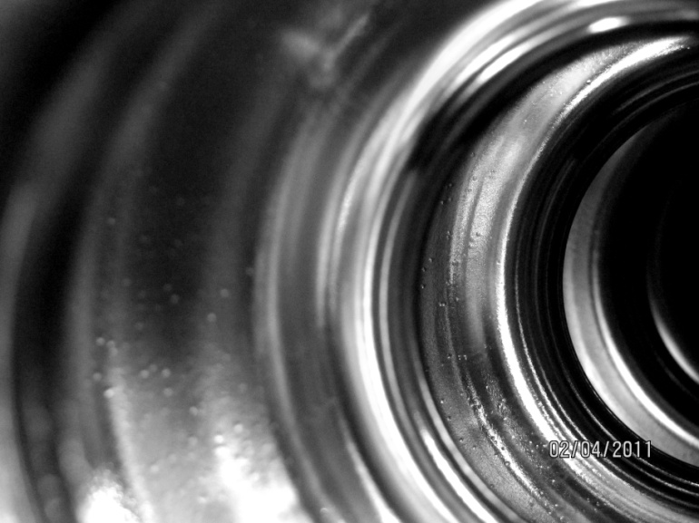
More…
TB9AES013: Pits observed in all three images, but generally enhanced by EP. Pits are not restricted to just the equator weld or the heat affected zone.
1) Optical inspection of equator weld before EP
2) Photo before electropolishing.
3) Photo after electropolishing ( ~ 120 microns removed)
1
2
3
This cavity reached 38 MV/m!

Slide 12
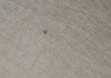
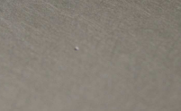
Niobium for Project X Cavities
3mm Nb sheets
All surfaces are rough, were high-speed buffed
Lots of inclusions, pits
Indications of poor handling, e.g., Nb on Nb rub marks
Deep scratches
Inspection by Z.Conway, T. Reid (ANL)
An SSR1 made from this material performed the best ever!

Slide 13
General Materials Issues
What types of material flaws matter?
Material cost, inspection/remediation effort, risk, etc.

