Slide 1
Scanning Tunneling Microscopy Studies of Single-Crystal Niobium Oxidation
Natalie A. Kautz, Yichen Yu, Kevin D. Gibson
and Steven J. Sibener
The James Franck Institute and The Department of Chemistry
The University of Chicago, Chicago, IL
in partnership with
DOE-HEP Collaboration and FermiLab
SRF Materials Workshop 2012

Slide 2
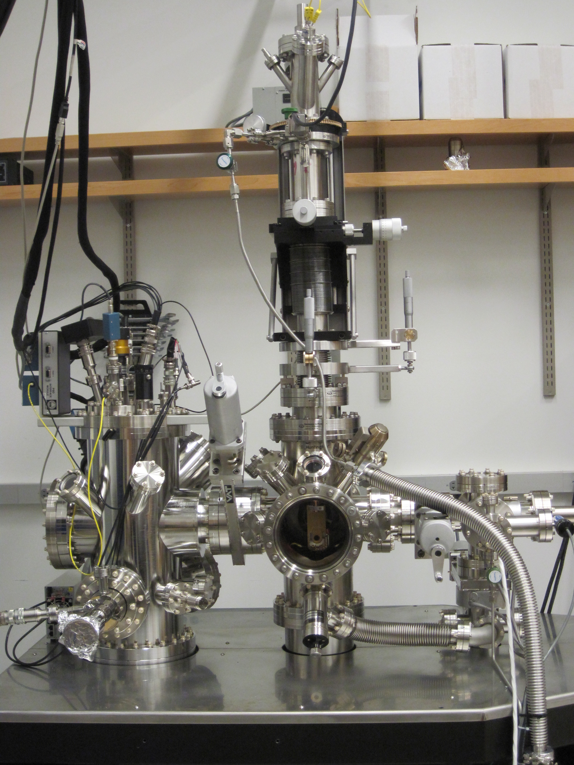
2011-2012… New Cryogenic STM Completed and Fully Operational
Instrument was specially designed and built to function in temperature range between liquid helium and > 1800 ºC for this work
System will sputter and heat crystals to temperatures > 1800 ºC for sample preparation
Chemical analysis of surface is performed by Auger spectrometry
Capable of studying reaction kinetics and performing TPD experiments
In situ STM and STS can be performed from liquid helium to > 1200 ºC temperatures
Single crystals allow us to identify the physical and chemical properties each individual face contributes to the polycrystalline SRF cavity
(111) and (100) used here, (110) available
Crystals heated in UHV to 1800 ºC to form niobium oxides
Nb(110)
Nb(111)
Nb(100)
STM performed at room temperature
Notes:
Newly designed and built within the last year, fully functional
Imaging hot and at liquid helium temperatures
Kinetic and TPD studies

Slide 3
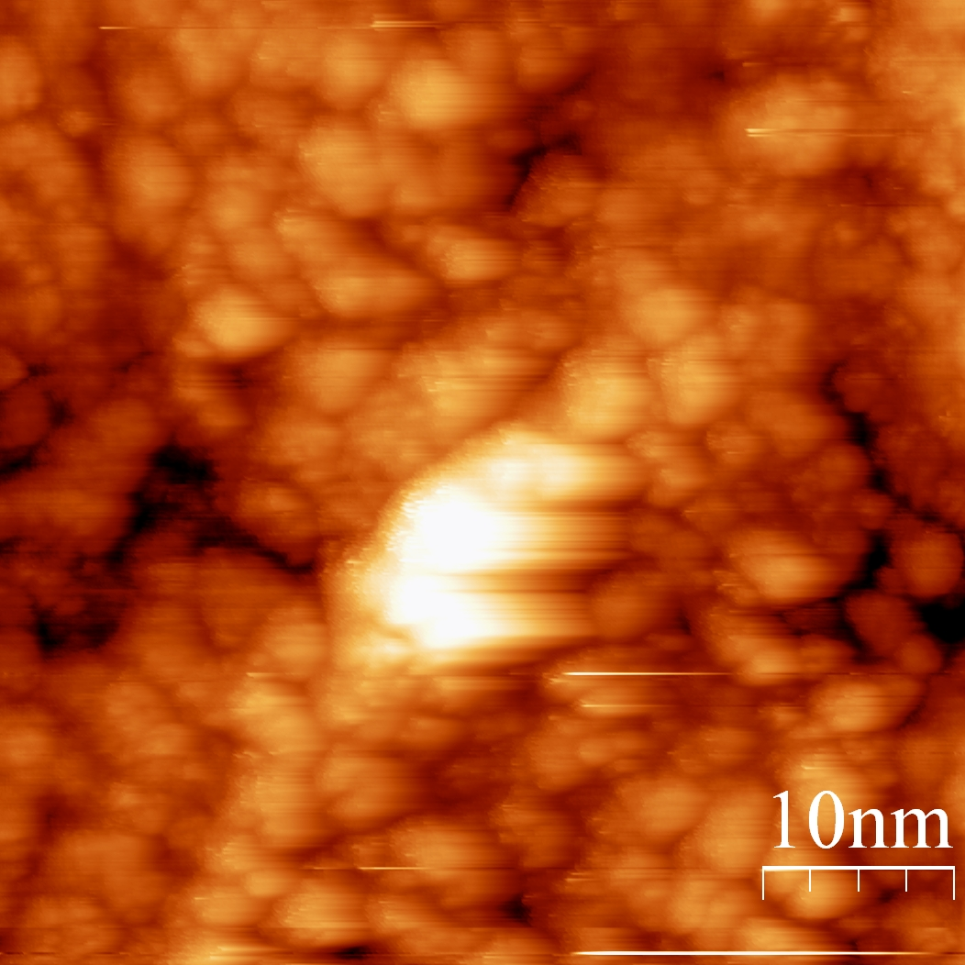
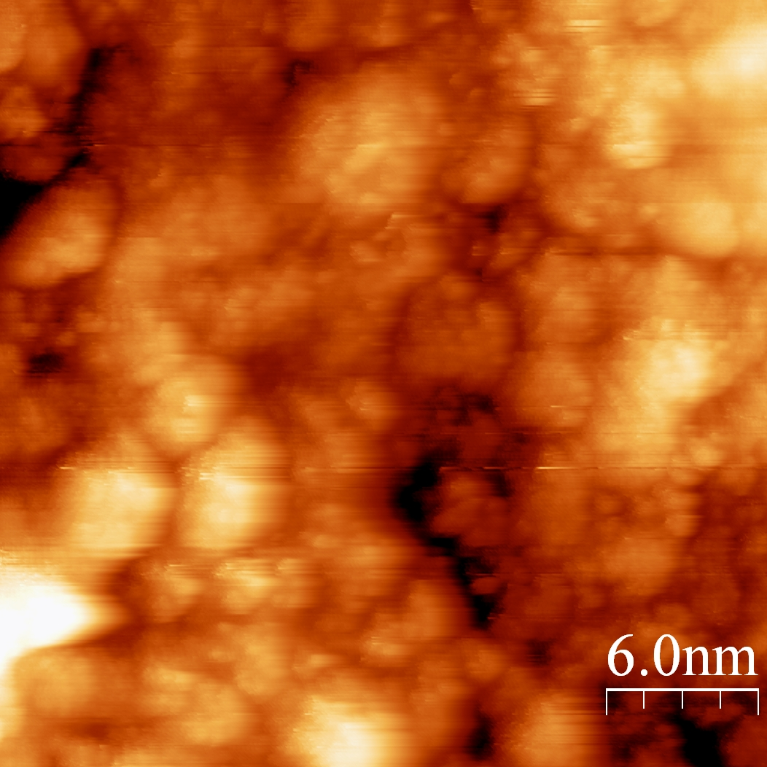
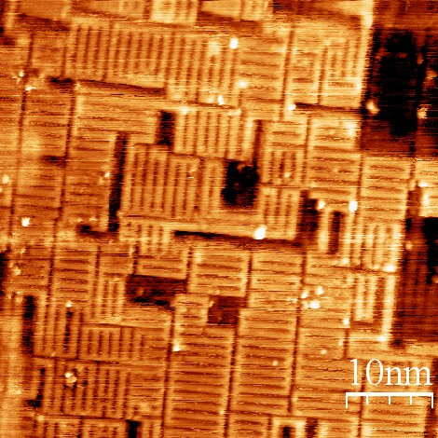
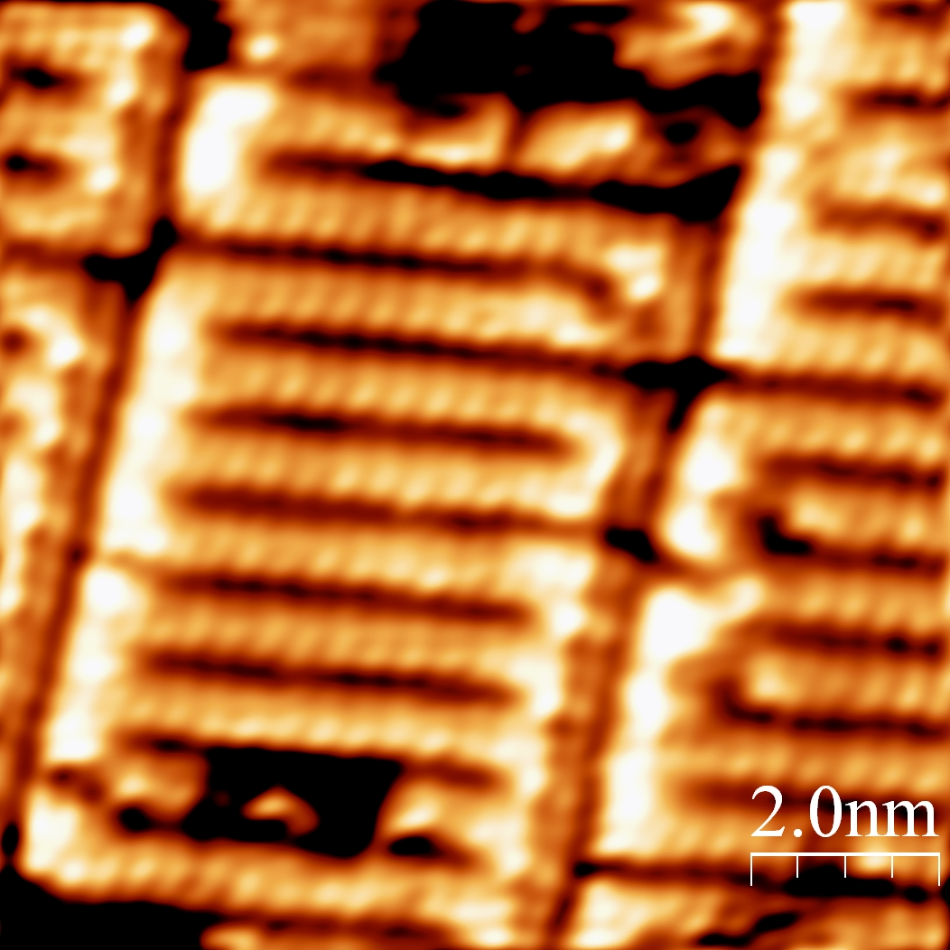
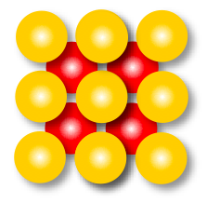
Underlying Crystal Face Influences NbO Structure
NbO on (111) is disordered
NbO on (100) orders beautifully
1850 ºC for >3 hrs.
-1 V, 0.5 nA
1750 ºC for 10 sec.
-0.5 V, 0.1 nA
Despite extensive heating, no long range NbO structure is
formed
Nb(100) is more closely packed
Repeating “ladder” structure formed after short heating times
Nb(111) crystal face is very “open”
Covers entire surface
Top Nb Layer
2nd Nb Layer
3rd Nb Layer
Notes:
Remember to highlight that this is NbO, not just Nb
More closely-packed surface

Slide 4
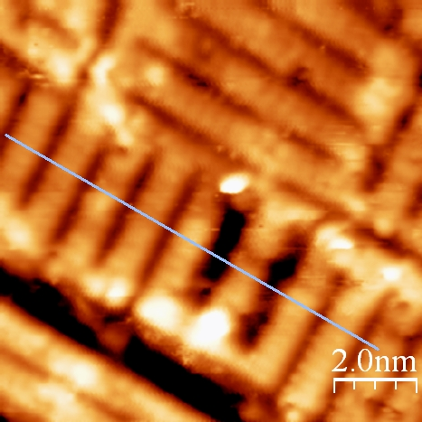
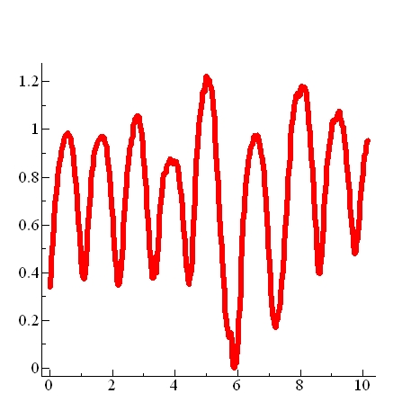
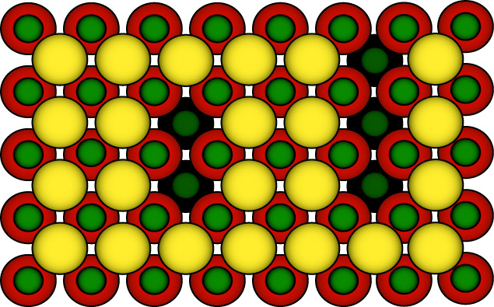
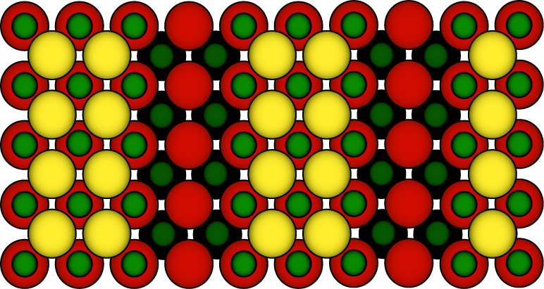
Formation of (nx1) Oxides on Nb(100)
Ladder-like features are composed of NbO
Observe coexistence of two
structures: (3x1)-O and (4x1)-O
Bright features are parallel
rows of Nb atoms
(4x1)-O
(3x1)-O
(3x1)-O
-0.5 V, 0.1 nA
nm
(3x1)-O
(4x1)-O
Ladder length ranges from
2.5 – 7.5 nm
Average
~ 4.8 nm
Å
~1.0 nm
~1.33 nm
Two NbO structures coexist on the (100) surface
Structural model proposed by An, B.; Fukuyama, S.; Yokogawa, K.; Yoshimura, M. Phys. Rev. B 2003, 68, 68.

Slide 5
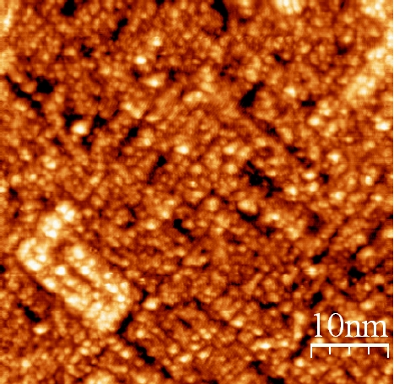
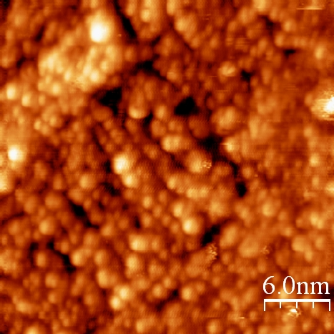
Preferential Binding Sites For Molecular Oxygen on Nb(100) Oxide
Surface has been exposed to 9L of O₂ at room temperature
Formation of amorphous NbO₂ and Nb₂O₅ structures
Observe large-scale features of the underlying ladder structure
Terraces and step edges remain
Amorphous oxides follow ladder orientation
-0.5 V, 0.1 nA
Oxide clusters do not uniformly cover the NbO surface
O₂
Oxygen binds along rows of Nb atoms
Notes:
Oxygen does not uniformally cover the surface
Include that this is (100)

Slide 6
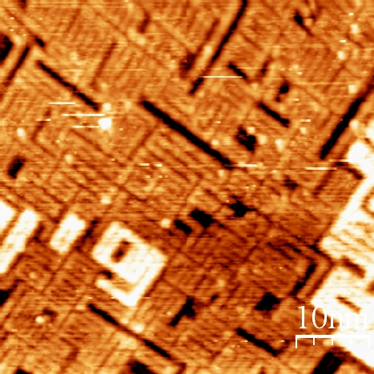
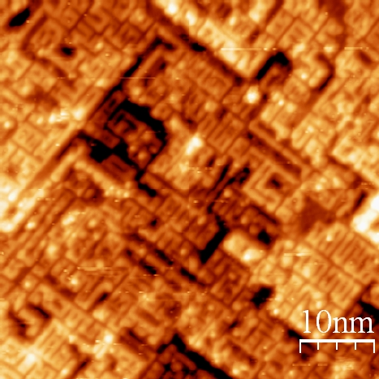
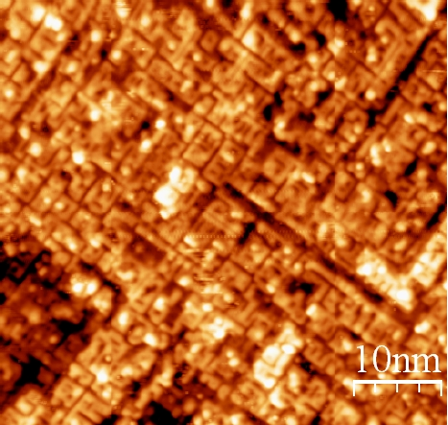
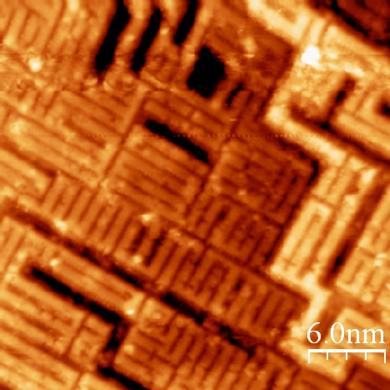
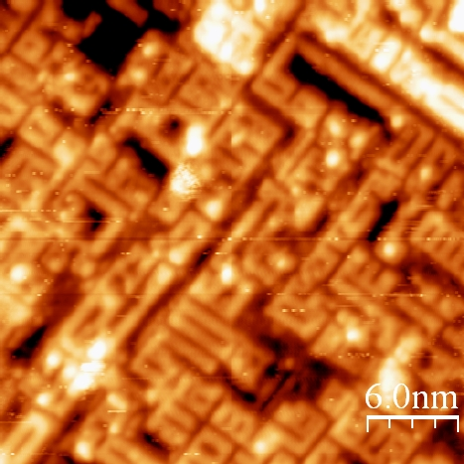
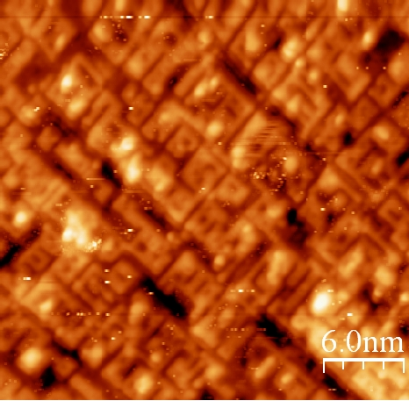
Low-Temperature Anneal Dissolves Higher Oxides Into Nb(100)-O
T = 0 min
Exposure = 0 L
T = 5 min
Exposure = 9 L
T = 15 min
Exposure = 27 L
Nb(100)-O exposed to O₂ at room temperature and heated to 430 ºC
Observe smaller domain sizes and increasing surface disorder
T = 0 min, E = 0 L
2.5-7.5 nm
1 nm
1.33 nm
T = 15 min, E = 27 L
Nb(100)-O structure is significantly altered as oxygen moves from the surface into the bulk upon annealing at 430 ºC
2 nm
1 nm

Slide 7
Our Results Show Surface Structure Influences Communication With Bulk
Specially designed instrumentation allows surface preparation and analysis from liquid helium temperatures to 1800 ºC
Crystal face determines surface structure and order
NbO forms multiple structures on Nb(100)
Molecular oxygen preferentially binds on Nb atoms before NbO
Oxygen dissolving into the bulk significantly alters pre-existing surface structure
Spectroscopy and kinetic studies
What influence do hydrides have on oxygen chemistry?
Is there saturation of the NbO surface?
How robust is the NbO? Sputtering?
Notes:
Surface-bulk communication
Influence of underlying Nb structure on surface-bulk
Our Results Show Communication With Bulk Depends on Surface Structure
Crystal face affects surface ordering

Slide 8
Summary and Plans Going Forward
Early Work: Emphasis on oxide composition and surface defects found in polycrystalline samples provided by FermiLab
XPS results show initial samples contain Nb₂O₅ and Nb. A robust NbO layer is formed after Ar⁺ ion sputtering and heating to ~520 ºC , with subsequent exposure to air forming NbO₂.
A polished sample imaged with SEM and AFM reveal numerous defects, including scratches and weld pits, that can influence overall cavity performance.
Current Work: Emphasis on Nb single-crystal oxidation studies
STM reveals crystal orientation affects NbO surface ordering and structure.
Nb(100)-O forms ladder-like structures that show preferential binding when exposed to molecular oxygen. Low-temperature annealing dissolves higher ordered oxides into the bulk and changes the Nb(100)-O structure.
Currently investigating oxidation kinetics and role of niobium hydrides.
Future Work: Emphasis on niobium thin films and alloys
We are presently prepared to create NbCu thin film substrates to investigate how the chemical and structural changes influence the oxidation chemistry.
We also will explore how alloys such as Nb₃Sn affect the physical and chemical properties of niobium reactions.

