Slide 1


In-situ EELS study and atomic scale characterization of Niobium from SRF cavities
Runzhe Tao, Robert. F. Klie
Nanoscale Physics Group
University of Illinois at Chicago
7th SRF Material Workshop, JLab, Newport News, VA
July 17th, 2012

Slide 2
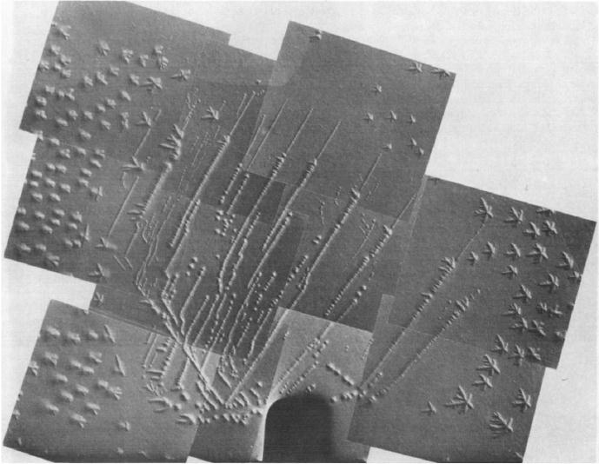
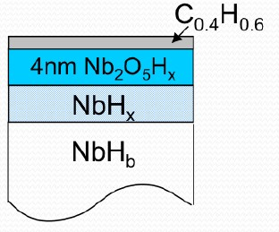
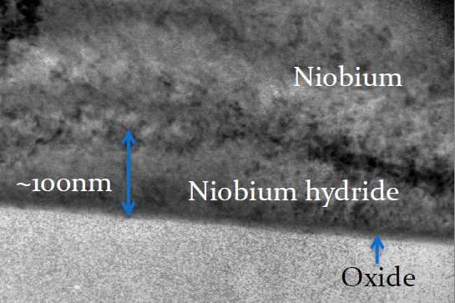
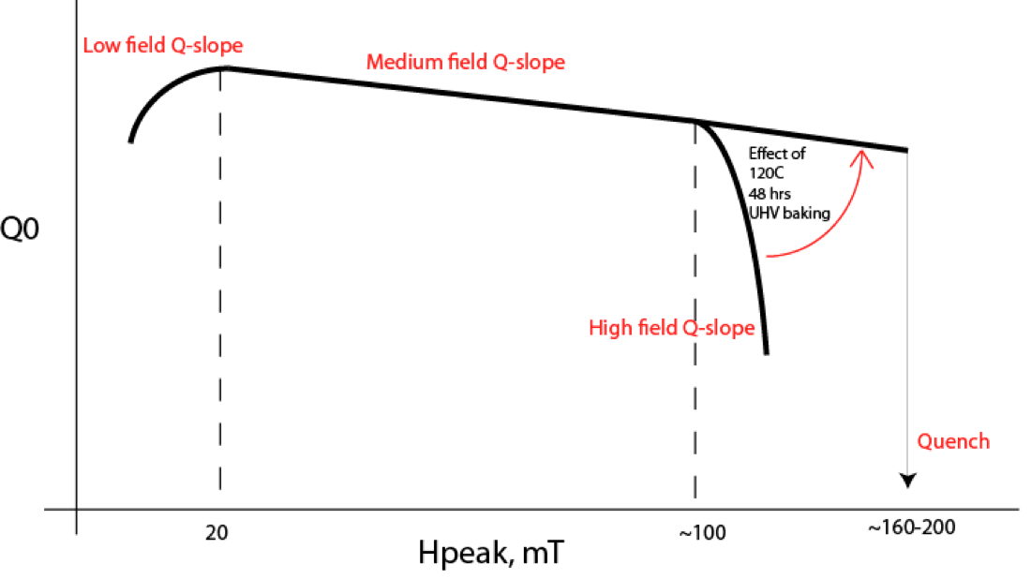
Introduction
Grossbeck, Birnbaum, Acta Metall 25, p135 (1977)
A. Romanenko, Raising Medium Field Q0, June 2011
What is the effect of impurities diffusion (H, O, C) during the 120° C bake?
7th SRF Material Workshop, JLab, Newport News, VA
July 17th, 2012

Slide 3
Outline
Results of TEM and EELS analysis in the 90 – 393 K temperature range:
Electron energy loss spectroscopy of powder reference samples, including Nb, NbO, NbO₂, Nb₂O₅, and theoretical simulation on oxygen K-edge
Analyze Nb valence/oxygen change caused by baking process (393K for 48 hours in vacuum)
Role of Hydrogen ordering in Nb cavities:
Superlattice formed by Nb hydride ordering occurs below 94K
HAADF and ABF image of Nb hydride near SRF cavity surface
Hydrogen concentration changes along near cavity surface from room temperature to low temperature (94K)
7th SRF Material Workshop, JLab, Newport News, VA
July 17th, 2012

Slide 4
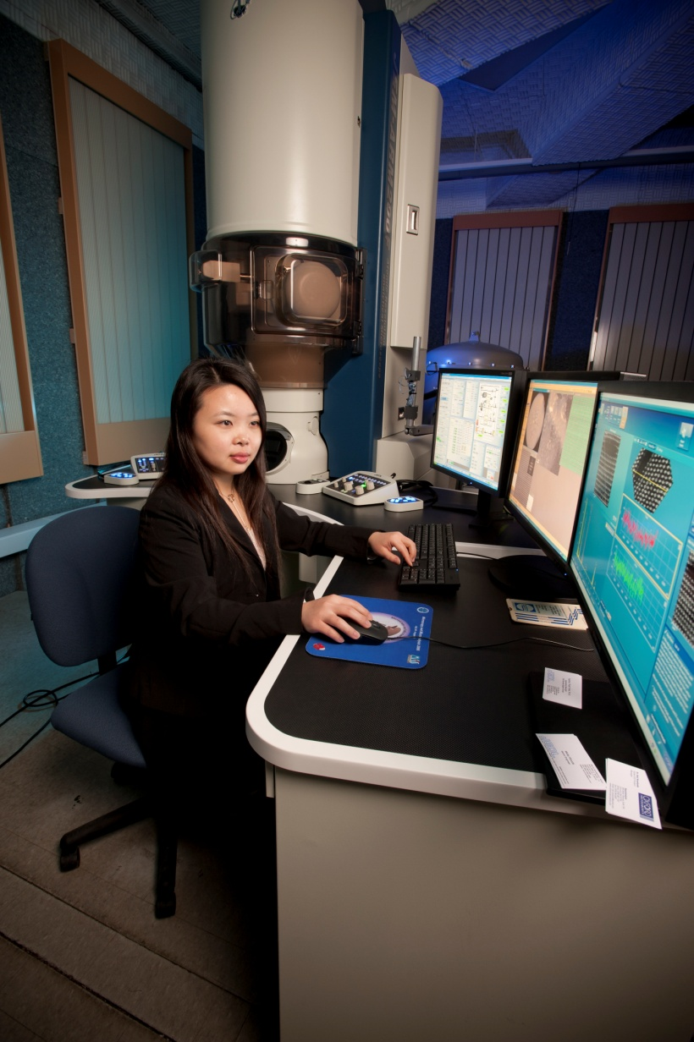
New JEOL JEM-ARM 200CF at UIC
Cold field emission (0.4 eV resolution)
Probe spherical aberration corrector (less than 78pm spatial resolution)
Gatan Enfina 1000 EELS system
HAADF detectors, BF detector and ABF detector
Heating, Cooling and Tomography stages.
7th SRF Material Workshop, JLab, Newport News, VA
July 17th, 2012
Notes:
4

Slide 5
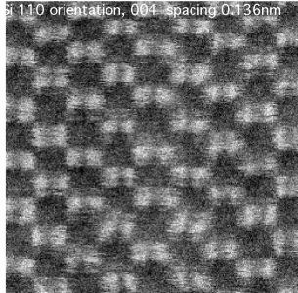
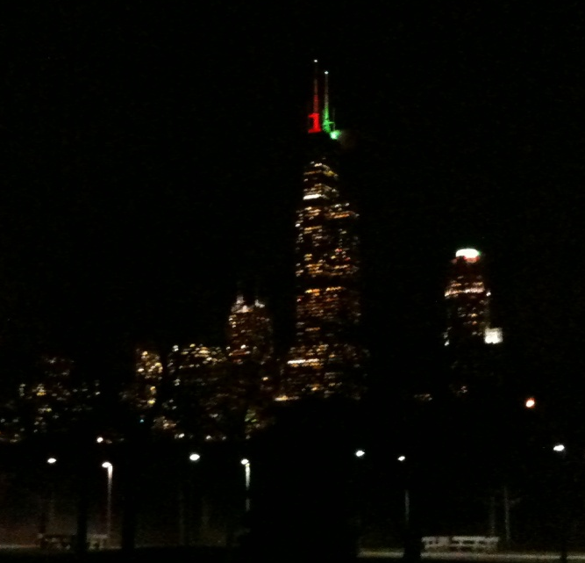
New JEOL JEM-ARM 200CF at UIC
HAADF of Si (110)
Zero-loss peak
FFT
(800)
Spatial resolution of 68 pm possible
Energy resolution of 0.35 eV possible
7th SRF Material Workshop, JLab, Newport News, VA
July 17th, 2012
Notes:
5

Slide 6
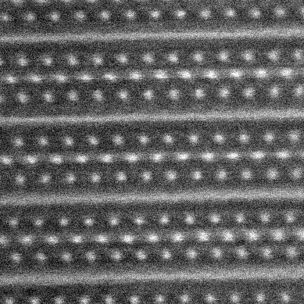
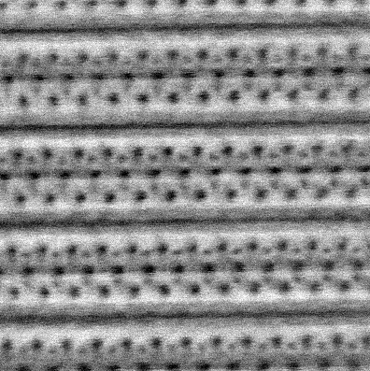
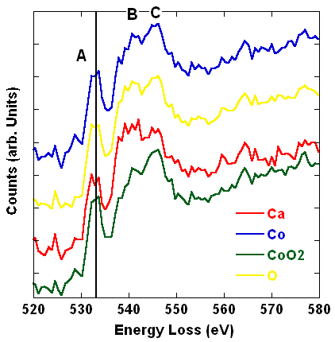

The Key to STEM:
Incident Probe
Annular Detector
Z-contrast Image
ABF-Image
Spectrometer
CCD-EELS
Detector
7th SRF Material Workshop, JLab, Newport News, VA
July 17th, 2012

Slide 7
Electronic Excitations in the Electron Microscope:
INNER SHELL OUTER SHELL DE-EXCITATION
Light
Auger
E
v
ac
Secondary
Electron
E
F
X-Ray
L
K
R. F. Egerton, EELS in the Electron Microscope, Plenum 1996
7th SRF Material Workshop, JLab, Newport News, VA
July 17th, 2012
University of Illinois at Chicago

Slide 8
O K-edge of EELS for standard Nb oxides
Nb oxides can be identified by O K-edge (including splitting distance and ratio between minor peaks)
Both of the simulation results fit our experiment very well.
FEFF9 shows less fit but significantly faster
R. Tao, et al., Journal of Applied Physics, 110, 11 (2011)
7th SRF Material Workshop, JLab, Newport News, VA
July 17th, 2012

Slide 9
Niobium RF cavity samples valence
unbaked
baked
In the entire surface oxide layer, the baked sample exhibits higher Nb valence compared to unbaked surface
Oxygen diffusion occurs from near surface defects during mild baking process
R. Tao, et al., Journal of Applied Physics, 110, 11 (2011)
7th SRF Material Workshop, JLab, Newport News, VA
July 17th, 2012

Slide 10
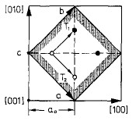
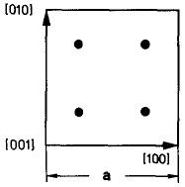
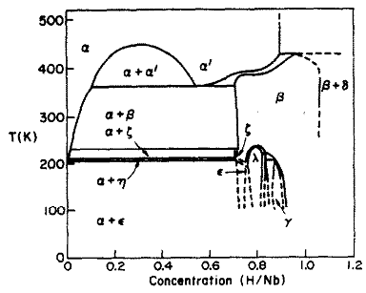
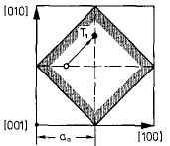
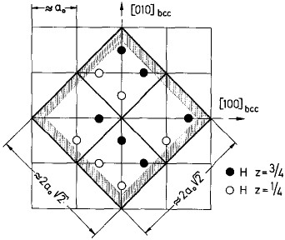
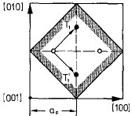
Nb-Hydrogen System
NbH phase transition system
B. J. Makenas and H.K. Birnbaum, Acta metallurgica , vol 30 pp469, 1982
a₀=3.47A
Nb

Slide 11
Superlattice at 94 K
Beta phase
Gamma phase
Nb cubic
Epsilon phase

Slide 12
Effects of H incorporation
Room temperature
Room temperature
94 K
a
b
c
image | NbH phase | a/√2 (A) | std. dev
a | bcc Nb metal | 2.04 | 0.012
b | beta | 2.16 | 0.025
c | gamma | 2.22 | 0.015
The Nb unit cell expands at low temperature between b and c.
The sample a with no superlattice has smallest lattice constant.
7th SRF Material Workshop, JLab, Newport News, VA
July 17th, 2012

Slide 13
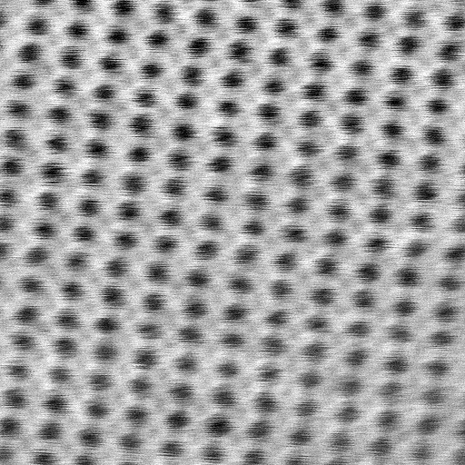

ABF and HAADF imaging of Nb hydride
Annular bright field image β-NbH(110)
High-angle annular dark field image
Hydrogen atom
Niobium atom
Hydrogen atoms are clearly visible in ABF image
7th SRF Material Workshop, JLab, Newport News, VA
July 17th, 2012

Slide 14
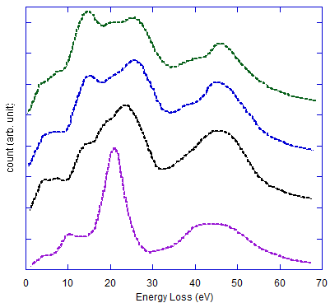
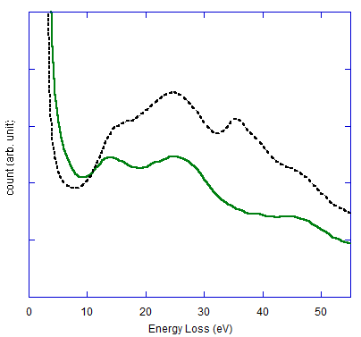
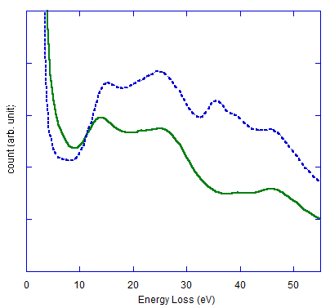
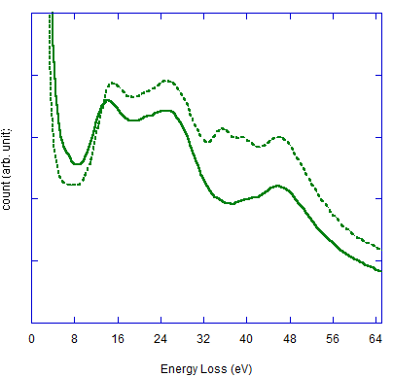
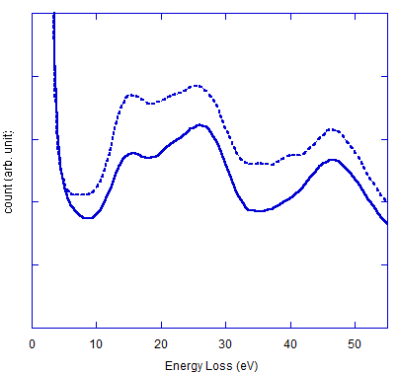
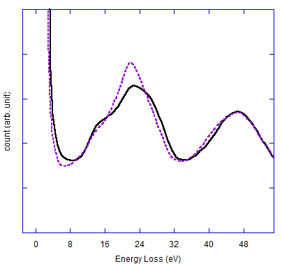
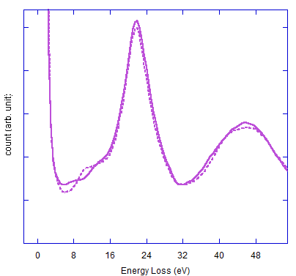
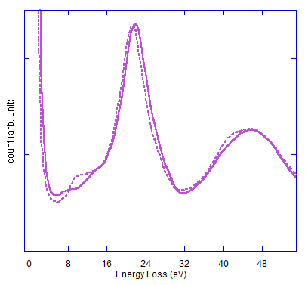
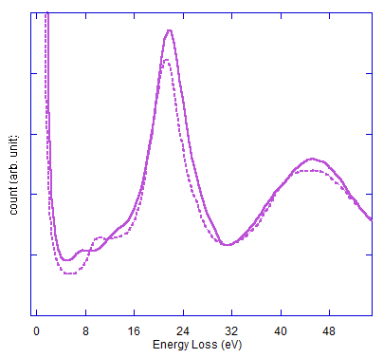
What does EELS low-loss peak tell us?
Superlattice area
Normal area
Nb₂O₅
NbO₂
NbO
Nb
D. Bach, R. Schneider, et al, Microscopy and Microanalysis, 15, 505-523 (2009)
Superlattice area (dash line) has stronger hydrogen signal and lower oxidation on surface
7th SRF Material Workshop, JLab, Newport News, VA
July 17th, 2012

Slide 15
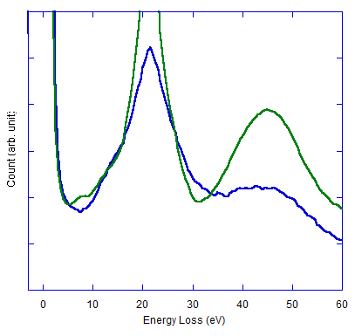
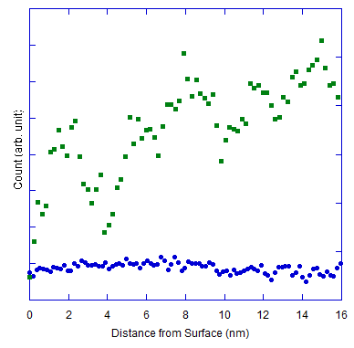
Changes in Hydrogen Density at 94 K
NbO_{x}
300K (RT)
94K
300K (RT)
94K
The hydrogen density raises up from surface into bulk area at 94K
7th SRF Material Workshop, JLab, Newport News, VA
July 17th, 2012

Slide 16
Summary and outlook
EELS measurements suggest that oxygen has diffused towards the cavity surface during baking process.
Different hydrogen phases are found in Nb crystal at 94K.
Using aberration-corrected ABF imaging, Hydrogen atoms can be directly imaged in β-NbH [110].
Hydrogen concentration is low at surface at 300 K but increases away from cavity surface at 94K
Future work
Image simulation to confirm Nb hydride.
Atomic-resolution imaging combined with EELS on Nb oxide and hydride.
Image hydrogen atoms at 94 K.
Study other phases including Nb oxides, nitrides and carbide (already seen in preliminary STEM images).
7th SRF Material Workshop, JLab, Newport News, VA
July 17th, 2012

Slide 17



Acknowledgement
This program is funded by URA Visiting Scholars Program at Fermilab
Alexander Romanenko , Lance Cooley
YoonJun Kim, David Seidman
Alan Nicholls, Ke-Bin Low
Randall Meyer, Weronika Walkosz
Nanoscale Physics Group
7th SRF Material Workshop, JLab, Newport News, VA
July 17th, 2012

Slide 18


