Slide 1


Atomic-scale characterization of Nb for SRF cavities using UV
laser-assisted LEAP tomography and Cs-corrected TEM
YoonJun Kim¹, David Seidman¹, Runzhe Tao², Robert Klie²
1. Department of Materials Science and Engineering
Northwestern University, Evanston, IL
2. Department of Physics, University of Illinois, Chicago, IL
7th SRF Materials Workshop, JLAB Newport News, VA
July 16-17, 2012

Slide 2
❑ LEAP Tomography - Pure Nb coupon
A pure Nb coupon had been analyzed using LEAP.
- Sample ID: R06_17114.RHIT
Sample preparation:
(1) (at FNAL) Pure Nb coupons supplied by Alex Romanenko
- A buffered chemical polished single-grain Nb sheet.
- Test coupons were cut using electrical discharge machining (EDM).
Approximate dimensions of 10 x 10 x 2 mm³
(2) (at NU) Tip preparations
- Baked at 800 ºC for 4 hours in UHV furnace
- Pt deposition using South Bay Technology - Ion beam sputtering (≈150nm)
- Lift-out method using a dual-beam FIB
LEAP tomography conditions
(1) Pulse rate: 250 kHz
(2) Pulse energy: 50 pJ (necessary for oxide analysis)
(3) Temp.: 30 K
(4) Evaporation rate: 0.50%

Slide 3
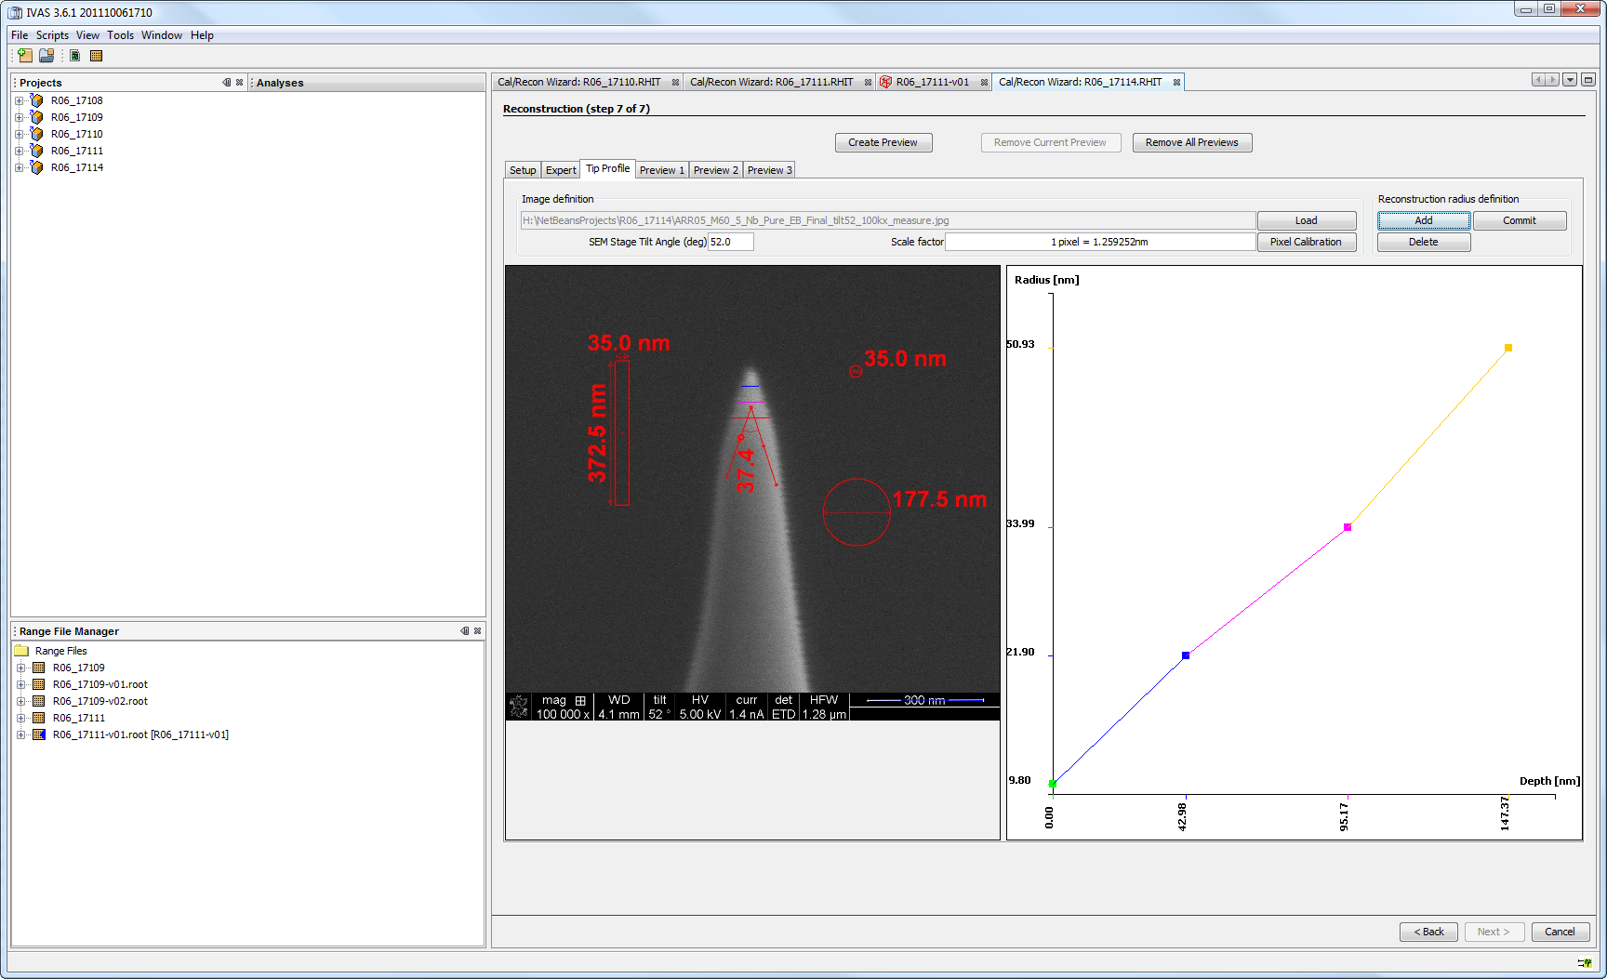
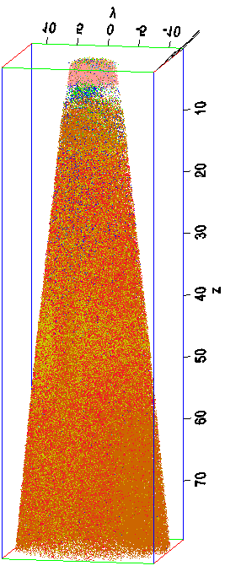
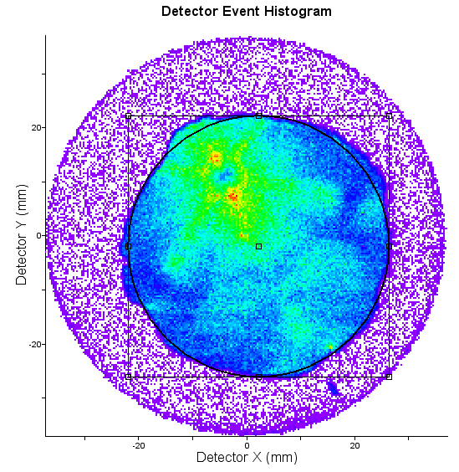
❑ LEAP Tomography – Results (3-D reconstruction)
Results: 3D-reconstruction
Detector Histogram | Tip Profiling | 3-D Reconstruction
Pt
NbO
300 nm
NbO₂
Nb₂O₅
Nb
H
NbH
O
Ga

Slide 4
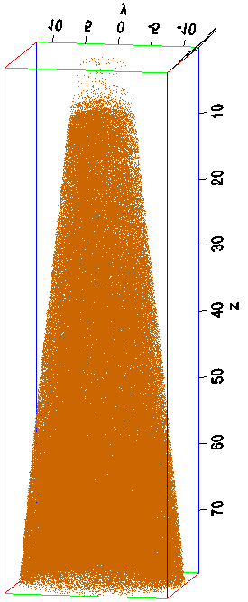
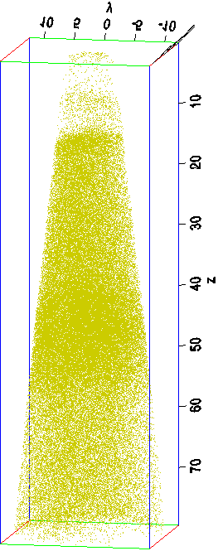
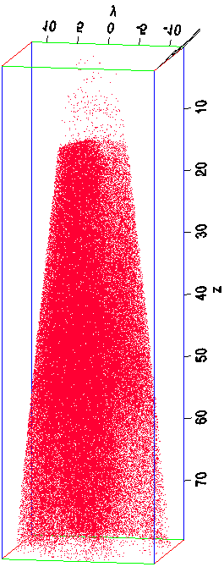
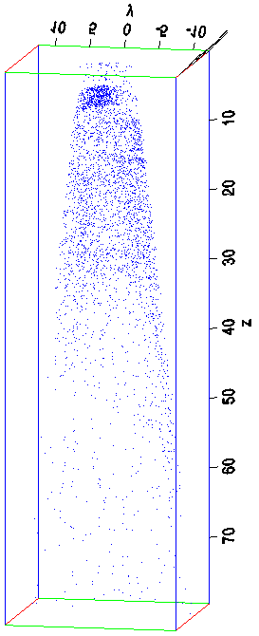
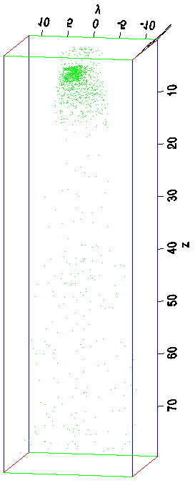
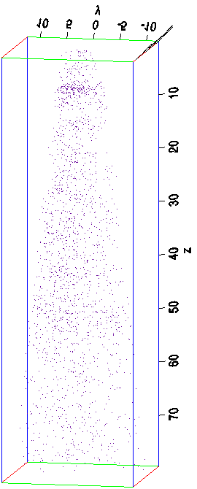
❑ LEAP Tomography – Results (3-D reconstruction)
Results: 3D-reconstruction (Front view)
Sequence (Top down)
: Pt (not displayed) → Oxides (~5 nm, NbO₂→NbO→Nb₂O₅)→Pure Nb (~5 nm)
→ Nb, H, NbH mixture (~40 nm) → Bulk Nb
Nb | H | NbH | NbO | NbO₂ | Nb₂O₅

Slide 5
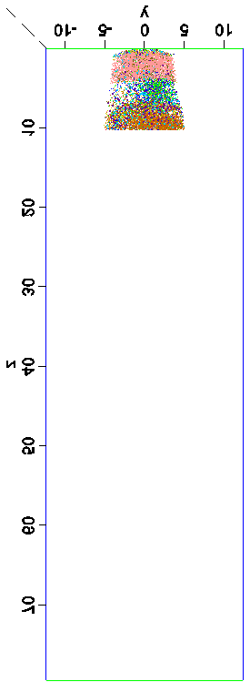
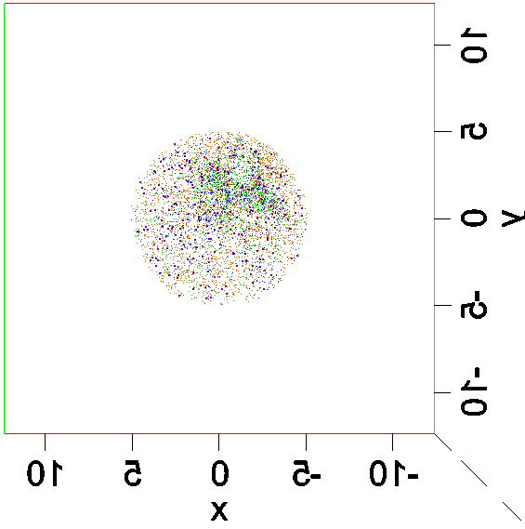
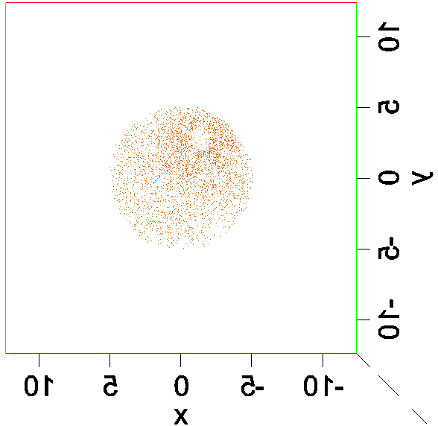
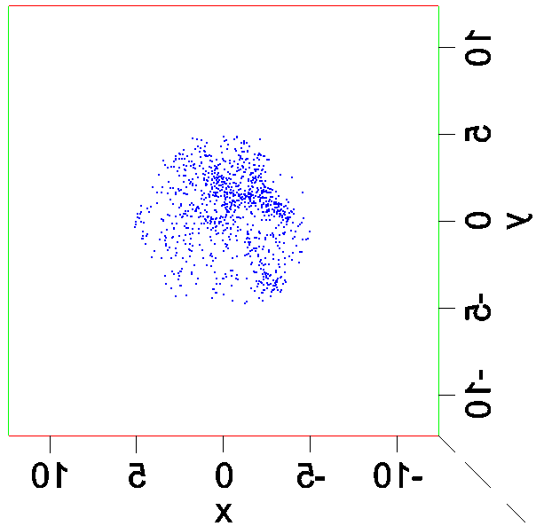
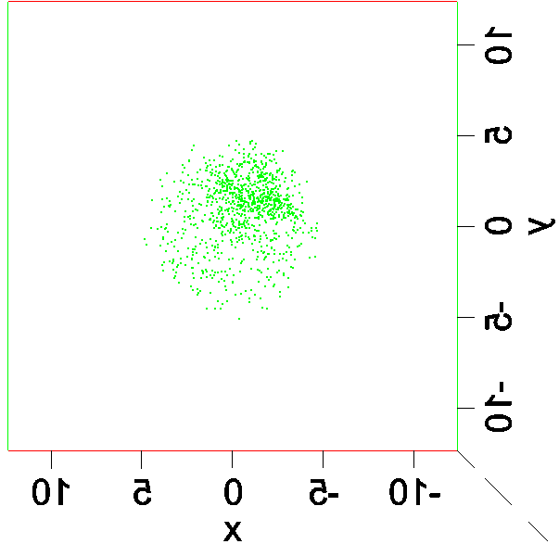
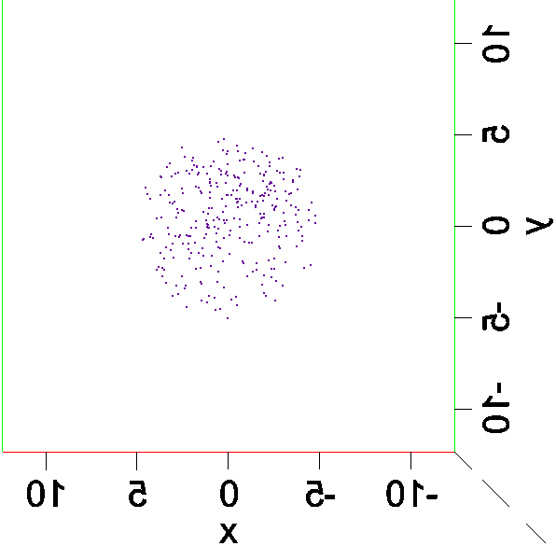
❑ LEAP Tomography – 3-D reconstruction- top views
All (0-10 nm) | All | Nb
NbO | NbO₂ | Nb₂O₅

Slide 6
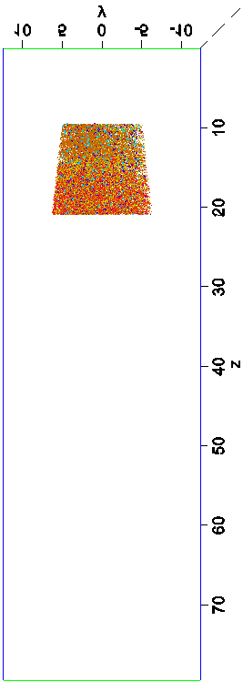
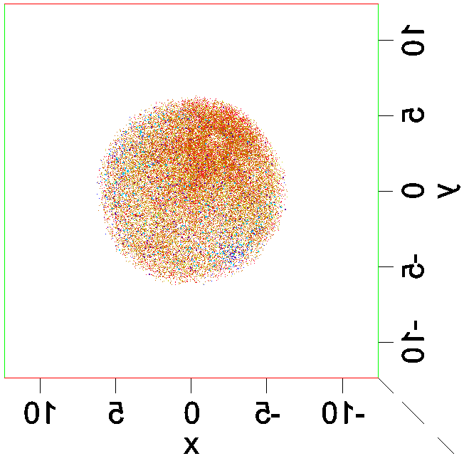
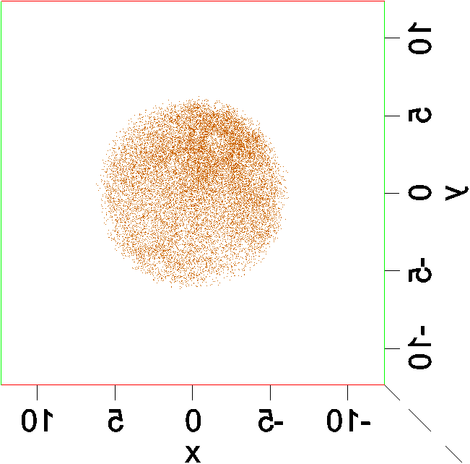
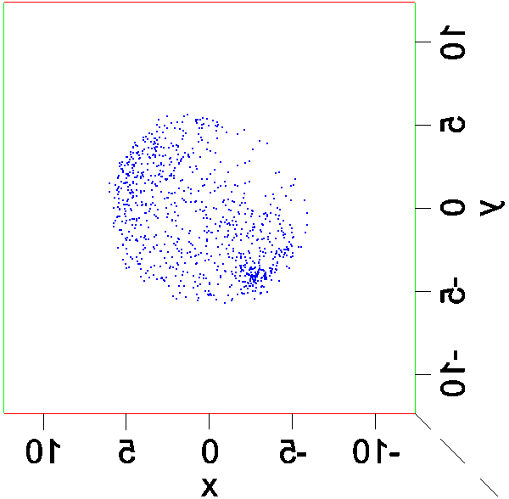
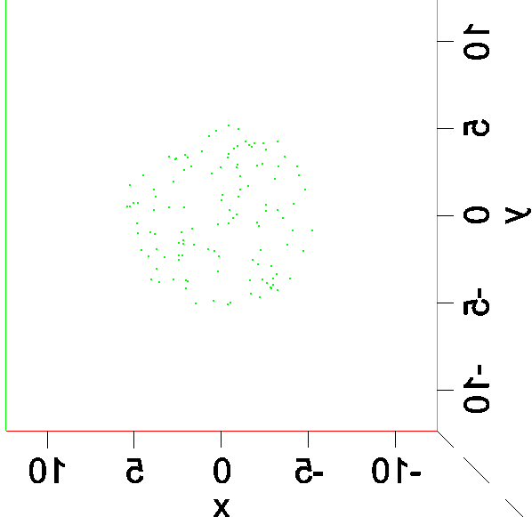
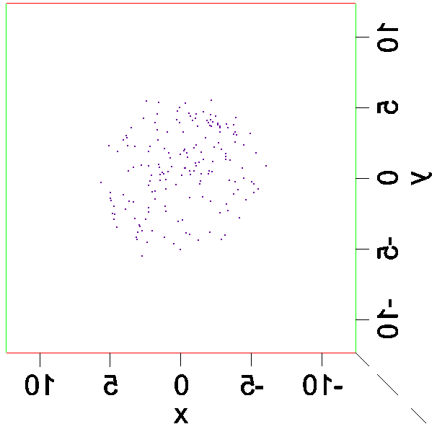
❑ LEAP Tomography – 3-D reconstruction- top views
All (10-20nm) | All | Nb
NbO | NbO₂ | Nb₂O₅

Slide 7
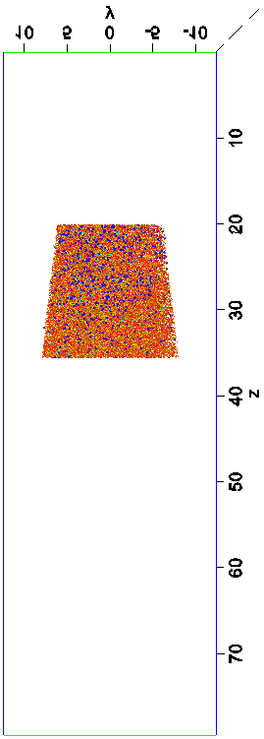
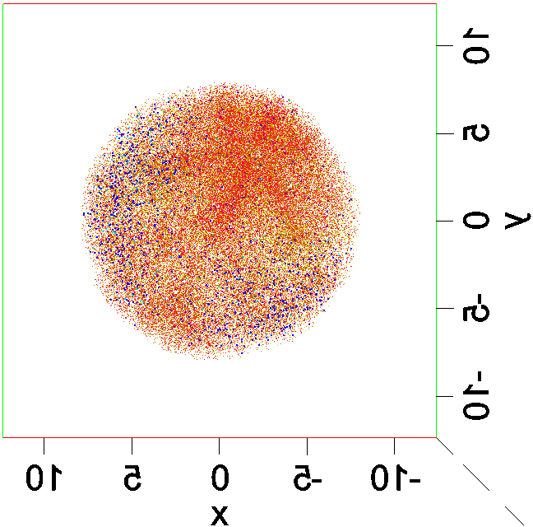
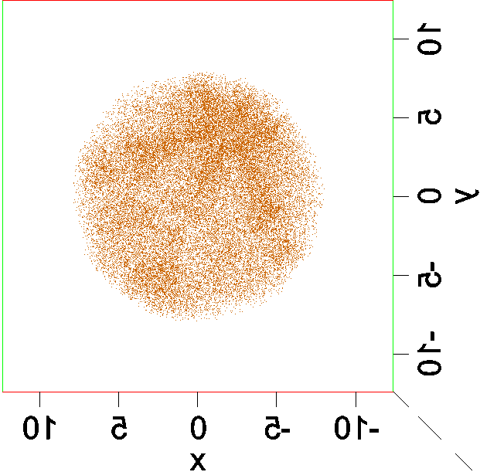
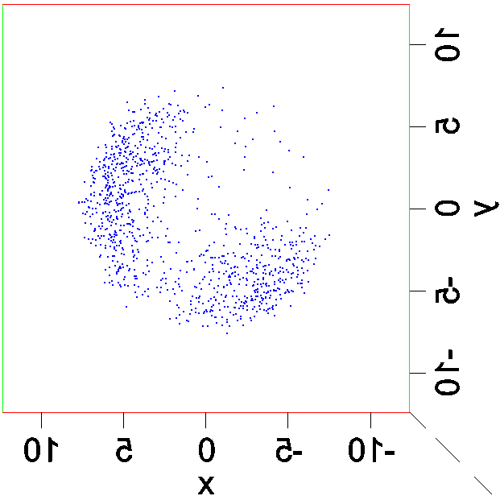
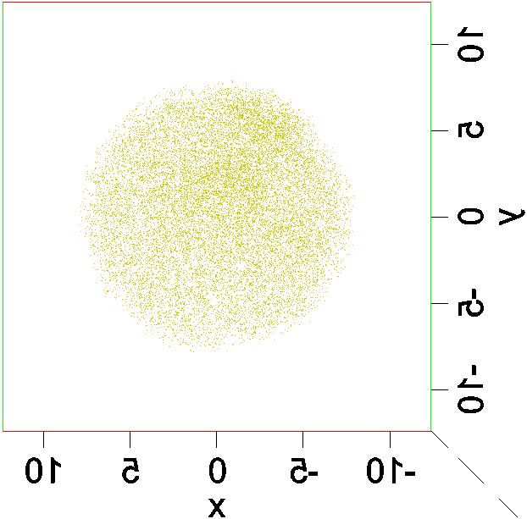
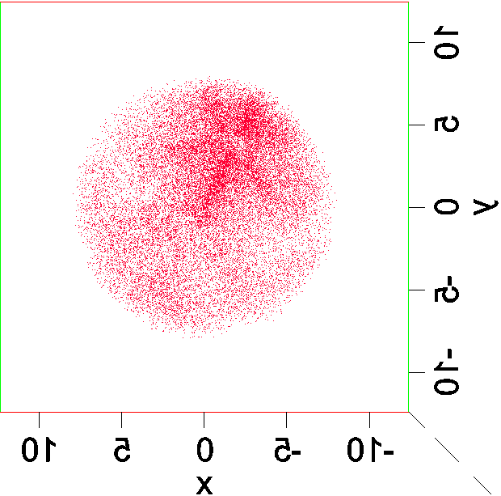
❑ LEAP Tomography – 3-D reconstruction- top views
All (20-35 nm) | All | Nb
NbO | H | NbH

Slide 8
❑ Overall O/Nb and H/Nb Ratios along Z-axis
Oxide
Pure
Nb
Hydride
layer
Bulk
Nb
1.5
1.0
0.7
O/Nb ratio is highest value of 1.5 at the top surface as deep as 2 nm, then decreases
and is 1.0 at 4 nm depth.
H/Nb fluctuates inside of oxide layer and stabilizes at ~0.7 below a depth of 10 nm
(possibly β or ζ phases).
Further phase identification has been performed using TEM/EELS in collaboration
with Prof. R. Klie and R. Tao at University of Illinois at Chicago.

Slide 9
❑ TEM/STEM Analysis – 1. Hydride
Selected Area Diffraction Patterns at R.T. (300K)
110 zone BCC
+ superlattice reflections
110 zone of BCC

Slide 10
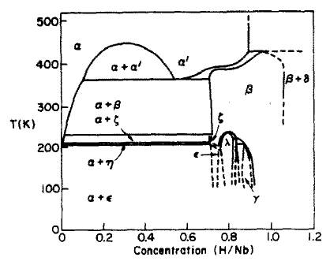
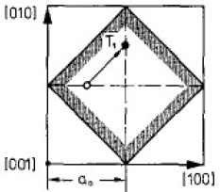
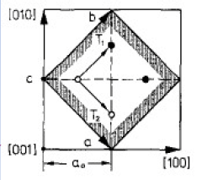
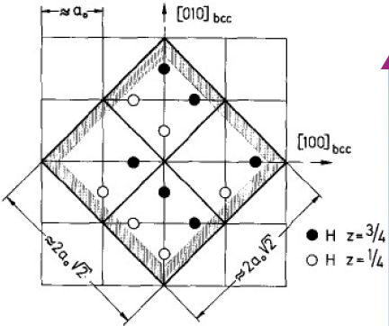
❑ TEM/STEM Analysis – 1. Hydride
T. Schober et al., Topics in Applied Physics, 29, 11-71, 1978
Selected Area Diffraction Patterns at 94 K
ζ
H/Nb≈0.70
ε
β
H/Nb≈1
H/Nb≈0.75

Slide 11
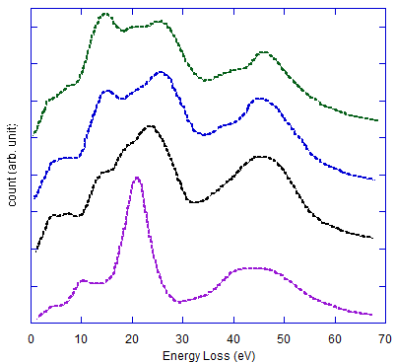
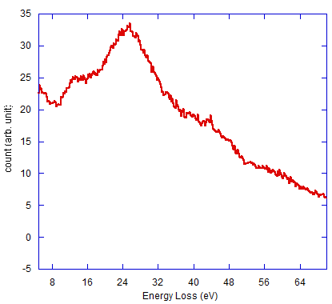
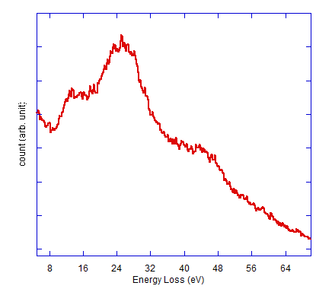
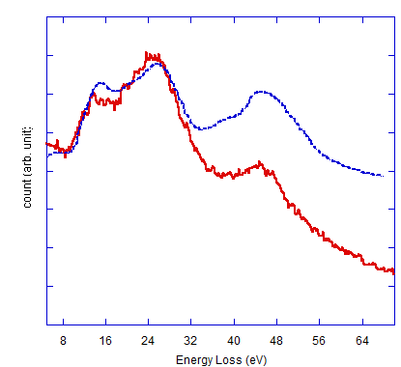
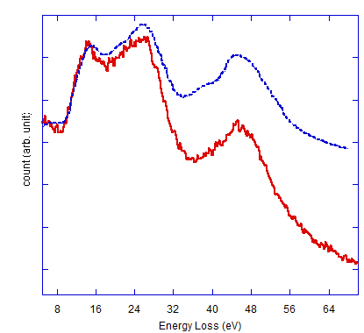
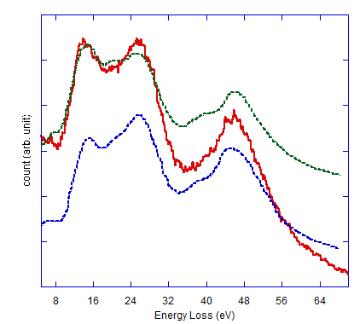
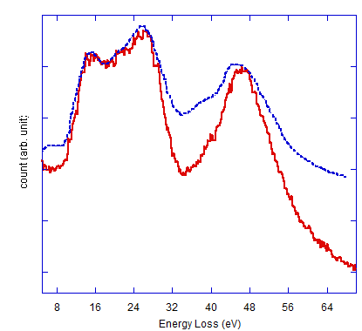
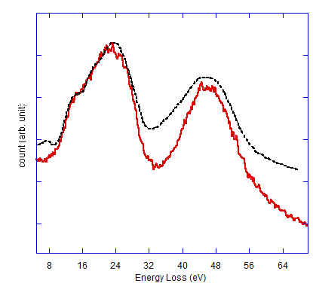
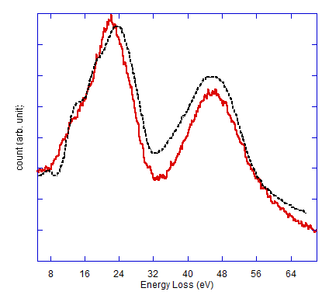
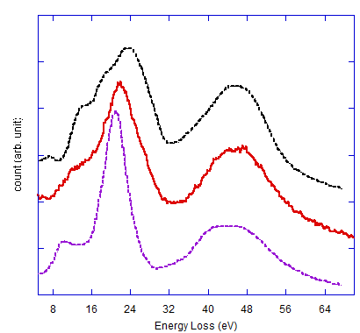
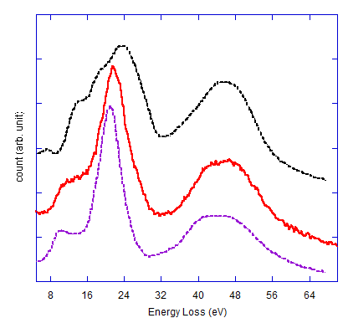
❑ EELS – Plasmon peaks analyses at 94K
Bach et al., Microc. Microanal. 15, 505-523, 2009
Pt Layer
Oxide
Bulk Nb
Nb₂O₅
NbO₂
NbO
Nb
1
2
3
4
5
6
7
8
9
10
1
2
3
4
5
Nb₂O₅
NbO₂
NbO₂
NbO₂
6
7
8
9
10
NbO₂
NbO
NbO
NbO
NbO
Nb
Nb

Slide 12
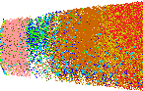
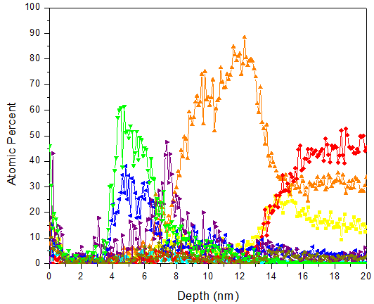
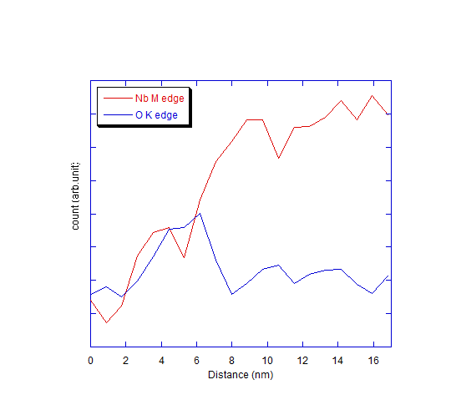
❑ TEM/EELS vs. LEAP Tomography
Oxide type identification using Plasmon peak
Pt
Layer
NbO
Nb
Oxide
layer
NbO₂
Nb₂O₅
Nb
Nb₂O₅
NbO₂
NbH
NbO
H
<Core-loss peak of Nb M and O K-edges>
Three different oxides (NbO₂, NbO, and Nb₂O₅) are coexist with 4-5 nm in thickness.
NbO₂ is observed to be a predominant oxide type quantitatively
Sequence of oxides is not perfectly identical between EELS (NbO₂→ Nb₂O₅→NbO)
and LEAP tomography (NbO₂→NbO→ Nb₂O₅).

Slide 13
❑ Summary
3-D LEAP tomographic reconstructions show oxides, hydride, and bulk Nb layers.
Oxide layers consist of NbO, NbO₂, and Nb₂O₅, 5 nm in thickness, followed
by a pure Nb layer about 5nm in thickness.
All types of oxides are found around 110 type pole regions of Nb, but NbO is also
rich in 100 type pole regions.
NbH layer forms at 40 nm between pure Nb layers and is found mostly around
110 type pole regions of Nb.
O/Nb ratio within oxide layer decreases from 1.5 to 1.0 and H/Nb ratio within
hydride layer is 0.70.
There are bumps of H/Nb ratio (rich in H ) at the interfaces between layers.
Oxide analyses compared to EELS analyses
: From line scans of the surface region based on the low-loss EELS spectrum
at 94 K, oxide layer consists mostly of NbO and NbO₂. This agrees with
LEAP tomographic analyses.

Slide 14
❑ Acknowledgements
This study is funded by USDOE through Fermi National Accelerator Laboratory
(FNAL).
We are grateful to Drs. Lance Cooley and Alex Romanenko in FNAL for supplying
samples and valuable discussions.
The LEAP tomographic measurements were performed at the Northwestern
University Center for Atom-Probe Tomography (NUCAPT).
The LEAP tomograph was purchased and upgraded with funding from
NSF-MRI (DMR-0420532) and ONR-DURIP (N00014-0400798, N00014-0610539,
N00014-0910781) grants.

