Slide 1
Genesis of topography by buffered chemical polishing of niobium
Liang Zhao, Taina Matos, Tina Wang, Josh Spradlin, Charles E. Reece, Michael J. Kelley
College of William and Mary
Jefferson Lab
7th SRF Material Workshop, July 17 2012, Jefferson Lab

Slide 2
Briefing buffered chemical polishing (BCP)
State-of-the-application in cavity processing
1:1:2 (49% HF: 69.5% HNO3: 85% H3PO4)
Acid temperature below 15 C
“dunking” or acid circulation
Known and unknown
Damage layer removed, surface degreased and shiny after BCP
Limit cavity performance possibly due to field enhancement at sharp features
Mechanism of the reaction process
How is surface finish related to acid temperature
How is surface finish affect by gas evolution
Reference
PADAMSEE, H., KNOBLOCH, J. and HAYS, T., 1998. RF Superconductivity for Accelerators. United States of America: Wiley.

Slide 3
Chemical reaction
Nb + 5HNO₃ + 5HF = H₂NbOF₅ + 5NO₂ + 4H₂O
Reaction rate R: temperature & concentration
R = k[A]ª[B]^{b} = k[HNO3]ª[HF]^{b}
Rate constant k: temperature & Ea
k = Aexp(-E_{a}/RT)
Activation energy Ea: reaction mechanism
Experiments to obtain Ea:
Polycrystalline, 0~30C, 1~10min, weight loss, etching rate (R) – time (t) at different temperatures, lnR – 1/T

Slide 4
Temperature effect - Etching rate
BCP mechanism
Chemical kinetics – Arrhenius equation
Etching rate – etching time curves exhibit power relation.
Etching rate, R = kt^{-0.2}
lnRate = ln(k[HNO3]ª[HF]^{b})
= ln(A*exp(-E_{a}/RT)* [HNO3]ª[HF]^{b})
= lnA+ln[HNO3]ª[HF]^{b}- E_{a}/RT
E_{a}=-Slope*R = 10.69 kcal/mol
Chemical reaction control dominates at 0 ~ 20 C, diffusion control takes over at higher temperature.
Temperature C | k
0 | 0.8
10 | 1.7
20 | 3.3
30 | 3.4

Slide 5
How does BCP affect the surface
Remove atoms from the surface – preferential sites (GB, certain orientation, etc.)
Produce gas on surface being etched
Therefore, we investigated:
Polycrystalline: 10C/R.T, up to 20min
Single crystal: R.T., up to 90min
Bi-crystal: R.T., 8min

Slide 6
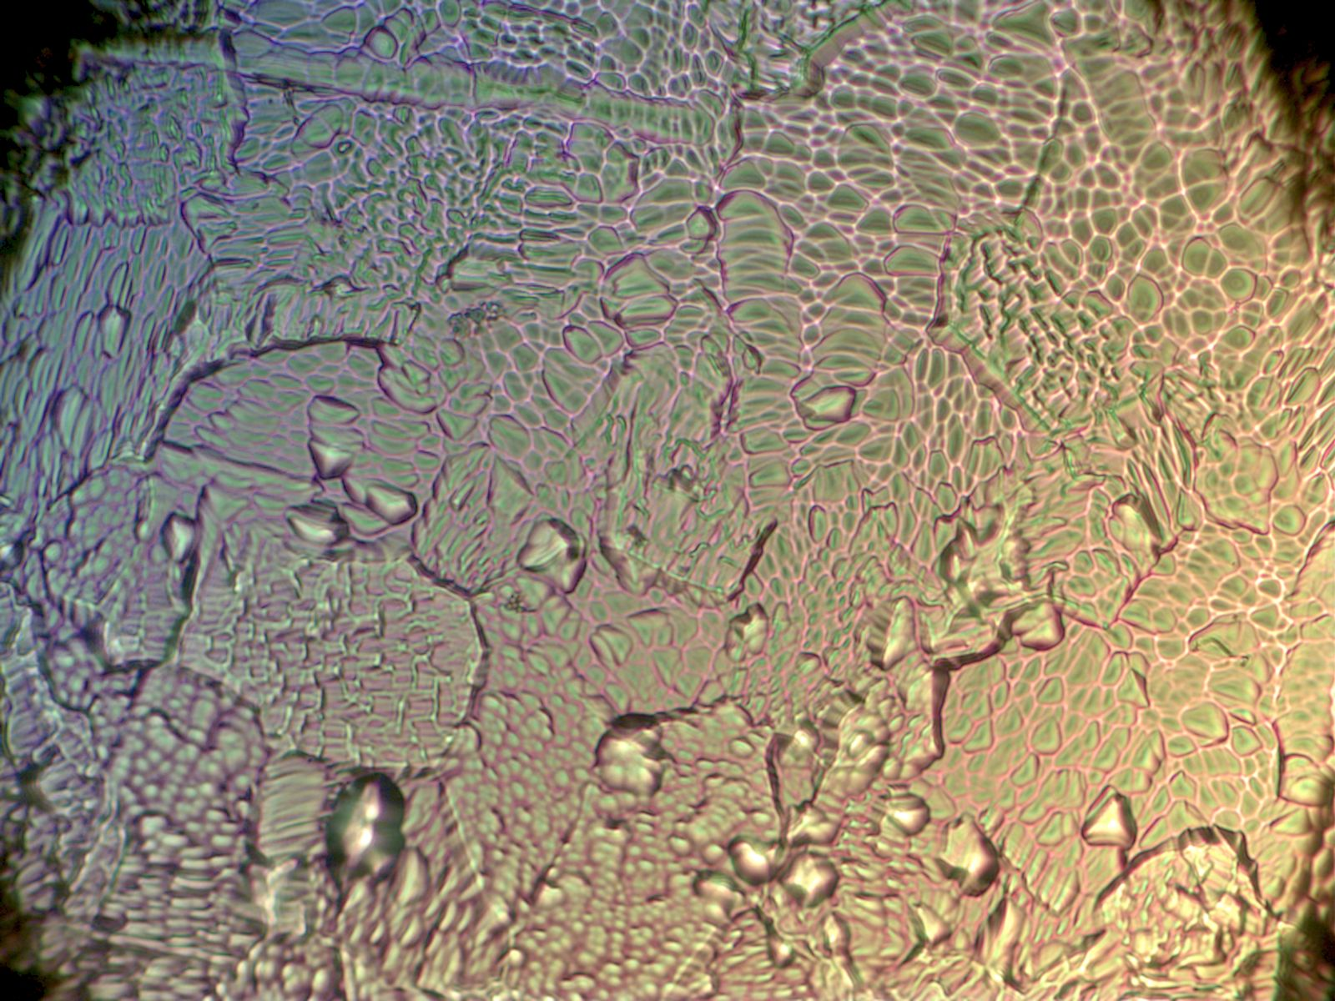
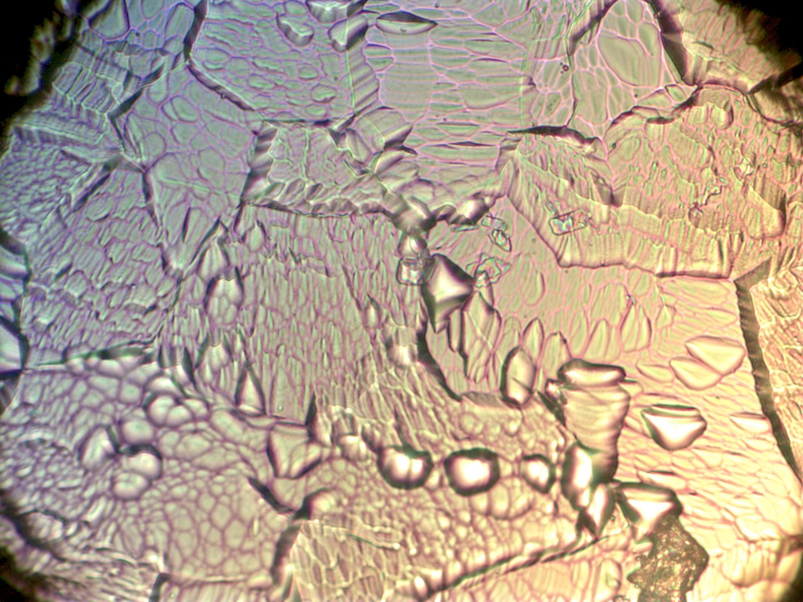
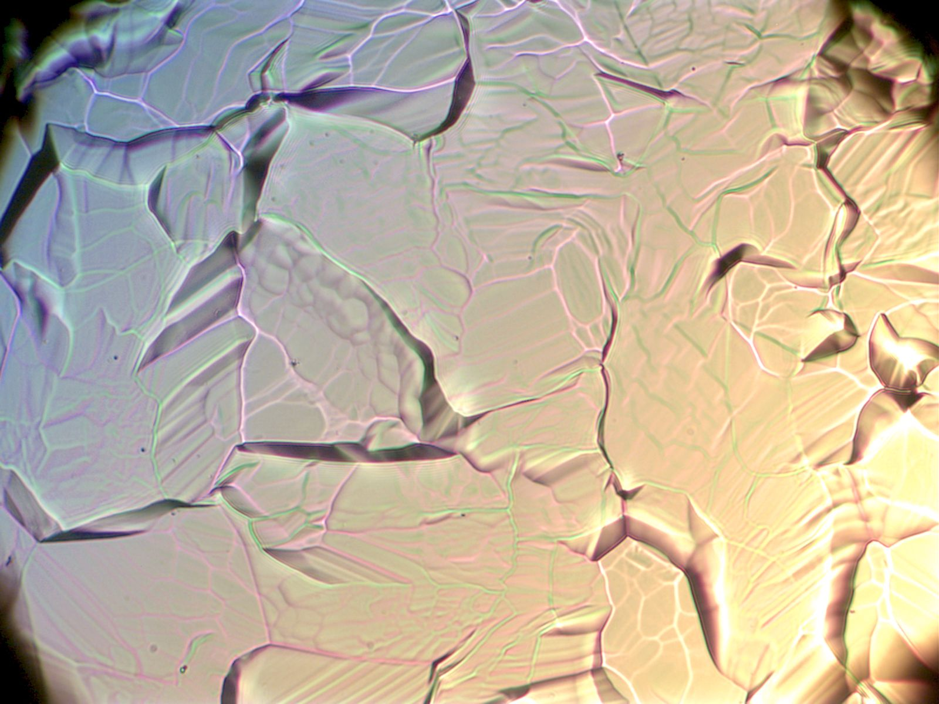
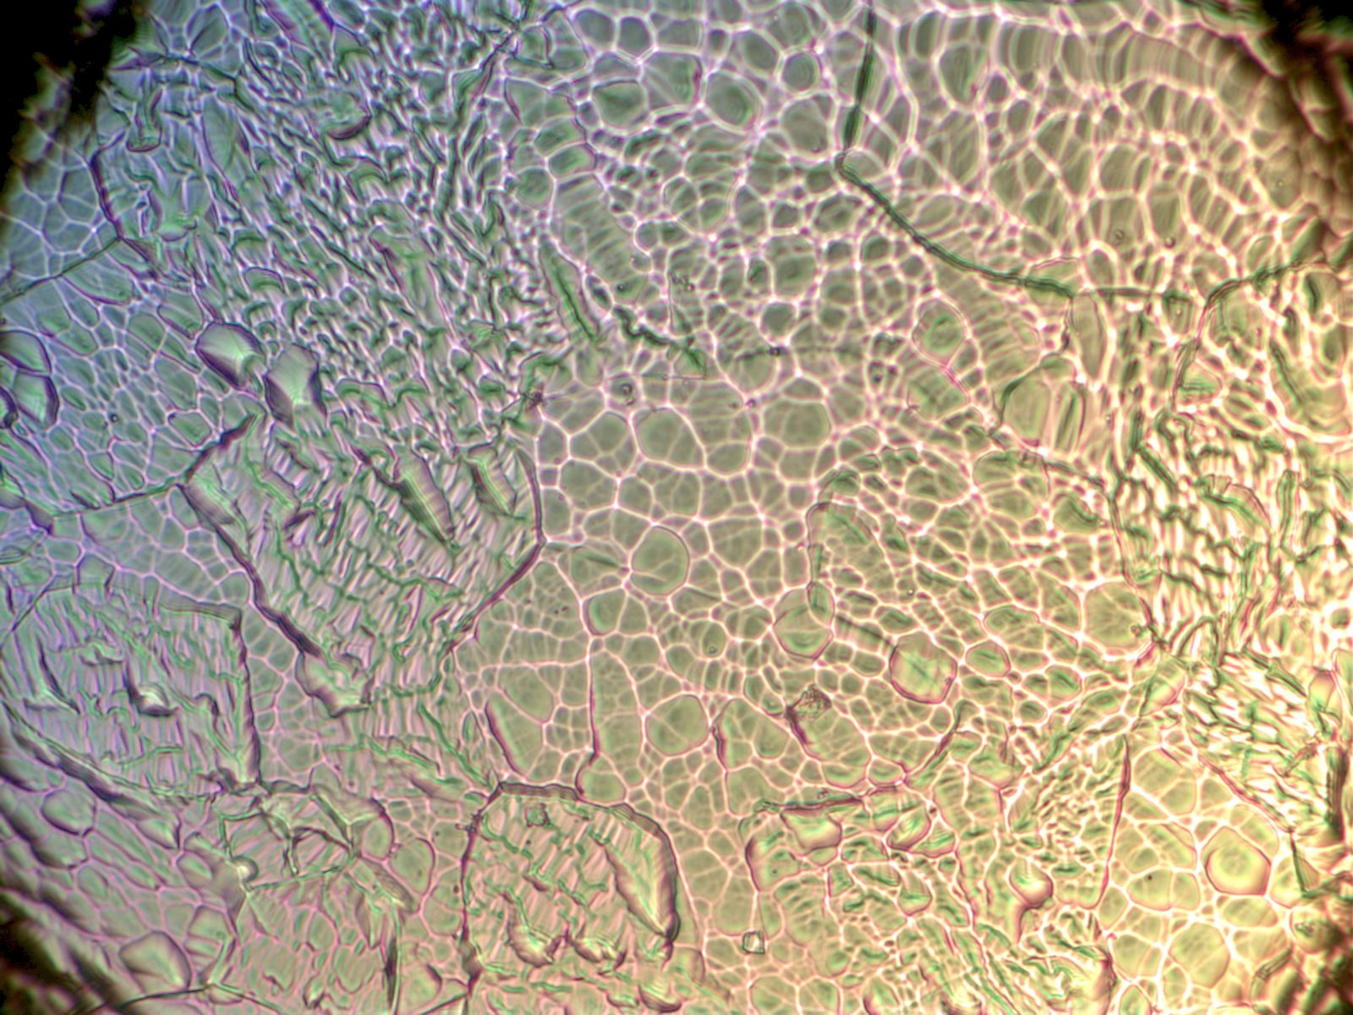
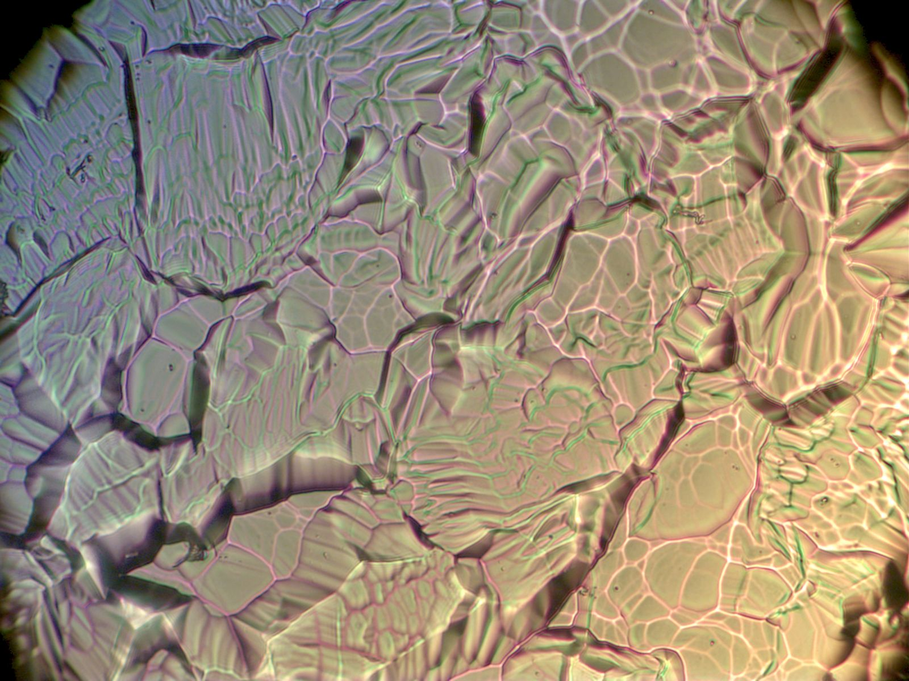
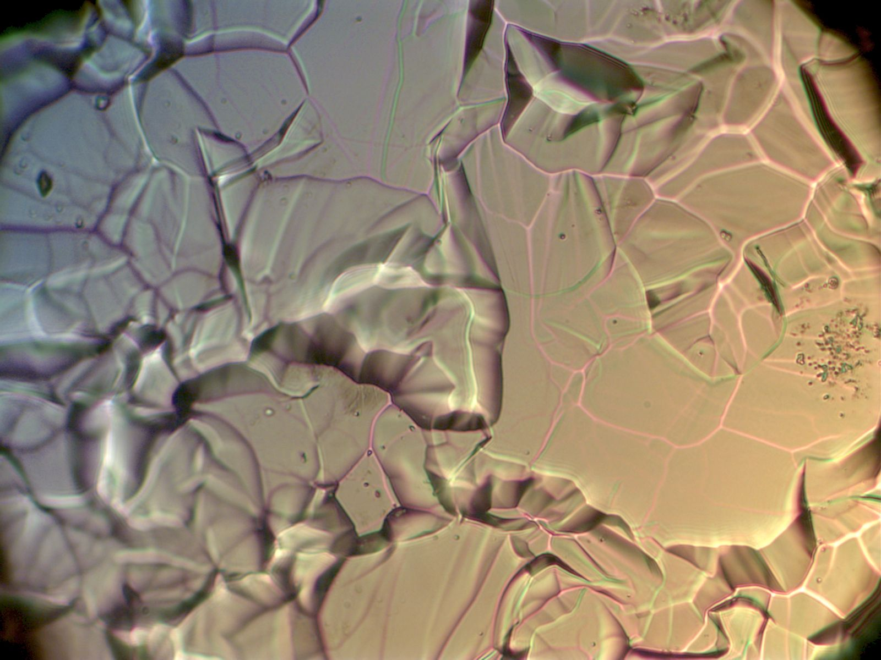
Temperature effect – Optical microscope images, X400
BCP topography
10 C 1min 7min 20min
22 C
Shallow etching reveals fine features within individual grains. Deep etching smooth surface within individual grains, but causes facets, steps and edges.
Temperature does not change topography significantly from 10 C to 22 C. Higher temperature results in faster etching.

Slide 7
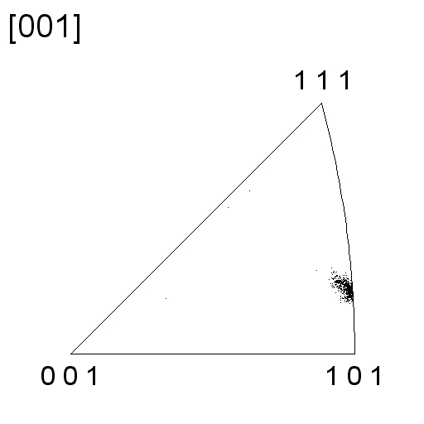
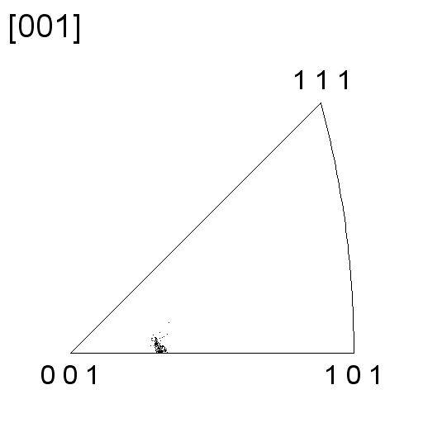
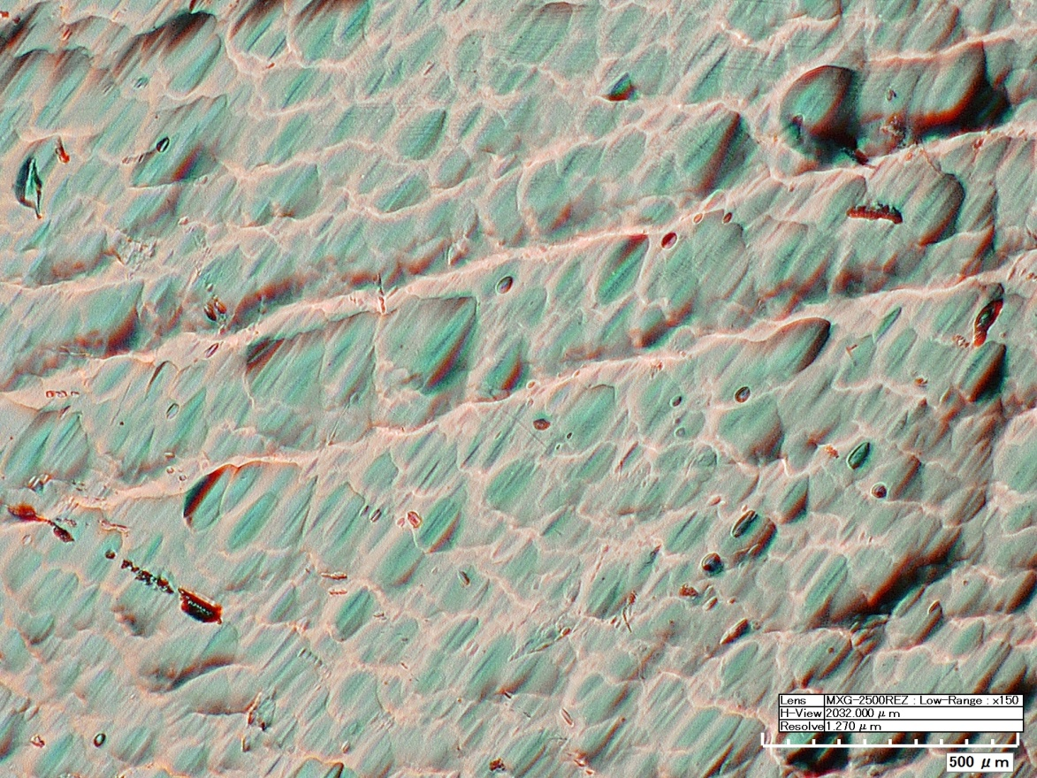
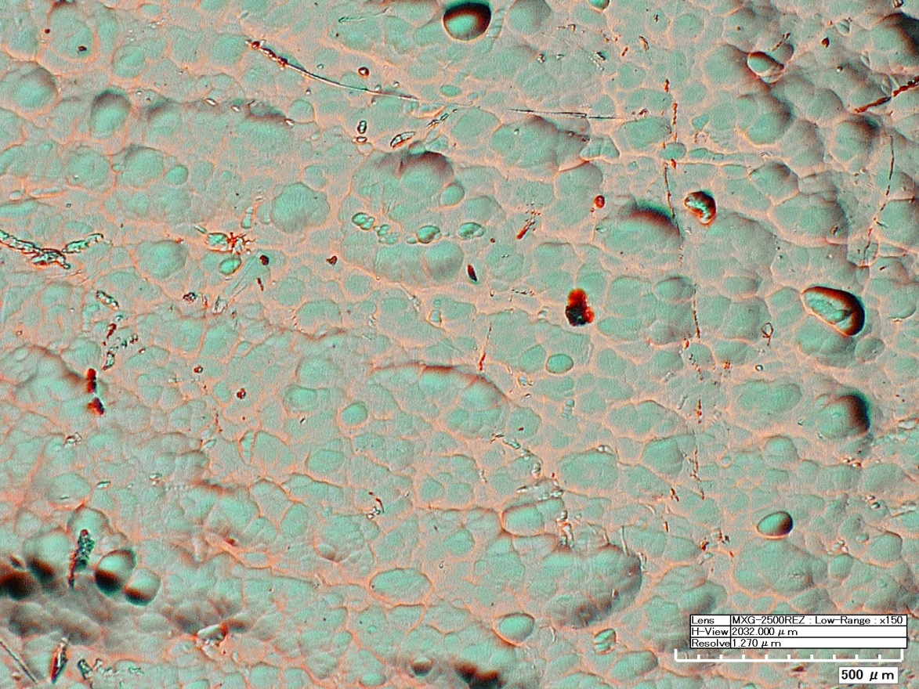
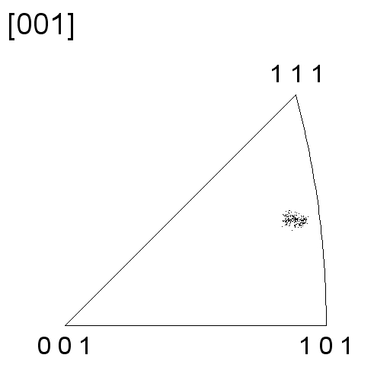
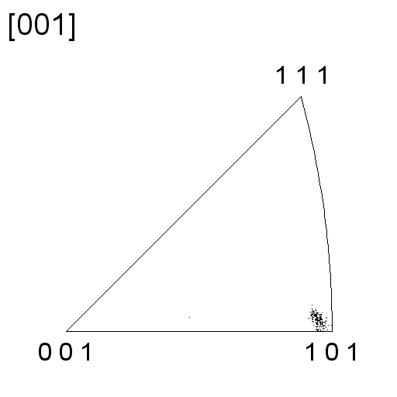
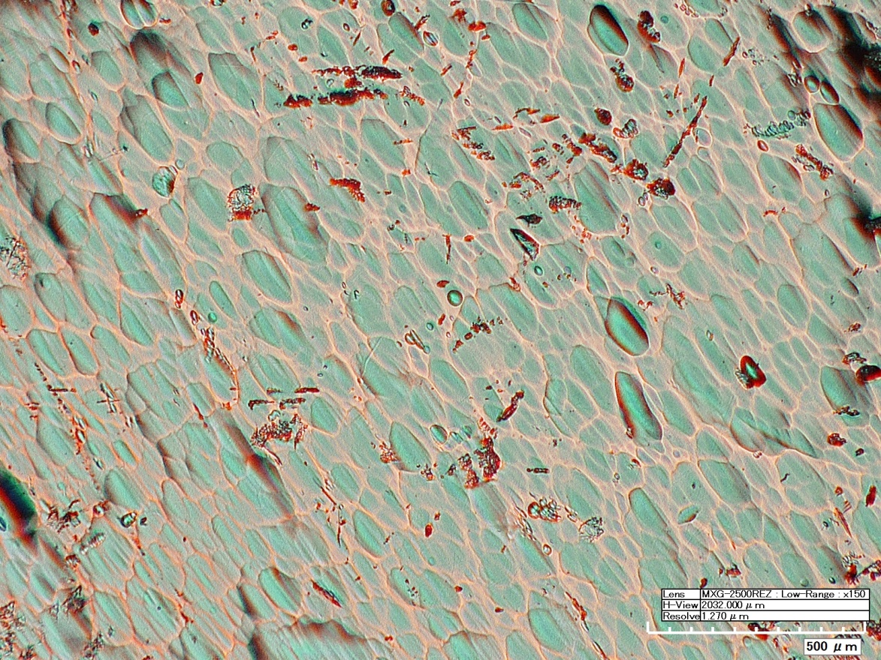
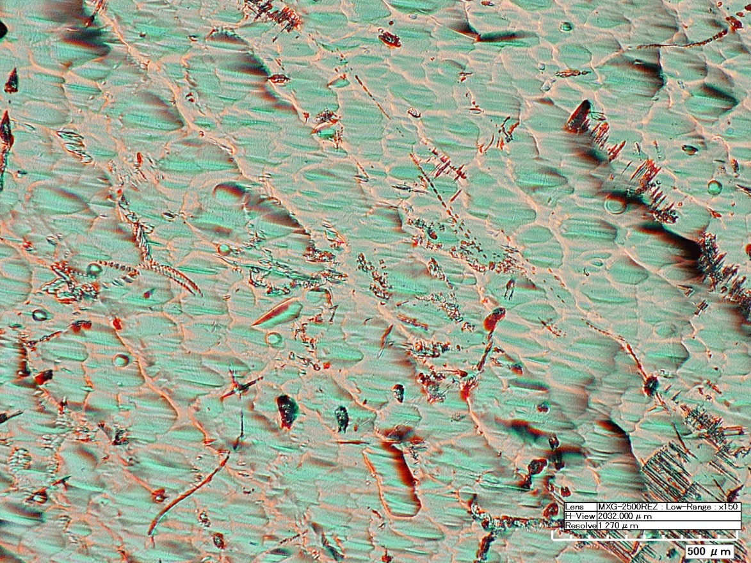
Grain size effect – EBSD, optical microscope images
BCP topography
Single crystal X150
R.T. BCP, total of 90 mins
Surface features orientation dependent, at low magnification
Weight loss was not significantly different due to close orientations

Slide 8
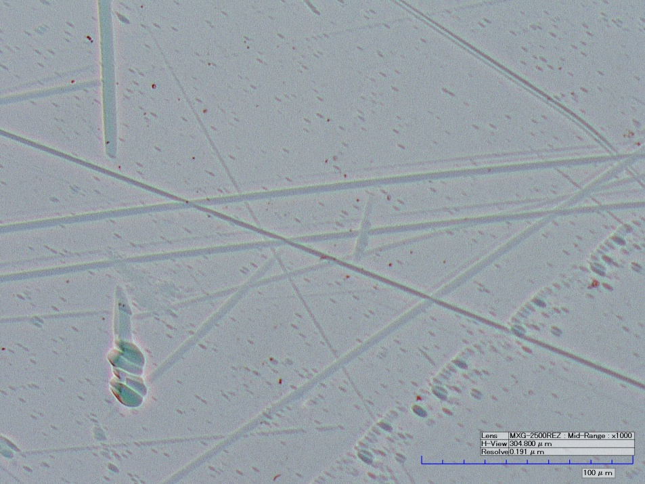
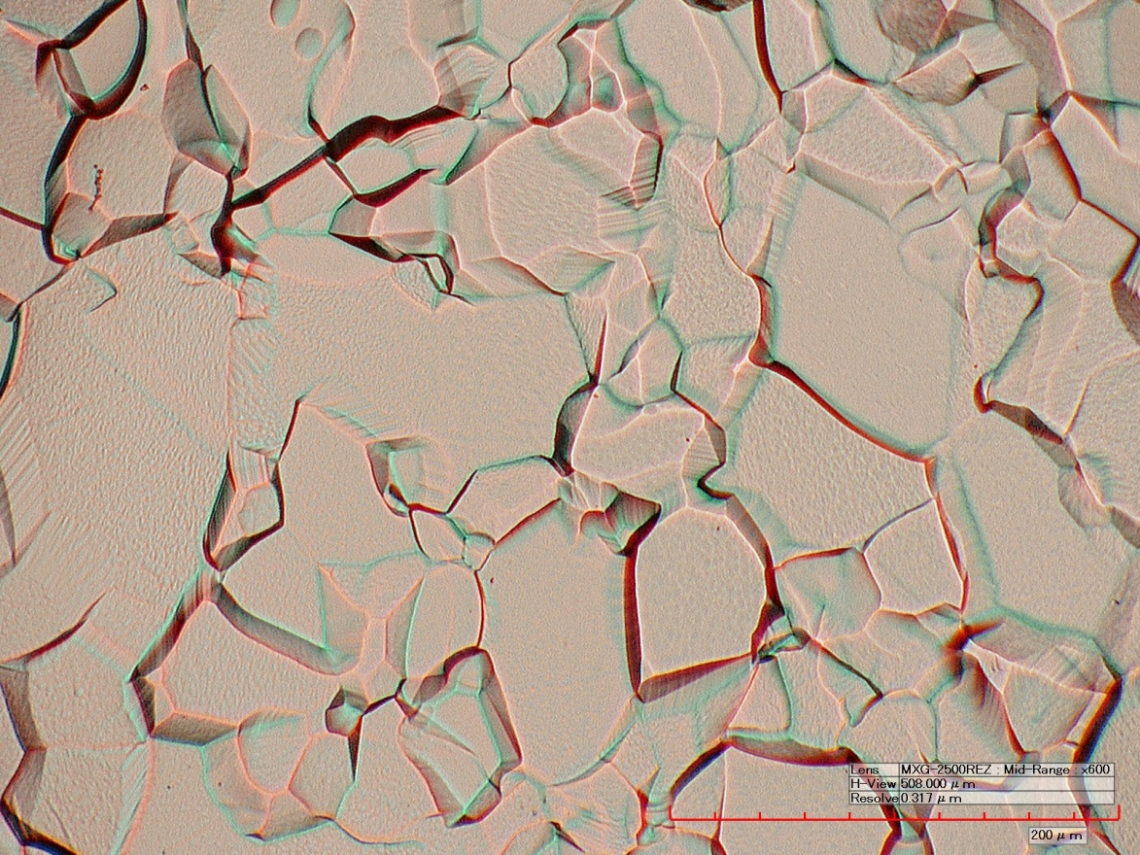
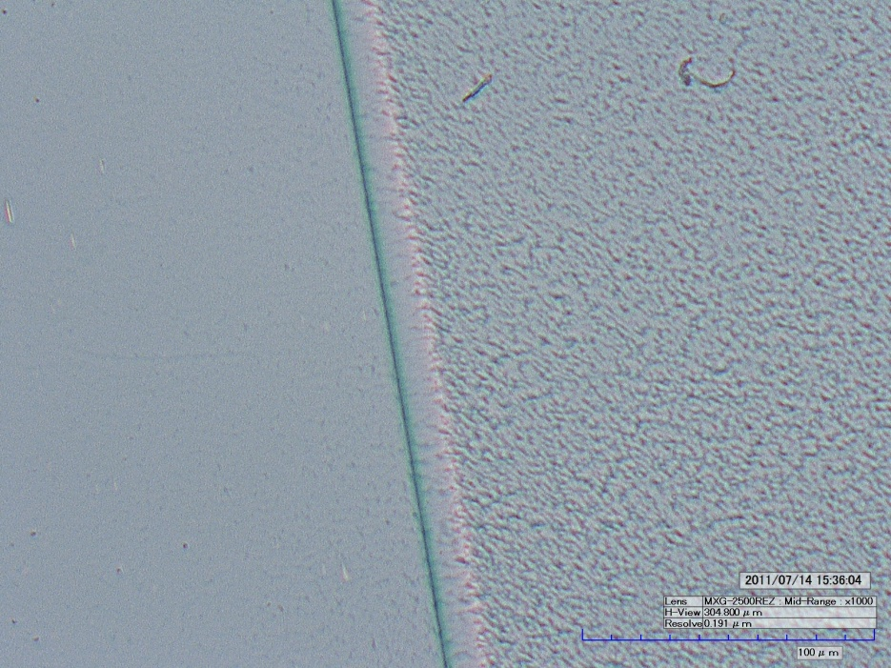
Grain size effect – Optical microscope images
BCP topography
Single
Crystal
R.T. 12min
X1000
Polycrystalline, R.T. 6min, X600
Grains are separated from each other due to different etching rate on different orientations and grain boundary revealed for poly crystal
Grain boundary is revealed for bi-crystal
No prominent features found on single crystal at high magnification
Bi-crystal
R.T. 8min
X1000

Slide 9
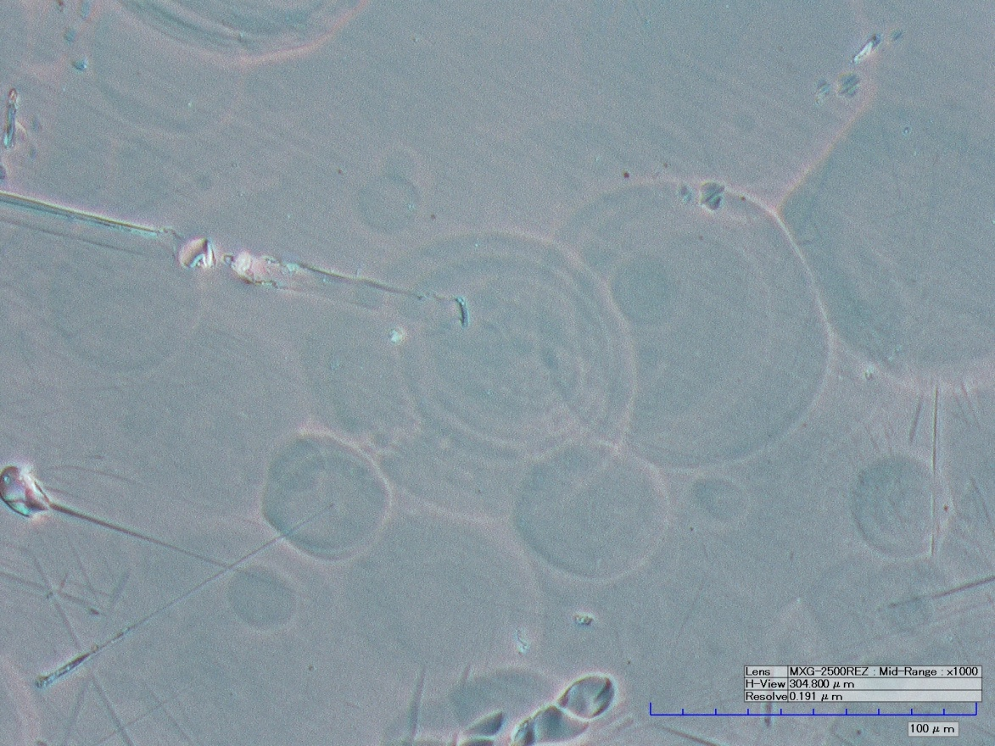
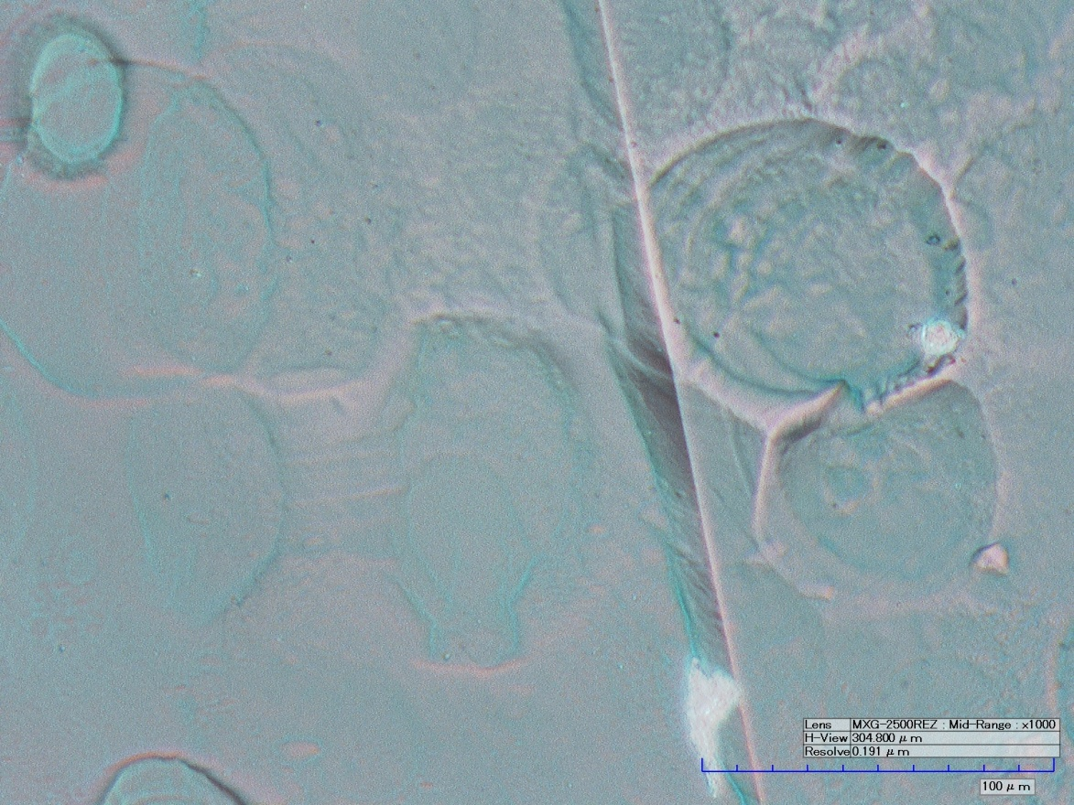
Gas evolution effect – Optical microscope images
BCP topography
Bubbles leave dents on the surface. Edges of these dents could develop into sharp edges where the dent is deep or two dents meet.
Grain boundary and bubble dents do not interfere with each other.
Single crystal X1000
Bi-crystal X1000

Slide 10
BCP topography
Is a combination of:
Orientation dependent etching pits and patterns
Steps and grooves at grain boundary due to orientation dependent etching rate
Prints, steps, dents caused by gas evolution

Slide 11
Conclusion
Polishing rate of BCP at different temperatures from 0 to 30 C was measured. At 0 to 20 C chemical reaction is the controlling step. At 30 C diffusion control seems to be more evident.
BCP topography shows no different features between 10 C and 20 C. Surface geometry depends on the amount of removal from the surface. Higher temperature results in fast removal and therefore produce heavily etched surface earlier than at lower temperature.
Etching rate shows orientation dependence for poly crystals, which causes steps at grain boundaries. Gas evolution leaves dents and steps on the surface as well.
Single crystal showed orientation dependent patterns visible at low magnification, but unnoticeable at high magnification.

Slide 12
Thanks for your attention!

