Slide 1


Tensile Tests on Single Crystal Specimens with Different Orientations
D. Kang¹, D. Baars¹, T. Bieler¹, C. Compton²
¹Michigan State University, East Lansing, MI
²Facility for Rare Isotope Beams, East Lansing, MI
Work funded by DOE-OHEP
7th SRF Materials Workshop

Slide 2
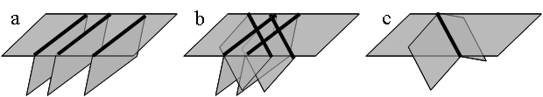
Identifying active slip systems in Nb
Motivation
  Slip activities → recrystallization → cavity performance
  Simulating deformation and recrystallization
Determining slip systems
  Slip trace: intersection of surface and slip plane
  Slip direction: usually rotates towards tensile direction
  High resolved shear stress
Single
slip system
Two slip systems
Two with similar trace
Baars, Investigation of active slip systems in high purity single crystal niobium, PhD dissertation

Slide 3
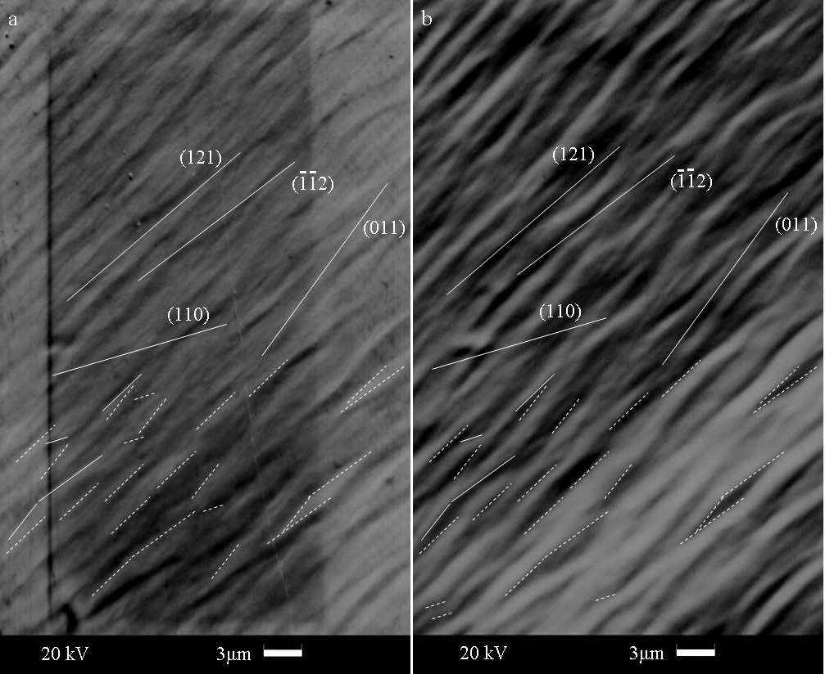
Slip trace analysis – an example
Baars, Investigation of active slip systems in high purity single crystal niobium, PhD dissertation

Slide 4
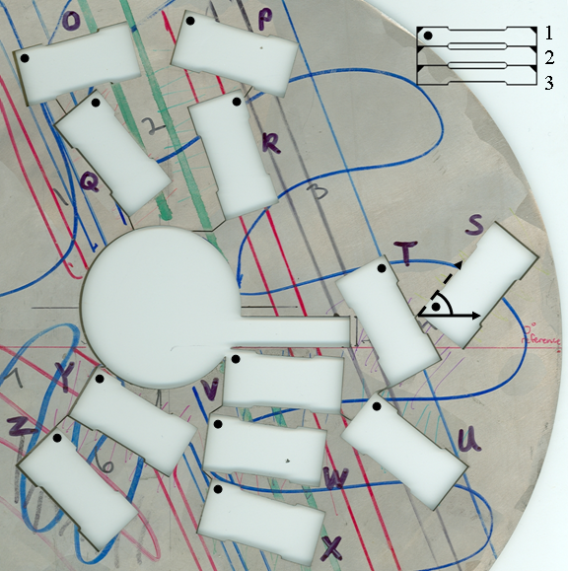
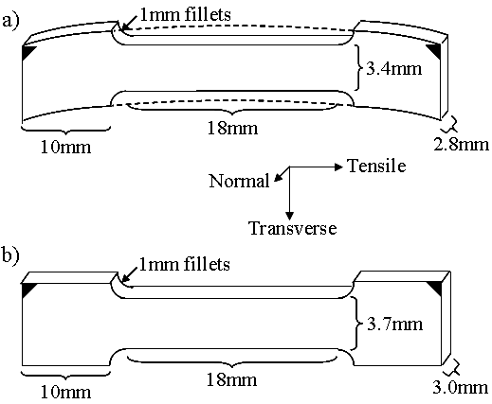
Uniaxial tensile tests for studying active slip systems
12 sets of specimens (O~Z) favoring different slip systems
9 of them deformed to 40% engineering strain
Loading rate: 1mm/min
Baars, Investigation of active slip systems in high purity single crystal niobium, PhD dissertation

Slide 5
Stress-strain behavior varies greatly with orientations
Start
End
S and T ended up being the softest two
U hardened more than a typical poly-crystal
P and T had a similar initial hardening slope
Baars, Investigation of active slip systems in high purity single crystal niobium, PhD dissertation

Slide 6
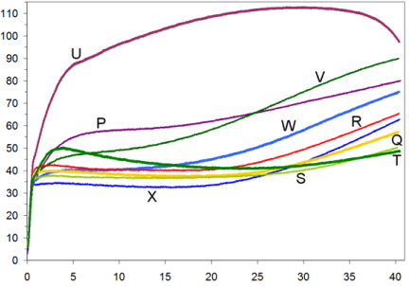
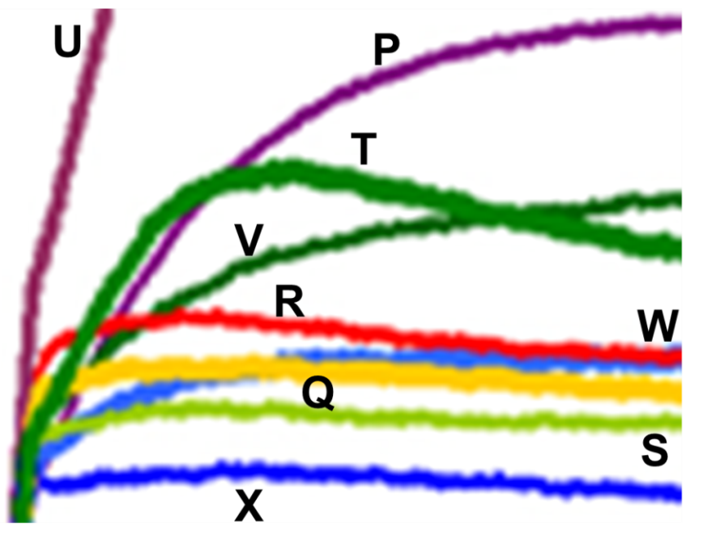
{112} slip almost accounts for all the initial
hardening behavior of the 9 specimens
Specimen | Difference between highest resolved shear stress on primary and secondary {112} slip systems (MPa), and ratio of resolved shear on two highest {112} systems | Initial hardening rate
X3 | 4 1.316 | Barely
Q2 | 4 1.263 | Barely
S3 | 3.5 1.237 | Barely
R2 | 3.5 1.200 | Slight
W3 | 1.4 1.091 | Moderate-Low
T3 | 1.3 1.073 | High
U3 | 0.6 1.027 | Very High
V3 | 0.4 1.022 | Moderate-High
P3 | 0.1 1.042 | High
Baars, Investigation of active slip systems in high purity single crystal niobium, PhD dissertation

Slide 7
Limitations with previous tests; in-situ tensile tests
Path for orientation evolution from 0% to 40% strain is unknown
Specimens were not heat treated to get rid of preexisting dislocations
In-situ tensile tests
  Better correlation between real time orientations and slip traces
  Multiple locations along tensile axis are examined for orientation gradient effects
  Heat treatment at 800°C for 2h to reduce the number of possible forest dislocations
Start
End

Slide 8
First attempt with specimen O3, loading rate 4 µm/s

Slide 9
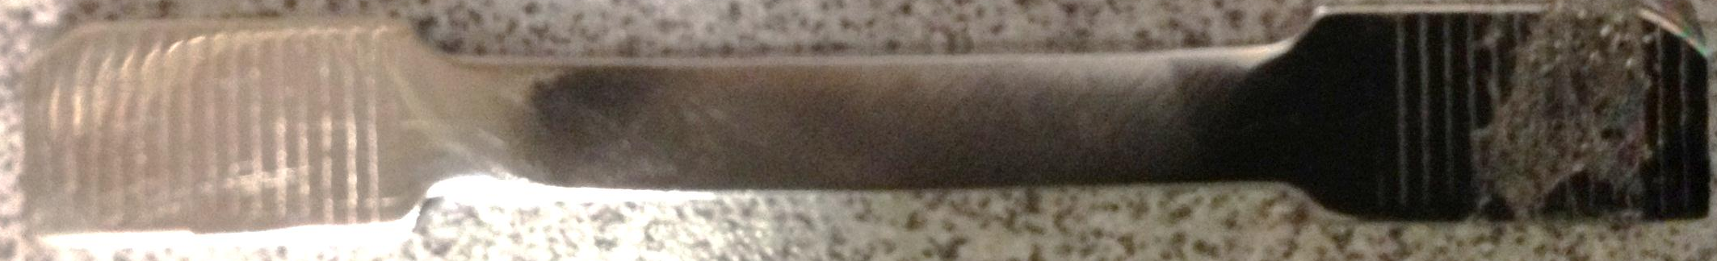
After deformation to 19% engineering strain*
*Strain is calculated based on positions of the two markers

Slide 10
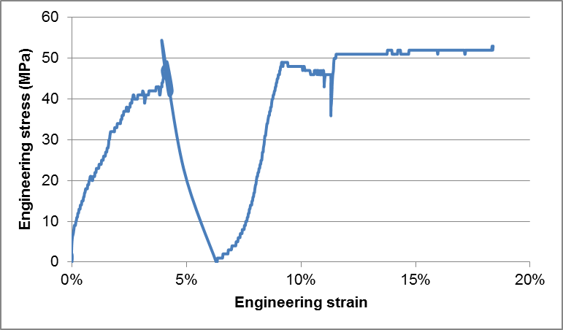
Engineering stress-strain curve
Three increments (0%→9%→12%→19%) were used
Tensile stage lost control at the end of first increment and reloaded from 0
The stage reached its limit before 20% strain

Slide 11
Comparison with previous tests
Nothing striking in terms of yield strength and work hardening

Slide 12
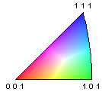
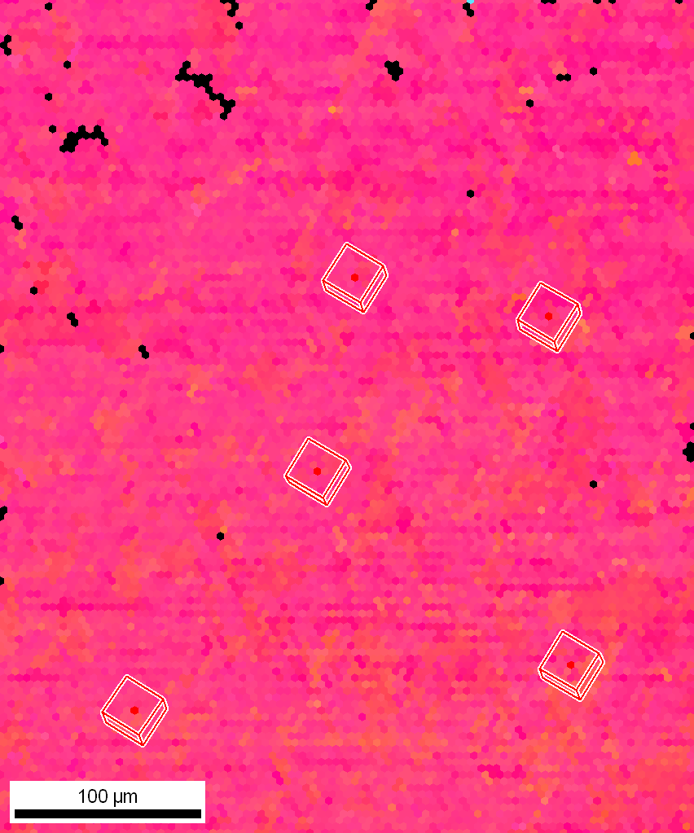
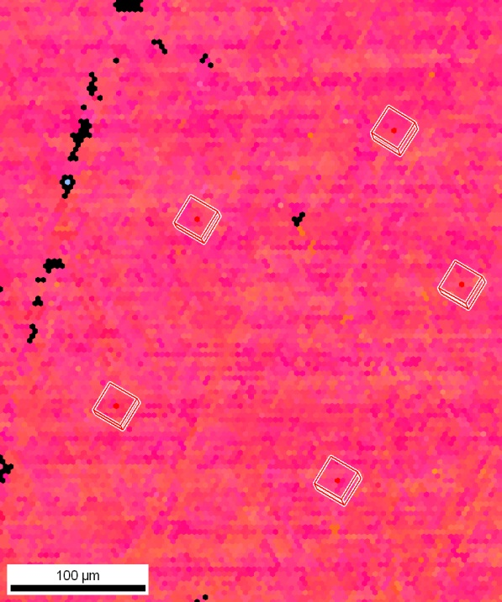
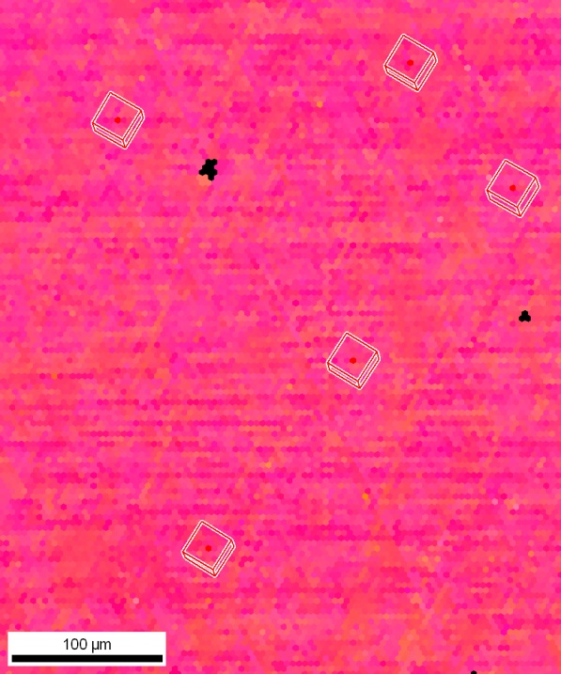
Before deformation – orientation map
5 mm

Slide 13
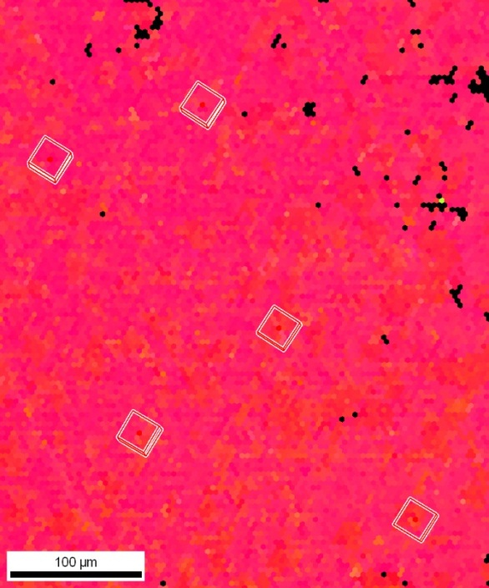
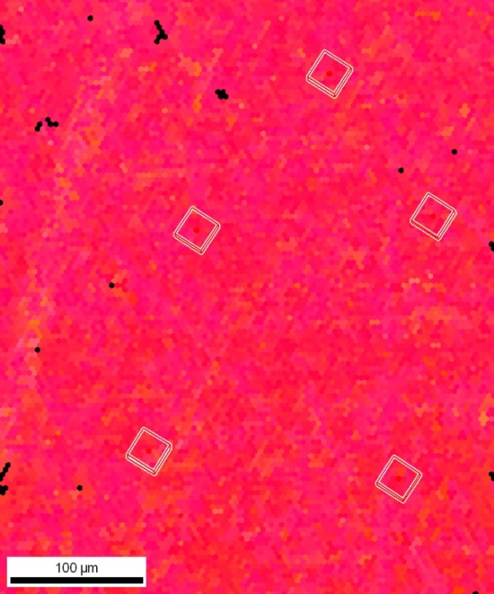
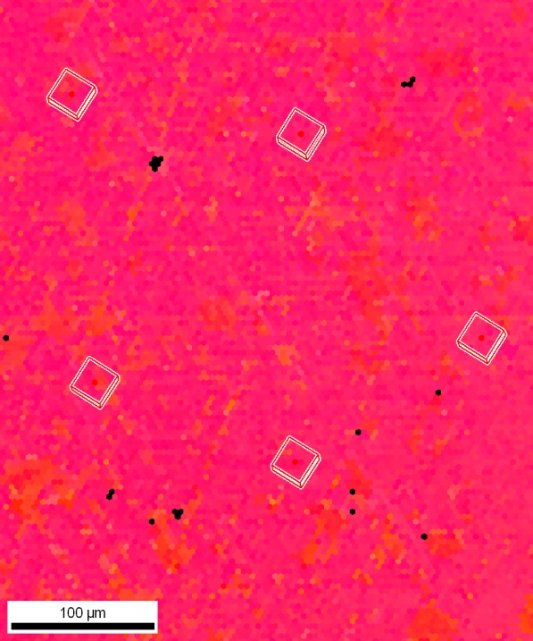
After 9% engineering strain – orientation map
5 mm

Slide 14
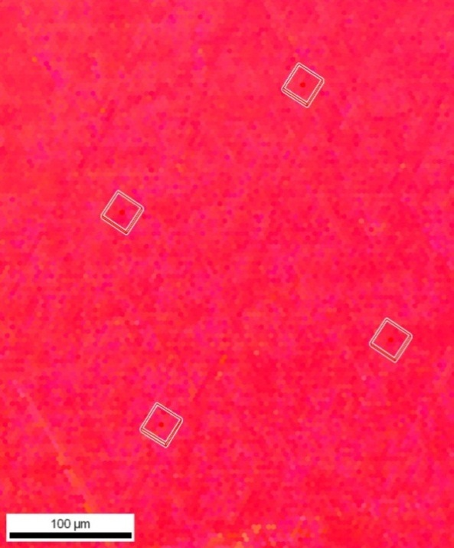
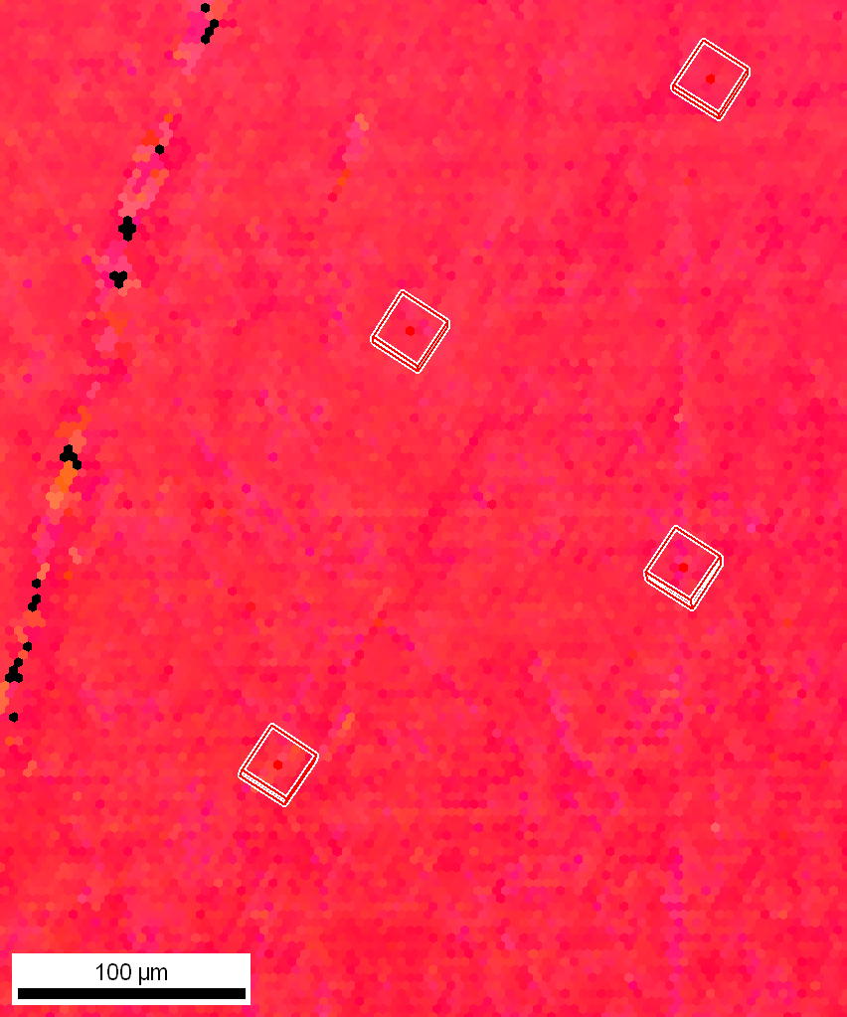
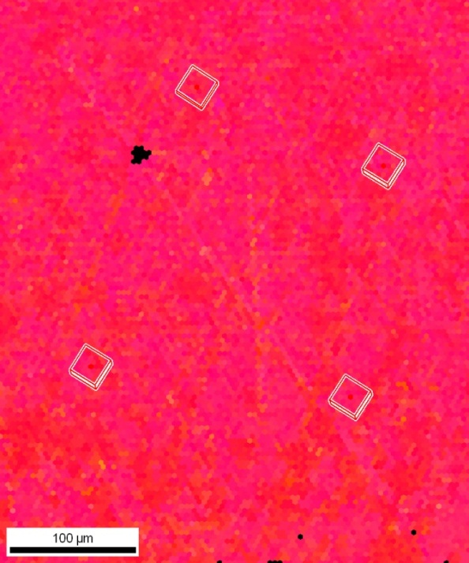
After 12% engineering strain – orientation map
5 mm

Slide 15
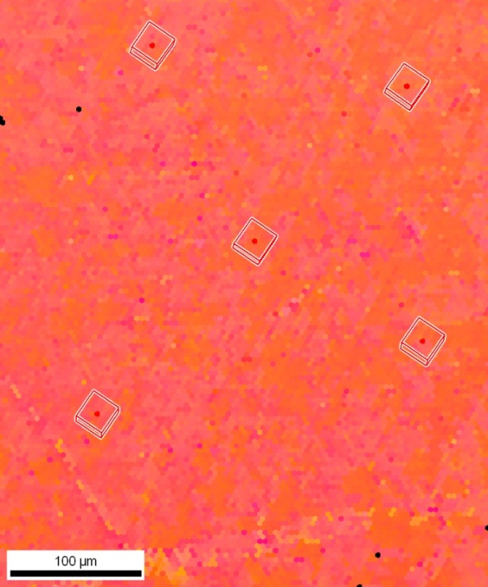
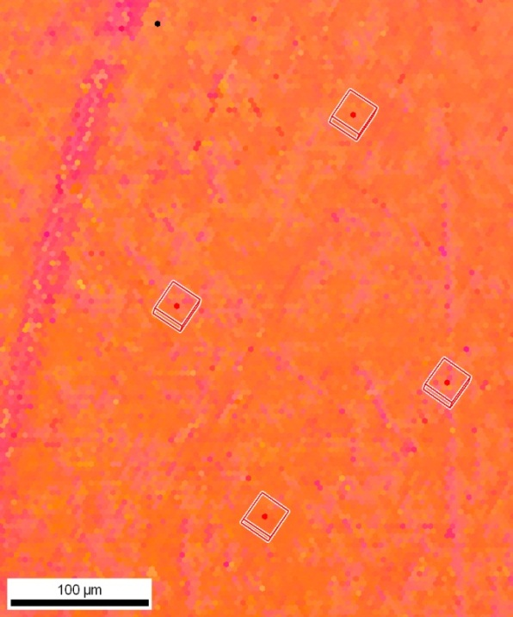
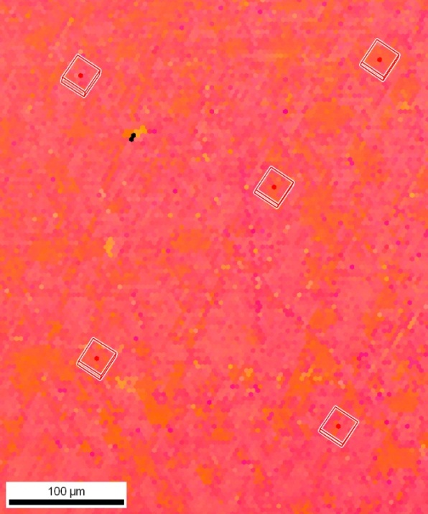
After 19% engineering strain – orientation map
5 mm

Slide 16
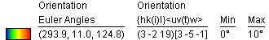
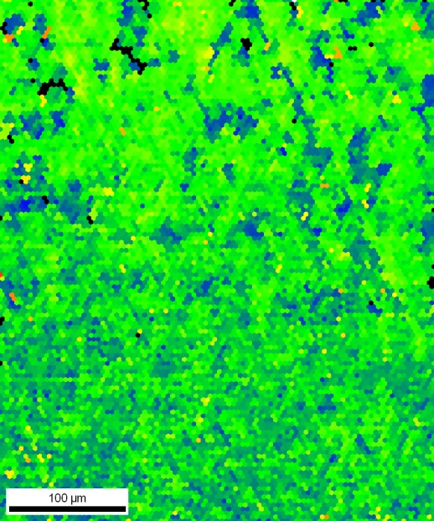
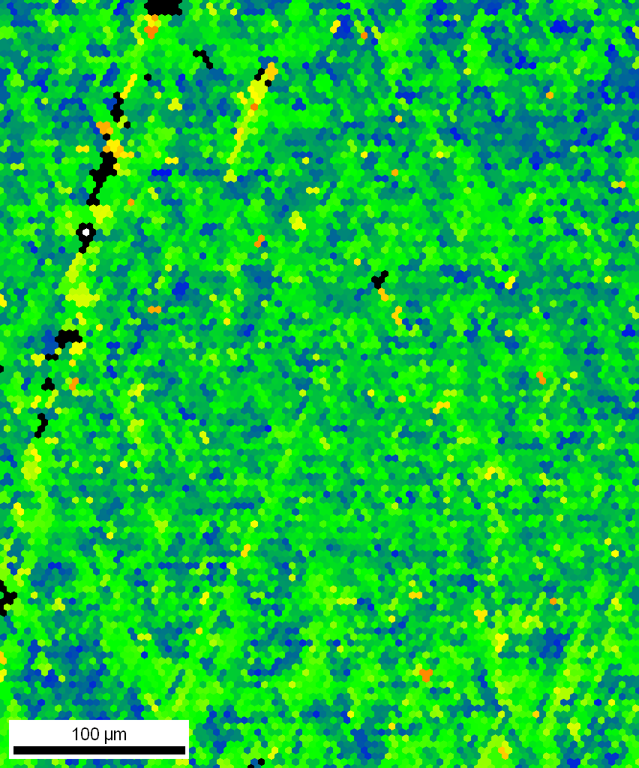
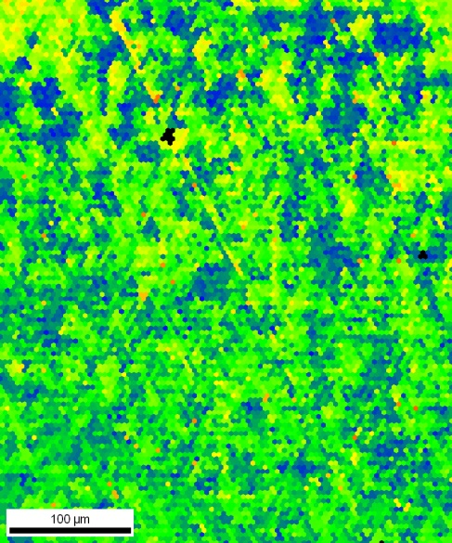
Before deformation – orientation deviation map
5 mm

Slide 17
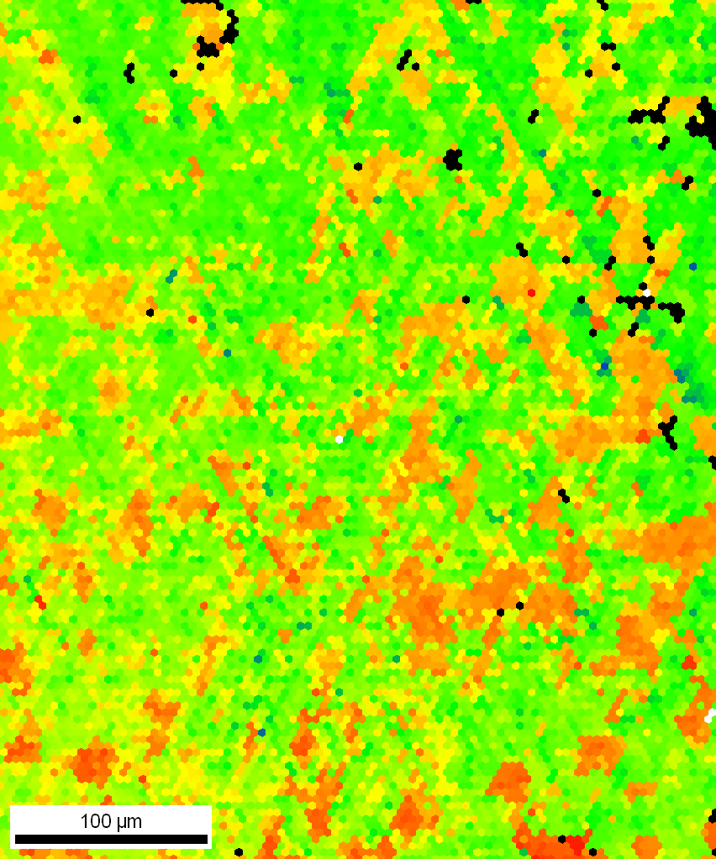
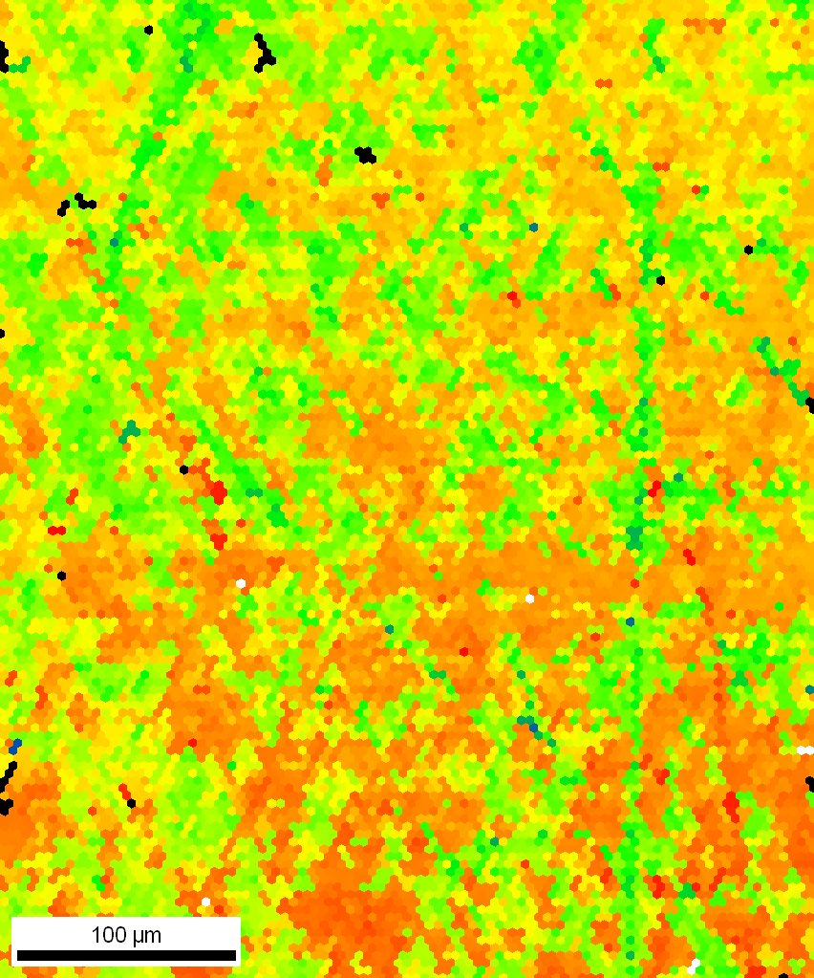
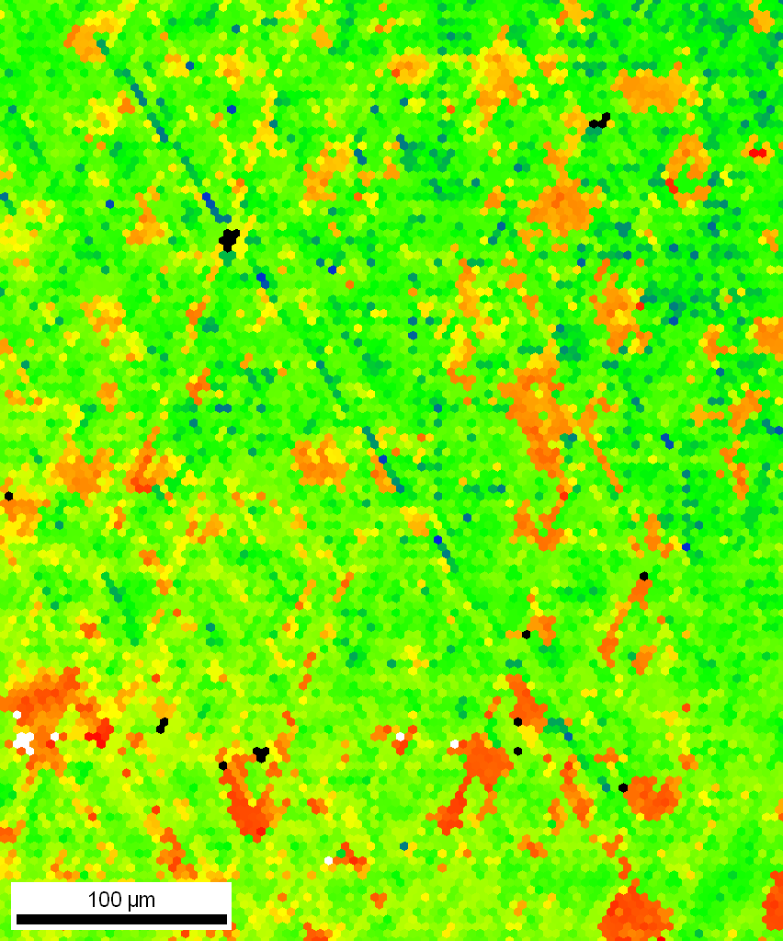
9% strain – orientation deviation map
5 mm

Slide 18
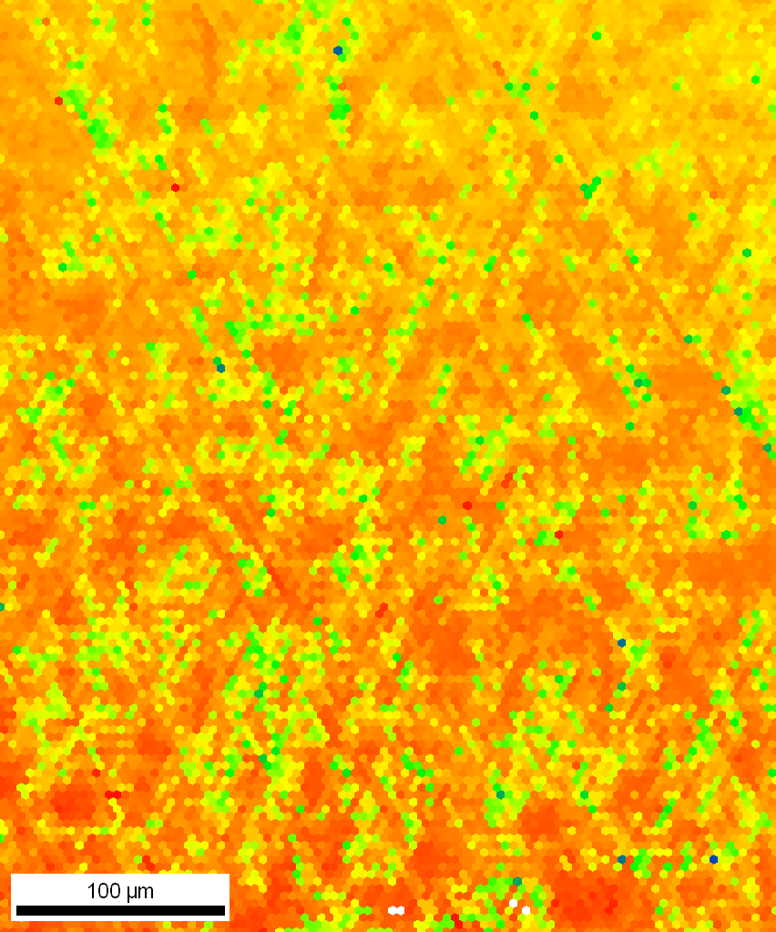
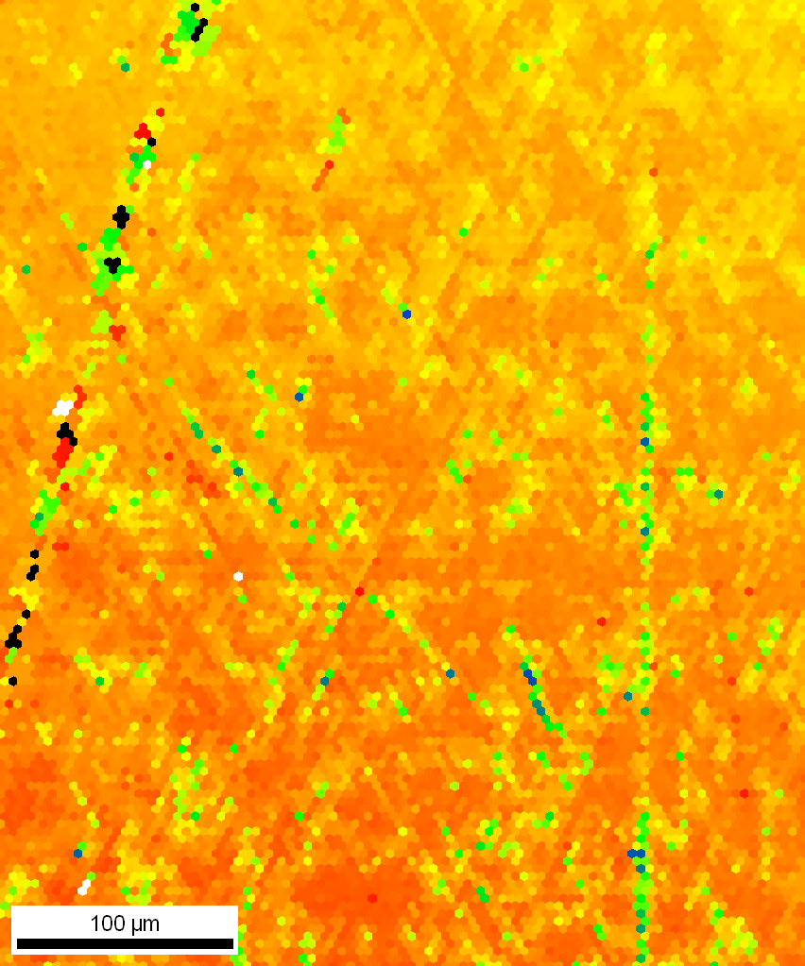
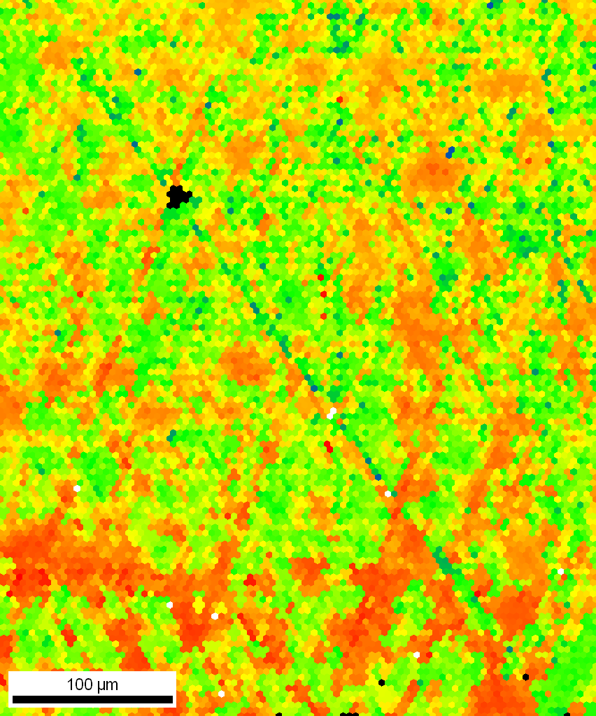
12% strain – orientation deviation map
5 mm

Slide 19
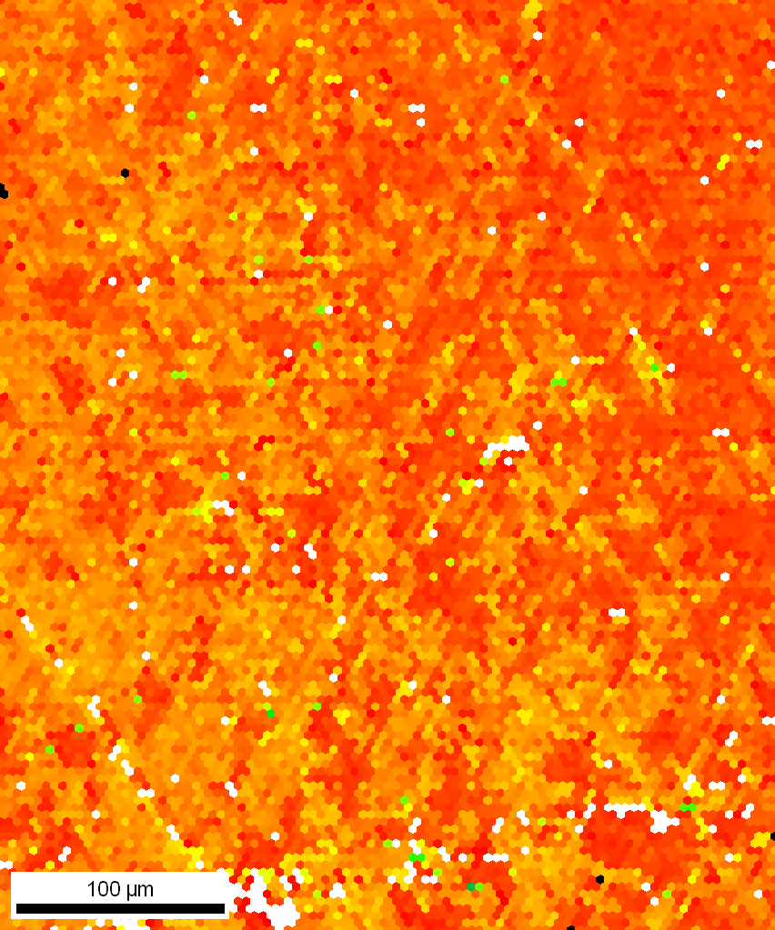
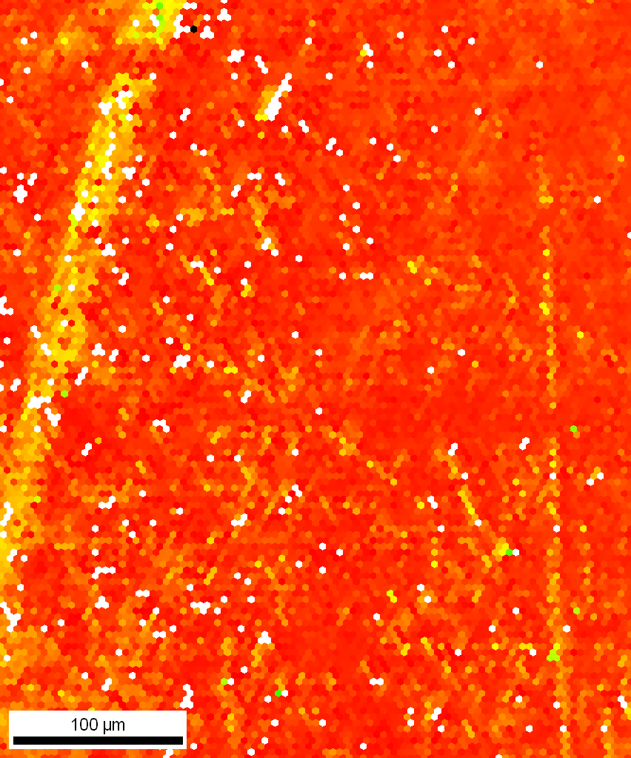
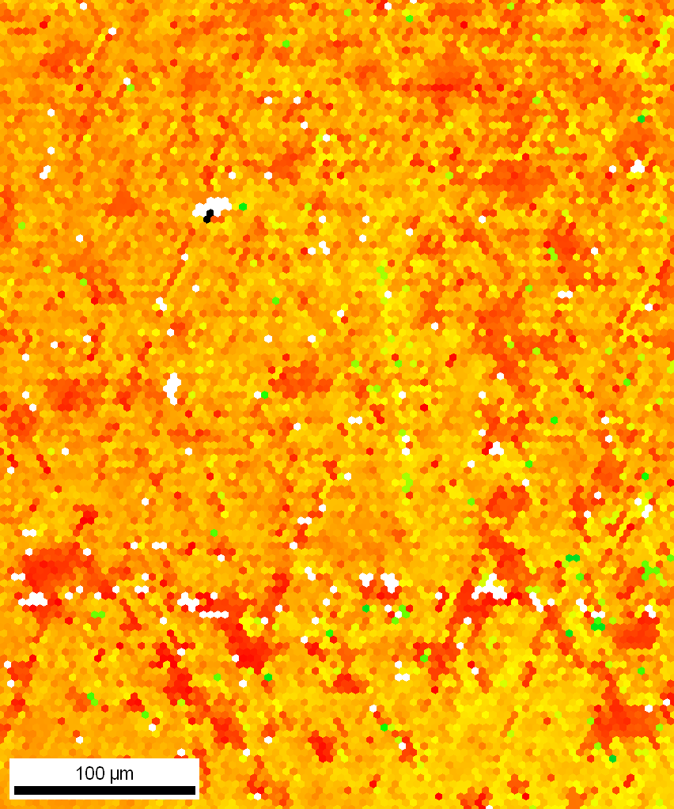
19% strain – orientation deviation map
5 mm

Slide 20
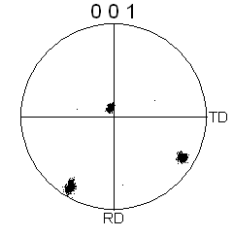

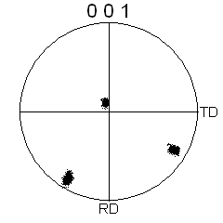
Before deformation – pole figures
5 mm

Slide 21
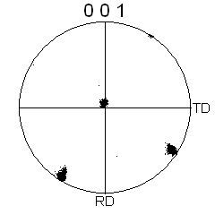

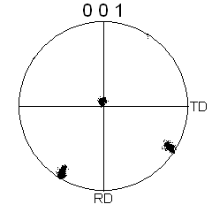
9% strain – pole figures
5 mm

Slide 22
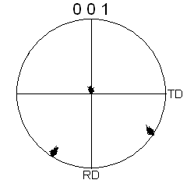
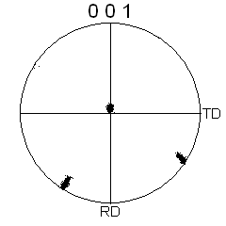

12% strain – pole figures
5 mm

Slide 23
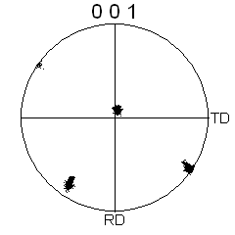
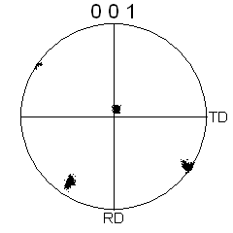

19% strain – pole figures
5 mm

Slide 24
Before deformation – SEM images
5 mm
SEI
BEI
200 µm
SEI – Secondary electron imaging
BEI – Backscattered electron imaging

Slide 25
9% strain – SEM images
5 mm
SEI
BEI
200 µm

Slide 26
12% strain – SEM images
5 mm
SEI
BEI
200 µm

Slide 27
19% strain – SEM images
5 mm
SEI
BEI
200 µm

Slide 28
Summary
{112} slip arguably has an advantage over {110} during deformation at room temperature for high purity Nb
In situ tensile tests enable better correlation between slip systems and orientations, although there are challenges
  Could not reach 40% strain due to stage limits
  Occasional hiccups with the tensile stage
  Stress relaxation between strain increments is a potential source for inaccuracy

