Slide 1
Examination of Surface Damage Layer on SRF Cavities using EBSD
D. Kang¹, G. Ciovati², T. Bieler¹, C. Compton³
¹Michigan State University, East Lansing, MI
²Jefferson Lab, Newport News, VA
³Facility for Rare Isotope Beams, East Lansing, MI
Samples supplied by Dr. Gigi Ciovati
Work funded by DOE-OHEP
7th SRF Materials Workshop

Slide 2
Surface damage layer affects cavity performance
Achievable gradient depends on the amount of material removed from surface
The surface damage depth from rolling and deep drawing has been established to be 100~200 µm
Kneisel et al.: Performance of 1300 MHz KEK-Type Single-Cell Niobium Cavities, Proceedings of SRF97
Padamsee, RF Superconductivity: Science, Technology, and Applications

Slide 3
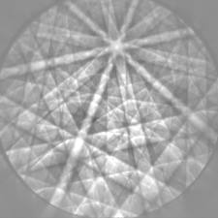
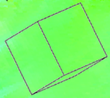
Observing surface damage effects with EBSD
Electron Backscattered Diffraction (EBSD)
Orientation map
Crystallographic Orientations
Grain Reference Orientation Deviation
Local Average Misorientation
Deformation mainly results in two types of defects:
Dislocations (linear defect, very common)
Grain boundaries (surface defect, less common)
→ An array of dislocations
Hull and Bacon, Introduction to Dislocations, Fifth Edition, Elsevier Ltd.

Slide 4
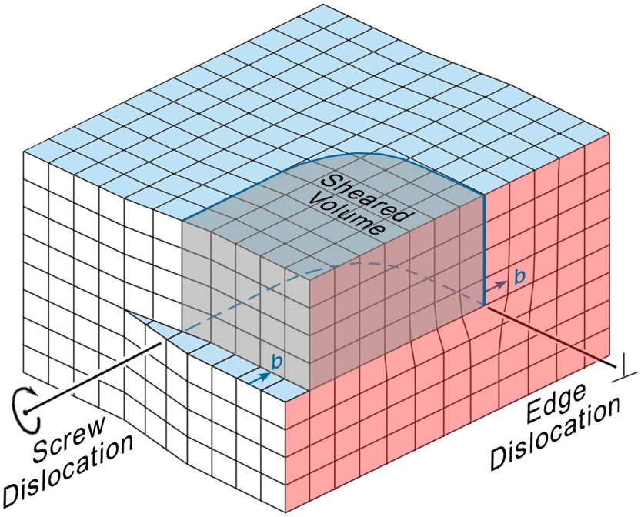
Dislocations and cavity performance
Dislocations are known to affect cavity performance in two ways:
Pinning magnetic flux → irreversibility of magnetization curves
Vibration of dislocation lines reduces thermal conductivity
How are dislocations observed with EBSD?
Dislocations alter grain orientations locally
The change is evident from an orientation/misorientation map
EBSD only detects “net” dislocations
Padamsee, RF Superconductivity: Science, Technology, and Applications
Bieler et al., Physical and mechanical metallurgy of high purity Nb for accelerator cavities

Slide 5
Dislocation annihilation; forming a grain boundary
+
Dislocations with opposite signs can annihilate with each other at elevated temperature, leaving “net” dislocations that do not have a partner
EBSD reports only these dislocations, which tend to rearrange themselves into a grain boundary
Bieler et al., Physical and Mechanical Metallurgy Lexicon relevant to Nb cavity fabrication

Slide 6
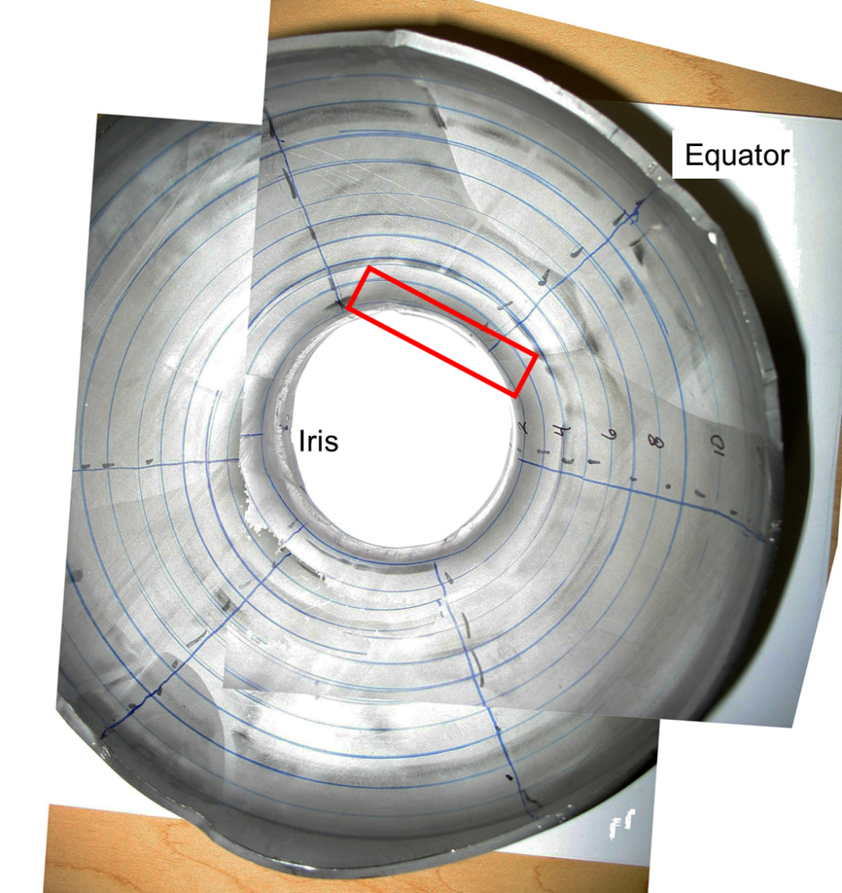
Iris and equator specimens for EBSD (as deep drawn)
left
right
neck
grain
boundary
grain
boundary

Slide 7
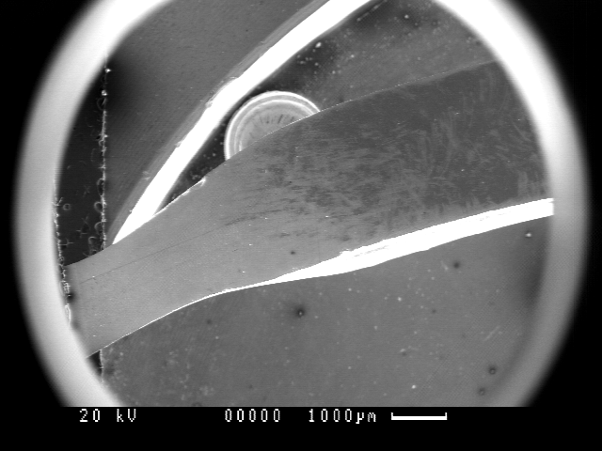
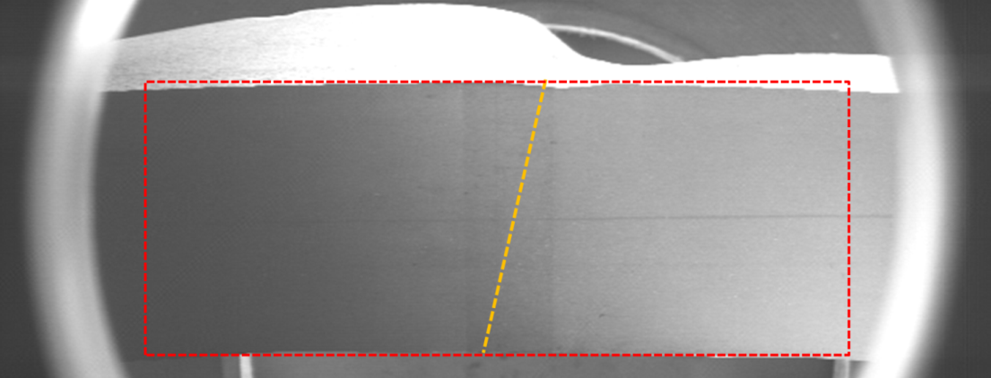
Secondary electron images for areas scanned
outside
Area scanned
Iris specimen (left)
inside
neck
outside
Equator
specimen
Grain boundary

Slide 8
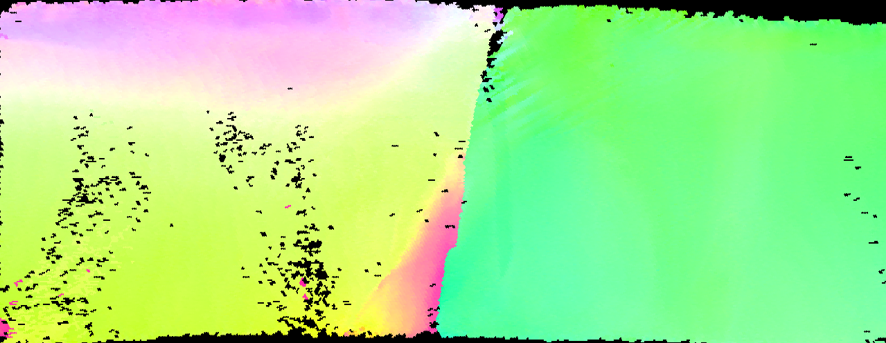
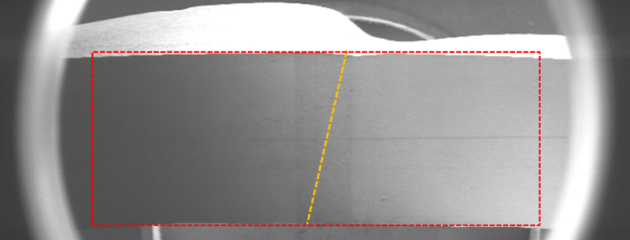
Equator – grain orientation map
Orientation oscillates more in the left grain than in the right

Slide 9
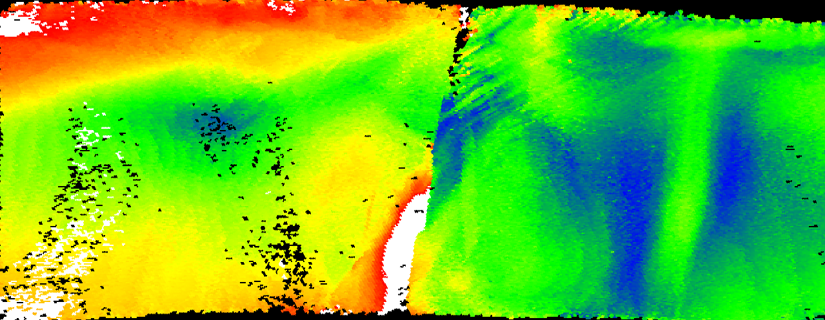
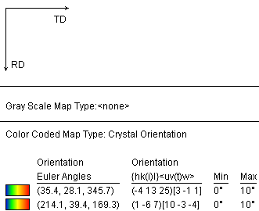
Equator - grain reference orientation deviation map
Reference: average orientation for each grain
Deviation for a point:
0° (blue) →10° (red)
White: >10° deviation
Reference
Grain boundary stimulated deformation bands in right grain; left grain has larger orientation gradients

Slide 10
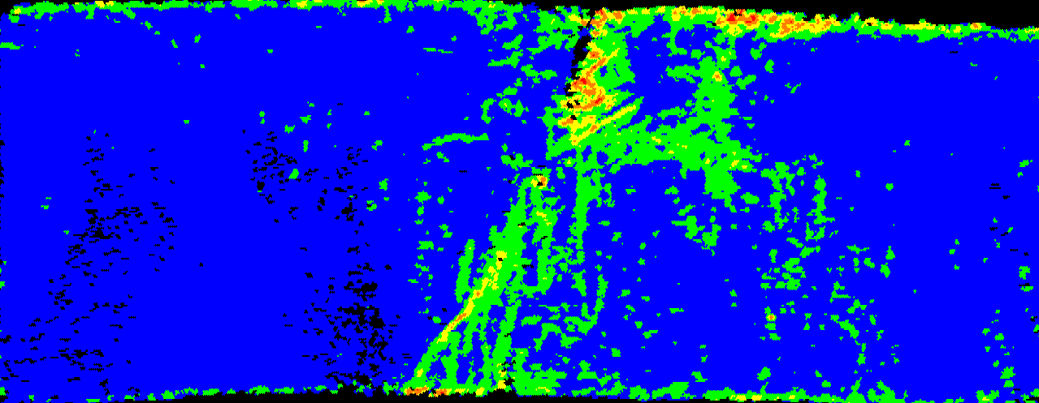
Equator – Local Average Misorientation (LAM) map
Average misorientation between all neighboring points within a kernel
2nd neighbor (40µm apart) was used
LAM are greater in right grain
3rd nearest neighbor sampling area

Slide 11
Local Average Misorientation and hot spots
“Hot” regions
“Cold” regions
0° (blue) → 2° (green)
Romanenko, Review of high field Q-slope, surface measurements, SRF2007, TU103

Slide 12
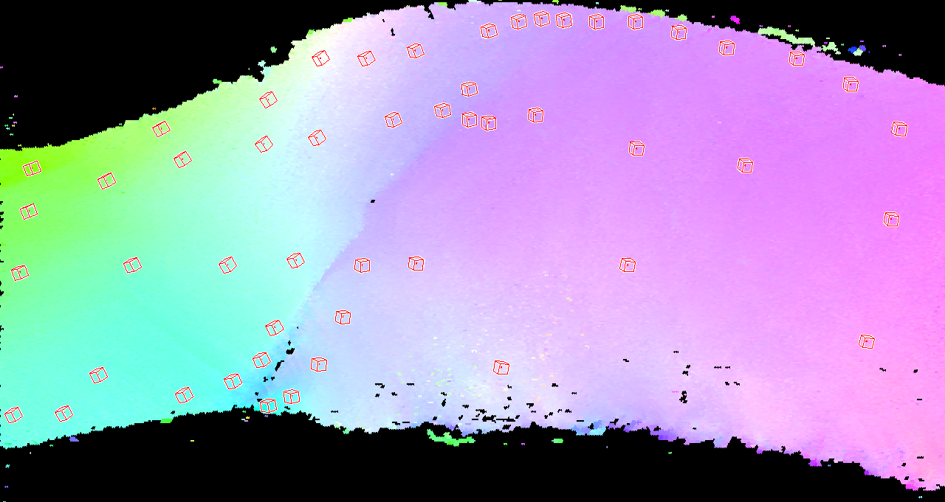
Iris – grain orientation map
Deformation resulted in large orientation gradient and formation of a high angle boundary

Slide 13
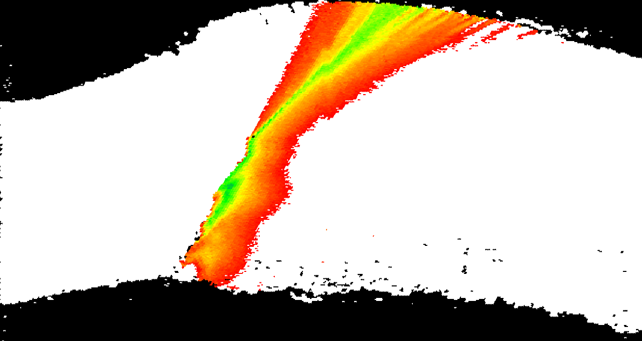
Iris - grain reference orientation deviation map
Orientation gradient is so large that only a small portion is within the 0~10° range
Reference (average orientation)

Slide 14
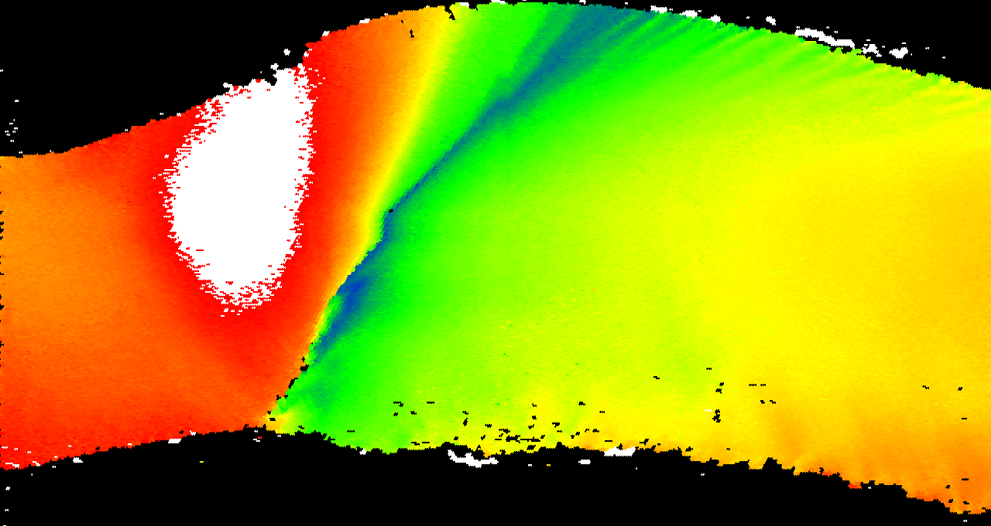
Iris - grain reference orientation deviation map
One area has >30° deviation from reference
Same reference

Slide 15
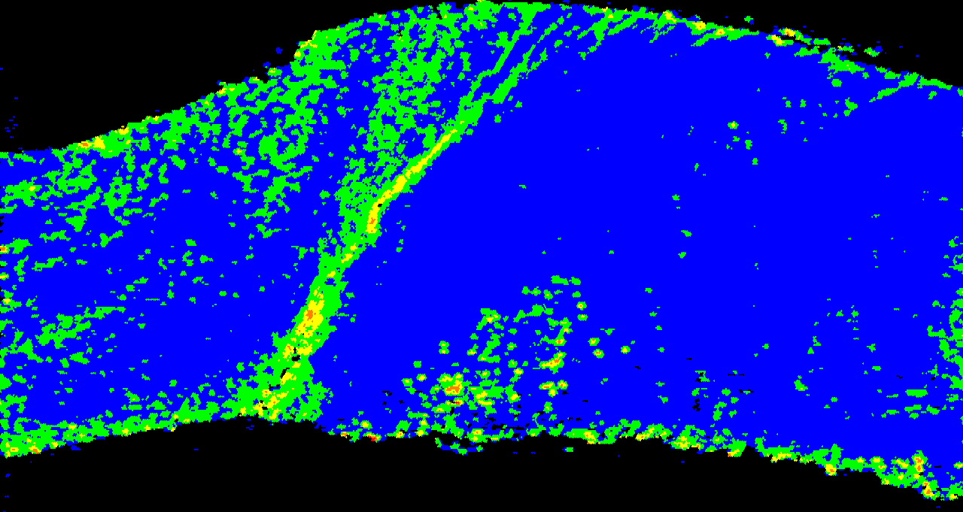
Iris – Local Average Misorientation map
neck
2nd neighbor (40µm) used
Even the bulk has large LAMs, especially near the neck

Slide 16
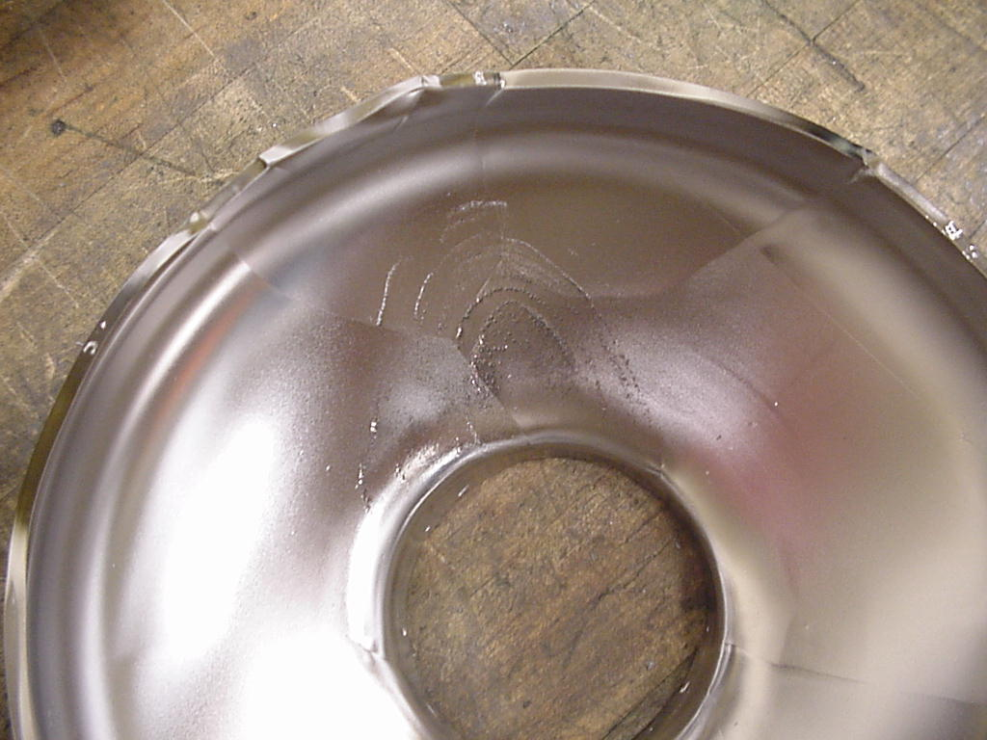
Etch pits emerged only from inside surface when 70µm was removed from both inside and outside
Mating half of the half cell studied by EBSD (courtesy of JLab)

Slide 17
Summary
The surface damage depth from deep drawing depends on grain orientations; damage to the inside surface seems more severe, though the difference is subtle
Damage is more dramatic for the iris than for the equator
LAM is sometimes large even in the bulk → heat treatment is necessary
Much greater orientation gradient is present at iris, which in one case resulted in the formation of a grain boundary
Grain boundaries can stimulate deformation bands and deformation is heterogeneous near grain boundaries
Whether the damage depth depends on grain size (i.e. fine vs. large grain cavities) is to be investigated

