Slide 1

High Temperature Heat Treatment to Raise the Quality Factor of Large Grain Niobium Cavities
Pashupati Dhakal
Gianluigi Ciovati
Ganapati Rao Myneni
July 16-17, 2012

Slide 2
10¹¹
Increase Q
Increase E_{acc}
10¹⁰
Q = G/R_{s}
Q₀
MP, FE, Quench
10
20
30
40
50
E_{acc} (MV/m)
July 16-17, 2012

Slide 3
Typical SRF cavity Processes
~100 μm CBP
~Light BCP/EP
HT
(600-800 ºC)
~20 μm
BCP/ EP
HPR
~LTB (120-140 ºC)
RF Test
July 16-17, 2012

Slide 4
High Temperature Heat Treatment
1970s → ~1800 ºC UHV HT for ~10 hrs.
1980s → ~1300 ºC solid state getter, such as Titanium,
was used in-side the furnace to "post-purify”.
2000s → 600-800 ºC, mainly just to degas hydrogen absorbed
by the Nb during cavity fabrication and surface
treatments.
    BCP/ EP needed to remove “polluted” layer after HT
    Reintroduces hydrogen
    May be the cause of strong RF losses
July 16-17, 2012

Slide 5
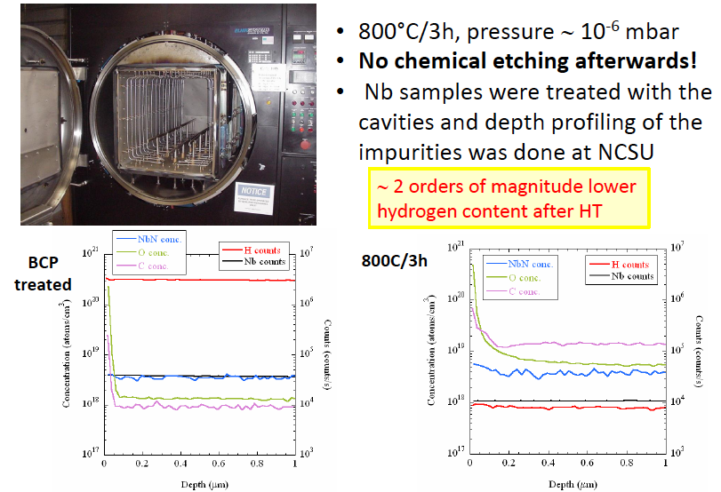
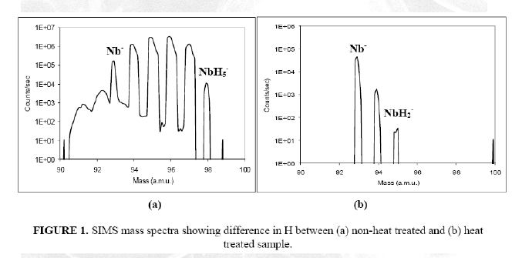
High temperature annealing removes gross hydrogen
Standard (600-800 ºC) Furnace Treatment
The standard furnace used for the high-temperature heat treatment of SRF cavities is an ultra-high-vacuum furnace with molybdenum hot-zone; molybdenum (or tungsten) resistive heating elements and cavities are heated by radiation from the heating elements.
Ciovati et al, PRSTAB 13, 022002 (2010)
July 16-17, 2012

Slide 6
Induction Heating
UHV with all Nb hot zone
Clean (avoid post HT chemical etching)
Pure gas injection for surface passivation
Dhakal et al, Rev. Sci. Instrum. 83, 065105 (2012)
July 16-17, 2012

Slide 7
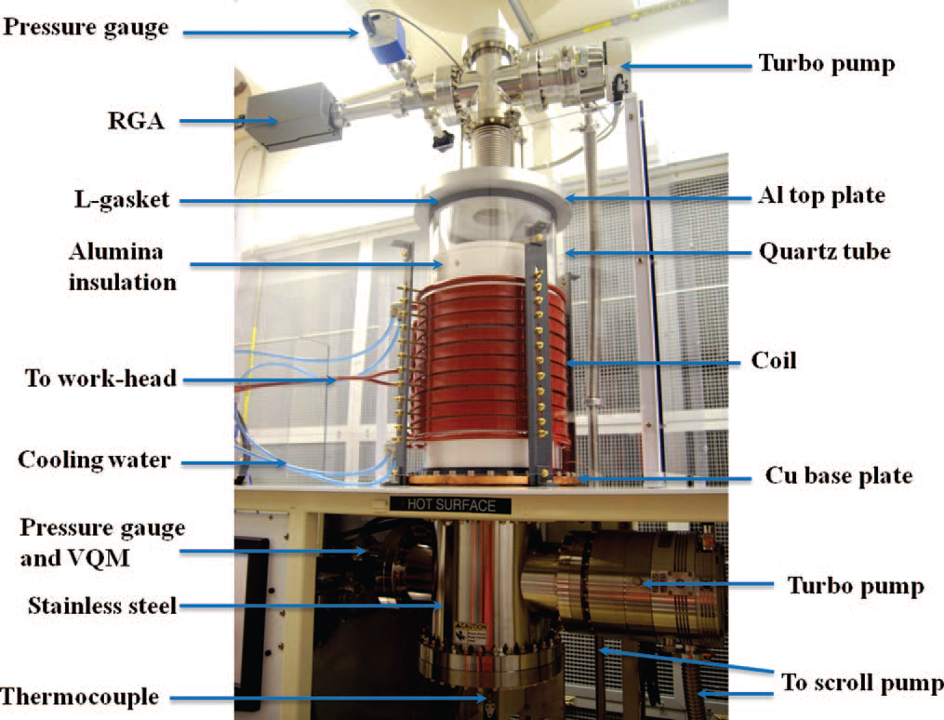
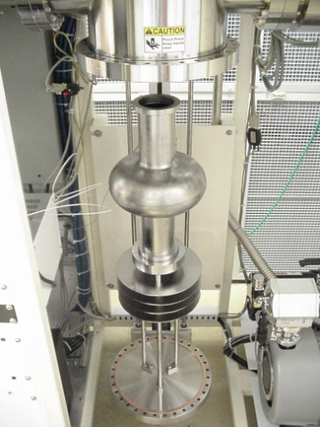
Induction Furnace
Dhakal et al, Rev. Sci. Instrum. 83, 065105 (2012)
July 16-17, 2012

Slide 8
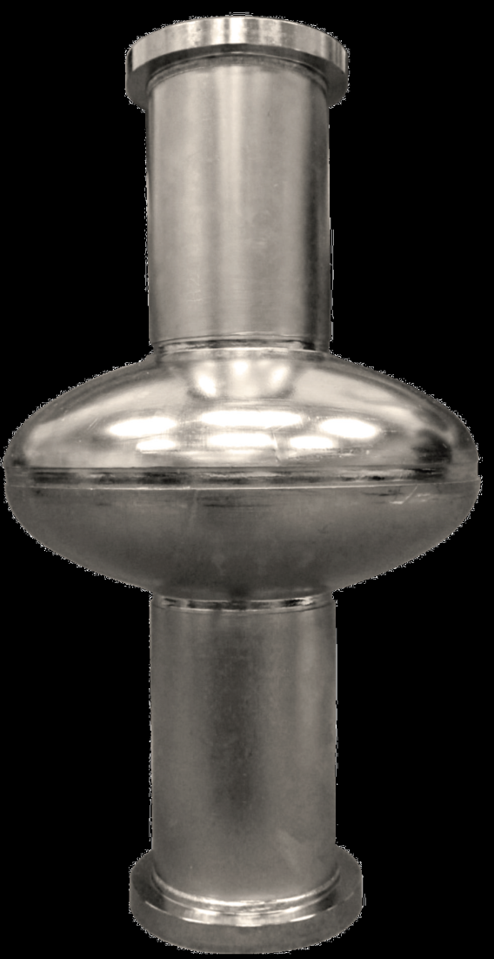
Large Grain Cavity
Ingot from CBMM
 | Ta | H | O | N | C | RRR
Ingot
F | 1330 | <1 | <6 | <3 | <30 | 226±10
G | 1375 | 7.1 | <6 | <3 | <30 | 197±8
H | 704 | <1 | <6 | <3 | <30 | 240±9
F1F2 → Standard Treatment
G1G2 → New Treatment
H1H2 → New Treatment (limited by pits)
G1G2
July 16-17, 2012

Slide 9
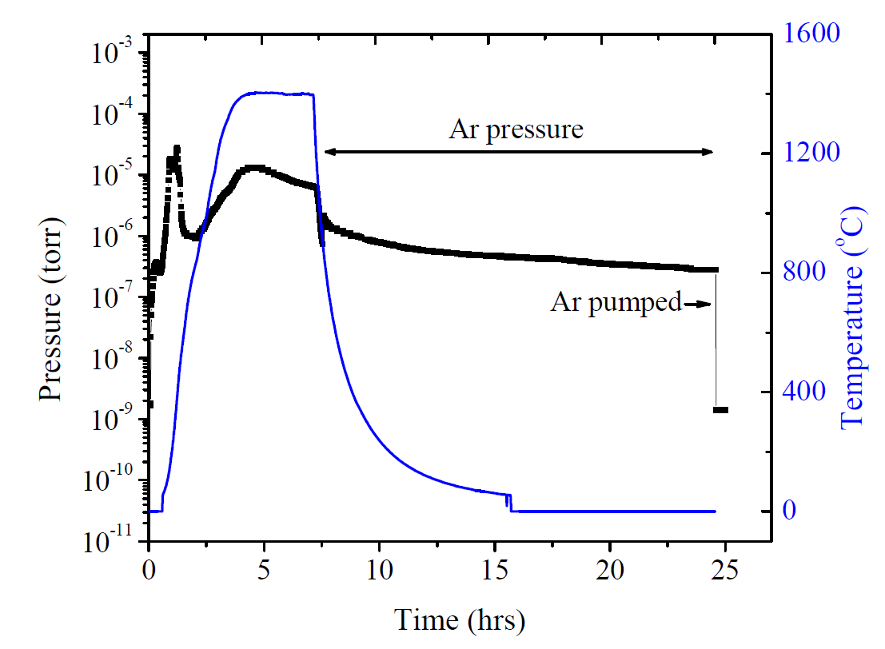
1400 C HT in induction Furnace
Vent with
O₂ at RT
July 16-17, 2012

Slide 10
RF Test
R_{res}
~2 nΩ
~1nΩ
Dhakal et al, IPAC 12, WEPPC091
July 16-17, 2012

Slide 11
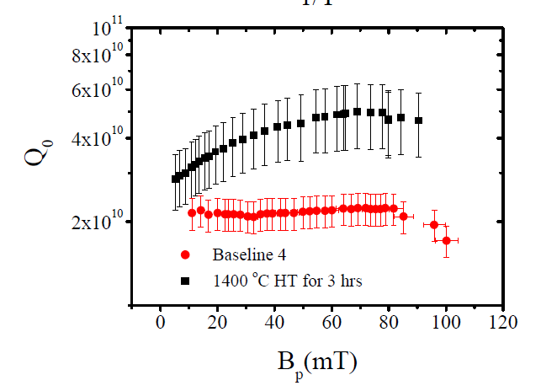
RF Test
4.6x10¹⁰ @ 20 MV/m
Q₀(1.5K)  2x10¹¹
CEBAF upgrade standard process
average Q₀(2K, 70 mT= 1.2±0.7x10¹⁰
Dhakal et al, IPAC 12, WEPPC091
July 16-17, 2012

Slide 12
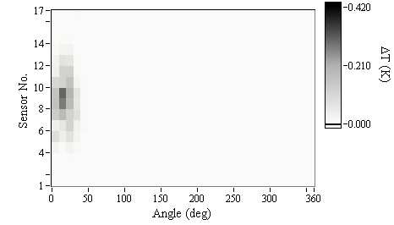
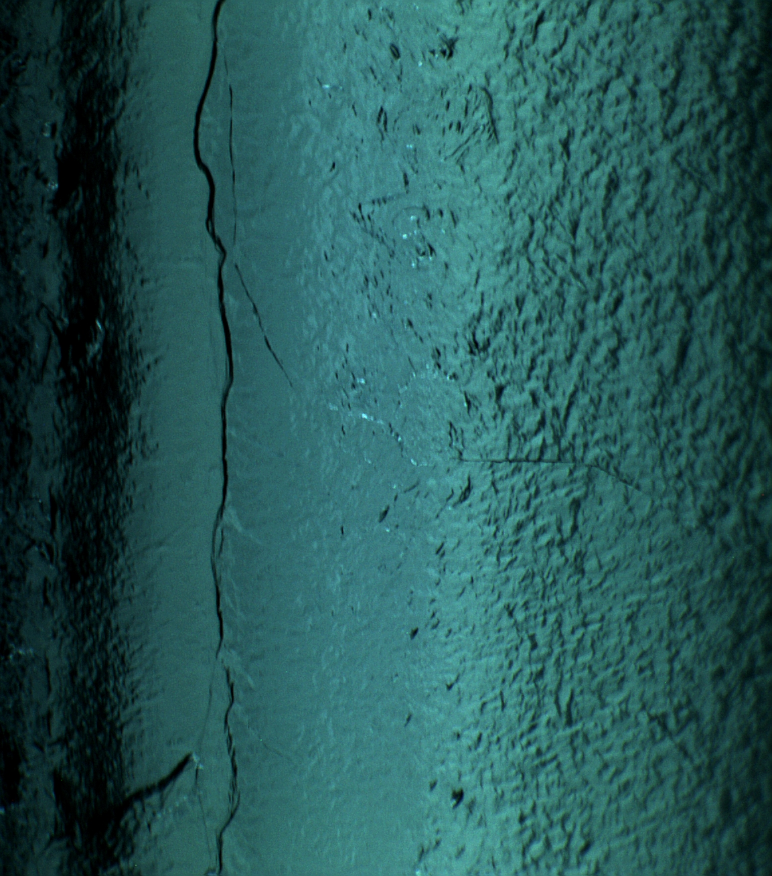
RF Test
Quench location near equator
Review of impurity depth profiling in Nb by SIMS
By: Prateek Maheshwari : Tomorrow 11:00 am
July 16-17, 2012

Slide 13
New Proposed Processes
~100 μm CBP
~Light BCP/EP
HT
(600-800 ºC)
HT
1400 ºC
~20 μm
BCP/ EP
Surface Passivation
HPR
HPR
~LTB (120-140 ºC)
RF Test
RF Test
July 16-17, 2012

Slide 14
Conclusions
The combination of large-grain Nb, high-temperature HT (~1400 °C) is a promising alternative to produce SRF cavities with high Q₀ values in the medium field range, which is particularly important for future continuous wave particle accelerators.
July 16-17, 2012

Slide 15
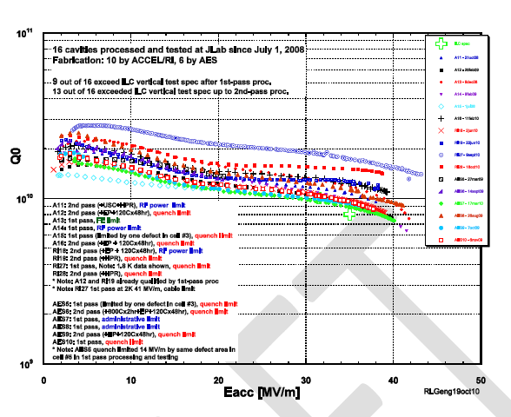
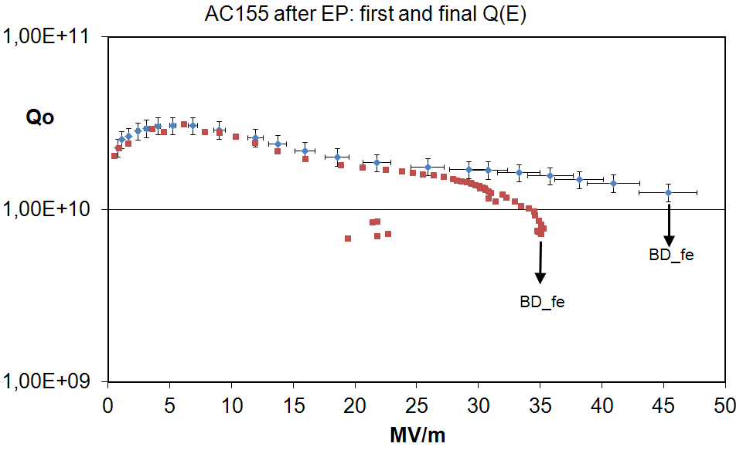
R. Geng, JLAB
DESY
July 16-17, 2012

Slide 16
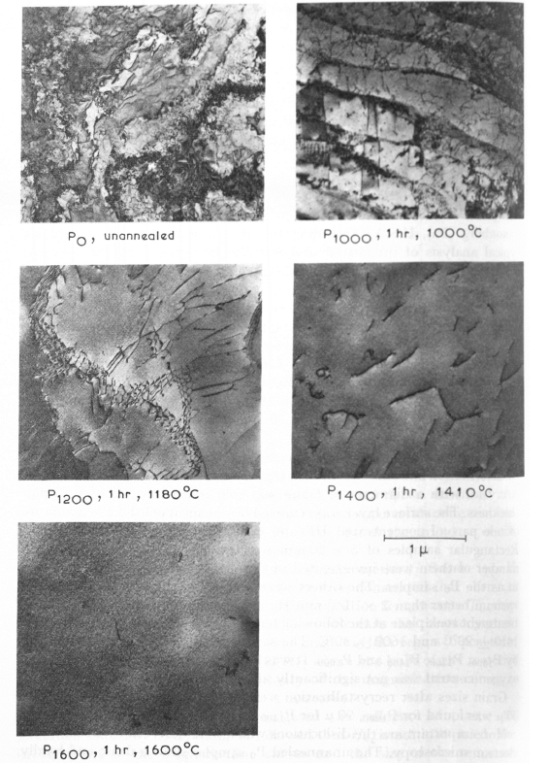
Effect of HT on Nb
surface

