Slide 1
Beam Diagnostics R&D
(Towards large dynamic range beam diagnostics and
beam dynamics studies)
Pavel Evtushenko, JLab FEL

Slide 2
Motivation
LINACs with average current 1-2 mA and energy 1-2.5 GeV are envisioned as drivers for next generation high average brightness Light Sources (up to 5 MW beam power) vs. presently operational linac based X-ray sources 24 uA (FLASH) and 15 nA (LCLS)
JLab IR/UV Upgrade is a 9 mA ERL with average beam power
of 1.2 MW – provides us with operational experience of high current linac and is a good testing ground for future development
Halo - parts of the phase space with large amplitude and small intensity - is one of the limitations for high current linacs
Linac beams have neither the time nor the mechanism to come to equilibrium – non Gaussian beams (unlike storage rings, which also run high current)
Besides Light Sources there is a number of linac application requiring high current operation with low or no beam halo
1/15
Notes:
The motivation for this program comes from two directions:
On one hand Linacs with the average current …
On the other hand there are existing facilities such as Jefferson Lab FEL that is a high current high average beam power machine that have demonstrated operation with average current of up to 9 MeV and beam power

Slide 3
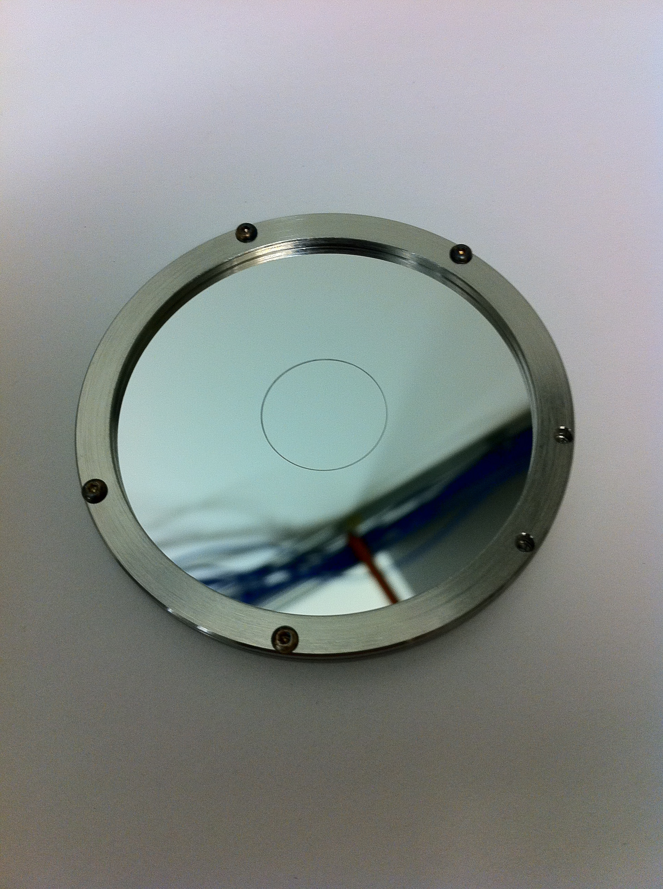
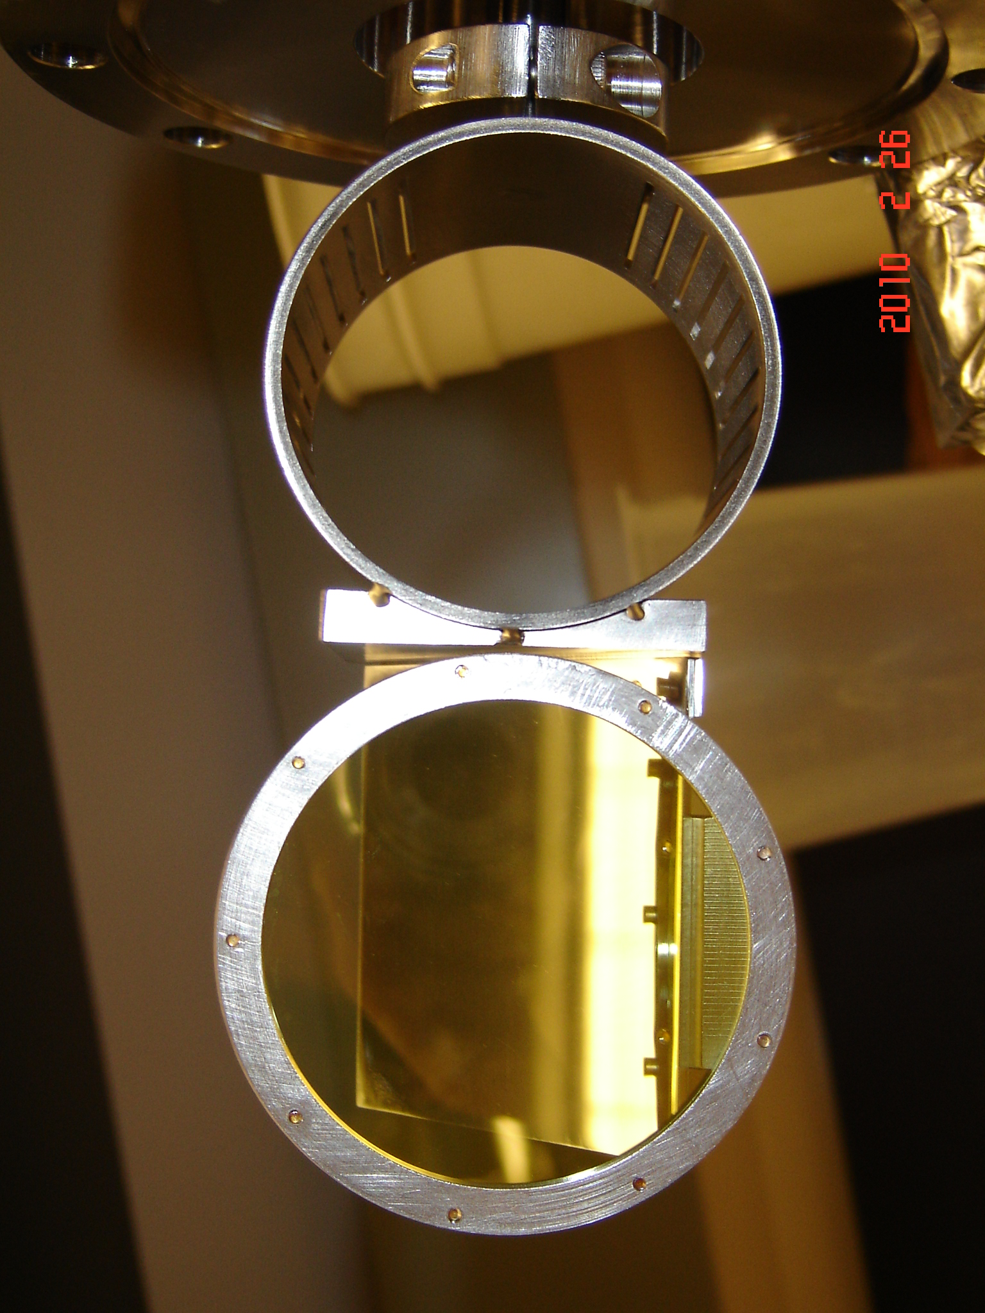
Transverse beam profile YAG:Ce, OTR, SR
The data shown here – transverse beam profiles measured at JLab FEL with:
In the injector (350 keV and 9MeV) 100 um thin, optically polished single crystal YAG:Ce scintillator is used.
Optical Transition Radiation (OTR)
is used at high beam energy (135 MeV).
Aluminized optically polished thin Si wafers.
2/15

Slide 4
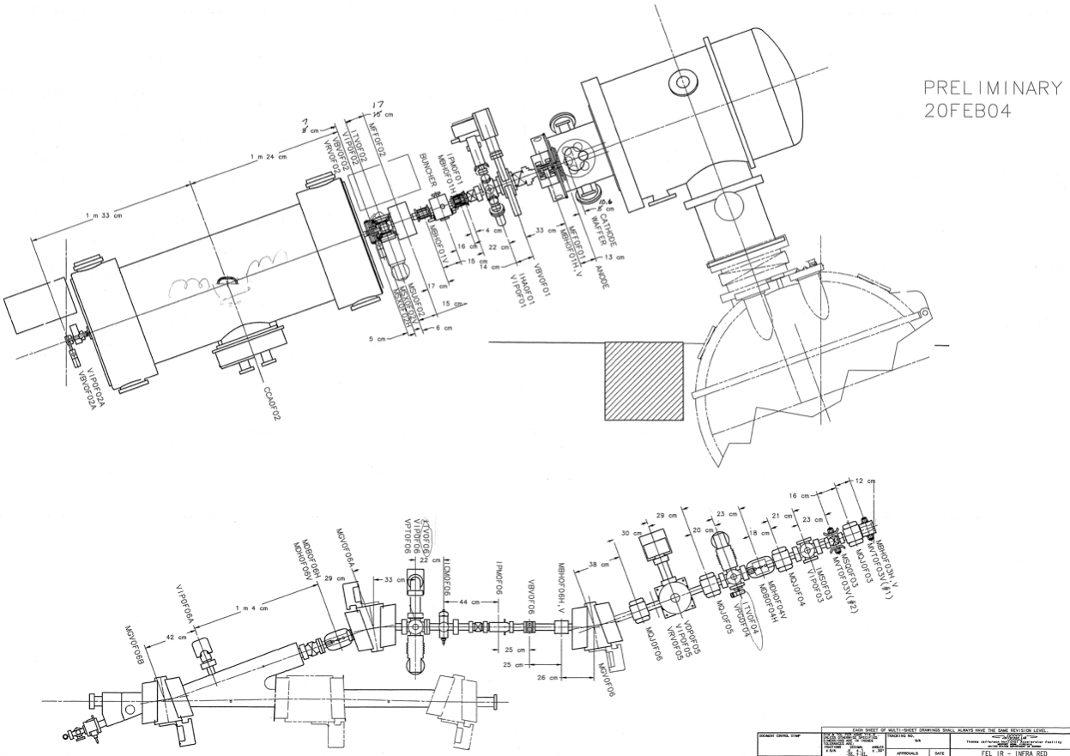
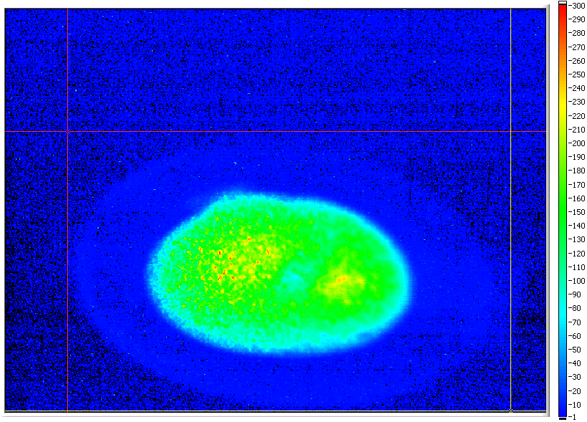
JLab FEL injector: 350 keV Gun and 9MeV booster
350 keV
0.35 – 9 MeV
acceleration
~25.1 mm
~15 mm
matching
section
3/15

Slide 5
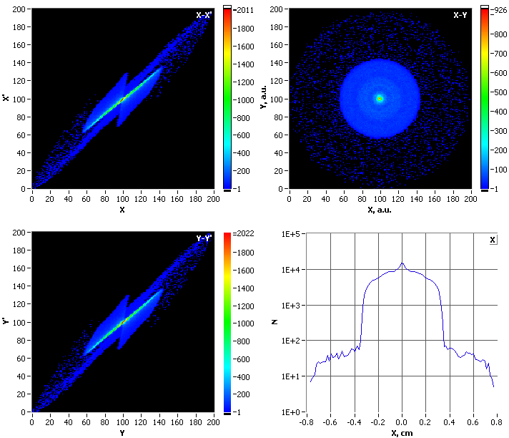
Measurements vs. Modeling at the level ~10³
Measured in JLab FEL injector,
local intensity difference of the
core and “halo” is about 500.
10-bit frame grabber & a CCD
with 57 dB dynamic range
PARMELA simulations of the same setup with 3e+5 particles:
X and Y phase spaces, beam profile and its projection show
the halo around the core of about 3e-3.
Even in idealized system (simulation) non-linear beam
dynamics can lead to formation of halo.
4/15

Slide 6
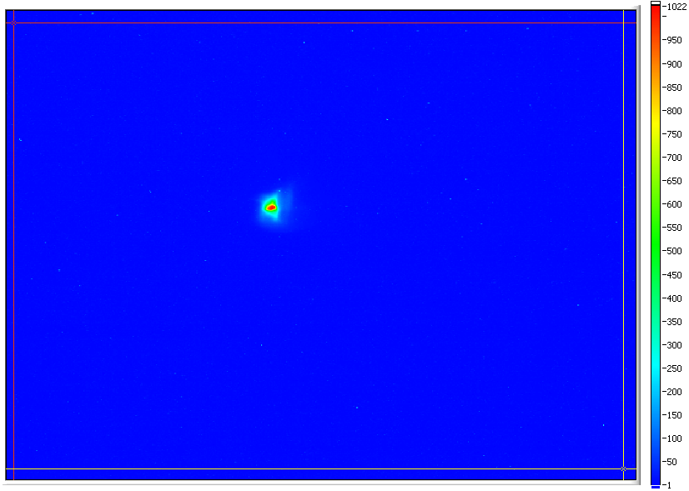
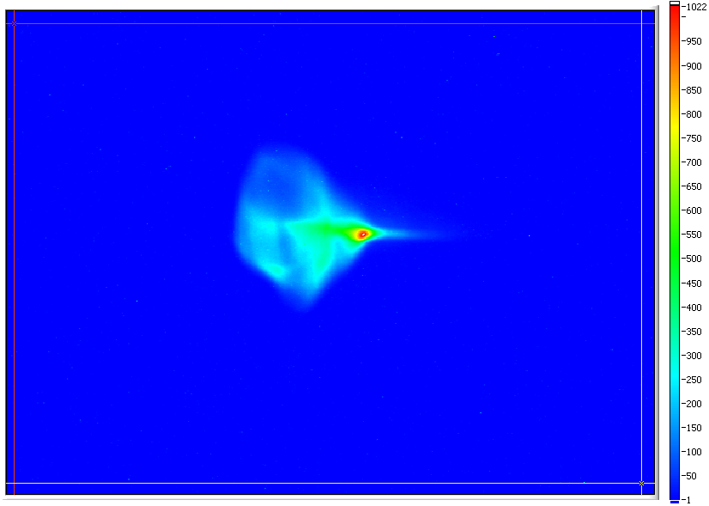
Non Gaussian Beams
E_{beam} 135 MeV
Bunch charge: 60 pC – UV FEL
135 pC – IR FEL
Rep. rate up to 74.85 MHz
25 μJ/pulse in 250–700 nm UV-VIS
120 μJ/pulse in 1-10 μm IR
Expansion in a long drift space between ARC1 and the chicane of the IR FEL. This section has 12 quads that were turned off for this demonstration to make the long drift.
5/15

Slide 7
“The Grand Scheme”
I. Transverse beam profile measurements with LDR
Wire scanner
LDR imaging
CW laser wire
Coronagraph
II. Transverse phase space measurements with LDR
III. Longitudinal phase space with LDR (in injector at 9 MeV)
Drive Laser LDR
measurements
to start modeling with LDR and real
Initial conditions
transverse
longitudinal
cathode Q.E. 2D
Tomography – where linear optics work (135 MeV)
Time resolving laser wire
(Thomson scattering, CW)
Scanning slit - space charge dominated beam (9 MeV)
Transverse kicker cavity + spectrometer + LDR imaging
IV. High order optics
to manipulate halo
V. Beam dynamics modeling with LDR
6/15

Slide 8
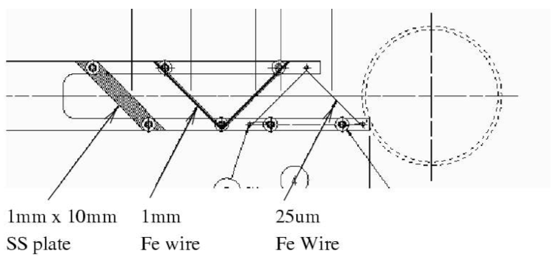
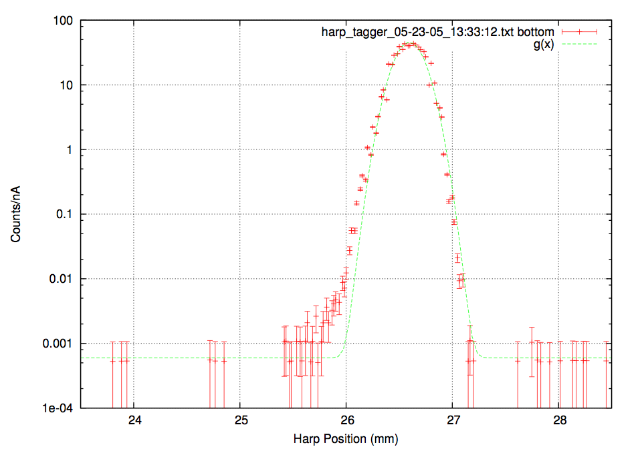
Wire scanner measurements
A. Freyberger, CEBAF measurements, in DIPAC05 proceedings
wire with diameter much smaller than the beam size interacts with beam as it is scanned across it
there is a number of interaction mechanisms:
beam capture
secondary emission
scattering
conversion
different ways to detect the signal
induced current
secondary particles (counting)
only 1D projections of 2D distributions
takes time (“patience limited”)
real LINAC beams – non-equilibrium
7/15

Slide 9
Wire scanner measurements
A. Freyberger, CEBAF measurements, In DIPAC05 proceedings
wire with diameter much smaller than the beam size interacts with beam as it is scanned across it
there is a number of interaction mechanisms:
beam capture
secondary emission
scattering
conversion
different ways to detect the signal
induced current
secondary particles (counting)
only 1D projections of 2D distributions
takes time (“patience limited”)
real LINAC beams – non-equilibrium
at JLab FEL
7/15

Slide 10
Wire scanner improvements (in progress)
At the FEL wire scanners were not used so far – all new system “from scratch”
A number of improvements required:
add time resolution
increase the max count rate as high as possible – faster measurements
In conventional scheme shower (EM cascade) particles gets converted to visible photons for detection with the help of PMT – large distance between the wire scanner and the detectors – complicated background.
Visible photon are generated on the wire directly via Optical Transition Radiation (OTR). Amount of the OTR photons is sufficient for measurements with CCD (no electronic gain) and very good signal to noise ratio.
Novel geometry of the wire scanner to allow outcoupling of the OTR photons from the wire locally.
Removing the PMTs from the accelerator tunnel to reduce the background level.
Transport the OTR light to the PMTs in large core quartz fiber.
8/15

Slide 11
Large Dynamic Range imaging (1)
To explain the idea we consider JLab FEL tune-up beam and the use of OTR.
Beam – 250 μs macro pulses at 2 Hz, bunch rep. rate ~ 4.678 MHz, 135 pC bunch charge, ~ 158 nC integrated charge (limits the beam power to safe level)
With typical beam size of few hundred μm OTR signal is attenuated by ~ 10 to keep CCD from saturation. For phosphor or YAG:Ce viewers attenuation of at least 100 is used. Insertable ND1 and ND2 filters are used.
Quantitative OTR intensity measurements agrees well with calculations – well understood
With OTR there is enough intensity to measure 4 upper decades. Lower two decades need gain of about 100 to be measured.
The main principle is to use imaging with 2 or 3 sensors with different effective gain simultaneously and to combine data in one LDR image digitally
The key elements:
image intensifiers (necessary gain and higher is available)
accurate alignment and linearity
the algorithm, data overlap from different sensors
understanding CCD well overflow - transverse extend
9/15

Slide 12
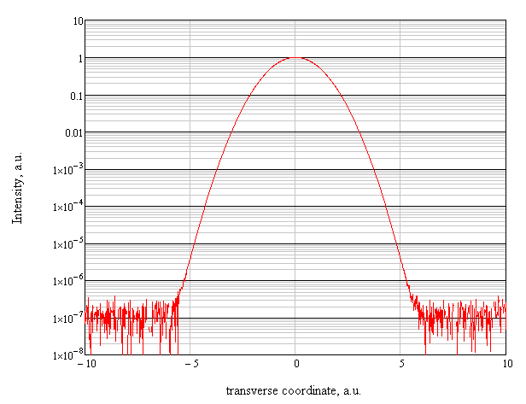
Large Dynamic Range imaging (2)
To be measured with
imaging sensor #1
and attenuation ~ 10
Intensity range that can
be measured now with
no additional gain.
To be measured with
imaging sensor #2
and gain ~ 200
Intensity range where
additional gain of ~ 100
is needed
10/15

Slide 13
Large Dynamic Range imaging (3)
To be measured with
imaging sensor #1
and attenuation ~ 10
Intensity range that can
be measured now with
no additional gain.
To be measured with
imaging sensor #2
and ~ no gain
Intensity range where
additional gain of ~ 100
is needed
To be measured with
imaging sensor #3
and gain ~ 200
10/15

Slide 14
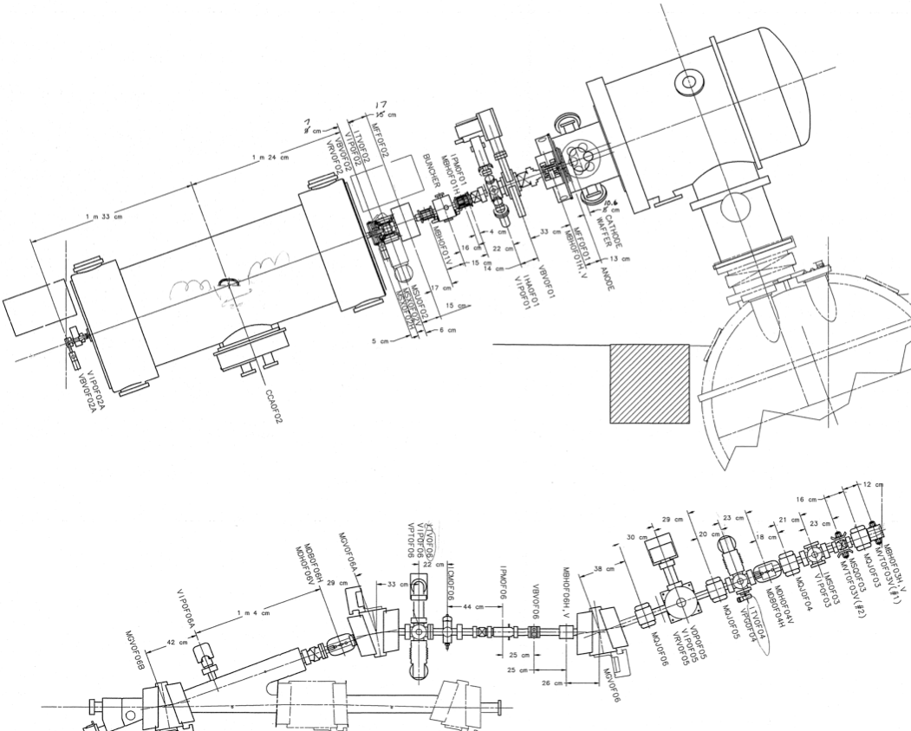
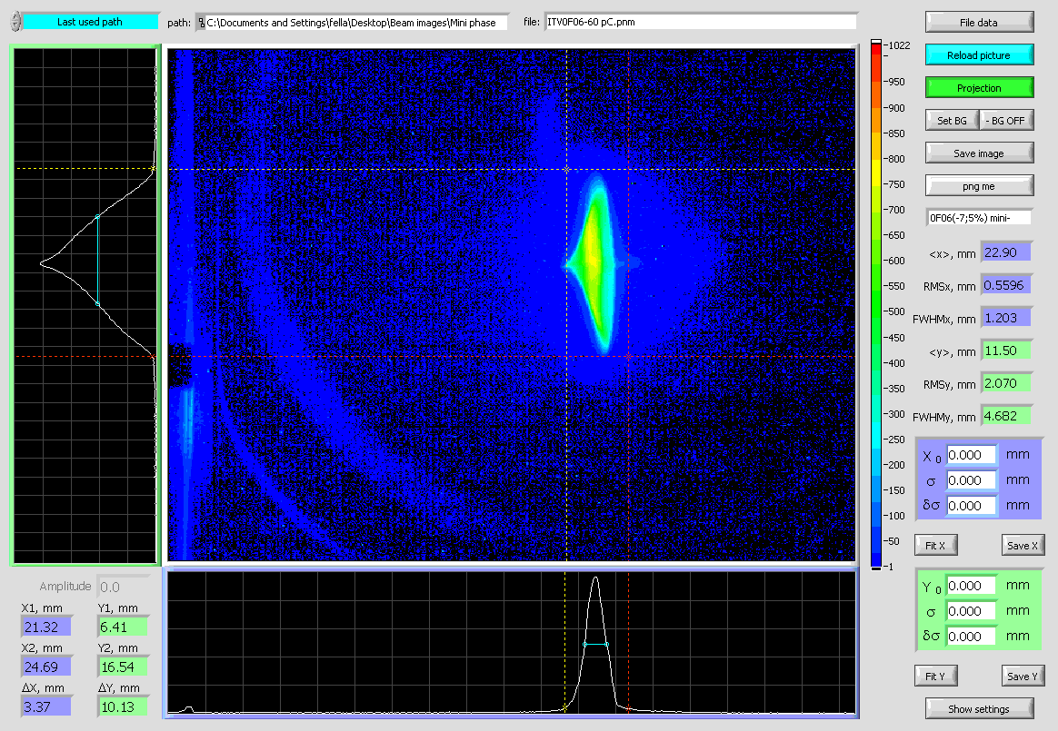
From longitudinal to transversal
At high energy we are mostly concerned with transverse halo.
In the injector beam dynamics is space charge dominated.
Space charge couples transverse and longitudinal dynamics in the injector.
Due to the coupling longitudinal “tails” can evolve in to transverse ones.
Might need to know the longitudinal phase space distribution in the injector to understand the origins of the transversal halo at high energy.
Two ways to measure the long. phase space distribution with LDR
Transverse kicker cavity + LDR imaging – tune-up beam
Time and Energy resolving “laser wire” (Thomson scattering) for high current CW beam
Max dispersion & small β_{x}: X – E_{b} i.e. horizontal beam profile is energy spectrum
11/15

Slide 15
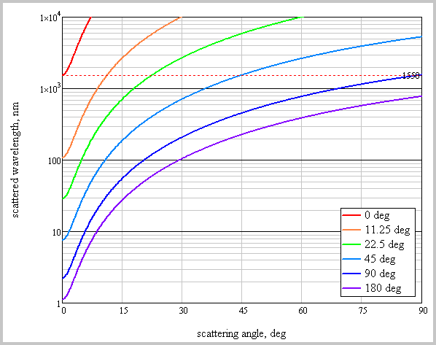
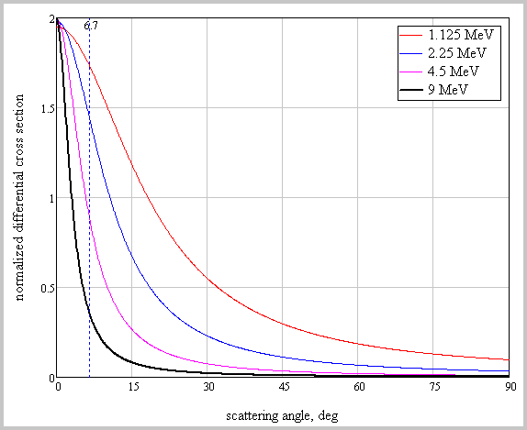
CW laser wire (1)
wavelength conversion assuming:
beam energy 9 MeV
laser wavelength 1.55 μm
differential cross section
(angular extent dependence
on the beam energies)
initial wavelength
1.55 μm
12/15

Slide 16
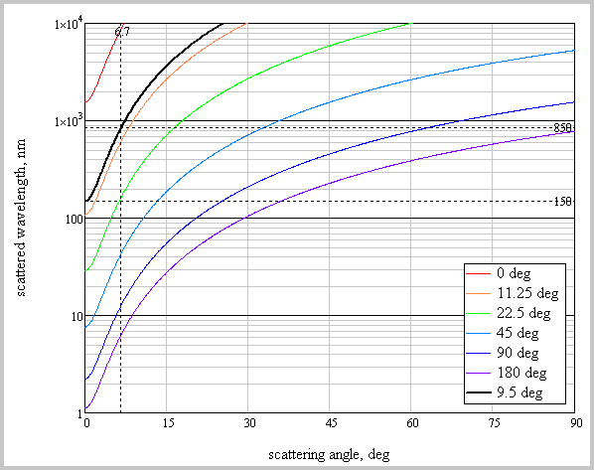
CW laser wire (2)
wavelength conversion assuming:
beam energy 9 MeV
laser wavelength 1.55 μm
differential cross section
(angular extend dependent
on the beam energies)
wavelength range:
150 nm – 850 nm
(to stay out of VUV
And be able to use
PMTs)
13/15

Slide 17
CW laser wire (3)
wavelength conversion assuming:
beam energy 9 MeV
laser wavelength 1.55 μm
photon rate
Assuming:
bunch charge 135 pC
laser wavelength 1.55 μm
pulse energy ~7 nJ
τ_{laser} 500 fs
τ_{beam} 2.5 ps
f_{beam} 9.356 MHz
r_{laser} 100 μm
We get N_{s}=0.02, but f_{s}=174 kHz !
There is factor of 10-100 to be lost;
But the energy per pulse can be by the
same factor 10-100 higher.
Plus lock-in amplifier improves SNR as:
wavelength range:
150 nm – 850 nm
(to stay out of VUV
And be able to use
PMTs)
14/15

Slide 18
Conclusion / Outlook
Beam halo is one of the limiting factors for high current CW LINACs
We are working on an R&D program (BES funded under early career research grant) with the goal to understand beam halo formation and evolution via development of new beam diagnostics that should allow direct halo measurements (large 1e+6 .. 1e+7 dynamic range)
The outline of the approach is the following:
develop and built diagnostics tools – for trans. & long. beam profile measurements
study beam dynamics – phase space measurements and its evolution
implements beam optics for better manipulation of the halo
use the experimental data for modeling that is close to reality in sense of initial conditions (iterate between the experiments and the modeling)
JLab accelerators are unique test ground for such R&D program
Thank you for your attention.
15/15

