Slide 1
Update on Silicon Photomultipliers
Yi Qiang
DOE S&T Review
May 10, 2012
Notes:
Good morning
In this talk, I’m going to give you some update on our recent study on the photomultipliers, particular related with its applications in Hall-D.

Slide 2
Bio – Yi Qiang
MIT – Ph.D. (2007)
Search for pentaquarks in Hall-A at Jefferson Lab
Duke University – Post. Doc. (2007 – 2010)
6 GeV neutron transversity in Hall-A at Jefferson Lab, in charge of polarized ³He target
Co-spokesperson of a 12 GeV SoLID SIDIS experiment using a longitudinal polarized ³He target
Jefferson Lab Hall-D – Staff Scientist (2010 – present)
In charge of photon beam radiator
Silicon photo multipliers, particularly for the Barrel Calorimeter
Notes:
My name is Yi Qiang.
Both of my Ph.D. study at MIT and post doc work at duke university are mainly related with experiential nuclear physics research in JLab Hall A, including the search for pentaquarks and the first measurement of neutron transversity using a polarized 3He target.
In 2010, I become a staff scientist of Hall-D. And my main responsibilities are the photon beam radiator and the silicon photo multipliers.

Slide 3
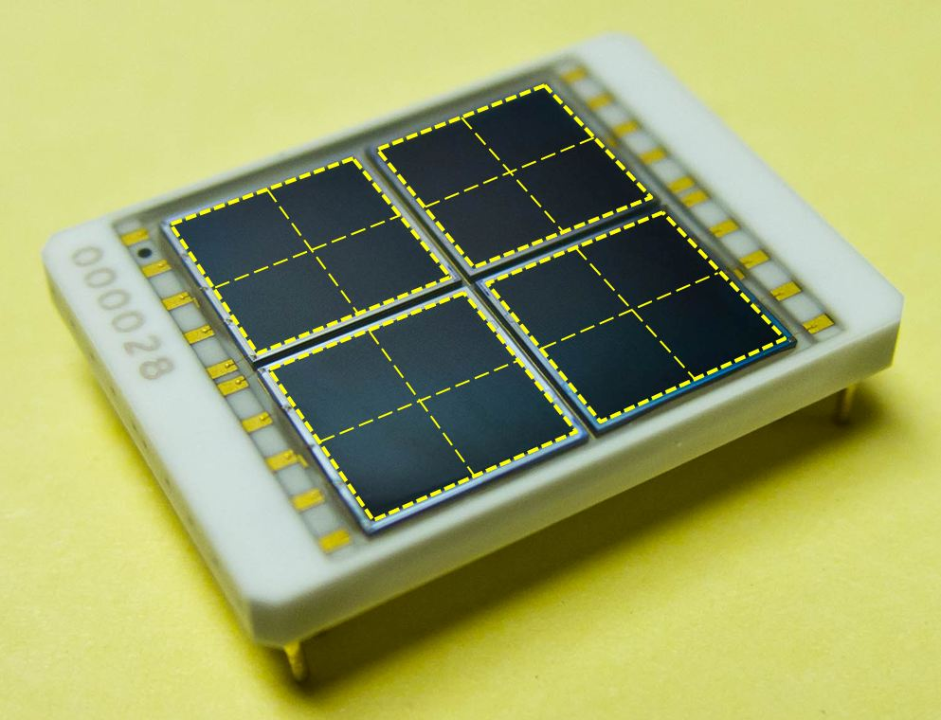
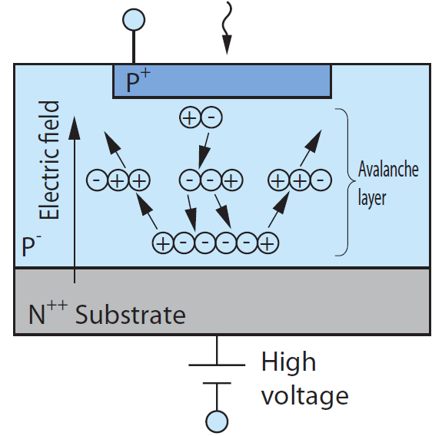
Introduction
Silicon Photo Multiplier (SiPM) is a new type of photon-counting device made up of multiple Avalanche Photo-Diode (APD) pixels operating in Geiger mode. Each APD pixel outputs a pulse signal when it detects one or more photons, and the output of the SiPM is the total sum of all these pulses.
50 μm
12 mm
Hamamatsu
4×4 Array of
3×3 mm² SiPMs
Notes:
Made of many avalanche photo diode pixels.
Each APD outputs a pulse signal when a photo electron is created and induces avalanche.
As all the pixels are working in Geiger mode, the summed output of a SiPM detector is proportional to the number of pixels fired.
Here is the a photo of a SiPM array we are going to use in Hall-D as the photon detector of the barrel calorimeter. Each array consists of 16 3x3 mm2 SiPMs. With a maginfying glass, you will be able see its 50 um pixels.

Slide 4
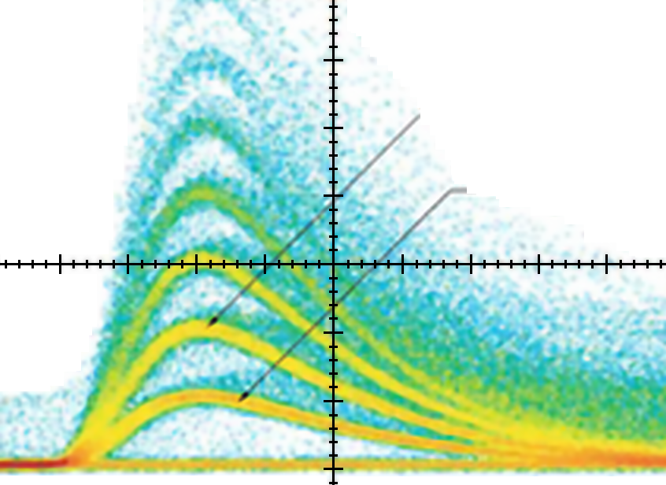
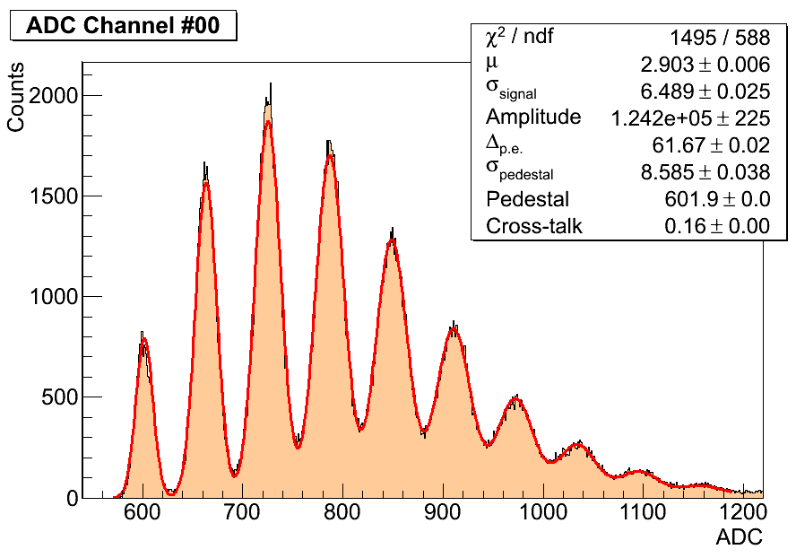
Features of SiPM
Immune to strong magnetic field: few Tesla
Good photon detection efficiency (PDE) : > 20%
High gain: ~ ×10⁶
Compact size
No HV needed
Photon counting for weak light
Some disadvantages
Noise rate
can be reduced by cooling the sensor
Cross talk and after pulses: 10 ~ 20%
Limited range of gain:
strong corr. between gain and PDE
Radiation hardness
20 ns
2 pixels
Amplitude
1 pixel
Time
2 pixels
1 pixel
Notes:
Arrows, APD few hundreds gain, pulse shape
List features
Top plot: typical signal output captured by an oscilloscope, bottom plot, integrated charge distribution. You can clearly identify the peaks corresponding to different numbers of pixels fired.
Radiation hardness is the major concern to use SiPMs in nuclear and high energy physics. Therefore, at Jefferson lab, we did a lot of study of the radiation damage and I will show you more details later in my talk.

Slide 5
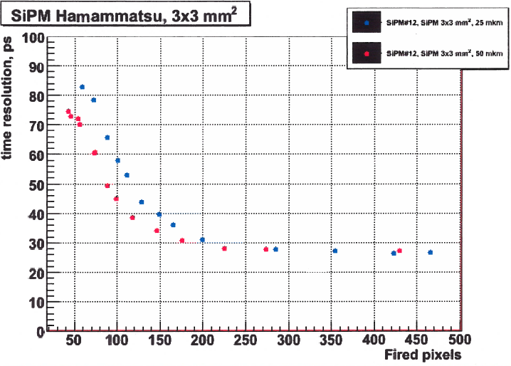
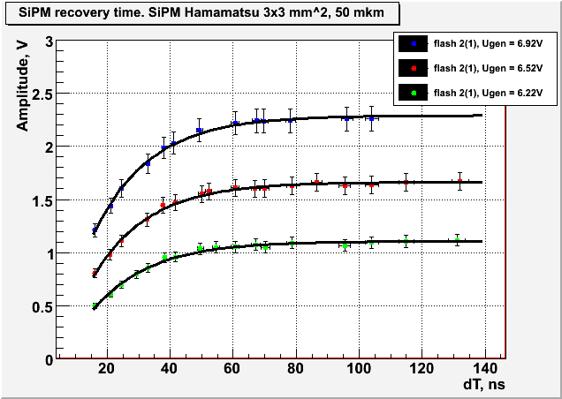
Time Resolution and Recovery Time
PLP-10 Picosecond Light Pulser from Hamamatsu:
Pulse width < 70 ps
Repetition rate up to 100 MHz
Intrinsic time resolution
< 30 ps
Good enough for most of
the TOF applications
Pixel recovery/dead time
10 ~ 50 ns, depends on pixel size,
smaller size → shorter recovery
Can handle MHz level input rate
25 μm pixel
50 μm pixel
Resolution
of TDC
50 μm pixel
low → high
input light intensity
Amplitude of the 2nd pulse
50 ns dead time
A NIM article is being prepared
Time difference between two pulses (ns)
Notes:
Other than the features I previously mentioned, in Hall-D we also studied the timing properties of SiPMs to find its feasibilities in other applications.
In order to do this study, we purchased

Slide 6
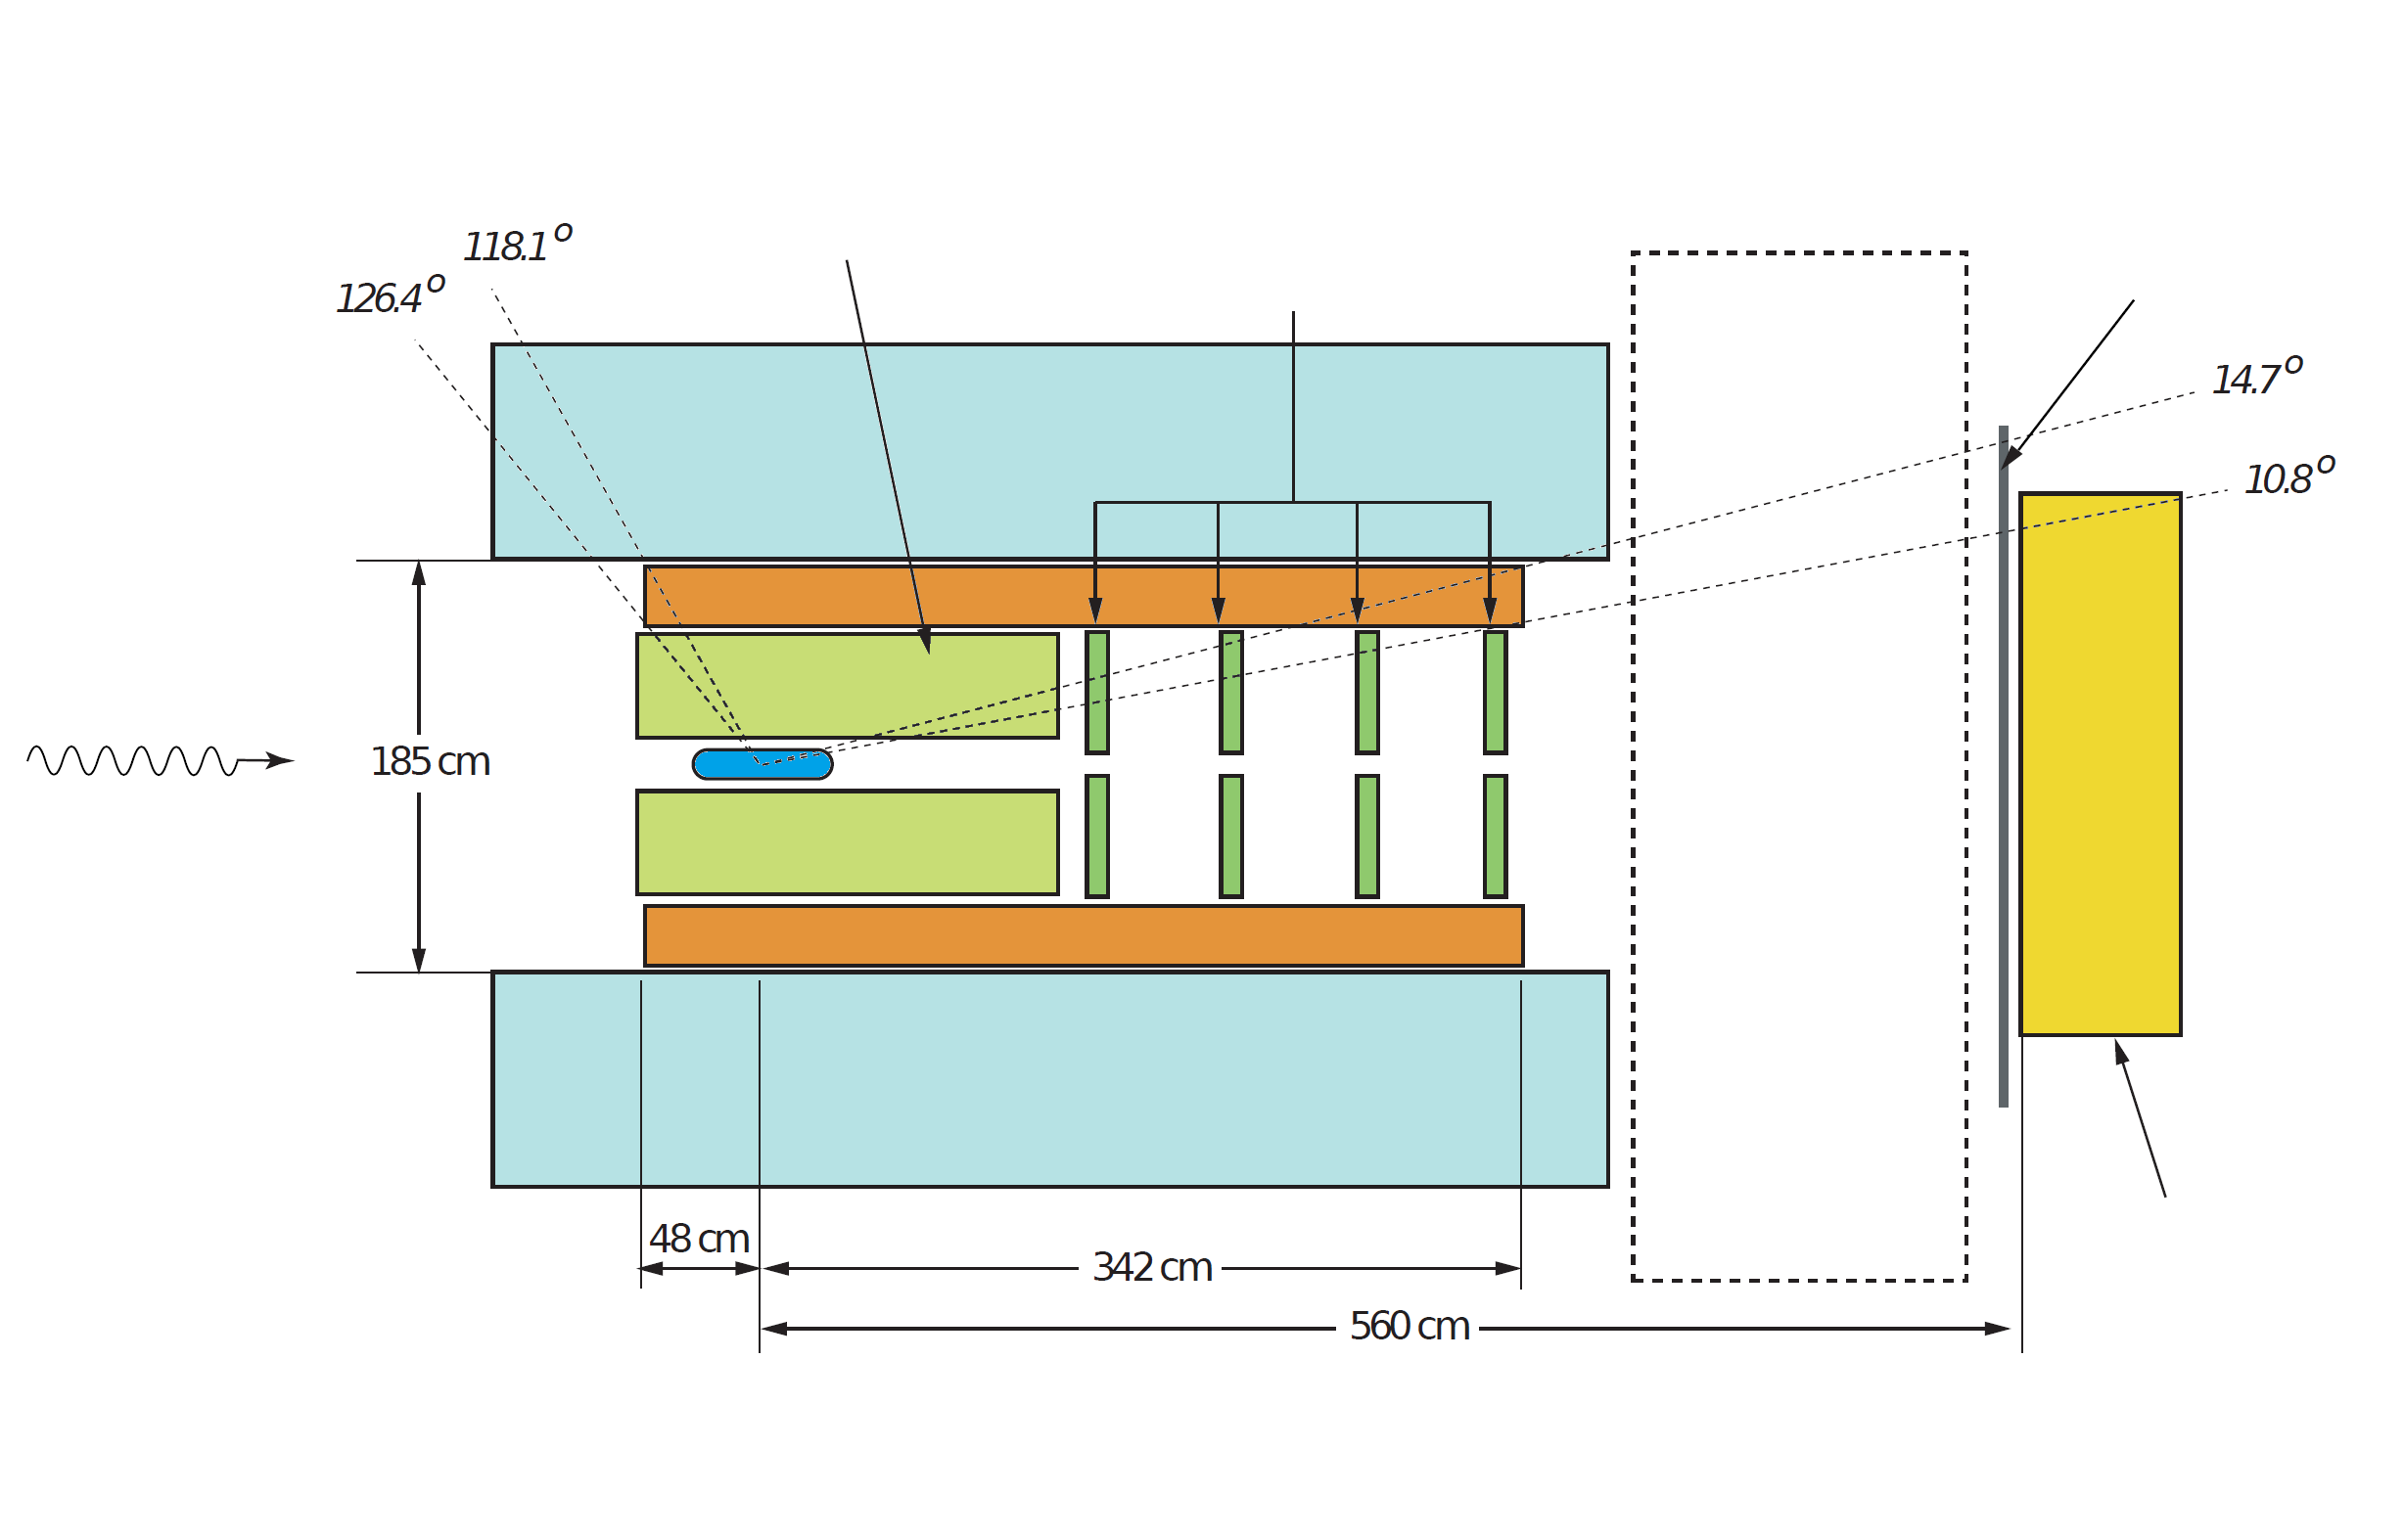
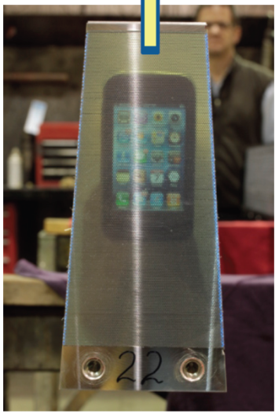
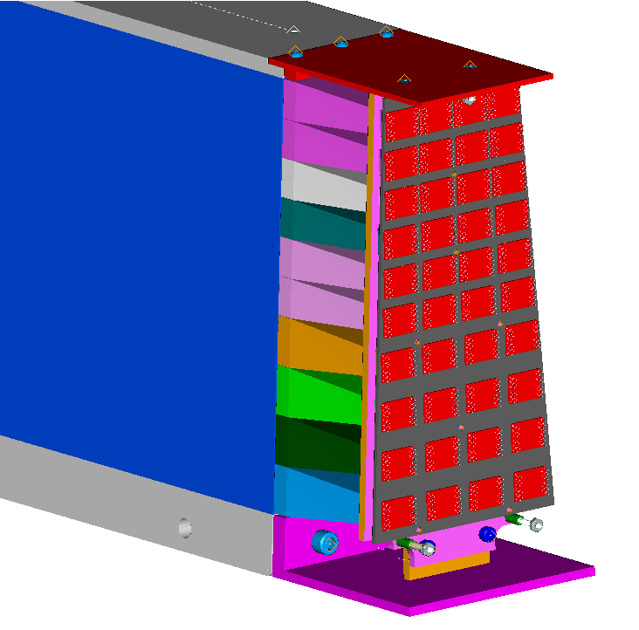
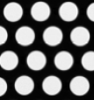
SiPM for Hall-D Barrel Calorimeter
Barrel Calorimeter (BCAL)
Scintillator fiber – Lead
48 trapezoidal modules
Photon energy and position
Reasons to use SiPM
Strong magnetic field: > 1 T
Tight space for readout
Similar cost as fine-mesh PMTs
Good time resolution
Additional benefits
Natural radial segmentations for additional PID
CDC
Central Drift Chamber
FDC
Forward Drift Chambers
Future
Particle ID
TOF
Time-of-Flight
Photon beam
BCAL
Barrel Calorimeter
Solenoid: 2.2 Tesla
FCAL
Forward
Calorimeter
phone on the other end
SiPMs
BCAL
Module
Light Guides
Sci. Fiber
Lead
Notes:
Such a configuration gives us additional PID capability for the natural radial segmentations.

Slide 7
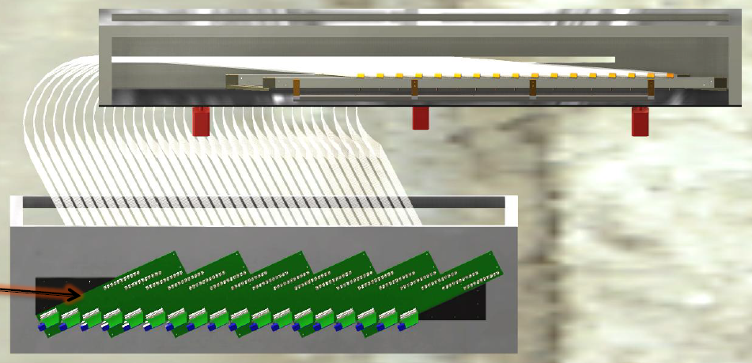
Applications for Scintillating Counters in Hall-D
Beam line hodoscopes: tagger microscope and pair spectrometer
Small size to couple to thin fibers
Capability to handle high
rates, short recovery time
Start Counter:
Small size
Good time resolution
Photon Tagger Microscope
Scintillating Fibers
SiPMs and Electronics
Bent Scintillator
SiPM
Source and
Trigger PMT
Start Counter Test Setup
Notes:
Since the SiPMs have the great capablity to deal with high couting rate, we are going to use them in our photon beam hodoscopes, including the tagger microscope and the pair spectrometer.
In addtion, we will also use the sipms for the start couter as part of our time of flight system for its extraordinary time resolution.

Slide 8
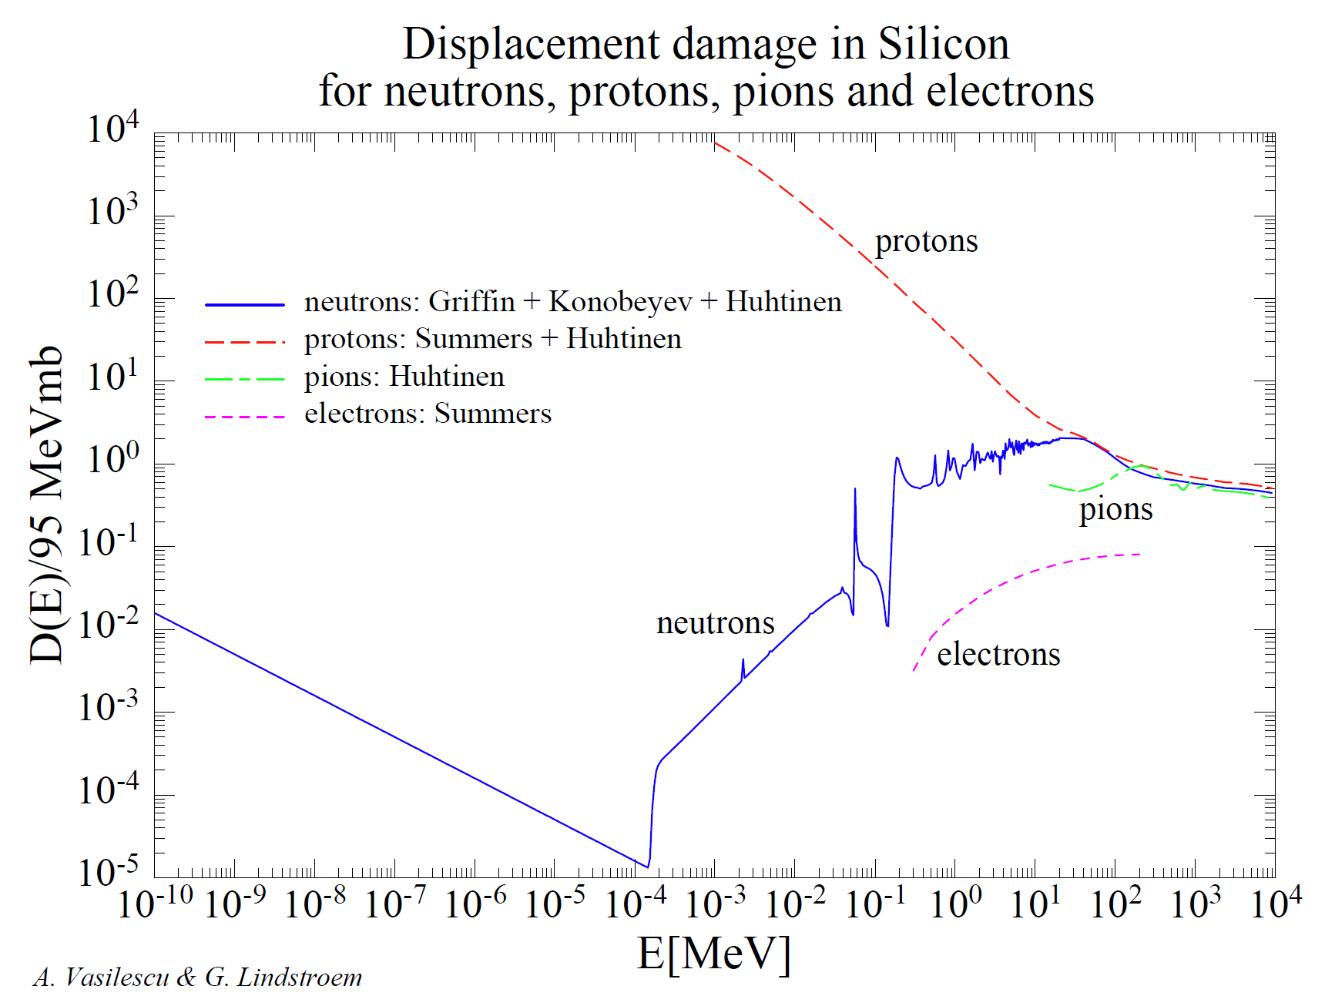
Radiation Damage to Silicon Detectors
Bulk radiation damage in silicon detectors is primarily due to displacing a Primary Knock on Atom out of its lattice site.
Proportional to The Non-Ionizing Energy Loss (NIEL).
Heavier particles induce greater damage.
Neutron damage is the major concern for SiPMs in Hall D:
> 90% damage
10 years running: 2.5×10⁹n_{eq}/cm²
Requires dark rate < 100 MHz for each SiPM array

Slide 9
Neutron Radiation Tests at JLab
Test using neutron background during P-REX in Hall-A
12×12 mm² SiPM arrays from Hamamatsu and SenSL, 1×1 mm² and 3×3 mm² SiPMs from Hamamatsu (50 μm)
Self-annealing at room temperature
Need to cool these devices during GlueX operation
Test using JLab RadCon AmBe source
1×1 mm² SiPMs from Hamamatsu (50 μm)
Measure temperature dependence
Radiation damage
Self-annealing
Impact of radiation damage on the dark rate temperature dependence
Accumulated radiation damage with annealing
NIM paper being submitted

Slide 10
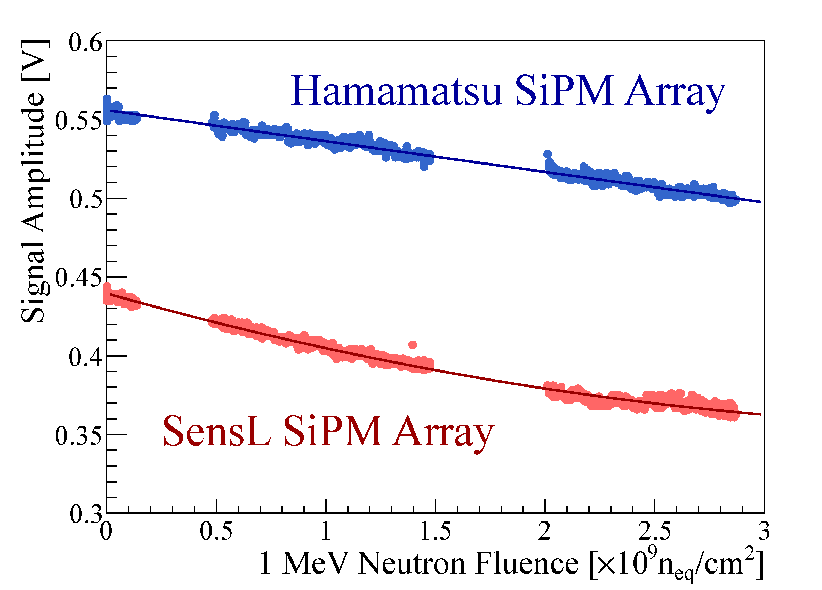
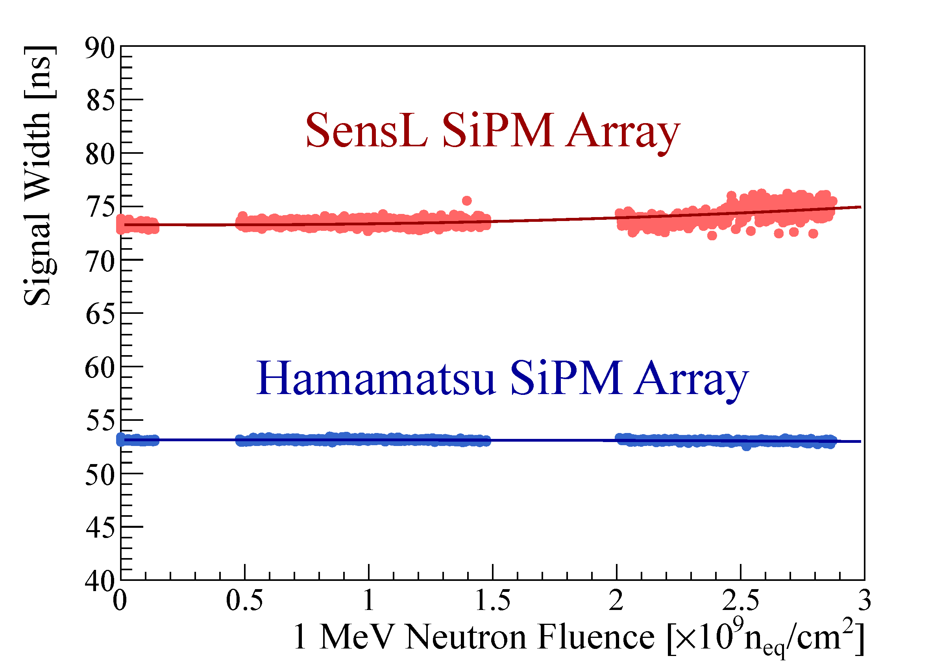
First Look at the Radiation Damage
2 days during P-REX@Hall-A
10% drop in amplitude
15 years
@Hall-D
No change in width
Damage independent
on bias voltage
Approximate Linear damage curve

Slide 11
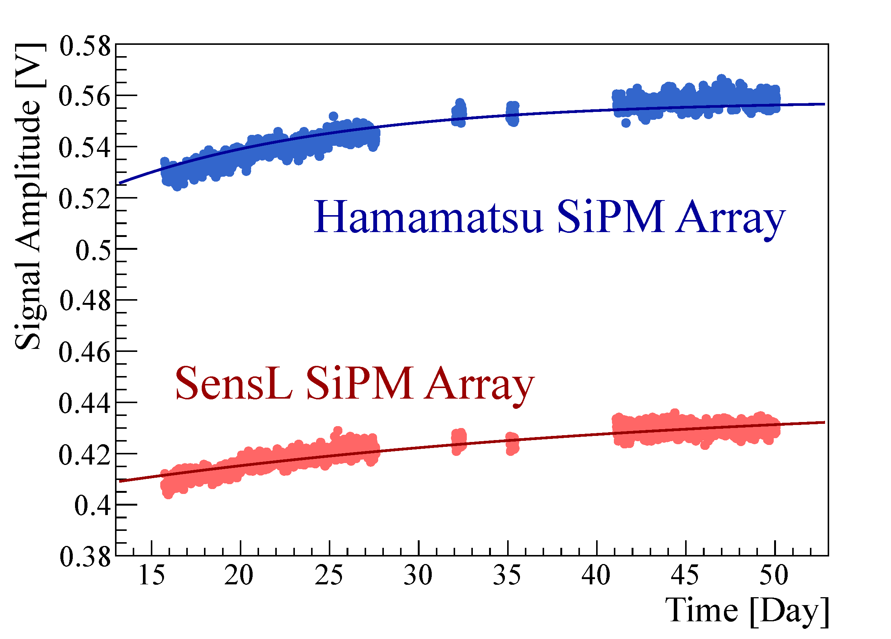
Annealing at Room Temperature
About half of the increase of the dark current caused by radiation damage recovered
Decay time ~ 10 days
Drop in amplitude fully recovered

Slide 12
Test Sequence using AmBe Source
12 1×1mm² Hamamatsu SiPM (50 μm)
Different temperature conditions/combinations
Two irradiations and two annealings
Total fluence ~ 13 years of high intensity running of GlueX
1st Irradiation
1st Annealing
2nd Irradiation
2nd Annealing
25ºC ×6
60ºC ×4
60ºC
×8
25ºC ×6
40ºC ×12
25ºC ×4
-5ºC ×6
25ºC ×2
-5ºC ×6
-5ºC ×4
-5ºC ×2
Numbers of units tested at different temperatures are shown in the blocks

Slide 13
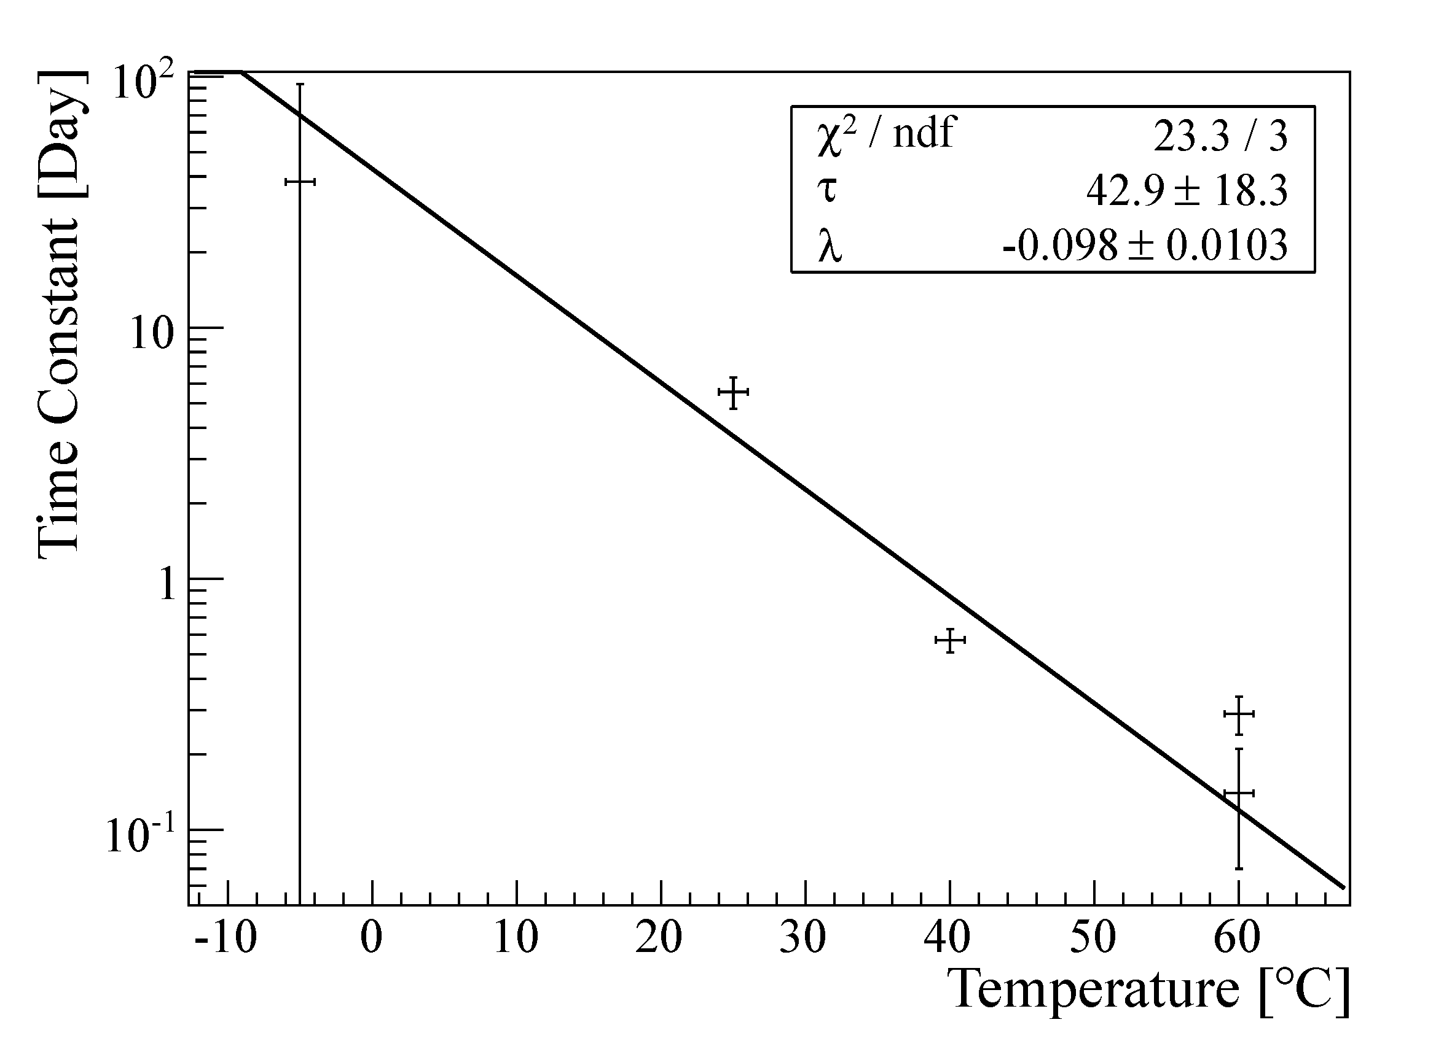
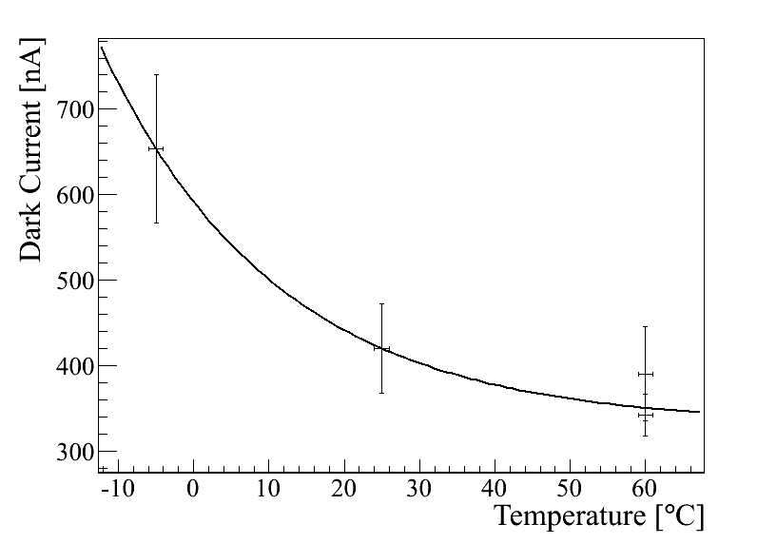
Recovery at Different Temperatures
Results from first irradiation
Exponential dependent
decay time
Recovery baseline:
saturates at higher temperature
Higher Temperature brings faster and stronger self-annealing
Fit curve: exponential decay

Slide 14
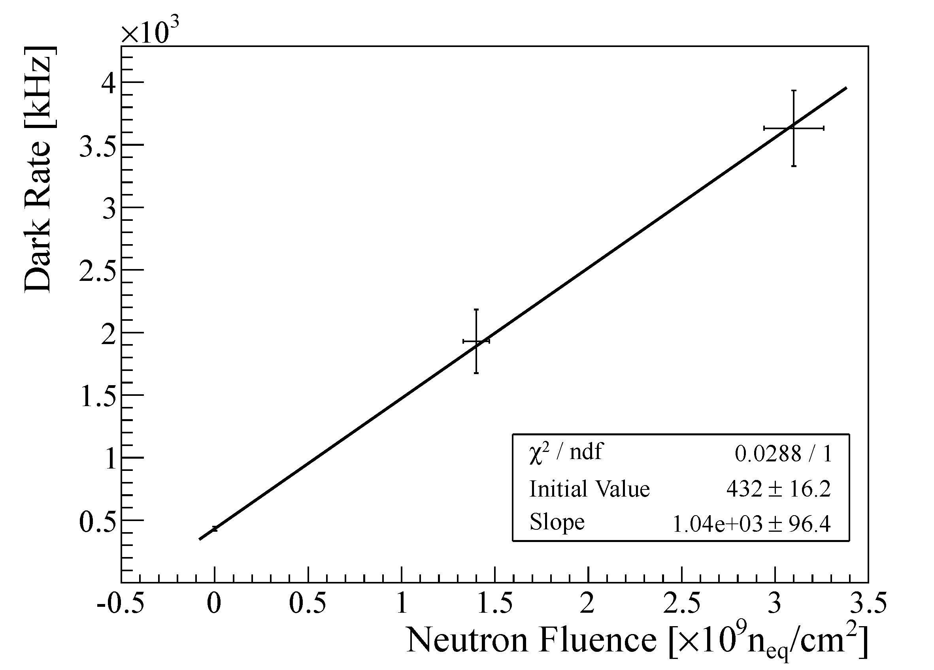
Damage Curve
Radiation damage does NOT depend on temperature
Radiation damage does NOT depend on previous irradiations
1×1 mm² SiPM@25ºC w/ annealing
2nd irradiation
Equivalent to 13 years of operation
1st irradiation

Slide 15
Expected Lifetime in Hall-D
Hamamatsu improved initial dark rate of the production units, still same damage rate as prototype samples.
Life time in Hall-D ~ 8 years with high intensity beam:
10⁸ γ/s on a 30 cm LH₂ target, 30% running efficiency
SiPMs cooled to 5ºC, periodic annealing at 40ºC
BCal Limit
8 years@5ºC
with periodic
annealing at 40ºC
12×12 mm² SiPM Array
Notes:
Actually, after Hamamatsu sent us their prototype a couple of years ago, they managed to reduce its dark rate when they deliver our BCAL production units. Although such a change does not effect the damage slope, it indeed brings more margin for radiation damage.

Slide 16
R&D for Electron-Ion Collider
Except for the radiation hardness, SiPMs are ideal for future high energy detector systems, such as EIC:
High gain, compact form factor, good photon detection efficiency and immunity to magnetic field.
An R&D proposal “to test improved radiation tolerant Silicon Photomultipliers” for EIC has been approved:
Collaborate with JLab detector group and Hamamatsu. Perform bench tests on samples with varied manufacturing parameters, then give feedback to Hamamatsu and continue the loop.
Received the first group of samples in April, test is ongoing.

Slide 17
Summary and Outlook
Silicon photo multiplier is a novel photo detector with many desirable features.
We thoroughly studied its performance including radiation hardness, time resolution and dead time.
Applications in Hall-D:
Barrel Calorimeter
Beam line hodoscopes
Start counter
Future applications in EIC
Many possibilities
R&D with Hamamatsu on the radiation hardness

Slide 18
Acknowledgement
Hall-D
Elton Smith (Scientist)
Alexander Somov (Scientist, SiPM timing measurement)
Ivan Tolstukhin (Grad. Student, SiPM timing measurement)
Detector Group
Carl Zorn (Scientist, SiPM characterization and radiation measurements)
Radiation Control Group
Pavel Degtiarenko (Scientist, Flux simulation)
Melvin Washington (Radiation monitoring)
John Jefferson (AmBe source)

