Slide 1
5/9-11/2012 Science and Technology Review
Detector Technology and Applications
Radiation Detector and Imaging Group
Nuclear Physics Division
Drew Weisenberger

Slide 2
Outline
Brief Overview of the Radiation Detector and Imaging (RD&I) Group
Highlight of Current Fundamental Nuclear Physics Detector Development in RD&I Group
Tech Transfer: Applications of RD&I Group Technology to Nuclear Imaging

Slide 3
Radiation Detector & Imaging Group- 7 Scientists and Engineers
Expertise in nuclear particle detection-
gas based detectors
standard and position-sensitive photomultiplier tubes (PSPMTs)
silicon photomultipliers (SiPMs)
scintillation and light guide techniques
fast analog readout electronics and data acquisition
on-line image formation and analysis
3D image reconstruction algorithm development
compact detectors
Support design and construction of new detector systems-
R+D detector components & systems for all Halls (6 GeV & 12 GeV )
Technical consultants for the lab scientists and users-
recent examples-
Cherenkov Mirror Reflectance test setup for the Halls
Support x-ray emission studies for high gradient SRF cavity R&D
Development and use of imaging and non-imaging detector systems

Slide 4
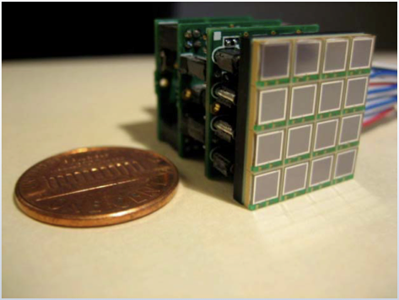
Detector R&D for JLab & Society
Fundamental Detector Development:
-Can SiPM’s be a robust detector element for nuclear physics?
SiPM Radiation Damage R&D
Generic Detector R&D for an Electron Ion Collider
SiPM Detector Development
DOE-NP Grant
SiPM based Electro-Optically Coupled Detector
DOE-NP Early Career Research proposal
Applications to Nuclear Imaging:
-Can nuclear physics detector technology meet societal needs?
Clinical/Preclinical nuclear medicine imaging
(collaborating institutions)
Biological Systems Imaging
DOE-BER (Scientific Focus Area: SFA)
JLab/RD&I
JLab/RD&I

Slide 5
Fundamental Detector Development

Slide 6
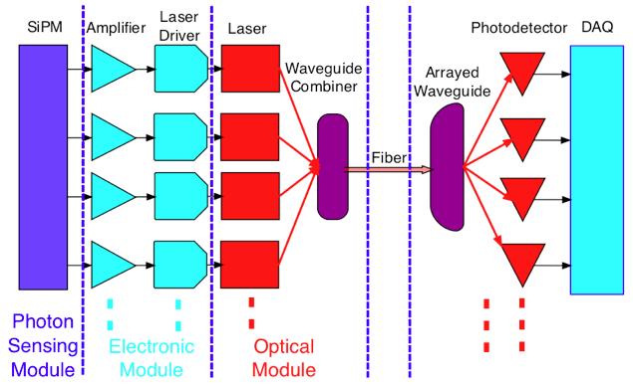
A Radiation Tolerant High-Magnetic Field Immune High-Signal Fidelity Electro-Optically Coupled Detector (EOCD) for Nuclear Physics
Problem- Need for robust detector components able to tolerate:
high-radiation
high-magnetic field
Applications-nuclear and high energy physics:
detectors of internal-reflected Cerenkov light (DIRCs)
electromagnetic calorimeters (EMCs)
Solution- EOCD
radiation tolerant
ultra-compact
immune to B-fields
reduced complexity (less cables)
signal pulse preserved:
amplitude
timing
phase
SiPM signals:
converted simultaneously to multi-λ optical signals
optically amplified via laser pumped erbium doped fiber
multiplexed into a single mode fiber by λ−division
de-multiplexed by receiver
converted back for remote DAQ
provisional patent 61/575,948 31 Aug. 2011
Notes:
Detector system with EOCD : SiPM signals convert simultaneously to multi-wavelength optical signals, optically amplified (10dB) and then multiplexed into a single mode fiber by wavelength division. Receiver demultiplexs the signal and converted back for remote DAQ. Erbium doped fiber which is laser pumped provides amplification.

Slide 7
Nuclear Imaging

Slide 8
Tech Transfer: Leveraging the National Lab Strengths
Jefferson Lab provides a unique technical environment not found typically in one place in academia or industry.
Technical resources brought together to do basic nuclear physics research:
advanced radiation detection methods
state of the art electronics
software development for 3D imaging
high performance data acquisition
optics
Applying nuclear imaging detector techniques for challenges in other fields:
nuclear medicine for improved patient care
bio-medical research using radioisotopes
biological systems research using radioisotopes
Jefferson Lab is a single purpose lab requiring collaborations →

Slide 9
External Partners
Oak Ridge National Laboratory
Triangle Universities Nuclear Laboratory
West Virginia University
Hampton University Proton Therapy Institute
University of Virginia
University of Maryland
Johns Hopkins University
Case Western Reserve University
College of William and Mary
Duke University
Columbia University
Dilon Technologies, Inc.
Internal Partners
Fast Elec. Group
DAQ Group
External Funding
(beyond DOE NP)
DOE BER
NIH (WFO)
DOD
JSA
Tech Transfer
JLab Patents: 1991-present: 99
Physics Div. Patents: 1995-present: 35
Detector Grp. Patents: 1995-present: 31

Slide 10
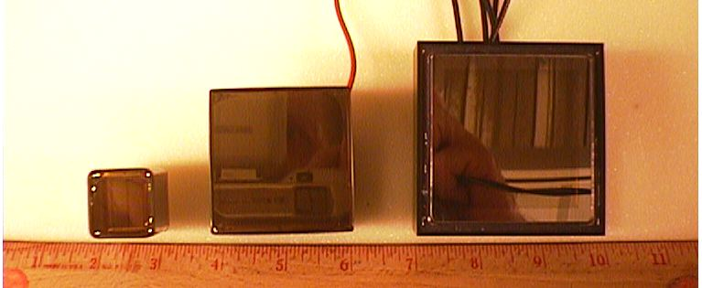
Nuclear Physics Detector Technology:
photon detectors (e.g. photomultiplier tubes- PMTs)
light-guides
scintillators
collimators
high speed electronics
data processing
crystal scintillators
PMTs

Slide 11
Nuclear Imaging-the Basics:
Radioisotopes that emit high energy photons and beta particles are incorporated into molecules that have a biological function of interest. The tagged molecules are then injected or introduced in vivo into biological systems:
people
animals
plants
microbes
Molecular Imaging: The bio-distribution of tagged molecules is imaged externally by devices capable of detecting the emitted particles. Typically the high energy photons are highly penetrating thus can be detected and imaged externally. Two molecular imaging techniques:
Single Photon Emission Computed Tomography (SPECT)
Positron Emission Tomography (PET)

Slide 12
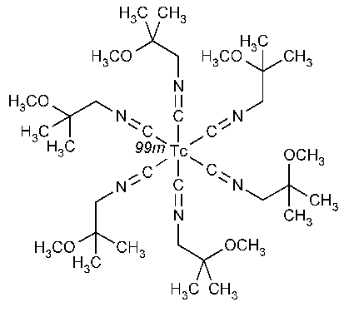
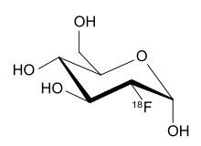
Most common single photon emitters used in nuclear medicine
^{99m}Tc-sestamibi: C₃₆H₆₆N₆O₆^{99m}Tc
→ targets cells with active mitochondria e.g. cancer
Most common positron emitters used in nuclear medicine
¹⁸F -fluoro-2- deoxyglucose (FDG): C₆H₁₁¹⁸FO₅
→ targets rapidly growing cells e.g. cancer

Slide 13
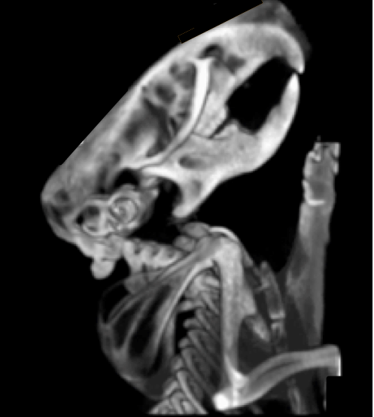
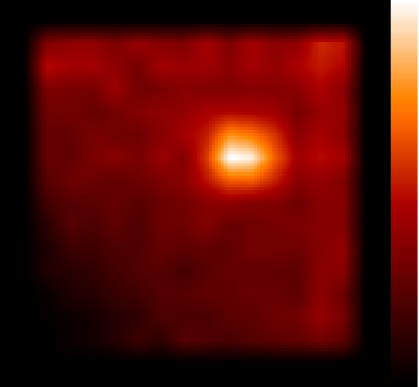
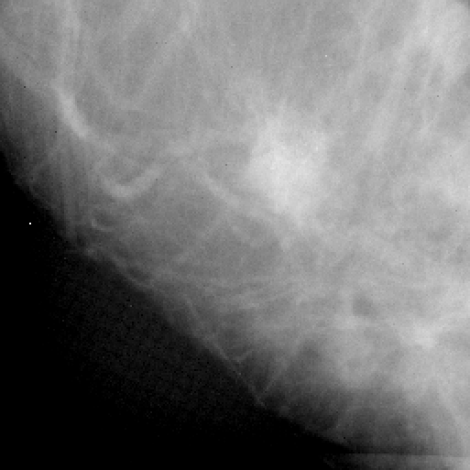
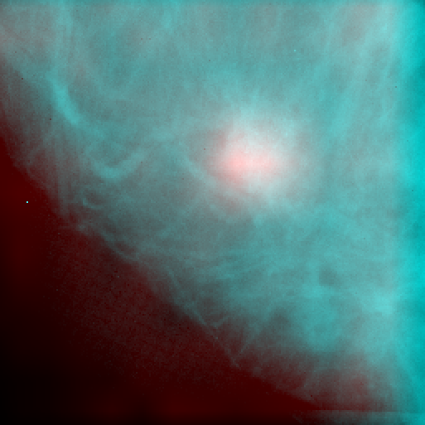
Bio-Medical Imaging Modalities
Structural
X-ray CT
MRI
Functional
Single Photon Emission Computed Tomography (SPECT)
Positron Emission Tomography (PET)
Multi Modality
PET-CT
PET-MRI
SPECT-CT
digital x-ray of mouse (JLab)
Tc99m-bone scan of live mouse
(JLab)
JLab/RD&I
JLab/RD&I
JLab/RD&I
Tc99m
mammogram
co-registered
breast tumor imaged via Tc99m and digital x-ray then co-registered

Slide 14
Clinical Application- Breast Cancer Detection
Context: Estimated new cases and deaths from breast cancer in the United States in 2012:
New cases: 226,870
Deaths: 39,510
Problem: Standard clinical systems not designed for breast cancer imaging
Standard clinical gamma cameras too large & inadequate resolution
Solution: Develop a detector using state of the art nuclear physics detector components to design a gamma camera built for the task

Slide 15
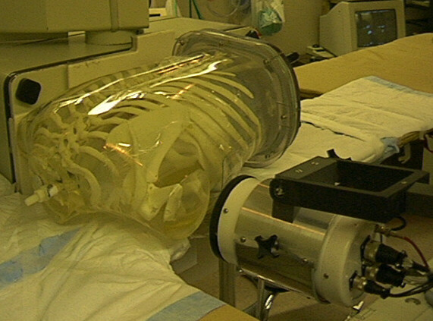
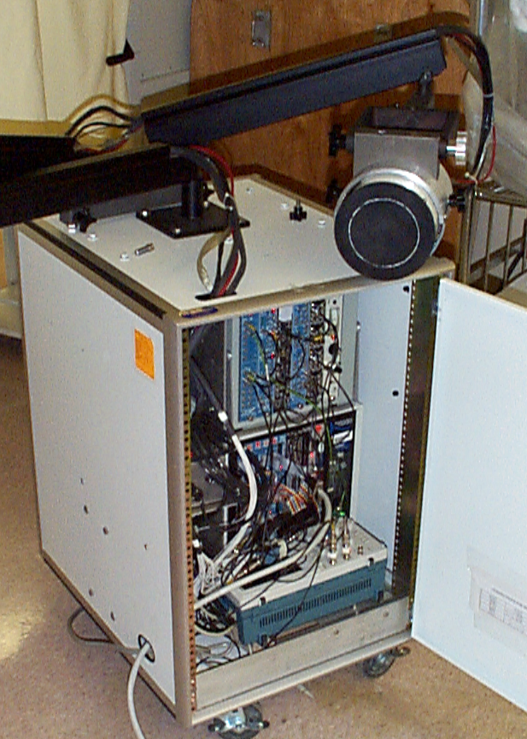
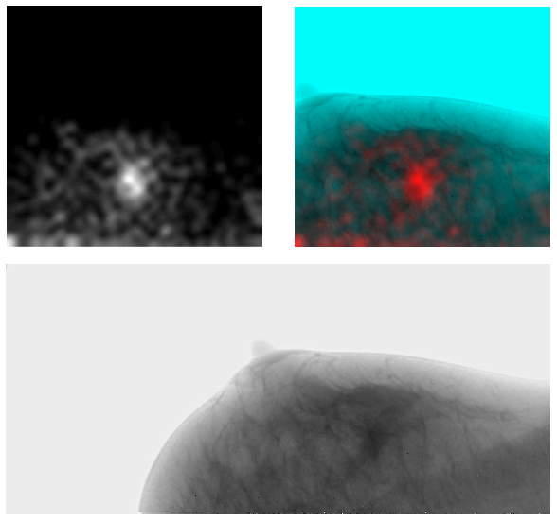
“Gamma Emission Mammography” developed by JLab Detector Group undergoing tests at the University of Virginia Medical Center
Early prototype development
GAMMA
FUSED
DIGITAL MAMMOGRAM
Gamma camera based on nuclear physics technology: NaI(Tl) scintillator, position sensitive photomultiplier tube & CAMAC electronics
JLab/RD&I

Slide 16
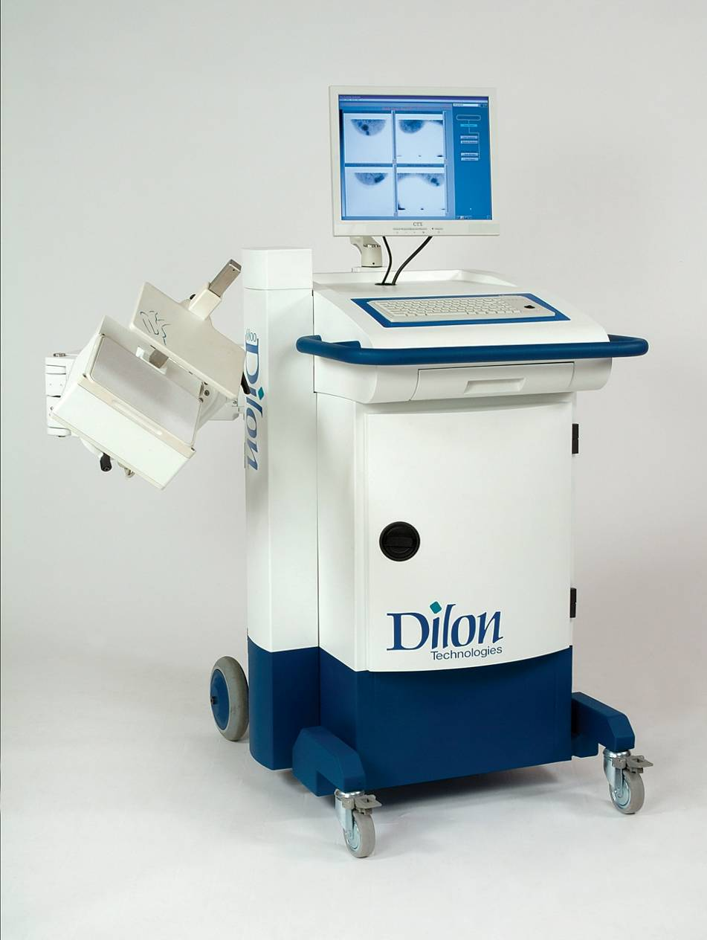
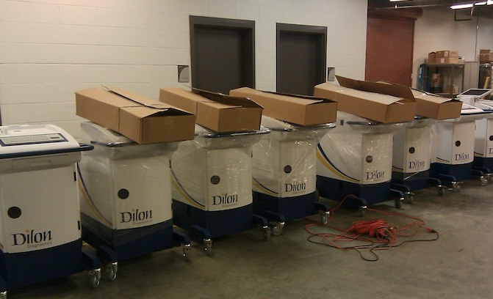
Dilon 6800
Gamma Camera
Final: Commercial version
Dilon Technologies, Inc.
Newport News, Virginia
~20 employees
Based on JLab/RD&I Group spin-off
Several patents licensed from JLab. Presently Dilon and JLab initiating a new CRADA agreement to enhance gamma camera performance.

Slide 17
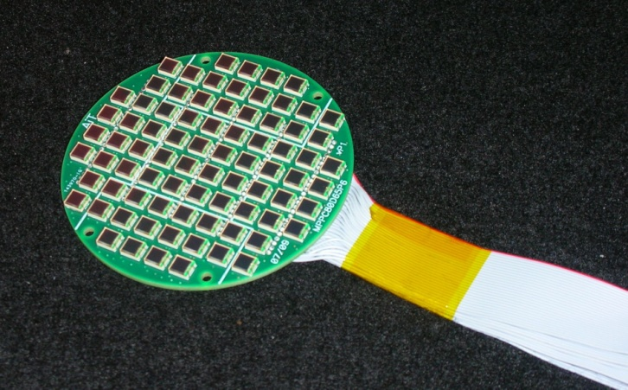
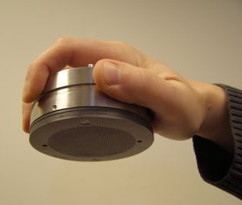
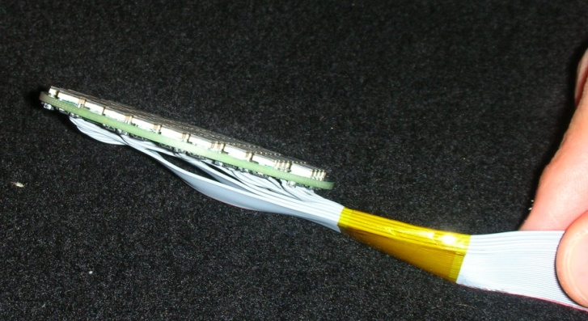
Clinical Application- Cancer Surgery
Problem: Need for compact handheld imaging gamma-ray detector to do lymphoscintigraphy for use in cancer surgery
Solution: Use array of 80 SiPMs to develop a compact detector with LaBr₃ (5 cm diam, 6 mm thick) scintillator and custom tungsten-polymer composite two-part collimator
“Gamma Puck”: Handheld detector with tungsten shell and tungsten collimators
SiPMs mounted to PCB

Slide 18
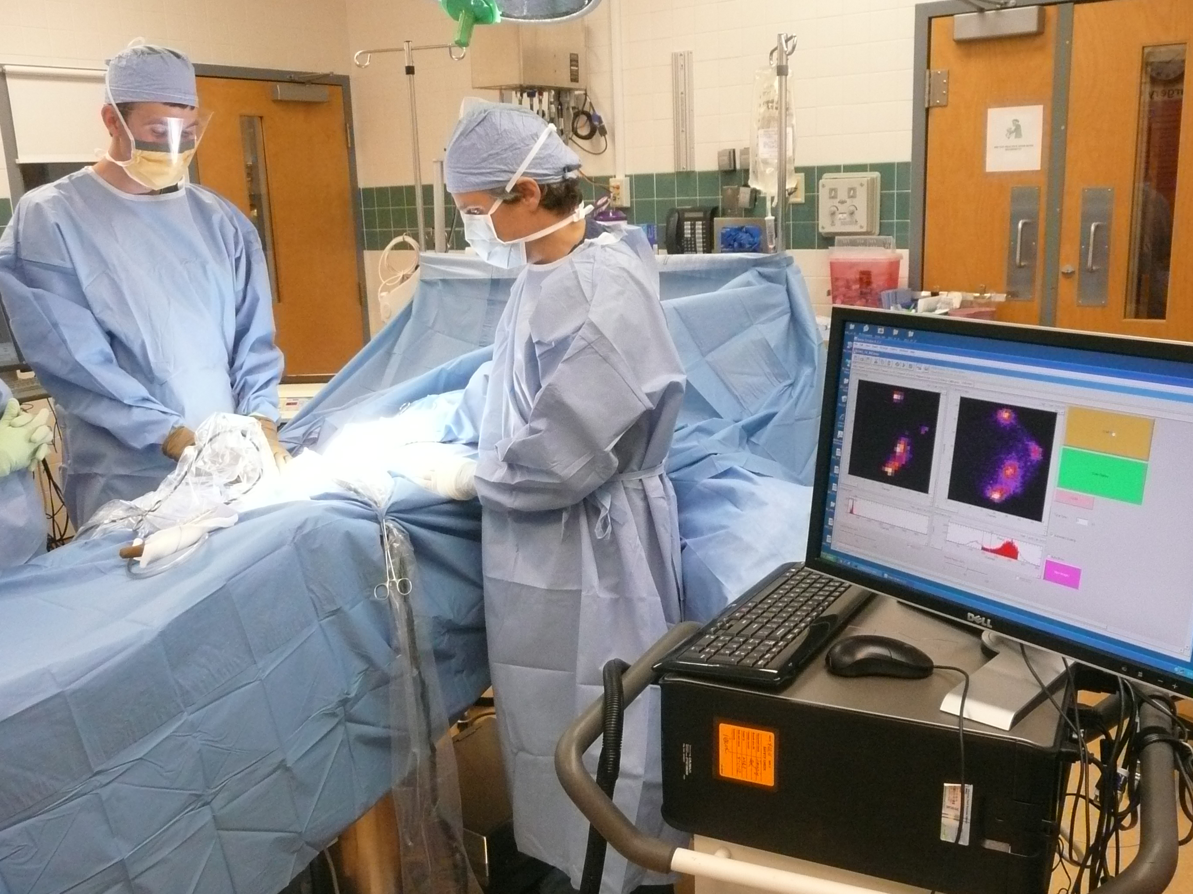
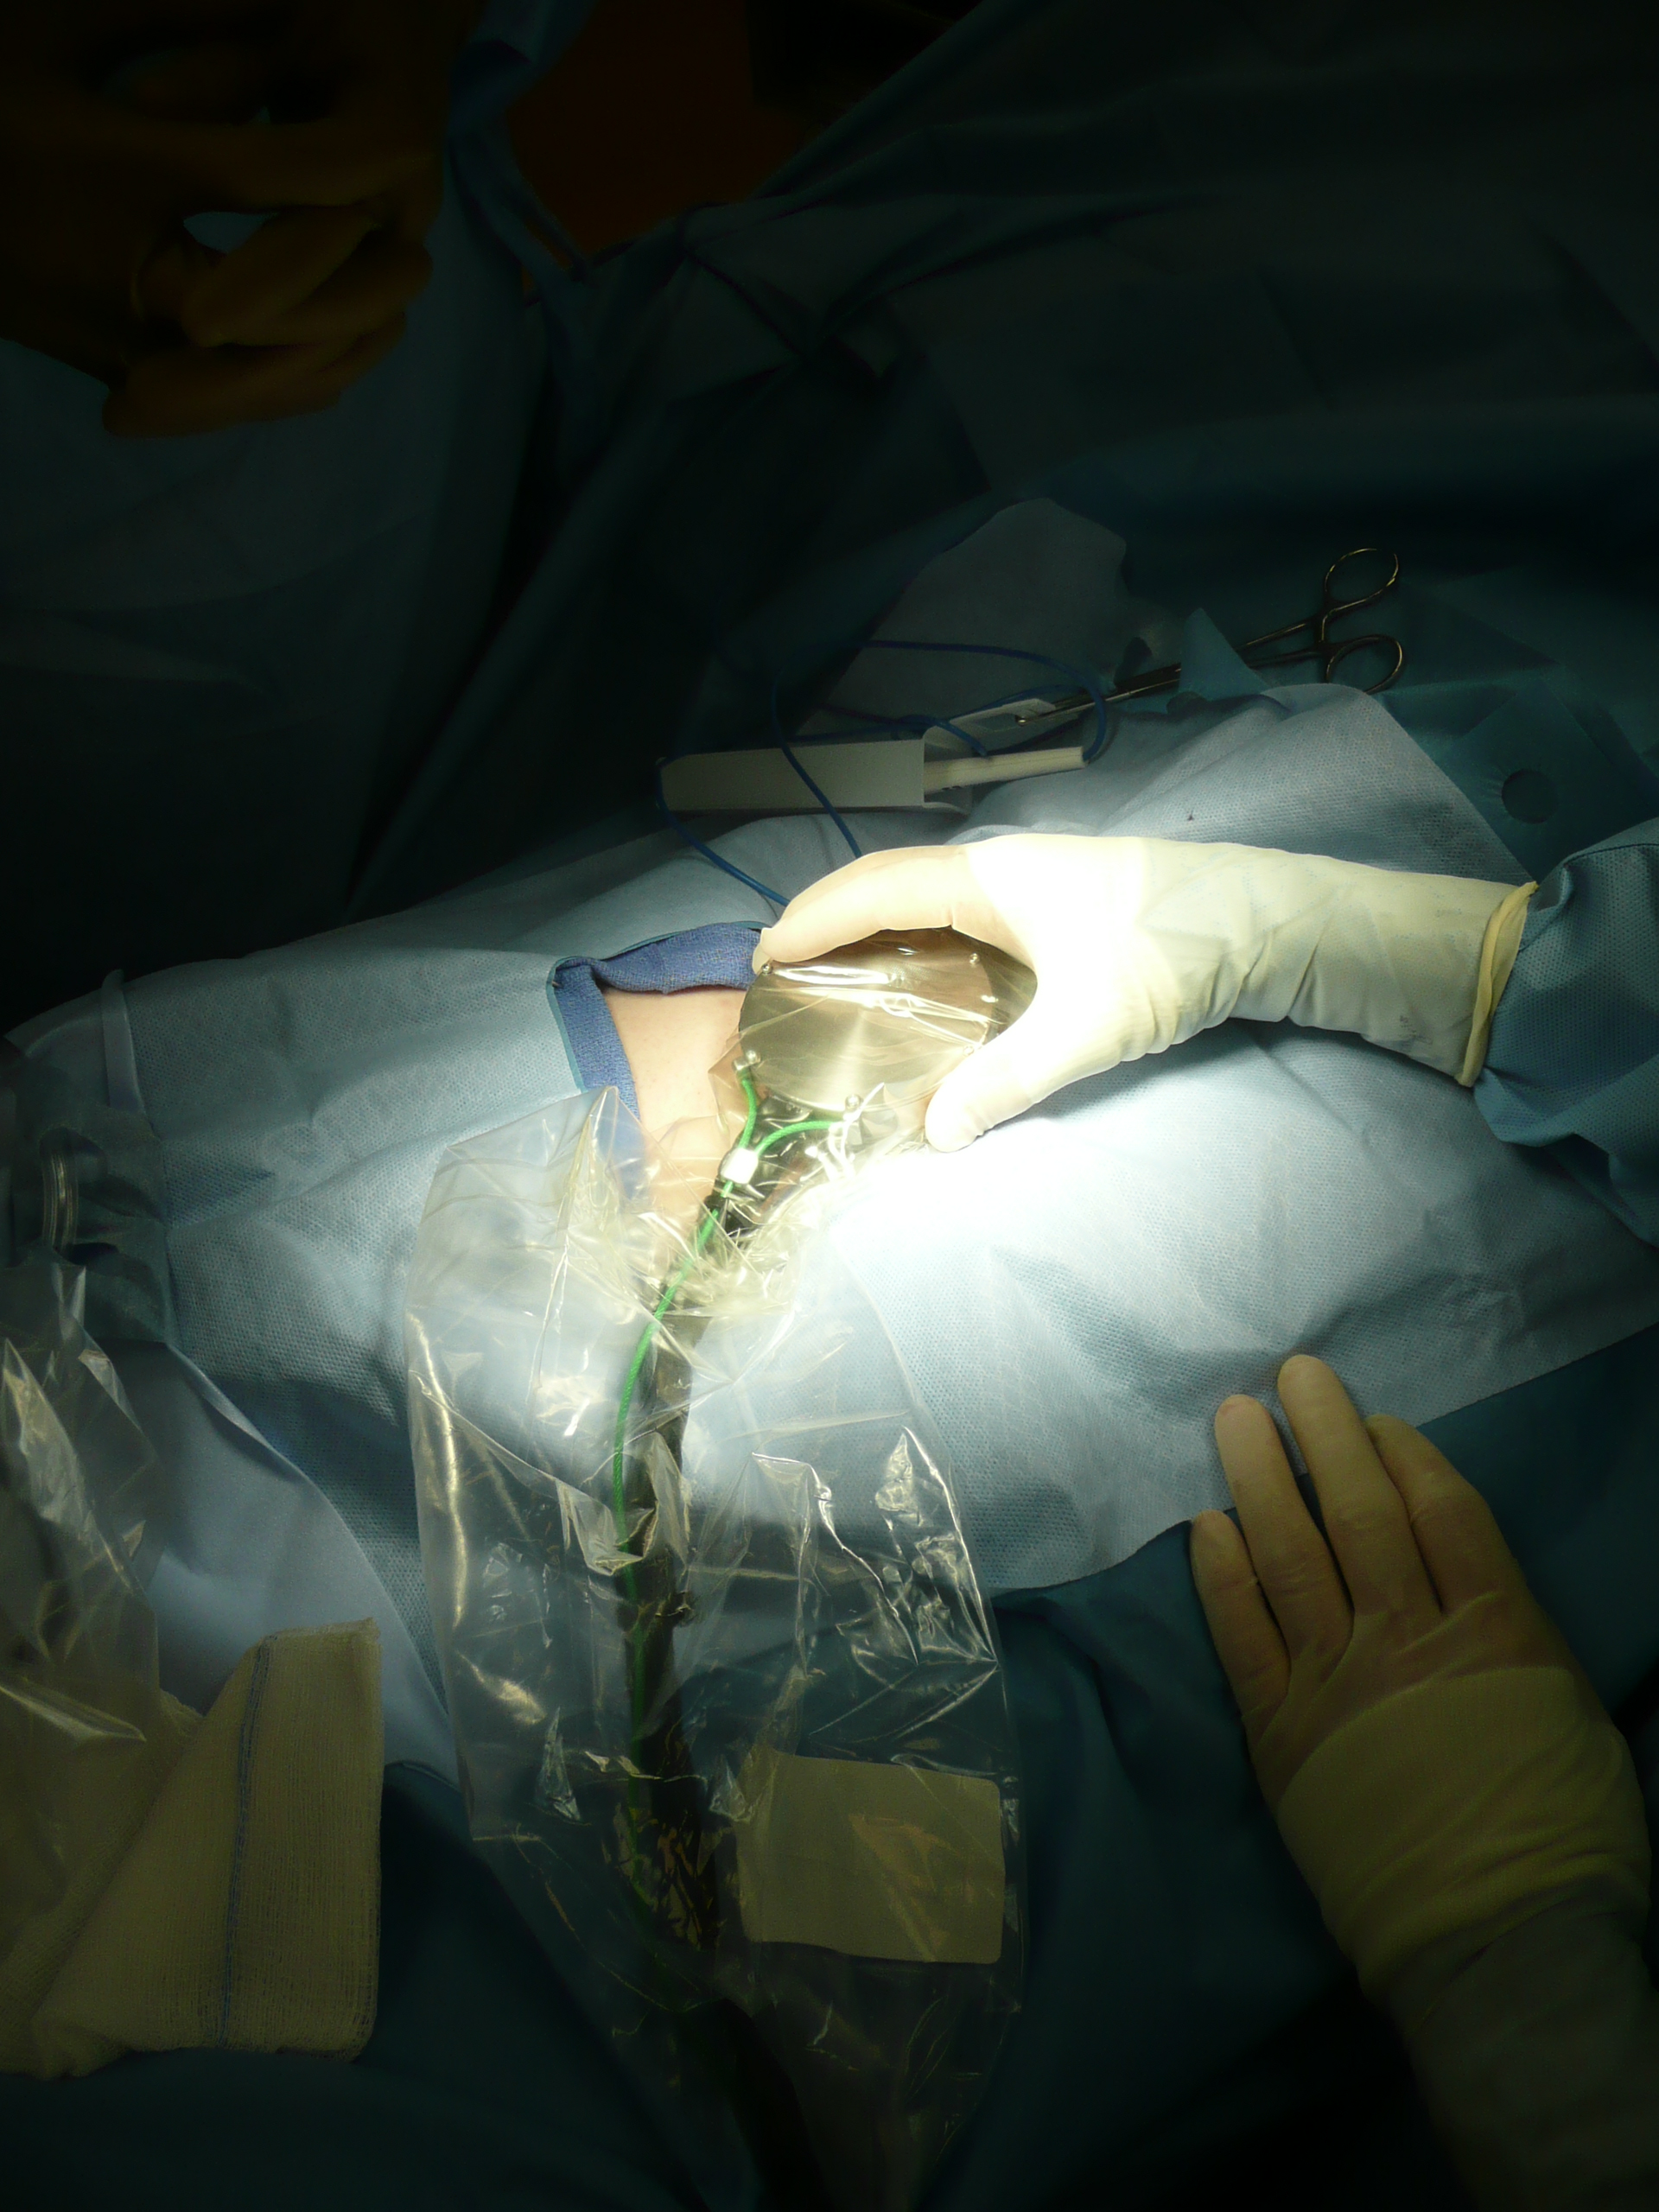
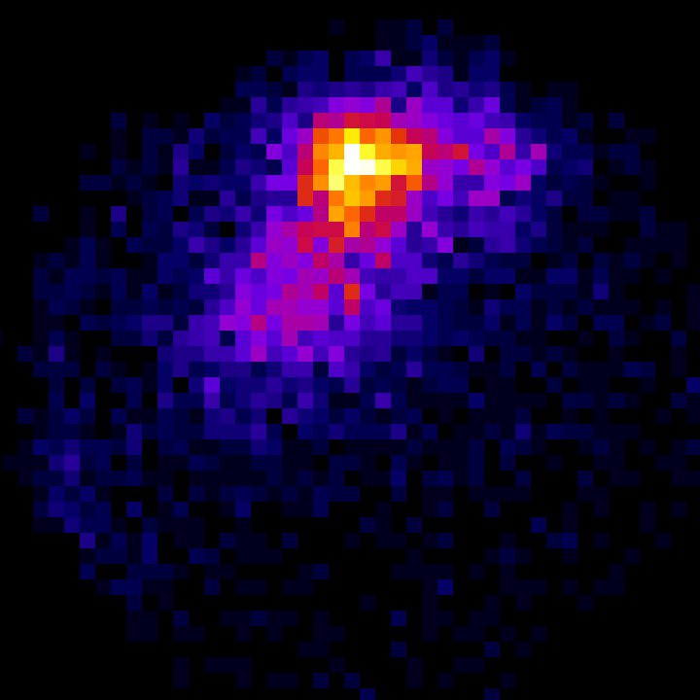
Clinical trials of Gamma Puck at University of Virginia
radiopharmaceutical used to identify sentinel lymph nodes with cancer involvement during breast cancer surgery
JLab/RD&I
~ 3cm lymph node

Slide 19
Pre-Clinical Application- Animal models for diseases
Problem: Anesthesia inhibits or complicates brain based research that use animal models of human diseases. Calls for a molecular imaging methodology to allow determination of bio-distribution of tagged neuro-active compounds in un-anesthetized small animals to study neurological based diseases such as:
Addiction research
Neuro-degeneration:
Alzheimer's Disease
Parkinson's Disease
Brain inflammation (i.e. HIV, MS)
Notes:
AD:
5 million people in the United States are living with Alzheimer’s
Every 72 seconds, someone develops Alzheimer’s
The direct and indirect costs of Alzheimer’s and other dementias amount to more than $148 billion annually.
Seventh-leading cause of death in the United States
Parkensons:
Nerve cells (neurons) in a part of the brain called the substantia nigra die or become impaired. Normally, these cells produce a vital chemical known as dopamine. Dopamine allows smooth, coordinated function of the body's muscles and movement.
When approximately 80% of the dopamine-producing cells are damaged, the symptoms of Parkinson disease appear.
In the United States, it is estimated that 60,000 new cases are diagnosed each year, joining the 1.5 million Americans who currently have Parkinson disease.
While the condition usually develops after the age of 65, 15% of those diagnosed are under 50.

Slide 20
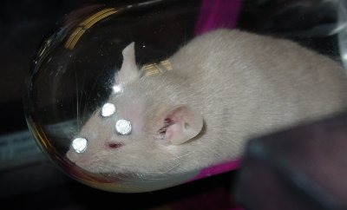
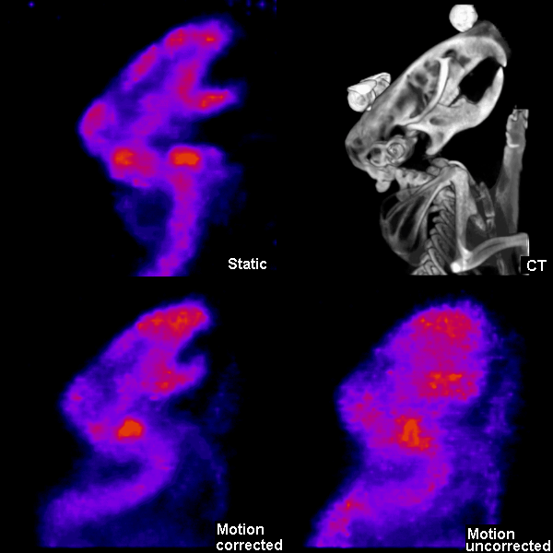
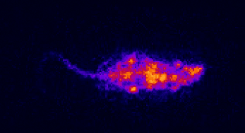
Solution: DOE-BER funded awake animal SPECT imaging system involving ORNL & JHU which images radioisotope tagged molecules and tracks head movement via IR cameras in awake mice.
Awake animal SPECT scan Tc99m-MDP
Movie of Multiple SPECT Projections
Example of bone scan of awake mouse in which motion effects are removed

Slide 21
Biological Systems Application- Imaging for plant biology
Global Climate Change and Plant Productivity
Context: Radioisotope imaging can provide a powerful imaging tool to plant biology researchers. For instance: findings in 1980’s-1990’s of enhanced plant productivity with enhanced CO₂ in greenhouse and open top chamber experiments.
Problem: limiting factors not understood
Can the initial enhanced plant productivity with increased CO₂ be maintained?
What are the products of photosynthesis and their impact to the short-term root microbial activity that could stimulate nutrient turnover?
Are there ways to stimulate plants to sequester more CO₂?
Solution: Specialized plant PET for in vivo carbon-11 imaging using a range of detector geometries: dual detector planes to rings of detectors
Notes:
For several decades through BER, DOE has been actively funding basic ecological research to understand the direct impacts of enhanced atmospheric CO₂. Findings of enhanced plant productivity with enhanced CO₂ in greenhouse and open top chamber experiments in the 1980’s and 1990’s were only partially confirmed by current Free Air Carbon Dioxide Enrichment (FACE) experiments suggesting nutrient limitations to plant productivity in natural ecological settings. Some remaining questions include: (1) how can the initial enhanced plant productivity with increased CO₂ be maintained? (2) what is the role of enhanced plant photosynthate production to the short-term microbial activity that could stimulate nutrient turnover? (3) are there ways to stimulate plants to sequester more CO₂?

Slide 22
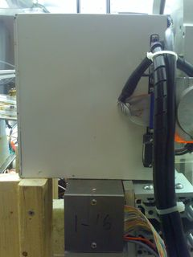
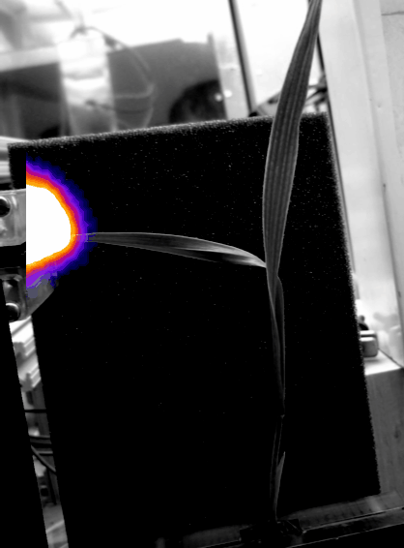
Plant Biology PET Prototypes: dual detector plane based limited angle tomography for carbon-11 imaging using coincident detection of positron annihilation 511 keV photons to facilitate photosynthesis studies
Prototype studies
The model plant used for the experiment was barley (Hordeum distichum L.) in which ¹¹CO₂ introduce to leaf (A) of plant grown in hydroponic fluid (B)
Overlay movie of carbon translocation in barley plant, 5 min x 12 frames = 1 hour

Slide 23
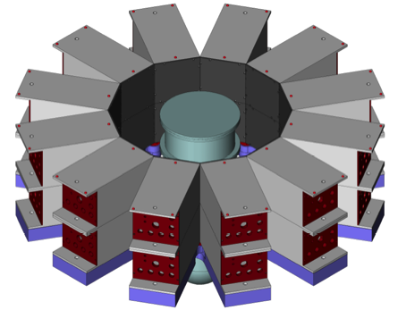
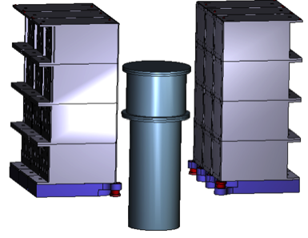
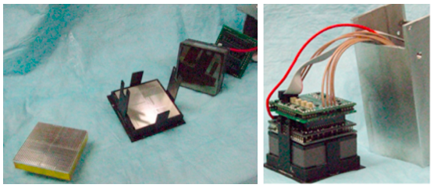
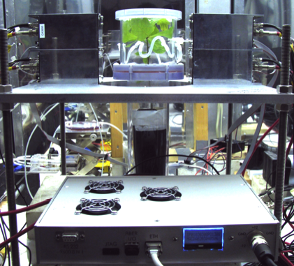
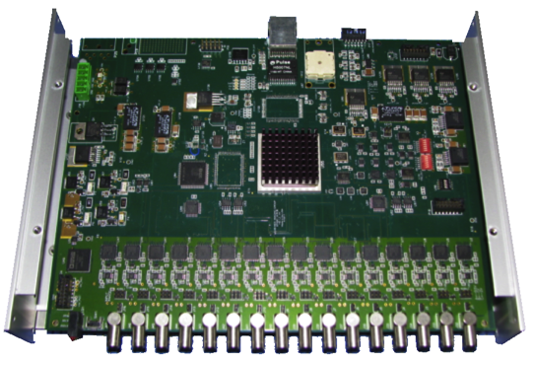
Development of Position-Sensitive (PS)PMT Based PhytoPET: arrays of PSPMTs w/ LYSO scintillator based detector modules to allow flexible geometries for plant imaging
PSPMT-scintillator detector modules
JLab 16 channel FPGA base flash ADC developed by JLab Fast Electronics Group

Slide 24
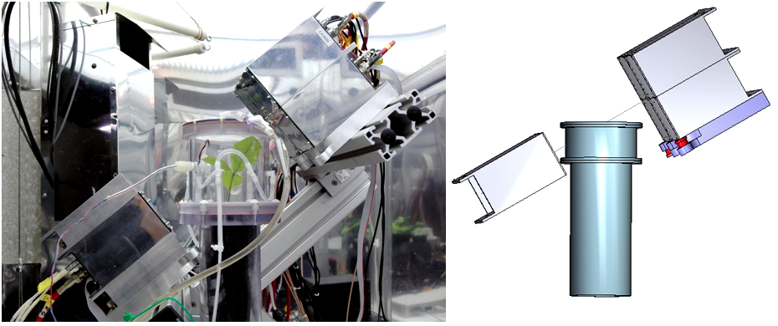
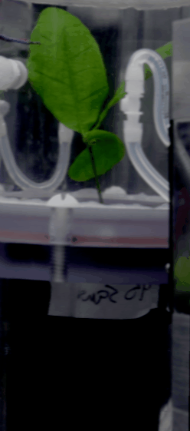
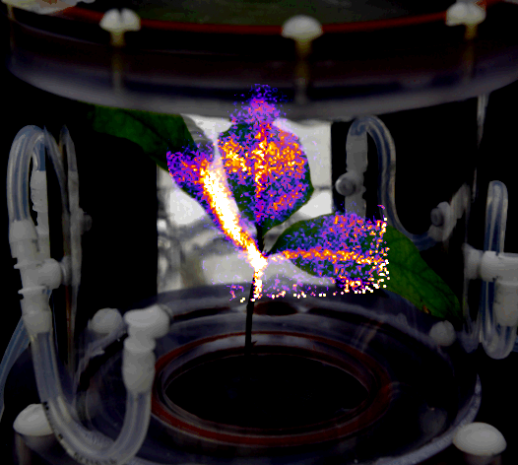
CO₂ Studies w/five PhytoPET modules: oak seedling in whole plant CO₂ induction chamber
detector arrangement
Carbon translocation in oak seedling using whole plant CO₂ induction chamber

Slide 25
Summary
Radiation Detector and Imaging (RD&I) Group Overview
Technology development group within Physics Division
Resource for Physics Div., Accelerator Div. & Users
Current RD&I Group Fundamental Nuclear Physics Detector Development
Silicon PM technology R&D
Electro-Optical/Silicon PM based detector development
Current RD&I Group Applications to Nuclear Imaging
Clinical: cancer diagnostics and surgery
pre-clinical: small animal research tool for bio-medical research
plant biology: ¹¹C imaging for photosynthesis based studies

