Slide 1
Studies of niobium material properties
G. Myneni, G. Ciovati, P. Dhakal,
Jefferson Lab S&T Review
May 9-11, 2012

Slide 2
Overview
An eight-year program to refine the understanding of Niobium properties for superconducting cavities
Pyrochlore and columbite/tantalite niobium
Fine grain and ingot niobium technologies
Q₀ improvement program
Future outlook for ingot niobium technology

Slide 3
Glossary 1
Niobium – highly ductile refractory metal with highest
superconducting transition temperature
RRR – Residual Resistance Ratio ~ R₃₀₀/R_{4.2}
Important Interstitials H, C, N and O that contribute to RRR significantly
  and tantalum, substitutional impurity does not significantly contribute to RRR
Surface Resistance R_{s}= R_{BCS}+R₀+R_{Dislocations}
R_{BCS} depends on surface magnetic field, electron mean free path, temperature and frequency

Slide 4
Glossary 2
Quality Factor Q₀= G/R_{s,} where G is the geometry factor and it is independent of the cavity frequency (ideal ~ 2×10 ¹¹ @ 2 K)
H_{pk} Surface peak magnetic field (mT)
E_{acc} Accelerating gradient (MV/m)
Optimized Processes and procedures: forming cells, cleaning, welding, surface treatments and stress relieving processes and final contamination free evacuation
Figure of merit of Nb ~ Q₀*E_{quench}

Slide 5
Niobium For SRF Cavities
At present, Niobium for SRF cavities comes from Columbite/Tantalite ore
  Niobium is present as “impurity”
  Niobium is produced as a by-product
Primary reason – the Tantalum content is lower
  Tantalum is generally believed to negatively impact SRF properties of Niobium
  JLab data shows reducing Tantalum content below 1000 ppm has no advantage for Superconducting RF cavities
  Low Tantalum niobium is relatively expensive

Slide 6
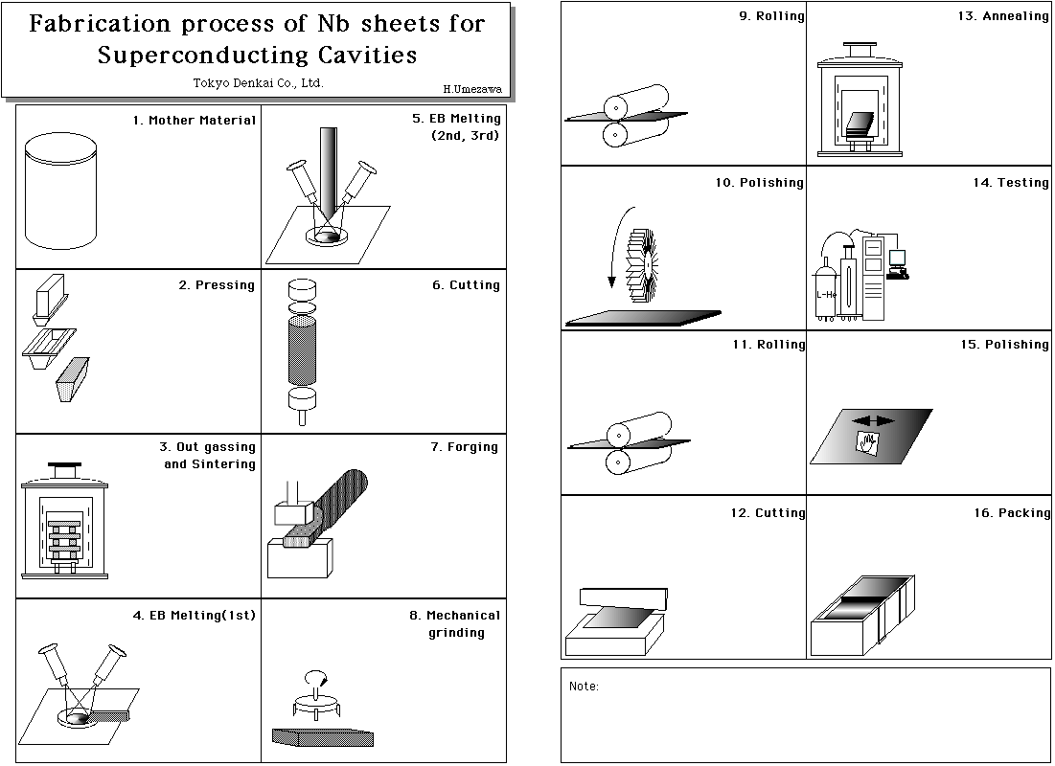
Process steps - fine grain Niobium
During this process foreign materials
can be embedded so QA is required

Slide 7
Ingot Niobium Technology
CBMM-JLab CRADA, August 2004
CBMM/JLab jointly applied for US Patent in April 2005 and the patent 8128765 B2 was granted on March 6, 2012. G. Myneni, P. Kneisel and T. Carneiro (CBMM) are the inventors
Many international institutions in Asia, Europe and America are developing ingot niobium cavities. DESY, KEK are among them. Niowave, RI and AES industries are involved. CBMM, Heraues, Ningxia, Tokyo Denkai and Wah Chang are able to provide ingot niobium
W. Singer Private Communication
DESY sets E_{acc} world record with ingot niobium 9 cell TESLA cavities

Slide 8
Economic path for CW applications
Cost of the ingot sliced Nb sheets anticipated
to be less than a third of polycrystalline Nb & no QA

Slide 9
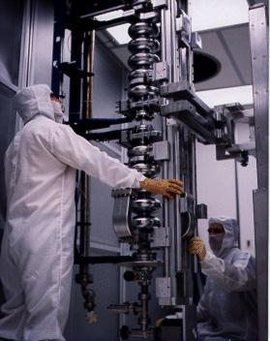
Niobium cavity – performance (CW)
SRF Technology Potential
TESLA single cells with ingot Nb
and un-optimized processes
Lowers operating cost
*
ILC
*
12 GeV Upgrade Spec
*
CEBAF Operations
*
CEBAF Spec
Lowers construction cost
RRR, type of niobium and vendor has no influence on cavity performance
Development of Large Grain/Single Crystal Niobium Cavity Technology at Jefferson Lab
P. Kneisel, G. Myneni, G. Ciovati, T. Carneiro Proc of Linac 2004

Slide 10
Tantalum does not affect the performance
Ingot niobium has superior performance
Large grain ingot niobium
Polycrystalline niobium
G. Ciovati will present the low RRR 1300 wt ppm ingot niobium cavity data showing 1.0 x10¹² figure of merit
Influence of Ta content in high purity niobium on cavity performance
P. Kneisel, G. Myneni, G. Ciovati, D. Proch, W. Singer, T. Carneiro et al in Proceedings of PAC 2005

Slide 11
Extrinsic and intrinsic contamination of Nb determines the performance of the cavities
Extrinsic
Intrinsic
Surface contamination
  Molecular and particulate
Niobium is a prolific hydrogen absorber in the absence of the natural surface oxide
  Hydride formation
  Dislocations
Talk by Bob Rimmer

Slide 12
Q₀, hydrogen & cavity performance
Q-disease in the cavities is an example of a gross manifestation of hydrogen effect similar to gross air leak in high vacuum systems
As we are looking to improve the cavity performance (Q) further we need to understand the effects of proton in niobium and take steps to minimize the solid-solution of protons, similar to eliminating smaller air leaks in UHV systems
Hydrogen is difficult to measure quantitatively at the concentration levels that we have to in materials in general and greatly in niobium
Like vacuum leak standards, we need to develop Nb-hydrogen standards

Slide 13
Goals of the DOE ONP ARRA Q₀ Improvement Program
1. Scientific Understanding

Slide 14
Hydrogen absorption with BCP and EP
Very high equilibrium hydrogen activities (fugacity) have been estimated when Nb metal is in contact with water or BCP solution
Hydrogen is readily absorbed into Nb when the protective oxide layer is removed
Lower H fugacity's are obtained due to an anodic polarization of Nb during EP and hence lower hydrogen absorption
R.E. Ricker, G. R. Myneni, J. Res. Natl. Inst. Stand. Technol. 115, 353-371 (2010)
NIST/JLab

Slide 15
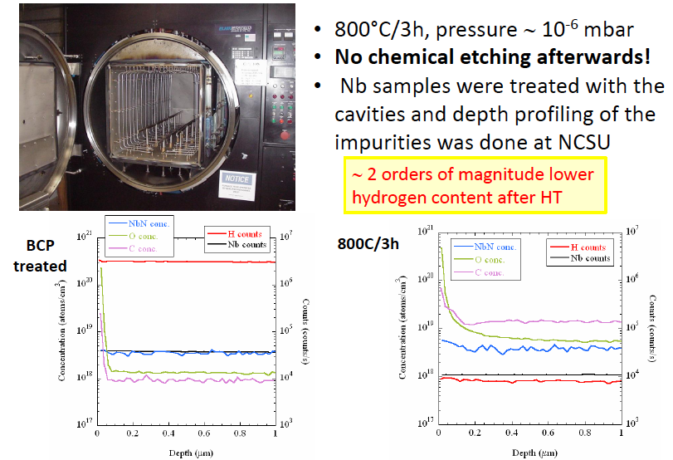
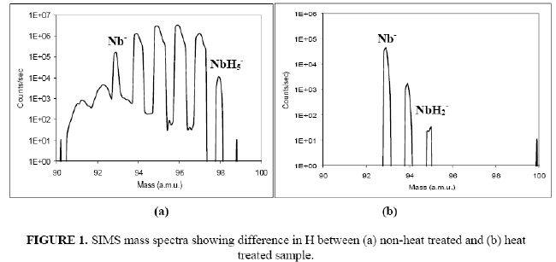
Heat treatment to remove hydrogen
Currently used furnaces contaminate the cavity surfaces, chemical re-etching reintroduces H
G. Ciovati, G. Myneni, F. Stevie, P. Maheshwari, and D. Griffis, Phys. Rev. ST Accel. Beams 13, 022002 (2010).

Slide 16
Goals of the DOE ONP ARRA Q₀ Improvement Program
2. Technology Development

Slide 17
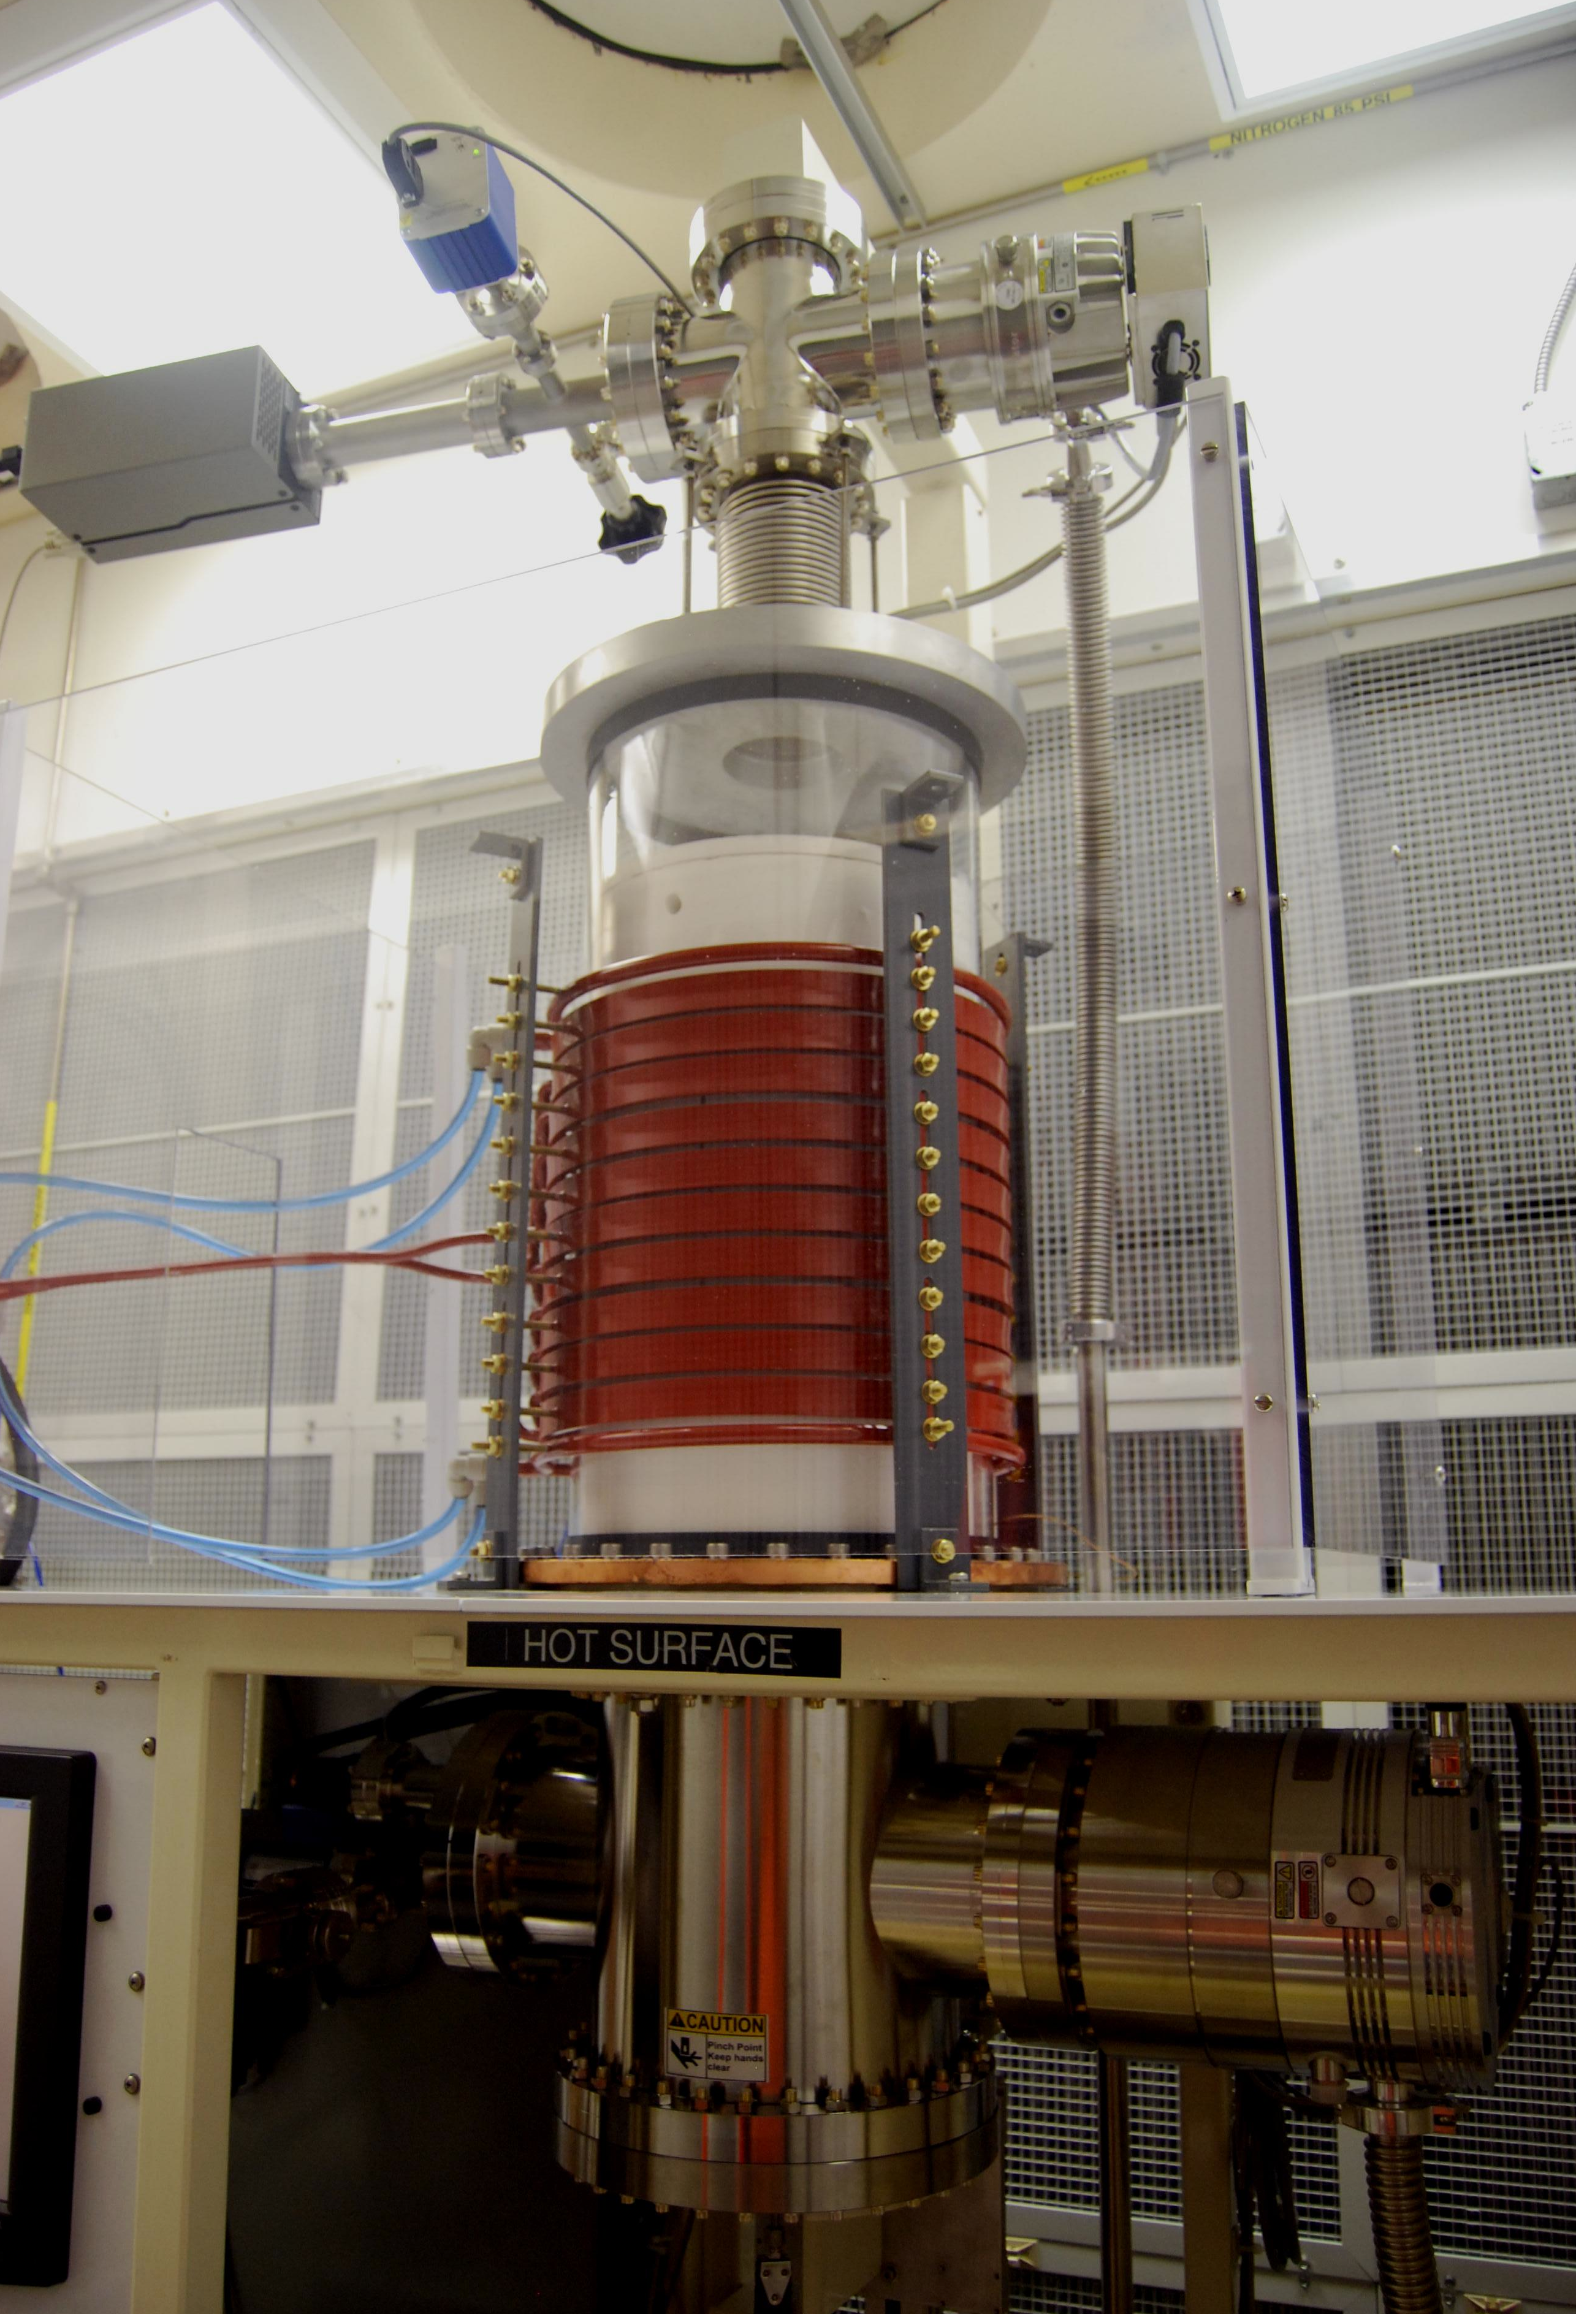
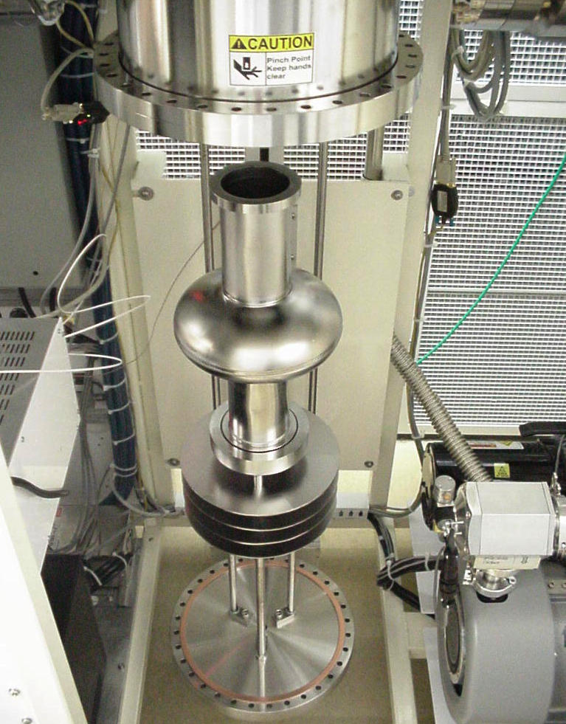
Clean UHV furnace - patents applied for
Design and Performance of a new Induction Furnace for Heat Treatment of Superconducting
Radiofrequency Niobium Cavities, P. Dhakal, G. Ciovati, W. Rigby, J. Wallace, G. Myneni submitted to Review of Scientific Instruments

Slide 18
What has been demonstrated
High RRR (~>300) is not essential
Fourth melt ingot Nb is OK
Tantalum up to 1300 wt ppm is fine
Ingot niobium technology demonstrated by DESY with conventional processes
Simplified JLab new processes provide a factor of ~ 4 Q₀ improvement
Talk by Gigi Ciovati

Slide 19
Proposal Submitted to ARPA-E
Demonstrate a factor of 4 improvement of Q0 (2K, 20-25 MV/m) in a cryomodule and in an accelerator
  Need 8 multi cell cavities
  Large clean UHV induction furnace
3. Improved magnetic shielding
4. Streamlined clean assembly processes

Slide 20
Future Outlook
Ingot niobium technology (low RRR, high tantalum content) has proven to be ideal for CW SRF applications
We expect that this technology will be the preferred choice for future superconducting CW linacs world-wide

