Slide 1
World Record Q₀ with Ingot Niobium Cavity
G. Ciovati, P. Dhakal, G. Myneni
Jefferson Lab S&T Review
May 9-11, 2012

Slide 2
High Q₀ for CW SRF accelerators
Future accelerators for a wide variety of applications will be based on CW SRF technology.
One of the key technical issues to make such accelerators cost effective is to increase the Q₀ of the SRF cavities:
Design optimizations indicate E_{acc} = 15-20 MV/m
M. Liepe and J. Knobloch, Nucl. Instrum. Methods Phys. Res. A 557 (2006) 354

Slide 3
Material and Process Development
Cavity built from ingot Nb
Centrifugal Barrel Polishing (CBP)
Buffered Chemical Polishing (BCP)
High-temperature heat treatment
Degreasing and High Pressure Water Rinse (HPR)
Low-temperature baking

Slide 4
High Temperature UHV Heat treatment
Back in the 1970s, heat treatment at 1800 °C in UHV for ∼10 h was the standard practice to achieve high Q₀-values
  “homogenize” the material by dissolving precipitates and clusters of impurities
  stress relief, reduce dislocation content
Heat treatment temperature reduced to ∼1400 °C in combination with Titanium for post-purification of Nb material in the 1990s
  Improve thermal conductivity of the material for thermal stabilization of defects
Heat treatment temperature reduced to ∼600-800 °C to avoid “softening” of the material
  Hydrogen degassing to avoid Q-disease

Slide 5
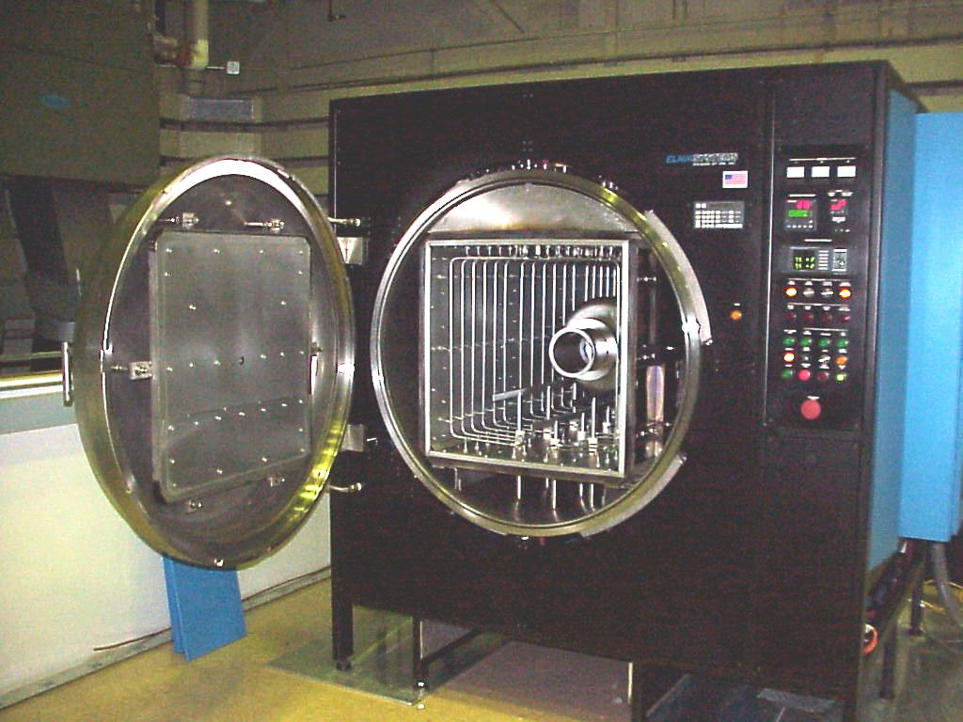
“Standard” UHV furnace for cavity heat treatment
“polluted” layer left on the cavity surface removed by “wet” chemistry (BCP or EP)
Molybdenum “hot-zone” box and heaters in the same vacuum space as the cavity. Maximum temperature ∼1250°C
Hydrogen absorption → high H concentration measured near the surface
Design a new furnace with Nb hot-zone and improved hydrogen pumping system

Slide 6
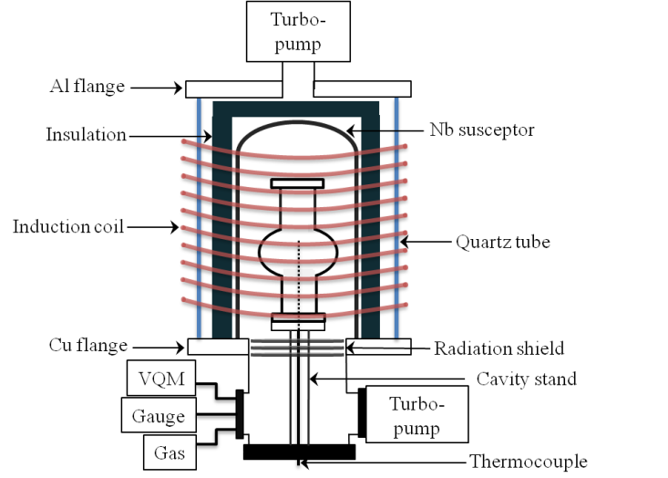
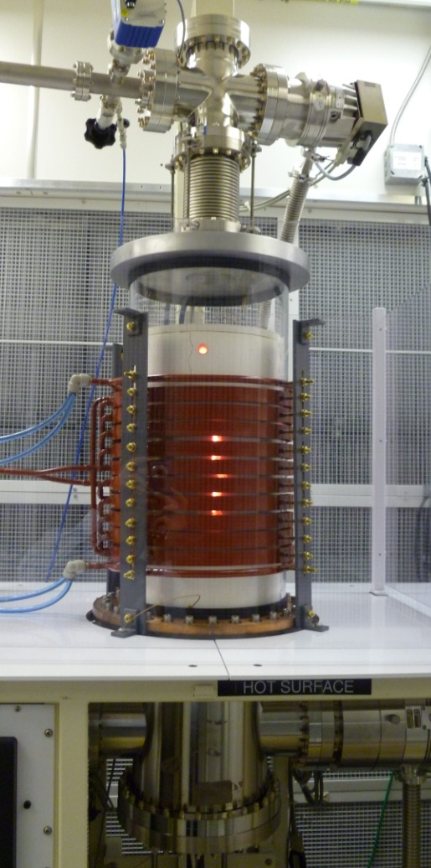
New furnace for cavity heat treatments
Funded by DOE-NP, American Recovery and Reinvestment Act, project LAB 09-13
50 kW, 11 kHz induction heating
Designed for up to ∼2000°C
P. Dhakal et al., submitted to Rev. Sci. Instrum. 2012

Slide 7
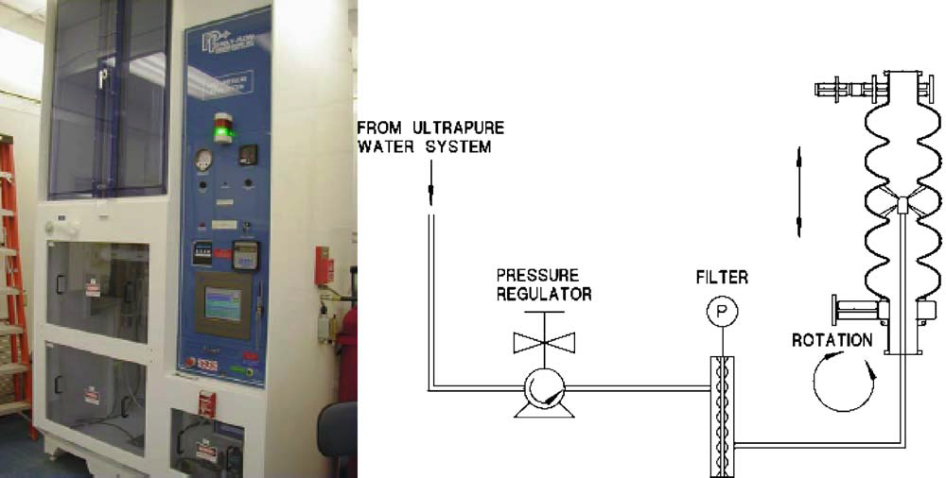
No “wet” chemistry after heat treatment
Standard cleaning before assembly in clean room:
Degreasing in water + detergent with ultrasonic agitation
High-pressure rinse with DI water to remove particulate contamination from the cavity surface
P. Kneisel, Nucl. Instrum. Methods Phys. Res. A 557 (2006) 250

Slide 8
Heat treatment study
Baseline: ∼20 μm etching by BCP
Heat treatment at 800 – 1400 °C
To be published
Q₀(2.0 K, 70 mT) = (1.2 ± 0.2)×10¹⁰ is the average from series production of multi-cell cavities with standard material and processes

Slide 9
R_{s}-temperature dependence
To be published
Fits with BCS-theory code indicate the following changes after HT:
  ∼2% increase of energy gap
  ∼×4 reduction of normal electrons’ mean free path
  R_{res} reduced from 2.0 nΩ to 1.0 nΩ

Slide 10
RF field dependence of Q₀
To be published
Low-field Q-increase extending up to ∼70 mT
Q₀ is ∼4× higher than currently achieved in series production of multi-cell cavities
Q₀(1.5 K) ∼ 2×10¹¹

Slide 11
Low-field Q-increase
T=2.0 K
M. A. Allen et al., IEEE Trans. Nucl. Sci. 18 (1971) 168
R. Geng, Proc. of the 15th SRF Conf., Chicago, IL, 2011, MOPO012
The origin of this phenomenon is not well understood
It was proposed to be related to non-equilibrium superconductivity due to niobium oxide precipitates near the surface
J. Halbritter, Proc. of the 2nd SRF Workshop, Geneva, Switzerland, 1984, p. 427

Slide 12
Surface analysis on samples
Two Nb samples heat treated at 1400 °C with the cavity were analyzed with different surface analytical methods:
  Secondary Ion Mass Spectrometry (SIMS) (F. Stevie and P. Maheshwari, North Carolina State Univ.) → depth profiling of impurities near the surface
  Energy-dispersive X-ray spectroscopy (EDX) → near-surface elemental analysis
  Point Contact Tunneling (PCT) → electron density of states in the superconducting state
T. Proslier, N. Groll, J. Zasadzinski and K. Gray, Argonne Nat’l Lab

Slide 13
Preliminary sample analysis results
∼1 at.% Titanium at the surface
Oxygen concentration follows Ti profile
Increased Carbon concentration at the surface
Lower Hydrogen content
Gap value of clean, bulk Nb, Δ=1.56 ± 0.089 meV
Low inelastic scattering parameter
Cavity flanges are made of Ti45Nb alloy
Good SC properties

Slide 14
Possible cost savings
Example: CEBAF Upgrade
  275 W/cryomodule max dynamic heat load at 2.07 K from cavities × 10 cryomodules = 2.75 kW
  CHL2: 4.5 kW at 2.07 K, ∼6 MW outlet power
0.7 kW
2.4 kW
3.2 MW
At 0.1 $/kWh corresponds to a saving of ∼2.5 M$/year of operating costs!
Over a ∼20 year lifetime of an accelerator facility the total saving is at least 50 M$
The results I’m presenting were achieved with a budget of ∼0.6 M$...

Slide 15
Towards a “sustainable” SRF Cryomodule
Continue single-cell study to prove reproducibility of performance and improved understanding
Seek funding for multi-cell cavity furnace
Demonstrate improved performance on multi-cell cavities
Maintain improved performance in multi-cell cavities inside a cryomodule

Slide 16
Summary
Ingot Nb and high-temperature heat-treatment proved to be a cost-effective material/process combination which allowed achieving a world-record high Q₀-value
Further studies will focus on the reproducibility of the exceptional result through a better understanding of the role played by the various impurities at the Nb surface

