Slide 1
The Long Shut Down
Fulvia Pilat
S&T Review May 9-11, 2012

Slide 2
Outline
6MSD (6-month Shut-Down) and LSD (Long Shut-Down): Lab-wide integration
LSD scope of work
Organization
Preparation: schedule, resources, baseline
Execution: field organization, change control, schedule progress

Slide 3
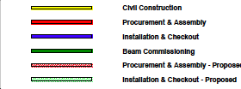
6MSD and LSD

Slide 4
ESH&Q
Facilities
FEL
Upgrade
and operations
12 GeV Project
Civil
LSD Laboratory Integration
Hall D
12 GeV
Project
TEDF/TLA
Hall A
Hall B
Hall C
Accelerator Maintenance
&operations
Hall A
12 GeV
Project
12 GeV Project Accelerator
Hall B
12 GeV
Project
Hall C
12 GeV
Project

Slide 5
6MSD Summary
Length: May 15 –Nov 19
Wide scope of work: 12 GeV civil construction 12 GeV accelerator, Halls maintenance, Accelerator maintenance, Facilities, FEL operation, TEDF construction
Challenge: quick return to operations for the last 6 GeV physics run
→ Lab-wide coordination and integration, Director appoints “czar”
6MSD Czar, Team, Project Management practices and support
Preparation: Sep 2010 – May 2011
Execution: May 2011 – Nov 2011
Scope of work accomplished (exceeded the 12 GeV Project “stretch goal”)
Machine operations restarted at the target date
Critical to include in the plan 6 weeks of system hot-checkouts and machine re-commissioning

Slide 6
LSD vs. 6MSD
LSD main differences from 6MSD:
length (16+ months)
Limited civil construction
Much more scope for 12 GeV Project accelerator
Begin of the installation of 12 GeV Project detectors in 4 Halls
Commissioning of new machine at the end
More limited resources (2012-13 budgets)
Planning and execution of LSD based on 6MSD but:
Adjustment of Team composition to scope of work
Incorporation of lesson learned from 6MSD
Adaptation of organization to the longer time-scaled
More dynamic schedule (re-baseline every 5 months)

Slide 7
LSD Scope of Work, High-Level
12 GeV Project, accelerator
Install and commission 8 cryomodules
Complete all new RF zones
Remove/rework/replace all spreaders and re-combiners
Refurbish Arcs 1 and 3, complete Arc 10
Complete and commission CHL2 and Hall D refrigerator
Rework HA HB HC beam-lines, install beam-line to HD
New box and trim supplies
Non-12 GeV Project, accelerator
CHL-1 cooling tower and transfer lines maintenance
Upgrade of the injector
PEPPo running (experiment to demonstrate polarized positron production)
11 GeV separators
Dogleg upgrade
Hall A dump
Application software and operations database upgrade
Maintenance tasks

Slide 8
Scope of Work – High Level
Facilities Management
CHL-1 cooling tower replacement
40 MVA to 22 MVA Tie line
Tunnel penetrations repairs
Counting house renovation
Replacement of MCC HVAC/roof
Countless maintenance activities (including waste disposal)
FEL
Run until July 31 (CHL-1 down)
Pull FL02, FL03, FL01 cryomodules
Upgrade and reinstall cryomodules
Prepare injector upgrade
FEL run starting February 2013

Slide 9
FEL

Slide 10
Scope of Work – High Level
Hall A
Upgrade Compton and Moeller polarimeters
Remove G2P experiment
Install first 12 GeV experiment (APEX or A1N)
Upgrade cryogenics
Hall B
Disassemble and remove CLAS
Prepare for installation CLAS12 experiment
Beam-line components
Infrastructures (electrical, LCW, cryogenics, computing)
Hall C
Decommission and remove Qweak
SHMS installation
Magnet, power supplies and controls installation
Hall D
Tagger area magnet and equipment
Infrastructure Tagger area and Hall D
New beam-line components
BCAL, Pair Spectrometer, FDC, CDC, Target/Start Counter, FCAL, TOF
For all Halls: commissioning

Slide 11
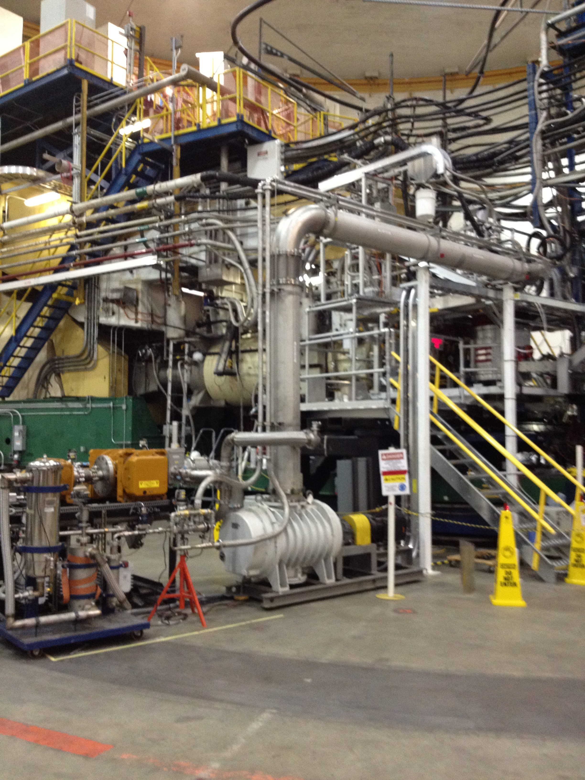
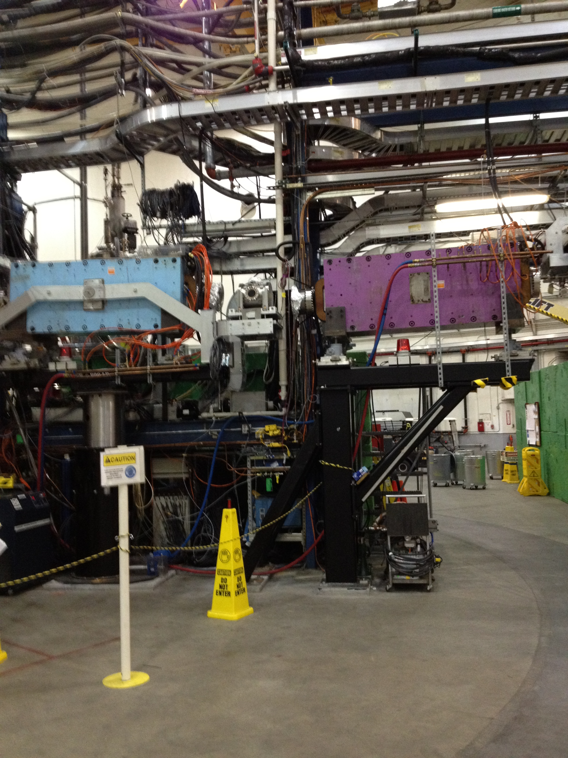
Hall A De-Installation

Slide 12
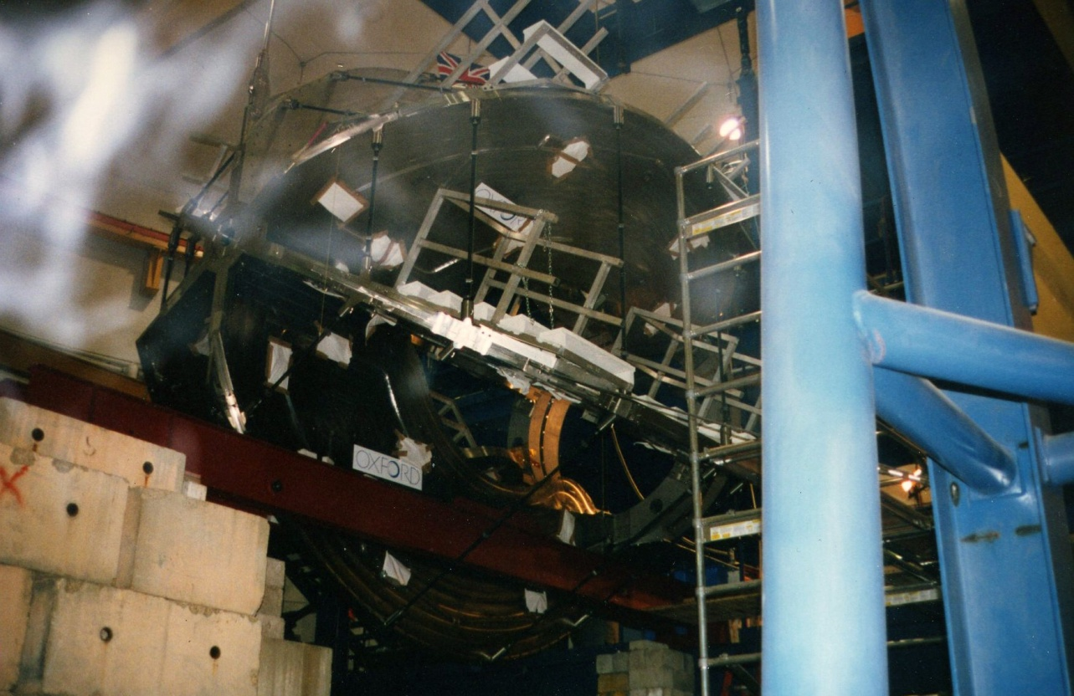
Hall B Torus and Drift Chamber Removal

Slide 13
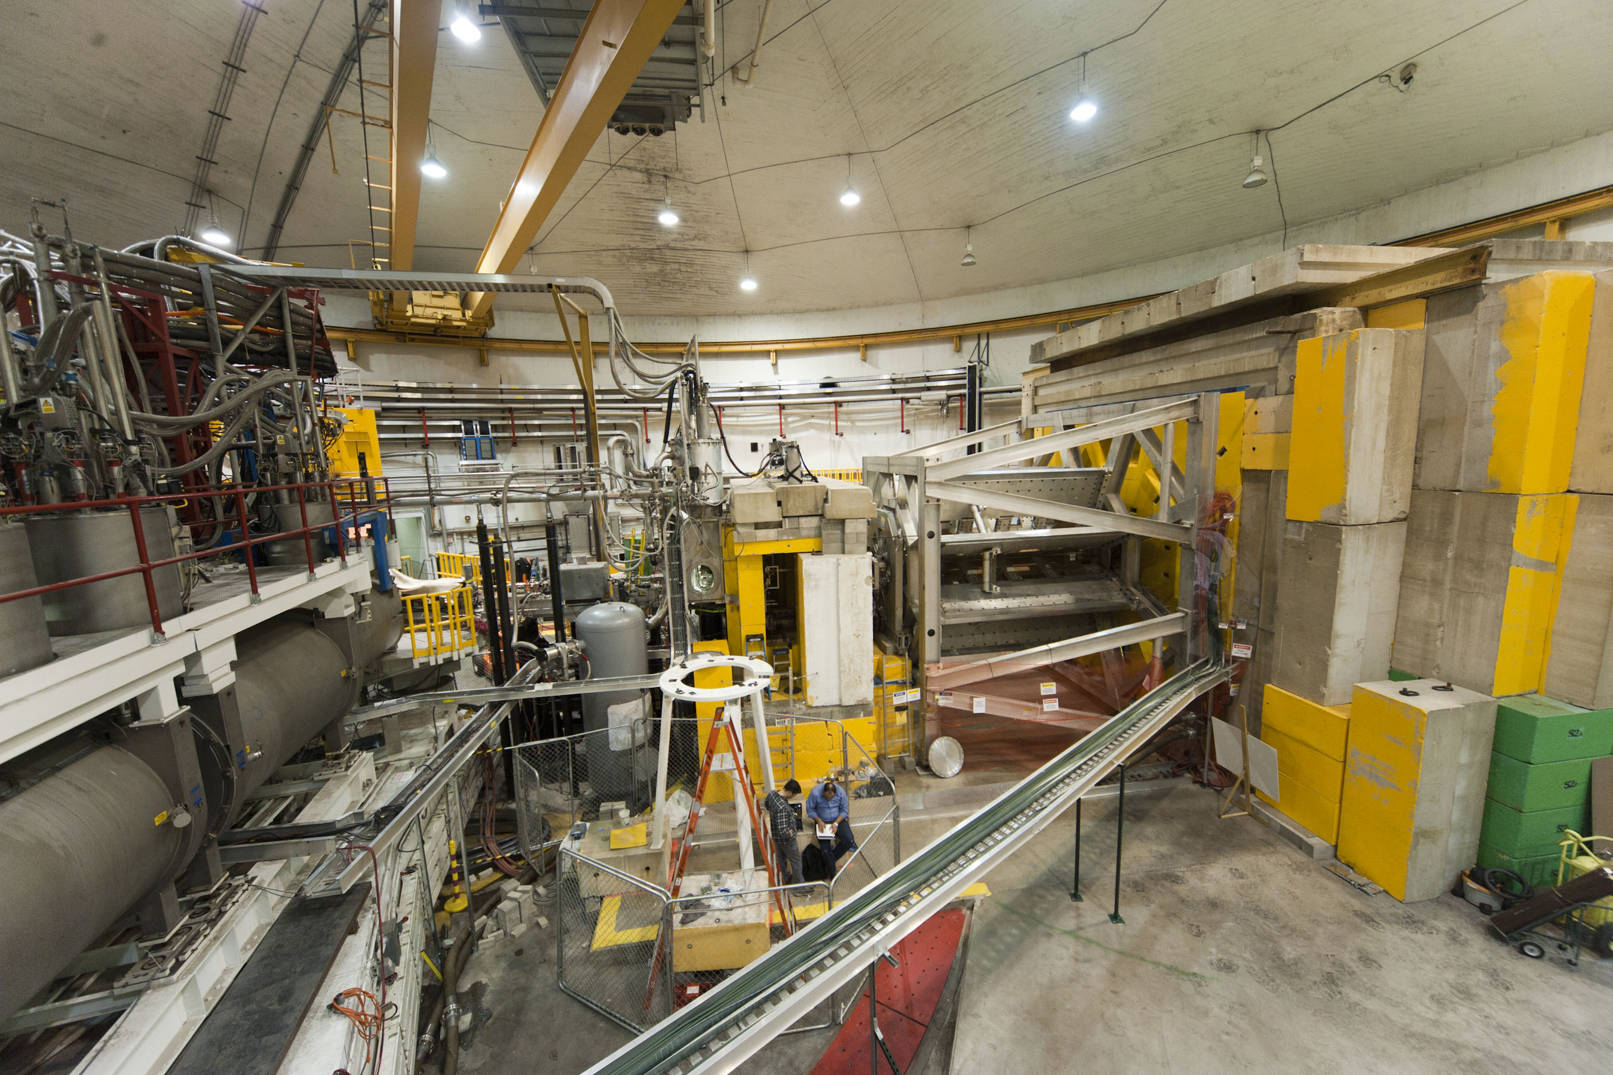
Hall C De-Installation

Slide 14
LSD Organization
Lab Director
LSD Coordinator
LSD Team
LSD Deputies
Project
Management
Scheduler
Integrated schedule
Field operations
Team: coordination, priorities, problem solving
Representation from all Lab parties with scope of work
Appropriate level
Integrated schedule
Risks tracking

Slide 15
LSD Team
LSD Coordinator F. Pilat
Physics W. Akers, R. Ent, J. Gomez
Accelerator S. Suhring, A. Freyberger
12 GeV Project - Physics G. Young & CAMS
12 GeV Project - Accelerator L. Harwood
FEL B. Legg
Facilities (FML) B. Sperlazza
Engineering W. Oren
Integration and Schedule D. Napier
ES&H M. Logue, D. Owen, K. Welch
Project Management H. Derby, P. Collins

Slide 16
LSD Integrated Schedule
Integrated schedule in Primavera software, over 2000 activities
Progressed every months
Change control
Cost not managed but labor costs
can be tracked
Responsibility = Project Manager
in charge of this scope/activity
% Complete - Progressed every month
(end of the month)
Resource IDs = resources required to
perform the scope/activity

Slide 17
Structure, Requirements and Constraints
Schedule Integration
Integration Engineers
D. Napier
Facilities
(B. Sperlazza)
R. Yasky
FEL
(B. Legg)
C. Whitlatch
Accelerator Maintenance and Operations
(S. Suhring)
L. Harwood
12 GeV Project CAM’s
J. Hogan
LSD: Integrated Project Schedule
F. Pilat
12GeV Project Schedule
C. Rode
W. Merz
Scheduler
L. Harwood
D. Arenius
M. Bevins
M. Spata
ESH&Q
(R. Owen)
Hall Coordinators
12 GeV Project
CAM’s
G. Young
E. Folts
J. LeRose
W. Akers
D. Kashy
L. Elouadrhiri
W. Kellner
H. Fenker
T. Carstens
E. Chudakov
Status and Reporting

Slide 18
Resource planning and leveling
Use detailed skill type built into the schedule for each activity
Identify manpower needs for each day
Calculate utilization factor
total hours per day for each activity / (# people available x 8 hours)
Utilization factor >= 1 identify problems (we used in fact 0.8)
The peaks are examined – especially for “challenge” resources.
Rule out possible mistakes (i.e. incorrect estimates, entry problem, etc.)
Convene project leaders competing for resources
Level resources demand by shifting activities which have float or adding manpower (Process effectively used for manpower plans)

Slide 19
Resource Graphs (Mech Vac Tech Example)

Slide 20
LSD Preparation Timeline
Weekly update meetings, November 2011 to May 2012
Define scope of work
Identify priorities
Build integrated schedule (Primavera)
Resource allocation and leveling (April 27)
Baseline (end April)
Lab all-hands scope/safety meeting (May 7-8)
Director review of baseline (May 16)
Shutdown start (May 18, day before Open House)

Slide 21
LSD execution
Daily coordination meetings at 8am
Weekly LSD Team meetings (long term planning)
Bi-weekly resource allocation meetings
Monthly schedule progressing
Monthly CCB (Change Control Board) meetings
Institution of Long Shut-Down Deputies
Re-baseline every ~5 months (adapting to funding levels and changes)

Slide 22
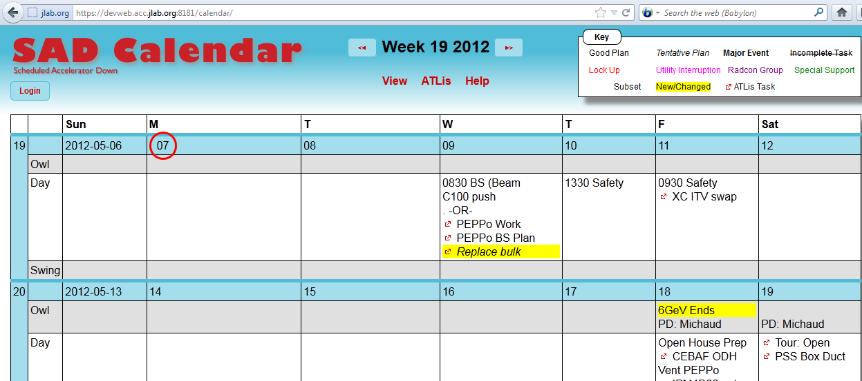
https://devweb.acc.jlab.org:8181/calendar/
https://www.jlab.org/div_dept/directorate/proj_mgmt/lsd/index.html

Slide 23
Conclusions
Successful planning and execution of the 6 month shutdown is the basis for the long shutdown organization
The preparation phase is almost done with the LSD starting on May 18
Critical for the success of the LSD
Adequate resources and funding
Managing an evolving schedule as needed
Careful integration of LSD and machine commissioning activities in the late phases of the LSD

