Slide 1
Experimental Facilities and Operations Metrics
Javier Gomez
Science & Technology Review
May 2012
Our Metrics
Individual Halls
Preparations for the Future

Slide 2
Our Metrics
Quality of Science (S&T Review)
Completed experiments
Number of publications
PhD theses
Availabilities of the halls

Slide 3
Experiments - Status & Completed
Four experiments taking data – g₂^{p}/G^{E}p (Hall A), HDice (Hall B) and, Qweak (Hall C)
A fifth PAC approved experiment, PEPPo, added to the schedule recently. Minimal impact on the 12 GeV upgrade schedule.
PEPPo uses only the injector. It is expected to have a dedicated run May 25 – June 8.
Hall | Start of Physics | Experiments Completed (full/partial) | Experiments Completed (equivalent)
C | 10/95 | 38/5 | 40.6
A | 5/97 | 64/0 | 64.0
B | 11/97 | 76/5 | 79.6
Totals | Today | 178/10 | 184.2
Totals | S&T 2009 | 155/14 | 162.7

Slide 4
Publications (Users/Staff) as 4/30/12
Publication | Calendar Year |  |  |  |  | Total
 | 08 | 09 | 10 | 11 | 12
Phys. Rev. Lett. Phys. Lett. | 7 | 10 | 13 | 13 | 6 (+1) | 179
Other Refereed Journals | 33 | 26 | 14 | 36 | 10 (+2) | 365
Invited Talks in Conf. Proc. | 29 | 29 | 20 | 23 | 6 (+2) | 278
Instrumentation Papers | 4 | 4 | 2 | 4 | 2 (+2) | 80
Contributed Papers | 24 | 60 | 17 | 34 | 49 (+19) | 676
Brackets indicate papers submitted, not yet published

Slide 5
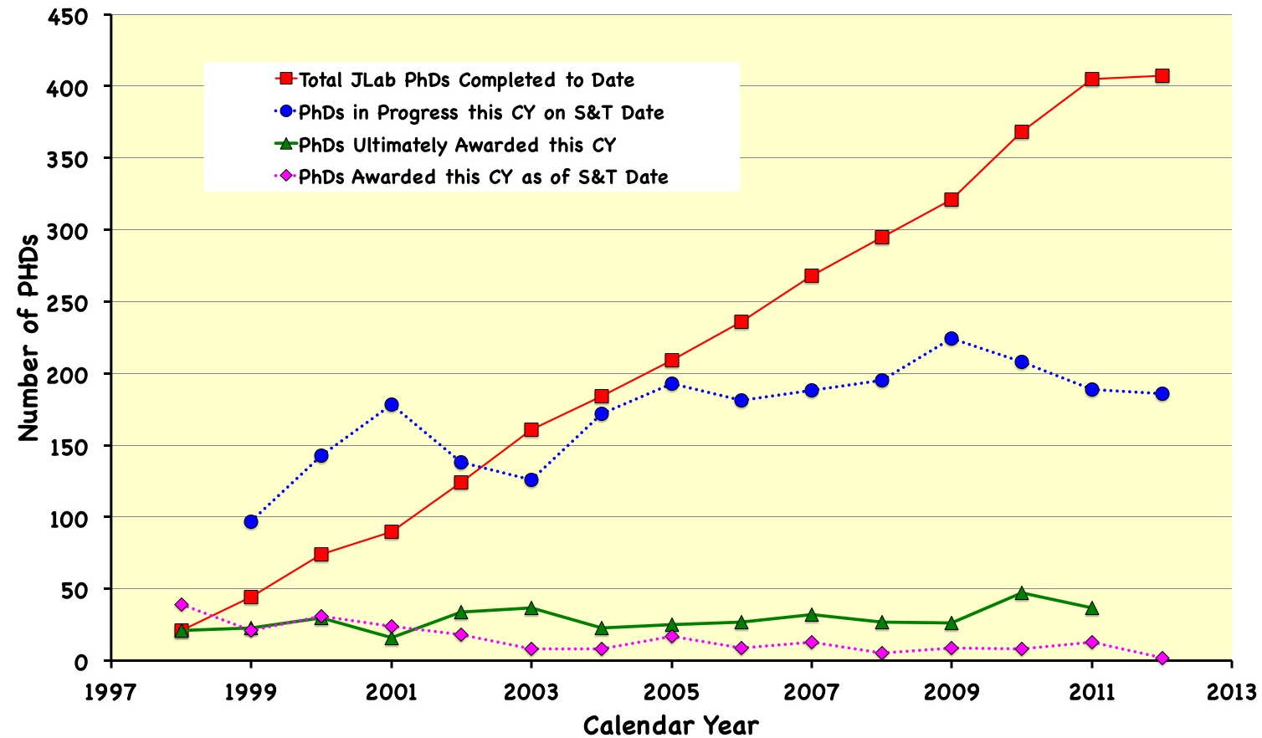
No. of PhDs Related to JLab Research
407
186
37
2

Slide 6
Since 2009 S&T Review
Metric | FY09 |  | FY10 |  | FY11 |  | FY12
Availability | Goal | Actual | Goal | Actual | Goal | Actual | Goal | 4/30
Accelerator | 78% | 75% | 77% | 77% | 76% | 80% | 74% | 75%
Hall A | 90% | 93% | 91% | 69% | 87% | 86% | 86% | 36%
Hall B | 91% | 89% | 91% | 82% | 89% | 66% | 88% | 76%
Hall C | 91% | 47% | 81% | 55% | 75% | 66% | 70% | 91%
Hall Weighted Average* | 91% | 78% | 89% | 73% | 83% | 72% | 81% | 68%
Operating Weeks | 34 | 33.3 | 35 | 34.7 | 34.3 | 29.9 | 26.5 | 22.2
Weighted Average – each Hall’s availability data is weighted by its expected contribution to the reported metric.

Slide 7
Availability #s
FY09 - Hall C
Polarized target magnet failure during the SANE exp. Target repaired and g₁^{d} measurement dropped to achieve full SANE goals.
FY10 - Hall A
Multiple failures caused by radiation damage (PREx) - data published albeit with statistical errors 2X experiment goal.
FY10 - Hall C
HKS experiment - Major installation with new spectrometer. Delays due to installation of beam transport line and backgrounds caused by the beam transport. Overcame problems & acquired all the anticipated data.
FY11 - Hall B
HDice - Target failed to reach operating temperature during Spring run. Run postponed to the Fall. Running well
FY11 - Hall C
Qweak - Largest installation yet in Hall C. Starting “growing pains”. Expected to achieve close to proposal goals.

Slide 8
Availability #s (cont.)
FY12 - Hall A
g₂^{p}/G^{E}_{p} polarized target failed - Rebuilt target. Will achieve main physics goals (low Q² points).
Summary
Driven by a Scientific Priorities schedule, the last three years have been characterized by a greater concentration of technically demanding experiments than had been typical for the first decade of operations while being constrained by the upcoming 12 GeV upgrade.

Slide 9
Individual Halls
Experiments + Few Highlights

Slide 10
Hall A - Experiments since 2009 S&T Review
Experiment | Title | Spokespersons
E05-109 | A Measurement of Nucleon Strange Form Factors at High Q² | Souder/Paschke
E08-011 | Parity Violation in Deep Inelastic Scattering at 6 GeV | Zheng/Reimer/Michaels
E06-002 | A Clean Measurement of the Neutron Skin of ²⁰⁸Pb Through Parity Violating Electron Scattering | Michaels/Souder/Urciuoli
E07-007 | Complete Separation of Deeply Virtual Photon and π⁰ Electroproduction Observables of Unpolarized Protons | Muñoz-Camacho/Bertin Hyde/Roche
E08-025 | Measurement of the Deeply Virtual Compton Scattering Cross-Section off the Neutron | Mazouz/Camsonne/Hyde

Slide 11
Hall A - Experiments since 2009 S&T Review (cont.)
Experiment | Title | Spokespersons
E08-010 | Measurement of the Coulomb quadrupole amplitude in the γ* p → Δ (1232) reaction in the low momentum transfer region | Sparveris/Gilad Higinbotham/Sarty
E07-006 | Studying Short-Range Correlations in Nuclei at the Repulsive Core Limit via the Triple Coincidence (e,e’pN) Reaction | Piasetzky/Gilad Higinbotham/Sulkosky Watson
E08-009 | Detailed Study of ⁴He Nuclei through Response Function Separations at High Momentum Transfers | Saha/Aniol/Benmokhtar Gilad/Higinbotham
E08-008 | Exclusive Study of Deuteron Electrodisintegration near Threshold | Norum/Bertozzi Gilad/Wang

Slide 12
Hall A - Experiments since 2009 S&T Review (cont.)
Experiment | Title | Spokespersons
E08-014 | Three-nucleon short range correlations studies in inclusive scattering for 0.8<2.8 (GeV/c)² | Solvignon/Arrington Day/Higinbotham
E08-027** | A Measurement of g₂^{p} and the Longitudinal-Transverse Spin Polarizability | Slifer/Camsonne/Chen
E08-007** | Measurement of the Proton Elastic Form Factor Ratio at Low Q² | Ron/Arrington/Day Gilman/Higinbotham Sarty
** In progress

Slide 13
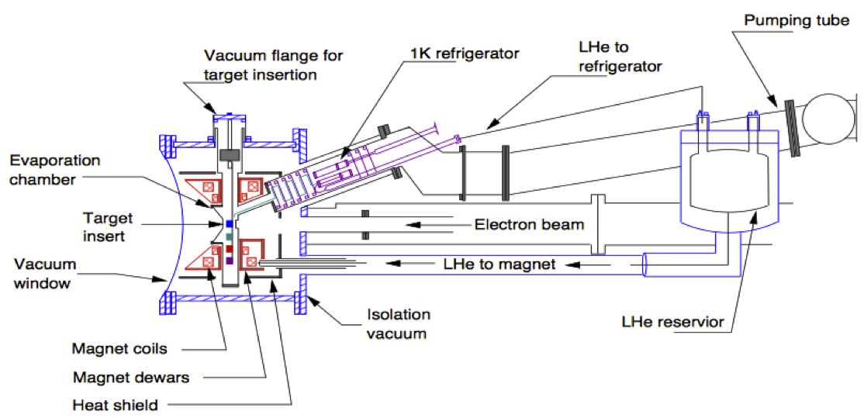
Hall A – g₂^{p}/G^{E}_{p} Target
Sept. 2011 - JLab/UVa polarized target magnet failed beyond repair.
Solution - “Transplant” Hall B polarized target magnet (field along beam) to work in the two configurations needed by Hall A - field direction 90° and 6° to beam.
Hall B Polarized Target
JLab’s target group completed successfully the modifications and many improvements by mid-February 2012:
New carbon fiber target stick (eliminated frequent jamming during insertion due to freezing)
Improved cooling & monitoring of temps and levels
New magnet rotation design allows to switch between transverse and longitudinal orientations in minutes instead of several hours for previous experiments.
90% polarization at 5T/1K
>50% pol. at 2.5T/1K (previous best was ≤40%).
Target reliability has been much higher than its predecessor due to the improvements made.

Slide 14
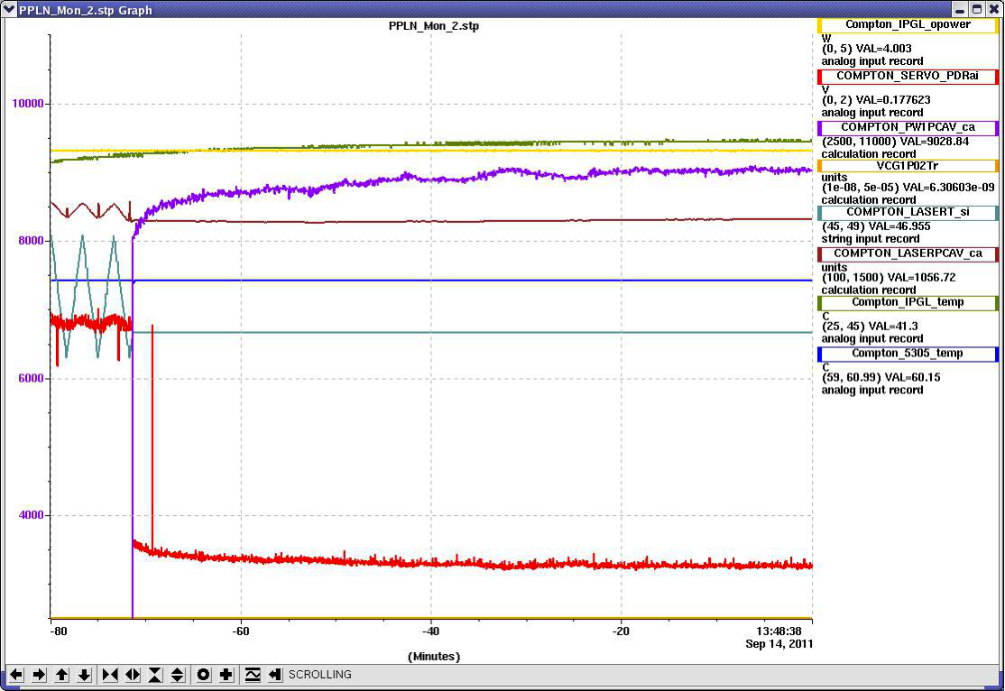
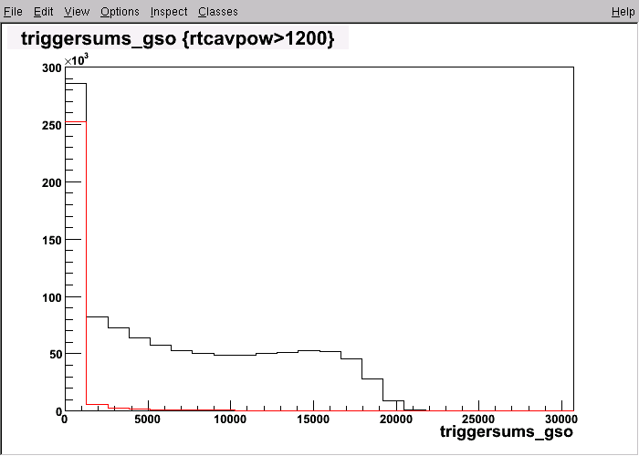
Hall A - Compton Fabry-Perot Cavity
Design
532 nm green laser
High gain Fabry-Perot cavity
1.5 kW stored power
Initial operation
> 2kW green power achieved (2010)
Installed and commissioned in Hall A
Successful Compton polarimetry for PREx
9.4 kW Lock acquisition
Recent Developments
Higher finesse mirror installed in 2011
>9kW cavity power achieved with 0.8W injection (~ 10⁴ gain)
Commissioned with beam during g₂^{p} exp.
>100 Signal/Background in photon calorimeter
Laser on
Laser off

Slide 15
Hall B - Experiments since 2009 S&T Review
Run Group | Physics Goals
eg1-dvcs (100%) E05-113/E05-114 | Semi-Inclusive Pion Production with a Longitudinally Polarized Target at 6GeV. Deeply Virtual Compton Scattering at 6 GeV with polarized target and polarized beam using the CLAS detector
eg6 (75%) E07-009/E08-024 | Meson spectroscopy in the Coherent Production on ⁴He with CLAS Deeply Virtual Compton Scattering off ⁴He
g9-Frost (100%) E02-112/E03-105/E04-102/E05-102/E06-013 (Transverse target pol.) | Search for Missing Nucleon Resonances in the Photoproduction of Hyperons Using A Polarized Photon Beam and A Polarized Target Pion Photoproduction from a Polarized Target Helicity Structure of Pion Photoproduction Measurement of Polarization Observables in eta-photoproduction with CLAS Meaurement of π+π- Photoproduction in Double-Polarization Experiments using CLAS

Slide 16
Hall B - Experiments since 2009 S&T Review (cont.)
Run Group | Physics Goals
PrimEx-II (100%) E08-023 | An updated High Precision Measurement of the Neutral Pion Lifetime via the Primakoff Effect
eg5 (100%) E04-116 | Beyond the Born Approximation: A Precise Comparison of Positron-Proton and Electron-Proton Elastic Scattering in CLAS
g14/HDice** E06-101 | N* Resonances in Pseudoscalar-meson photo-production from Polarized Neutrons in polarized H & D and a complete determination of the γn→Κ⁰Λ amplitude
** In progress

Slide 17
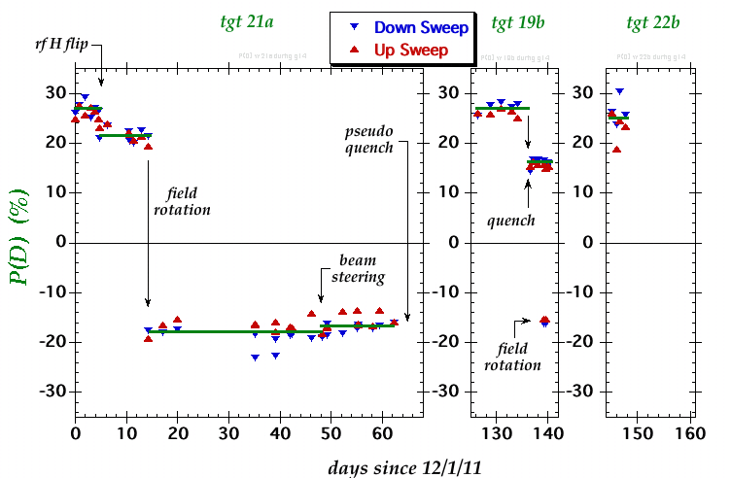
Hall B - Status of g14/HDice
Deuteron polarization (%)

Slide 18
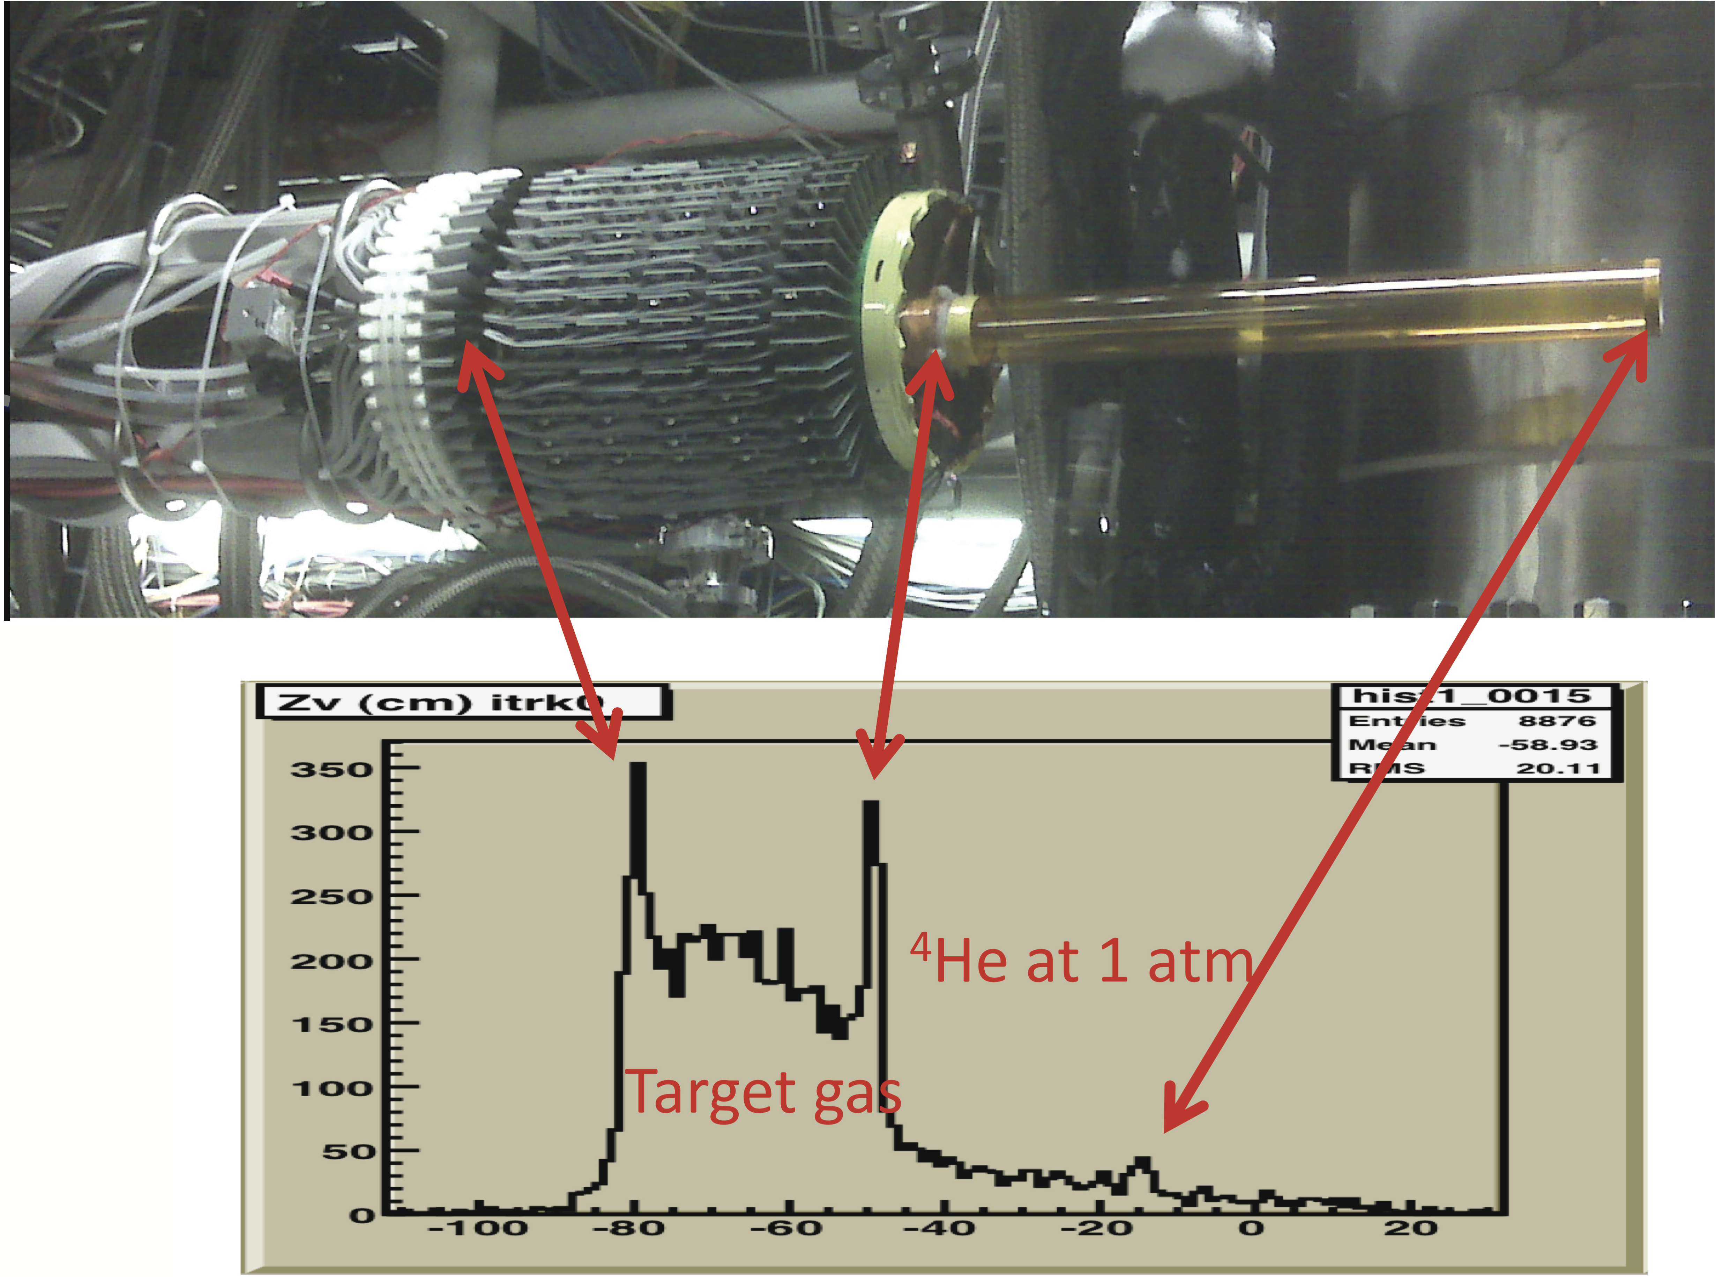
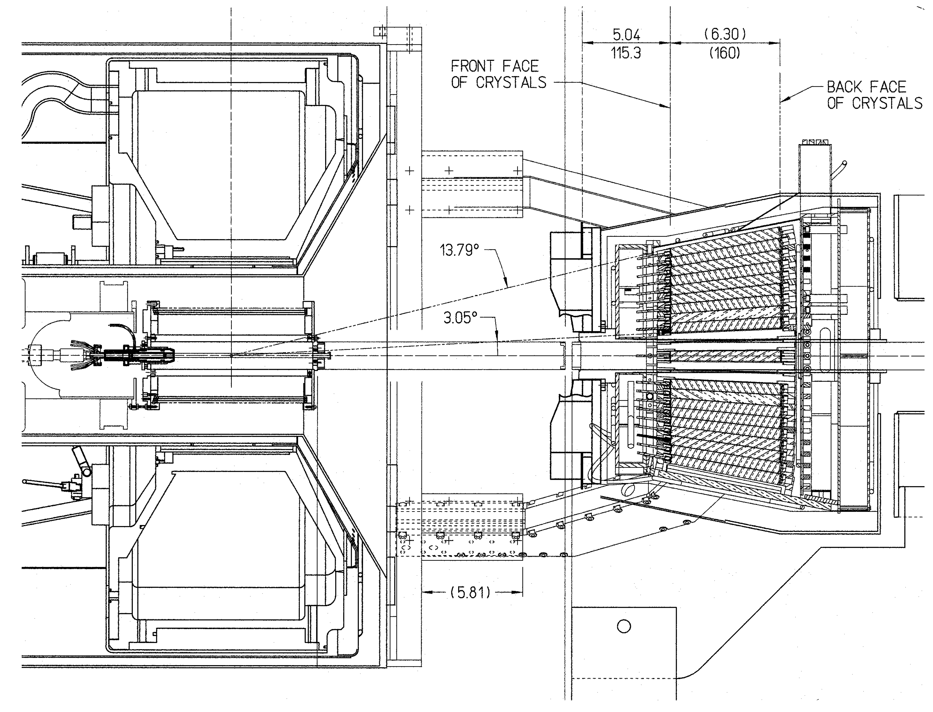
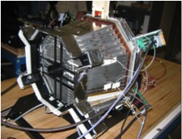
Hall B/eg6 CLAS + Additions
4.6 T Superconducting magnet for
momentum analysis & Moller electron
shielding
Radial Time Projection Chamber & Target
Beam
Inner Calorimeter

Slide 19
Hall C - Experiments since 2009 S&T Review
Experiment | Title | Spokespersons
E05-115 | Spectroscopic investigation of the hypernuclei in the wide mass region using (e,e'k⁺) reaction | Hashimoto/Nakamura Reinhold/Tang
E08-016** | The Qweak Experiment: A Search for New Physics at the TeV scale via a Measurement of the Proton's Weak Charge | Carlini/(Finn) Kowalski/Page
** In progress

Slide 20
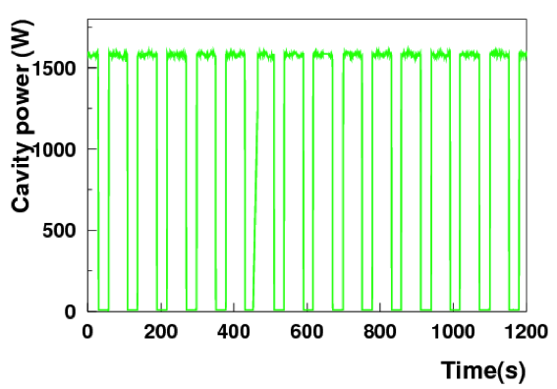
Hall C - Compton Polarimeter
Components
Laser: Low gain Fabry-Perot cavity pumped with 10 W green laser (UVa, JLab)
Photon Detector: Lead tungstate + LED system (Yerevan, W&M)
Electron Detector: Diamond strip detector (Miss. State, U. Winnipeg, Manitoba)
Dipole chicane and beamline modifications: (MIT-Bates, JLab)
Excellent laser performance
Stored laser power = 1.2 to 1.5 kW
Novel technique developed by UVa will allow knowledge of laser polarization in cavity to <0.4%

Slide 21
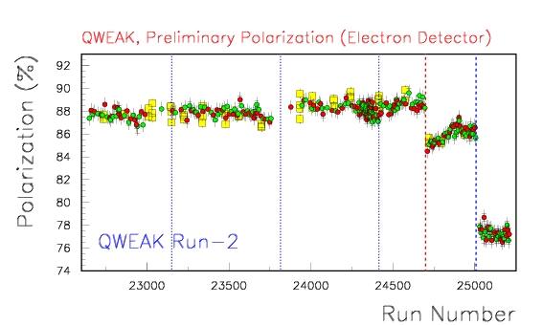
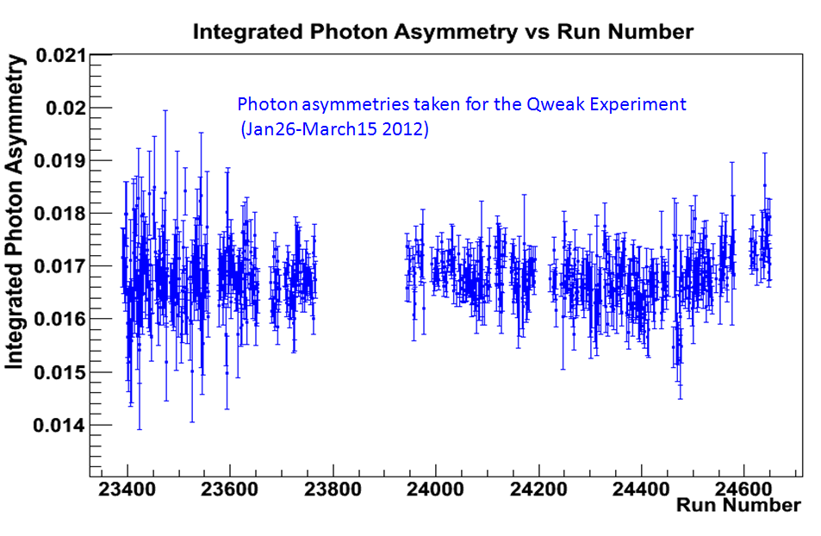
Hall C - Compton Performance
Electron detector performance improved for Run 2 w/new amplifier-discriminators, vacuum cables
Online results in good agreement with Møller
δP/P (stat) < 0.5% in 1 hour
On track for δP/P (syst) < 1%
Møller
Compton Electron detector
877 MeV
Lead tungstate photon detector w/active cooling in use for all of Run 2
Linearity and analyzing power still under study
Monitor relative asymmetry online – convert to absolute polarizations after LED linearity studies complete

Slide 22
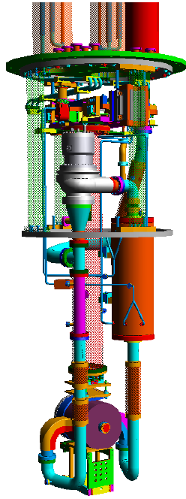
Hall C - The Qweak LH₂ Target
A very successful target design:
Achieves 46 ppm contribution to main detector width (noise) at 180 μA beam current, 4X4 mm² beam raster and 960 Hz helicity reversal rate.
Achieves 1.1 Kg/s mass flow (~ 15 l/s) with low head pressure (1.1 psi).
Achieves 3 kW cooling power.
Highly reliable - only significant problem was a bearing failure in more than 13 months of operation.
Validated the use of Computational Fluid Dynamics for the next generation of targets.

Slide 23
Preparations for the Future

Slide 24
CEBAF Online Data Acquisition
CODA is a suite of software and hardware components with which high speed data acquisition systems for experiments can be implemented. CODA versions 1 & 2 were used during the 6 GeV program
CODA version 3 is a major overhaul aimed to meet the 12 GeV online requirements. The main features are:
Use of “pipeline” electronics to allow trigger rates above 100kHz.
Completely rewritten readout code to handle the pipeline and allow Linux OS to be used on embedded processors.
Completely rewritten data transport software to take advantage of modern network hardware and allow data rates over 50 MByte/s from individual embedded processors.
A modular and parallel event building, monitoring and storage system to allow data rates in excess of 300 MByte/s to disk storage.
An agent based distributed control system to control hundreds of devices.
A publish and subscribe messaging system to bind it all together.
Status: Major components are implemented and being tested and debugged.

Slide 25
On-going Tests with Beam
CsI on GEM Cherenkov Prototype Test in Beam in Hall A
Tests of the Multi-Gap Resistive Plate Chamber (MRPC) in Hall A
Testing a Prototype Cherenkov Detector in Hall A
Hall D Beam Test of Forward Calorimeter (in Hall B)
Hall D Beam Test of Barrel Calorimeter (in Hall B)
Hall B Prototype Test for the CLAS 12 Forward Tagger
Test of Hall A SoLID Calorimeter Prototype under CLAS Photon Tagger
Hall B CLAS 12 Silicon Vertex Tracker Module Test in Beam
Heavy Photon Search Ecal Beam Test Using the Hall B Pair Spectrometer
Heavy Photon Search Test Run Using the Hall B Pair Spectrometer

Slide 26
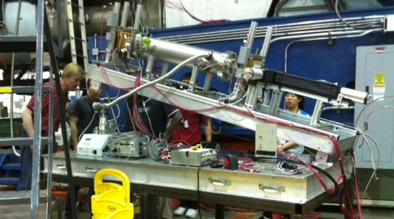
Hall A - Test of CsI on GEM Cherenkov Prototype
Being evaluated for several 12 GeV experimental programs (SBS, SoLID)
Cherenkov
CsI on GEM photocathode
1 meter CF₄ radiator
VUV Mirror
MgF₂ overcoated for reflection to 120 nm
Ultra High Purity recirculating gas system
< 1ppm O₂ and H₂O
Expect 20 photoelectrons/ring. Each photoelectron measured w/ 115 μm resolution.
EMCal
10X10 cm² GEM
Evaluate use of Scalable Readout System for Micro-Pattern Gas Detectors (MPGDs) (RD51 Collaboration) for GEM readout.
http://rd51-public.web.cern.ch/rd51-public/
Collaboration: Stony Brook University, University of Virginia, Jefferson Lab, Brookhaven Lab

Slide 27
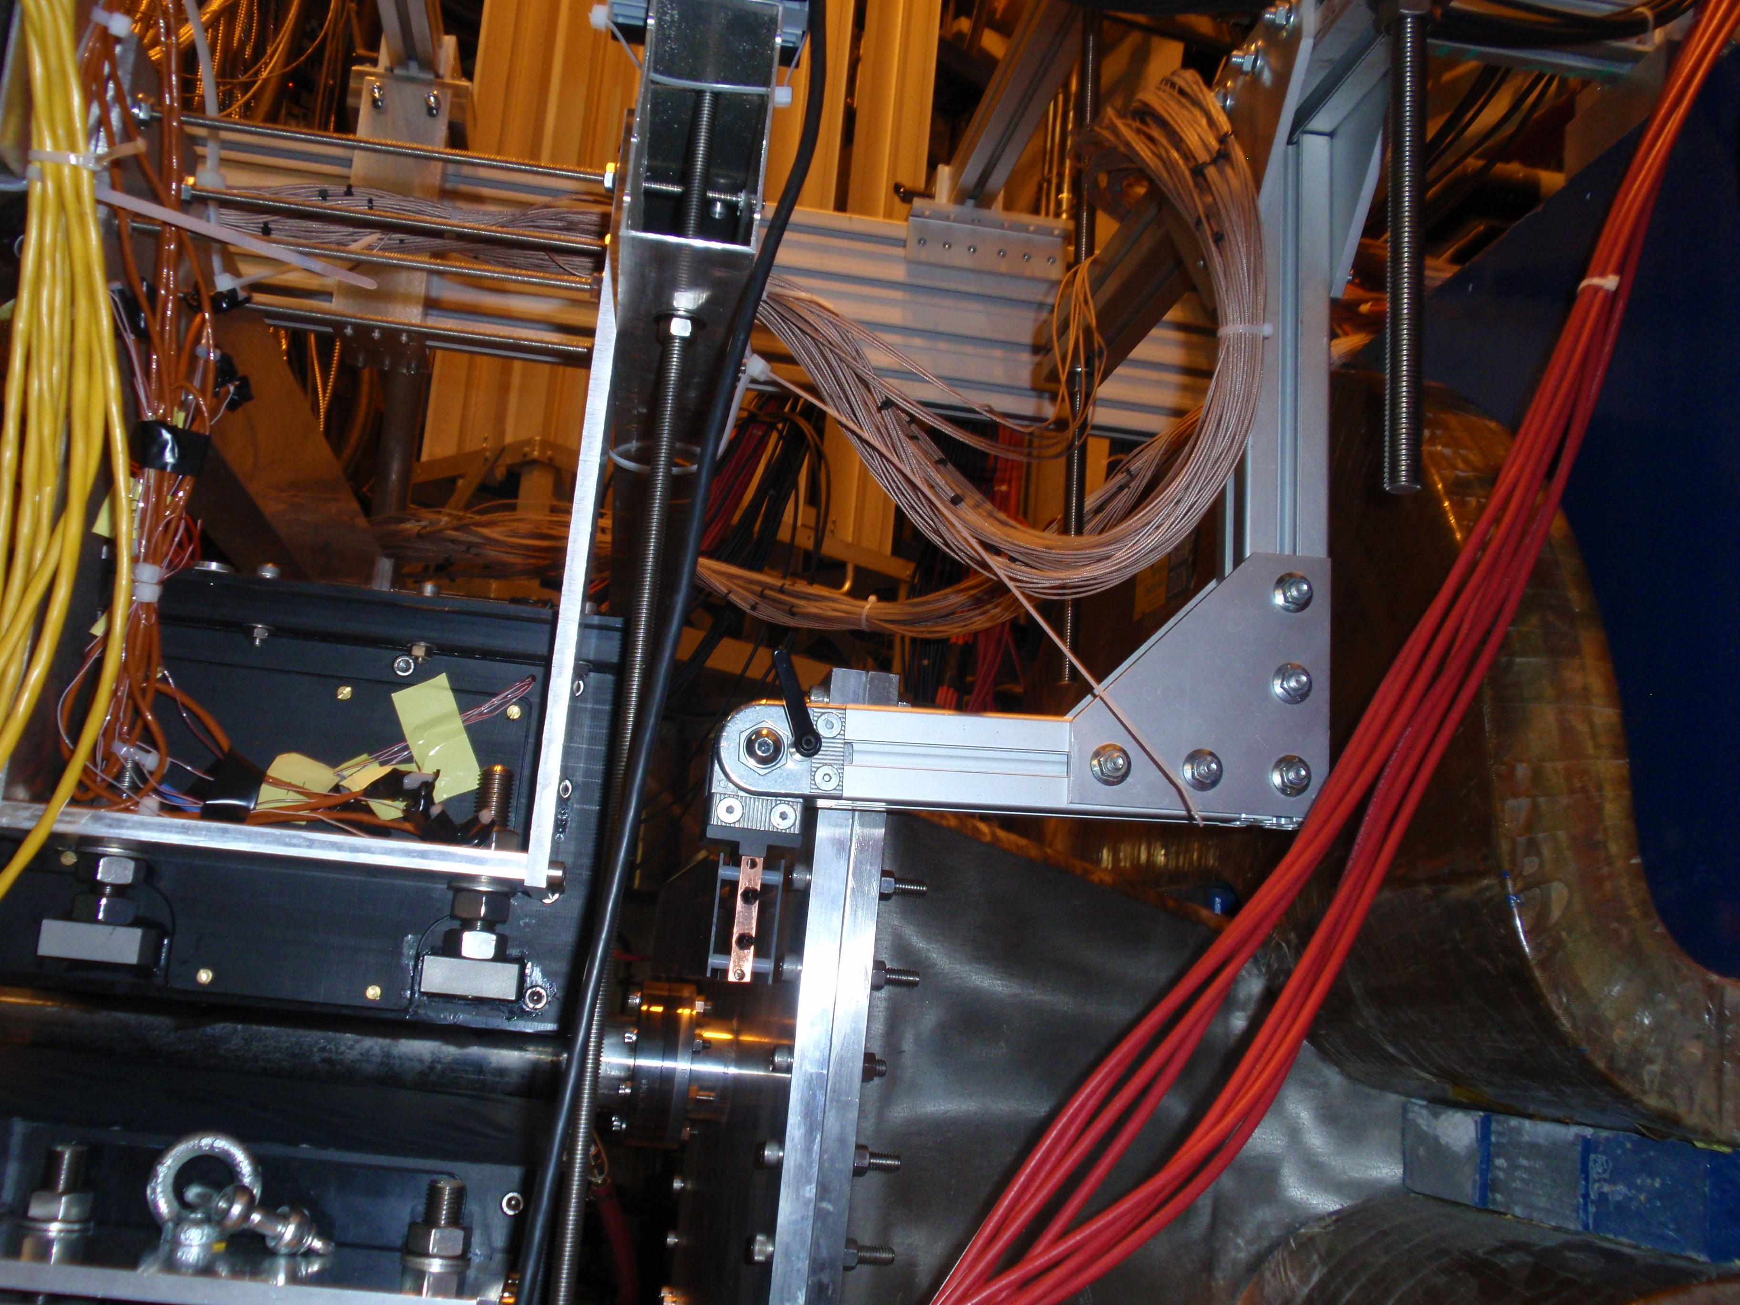
Hall B - CLAS 12 Silicon Vertex Tracker Module Test
Pair Spectrometer
magnet
CLAS 12 SVT Module
HPS-ECal
ϒ beam

Slide 28
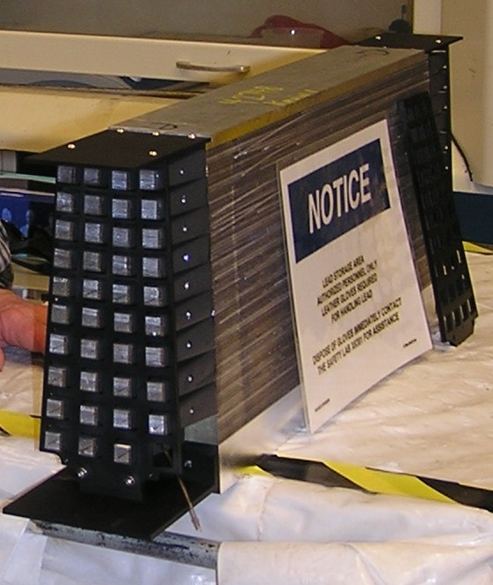
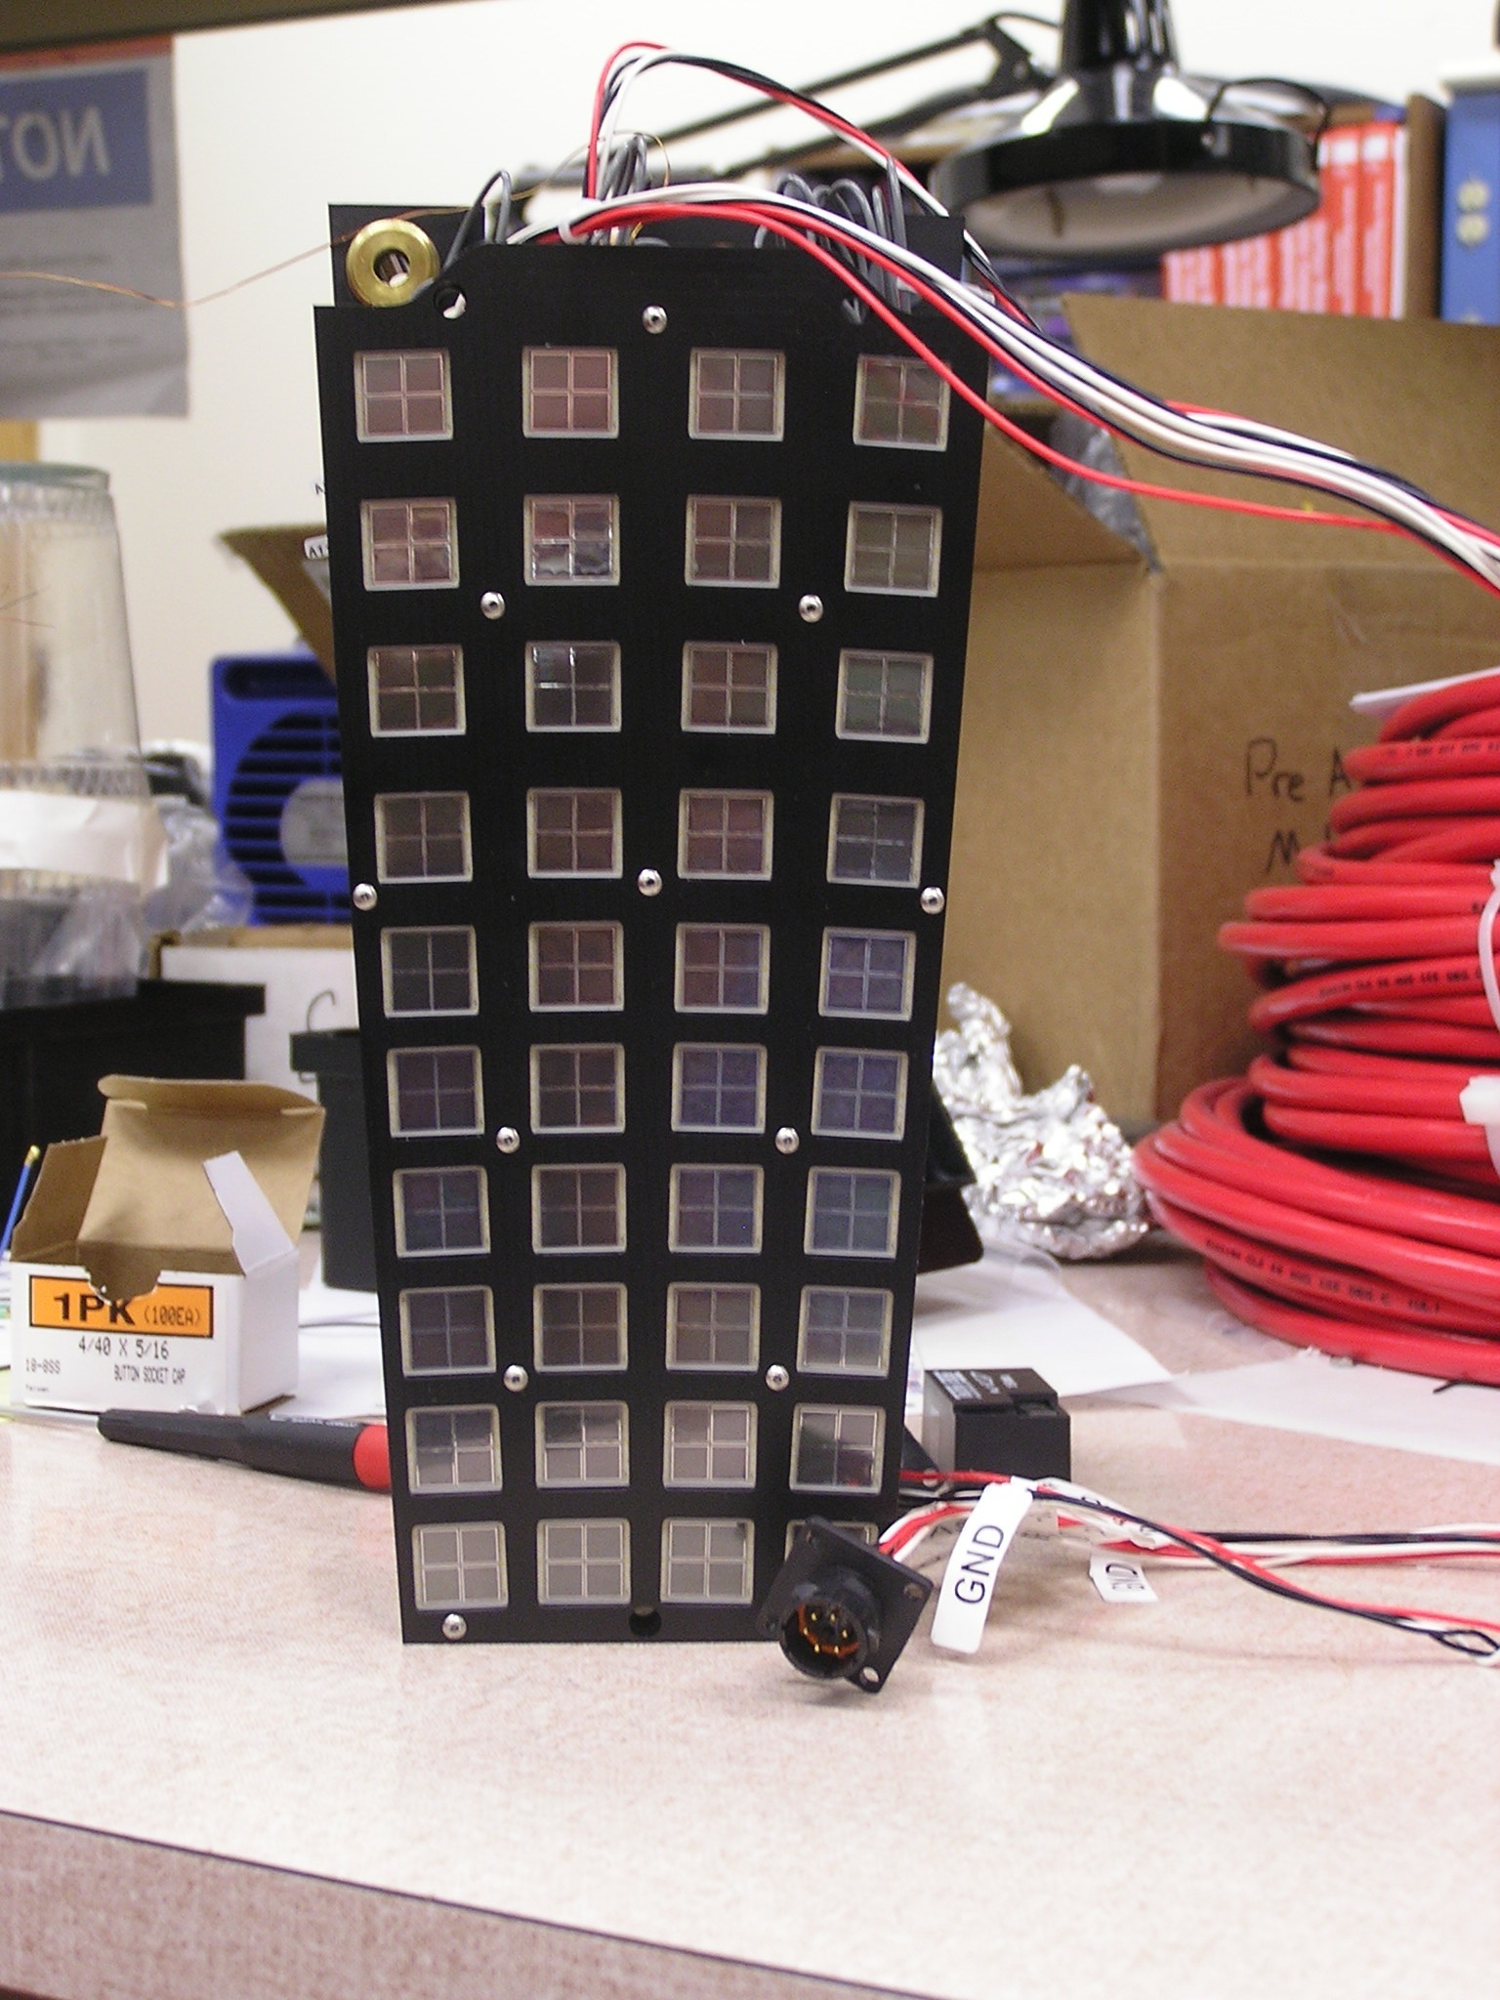
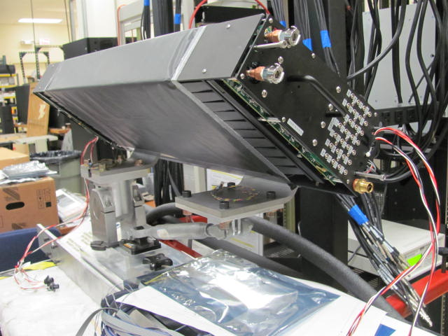
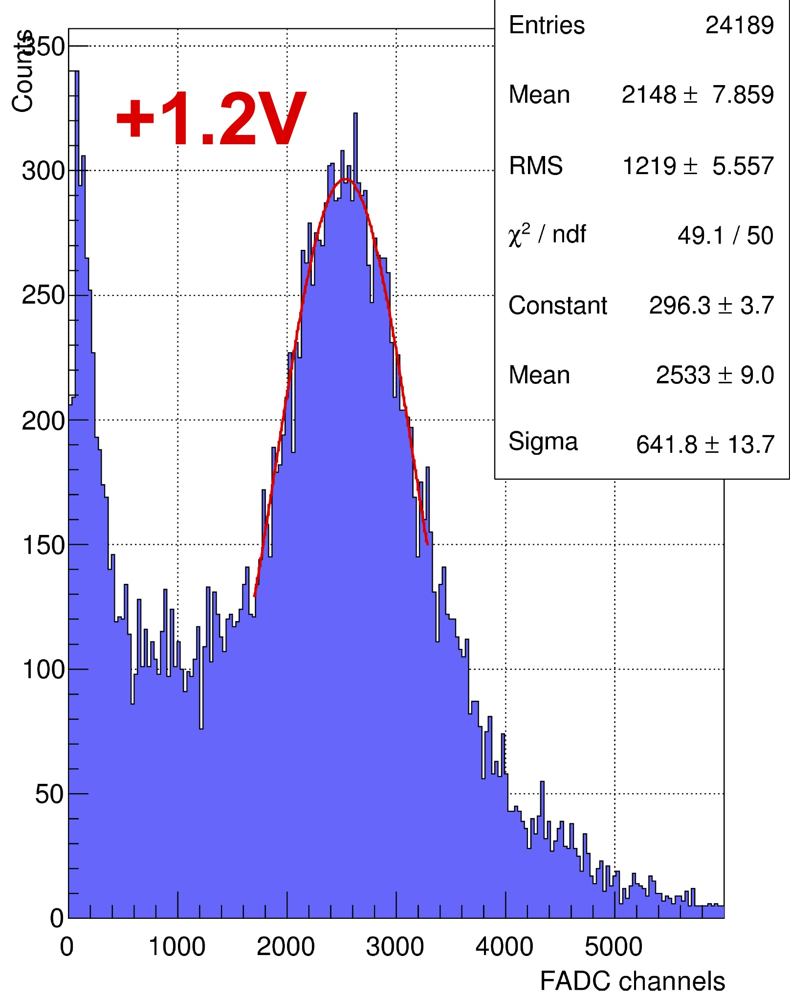
Test of Hall D Barrel Calorimeter (in Hall B)
Assembled Module
Module & fiber light guides
SiPM Readout
59 cm long instead of 390 cm of actual module, otherwise identical.
Fully instrumented – first test of actual SiPM readout including preamps, FADCs and cooling.
Placed underneath Hall B Tagger – module location determines electron energy. Orientation adjustable to obtain normal electron incidence.

Slide 29
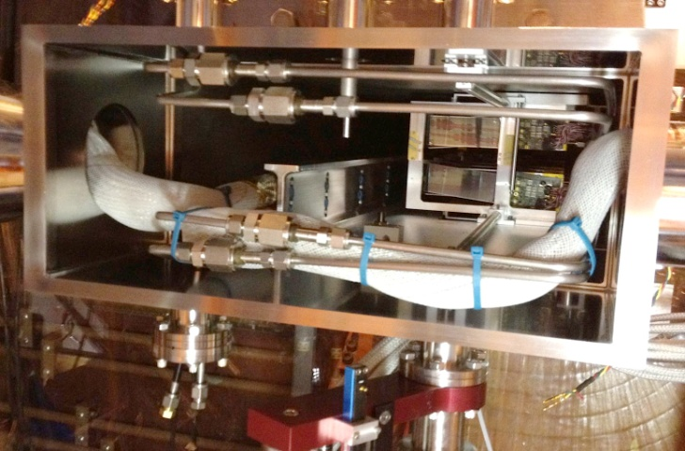
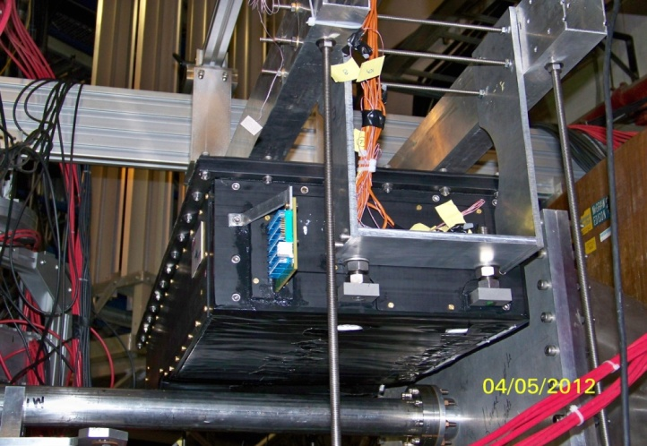
Hall B - Heavy Photon Search Test Run
Snapshot:
HPS-Si tracker installed in the vacuum box inside the Hall-B pair spectrometer magnet.
HPS-ECAL 10cm behind the vacuum chamber flange.
Si tracker DAQ and ECAL integrated to JLAB & operational.
Control software in place. Developing Run Control (e.g. alarms, warnings & procedures)
Trigger debugging in progress (single cluster trigger already functional)

Slide 30
Summary
Very productive three years in all three halls - nearing successful completion of “6 GeV program” including very demanding set of experiments.
Solid record of publications and PhD thesis based on JLab research.
Have and continue developing leading edge technology to make possible the next generation of experiments – pipelined electronics, DAQ, targets, detectors, …
Well in our way to implement the instrumentation required for the 12 GeV upgrade
Potentially high-impact experiments already waiting eagerly for the 12 GeV era beam.

