Slide 1
The Jefferson Lab Users Group Report
Zein-Eddine Meziani (Past chair, UGBoD)
For
Sebastian Kuhn (Chair, UGBoD)
Old Dominion University
https://wiki.jlab.org/cugwiki

Slide 2
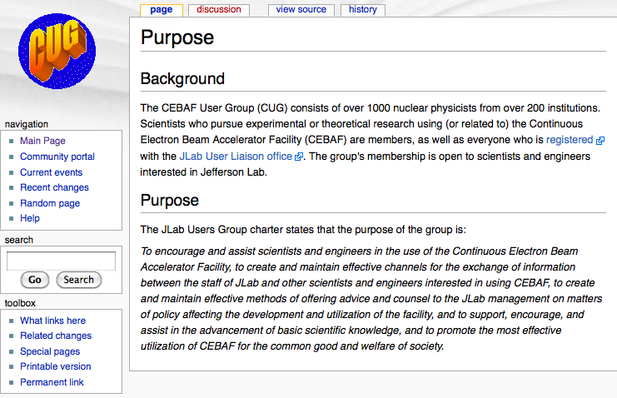
WHO is the Users Group?
The Jefferson Lab User Group is the organization of all scientists (including students, postdocs, and JLab staff) who conduct experimental, theoretical or applied research at Jefferson Lab or using Jefferson Lab facilities.
https://wiki.jlab.org/cugwiki

Slide 3
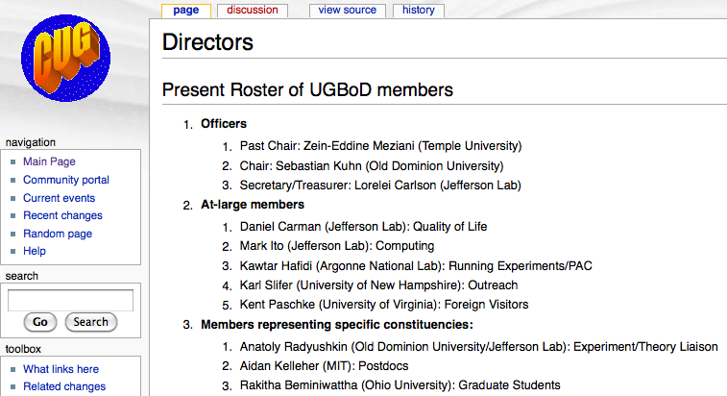
User Group Board of Director (UGBoD)
Elections in Spring 2012:
Chair elect, 3 at-large members, Postdoc and Graduate Student Rep.
UGBoD:
Represents all Users to the Jefferson Lab Management, JSA, and outside stakeholders
Runs competitions (Thesis Prize, Postdoc Prize, Poster Prize…
Runs the Annual User Meeting and two satellite meetings (APS April and DNP Fall meetings)
Follows up on User input, complaints, comments…
Helps JSA to select proposals for the annual JSA initiatives fund
Meets twice annually with Jefferson Lab leadership
Has members representing various areas of responsibility which are elected for two-year terms by the user community
https://wiki.jlab.org/cugwiki
Notes:
*) Short-term replacement

Slide 4
Recent Users Group Board Activities
Organized and held the annual Users Meeting (including Larry Cardman’s retirement symposium) (June, 2011). During the Meeting: Selected and awarded Poster Prize winners
Evaluated the JSA initiative proposal from users (August, 2011)
Held satellite meeting during the APS DNP Fall Meeting in East Lansing, Michigan (October, 2011)
Selected the winner of the 2012 postdoc prize (February, 2011)
Evaluated submitted theses from graduate students nominated for the 2011 thesis prize.
Nominated new members to the board through a nomination committee (elections April to early May)
Organized and held “Users Town Meeting” (March 16, 2012) at Jefferson Lab
Science exhibition on Capitol Hill (March 28-29, 2012) (organized by NUFO); Aidan Kelleher (UGBoD postdoc rep) attended
Held satellite meeting at the APS April Meeting in Atlanta, GA (April, 2012)
Received feedback from the user community and helped resolve any issues through discussions with Lab management and JSA / SURA
Two UGBoD meetings annually at Jefferson Lab

Slide 5
Interaction with JSA Programs Committee
UGBoD Chair takes part in 2 annual meetings and reports on User Group activities (last meeting: St. Petersburg, FL)
UGBoD evaluates user-submitted proposals (usually in August) and passes along ratings and comments to Programs Committee
junior scientist travel support, postdoc interview training, graduate student organziation
topical workshops, collaborative efforts
JLab and JSA-generated initiatives (e.g. Outstanding Nuclear Physics Award – first awarded to Bill Bertozzi in June 2011)
JSA Initiatives funds several User Group activities
Two Satellite Meetings per year - in Fall 2011, APS/DNP Meeting in Lansing and in Spring 2012, APS April meeting in Atlanta. Presentations by UGBoD Chair and Jefferson Lab leadership, Q&A
Postdoctoral Prize
Thesis Prize
Users Group Annual Meeting (+Poster Competition, Student lunches)

Slide 6
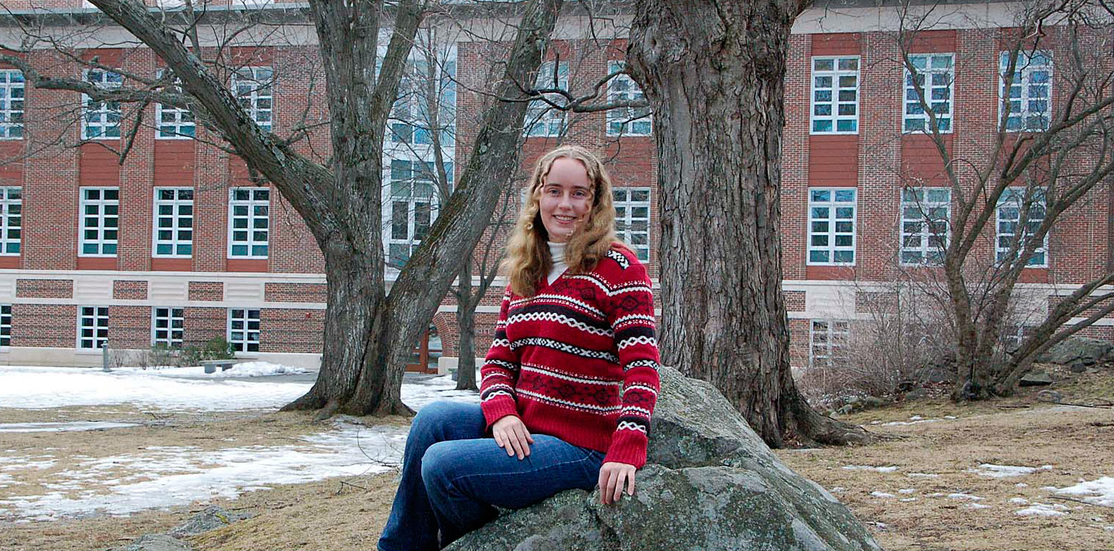
JSA Postdoctoral Research Prize
Winner 2012: Sarah Phillips
Criteria: a record of accomplishment in physics, a planned high-impact Jefferson Lab physics program, and promise of further accomplishments in the Jefferson Lab research fields in the future.
Sarah will speak at the June 4-6, 2012 Users Meeting
Board expects that we will have a new winner each year – previous winners will not be eligible to win again
THANKS to Jefferson Science Associates for funding this award
Project: Produce and detect “true muonium” µ⁺µ⁻ using the HPS experiment in Hall B
Next Deadline: Probably early January, 2013

Slide 7
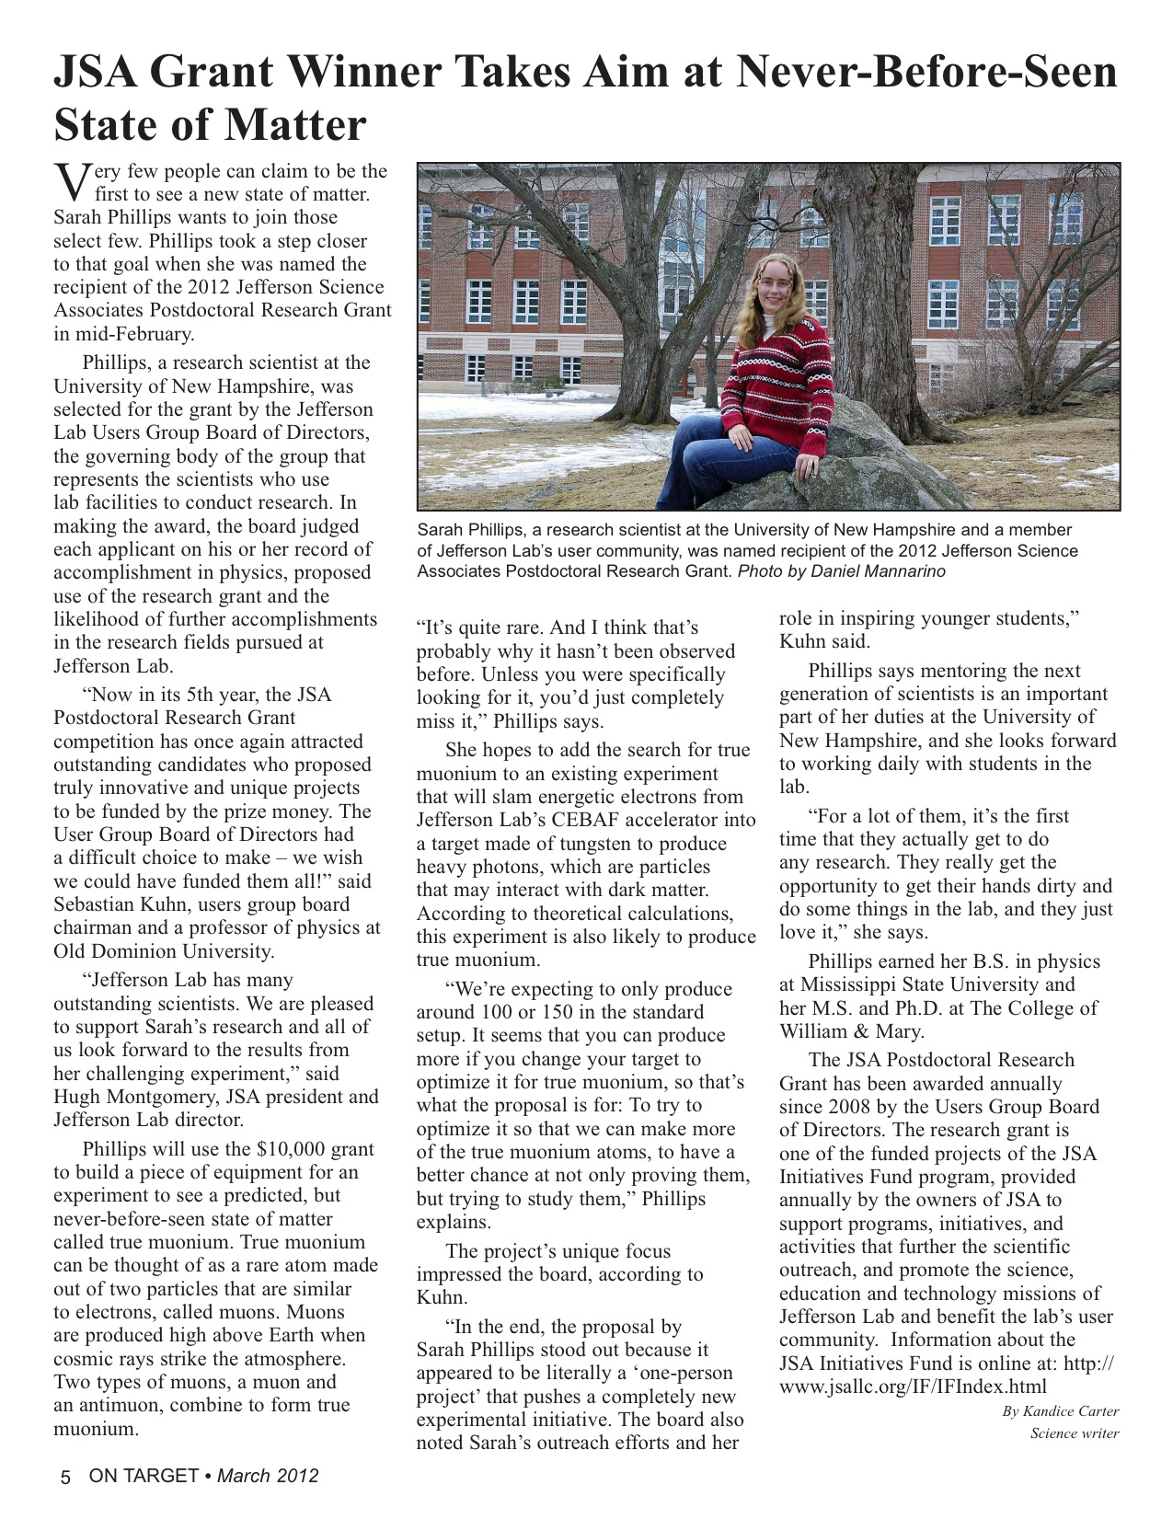

Slide 8
Thesis Prize
Last year’s winner was: Xin Qian (Duke University, now at CALTECH)
Received 10 applications for 2011. UGBoD selected three finalists which are evaluated by selection panel: Doug Higinbotham, Hari Areti and Carl Carlson
Winner will be announced at 2012 User Group Meeting and will give a presentation
Thanks to the UGBoD and final judging panel and JSA for funding
Criteria for evaluation: quality of written thesis (40%), contribution of student to work (30%), impact of work (15%), service to JLab physics (15%)
Next deadline: Probably January 31st 2013
Theses completed in 2012 or the last quarter of 2011 will be eligible

Slide 9
UGBoD Elections
Elections during April and early May
Great candidates thanks to Nominating Committee:
M. Eric Christy (HU), chair
Raffaella DeVita (Genova)
Ron Gilman (Rutgers)
Beni Zihlmann (Jefferson Lab)
2 candidates for chair-elect (will become chair in 2013)
John Arrington (Argonne)
Chaden Djalali (South Carolina)
7 candidates for 3 at-large positions, 2 candidates each for postdoc rep. and graduate student rep.

Slide 10
Outreach
Participated with poster in Science exhibition on Capitol Hill (March 28-29, 2012) (organized by NUFO)
Aidan Kelleher (UGBoD postdoc rep) attended

Slide 11
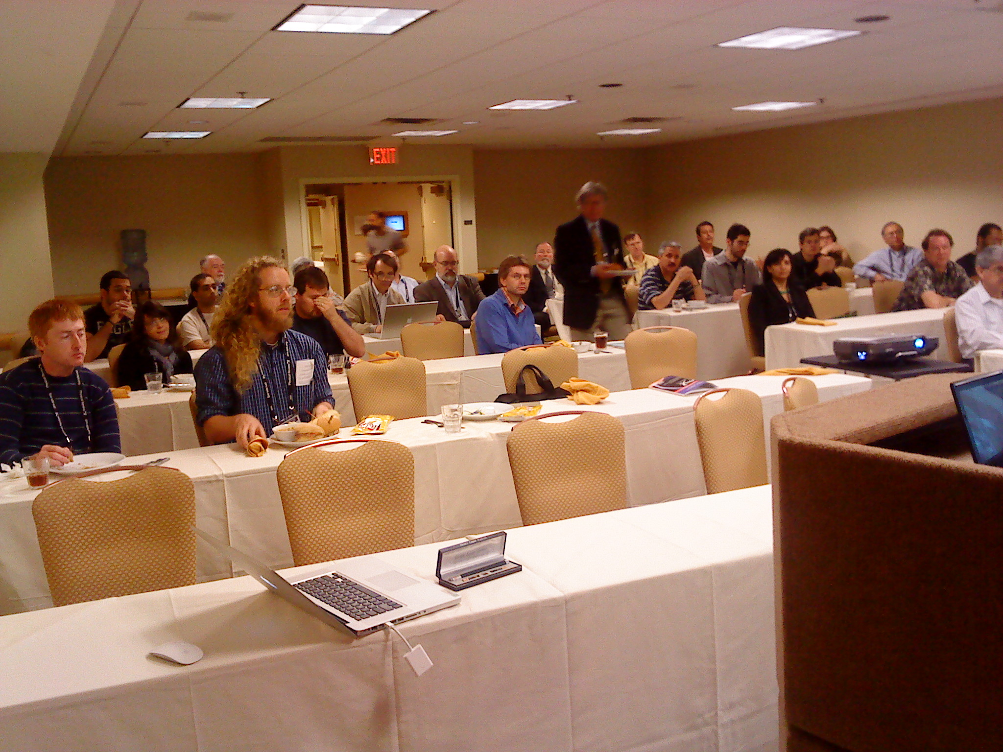
Satellite Meeting
User meeting at APS April meeting in Atlanta
Presentations by Bob McKeown, Rolf Ent, Robert Edwards and Sebastian Kuhn

Slide 12
Users concerns and feedback
Recent and Ongoing issues
User space, storage and amenities; refurbishing of Counting House
Data transfer from and to JLab
Lingering aftermath of “cyber event”, web redesign
Student and visitor health insurance
Reaching out to Congress to advocate for continued funding
New student orientation, supervision
PAC, DNP nominations,…
Recent important decisions
One PAC / year in summer (until begin of 12 GeV experiments)
New user space in ARC building
Begin implementation of “hoteling software”

Slide 13
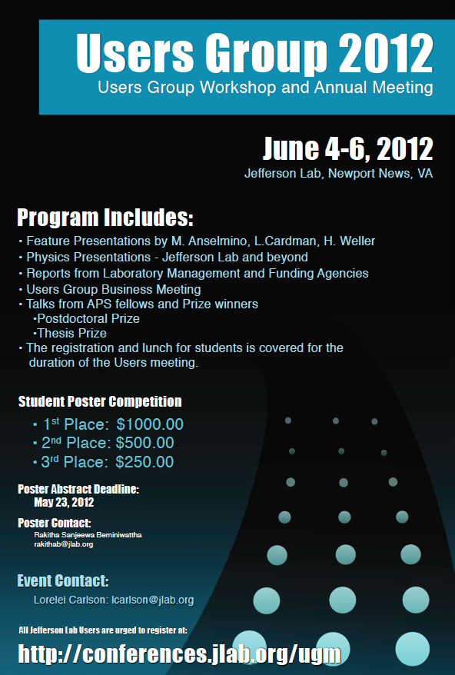
Coming up:
Several distinguished speakers, incl. S. J. Gates, Jr., M. Anselmino, L. Cardman, Renee Fatemi and H. Weller,
Main topic: end of the 6 GeV era at Jefferson Lab
Presentations from funding agencies, lab management, prize winners and users
Special program for students (thanks to JSA): Lunch talks, Poster competition, free registration
Program nearly complete – first announcement will go out shortly
Will be followed by UGBoD meeting (outgoing+incoming members)

Slide 14
Conclusion
The User Group is active and the Board of Directors is busy working for the benefit of the Users
Management is responsive to the users and helps in nurturing a strong scientific user activity. Some areas (e.g., computing and data exchange) may need further improvement.
Next Users Meeting: June 04-06, 2012.

