Slide 1
MEIC Machine Design
Yuhong Zhang
Science & Technology Review, May 9th – 11th, 2011

Slide 2
Outline
Introduction
MEIC Baseline Design
Accelerator R&D
Summary

Slide 3
Introduction: EIC as JLab’s Future
JLab’s fixed target program after 12 GeV CEBAF upgrade will be world-leading for at least a decade.
A Medium energy Electron-Ion Collider (MEIC) at JLab will open new frontiers in nuclear science.
The timing of MEIC construction can be tailored to match available DOE-NP funding while the 12 GeV physics program continues.
MEIC parameters are chosen to optimize science, technology development, and project cost. We maintain a well defined path for future upgrade to higher energies and luminosity.
A conceptual machine design has been completed, providing a base for performance evaluation, cost estimation, and technical risk assessment

Slide 4
MEIC Design Parameters
Energy (bridging the gap of 12 GeV CEBAF & HERA/LHeC)
  Full coverage of s from a few 100 to a few 1000
  Electrons 3-11 GeV, protons 20-100 GeV, ions 12-40 GeV/u
Ion species
  Polarized light ions: p, d, ³He, and possibly Li
  Un-polarized light to heavy ions up to A above 200 (Au, Pb)
Up to 3 detectors
Luminosity
  Greater than 10³⁴ cm⁻²s⁻¹ per interaction point
  Maximum luminosity should optimally be around √s=45 GeV
Polarization
  At IP: longitudinal for both beams, transverse for ions only
All polarizations >70% desirable
Upgradeable to higher energies and luminosity
  20 GeV electron, 250 GeV proton, and 100 GeV/u ion

Slide 5
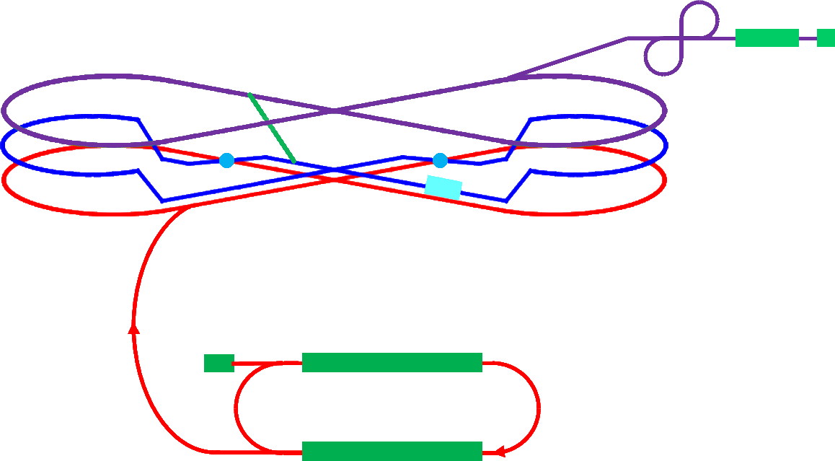
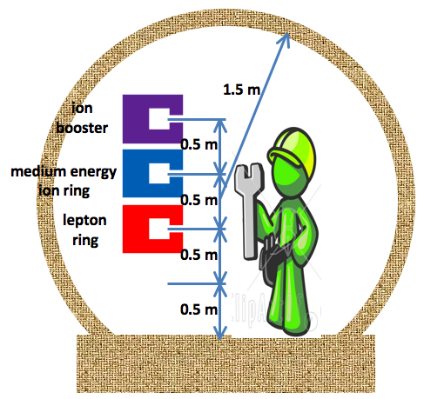
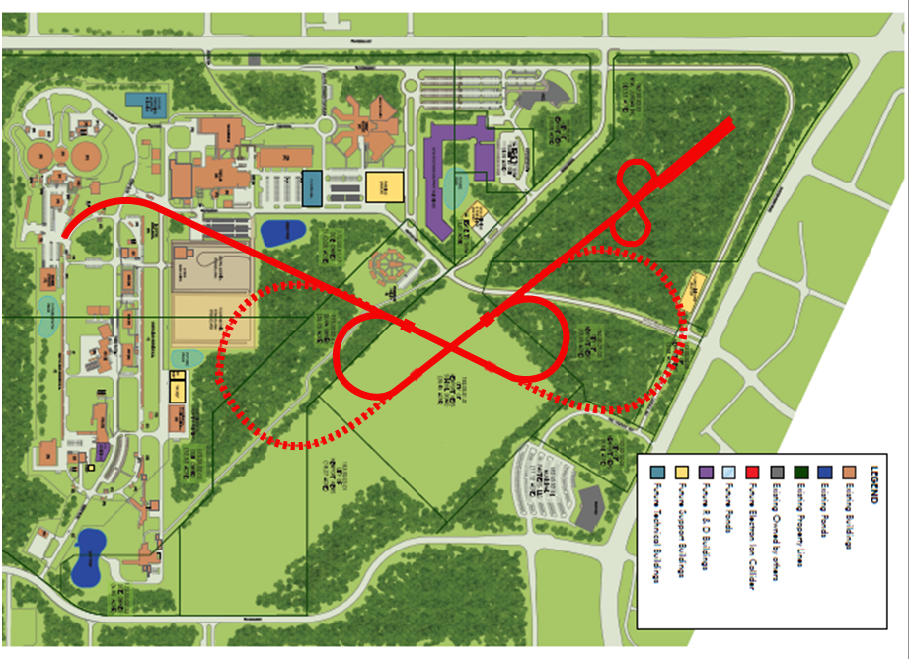
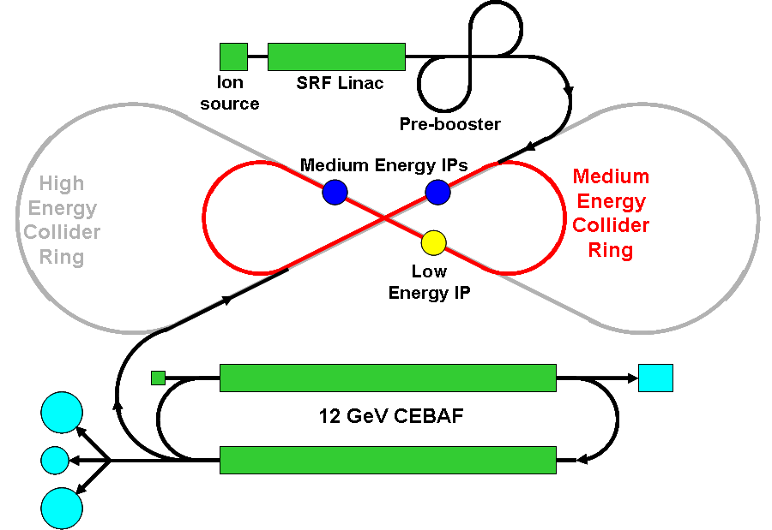
MEIC Schematic Layout
Pre-booster
Ion
source
Warm large booster
(up to 20 GeV)
transfer beam line
SRF linac
Three compact figure-8 rings stacked vertically
Medium energy IP
Electron collider ring
(3 to 11 GeV)
Cold ion
collider ring
(up to 100 GeV)
Injector
12 GeV CEBAF
Full energy collider rings

Slide 6
Design Features: High Luminosity
Based on high bunch repetition rate CW colliding beams
  Very high bunch repetition rate Very small bunch charge
  Very short bunch length Very small β*
  Crab crossing Small transverse emittance
A proved concept: KEK-B @ 2x10³⁴ /cm²/s
JLab will replicate the same success in colliders w/ hadron beams
  The electron beam from CEBAF possesses a high bunch repetition rate
  Ion beams from a new ion complex can match the electron beam
 |  | KEK-B | MEIC | eRHIC
Repetition rate | MHz | 509 | 748.5 | 13.1
Particles per bunch (e⁻/e⁺) or (p/e⁻) | 10¹⁰ | 3.3 / 1.4 | 0.42 / 2.5 | 20 / 2.4
Beam current | A | 1.2 / 1.8 | 0.5 / 3 | 0.42 / 0.05
Bunch length | cm | 0.6 | 1 / 0.75 | 8.3 / 0.2
Horizontal & vertical β* | cm | 56 / 0.56 | 10/2 to 4/0.8 | 5 / 5
Beam energy (e⁻/e⁺) or (p/e⁻) | GeV | 8 / 3.5 | 60 / 5 | 250 / 10
Luminosity per IP, 10³⁴ | cm⁻²s⁻¹ | 2 | 0.56 ~ 1.4 | 0.97

Slide 7
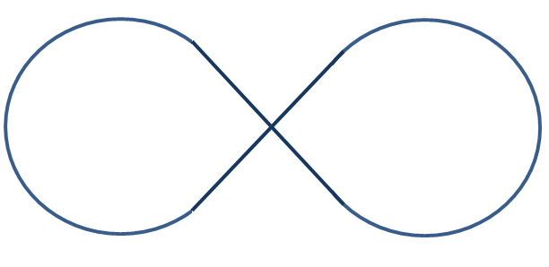

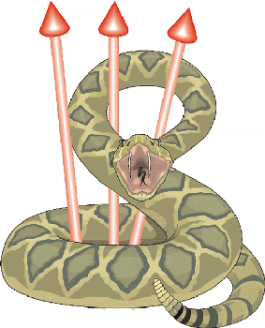
Design Features: High Polarization
All ion rings (two booster, collider) have a figure-8 shape
  Spin precessions in the left & right parts of the ring are exactly cancelled
  Net spin precession (spin tune) is zero, thus energy independent
  Ensures spin preservation and ease of spin manipulation
  Avoids energy-dependent spin sensitivity for ion all species
  The only practical way to accommodate polarized deuterons
  This design feature promises a high polarization for all light ion beams
(The electron ring has a similar shape since it shares a tunnel with the ion collider ring)
Use Siberian Snakes/solenoids to arrange polarization at IPs
Proton or Helium-3:
longitudinal polarization at both IPs
Proton or Helium-3:
transverse polarization at both IPs
Deuteron: Longitudinal polarization at one IP
Deuteron: transverse polarization at one IP
Vertical axis
Solenoid
Insertion
longitudinal axis

Slide 8
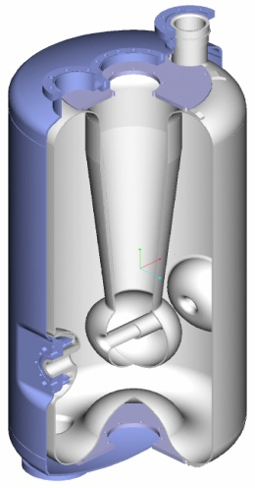
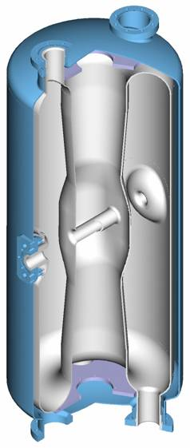
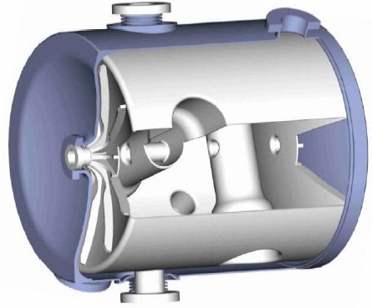
A New Ion Complex at JLab
cooling
cooling
to high energy collider ring
ion sources
SRF Linac
pre-booster
(accumulator ring)
large booster
medium energy collider ring
 | Length (m) | Max. energy (GeV/n) |  | Electron Cooling | Process
 |  | Proton | Lead
SRF linac | ~100 | 0.285 | 0.1 |  | Stripping
Pre-booster | ~300 | 3 | 1.2 | DC | accumulation
Large booster | ~1350 | 20 | 8 |  | Stacking
collider ring | ~1350 | 100 | 40 | ERL | De-bunching/ re-bunching
Pre-booster (by NIU)
Beam from LINAC
Extraction to large booster
Electron Cooling
ARC 1
Collimation
ARC 3
Injection Insertion
section
RF Cavities
Solenoids
ARC 2
RFQ
IH
QWR
QWR
HWR
DSR
Ion Sources
MEBT
Stripper
Normal conducting
Superconducting
Ion Linac (by ANL)
Quarter Wave Resonator (QWR)
Half-Wave Resonator (HWR)
Double Spoke Resonator (DSR)

Slide 9
Electron Cooling
Essential to achieve high luminosity for MEIC
Traditional electron cooling, not Coherent Electron Cooling
MEIC cooling scheme
  Pre-booster: Cooling for assisting accumulation of positive ion beams
  (Using a low energy DC electron beam, existing technology)
  Collider ring: Initial cooling after injection
  Final cooling after boost & re-bunching, for reaching design values
  Continuous cooling during collision for suppressing IBS
  (Using new technologies)
Challenges in cooling at MEIC collider ring
  High ion energy
  (State-of-the-art: Fermilab recycler, 8 GeV anti-proton, DC e-beam)
  High current, high bunch repetition rate CW cooling electron beam

Slide 10
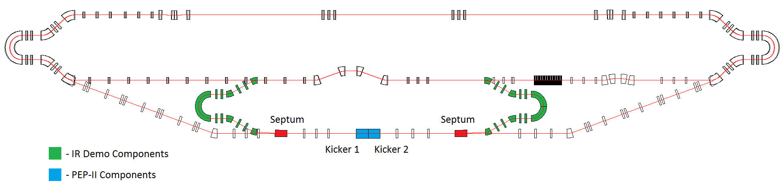
ERL Circulator Electron Cooler
solenoid
Design Choices
Energy Recovery Linac (ERL)
Compact circulator ring
to meet design challenges
Large RF power (up to 81 MW)
Long gun lifetime (average current 1.5 A)
Required technologies
High bunch charge magnetized gun
High current ERL (55 MeV, 15 to150 mA)
Ultra fast kicker
ion bunch
electron bunch
Cooling section
Fast kicker
circulator ring
Fast kicker
energy recovery
injector
SRF Linac
dump
e-bunches circulates 10 -100 times ➔ reduction of current from an ERL by a same factor
Optimization
eliminating a long return path
could double the cooling rate
Proposal: A technology demonstration
using JLab FEL facility
30 m
Solenoid (20 m)
injector
SRF
dumper
Edward Nissen’s talk
Slide 10
Notes:
10

Slide 11
Reviews and Activities
2nd EIC International Advisory Committee Review (Nov. 2-3, 2009)
(Accelerator members: R. Gerig, U. Wienands)
Physics-Machine Joint Meeting (for a design goal) (Feb. 11&12, 2010)
MEIC Machine Design Week (March 4-8, 2010)
  (Detector/IR consultant: M. Sullivan of SLAC )
MEIC Internal Machine Design Review (Sept. 15-16, 2010)
(Reviewers: A. Chao and G. Hoffstaetter)
RF & Beam Synchronization Mini-Workshop (Oct. 29, 2010)
MEIC Ion Complex Design Workshop (Jan. 27-28, 2011)
3rd ElC International Advisory Committee Review (April 9, 2011)
(Accelerator members: R. Gerig, S. Nagaitsev, V. Shiltsev)
MEIC Detector and IR Design Mini-Workshop (Oct. 31,2011)
ERL Circulator Cooler Test Facility Retreat (Jan. 31, 2012)
All presentations are posted on the JLab web site

Slide 12
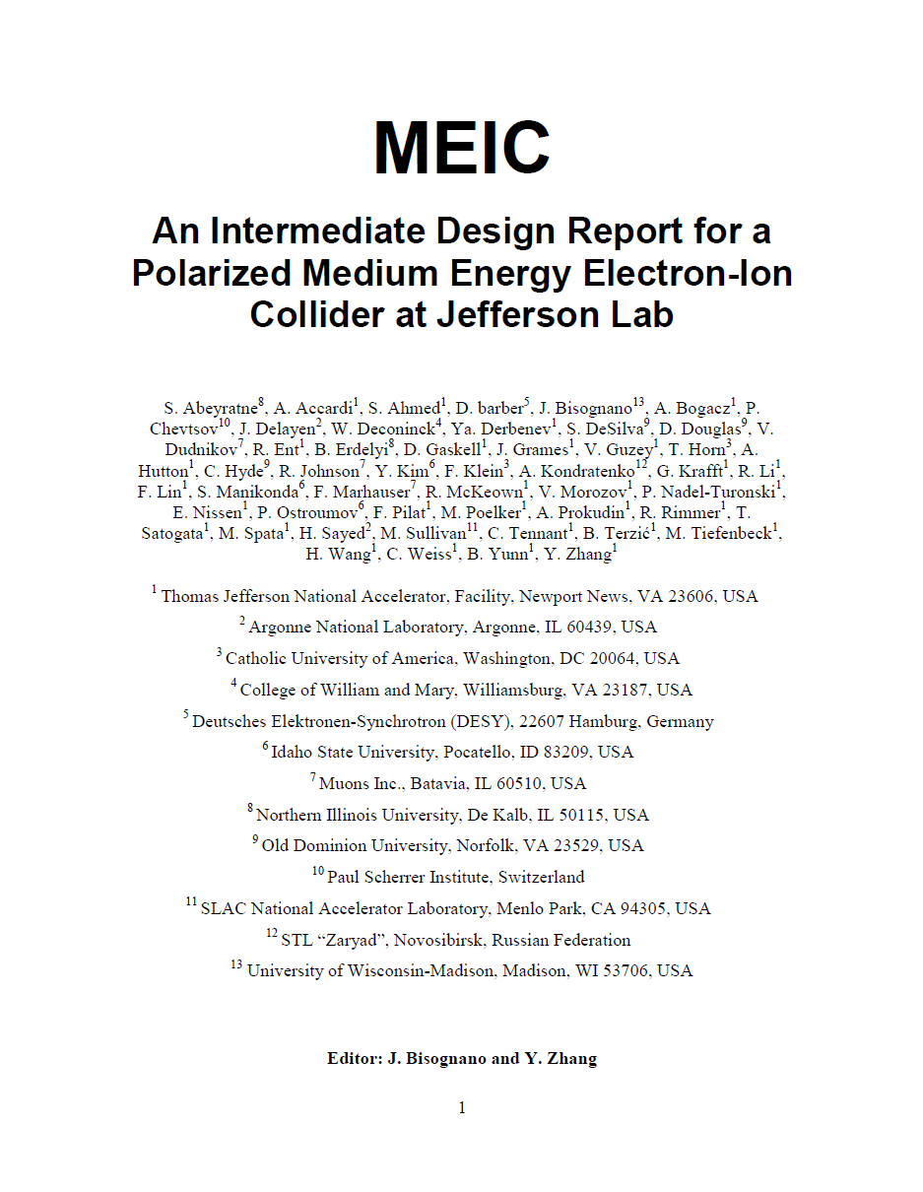
Towards the Next NSAC LRP
Design optimizing, filling the gaps
  Integration of detector and interaction region
  Critical accelerator R&D
MEIC Design Report nearly complete
An internal cost estimate in progress
The 2nd machine design review in planning
JLab-BNL collaborative approach at LRP
  Common machine design requirements
  (Already presented in the EIC White Paper)
  Lab-based implementations
Support JLab-BNL R&D collaboration
  Coherent Electron Cooling Proof-of-Principle Experiment

Slide 13
Accelerator pre-R&D
Electron cooling
  Electron cooling of medium energy ion beam (by simulations)
  ERL circulator cooler design optimization, technology development
  ERL-circulator cooler demo (using JLab FEL facility)
Interaction region
  Detector integration
  Sufficient dynamic aperture with low beta insertions
Polarization
  Demonstrate superior ion polarization with figure-8 ring
  Electron spin matching
Collective beam effects
  (Long time scale) beam-beam with crab crossing
  Space charge effects in pre-booster
  Electron cloud in the ion rings and mitigation
Ion Injector complex optimization and beam studies
Bold font indicates high priority

Slide 14
Building Up an Extended Team
JLab MEIC team
Ya. Derbenev, R. Li, F. Lin, V. Morozov, E. Nissen, B. Terzic, B. Yunn, Y. Zhang
Low energy ion complex
source: V. Dudnikov (Muons, Inc)
Linac: P. Ostroumov, S. Manikonda (Argonne Lab)
Pre-booster: B. Erdelyi (Northern Illinois Univ.)
Electron cooling
  ERL-CR cooler demo: D. Douglas and C. Tennant (FEL, JLab)
  Magnetized gun: S. Kondrashev, P. Ostroumov (Argonne Lab)
Interaction regions
Detector integration: C. Hyde (Old Dominion Univ.), P. Nadel-Turonski (NP, JLab)
SR background: M. Sullivan (SLAC)
Crab cavity: J. Delayen, S. DeSilva (Old Dominion Univ.)
Collective beam effects
  Beam-beam: Y. Cai (SLAC)
  Electron cloud: M. Pivi (SLAC)
Polarization A. Kondratenko (NTL Zaryad, Novosibirsk), D. Barber (DESY)
RF systems R. Rimmer, H. Wang, S. Wang (SRF Institute, JLab)
Feedback Y. Kim (Idaho State Univ.)

Slide 15
Pending R&D Proposals
Responding to “Research and Development for Next Generation Nuclear Physics Accelerator Facilities” (LAB 12-632 and DE-FOA-0000632)
Jefferson Lab Proposal (PI: Y. Zhang)
  Project 1: Electron Cooling
  Project 2: Cooler Demonstration Experiment
  Project 3: Interaction Region
  Project 4: Polarization in Figure-8 Rings
  Project 5: Electron Cloud (in collaboration with SLAC)
Old Dominion University Proposal (PI: J. Delayen)
  Project 1: Beam-Beam and Other Beam Dynamics Effects (in collaboration with SLAC)
  Project 2: Crab Crossing Schemes and Studies for MEIC
Argonne National Lab Proposal (PI: P. Ostroumov)
  Project 1: Nonlinear Dynamics of Space Charge Dominated Beams in Pre-booster
  Project 2: Magnetized Thermionic NCRF Electron Gun
Northern Illinois University Proposal (PI: B. Erdelyi)
  Project: Electron Cooling Software Development
Idaho State University (PI: Y. Kim)
  Project: Longitudinal Beam Feedback System
Total request: ~$3M/year

Slide 16
Pending R&D Proposals
Responding to “Scientific Discovery through Advanced Computing (SciDAC)” (DE-FOA-0000581)
A Joint Proposal for supporting accelerator R&D for NP applications (by JLab, BNL, MSU, SLAC, LBNL, NIU, RPI, UT Austin and Tech-X)
Project management team: Y. Zhang (JLab), D. Bruhwiler (Tech-X), X. Li (LBNL)
The following projects support MEIC
JLab (PI: Y. Zhang)
  Project 1: Beam-beam simulation
  Project 2: Electron cooling simulation
LBNL (PI: J. Qiang)
  Project: BeamBeam3D and IMPACT code enhancement and support
Northern Illinois Univ. (PI: B. Erdelyi)
  Project: Electron cooling software development
Tech-X Corp. (PI: D. Bruhwiler)
  Project: VORPAL code enhancement and support
Total request: ~$1.85M/year
MEIC related: ~$300k/year

Slide 17
Project Accelerator R&D
We will focus on design optimization, technology development & demonstration
ERL circulator cooler
  High bunch charge magnetized electron gun development
  Fast kicker development, prototyping and beam test
  Phase II e-Cooler demo (with full design capability)
Interaction region
  Crab cavity prototyping and beam test
  Special magnets
Other design works and accelerator R&D
  Universal atomic beam polarized ion source
  Ion linac SRF cavity prototyping
  Electron ring RF system
  SRF cavity studies associated to beam synchronization
  Feedback systems

Slide 18
Summary
A conceptual machine design of MEIC has been completed.
MEIC permits high performance (luminosity & polarization).
We have an accelerator R&D plan which will require support.
We have established collaborations with several national labs and universities.
In a near term, we will focus on cooling simulation, cooler demo, dynamics aperture and polarization studies.

