Slide 1
Modernization, Sustainability and
Cost Improvements to Enhance
Scientific Productivity Mike Dallas, COO
DOE Science and Technology Review of Jefferson Lab
May 9, 2011

Slide 2
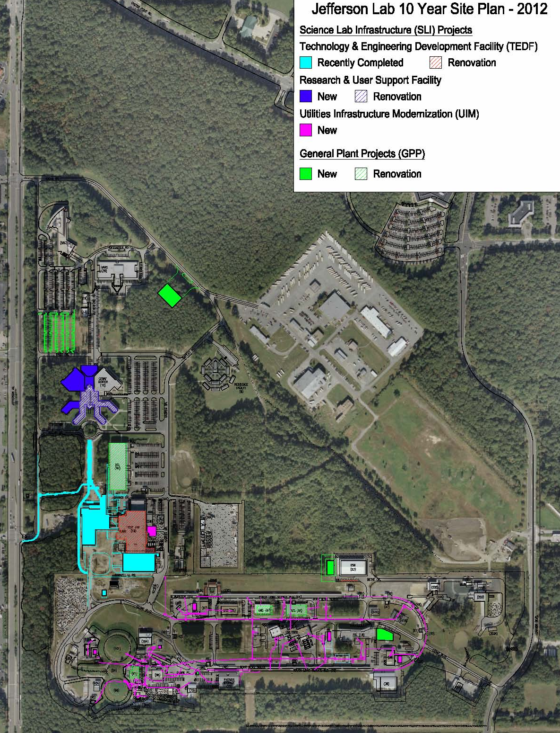
Mission Readiness: The Ten Year Modernization Plan
Facilities – New and Renovated
Research and Development
TEDF (SLI)
Staff & User Support
Research & User Support Facility (SLI)
Experimental Staging, Assembly and Operational Support
Renovate Counting House (GPP)
RADCON Calibration Facility (GPP)
Renovate EEL (GPP)
Renovate Bldgs. 87 & 89
Shipping & Receiving (GPP)
Utilities (SLI/GPP)
- Additional 40 MVA substation in FY13 (GPP)
Electrical distribution and reliability (SLI)
Process cooling to support accelerator operations and scientific computing (SLI)
Cryogenics to support SRF R&D and Experimental Halls (SLI/GPP)
Communications Upgrades to ensure current and future mission success (SLI)

Slide 3
Investment in Modernization (K$)
 | What it Does | $ 2009 | $ 2010 | $ 2011 | $ 2012 | $ 2013 | $ 2014 | $ 2015 | $ 2016 | $ 2017 | $ 2018 | $ 2019 | Total
SLI
TEDF | 117,000 SF technical space | 3,700 | 27,687 | 28,419 | 12,337 |  |  |  |  |  |  |  | 72,143
Utility Upgrades | Upgrades aging utilities |  |  |  |  | 2,500 | 26,700 |  |  |  |  |  | 29,200
Research & User Support | 95,000 SF & renovates existing |  |  |  |  |  |  |  |  |  |  | 20,000 | 20,000
Total SLI |  | 3,700 | 27,687 | 28,419 | 12,337 | 2,500 | 26,700 | 0 | 0 | 0 | 0 | 20,000 | 121,343
GPP Major Categories
Facilities | Renovations & sustainability | 7,800 | 300 | 650 | 2,000 | 1,000 | 1,800 | 1,500 | 3,000 | 3,000 | 2,200 | 3,000 | 26,250
Utilities | LCW, metering. Electrical | 2,500 | 1,100 | 1,770 |  | 1,500 | 700 | 700 |  |  |  |  | 8,270
General Site | Roads, parking, drainage | 1,500 | 600 | 130 |  |  |  | 800 |  |  | 800 |  | 3,830
Total GPP |  | 11,800 | 2,000 | 2,550 | 2,000 | 2,500 | 2,500 | 3,000 | 3,000 | 3,000 | 3,000 | 3,000 | 38,350
SLI investment critical to modernization
GPP investment must grow from $2.0M to $3.0M per year (FYs 10-19) to meet goals:
Modern, sustainable facilities
Adequate technical, administrative and experimental assembly space
Site utilities that are capable of supporting current and future missions

Slide 4
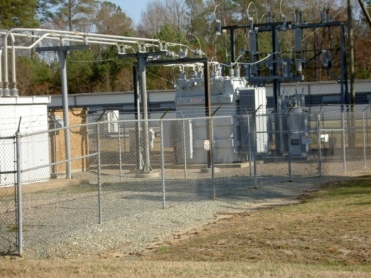
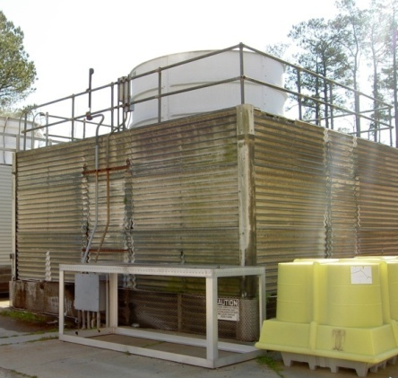
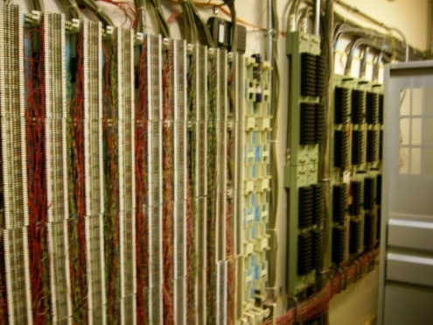
UIM Project Overview
Electrical Distribution
Replace feeders to 26 substations past service life supporting accelerator and experimental hall operations
Provides alternate power feed to accelerator site for backup restart of Central Helium Liquefier (CHL)
Process Cooling
Replace 8-12 cooling tower cell replacements (consolidating as practical) past service life supporting accelerator and experimental hall operations.
Expand the existing chiller plant and piping to provide cooling for the computing center as well as the original CEBAF Center Building. In addition provide additional uninterruptable power to support computing.
Cryogenics
Double the size of the Cryogenic Test Facility (CTF) building and revise cryogenic piping and install a cryostat. Double cryogenics capacity with no resultant increase in energy
Communications:
Replace 20 to 40 year old underground communications and data cabling by providing distributed communications huts with new underground distribution pathway, fiber optic backbone with 627 miles of fiber optic cable and switches. Provide additional telecommunications and data cabling capacity.

Slide 5
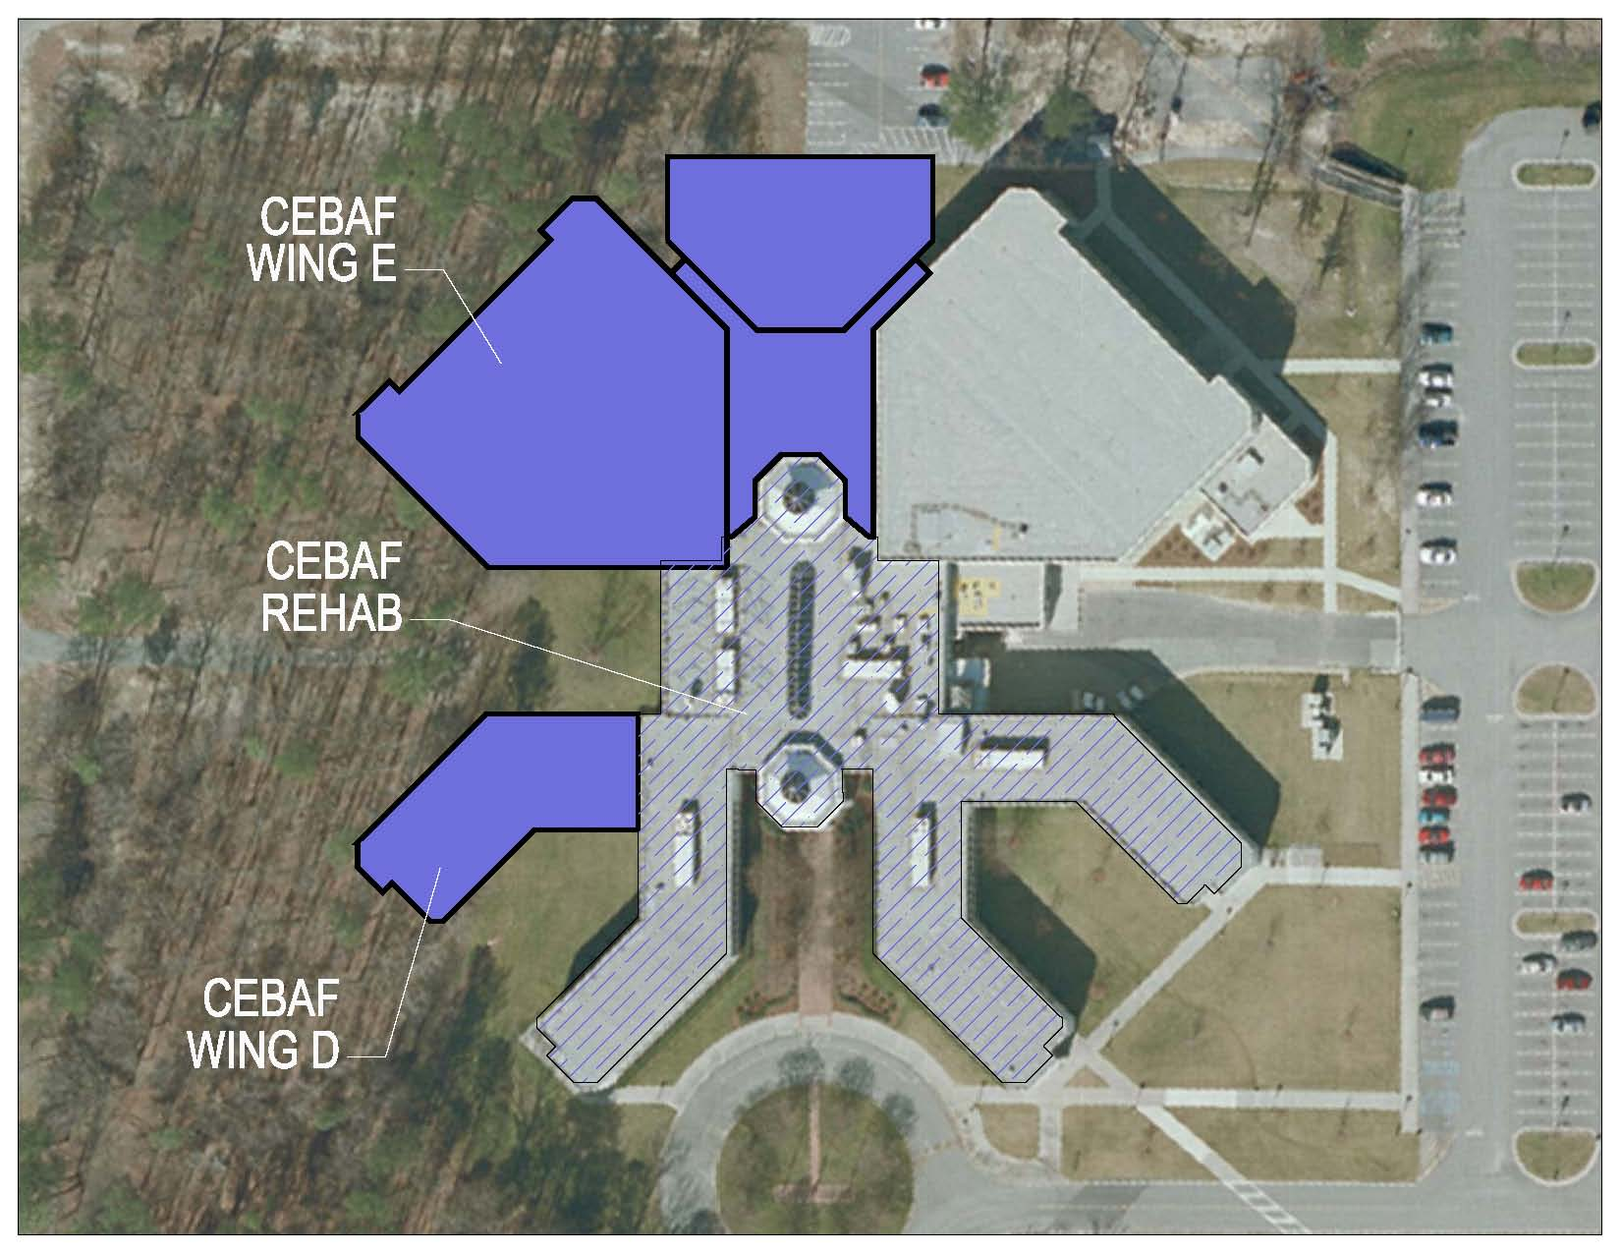
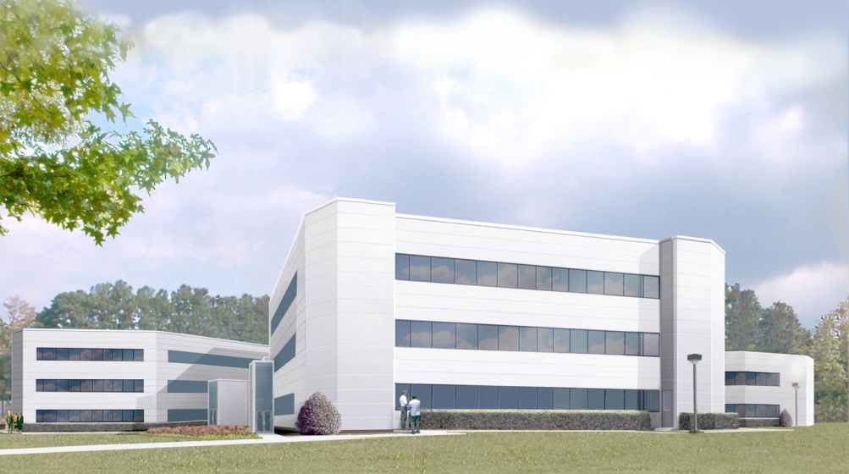
Research and User Support Facility
Scope
Construction of 95K SF in two additional wings with expanded atrium
Rehabilitation of 67.3K SF of current space in the facility
$78-$91M
Schedule
FY19 Design/Build Start
FY20 New Construction/Rehab
FY21 Project Complete

Slide 6
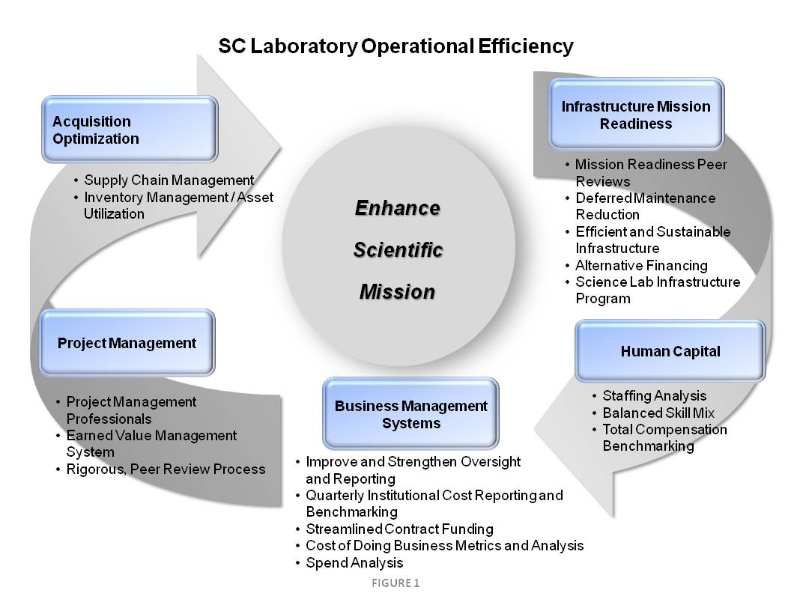
Science Lab Operations Improvement Committee (OIC)
OIC Objectives
Leverage established programs and initiatives being managed and improved under the SC Contractor Assurance System
Collect and share best business practices
Produce analysis and reports on achieved efficiencies
Collect and report on successes and progress on on-going and planned initiatives
Identify SMEs to evaluate potential efficiencies and recommend new initiatives

Slide 7
SC Laboratory Mission Reinvestment
FY11 Cost Savings/Avoidance for All Labs
Acquisition Optimization
Infrastructure Mission Readiness
E-catalogues
pCards
Total Supply Chain Management Improvement
ICPT-sponsored pricing agreements
Reverse auctions
Subtotal $52.5M
Safeguards & Security Initiatives ($3.6M)
Predictive maintenance programs
Energy efficiency projects
Re-engineered processes & programs
Subtotal $8.6M
$112.0M
Annual SC Mission Reinvestment
Project Management
Human Capital
Re-engineered processes
Performance reviews
Value engineering
Subtotal $0.7M
Business Management Systems
Reduced pension & medical costs
Re-engineered business processes
Modification of stop-loss coverage
Subtotal $28.7M
Integrating management systems
Lean initiatives
Re-engineered business processes
Centralizing email, upgrading IT systems
Subtotal $21.5M

Slide 8
JLab Mission Reinvestment
FY04-12 Cost Savings/Avoidance
Acquisition Optimization
Infrastructure Mission Readiness
E-catalogues
pCards
DOE-wide Pricing Agreements
Reverse Auctions
Subtotal $5.8M
Cryogenics Plant Redesign
3rd Party Funding for Electrical System Upgrade
Emergency Services Agreement
Lease of State-Owned Office Space
SF6 Capture and Reuse System
Energy Connect
Subtotal $14.7M
$21.9M
JLab Mission Reinvestment
FY04-12
Project Management
Human Capital
Business Management Systems
Access to CSC Skillport
Subtotal $0.6M
Value Engineering
Subtotal $0.6M
Virtual Machine Deployment
Subtotal $0.2M

Slide 9
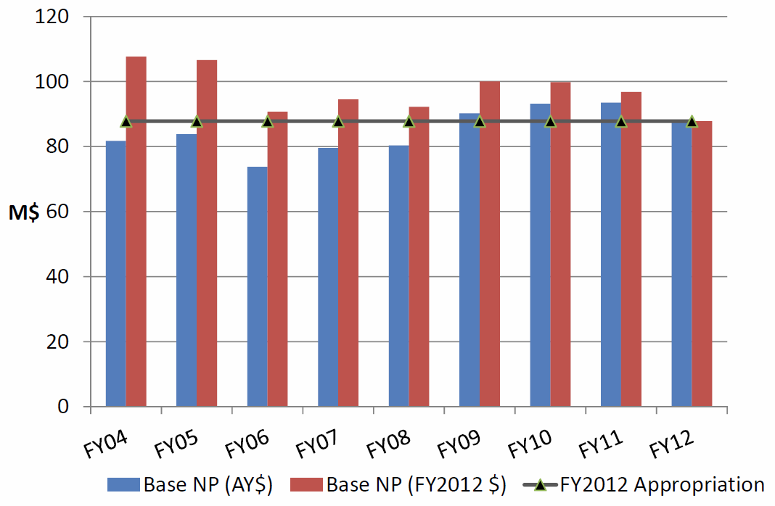
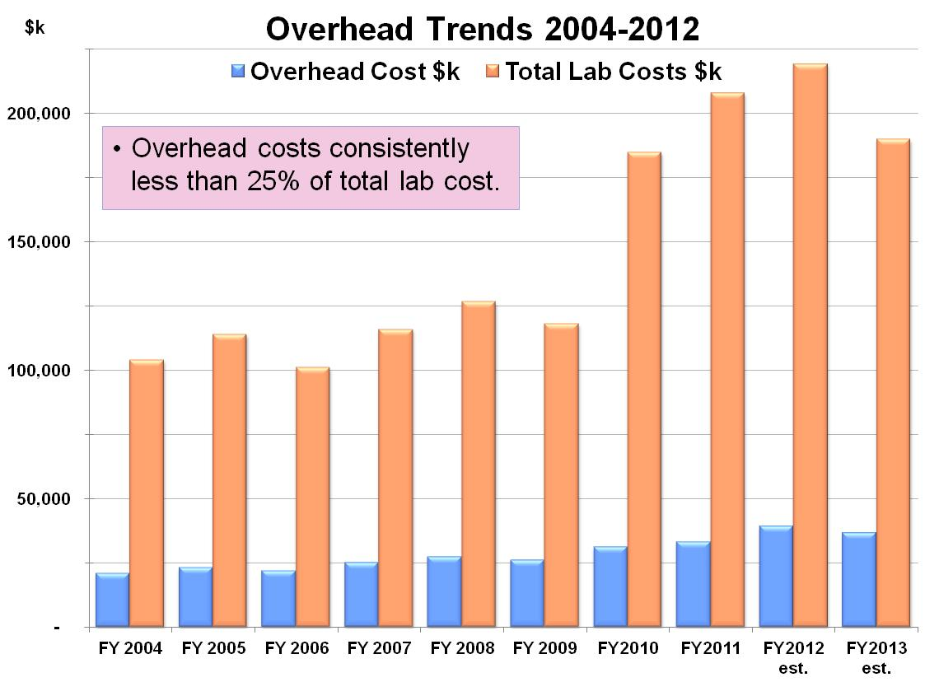
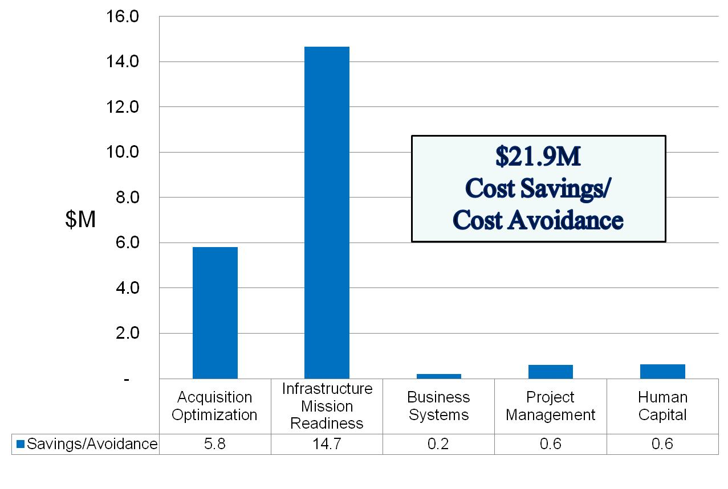
Enhanced JLab Science Through Efficient and Effective Operations
NP Base Funding in FY04-FY12
• Cost Savings/Avoidance have enabled JLab to fully achieve its scientific mission objectives:
Retained critical staff to achieve the science program
Completion of 6 GeV research program
Six-month shutdown to upgrade facilities
Advancements in accelerator operation & technology
Delivered ~1200 Coulombs to Q-weak
Upgraded superconducting cavities from 4 GeV to 6 GeV
Four generation improvements to the injector gun
Polarization improved from 0% to 85%
Enabled new generation of polarized experiments
Completion of experiments and apparatus
Completed Strangeness in Nucleon Program (SC Milestone)
HD-Ice apparatus operational (culminating ~30 years of community effort)
New areas for study
Prospects for Heavy Photon Searches
World-leading parity experiments due to improved helicity correlated errors
Cost Efficiencies 2004-2012
9

Slide 10
Energy / Buildings / Fleet / Waste / Meters
Sustainability Categories / Goals | Plans / Strategies | Status
Energy 30% Reduction (2015) Renewable Energy (7.5% / year) | Energy Conservation Measures / Projects Renewable Energy Credits
Buildings 15% High Performance (2015) New Construction / Major Renovations Cool Roofs | Efficiency Upgrades / Building Renovations LEED Certification – TEDF / Test Lab Cool Roof Replacement Program
Fleet Fuel Management 10% Annual Alternative Fuel Increase 2% Annual Petroleum Reduction | E-85 Storage On-Site Gasoline Fleet Reduction Program
Waste Reduction 50% Diversion from Landfill (Annual) | Recycle Program & Waste -to-Energy
Metering Electricity (2012) Water / Natural Gas (2015) | Electric / Water / Gas Metering Installed

Slide 11
Green House Gas Emissions / Water
Sustainability Categories / Goals | Plans / Strategies | Status
GreenHouse Gas Scope 1 / Fugitive Gases Scope 2 / Purchased Electricity Scope 3 / Air – Ground Emissions | SF 6 Capture program Power Purchase Agreement Travel / Commuting Reduction Program
Water 26% Potable Water reduction (2020) 20% Non-Potable Water Reduction (2020) | Water Reuse / Desalination Project Not Applicable

Slide 12
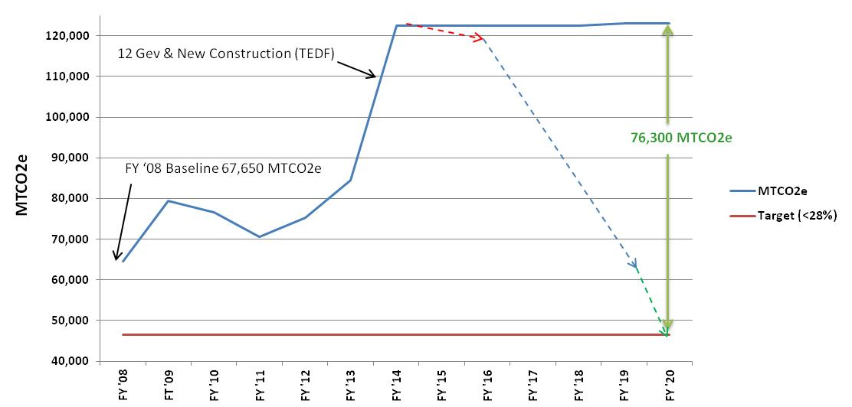
Strategy to Achieve Scope 1 & 2 GHG Reduction by 2020

Slide 13
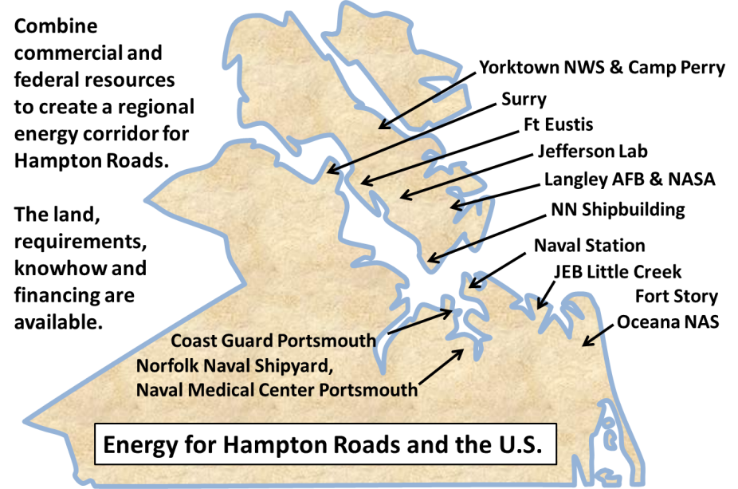
Hampton Roads Energy Corridor
Vision:
Establish an energy corridor in Hampton Roads based on unique regional assets providing a variety of long-term sustainable power options for the region’s facilities, and act as a centerpiece for business development, R&D, education and training for the region, state and U.S.
Discussion Partners:
Hampton Roads Partnership
Commonwealth of Virginia
Hampton Roads Military and Federal Facilities Alliance
Areva
Army
CNU
Cox Communications
Dominion Power
Green Jobs Alliance
Hampton University
Huntington Ingalls Industries
Jefferson Lab
NASA LaRC
Navy
ODU
Savannah River Site
W&M
Unique Opportunity → Economic Engine
Leverages Hampton Roads Partnership to keep the region globally competitive and aligns with the Comprehensive Economic Development Strategy
Multiple federal and commercial facilities with space, security, and sustainable energy requirements
Natural resources: biomass, offshore wind, space
Power companies with experience in large reactors, energy distribution
Commercial and federal experience with Small Modular Reactors (SM-Reactors) on ships
Ability to finance and manage liabilities and risks; new businesses, jobs and workforce development
University and laboratory R&D assets for relevant technologies; potential to partner with other regions

