Slide 1
Jefferson Lab
The FY 12 FEL Program
George R. Neil
Associate Director
May 9, 2012

Slide 2
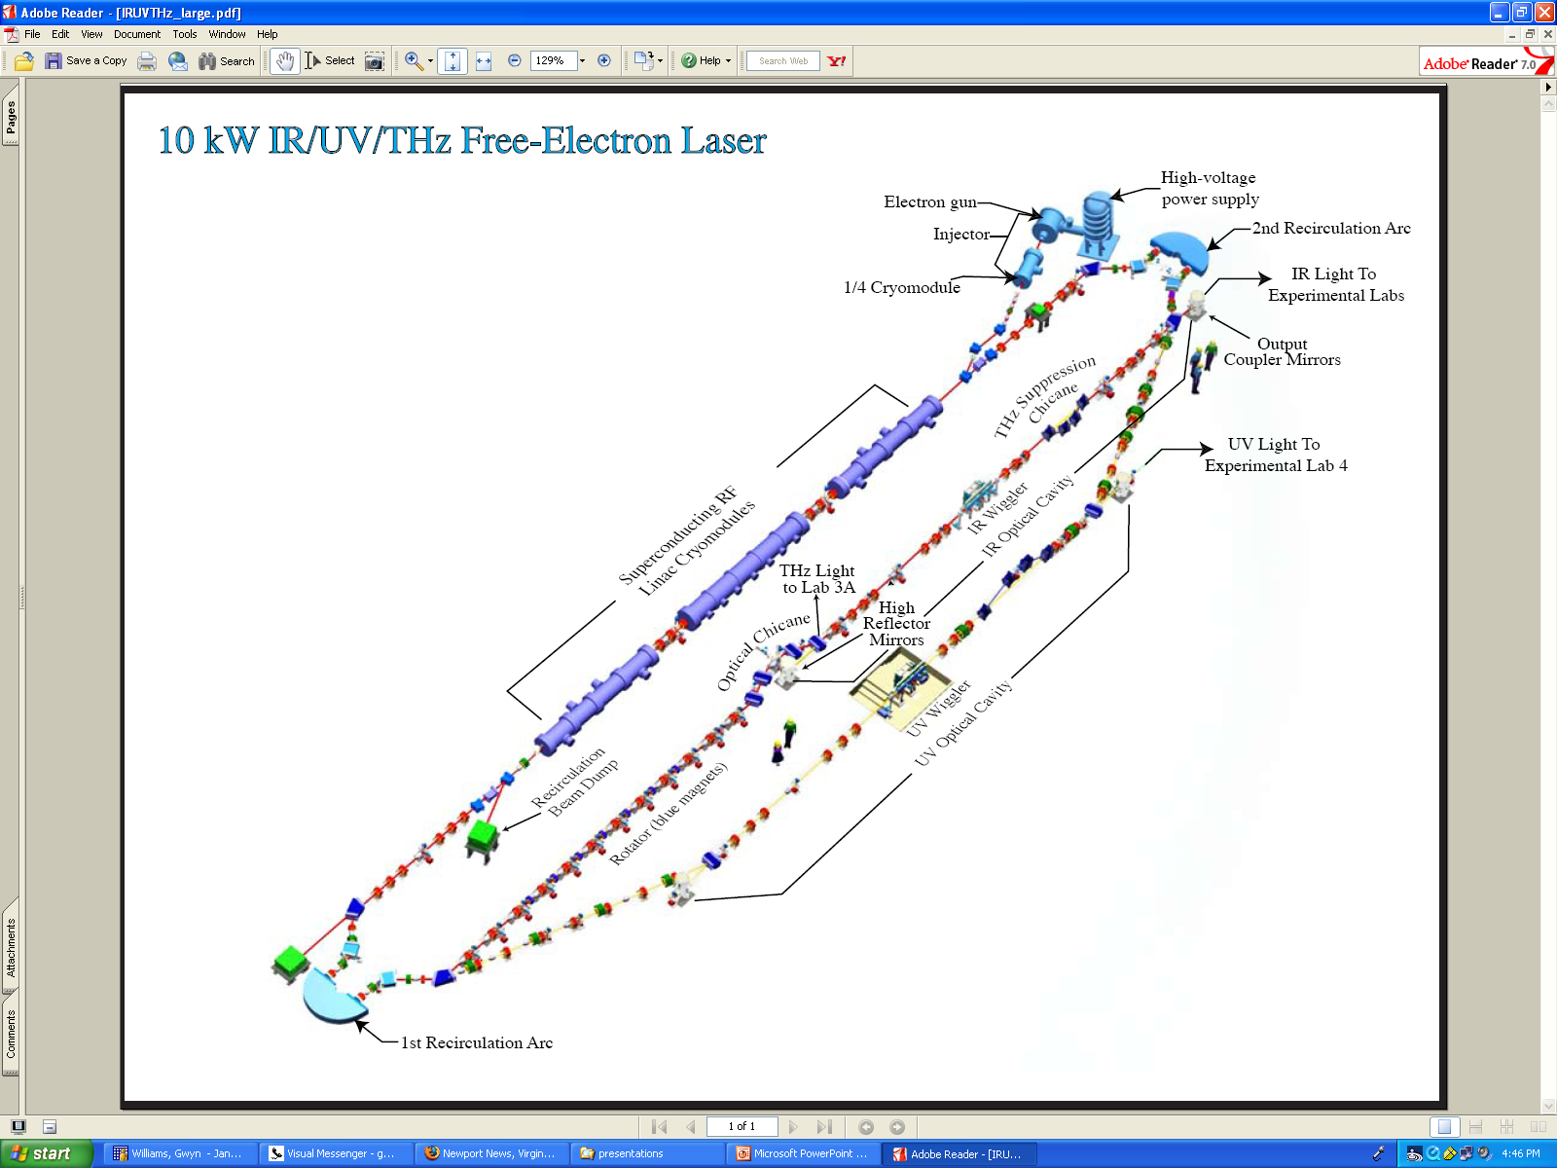
JLab FEL Schematic
E = 135 MeV
135 pC pulses up to 75 MHz
20/120/1 microJ/pulse in UV/IR/THz
350 nm – 14 microns, 0.1 – 5 THz
The world’s first high average current energy recovering linac
spawned a host of programs worldwide
2

Slide 3
from the announcement (date?):
UV and VUV Capability
“ 5 nanoJoules of fully coherent light was measured in each 10eV micropulse, which represents approximately 0.1% of the energy in the fundamental, as expected.
These numbers allow us to anticipate being able to deliver 25 - 100 mW by operating CW at up to 4.687 MHz with more optimized water-cooled optics, and several 100's of mW with cryogenically-cooled optics. Optics upgrades, and installation of an optical transport beamline to a user laboratory for full characterization, including bandwidth, are in progress.
We note that for many applications the anticipated narrow bandwidth eliminates the need for a spectrometer. This allows substantially higher flux to be delivered to user experiments than is possible at storage rings. “

Slide 4
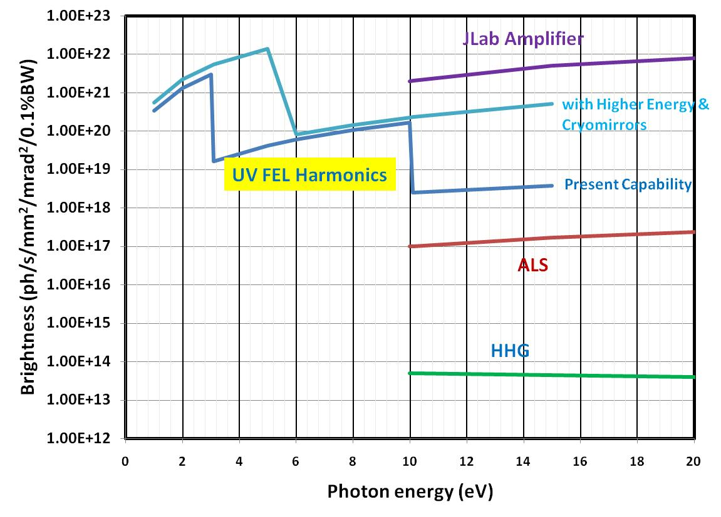
Wavelength (nm)
600 300 200 150 120 100 88 77 68 62
4

Slide 5
Key elements of FY12 FEL Program
High power FEL/ERL
  ONR - High current beam studies: longitudinal space charge, coherent synchrotron emission instabilities
  ONR- Studies of UV damage on optical coatings
  BES/ONR - Beam diagnostic development and testing; high dynamic range beam phase space, two-pass BPMs
  (P. Evtushenko talk)
  Parasitic Virginia university and other user operations in THz, IR driven insulator/metallic transition studies
Initiated ONR-funded upgrades for robust operation: higher beam energy, injector mods, rf and controls upgrades
UV FEL Operation
  Kr dating
Concept test for DarkLight HEP/NP experiment
Done
In progress
Planned

Slide 6
FY12 Experimental program details
Optics Testing: perform absorption measurements and UV degradation on mirrors supplied by ONR collaborators
JTO efficiency test: investigate limits of low injection energy
CSR/LSC test: measure charge thresholds for observation of increases in energy spread/loss www.jlab.org/~douglas/Tennant_animation.pps *
IR dynamics: resonant evaporation of ice (Can. Mem. U), molecular resonance studies (JMU/W&M)
Atomic trapping: first test of VUV excitation of Kr: Influence of fundamental on the measurement: ODU/Argonne *
DarkLight: (Ebeam only) Measure radiation background and halo interception on narrow channel: MIT-led HEP/NP/Virginia collaboration *
* discussion to follow
Notes:
6

Slide 7
Activity Name | Q4 2011 | Q1 2012 | Q2 2012 | Q3 2012 | Q4 2012 | Q1 2013 | Q2 2013
FEL Beam Operations
Re-establish beam operations in IR
Optics testing for ONR/JTO
JTO Efficiency Test
CSR/LSC Test
Commission new UV wiggler
Atomic Trapping
DarkLight
Shutdown for upgrade

Slide 8
Beam distortion as a function of bunch compression is a major issue for next generation light sources
Input
beam
E
Observation
Point
Φ
E
E
Φ
Φ
Beam from accelerator is given a time-energy correlation by riding 10 degrees off crest. The position of maximum compression can be varied by adjusting quadrupole strengths in Arc1
8

Slide 9
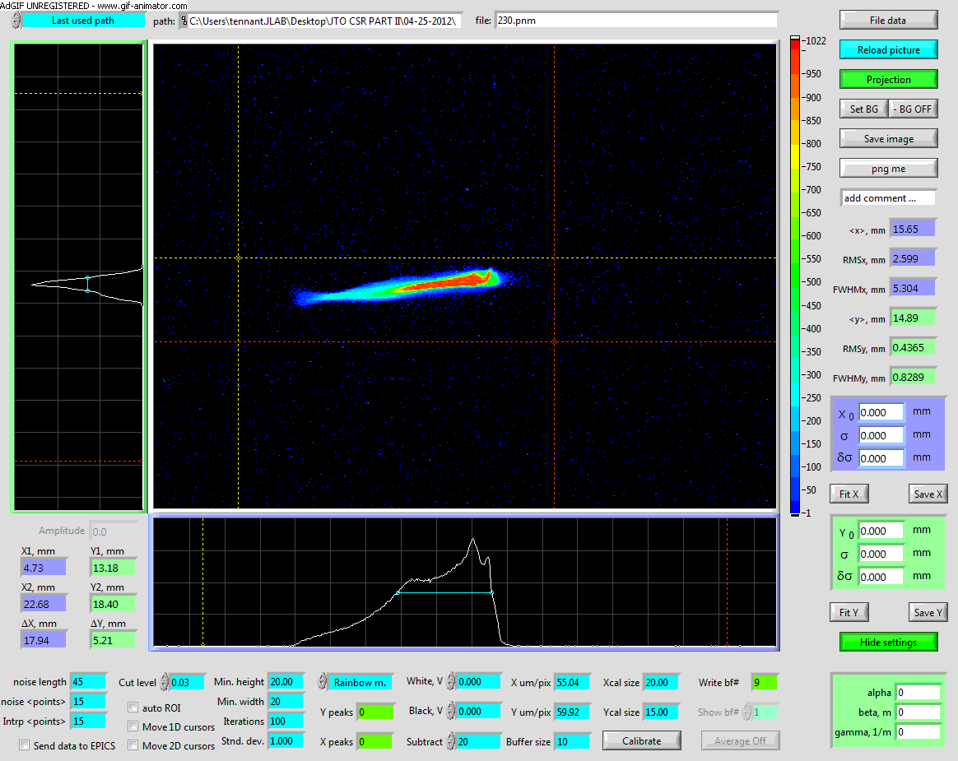
CSR and space charge instability have major impact on performance of Xray FEL and EIC. They must be properly managed and controlled. FEL is unique system for study.
When bunch is compressed it:
radiates coherently,
loses energy,
redistributes charge
depending on degree of compression and location
By varying compression and location we can study these effects, compare with models, and remediate or avoid problems
y
E
9

Slide 10
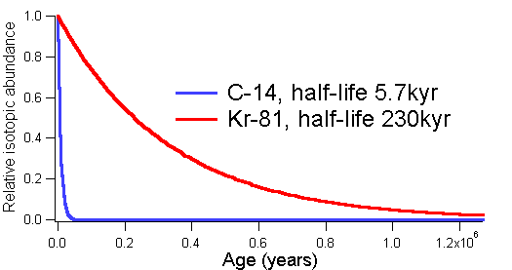
Radio-Krypton Dating
⁸¹Kr (t_{1/2} = 230kyr, I.A.= 6 x 10⁻¹³)
Cosmic
p, n
⁸³Kr, ⁸²Kr...
⁸¹Kr
⁸¹Kr
Polar Ice as a natural archive
temperature, precipitation, gas composition, volcanic eruption, solar variability...
Number of ⁸¹Kr atoms in 1 liter of :
Air → 20,000
Water → 1,000
Ice → 1,000
Courtesy Lu Zheng-Tian (ANL)
Slide courtesy Lu Zheng-Tian

Slide 11
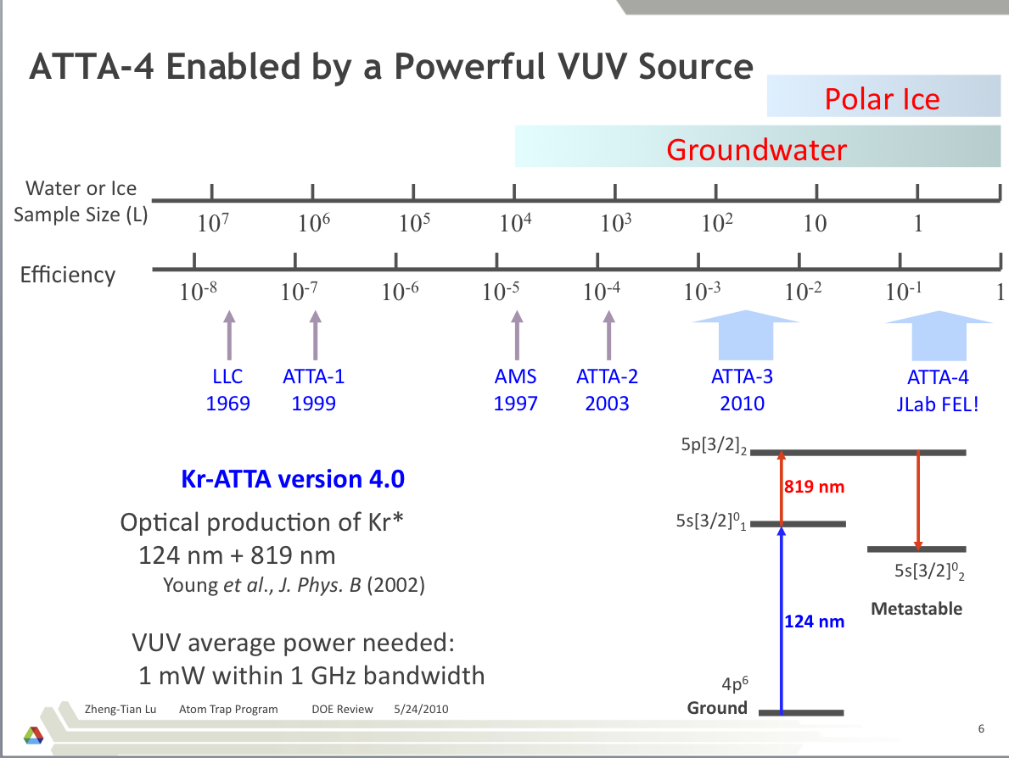
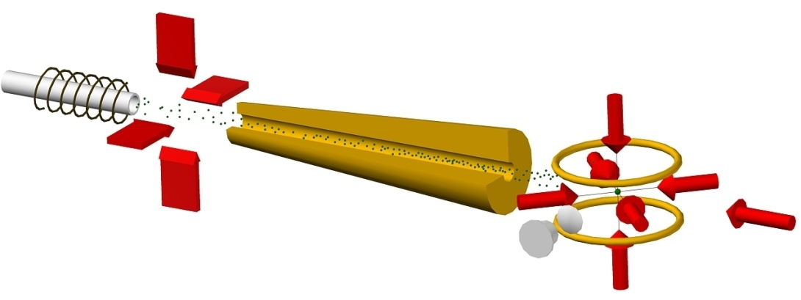
Substantially smaller sample sizes are enabled by the JLab VUV source rendering feasible accurate polar ice core sampling
Metastable krypton atoms are cooled and trapped by the laser beams shown as solid arrows. The fluorescence of individual trapped atoms is imaged to a detector.
Courtesy Lu Zheng-Tian (ANL)
11

Slide 12
DarkLight Feasibility Test
Courtesy R. Milner (MIT)
Notes:
12

Slide 13
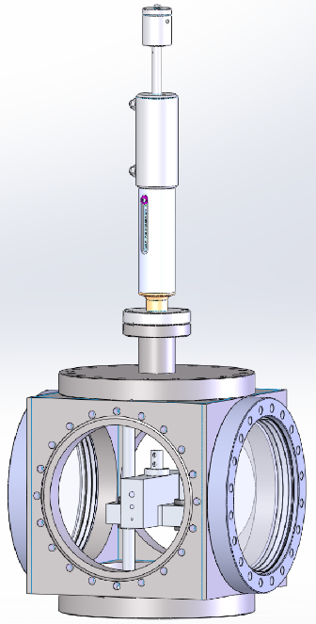
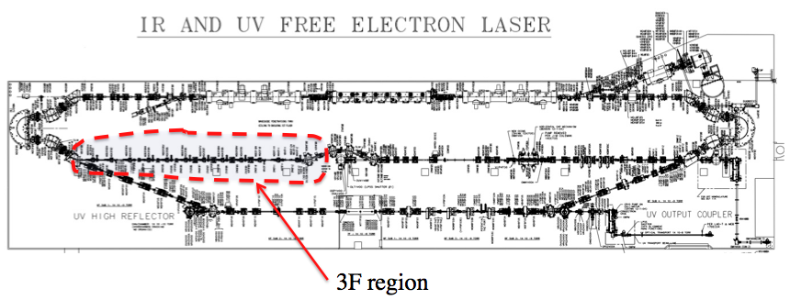
DarkLight Feasibility Test
Target
Chamber
Stepper motor
Simulate high-power ERL operation with an internal gas-jet target controlling power deposition from beam loss and impedance/wake effects from both beam core and halo components through a 10 cm long small aperture (6, 4, or 2 mm diameter)
Tube block
Notes:
13

Slide 14
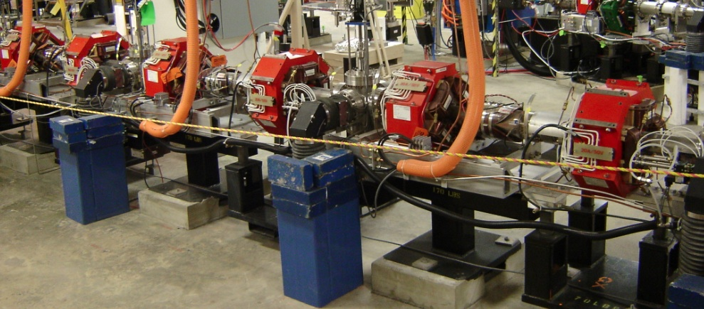
DarkLight Installation Region
Rotate 45°
To be replaced by Target chamber
8
3F7s
3F7
3F6s
3F6
3F5s
Insert 1 viewer
To be replaced
Notes:
14

Slide 15
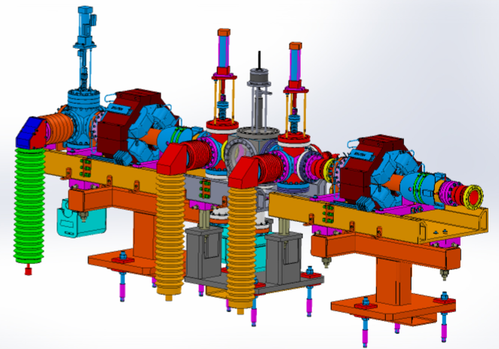
Darklight Experiment
Viewer1 inserted
Chamber
Viewer2
replaced
3F7 Quad
E-beam
3F6 Quad
Also includes radiation detectors for background determination
Notes:
15

Slide 16
ONR and (Virginia) Funded Upgrades
New gun and eventually
¼ cryomodule
Replace Module
Argon Process
Also magnet power supply, drive laser, and low level rf control improvements
16

Slide 17
Other recent science activities of the FEL Division
We taught a two week USPAS Course on FEL Design and hands on electron beam operation for 12 graduate level students. Course completed with students turning of the IR FEL.
Hosted a five-day ICFA-sponsored Workshop on Future Light Sources, FLS2012 with 140 attendees from 11 countries. Papers to be published on line with JACOW.
Hosted Beam Instrumentation Workshop, BIW2012 with 250 attendees plus 12 corporate sponsors in Newport News City Center.
Notes:
17

Slide 18
Conclusions
Ongoing ONR Program continues to provide synergistic benefits to JLab accelerator technology core competency
ONR and Commonwealth of Virginia* funds will permit upgrades for more robust and higher energy operation which will benefit VUV and NP/HEP efforts
We are operating and characterizing the VUV-FEL in preparation for utilization by several high profile users under funding by the Commonwealth
Applications to NP/HEP programs are being investigated where advantages of high average current ERL can be utilized
Negotiating with LBNL on participation in their NGLS proposal
* FY13-14 Virginia budget not yet to final approval
Notes:
18

