Slide 1
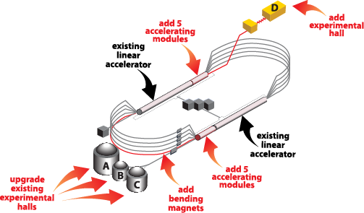
12 GeV Upgrade Project
Status & Plans
Science & Technology Review
May 9-11, 2012
C. H. Rode

Slide 2
Agenda
Progress Highlights
  6-month Shutdown Accomplishments
  Subsystem Status
Problems
  Major – SC Magnets
  Minor
Funding
  FY11 – Project was funding limited
  FY12 - $16M cut
  FY13 – Major issue
Summary and Beam Goals

Slide 3
Progress Highlights
As of 31-MAR-2012
  Percent complete 61%
  Percent obligated (including phased contracts) 74%
Effort had peaked at 210 FTEs during 6-Month Shutdown
Project is running:
4% over cost
4% late (8 weeks)

Slide 4
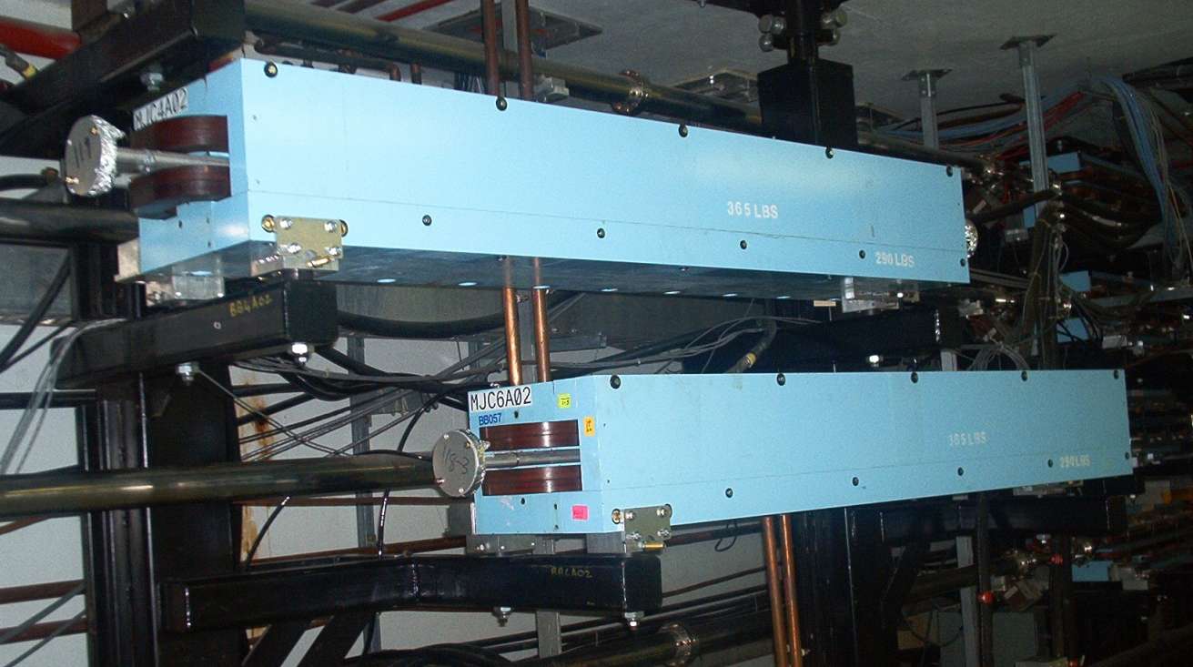
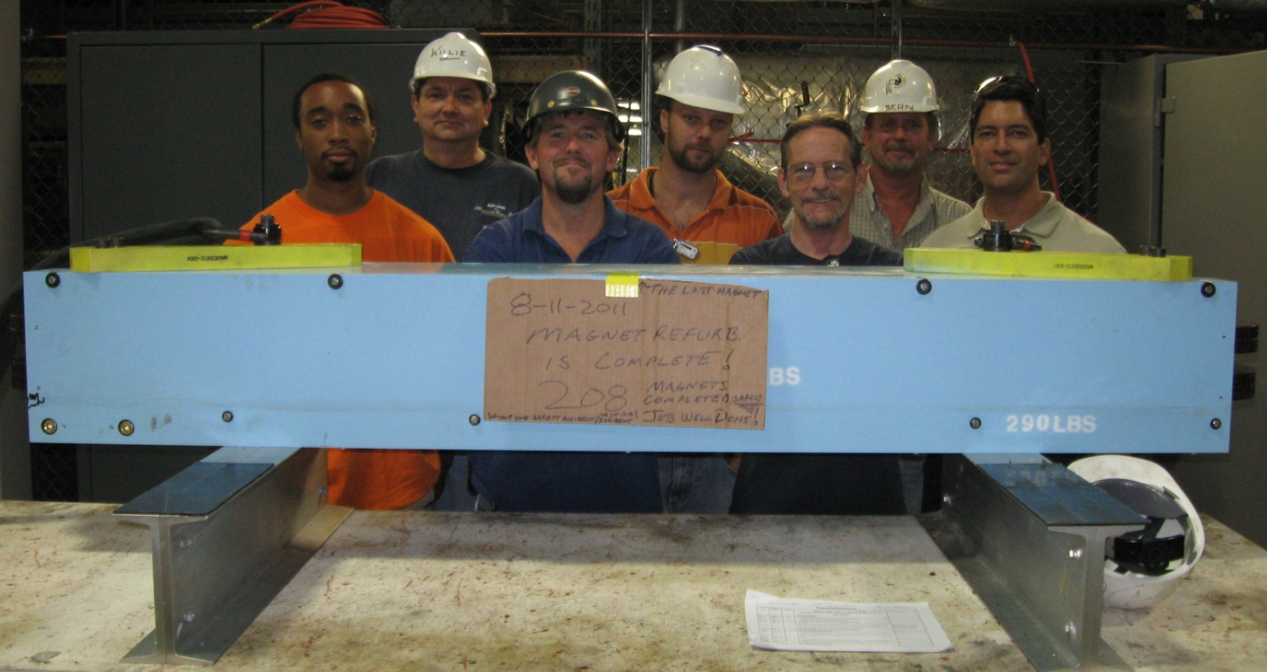
6-Month Shutdown - Accomplishments
7 of the 9 existing Magnet arcs were refurbished and upgraded – 175% of baseline plan
First Two
Last One: #208

Slide 5
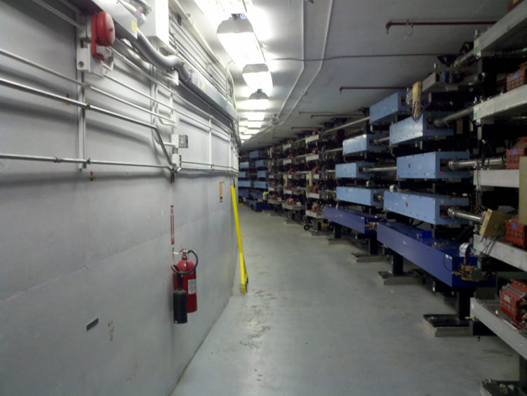
6-Month Shutdown - Accomplishments
Refurbished Dipole Re-installation and New Arc 10 Beamline

Slide 6
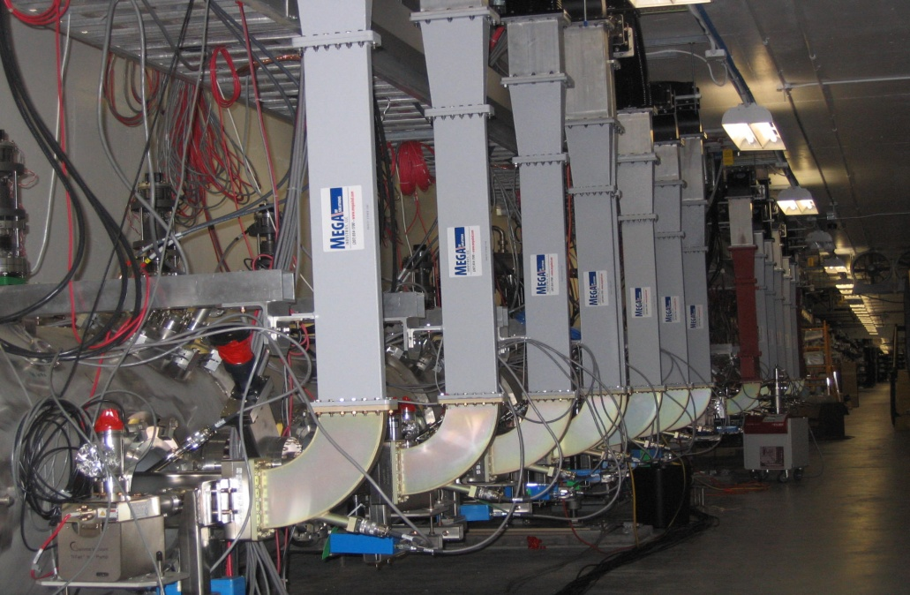
6-Month Shutdown - Accomplishments
2 of the 10 Cryomodules were installed and commissioned.
CURRENT STATUS: All 10 strings complete.
4 cryomodules in tunnel: 1 being tested; 5 being assembled.
25-APR: 12 GeV gradients and full current.

Slide 7
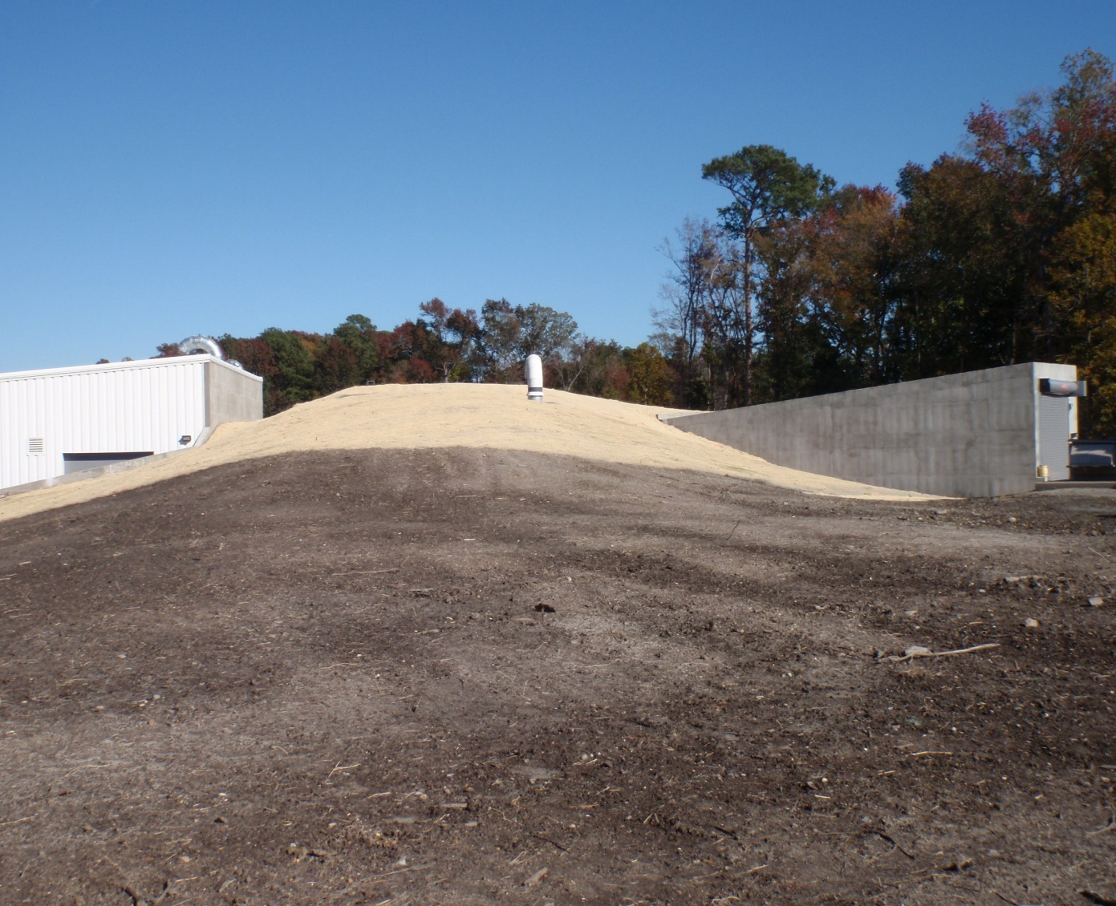
6-Month Shutdown - Accomplishments
Hall D tunnel extension was completed.

Slide 8
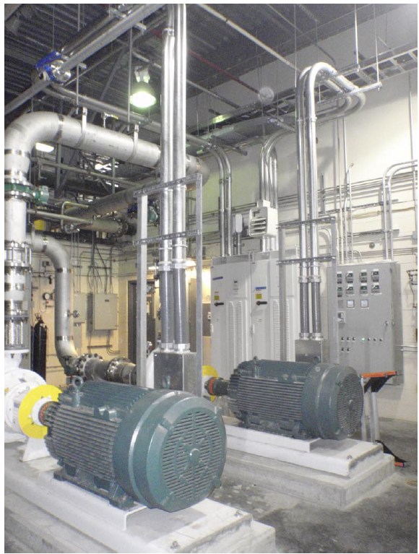
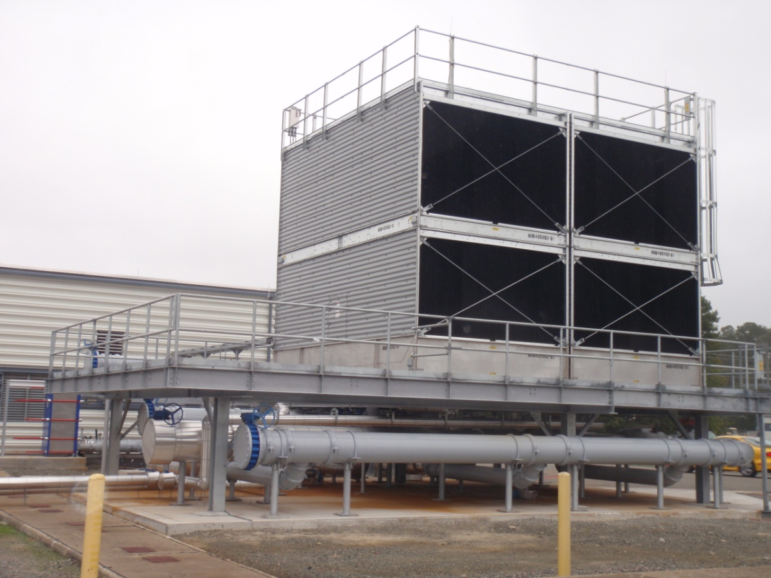
6-Month Shutdown - Accomplishments
Low Conductivity Water (LCW) Upgrade was completed.

Slide 9
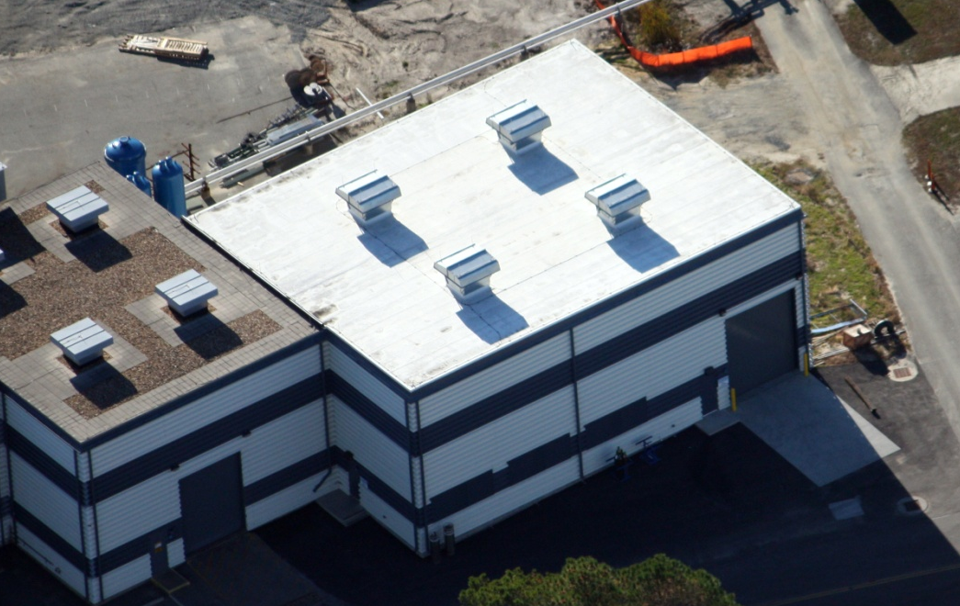
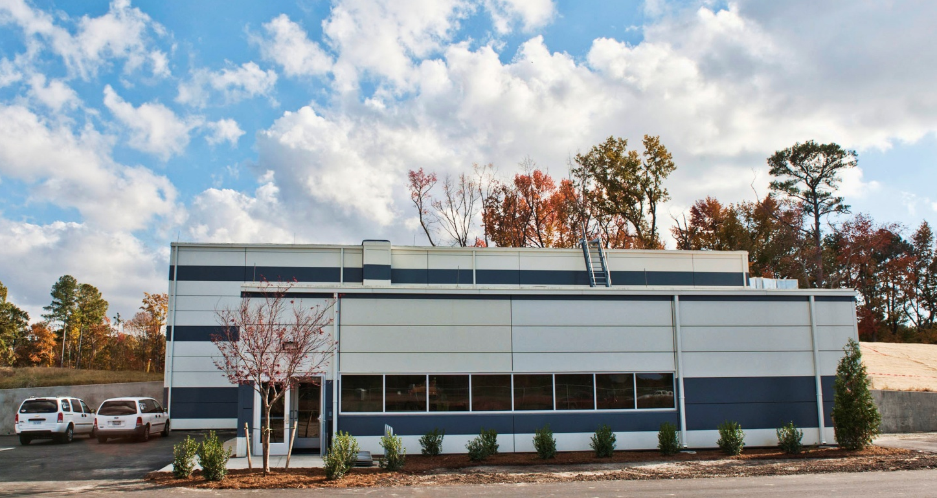
Civil is Basically Complete
Two minor FY14 tasks remain.
CHL Addition
Hall D Counting House

Slide 10
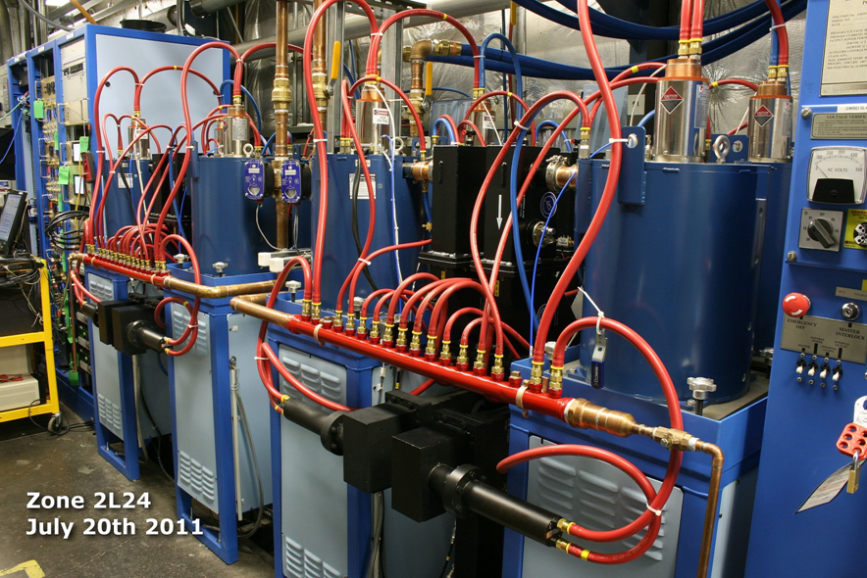
Accelerator
4 of 10 RF Zones operational.

Slide 11
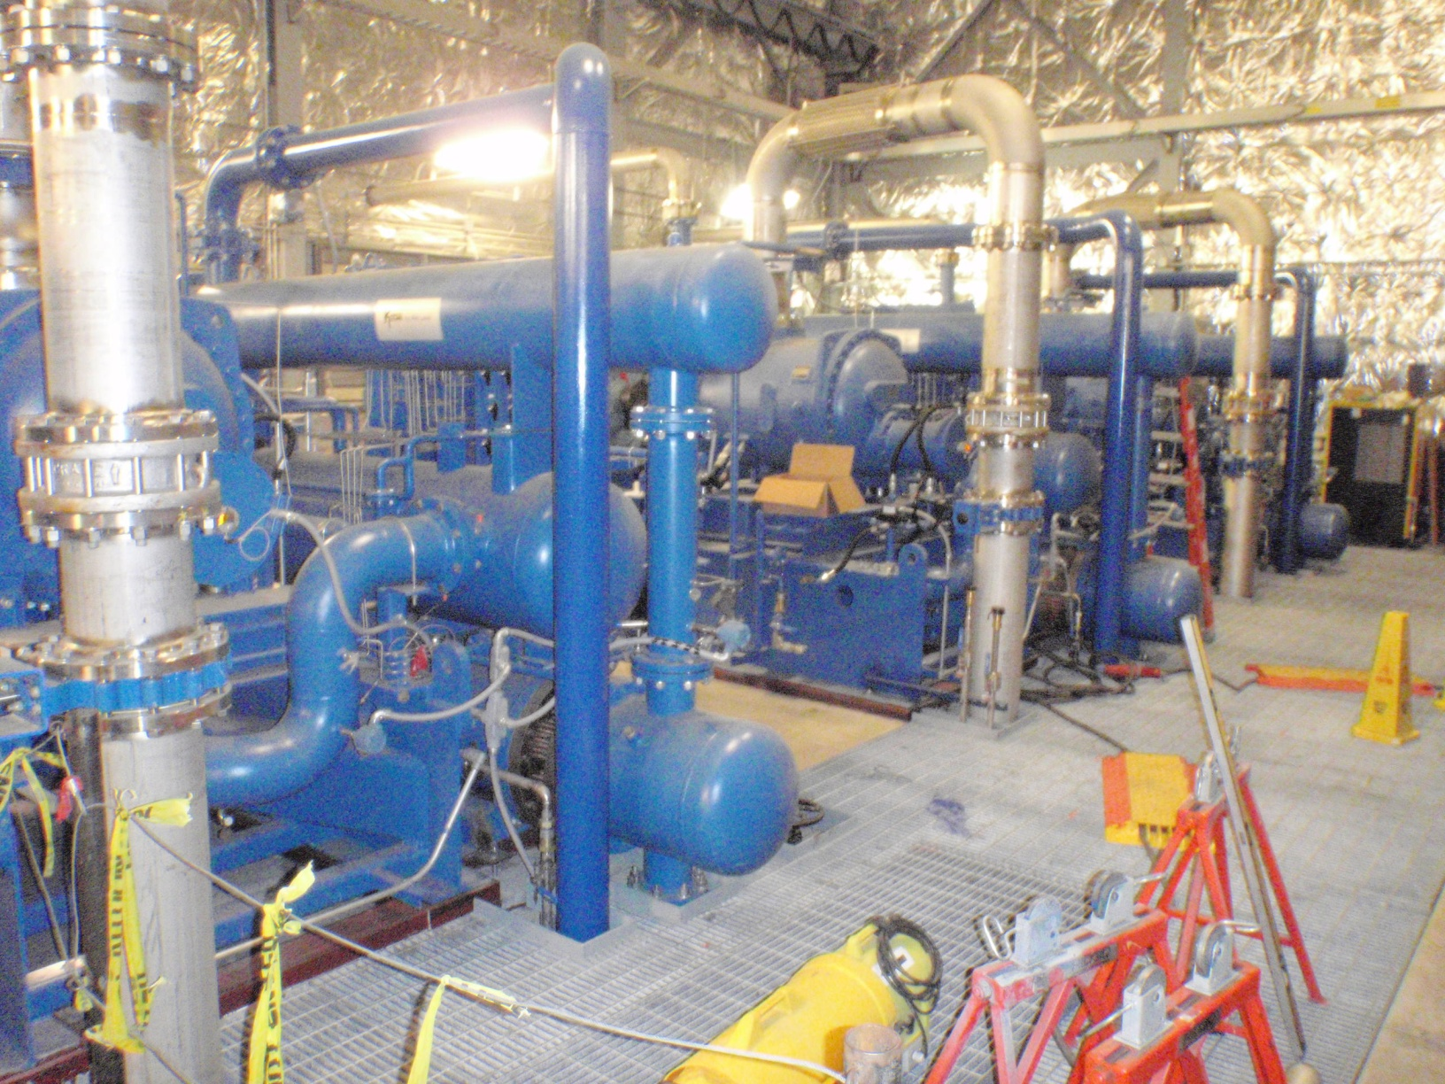
Accelerator (Continued)
CHL Compressors installed.

Slide 12
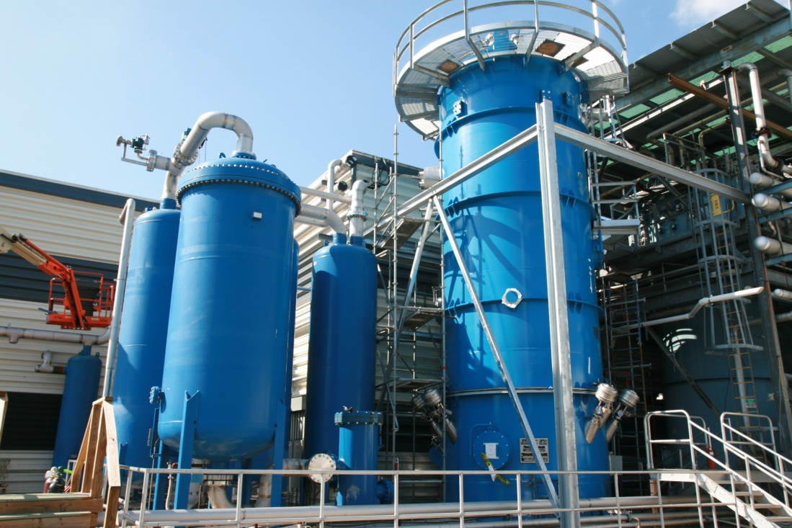
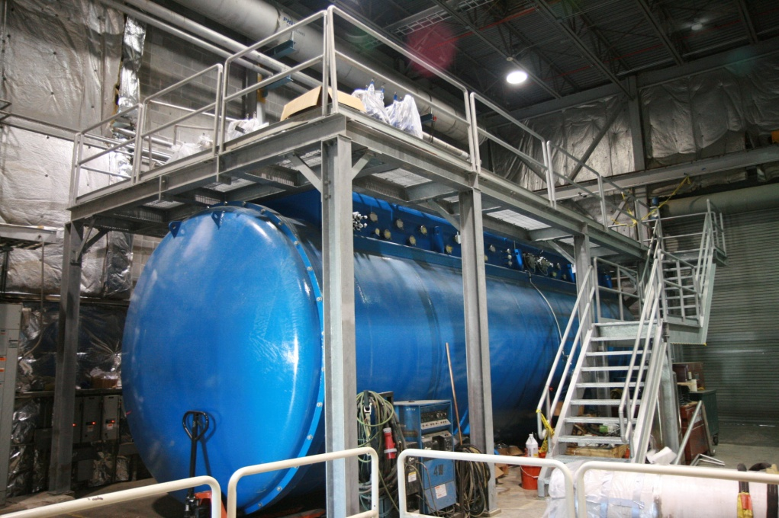
Accelerator (Continued)
Upper Coldbox
Lower Coldbox

Slide 13
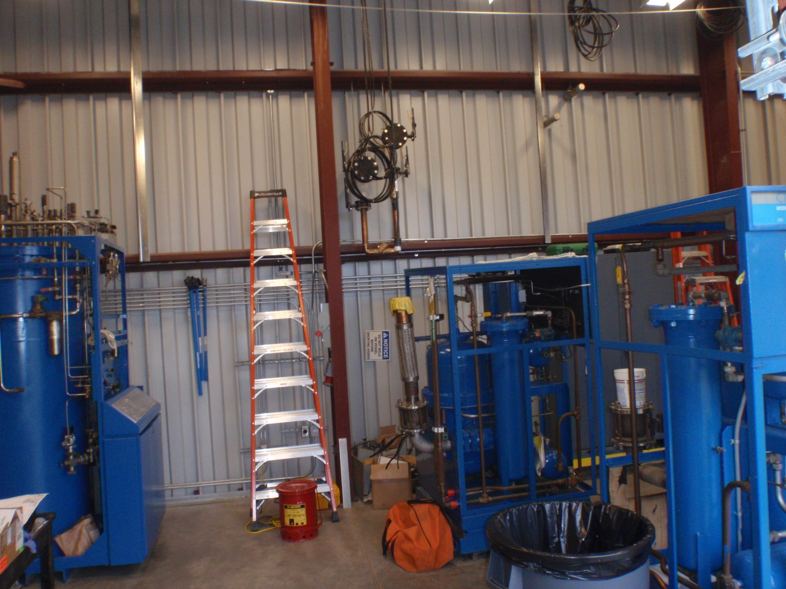
Accelerator (Continued)
Hall D refrigerator installation started.

Slide 14
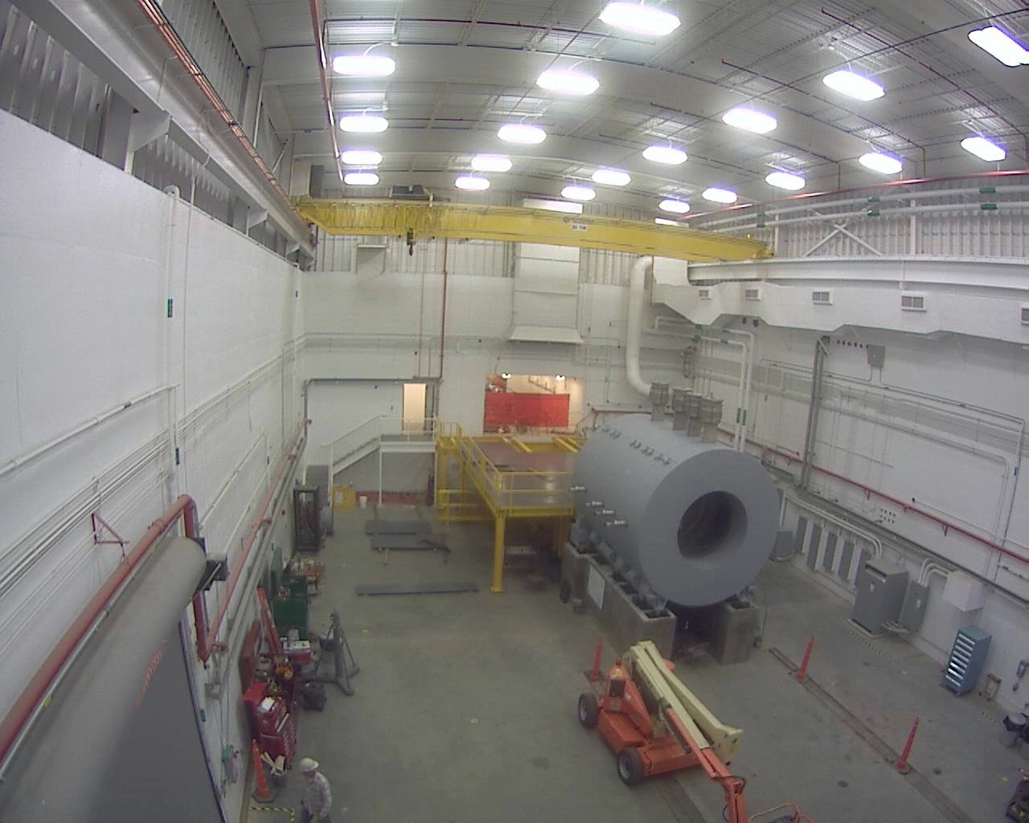
Physics – Hall D
The 48 Hall D Barrel Calorimeter (BCAL) segments were delivered.
The Hall D Solenoid was installed.

Slide 15
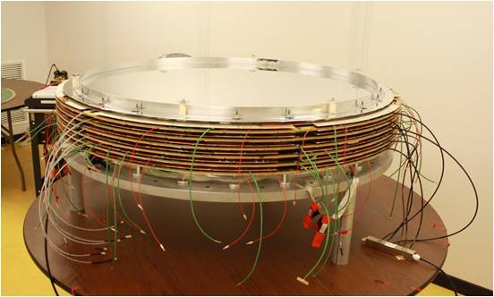
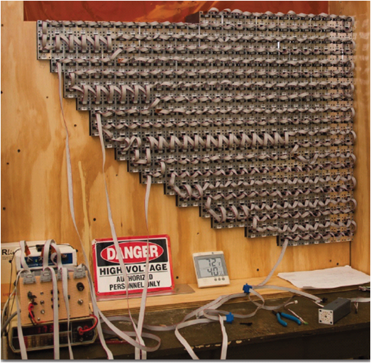
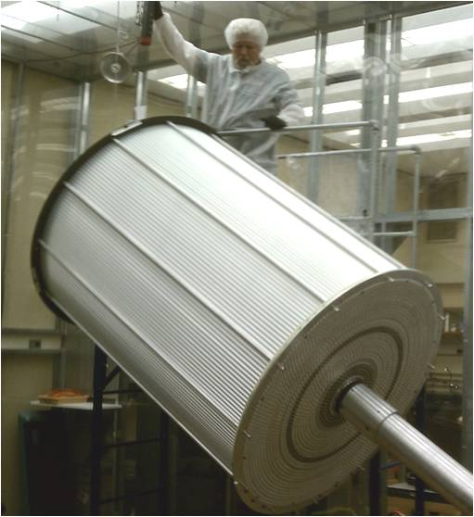
Physics – Hall D (Continued)
DETECTOR
The FDC is beyond the half-way point building chambers.
The FCAL leadglass detectors are done. The last part of the bases are underway at Indiana U.
The CDC has all straw tubes and over half of the electrical hook-up done.

Slide 16
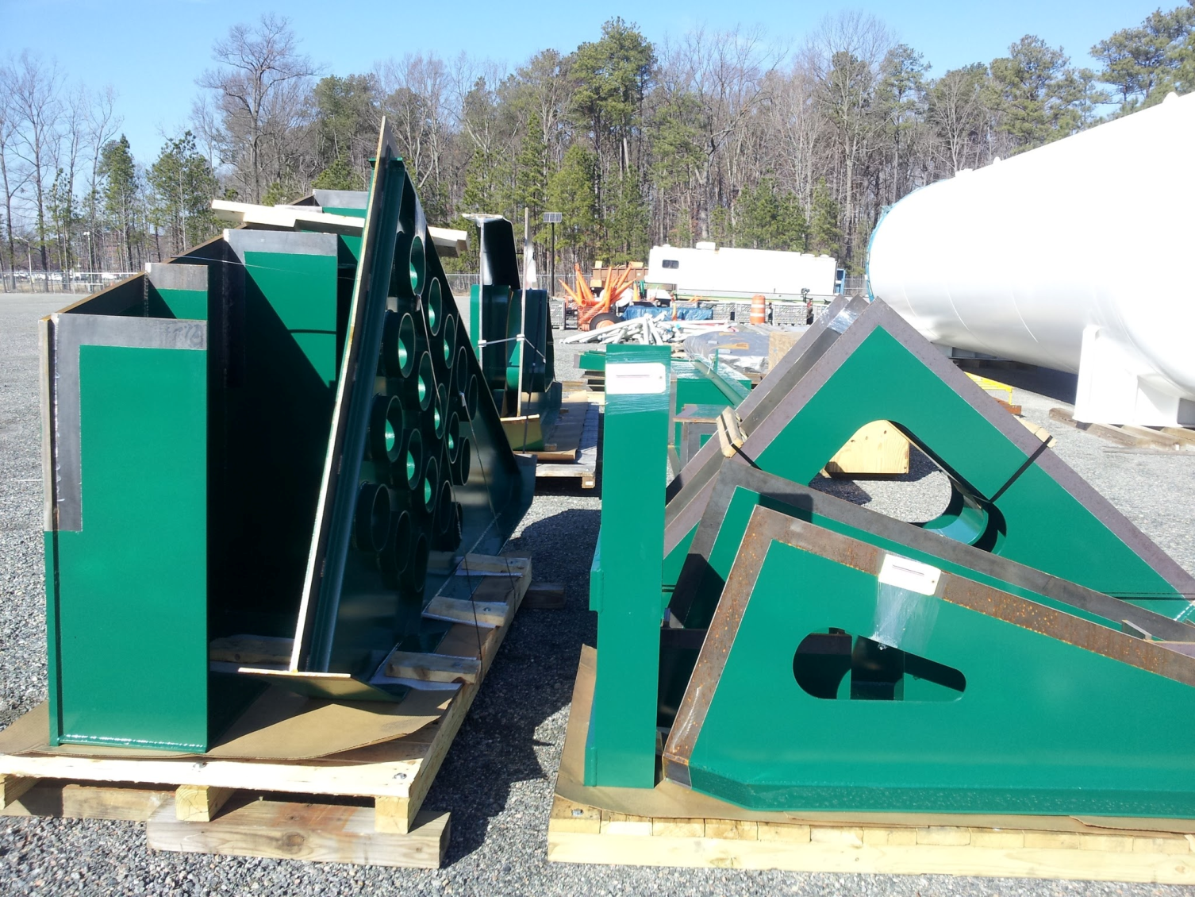
Physics – Hall C
All the Spectrometer support carriage parts are expected to arrive by June.

Slide 17
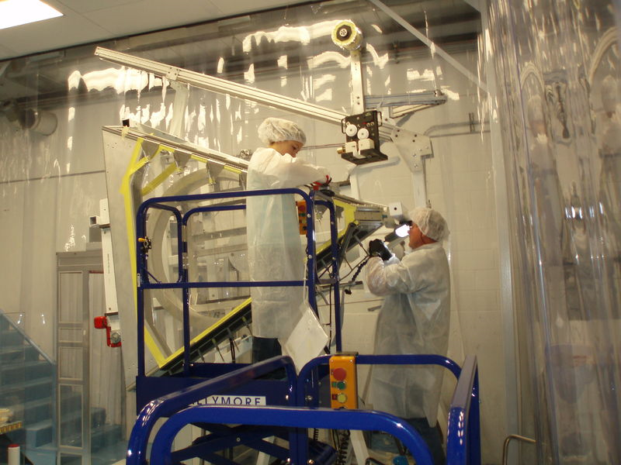
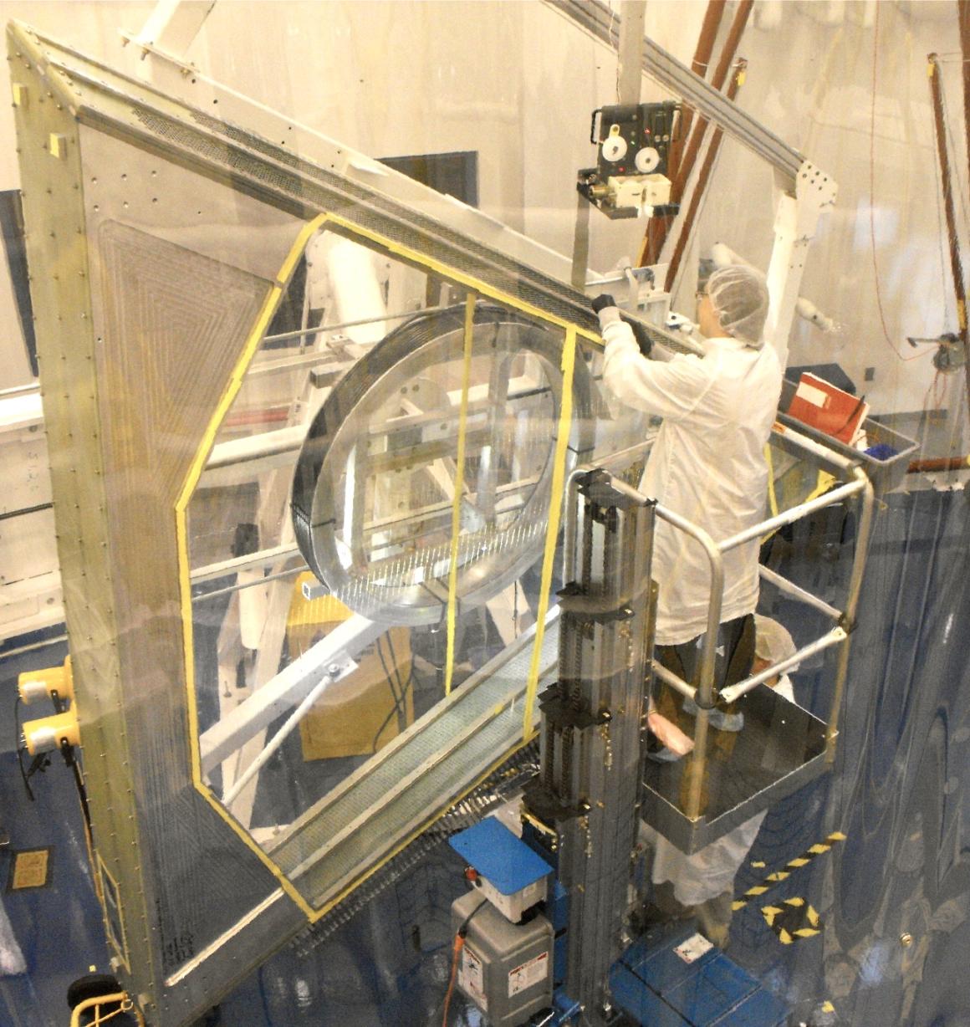
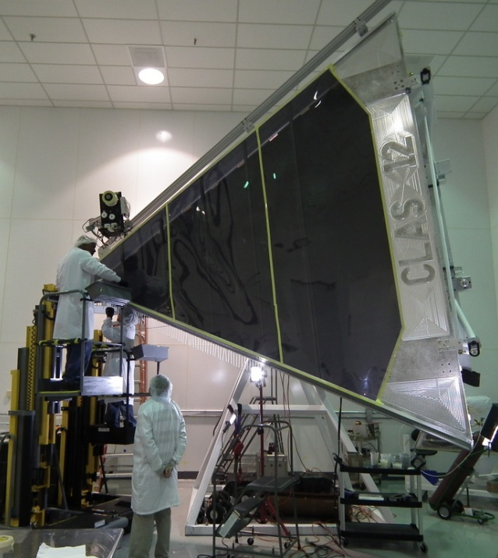
Physics – Hall B – Drift Chambers
At ISU: Reg.1 #2 Being tested at ISU. #3 and #4 in progress.
At ODU: Reg.2 #2 shipped to JLab for testing. #5 in progress.
At JLab: Reg.3 #1 and #2 in progress.
We are at the half-way point!!!
ODU – Old Dominion Univ.
ISU – Idaho State Univ.

Slide 18
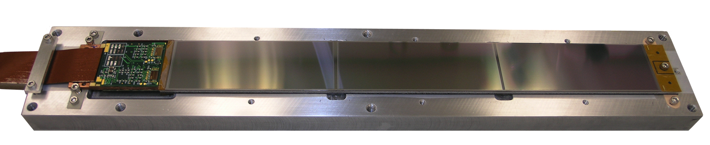
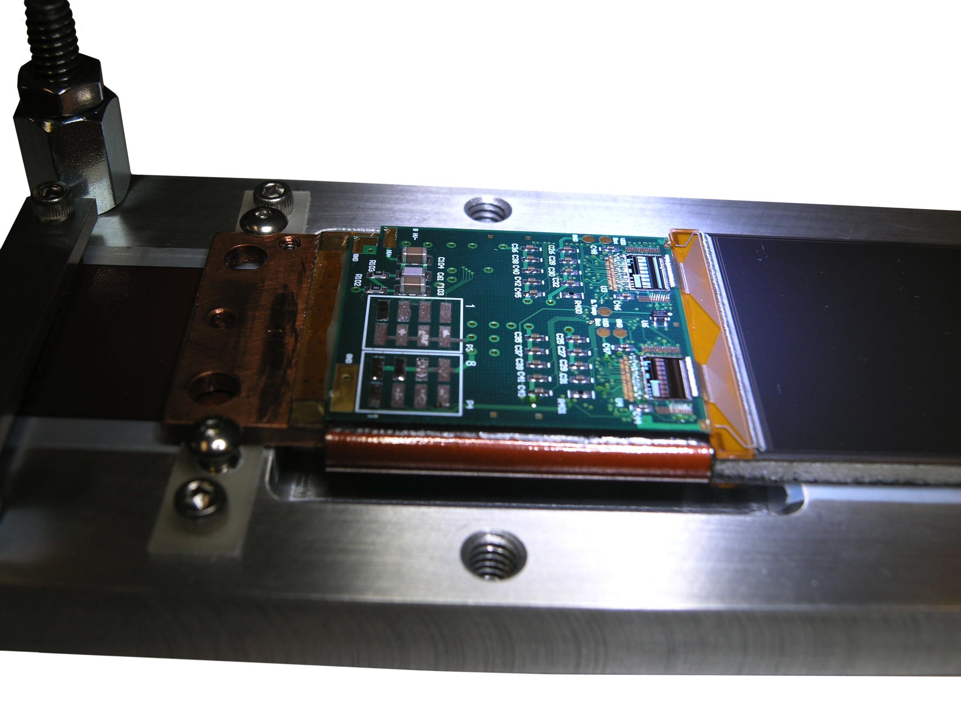
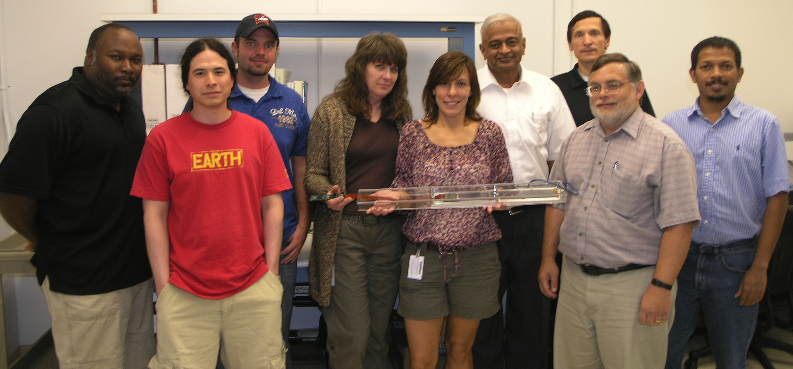
Physics – Hall B – Silicon Vertex Detector
  Sensors are being manufactured by Hamamatsu.
Staves are being assembled by Fermilab.
Several external technical progress reviews have been held.

Slide 19
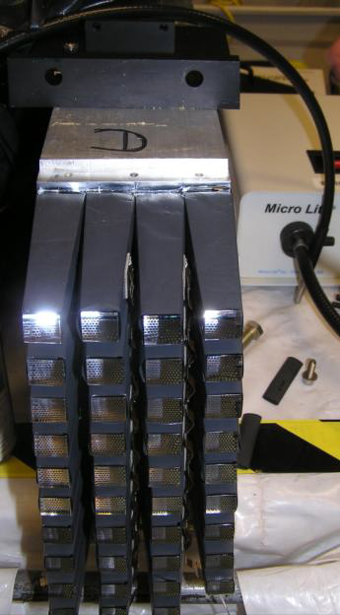
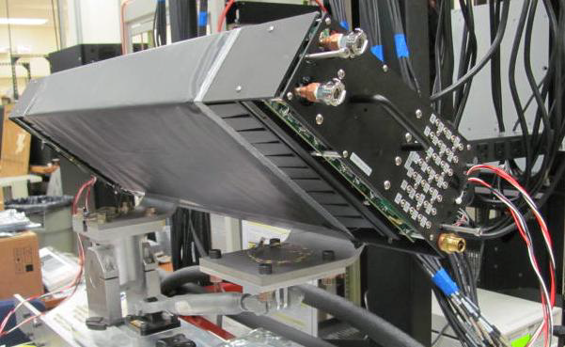
Physics – Detector Beam Tests
  Hall B SVT Two Stave Test
  Hall D FCALTest
  Hall D Mini-BCAL Test
End view of mini-BCAL module showing showing light guides.

Slide 20
Major Problem – Hall B SC Magnets
Two existing contracts have been terminated due to QA and schedule
  We have assumed the three machine shop sub-contracts.
  Five truck loads of equipment have arrived at JLab.
  We are attempting to qualify industrial conductor soldering vendors.
  We are in the process of setting up an in-house conductor soldering line.
Hall B Torus
  The Fermi Lab contract for cold mass fabrication has been awarded.
  Planning for Cryostat assembly has not started.
Hall B Solenoid
  We are out to bid to three industrial vendors.

Slide 21
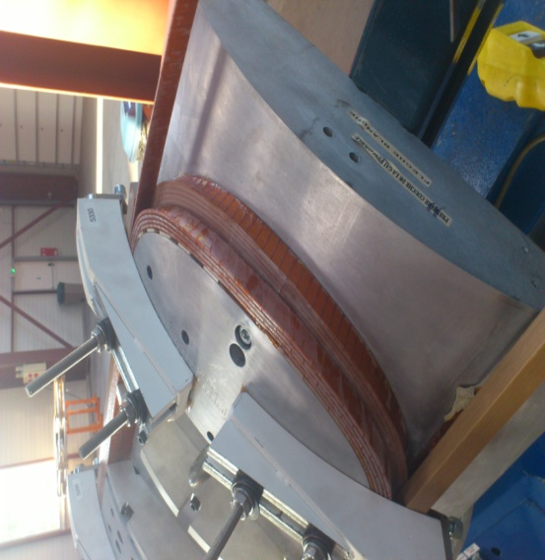
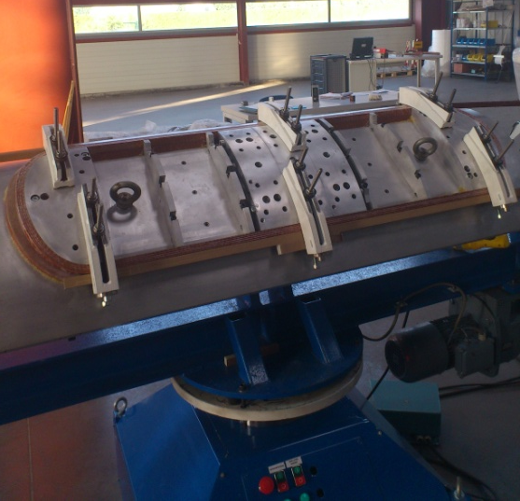
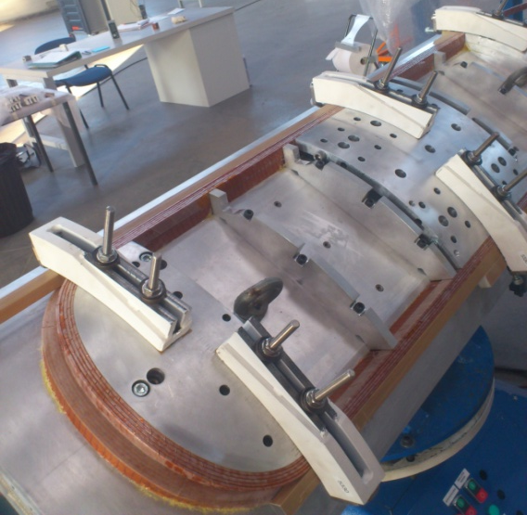
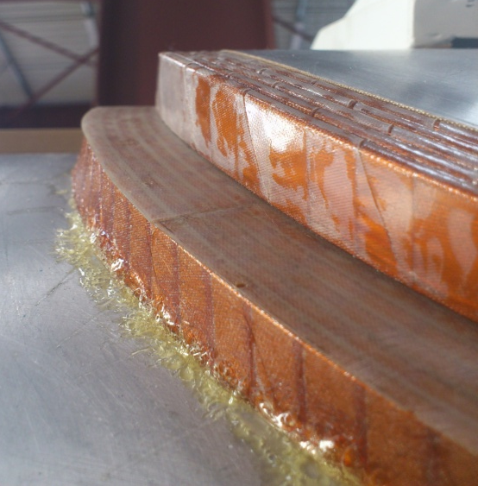
Major Problem – Hall C SC Magnets
Hall C Q2/Q3/Dipole
50% of the conductor has been soldered.
Prototype short Dipole
winding continues.
Vendor is procuring a second winding table.
Production winding has not started.
Schedule issues remain to be settled.
Dipole Final Design Review is 9-May.

Slide 22
Minor Problems
We have canceled the contract for the 15 high power “Box PS”
  Schedule and cost issue
  The two high precision PS (ARC 1 & Hall A) have been awarded
  The rebid of Box PS proposals are due in late May
The two CHL coldbox and compressor deliveries were very late.
The commissioning of CHL #2 has been delayed to late in the Long Shutdown.

Slide 23
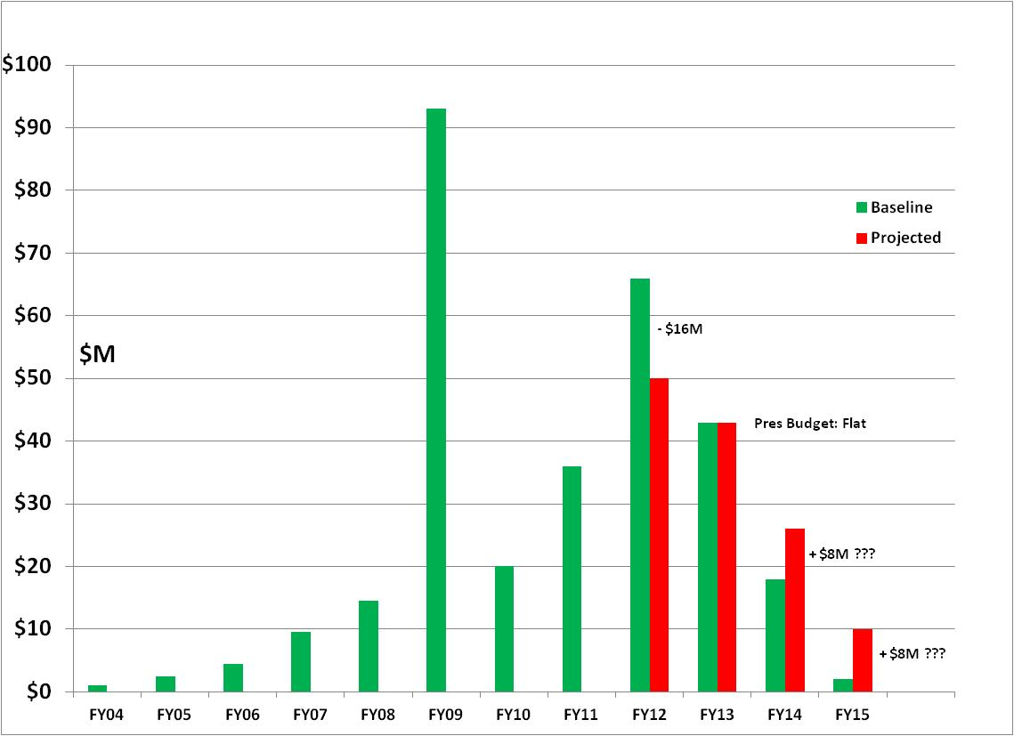
12 GeV - $310M TPC
FY12: reduction of $16M
FY13: Pres Request – no restoration
CD-4B may be at Risk
ARRA Shift of $65M
from FY10/11 to FY09

Slide 24
12 GeV Project Progress vs Funding

Slide 25
FY12 - $16M Cut
The $16M cut forced the project to:
  Lengthen the 12-month shutdown to 16-month shutdown
    Reduced contractors ($1M)
    Delays some Accelerator procurements ($2M)
  Postpone remaining Civil to FY14 ($2M)
  Postpone Hall D replacement solenoid design to Jul-2013 ($1M), and FAB to APR 2014 ($7M)
  Reduce Hall B & C staffing ($1M)
  Postpone some Physics procurements ($3M)
No contingency for cost overruns

Slide 26
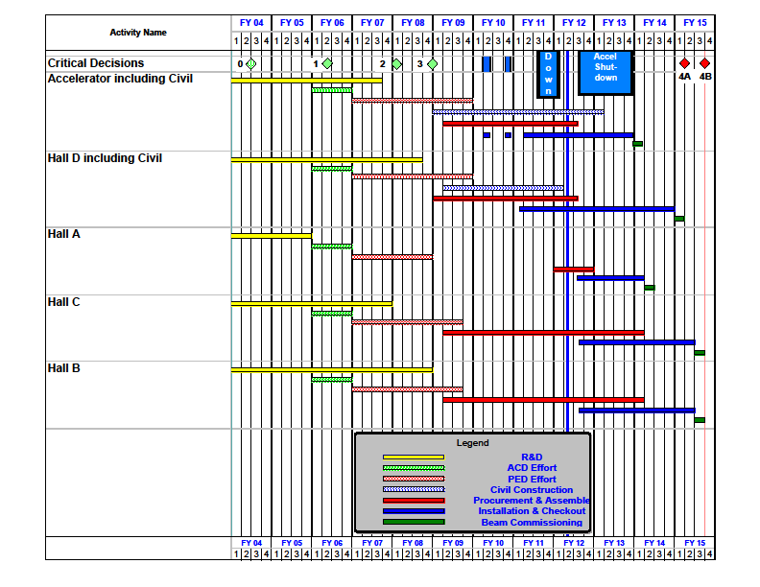
12 GeV Upgrade Project Schedule
    Two short parasitic installation periods in FY2010
    6-month installation
    May-Oct 2011
    12 16-month installation
    May 2012 - May Sept 2013
    Hall A commissioning start Oct 2013 Feb 2014
    Hall D commissioning start
    April 2014 Oct 2014
    Halls B & C commissioning start Oct 2014 Apr 2015
    Project Completion June 2015
    CD-4B may be at risk

Slide 27
REVISED 12 GeV BEAM GOALS
We are proceeding to hold CD4A & 4B
  Jan-2014 Accelerator (4-month slip) Driven by FY12 funding
  Feb-2014 Hall A (4-month slip) Driven by 16 month shutdown
  Oct-2014 Hall D (6-month slip) Driven by UIM shutdown
  Apr-2014 Halls B & C (6-month slip) Driven by FY13 funding
If no additional FY13 funding becomes available, in 3QFY13 we may need to abandon CD-4B and slow down the project, primarily Hall B & Hall C.

Slide 28
SUMMARY
Current status of 12 GeV Project:
  Performance Index: schedule 96% ; cost 96%
  Excellent progress to date
Concern about FY12 funding issue:
  $16M below profile
  Not restored in FY13
Although Project is progressing well, funding issues will severely challenge the schedule.

