Slide 1


Experimental Nuclear Physics
Rolf Ent
DOE/ONP S&T Review
May 9, 2012

Slide 2
Experimental Nuclear Physics - Outline
Status & Accomplishments of 6-GeV Program
Progress since 2009 S&T Review
Planning for the long down – key efforts to support 12 GeV
Plan for commissioning and early experiments
Planning for longer term

Slide 3
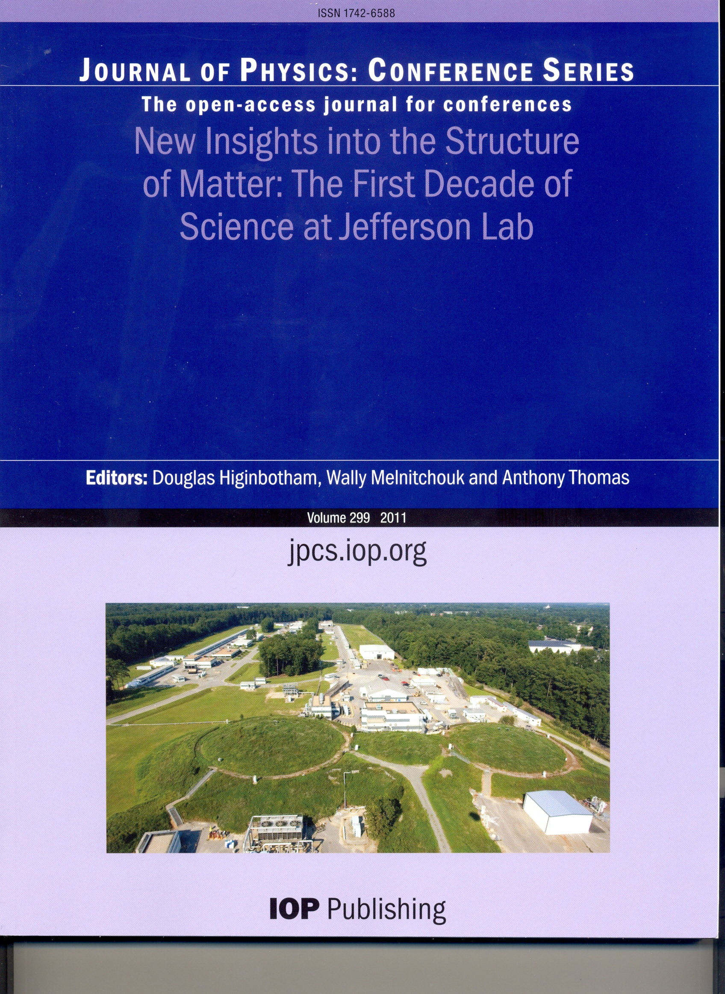
First Decade of CEBAF Published
Published in 2011
Foreword: A Long Decade of Physics
Making the case for Jefferson Lab
Nucleon Form Factors
Strange Vector Form Factors
Unpolarized Structure Functions
Spin Structure Functions
Deeply Virtual Exclusive Processes
Lattice QCD
Results from the N* Program
Transition to Perturbative QCD
Short-Distance Structure of Nuclei
Medium Modifications of Hadrons & Partons
Searches for Physics Beyond the SM
Hypernuclear Spectroscopy
The Free Electron Laser Program
CEBAF Accelerator Achievements

Slide 4
Recent Highlights & Overview of Presentations
QCD and the Structure of Hadrons
  Strangeness content of the proton
  Initial exploration of TMDs and GPDs
Nuclei: From Structure to Exploding Stars
  New information on correlations and the EMC effect
  Measurement of the neutron skin
In Search of the New Standard Model
  Factor 5 → 25 increase in precision of Standard Model couplings
J. Gomez Metrics & many technical achievements
F.X. Girod DVCS recent accomplishments & 12 GeV outlook (GPDs)
K. Allada Neutron Transversity results & 12 GeV outlook (TMDs)
P. Solvigon SRC & EMC connection & 12 GeV outlook (Physics of Nuclei)
R. Michaels Neutron Skin results & 12 GeV outlook (Fundam. Symmetries)
E. Chudakov 12 GeV outlook (Spectroscopy)
Y. Qiang SiPM progress for Hall D Barrel Calorimeter readout
D. Weisenberger Imaging for Nuclear Physics & Applications

Slide 5
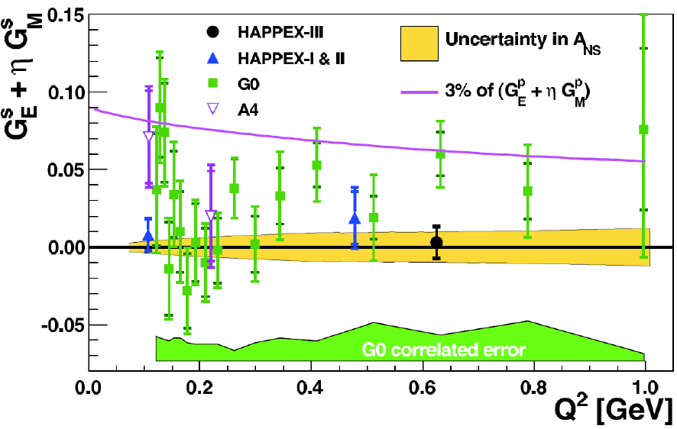
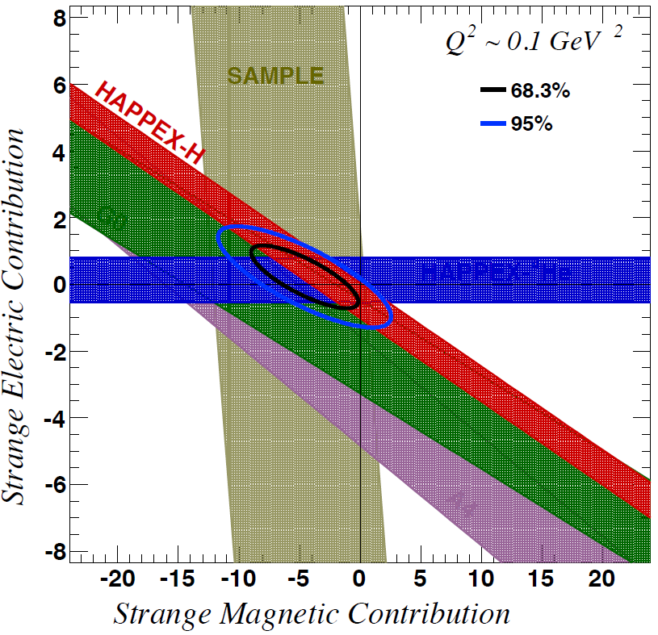
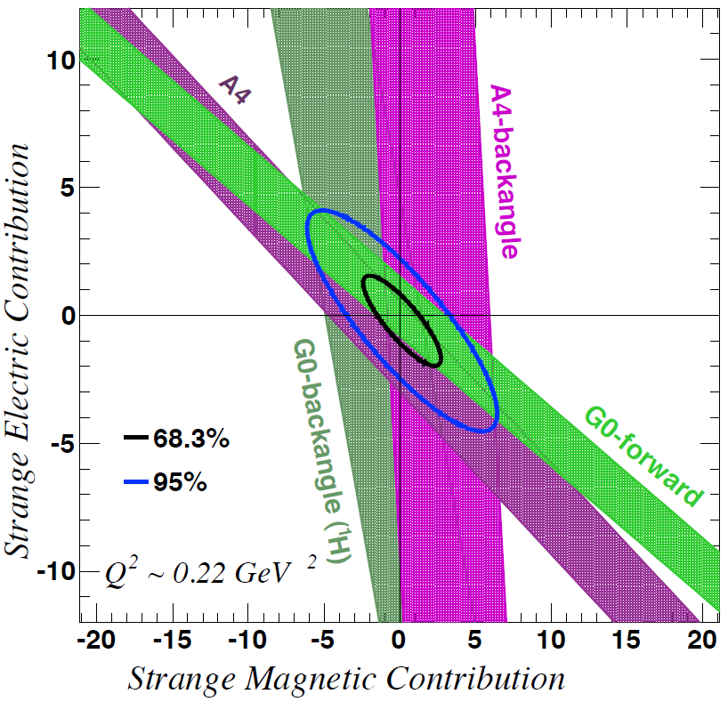
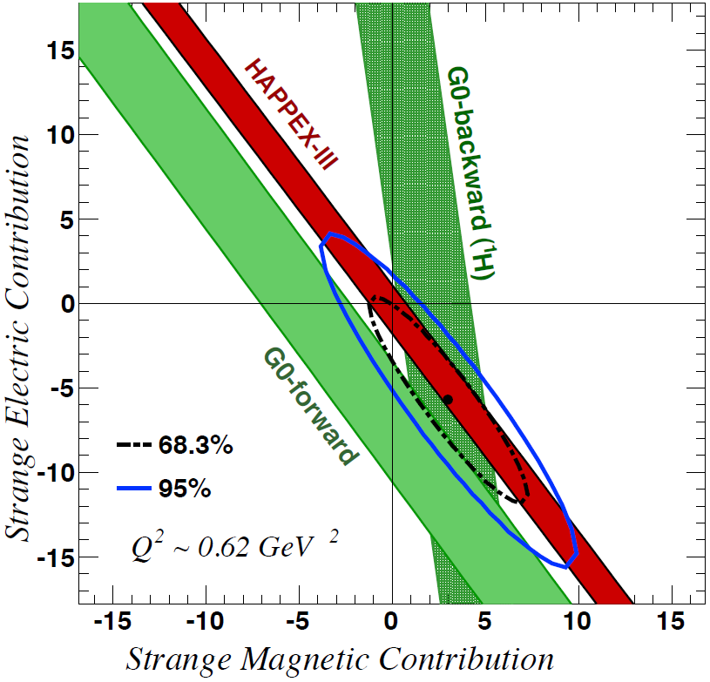
Strangeness Contribution to Nucleon Form Factors
HAPPEx-3: PRL 108 (2012) 102001
G0-Backward: PRL 104 (2010) 012001
Purple line represents 2% of the proton form factors
→ strange quarks do not play a substantial role in the long-range electromagnetic structure of nucleons
Completes Performance Measure HP4

Slide 6
CLAS impact on N* states in PDG 2012
Results based on Bonn-Gatchina coupled-channel analysis
State N((mass)J^{P} | Status PDG 2010 | Status PDG 2012 | KΛ 2012 | KΣ 2012 | Nγ 2012
N(1710)1/2⁺ | *** not seen in GW analysis | *** | *** | ** | ***
N(1880)1/2⁺ |  | ** | ** | * | **
N(1895)1/2⁻ |  | ** | ** | * | ***
N(1900)3/2⁺ | ** | *** | *** | ** | ***
N(1875)3/2⁻ |  | *** | *** | ** | ***
N(2150)3/2⁻ |  | ** | ** |  | **
N(2000)5/2⁺ | * | *** | ** | * | **
N(2060)5/2⁻ |  | *** |  | ** | ***

Slide 7
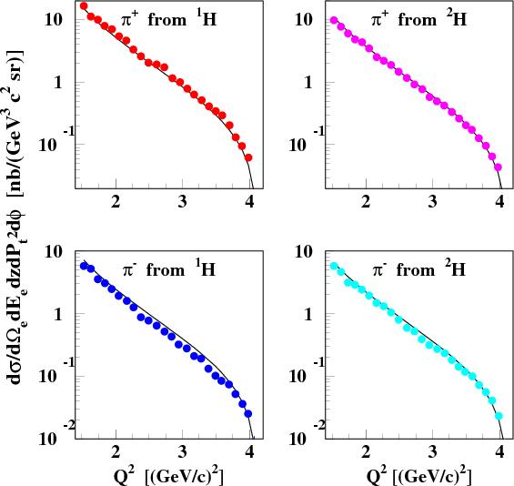
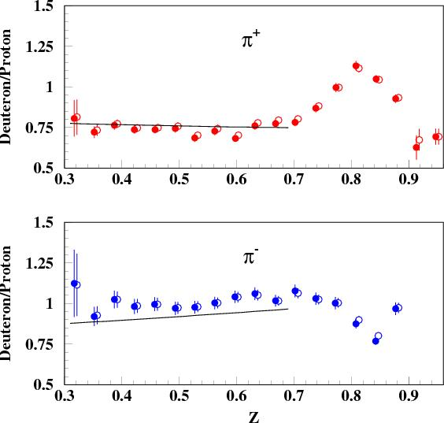
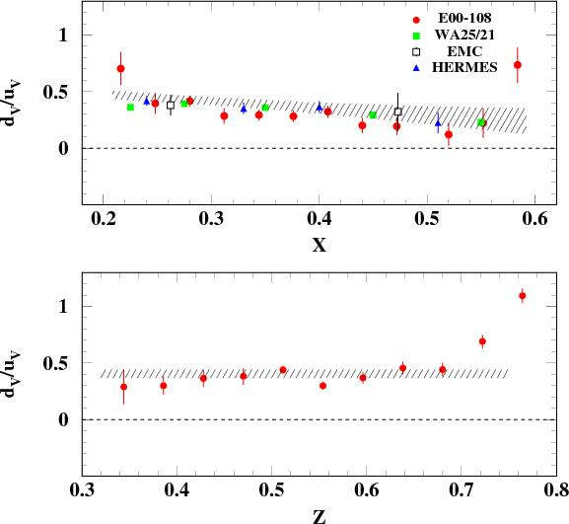
E00-108: Onset of the Parton Model in SIDIS
Solid (open) symbols are after (before) subtraction of diffractive ρ events
x = 0.32
N-Δ region
x = 0.4
Phys. Rev. C85: 015202 (2012)
Curves are parton model calculations using CTEQ5M parton distributions at NLO and BKK fragmentation functions.
Agreement with the parton model expectation is always far better for ratios, also for D/H, Al/D, or for ratios versus z or Q².
Bodes well for SIDIS at 12 GeV

Slide 8
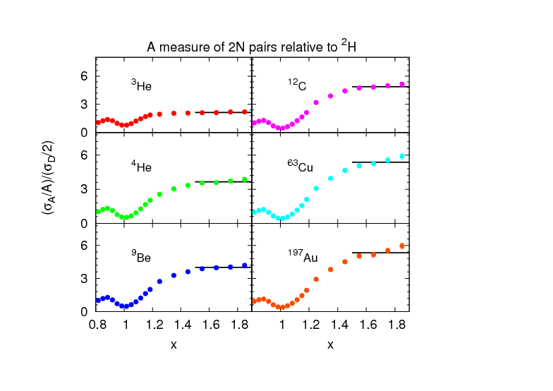
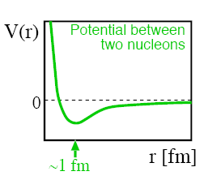
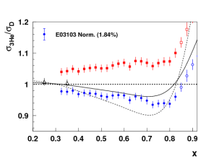
Short-Range Correlations (SRC) and European Muon Collaboration (EMC) Effect Are Correlated
EMC Slopes
0.35 ≤ X_{B} ≤ 0.7
Fomin et al, PRL 108, 092502 (2012)
SRC Scaling factors X_{B} ≥ 1.4
SRC: nucleons see strong repulsive core at short distances
EMC effect: quark momentum in nucleus is altered
Weinstein et al, PRL 106, 052301 (2011)

Slide 9

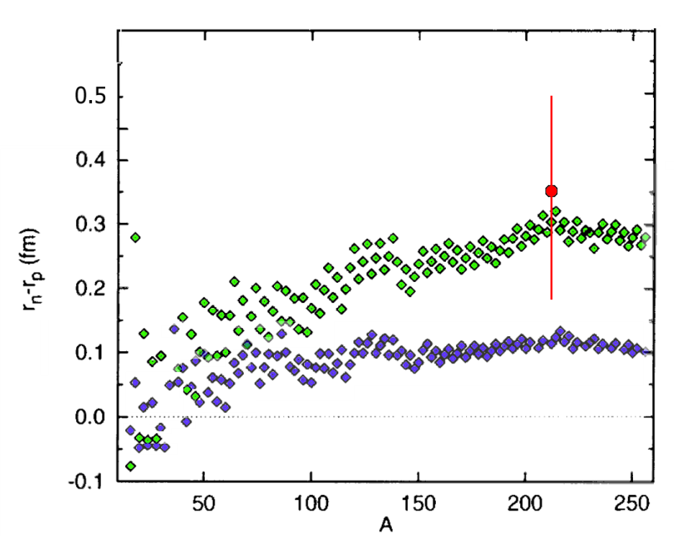
Lead (²⁰⁸Pb) Radius Experiment : PREX
Elastic Scattering Parity-Violating Asymmetry
Z⁰ : Clean Probe Couples Mainly to Neutrons
Applications : Nuclear Physics, Neutron Stars,
Atomic Parity, Heavy Ion Collisions
PREX
PREX
Relativistic mean field
Nonrelativistic skyrme
A neutron skin of 0.2 fm or more has implications for our understanding of neutron stars and their ultimate fate
The Lead (²⁰⁸Pb) Radius Experiment (PREX) finds neutron radius larger than proton radius by +0.35 fm (+0.15, -0.17).
This result provides model-independent confirmation of the existence of a neutron skin relevant for neutron star calculations.
Follow-up experiment to reduce uncertainties by factor of 3 and pin down symmetry energy in EOS.

Slide 10
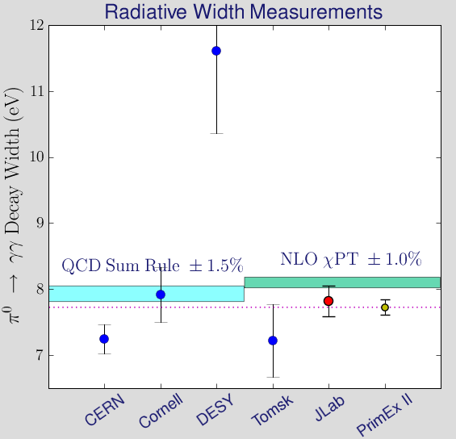
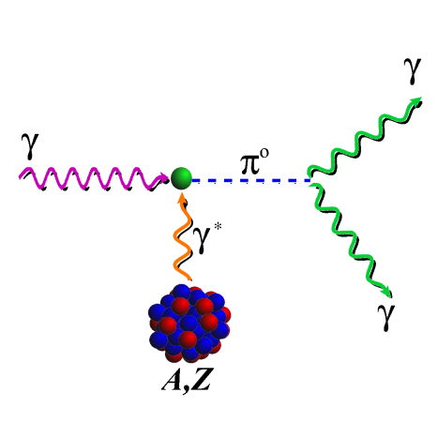
PrimEx
Precision Measurement of π⁰ life time
Chiral anomaly of QCD predicts exact value of decay width.
γ
π⁰
E02-103, E08-023
Primakoff effect
Γ(π⁰→γγ) = 7.82eV±0.14±0.17
(2008)
(2002)
Projected uncertainty for PrimEx-II (E08-023) – data taken in Fall 2010.
E02-103
PrimEx I
I. Larin et al., Phys. Rev. Lett. 106: 162303 (2011).

Slide 11
10 SC Milestones in Hadronic Physics related to Jlab
2 for 12 GeV and 2 for Theory
Year | # | Milestone
2009 | HP3 | Complete the combined analysis of available data on single π, η and K photo-production of nucleon resonances and incorporate the analysis of two-pion final states into the coupled-channel analysis of resonances.
2010 | HP4 | Determine the four electromagnetic form factors of the nucleons to a momentum-transfer squared, Q², of 3.5 GeV² and separate the electroweak form factors into contributions from the u, d and s-quarks for Q² < 1 GeV² .
2010 | HP5 | Characterize high-momentum components induced by correlations in the few-body nuclear wave functions via (e,e'N) and (e,e'NN) knock-out processes in nuclei and compare free proton and bound proton properties via measurement of polarization transfer in the ⁴He (e,e’p) reaction.
2011 | HP6 | Measure the lowest moments of the unpolarized nucleon structure functions (both longitudinal and transverse) to 4 GeV² for the proton, and the neutron, and the deep inelastic scattering polarized structure functions g₁(x,Q²) and g₂(x,Q²) for x=0.2-0.6, and 1 < Q² < 5 GeV² for both protons and neutrons.
2012 | HP7 | Measure the electromagnetic excitations of low-lying baryon states (<2 GeV) and their transition form factors over the range Q²=0.1–7 GeV² and measure the electro- and photo-production of final states with one and two pseudoscalar mesons.
2012 | HP11 | Measure the helicity-dependent and target-polarization-dependent cross-section differences for Deeply Virtual Compton Scattering (DVCS) off the proton and the neutron in order to extract accurate information on generalized parton distributions for parton momentum fractions, x, of 0.1 – 0.4, and squared momentum transfer, t, less than 0.5 GeV² .
2014 | HP9 | Perform lattice calculations in full QCD of nucleon form factors, low moments of nucleon structure functions and low moments of generalized parton distributions including flavor and spin dependence.
2014 | HP10 | Carry out ab initio microscopic studies of the structure and dynamics of light nuclei based on two-nucleon and many-nucleon forces and lattice QCD calculations of hadron interaction mechanisms relevant to the origin of the nucleon-nucleon interaction.
2018 | HP14 | Extract accurate information on spin-dependent and spin-averaged valence quark distributions to momentum fractions x above 60% of the full nucleon momentum
2018 | HP15 | The first results on the search for exotic mesons using photon beams will be completed.

Slide 12
Status: The 6 Milestones for the JLab 6 GeV Experimental Program
Year | # | Milestone | Status: Complete or Activities Needed to Complete UPDATE
2009 | HP3 | Complete the combined analysis of available data on single π, η and K photo-production of nucleon resonances and incorporate the analysis of two-pion final states into the coupled-channel analysis of resonances. | Precise Nπ, pη, KΛ/Σ photo-production cross section data and Λ and Σ hyperon recoil polarization data from CLAS published. World-first “complete experiment” with FROzen Spin Target in FY10. First CLAS/EBAC coupled channel analysis of single and double π production complete, K- channel incorporated in dynamical coupled-channel analysis. Strong evidence for several “missing” states found in measurement of high precision hyperon data. New N*’s to be listed in PDG2012.
2010 | HP4 | Determine the four electromagnetic form factors of the nucleons to a momentum-transfer squared, Q², of 3.5 GeV² and separate the electroweak form factors into contributions from the u, d and s-quarks for Q² < 1 GeV². | Base data for EM form factors complete; G_{M}^{n} , G_{E}^{n} , and G⁰ forward and backward angle data all complete and published. HAPPEx He, HAPPEX II and HAPPEx III completed and published; Flavor separation completed and published. Could be declared complete.
2010 | HP5 | Characterize high-momentum components induced by correlations in the few-body nuclear wave functions via (e,e'N) and (e,e'NN) knock-out processes in nuclei and compare free proton and bound proton properties via measurement of polarization transfer in the reaction. | Multiple (e,e’N) and several (e,e’NN) results published; related DIS (e,e’) published; ¹²C(e,e’NN) results published. Followup completed. Two experiments completed and published. Could be declared complete. Discovered connection of high-momentum components in NN correlations (SRC) to the EMC effect.
2011 | HP6 | Measure the lowest moments of the unpolarized nucleon structure functions (both longitudinal and transverse) to 4 GeV² for the proton, and the neutron, and the deep inelastic scattering polarized structure functions g₁(x,Q²) and g₂(x,Q²) for x=0.2-0.6, and 1 < Q² < 5 GeV² for both protons and neutrons | Longitudinal structure function moments for proton to be submitted, and F_{L} results for deuteron final and drafted. New precision data on g₁^{p} and g₁^{d}; BoNuS analysis of F_{2n}/F_{2p} published. Data for g₂^{p} and g₂^{n} up to Q² ~ 1 GeV² published, and data at Q² = 4 GeV² accumulated and nearing completion of analysis. Anticipate to be declared complete end of 2012.
2012 | HP7 | Measure the electromagnetic excitations of low-lying baryon states (<2 GeV) and their transition form factors over the range Q² = 0.1 – 7 GeV² and measure the electro- and photo-production of final states with one and two pseudoscalar mesons. | Delta, Roper, S₁₁ and D₁₃ published; First EBAC results on electro-production resonance analysis of CLAS data published. Complete photo-production measurements performed by end of 6-GeV era.
2012 | HP11 | Measure the helicity-dependent and target-polarization-dependent cross-section differences for Deeply Virtual Compton Scattering (DVCS) off the proton and the neutron in order to extract accurate information on generalized parton distributions for parton momentum fractions, x, of 0.1 – 0.4, and squared momentum transfer, t, less than 0.5 GeV². | Hall A DVCS experiment and Hall B experiment on DVCS with polarized beam both completed and published. Follow-up Hall A experiment on proton and neutron completed. Polarized target experiment on DVCS in Hall B completed - analysis nearing completion. First extraction of GPD related Compton form factor H, H-tilde published. GPD extraction in combined analysis of unpolarized and all polarized data in preparation.

Slide 13
More Physics Results …
FY09 — FY12 has shown a myriad of physics results not discussed, see backup slide
Similarly, several key physics results are under analysis, some connected to HP milestones, see second backup slide

Slide 14
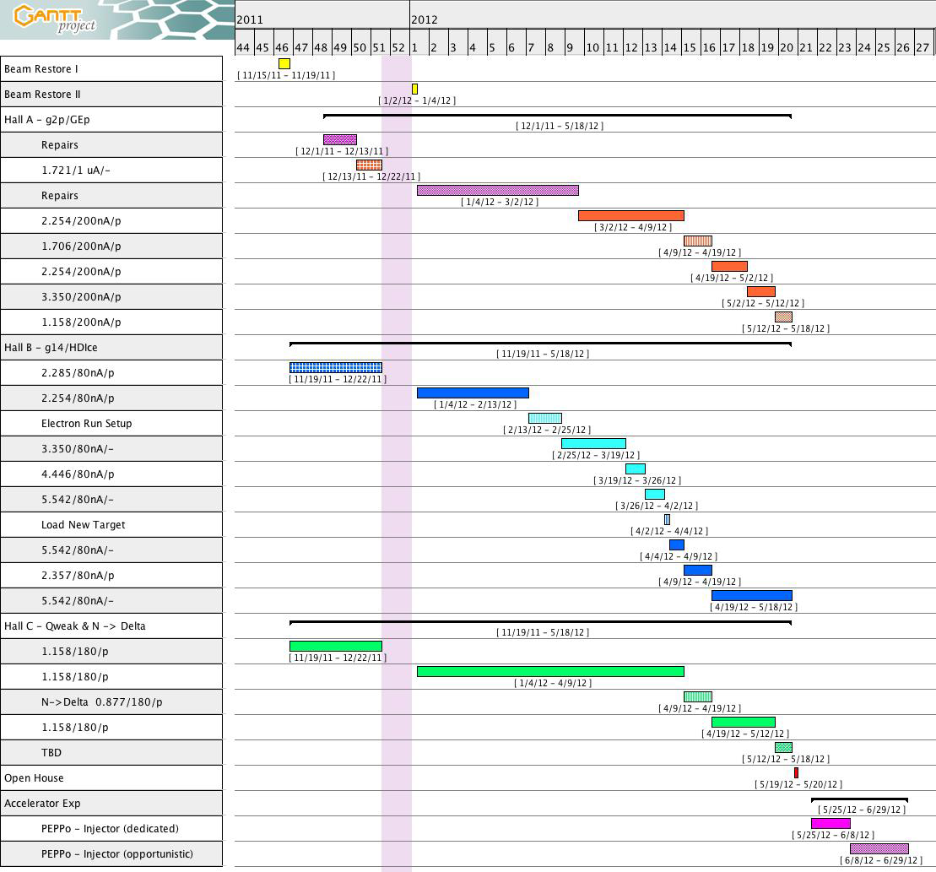
Posted FY12 schedule
commissioning
g2p/GEp
HDIce
e test
HDIce
γ run
N-Δ parasitic
Qweak
DIS parasitic
PEPPo
S&T Review May 2012 Page 14

Slide 15
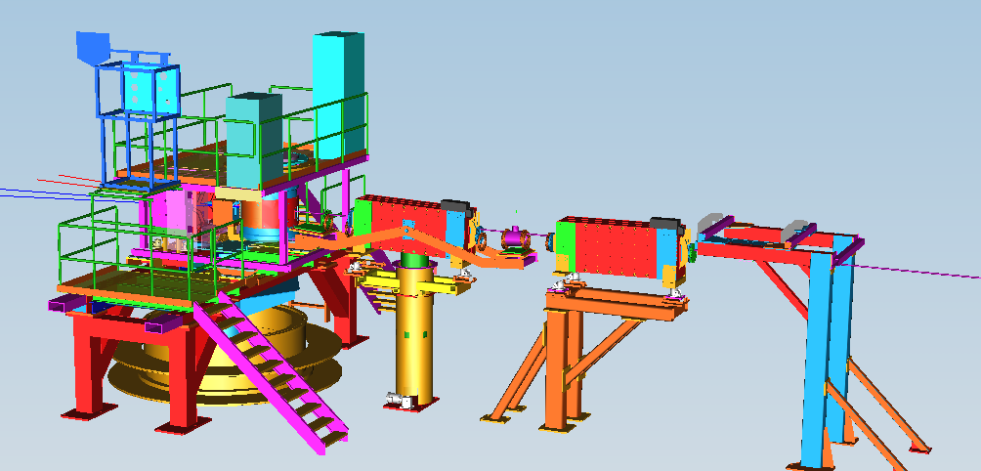
G2p/GEp: Major New Installation in Hall A
Strong Support from DOE/NP and an additional ≈$200K of User Contributions
Spin Polarizability : Major failure (>8σ) of χPT for neutron δ_{LT}. Need g₂ isospin separation to solve.
Hydrogen HyperFine Splitting : Lack of knowledge of g₂ at low Q² is one of the leading uncertainties.
Proton Charge Radius : one of the leading uncertainties in extraction of <R_{p}> from μ−H Lamb shift.
Septa
New Beam Diagnostics
(BPM,BCM,Harps,Tungsten Calo)
Chicane
Local Dump
Polarized Target

Slide 16
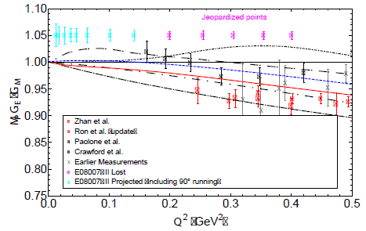
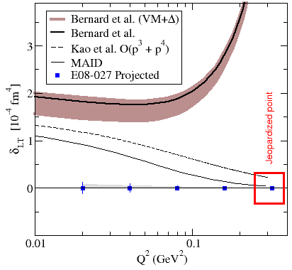
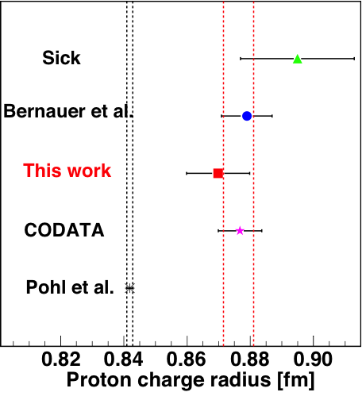
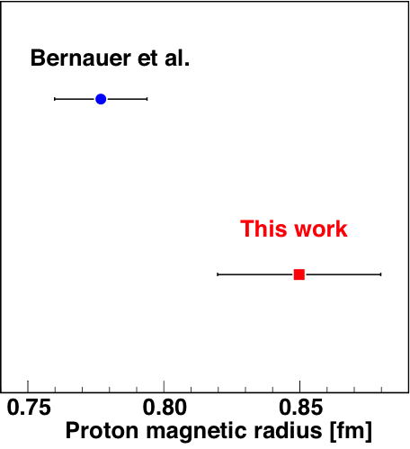
Hall A: g2p/GEp status
SC Target magnet problem – successfully modified Hall B target!
Late start prevented higher Q² running
  - Physics impact minor
  - Lost one high Q² data point for g₂^{p}
  For G_{e}^{p} overlap points lost
DAQ speed/HRS at 7-8 KHz (<30%
dead time) compensates for lost time

Slide 17
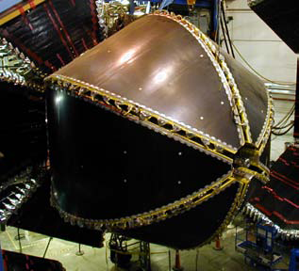
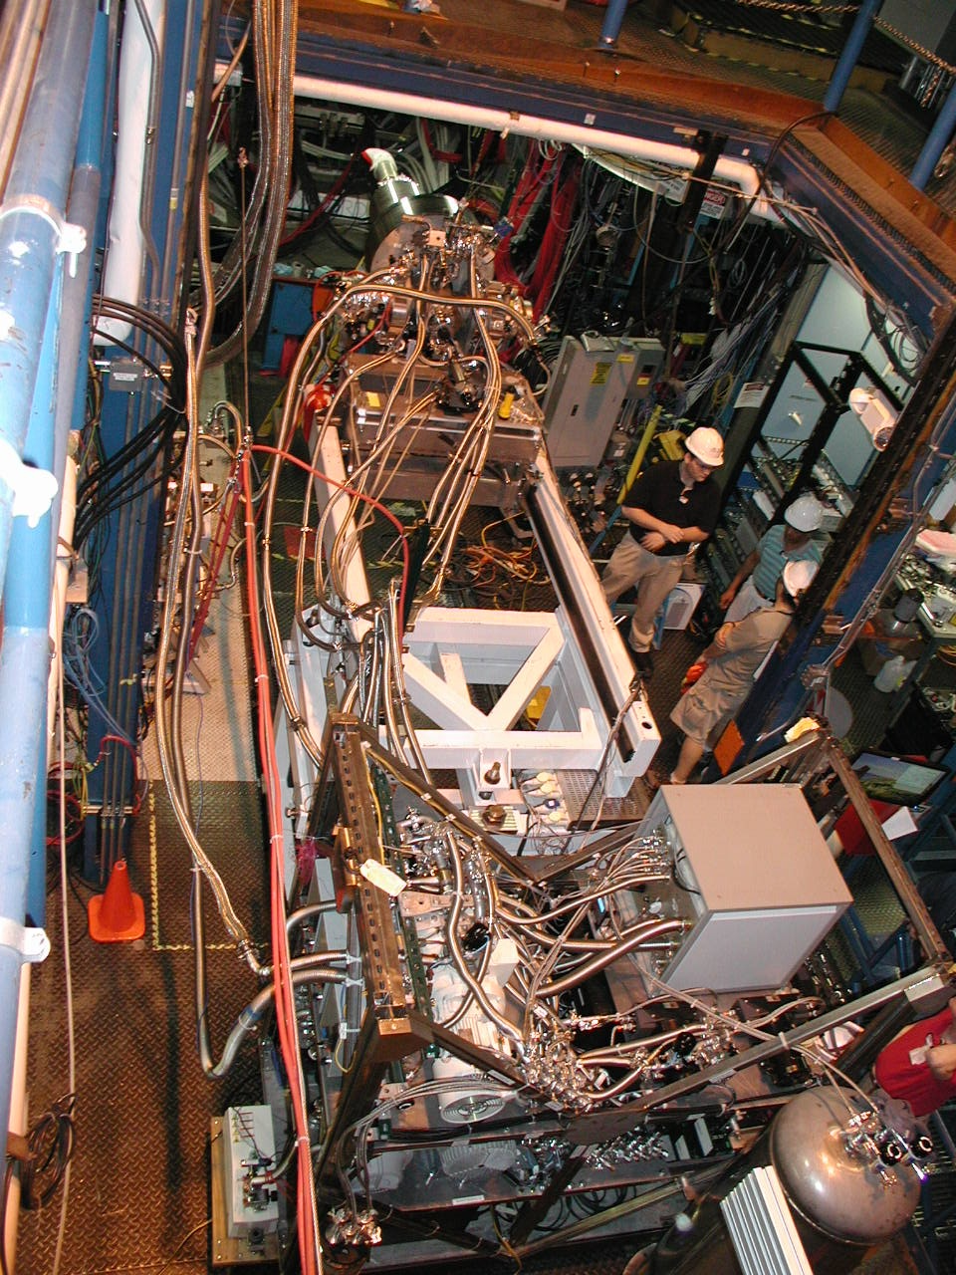
Status of Single Meson Production on Protons & Neutrons
✔ - published ✔ - acquired ✔ - HDIce
Technical progress on HDIce target in J. Gomez’ talk
 | σ | Σ | T | P | E | F | G | H | T_{x} | T_{z} | L_{x} | L_{z} | O_{x} | O_{z} | C_{x} | C_{z}
pπ⁰ | ✔ | ✓ | ✓ |  | ✓ | ✓ | ✓ | ✓
nπ⁺ | ✔ | ✓ | ✓ |  | ✓ | ✓ | ✓ | ✓
pη | ✔ | ✓ | ✓ |  | ✓ | ✓ | ✓ | ✓
pη’ | ✔ | ✓ | ✓ |  | ✓ | ✓ | ✓ | ✓
pω | ✔ | ✓ | ✓ |  | ✓ | ✓ | ✓ | ✓
K⁺Λ | ✔ | ✓ | ✓ | ✔ | ✓ | ✓ | ✓ | ✓ | ✓ | ✓ | ✓ | ✓ | ✓ | ✓ | ✔ | ✔
K⁺Σ⁰ | ✔ | ✓ | ✓ | ✔ | ✓ | ✓ | ✓ | ✓ | ✓ | ✓ | ✓ | ✓ | ✓ | ✓ | ✔ | ✔
K^{0*}Σ⁺ | ✔ | ✓ |  |  |  |  |  |  |  |  | ✓ | ✓
pπ⁻ | ✔ | ✓ | ✓ |  | ✓ | ✓ | ✓ | ✓
pρ⁻ | ✓ | ✓ | ✓ |  | ✓ | ✓ | ✓ | ✓
K⁻Σ⁺ | ✓ | ✓ | ✓ |  | ✓ | ✓ | ✓ | ✓
K⁰Λ | ✓ | ✓ | ✓ | ✓ | ✓ | ✓ | ✓ | ✓ | ✓ | ✓ | ✓ | ✓ | ✓ | ✓ | ✓ | ✓
K⁰Σ⁰ | ✓ | ✓ | ✓ | ✓ | ✓ | ✓ | ✓ | ✓ | ✓ | ✓ | ✓ | ✓ | ✓ | ✓ | ✓ | ✓
K^{0*}Σ⁰ | ✓ | ✓
Proton targets
Data taking completed
With g9b-FROST
Neutron targets
Underway in G14-HD run

Slide 18
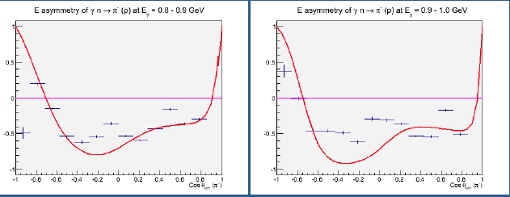
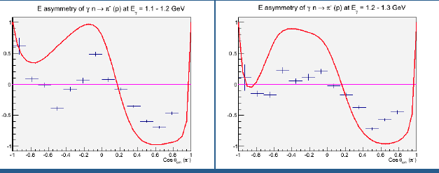
First double asymmetry E^{n} on neutron
γn π⁻p
Graphs show sample of double polarization asymmetries with circular photons and longitudinal neutron (D) polarization from ongoing HDIce run.
The red line is from a fit to the E^{p} asymmetry on protons. The discrepancy with the data at higher mass shows that excited neutrons have a different helicity structure from excited protons.
Data will be used in global coupled channel analyses to identify excited neutron states.
W=1.575 GeV
W=1.635 GeV
SAID extrapolation from proton data
Preliminary
N. Walford - CUA
W=1.745 GeV
W=1.800 GeV

Slide 19
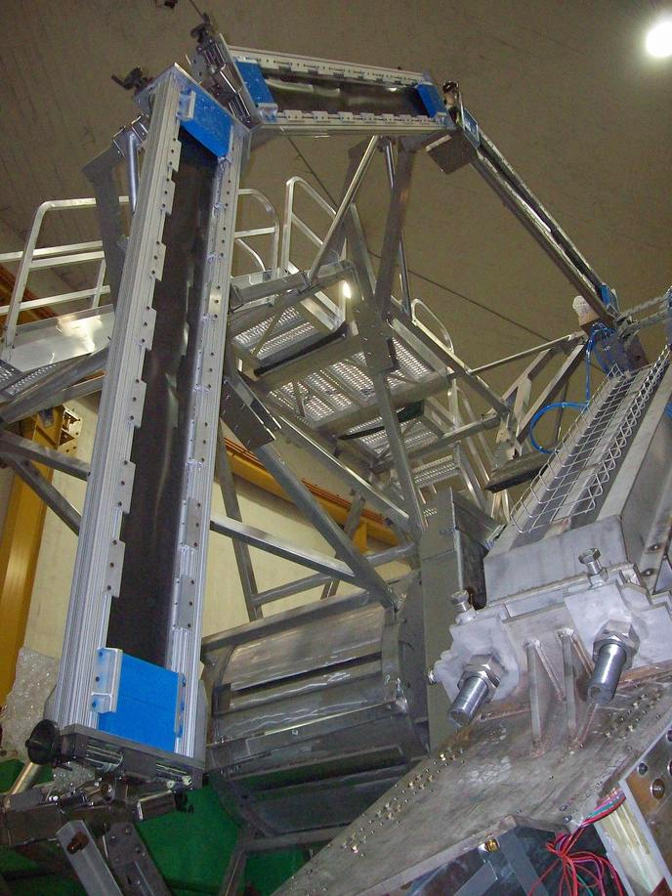
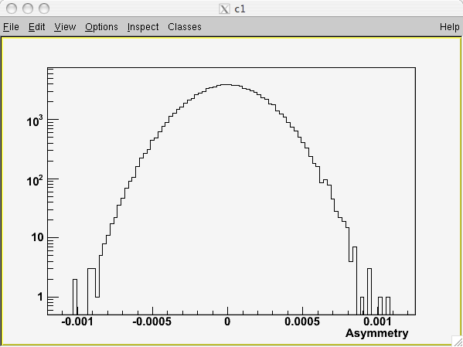
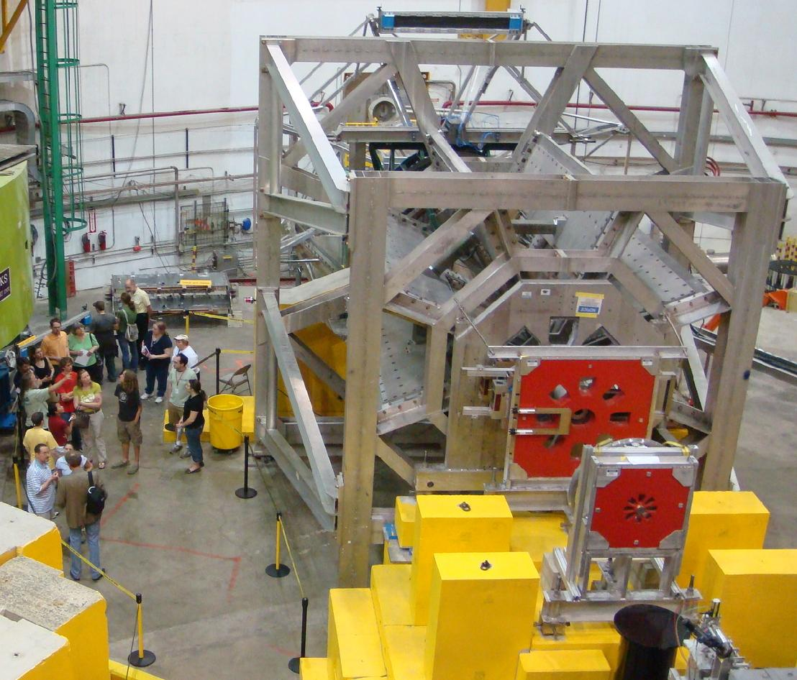
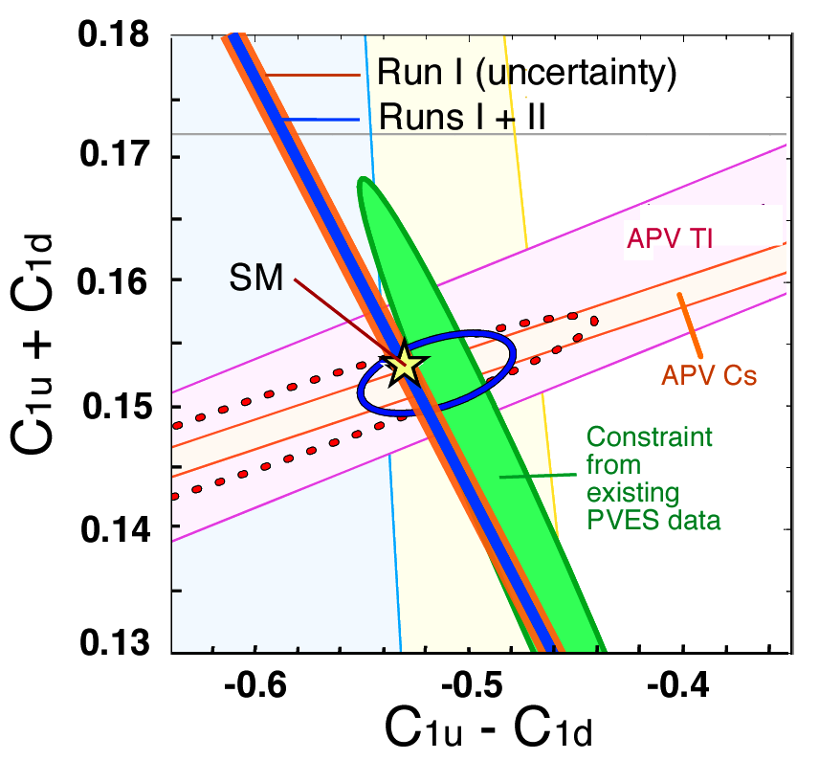
Qweak: Measuring the weak charge of the proton
Q_{w}= (1 – 4 sin² Θ_{W})
• Precision measurement of the proton’s weak charge
• Search for parity-violating new physics up to the ~ 2 TeV scale
Beam: routine data-taking at 180 μA @ ~85+% polarization, with 960 Hz helicity flip
• No show-stoppers found, on track for (close to) proposed 4% precision on Q^{p}_{Weak}
Q^{P}_{W} = - 2 (2C_{1u} + C_{1d} )
Isoscalar weak charge
Young, Carlini,
Thomas & Roche, PRL
Anticipated constraints if
Q^{P}_{W} is consistent with the Standard Model.
Isovector weak charge

Slide 20
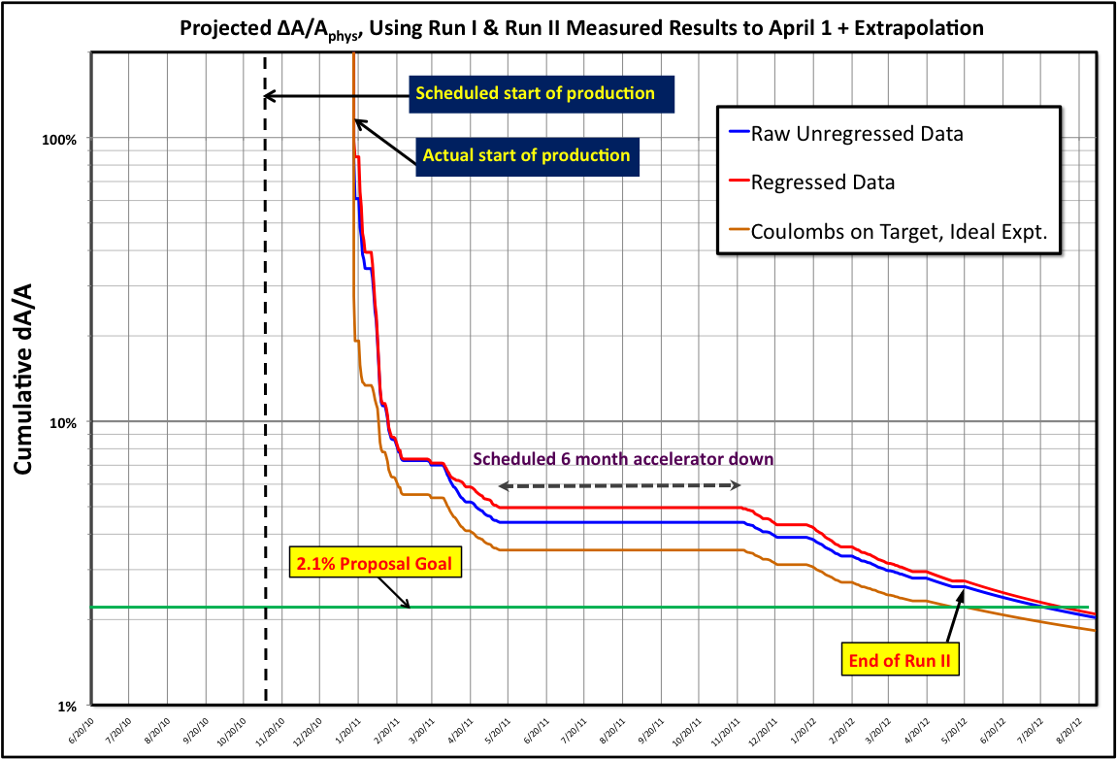
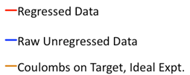
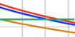
Qweak Progress & Success!
8/20/10
11/20/10
2/20/11
5/20/11
8/20/11
11/20/11
2/20/12
5/20/12

Slide 21
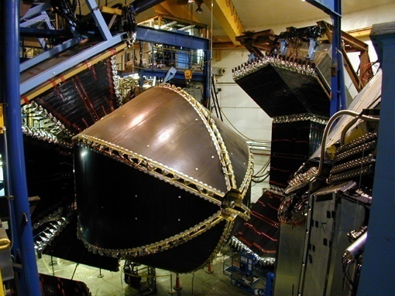
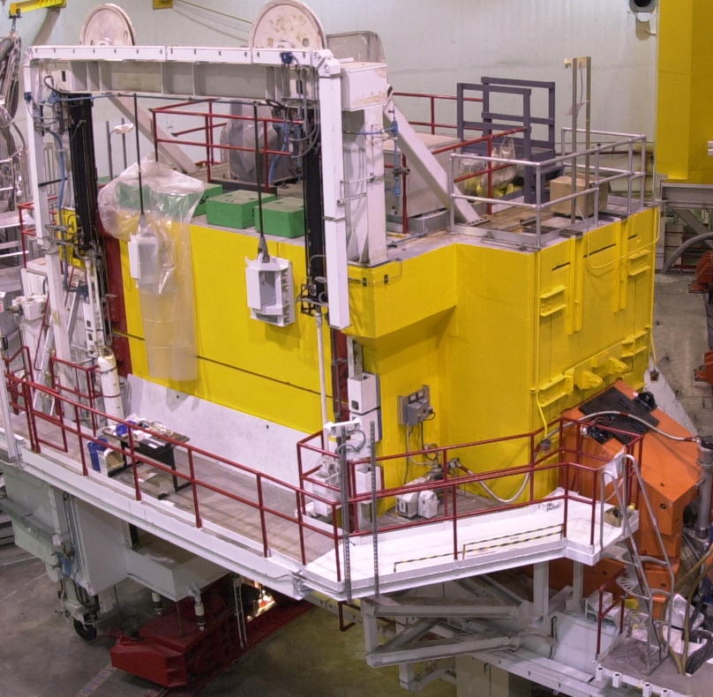
Planning for the Down – De-installation
Plans for CLAS, SOS (and Qweak) de-installation in place
70% of scope planned for FY12
Labor planning completed
  – assistance from Physics and Engineering in crunch time
Plans for storage of detector components to be salvaged in place
  – e.g., frames prepared for CLAS/FTOF components to be used in future Hall C/SRC experiment led by Tel Aviv group
  – and of course for components to be recycled for 12 GeV

Slide 22
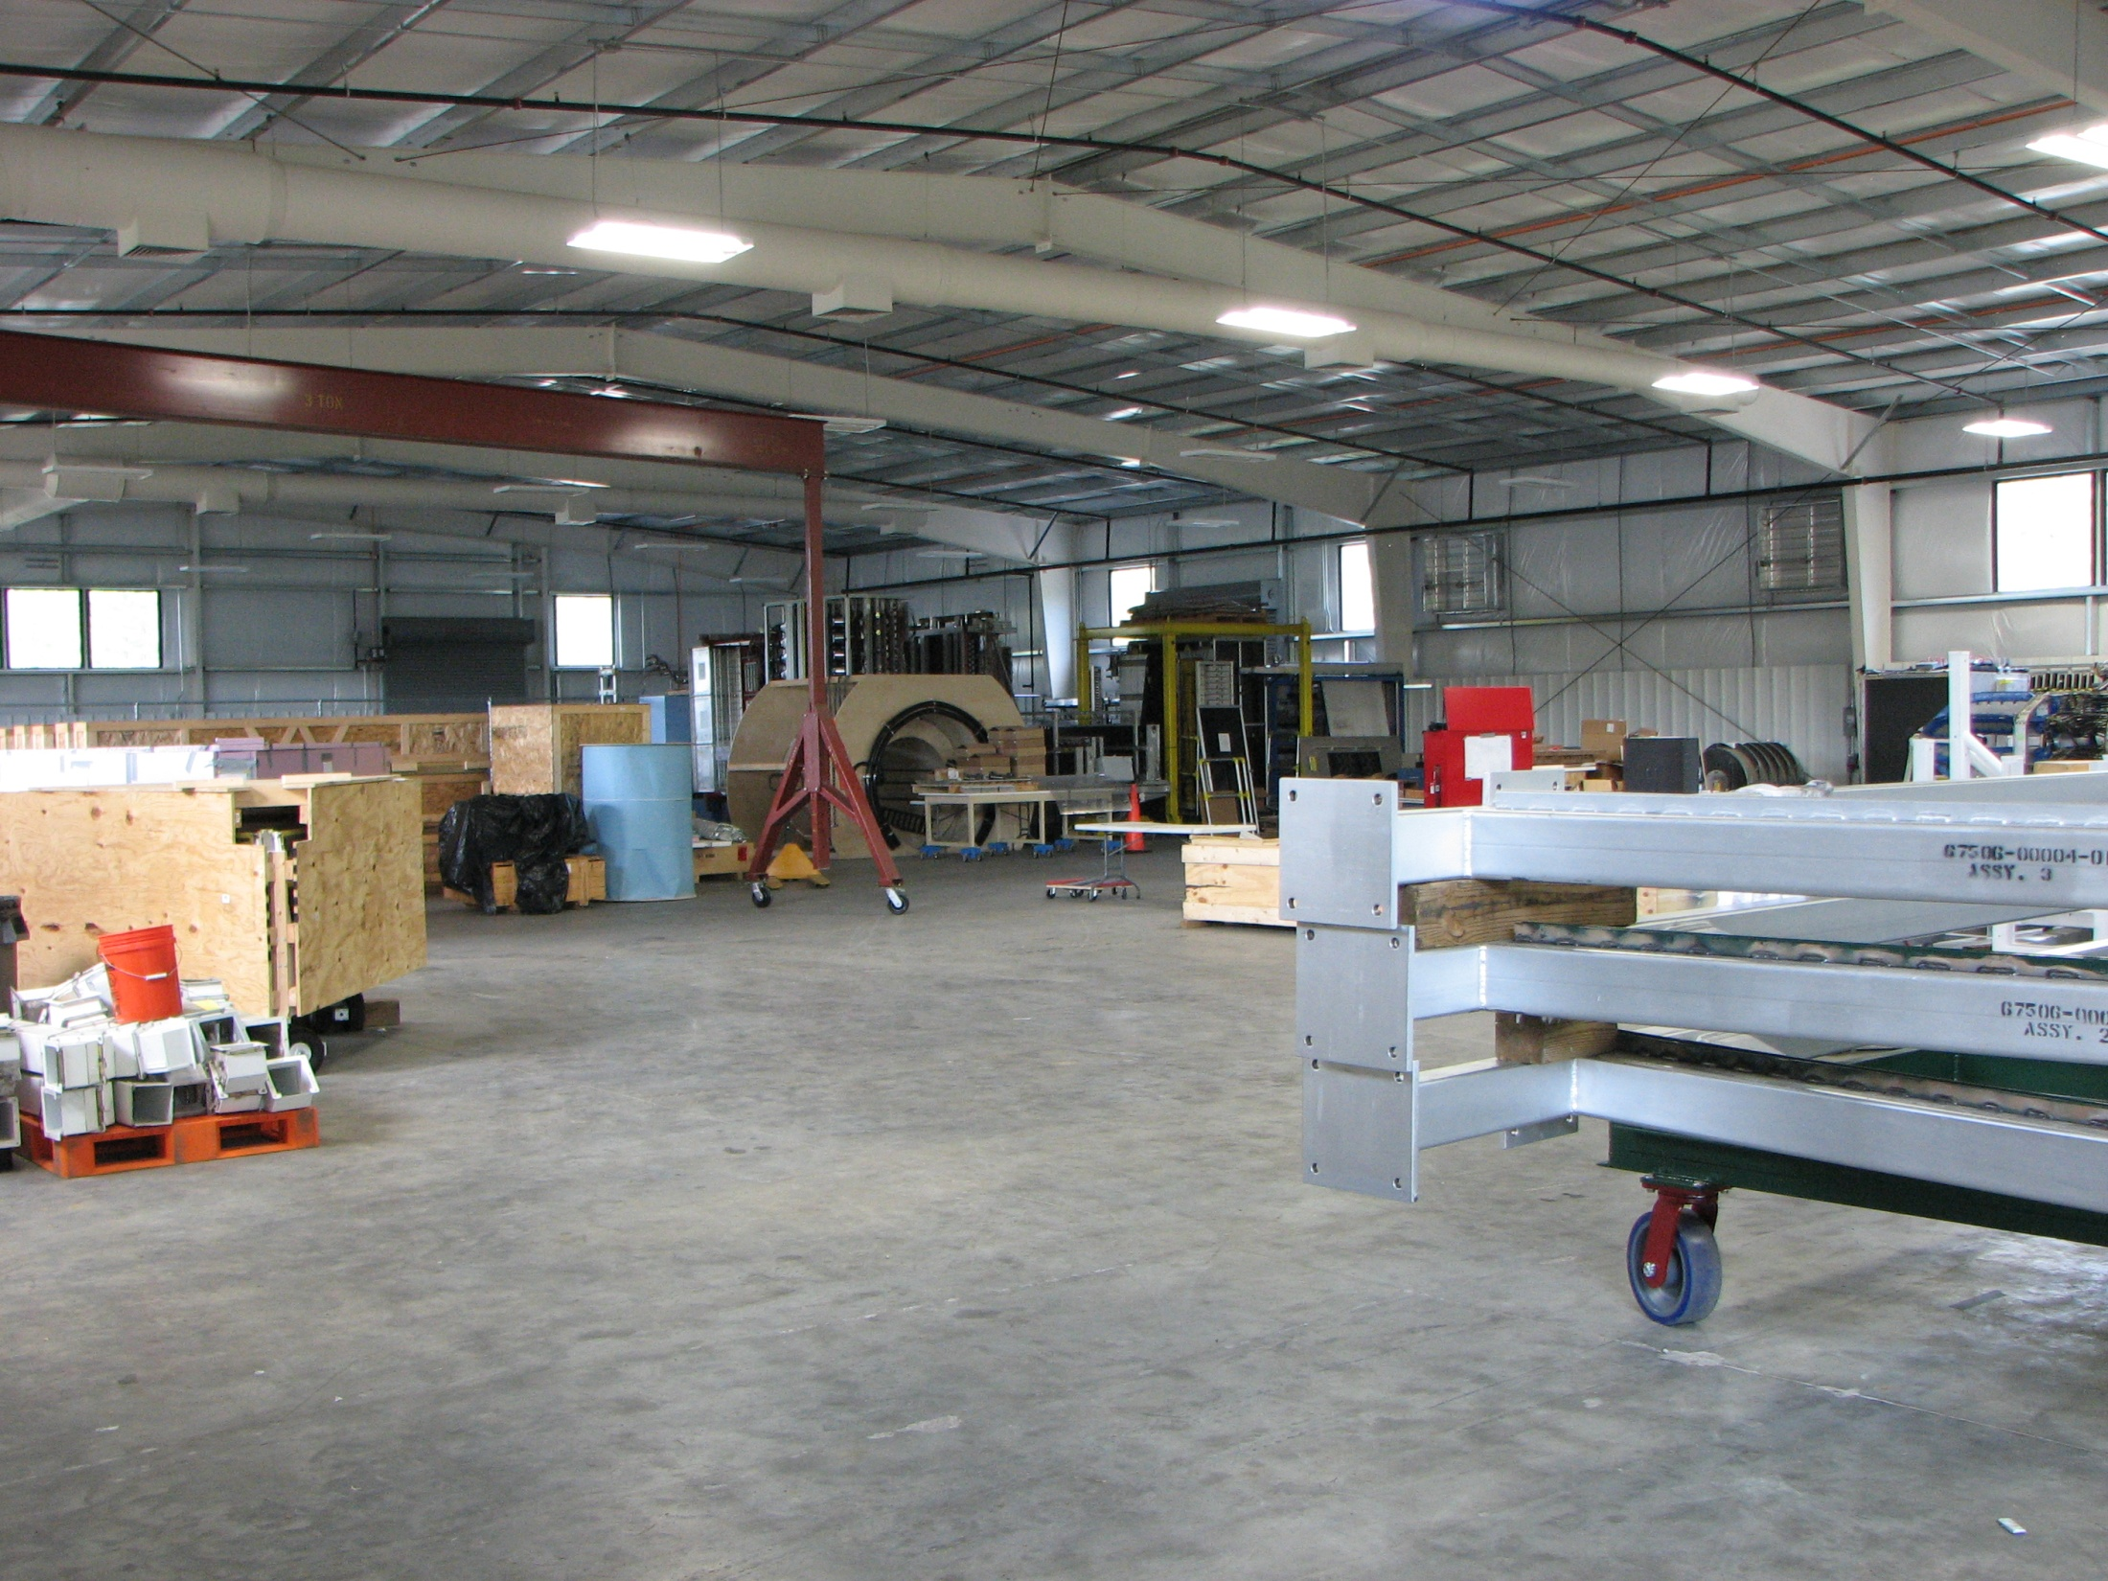
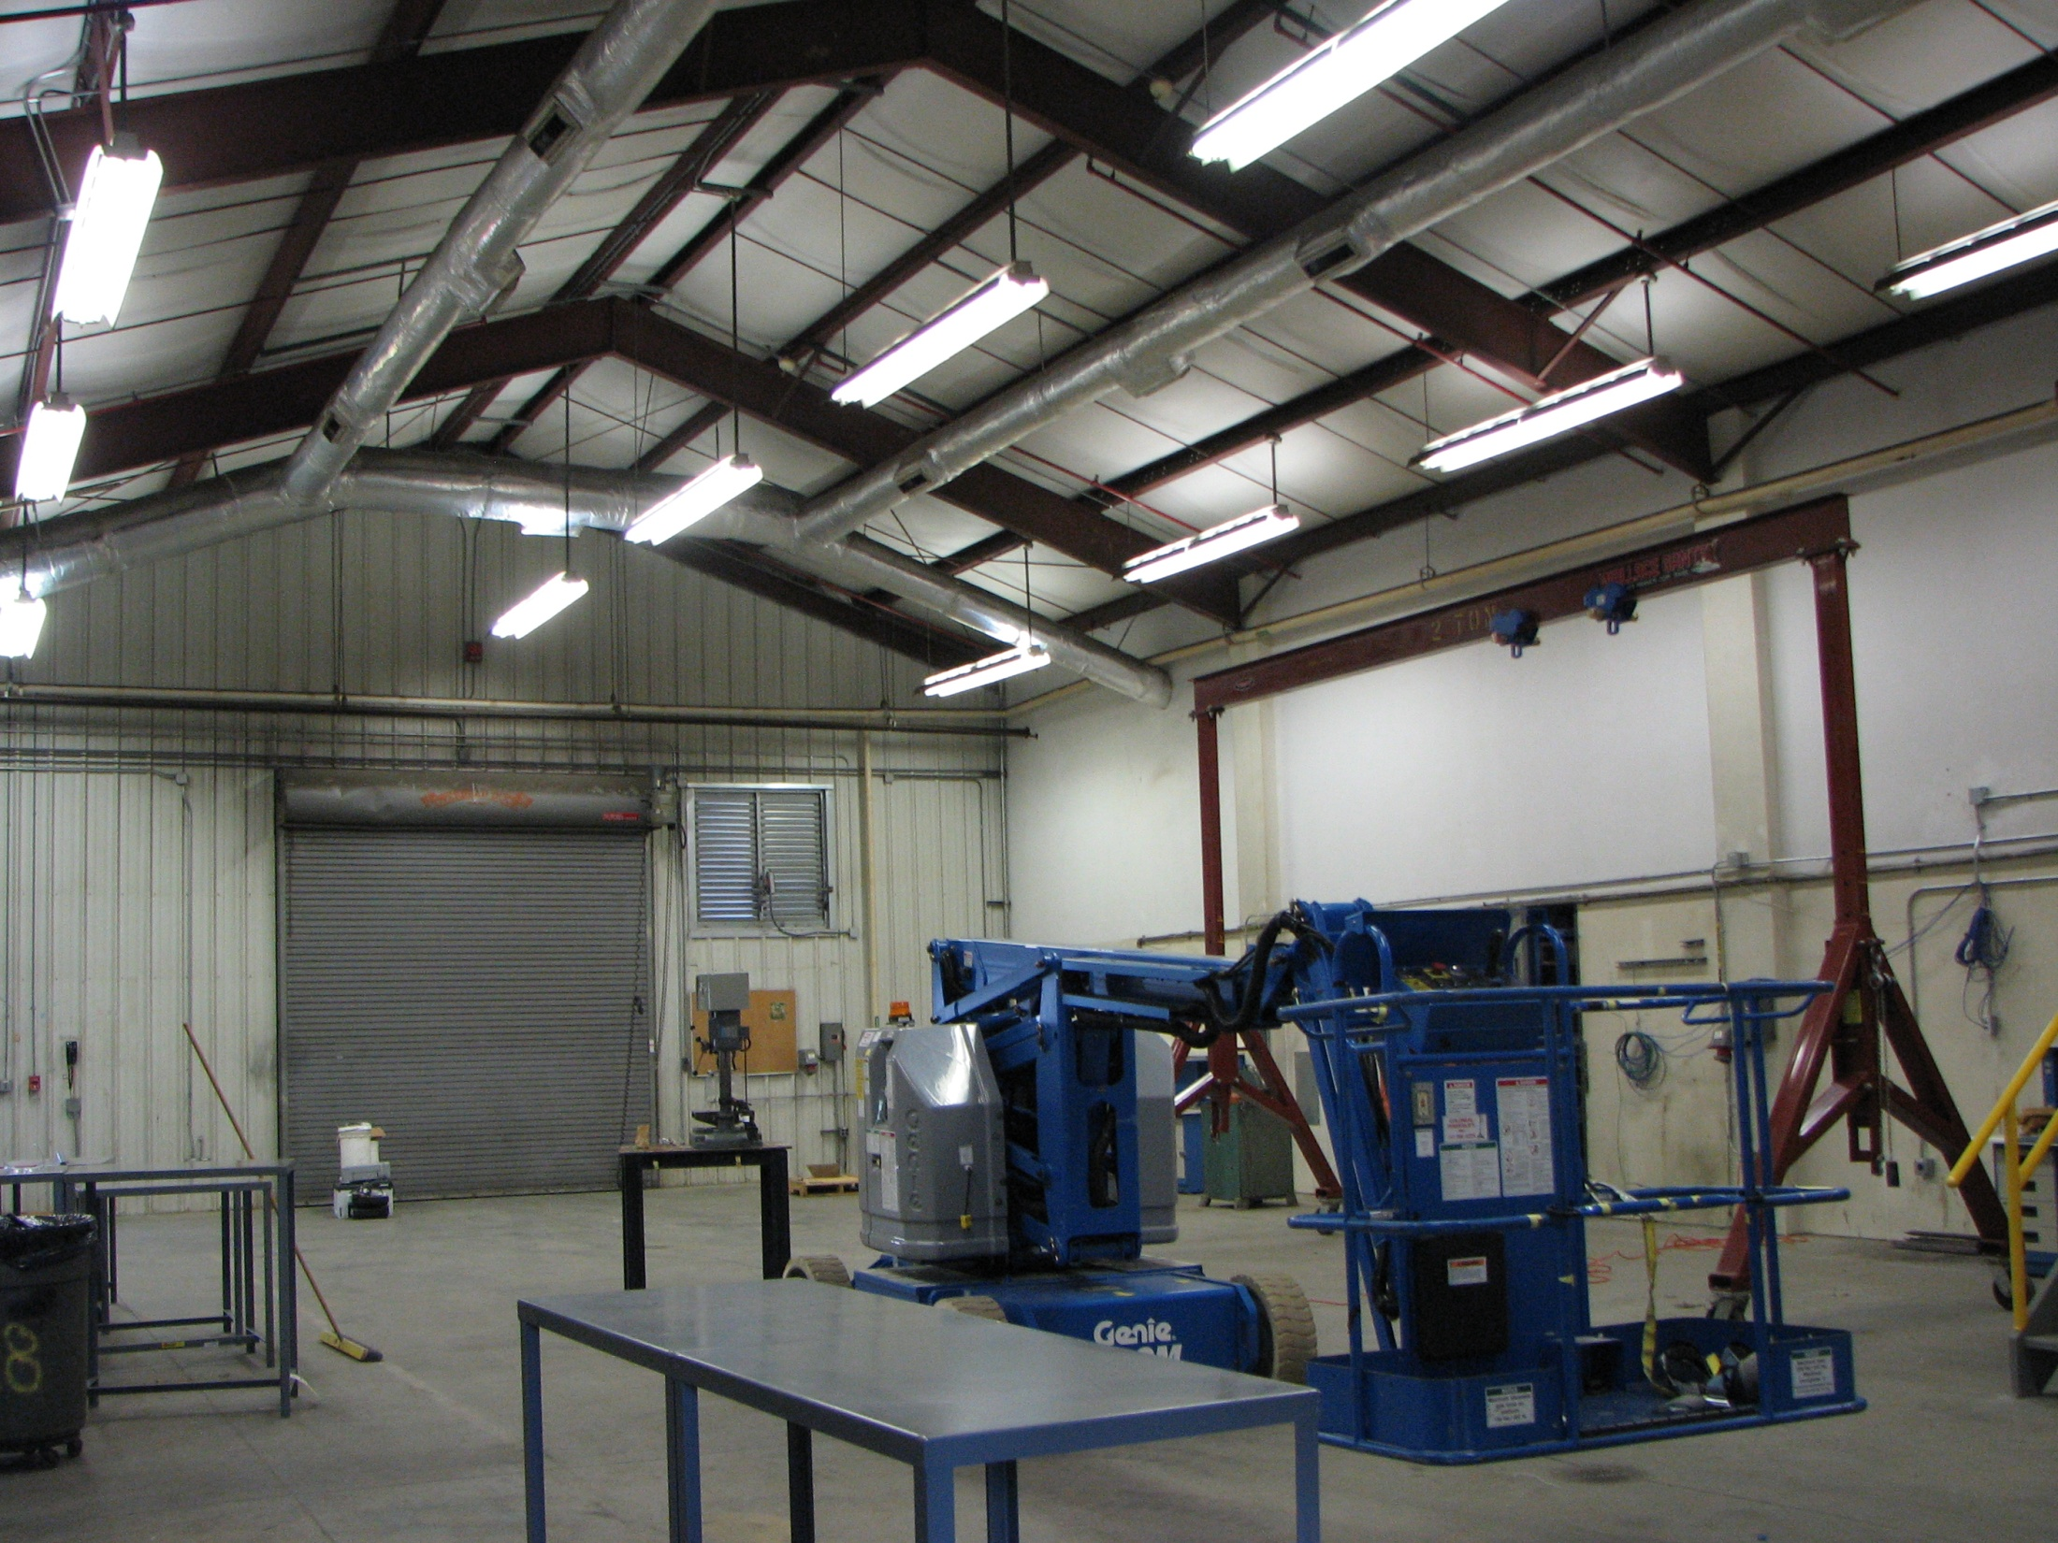
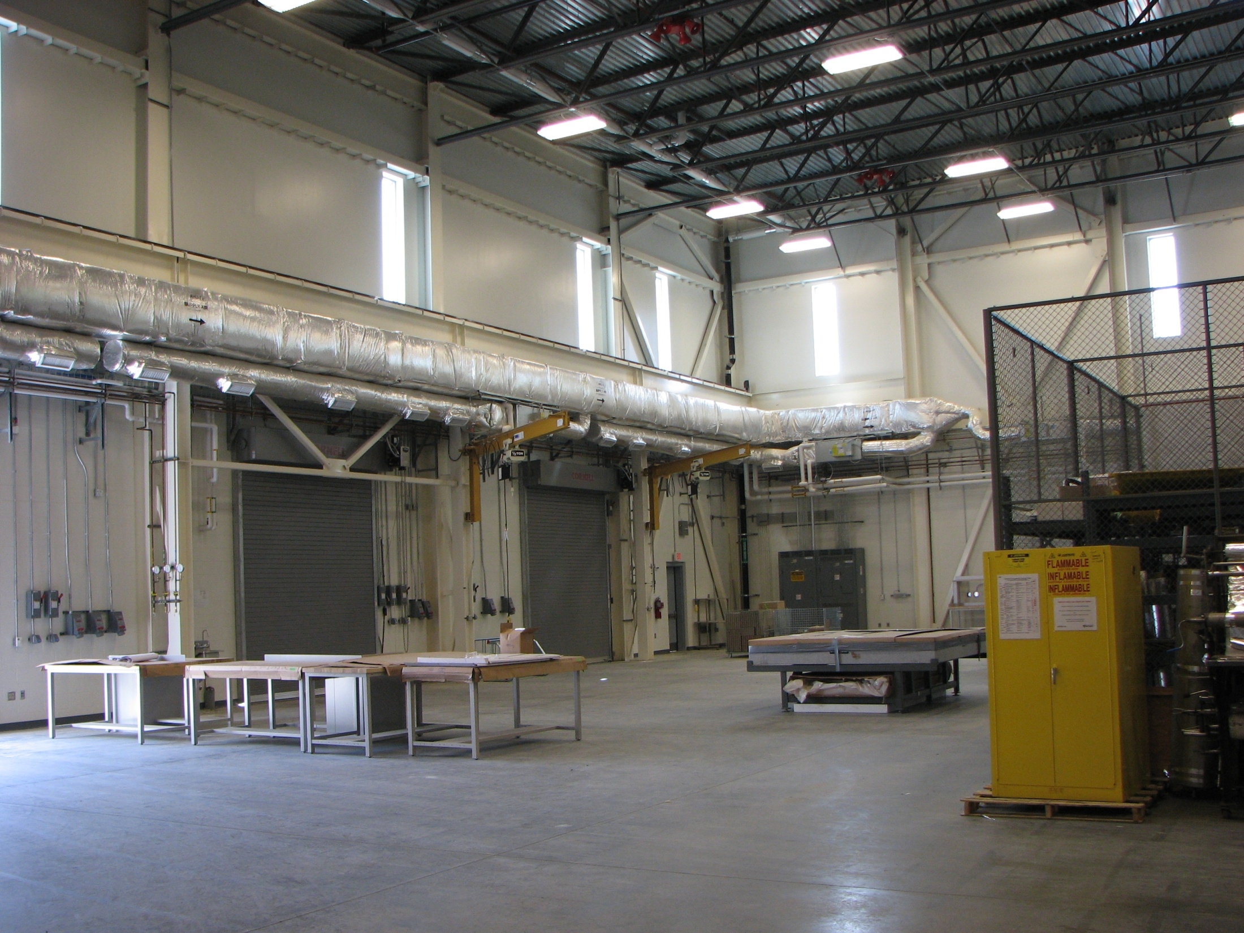
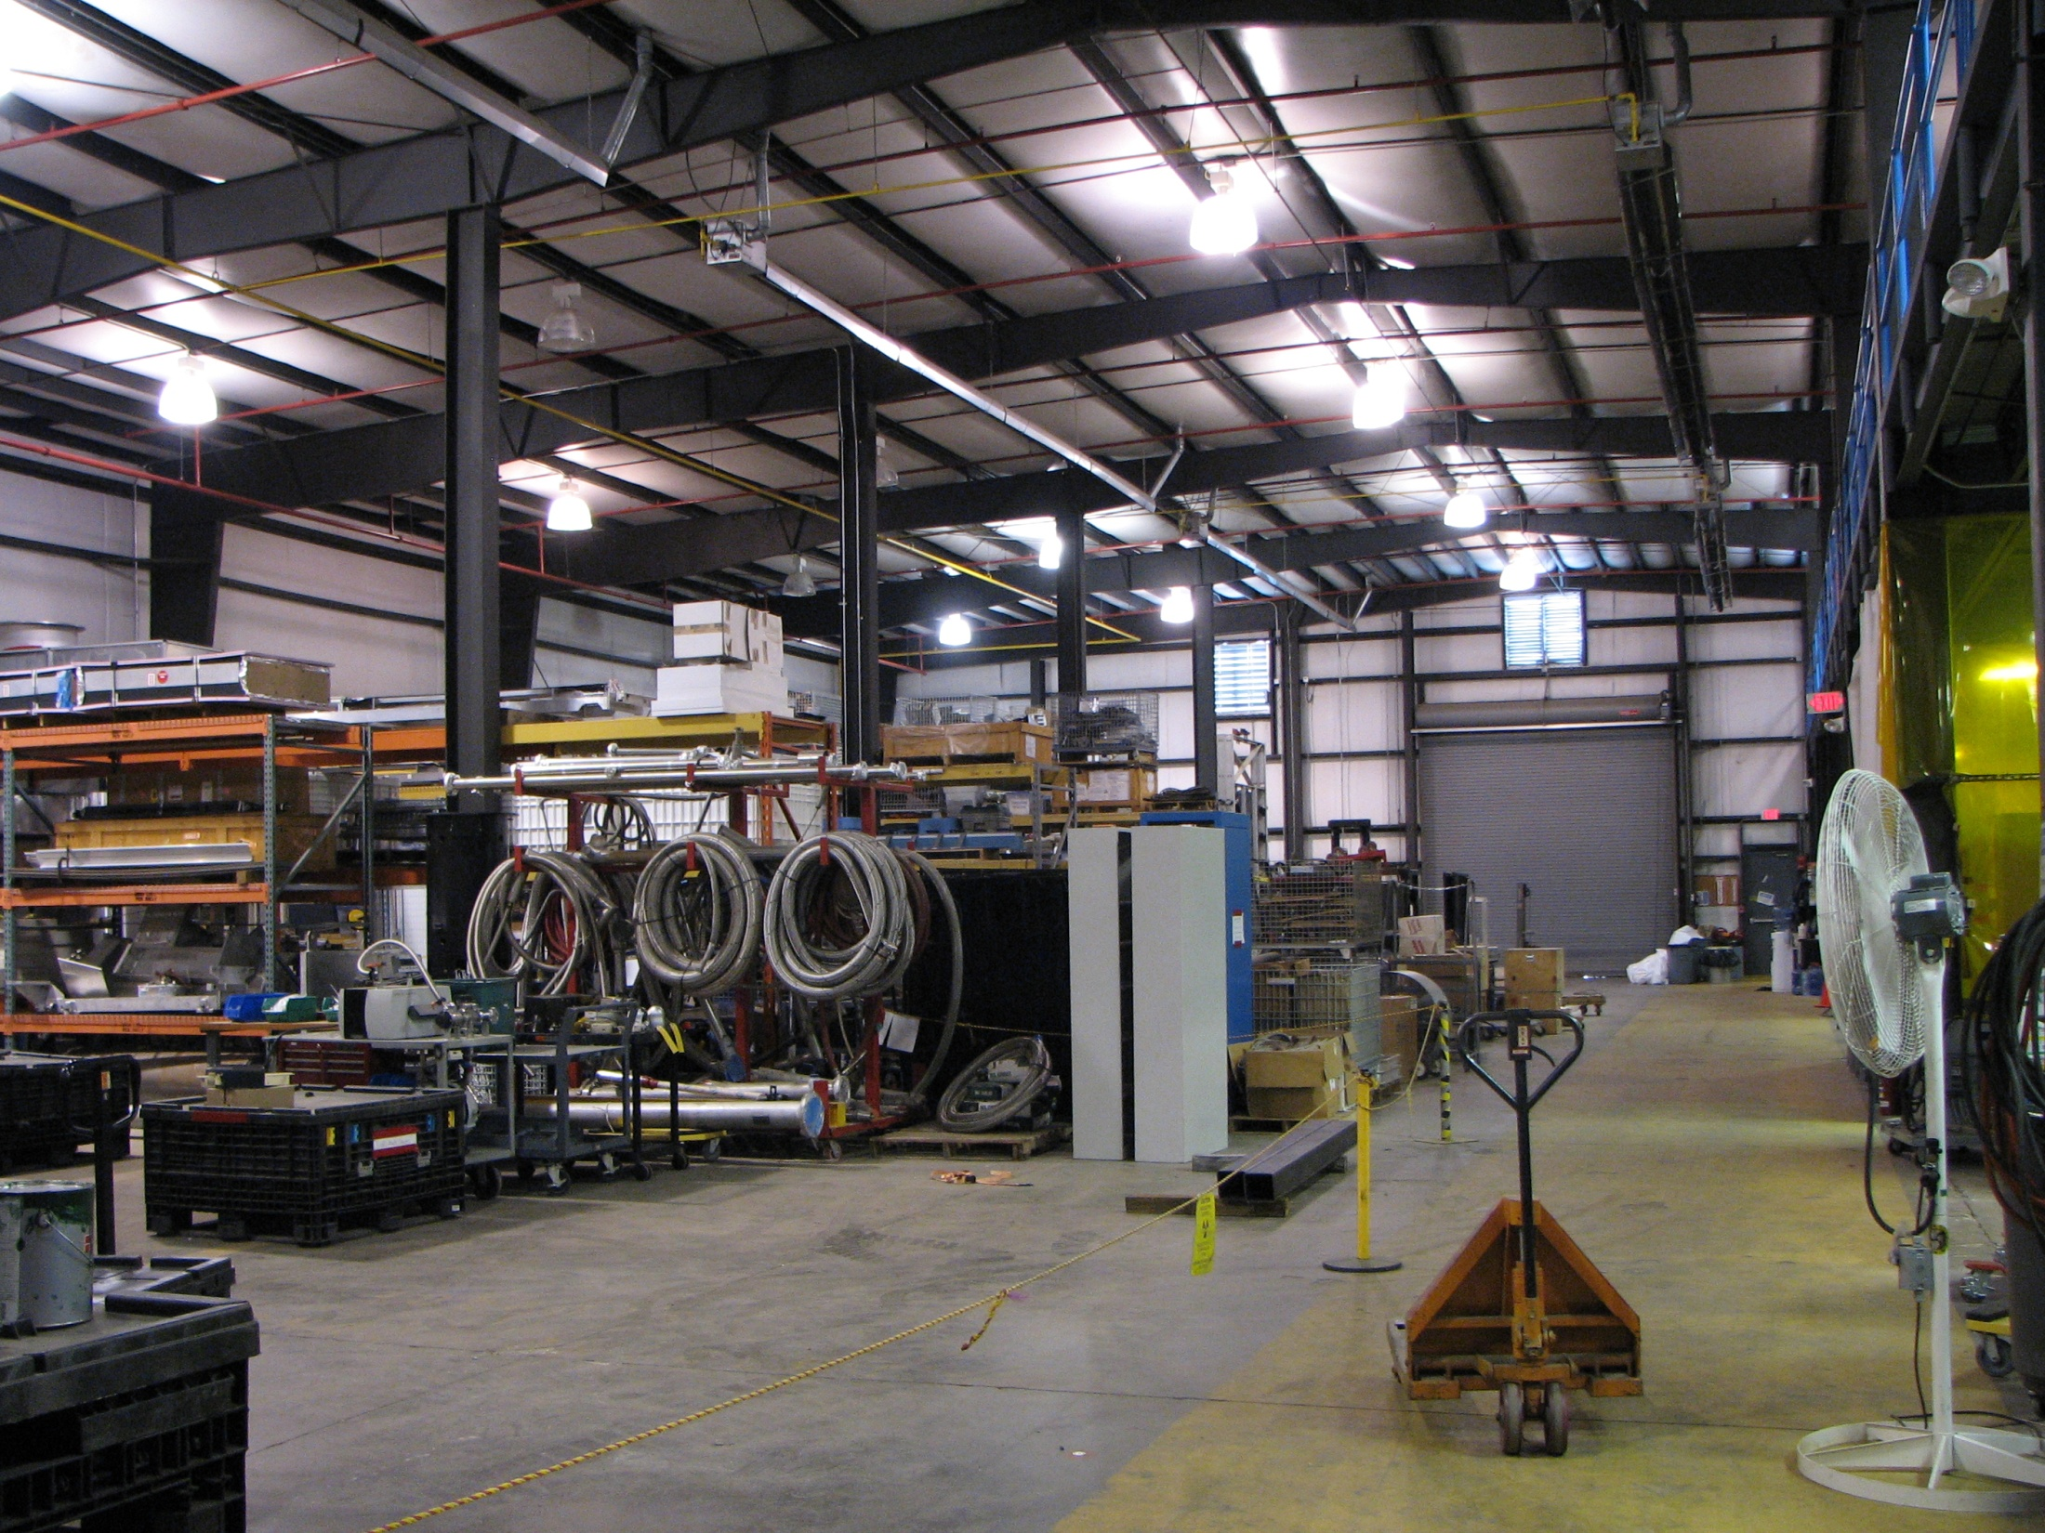
Planning for the Down - Space
Experimental Staging Building
15,000 Sq. Ft., temperature controlled
Home for detectors moving in and out of Hall
Hall D/Bcal, Hall B/PCAL, Hall B/DC, HKS/HES
Chalet Building 98
4,400 Sq. Ft., temperature controlled
Future home for various Hall workshops
Hall B/FTOF construction
TEDF High Bay
4,600 Sq. Ft., temperature controlled
Home for detector construction
Hall D space, Hall B/HTCC & LTCC
Physics Storage Building
15,000 Sq. Ft., floor space
5,000 Sq. Ft. mezzanine space
Storage of equipment coming in and out of Hall (but cleaned up, so emergency space)

Slide 23
Planning for 12 GeV – Software Review
12 GeV Software and Computing Review scheduled for June 7 + 8
Convened by Bob McKeown
Committee: Torre Wenaus (BNL/ATLAS – Chair)
Patricia McBride (FNAL/CMS)
Claude Marchand (Saclay/COMPASS)
Martin Purschke (BNL/PHENIX)
David Nathan Brown (LBL/Babar)
12 GeV Software and Computing Review Committee Charge
The committee is asked to review the state of software and computing developments for the 12 GeV program at Jefferson Lab, with particular emphasis upon
Detector simulation, calibration, and event analysis
Workflow tools for production analysis
The review will cover all 4 halls, including data acquisition, planning for computing resources, and management.

Slide 24
Planning for 12 GeV – Early Experiments
PAC39 scheduled for week of June 18, 2012
Consider new proposals and letters of intent
Hall Leaders to present “early running” plans
- Select commissioning experiments
- Discuss early-year physics plans
Discussion of priorities, jeopardy, etc.
(Jeopardy is the process we used to control the 6-GeV science backlog: if an experiment was not on the running schedule for three years, it had to come back for a PAC reevaluation)

Slide 25
Early Beam Guidance in PAC Days
Fold in planning of beam development by Accelerator/OPS – see A. Freyberger talk
The table is split in years, but the exact correlation with FY or CY may shift. Treat the entries simply as one-year blocks to give some guidance on the best expectations for startup.
32 weeks of operations ~ 80 PAC days/Hall (for Hall multiplicity of 3)
YEAR | Hall A | Hall D | Hall B | Hall C
-1 | 25 (15)*
0 | 60 (<10)* | 25
1 | 90 | 90 | 25 | 25
2 | 80 | 80 | 80 | 80
3 | 80 | 80 | 80 | 80
* PAC days between parentheses indicate possible choice of energies < 2 GeV/pass
(While 12 GeV machine development is ongoing, we assumed a conversion of actual days to PAC days of less than 50%)

Slide 26
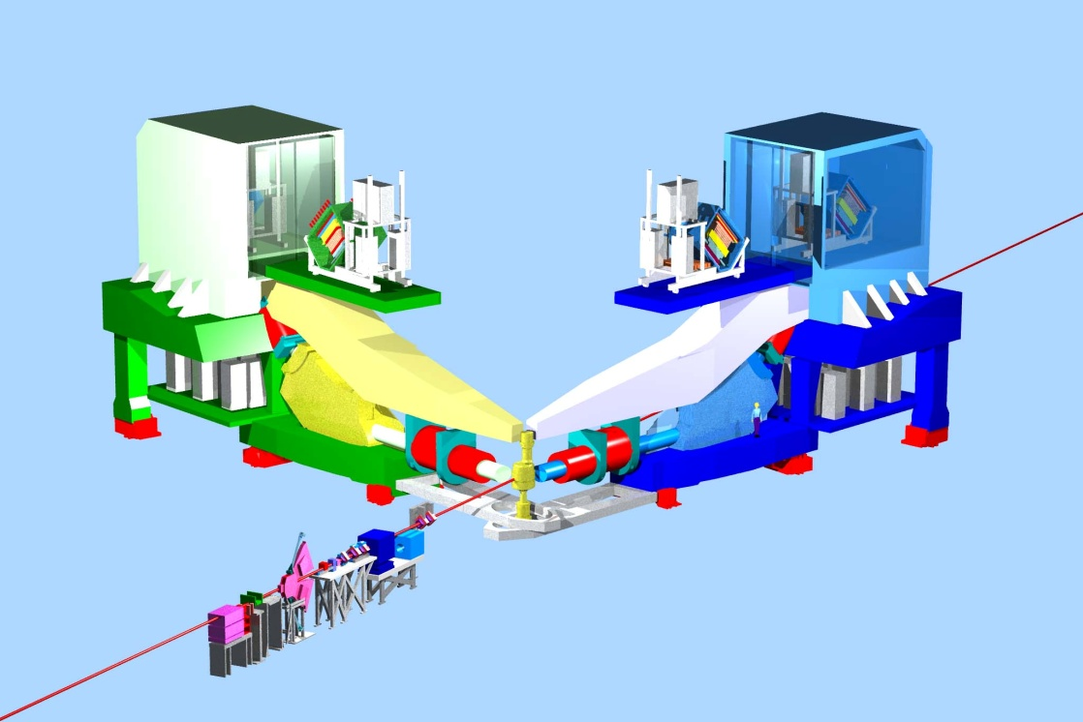
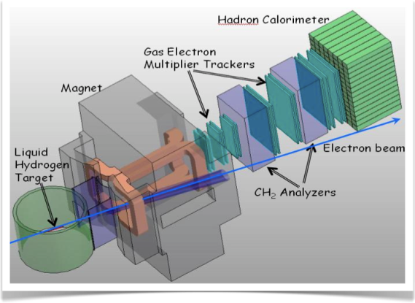
Hall A Planning – Draft
Early Beam in Hall A
16 mo. Shutdown
12 GeV Commissioning
Early Experiments
APEX and/or PREX
A1n / DVCS
Dark Matter
Neutron Skin
Neutron Spin
Structure
Deeply Virtual Compton Scattering
SBS Experiments
HP14
EM Form Factors
at high Q²
SBS Project
SuperBigbite
Beam 1st to Hall A
11 GeV
FY 2013
FY 2014
FY 2015
FY 2016
FY 2017

Slide 27
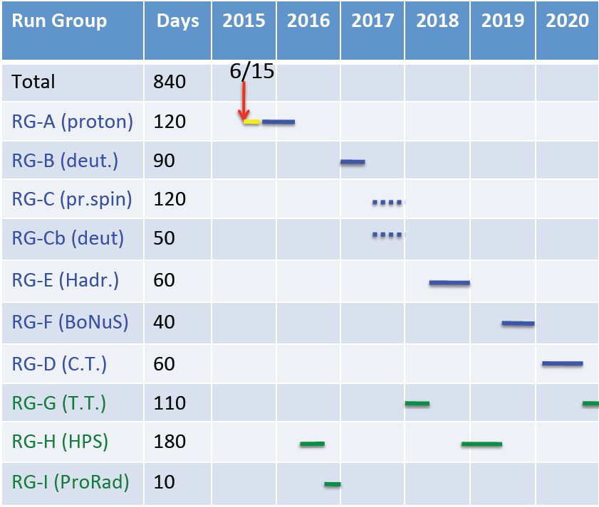
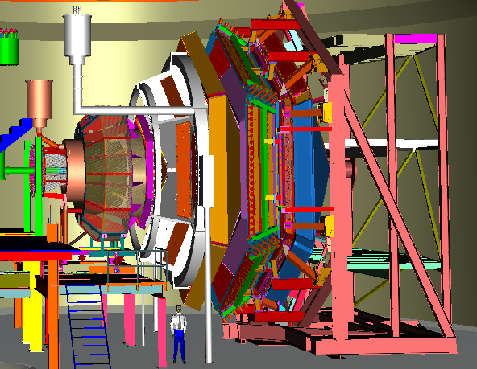
Hall B planning (approved & conditionally approved) – Draft
Experiments with similar equipment and beam/target requirements are combined in Run Groups
During first 5 years all approved/CA experiments would get part (or all) of approved time

Slide 28
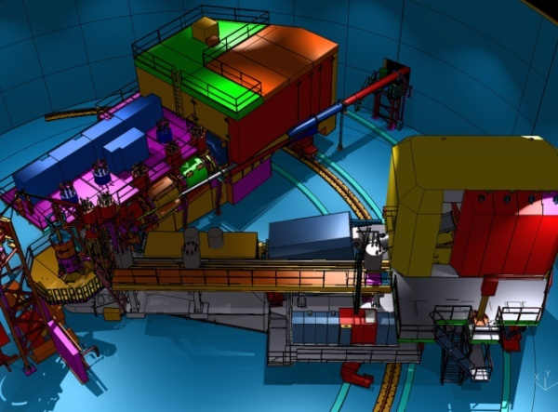
Hall C Planning – Draft
1st Commissioning “experiment” ~ 25 PAC days
  (9 days of) Search for Color Transparency – A(e,e’p)
  “Easy coincidence experiment”
  F₂^{p,d} structure functions at large x
  “Momentum scans to check acceptance”
  (2 days of) F₂ in light nuclei, integrated in F₂^{p,d} run plan
  “Momentum scan with point target”
HP14
1st Year of Experiments ~ 80 PAC days
  P_{T} dependence of basic SIDIS cross sections
  “commissions particle id, including kaons”
  Precise π⁺/π⁻ ratios in SIDIS: CSV parton distributions
  “similar kinematics as E12-09-017, push understanding”
  L/T separated (e,e’K⁺): factorization test
  “easiest L/T separation”
  These three experiments are forming a joint run plan to allow contingencies
5th Experiment
  g₂^{n} measurements at fixed Q²
  “1st polarized 3He target experiment in Hall C”
  Likely followed by A₁^{n} measurements at high x
HP14

Slide 29
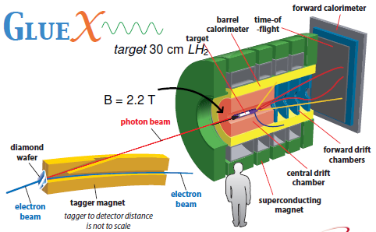
Hall D Planning – Per PAC30/GluEx Proposal
Assumption: electron beam commissioning will be done independently and earlier.
Run I 30 PAC days
Photon beam equipment and detector
commissioning, including troubleshooting,
alignment, calibration, etc.
Run II 30 PAC days
‘Physics commissioning‘ with electron
beam energy of >11 GeV and an electron
beam current of 200 nA.
Run III 60 PAC days
Full scale GlueX running with 12 GeV, 200 nA e-beam and mostly with linearly polarized photons at the "low“ intensity of 10⁷ Hz in the peak. Commissioning of the high intensity running(10⁸ Hz in the peak).
This run will address the initial goals of GlueX in the non-strange sector
HP15

Slide 30
Long-Term Planning for Ancillary Equipment
Developed FY13-FY18 capital equipment plan including (parts of)
  Hall A: SBS basic, SBS neutron, SBS proton, Tritium target, …
  Hall B: Forward Tagger, Polarized target, one-sector RICH, HDIce-transverse
  Hall C: Beamline/Compton, Polarized 3He, Target upgrade, large experiments
  Hall D: L3 Farm, Forward Calorimeter upgrade, Cherenkov
  Division: fast pipelined electronics to rotate amongst Halls for experiments
Still ongoing discussion: planning for new/upgraded End Station Refrigerator for future high cryogenic demand experiments such as the Moller experiment

Slide 31
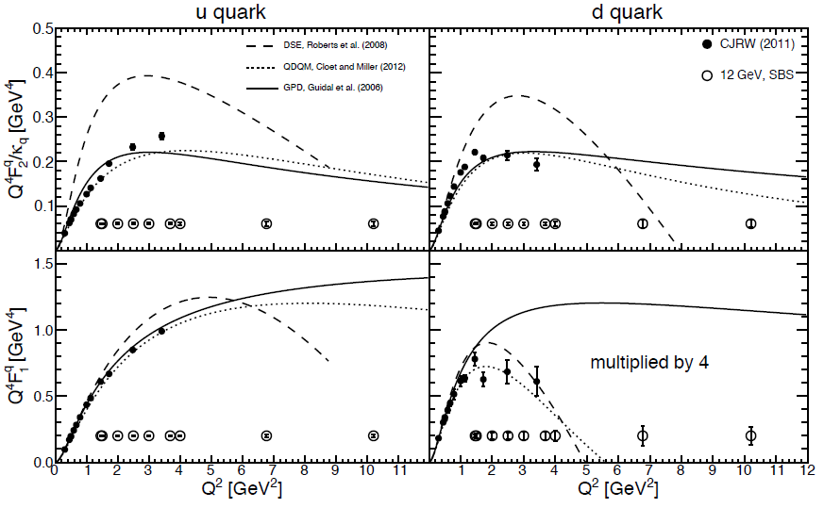
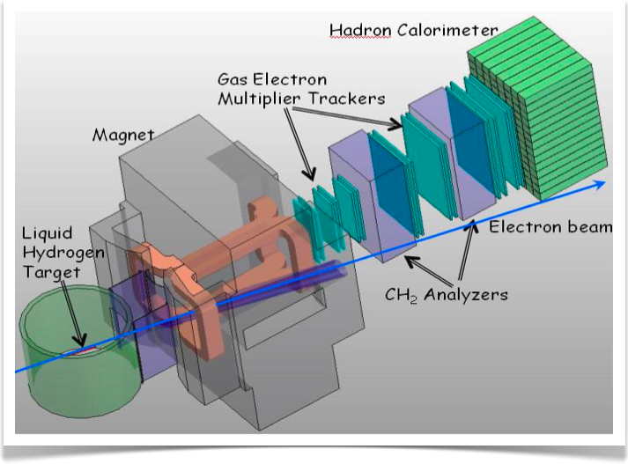
SBS: Provides Lion’s Share of JLab12 Form Factor Program
Physics Reach of the Super BigBite Spectrometer in Hall A:
Electromagnetic Form Factors at high Q²
  Use high luminosity
  + open geometry
  + GEM detectors
  Pushes G_{E}^{p}/G_{M}^{p}, G_{E}^{n}, G_{M}^{n} to high Q²
  Allows for flavor decomposition to distance scales deep inside the nucleon
Semi-Inclusive Deep Inelastic Scattering
  Active program foreseen at 12 GeV in Halls A, B, C
  Approved SBS experiment provides precision data early on with transversely polarized ³He at large x and Q²
Possibly also other proposals

Slide 32
Summary
Period since last S&T review has seen stellar progress
    Many high-profile key results recently coming out
    Science program grows (e.g., heavy photons, TMD science, SRC-EMC)
    Myriad of technical achievements
Mission accomplished at 6 GeV
Preparation for 12 GeV well advanced
    De-installation tasks well defined and prepared for
    Space available and near-ready for equipment
    Planning for commissioning & early 12-GeV experiments ongoing
    Planning for beam development and ancillary equipment ongoing
    SBS recently approved by DOE/NP
Longer-term vision
    Planning for future projects: Moller MIE, SOLID
    MEIC embodies Future QCD Science at Jefferson Lab
        JLab staff & users played dominant role in EIC science and needs
        JLab spearheaded the integrated detector and interaction region design
        Competitive MEIC design, with intermediate design report near-complete

Slide 33
Backup

Slide 34
Physics Results – Not discussed
Many more physics results in FY09-FY12, not discussed, e.g.:
F₂^{d} & F₂^{p} results at large x & first confirmation of duality in F₂^{n}
Neutron resonance structure & F₂^{n}/F₂^{p} from BoNuS
APEX test measurement provides early result on A’ search
G_{E}^{n} & G_{M}^{n} form factor results at high Q² & flavor dependence of form factors
Proton electromagnetic form factor ratio up to Q² = 8.5 GeV²
Constraints of 2-γ Effects in ep Polarization Transfer
Electromagnetic decays of Σ^{0,+}(1385) & Branching Ratio of the Decay of Σ⁺(1385)
Pion and N-Δ parity-violating asymmetries from G0
Pion form factor archival papers & charged-pion scaling tests
Differential cross sections for kaon photo- and electro-production
L/T separated charged-kaon cross sections up to Q² ~ 2.3 GeV²
Single and double spin asymmetries in charged-pion electro-production
Beam spin asymmetry for semi-inclusive π⁰
³He and ⁴He high-q form factor results
Onset of Color Transparency in A(e,e’π⁺) and A(e,e’ρ⁰)
Kaon nuclear multiplicities & Kaon transparencies
Absorption of ω and φ mesons in nuclei
Medium modifications from ⁴He(e,e’p)³H polarization transfer
Comparison of forward and backward pp pair knockout in ³He(e,e'pp)n

Slide 35
Physics Results – Under Analysis
Beyond the FY12 experimental program, many key physics results following the executed physics program in FY09-FY11 are under analysis, e.g.:
L/T separation in Deeply-Virtual Compton Scattering: DVCS²-BH interference
Deeply-Virtual Compton Scattering off the Neutron
Global Analysis of DVCS unpolarized & polarized experiments to extract GPDs
Series of experiments elucidating the role of tensor/short-range correlations
- pp vs. pn correlations in ⁴He as function of pair momentum
- 2N and 3N correlations via x > 2 nuclear ratios
Measure real part of interference between one- and two-photon exchange
- non-linearity in elastic e-p Rosenbluth separations
- direct comparison of positron and electron yields
Final analysis of the FROST polarized proton photo-production data
A high precision (< 1.5%) measurement of the neutral pion lifetime
Spin asymmetries on proton and neutron to map the g₂ structure function and determine the nucleon color polarizabilities
Map the excitation spectrum of medium-heavy hypernuclei to provide precise binding energies and widths for the Λ hyperon
[HP11]
[HP3]
[HP6]

