Slide 1
Accelerator Overview
Andrew Hutton
Associate Director

Slide 2
Outline
Accelerator Division Overview
Major accomplishments since the last S&T Review
Introduction to plans for transition to CEBAF operations
Introduction to plans for future NP facility at Jefferson Lab
Overview of accelerator R&D
  SRF, injector, accelerator physics
  New Technical Engineering Design Facility (TEDF)
  Work for other projects (FRIB, APS-SPX)
Education

Slide 3
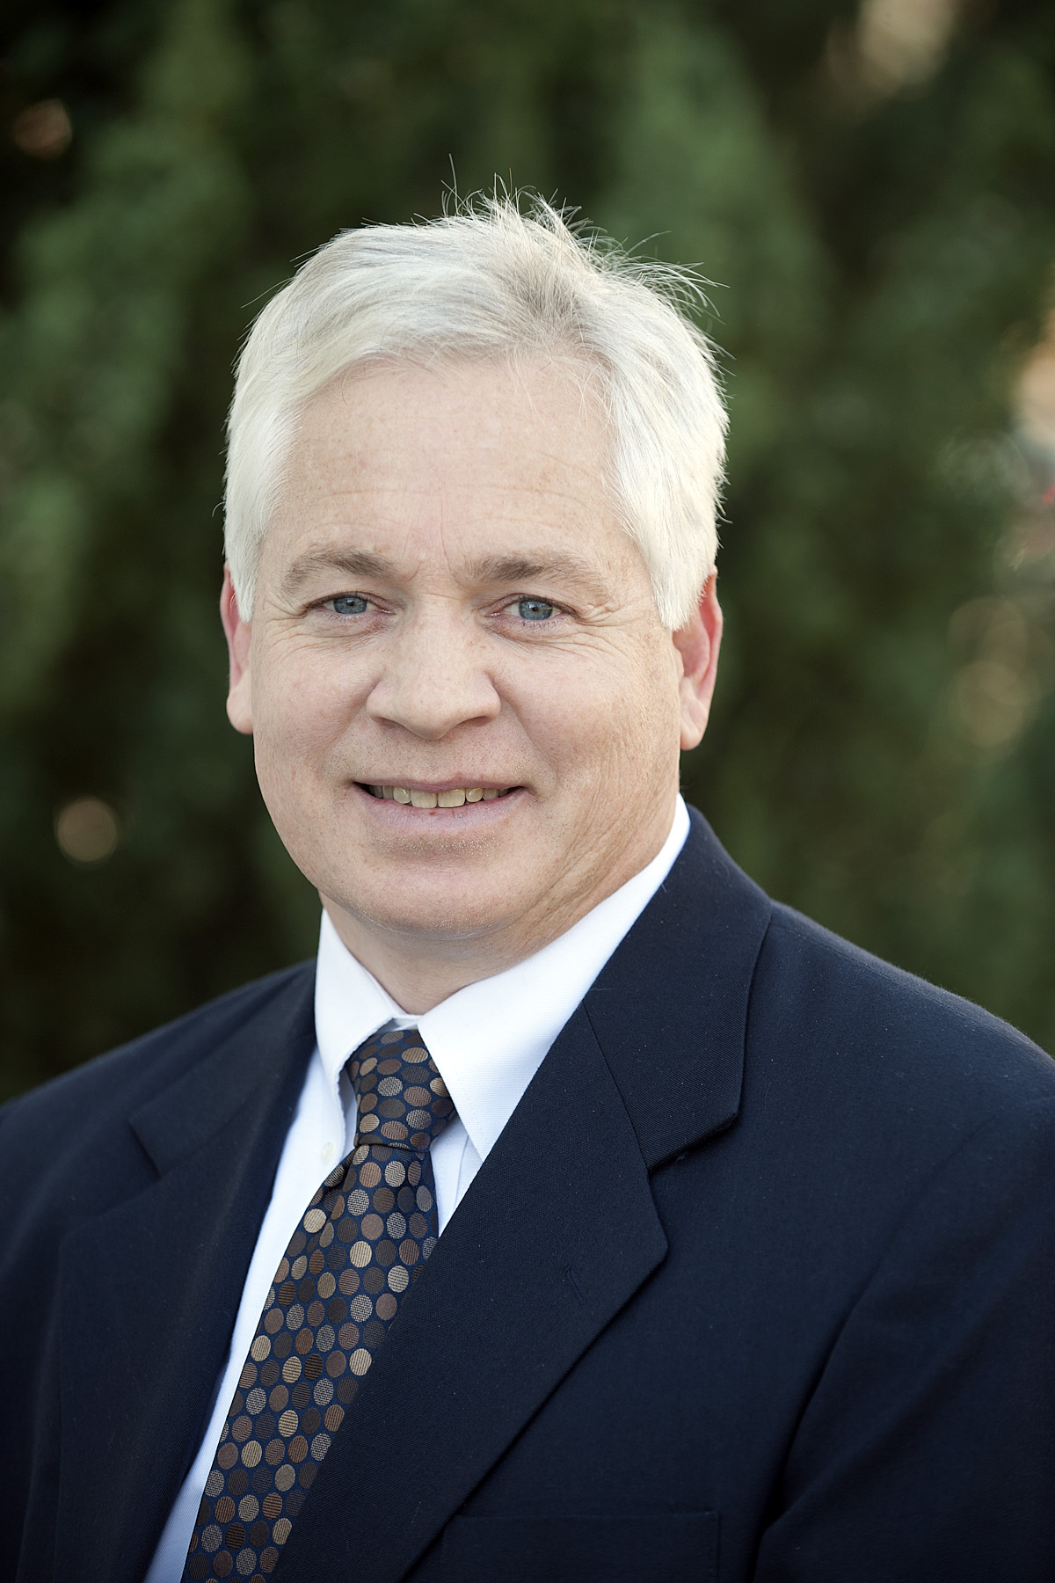
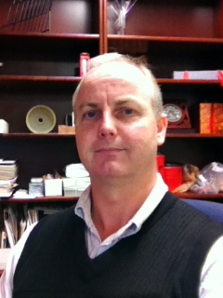
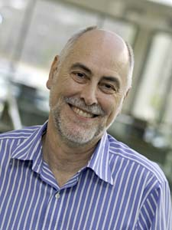
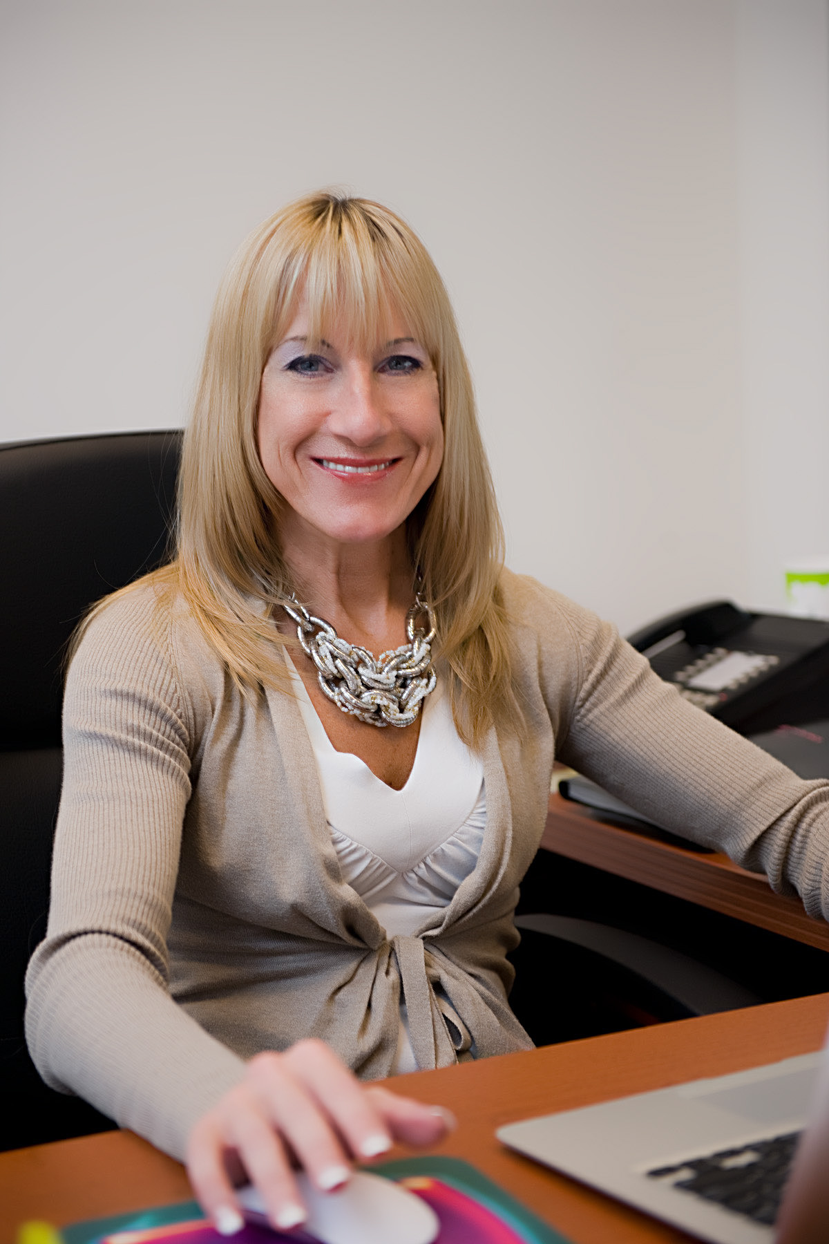
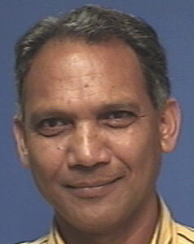
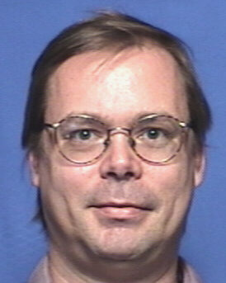
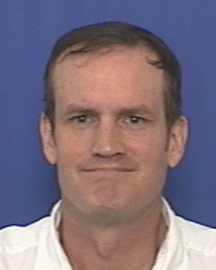
Lawrence Award Winner 2011
Matt Poelker,
CIS Director
Bob Rimmer,
Director of SRF Institute
Fulvia Pilat,
Deputy Director, Accelerators
Andrew Hutton,
Associate Director, Accelerators
Hari Areti,
Experimental Coordinator
Arne Freyberger, Director of Operations
Geoff Krafft,
CASA Director

Slide 4
Accelerator Mission
The Accelerator Mission is to advance the capability of Jefferson Lab to carry out world-class nuclear science and, more broadly, to develop Jefferson Lab’s expertise in technologies associated with high-power superconducting linacs
The goals to achieve the mission deliver results in four strategic areas:
  Operate and upgrade the JLab accelerator facilities
  Prepare the future evolution of nuclear physics experimentation at Jefferson Lab
  Expand Jefferson Lab’s core accelerator competencies to support DOE Office of Science projects and other partnerships
  Attract and educate the next generation of accelerator scientists and engineers

Slide 5
Scope of Current Activities 1
Operate and upgrade the JLab accelerator facilities
  Maintain energy capability
    C50 program (refurbishing original CEBAF cryomodules)
  Improve beam quality for Users
    Parity quality, maximum current (180 μA)
  Support the 12 GeV Upgrade Project
    Accelerator physics design
    Construct ten C100 cryomodules (100 MV per cryomodule)
    Extraction system design
    Prepare to meet the 12 GeV project commissioning milestones
  Prepare to commission 12 GeV nuclear physics program
  Talks by Arne Freyberger, Matt Poelker, Bob Rimmer

Slide 6
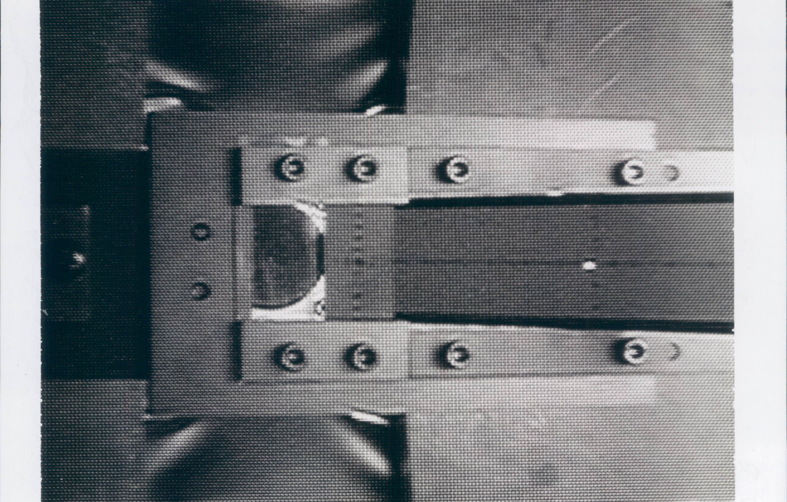
Accomplishments
We will soon complete the 6 GeV experimental program
  End of 18 extremely successful years of operation
  Beam On Target - July 24, 1994
  A polarized gun was not included in the construction project
    Four generations of gun improvements led to >85% polarization
    Now, most experiments require polarized beam
  Design maximum energy was 4 GeV
    Maximum energy is now 6 GeV

Slide 7
Shut-Down Activities
Carried out 6 month shut-down to install some 12 GeV equipment and successfully restored beam to Users
  Precursor of Long Shut Down which starts in May
    More on work coordination and organization from Fulvia Pilat

Slide 8
Parity Violation Experiments at CEBAF
Experiment | Energy (GeV) | I (µA) | Target | A_{pv} (ppb) | Maximum Charge Asym (ppb) | Maximum Position Diff (nm) | Maximum Angle Diff (nrad) | Maximum Size Diff (δσ/σ)
HAPPEx-II (Achieved) | 3.0 | 55 | ¹H (20 cm) | 1400 | 400 | 1 | 0.2 | Was not specified
HAPPEx-III (Achieved) | 3.484 | 100 | ¹H (25 cm) | 16900 | 200±100 | 3±3 | 0.5±0.1 | 10⁻³
PREx | 1.063 | 70 | ²⁰⁸Pb (0.5 mm) | 500 | 100±10 | 2±1 | 0.3±0.1 | 10⁻⁴
QWeak | 1.162 | 180 | ¹H (35 cm) | 234 | 100±10 | 2±1 | 30±3 | 10⁻⁴
Møller | 11.0 | 75 | ¹H (150 cm) | 35.6 | 10±10 | 0.5±0.5 | 0.05±0.05 | 10⁻⁴
Parity Violation experiments motivate polarized e-source R&D

Slide 9
First test

Slide 10
C100 Cryomodules in construction
C100-1 and C100-2 in operation; C100-3 and C100-5 in the tunnel (safe storage)

Slide 11
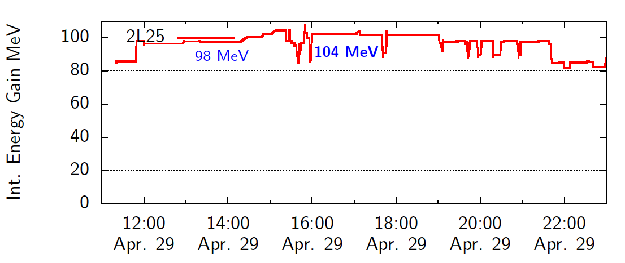
C100 Performance Demonstration
Current through module = 465 μA
C100 cryomodule operated at nominal specifications while delivering parity-quality beam to Users

Slide 12
Scope of Current Activities 2
Prepare the future evolution of nuclear physics experimentation at Jefferson Lab
  Design a Medium-energy Electron Ion Collider (MEIC) to be built at Jefferson Lab
  Collaborate with BNL and MIT on generic electron-ion collider R&D
  Talk by Yuhong Zhang
Developed a plan to build an electron cooling ring demo in the FEL to evaluate the validity of the concept for MEIC
  Funding requested from ONP (DE-FOA-0000632) Talk by Ed Nissen
Develop the capability to produce polarized positron beams (PEPPo)
  Talk by Joe Grames

Slide 13
Scope of Current Activities 3
Expand Jefferson Lab’s core accelerator competencies to support DOE Office of Science projects and other partnerships
  1. Reduce the electric power requirements for superconducting linacs
  2a. Increase the maximum gradient, with equal or lower cryogenic requirements
  2b. Develop reliable long-lifetime photo-guns that provide high-current polarized and unpolarized electron beams
  2c. Develop advanced recirculated and energy recovery linac designs and technologies
  3. Collaborate on projects using SRF technology to grow our capabilities
  4. Develop new cavity types for different uses
  5. Exploit TEDF to maximize beneficial impact for SRF, Industry and the DOE complex

Slide 14
Unique Capabilities
Only high-power CW electron accelerators in the world
  CEBAF, FEL
Injector test stand
  Will be expanded during the Test Lab refurbishment
High-polarization, high-current beams
New SRF facility (TEDF), which incorporates and improves the capabilities of the existing Test Lab
  Highly experienced SRF workforce
    Scientists, engineers and technicians
  Track record in delivering large SRF projects
    Original CEBAF cryomodule construction – 2 cryomodules/month
    SNS superconducting proton cavities
    C-100 cryomodules for the 12 GeV Project
World-leading cryogenics group

Slide 15
Accelerator R&D Highlights
SRF cavity gradient has been the top priority
  ILC experience applied to C100 cryomodules
Reducing cryogenic losses is now the top priority
  Recent breakthrough in obtaining high Q₀
    Q₀ = 4.6 x 10¹⁰ @ ~20 MV/m (1.5 GHz, 2K)
  Talks by Ganapati Myneni, Gigi Ciovati
  Gain must be translated to production
    Requires elimination of field emission
    Reduction of stray magnetic fields, etc.
  Talk by Bob Rimmer
  We will eventually expand R&D to every aspect of electrical consumption of superconducting linacs

Slide 16
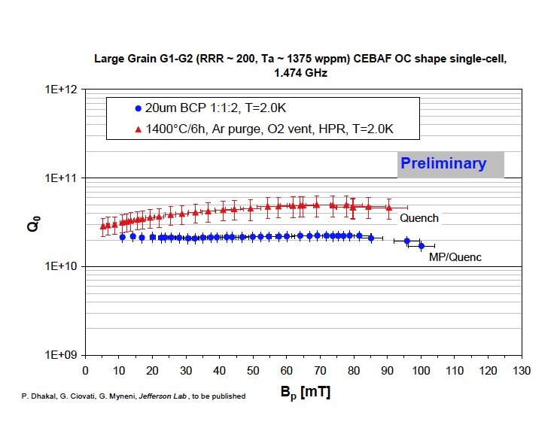
Lower cost Niobium due to fewer purification and preparation steps
World Record Q₀
4.6x10¹⁰ @ 20 MV/m

Slide 17
High Gradient
We will continue to push high gradients
  Funded by ILC through FY12, but funding unlikely in FY13
Jefferson Lab processed a run of 10 cavities built by Research Instruments
  Nine exceeded ILC specifications (90%)
  This is the only example of a cavity series reaching ILC needs
All the cavities in the “American” cryomodule recently assembled at Fermilab were processed at Jefferson Lab
  Talk by Bob Rimmer

Slide 18
R.L. Geng et al., IPAC11, MOPC111, p334-336.

Slide 19
Accelerator R&D
“Develop advanced recirculated and energy recovery linac designs and technologies”
Alex Bogacz has been heavily involved in designing schemes for muon acceleration with superconducting linacs
  Developed a Recirculating Linac Accelerator (RLA) concept
An electron demonstration project has been developed
  Has been presented twice to the Muon Collaboration
    We will be seeking HEP AARD funding

Slide 20
Size-down: IDS Muon RLA to Electron Demo
Droplet Arcs: 7 (1+5+1) super-periods × 24 combined function magnets (50 cm )
0.9 GeV (m±)
1.8 GeV
3.0 GeV
m 2-pass
droplet
m 2-pass
droplet
1.2 GeV
2.4 GeV
79 m
0.6 GeV/pass linac based on 200 MHz SRF
B | 2.6 Tesla
G | 45 Tesla/m
B | 1 .7 Tesla
G | 28 Tesla/m
energies reduced by factor of 200 (m_{m}/m_{e})
size reduced by factor of 7.5 (1500/200)
4.5 MeV (e⁻)
B | 975 Gauss
G | 170 Gauss/cm
9 MeV
15 MeV
16 m
16 m
6 MeV
12 MeV
B | 638 Gauss
G | 110 Gauss/cm
11 m
3 MeV/pass linac based on 1.5 GHz SRF
Fits in 25 m × 7 m
20

Slide 21
SRF Collaborations - FRIB
We are processing a half-wave cavity for MSU
  It has been agreed that Jefferson Lab will process all the half-wave cavities for the project
  We have received funds from MSU to develop a detailed proposal for Jefferson Lab to assemble all of the half-wave cryomodules
    Similar package to the SNS superconducting linac built at JLab
Jefferson Lab also has a well-defined scope of work to help MSU develop the FRIB cryogenics plant
Jefferson Lab would be interested in expanding the scope of work into other areas
  This should happen naturally as the project advances

Slide 22
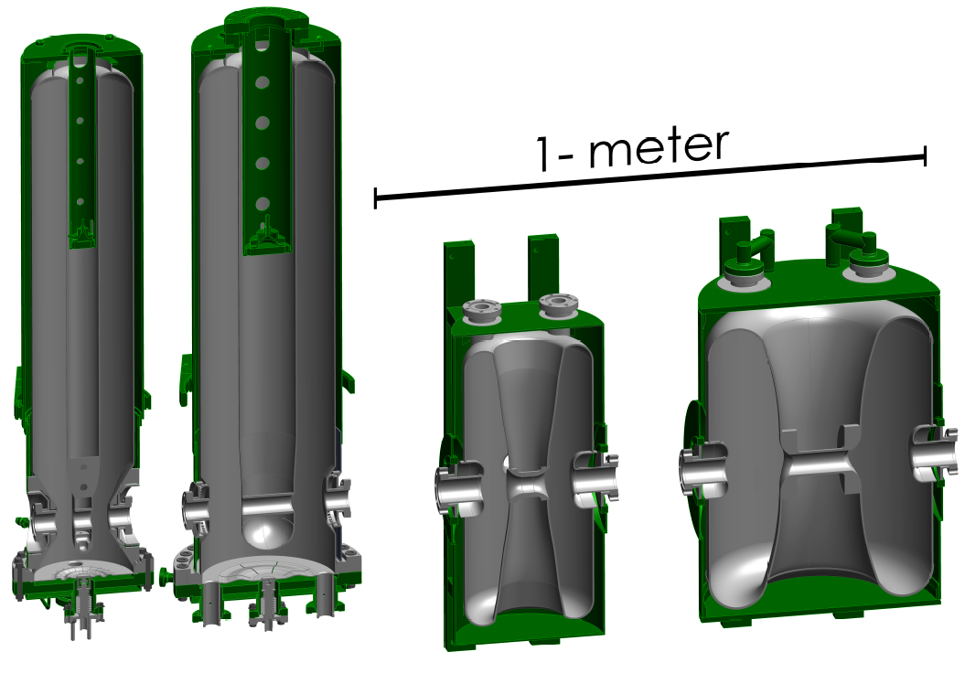
FRIB Superconducting Cavities
52 cryomodules required for FRIB driver linac
4 main cryomodule types
3 matching cryomodules
344 cavities required
4 cavity types
79 solenoids
QWR, 80.5 MHz, beta=0.041
QWR, 80.5 MHz, beta=0.085
HWR, 322 MHz, beta=0.29
HWR, 322 MHz, beta=0.53
QWR 80.5 MHz
Beta=0.041
QWR 80.5 MHz
Beta=0.085
HWR 322 MHz
Beta=0.29
HWR 322 MHz
Beta=0.53
= Cavity
= Solenoid

Slide 23
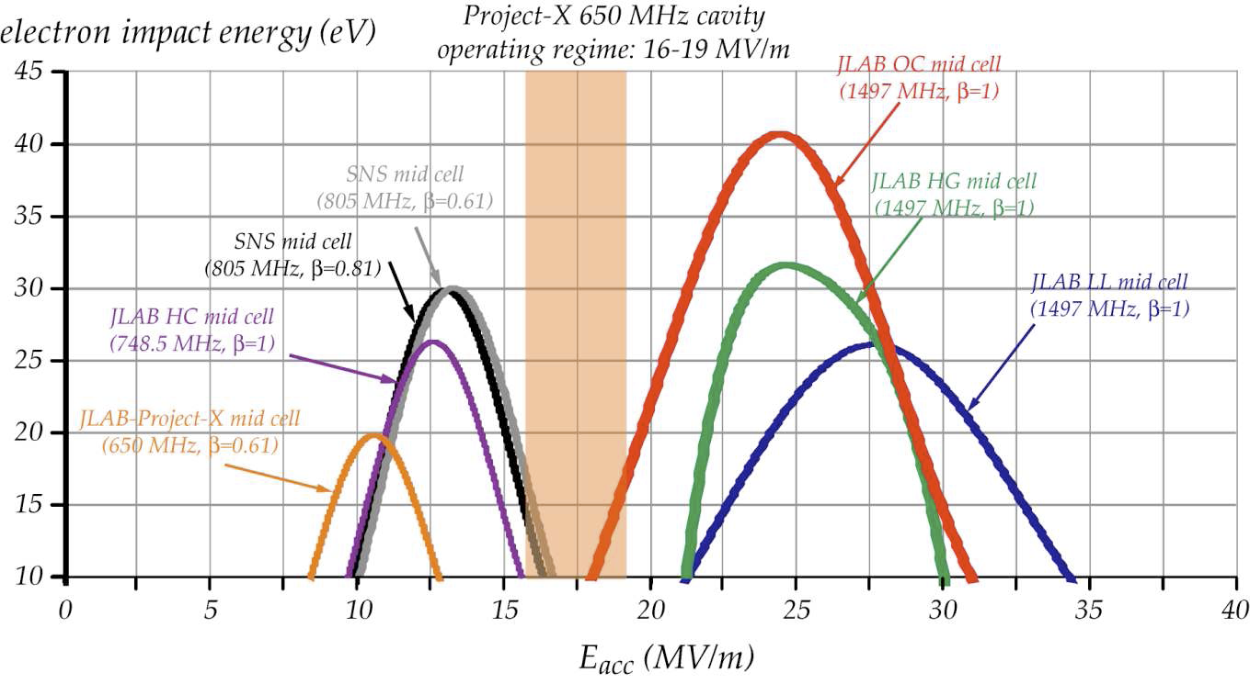
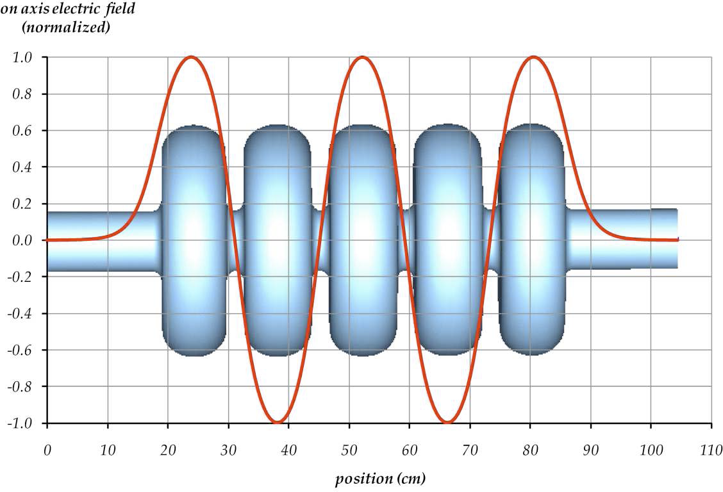
Project X 650 MHz Cavity Design
Frank Marhauser designed this cavity shape to reduce multipacting
Three prototype cavities built at Jefferson Lab and successfully tested

Slide 24
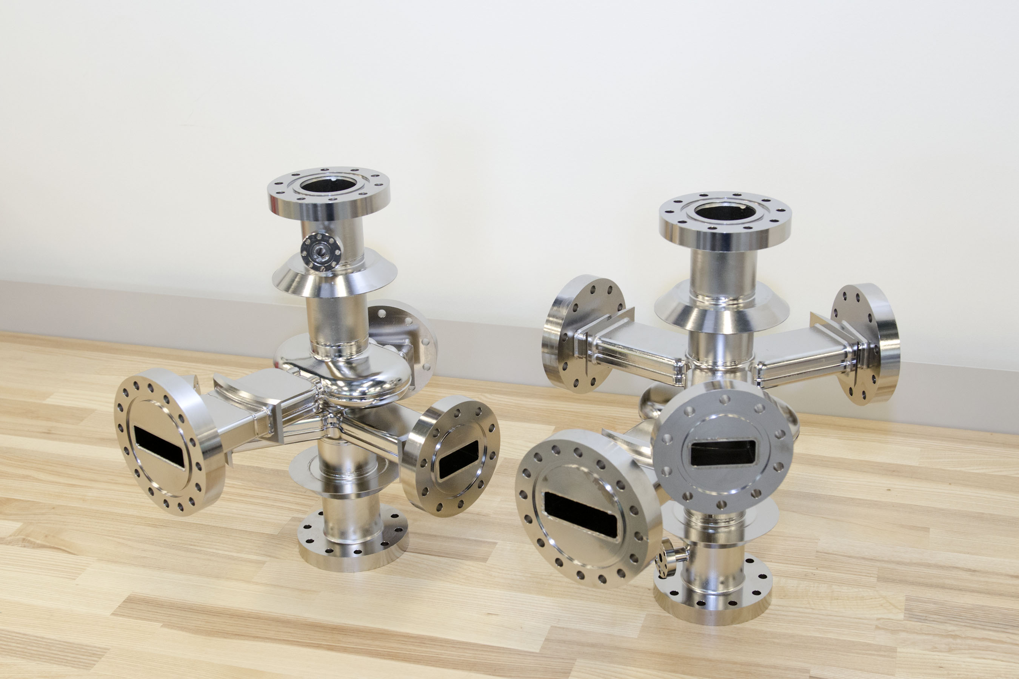
ANL SPX Crab Cavity Development
JLab developing SRF crab cavities and a fully integrated cryomodule package

Slide 25
MYRRHA - the Belgian ADS Project
Accelerator
(600 MeV – ≤ 4 mA proton)
Reactor
Subcritical mode (~85 MW_{th})
Critical mode (~100 MW_{th})
Jefferson Lab Area of Interest

Slide 26
US Participation in MYRRHA
US participation in MYRRHA would provide a way for the DOE to explore ADS, with the advantage that Belgium is taking responsibility for nuclear regulatory approval
Andrew’s (ambitious) goal:
  The US would develop enabling technologies for the MYRRHA SRF linac, with JLab having a key lead role in the USA
    Other DOE labs, other institutions and US industry would be integrated into the US effort
Andrew’s (even more ambitious) goal:
  JLab contribution would be funded by DOE as an “in-kind” contribution to MYRRHA
  Hamid Aït Abderrahim, Director of MYRRHA will be visiting the US (JLab, ANL, INL and DOE) June 11-15 to discuss possibilities for collaboration

Slide 27
Scope of Current Activities 4
Attract and educate the next generation of accelerator scientists and engineers
  Provide opportunities for high school (1-2 per year) and undergraduate science students (~8 per year) to be exposed to accelerator science
  Maintain the number of doctoral students in accelerator science
  Collaborate with the Center for Accelerator Science at ODU (now 7 faculty) and the Idaho Accelerator Center at ISU
  Provide instructors at the United States Particle Accelerator School
  Attract female and minority students to accelerator science
    Successful for females
    Actively seeking collaborations with minority-serving institutions

Slide 28
Education: All Graduate Theses Completed in
Accelerator Research at JLAB
Year | # Degrees
1994 | 1 | Ph.D.
1995 | 1 | Ph.D.
1996 | 1 | Ph.D.
1997 | 0
1998 | 1 | Ph.D.
1999 | 1 | Ph.D.
2000 | 1 | Ph.D.
2001 | 0
2002 | 3 | Ph.D.
2003 | 1,1 | Ph.D., M.S.
2004 | 1 | M.S.
2005 | 1 | Ph.D.
2006 | 1 | Ph.D.
2007 | 1,1 | Ph.D., M.S.
2008 | 3,2 | Ph.D., M.S.
2009 | 1,1 | Ph.D.,M.S.
2010 | 3 | Ph. D.
2011 | 4 | Ph. D.
2012 | 4 | Ph. D.

Slide 29
Education: Ph.D. Theses completed in Accelerator Research at JLAB since 2010
Serkan Golge (2010). Feasibility and Conceptual Design of a C.W. Positron Source at CEBAF. Old Dominion University
Eman Ahmed (2010). Spectroscopic Study of Ultracold Rubidium Atoms in an Optical Dipole Force Trap. Old Dominion University
Megh Niroula (2010), Beyond the Born Approximation: A Precise Comparison of e+p and e-p Elastic Scattering in CEBAF Large Acceptance Spectrometer (CLAS). Old Dominion University
Daniel Bowring (2011), Multilayer Thin Films for SRF Accelerating Cavities University of Virginia
Hisham Sayed (2011), Compensation Techniques in Accelerator Physics
Old Dominion University
Gambhir Ranjit (2011), Experimental Investigation of Long-lived “ZEKE” Rydberg States in Ultracold Argon, Old Dominion University
Jonathan Dumas (2011), Feasibility Studies of a Polarized Positron Source based on the Bremsstrahlung of Polarized Electrons, Universite Joseph Foruier
Senthilraja Singaravelu (2012), Laser Processing of Metals and Polymers, Old Dominion University
Ashwini Dhawale (2012) Study of RF structures for Linear Accelerators, Homi Bhabha National Institute
Alicia Hofler (2012), Optimization Framework for a Superconducting Radio Frequency Gun Based Injector, Old Dominion University
Michael Spata (2012), Application of Chebyshev Formalism to Identify Non-linear Magnetic Fields in Beam Transport Systems, Old Dominion University

Slide 30
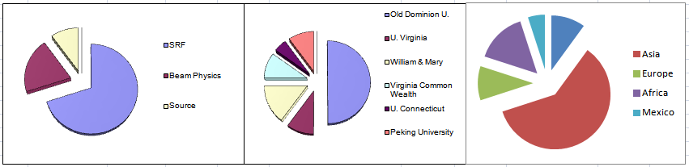
Education: Graduate Students Presently Enrolled
 | Discipline | #Students |  | University | #Students |  |  | #Students
 | SRF | 14 |  | Old Dominion University | 10 |  | USA | 2
 | Beam Physics | 4 |  | University of Virginia | 2 |  | Asia | 12
 | Source | 2 |  | William & Mary | 3 |  | Europe | 2
 |  |  |  | Virginia Commonwealth U. | 2 |  | Africa | 3
 |  |  |  | University of Connecticut | 1 |  | Mexico | 1
 |  |  |  | Peking University | 2
Goal is to increase this

Slide 31
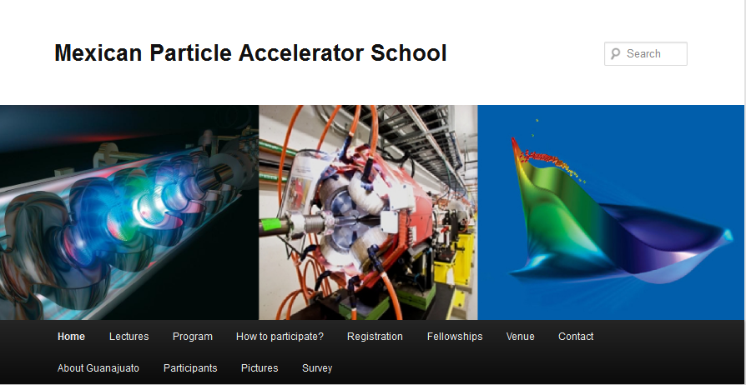
First Mexican Particle Accelerator School
Developed by JLab
Organized by JLab and Guanajuato University
Funded by Mexican Government (including travel for lecturers)
http://www.ifug.ugto.mx/~mepas2011/

Slide 32
Vision for the Future
Operate and upgrade the JLab accelerator facilities
  Continue with 12 GeV and succeeding on-site facilities
Prepare the future evolution of nuclear physics experimentation at Jefferson Lab
  Continue MEIC design
    Focus on staging and value engineering
Expand Jefferson Lab’s core accelerator competencies to support DOE Office of Science projects and other partnerships
  Be the partner of choice for SRF accelerators world-wide
  Associate other core competencies with SRF to expand our capabilities
Attract and educate the next generation of accelerator scientists and engineers
  Continue at about the same level

Slide 33
Summary
CEBAF accelerator operations continued to be excellent
  Polarization, parity quality beams and energy reach are hallmarks
  Preparing for 12 GeV operations
Preparing for the next machine at Jefferson Lab – MEIC
Accelerator R&D is vibrant
  World record Q₀, best performance for ILC gradient
  We are collaborating on SRF with FRIB, APS SPX, Project X
  We are negotiating with LBNL on NGLS participation
  We are developing accelerator R&D projects
Education activities are broad-based and effective

