Slide 1
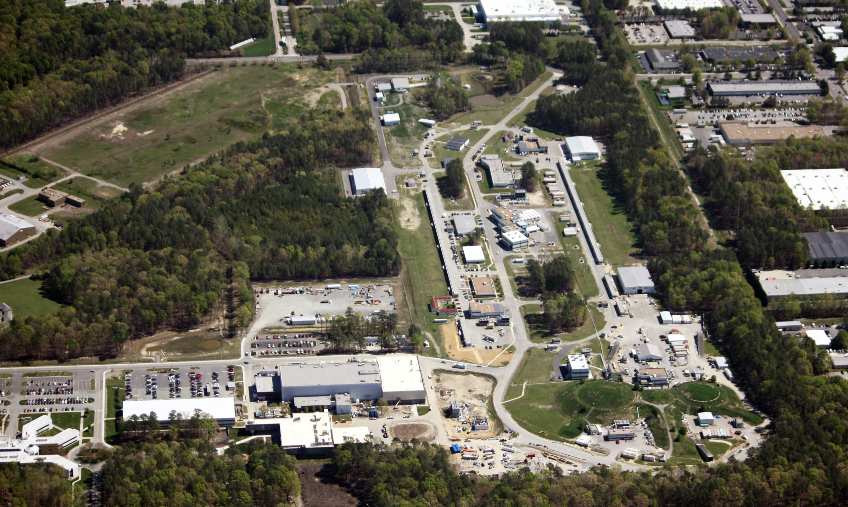
Jefferson Lab –
An Introduction
Hugh Montgomery; May 9, 2012

Slide 2
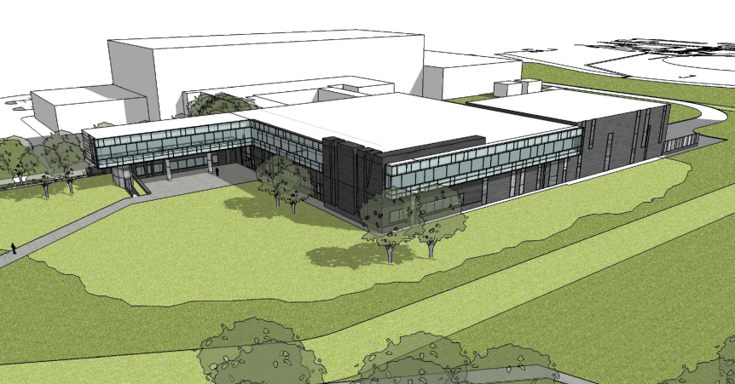
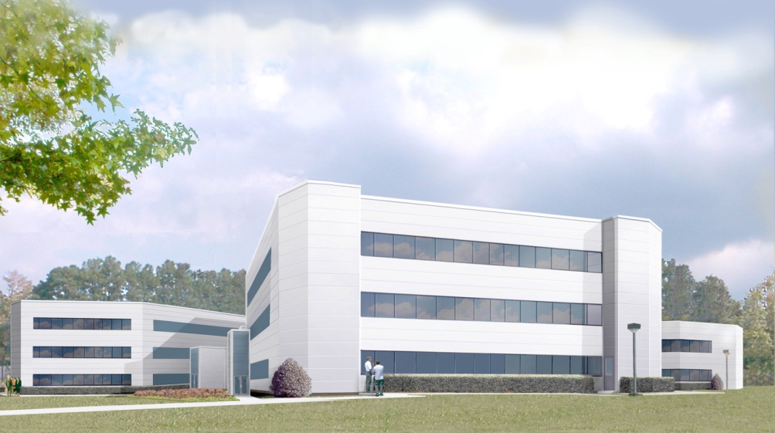
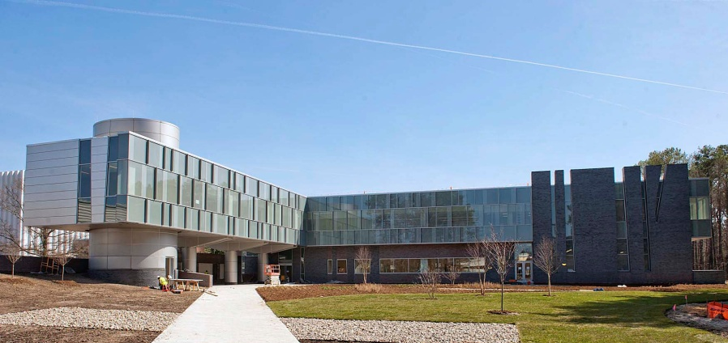
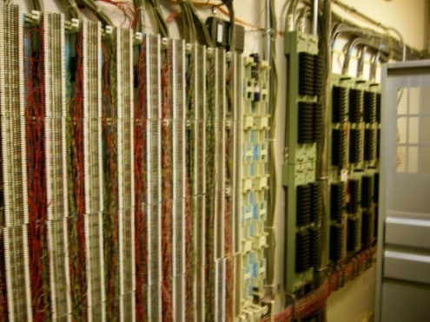
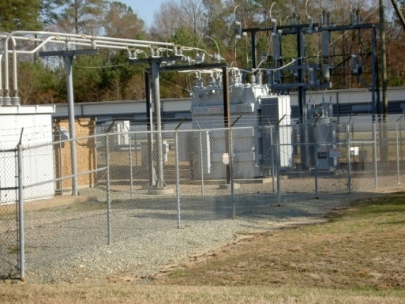
Federal Investments in Jefferson Lab Infrastructure
CEBAF Center Add & Rehab - $78-92M (Planned)
TEDF Construction - $72.2M
Utilities Infrastructure Modernization - $29.2M

Slide 3
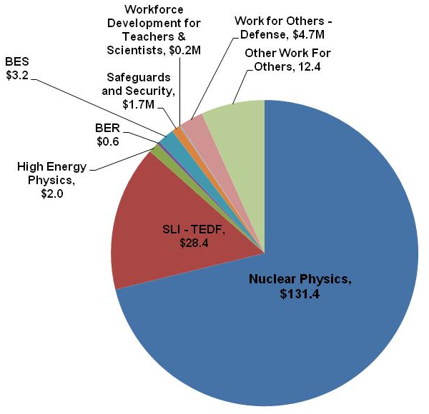
Jefferson Lab At-A-Glance
Created to build and Operate the Continuous Electron Beam Accelerator Facility (CEBAF), world-unique user facility for Nuclear Physics: Mission is to gain a deeper understanding of the structure of matter Through advances in fundamental research in nuclear physics Through advances in photon science and related research In operation since 1995 1,376 Active Users 174 Completed Experiments to date; 2 remaining in 6 GeV program Produces ~1/3 of US PhDs in Nuclear Physics (406 PhDs granted, 180 more in progress) Managed for DOE by Jefferson Science Associates, LLC (JSA) Human Capital: 769 FTEs 22 Joint faculty, 27 Post docs, 14 Undergraduate; 33 Graduate students K-12 Science Education program serves as national model Site is 169 Acres, and includes: 83 Buildings & Trailers: 749K SF Replacement Plant Value: $331M
FY 2011:
Total Lab Operating Budget: $103.3M
Total Lab Construction Budget: $64.3M
Total Non-DOE Budget: $17.1M
TOTAL: $184.7M
All data as of FY2011

Slide 4
Jefferson Lab Science Organization
Accelerator Science
Advisory Comm.
Director
H. Montgomery
Nuclear Physics
Program Adv. Comm.
Note: For this review this
organization chart shows only
the Science and Tech organization, not those under Operations.
Deputy Director
Science & Tech
R. McKeown
Deputy Director
Operations and Chief Operating Officer
M. Dallas
Photon Science
Program Adv. Comm.
University Relations
Free Electron
Laser
G. Neil
12 GeV Project Office
C. Rode
Experimental Physics
Rolf Ent
Accelerator
A. Hutton
Theoretical & Computational Physics
M. Pennington
Deputy: P. Rossi
J. Gomez
Deputy: F. Pilat
Deputy: D. Richards
Deputy: G. Williams
Deputy: A. Lung
APM: L. Harwood
APM: R. Yasky
APM: G. Young
Hall A: B. Michaels-Acting
Hall B: V. Burkert
Hall C: S. Wood
Hall D: E. Chudakov

Slide 5
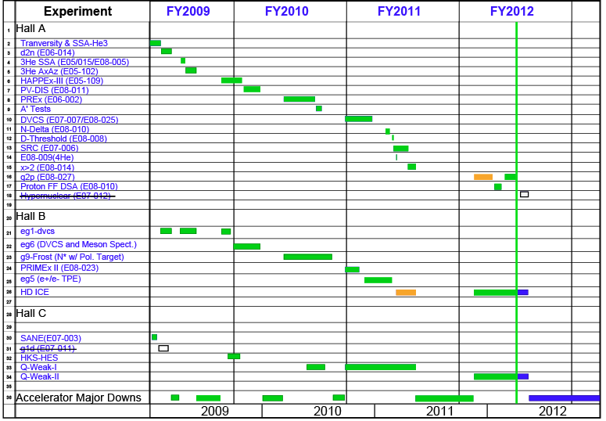
Experimental Nuclear Physics Program
X

Slide 6
12 GeV Upgrade
New Hall
CHL-2
Maintain capability to deliver
lower pass beam energies
Enhanced capabilities in existing Halls

Slide 7
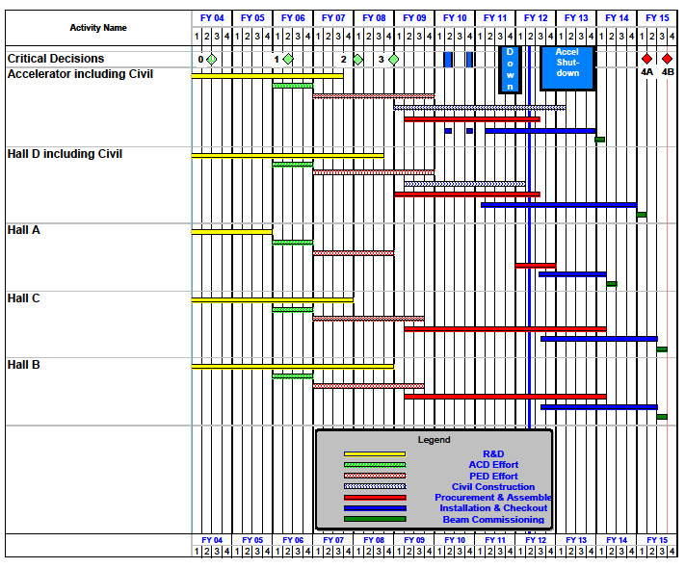
12 GeV Upgrade Project Schedule
Two short parasitic installation periods in FY2010
6-month installation
May-Oct 2011
12 16-month installation
May 2012 - May Sept 2013
Hall A commissioning start Oct 2013 Feb 2014
Hall D commissioning start
April 2014 Oct 2014
Halls B & C commissioning start Oct 2014 Apr 2015
Project Completion June 2015
CD-4B may be at risk

Slide 8
EIC Realization Imagined
Activity Name | 2010 | 2011 | 2012 | 2013 | 2014 | 2015 | 2016 | 2017 | 2018 | 2019 | 2020 | 2021 | 2022 | 2023 | 2024 | 2025
12 Gev Upgrade
FRIB
EIC Physics Case
NSAC LRP
EIC CD0
EIC Machine Design/R&D
EIC CD1/Downsel
EIC CD2/CD3
EIC Construction

Slide 9
Jefferson Lab Light Source
Accelerator R&D and devel.
funded by Navy (ONR) and Air Force
E = 120 MeV emittance 5 microns
135 pC pulses @ 75 MHz 150 fs
ERL
2 FELs
IR (1-10 microns), 14 kW
UV (down to 300nm)
4 eV in fund. 12eV in
3rd harmonic
A VUV/IR/THz 4th Generation Light Source

Slide 10
Jefferson Lab Injury History

Slide 11
Commonalities and Mitigative Actions
Common Causes
Newer employees are at risk
Work planning not recognizing obvious hazards/ over-reliance on experience
Workers in a hurry/ last evolution of job
Actions
Revised ES&H Orientation
All Managers’ meeting (2/16/12), emphasizing pre-job briefing/ walk down of work site
Human Performance Improvement (HPI) training (5/3-4/12)
All-Hands Meeting (5/7-8/12) prior to Long Shutdown
Safety Culture Survey and Predictive Analysis Efforts (Summer 2012)
ES&H Directors’ Meeting at JLab (4/23-24/12) will inform this effort

Slide 12
S&T Review 2009 Recommendations
Formulate a plan to mitigate the risks associated with not having produced and tested a full 12 GeV cryomodule, in the context of recent cryomodule performance, and present it at the upcoming Lehman Review of the 12 GeV project.
Plan was formulated, presented at Lehman Review in September 2010. Installation and commissioning of 2 cryomodules was moved forward to FY2011/12. Required performance now demonstrated.
Prepare a laboratory staffing plan for all activities extending into the 12 GeV era that also includes the past staffing history since FY 2004. This plan should be submitted to Department of Energy (DOE) Office of Nuclear Physics by October 13, 2009.
Presentation Nov 24, 2009 by Mont in Germantown

Slide 13
Operations Review 2010 Recommendations
Provide a plan to DOE that describes the implementation plan and proposed NP funding support of the TEDF by May 1, 2011
Develop a plan for Hall A physics that articulates the scope, goals, schedule and resources needed to implement a physics program for Hall A in the 12 GeV era. Submit to DOE by May 1, 2011
Work on the Super-Bigbite may not proceed with base funding until a path forward for supporting these activities has been identified and agreed upon with NP
Prepare a document which identifies and justifies the needed resources and changes of those resources through FY 2016 relative to FY 2004 for all of the B&R accounts covered by this review. A template will be provided by the Office of Nuclear Physics. This should be submitted to Department of Energy (DOE) Office of Nuclear Physics by May 1, 2011
Identify increments for additional funding above constant effort and prioritize them. Identify increments for staffing above FY 2004 levels and prioritize them. Submit to DOE by May 1, 2011

Slide 14
Operations Review 2010 Recommendations
Lab responded April 13, 2011 on items 1, 2, 4 & 5
Item 3
SBS Review: October 13-14, 2011
SBS Program Management Plan sent to NP Dec 22, 2011
Follow up responses on item 4
July 29, 2011 Completed DOE provided template
Sept 1, 2011
Sep 23, 2011 Follow up Meeting
Oct 3, 2011
Oct 10, 2011

Slide 15
Jefferson Lab
6 GeV Program a manifest success
World class accelerator technology: SRF, Cryogenics
Leadership in Nuclear Theory
Successful 12 GeV Project - budget uncertainties
12 GeV Physics Program: exciting discovery potential
MEIC development: a mature alternative for the future
FEL/ERL machine provides important breadth and synergy
Supporting Infrastructure improvement program
A coherent program evolving in exciting directions

