Slide 1

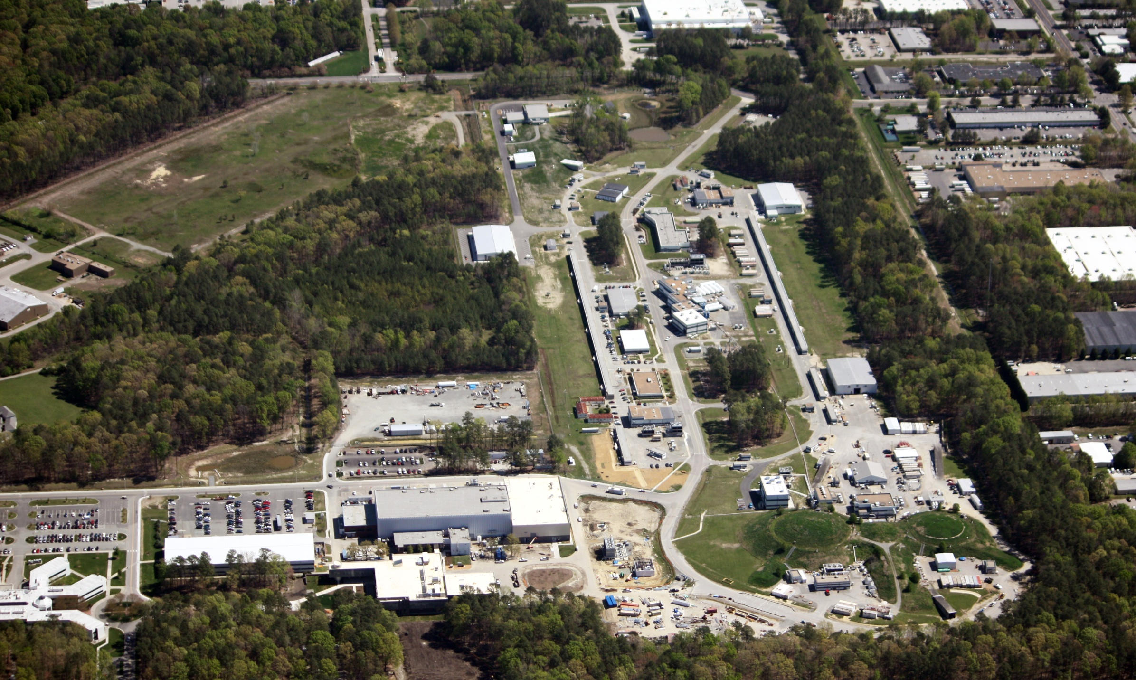
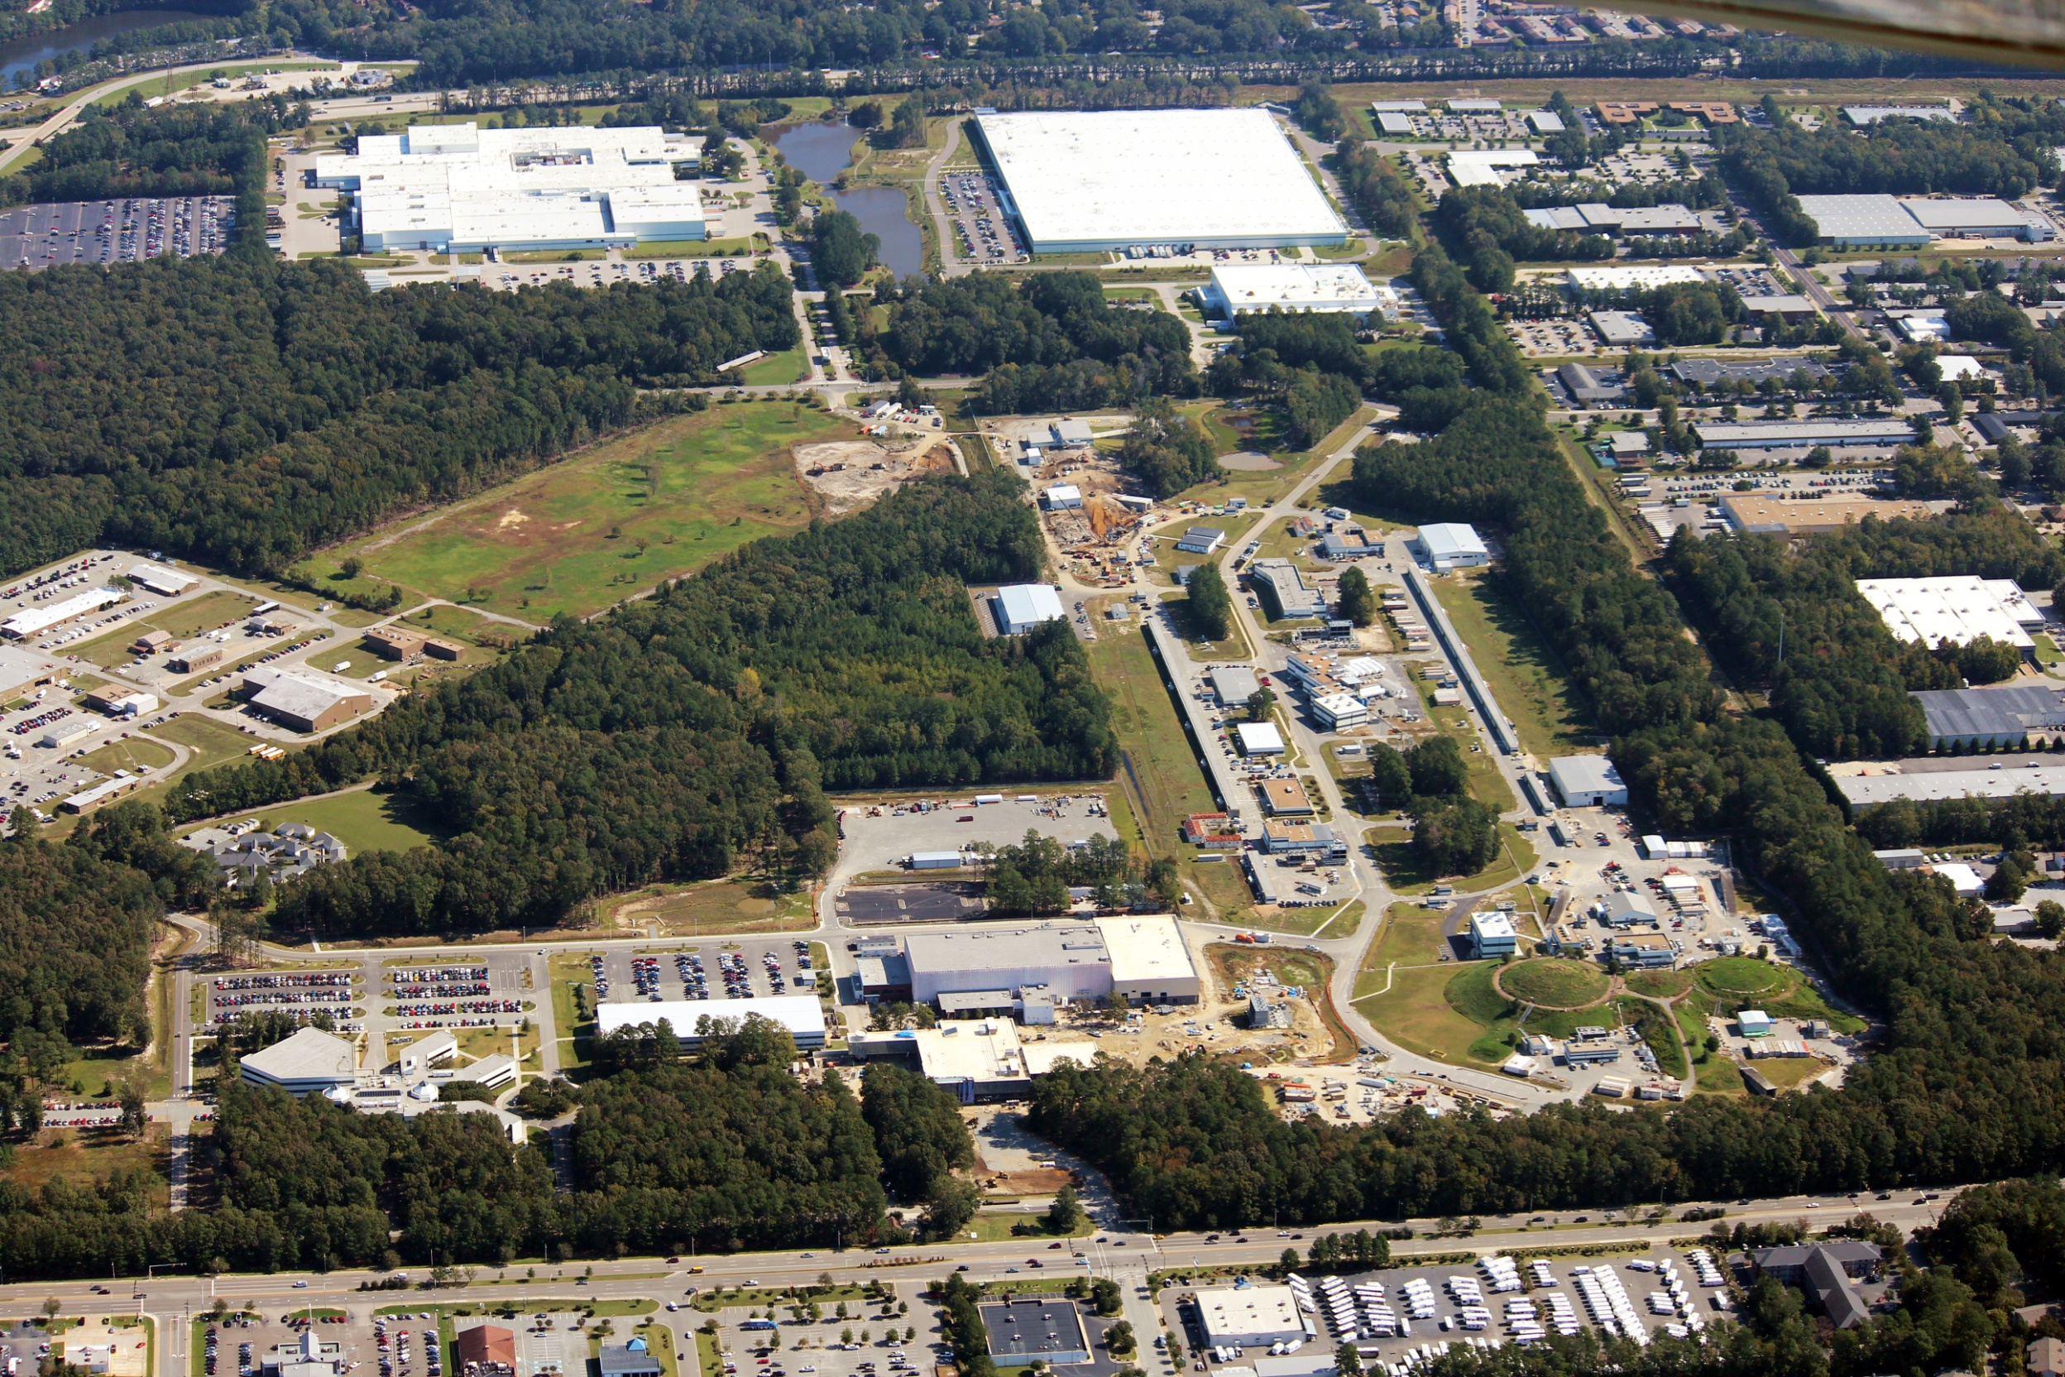
Jefferson Laboratory
Science Overview
R. D. McKeown
DOE/ONP S&T Review
May 9, 2012

Slide 2
Outline
JLab context in Nuclear Physics
12 GeV Physics Program
phenomenology
techniques (theory+exp)
standard model tests
MEIC
Outlook
Discovery
Potential
New
Note: Recent Accomplishments, Accelerator S&T, Theory/Computation
to be covered in following talks
Notes:
Like to give an overview of Jefferson Lab.
I can’t get going without saying something of the current status of the lab.
The dominant part of the talk will concern our 12 GeV Upgrade Project, the physics and the project status.
However, the technology which enables our nuclear physics and its enhancement also provides opportunities in the future
Photon Science
Accelerator Driven Systems
Nuclear Physics
Conclude

Slide 3


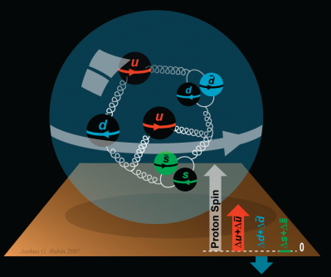
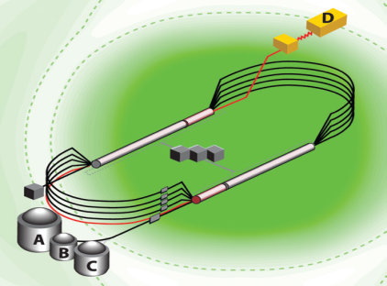

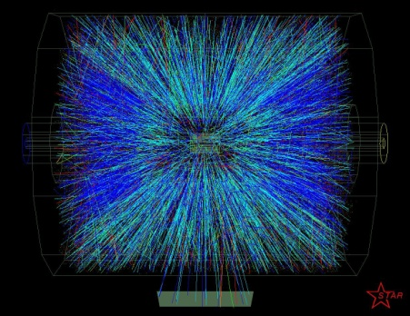


A Laboratory for Nuclear Science
Nuclear Structure
Structure of Hadrons
Fundamental
Forces & Symmetries
Accelerator S&T
Medical Imaging
Quark Confinement
Hadrons from QGP
Theory and Computation

Slide 4
JLab: 21st Century Science Questions
What is the role of gluonic excitations in the spectroscopy of light mesons? Can these excitations elucidate the origin of quark confinement?
Where is the missing spin in the nucleon? Is there a significant contribution from valence quark orbital angular momentum?
Can we reveal a novel landscape of nucleon substructure through measurements of new multidimensional distribution functions?
What is the relation between short-range N-N correlations and the partonic structure of nuclei?
Can we discover evidence for physics beyond the standard model of particle physics?

Slide 5
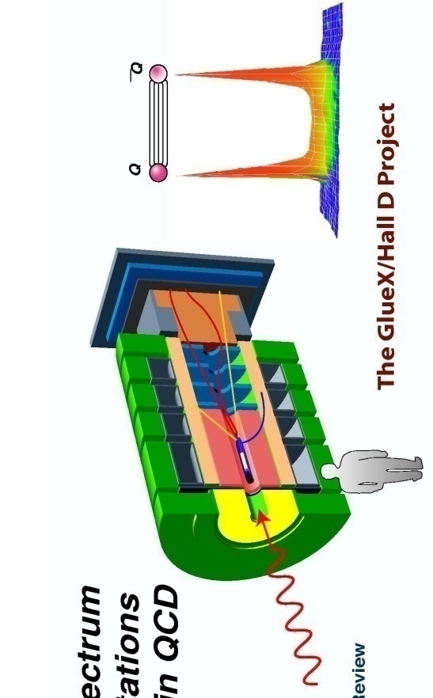
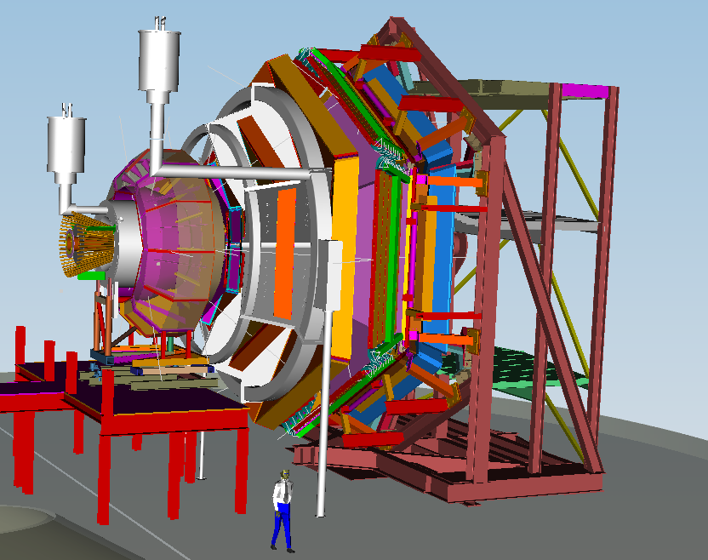
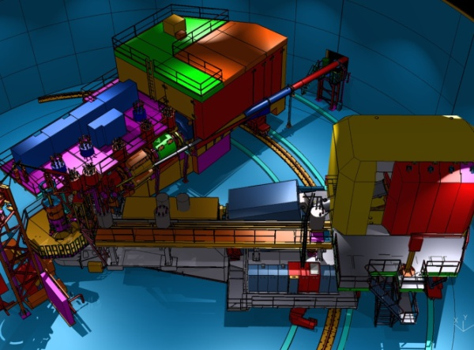

12 GeV Scientific Capabilities
Hall D – exploring origin of confinement by studying exotic mesons
Hall B – understanding nucleon structure via generalized parton distributions
Hall C – precision determination of valence quark properties in nucleons and nuclei
Hall A –form factors, future new experiments (e.g., PV and MOLLER)
Notes:
5
Note BSM not included in project

Slide 6
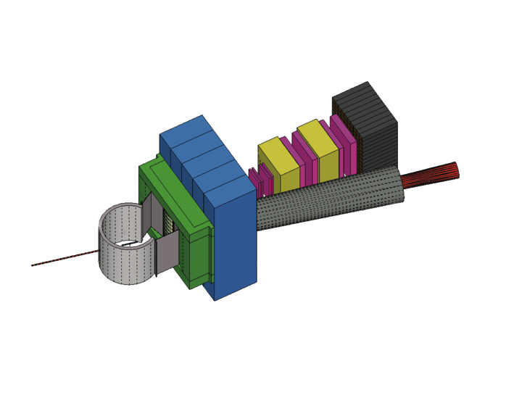
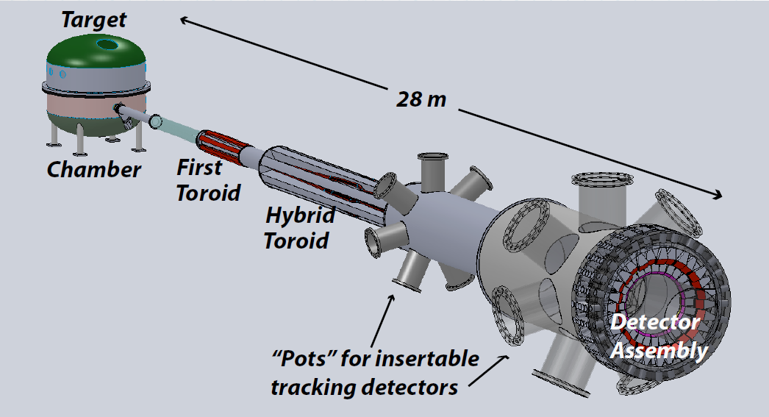

Beyond 12 GeV Upgrade
Super BigBite Spectrometer
(Approved for FY13-15 construction)
MOLLER experiment
(MIE – FY14-18?)
SoLID
Chinese collaboration
CLEO Solenoid?

Slide 7
12 GeV Science Program
The physical origins of quark confinement (GlueX, meson and baryon spectroscopy)
The spin and flavor structure of the proton and neutron (PDF’s, GPD’s, TMD’s…)
The quark structure of nuclei
Probe potential new physics through high precision tests of the Standard Model
Defining the Science Program:
  Seven Reviews: Program Advisory Committees (PAC) - 2006 through 2011
  Results: 48 experiments approved; 7 conditionally approved
  PAC39 scheduled June 2012
  White paper for NSAC subcommittee (in progress)
Experiments for 4 Halls approved for
more than five years of operation beginning in FY15.

Slide 8
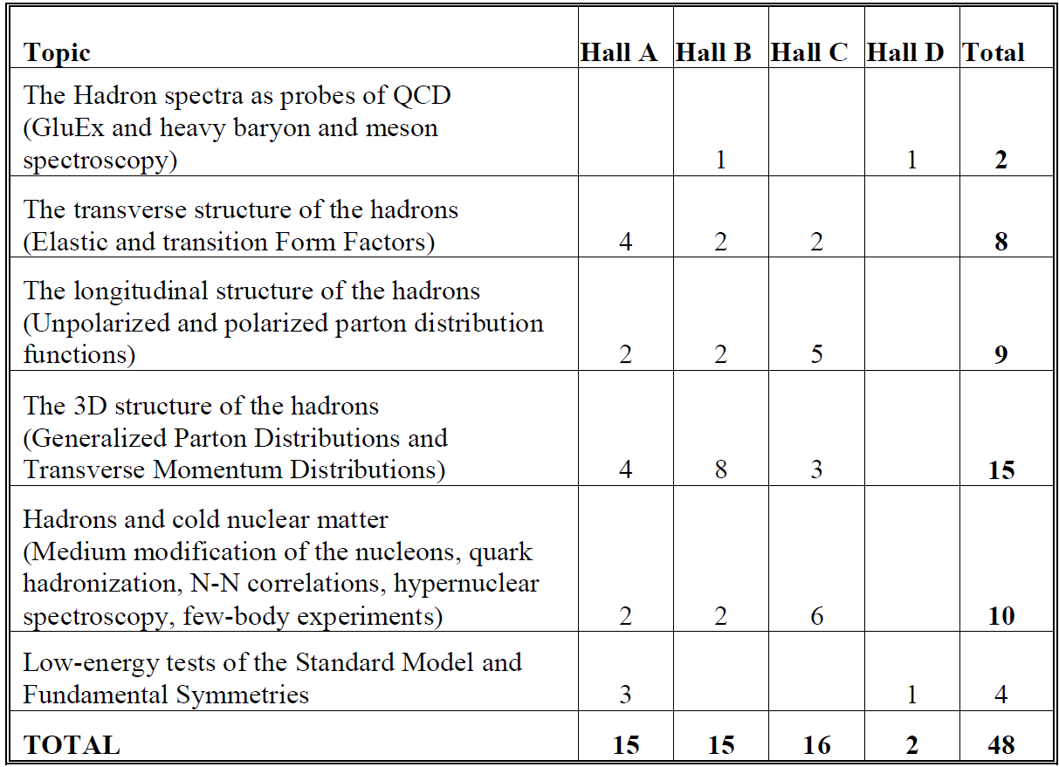
12 GeV Approved Experiments by Physics Topics
E12-11-105 has not been counted with the experiments since it is considered a test

Slide 9
12 GeV Approved Experiments by PAC Days
(All approved experiments received scientific rating since last PAC)
 | Hall A | Hall B | Hall C | Hall D | Total
The Hadron Spectra as Probes of QCD (GluEx & heavy baryon and meson spectroscopy) |  | 119 |  | 120 | 239
The Transverse Structure of the Hadrons (elastic and transition form factors) | 144 | 70 | 102 |  | 316
The Longitudinal Structure of the Hadrons (Unpolarized and polarized parton distributions) | 65 | 120 | 140 |  | 325
The 3D Structure of the Hadrons (GPDs and TMDs) | 289 | 802 | 108 |  | 1199
Hadrons and Cold Nuclear Matter | 54 | 120 | 179 |  | 353
Low-Energy Tests of the Standard Model and Fundamental Symmetries | 547 |  |  | 79 | 535
Total | 1099 | 1231 | 529 | 199 | 3058
E12-11-105 has not been included here since it is an injector test experiment
638 PAC days in Hall A are associated with the Moller and SOLID programs

Slide 10
CLAS12 Experiments – Optimal Running
Proposal | Physics | Contact | Rating | Days | Group | all equipment available day 1 | Energy | Group | Target
E12-07-104 | Neutron magnetic form factor | G. Gilfoyle | A- | 30 | 90 | Neutron detector RICH IC | 11 | A | liquid D₂ target
PR12-11-109 (a) | Dihadron DIS production | Avakian
E12-09-007a | Study of partonic distributions in SIDIS kaon production | K. Hafidi | A- | 56
E12-09-008 | Boer-Mulders asymmetry in K SIDIS w/ H and D targets | M. Contalbrigo | A- | TBA
11-003 | DVCS on neutron target | S. Niccolai | A | 90
E12-06-108 | Hard exclusive electro-production of π⁰, η | P. Stoler | B | 80 | 119 | RICH IC Forward tagger | 11, 8.8, 6.6 | B | liquid H₂
E12-06-112 | Probing the proton’s quark dynamics in Semi-Inclusive pion production | H. Avakian | A | 60
E12-06-119 | Deeply Virtual Compton Scattering | F. Sabatie | A | 80
E12-09-103 | Excitation of nucleon resonances at high Q² | R. Gothe | B+ | 40
E11-005 | Hadron spectroscopy with forward tagger | M. Battaglieri | A- | 119
PR12-11-103 | DVMP of ρ , ω, φ | M. Guidal
E12-06-106 | Color transparency in exclusive vector meson electroproduction off nuclei | K. Hafidi | B+ | 60 | 60 |  | 11 | C | Nucllear targets
E12-06-117 | Quark propagation and hadron formation | W. Brooks | A- | 60 | 60 |  | 11 | D | Nuclear
E12-10-102 | Free Neutron structure at large x | S. Bueltman | A | 40 | 40 | Radial TPC | 11 | E | Gas D₂
E12-06-109 | Longitudinal Spin Structure of the Nucleon | S. Kuhn | A | 80 | 170 | Polarized target RICH IC | 11 | F | NH₃ ND₃
E12-06- 119(b) | DVCS on longitudinally polarized proton target | F. Sabatie | A | 120
E12-07-107 | Spin-Orbit Correl. with Longitudinally polarized target | H. Avakian |  | 103
PR12-11-109 (b) | Dihadron studies on long. polarized target | H. Avakian
E12-09-007(b) | Study of partonic distributions using SIDIS K production | K. Hafidi | A- | 110
E12-09-009 | Spin-Orbit correlations in K production w/ pol. targets | H. Avakian | A- | 103
PR12-11-109 | SIDIS on transverse polarized target | M. Contalbrigo |  |  |  | Transverse target | 11 | G | HD
TOTAL run time |  |  |  | 1231 | 539

Slide 11
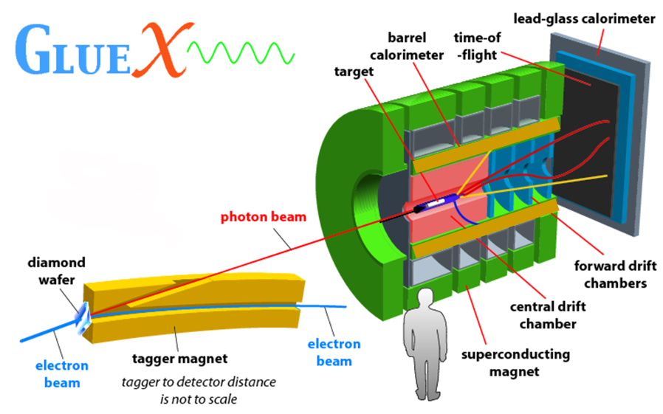
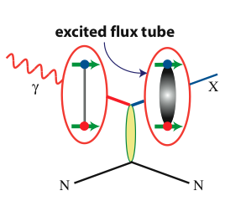
Hall D
FCAL
TOF
BCAL
Start counter
FDC
CDC
BCAL
◻ E. Chudakov talk

Slide 12
Quantum Numbers of Hybrid Mesons
Excited
Flux Tube
Quarks
Hybrid Meson
like
Exotic
like
Flux tube excitation (and parallel quark spins) lead to exotic J^{PC}

Slide 13
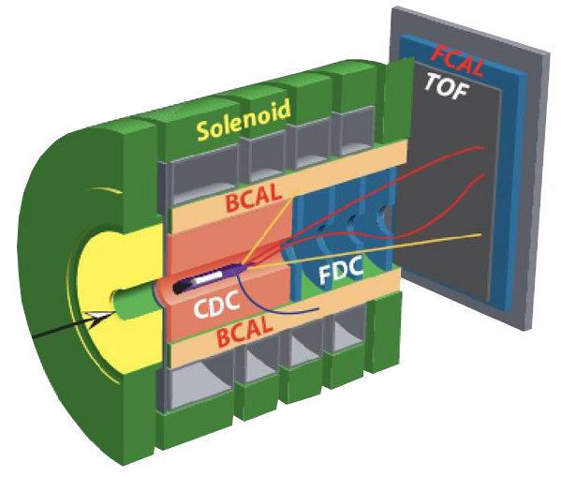

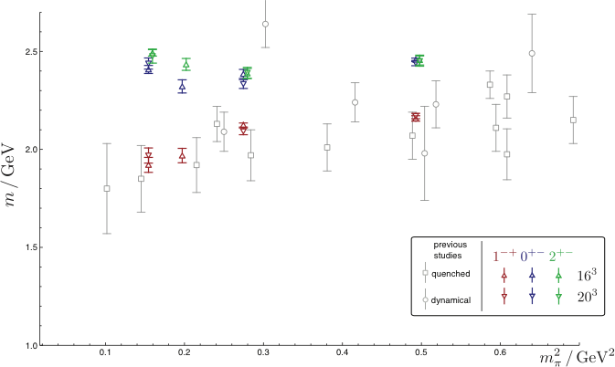
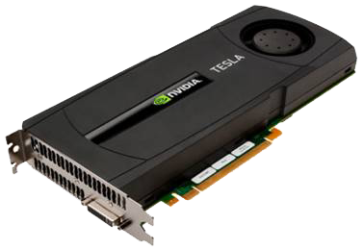

Isovector Meson Spectrum
Hall D@JLab
States with Exotic Quantum Numbers
2
+-
0
+-
1
-+
Dudek et al.

Slide 14
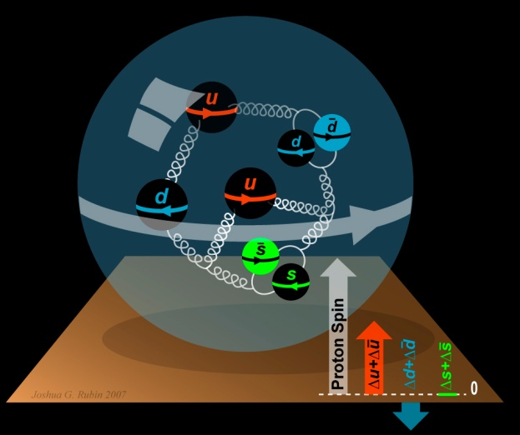
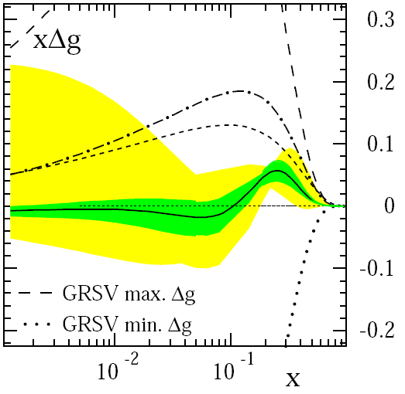
The Incomplete Nucleon: Spin Puzzle
1
1
ΔΣ
+
L_{q}
+
J_{g}
=
2
2
[X. Ji, 1997]
DIS → ΔΣ ≅ 0.25
RHIC + DIS → ΔG« 1
→ L_{q}
D. de Florian et al., PRL 101 (2008) 072001

Slide 15
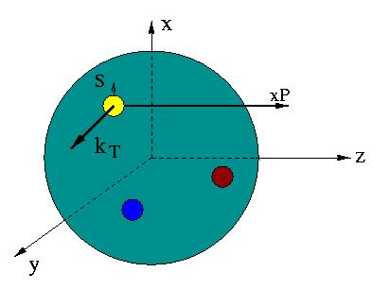

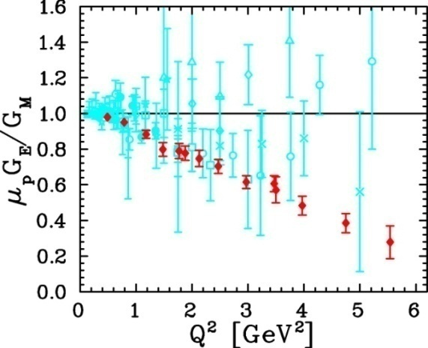
Unified View of Nucleon Structure
W_{p}^{u}(x,k_{T},r ) Wigner distributions
6D Dist.
d³r
d²k_{T} dr_{z}
TMD PDFs f₁^{u}(x,k_{T}), .. h₁^{u}(x,k_{T})‏
GPDs/IPDs
3D imaging
dx &
Fourier Transformation
d²k_{T}
d²r_{T}
Form Factors
G_{E}(Q²),
G_{M}(Q²)‏
PDFs
f₁^{u}(x), .. h₁^{u}(x)‏
1D

Slide 16
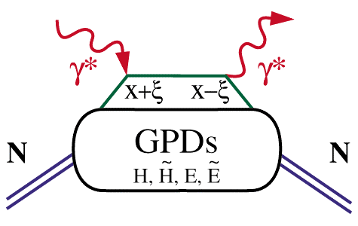
Extraction of GPD’s
◻ F. X. Girod talk
Cleanest process: Deeply Virtual Compton Scattering
hard vertices
σ⁺ − σ⁻
σ⁺ + σ⁻
Δσ
2σ
A =
=
ξ=x_{B}/(2-x_{B})
t
Polarized beam, unpolarized target:
~
H(ξ,t)
Δσ_{LU}~ sinφ{F₁H+ ξ(F₁+F₂)H+kF₂E}dφ
Unpolarized beam, longitudinal target:
~
~
Δσ_{UL}~ sinφ{F₁H+ξ(F₁+F₂)(H+ξ/(1+ξ)E)}dφ
H(ξ,t)
Unpolarized beam, transverse target:
Δσ_{UT}~ sinφ{k(F₂H – F₁E)}dφ
E(ξ,t)

Slide 17
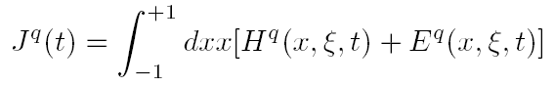
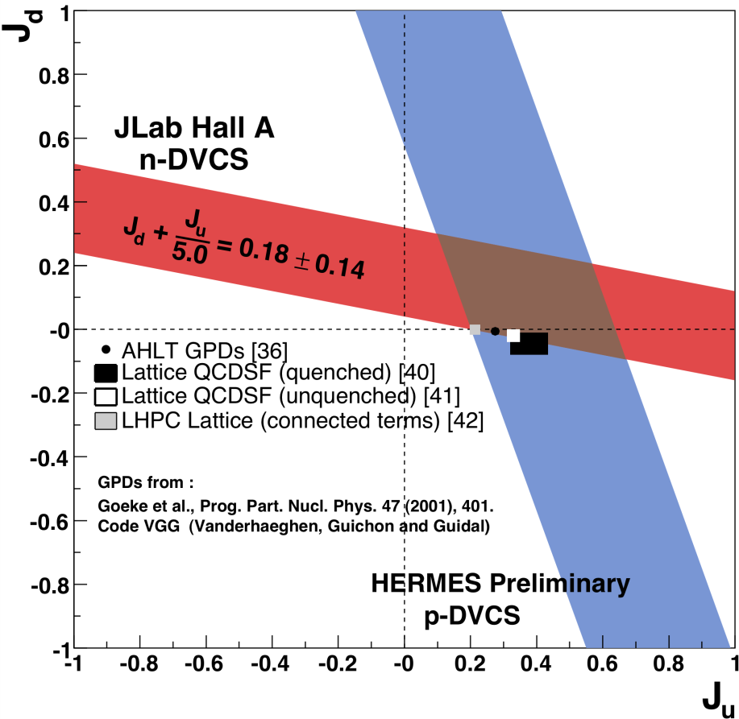
Quark Angular Momentum
→ Access to quark orbital angular
momentum

Slide 18
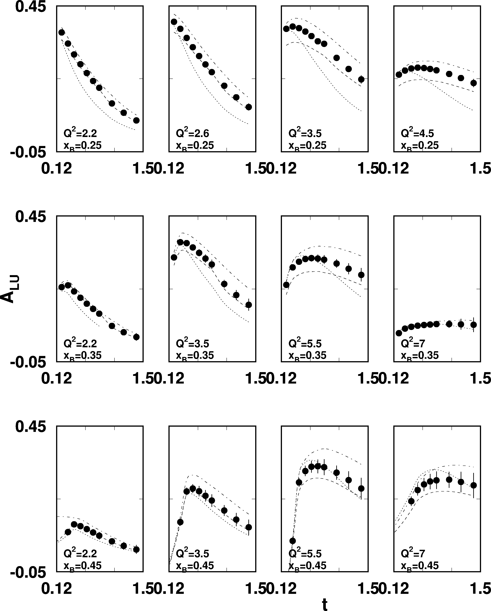
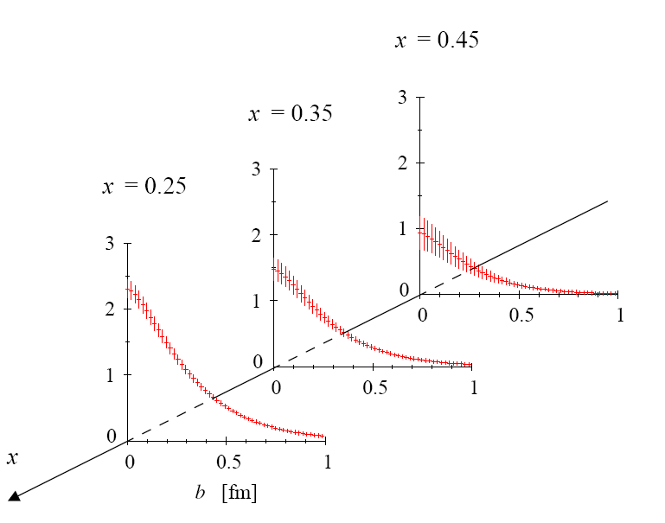
DVCS beam asymmetry at 12 GeV
CLAS12
sinφ moment of A_{LU}
ep epγ
High luminosity and large acceptance allows wide coverage
in Q² < 8 GeV², x_{B}< 0.65, and
t< 1.5GeV²
◻ F. X. Girod talk

Slide 19
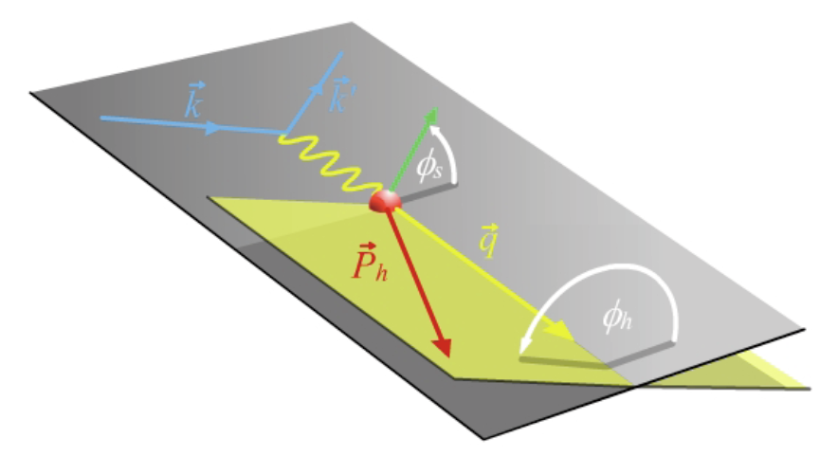
SIDIS Electroproduction of Pions
◻ K. Allada talk
Separate Sivers and Collins effects
Sivers angle, effect in distribution function: (φ_{h}-φ_{s})
Collins angle, effect in fragmentation function: (φ_{h}+φ_{s})
Previous data from HERMES,COMPASS
New landscape of TMD distributions
Access to orbital angular momentum
target angle
hadron angle
Scattering Plane

Slide 20
SIDIS Studies with 12 GeV at JLab
CLAS12 in Hall B
General survey, medium lumi
SHMS- HMS in Hall C
L-T studies, precise π⁺/π⁻ ratios
SBS in Hall A
High x, High Q², 2-3D
SOLID in Hall A
High Lumi and acceptance – 4D

Slide 21
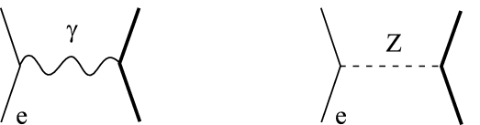
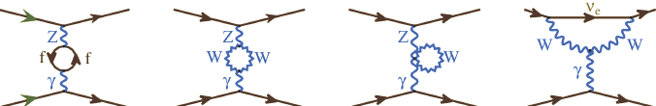
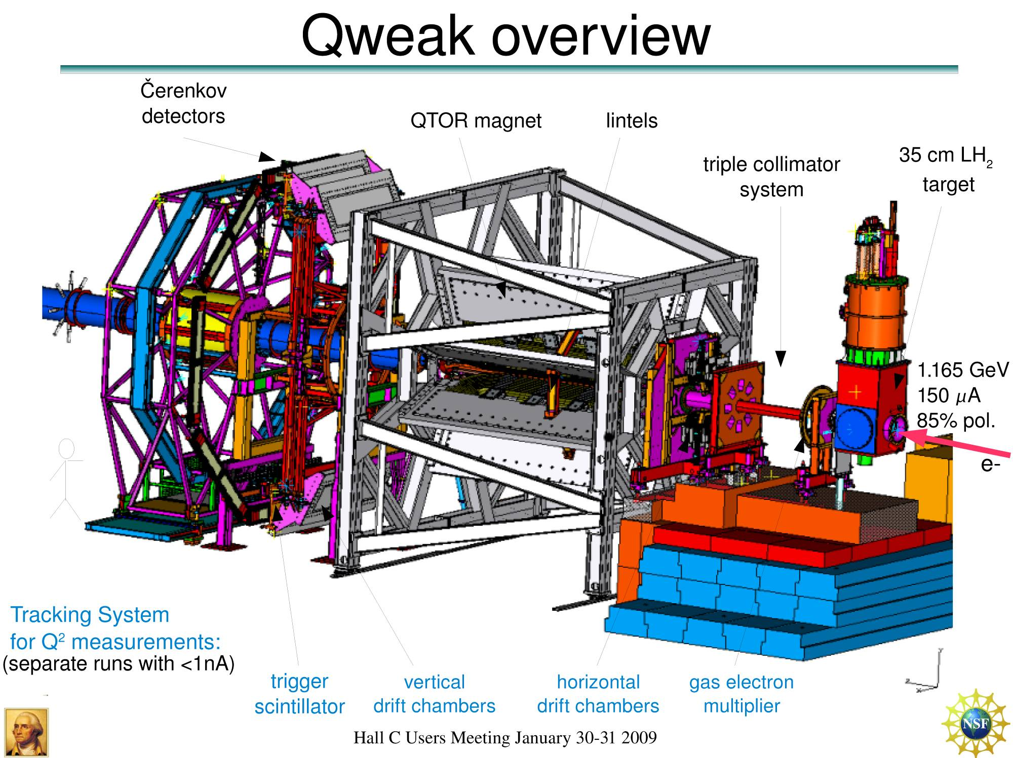
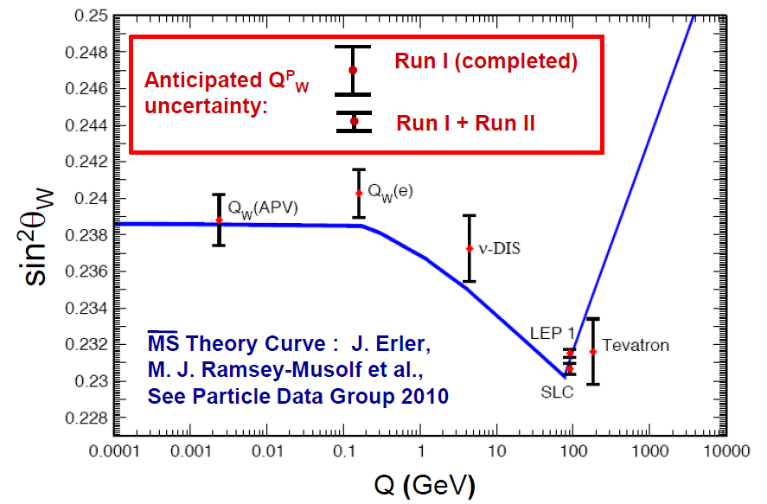
Qweak
Precise determination of
the weak charge of the proton
Q_{w}= -2(2C_{1u}+C_{1d})
=(1 – 4 sin² θ_{W})
2.2 kW
Luminosity
monitors
Luminosity
monitors
scanner

Slide 22
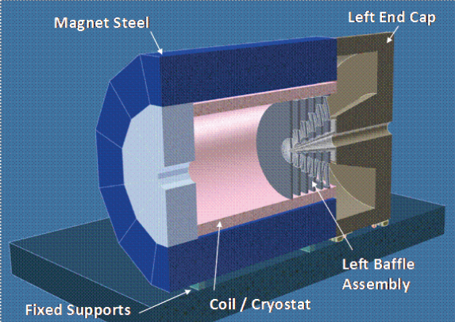
Future PV Program at JLab
◻ R. Michaels talk
PV Moller Scattering:
Custom Toroidal Spectrometer
5kW LH Target
SOLID (PVDIS):
High Luminosity on LD2 and LH2
Better than 1% errors for small bins
Large Q² coverage
x-range 0.25-0.75
W²> 4 GeV²

Slide 23
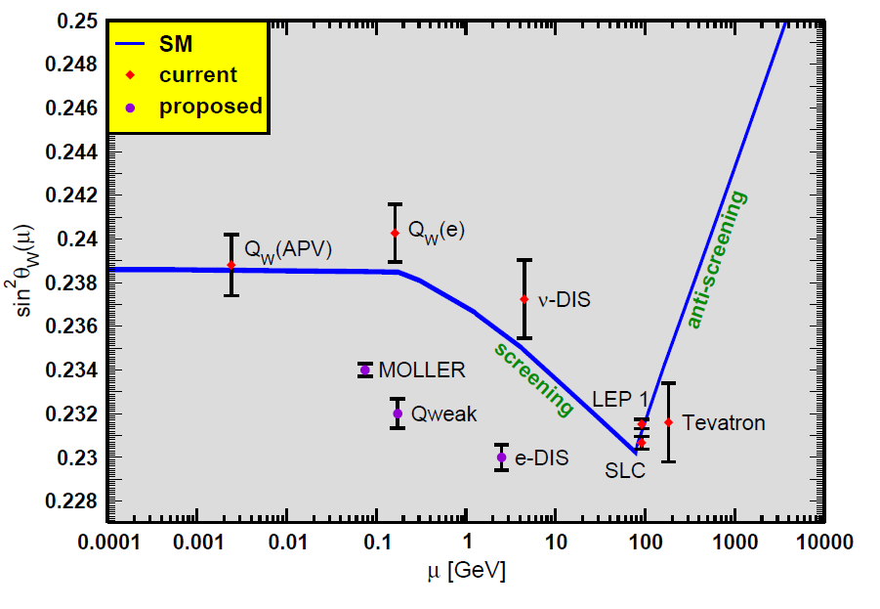
Projected Results
JLab program

Slide 24
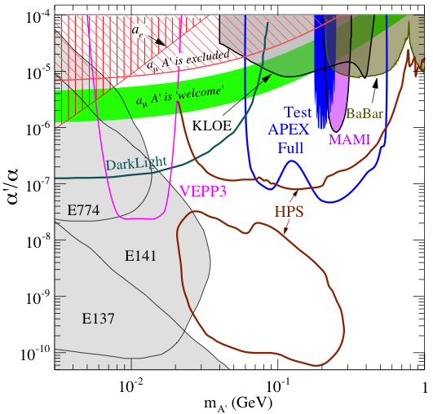
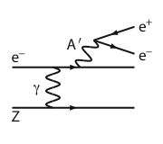
New Opportunity: Search for A’ at JLab
Search for new forces mediated by ~100 MeV vector boson A’ with weak coupling to electrons:
g – 2 preferred!
New ~GeV–scale force carriers are important category of physics beyond the SM
Fixed-target experiments @JLab (FEL + CEBAF) have unique capability to explore this!

Slide 25
12 GeV JLab – The Potential
Opportunity to discover and study new exotic mesons to elucidate the mechanism of confinement.
Opportunity to discover and study new exotic mesons to elucidate the mechanism of confinement.
Open a new landscape of nucleon tomography, with potential to identify the missing angular momentum.
Establish the quantitative foundation for the short-distance behavior in nuclei, underpinning the development of precision nuclear structure studies.
Provide stringent new tests of the standard model and extensions, complementing the information obtained at LHC.
Establish a firm basis for higher energy studies with a future
Electron Ion Collider

Slide 26

Electron Ion Collider
NSAC 2007 Long-Range Plan:
“An Electron-Ion Collider (EIC) with polarized beams has been embraced by the U.S. nuclear science community as embodying the vision for reaching the next QCD frontier. EIC would provide unique capabilities for the study of QCD well beyond those available at existing facilities worldwide and complementary to those planned for the next generation of accelerators in Europe and Asia.”
EIC “collaboration” – Milner & Deshpande contact persons, involves BNL and JLab communities
JLab and BNL are both developing “staged” designs
EICAC advisory comm. → Montgomery & Aronson (BNL)
Next NSAC Long Range Plan?

Slide 27

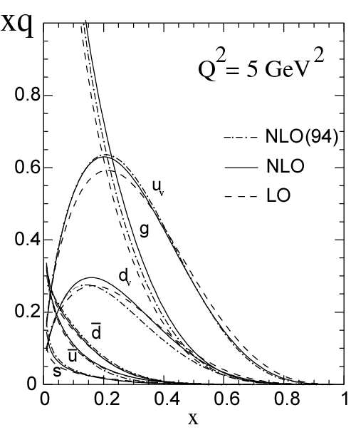
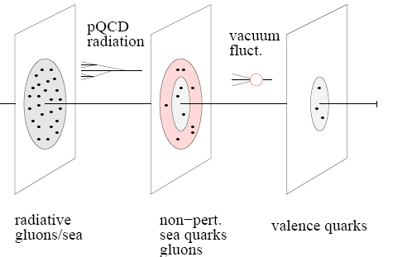
Into the “sea”: EIC
◻ P. Nadel-Turonski talk
An EIC aims to study the sea quarks, gluons, and scale (Q²) dependence.
With 12 GeV we study mostly the valence quark component
mEIC
EIC
12 GeV

Slide 28
EIC Science Frontier
Explore the nuclear landscape at low x to:
Discover the collective effects of gluons in nuclei
Complete the map of the spin and spatial structure of sea quarks and gluons in nucleons
Understand the emergence of hadronic matter from quarks and gluons

Slide 29
EIC: JLab Community Leadership
5 workshops in 2010 organized by JLab user community
JLab users and staff participated in 2010 INT program
We appointed JLab users as members of writers/editors of EIC white paper (in preparation)
At JLab we have fostered a united effort with BNL-RHIC community to move the science case forward

Slide 30

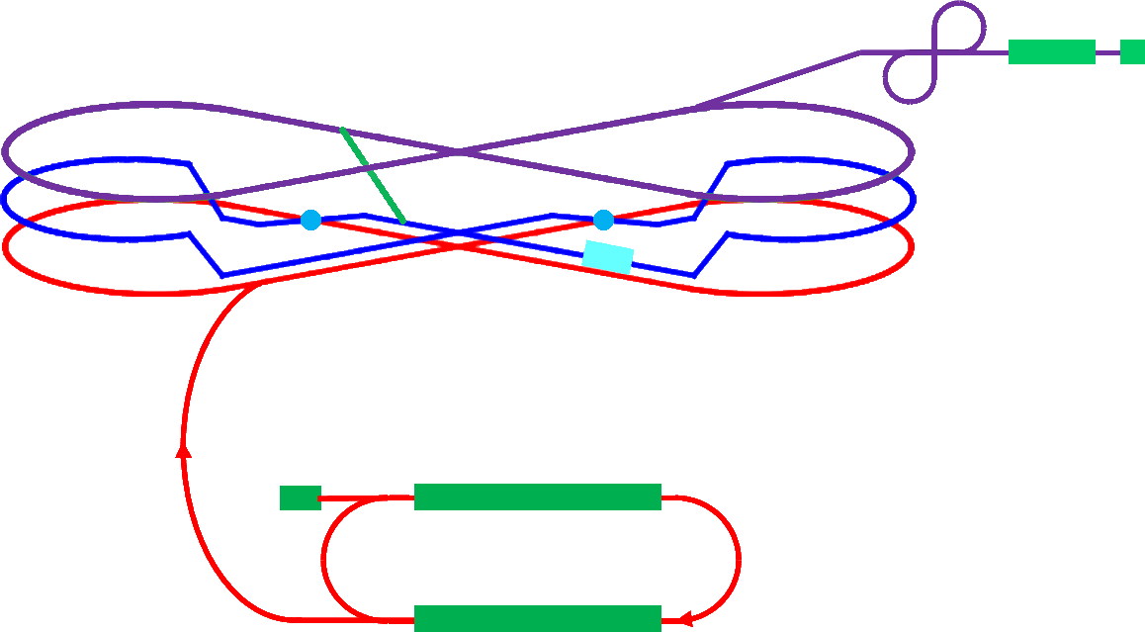
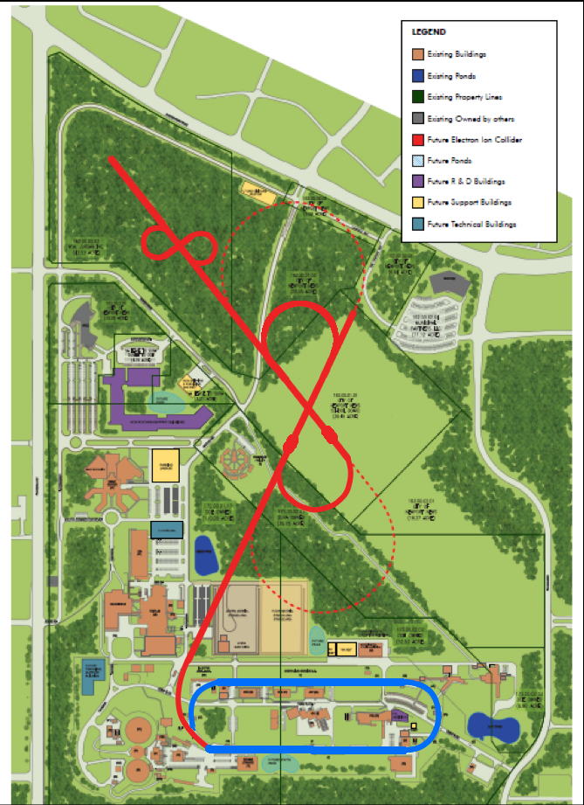
Medium Energy EIC@JLab
Warm large booster
(up to 20 GeV)
transfer beam line
Pre-booster
SRF linac
Ion
source
Cold ion
collider ring
(up to 100 GeV)
Medium energy IP
Electron collider ring
(3 to 11 GeV)
Injector
12 GeV CEBAF
◻Y. Zhang talk
JLAB Concept
Initial configuration (MEIC):
  3-11 GeV on 20-100 GeV ep/eA collider
  fully-polarized, longitudinal and transverse
  luminosity: up to few x 10³⁴ e-nucleons cm⁻² s⁻¹
    Upgradable to higher energies (250 GeV protons)

Slide 31
A Laboratory for Nuclear Science
The Jefferson Lab electron accelerator is a unique world-leading facility for nuclear physics research
12 GeV upgrade ensures at least a decade of excellent opportunities for discovery
– New vistas in QCD
– Growing program Beyond the Standard Model
EIC moving forward:
– Strong science case, much builds on JLab 12 GeV program
– MEIC design well developed – time scale following 12 GeV program is “natural”
Other topics not covered in this presentation:
– Theory and Computation
– Accelerator Science and Technology
– Medical Imaging applications

