Slide 1
Test of ERL Circulator Cooler at the Jefferson Lab FEL
Edward Nissen
Science and Technology Review
May 9th-11th, 2012

Slide 2
About the Speaker
B.S. in Physics 2005 at Johns Hopkins University
M.S. in Physics 2007 at Northern Illinois University
Master’s Thesis: “Chaos and its Role in Emittance Growth in Fixed Field Alternating Gradient Accelerators”
Ph.D. in Physics 2011 at Northern Illinois University
Ph.D. Dissertation: “Differential Algebraic Methods for Space Charge Modeling and Applications to the University of Maryland Electron Ring”
Winner of Distinguished Performance Award at the 4th International School for Linear Colliders, Beijing, 2009
Winner of NIU Dissertation Completion Fellowship, 2010-2011 Academic Year
Postdoctoral Research Fellow, Jefferson Lab, September 2011

Slide 3
Outline
Electron Cooling
Cooler Test Facility
Experiments
Timeline
Summary

Slide 4
Electron Cooling
Uses low temperature electron beam to cool a high temperature ion beam
Allows a lower ion emittance, increasing brightness
DC electron cooling is a mature technology for low energy hadron beams
High energy electron cooling requires new technologies

Slide 5
Challenges in High Energy Cooling
Energy | Charge | Frequency | Power | Beam Current
54 MeV | 2 nC | 750 MHz | 81 MW | 1.5 A
solenoid
Dump
Linac
Dump
Too high, energy recovery lowers the residual power
5 MeV | 2 nC | 750 MHz | 7.5 MW | 1.5 A

Slide 6
Cooling with Circulator Ring
Turns | Frequency | Power | Source Current
1 | 750 MHz | 7.5 MW | 1.5 A
5 | 150 MHz | 1.5 MW | 300 mA
10 | 75 MHz | 750 KW | 150 mA
100 | 7.5 MHz | 75 KW | 15 mA
Reduces current demands on the electron source
Reduces power being dumped by reusing the cooling beam for multiple passes,effectively reducing frequency
solenoid
ion bunch
Cooling section
Fast kicker
circulator ring
Fast kicker
energy recovery
injector
SRF Linac
dump

Slide 7
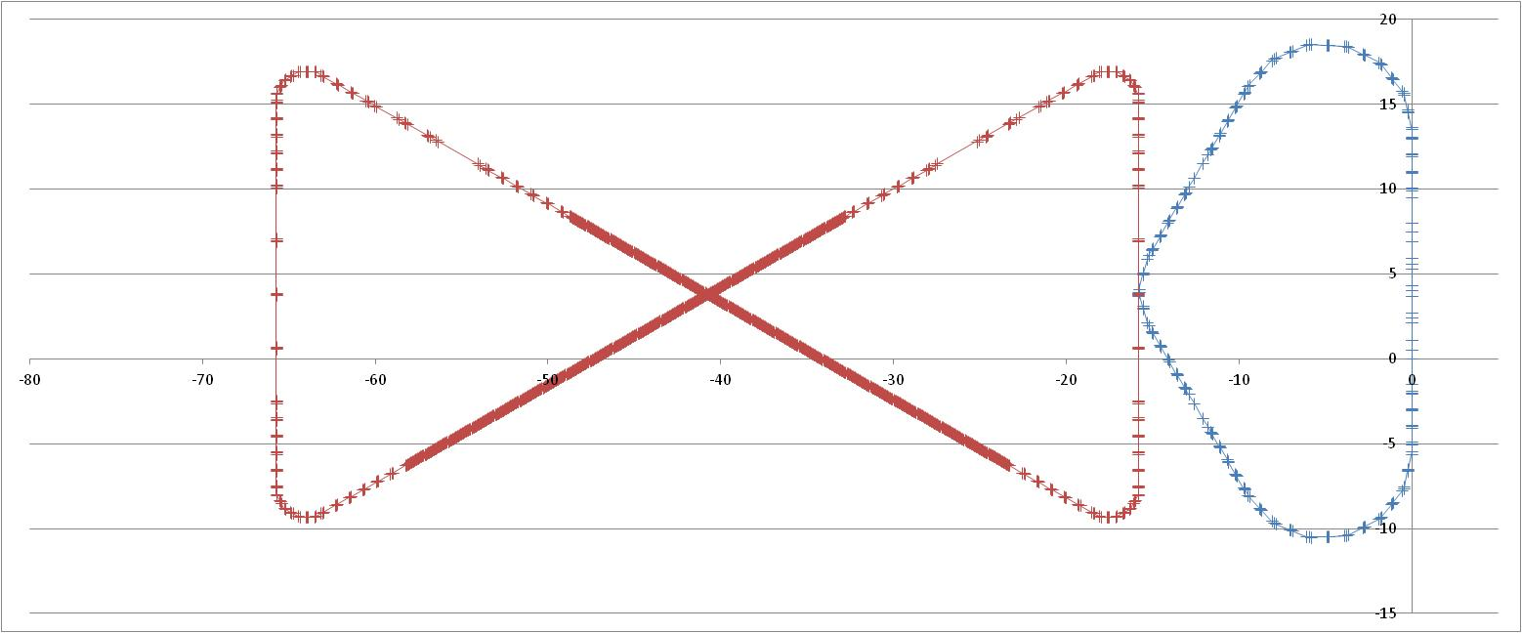
MEIC Cooling Complex
recirculation/decompression transport
CCR
dechirper
dump
beam exchange system
cooling solenoids
ERL
rechirper
injector
recovery/recompression transport
Dimensions in meters

Slide 8
Feasibility of the FEL as a Test Facility
 |  | JLAB FEL-ERL | MEIC Cooler ERL 1-100 turns
Energy | MeV | 80-210 | 10-54
Bunch charge | pC | 250 | 2000
Bunch frequency | MHz | 75 | 750-7.5
Gun current | mA | 10 | 1500-15
Energy range, and Frequency range are similar enough in the FEL and the MEIC Circulator Cooler Ring (CCR) to use it as a proxy.

Slide 9
ERL Circulator E-Cooler Test Facility
JLab Free Electron Laser Facility
Kickers on loan from SLAC
Bends available from IR demo
2 Septa actively being sought
Minimally invasive design allows the FEL facility to maintain original purpose.

Slide 10
Facility Objectives
An ERL with a circulating ring has never been attempted before
Certain issues must be addressed before the cooler can be made operational. The main purpose of the experiments in the facility will be investigating,
Bunch Quality Lifetime in a Circulator Ring
A Fast Injection/Extraction System

Slide 11
Bunch Quality Lifetime
The optimal number of turns depends on,
Space Charge
CSR Microbunching
Longitudinal Matching
Determining the lifetime of a bunch in the circulator ring is the first priority in the test facility, and will influence the manner in which the beam is created and transported through the cooler.

Slide 12
Bunch Quality Lifetime Experiments
Exact experimental plans still being determined
y
Allows analysis of the evolution of the beam over any desired number of turns
Goal is to measure collective effects with high precision
x

Slide 13
Coherent Synchrotron Radiation
Coherent Synchrotron Radiation is a collective effect that can cause microbunching instability
This limits the ability of the Linac to properly recover energy
Can possibly reduce cooling efficiency
Initial simulations show it may be an issue in the circulator ring
Investigate Mitigation Schemes
Simulations will be performed, but physical experimentation is necessary

Slide 14
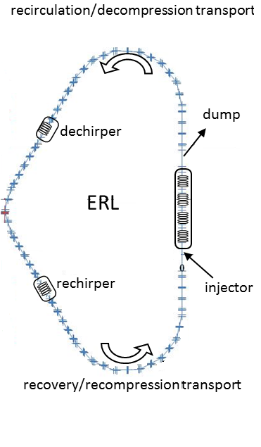
Longitudinal Match
δp
δp
δp
t
t
t
Accelerating in Linac
In Circulation Ring
Decelerating in Linac
The accelerating and decelerating parts of the Linac in the cooling complex require shorter bunches than the circulating section
Control is accomplished with special cavities in the linac transport system which can control the longitudinal match

Slide 15
Fast Injection/Extraction System
The test facility will use a pair of stripline kickers on loan from SLAC
Three Options
Replacing an entire bunch train after a set number of turns
Replacing a single bunch during each turn
Resonant replacement of multiple single bunches per turn

Slide 16
Fast Injection/Extraction(1): Bunch Train
Achievable with current technology
Requires a clearing gap which reduces cooling duty factor
May be problematic for electron source
solenoid
ion bunch
Cooling section
x100 Turns
Fast kicker
circulator ring
Fast kicker
energy recovery
injector
SRF Linac
dump

Slide 17
Fast Injection/Extraction(2): Fast Replacement
Uses future developments in kicker technology
Requires large number turns in the circulator ring
Electron source is pulsed
solenoid
ion bunch
Cooling section
Fast kicker
circulator ring
Fast kicker
energy recovery
injector
SRF Linac
dump

Slide 18
Fast Injection/Extraction(3): Resonant Replacement
Uses resonant RF similar to an RF separator
Very high duty factor, especially with a small number of survivable turns.
Low power requirements
Requires multi-harmonic signal amplifier
solenoid
ion bunch
Cooling section
Fast kicker
circulator ring
Fast kicker
energy recovery
injector
SRF Linac
dump

Slide 19
Tentative Schedule
First Year
Complete design of test facility, and evaluation of RF power source
Develop test plans and simulations, complete hardware procurement (RF power source and associated hardware)
Second Year
Perform simulations of the facility and test plans, bench test RF power supplies
Develop plans for diagnostics and hardware installation
Third Year
Hardware installation and commissioning
Conduct technology demonstration experiments

Slide 20
Project Milestones
Bunch Exchange Experiments
Demonstrate proper functioning of bunch train and fast replacement exchange methods
Demonstrate resonant replacement of the bunches
Beam Lifetime Experiment
Measure the beam over varying numbers of turns
Maintain proper phase space conditions over these turns
Longitudinal Manipulations
Use the M₅₆ of the Bates bends to properly manipulate the longitudinal phase space
Use a series of de-chirping and re-chirping cavities to manipulate longitudinal phase space

Slide 21
Summary
Electron cooling is an important technology for the MEIC, allowing the large luminosities required
In order to cool at large energies an energy recovery linac with a circulator ring is chosen to ease the demands on gun current and dump power
Using the JLab FEL facility, as well as components left over from the IR demo and on loan from SLAC, we can test the recirculating scheme
This test facility will allow us to test a number of ideas for the design of the high energy cooling system in the MEIC in a timely and cost effective manner

