Slide 1
PEPPo
a Proof-of-Principle Experiment
Polarized Electrons for Polarized Positrons
Outline
Motivation for (Polarized) Positrons and Source Options
The PEPPo concept, experiment and goals
CEBAF/PEPPo positron source
S&T Review, May 9th – 11th, 2012, Joseph Grames

Slide 2

Positron Motivation
Electrons and Positrons disentangle physics interactions (interference terms depend on lepton charge).
Generalized Parton Distributions
2γ exchange in elastic scattering
Coulomb distortion in the inelastic regime
Light dark matter search (gauge U-boson)
Neutral weak coupling (C_{3q} measurement)
Materials Science (2DACAR)
Lyon, June 23-26, 2009
5/5

Slide 3
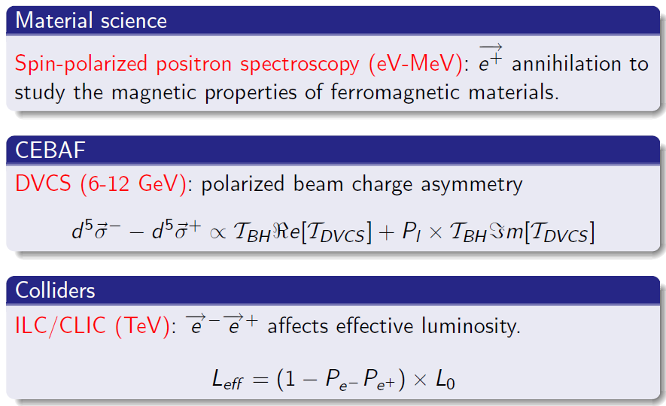
Polarized Positron Motivation

Slide 4
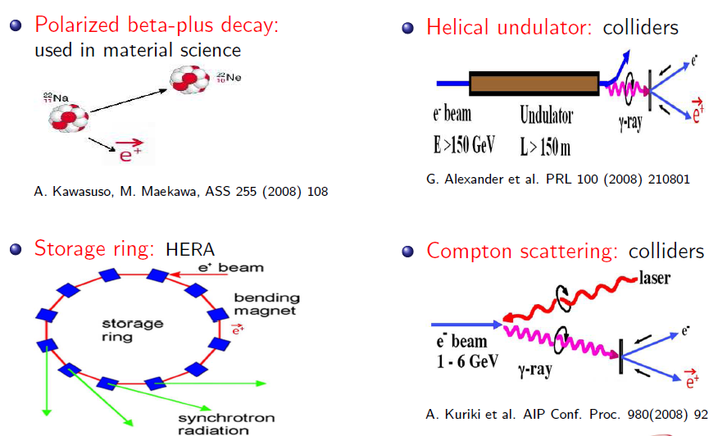
Where do people now get/propose polarized e+ ?

Slide 5


PEPPo Experiment
PEPPo, Polarized Electrons for Polarized Positrons,
is an experiment planned at the CEBAF Injector
Polarized Bremsstrahlung and pair production
Demonstrate producing polarized e⁺ from polarized e⁻ beam
Characterize low-energy (<10 MeV) polarized pair creation
E.G. Bessonov, A.A. Mikhailichenko, EPAC (1996) A.P. Potylitsin, NIM A398 (1997) 395

Slide 6













Grew support beginning ~2009 JPOS Workshop
A. Adeyemi, P. Aguilera, H. Areti, M. Baylac, G. Bosson, A. Camsonne,
L. Cardman, S. Covrig, C. Cuevas, O. Dadoun, J. Dumas, E. Fanchini,
T. Forest, E. Forman, A. Freyberger, S. Golge, J. Grames, P. Guèye,
C. Hyde, Y. Kim, J.-F. Muraz, M. Marton, M. Poelker, S. Setiniyaz,
J.-S. Réal, R. Suleiman, A. Variola, E. Voutier
(Growing) Collaboration…
In-Kind Support…
External Funding…

Slide 7
PEPPo Proposal to JLAB PAC
PAC35 enthusiastically endorsed LOI-10-010
“Any accelerator facility, like JLab, using polarized electrons for its physics program would like an intense beam of polarized positrons. This Letter marks a proof of principle experiment that should become a full proposal.”
PEPPo (PR12-11-105) will demonstrate a new technique to produce polarized positrons
A first step towards a polarized positron source for Nuclear Physics or Materials Science experiments at JLab.
PAC38 =>
  Rated an “A”
  Recommended integration to the Long Shut Down

Slide 8


Polarized bremmstrahlung & pair creation
Half-centry-old result of Olsen & Maximon (1959) revisited (2010) to address unphysical result of polarized pair creation at low energy <10MeV.
E.A. Kuraev, Y.M. Bystritskiy, M. Shatnev, E. Tomasi-Gustafsson, PRC 81 (2010) 055208
BREMSSTRAHLUNG
PAIR CREATION

Slide 9
PEPPo Proof-of-Principle Concept
Step 1: Polarization from e- to e+
Step 2: Collect positrons
P_{e-}
S₁
e⁻
D
T₁
S₂
P_{t}
e⁺
D
T₂
Calorimeter
Step 3: Measure e+ polarization
PEPPo will measure polarization transfer from electrons to positrons in 2-8 MeV energy range
S&T Review May 9-11, 2012

Slide 10
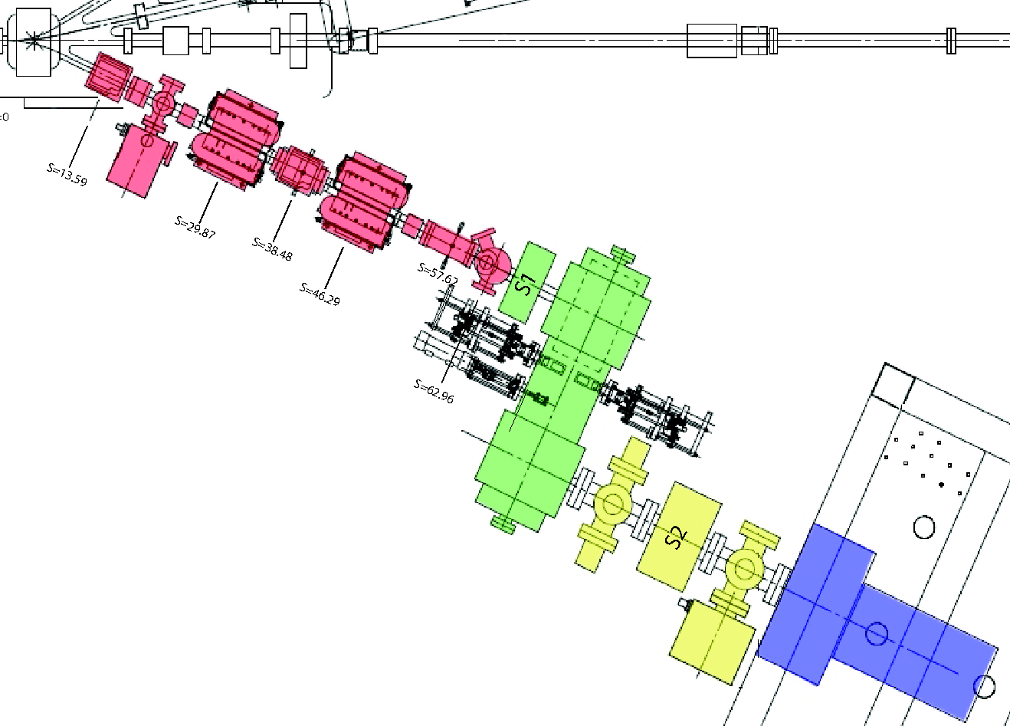

PEPPo Layout
Production
Targets
(0.1-1mm W)
e⁺ Diagnostic: coincidence annihilation detectors and 2-D profile monitor
e⁺ Detection: Compton transmission polarimeter
e⁻ Driver: CEBAF injector polarized electron beam
e⁺ Collection: solenoid & combined function spectrometer
Polarimeter Target
S&T Review May 9-11, 2012

Slide 11
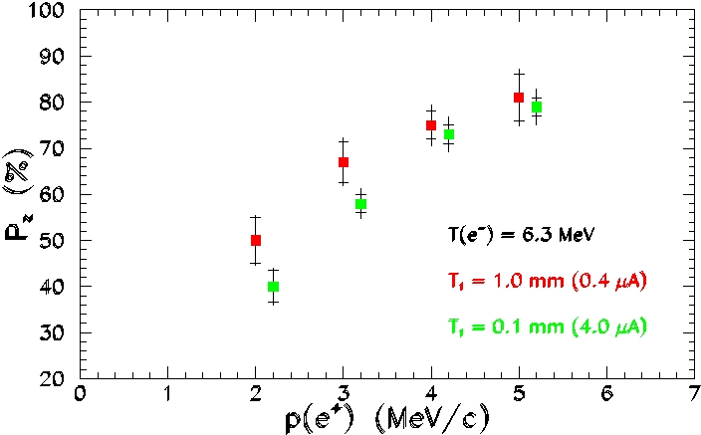
Polarized Electrons for Polarized Positrons
Projected Data
Positron momentum distribution and polarization will be measured during the run period from May 25 through June 29.
S&T Review May 9-11, 2012

Slide 12
CEBAF/PEPPo Polarized Positron Source
Desirable Positron Beam @ Physics Target
  Intensity >50nA (Hall B) to 5μA CW (Halls A, C)
  Polarization >75%
  Beam energies/quality comparable with electron beam
    Intensity stability
    Energy spread
    Beam size
    Tuning/Diagnostic capability

Slide 13
Polarized Positron Efficiency
Production efficiencies of10⁻⁴-10⁻³ may be expected and are required to provide ~μA polarized positron current.
Polarization >75% at maximum figure of merit (IP²) corresponds to ~E/2.
J. Dumas, Doctorate Thesis, 2011 (LPSC Grenoble/JLab)

Slide 14
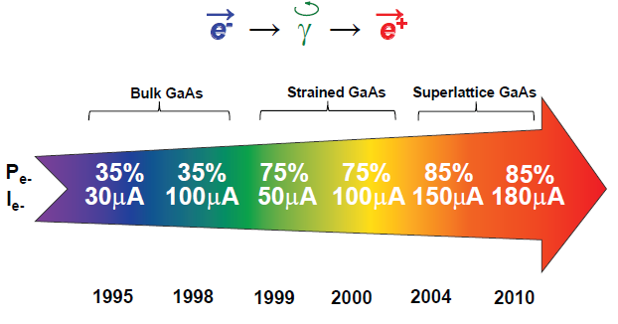
High Current Polarized Electron Source
PEPPo-style source may be realized due to advances of polarized electron sources during last ~20 years
e⁻ → γ → e⁺
Sustainable polarized electron intensities to 4 mA
demonstrated from a superlattice photocathode.
R. Suleiman et al., PAC’11, New York (NJ, USA), March 28 – April 1, 2011

Slide 15
Positron Collection Study
S. Golge, PhD Thesis, 2010 (ODU/JLab)
Requires high power 100kW target
Quarter Wave Transformer
(QWT) Solenoid
Collimators
e⁻
e⁻
γ
126 MeV
e⁺
24 MeV
W target
Combined Function Magnet
(QD)
A collection efficiency of 3х10⁻⁴ is predicted at the maximum positron production yield, corresponding to a positron energy of 24 MeV.
The resulting beam can then be accelerated without significant loss, and injected into the CEBAF main accelerator section.

Slide 16
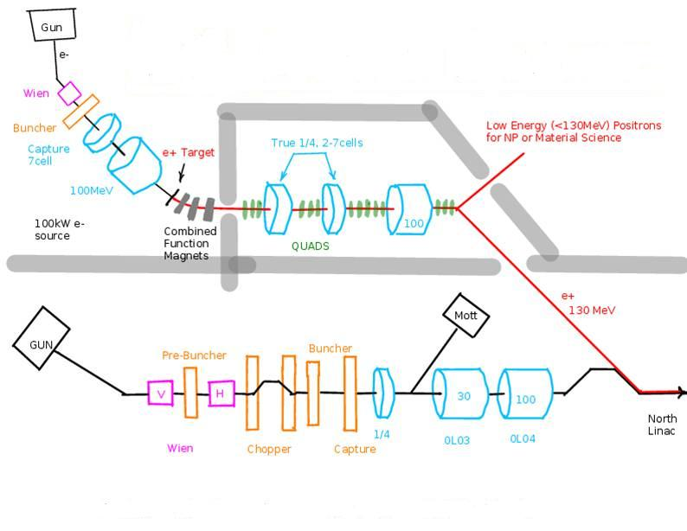
Polarized e⁺ Injector Concept
I = 300 nA
P_{e+} = 75%
δp/p = 10⁻²
ε_{x} = 1.6 mm.mrad
ε_{y} = 1.7 mm.mrad
A. Freyberger at the Town Hall Meeting, JLab, 2011
1mA
Low Energy (<130MeV) Positrons
For NP or Material Science
CEBAF North Linac

Slide 17
PEPPo Summary
Strong motivation exists for polarized positrons across the MeV – GeV (CEBAF) - TeV energy scale
PEPPo to be first demonstration and improve understanding of low energy polarized pair creation
PEPPo aims at new polarized positron source and builds upon state-of-the-art polarized electron source, fueled by NP and HEP experiments
Potentially realizable as a `University Scale’ source consistent with smaller energy, current, cost and (zero) radioactivity footprint.

