Slide 1
Polarized Electrons at Jefferson Lab
Outline
Polarized Source Requirements
Reliable lasers
Reliable gun: no field emission at high voltage and long operating lifetime
Lifetime limiting mechanisms
Parity Violation Experiments
Future R&D – 350kV photogun
Group Members: P. Adderley, J. Clark, S. Covert, J. Grames, J. Hansknecht, R. Mammei, M. Stutzman, R. Suleiman, K. Surles-Law
Grad Students: M. BastaniNejad, Md. Abdullah Mamun, J. McCarter
S&T Review, May 9th – 11th, 2012, Matt Poelker

Slide 2
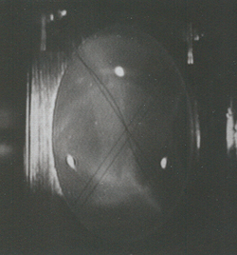
Polarized Photoinjector
Polarized Electron Source
(130 kV)
Synchronous Photoinjection
SRF Acceleration
(<65 MeV)
B
5 MeV Mott
Polarimeter
Synchrotron
Light Monitor
C
A
Chopper
Cryounit
Cryomodules
Apertures
Buncher
Capture
Gun#2
Bunchlength
Injection Chicane
V-Wien Filter
H-Wien Filter
FC#1
Cavity
FC#2
PreBuncher
Spin Solenoids
Gun#3
100/500 keV Mott
Polarimeter
45 MeV Dump/
Spectrometer
Electron Spin Manipulation
Bunching & Acceleration
500 keV
SRF Acceleration
(<10 MeV)
Injection
Chicane

Slide 3
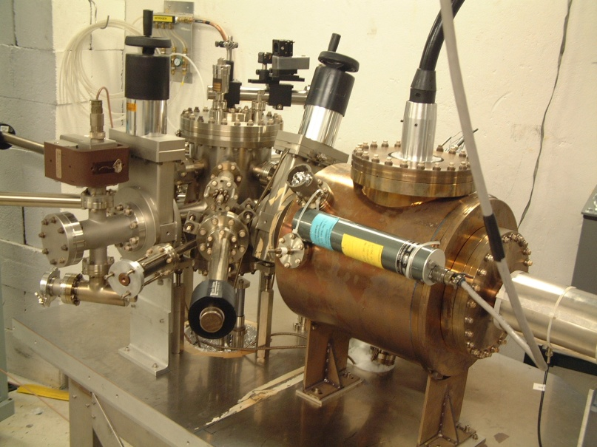
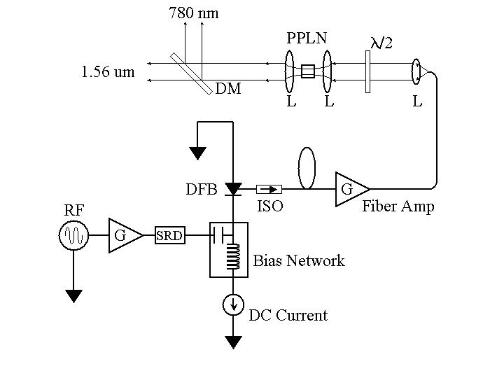
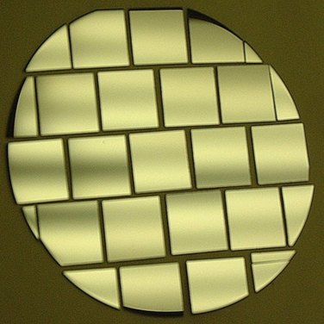
Polarized Electron Source “Musts”
Good
Electron Gun
Good
Laser
Good
Photocathode
Ultrahigh vacuum
No field emission
Maintenance-free
“Headroom”
Suitable pulse structure
Low jitter
High Polarization
Many electrons/photon
Fast response time
Long lifetime

Slide 4
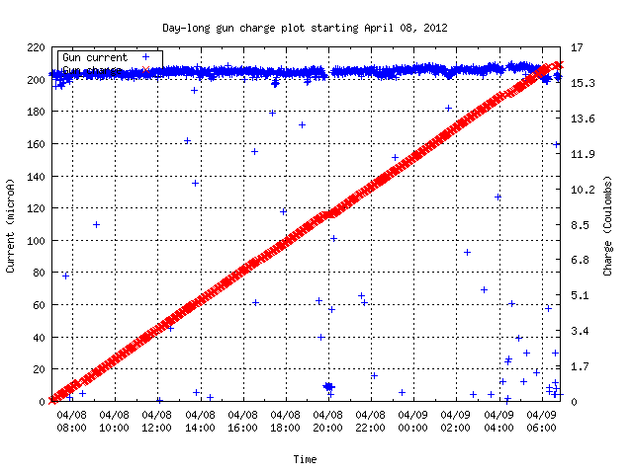
A good day when…..
Charge from photogun
Beam Current
24 Hours

Slide 5
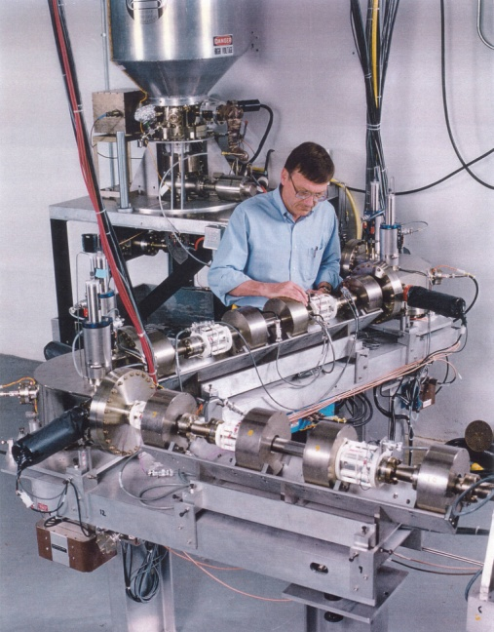
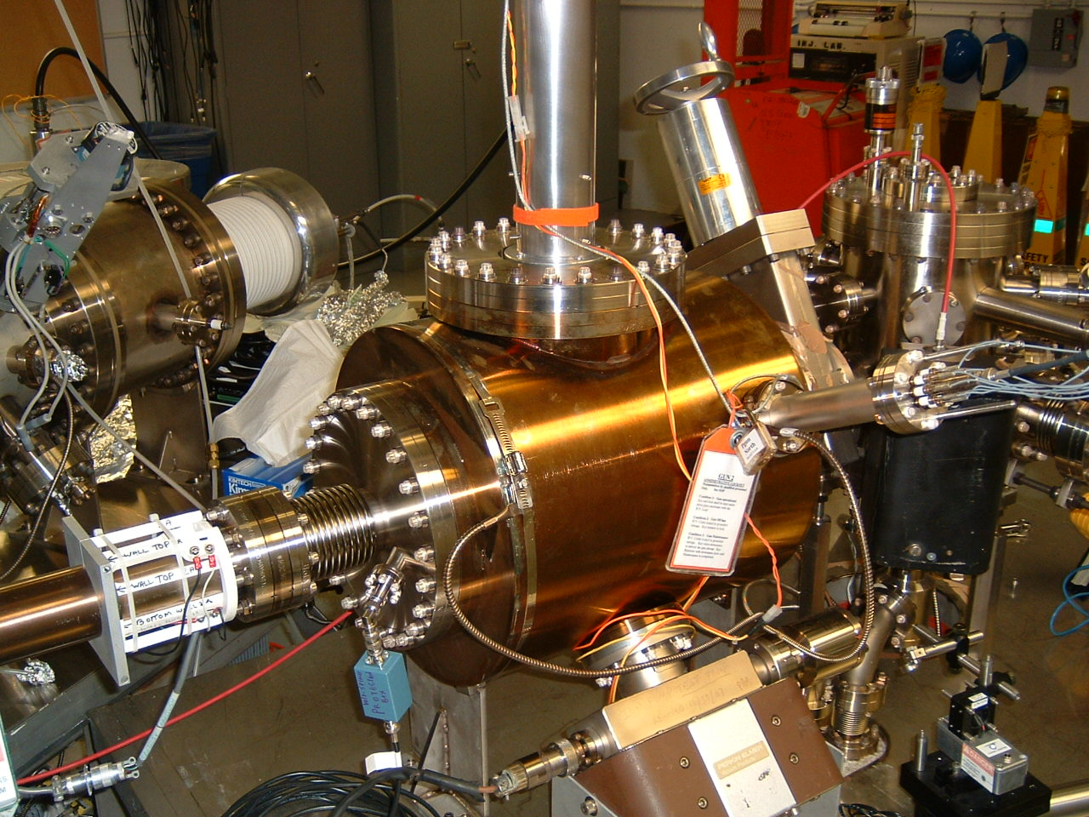
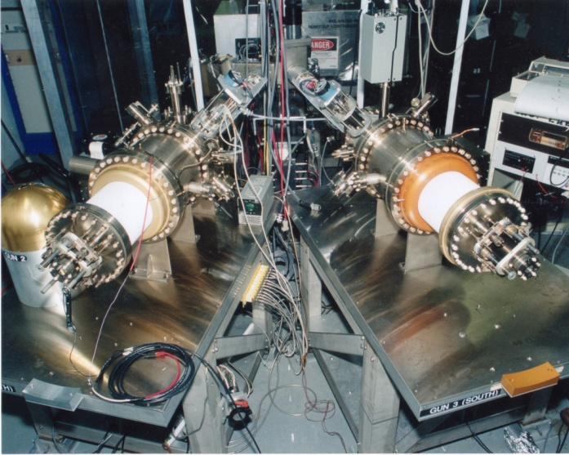
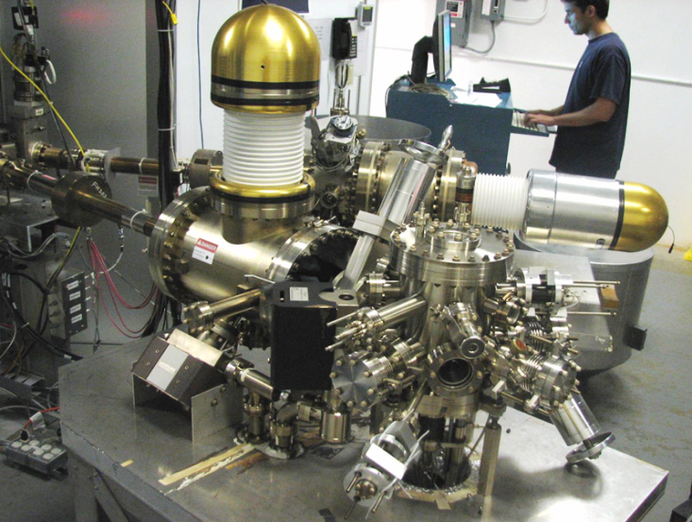
Always Tweaking the Design
1
4
Endless (?) quest for perfection
2
3

Slide 6
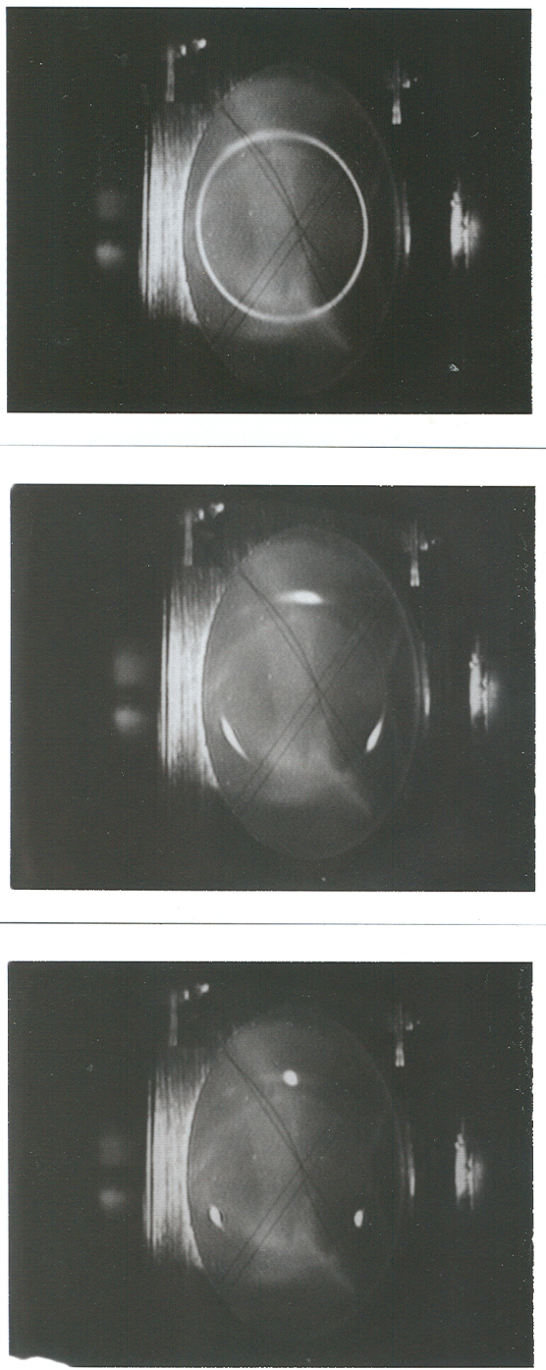
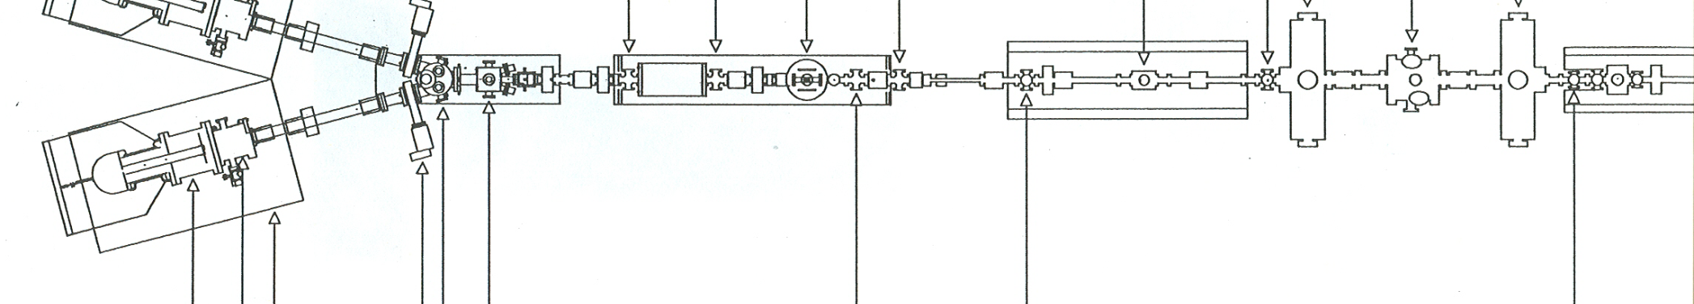
Synchronous Photoinjection
A B C A B C….
Beam Current
111ps
1497 MHz
Extracting DC beam, very wasteful, most of the beam dumped at chopper. Need ~ 2mA from gun to provide 100uA to one hall. Gun lifetime not good enough…..yet.
RF Chopper
Sets Bunchlength

Slide 7
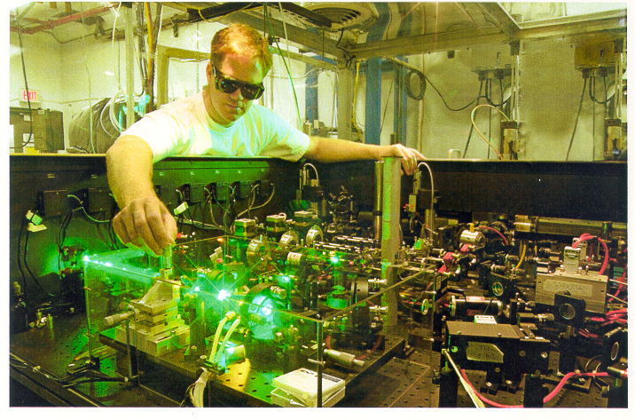
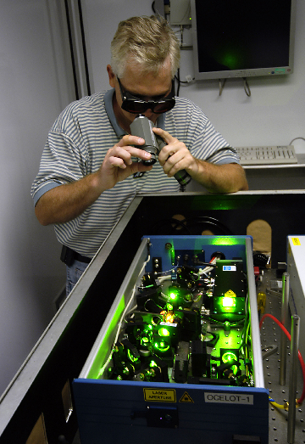
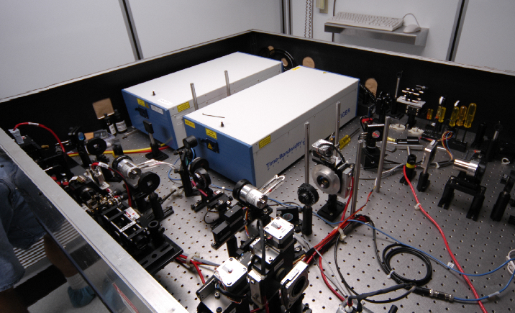
Ti-Sapphire Lasers at CEBAF
Needed more laser power for high current experiments
Diode lasers out, ti-sapphire laser in
Re-align Ti-Sapphire lasers each week
Homemade harmonic modelocked Ti-Sapphire laser. Seeded with light from gain switched diode. No active cavity length feedback. It was a bit noisy….
Commercial laser with 499MHz rep rate from Time Bandwidth Products

Slide 8
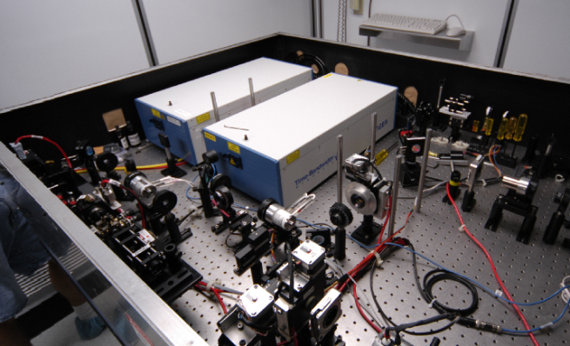
Accelerator Downtime FY05Q4 – FY06Q3
Realign Ti-Sapphire lasers each week

Slide 9
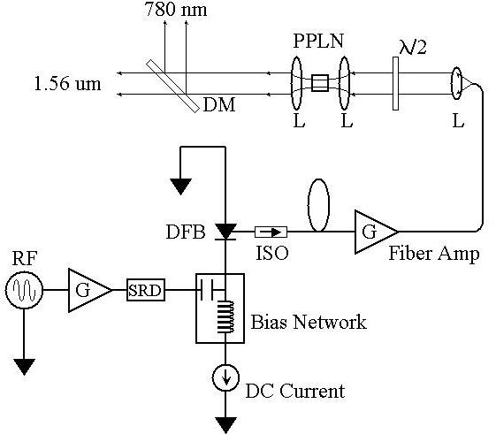
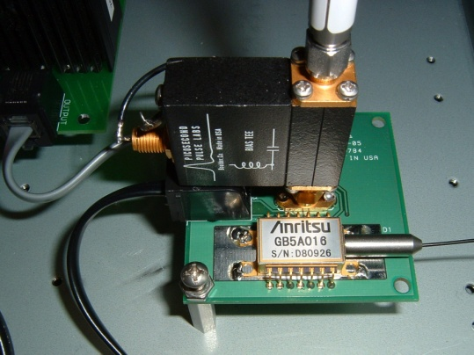
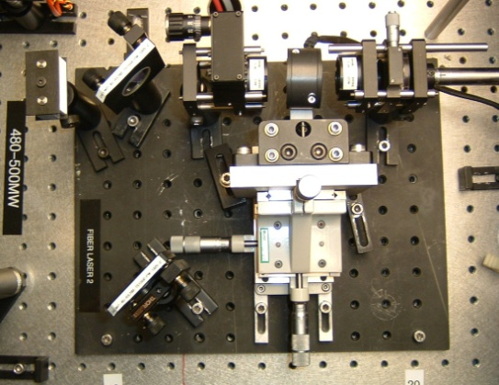
Fiber-Based Drive Laser
Gain-switched seed
780nm
Frequency-doubler
1560nm
ErYb-doped fiber amplifier

Slide 10
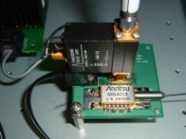
Accelerator Downtime FY06Q4 – FY07Q3
Fiber-based lasers reduce downtime

Slide 11
Ion Back-bombardment

Slide 12
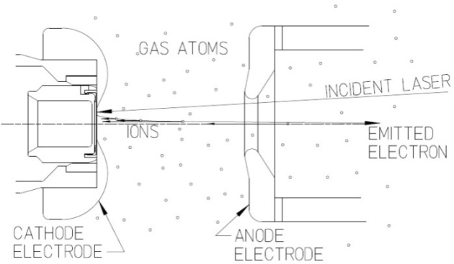
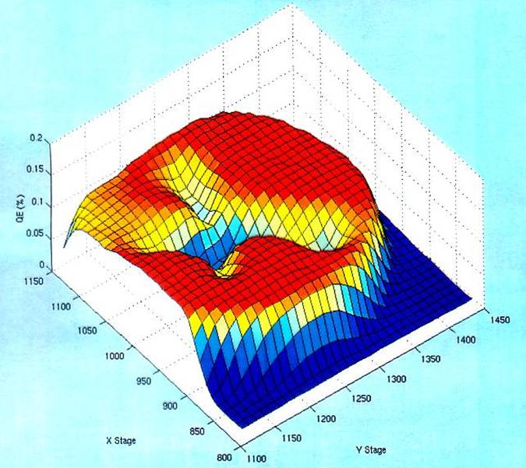
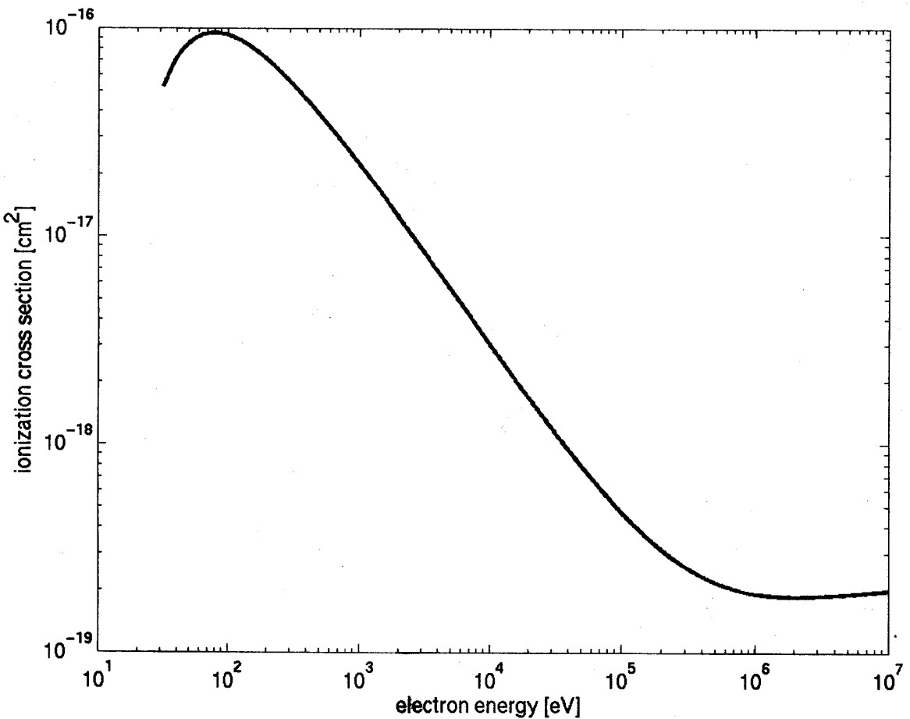
Imperfect Vacuum = Finite Lifetime
Ion bombardment –characteristic “trench” from laser spot to electrostatic center of photocathode
QE can be restored but takes about 8 hours
Active area = 5mm
Laser spot = 0.5mm dia.
Ionization cross section for H₂
Most ions created at low energy
100kV

Slide 13
Load-lock Photogun
Best vacuum inside HV Chamber, which is never vented
Photocathodes - Heated and Activated inside Preparation Chamber
Use “Suitcase” to replace photocathodes through a Loading Chamber
Activation Laser
Preparation Chamber
Loading Chamber
HV Chamber
Storage
Manipulators
“Load-locked dc high voltage GaAs photogun with an inverted-geometry ceramic insulator,” Phys. Rev. ST Accel. Beams 13, 010101 (2010)

Slide 14
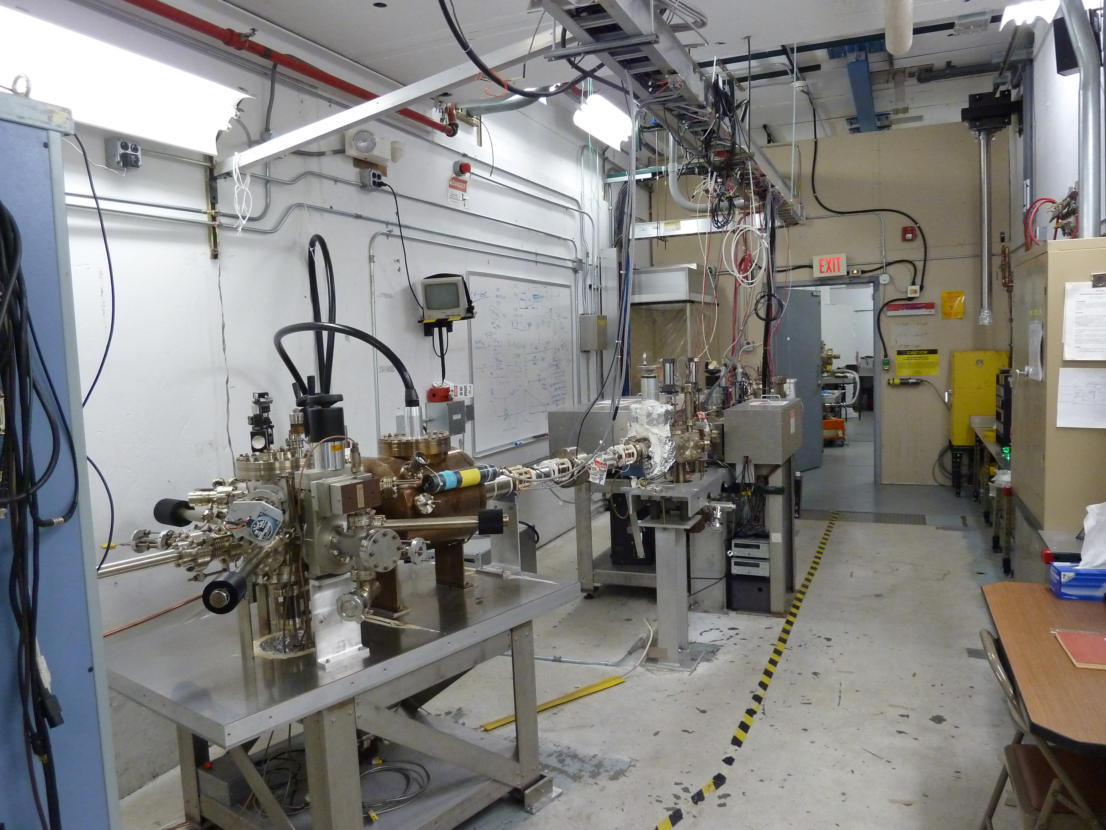

Slide 15
Improve Lifetime with Large Laser Spot?
(Best Solution – Improve Vacuum, but not easy)
Bigger laser spot, same # electrons, same # ions
Ionized residual gas
strikes photocathode
Ion damage distributed
over larger area

Slide 16
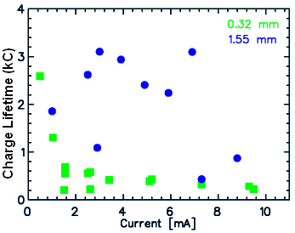
Lifetime with Large/Small Laser Spots
Tough to measure large Coulomb lifetimes with only 100-200 C runs!
Factor of 5 to 10 improvement with larger laser spot size
Expectation:
2
1500
≈ 18
350
“Charge and fluence lifetime measurements of a DC high voltage GaAs photogun at high average current.,” J. Grames, R. Suleiman, et al., Phys. Rev. ST Accel. Beams 14, 043501 (2011)

Slide 17
Parity Violation Experiments at CEBAF
Experiment | Energy (GeV) | I (µA) | Target | A_{pv} (ppb) | Maximum Charge Asym (ppb) | Maximum Position Diff (nm) | Maximum Angle Diff (nrad) | Maximum Size Diff (δσ/σ)
HAPPEx-II (Achieved) | 3.0 | 55 | ¹H (20 cm) | 1400 | 400 | 1 | 0.2 | Was not specified
HAPPEx-III (Achieved) | 3.484 | 100 | ¹H (25 cm) | 16900 | 200±100 | 3±3 | 0.5±0.1 | 10⁻³
PREx | 1.063 | 70 | ²⁰⁸Pb (0.5 mm) | 500 | 100±10 | 2±1 | 0.3±0.1 | 10⁻⁴
QWeak | 1.162 | 180 | ¹H (35 cm) | 234 | 100±10 | 2±1 | 30±3 | 10⁻⁴
Møller | 11.0 | 75 | ¹H (150 cm) | 35.6 | 10±10 | 0.5±0.5 | 0.05±0.05 | 10⁻⁴
PV experiments motivate polarized e-source R&D

Slide 18
Attenuator
IA
Rotatable GaAs
Photocathode
LP HWP LP
PC WP LP
Shutter
Helicity Fiber
Helicity Generator
HV Supply
(0 – 90 V)
15° Dipole
nHelicity
Fiber
Vacuum
Window
Delayed
Helicity Fiber
T-Settle
Fiber
Hall
RHWP
Charge Feedback (IA)
V-Wien Filter
Target
Parity
DAQ
Spin Solenoids
BCM
Charge Feedback (PITA)
H-Wien Filter
BPMs
Position
Feedback
Pockels
Cell
HV Supply
(0 – 4 kV)
CEBAF
5 MeV
Helicity Magnets
PZT
Mirror
IHWP
Electron
Beam

Slide 19
Benchmarking PARMELA Simulation Results Against Beam-Based Measurements at CEBAF/Jefferson Lab – work of Ashwini Jayaprakash, JLab
Measurements at CEBAF/JLab
PARMELA Simulation Results
Similar Trends
Message: Beam quality, including transmission, improves at higher gun voltage

Slide 20
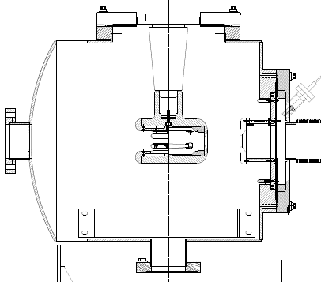
The CEBAF 200kV Inverted Gun
New design
Higher voltage = better beam quality.
The inverted design might be the best way to reach voltages > 350kV

Slide 21
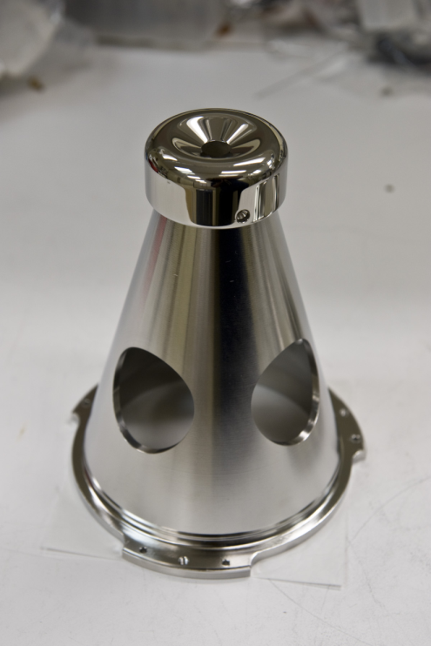
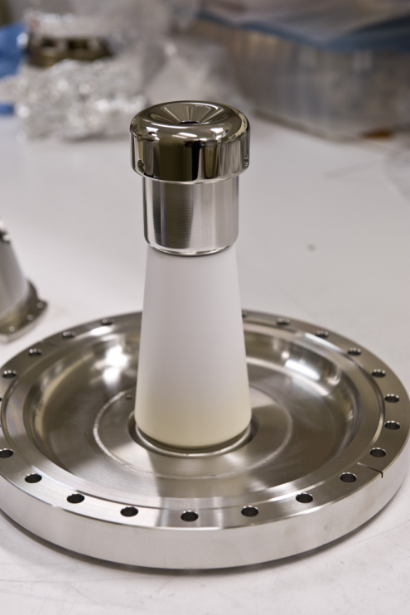
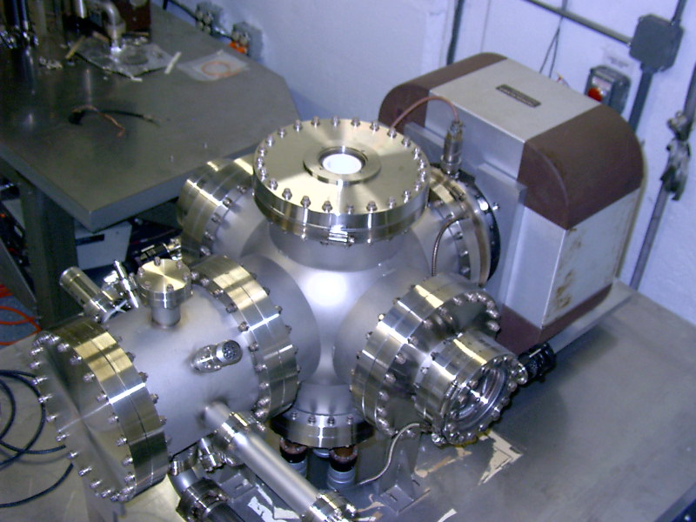
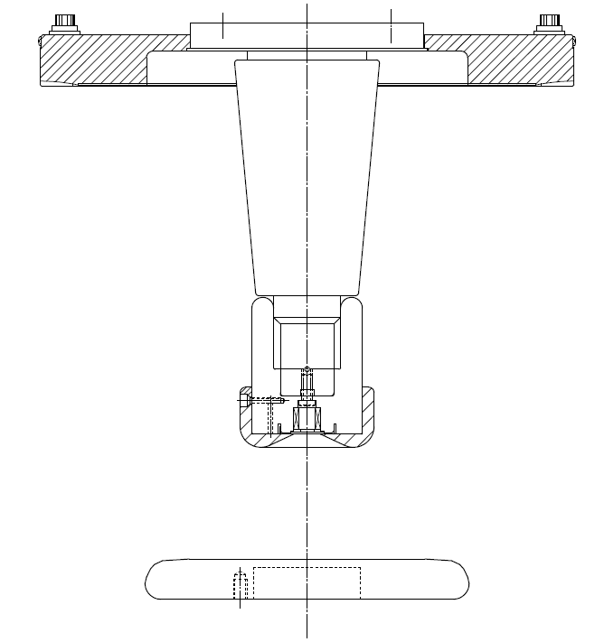
Niobium
Capable of operation at higher voltage and gradient?
Buffer chemical polish (BCP) much easier than diamond-paste-polish
Conventional geometry: cathode electrode mounted on metal support structure
Replace conventional ceramic insulator with “Inverted” insulator: no SF6 and no HV breakdown outside chamber

Slide 22
Field Emission from Niobium
Work of M. BastaniNejad
DPP stainless steel
Fine grain niobium
Large grain niobium
Single crystal niobium
Conventional High Voltage processing: solid data points
After Krypton Processing: open data points

Slide 23
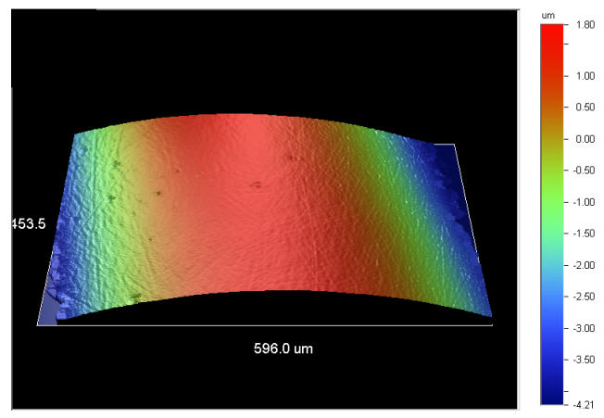
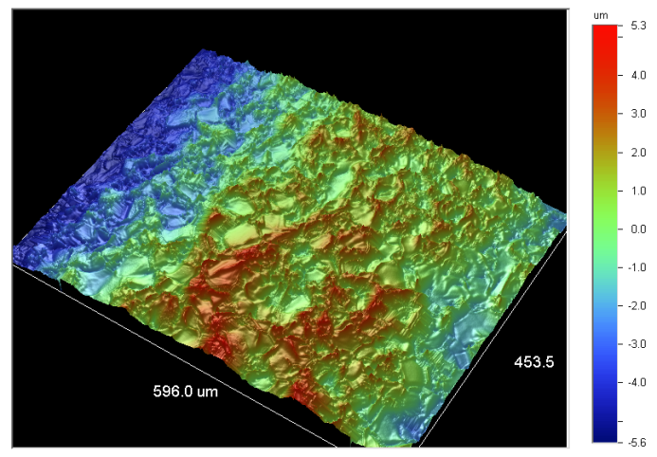
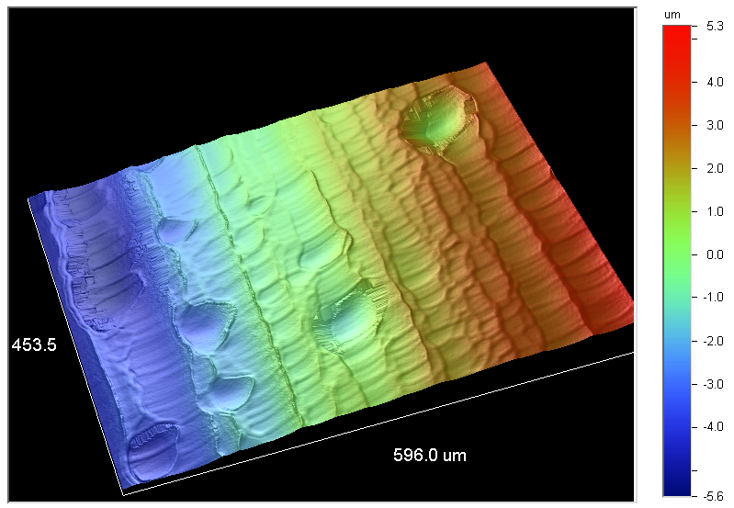
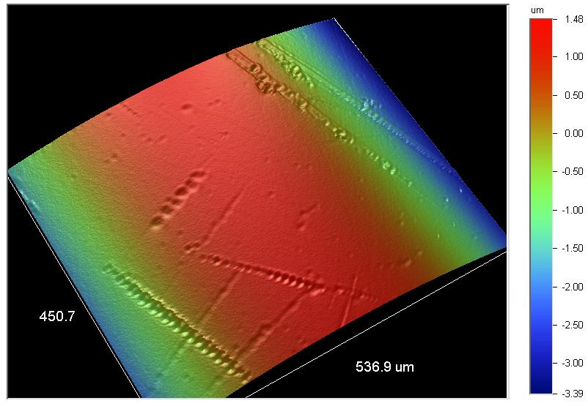
Surface Analysis
Stainless steel
Fine grain Nb
Large grain Nb
Single-crystal Nb

Slide 24
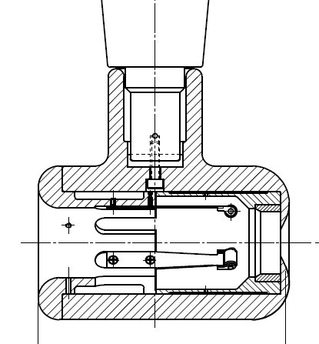
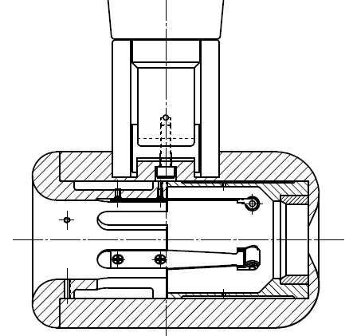
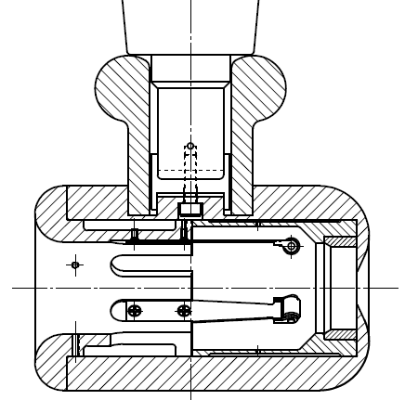
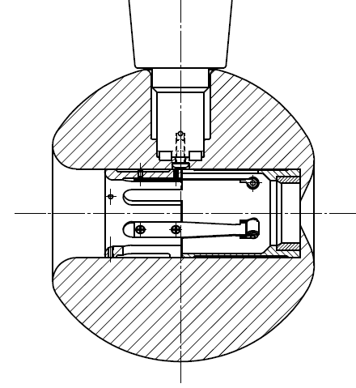
Plan B
Insulator sleeve
Plan A
No Improvement
Plan D
Plan C
In hand, but untested
Test this year

Slide 25
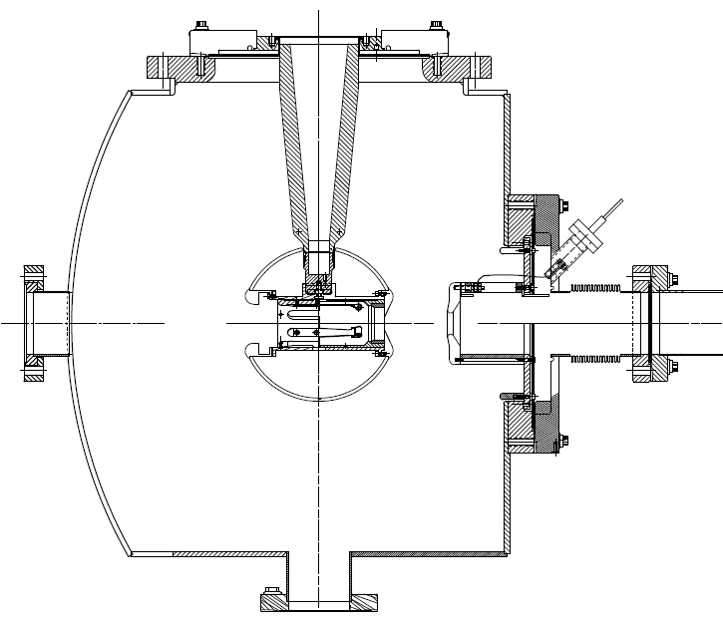
350kV Inverted Gun
Longer insulator
Spherical electrode
Thin NEG sheet to move ground plane further away

Slide 26
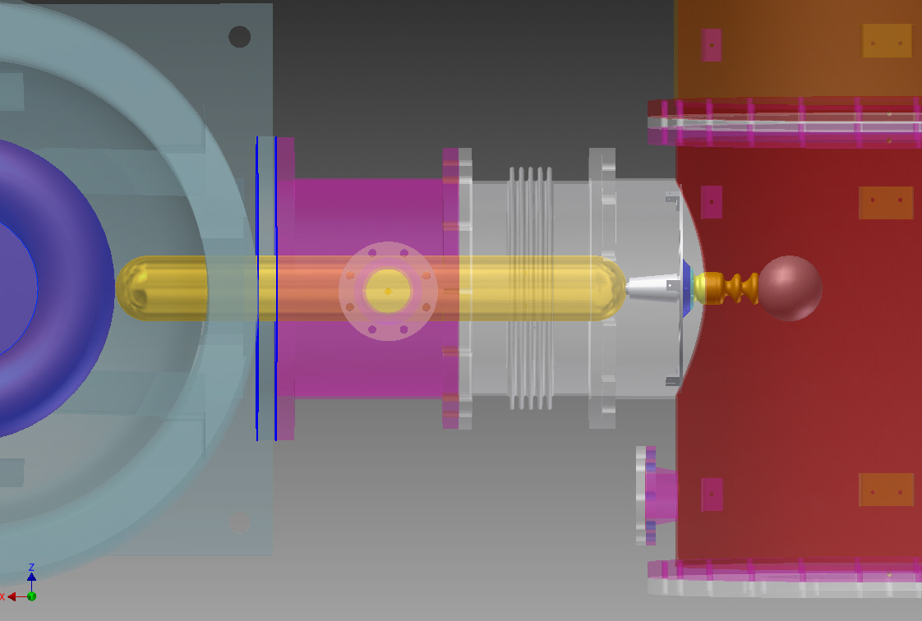
HV Issues: inside and outside the gun
600 kV supply at FEL gun test stand, with SF6 tank
Inverted insulator
4.5” long CEBAF insulator
reached 470kV before arcing to ground
Learn to apply high voltage without breakdown, dielectric plug inside insulator,
Then address the field emission problems inside the gun

