Slide 1
“High-Power” THz Sources and Applications
Eric Bryerton
Virginia Diodes, Inc.
Charlottesville, VA USA

Slide 2
My Background
B.S. University of Illinois 1995
Ph.D. University of Colorado 1999
“High-Efficiency Switched-Mode Circuits for Spatial Power Combining”
Nothing above 10 GHz
National Radio Astronomy Observatory (NRAO) 1999-2013
ALMA local oscillator development for 84-950 GHz
Cryogenic MMIC LNA design and testing
Virginia Diodes, Inc. (VDI) 2013-
Integrated sources and downconverters, mm-wave radiometers, new projects

Slide 3
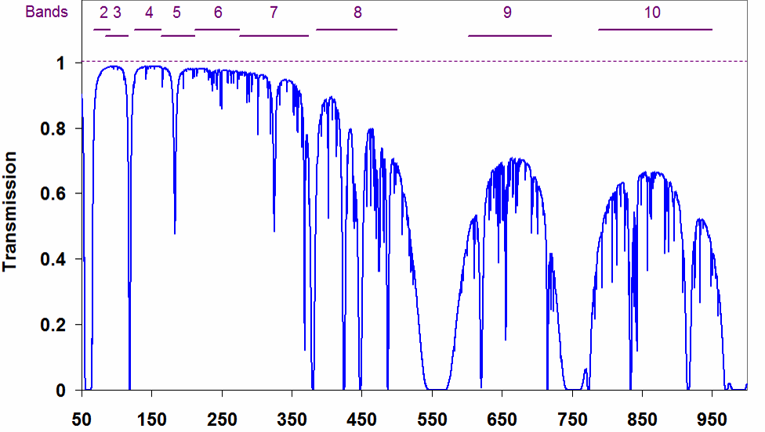
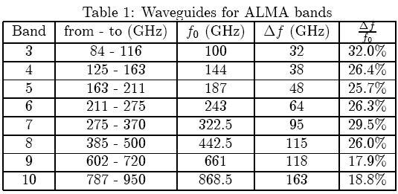
ALMA Development (~1998-2007)
Frequency [GHz]
66 Antennas
12 m & 7 m diameter dishes
2 Receivers for each band
12 VDI THz multiplier chains in each antenna
VDI

Slide 4
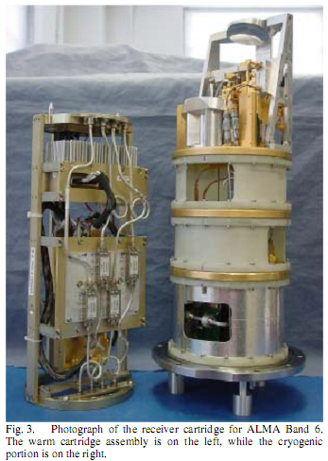
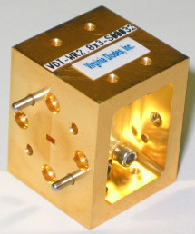
ALMA Front End
Cryogenic Front End
Warm Cartridge Assembly with LO YIG Tuned Oscillator and Driver Stage (up to ~120 GHz)
4K Stage with SIS Mixers
Driver contains integrated multi-chip modules taking ~12-24 GHz YTO output to 65-122 GHz output
VDI Multipliers on 77K Stage
Morgan, 2005 CSIC Digest

Slide 5
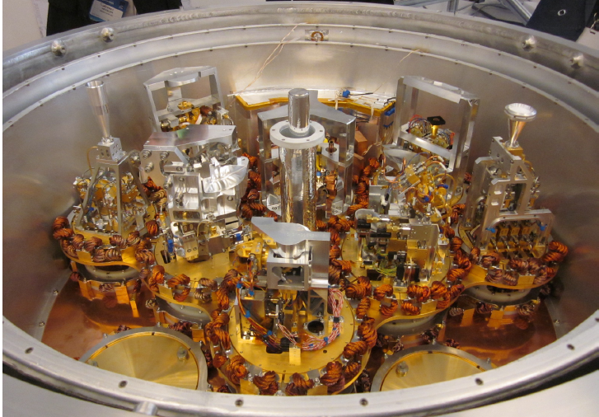
ALMA Front End Cryostat

Slide 6
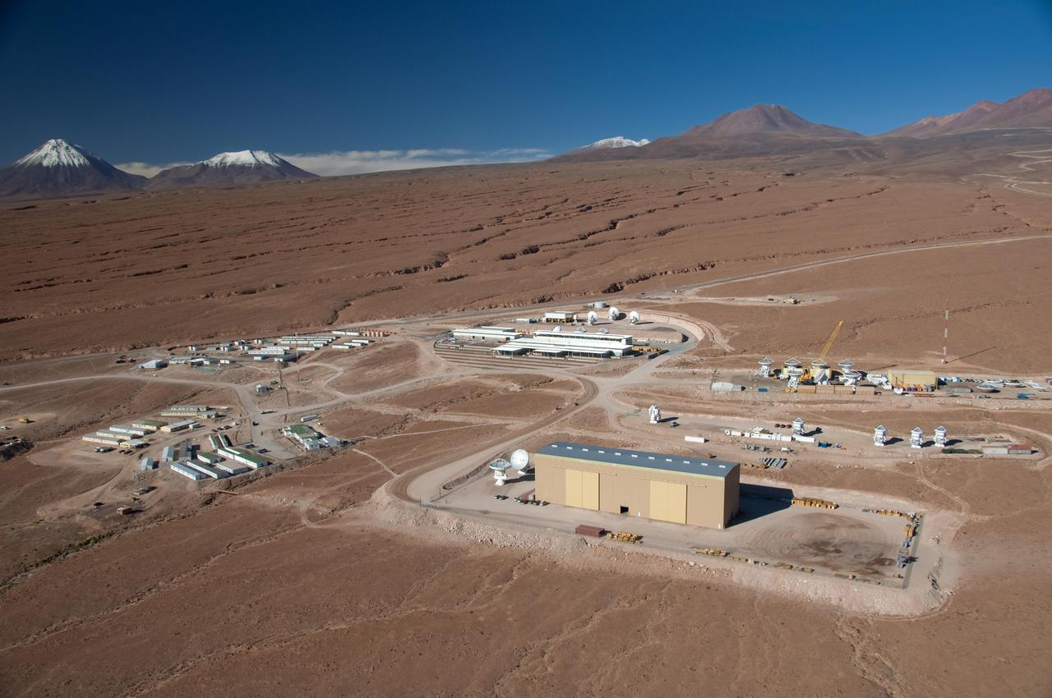
ALMA Operation Support Facility (2900m)

Slide 7
ALMA Chajnantor Site (5000m)

Slide 8
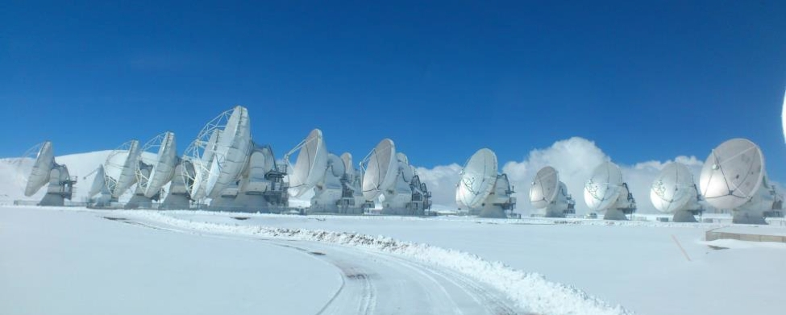
ALMA Chajnantor Site (5000m)

Slide 9
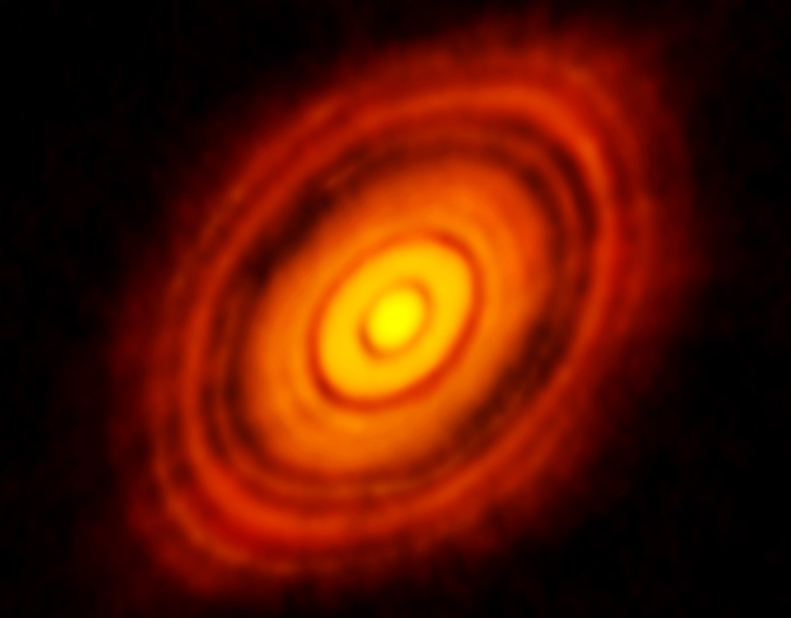
ALMA Science
ALMA image of the young star HL Tau and its protoplanetary disk. This best image ever of planet formation reveals multiple rings and gaps that herald the presence of emerging planets as they sweep their orbits clear of dust and gas. Credit: ALMA (NRAO/ESO/NAOJ); C. Brogan, B. Saxton (NRAO/AUI/NSF)

Slide 10
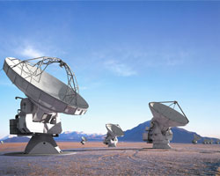
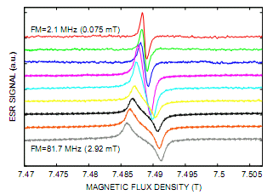
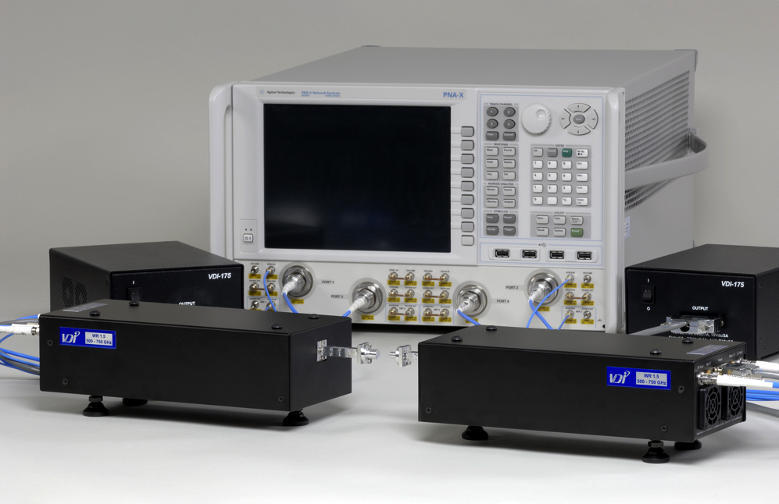
Applications
Spectroscopy
Imaging
Communications
Molecular Spectroscopy
Radio Astronomy, Atmospheric
EPR/NMR/DNP
Plasma Diagnostics
Weather Monitoring
General Test & Measurement
ALMA (NRAO)
Nafradi et al (EPFL)
THz VNA Extenders

Slide 11
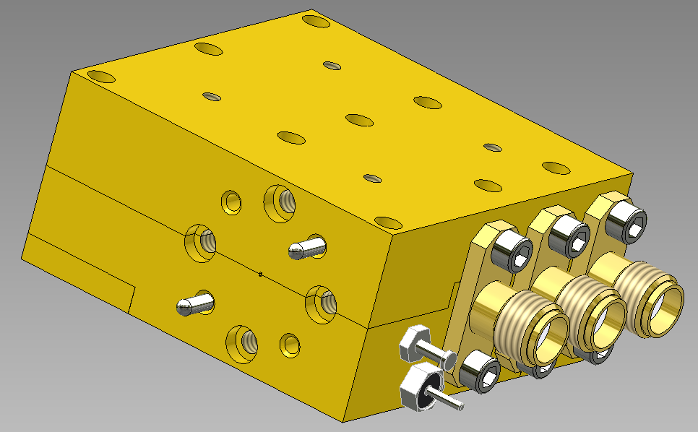
680 GHz Integrated Polarimeter
VDI funded through NASA SBIR Phase 2 for compact low-power 680 GHz polarimeters (e.g. for Cubesats)
1.50” x 1.50” x 0.75”, ~3W required DC

Slide 12
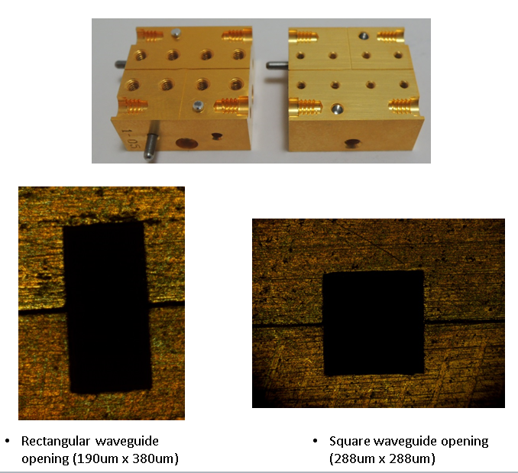
THz Orthomode Transducer
OMT used in polarimeters, to separate dual-polarized input into two orthogonal polarizations
To do in waveguide split-block requires very precise machining tolerances (widths and depths): e.g. +/- 2um at 600 GHz
Can laser micromachining do this better?

Slide 13
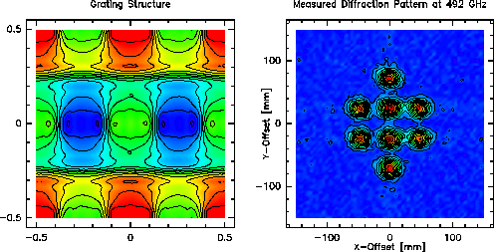
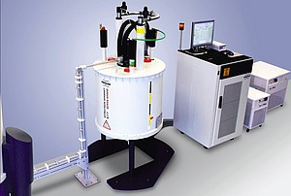
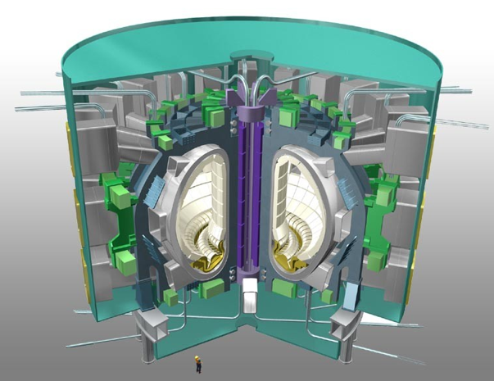
High Power Applications
Steady need for high-powered THz sources
Radio Astronomy
Focal Plane Array LO Sources
Spectroscopy
Electron Spin Resonance
Dynamic Nuclear Polarization
Plasma Diagnostics
ITER
http://www.astro.uni-koeln.de/
Bruker
ITER

Slide 14
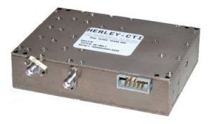
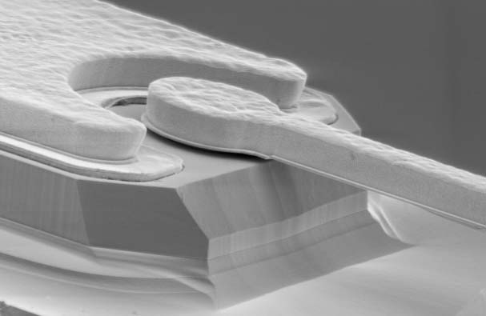
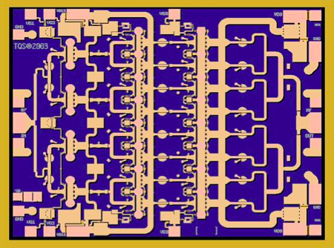
VDI Core Technology: Use the nonlinearity of diodes to extend the frequency range of traditional microwave electronics
Microwave Technology
VDI Technology
16.7 GHz
40 GHz
40 GHz
X8
320 GHz
X3
3 W
50 mW
Synthesizer
Schottky Diode
GaAs MMIC
Herley-CTI
Triquint

Slide 15
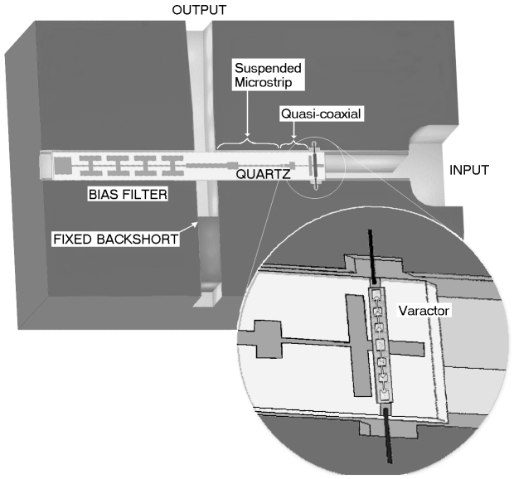
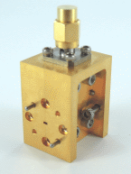
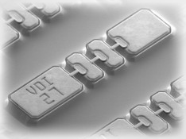
Schottky Diode Frequency Multipliers
Diode Multiplier
100 GHz
X2
200 GHz
Frequency Doubler

Slide 16
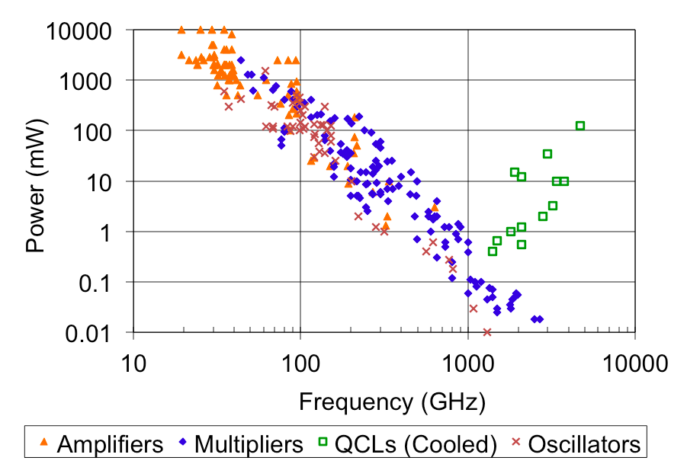
Power from Multipliers

Slide 17
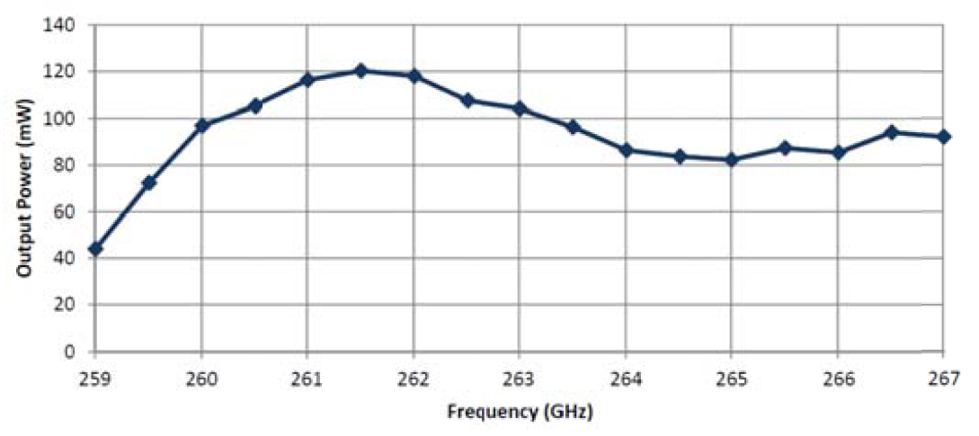
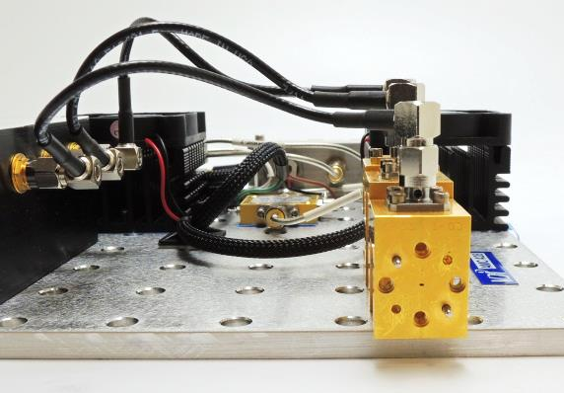
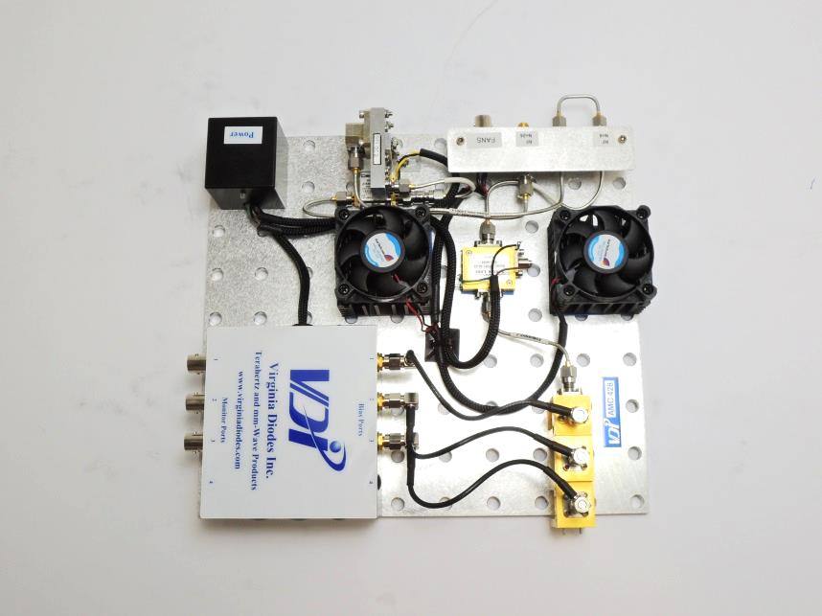
263 GHz Source for ESR/DNP
High power source for Electron Spin Resonance and Dynamic Nuclear Polarization experiments
Peak power 120 mW
Higher power version under development
Nafradi et al (EPFL)

Slide 18
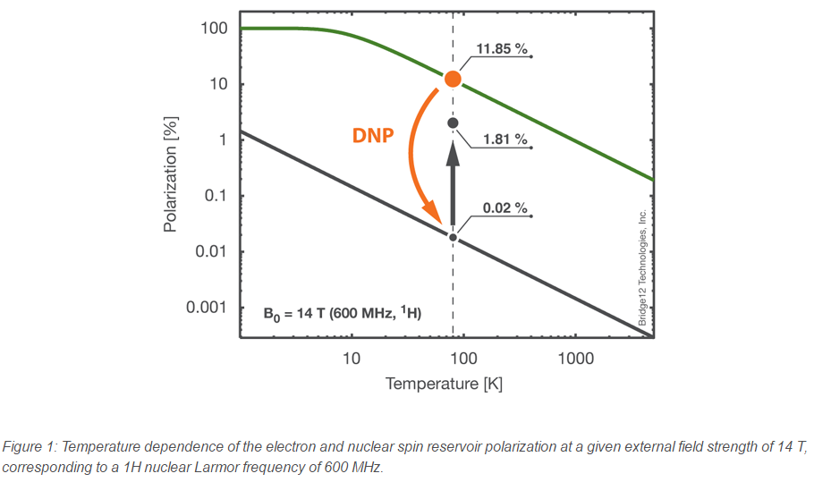
Sources for ESR and DNP

Slide 19
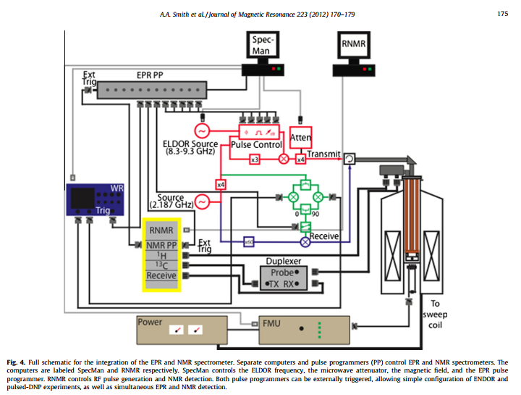
Sources for ESR and DNP

Slide 20
Sources for ESR and DNP
Need high-power sources to saturate the sample
The shorter the pulse, the more power needed
Standard DNP frequencies: 263 GHz, 395 GHz, 527 GHz (based on magnetic field)
Can start to do interesting things at >100mW
Can do even more with tens of Watts

Slide 21
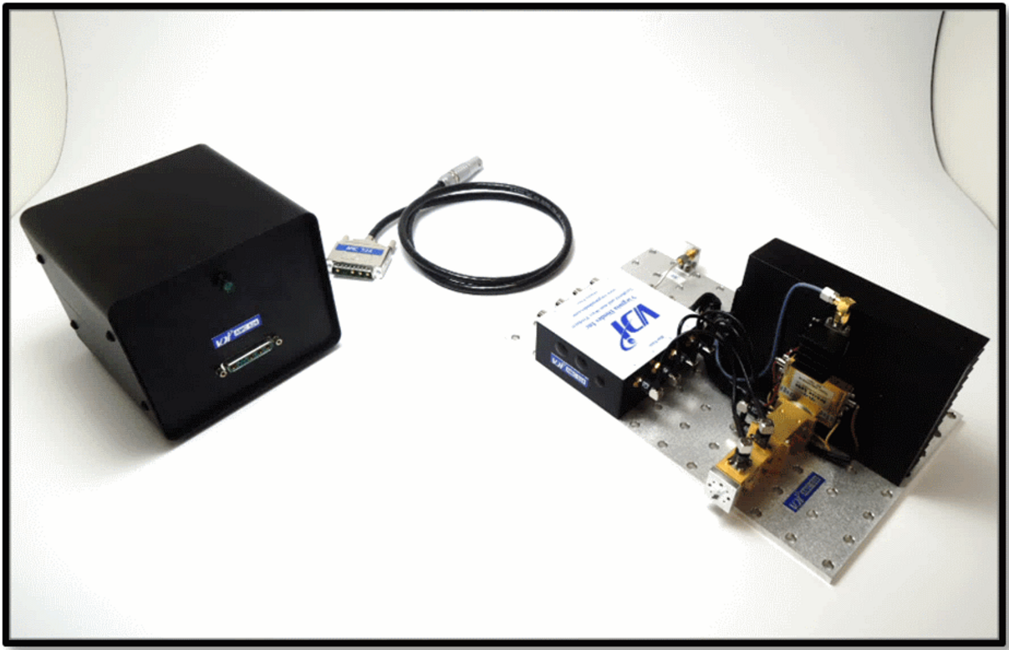
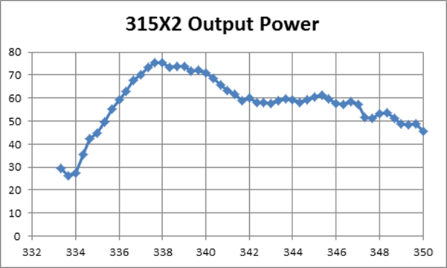
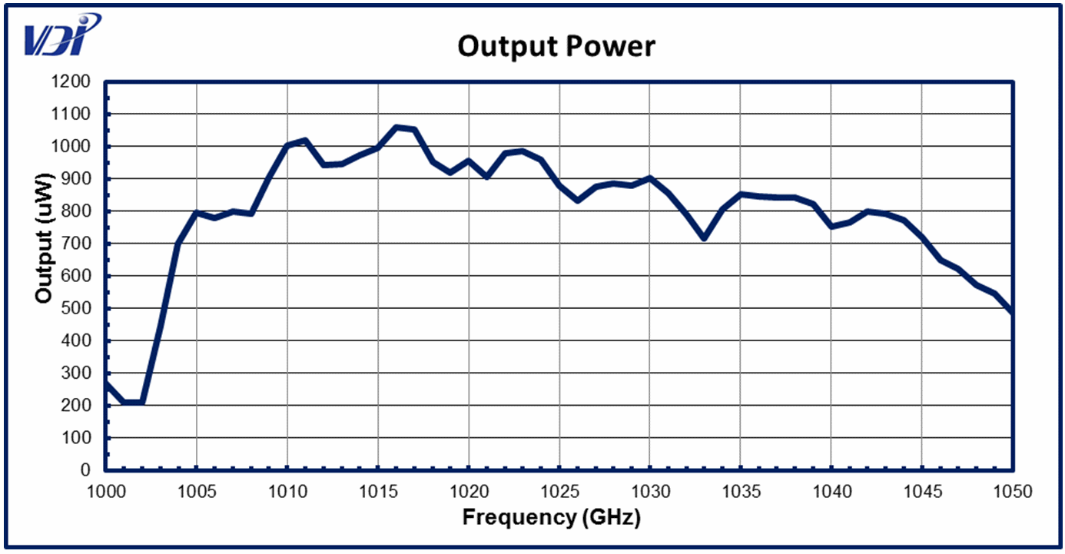
1 mW at 1 THz

Slide 22
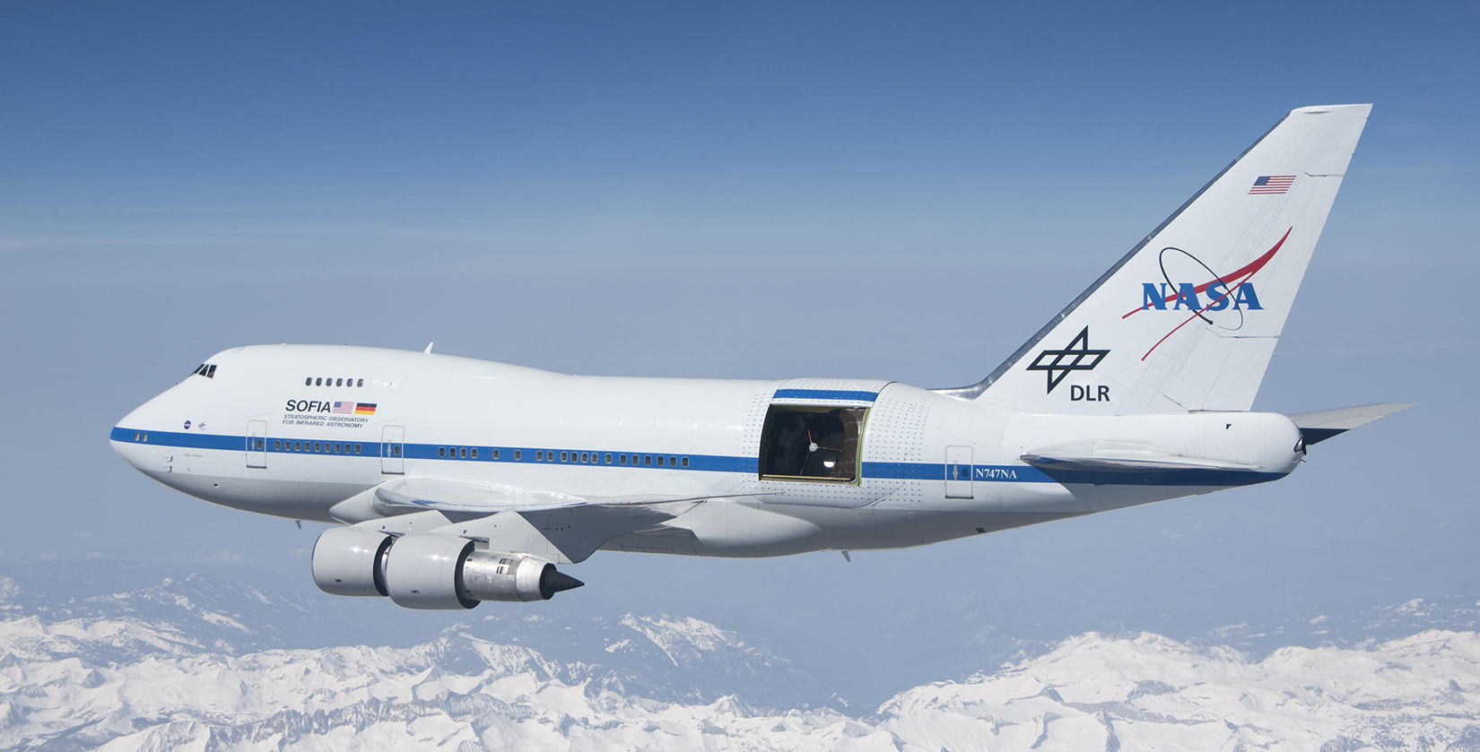
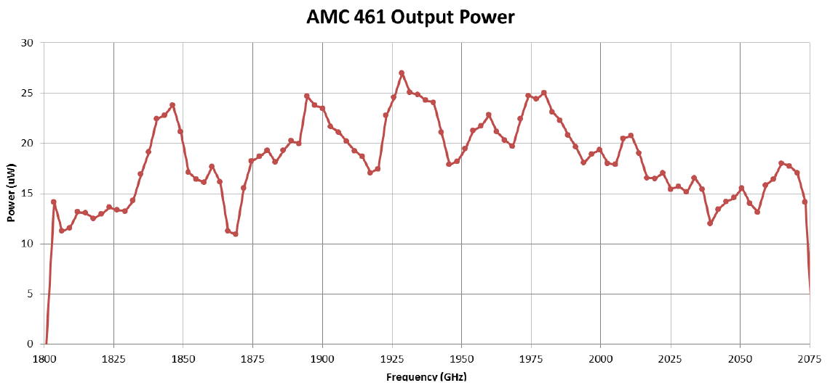
THz Sources for SOFIA
SOFIA Observatory
Meas. At Room Temp.

Slide 23
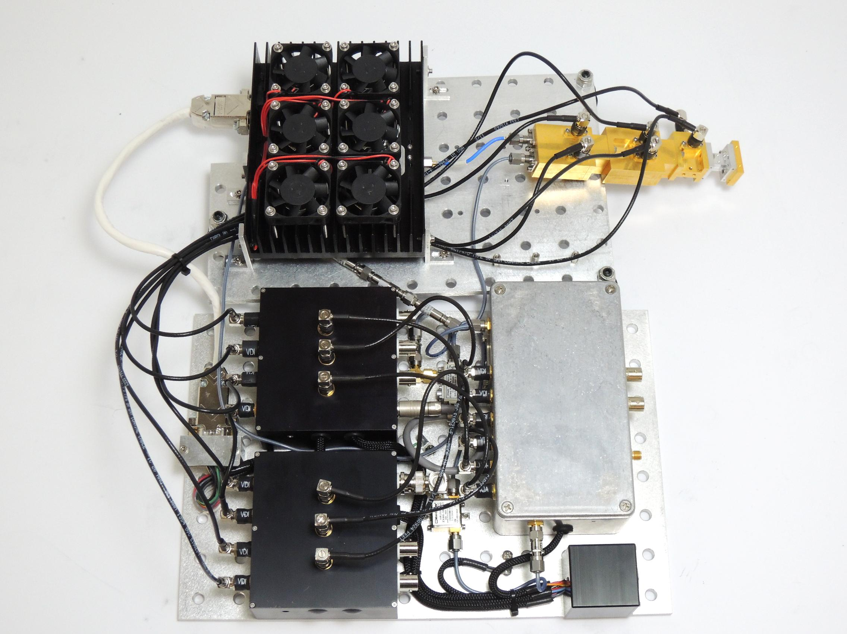
1.9 THz AMC
N = 144
x2Amp/x2/x2/x2/x3/x3
Two types of multipliers
Self-biased triplers
High power varactor doublers
Power amplifier is < 40 GHz.

Slide 24
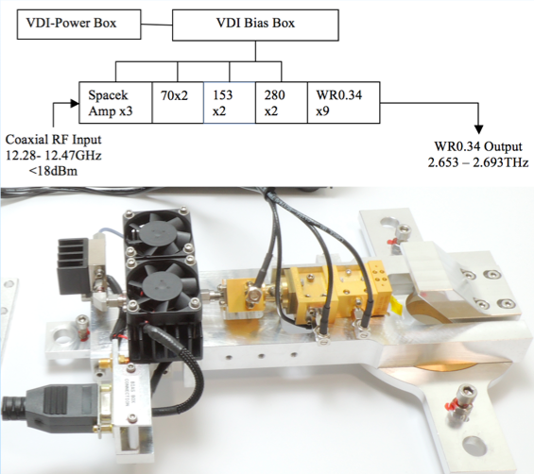
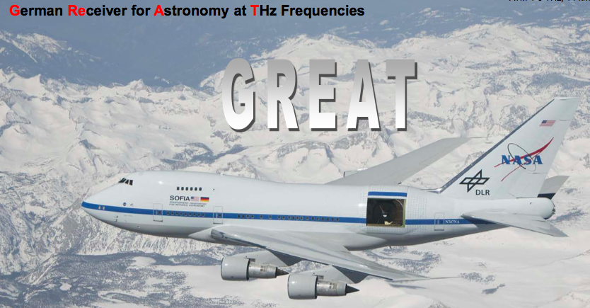
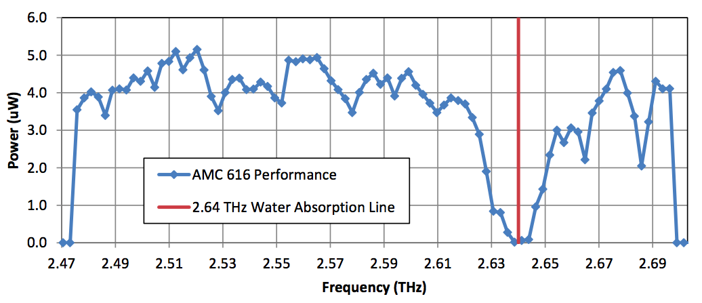
2.67 THz Solid-State Source
4 uW at 2.67 THz

Slide 25
Future Goal – 200mW at 264GHz

Slide 26
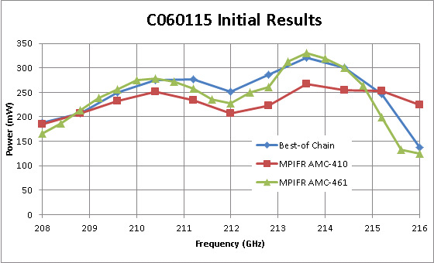
Recent High Power Result at 210 GHz

Slide 27
Other high-power applications
Plasma diagnostics
Molecular spectroscopy
Cloud radar
Imaging (medical, security, etc.)
???

