Slide 1
The Low Energy Recirculation Facility
INTRODUCTION
George R. Neil
March 17, 2017
Notes:
1

Slide 2
The Low Energy Recirculation Facility
Past – founded on Free Electron Laser research and applications thereof
Present – ongoing utilization of electron beam for a variety of science
Future – potential for broad utilization of unique laboratories and equipment
Notes:
2

Slide 3
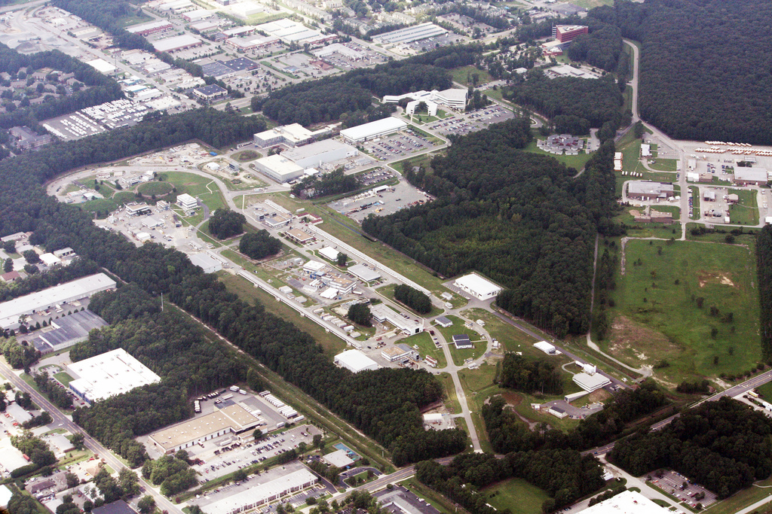
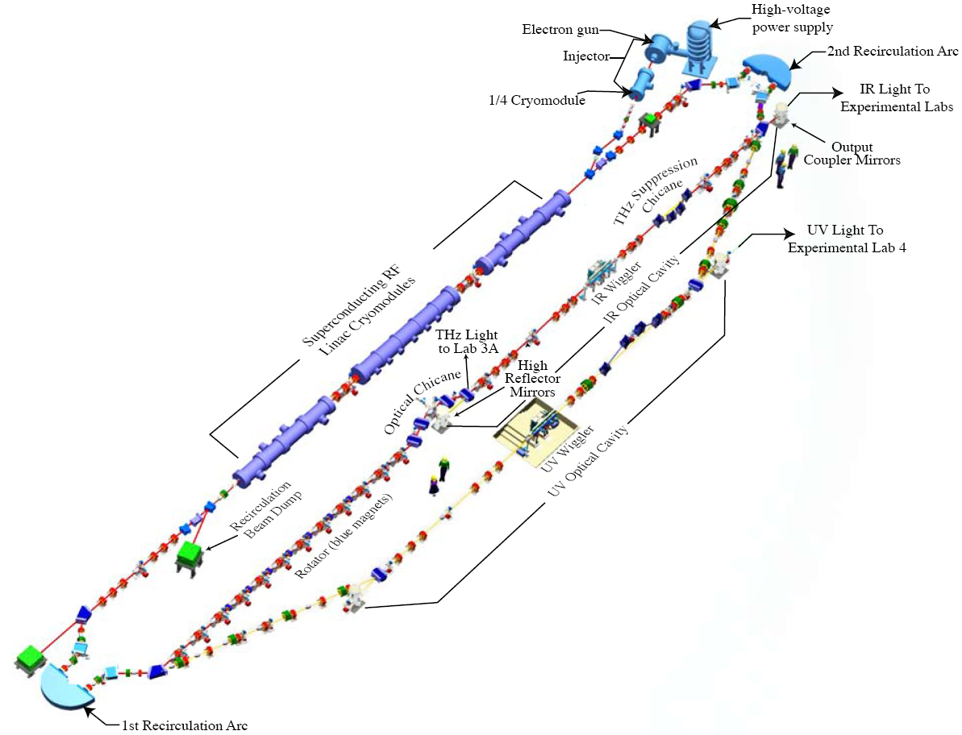
JLAB ERL: Low Energy Research Facility (LERF)
Beam accelerated from 9 to 170 MeV and then decelerated back to ~10 MeV, to recover the energy
Search for Dark Matter
Fixed Target Options
Accelerator Research
Powerful light source
  IR and UV FEL
  THz light
3

Slide 4
LERF Capabilities
The ERL in the LERF is available for:
Fixed target experiments at medium current (With new RSAD)
Internal target experiments at high current
Offline accelerator research and development
Diagnostic development
FEL studies in the IR and UV
THz production,
  Parameter Maximum value
  Current (ERL) 8 mA
  Energy 170 MeV
  Charge 150 pC
  Frequency 75 (750) MHz
  Current (fixed target) 0.5 mA

Slide 5
The Low Energy Recirculation Facility
Past – founded on Free Electron Laser research and applications thereof - examples
Present – ongoing utilization of electron beam for a variety of science
Future – potential for broad utilization of unique laboratories and equipment
Notes:
5

Slide 6
Lifetime of Hydrogen in Silicon
Bleaching decay
Hydrogen is a common impurity in crystalline silicon
Vibrational lifetimes of the hydrogen can be measured by a pump-probe of bleaching decay
⁽⁺⁾
H_{BC}
I (arb)
      Vibrational Lifetime of Bond-Center Hydrogen in Crystalline Silicon
  M. Budde,¹ G. Lüpke,² C. Parks Cheney,¹ N. H. Tolk,¹ and L. C. Feldman^{1,3}
  ¹Department of Physics and Astronomy, Vanderbilt University, Nashville, Tennessee 37235 ²Department of Applied Science, The College of William and Mary, Williamsburg, Virginia 23187 ³ Solid State Division, Oak Ridge National Laboratory, Oak Ridge, Tennessee 37831
Luepke et al. Phys. Rev. Letts 85, 1452 2000
Phys. Rev. Letts 88, 135501, 2002
Phys. Rev. Letts 87, 145501, 2001
Phys. Rev. B63 195203 2001
J. Appl. Phys. 93 2316, 2003
t (ps)
T₁ = 7.8 ± 0.2 ps

Slide 7
Benefits of short pulses and high rep. rate
Pulsed laser deposition with the JLab-FEL
A. Reilly et al. CWM
J. Appl. Phys. 95 3098 (2003)
Deposition of metals with high rate (up to 200 Å/sec)
Particulate free films (< 1 cm⁻²) of high quality compared to low repetition rate Amplified Ti:Sapphire deposition
TS
FEL
SEM (left) and AFM (right) of NiFe films grown with an amplified Ti:Saph (top) and the FEL (bottom).
Magnetization of NiFe films grown with amplified Ti:Saph and FEL. Note high quality, low coercivity (~ 5 Gauss) of FEL film.

Slide 8
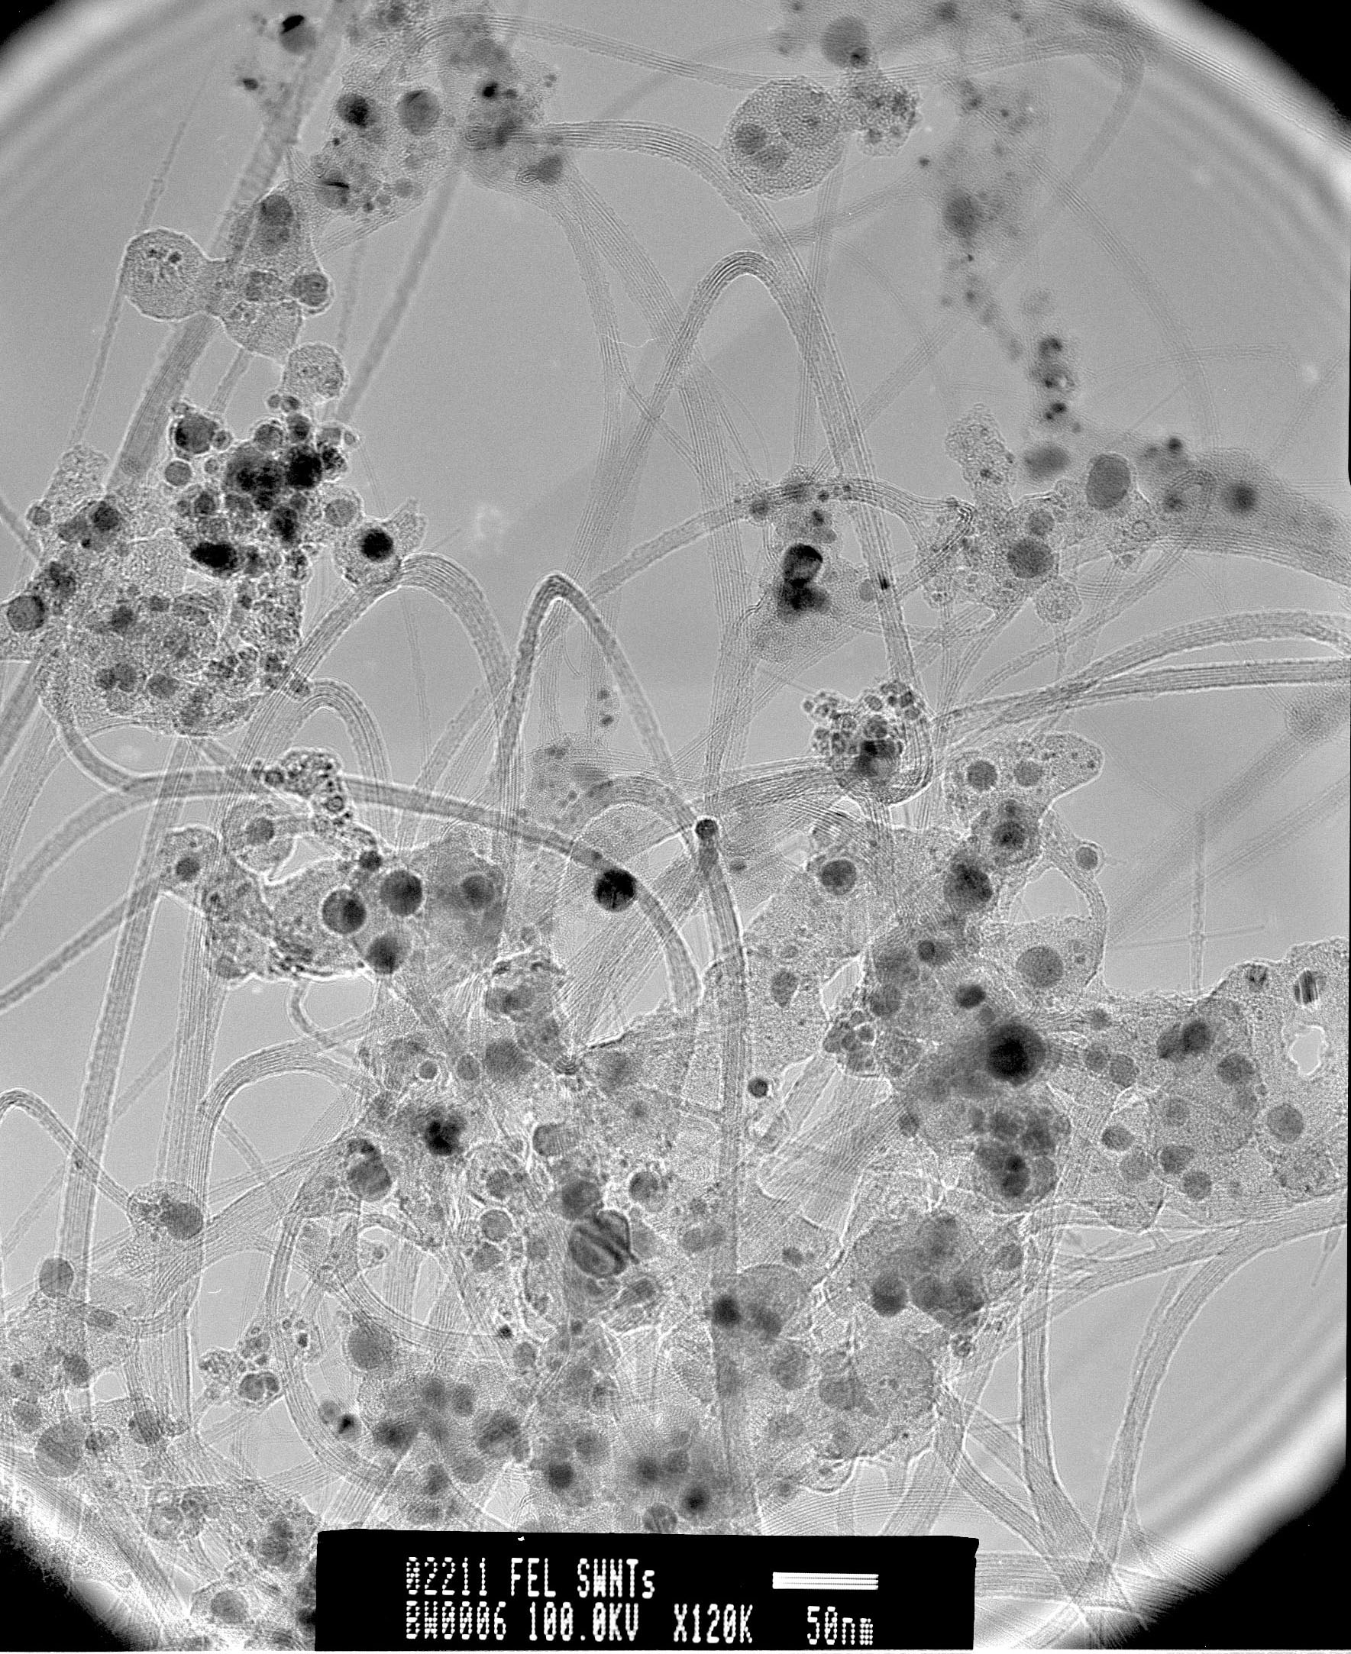
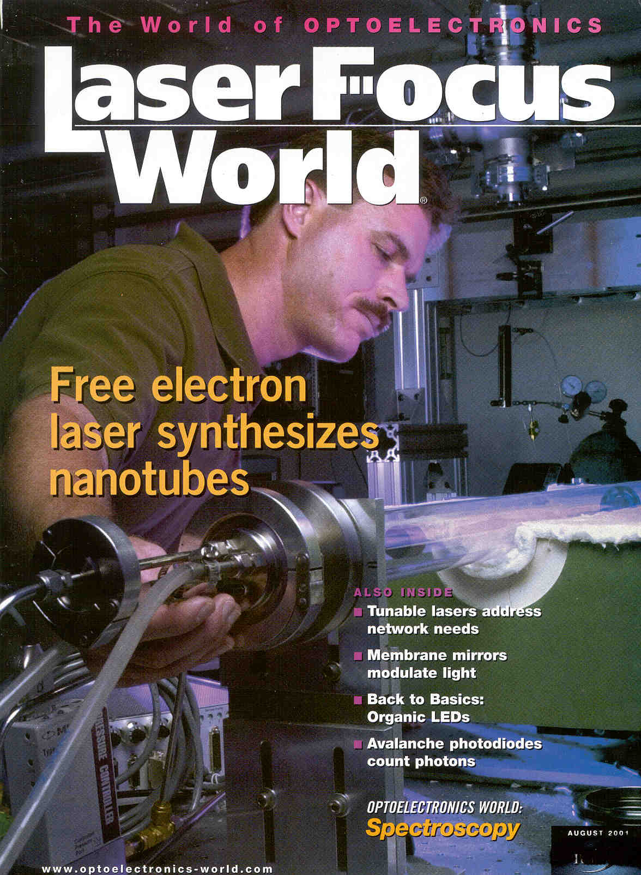
High quality carbon nanotube produced: transitioned to unique capability through boron nitride tubes now in commercial production in R&D quantities at spinoff small business
TEM indicates tube dia (~1.4 nm) and small bundle size (~12 nm)
TEM images by D. Luzzi and B. Smith, UPenn

Slide 9
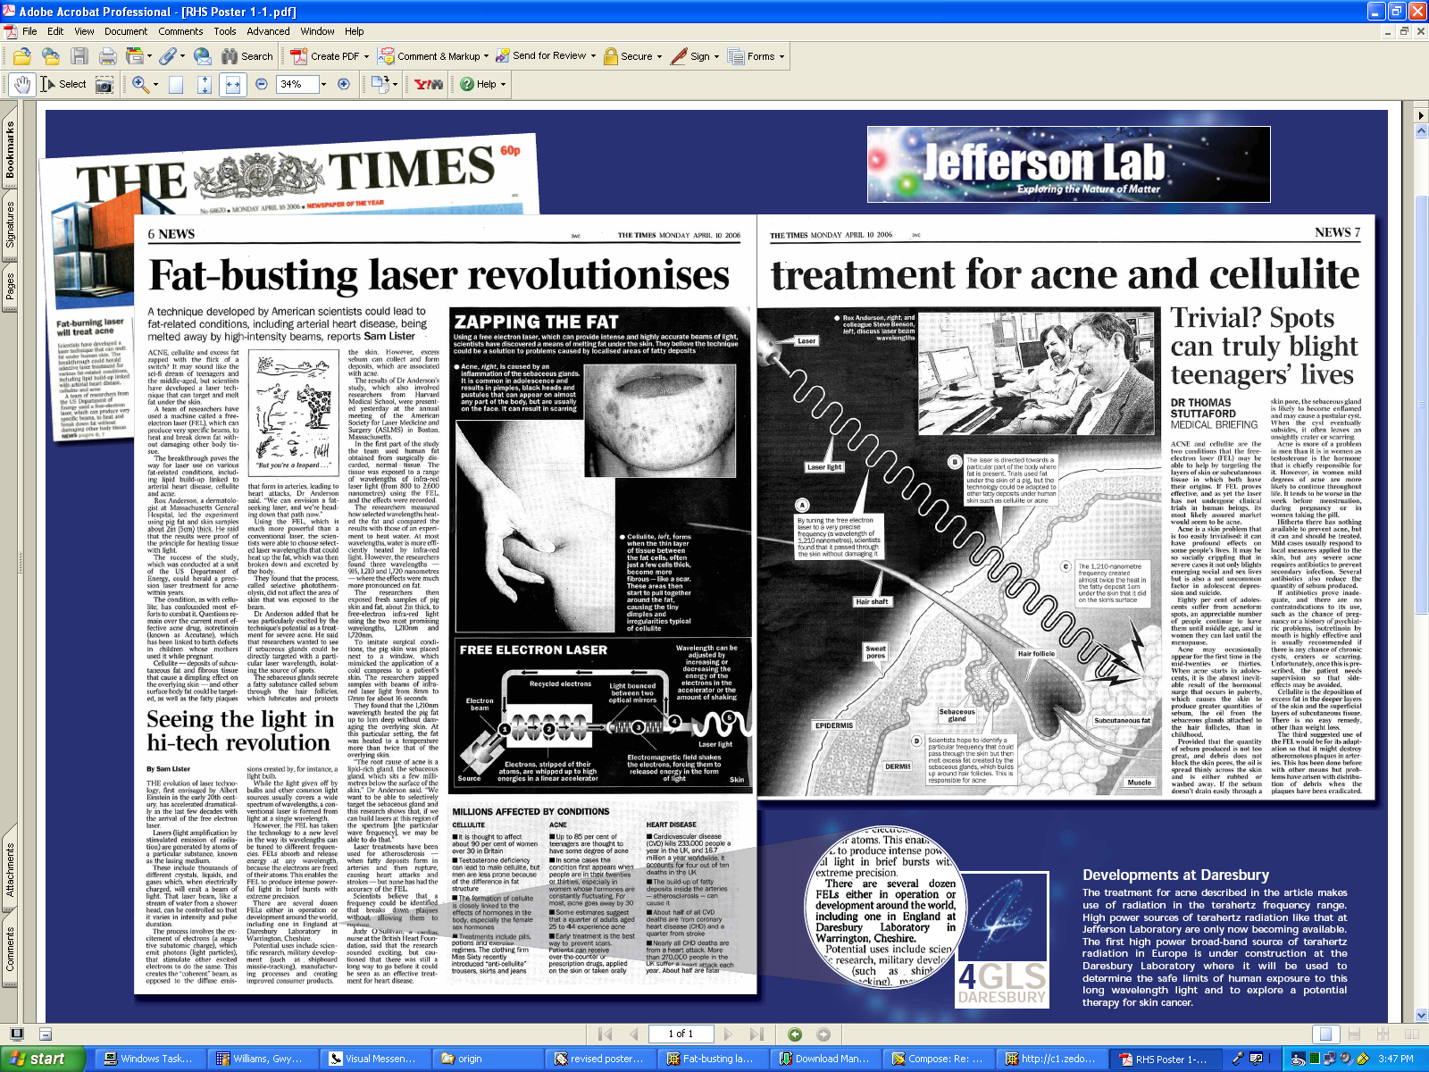
The benefits of high power and tunability: kill fat cells under the skin;
laser based treatment developed by R. Anderson, Wellman Center, Harvard
Monday, April 10, 2006

Slide 10
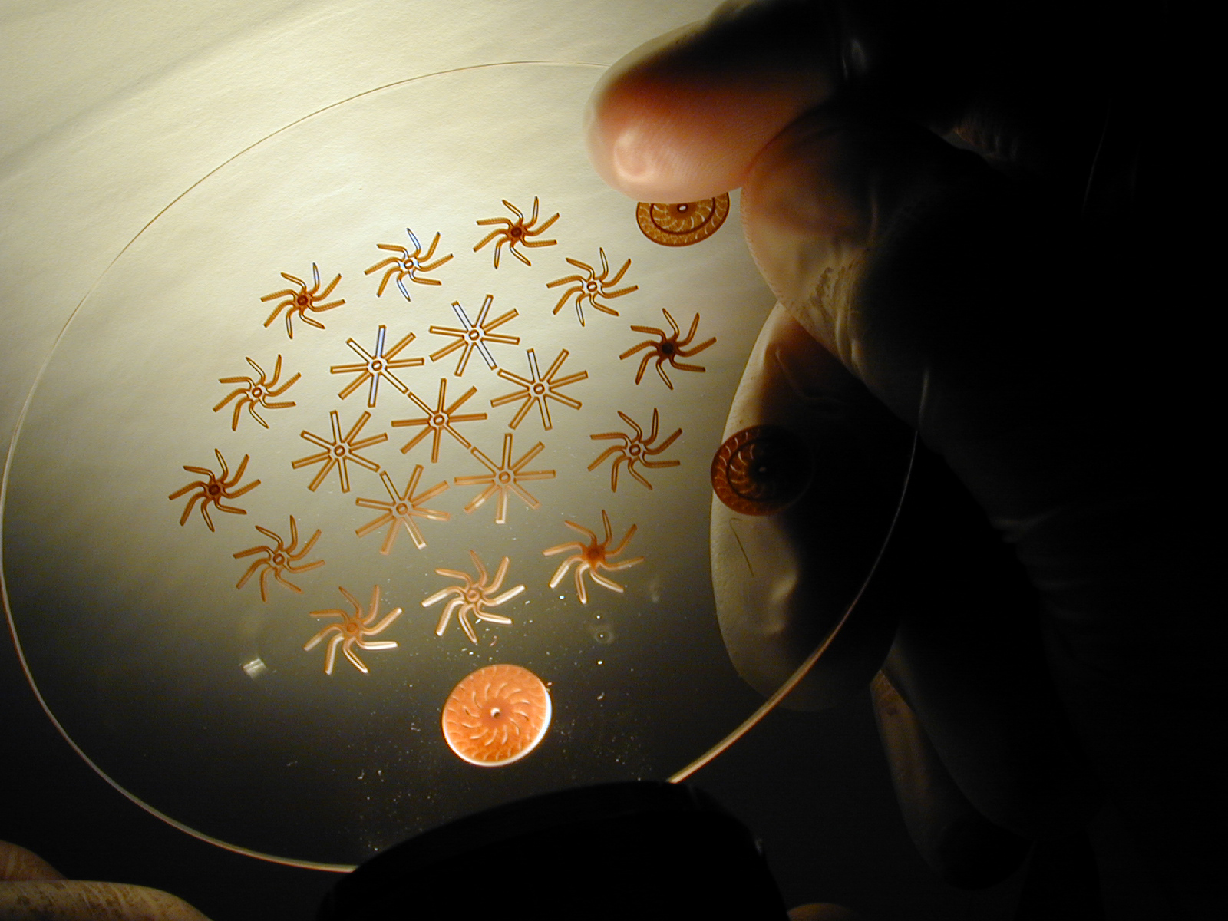
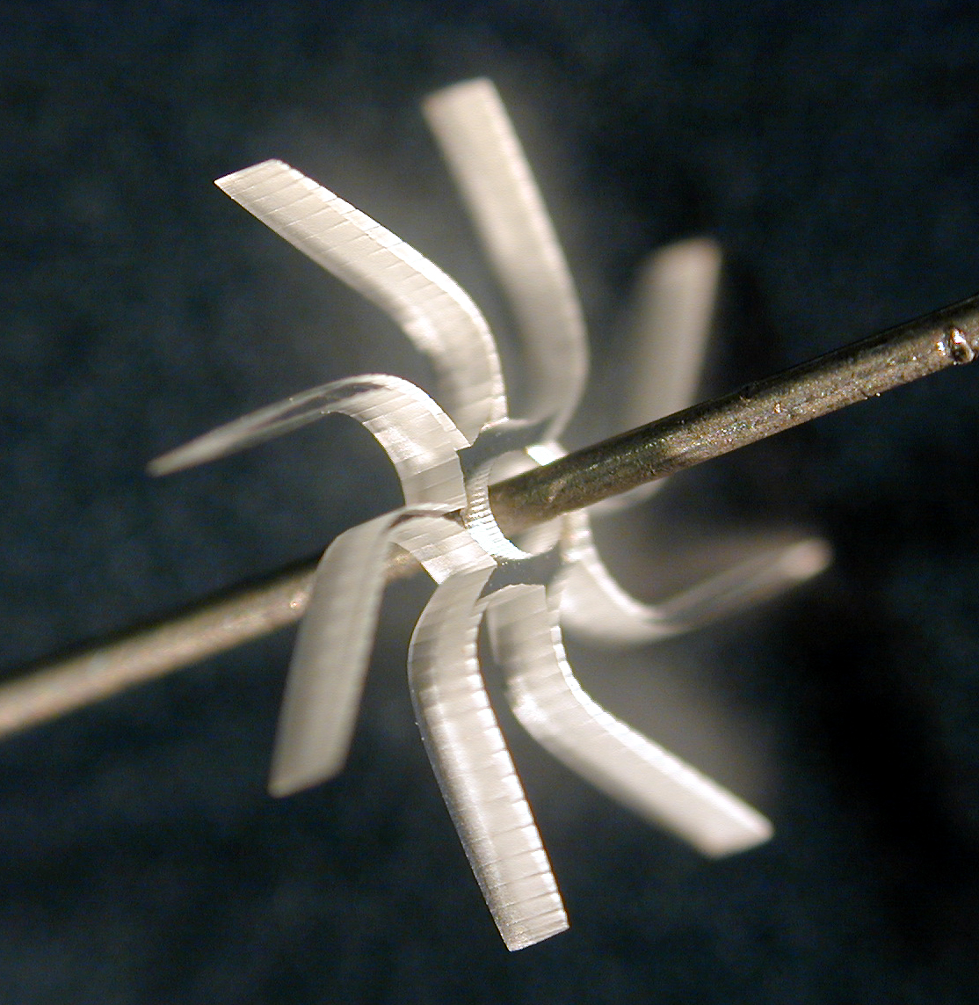
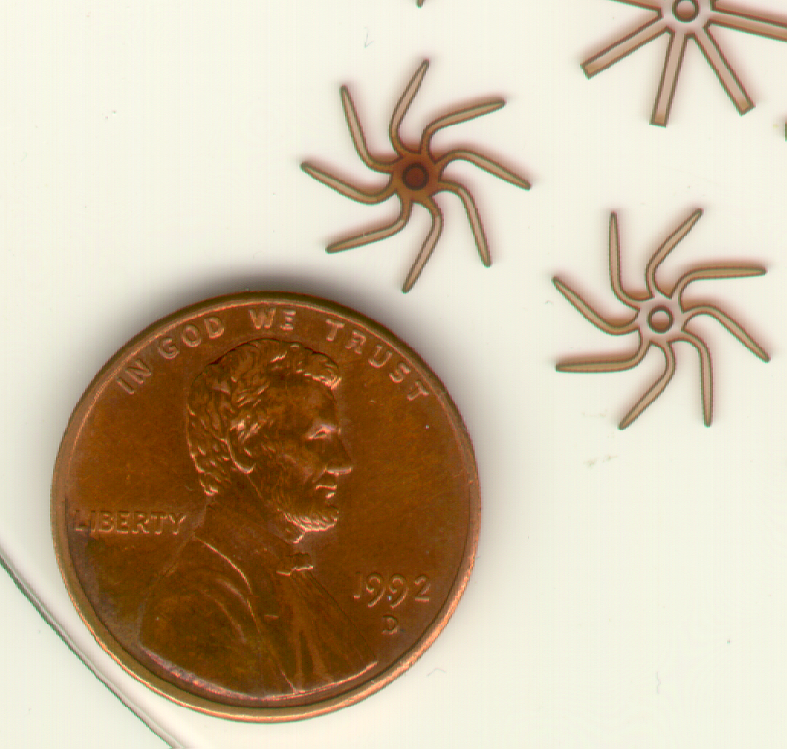
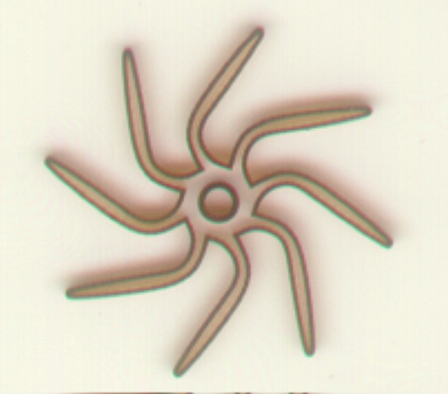
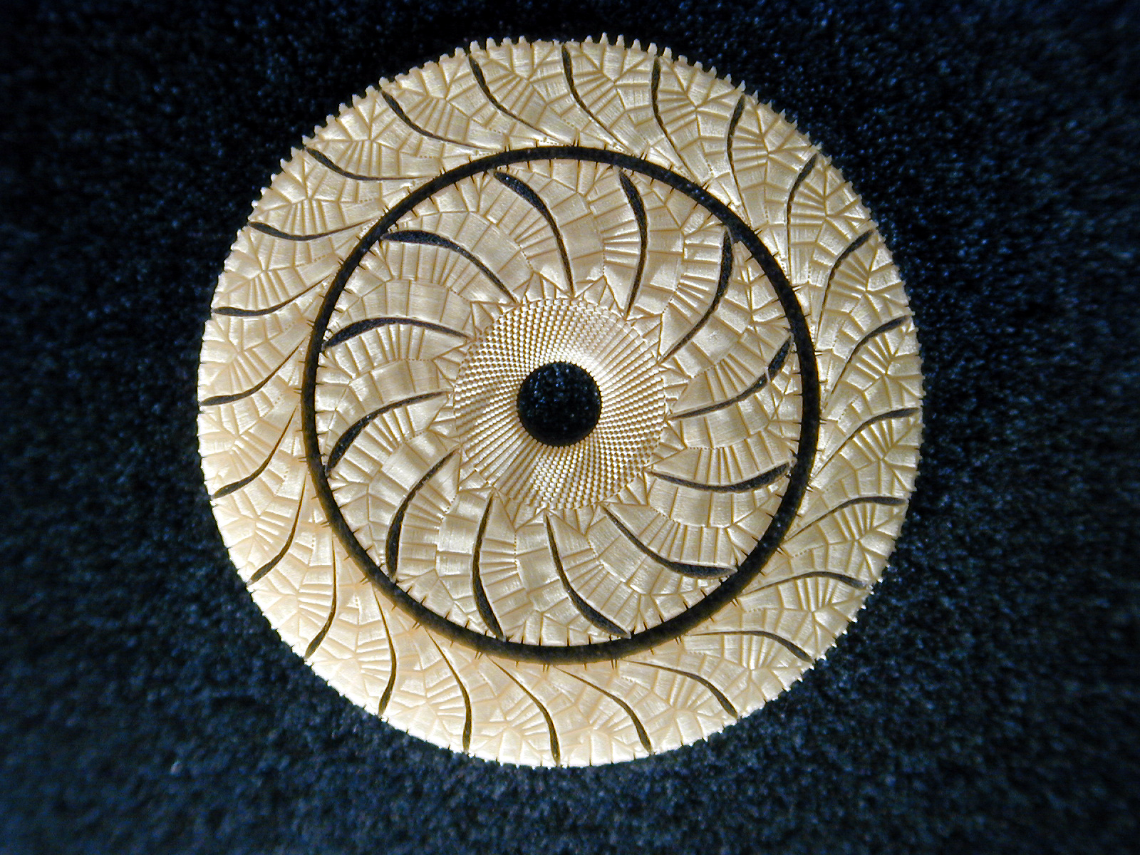
H. Helvajian, Aerospace Corp.
Laser Microfabrication Facility: works with FEL or conventional laser from 3-D CAD files
3D Test Turbines Patterned via Laser Exposure
100mm dia wafer
Multi-layer
Design
1 mm thick
Pattern 200 μm
Henry Helvajian, Aerospace Corp.

Slide 11
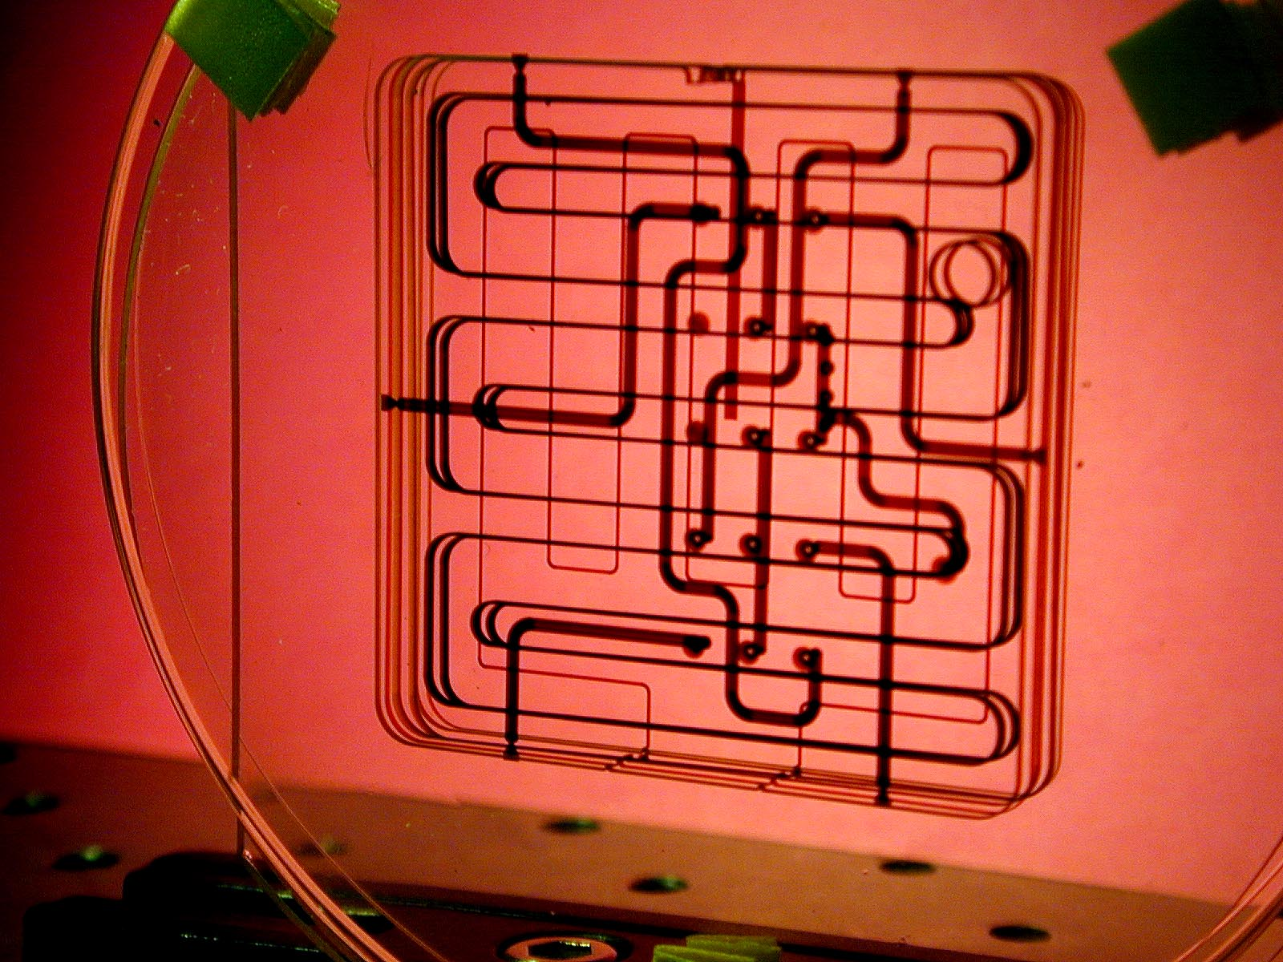
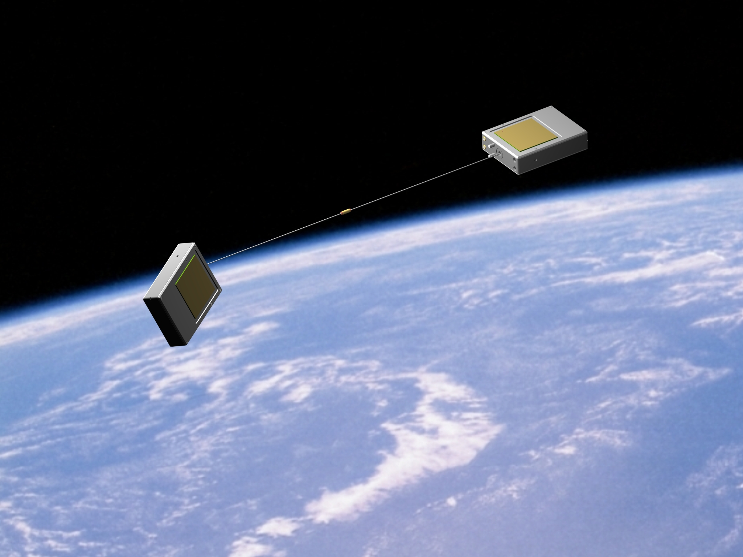
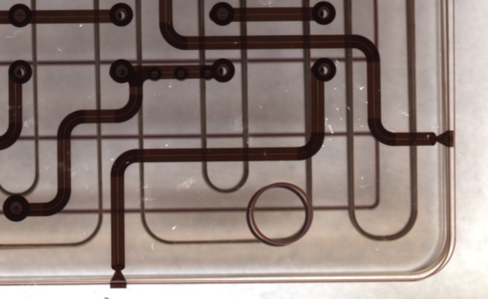
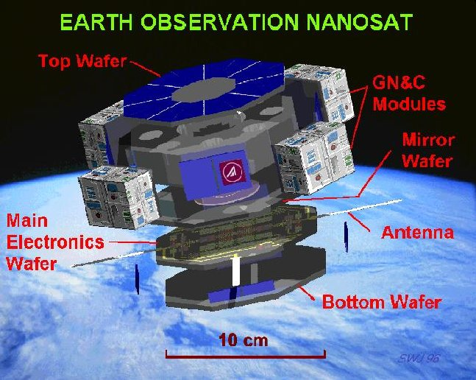
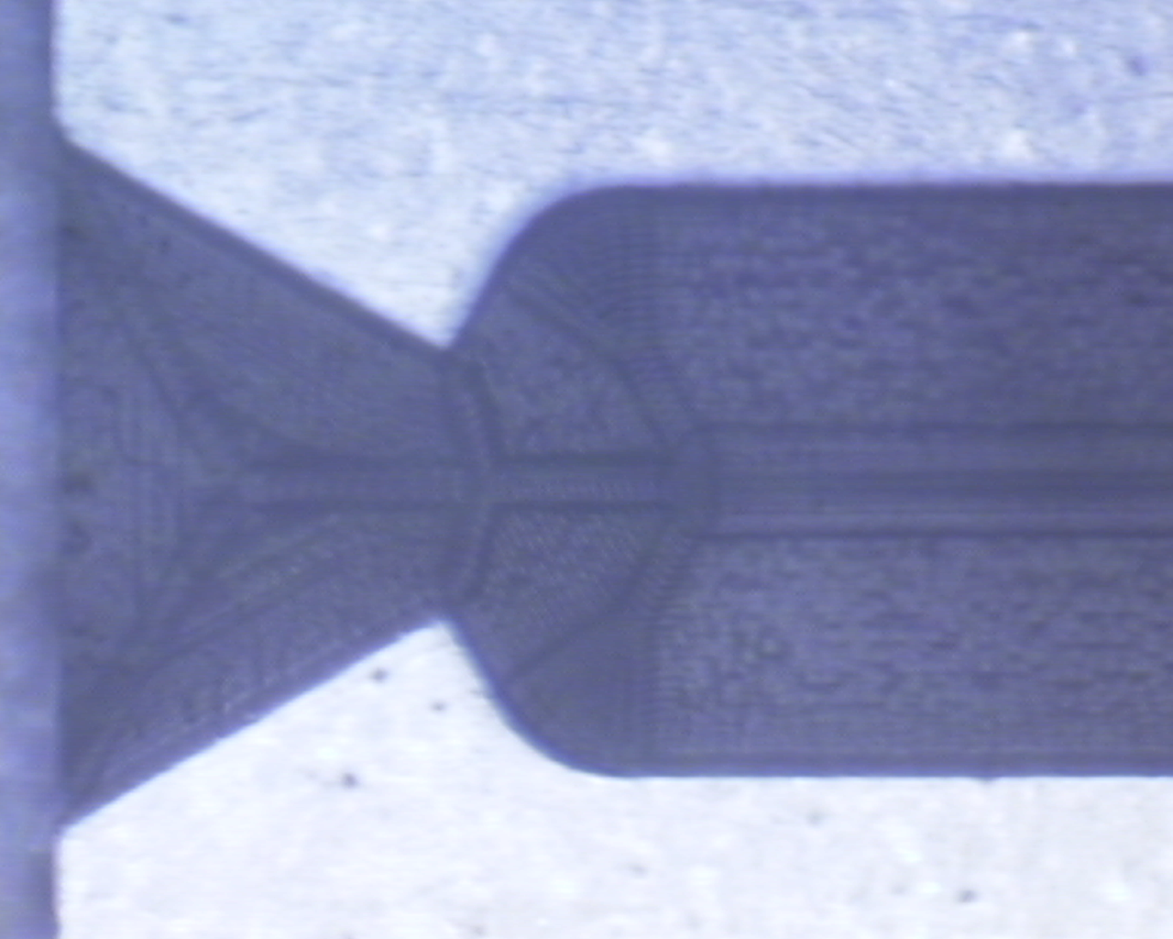
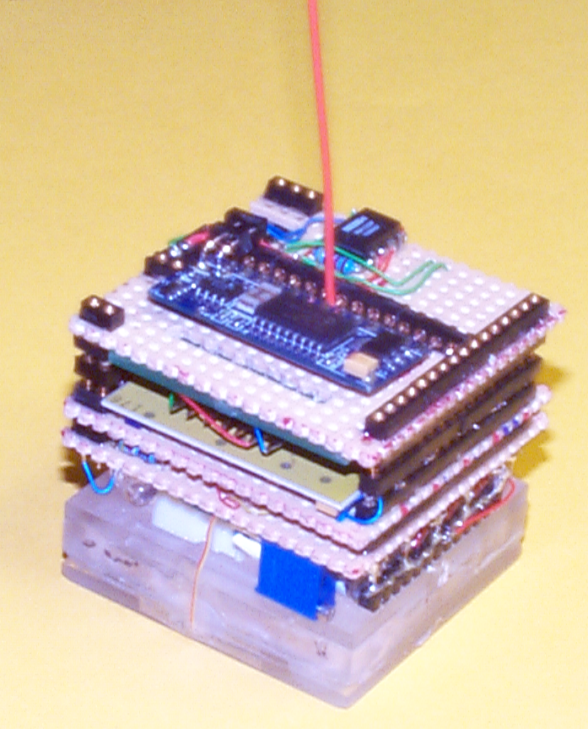
Picosat1
Launched 1/26/00
Picosat2
Launched
12.44 PDT 9/7/01
after more than a year storage inside a larger satellite
An example of what can be done
PICOSAT
~250g
DARPA/Aerospace/AFRL
COSA
50mm

Slide 12
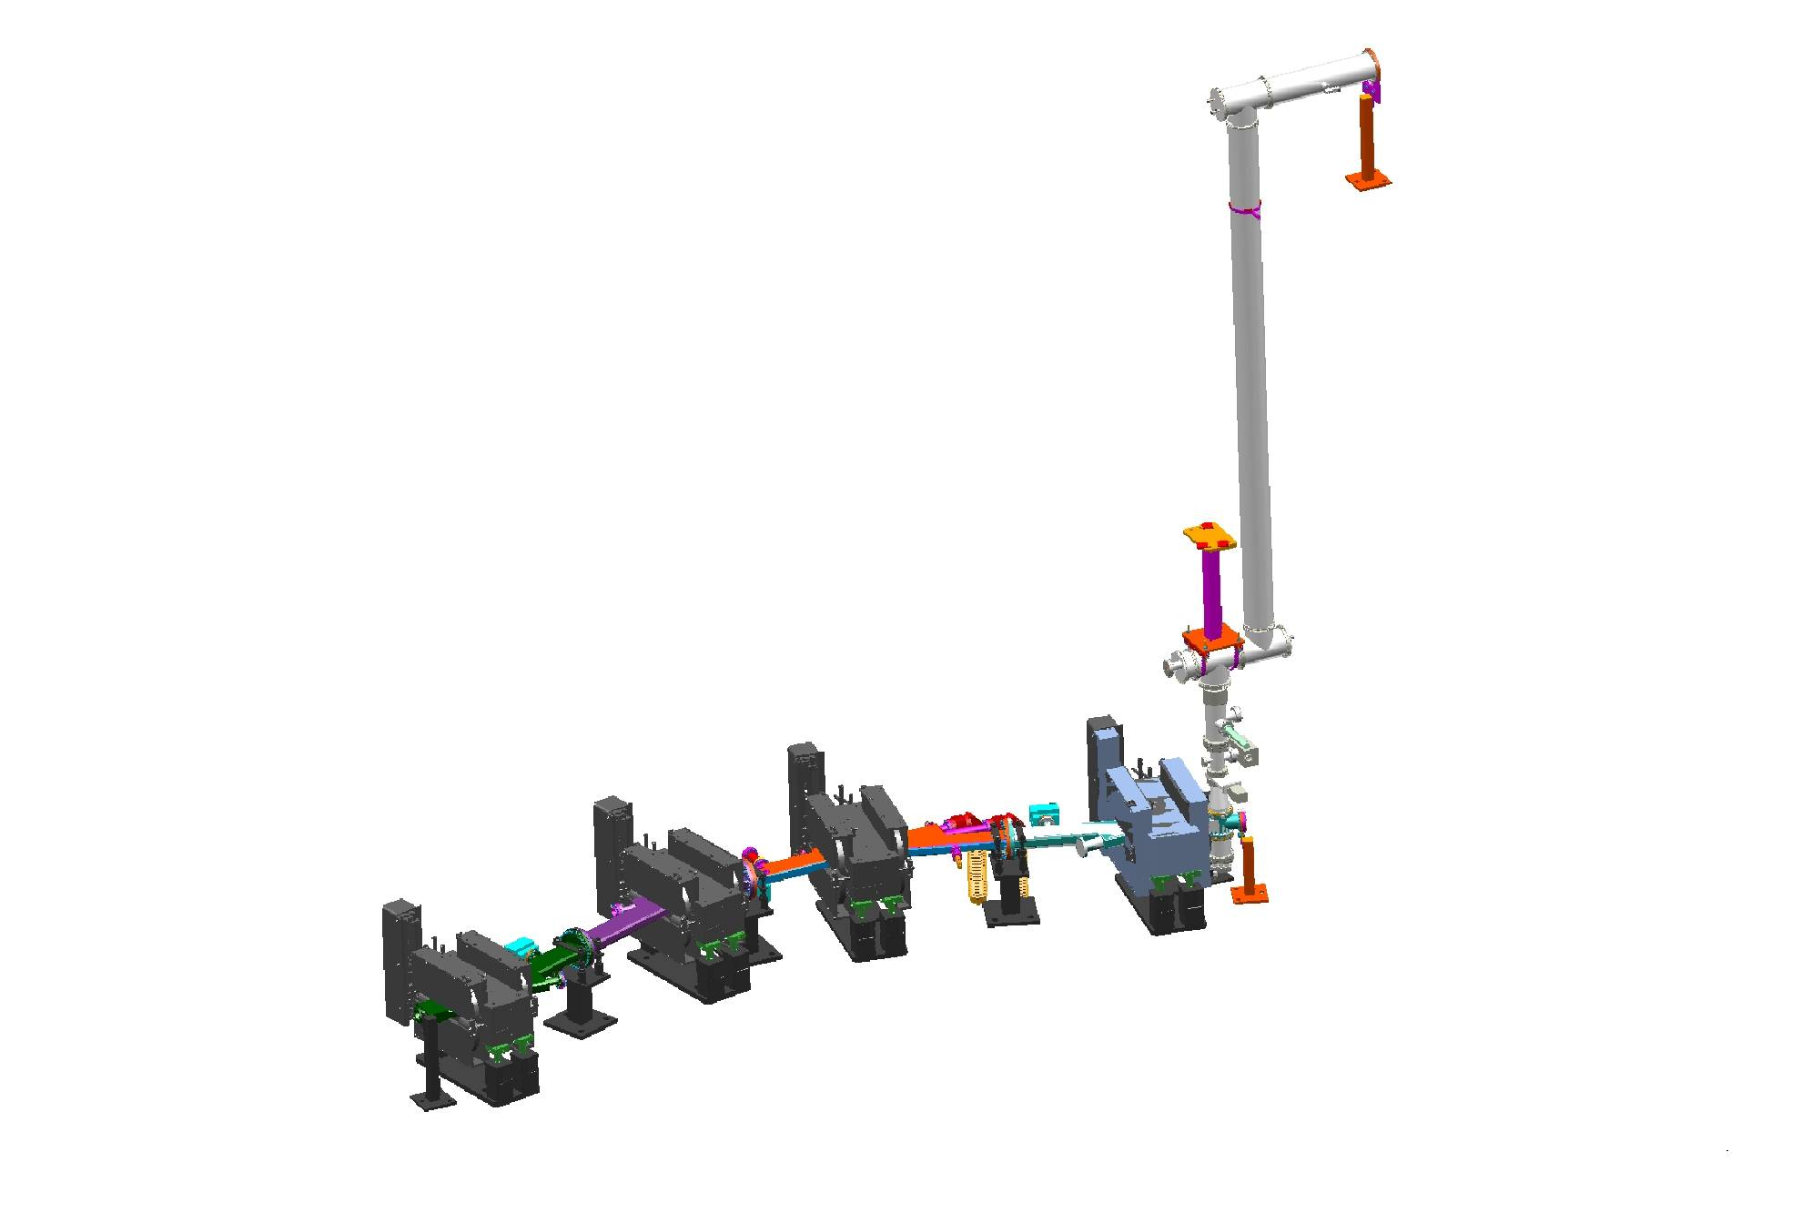
Terahertz Beam Transport
M4
F3
60x60mm
200x200mm
F2
60x60mm
M2
200x200mm
Measured spectral output in air; 350 fs electron pulse, ~ 1 μJ/pulse, 75 MHz.
Similar spectrum, pulse energy available using laser source but at low repetition rate
200x200mm
M1

Slide 13
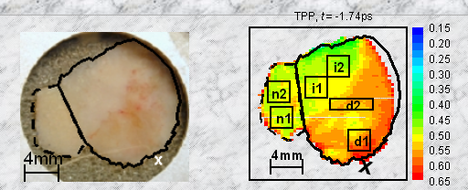
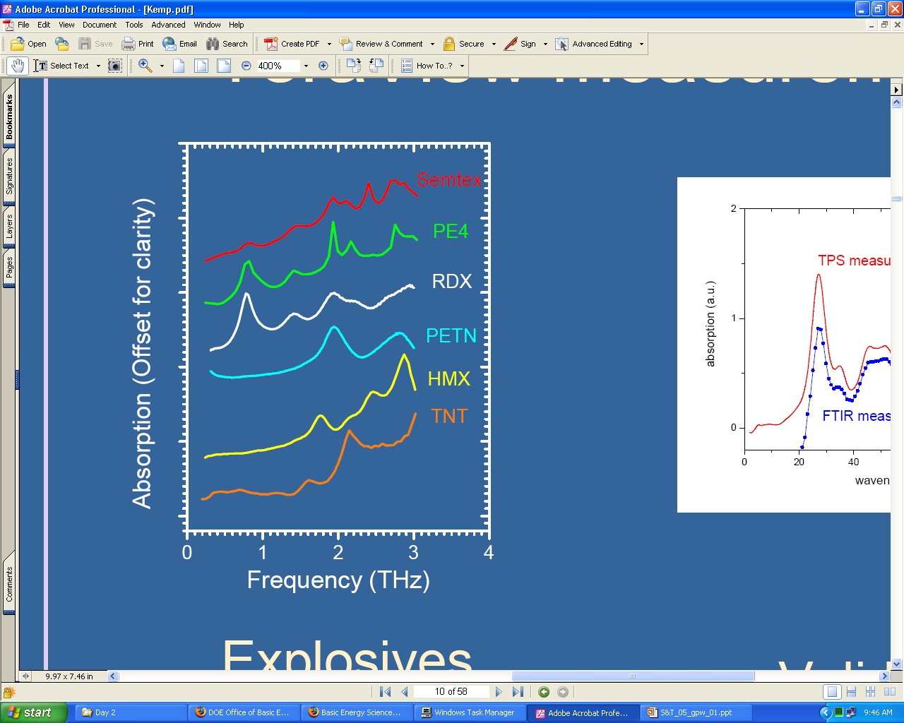
Why THz? Cancer screening, material testing
Basal cell carcinoma shows malignancy in red. From Teraview Ltd.
Teraview 1 mW source images 1 cm² in 1 minute
With Jlab source: 100 W source images whole body (50 x 200cm) in few seconds
Spectra of explosives
courtesy Teraview

Slide 14
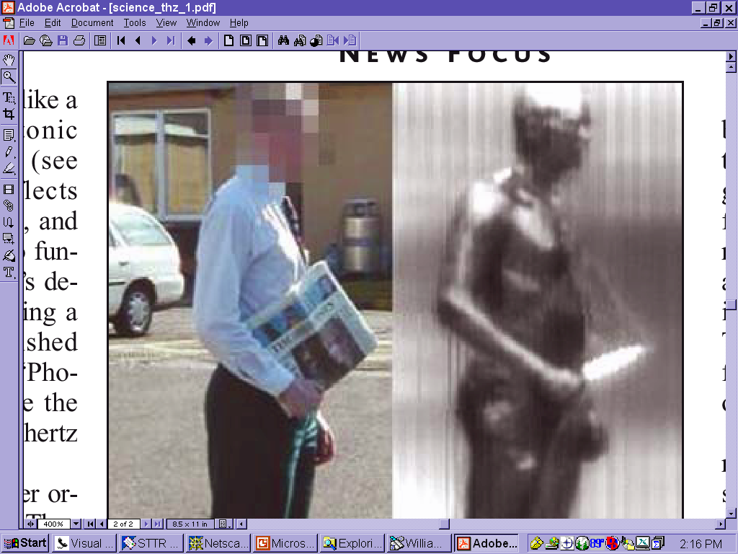
Why THz? Non-destructive testing and imaging
“Naked on the Monitor”

Slide 15
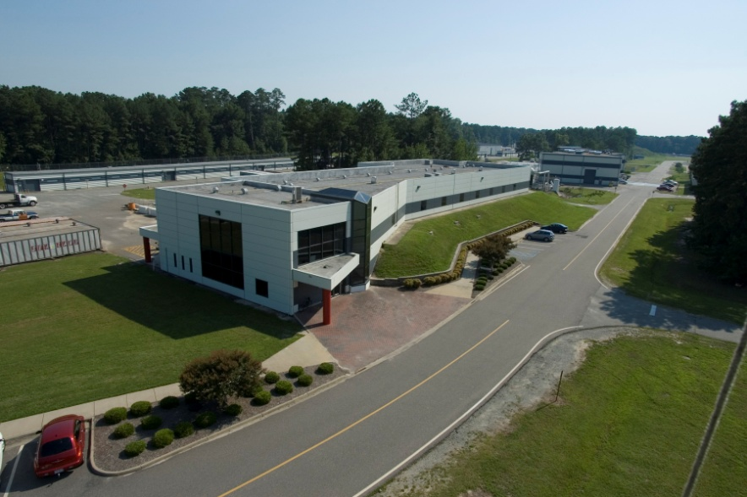
The Low Energy Recirculation Facility User Labs
Current User Facility has 7 Labs
Lab1 Dark Matter Search and General Purpose studies
Lab 2 Diagnostics development
Lab 3 THz dynamics and imaging
Lab 3a XHV assembly and studies
Lab 4 Aerospace LMES
Lab 5 PLD
Lab 6 Laser development
Laser
Dev.
PLD
Micro
fab
XHV
Lab
THz
Lab
Diag-
nostics
Dark
matter
Notes:
15

Slide 16
Generic User Lab Capabilities
All User Labs contain:
Laser Personnel safety system for class 3B and class 4 lasers. Some labs have laser hutches for hutch mode work (no laser eye protection required).
Utilities: LCW, chilled water, nitrogen, instrument air, electrical.
Either 30’x40’ (User labs 1 and 2) or 30’x20’ available area.
In principle, FEL light may be sent to any lab, though there is no funding to do so right now.
Each Lab has a Scientific Program Coordinator (SPC), who sets up and approves use of a lab, and a Laboratory Coordinator (LC), who handles safety and logistics. Users should contact the SPC to discuss possible uses of a lab.

Slide 17
The Low Energy Recirculation Facility
Past – founded on Free Electron Laser research and applications thereof
Present – ongoing utilization of electron beam for a variety of science
Future – potential for broad utilization of unique laboratories and equipment
Notes:
17

Slide 18
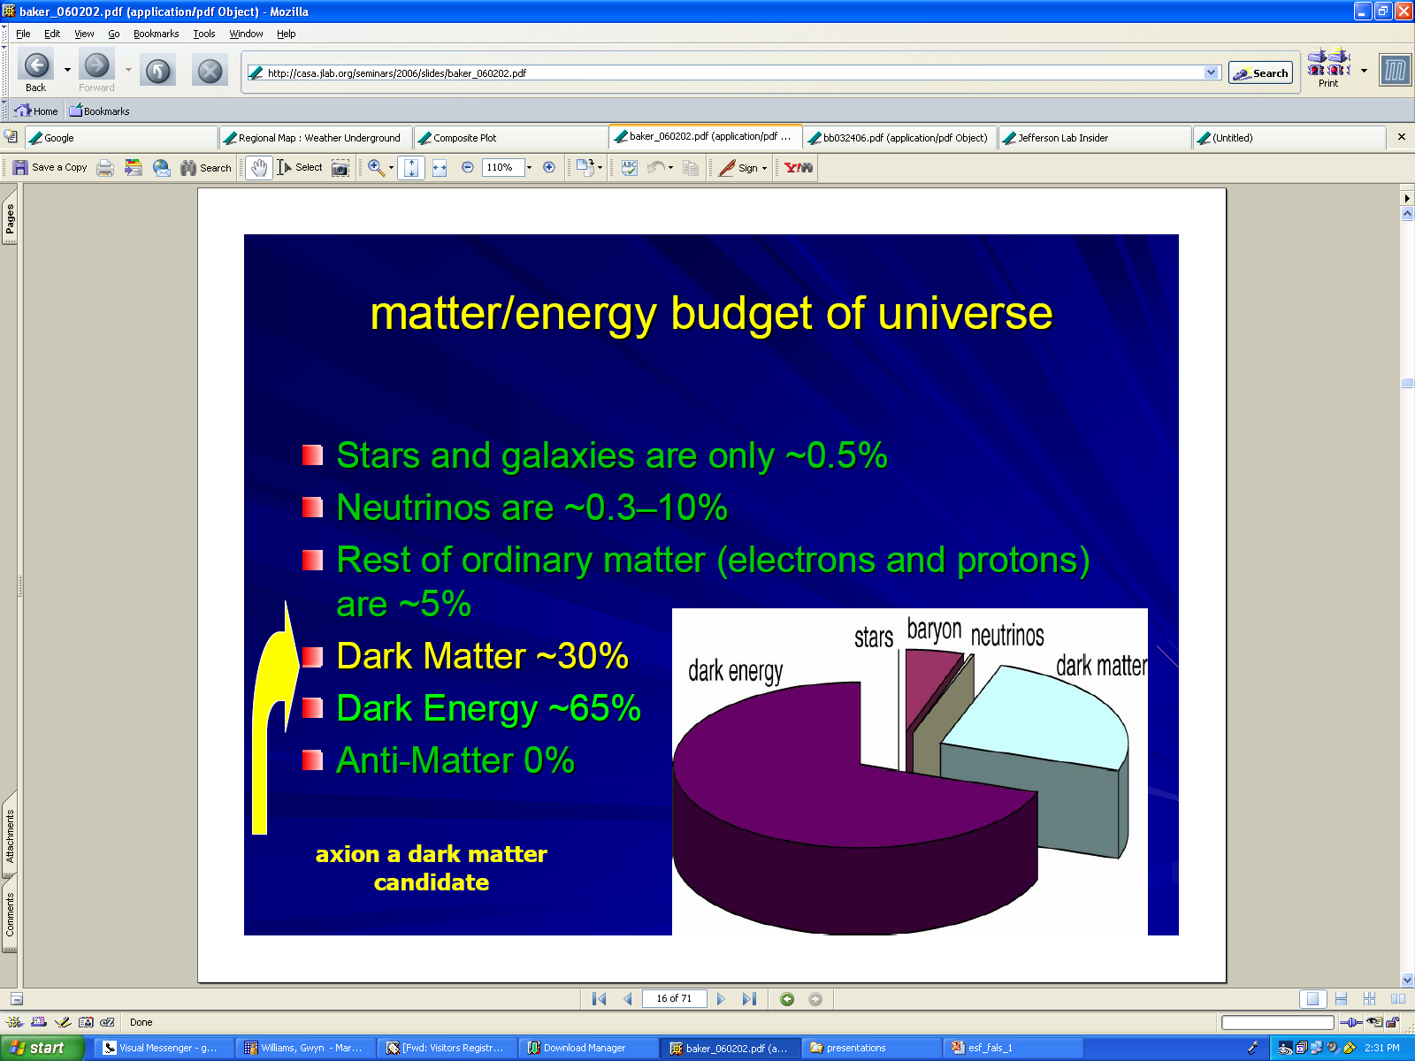
Schirber, Science 311 1535 (2006)
Zavattini E. et al. Phys. Rev. Lett. 96, 110406 (2006)
Lamoreaux, Nature 441 31 (2006)
Courtesy K. Baker Hampton U.

Slide 19
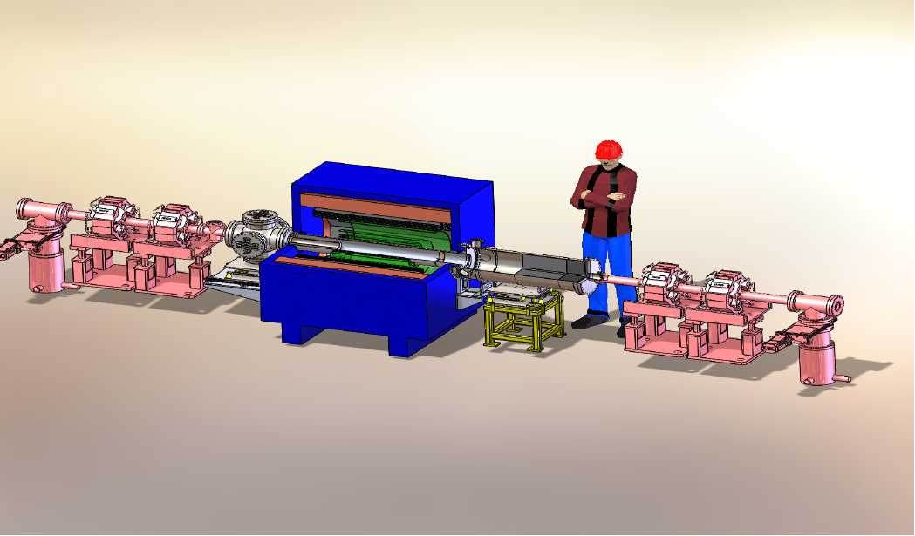
DarkLIGHT Experiment - Status
Phase I: funded by NSF MRI: $1M approximately
Install magnet and detector in place of current IR wiggler
Reuse existing solenoid magnet, use prototype GEM trackers and silicon detectors, funds low-pressure target & differential pumping system (constructed using elements of windowless gas target of OLYMPUS experiment)
Initial tests performed fall 2016
Planning underway for follow-on efforts (collaboration meeting this Saturday)

Slide 20
Proposal to DOE
Photoproduction of ⁶⁷Cu in Ga : ⁷¹Ga(γ,α)⁶⁷Cu
  Pavel Degtiarenko, George Kharashvili scientific lead
Medical isotope production
  ”Clean" process at lowest practical energies
  One of the most promising radioisotopes for cancer therapy
  Promising in diagnostics as well
T_{1/2} = 2.87 d
  β⁻ decay to stable ⁶⁷Zn
  Produces 184.58 keV photon (Y = 48.7%)
Collaboration with VCU and others

Slide 21
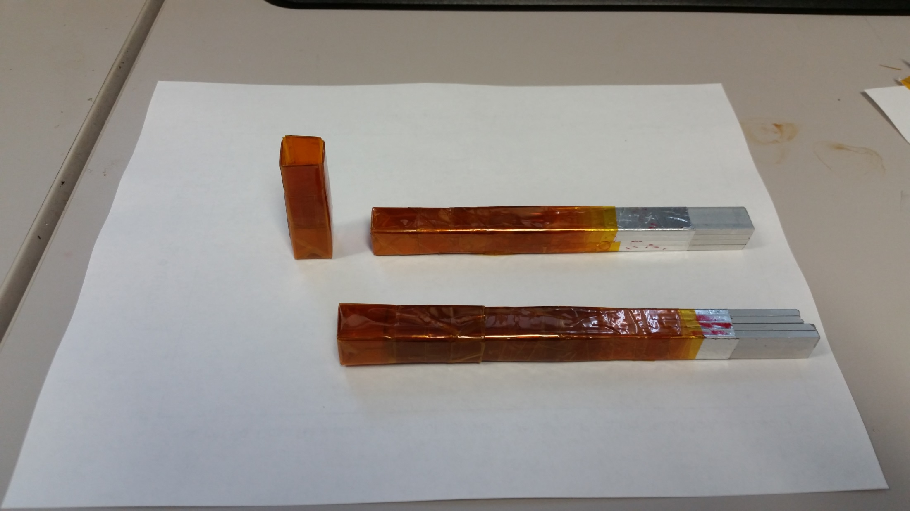
Low Power Gallium Target
  Kapton jar, rectangular, built using adhesive tape
  Windows: 6-8 layers, 0.4-0.5 mm (two faces)
  Sides and the bottom: 12-16 layers
  Three layers at vertices
  Aluminum bar wrapped in multiple Kapton layers serves as the plug-in cork
  Target: (1/2 in)³ of Gallium poured in, solidified, plug inserted, and then the jar taped over with Kapton
  The sets for the two targets available

Slide 22
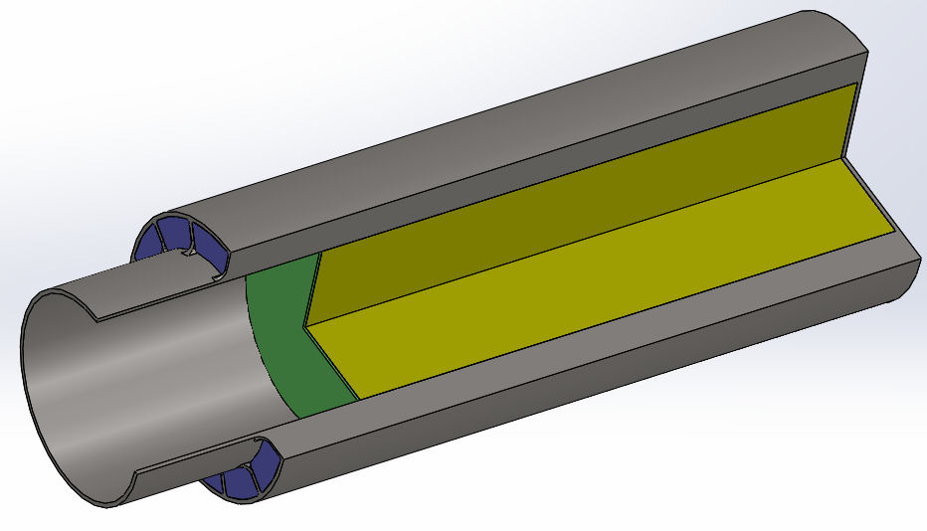
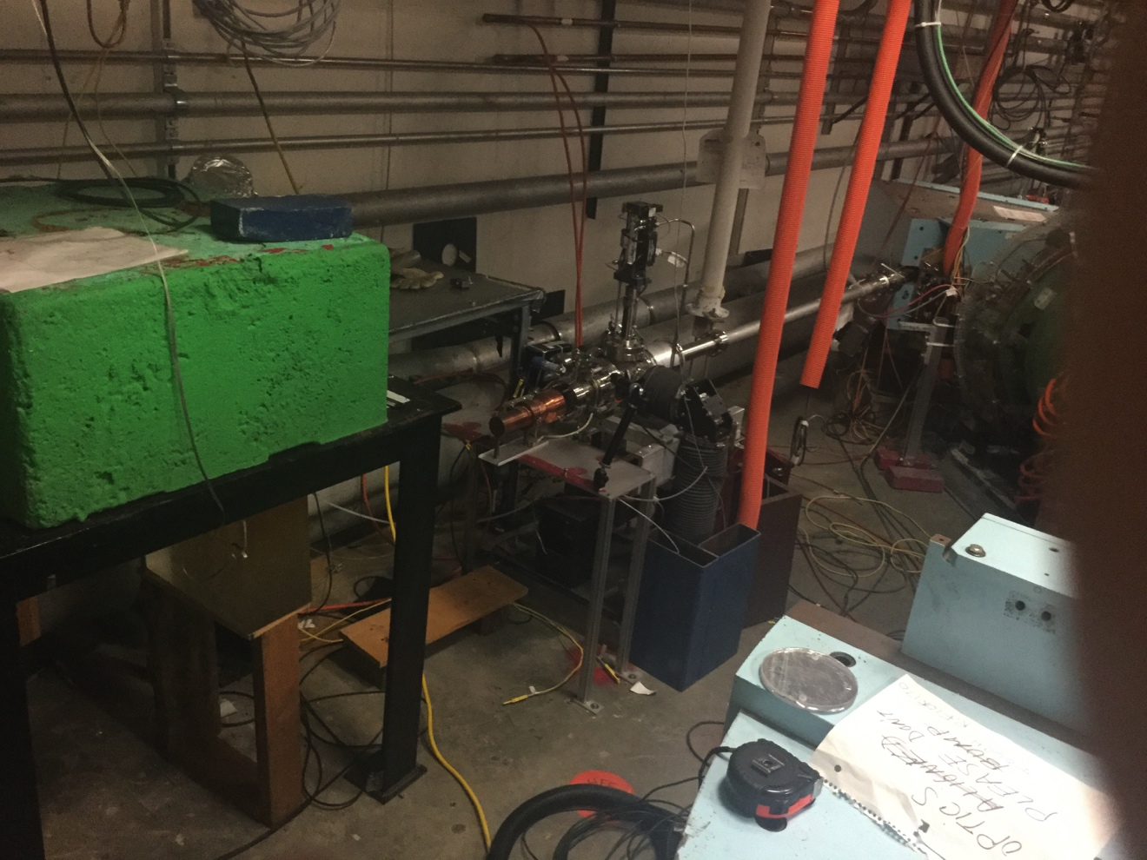
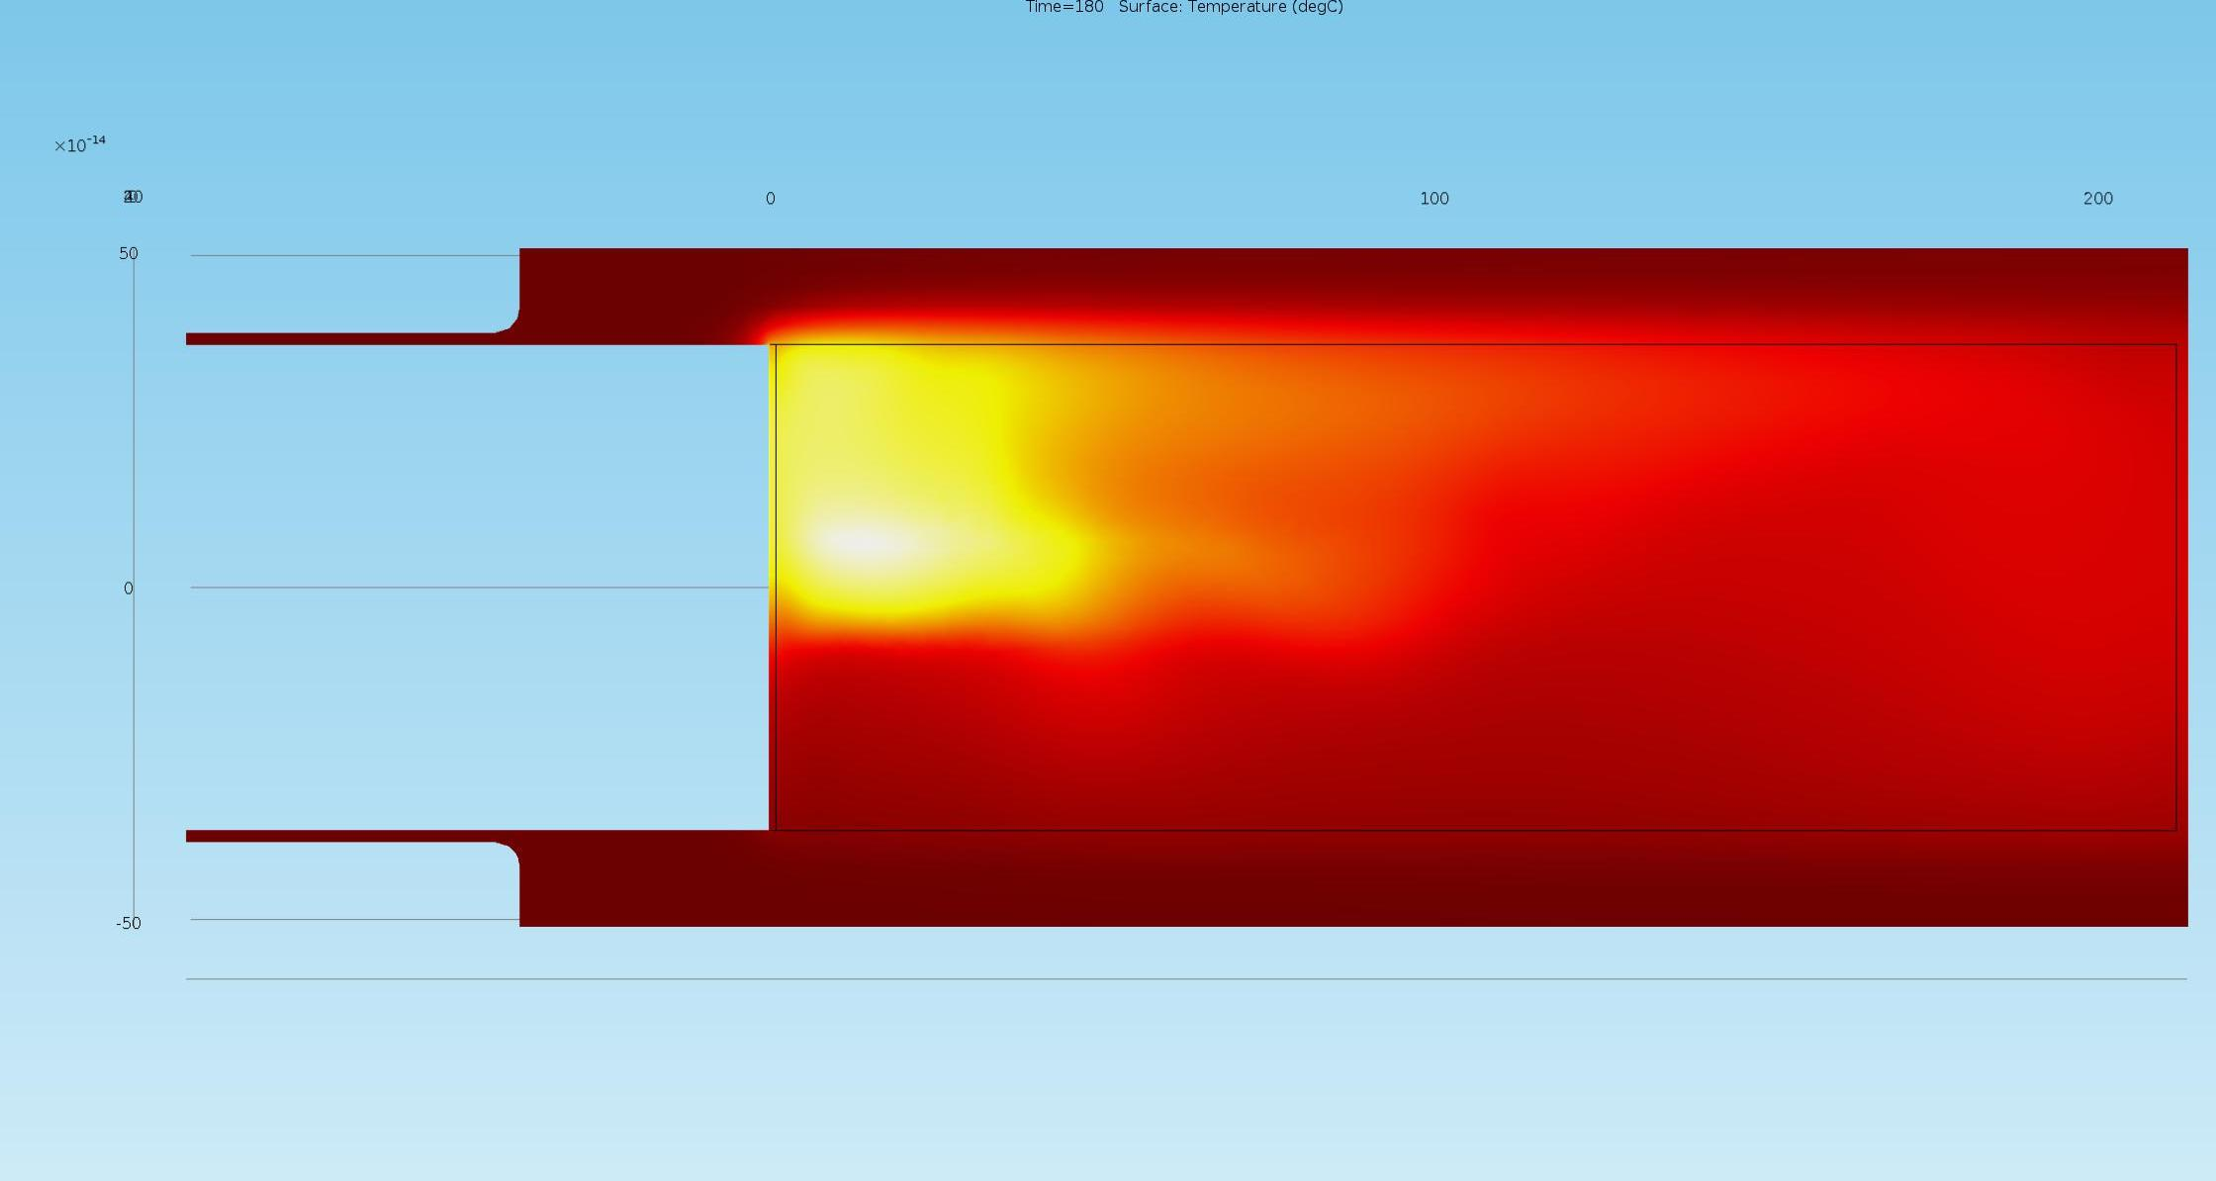
High Power Gallium Target Design
  Above: Gallium target, Green W, Yellow Ga, Blue H₂O.
  Below: Thermal modeling, asymmetry is due to natural convection in the gallium.
  High energy target position in LERF

Slide 23
A Joint JLab NASA Program
Low Energy Target Irradiation at LERF
Theresa Benyo and Larry Forsley
NASA Glenn Research Center
Determine the effect of low (below 3 MeV) kinetic energy gamma rays on beryllium and deuterated metals
Resolve electron screening thresholds in a stationary laboratory center of mass

Slide 24
The Low Energy Recirculation Facility
Past – founded on Free Electron Laser research and applications thereof
Present – ongoing utilization of electron beam for a variety of science
Future – potential for broad utilization of unique laboratories and equipment
Notes:
24

Slide 25
Generic User Lab Capabilities
All User Labs contain:
Laser Personnel safety system for class 3B and class 4 lasers. Some labs have laser hutches for hutch mode work (no laser eye protection required).
Utilities: LCW, chilled water, nitrogen, instrument air, electrical.
Either 30’x40’ (User labs 1 and 2) or 30’x20’ available area.
In principle, FEL light may be sent to any lab, though there is no funding to do so right now.
Each Lab has a Scientific Program Coordinator (SPC), who sets up and approves use of a lab, and a Laboratory Coordinator (LC), who handles safety and logistics. Users should contact the SPC to discuss possible uses of a lab.

Slide 26
User Lab Capabilities
Specialized User Labs contain:
Pulsed high power lasers at a variety of wavelengths
Optics diagnostics and characterization equipment
THz pulse generation, imaging and diagnostics
Clean room
Laser deposition capability
Material surface modification
Micromachining and micro-engineering of materials
All available for research without using the FEL
The rest of this workshop will discuss some of the specifics of these capabilities; we invite you to use your imagination to develop productive use of this valuable infrastructure

Slide 27
Outlook
Large investment in infrastructure capabilities offers the opportunity for leveraged proposals, “matching funds” equivalent, and opportunities for training students.
We look forward to working with anyone who has ideas for productive science at our facility

