Slide 1
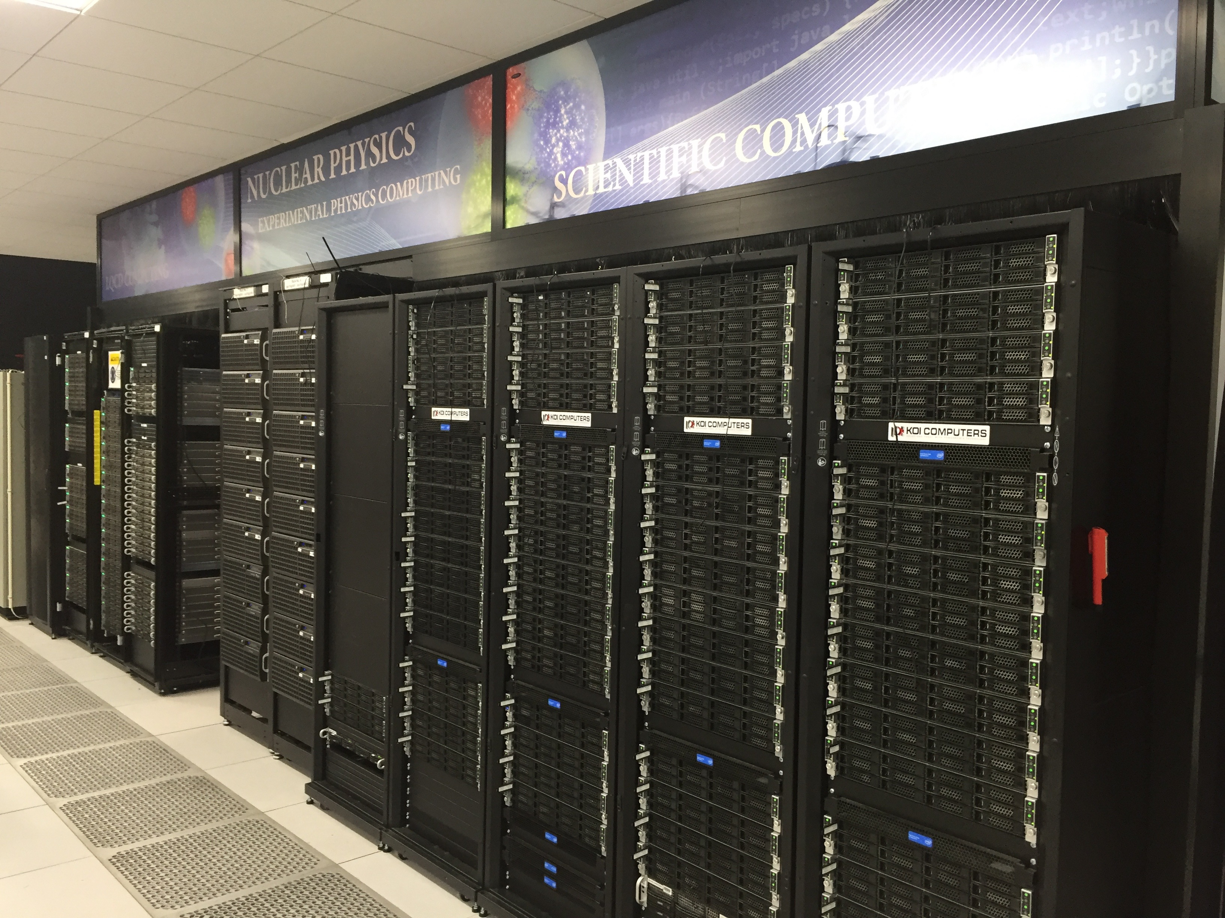
2017 IT
First Time: 100% Internet uptime
Multi Factor Authentication (MFA)
Minimized impact to the extent possible
Refurbished/New Data Center
Power Usage Effectiveness (PUE) <= 1.4
Minimized impacts of Central Computing move
Conducted IT service survey
Calls for more engagement/collaboration between IT & Physics
Eduroam deployed at Jlab
Amazon Web Services—billing in place
PAC proposal submission streamlined
Interactive Map of Jlab Users

Slide 2
Broader Engagement
3D Nucleon Tomography Workshop in March
Collaboration with User Group:
Software Carpentry Workshop May 17 - May 19
Future Trends In Nuclear Physics Computing in May
IT and Physics organize a computing round table to discuss common topics
Thank you for your attendance and support
S&T review
Computing featured at the review, received recommendations
Positive comments from DOE based on lab input
Signs that the Lab is starting to view Computing and Computation in an different light.

