Slide 1
HRS Acceptance analysis with R_function for DVCS3.
Gulakhshan Hamad Ohio University DVCS collaboration meeting, January, 2017, Athens, OH

Slide 2
outline
L-HRS Acceptance.
Why do we need to study the HRS acceptance ?
General R_function definition.
Defining the boundary line of a polygon.
HRS acceptance changed because Q1 was detuned.
Calculated R_function for data.
Future plans.
.

Slide 3
L-HRS Acceptance
A well-defined HRS acceptance boundary is critical for accurate evaluation of the cross section.
The quality of the optics elements at the HRS acceptance edge is not as good as in the central acceptance area.
We must apply acceptance cuts on the target variables (θ, , δ ,φ, y, x=0 is assumed).
The events at the acceptance edge may be excluded to suppress the effect of the imperfect optics.
L-HRS acceptance can be defined by a cut in the 5-D space.
A cut in the 5-D space is not straightforward.
R_function provides a convenient acceptance cut to select the acceptance region.

Slide 4
Why do we need to study the HRS acceptance for dvcs3 ?
In spring 2016 q1 was detuned. Due to q1 the acceptance changed.
In fall 2016 a new q1 was used. Due to using a new q1the acceptance changed.
We need to define the HRS acceptance for all the kinematics. For the accurate evaluation of the cross-section.

Slide 5
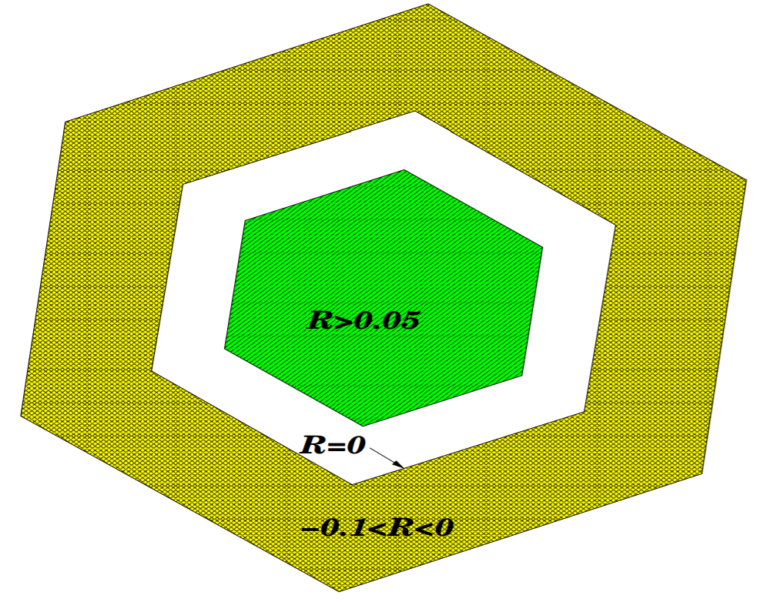
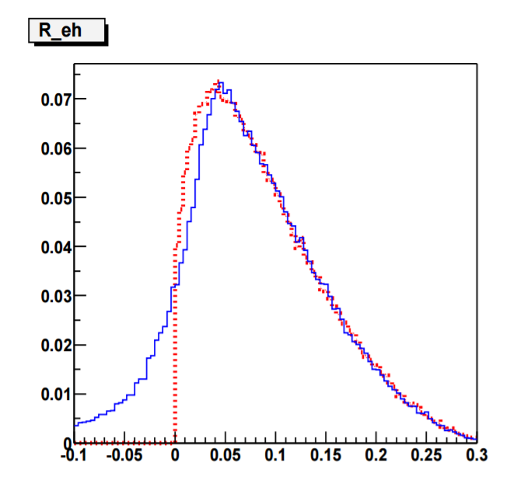
R_function was used to study the acceptance
R_function is the an excellent choice for such event selection.
R_function was used to define a good acceptance region;
1) Inside the polygon R>0.05 2) On the polygon boundary R=0. 3) Outside the polygon boundary -0.1 R<0.
Retrieved from www.physics.umd.edu/enp/jjkelly/e/theses/zwchai_thesis .pdf

Slide 6
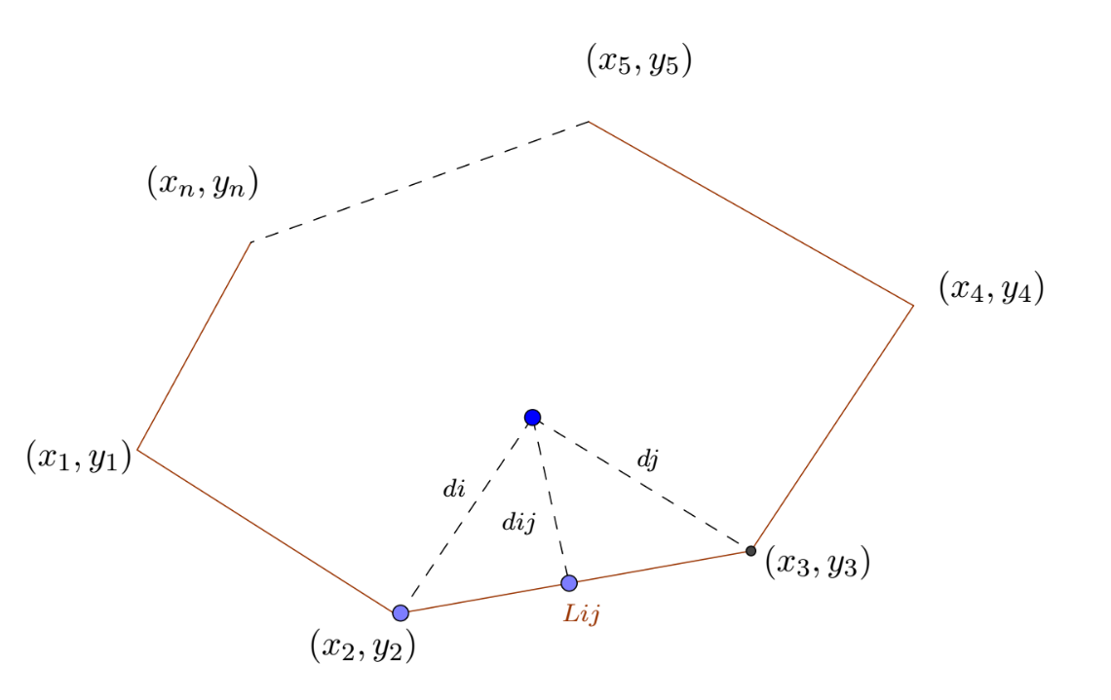
General R_function Definition for one segment of the polygon
R_FUNCTION IS THE MINIMUM DISTANCE FROM THE TESTPOINT (X,Y) TO THE BOUNDARY OF EACH SEGMENT OF THE POLYGON.
IF ${Lij}^{2 }+{di}^{2}−{dj}^{2}$>0 AND ${Lij}^{2 }+{di}^{2}−{dj}^{2}$>0. THEN, $d_{min}$= $d_{ij}$.
IF ${Lij}^{2 }+{di}^{2}−{dj}^{2}<$0 AND ${Lij}^{2 }+{di}^{2}−{dj}^{2}$<0. THEN, $d_{min}$=min($d_{i}$, $d_{j}).$
(x,y)
dddhdcbhdcdjdiqwsioqsncbjeujeduedebffjvhbkecjcnenckew
$$d_{i}$$
$$d_{j}$$
$$d_{ij}$$
(x1,y1)
(x2,y2)
$$L_{ij}$$

Slide 7
Example of polynomial definition in each of the six planes for kin48_1, which is used to define the R_function.

Slide 8
HRS acceptance changed because Q1 was detuned.

Slide 9
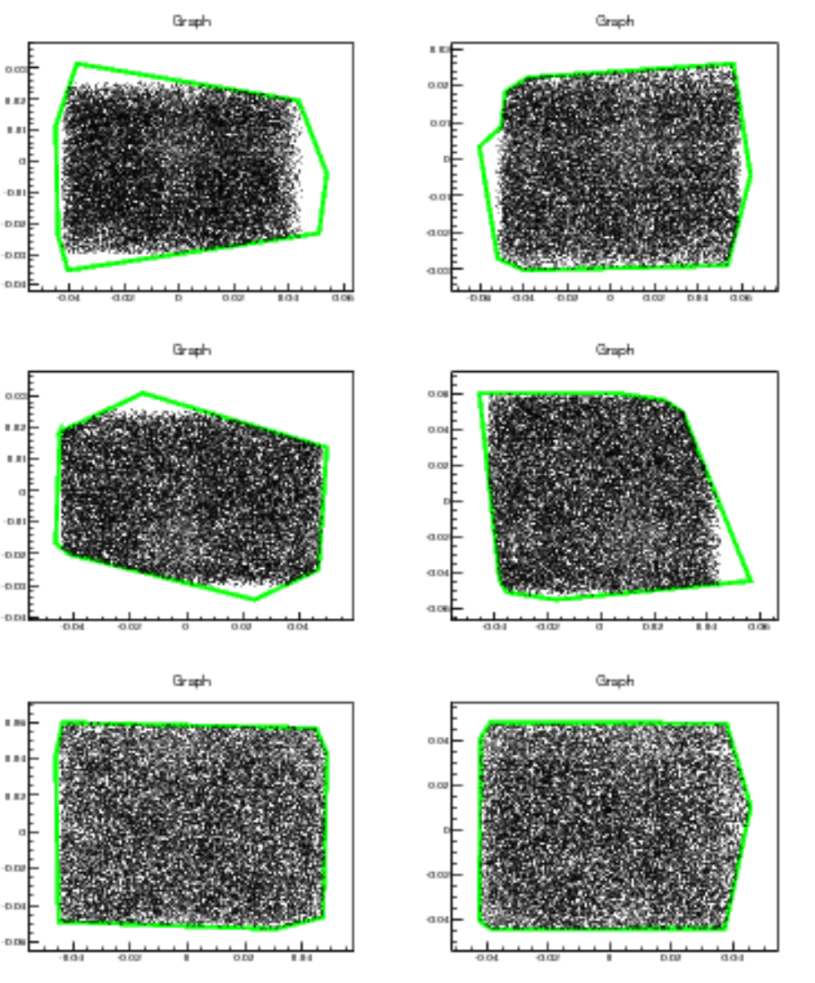
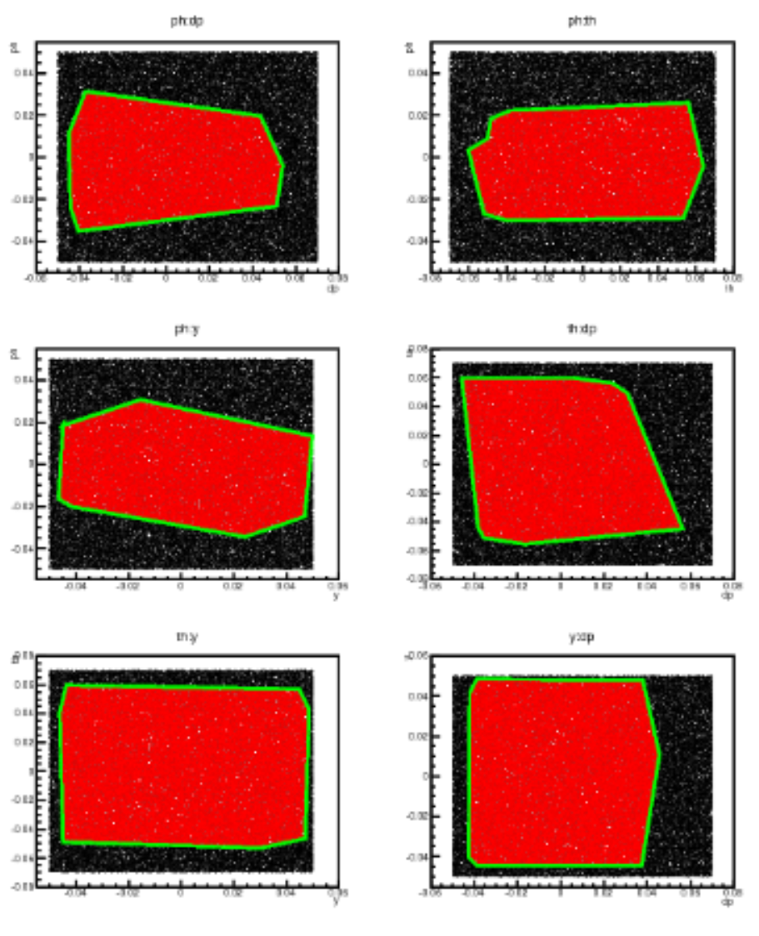
Calculated R_function for Generated data
R>0
R_2D
The left plot shows R_2d for the generated data in each of the six planes.
The right plot shows the minimum r for generated data in between all of the six planes.

Slide 10
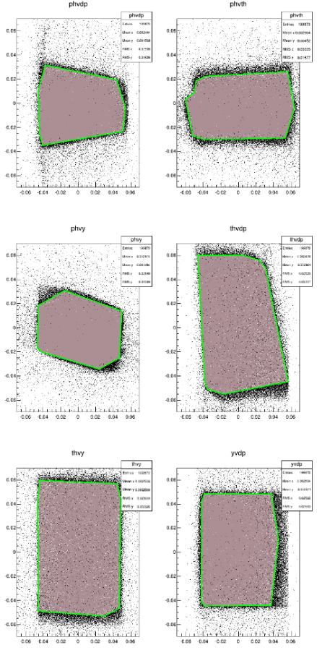
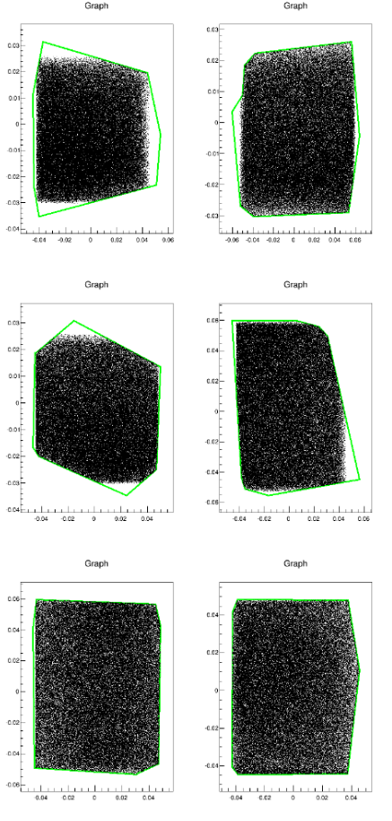
Calculated R_function for data
R_2D
R>0
Ph_dp
Ph_th
ph_dp
ph_th
The left plot shows R_2d for the data in each of the six planes.
The right plot shows the minimum r for data in between all of the six planes.
Ph_y
th_dp
ph_y
Th_dp
Th_y
Y_dp
Th_y
Y_dp

Slide 11
R_function for the data
Events
R_value

Slide 12
Future plans
I will do the simulation for KIn48_1.
I will define the acceptance for all the other kinematics using R_function.
I will evaluate the cross-section.

