Slide 1


Origin of Nucleon Mass in Lattice QCD
Quark and glue components of hadron mass
Decomposition of meson masses
πN σ term, strangeness and charmness
Decomposition of nucleon mass
Trento, Apr. 5, 2017

Slide 2
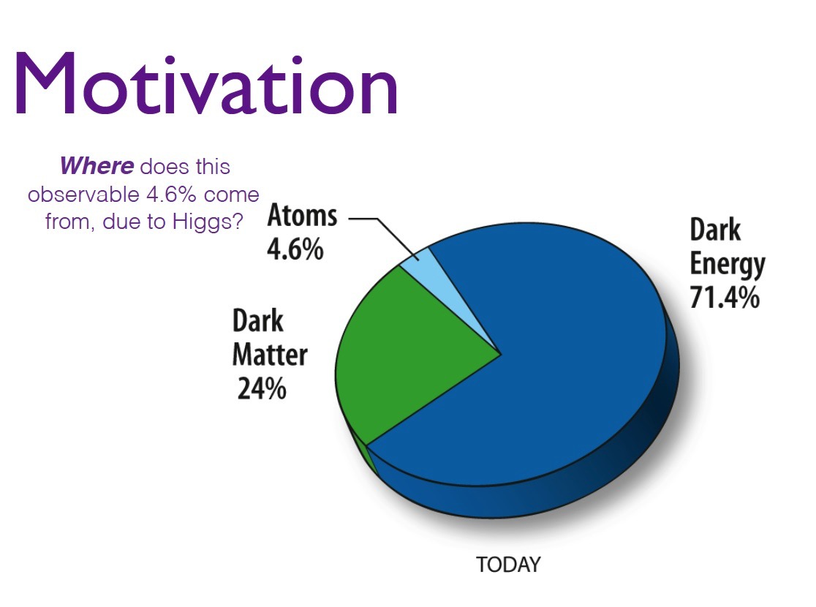

Slide 3
Where does the mass of the hadron come from?
Canonical Conformal Anomaly
M. Chanowitz and J. Ellis,
PRD 7, 2490 (1973)

Slide 4
Quark and Glue Components of Hadron Mass
Energy momentum tensor
Trace anomaly
Separate into traceless part and trace part

Slide 5
Decomposition of hadron mass
  Equation of motion
Xiangdong Ji, PRL 74, 1071 (1995);
PRD 52, 271 (1995)

Slide 6
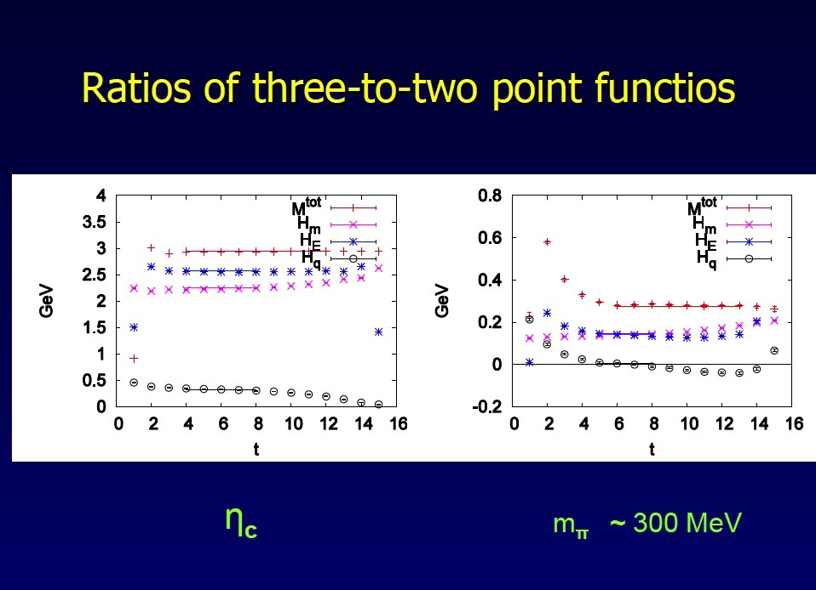

Slide 7
Pseudoscalar meson masses from m_{π} ~ 200 MeV to η_{c} ~3 GeV

Slide 8
Decomposition of Pion Mass

Slide 9
Vector meson masses from
m_{ρ} ~ 800 MeV to J/ψ ~3 GeV

Slide 10
ρ Mass

Slide 11
charmonium
η_{c}
J/ψ

Slide 12
Hyperfine Splitting

Slide 13
2+1 flavor DWF configurations (RBC-UKQCD)
La ~ 4.5 fm m_{π} ~ 170 MeV
32^3 x 64, a =0.137 fm
(O(a²) extrapolation)
La ~ 2.8 fm m_{π} ~ 330 MeV
La ~ 5.5 fm m_{π} ~ 140 MeV
24^3 x 64, a =0.115 fm
48^3 x 96, a =0.115 fm
La ~ 2.7 fm m_{π} ~ 295 MeV
La ~ 5.5 fm m_{π} ~ 140 MeV
32^3 x 64, a =0.085 fm
64^3 x 128, a =0.085 fm

Slide 14
Nucleon Mass

Slide 15
Hadron Structure with Quarks and Glue
Quark and Glue Momentum and Angular Momentum in the Nucleon

Slide 20
Quark Momentum Fraction -- DI

Slide 21
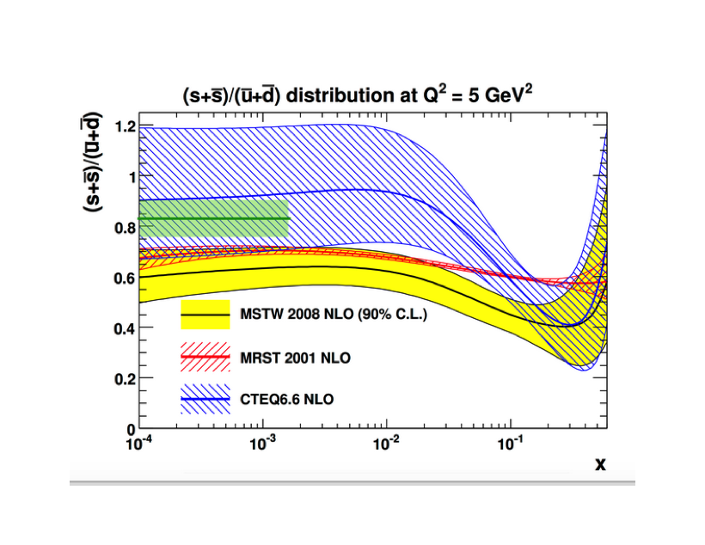
<x>_{s} /<x>_{u/d}(DI) = 0.83(7)
Lattice input to global fitting of PDF

Slide 23
Momenta and Angular Momenta of Quarks and Glue
Energy momentum tensor operators decomposed in quark and
glue parts gauge invariantly --- Xiangdong Ji (1997)
Nucleon form factors
Momentum and Angular Momentum

Slide 24
Renormalization and Quark-Glue Mixing
Normalization from Momentum and Angular Momentum Sum Rules
No anomalous gravito-magnetic moment – S. Brodsky
Renormalization and Mixing
M. Glatzmaier, KFL
arXiv:1403.7211

Slide 27
Nucleon Mass Components
x 1/4

Slide 28
Summary and Challenges
Decomposition of hadron masses into quark and glue components on the lattice is becoming feasible.
Normalization, renomalization and mixing to obtain quark and glue momentum fraction in scheme at 2 GeV is begin carried out.
System errors due to continuum limit at physical pion mass and large lattice volume with chiral fermions are being carried out.
Implication on and connection to experiments need to be addressed.

