Slide 1
Quark’s angular momentum
densities in position space
Based on: LM, Lorcé, Pasquini (in preparation)
Luca Mantovani
1

Slide 2
Outline
Angular Momentum definitions
Densities in position space
3D space
Impact-parameter space
Results in the Scalar Diquark Model
Summary and conclusions
2

Slide 3
Angular momentum definitions
See talk by C. Lorcé
3

Slide 4
Field-theoretical definition
Lagrangian invariant under Lorentz transformations
4

Slide 5
Field-theoretical definition
Lagrangian invariant under Lorentz transformations
Noether’s theorem
Generalized Angular Momentum density
4

Slide 6
Field-theoretical definition
Lagrangian invariant under Lorentz transformations
Noether’s theorem
Generalized Angular Momentum density
Canonical Energy-Momentum Tensor
In general:
4

Slide 7
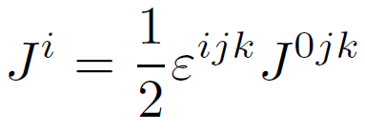
Field-theoretical definition
Lagrangian invariant under Lorentz transformations
Noether’s theorem
Generalized Angular Momentum density
Space components
Spin
Total AM
Orbital Angular Momentum (OAM)
4

Slide 8
Belinfante’s improved EMT
Belinfante, Rosenfeld (1940)
5

Slide 9
Belinfante’s improved EMT
Belinfante’s Generalized Angular Momentum density
with
Belinfante, Rosenfeld (1940)
5

Slide 10
Belinfante’s improved EMT
Belinfante’s Generalized Angular Momentum density
with
Belinfante, Rosenfeld (1940)
5

Slide 11
Canonical vs Belinfante’s total AM
Canonical
Belinfante
6

Slide 12
Canonical vs Belinfante’s total AM
Canonical
Belinfante
Clear distinction between OAM
and spin at the density level
Purely OAM density
6

Slide 13
Canonical vs Belinfante’s total AM
Canonical
Belinfante
Clear distinction between OAM
and spin at the density level
Purely OAM density
In general non-symmetric
Symmetric
6

Slide 14
Canonical vs Belinfante’s total AM
Canonical
Belinfante
Clear distinction between OAM
and spin at the density level
Purely OAM density
In general non-symmetric
Symmetric
Density level:
Integrating:
6

Slide 15
Canonical vs Belinfante’s total AM
Canonical
Belinfante
Clear distinction between OAM
and spin at the density level
Purely OAM density
In general non-symmetric
Symmetric
Density level:
Integrating:
No reason a priori to choose the Belinfante’s version
6

Slide 16
Kinetic EMT in QCD
Ji (1997)
7

Slide 17
Kinetic EMT in QCD
Ji (1997)
We focus on the quark part
7

Slide 18
Kinetic EMT in QCD
Ji (1995)
We focus on the quark part
The quark’s spin density is
7

Slide 19
Kinetic vs Belinfante’s quark EMT
8

Slide 20
Kinetic vs Belinfante’s quark EMT
Total AM
8

Slide 21
Kinetic vs Belinfante’s quark EMT
Total AM
Total AM
8

Slide 22
Kinetic vs Belinfante’s quark EMT
Total AM
Total AM
Non-symmetric
Symmetric
8

Slide 23
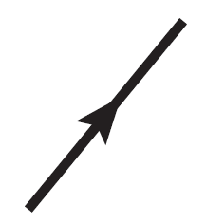
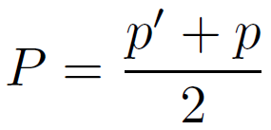
Form factors of the kinetic EMT
Bakker, Leader, Trueman (2004)
The average position is Fourier conjugate of
9

Slide 24
Form factors of the EMT
9

Slide 25
Form factors of the quark spin operator
10

Slide 26
Form factors of the quark spin operator
Axial-vector form factor
Induced-pseudoscalar form factor
From QCD Equations of motion
10

Slide 27
Densities in position space
11

Slide 28
OAM density in four-dimensional space
12

Slide 29
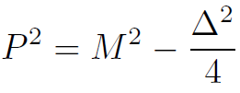
OAM density in four-dimensional space
From on-shell conditions:
depends on !!
12

Slide 30
OAM density in four-dimensional space
From on-shell conditions:
depends on !!
Explicit dependence on time
12

Slide 31
Breit frame densities
13

Slide 32
Breit frame densities
True density with probabilistic interpretation
13

Slide 33
Breit frame densities
With form factors
True density with probabilistic interpretation
13

Slide 34
Breit frame densities
OAM
14

Slide 35
Breit frame densities
OAM
Belinfante’s total AM
14

Slide 36
Breit frame densities
OAM
Belinfante’s total AM
Spin

Slide 37
Breit frame densities
OAM
Belinfante’s total AM
Spin
14

Slide 38
Breit frame densities
OAM
Belinfante’s total AM
Spin
Surface term
14

Slide 39
Breit frame densities
OAM
Belinfante’s total AM
Spin
Surface term
14

Slide 40
Breit frame densities
Belinfante’s total AM
15

Slide 41
Breit frame densities
Belinfante’s total AM
Monopole contribution
15

Slide 42
Breit frame densities
Belinfante’s total AM
Monopole contribution
Quadrupole contribution
Often discarded in the literature!
Polyakov (2003)
Goeke et al. (2007)
15

Slide 43
Elastic frame densities
16

Slide 44
Elastic frame densities
2D densities in the impact-parameter space
16

Slide 45
Elastic frame densities
2D densities in the impact-parameter space
We consider only the longitudal components
No explicit dependence on
16

Slide 46
Light-front densities
Light-cone coordinates
OAM density
17

Slide 47
Light-front densities
Light-cone coordinates
OAM density
17

Slide 48
Light-front densities
Light-cone coordinates
OAM density
Drell-Yan frame
(also )
Burkardt (2002)
17

Slide 49
Light-front densities
Light-cone coordinates
OAM density
Drell-Yan frame
(also )
Burkardt (2002)
2D densities in the impact-parameter space
17

Slide 50
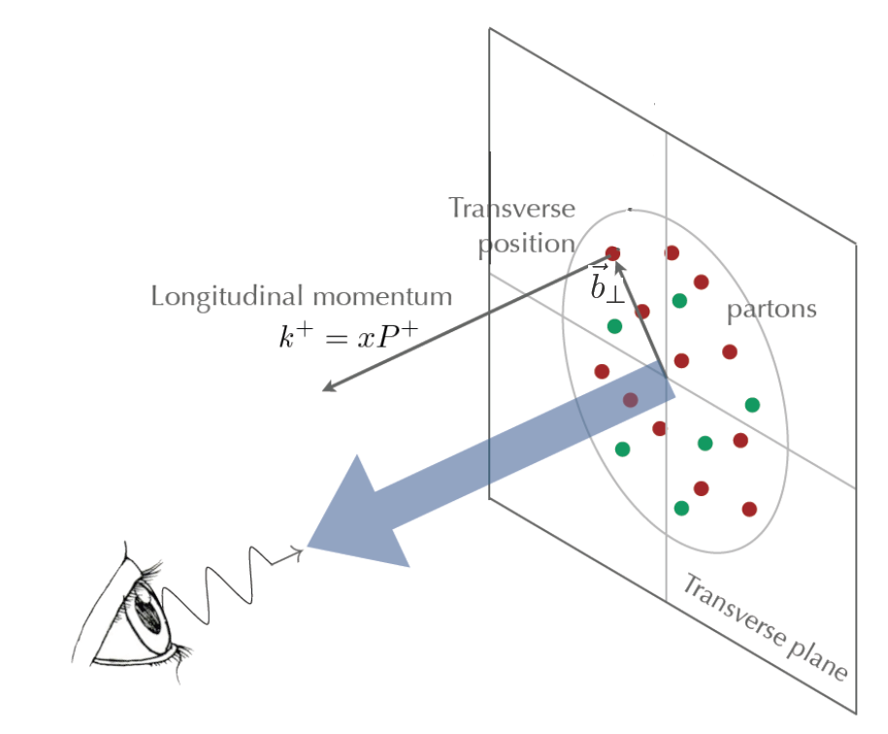
Light-front densities
18

Slide 51
Light-front densities
Instant form in elastic frame for is equivalent to light-front
18

Slide 52
Densities in the impact-parameter space
Fourier transform of the form factors in the space
OAM density
19

Slide 53
Densities in the impact-parameter space
OAM
Belinfante’s total AM
Spin
Surface term
20

Slide 54
Densities in the impact-parameter space
Belinfante’s total AM
Monopole contribution
Quadrupole contribution
21

Slide 55
Results in the scalar diquark model
See Adhikari, Burkardt (2016)
22

Slide 56
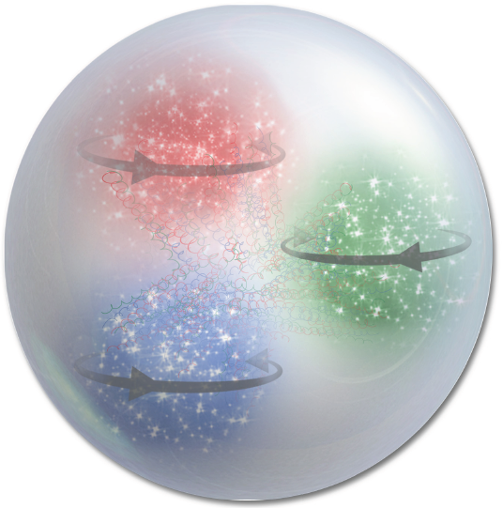
Scalar diquark model
Nucleon, mass
23

Slide 57
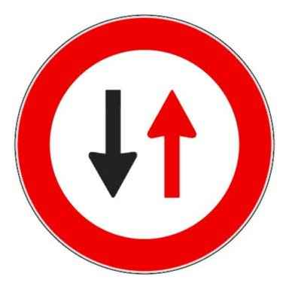
Scalar diquark model
Spin 0 diquark,
mass
$$\sim$$
Nucleon, mass
Spin 1/2 active quark, mass
23

Slide 58
Scalar diquark model
Spin 0 diquark,
mass
$$\sim$$
Nucleon, mass
Spin 1/2 active quark, mass
Yukawa coupling
No gauge field
23

Slide 59
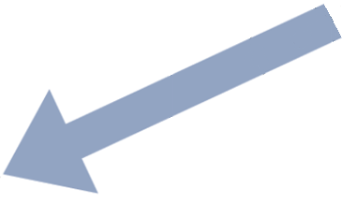
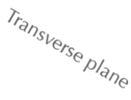
Quark’s Light-Front Wave Functions
24

Slide 60
Quark’s Light-Front Wave Functions
Adhikari, Burkardt (2016)
Probabilistic
interpretation
24

Slide 61
Quark’s Light-Front Wave Functions
Adhikari, Burkardt (2016)
Probabilistic
interpretation
Brodsky, Diehl, Hwang (2000)
24

Slide 62
Form factors of the EMT
For both quark and gluon components
Bakker, Leader, Trueman (2004)
GPD
25

Slide 63
Form factors in LFWF representation
26

Slide 64
Form factors in LFWF representation
Form factors from GPDs
in impact-parameter space
Ji (1997)
Diehl (2003)
26

Slide 65
Form factors in LFWF representation
Form factors from GPDs
in impact-parameter space
GPDs overlap representation
Ji (1997)
Diehl (2003)
Burkardt, Hwang (2004)
26

Slide 66
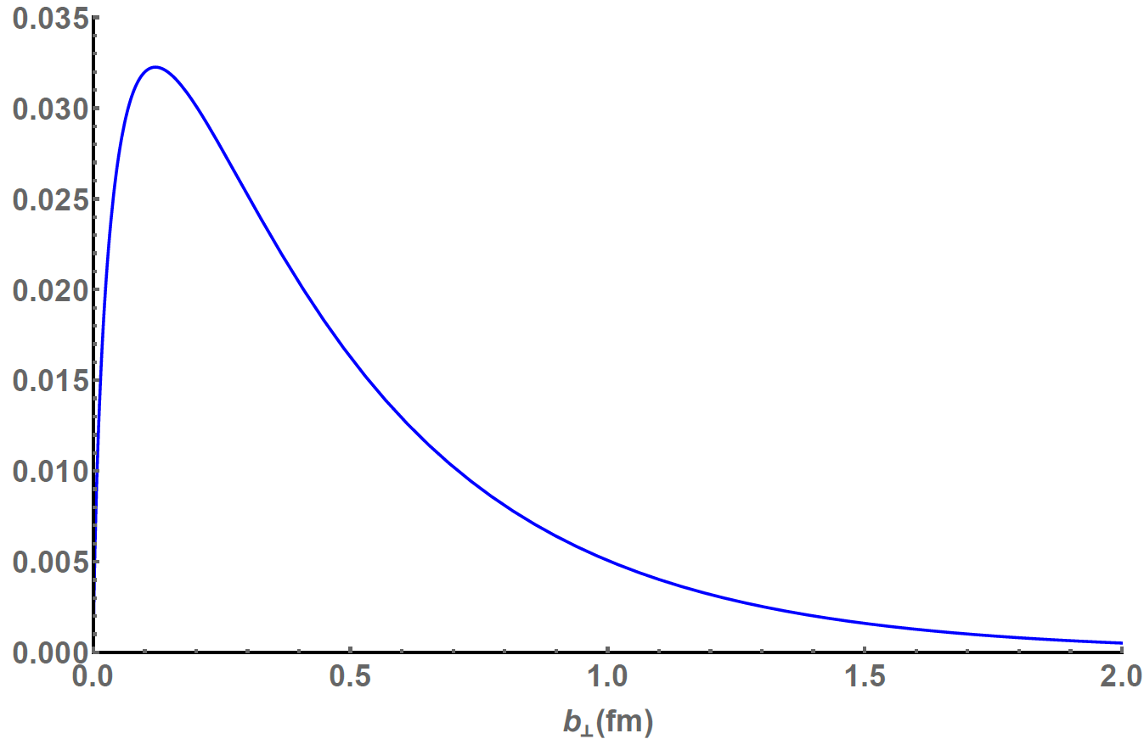
Kinetic OAM
27

Slide 67
OAM directly from LFWFs
Scalar Diquark Model has no gauge field
Jaffe-Manohar OAM
27

Slide 68
OAM directly from LFWFs
Scalar Diquark Model has no gauge field
Jaffe-Manohar OAM
27

Slide 69
OAM directly from LFWFs
$$=$$
Valid for all models with no gauge fields
28

Slide 70
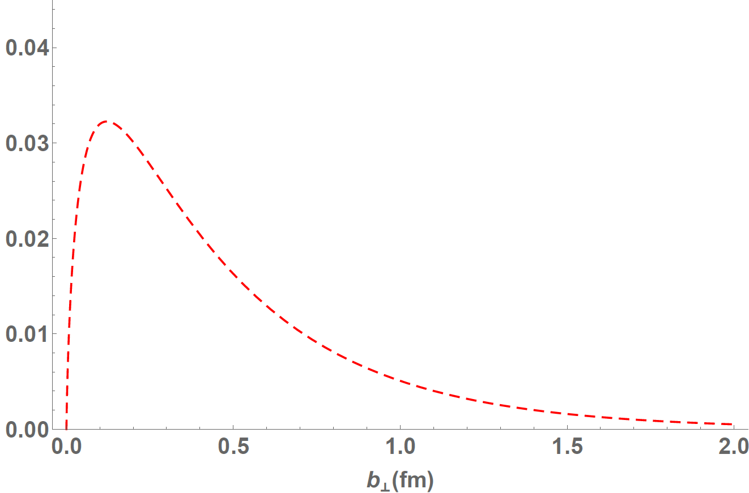
Kinetic OAM
29

Slide 71
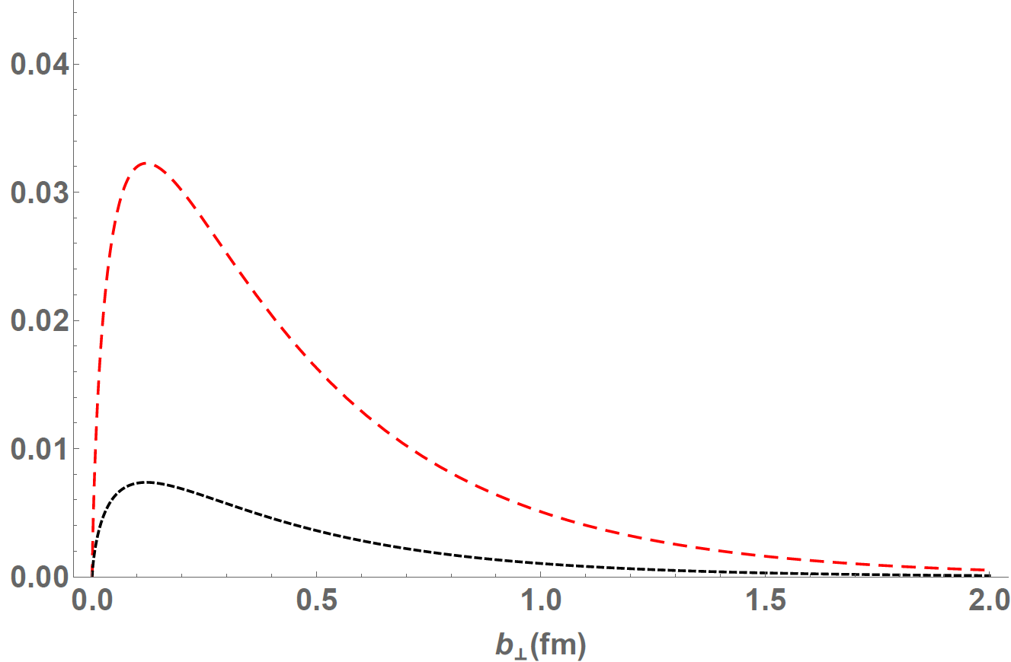
Kinetic spin term
29

Slide 72
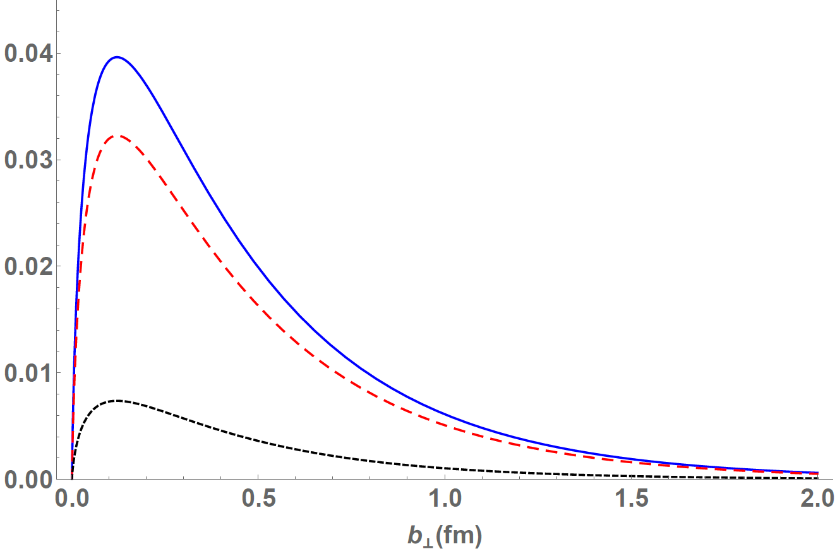
Kinetic total AM
29

Slide 73
Kinetic OAM
30

Slide 74
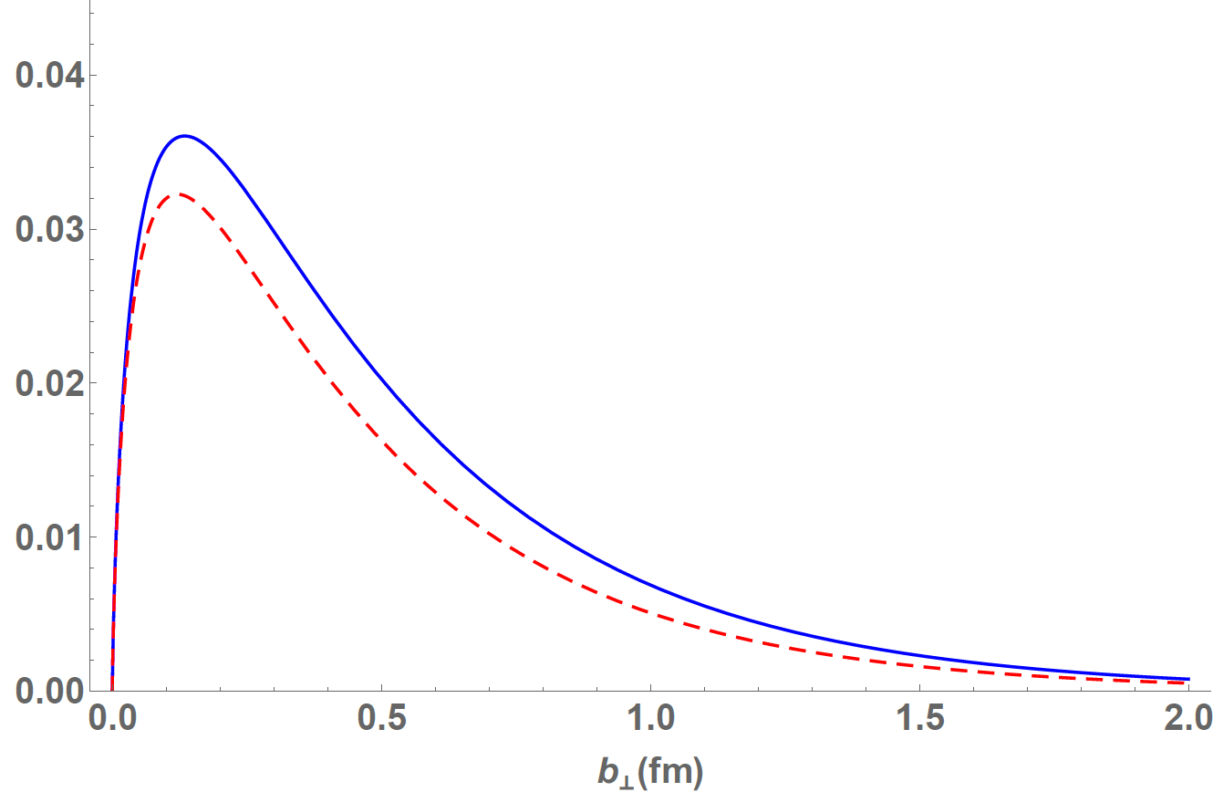
Belinfante’s AM
30

Slide 75
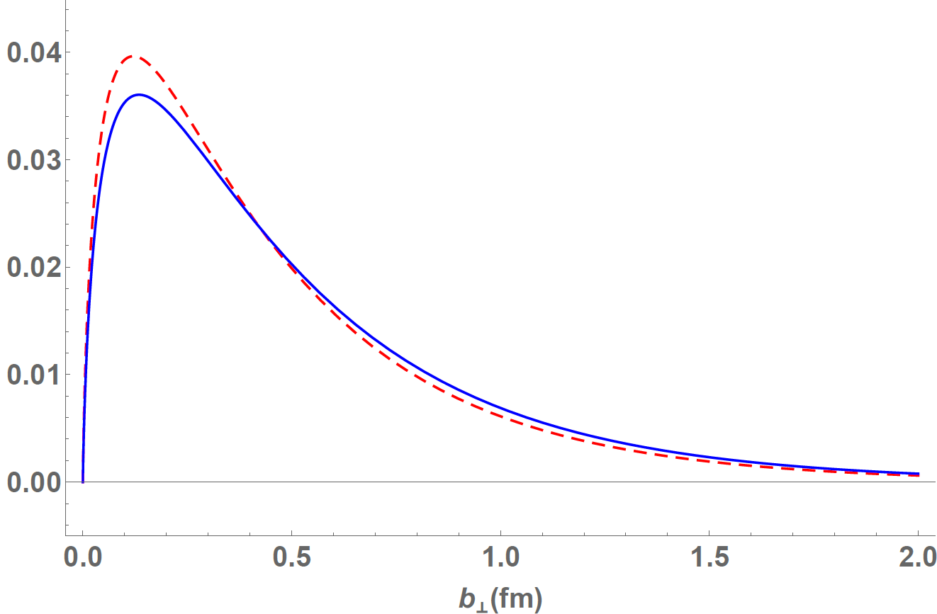
Belinfante’s and kinetic total AM
30

Slide 76
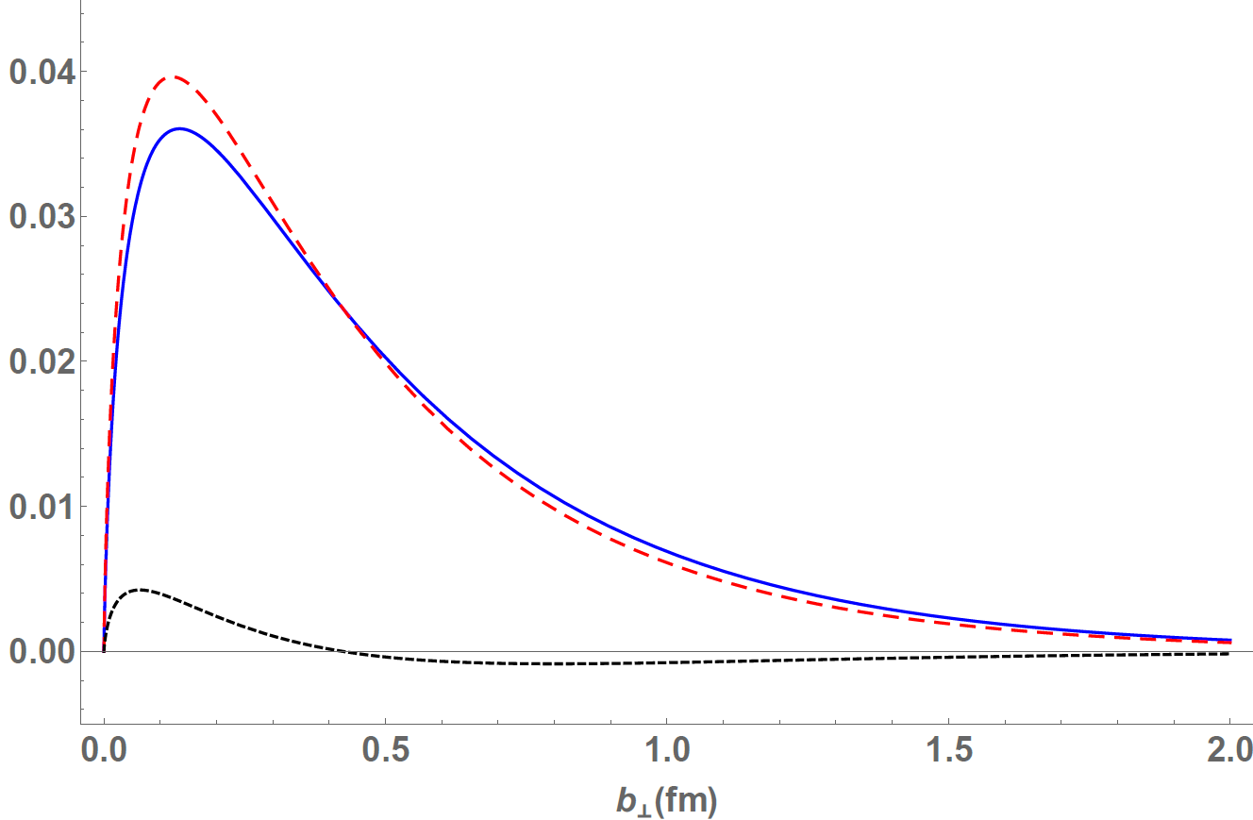
Belinfante’s and kinetic total AM
30

Slide 77
Belinfante’s and kinetic total AM
30

Slide 78
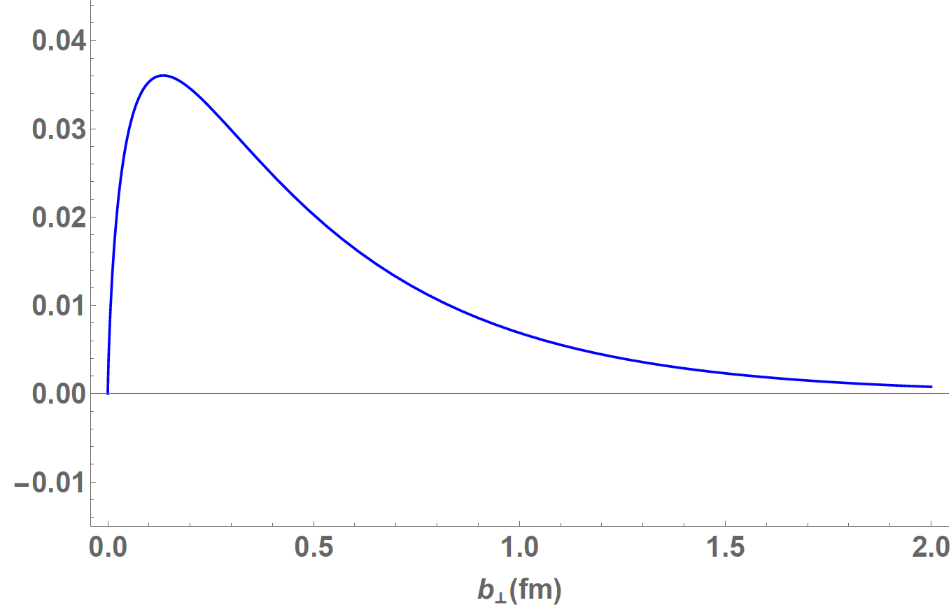
Belinfante’s monopole contribution
31

Slide 79
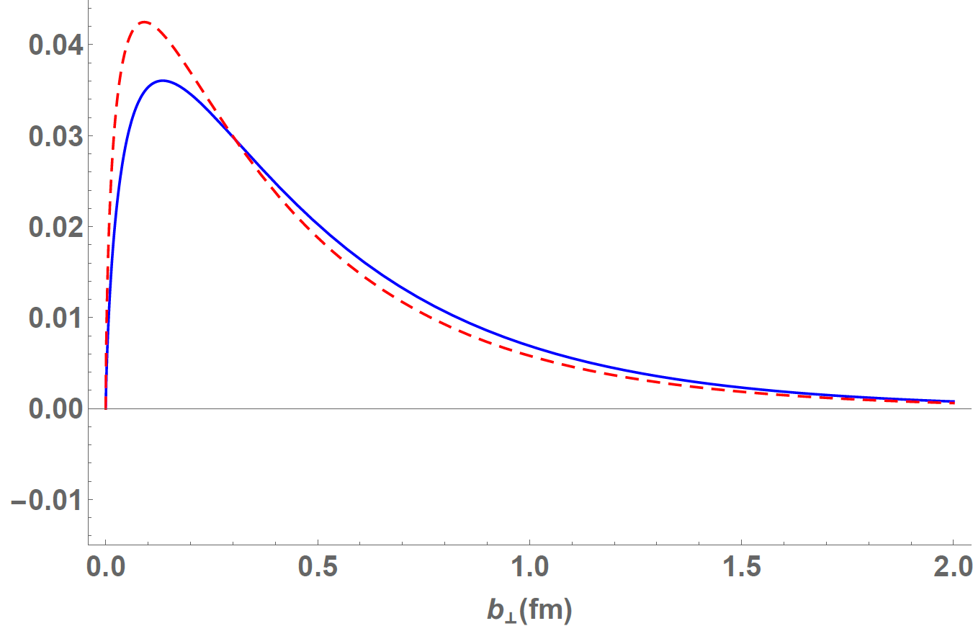
Belinfante’s monopole contribution
31

Slide 80
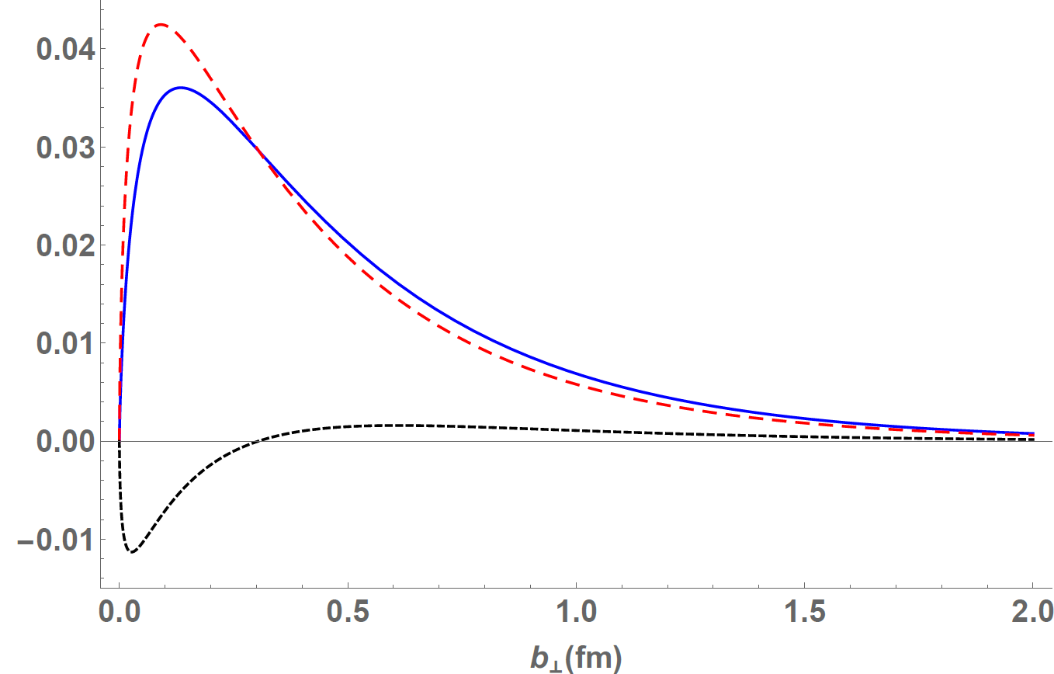
Belinfante’s quadrupole contribution
31

Slide 81
Belinfante’s quadrupole contribution
31

Slide 82
Summary and conclusions
32

Slide 83
Summary
I discussed the densities of angular momentum in position space, in 3D (Breit frame) and 2D (Elastic frame and light front).
Comparison between kinetic and Belinfante’s version of the quark EMT: at the density level, we have
while when integrating
33

Slide 84
Summary
I discussed the densities of angular momentum in position space, in 3D (Breit frame) and 2D (Elastic frame and light front in the Drell-Yan frame).
Elastic frame
DY frame
33

Slide 85
Summary
I discussed the densities of angular momentum in position space, in 3D (Breit frame) and 2D (Elastic frame and light front in the Drell-Yan frame).
Longitudinal components
Breit frame
Elastic frame
DY frame
33

Slide 86
Summary
I discussed the densities of angular momentum in position space, in 3D (Breit frame) and 2D (Elastic frame and light front in the Drell-Yan frame).
Longitudinal components
Breit frame
Elastic frame
DY frame
33

Slide 87
Summary
I discussed the densities of angular momentum in position space, in 3D (Breit frame) and 2D (Elastic frame and light front in the Drell-Yan frame).
Longitudinal components
Breit frame
Elastic frame
DY frame
33

Slide 88
Summary
I discussed the densities of angular momentum in position space, in 3D (Breit frame) and 2D (Elastic frame and light front in the Drell-Yan frame).
Longitudinal components
Breit frame
Elastic frame
DY frame
33

Slide 89
Summary
I discussed the densities of angular momentum in position space, in 3D (Breit frame) and 2D (Elastic frame and light front in the Drell-Yan frame).
Longitudinal components
Breit frame
Elastic frame
DY frame
Crucial at the
density level
Compare with Adhikari, Burkardt (2016),
Polyakov (2003), Goeke et al. (2007)
33

