Slide 1
Perspective on
the Origin
of Hadron Masses
Craig Roberts

Slide 2
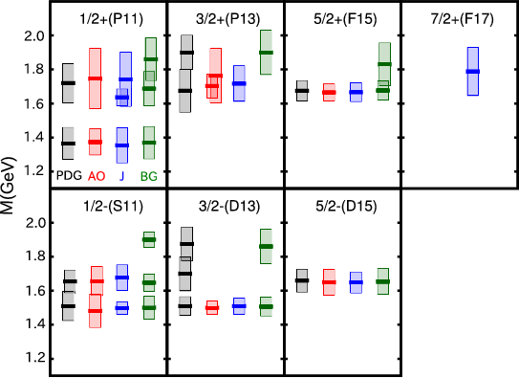
Strong Interactions in the Standard Model of Particle Physics
Extract from spectrum of nucleon states (resonances) with
mass less-than 2GeV
Experiment (PDG) compared with theory (AO, J, BG)
Theory results are outcome of massive computational effort, analysing 22,348 independent data points, representing complete array of partial waves
Nature’s scale for visible, strongly-interacting matter
= 1 GeV = 1.783×10⁻²⁷ kg ≈ 2000 × m_{e}

Slide 3
Strong Interactions in the Standard Model of Particle Physics
Extract from spectrum of nucleon states (resonances) with
mass less-than 2GeV
Experiment (PDG) compared with theory (AO, J, BG)
Theory results are outcome of massive computational effort, analysing 22,348 independent data points, representing complete array of partial waves
Why?
How?
Nature’s scale for visible, strongly-interacting matter
= 1 GeV = 1.783×10⁻²⁷ kg ≈ 2000 × m_{e}

Slide 4
Strong Interactions in the Standard Model of Particle Physics
Only apparent scale in chromodynamics is mass of the quark field
In connection with everyday matter, that mass is 1/250th of the natural (empirical) scale for strong interactions,
viz. more-than two orders-of-magnitude smaller
Quark mass is said to be generated by Higgs boson.
Plainly, however, that mass is very far removed from the natural scale for strongly-interacting matter
Nuclear physics mass-scale – 1 GeV – is an emergent feature of the Standard Model
No amount of staring at L_{QCD} can reveal that scale
Contrast with quantum electrodynamics, e.g. spectrum of hydrogen levels measured in units of m_{e}, which appears in L_{QED}

Slide 5
What & Where is Mass?

Slide 6
Whence Mass?
Classical chromdynamics … non-Abelian local gauge theory
Remove the current mass … no energy scale left
No dynamics in a scale-invariant theory; only kinematics … the theory looks the same at all length-scales … there can be no clumps of anything … hence bound-states are impossible.
Our Universe can’t exist
Higgs boson doesn’t solve this problem … normal matter is constituted from light-quarks & the mass of protons and neutrons, the kernels of all visible matter, are 100-times larger than anything the Higgs can produce
Where did it all begin?
… becomes … Where did it all come from?

Slide 7
Whence Mass?
Poincaré invariance entails that the Energy-Momentum Tensor is divergence-free, i.e. it defines a conserved current:
Noether current associated with a global scale transformation:
x → e^{-σ} x
is the dilation current: D_{μν}=T_{μν} x_{ν}
In a scale invariant theory, the dilation current is conserved
Consequently, in a scale invariant theory
the energy-momentum tensor must be traceless: T_{μμ} ≡ 0
T_{μν} can always
be made symmetric

Slide 8
Trace Anomaly
Classical chromodynamics is meaningless … must be quantised
Regularisation and renormalisation of (ultraviolet) divergences introduces a mass-scale
… dimensional transmutation: mass-dimensionless quantities become dependent on a mass-scale, ζ
α → α(ζ) in QCD’s (massless) Lagrangian density, L(m=0)
Under a scale transformation ζ → e^{σ} ζ, then α → σ αβ(α)
L→ σ αβ(α) dL/dα
⇒ ∂_{μ}D_{μ} = δL/δσ = αβ(α) dL/dα = β(α) ¼G_{μν} G_{μν} = T_{ρρ} =: Θ₀
Straightforward, nonperturbative derivation, without need for diagrammatic analysis …
quantisation of renormalisable four-dimensional theory forces nonzero value for trace of energy-momentum tensor
QCD β function
Trace anomaly
Notes:
Alpha -> alpha(zeta) seems to be enough to generate M(zeta), which is large for zeta small.

Slide 9
Where is the mass?

Slide 10
Trace Anomaly
Knowing that a trace anomaly exists does not deliver a great deal … indicates only that a mass-scale exists
Can one compute and/or understand the magnitude of that scale?
One can certainly measure the magnitude … consider proton:
In the chiral limit the entirety of the proton’s mass is produced by the trace anomaly, Θ₀
… In QCD, Θ₀ measures the strength of gluon self-interactions
… so, from one perspective, m_{p} is completely generated by glue.

Slide 11
On the other hand …

Slide 12
Trace Anomaly
In the chiral limit
⇒
Does this mean that the scale anomaly vanishes trivially in the pion state, i.e. gluons contribute nothing to the pion mass?
That is a difficult way to obtain “zero”
Easier, perhaps, to imagine that “zero” owes to cancellations between different operator-component contributions to the expectation value of Θ₀.
Of course, such precise cancellation should not be an accident.
It could only arise naturally because of some symmetry and/or symmetry-breaking pattern.

Slide 13
Trace Anomaly
In the chiral limit
⇒
No statement of the question
“Whence the proton's mass?”
is complete without the additional clause
“Whence the absence of a pion mass?”
Natural nuclear-physics mass-scale must emerge simultaneously with apparent preservation of scale invariance in related systems
Expectation value of Θ₀ in pion is always zero, irrespective of the size of the natural mass-scale for strong interactions = m_{p}

Slide 14
Whence “1” and yet “0” ?
Both statements are Poincaré invariant
In connection with any bound-state
only two things that any two observers can certainly agree upon:
eigenvalues of the two Casimir operators of the Poincaré group evaluated in that state:
M² → m² & W² → m² j(j+1)
… the mass and total spin
No decomposition of these quantities into separate contributions from constituents can ever be Poincaré-invariant or scale-invariant
This fact lies at the heart of the so-called “spin-crisis”, which could therefore have been avoided

Slide 15
Whence “1” and yet “0” ?
Even using light-front quantisation, both the natures of and contributions from constituents changes with resolving scale, ζ
In fact, the meaning of constituent changes with ζ
Can it be sensible to attempt an expression of these trace anomaly statements in a particular frame, e.g. a hadron’s rest-frame?
Difficulty
… a massless particle doesn’t have a rest frame
For a unified, simultaneous description,
a Poincaré-invariant analysis would seem to be advantageous

Slide 16
Whence?
Classical chromodynamics … non-Abelian local gauge theory
Local gauge invariance; but there is no confinement without a mass-scale
Three quarks can still be colour-singlet
Colour rotations will keep them colour singlets
But they need have no proximity to one another
… proximity is meaningless in a scale-invariant theory
Whence mass … equivalent to whence a mass-scale … equivalent to whence a confinement scale
Understanding the origin and absence of mass in QCD is quite likely inseparable from the task of understanding confinement.
Existence alone of a scale anomaly answers neither question

Slide 17
A New Era for hadro-particle physics

Slide 18
Overarching Science Challenges for the coming decade
What is origin of mass in our Universe?
What is the nature of confinement in real (dynamical-quarks) QCD?
How are they connected?
How can any
answers,
conjectures
and/or conclusions
be empirically verified?
Physics is an
Empirical Science

Slide 19
What is Confinement?

Slide 20
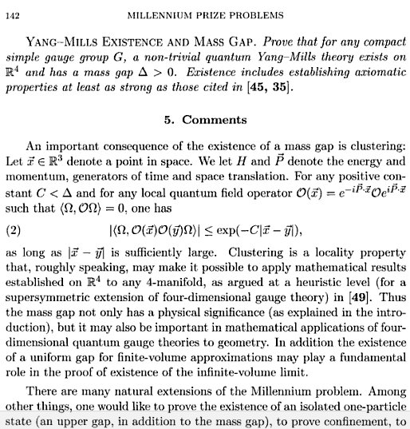
Confinement?
Millennium prize of $1,000,000 for proving that SU_{c}(3) gauge theory is mathematically well-defined, which will necessarily prove or disprove a confinement conjecture

Slide 21
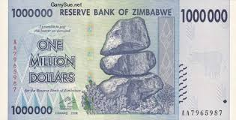
Confinement?
Millennium prize of $1,000,000 for proving that SU_{c}(3) gauge theory is mathematically well-defined, which will necessarily prove or disprove a confinement conjecture

Slide 22
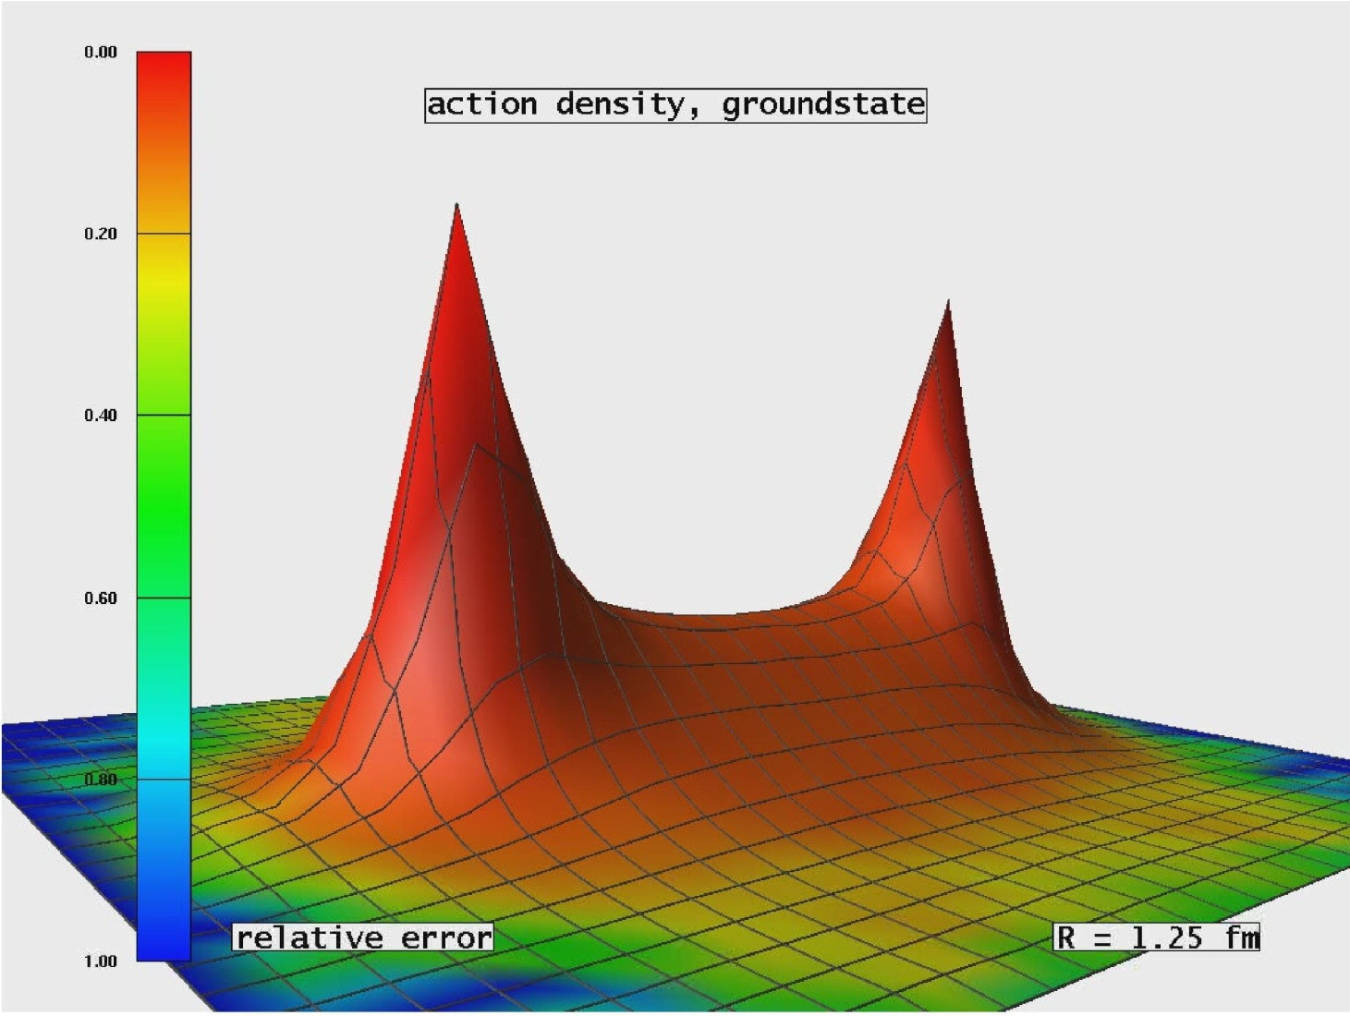
Light quarks & Confinement
Folklore … Hall-D Conceptual Design Report(5)
“The color field lines between a quark and an anti-quark form flux tubes.
A unit area placed midway between the quarks and perpendicular to the line connecting them intercepts a constant number of field lines, independent of the distance between the quarks.
This leads to a constant force between the quarks – and a large force at that, equal to about 16 metric tons.”

Slide 23
Light quarks & Confinement
Problem:
16 tonnes of force
makes a lot of pions.

Slide 24
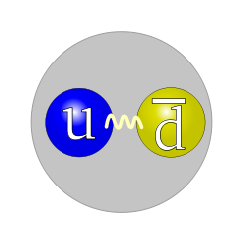
Light quarks & Confinement
Problem:
16 tonnes of force
makes a lot of pions.

Slide 25
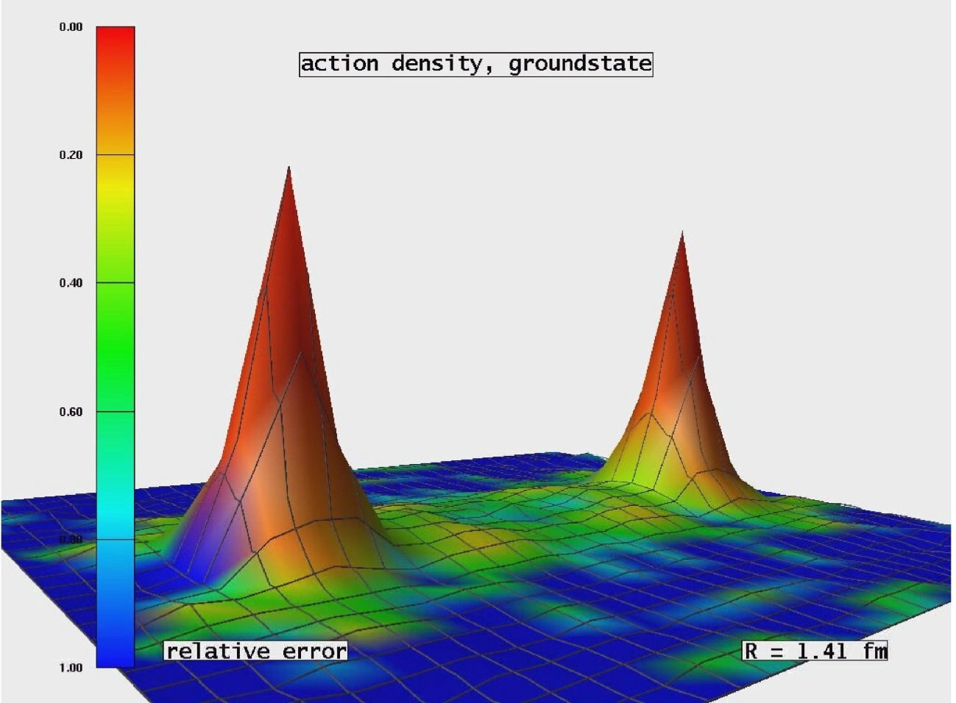
Light quarks & Confinement
G. Bali et al., PoS LAT2005 (2006) 308
In the presence of light quarks, pair creation seems to occur non-localized and instantaneously
No flux tube in a theory with light-quarks.
Flux-tube is not the correct paradigm for confinement in hadron physics

Slide 26
Light quarks & Confinement
G. Bali et al., PoS LAT2005 (2006) 308
In the presence of light quarks, pair creation seems to occur non-localized and instantaneously
No flux tube in a theory with light-quarks.
Flux-tube is not the correct paradigm for confinement in hadron physics
Confinement contains condensates Brodsky, Roberts, Shrock,Tandy arXiv:1202.2376 [nucl-th], Phys. Rev. C85 (2012) 065202
Nothing here, between the hadrons. No flux tubes, no condensates.
It’s the “trivial vacuum.”

Slide 27
Existence of mass-gap in pure-gauge theory
Strong evidence supporting this conjecture: lQCD predicts Δ ∼ 1.5 GeV
But Δ²/m_{π}² > 100,
So, can mass-gap in pure Yang-Mills play any role in understanding confinement when dynamical chiral symmetry breaking (DCSB) ensures existence of an almost-massless strongly-interacting excitation in our Universe?
Conjecture: If answer is not simply no, then it is probable that one cannot claim to provide an understanding of confinement without simultaneously explaining its connection with DCSB.
Conjecture: Pion must play critical role in any explanation of real-world confinement. Any discussion that omits reference to the pion's role is possibly irrelevant.

Slide 28
Reductive explanation of emergent phenomena?
Confinement and DCSB are emergent phenomena
Not revealed by any amount of staring at L_{QCD}
Yet, arguably, they determine the character of the QCD’s spectrum, and the structure and interactions of bound states
Can one understand confinement and DCSB in terms of properties of the degrees-of-freedom used to formulate QCD?
OR … Does the complexity of strong interaction phenomena make prediction and explanation impractical?
E.g., is it pointless to attempt to predict the nucleon’s form factor on a domain that is not yet empirically accessible?

Slide 29
Nonperturbative QCD
If YES:
Must rely on the vast array of effective field theories, developed for different systems, in order, e.g. to express & understand the consequences of confinement & DCSB, without identifying their source
If NO
Must develop nonperturbative calculational methods to define and tackle QCD
Lattice-regularised QCD
Continuum methods in quantum field theory
Truncation schemes and/or models,
each with varying degrees of separation from QCD
Combinations of all the above
Currently, each approach has strengths and weaknesses
So (iii) is probably the best:
combine all available methods to fullest extent reasonably possible

Slide 30
Gluon Gap Equation
Pinch Technique: Theory and Applications
Daniele Binosi & Joannis Papavassiliou
Phys. Rept. 479 (2009) 1-152

Slide 31
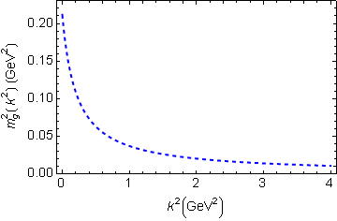
In QCD: Gluons become massive!
Bridging a gap between continuum-QCD and ab initio predictions of hadron observables, D. Binosi et al., arXiv:1412.4782 [nucl-th], Phys. Lett. B742 (2015) 183-188
Running gluon mass
Gluons are cannibals – a particle species whose members become massive by eating each other!
Expression of trace anomaly:
Massless glue becomes massive
gluon mass-squared function
Power-law suppressed in ultraviolet, so invisible in perturbation theory
5%
Interaction model for the gap equation, S.-x.Qin et al., arXiv:1108.0603 [nucl-th], Phys. Rev. C 84 (2011) 042202(R) [5 pages]
Class A: Combining DSE, lQCD and pQCD analyses of QCD’s gauge sector

Slide 32
Massive Gauge Bosons!
Gauge boson cannibalism
… a new physics frontier … within the Standard Model
Asymptotic freedom means
… ultraviolet behaviour of QCD is controllable
Dynamically generated masses for gluons and quarks means that QCD dynamically generates its own infrared cutoffs
Gluons and quarks with
wavelength λ > 2/mass ≈ 1 fm
decouple from the dynamics … Confinement?!
How does that affect observables?
It will have an impact in
any continuum study
Possibly (probably?) plays a role in gluon saturation ...
In fact, could be a harbinger of gluon saturation?

Slide 33
Confinement is dynamical

Slide 34
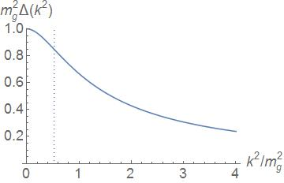
Confinement
All continuum and lattice solutions for Landau-gauge gluon & quark propagators exhibit an inflection point in k²
Violate reflection positivity = sufficient for confinement
Such states have negative norm
All observable states of a physical Hamiltonian have positive norm
Negative norm states are not observable
Inflexion point corresponds to r_{C} ≈ 0.5 fm:
Parton-like behaviour at shorter distances;
But propagation characteristics changed dramatically at larger distances.
m_{g} ≈ ½ m_{p} ≈ 0.47 GeV
Conformal anomaly: massless gauge boson acquires a Schwinger mass

Slide 35
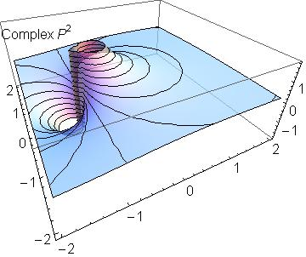
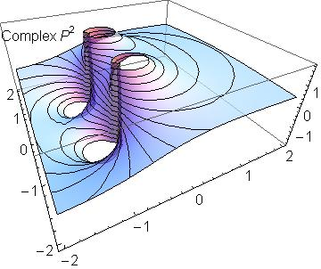
Confinement
Meaning (illustration) …
σ ≈ 1/Im(m)
≈ 1/2Λ_{QCD} ≈ ½fm
Real-particle mass-pole splits, moving into pair(s) of complex conjugate singularities, (or qualitatively analogous structures chracterised by a dynamically generated mass-scale)
Propagation described by rapidly damped wave & hence state cannot exist in observable spectrum

Slide 36
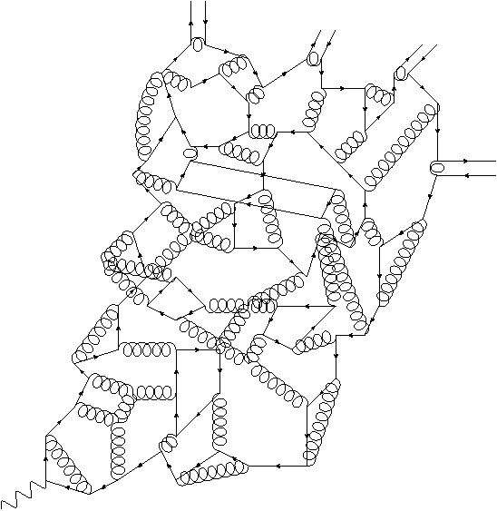
Quark Fragmentation
A quark begins to propagate
But after each “step” of length σ, on average, an interaction occurs, so that the quark loses its identity, sharing it with other partons
Finally, a cloud of partons is produced, which coalesces into colour-singlet final states
meson
meson
meson
meson
σ
Confinement is a dynamical phenomenon!

Slide 37
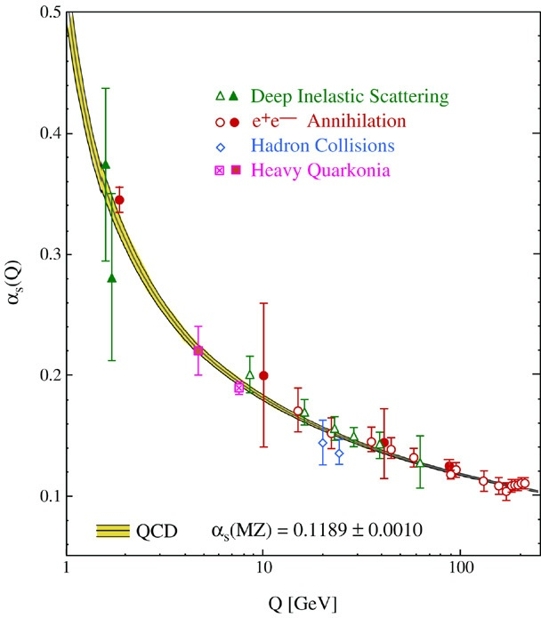
QCD’s Running Coupling
⇐
What’s happening
out here?!

Slide 38
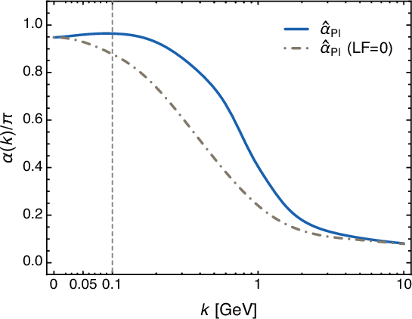
Process-independent QCD Effective Charge
Process independent strong running coupling
Binosi, Mezrag, Papavassiliou, Roberts, Rodriguez-Quintero
arXiv:1612.04835 [nucl-th]
Parameter-free prediction: curve is completely determined by results obtained for gluon and ghost two-point functions using continuum and lattice-regularised QCD.
Physical, in the sense that there is no Landau pole, and saturates in the IR: α̂(0) ≈ 0.9π, i.e. the coupling possesses an infrared fixed point
ghost-gluon dynamics is quantitatively important
Prediction is equally sound at all spacelike momenta,
uniquely connecting the IR and UV domains
Essentially nonperturbative: combination of self-consistent solutions of gauge-sector gap equations and lattice simulations

Slide 39
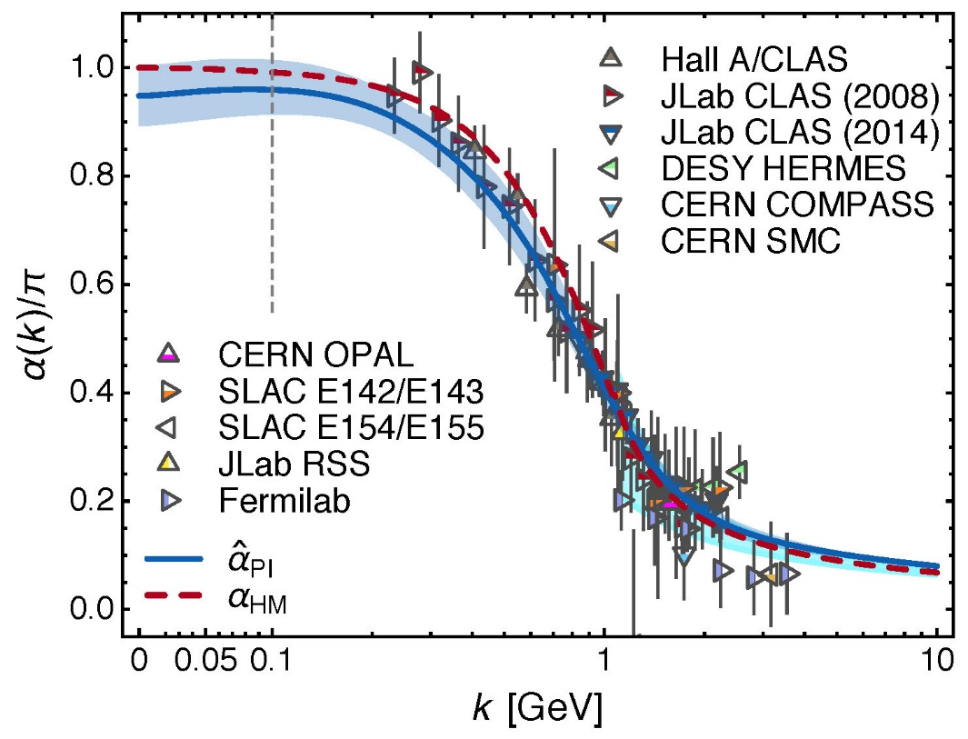
QCD Effective Charge
Process independent strong running coupling
Binosi, Mezrag, Papavassiliou, Roberts, Rodriguez-Quintero
arXiv:1612.04835 [nucl-th]
The QCD Running Coupling,
A. Deur, S. J. Brodsky and G. F. de Teramond,
Prog. Part. Nucl. Phys. 90 (2016) 1-74
Near precise agreement between process-independent α̂_{PI} and α_{g1}
and α̂_{PI} ≈ α_{HM}
Perturbative domain:
difference = (1/20) α_{M̅S̅}²
Parameter-free prediction:
curve completely determined by results obtained for gluon & ghost two-point functions using continuum and lattice-regularised QCD.
Data: process dependent effective charge: α_{g1} defined via Bjorken Sum Rule
Ghost-gluon scattering contributions are critical for agreement between the two couplings at intermediate momenta … omit them, and disagreement by factor of ∼ 2 at intermediate momenta

Slide 40
QCD Effective Charge
Process independent strong running coupling
Binosi, Mezrag, Papavassiliou, Roberts, Rodriguez-Quintero
arXiv:1612.04835 [nucl-th]
The QCD Running Coupling,
A. Deur, S. J. Brodsky and G. F. de Teramond,
Prog. Part. Nucl. Phys. 90 (2016) 1-74
α̂_{PI} is a new type of effective charge
direct analogue of the Gell-Mann–Low effective coupling in QED, being completely determined by the gauge-boson two-point function.
Prediction for α̂_{PI} is parameter-free
combines completely self-consistent solution of a set of Dyson-Schwinger equations with results from lattice-QCD
Prediction for α̂_{PI} smoothly unifies the nonperturbative and perturbative domains of the strong-interaction theory.
α̂_{PI} is process-independent and known to unify a vast array of observables
Existence of infrared-stable fixed-point in QCD supports efforts to use, e.g. extended technicolour scenarios for extension of Standard Model

Slide 41
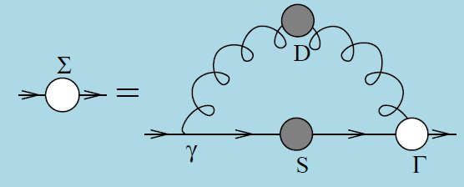
Quark Gap Equation

Slide 42
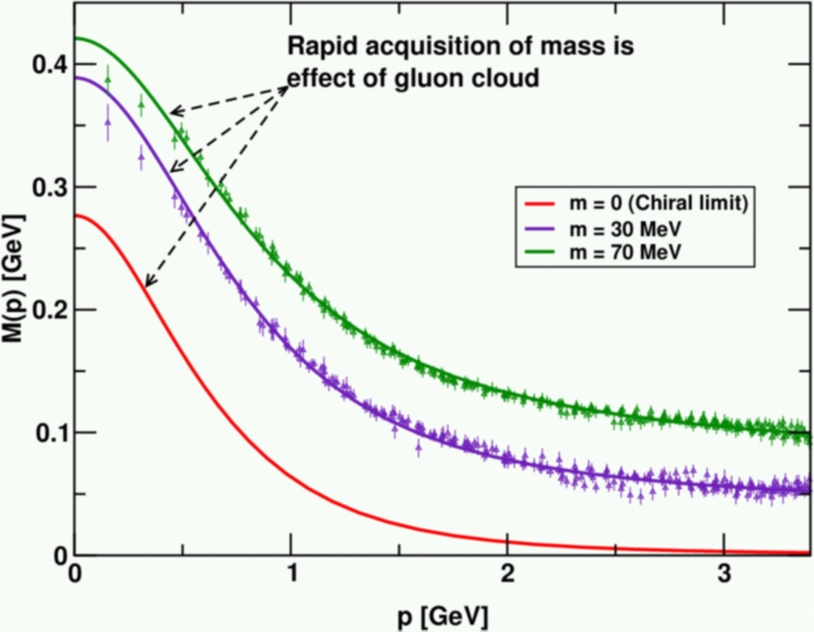
DCSB
Dynamical chiral symmetry breaking (DCSB) is
a critical emergent phenomenon in QCD
Expressed in hadron wave functions not in vacuum condensates
Contemporary theory indicates that DCSB is responsible for more than 98% of the visible mass in the Universe; namely, given that classical massless-QCD is a conformally invariant theory, then DCSB is the origin of mass from nothing.
Dynamical, not spontaneous
Add nothing to QCD ,
No Higgs field, nothing!
Effect achieved purely
through quark+gluon
dynamics.
Trace anomaly: massless quarks
become massive
Class A: Combining DSE, lQCD and pQCD analyses of QCD’s gauge and matter sectors

Slide 43
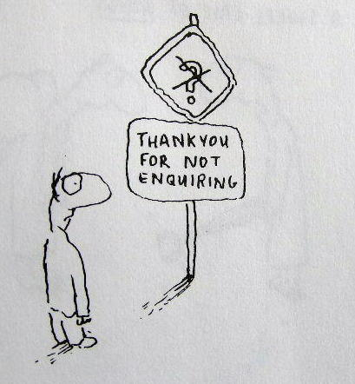
Enigma of Mass

Slide 44
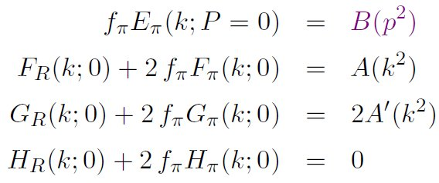
Pion’s Goldberger -Treiman relation
Maris, Roberts and Tandy
nucl-th/9707003, Phys.Lett. B420 (1998) 267-273
Pion’s Bethe-Salpeter amplitude
Solution of the Bethe-Salpeter equation
Dressed-quark propagator
Axial-vector Ward-Takahashi identity entails
B(k²)
Owing to DCSB
& Exact in
Chiral QCD
Miracle: two body problem solved, almost completely, once solution of one body problem is known

Slide 45
The most fundamental expression of Goldstone’s Theorem and DCSB
Rudimentary version of this relation is apparent in Nambu’s Nobel Prize work
Model independent
Gauge independent
Scheme independent
f_{π} E_{π}(p²) = B(p²)

Slide 46
Pion exists if, and only if, mass is dynamically generated
Rudimentary version of this relation is apparent in Nambu’s Nobel Prize work
Model independent
Gauge independent
Scheme independent
f_{π} E_{π}(p²)⇔ B(p²)

Slide 47
This is why m_{π}=0 in the absence of a Higgs mechanism
Rudimentary version of this relation is apparent in Nambu’s Nobel Prize work
Model independent
Gauge independent
Scheme independent
f_{π} E_{π}(p²)⇔ B(p²)

Slide 48
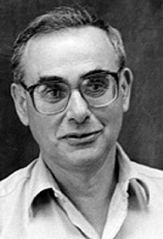
Enigma of mass
f_{π} E_{π}(p²) = B(p²)
This algebraic identity is why QCD’s pion is massless in the chiral limit
The quark level Goldberger-Treiman relation shows that DCSB has a very deep and far reaching impact on physics within the strong interaction sector of the Standard Model; viz.,
Goldstone's theorem is fundamentally an expression of equivalence between the one-body problem and the two-body problem in the pseudoscalar channel.
This emphasises that Goldstone's theorem has a pointwise expression in QCD
Hence, pion properties are an almost direct measure of
the dressed-quark mass function.
Thus, enigmatically, the properties of the massless pion
are the cleanest expression of the mechanism that is
responsible for almost all the visible mass in the universe.

Slide 49
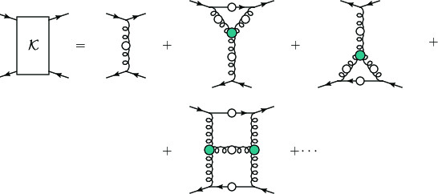
Pion masslessness
Renormalisation scale: ζ = 2GeV =: ζ₂
Pion’s Poincaré-invariant mass and Poincaré-covariant wave function are obtained by solving a Bethe-Salpeter equation.
This is a scattering problem
In chiral limit
two massless fermions interact via exchange of massless gluons … initial system is massless;
… and it remains massless at every order in perturbation theory
But, complete the calculation using an enumerable infinity of dressings and scatterings
Then …

Slide 50
Pion masslessness
Munczek, H. J., Phys. Rev. D 52 (1995) pp. 4736-4740
Bender, A., Roberts, C.D. and von Smekal, L., Phys. Lett. B 380 (1996) pp. 7-12
Maris, P. , Roberts, C.D. and Tandy, P.C., Phys. Lett. B 420 (1998) pp. 267-273
Binosi, Chang, Papavassiliou, Qin, Roberts, Phys. Rev. D 93 (2016) 096010/1-7
Obtain a coupled set of gap- and Bethe-Salpeter equations
Bethe-Salpeter Kernel:
valence-quarks with a momentum-dependent running mass produced by self-interacting gluons, which have given themselves a running mass
Interactions of arbitrary but enumerable complexity involving these “basis vectors”
Chiral limit:
Algebraic proof
at any & each finite order in symmetry-preserving construction of kernels for
the gap (quark dressing)
and Bethe-Salpeter (bound-state) equations,
there is a precise cancellation between
mass-generating effect of dressing the valence-quarks
and attraction introduced by the scattering events
Cancellation guarantees that
simple system, which began massless,
becomes a complex system, with
a nontrivial bound-state wave function
attached to a pole in the scattering matrix, which remains at P²=0 …
i.e., interacting, bound system remains massless

Slide 51
Pion masslessness
Munczek, H. J., Phys. Rev. D 52 (1995) pp. 4736-4740
Bender, A., Roberts, C.D. and von Smekal, L., Phys. Lett. B 380 (1996) pp. 7-12
Maris, P. , Roberts, C.D. and Tandy, P.C., Phys. Lett. B 420 (1998) pp. 267-273
Binosi, Chang, Papavassiliou, Qin, Roberts, Phys. Rev. D 93 (2016) 096010/1-7
Obtain a coupled set of gap- and Bethe-Salpeter equations
Bethe-Salpeter Kernel:
valence-quarks with a momentum-dependent running mass produced by self-interacting gluons, which have given themselves a running mass
Interactions of arbitrary but enumerable complexity involving these “basis vectors”
Chiral limit:
Algebraic proof
at any & each finite order in symmetry-preserving construction of kernels for
the gap (quark dressing)
and Bethe-Salpeter (bound-state) equations,
there is a precise cancellation between
mass-generating effect of dressing the valence-quarks
and attraction introduced by the scattering events
Cancellation guarantees that
simple system, which began massless,
becomes a complex system, with
a nontrivial bound-state wave function
attached to a pole in the scattering matrix, which remains at P²=0 …
i.e., interacting, bound system remains massless
Quantum field theory statement: in the pseudsocalar channel, the dynamically generated mass of the two fermions is precisely cancelled by the attractive interactions between them – iff –
f_{π} E_{π}(p²) = B(p²)

Slide 52
Pion masslessness
DCSB Paradigm
̃ ̃
̃ ̃
Parton-basis chiral-limit expression of the expectation-value of the trace-anomaly in the pion at ζ ≫ ζ₂
Metamorphoses into a new expression, written in terms of a nonperturbatively-dressed quasi-particle basis and associated, evolved wave functions
1st term = positive = one-body dressing content of the trace anomaly … Plainly, a massless valence-quark acquiring a large mass through interactions with its own gluon field is an expression of the trace-anomaly in the one-body subsector of the complete pion wave function
2nd term = negative (attraction) = 2-particle-irreducible scattering event content of the scale-anomaly … Plainly, acquires a scale because the couplings, and the gluon- and quark-propagators in the 2PI processes have all acquired a mass-scale
Away from the chiral limit, and in other channels, the cancellation is incomplete.

Slide 53
Observing Mass

Slide 54
Observing Mass
Goldberger-Treiman relations entail that on m≃0, dressed-quark mass function (almost) completely determines χ_{π} (wave function)
χ_{π} can be projected onto the light-front
Object thus obtained is strictly a probability amplitude and moments of a probability measure are truly observable.
Consequently, there is a mathematically strict sense in which moments of the dressed-quark mass function are observable.
Additionally, e.g. generalised parton distributions can rigorously be defined as an overlap of light-front wave functions
Practically, the mass function can be “measured” because it influences and determines a vast array of experimental observables
In this sense, M(p²), microscopic expression of trace anomaly, is observable at modern facilities, in measurements of
form factors (elastic and transition),
PDAs, PDFs, GPDs, TMDs, …
Examples …

Slide 55
Pion’s valence-quark Distribution Amplitude
Imaging dynamical chiral symmetry breaking: pion wave function on the light front, Lei Chang, et al., arXiv:1301.0324 [nucl-th], Phys. Rev. Lett. 110 (2013) 132001 (2013) [5 pages].
2012 … methods were developed that enable direct computation of the pion’s light-front wave function
φ_{π}(x) = twist-two parton distribution amplitude = projection of the pion’s Poincaré-covariant wave-function onto the light-front
Results have been obtained with the DCSB-improved DSE kernel, which unifies matter & gauge sectors
ϕ_{π}(x) ∝ x^{α} (1-x)^{α}, with α≈0.5

Slide 56
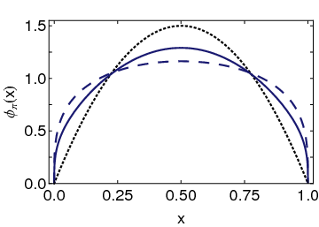
Pion’s valence-quark Distribution Amplitude
Imaging dynamical chiral symmetry breaking: pion wave function on the light front, Lei Chang, et al., arXiv:1301.0324 [nucl-th], Phys. Rev. Lett. 110 (2013) 132001 (2013) [5 pages].
Continuum-QCD prediction:
marked broadening of φ_{π}(x), which owes to DCSB
Conformal QCD
DB
RL
Real-world PDAs are squat and fat

Slide 57
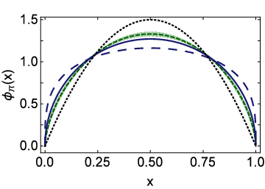
Lattice-QCD & Pion’s valence-quark PDA
Pion distribution amplitude from lattice-QCD
I. C. Cloët et al., arXiv:1306.2645 [nucl-th], Phys. Rev. Lett. 111 (2013) 092001 [5 pages]
Flavour symmetry breaking in the kaon parton distribution amplitude, Chao Shi et al., arXiv:1406:3353 [nucl-th], Phys. Lett. B 738 (2014) pp. 512–518
Isolated dotted curve = conformal QCD
Green curve & band = result inferred from the single pion moment computed in lattice-QCD
Blue solid curve = DSE prediction obtained with DB kernel
DSE & lQCD predictions are practically indistinguishable

Slide 58
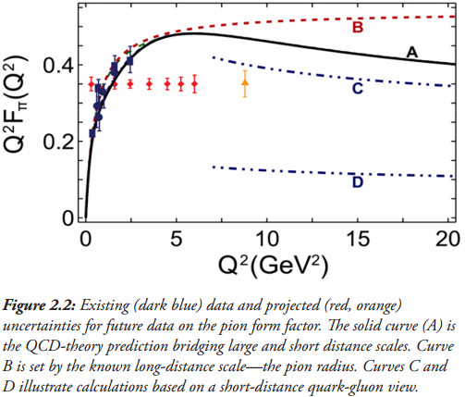
Pion’s electromagnetic form factor
Pion electromagnetic form factor at spacelike momenta L. Chang et al., arXiv:1307.0026 [nucl-th],
Phys. Rev. Lett. 111, 141802 (2013)
A: Internally-consistent DSE prediction
Broadening has enormous impact on understanding F_{π}(Q²)
C: Hard-scattering formula with broad PDA

Slide 59
Pion’s electromagnetic form factor
Pion electromagnetic form factor at spacelike momenta L. Chang et al., arXiv:1307.0026 [nucl-th],
Phys. Rev. Lett. 111, 141802 (2013)
A: Internally-consistent DSE prediction
Broadening has enormous impact on understanding F_{π}(Q²)
Appears that JLab12 is within reach of first verification of a QCD hard-scattering formula
C: Hard-scattering formula with broad PDA

Slide 60
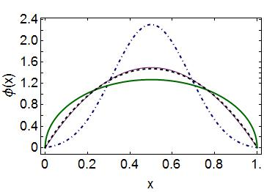
Emergent Mass vs. Higgs Mechanism
Parton distribution amplitudes of S-wave heavy-quarkonia Minghui Ding, Fei Gao, Lei Chang, Yu-Xin Liu and Craig D. Roberts arXiv:1511.04943 [nucl-th], Phys. Lett. B 753 (2016) pp. 330-335
When does Higgs mechanism begin to influence mass generation?
limit m_{quark}→ ∞
φ(x) → δ(x-½)
limit m_{quark} → 0
φ(x) ∼ (8/π) [x(1-x)]^{½}
Transition boundary lies just above m_{strange}
Comparison between distributions of light-quarks and those involving strange-quarks is obvious place to find signals for strong-mass generation
conformal
c+c_{bar}: Higgs
s+s_{bar}:
on the border
q+q_{bar}: Emergent

Slide 61
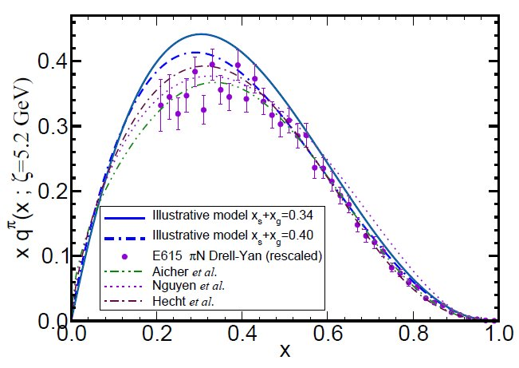
π & K Valence-quark Distribution Functions

Slide 62
π & K PDFs
Experimental data on π & K PDFs obtained in mesonic Drell-Yan scattering from nucleons in heavy nuclei; but it’s old: 1980-1989
Newer data would be welcome:
persistent doubts about the Bjorken-x ≃1 behaviour of the pion’s valence-quark PDF
single modest-quality measurement of u^{K}(x)/u^{π}(x) cannot be considered definitive.
Approved experiment, using tagged DIS at JLab 12, should contribute to a resolution of pion question; and a similar technique might also serve for the kaon.
Furthermore:
new mesonic Drell-Yan measurements at modern facilities could yield valuable information on π and K PDFs,
as could two-jet experiments at the large hadron collider;
and an EIC would be capable of providing access to π and K PDFs through measurements of forward nucleon structure functions.
Gribov-Lipatov reciprocity (crossing symmetry) entails connection between PDFs and fragmentation functions on z ≃ 1 (z ≥ 0.75)
D_{H/q}(z) ≈ z q^{H}(z)
Reliable information on meson fragmentation functions is critical if the worldwide programme aimed at determing TMDs is to be successful

Slide 63
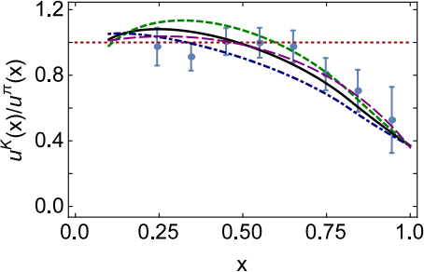
Gluon content of kaon
Basic features of the pion valence-quark distribution function,
Lei Chang, Cédric Mezrag, Hervé Moutarde, Craig D. Roberts, Jose Rodríguez-Quintero and Peter C. Tandy,
arXiv:1406:5450 [nucl-th], Phys. Lett. B 737 (2014)pp. 23–29
Valence-quark distribution functions in the kaon and pion,
Chen Chen, Lei Chang, Craig D. Roberts, Shaolong Wan and Hong-Shi Zong, arXiv:1602.01502 [nucl-th], Phys. Rev. D93 (2016) 074021/1-11
〈x〉_{g}^{K}(ζ_{H}) = 0.05 ± 0.05
⇒ Valence quarks carry 95% of kaon’s momentum at ζ_{H}
Evolved to ζ₂
Valence-quarks carry ⅔ of kaon’s light-front momentum
0%
10%
1st DSE analysis (Tandy et al., fully numerical DSE solutions)

Slide 64
π & K PDFs
Marked differences between π & K gluon content
ζ_{H}:
One-third of pion’s light-front momentum carried by glue
One-twentieth of the kaon’s light-front momentum lies with glue
ζ₂² = 4 GeV²
Glue carries half of pion’s momentum and two-thirds of kaon’s momentum
Evident in differences between large-x behaviour of valence-quark distributions in these two mesons
Signal of Nambu-Goldstone boson character of π
Nearly complete cancellation between
one-particle dressing and binding attraction
in this almost massless pseudoscalar system
2 M + U ≈ 0

Slide 65
π & K PDFs
Existing textbook description of Goldstone’s theorem via pointlike modes is old-fashioned, outdated and simplistic
The appearance of Nambu-Goldstone modes in the Standard Model is far more interesting
Nambu-Goldstone modes are nonpointlike!
Intimately connected with origin of mass!
Quite probably inseparable from expression of confinement!
Difference between gluon content is measurable … using well-designed EIC
Write a definitive new chapter in future textbooks on the Standard Model

Slide 66
Structure of Baryons

Slide 67
Baryon Structure
R.T. Cahill et al.,
Austral. J. Phys. 42 (1989) 129-145
Poincaré covariant Faddeev equation sums all possible exchanges and interactions that can take place between three dressed-quarks
Confinement and DCSB are readily expressed
Prediction: owing to DCSB in QCD, strong diquark correlations exist within baryons
Diquark correlations are not pointlike
Typically, r₀₊ ~ r_{π} & r₁₊ ~ r_{ρ} (actually 10% larger)
They have soft form factors

Slide 68
Baryon Structure
Both scalar-isoscalar and pseudovector-isotriplet diquark correlations feature within a nucleon.
Any study that neglects pseudovector diquarks is unrealistic because no self-consistent solution of the Faddeev equation can produce a nucleon constructed solely from a scalar diquark
The relative probability of scalar versus pseudovector diquarks in a nucleon is a dynamical statement.
Realistic computations predict a scalar diquark strength of approximately 60%
This prediction can be tested by contemporary experiments.

Slide 69
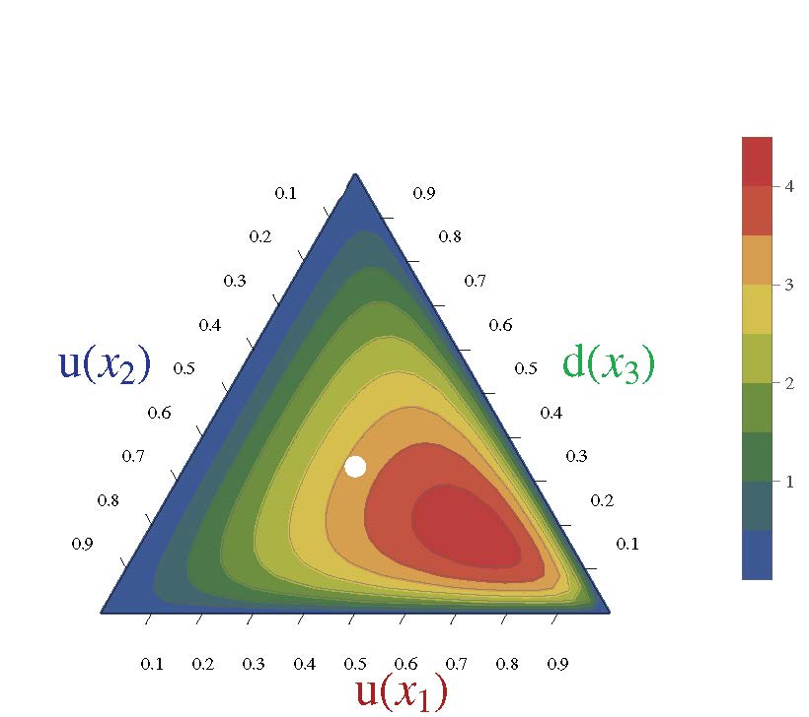
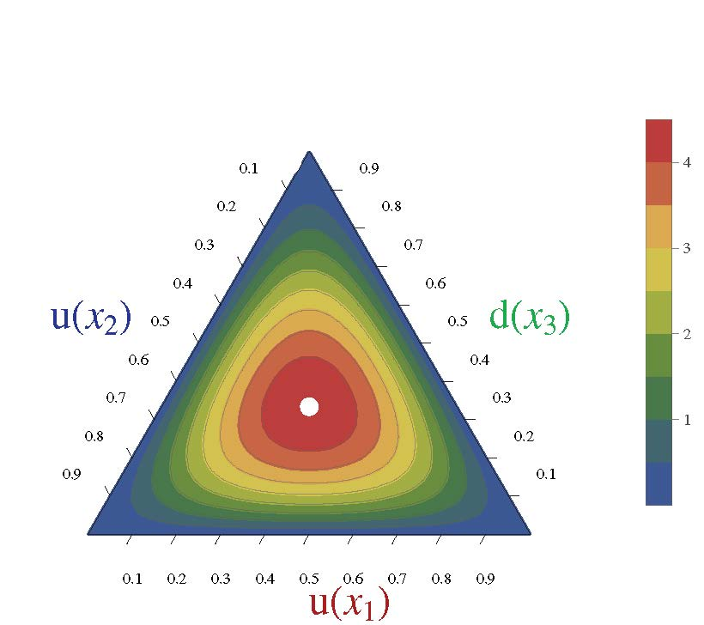
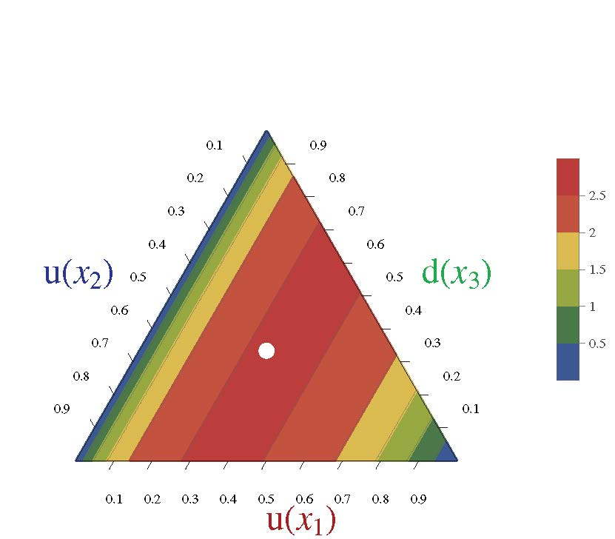
Nucleon Parton Distribution Amplitudes
Cédric Mezrag, et al. ANL
Computations underway. First results available.
Realistic, finite size (0.7fm) 0⁺ diquark [u(x₂)d(x₃)]
Diquark clustering skews the distribution toward the dressed-quark bystander, which therefore carries more of the proton’s light-front momentum
(0.6,0.2,0.2)
conformal limit:
120 x₁x₂x₃
〈x_{i}〉=⅓ … peak of the distribution
Pointlike 0⁺ diquark [u(x₂)d(x₃)]

Slide 70
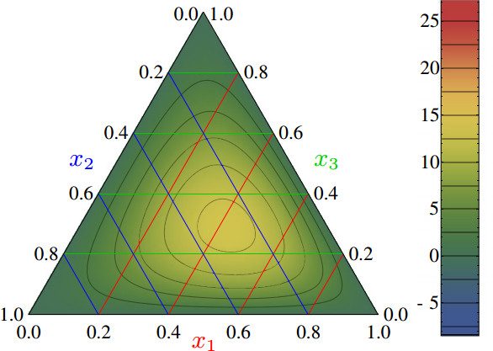
Nucleon PDAs & lQCD
Light-cone distribution amplitudes of the nucleon and negative parity nucleon resonances from lattice QCD
V. M. Braun et al., Phys. Rev. D 89 (2014) 094511
Light-cone distribution amplitudes of the baryon octet
G. S. Bali et al. JHEP 1602 (2016) 070
First lQCD results for n=0, 1 moments of the leading twist PDA of the nucleon are available
Used to constrain strength (a₁₁) of the leading-order term in a conformal expansion of the nucleon’s PDA:
Φ(x₁,x₂,x₃)
= 120 x₁ x₂ x₃ [ 1 + a₁₁ P₁₁(x₁,x₂,x₃) + … ]
Shift in location of central peak is consistent with existence of diquark correlations within the nucleon
(0.5,0.25,0.25)
Notes:
The calculation is done using Nf = 2 + 1 flavors of dynamical (clover) fermions on lattices of different volumes and pion masses down to 222 MeV. Significant SU(3) flavor symmetry violation effects in the shape of the distribution amplitudes are observed.

Slide 71
σ terms
Sigma Terms of Light-Quark Hadrons, V.V. Flambaum, et al., nucl-th/0510075, Few Body Systems 38 (2006) pp. 31-51.
Exploring the light-quark interaction, Lei Chang et al.,
arXiv:0906.4304 [nucl-th], Chin. Phys. C33 (2009) pp. 1189-1196
Nucleon tensor charges and electric dipole moments, Mario Pitschmann et al. arXiv:1411.2052 [nucl-th], Phys.Rev. D91 (2015) 074004
Light-quarks: σ_{N}^{u+d}/m_{N} ≈ 6.4%
s-quarks σ_{N}^{s}/m_{N}≈ 2.4%
σ-terms vanish in absence of explicit chiral symmetry breaking (ECSB); but their effect is a product ECSB × DCSB
Value is ≈1.1 for uncorrelated proton wave function.
So … presence of diquark correlations within the proton enhances the contribution of d-quarks to the proton’s σ-term.
f_{π} m_{π}² = (m_{u}+m_{d}) ρ_{π} ⇒ σ_{π} = ½m_{π}
But σ_{π} = ½m_{π} does not mean that 50% of the pion’s mass owes to DCSB. ALL of the pion’s mass owes to ECSB, with DCSB-driven enhancement factor

Slide 72
Epilogue

Slide 73
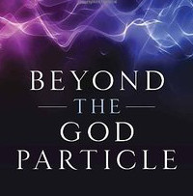
Epilogue
LHC has NOT found the “God Particle” because the Higgs boson is NOT the origin of mass
Higgs-boson only produces a little bit of mass
Higgs-generated mass-scales explain neither the proton’s mass nor the pion’s (near-)masslessness
Hence LHC has, as yet, taught us very little about the origin, structure and nature of the nuclei whose existence support the Cosmos
Strong interaction sector of the Standard Model,
i.e. QCD, is the key to understanding the
origin, existence and properties
of (almost) all known matter

Slide 74
Epilogue
Emergence:
Confinement and dynamical chiral symmetry breaking in the Standard Model
Are they related?
Are they the same?
Role of the pion seems to be key in answering these questions
Conformal anomaly
Can have neither confinement nor DCSB if scale invariance of (classical) chromodynamics is not broken by quantisation
Know a mass-scale must exist, but only experience/experiment reveals its value
Once size known, continuum and lattice-regularised quantum chromodynamics ⇒ gluons and quarks acquire momentum-dependent masses
Values are large in the infrared m_{g} ∝ 500 MeV ≈ m_{p}/2 & M_{q} ∝ 350 MeV ≈ m_{p}/3
Seem to be the foundation for DCSB
Can be argued to explain confinement as a dynamical phenomenon, tied to fragmentation functions

Slide 75
Epilogue
Reductive explanation
Fundamental equivalence of the one- and two-body problems in the matter-sector
Quark gap equation ≡ Pseudoscalar meson Bethe-Salpeter equation
Entails that properties of the pion & kaon
Nature’s lightest observable strong-interaction excitations
are (possibly) the cleanest means by which to probe the origin
and manifestations of mass in the Standard Model
Numerous predictions (meson & baryon PDAs, PDFs, form factors, etc.) that can be tested at contemporary and planned facilities
JLab 12GeV
EIC
Refining those predictions before experiments begin will require combination of all existing nonperturbative approaches to strong interaction dynamics in the Standard Model

