Slide 1

GenFit and RAVE in sPHENIX under Fun4All
Haiwang Yu (NMSU)
EIC Software Workshop @ BNL
Oct. 17 2016
Outline:
Kalman Filter and GenFit2 introduction
GenFit2 in sPHENIX under the Fun4All framework.
RAVE introduction and preliminary tests

Slide 2
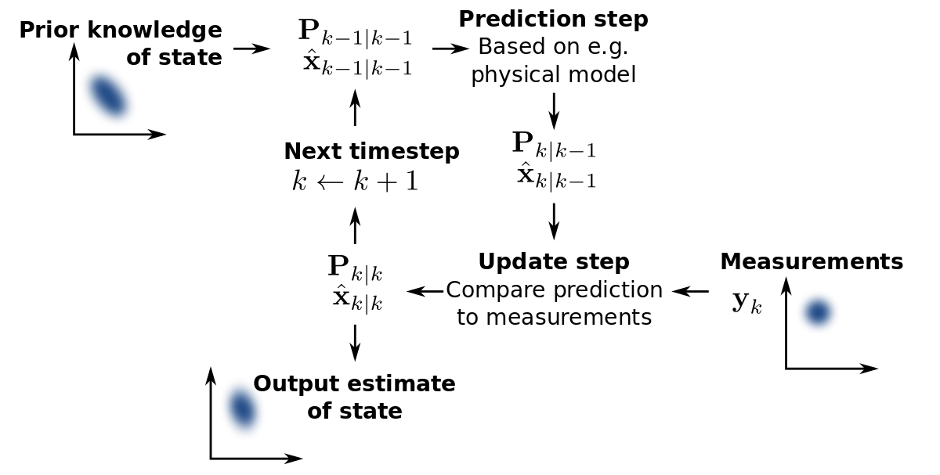
Kalman Filter for Track Fitting
Kalman Filter:
  Time domain filter.
  Average measurements and predictions
Predictions In Tracking:
  Charged particle propagate through magnetic field.
  Material effects:
    Energy loss
    Multiple scattering

Slide 3
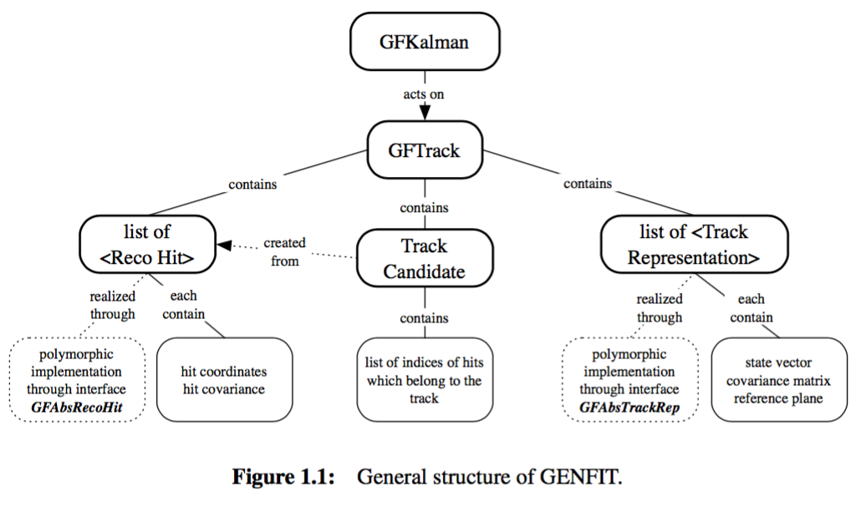
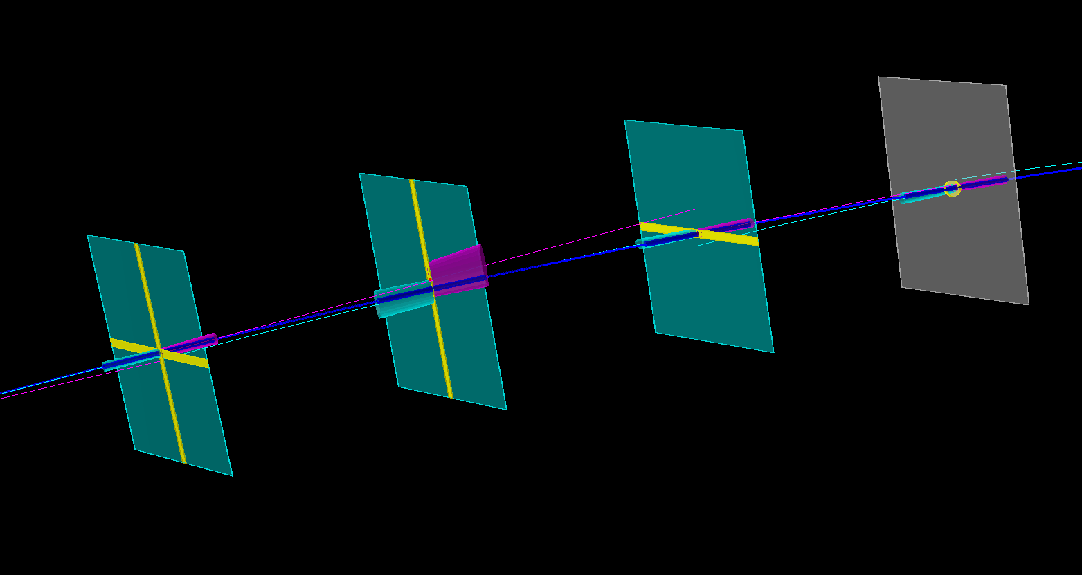
GenFit Kalman Filter
Developed for PandaRoot, and have been used in several experiments: . Belle II, PANDA, SHiP, AFIS, GEM-TPC, FOPI...
Modularized design:
  Abstract Measurements
  Abstract TrackRep (track propagator)
Originally needs external track propagator. Now the GenFit2 included a track propagator based on Runge Kutta propagation extracted from GEANE.
RKTrackRep:
  Useful both in the track fitting and the track extrapolation with a fitting track.
    DCA analysis
    Calorimeter matching
  Requirements:
    Needs TGeo geometry input
    Field map interface
Useful links:
  https://github.com/GenFit/GenFit
  http://genfit.sourceforge.net/GENFIT_v1_2.pdf
GenFit Event Display:
Smoothed track: weighted average between forward fit and backward fit.

Slide 4
Implementation for sPHENIX under Fun4All
Geometry
Magnetic field
Customized user interface (optional)

Slide 5
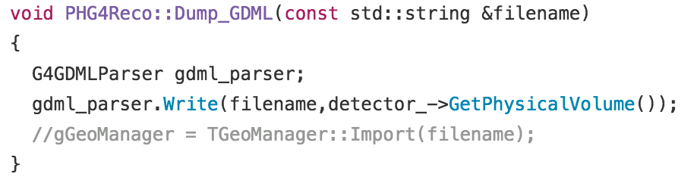
GEANT4 -> TGeo
sPHNEIX simulation mainly uses GEANT4.
GEANT4 geometry could be saved into GDML file (.xml). And convert into ROOT TGeo.
  #include <Geant4/G4GDMLParser.hh>
  Needs a XML package called "Xerces"
  ROOT: TGeoManager::Import("geometry.xml")
G4->TGeo translation package (Jin Huang, BNL):
  https://github.com/sPHENIX-Collaboration/coresoftware/tree/master/offline/packages/PHGeometry

Slide 6
Magnetic field
sPHENIX has its magnetic field saved in root format.
The magnetic field adaptor for GenFit2 is relatively easy.
  Read in magnetic field and build up histograms.
  Extract field values from histograms:
    TVector3 get(const TVector3& pos) const;
A simple magnetic field reader:
  https://github.com/sPHENIX-Collaboration/coresoftware/tree/master/offline/packages/PHGenFitPkg/GenFitExp/fields
sPHENIX 2d field map

Slide 7
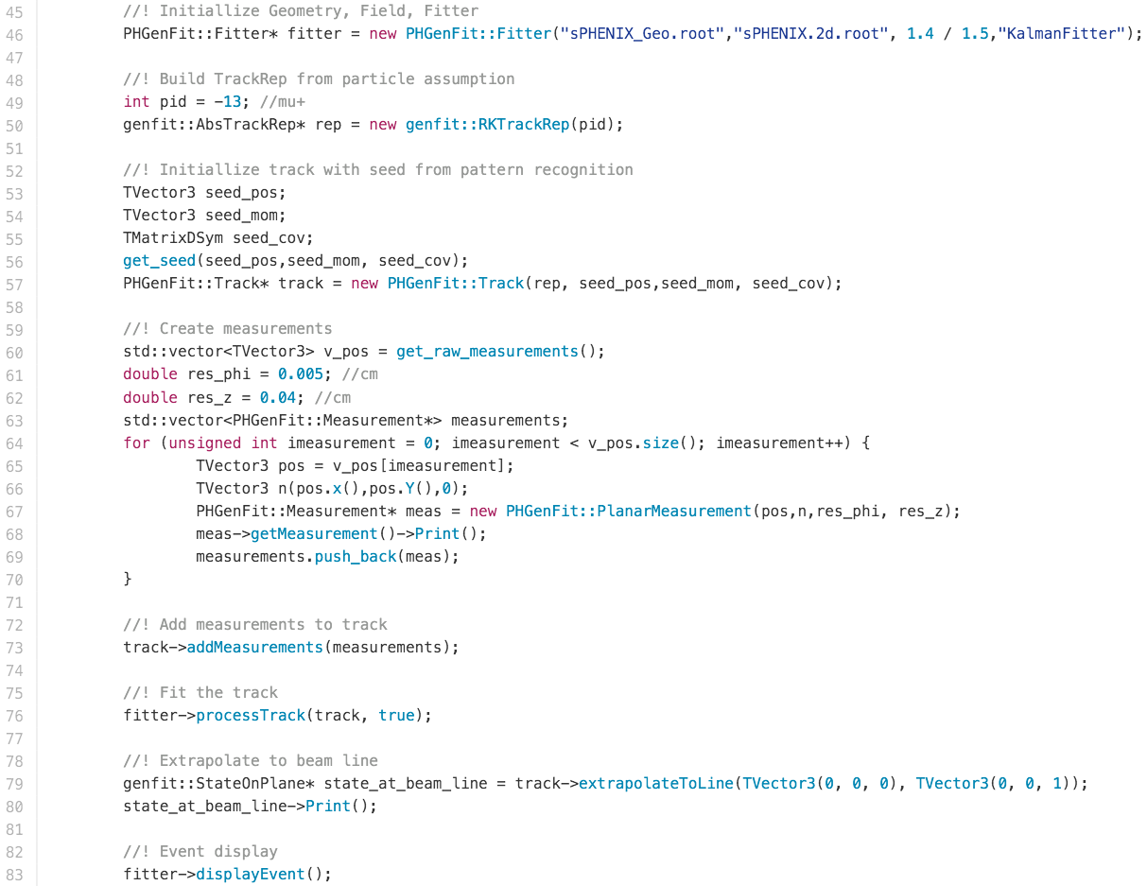
PHGenFit interface, minimum example:
PHGenFitPkg/Example/minimumTestPHGenFit.cc
Server
Initialize track with seed
Add measurements
Fit
Various ways of looking at the fitting result

Slide 8
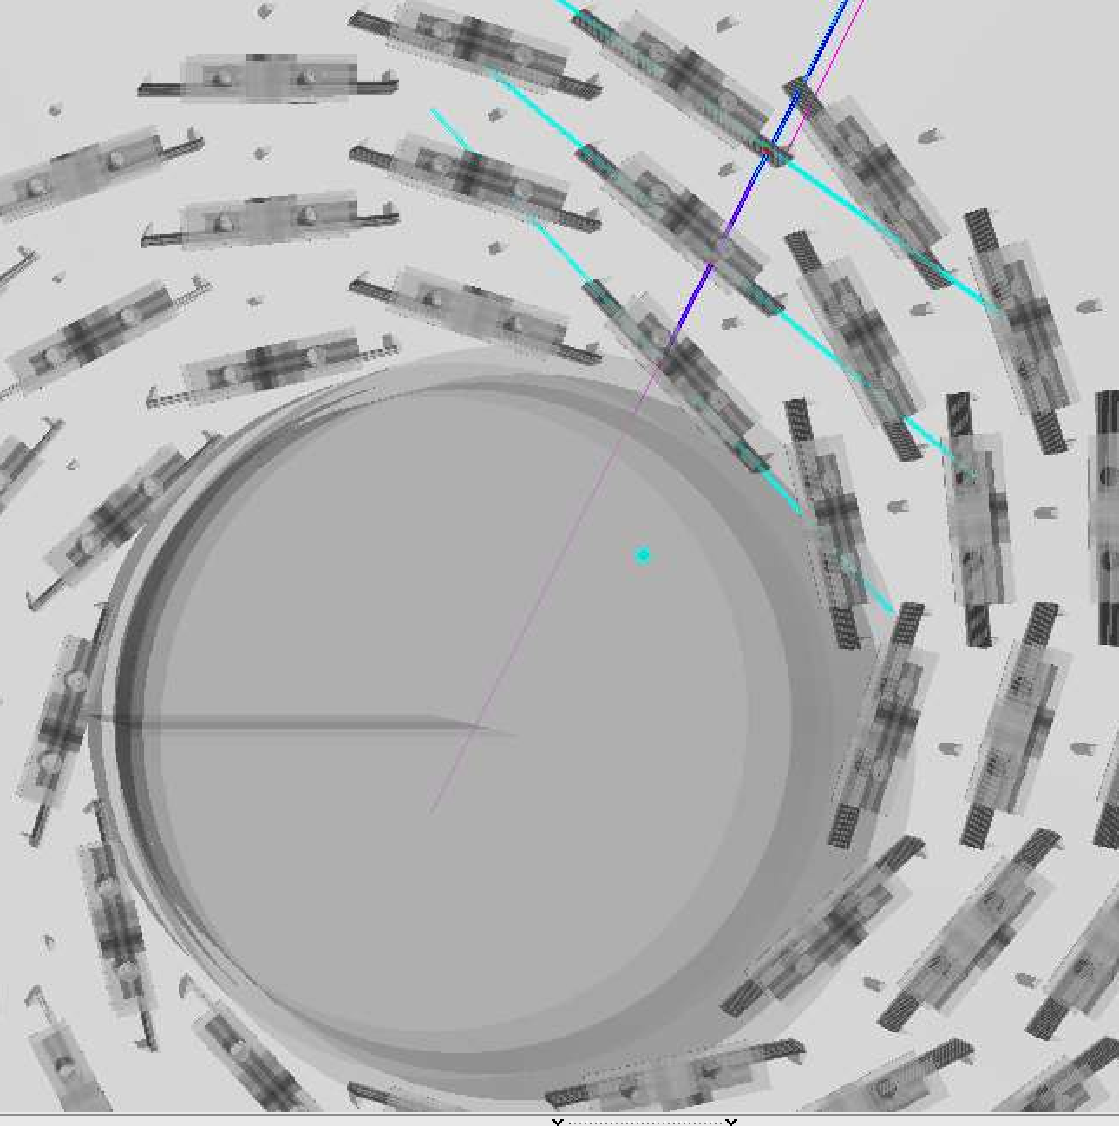
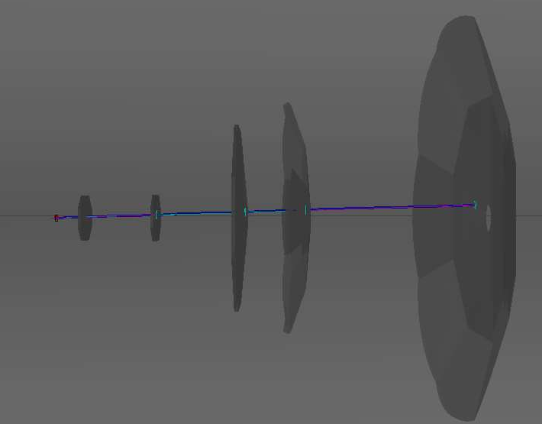
PHGenFit in sPHENIX: current status
PHG4TrackKalmanFilter: refitting and vertexing module.
Suppose to have
  significant improvements with ladder geometry
  small improvements with realistic field
https://github.com/sPHENIX-Collaboration/coresoftware/tree/master/simulation/g4simulation/g4hough
PHG4TrackFastSim: truth tracking based on smeared PHG4Hits.
Initially developed within 1day.
https://github.com/sPHENIX-Collaboration/coresoftware/tree/master/simulation/g4simulation/g4hough

Slide 9
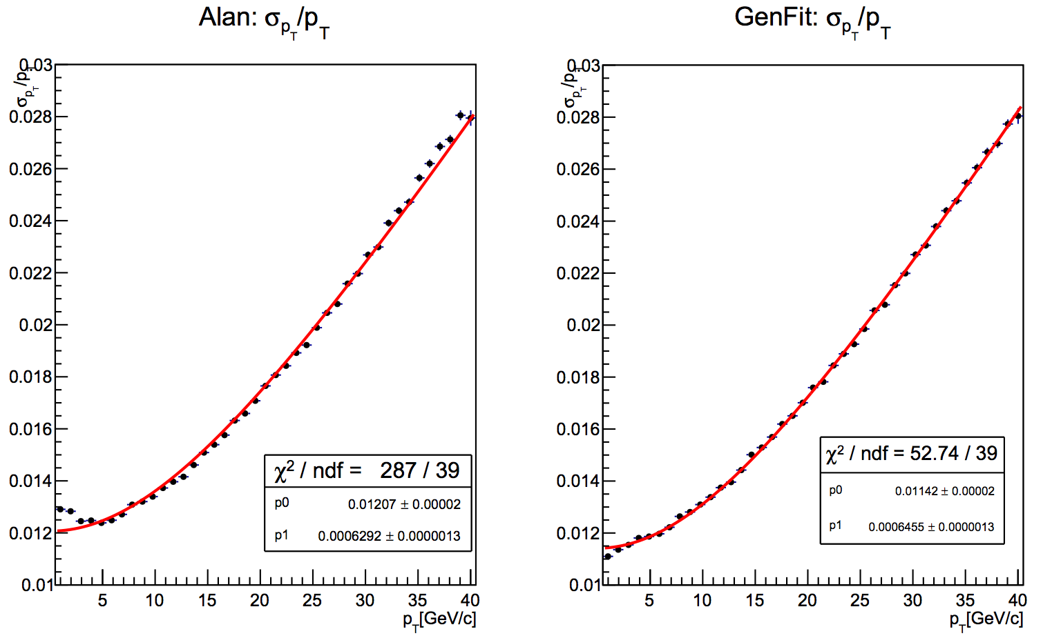
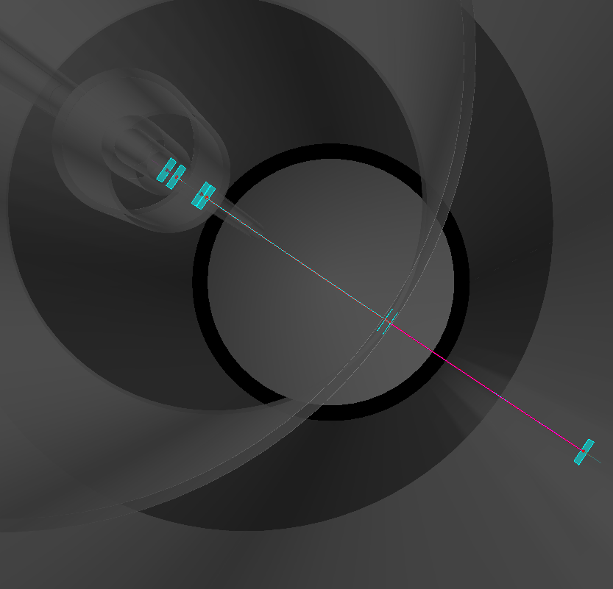
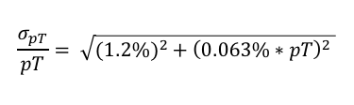
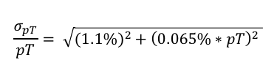
Preliminary Test: pT resolution, Single Pion
Proofed Ad-hoc solution (Alan Dion)
GenFit2
7-layer silicon tracker
$$\frac{σ_{pT}}{pT}= \sqrt{(1.2{\%)}^{2}+{\left(0.063\%∗pT\right)}^{2} }$$
$$\frac{σ_{pT}}{pT}= \sqrt{(1.1{\%)}^{2}+{\left(0.065\%∗pT\right)}^{2} }$$

Slide 10
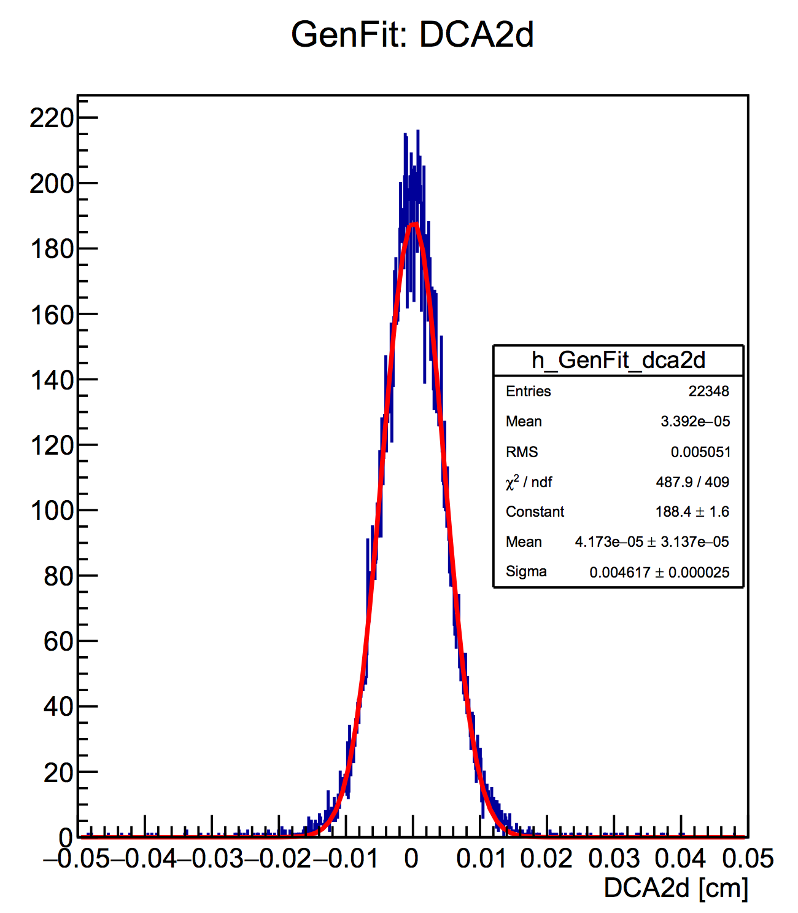
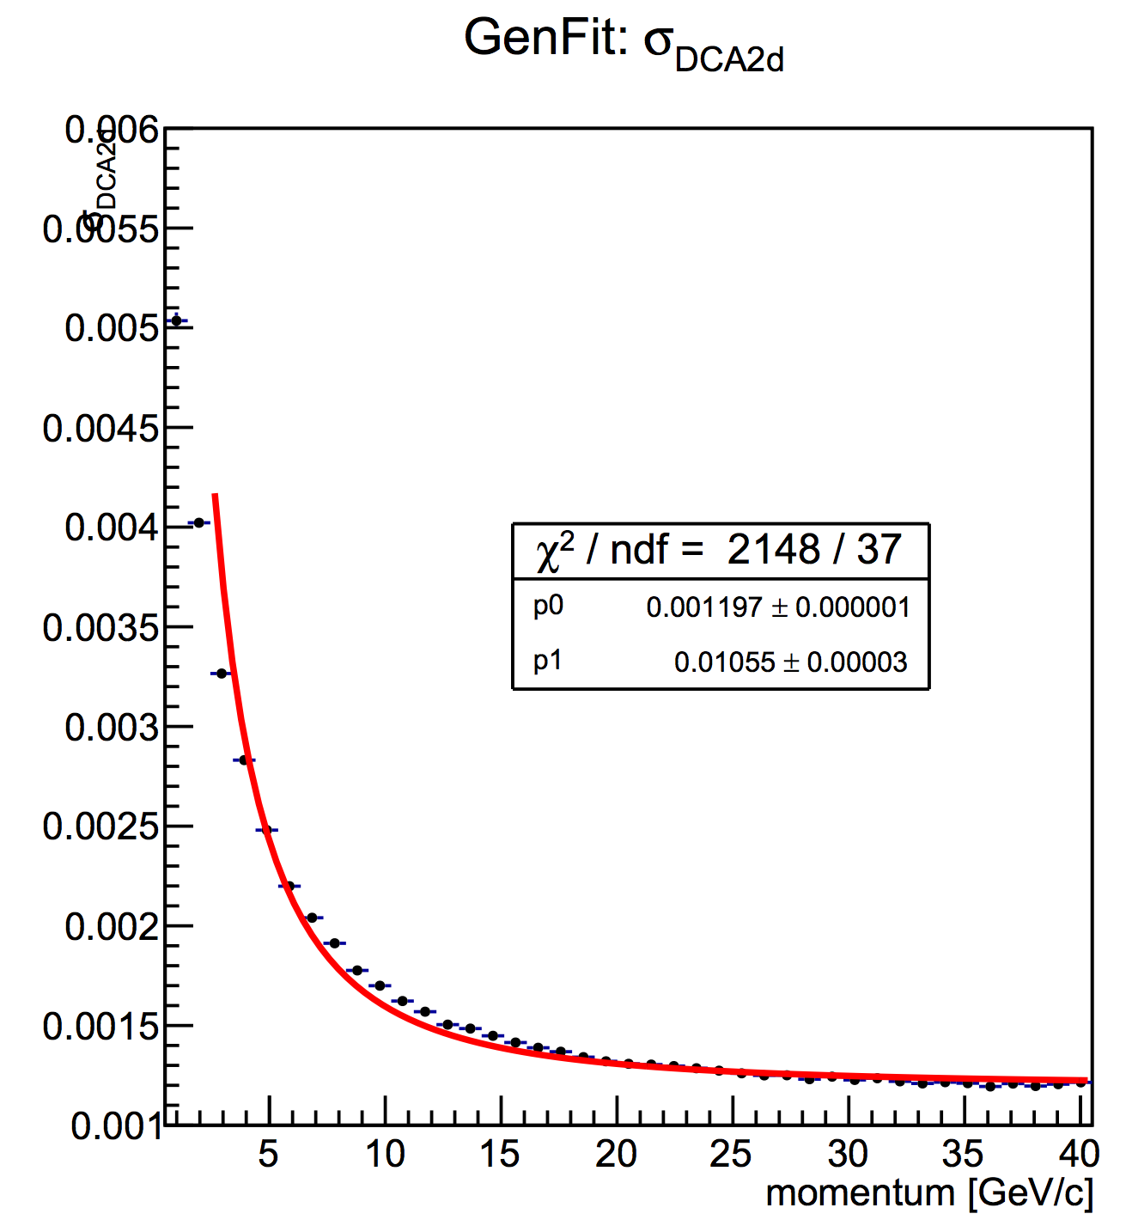
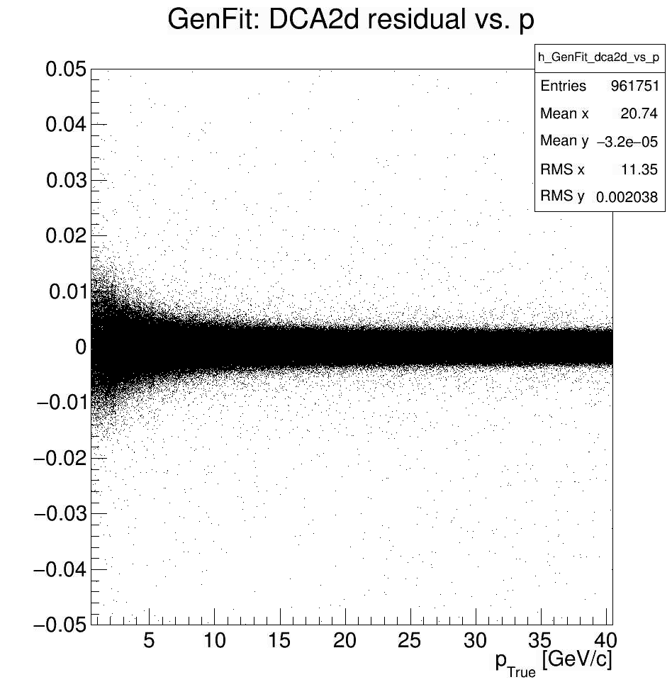

Preliminary Test: Single Pion Track DCA2d resolution, using true vertex
DCA2d residual vs. true momentum (p_True)
DCA2d residual
1 < p_True < 2GeV
DCA2d resolution
$$σ_{DCA2d} = \sqrt{{\left(12μm\right)}^{2}+{\left(\frac{106μm∙GeV}{p}\right)}^{2} }$$

Slide 11
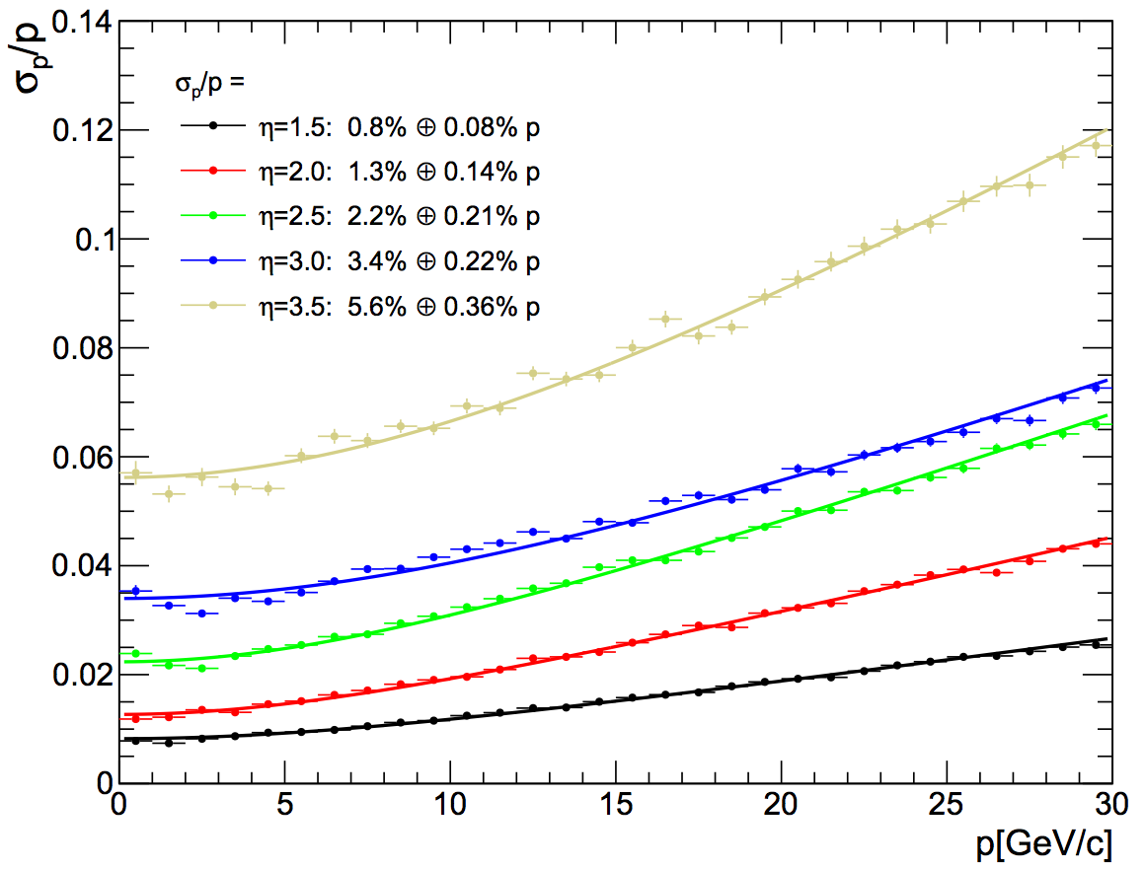
Truth Tracking also using PHGenFit
g4simulation/g4hough/PHG4TrackFastSim
Truth tracking based on smeared PHG4Hits.
Can handle cylindrical or vertical plane measurements.
Tested on FGEM detector, consistent results with previous Matlab Sagitta calculation.

Slide 12
RAVE
Rave
  Reconstruction in an Abstract, Versatile Environment
  vertex reconstruction toolkit with input of reconstructed track – developed for CMS
Links:
  https://rave.hepforge.org/
  Wolfgang Waltenberger' thesis: https://www.researchgate.net/publication/210245873_Development_of_Vertex_Finding_and_Vertex_Fitting_Algorithms_for_CMS

Slide 13
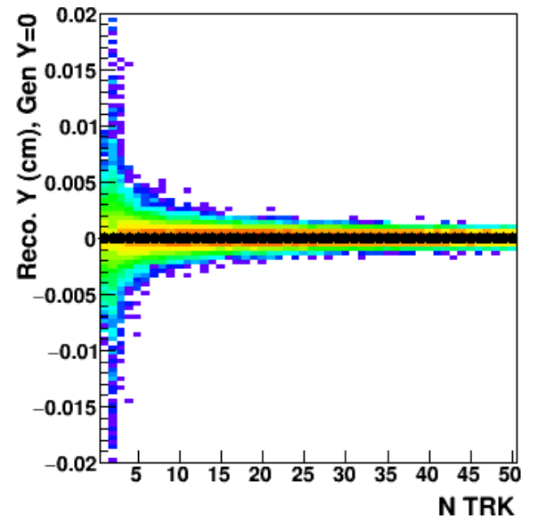
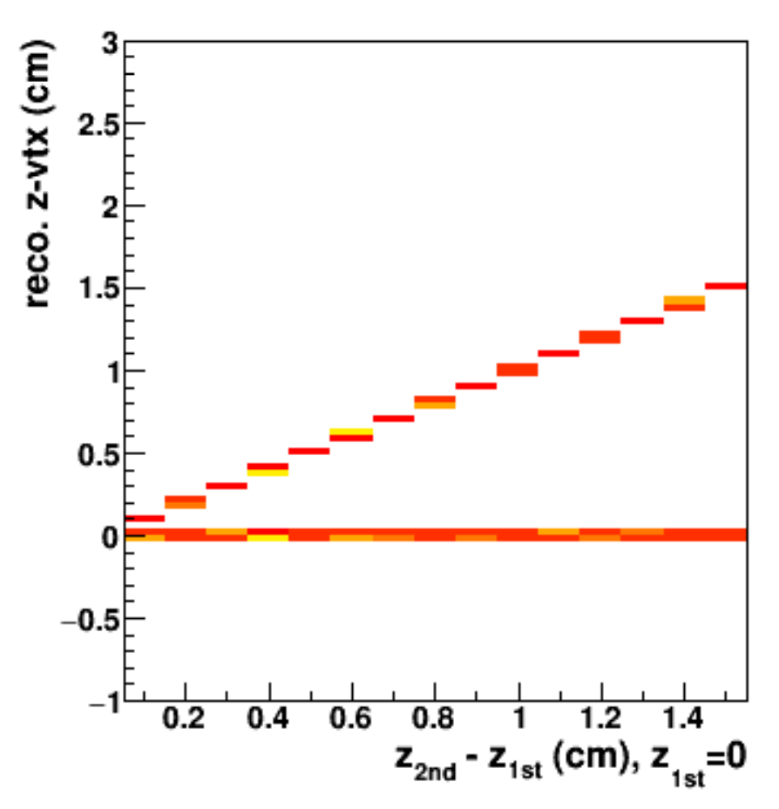
Using RAVE with GFRave
Sanghoon Lim (LANL)
GFRave
  Interface between Genfit and Rave
  Reconstructed tracks from Genfit can be used directly
GFRave in sPHENIX
  https://github.com/sPHENIX-Collaboration/coresoftware/tree/master/simulation/g4simulation/g4hough

Slide 14
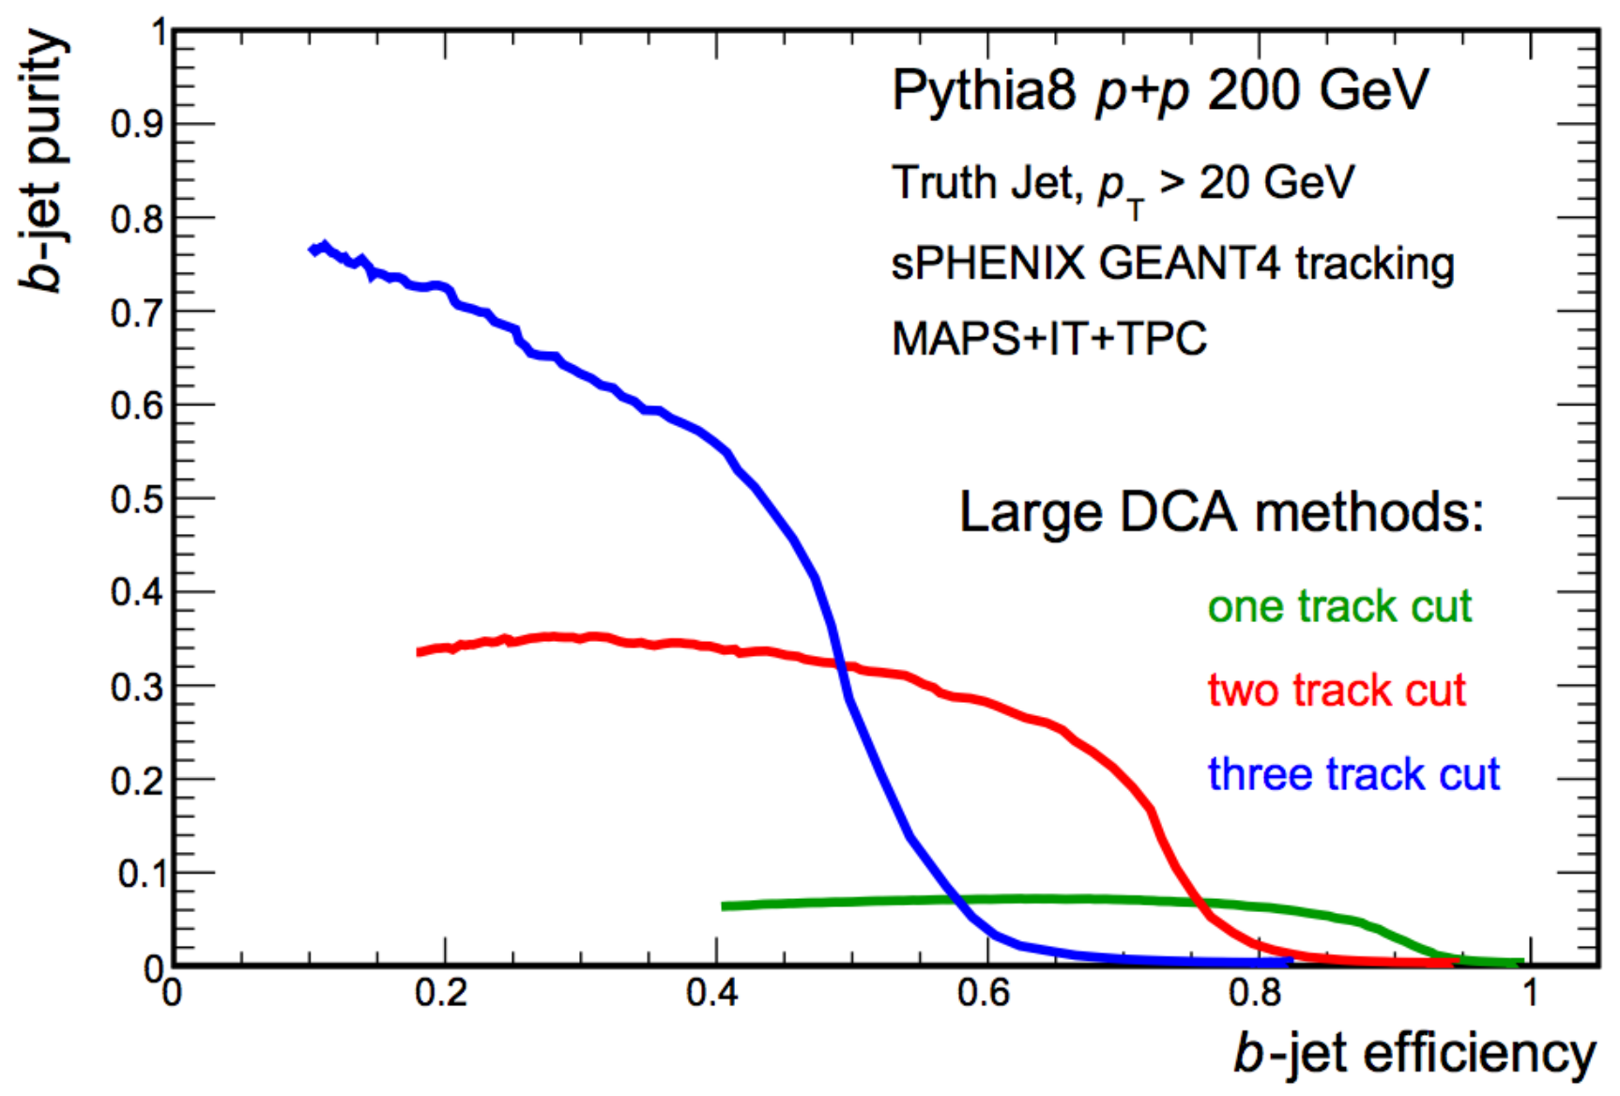
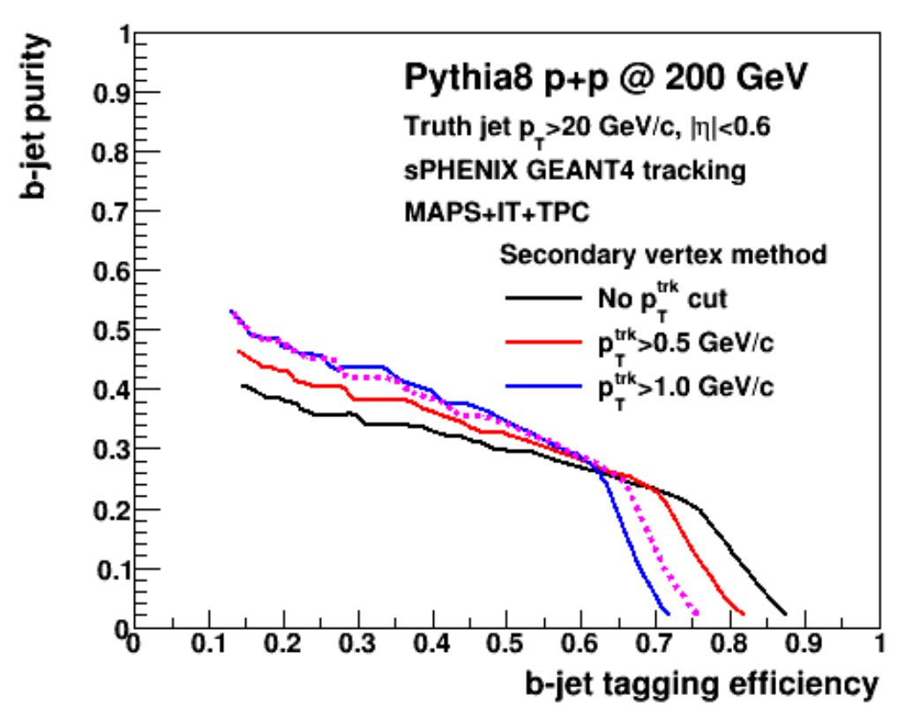
B-Jet tagging
track impact parameter method
secondary vertex method
Haiwang Yu (NMSU)
Sanghoon Lim (LANL)

Slide 15
Remarks
GenFit is a generic Kalman Filter
  For a full tracking software, some pattern recognition is needed
We implemented interfaces for sPHENIX and the preliminary test results are consistent with our previous ad-hoc solution
Intended to substitute the previous ad-hoc solution:
  Seeds without any previous knowledge
  Improvements compared with previous sPHENIX solution with realistic geometry
RAVE is a generic vertexing tool
  Very versatile and easy to use
  GenFit has interfaces to RAVE, GenFit tracks could be used directly
  Preliminary tests shows it works well for single/multiple vertexing
Both tools shows good performance in our study on the B-Jet tagging (track impact parameter method, secondary vertex method).

Slide 16
Backups

