Slide 1
Status of the ISOL-SRS project
Ian Lazarus for Robert Page
Warwick, January 2017

Slide 2
ISOL-SRS project
Deliverables (two work packages) of project January 1st 2015 – September 30th 2019
In-ring spectrometer
External spectrometer
For each the project provides the mechanics (chambers and supports), the detectors, the readout electronics, and the software for data acquisition and control.
Funded project partners are Universities of Edinburgh, Liverpool and STFC Daresbury Laboratory. T&S funding available to other UK partners.
UK Management Board
Spokesperson: Phil Woods (chair)
Deputy Spokespersons: Peter Butler, Sean Freeman
PIs from institutions: Robert Page, John Simpson
Technical co-ordinator: Ian Lazarus
Deputy tech co-ordinator: Alan Grant
Project Manager: Mike Cordwell
WP leaders: Ian Lazarus (WP1, management),
Tom Davinson (WP2, internal spectrometer)
Robert Page (WP4, external spectrometer)

Slide 3
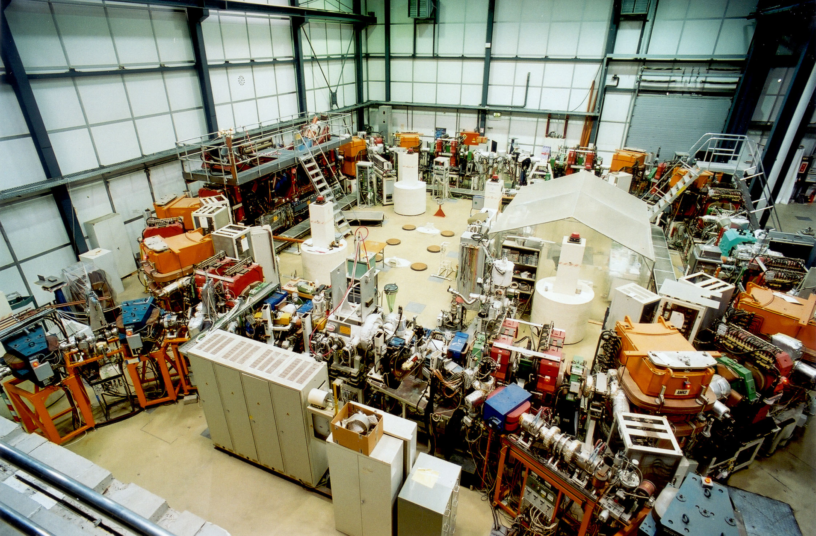
The heavy ion storage ring (TSR)
ECOOL
resonator
Circumference: 55m
extraction
injection
Notes:
The heavy ion storage ring is shown on these transparency
The beam coming from the post accelerator is injected trough the beam line shown on the right side
The same straight section is also used or slow extraction
The left straight section is used for electron cooling.
The third one for experiment.
The last one for diagnostics and for RF system.
Multiturn injection is used to fill the storage ring with ions
.

Slide 4
TSR is “on ice”- mitigation plans
TSR Delayed
September 2016- DG informed Council
TSR work is on hold until at least 2020/21
Earliest possible date for physics is 4 years later.
Mitigation planning
In-ring Spectrometer- CRYRING at GSI
External Spectrometer- XT02 in ISOLDE Hall
Work under way now to show viability within project budget and timescale to deliver science
Potential Benefit
Likely to lead to earlier science exploitation
Notes:
The heavy ion storage ring is shown on these transparency
The beam coming from the post accelerator is injected trough the beam line shown on the right side
The same straight section is also used or slow extraction
The left straight section is used for electron cooling.
The third one for experiment.
The last one for diagnostics and for RF system.
Multiturn injection is used to fill the storage ring with ions
.

Slide 5
In-Ring Spectrometer (WP2)
EDAQ is based on AIDA
EDAQ hardware delivered
AIDA ASIC mezzanine PCBs
AIDA FEE64 cards
AIDA MACB timestamp distribution modules
AIDA FEE64 PSUs
other infrastructures (chiller, detector HV etc)
Prototype FEE64 cooling plate delivered
UHV feedthrough to FEE64 flexi-rigid
cabling & adaptor design underway
Ready to commence systems integration
Notes:
The heavy ion storage ring is shown on these transparency
The beam coming from the post accelerator is injected trough the beam line shown on the right side
The same straight section is also used or slow extraction
The left straight section is used for electron cooling.
The third one for experiment.
The last one for diagnostics and for RF system.
Multiturn injection is used to fill the storage ring with ions
.

Slide 6
CRYRING
Physics book: CRYRING@ESR
Lestinsky, M., Andrianov, V., Aurand, B. et al.
Eur. Phys. J. Spec. Top. (2016) 225: 797
doi:10.1140/epjst/e2016-02643-6
Developing combined atomic & nuclear physics chamber
with CRYRING collaboration
Challenges
XUHV 10⁻¹¹ – 10⁻¹² mbar ( cf. ~10⁻¹⁰ mbar @ ESR )
Single experiment station
Limited space ~1.5m ( cf. 2.5m @ ESR )
de-scope detector array & combine operations
Transfer time ( inject – cool – extract @ ESR
inject @ CRYRING ) ~10s

Slide 7
Opportunities
CRYRING installed
initial p+ commissioning commenced Q4/2016
Extant gas jet target
new GSI internal target Petridis et al.
gas target species from H – Xe
target densities ( 0.1cm width ) ~10¹⁴ cm²
CRYRING provides fully stripped beams
In-flight selection of fragmented beams
  avoid chemical selectivity of ISOL targets & sources

Slide 8
CRYRING Operation Parameters
doi:10.1140/epjst/e2016-02643-6

Slide 9
CRYRING Layout
doi:10.1140/epjst/e2016-02643-6

Slide 10
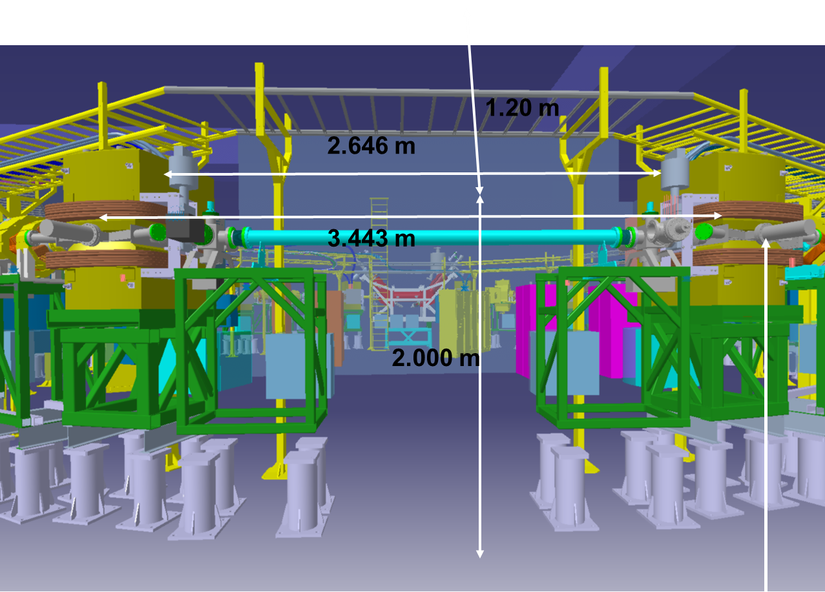
Atomic & Nuclear Physics
Experiments
CRYRING Layout

Slide 11
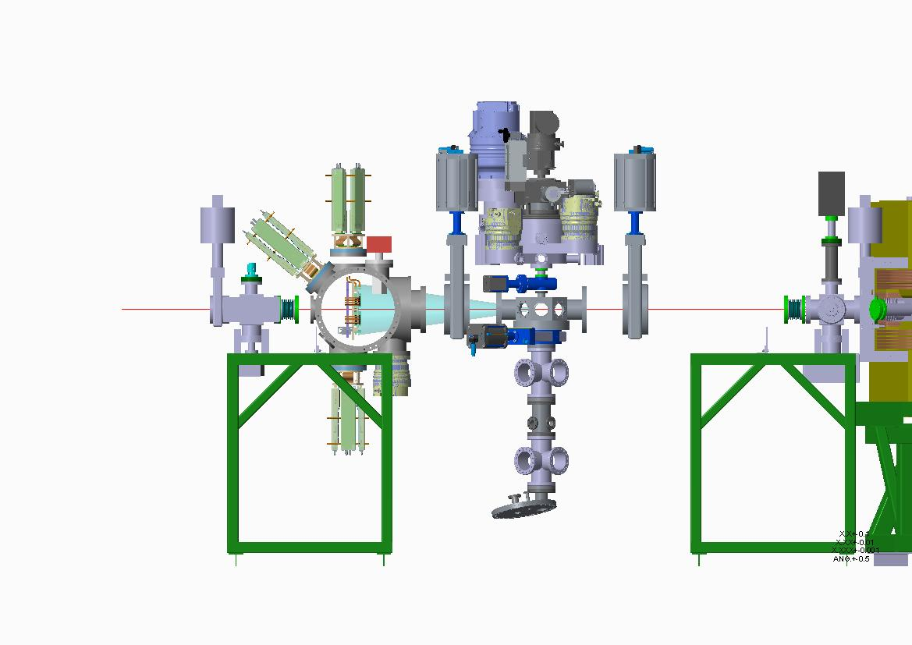
Combined Nuclear & Atomic Physics
Experiment Section - concept
New GSI internal target inlet chamber
Petridis et al.
Silicon DSSSDs
Silicon DSSSDs (not shown)
Beam
Interaction
chamber
FEE64s
Extant CRYRING target dump
Courtesy – Dave Seddon, University of Liverpool

Slide 12
Downstream Dipole Box for Radiative Capture Measurements
Under construction at GSI
WP2 DSSSDs & instrumentation
Courtesy – Jan Glorius GSI

Slide 13
DSSSDs for Radiative Capture Measurements at ESR
UHV compatible
- no plastic, no solder
- bakeable to 150 deg C
- ceramic carrier, silver-loaded epoxy

Slide 14
In-Ring Spectrometer Outlook
New design concepts being developed
New design and example science program to be presented to OsC
for review March 2017
Objectives for 2017
Finalise mechanical design
Review design
Commence manufacture
Purchase silicon detectors and vacuum systems
Systems integration

Slide 15
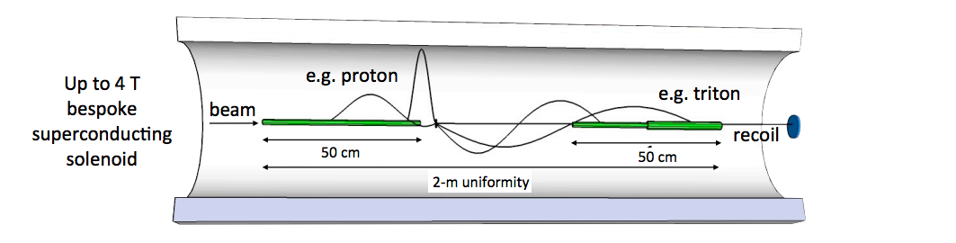
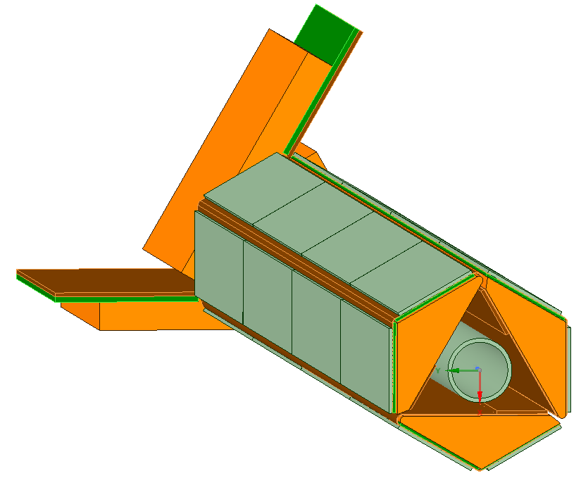
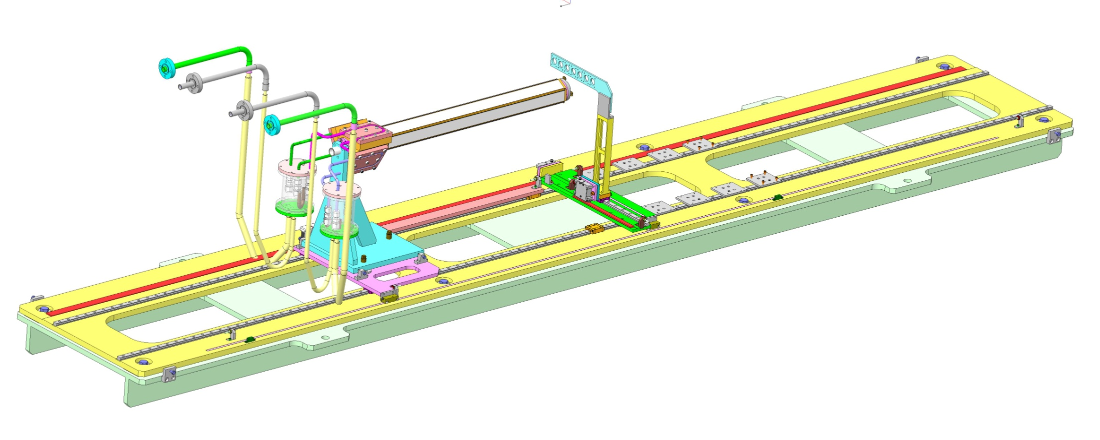
External spectrometer (WP4) for high-resolution studies of nuclear reactions on heavier nuclei
HELIOS concept
detector
1m uniform B field
e.g. Q-value = 1.01 E_{lab} (MeV) - 9.92 - 0.21 z (cm)
for 10 MeV/u ¹³²Sn(d,p)
DSSDs + R³B ASIC readout
  1 mm thick
  x: 128 × 0.95 mm
  y: 11 × 2 mm

Slide 16
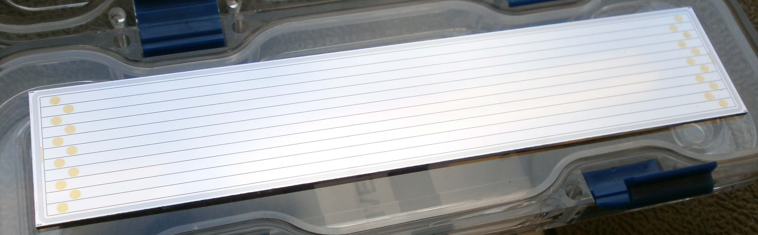
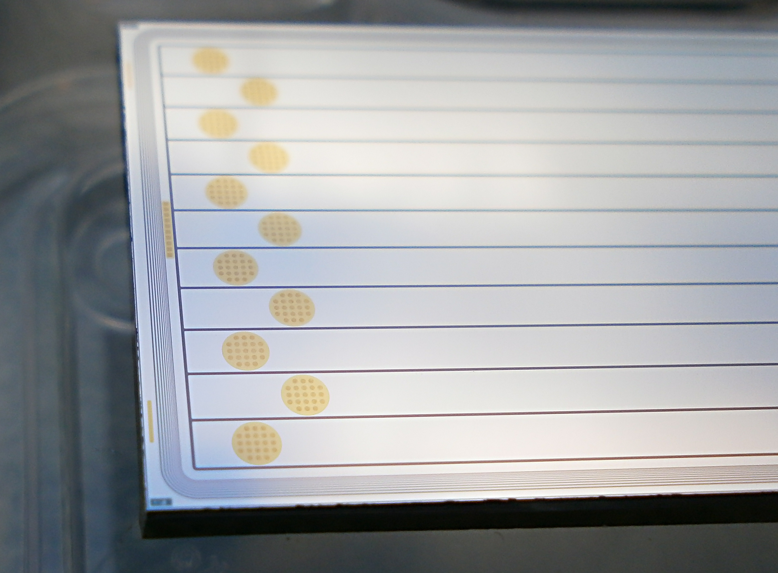
Si DSSD mask design approved April 2016
Ohmic
(glue bonded)
125mm x 25mm x 1mm thick
Active area 11 x 2mm

Slide 17
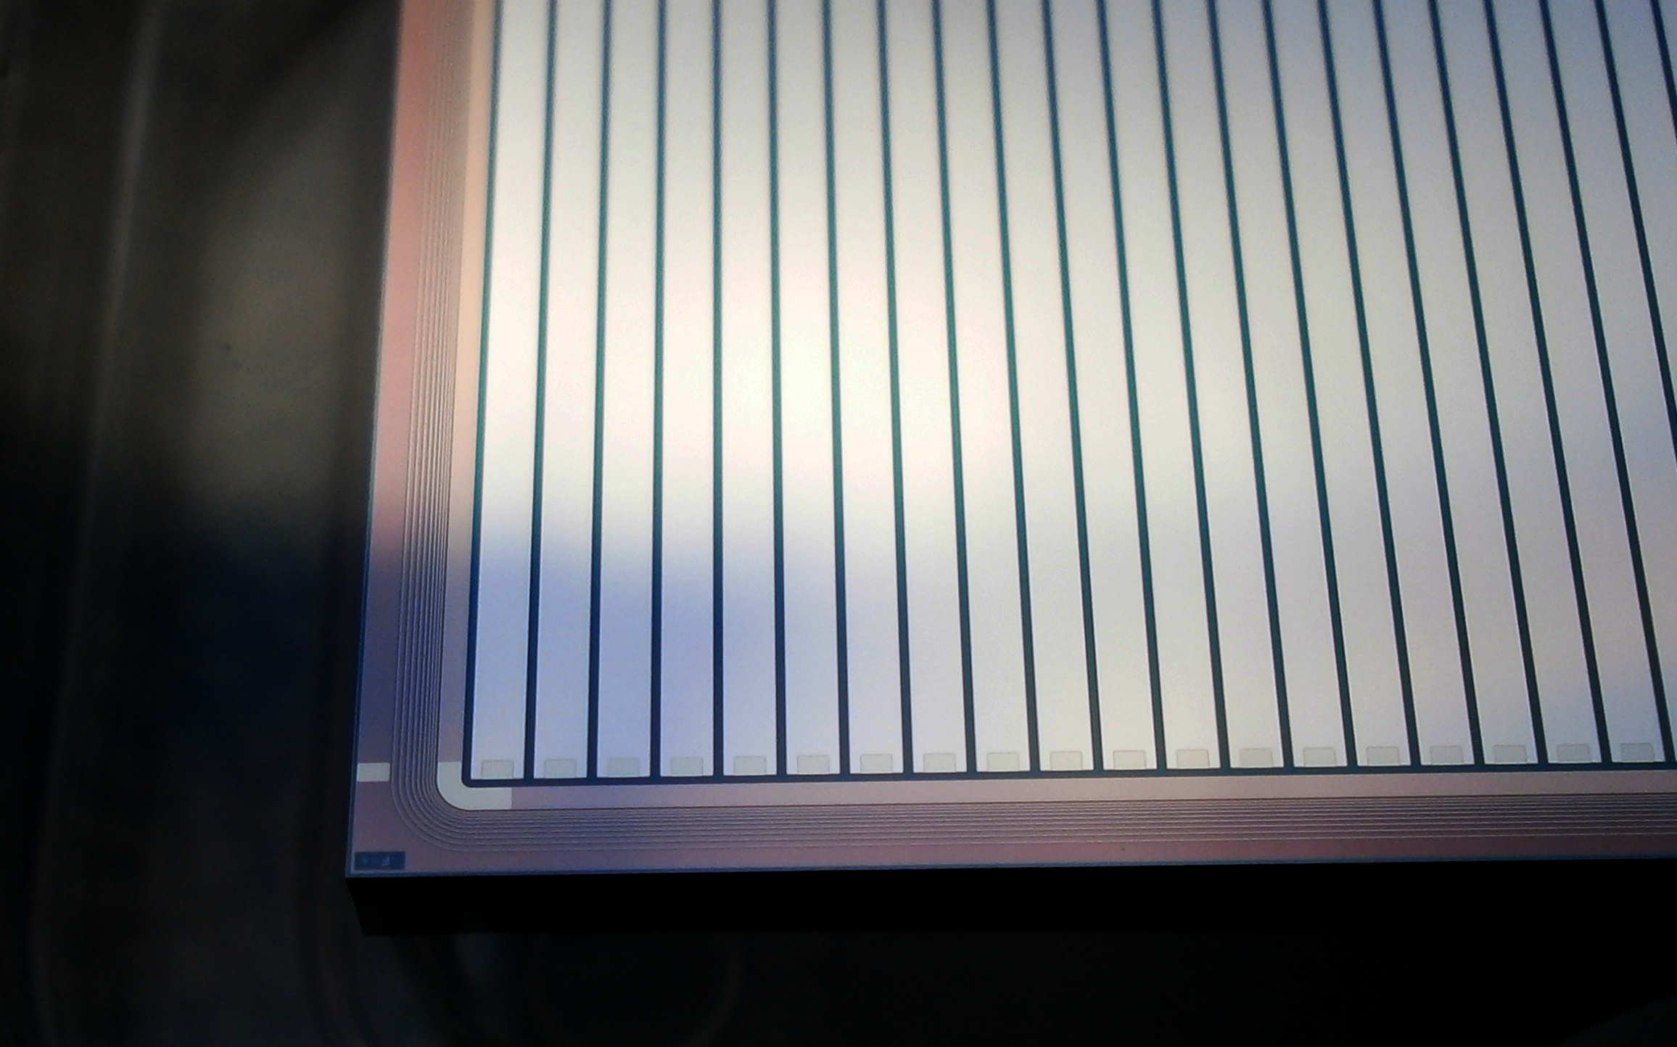
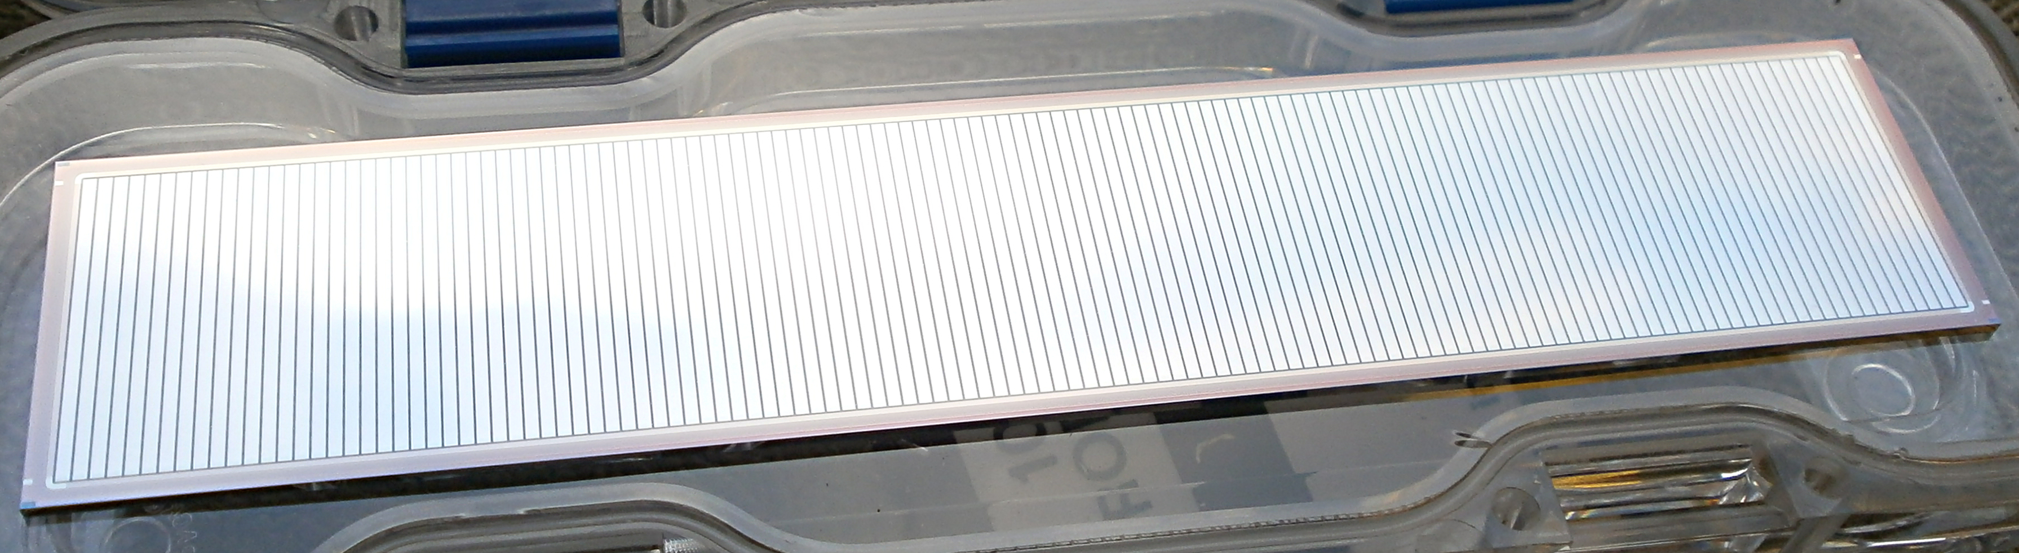
Si DSSD mask design approved April 2016
Junction
(wire bonded)
125mm x 25mm x 1mm thick
Active area 128 x 0.95mm

Slide 18
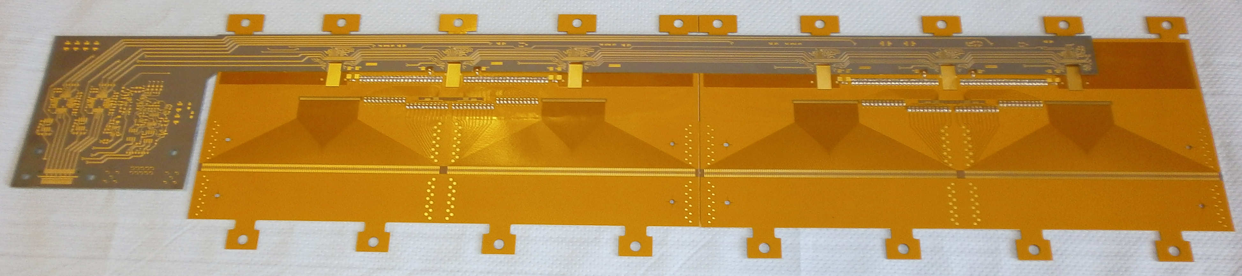
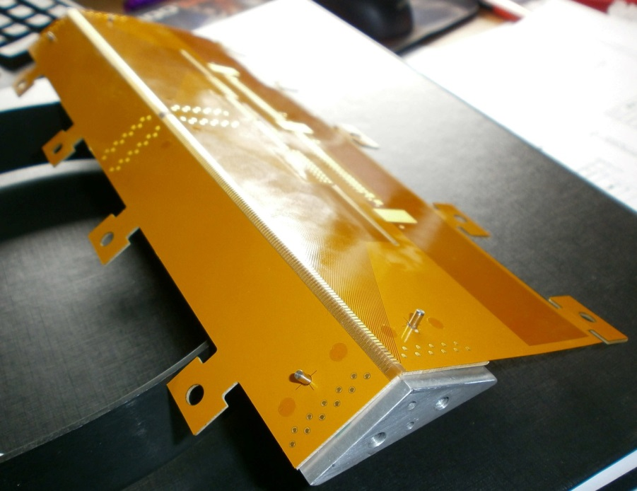
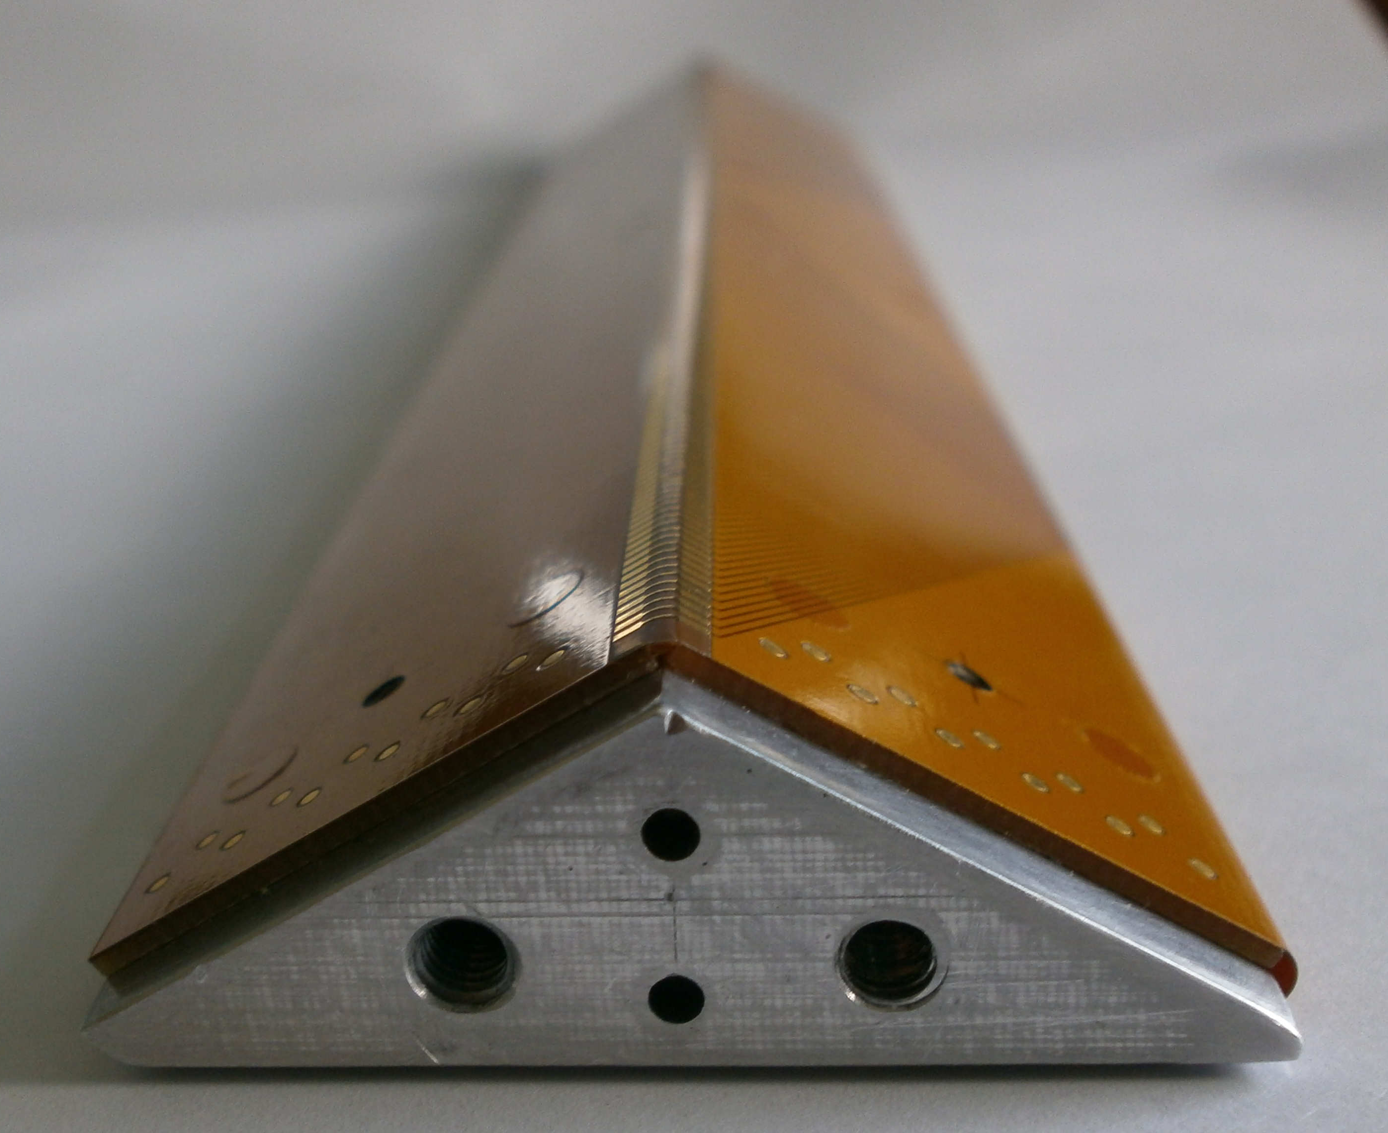
PCB progress
Flex PCB bend
tests successful

Slide 19
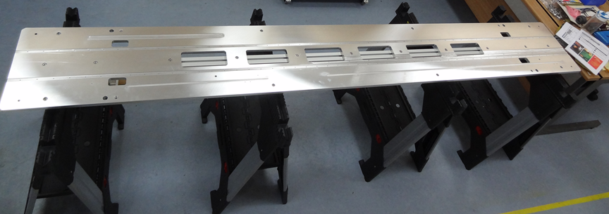
Manufacturing progress

Slide 20
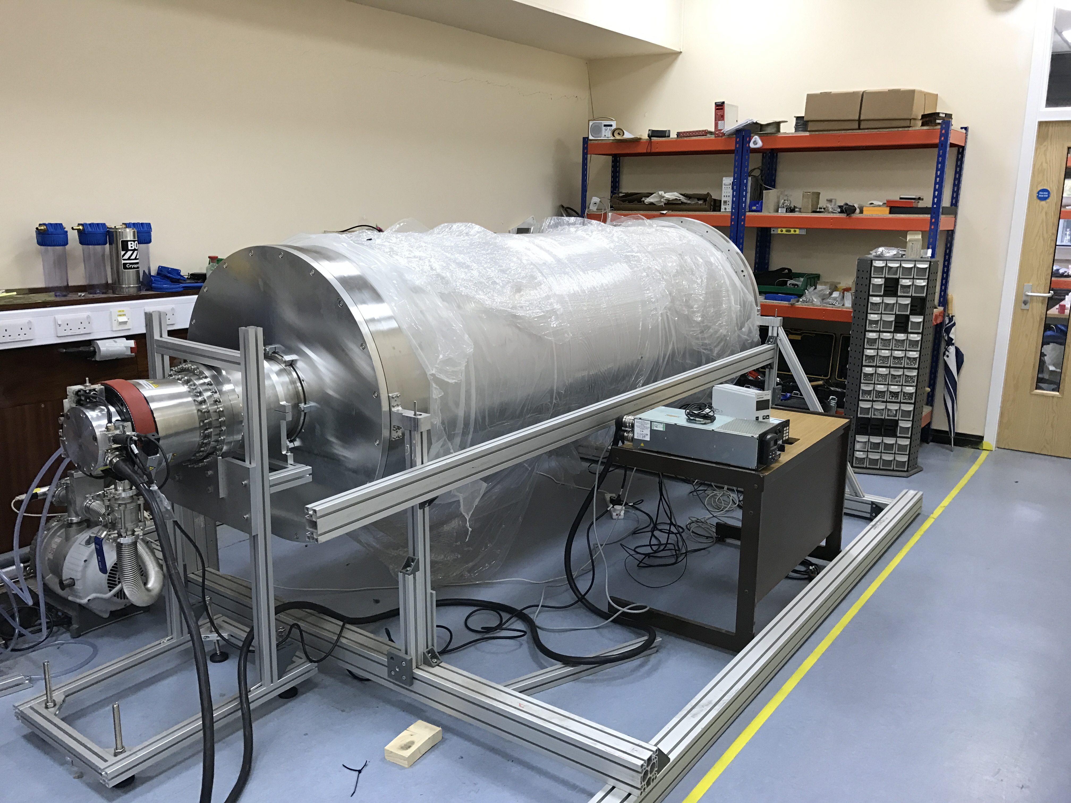
Vacuum test rig

Slide 21
Status of magnet procurement (1/16)
Magnet funding awarded (STFC/UoL)
Magnet available from Brisbane (UQ)
  OR66 4T ex-MRI magnet
  “Active shield” reduces stray field
  Installed February 2003
  Discharged then warmed ~2013
Order for magnet has been placed!
To be delivered & paid by 31/3/2016
(Slide from Peter Butler’s presentation at Warwick in January 2016)

Slide 22
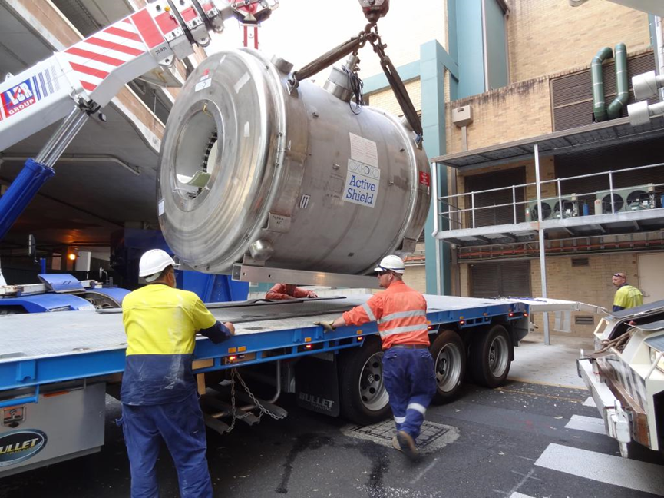
Loading magnet onto truck

Slide 23
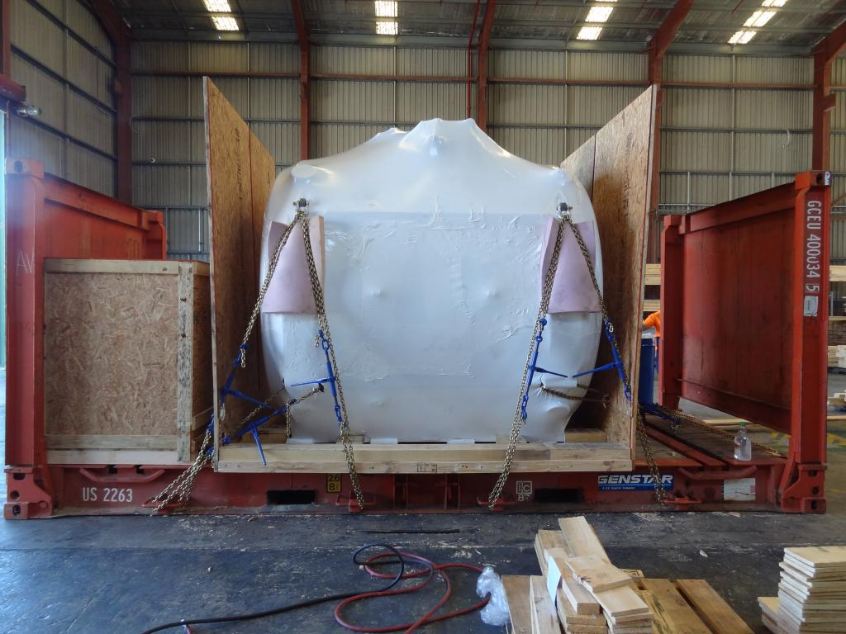
Packing magnet ready for voyage

Slide 24
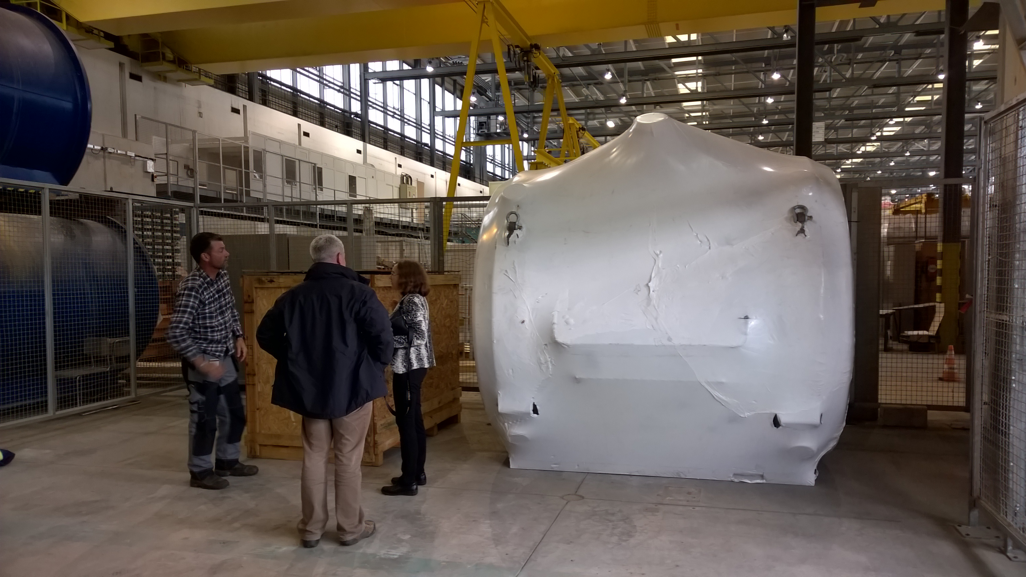
Magnet safely delivered to CERN

Slide 25
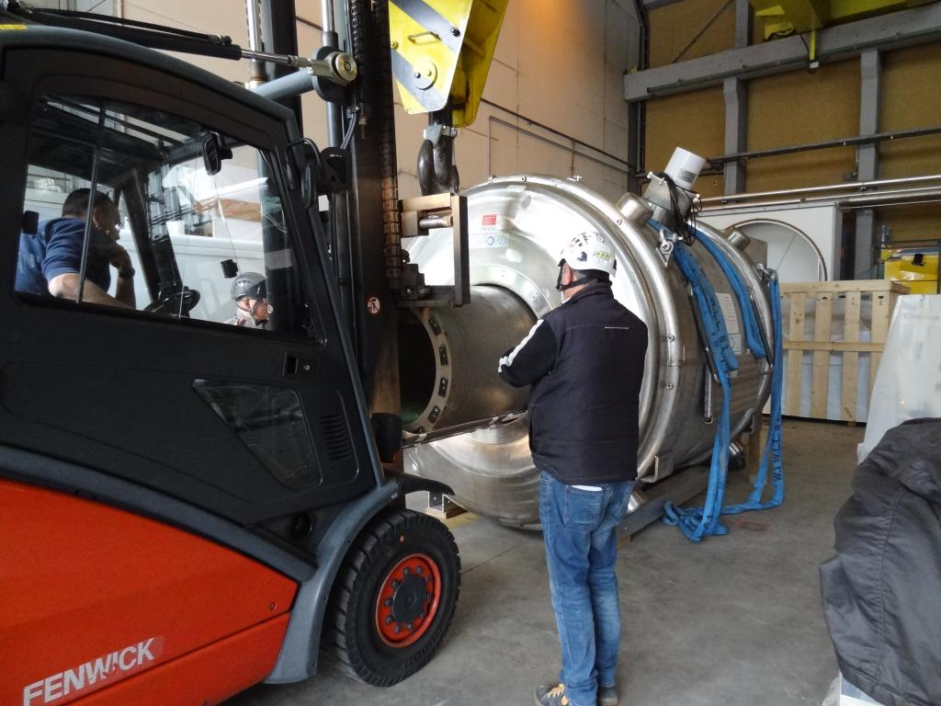
Removing gradient coils

Slide 26
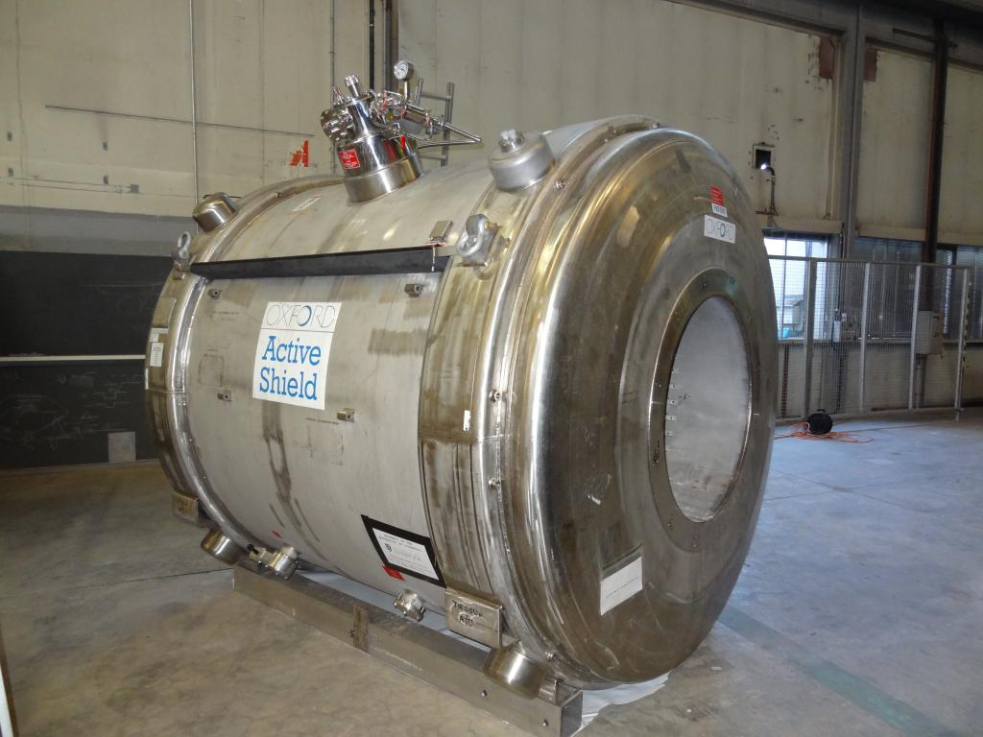
Magnet in CERN Building 190

Slide 27
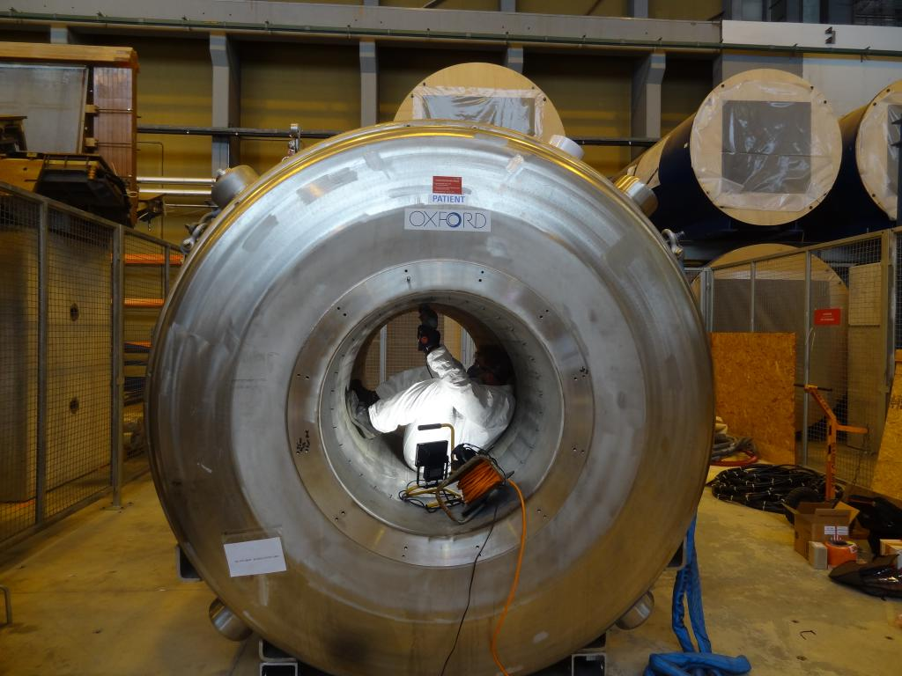
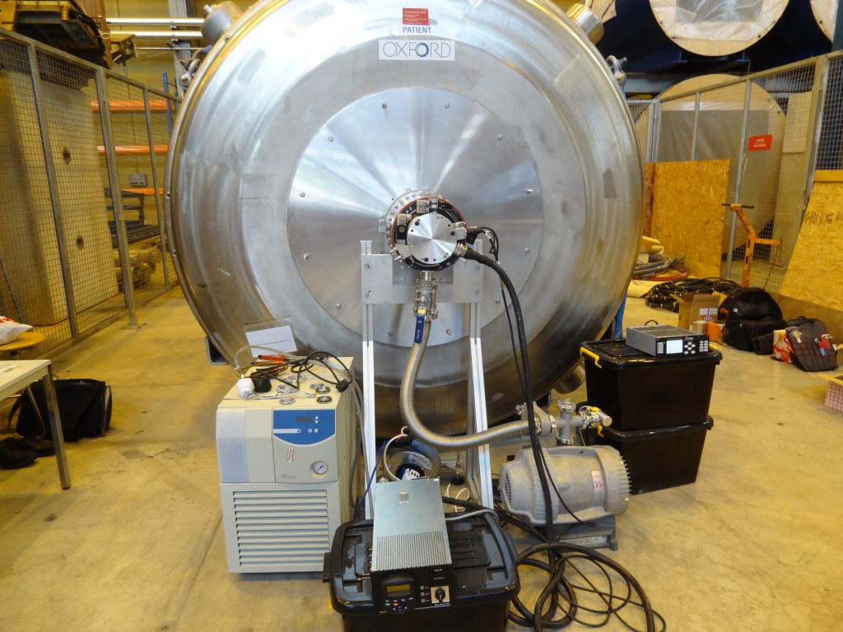
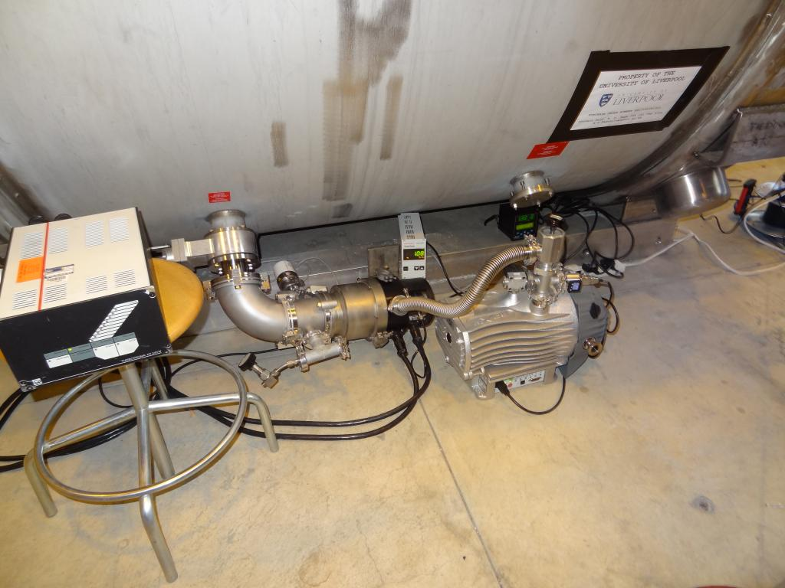
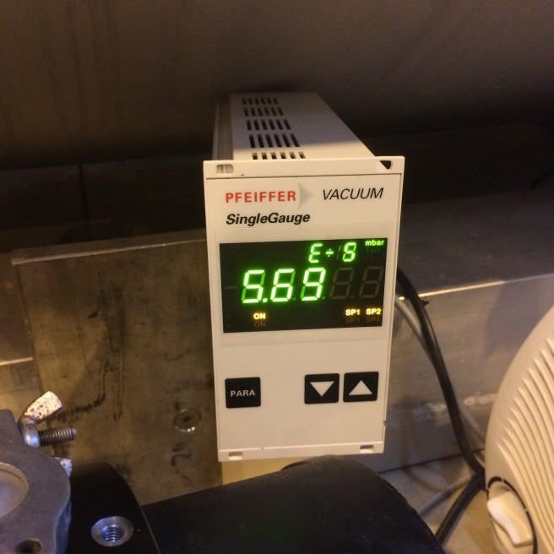
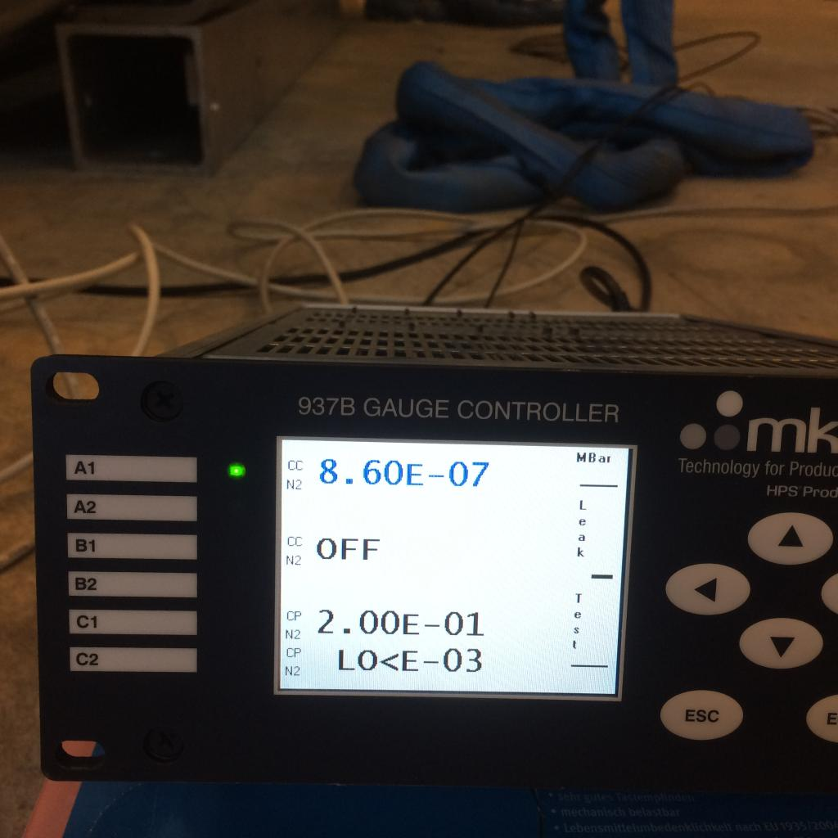
Magnet vacuum tests successful
OVC 5.69x10⁻⁵mbar
Bore 8.6x10⁻⁷mbar

Slide 28
Magnet commissioning
Meetings with CERN safety & cryogenics groups
Moved to building 180 in Dec 2016
Cool down & energise in Building 180 next week
Move to ISOLDE Hall by 31st January 2017

Slide 29
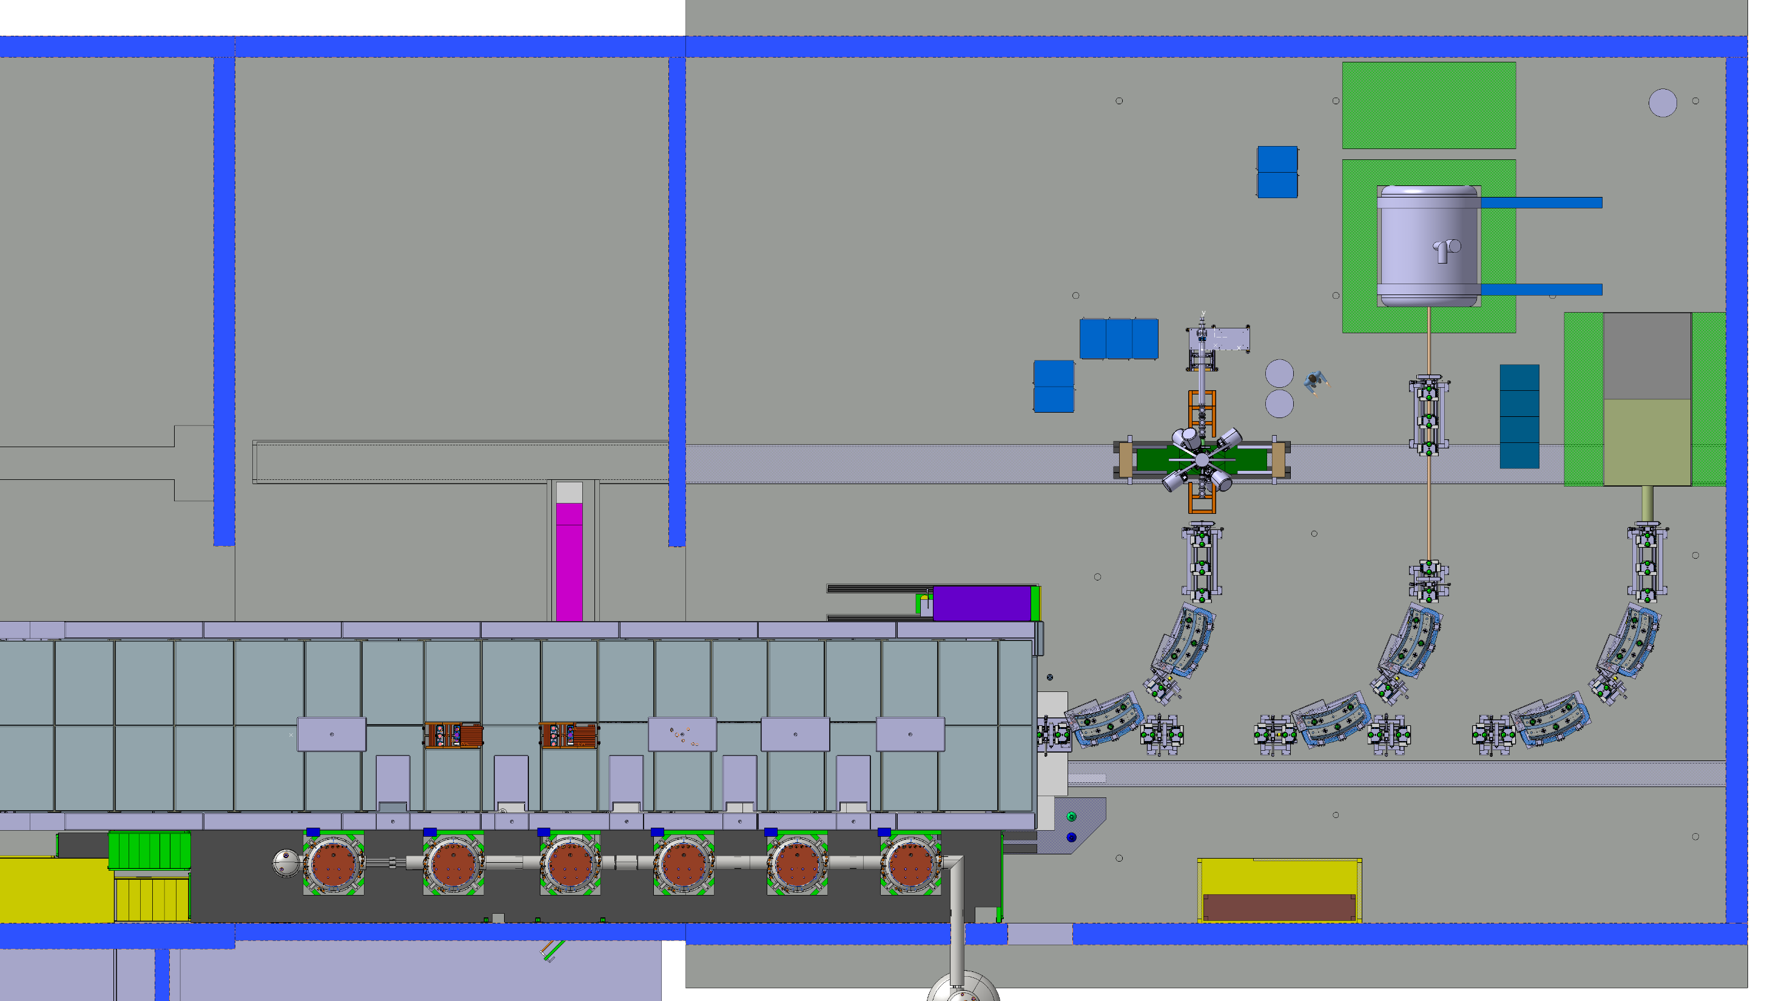
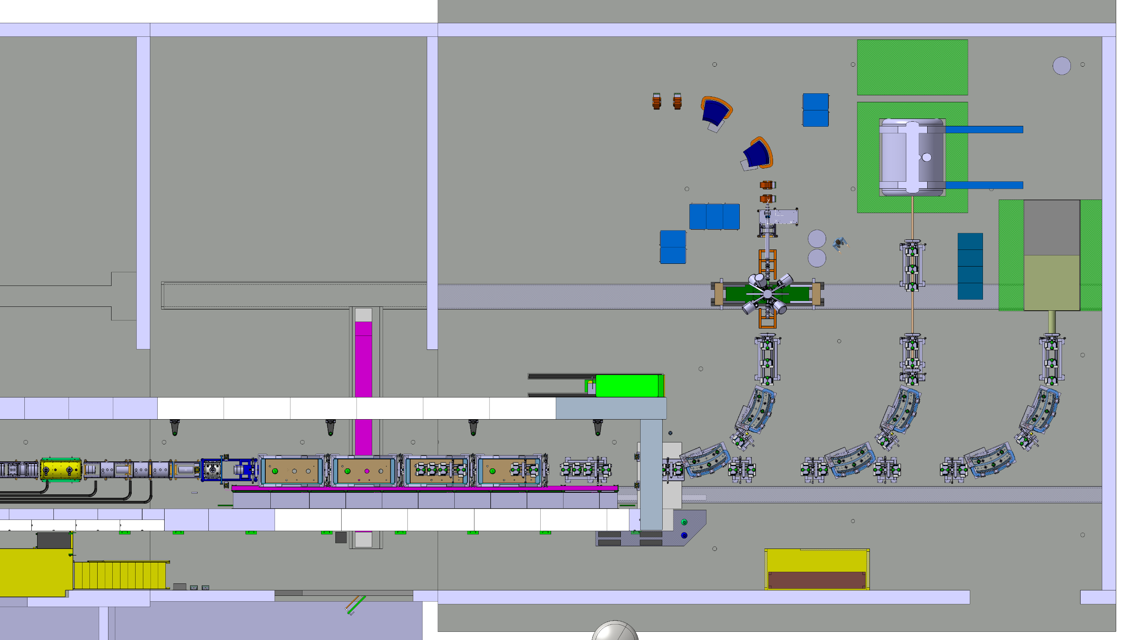
Installation in the ISOLDE Hall
Preliminary experiments 2017/18
Early 2019 – commission new Si
Exploit with HIE beams after LS2

Slide 30
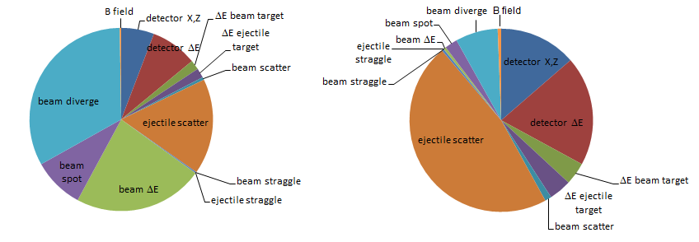
What if there’s no TSR beam cooling?
EXTERNAL SPECTROMETER: d(²⁴Ne,p)²⁵Ne @ 10 MeV/u
HIE-ISOLDE beam: 38 keV
Cooled TSR beam: 22 keV
Study launched to explore other ways to improve beam
characteristics (e.g., collimate, de-bunch & rotate phase)

Slide 31
Summary
Good progress on both spectrometers
Looking positive for science without TSR
  In-ring spectrometer welcomed at CRYRING
  Constructive first meeting in December about ISOLDE beam manipulation for ext spectrometer
ISS solenoid finally approved to recommission
Thanks to people who provided slides and pictures: Peter Butler, Tom Davinson, Stephane Maridor, Paul Morrall, Robert Page, Dave Seddon, Jim Thornhill

