Slide 1
&
Inspiring
Involving
Public Engagement in STFC
Dr Elizabeth Cunningham
Particle & Nuclear Physics
Outreach Officer
Elizabeth.Cunningham@stfc.ac.uk
Incredible Science  Inspirational People  Astounding Places

Slide 2
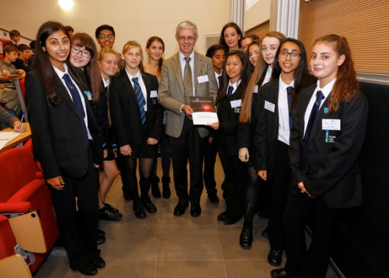
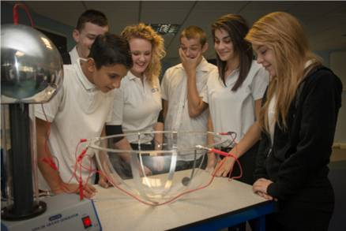
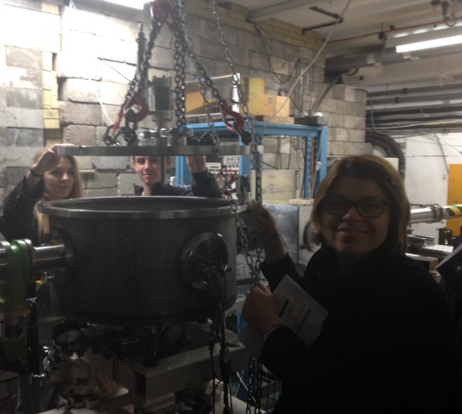
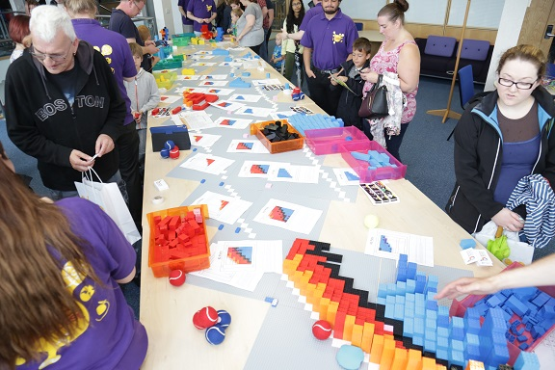
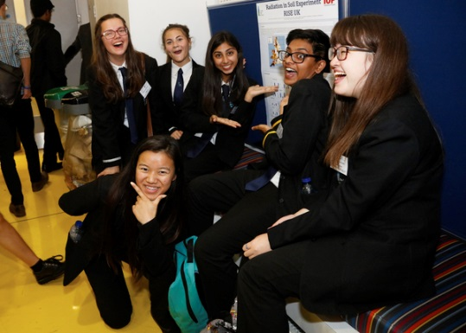
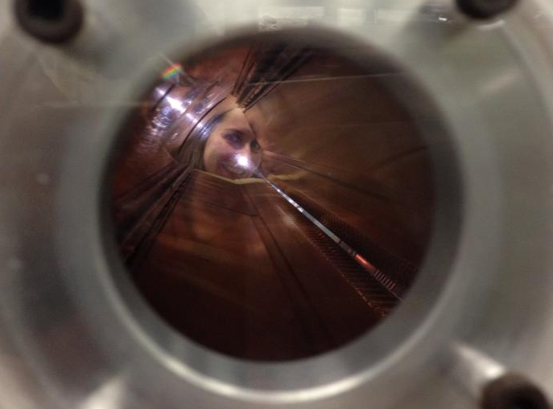
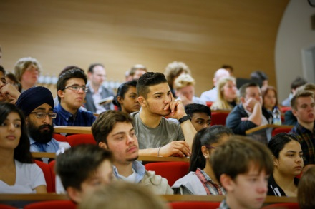
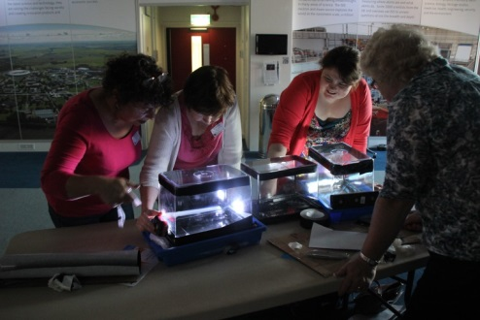
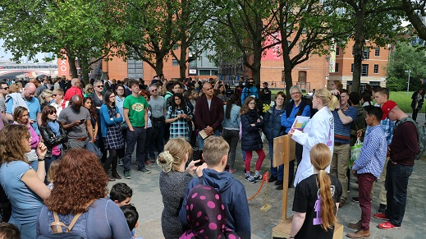
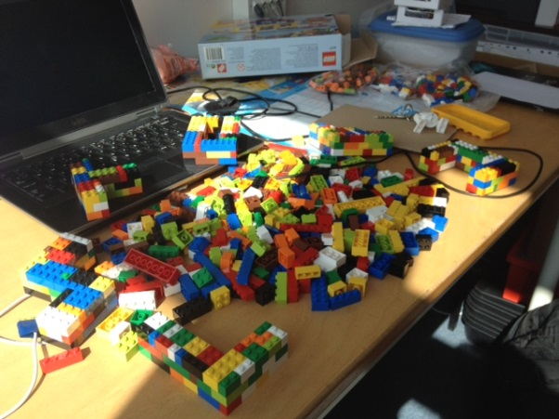
New STFC Public Engagement Strategy
Copies available upon request!
Enabling you
STFC funding and support
Successful nuclear physics outreach awards
Examples of excellence!
STFC nuclear physics public engagement
What have I been doing?
Impact
Notes:
Another good year – Thank you everyone who has supported NP PE over the last year!

Slide 3
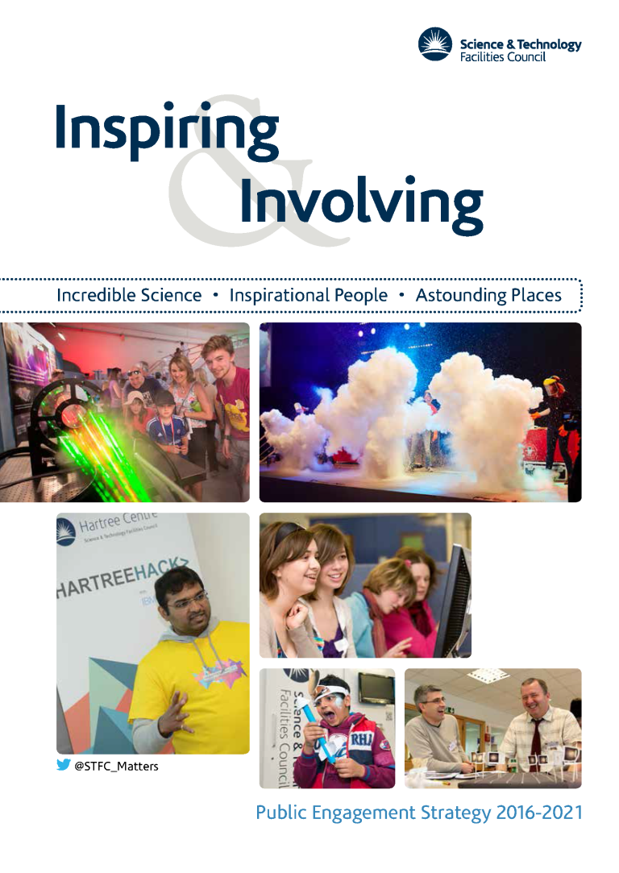
Our Public Engagement Strategy, 2016-2021
Incredible Science, Inspirational People, Astounding Places…
http://www.stfc.ac.uk/files/corporate-publications/stfc-public-engagement-strategy/

Slide 4
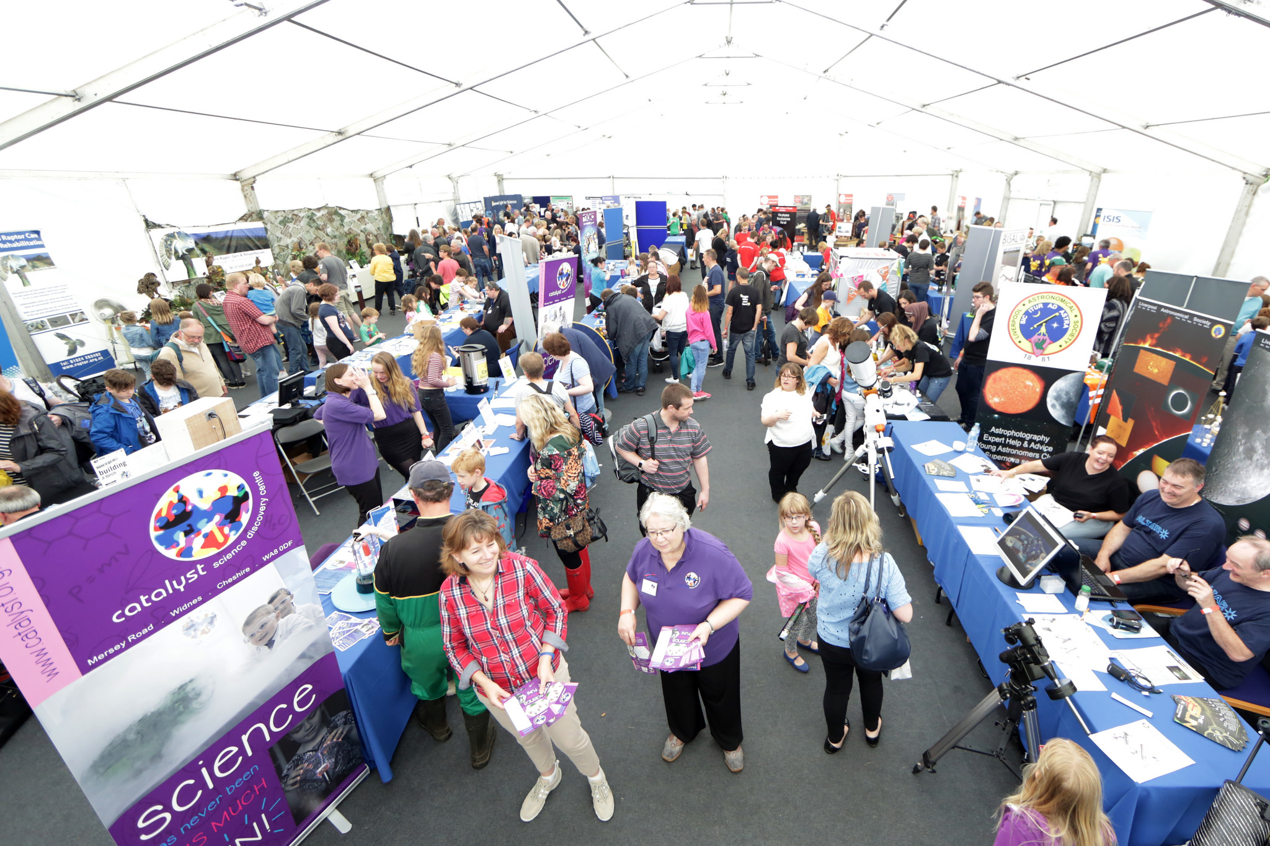
Our vision is of a society that values and participates in scientific endeavour.

Slide 5
Our mission is to use our stories, communities, and facilities as the basis of world-class public engagement that inspires and involves people with our science and technology.

Slide 6
Our Public Engagement Strategy, 2016-2021
Our vision is of a society that values and participates in scientific endeavour.
Our mission is to use our stories, communities, and facilities as the basis of world-class public engagement that inspires and involves people with our science and technology.
Showcasing STFC science & technology
Building the right partnerships
Developing & supporting STEM influencers
Improving our reach with diverse audiences
Delivering high quality public engagement activities & outcomes
What’s the difference?
Increased focus on engaging audiences that are new to STEM, and/or in late primary & early secondary school.
More partnership working to increase our reach and impact.
Much more prominent expectations on planning & evaluation.
Greater attention to a supportive culture of engagement in academia.

Slide 7
Why bother with public engagement?
To share new research results?
To discuss societal challenges?
To create new researchers?
To encourage participation?
To build relationships or gain influence?
To improve trust and understanding?

Slide 8
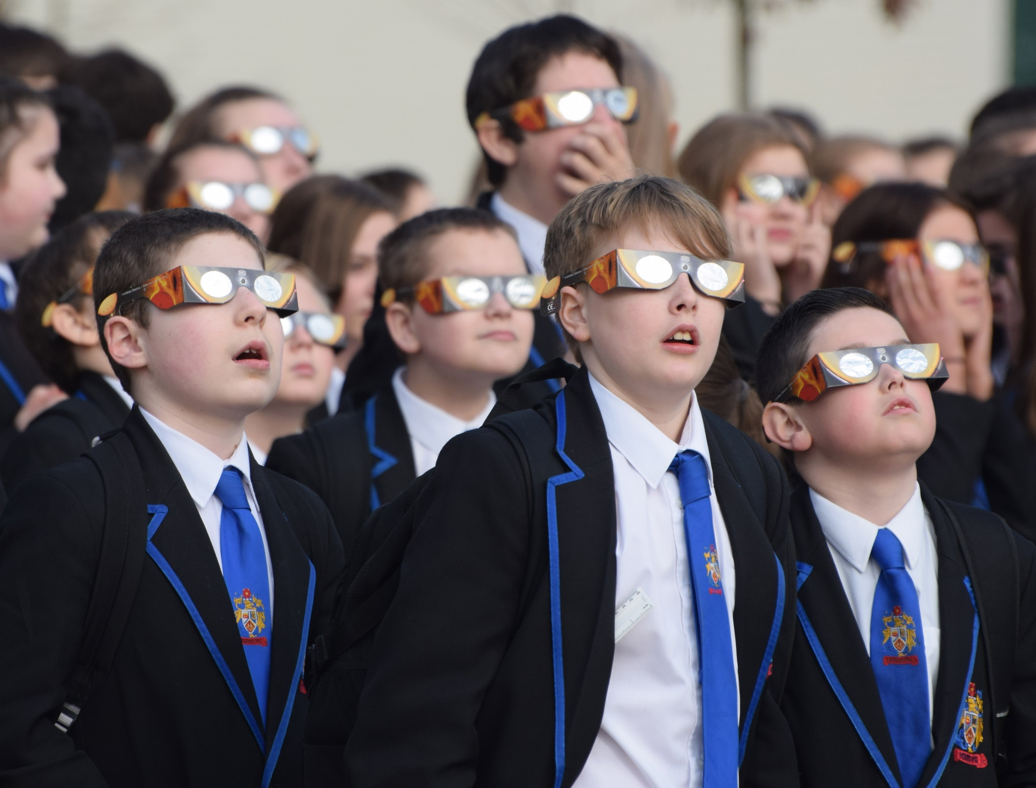
Every year, we reach over 750,000 people with our public engagement...

Slide 9
Every year, we reach over 750,000 people with our public engagement...
But we can’t do it without you!

Slide 10
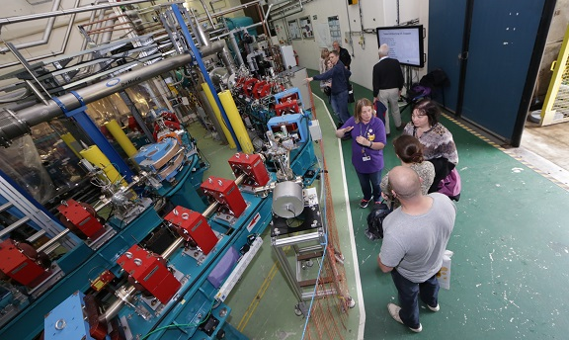
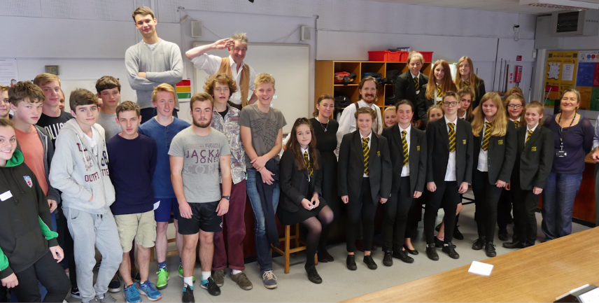
Enabling you – small awards
STFC, Small Awards. Funds £500 - £10,000 for small, local or 'pilot' projects promoting STFC science and technology.
Dr Christopher Edmonds
University of Liverpool ‘acceleratAR’ - £9,668
Virtual tours of the accelerator facilities at Daresbury
Ms Rae Hoole
Daisi
‘Lise Meitner: The Battle for Ultimate Truth’ - £9,800
A day long schools event, to encourage more young women into physics

Slide 11
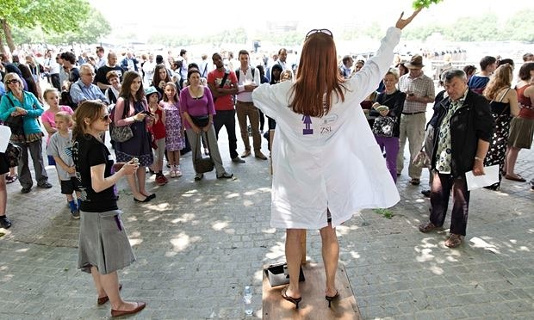
Enabling you – large awards
STFC, Large Awards. Funds up to £100,000 for projects which are expected to have a significant regional or national impact.

Slide 12
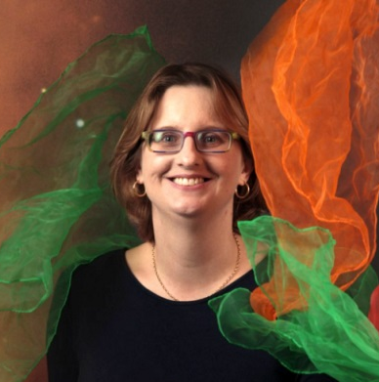
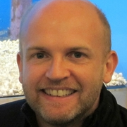
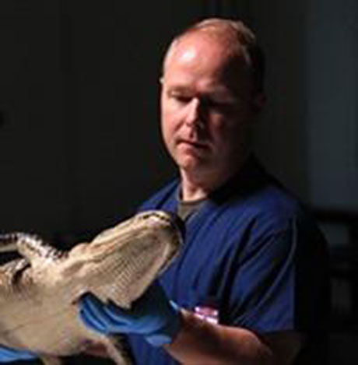
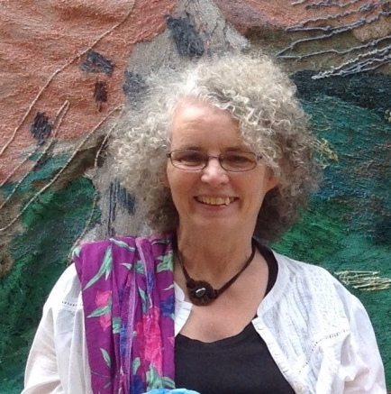
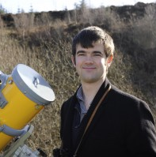
Enabling you – PE fellowships
STFC, PE fellowships. Purchase a proportion of a researcher’s time to enable them to concentrate more on public engagement activities that will have a significant national or regional impact.
Aimed at those with significant research experience.
Who have demonstrated a track record in outreach or communications work

Slide 13
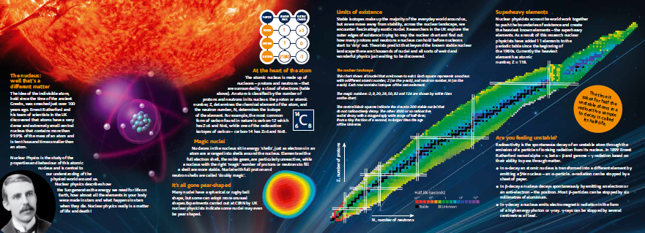
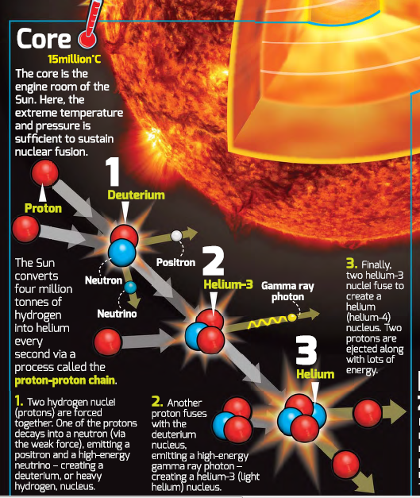
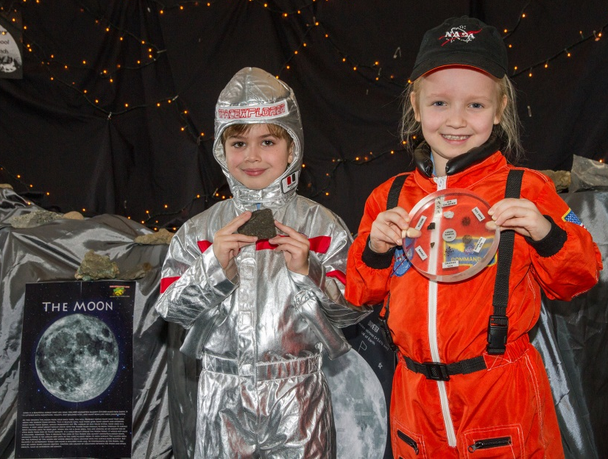
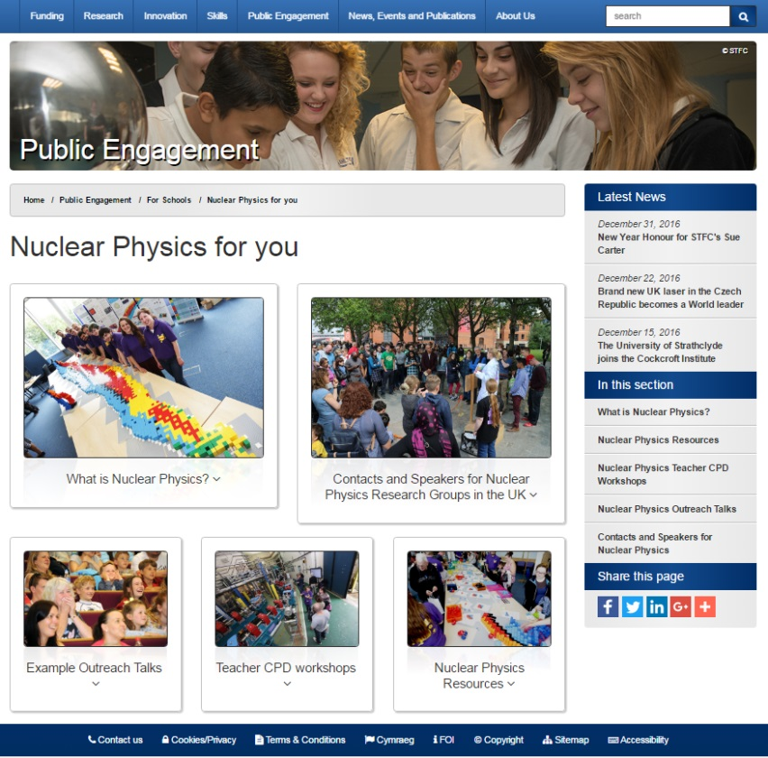
Enabling you – Resources
Free of charge publications for your events.
Borrow the Moon for your events.
Website: Nuclear Physics for You!

Slide 14
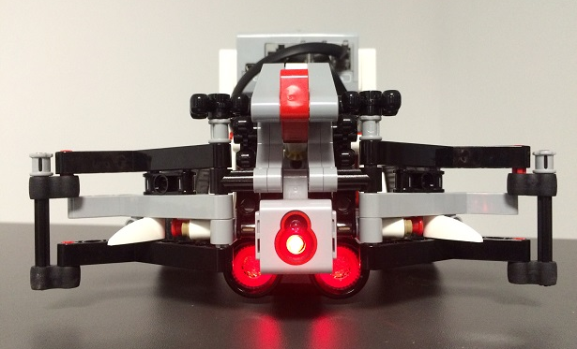
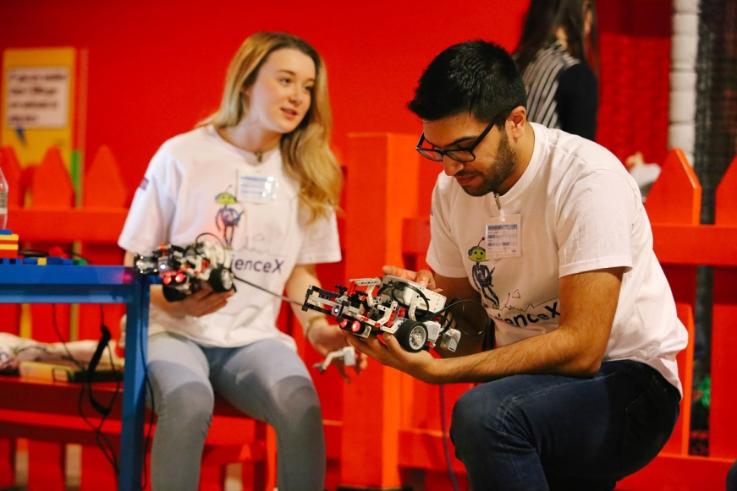
Nuclear Physics Small Awards
How to handle a radioactive nucleus:
ISOLDE 50th anniversary robot competition.
Workshops for Year 10/11 pupils –
- introduce how robots are used to handle nuclear material at ISOLDE
- teach how to program the robots to locate and move a “radioactive” block
Goals –
- address misconceptions about nuclear physics - teach some basic programming skills
- promote the work of ISOLDE
Notes:
Over the period of the workshop 100 local school pupils participated in the workshop and several hundred members of the public interacted with the robots at a public event at Legoland.

Slide 15
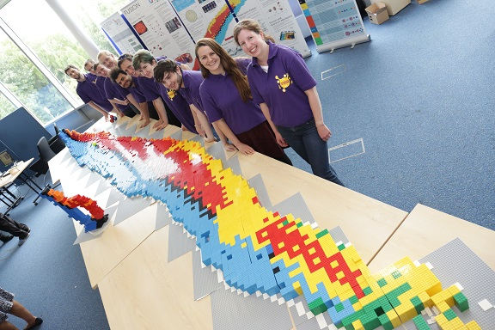
Nuclear Physics Small Awards
LEGO Chart of Nuclides:
Inspiring Future Physicists
Hands on Lego activity for teachers & students:
- introduce the underlying principles of nuclear physics
- discuss development of nuclear applications
Goals –
- demonstrate the links between nuclear physics
and astrophysics, fusion & fission, medicine…
- to inspire the next generation of nuclear
physicists

Slide 16
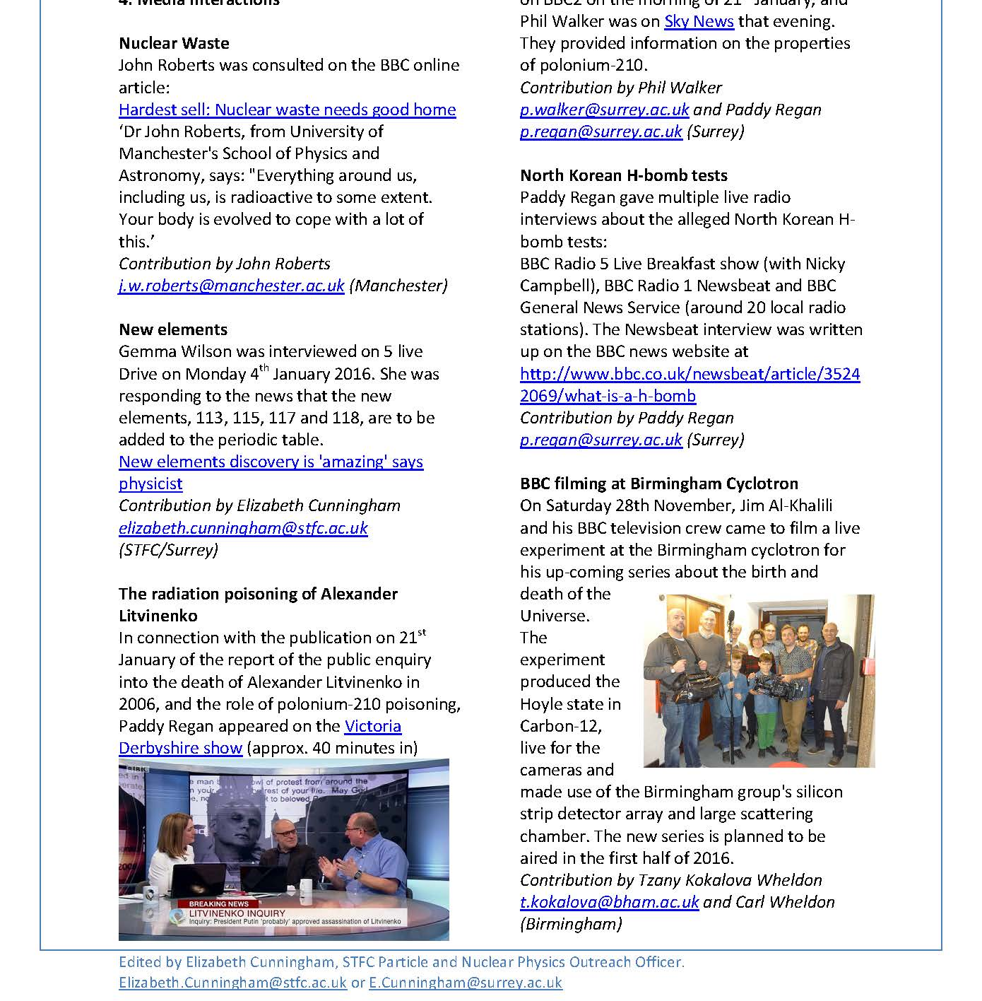
Monthly Newsletter
Notes:
Keep those articles coming!

Slide 17
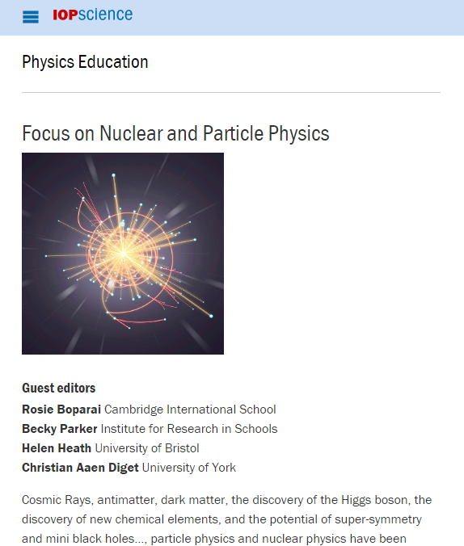
IOP Physics Education Journal
Deadline 31st April 2017!
Notes:
Keep those articles coming!

Slide 18
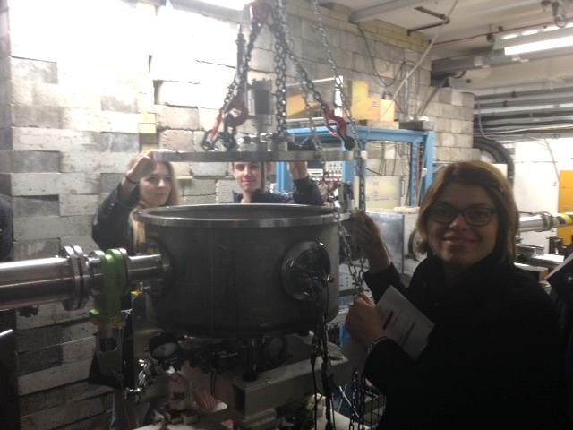
Nuclear Physics Masterclasses
Once day events for GCSE or A Level students focussing on the delights of nuclear physics!
‘10/10 would science again’!
Lectures
Laboratory experiments
Hands on workshops
Careers activities
Computer sessions
Skype chats
Tours of facilities
Notes:
Next group!

Slide 19
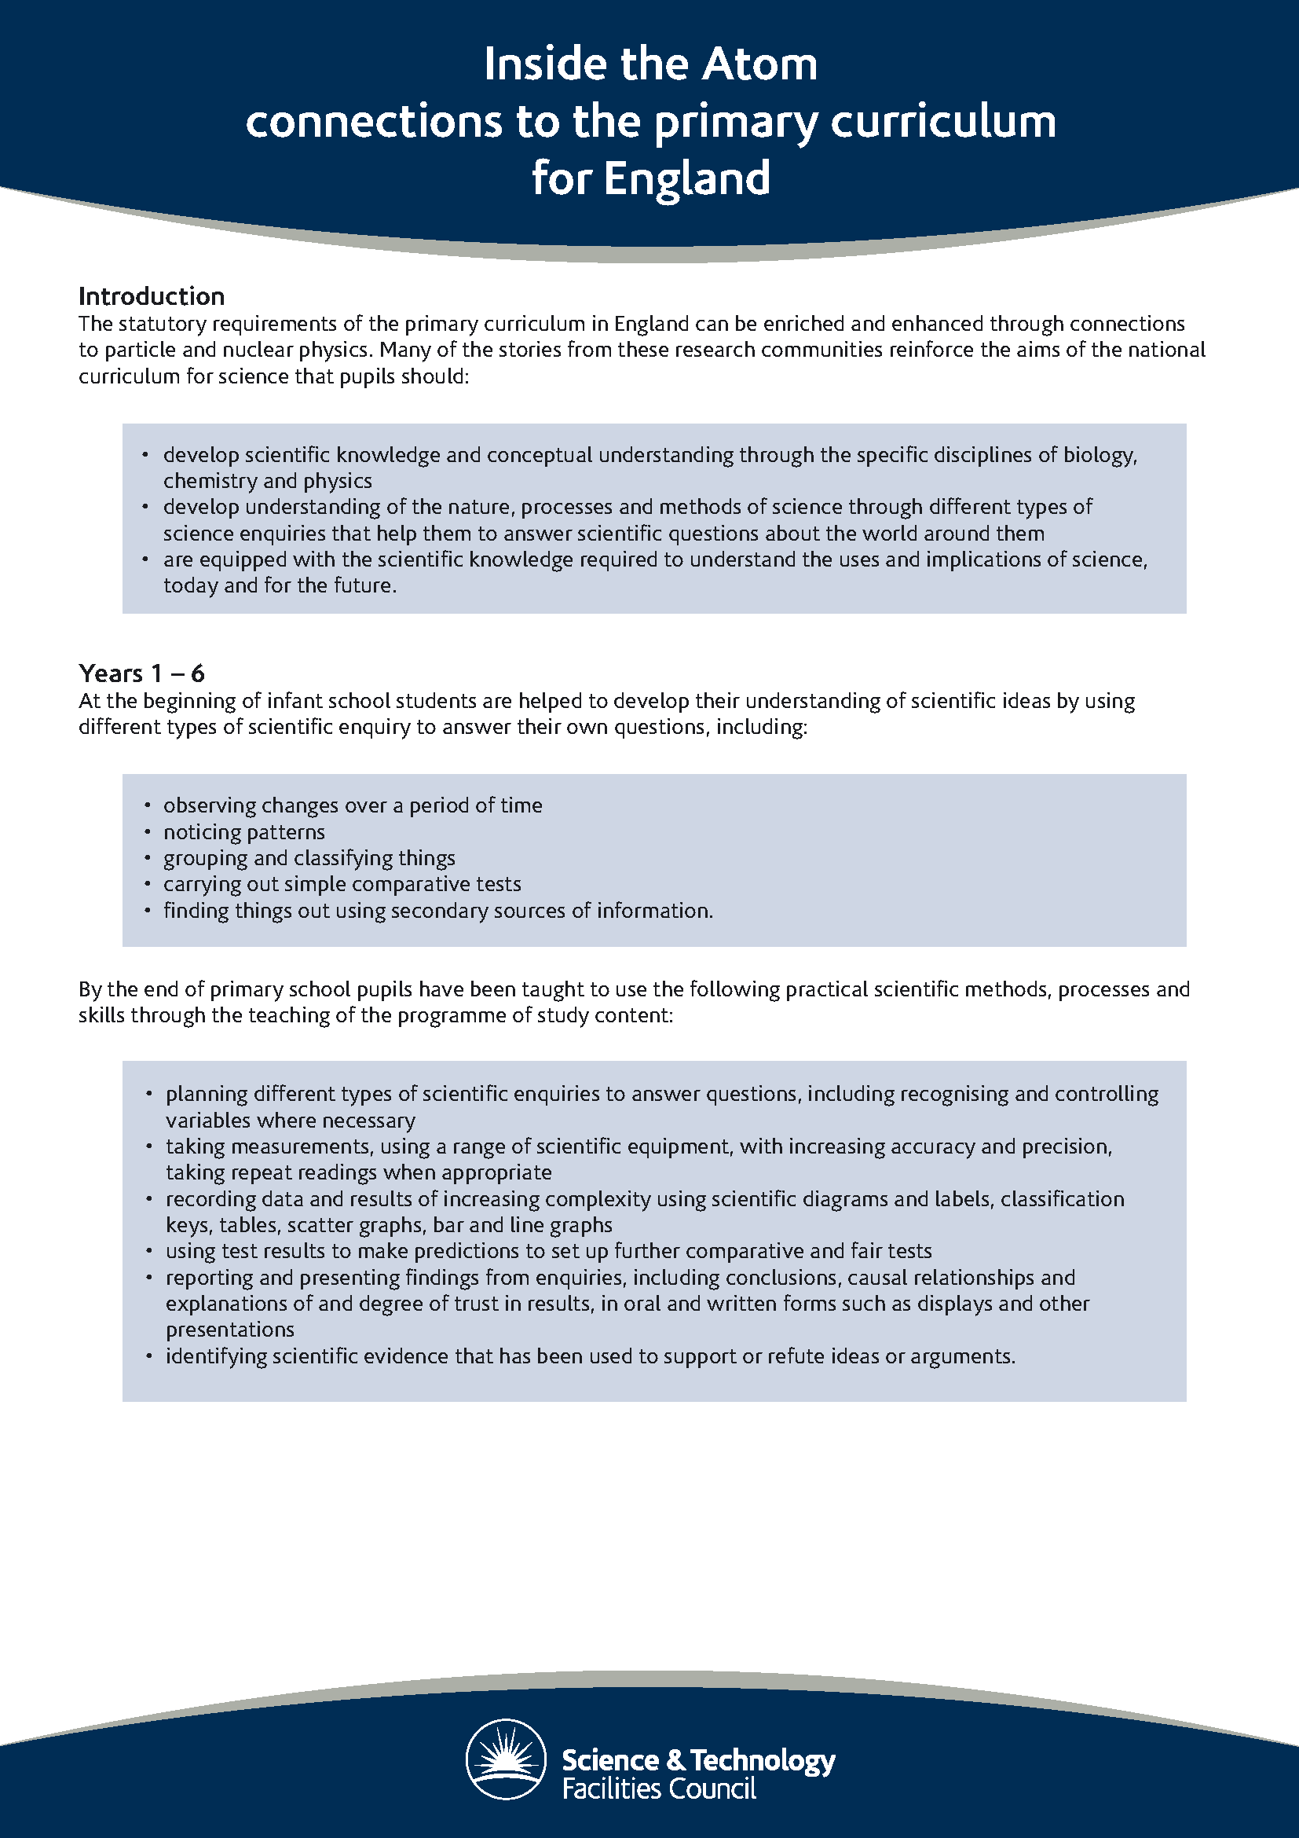
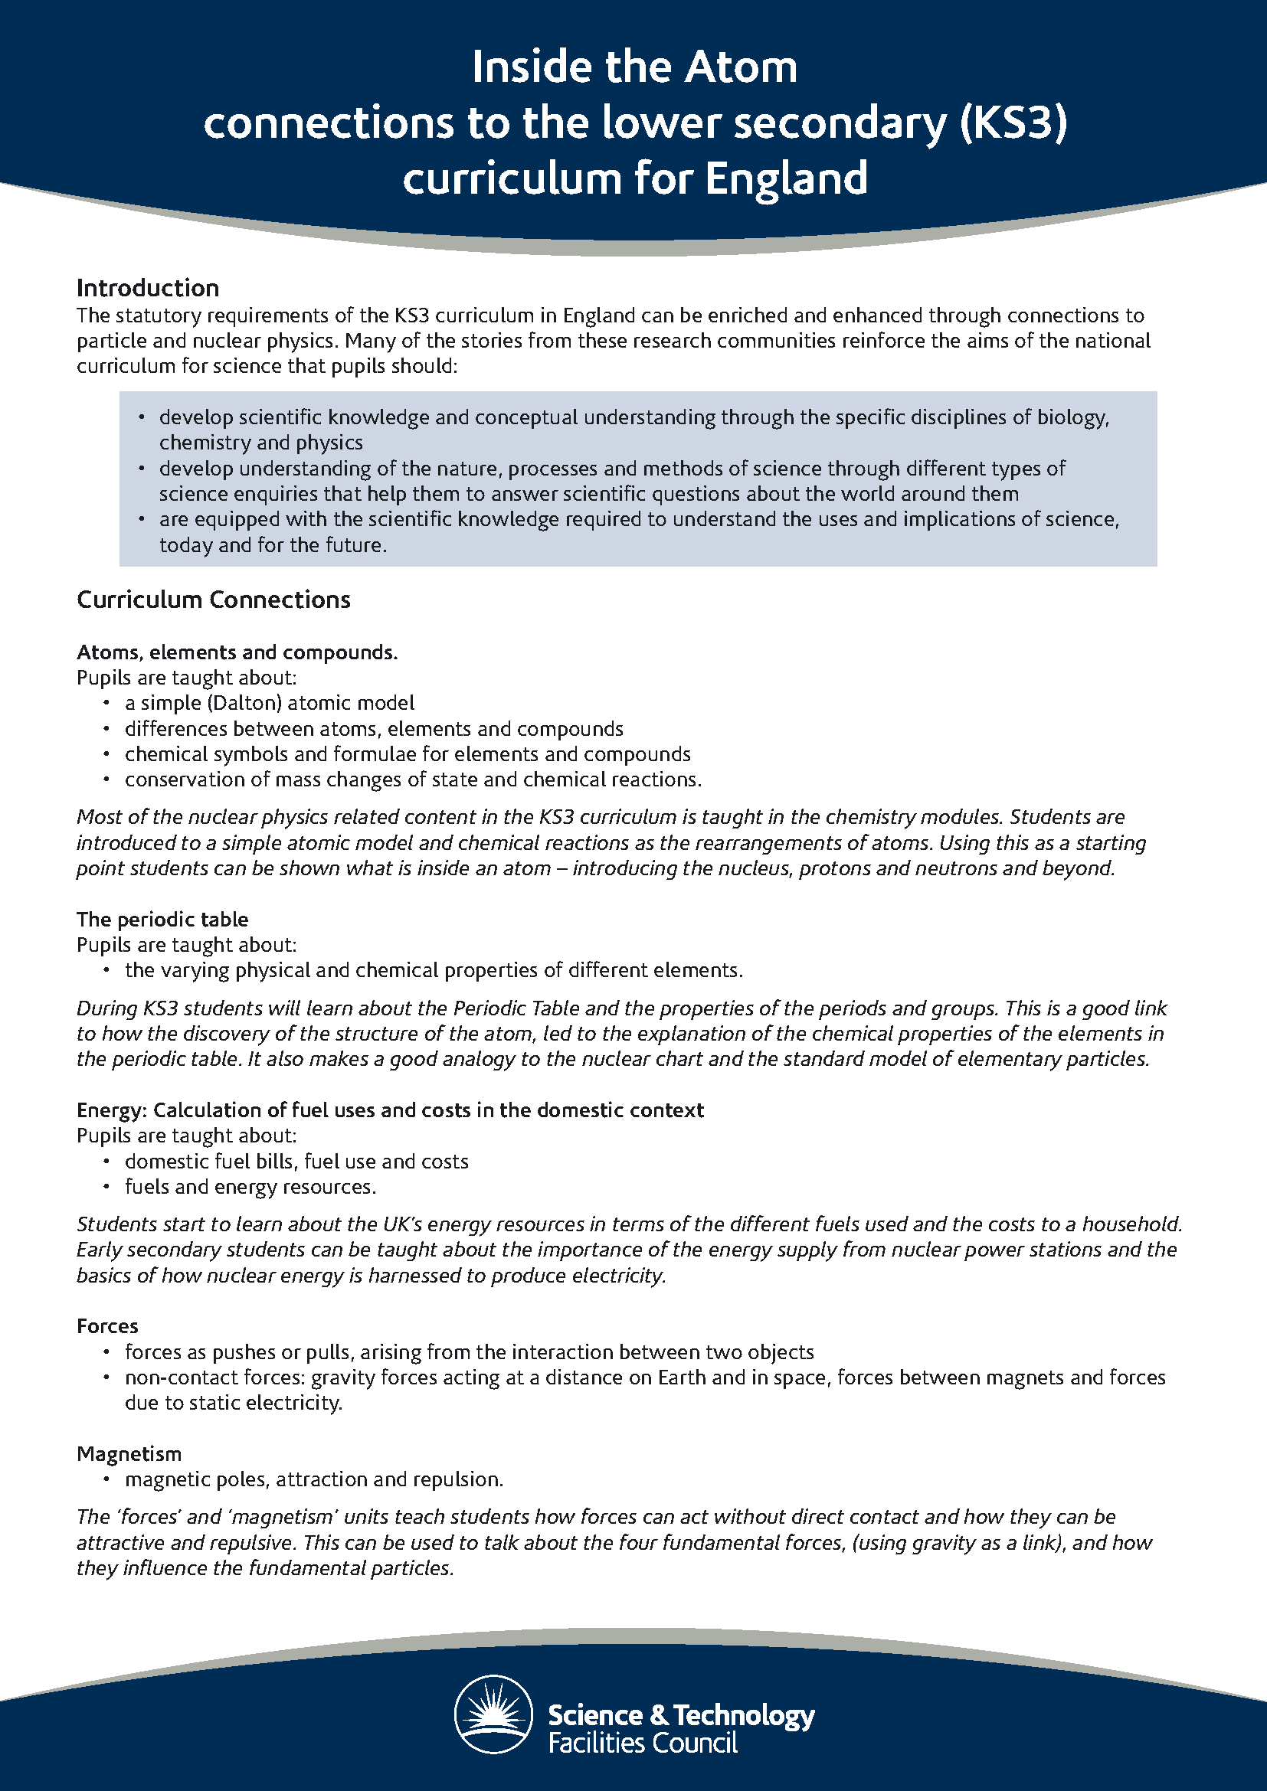
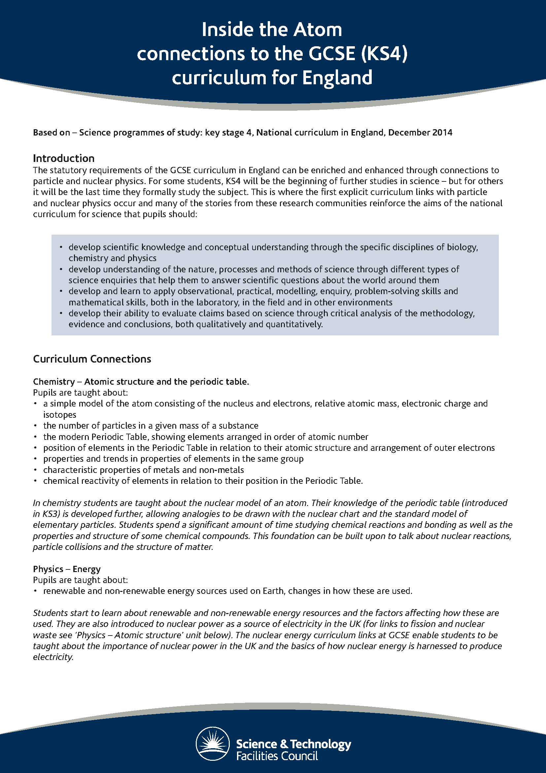
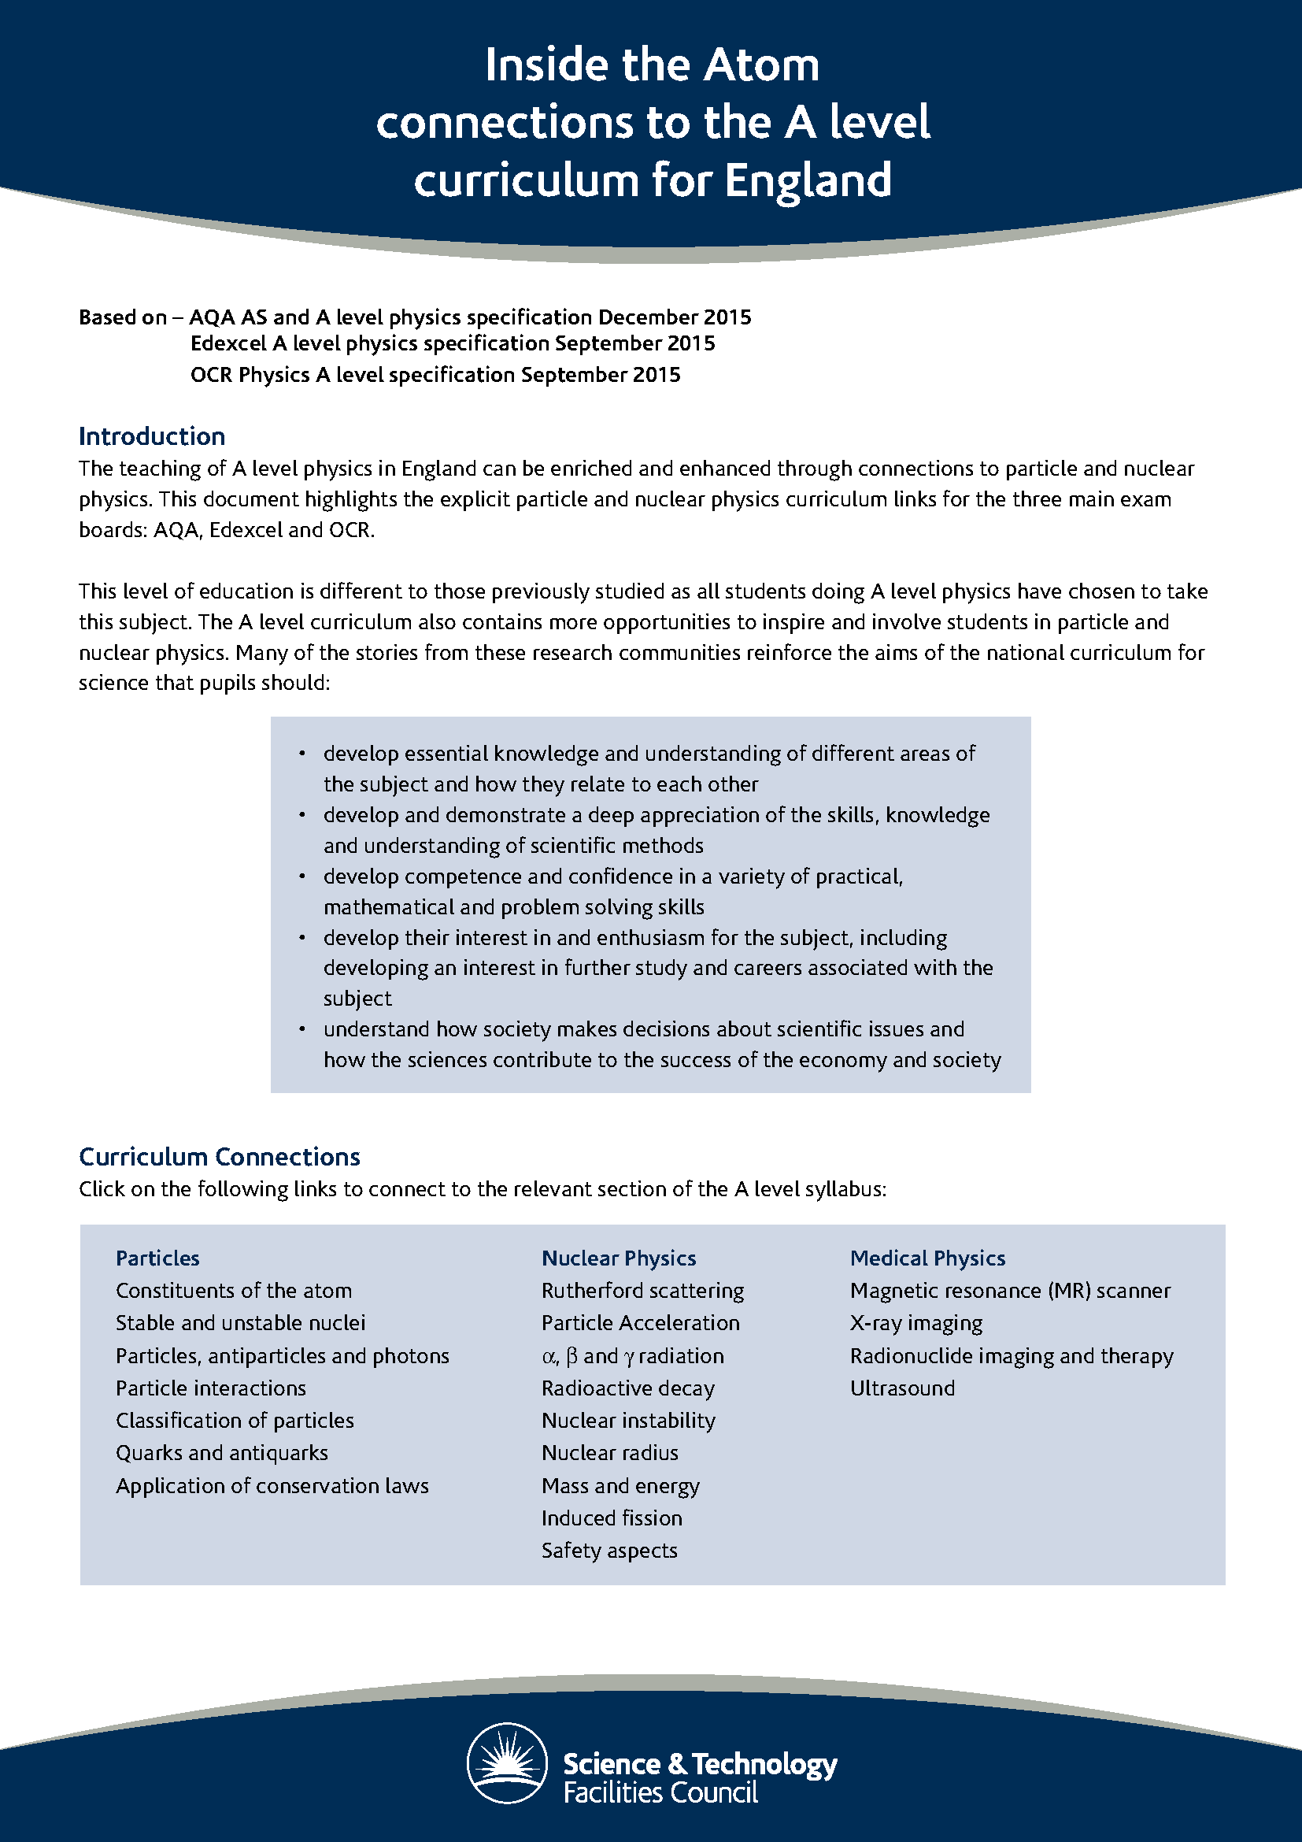
Nuclear Physics Curriculum links
Documents that highlight the particle and nuclear physics curriculum links for primary, lower secondary, GCSE and A level.
Notes:
Next group!

Slide 20
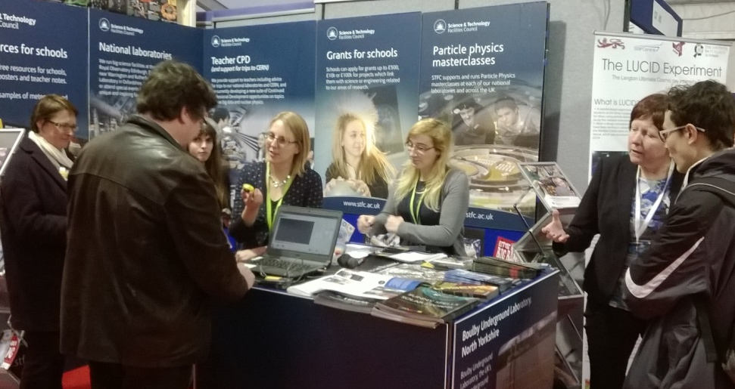
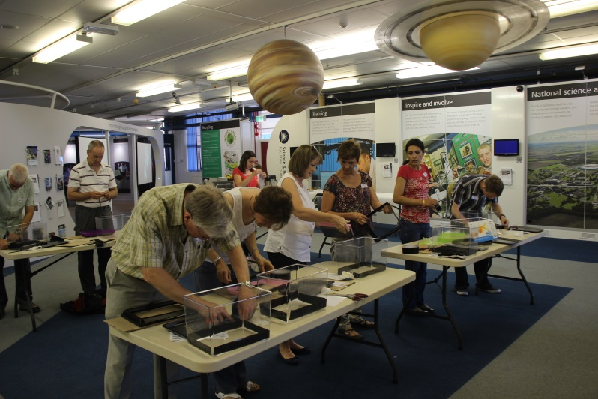
Working with teachers
One day teacher training events including lectures, curriculum linked nuclear physics classroom activities and teacher notes
‘It’s good to see real science going on in the real world and to take it back for students.’
Using ‘Inside the Atom’ as an exciting context for teaching

Slide 21
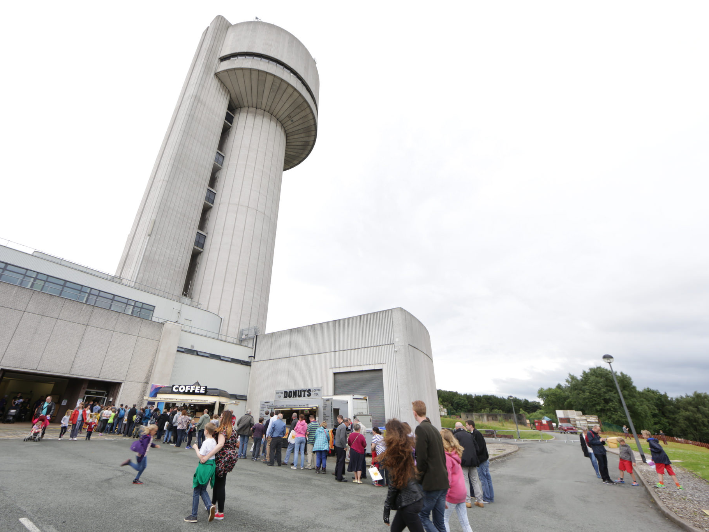
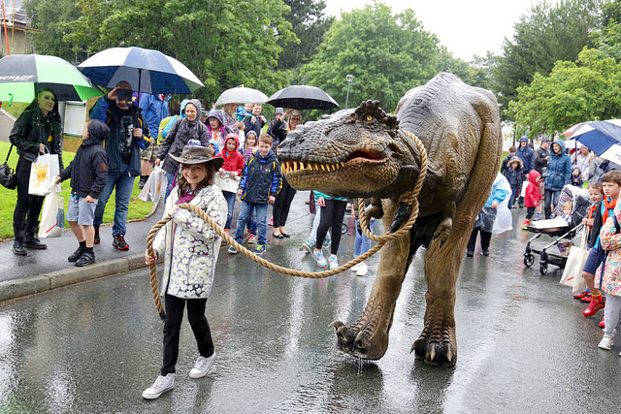
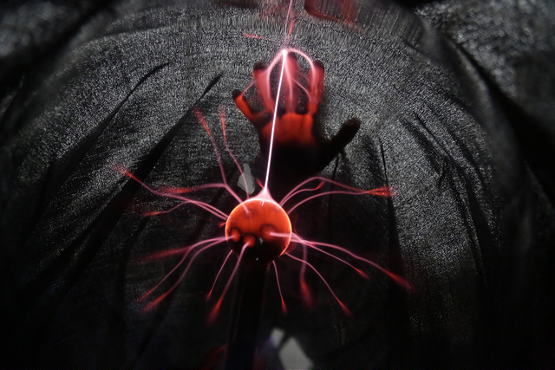
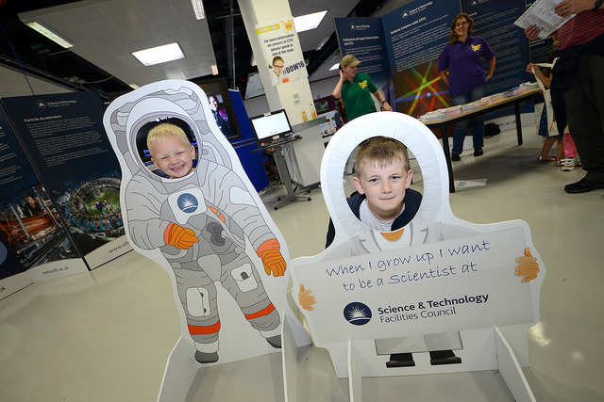
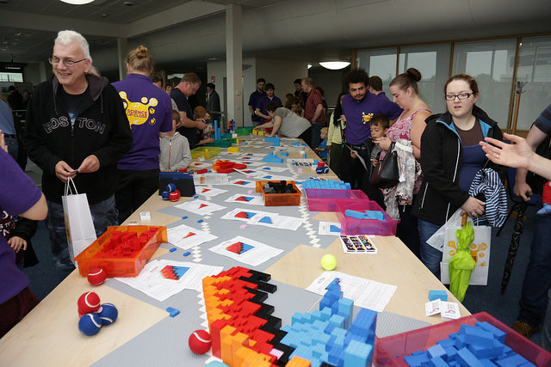
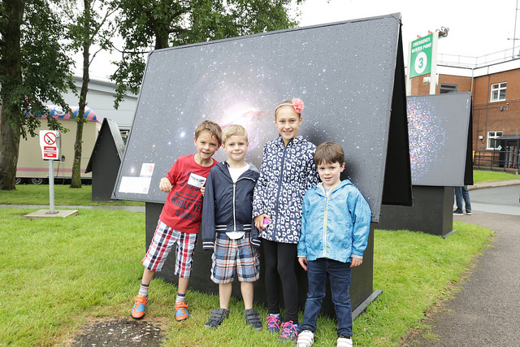
Daresbury Open Week
5th – 9th July 2016, 7,500 visitors on the public day
“Fabulous day enjoying every minute BEST DAY EVER!”
“We loved Daresbury Labs ☺ ”
“I want to be a scientist”
“Fabulous event – thanks to all the volunteers. Can’t wait for the next one”
Notes:
Brand new event (last 1998)
16,000 = London Science Museum on a busy summer’s day.
CERN (with 2,235 workers) attracted 35,000 on each day of its open weekend.
The Public Day = 62,000 hours of visitor engagement. Average length of stay = 4 hours

Slide 22
300K
Impact
School students
19.5K
2.0M
Teachers & educators
Members of the public

Slide 23
Elizabeth.Cunningham@stfc.ac.uk
Notes:
Another good year – Thank you everyone who has supported NP PE over the last year!

