Slide 1
Nuclear Physics Masterclass
University of Liverpool
University of Surrey
Daresbury
Birmingham University
University of York
ljh@liverpool.ac.uk

Slide 2
 | Liverpool | Daresbury
Participants | 6th Form | 6th Form
Format | 5 x 3hr afternoons in term time OR 2 x 1day in half-term break | 1 day (6 hours)
Capacity | 30 students | 80 students
Frequency | 2 p.a. | 1 p.a.
Talks | 4 to 5 20min talks by academics plus 1 invited industry talk | 2-3 talks, ranging 20 to 40 mins
Workshops | 1 practical per afternoon | Rotations through practicals
Skills | Science Communication, poster or talk
Additional | Mini-conference event, posters/talks and students receive certificates | Short Quiz

Slide 3
 | Group 1 | Group 2 | Group 3 | Group 4
09:00 | Arrival of Schools and Welcome to Daresbury
 | Lectures "Intro to nuclear physics” & “Intro to medical imaging”
10:00
 | Medical Imaging wkshop | Inside the atom wkshop | Detector simulations | Gamma-ray detection wkshop
11:00
 | Teas/coffee
 | Inside the atom wkshop | Medical Imaging wkshop | Gamma-ray detection wkshop | Detector simulations
12:00
 | Lunch
13:00 | Detector simulations | Gamma-ray detection wkshop | Medical Imaging wkshop | Inside the atom wkshop
14:00 | Gamma-ray detection wkshop | Detector simulations | Inside the atom wkshop | Medical Imaging wkshop
15:00 | Lecture "Nuclear energy"
 | Quiz and Evaluation
Close

Slide 4
Inside the Atom
Identify shape and size of a hidden object (without looking or feeling)
Roll particles at the hidden object underneath a sheet of cardboard. Draw the path of the particles
Repeat step 1 as many times as needed to identify the shape
Draw the shape

Slide 5
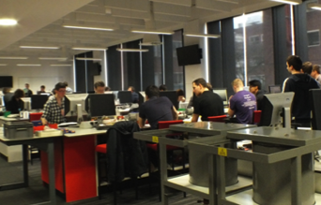
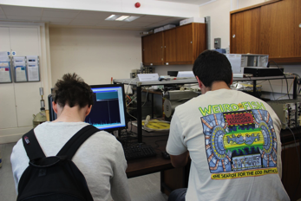
Gamma-ray detection workshop
Liverpool
Identifying unknown sources of radiation
Equpiment: NaI, HPGe detectors, calibration sources, samples
Students verify calibration
Handout concealed samples e.g. smoke detector, watches, soil samples
Students do a “Snap” comparison to a printed database of spectra
Surrey

Slide 6
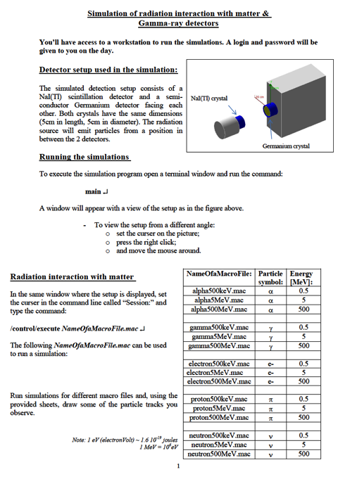
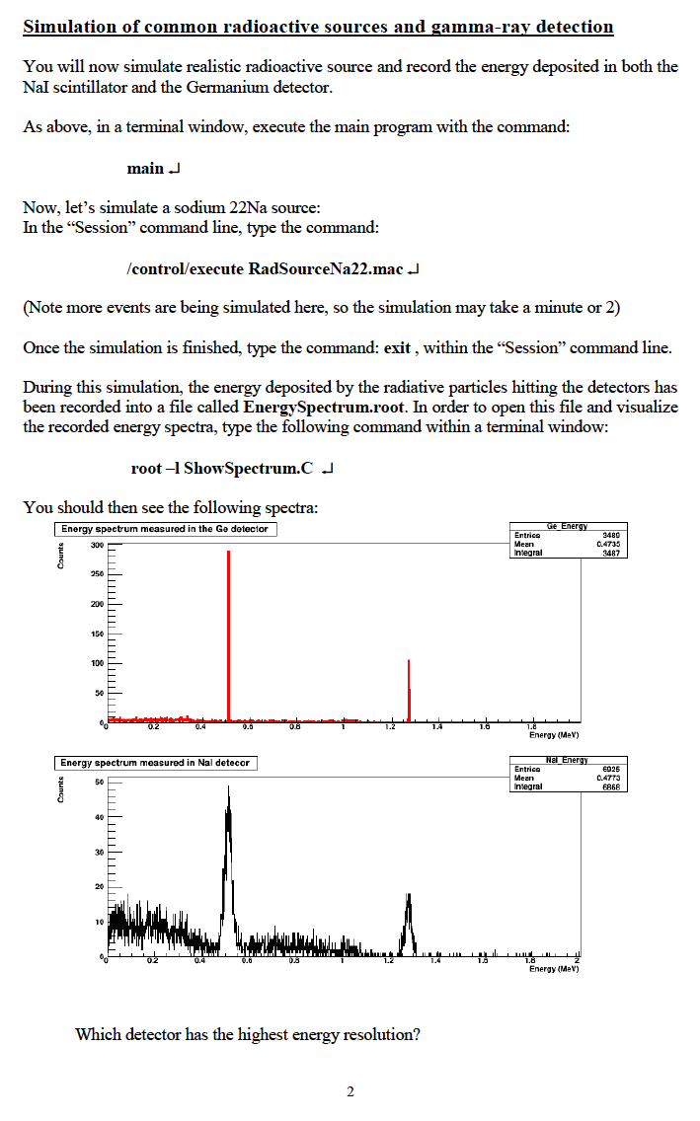

Slide 7
Evaluation – Daresbury 2015
50 students, 7 teachers 82% male, 18% female

Slide 8
Evaluation – Daresbury 2015

Slide 9
Evaluation – Daresbury 2015

Slide 10
Resources
Staff time
PGR/UG demonstrators
Travel costs of students and/or industrial speakers
Any equipment required (typically using what is already available through existing resources)
Catering

Slide 11
Benefits
Good advert/potential recruitment for NP and your group/university
Opportunity for participants to engage with your research
Opportunity to engage with teachers and schools
Intellectually challenging opportunity for potential UG students to be upskilled for labs
Opportunity to link with STEM industry
Positive impact for UG/PGR demonstrators

Slide 12
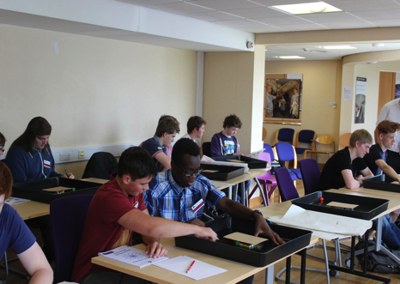
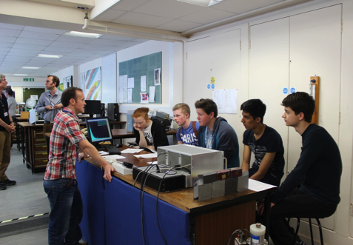
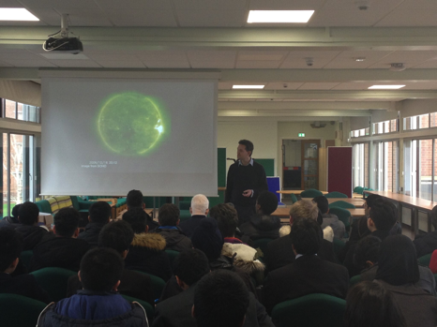
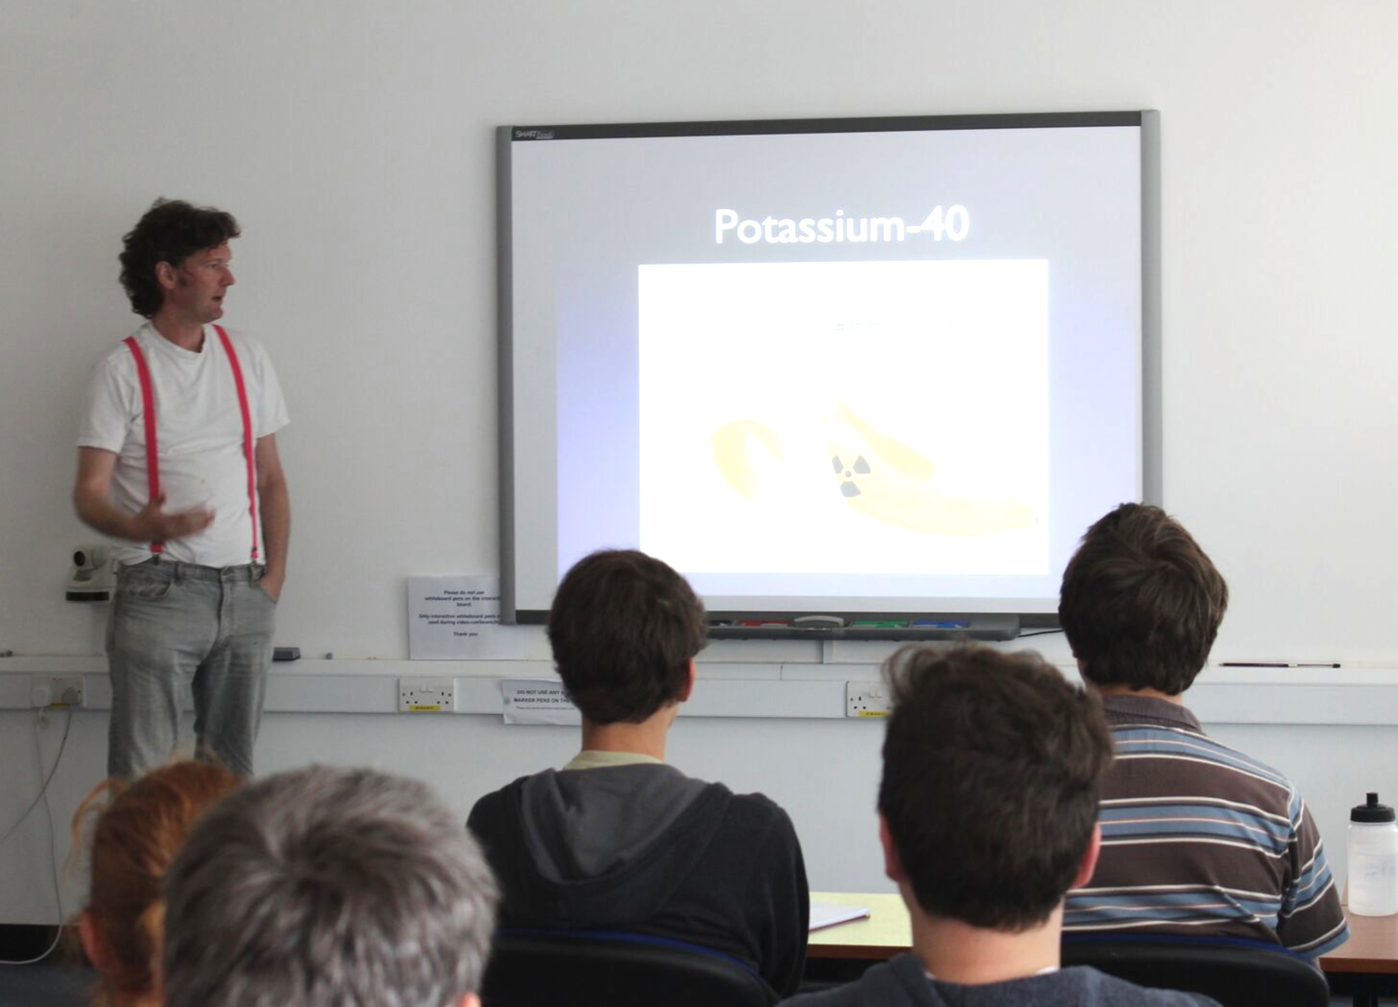
Daresbury
Surrey
Surrey
Birmingham

Slide 13
2017 Nuclear Physics Summer School
21st August until 2nd September at Queen’s University Belfast
Co-Organisers: Laura Harkness-Brennan and Arnau Rios
Invited lecturers: Alison Bruce, Bradley Cheal, Ren Cooper, Liz Cunningham, David Evans, David Ireland, Antonio Moro, Alessandro Pastore, Marina Petri, Achim Schwenk, Artemis Spyrou
https://sites.google.com/site/uknpss2017/

