Slide 1
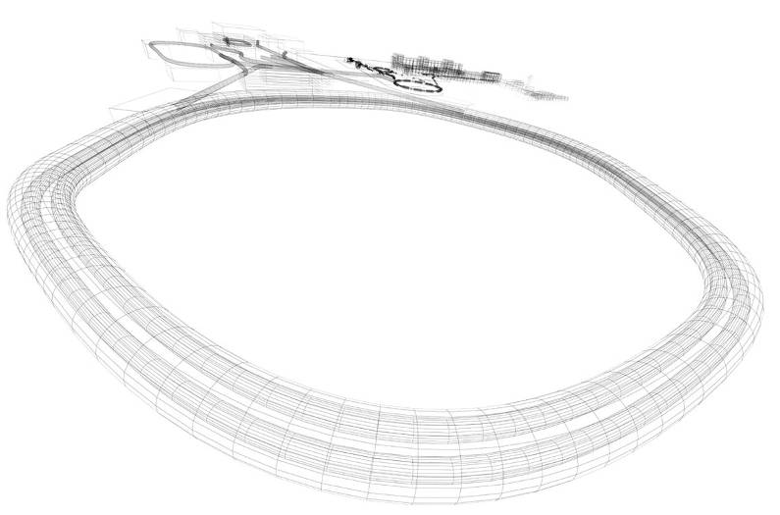

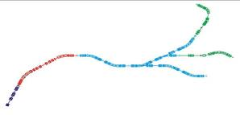
Nuclear Structure, Astrophysics and Reactions
(NuSTAR) at FAIR
The University of Birmingham
The University of Brighton
The University of Edinburgh
The University of Liverpool
The University of Manchester
The University of Surrey
The University of the West of Scotland
The University of York
STFC Daresbury Laboratory

Slide 2
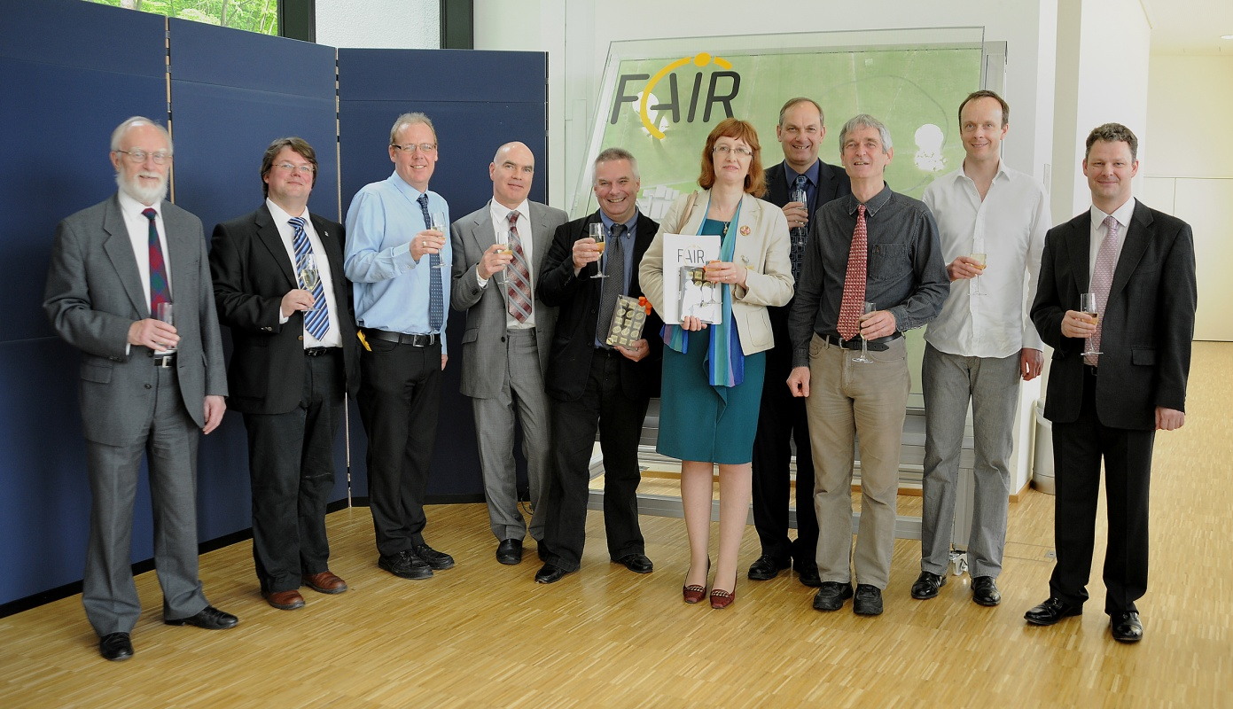
UK investment in FAIR
UK is Associate Member
Equipment built via the AIDA and NUSTAR grants
3rd of May 2013
Photo: G. Otto (GSI)

Slide 3

NUSTAR – The project
 | Super-FRS | RIB production, separation, and identification
PSP | Experiment | Description
1.2.2 | HISPEC/ DESPEC | In-beam γ-spectroscopy at low and intermediate energy, n-decay, high-resolution γ-, β-, α-, p-, spectroscopy
1.2.3 | MATS | In-trap mass measurements and decay studies
1.2.4 | LaSpec | Laser spectroscopy
1.2.5 | R³B | Kinematical complete reactions with relativistic radioactive beams
1.2.6 | ILIMA | Large-scale scans of mass and lifetimes of nuclei in ground and isomeric states
1.2.10 | Super-FRS | High-resolution spectrometer experiments
1.2.11 | SHE | Synthesis and study of super-heavy elements
1.2.8 | ELISe(*) | Elastic, inelastic, and quasi-free e⁻-A scattering
1.2.9 | EXL(*) | Light-ion scattering reactions in inverse kinematics
(*) NESR required – alternative/intermediate “operation” within MSV under discussion.
SHE physics case to be evaluated.
Notes:
3

Slide 4
FAIR (modularised start version)
CBM –hadron physics
APPA –atomic, plasma, applied
NuSTAR –nuclear physics
PANDA - antiprotons

Slide 5
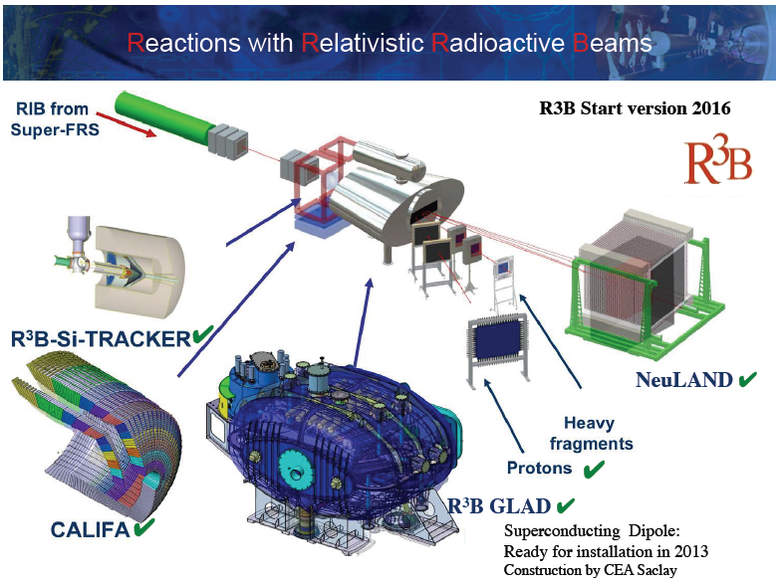
Roy Lemmon

Slide 6
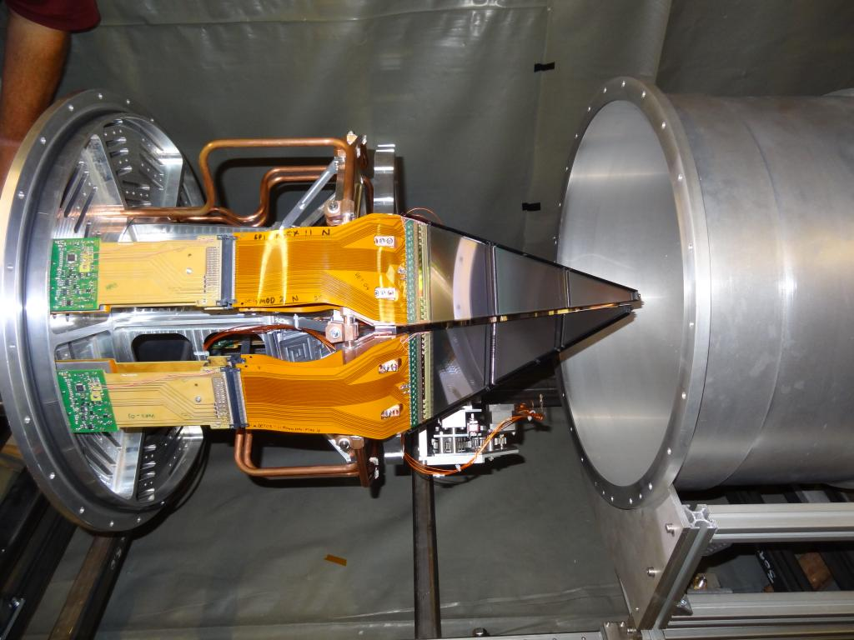
Reactions with relativistic radioactive beams (R³B)
two 300 µm DSSD layers (80k strips)
New ASIC developed
Successful test at GSI, autumn 2014
Detectors built
GSI campaign:
2018-2020

Slide 7
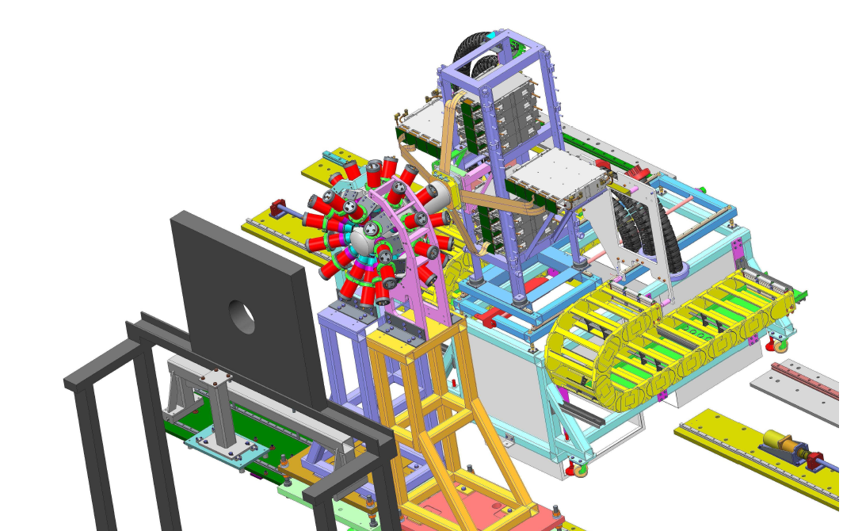
DESPEC: decay spectroscopy
Paddy Regan
LaBr3(Ce) fast-timing array
AIDA (EPSRC grant)

Slide 8
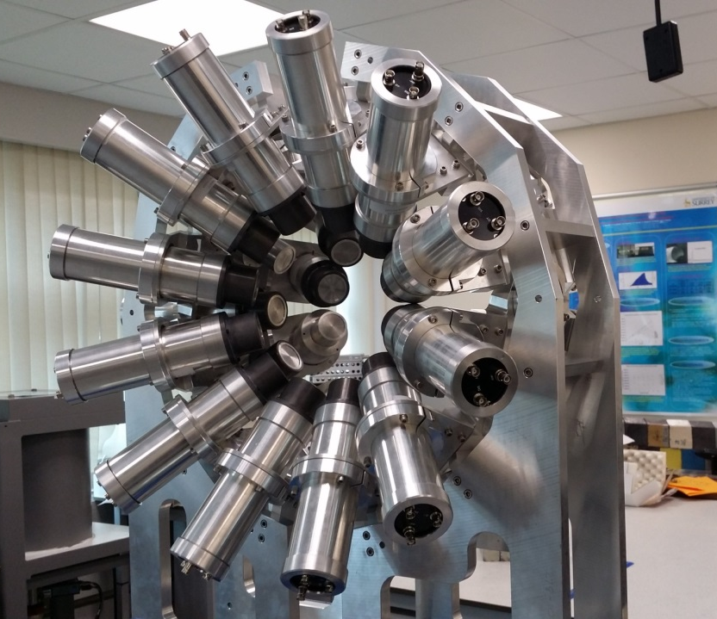
Decay spectroscopy (DESPEC)
Detectors used at Bucharest, ILL, RIKEN, Jyvaskyla
Commissioning of the whole system (including EDAQ)
Argonne National Laboratory (Dec. 2015-Jan. 2016)
Approved exps. at GANIL (coupled with AGATA), Orsay
2018–2020 GSI campaign:
Fast-timing to be coupled
with AIDA type detector

Slide 9
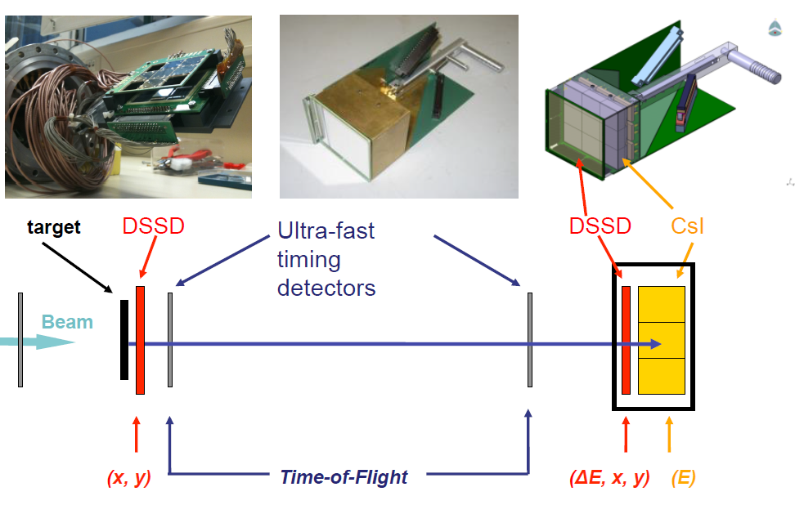
HISPEC: high-resolution in-flight spectroscopy
Mike Bentley
LYCCA: P.Golubev et al., NIM. A723 , 55 (2013)
Time of flight measurement: diamond, Si or plastic?
We provide: ToF solution, Si (DSSD) EDAQ,
general mechanics, integration

Slide 10
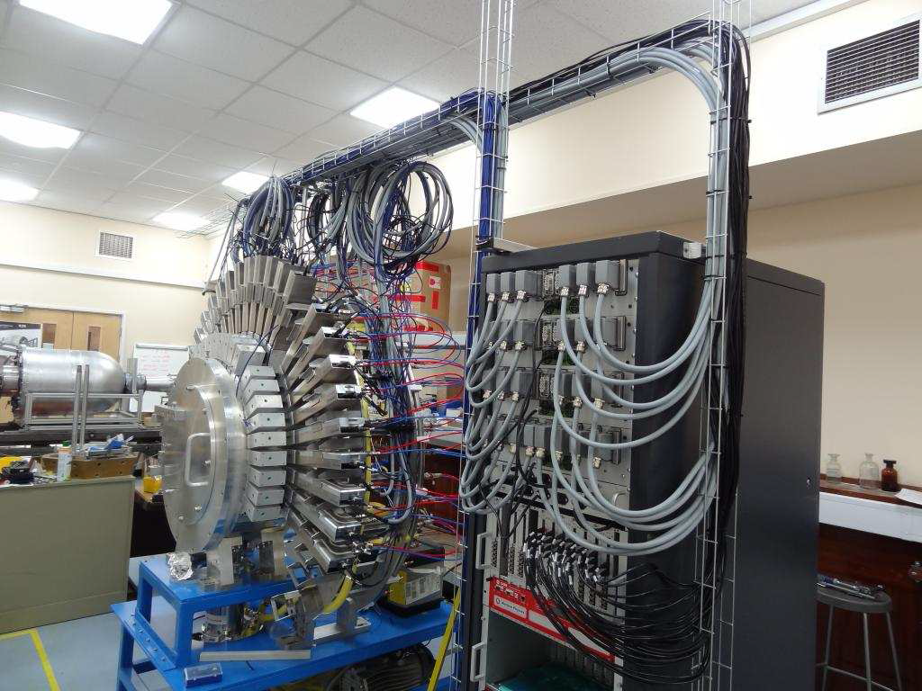
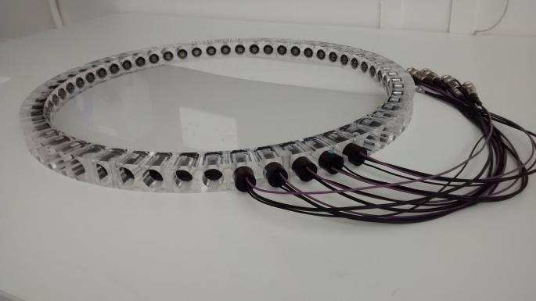
High-resolution in-flight spectroscopy (HISPEC)
February-April 2014: AGATA+LYCCA campaign at GSI
LYCCA in Cologne (Tandem accelerator)
Experimental campaign in 2017--
LYCCA TOF
Stop det.
D = 40 cm
56 PMTs

Slide 11
Beam time at GSI
2017: SIS-18 upgrade and shielding enforcement
Q3-4: SIS-18 comissioning
2018: 4-5 months, FAIR preparations and experiments
2019: 5-6 months, FAIR preparations and experiments
2020: 5-6 months, FAIR preparations and experiments
Call for proposals: spring 2017
Phase-0 NUSTAR: R3B, DESPEC, ILIMA, EXL, SuperFRS

Slide 12
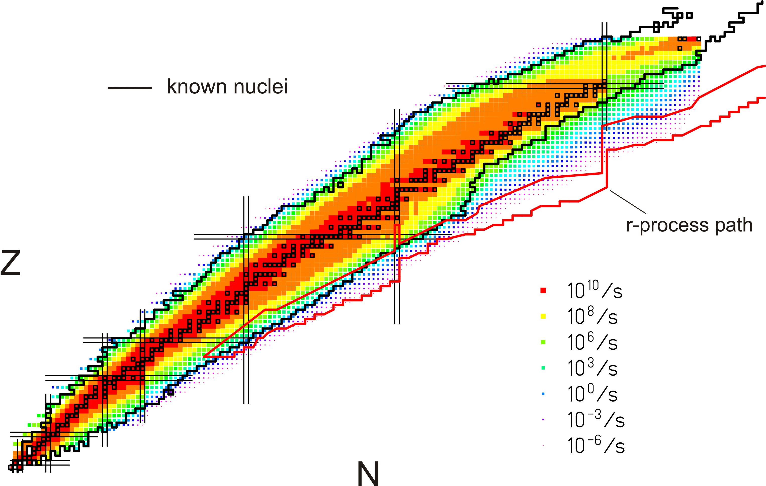
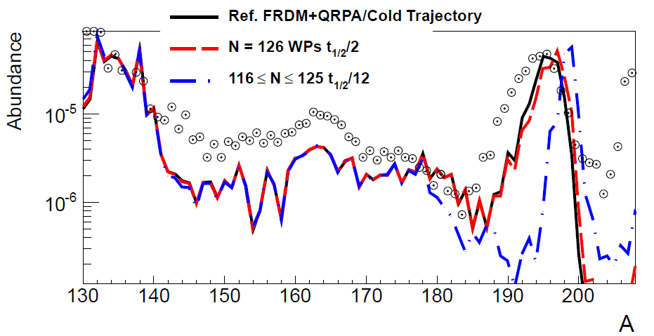
DESPEC in 2018-2020 (Phase 0)
Physics workshop held in September 2016
Focus on heavy neutron-rich nuclei
²⁰⁸Pb and ²³⁸U beams
Several detector systems ready:
DTAS, FATIMA, AIDA,
DEGAS, BELEN
Phase-0
Phase-1
old T_{1/2} predictions
new T_{1/2} predictions
Phase-2
3rd waiting point
β-lifetimes
r-process path
DESPEC will measure
-β-lifetimes
-neutron-branchings
-strength distributions
-level structure
Mass abundances depend on the detailed structure of N=126 nuclei around the 3rd r-process waiting point
Also ILIMA

Slide 13

Phase 0 physics program in 2018/19 (green/orange)
R3B program will strongly benefit from the availability of 1 GeV/nucleon beams (installation and commissioning of GLAD will be finished in 2017)
➔ Large fraction of the physics program can be started with partly completed detection systems in 2018:
Dipole response of neutron-rich nuclei: partly possible for light nuclei already 2018 ✔
Dipole strength of halo nuclei up to 30 MeV excitation energy (reduced n efficiency) ✔
Pygmy and Giant Resonances, Dipole polarizability (EoS of asymmetric nuclear matter) : needs CALIFA; delayed until construction accomplished (2020 depending on funding) No
(p,2p) – single-particle and shell structure: possible to start already 2018 ✔
(p,2pN) – NN tensor short-range correlations: needs CALIFA; delayed to 2020 No
(p,2p) fission - fission barriers: possible already in 2018 ✔
Fission (elm. excitation) - nuclear structure: possible (reduced information on neutrons) ✔
Light drip-line nuclei: up to 2n decays possible (reduced NeuLAND efficiency) ✔
Beyond neutron drip-line: up to 2n decays possible (reduced NeuLAND efficiency) ✔
Pure neutron systems, multi-neutron (>4) decays: (needs NeuLAND completion) No
Spectroscopy of 2⁺ states of heavy neutron-rich nuclei ✔
Elastic and inelastic scattering using the active target (smaller prototype available) (✔)
Nuclei at and beyond the proton drip-line (needs PAS, ready only in 2022) No

Slide 14
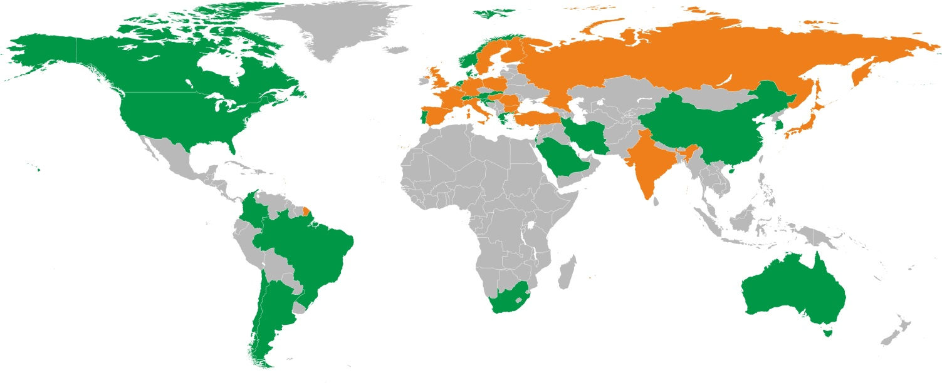
NUSTAR Collaboration
> 800 registered “interested” scientists in the NUSTAR data-base
  39 countries
  more than 180 institutes
Secured funding and expression of interest in funding
(status: January 2016)
16 countries (incl. 9 FAIR partner countries)

Slide 15
Leadership roles (probably only Germany has more):
Bruce: Deputy Chair of the NuSTAR Board (one of the five elected); previously on the board: Regan, Gelletly
Podolyak: HISPEC/DESPEC spokesperson; previously DESPEC spokespersons Bruce, Wood
Herzberg: spokesperson of Superheavy Elements collaboration (now part of NUSTAR)
Walker: ILIMA spokesperson
Campbell: used to be spokesperson of LASPEC
Chartier: used to be spokesperson of EXL
Lemmon: R3B Technical Director
Bruce, Walker, Podolyak: members of the NUSTAR Collaboration Committee
Bentley: coordinated the fast PRESPEC campaign (AGATA at GSI)
Regan: coordinated the stopped RISING campaign
Catford (Surrey) Member of General PAC (GSI)
Regan: chaired to PRESPEC SC
Simpson: was spokesperson of AGATA (while at GSI); PRESPEC SC
Nolan: was chair of AGATA SC
Labiche: Convener NuSTAR working group on simulations
Lazarus: on EDAQ working group
Woods: led the first reactions in the storage ring experiment (EXL type exp).
Bentley, Podolyak: led PRESPEC (AGATA at GSI) experiments
Regan, Bruce, Wadsworth, Page, Cullen, Podolyak etc: led RISING exps (DESPEC type)
Bentley: led fast RISING exps.
Lemmon, Chartier: led R3B type exps.
Walker: led storage ring experiments

Slide 16
NUSTAR time line
2015 | 2016 | 2017 | 2018 | 2019 | 2020 | 2021 | 2022 | 2023
Super-FRS
construction and installation
commissioning
operation
NUSTAR caves
civil construction
Phase 0
Phase 1
NUSTAR experiments
construction and operation „outside“ FAIR
installation
commissioning
operation at FAIR
16

Slide 17
NUSTAR grant
NUSTAR grant: 1 April 2010 – 31 March 2015
One year zero-cost extension => grant ends 31/03/2016
NUSTAR2 SoI submitted: March 2012
(6.9M for DESPEC, ILIMA, LaSPEC, R3B)
A project building equipment for fragmentation facilities
would be better (RIKEN, FAIR, FRIB?)
R3B: £4025k 34.3 FTE
HISPEC: £1901k 16.9 FTE
DESPEC: £939k 10.5 FTE
Project management: £512k 5.36 FTE
Working allowance: £673k
TOTAL: £8049 (STFC contribution) 67.1FTE

Slide 18
NUSTAR grant
SoI submitted: June 2007
Grant request submitted: Feb. 2008
Grant announced: Aug. 2009
early LYCCA funds from Oct. 2008
New announcement: April 2010 (10% chop)
NUSTAR grant: 1 April 2010 – 31 March 2015
One year zero-cost extension => grant ends 31/03/2016
=> overlap with the new grants
NUSTAR2 SoI submitted: March 2012
(6.9M for DESPEC, ILIMA, LaSPEC, R3B)
R3B: £4025k 34.3FTE
HISPEC: £1901k 16.9 FTE
DESPEC: £939k 10.5 FTE
Project management: £512k 5.36 FTE
Working allowance: £673k
TOTAL: £8049 (STFC contribution) 67.1FTE

Slide 19
UK contribution to NuSTAR (CAPITAL)
Project | UK contribution | UK capital £k | Total estimated capital cost^{a)} M€
R³B | Si tracker of target recoil detector, Mechanical design, EDAQ | 1784 | 14.6
HISPEC | LYCCA, Time-of-flight detectors, Mechanical design EDAQ, AGATA^{b)} | 661 | ~8^{b,c)}
DESPEC | Fast timing detectors, AIDA^{d)}, Mechanical design | 1037 | ~8.5^{c)}
 | Sub total | 3482 | 31.1
Notes | a) Costs are from CORE-E, April 2006. b) This figure does not include the cost of AGATA. c) HISPEC and DESPEC have been costed together at 16.5M€. d) Funded from a previous EPSRC/STFC grant – capital cost £640k.
The total estimated capital cost of NuSTAR is 71.1M€.

Slide 20
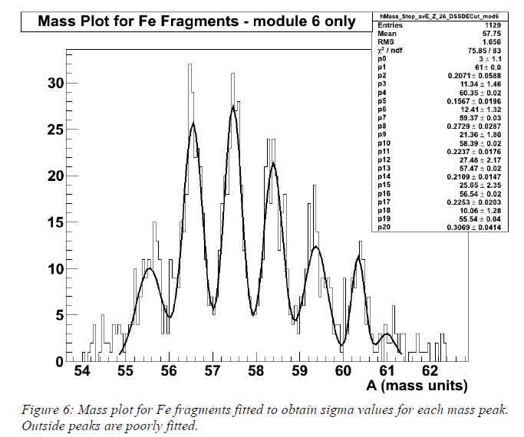
LYCCA TOF solutions:
Plastic-plastic:
Δt (FWHM)= 61 ps => 43 ps for one detector (requirement=100ps)
Δ A (FWHM)=0.5
This is within specifications
and this solution is used in
the AGATA campaign
Diamond-plastic:
Home made diamond:
Δ t (FWHM) < 100 ps for high Z
F. Schirru et al.,
J. of Instr. 7, P05005(2012)
L. Scruton, Univ. of York

Slide 21
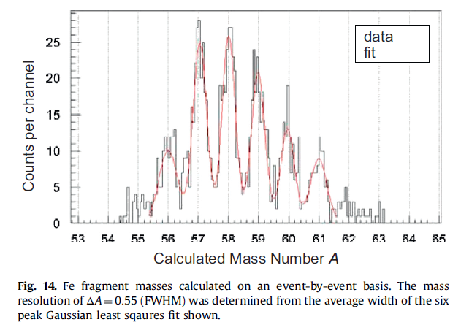
LYCCA TOF solutions:
Plastic-plastic:
Δt (FWHM)= 61 ps => 43 ps for one detector (requirement=100ps)
Δ A (FWHM)=0.5
This is within specifications
and this solution is used in
the AGATA campaign
Diamond-plastic:
Home made diamond:
Δ t (FWHM) < 100 ps for high Z
F. Schirru et al.,
J. of Instr. 7, P05005(2012)
P. Golubiev et al., NIM A 723 (2013) 55
L. Scruton, Univ. of York

Slide 22
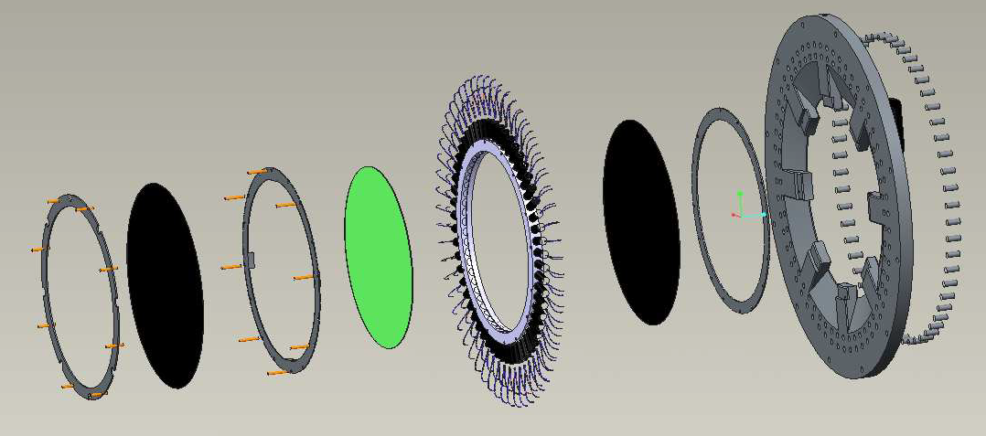
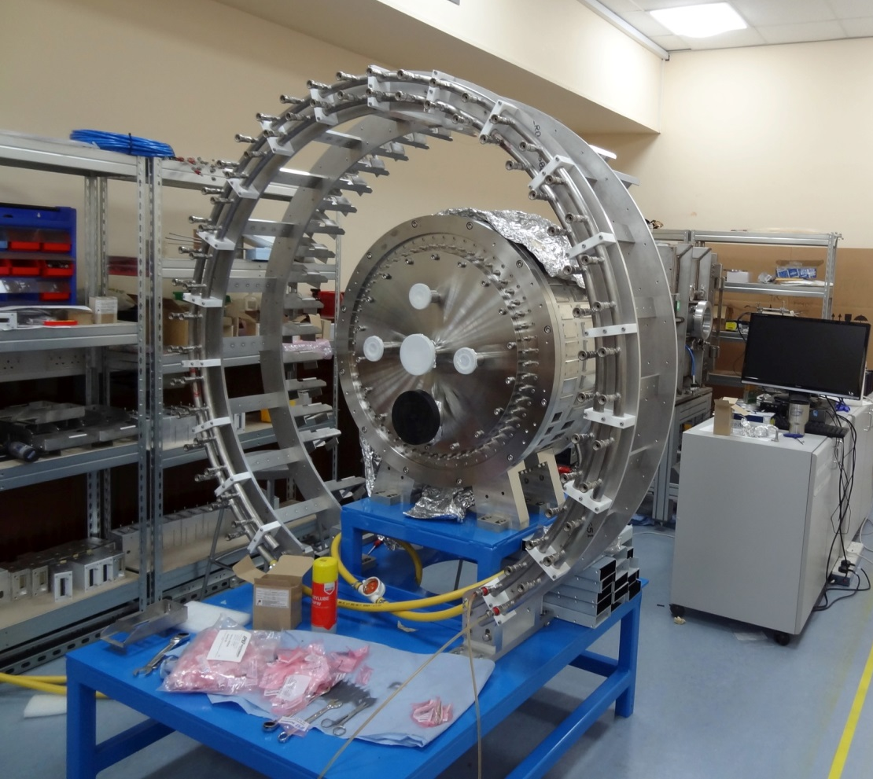
LYCCA TOF Stop detector
Diameter = 40 cm
56 PMTs

Slide 23
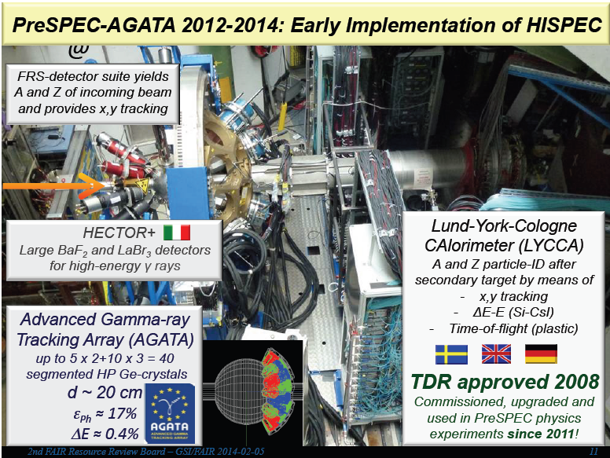
-AGATA at GSI commissioning 2012
-Experiments: Oct-Nov 2012 and
Oct 2013-March 2014; 2 UK led

Slide 24


White Rabbit
timing
Detectors in Vacuum
DAQ in Air
Si Inner
FMC
i/f
CALIFA Timestamp & coincidence links
FPGA
ASIC
Clk & trig i/f
enet
Si Inner
ASIC
x6
FMC
i/f
FPGA
ASIC
enet
ASIC
3x uTCA
crates
Si Middle
Slow Control
FMC
i/f
FPGA
ASIC
Si Middle
ASIC
enet
x12
10G Switch
FMC
i/f
FPGA
ASIC
DAQ PC(s)
ASIC
enet
Si Outer
ASIC
FMC
i/f
FPGA
10G Switch
Si Outer
ASIC
enet
To R3B DAQ
x12
ASIC
FMC
i/f
FPGA
ASIC
enet
120k strips
912 ASICs
30 uTCA FEE cards + switches and clock card
R3B Si Tracker (NUSTAR)

Slide 25
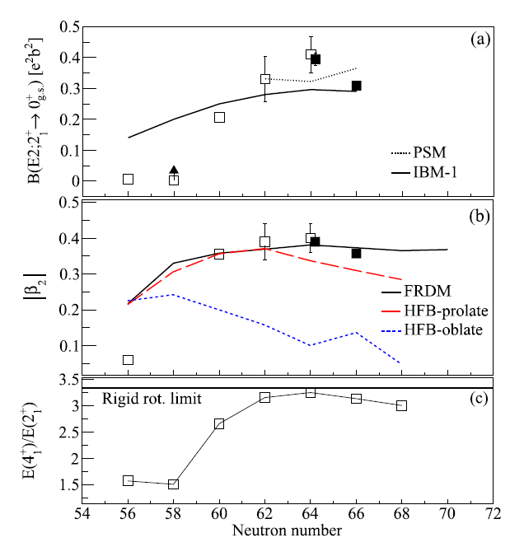
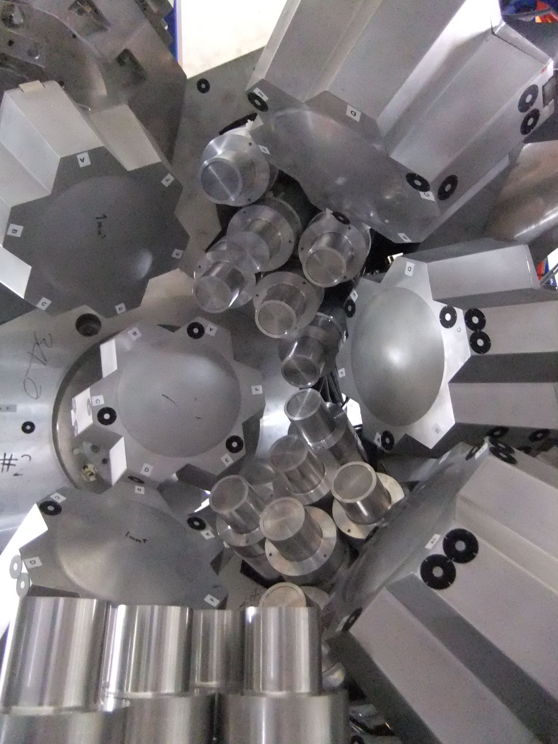
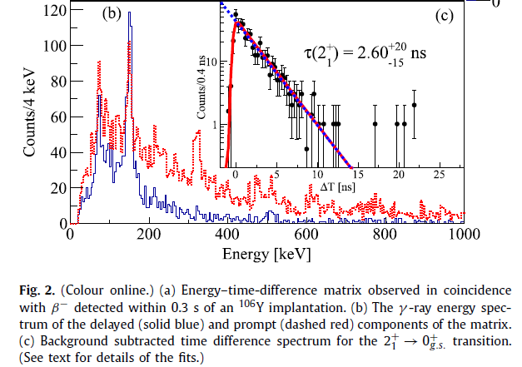
Experiments at RIKEN
2⁺ lifetimes in ^{104,106}Zr
The whole system
needs to be commissioned
(EDAQ not used at all so far!)
F. Browne et al.,
Phys. Lett. B 750 (2015) 448

Slide 26
UK-NUSTAR project
Cross-community effort for 2015-16 was awarded.
Additional effort paid from working allowance.
The NUSTAR equipment grant will finish 31 March 2016.
Plan for post-grant period:
Money saved in Birmingham and Liverpool will be used for R3B
-build spare ladder
-build up full Si tracker
Money saved in Manchester and Surrey will be used to prepare
DESPEC/HISPEC
-setting up array at GSI/help in Cologne
-integration with AIDA
-simulations of commissioning experiments.
R3B/HISPEC/DESPEC on consolidated grants from Oct. 2017.

Slide 27
DESPEC and R3B in 2018-2020
DESPEC (and ILIMA):
Z~82/ N~126; r-process nuclei
Previous GSI measurements contradict earlier β-lifetime predictions!
→ Mass abundances not understood!!
GSI
Phase-0
old T_{1/2} predictions
new T_{1/2} predictions
Phase-1
Phase-2
3rd. waiting point
β-lifetimes
r-process path
Mass abundances depend on the detailed structure
of N=126 nuclei around the 3rd. r-process waiting point
NUSTAR will measure all relevant
-masses
-β-lifetimes
-neutron-branchings
-strength distributions
-level structure

Slide 28
Definition of NUSTAR experiment phases
Phase 0
  R&D and experiments to be carried out with present facilities and FAIR/NUSTAR equipment
Phase 1
  Core detectors and subsystems completed
  First measurements with FAIR/Super-FRS beams
    Carry out experiments with highest visibility as part of the core program and within the FAIR MSV
Phase 2
  FAIR evolving towards full power
  Completion of experiments within MSV
    Essentially the full program of MSV can be performed
Phase 3
  Moderate projects, which have been initiated on the way (outside MSV) can be included (e.g. experiments related to return line for rings)
Phase 4
  Major new investments and upgrades for all experiments

Slide 29
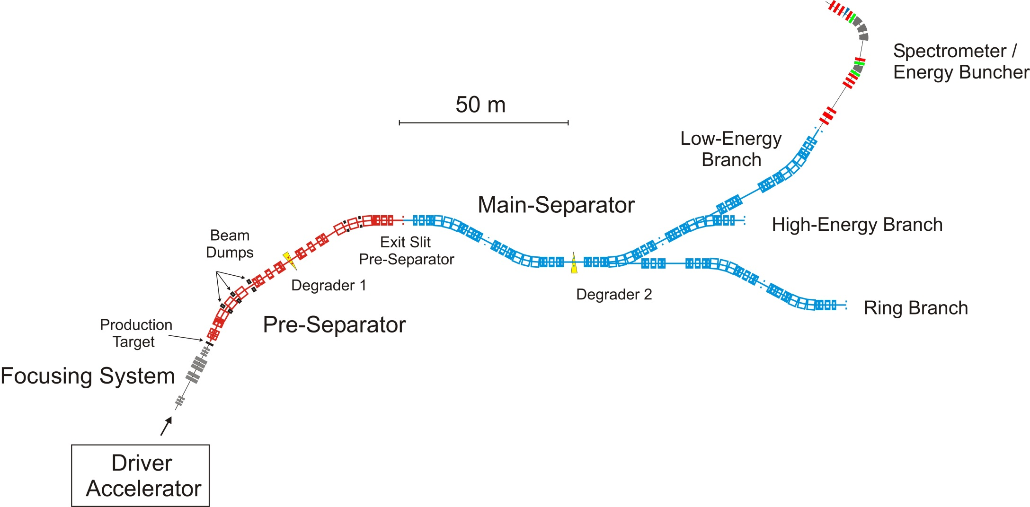
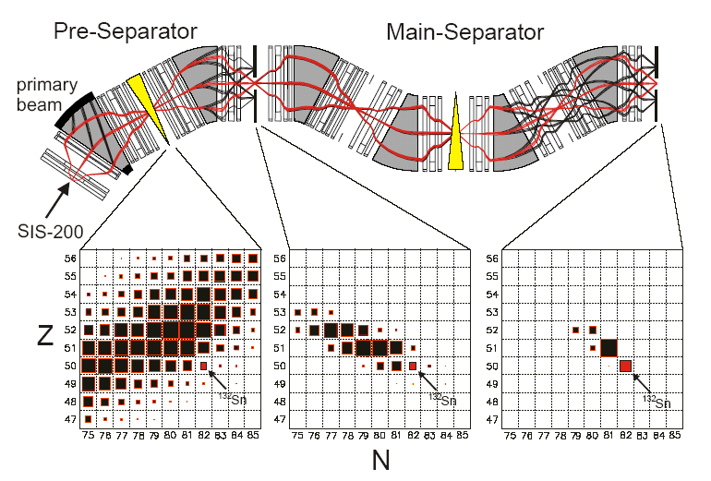
NuSTAR (Nuclear Structure, Astrophysics and Reactions)
Transmission
3 branches
=> Radioactive beam intensity:
~10² – 10³ higher than today
and ‘cleaner’

Slide 30
Recommendations by the
International Review Committee for the FAIR Project
concerning the ranking of the science pillars (spring 2015)
Ranking
‘NuSTAR and APPA are viewed as the top priorities, as they are unique, have adapted their programmes to the Modularised Start Version (MSV), and the science questions they address will still be open and exciting in 2025.
Due to the high primary beam energies NuSTAR has world-wide unique and leading capabilities for the study of exotic nuclei that will provide important insights into the structure and dynamics of nuclei. The collaboration with its various experiments is versatile and flexible and has adjusted well to the limitations set by the MSV. The program has clear discovery potential and high impact in the areas of unique access. ‘
=> Low-energy branch building is in the plan!

Slide 31
International situation
FAIR Council decision
FAIR Council accepts new planning for the FAIR facility – end of construction in 2022
In an extraordinary meeting of the FAIR Council in September 2015:
A cost cap of 1,262 million € (price level 2005) was determined, plus site-related costs of 95 million € already borne by Germany. Thus the overall cost frame was fixed at 1,357 million €. The Council expects construction of the MSV within this budget and will actively accompany project progress and intensively follow the cost development. In 2019, the project will be subject to an external review.
The FAIR management was asked to pursue project execution as fast as possible and in a reasonable stepwise approach in order to enable first FAIR experiments at the earliest possible stage.
The shareholders have committed themselves to providing the financial means required for the project. For the first step of realisation with additional costs of 158 million € (price level 2005) compared to the original planning, the shareholders will confirm their obligation in the first half of 2016. The funds for the MSV shall be provided from 2019 onwards and be released after the review mentioned above.
(UK share, 0.5%: 1.7 MEuro)

Slide 32
NuSTAR and the UK Nuclear Physics Community
Experimental Nuclear Physics
(49 academic staff)
NUSTAR exploitation
(+9 theorists)
NuSTAR grant: 16 UK academics
NuSTAR exploitation: ~31 UK academics
Rolling grant: strong support for ‘NuSTAR physics’

Slide 33
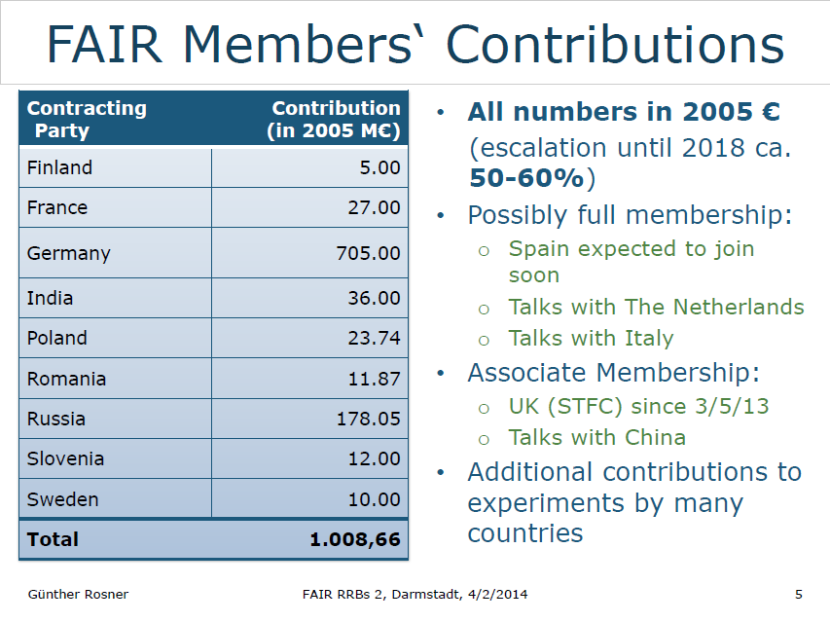

Slide 34
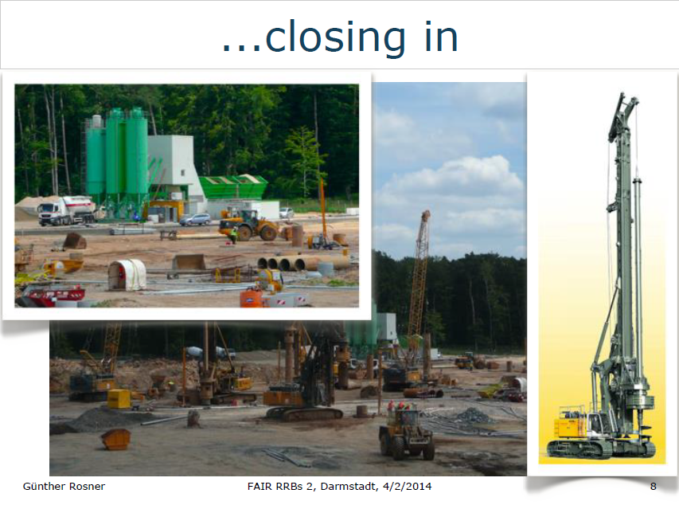

Slide 35
FAIR timescales (modularised start version)
schedule is driven by civil construction
CBM –hadron physics
APPA –atomic, plasma, applied
NuSTAR –nuclear physics
PANDA - antiprotons
Green paper Oct. 2009
Module | Construction time (Months) | Start of construction | Readiness for operation
SIS | 72 | 2010/11 | 2015/16
CBM/APPA cave | 28 | 2010/11 | 2015/16
NuSTAR (SuperFRS) | 60 | 2012 | 2016
PANDA | 60 | 2012 | 2016

Slide 36
FAIR timescales (modularised version)
schedule is driven by civil construction
CBM –hadron physics
APPA –atomic, plasma, applied
NuSTAR –nuclear physics
PANDA - antiprotons
Oct. 2010
Green paper Oct. 2009
Module | Construction time (Months) | Start of construction | Readiness for operation
SIS | 72 | 2010/11+1 | 2015/16+1
CBM/APPA cave | 28 | 2010/11+1 | 2015/16+1
NuSTAR (SuperFRS) | 60 | 2012 | 2016+1 for installation
PANDA | 60 | 2012+1 | 2016+1
Module | Construction time (Months) | Start of construction | Readiness for operation
SIS | 72 | 2010/11 | 2015/16
CBM/APPA cave | 28 | 2010/11 | 2015/16
NuSTAR (SuperFRS) | 60 | 2012 | 2016
PANDA | 60 | 2012 | 2016

Slide 37
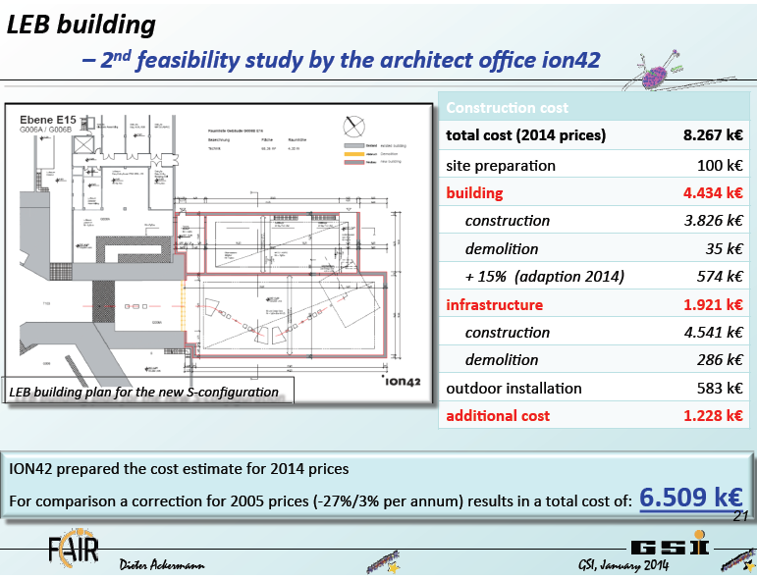

Slide 38
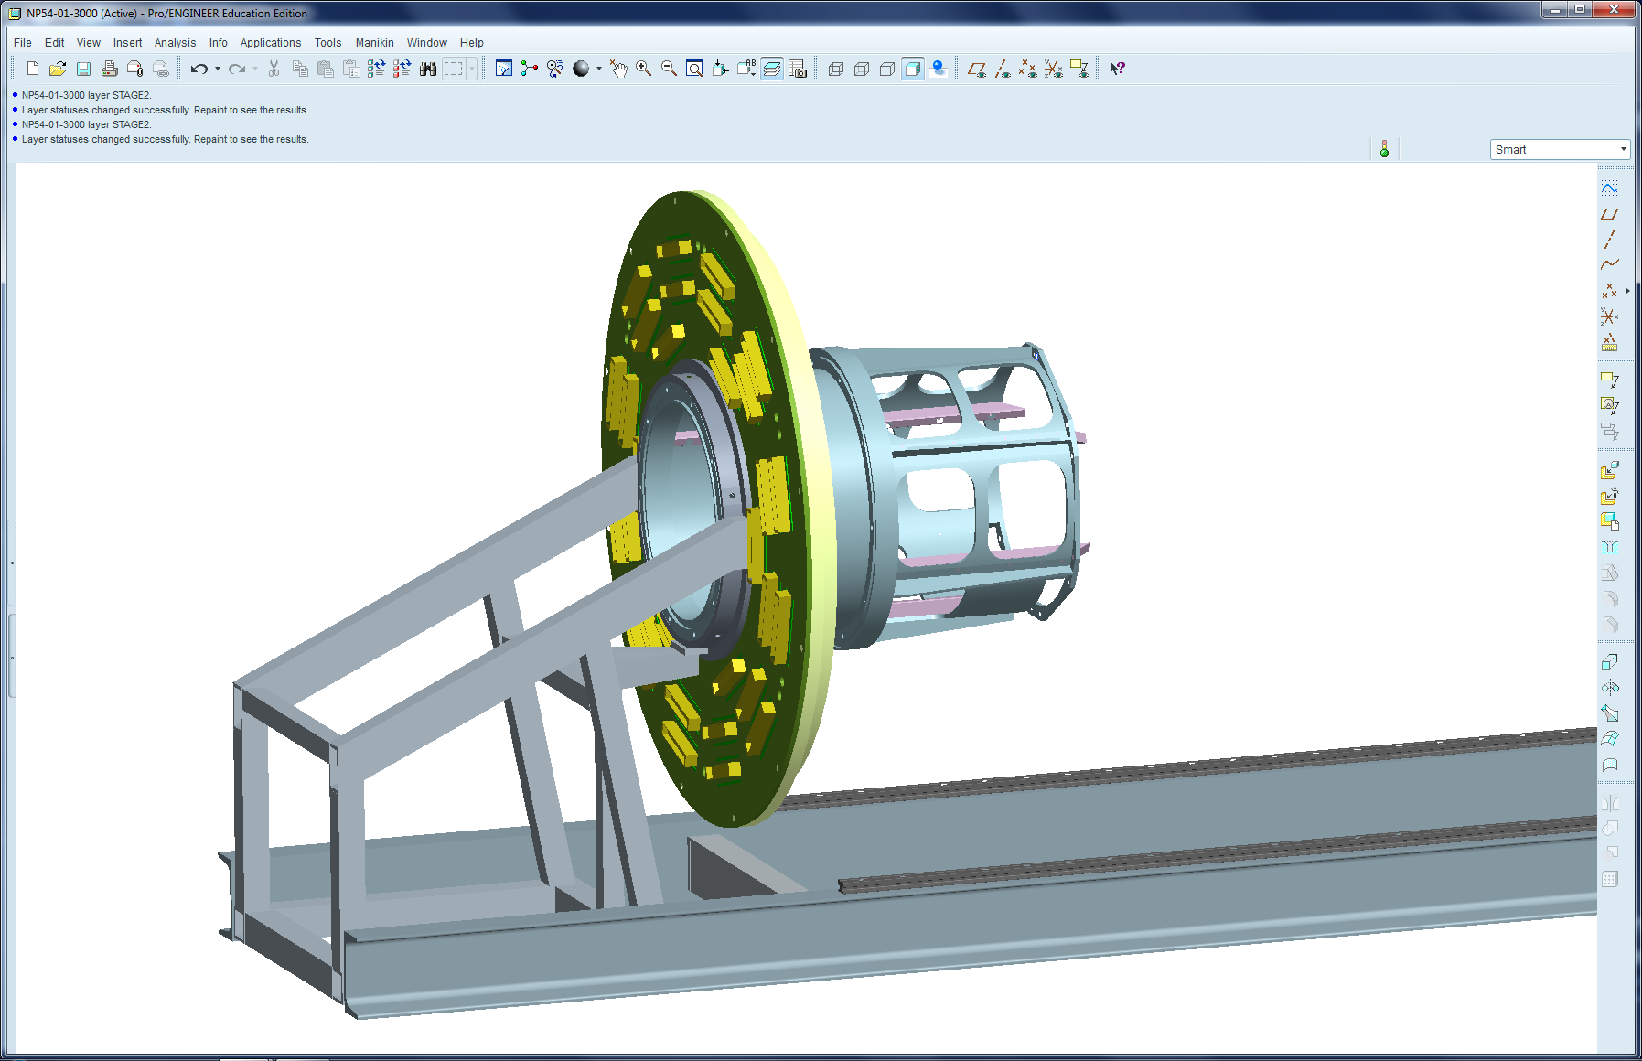
ASSEMBLY OF MAIN SUPPORT TUBE WITH BULKHEAD PLATE AND FEEDTHROUGH BOARD
(PLEASE NOTE THAT BULKHEAD PLATE AND FEEDTHROUGH BOARD ARE NOT IN THEIR FINAL POSITION)

Slide 39
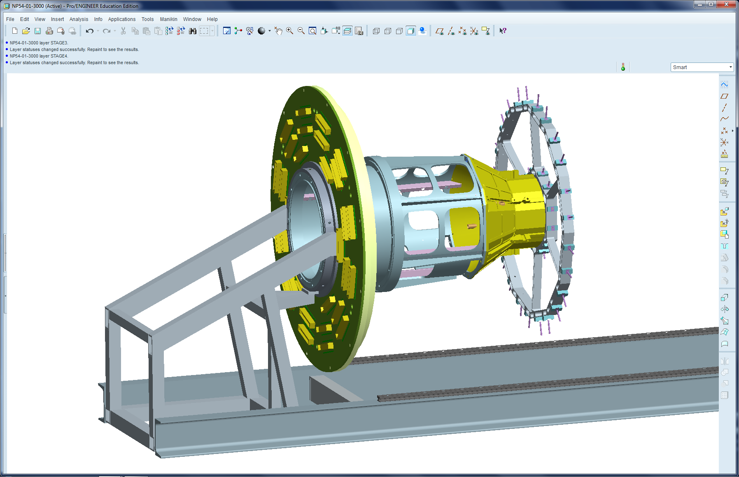
ASSEMBLY OF DETECTOR SUPPORT FRAME

Slide 40
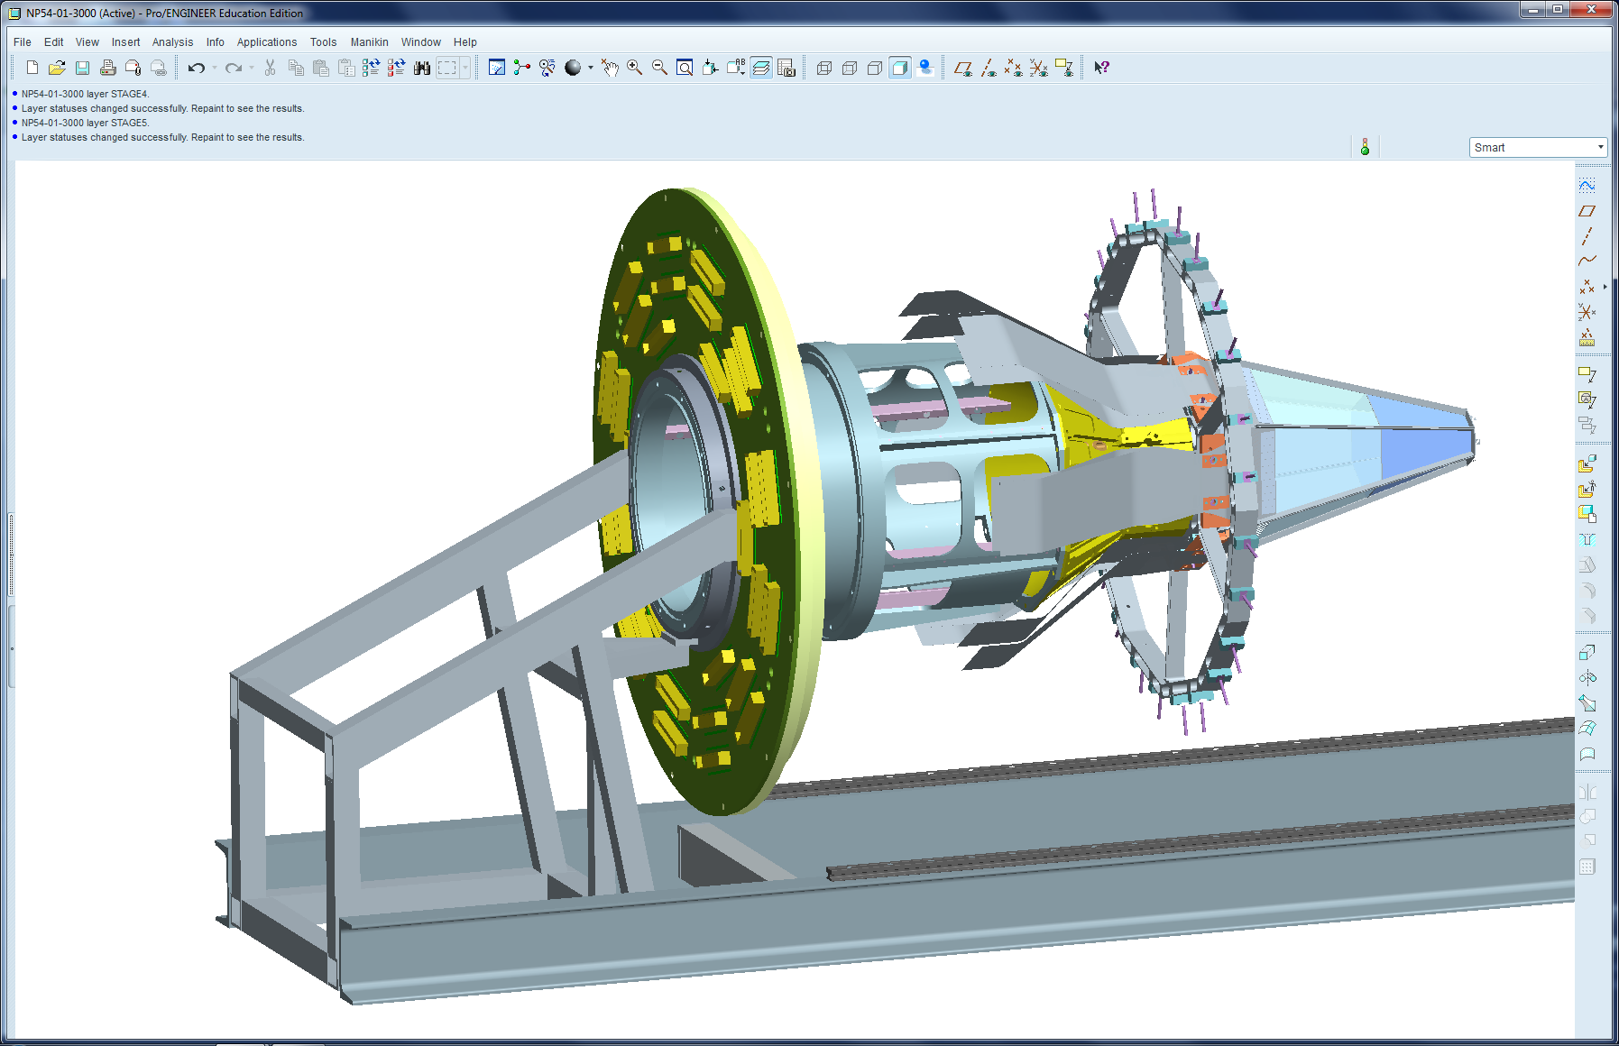
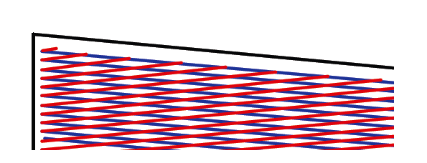
ASSEMBLY OF INNER DETECTORS: 100μm
50.5 um strips in stereo configuration of p and n side

Slide 41
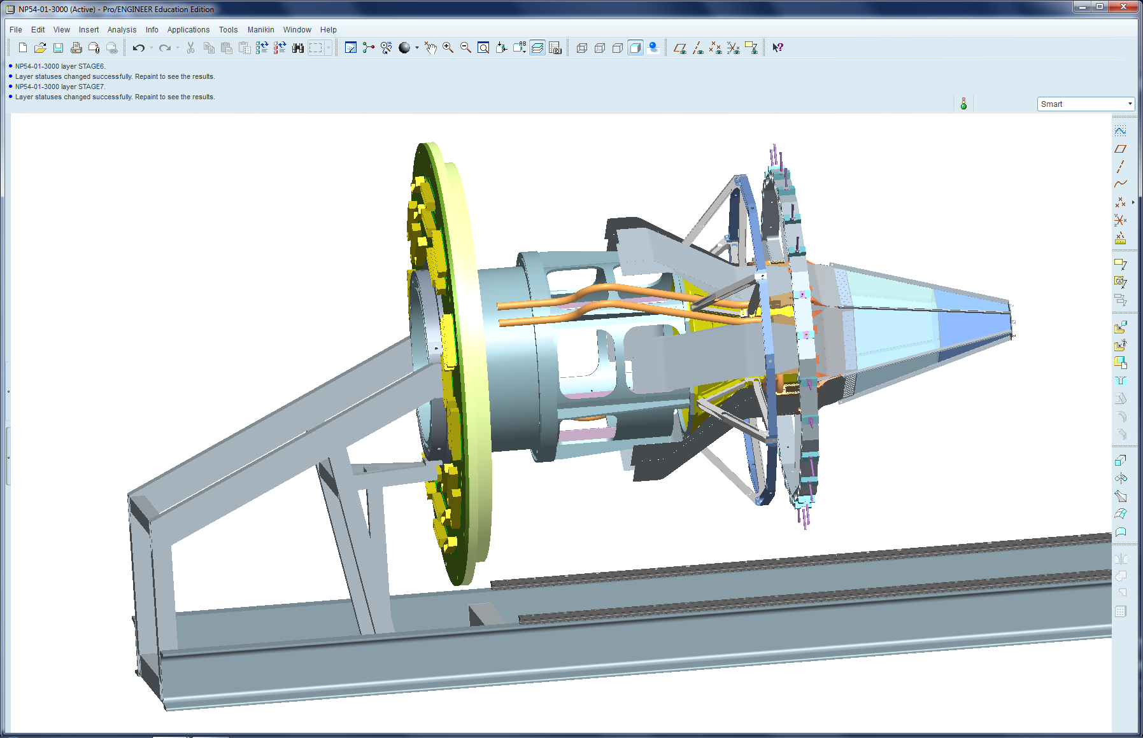
ASSEMBLY OF MID/OUTER DETECTOR COOLING SUPPORT FRAME
300μm

Slide 42
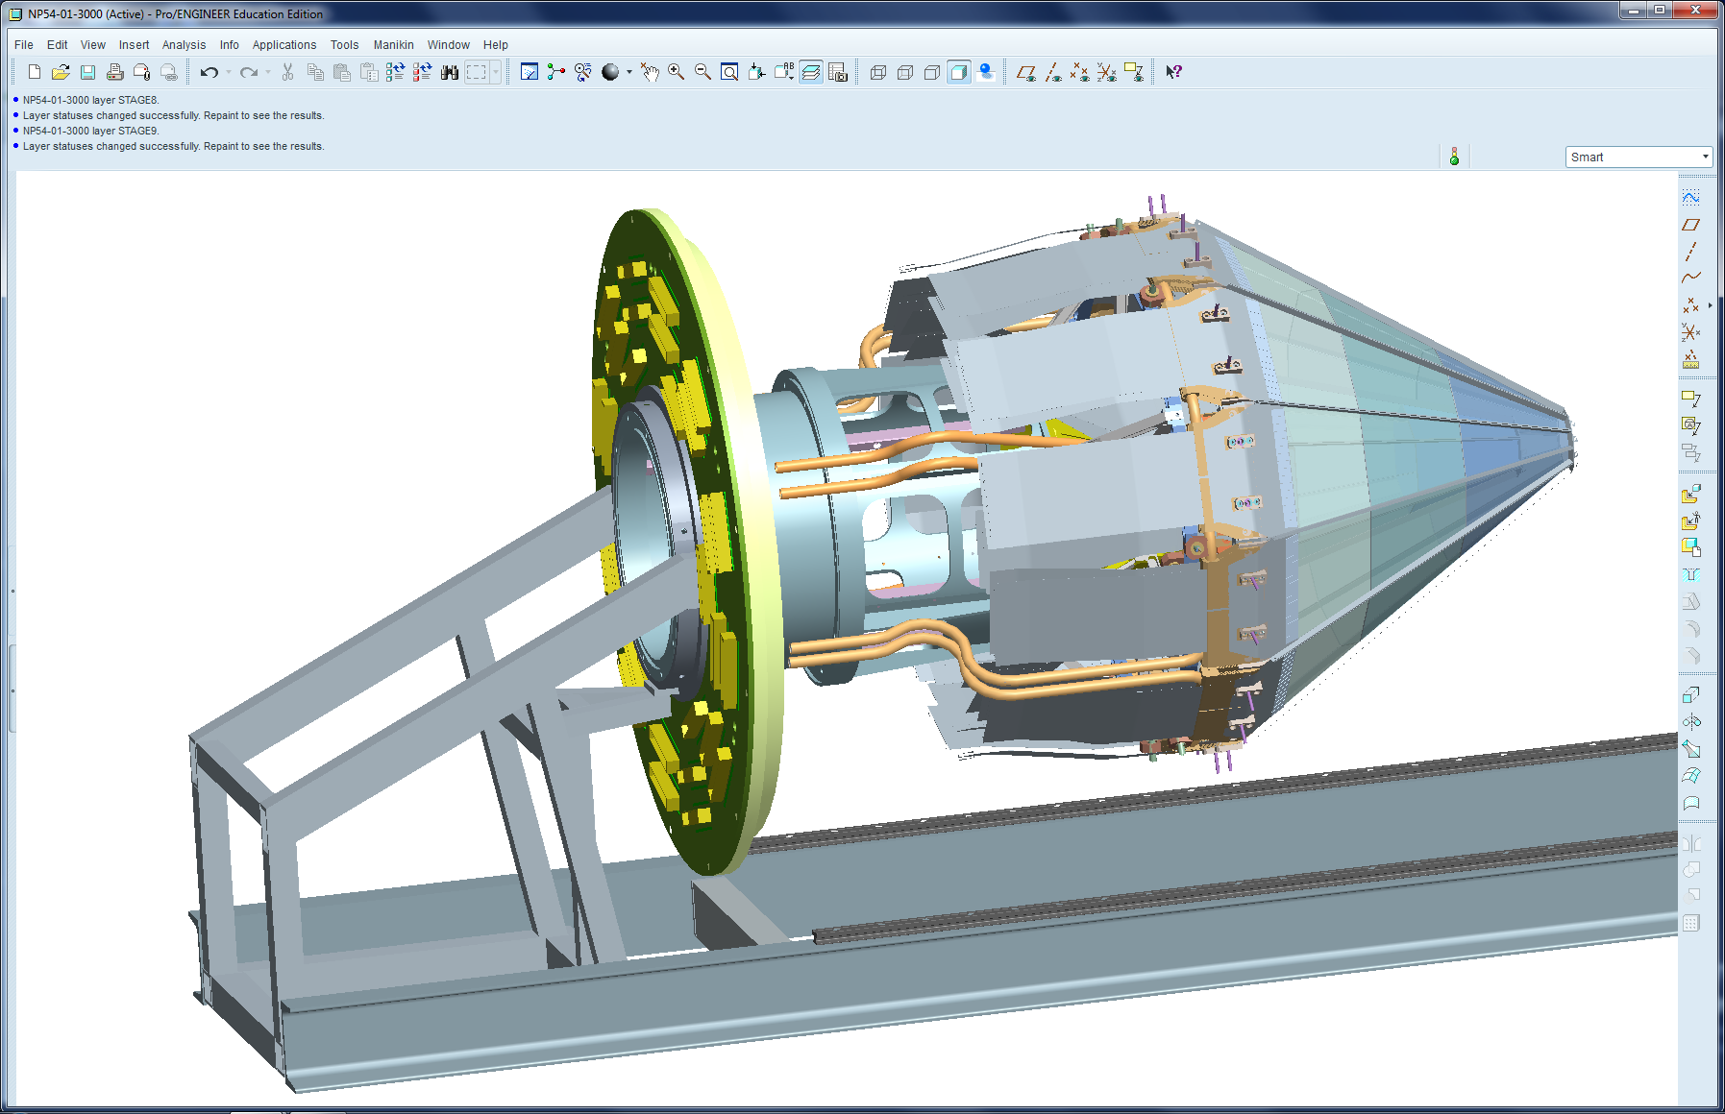
ASSEMBLY OF MID DETECTOR COOLING

Slide 43
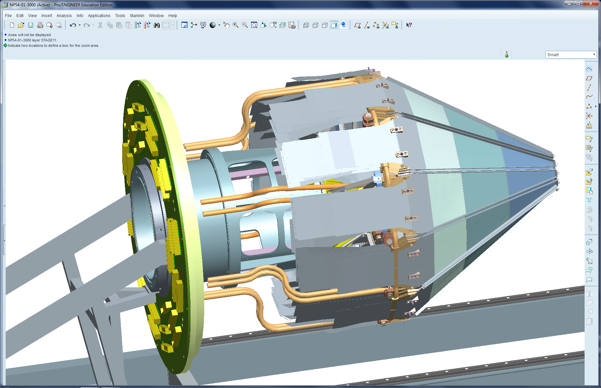
ASSEMBLY OF OUTER DETECTOR COOLING
300μm

Slide 44
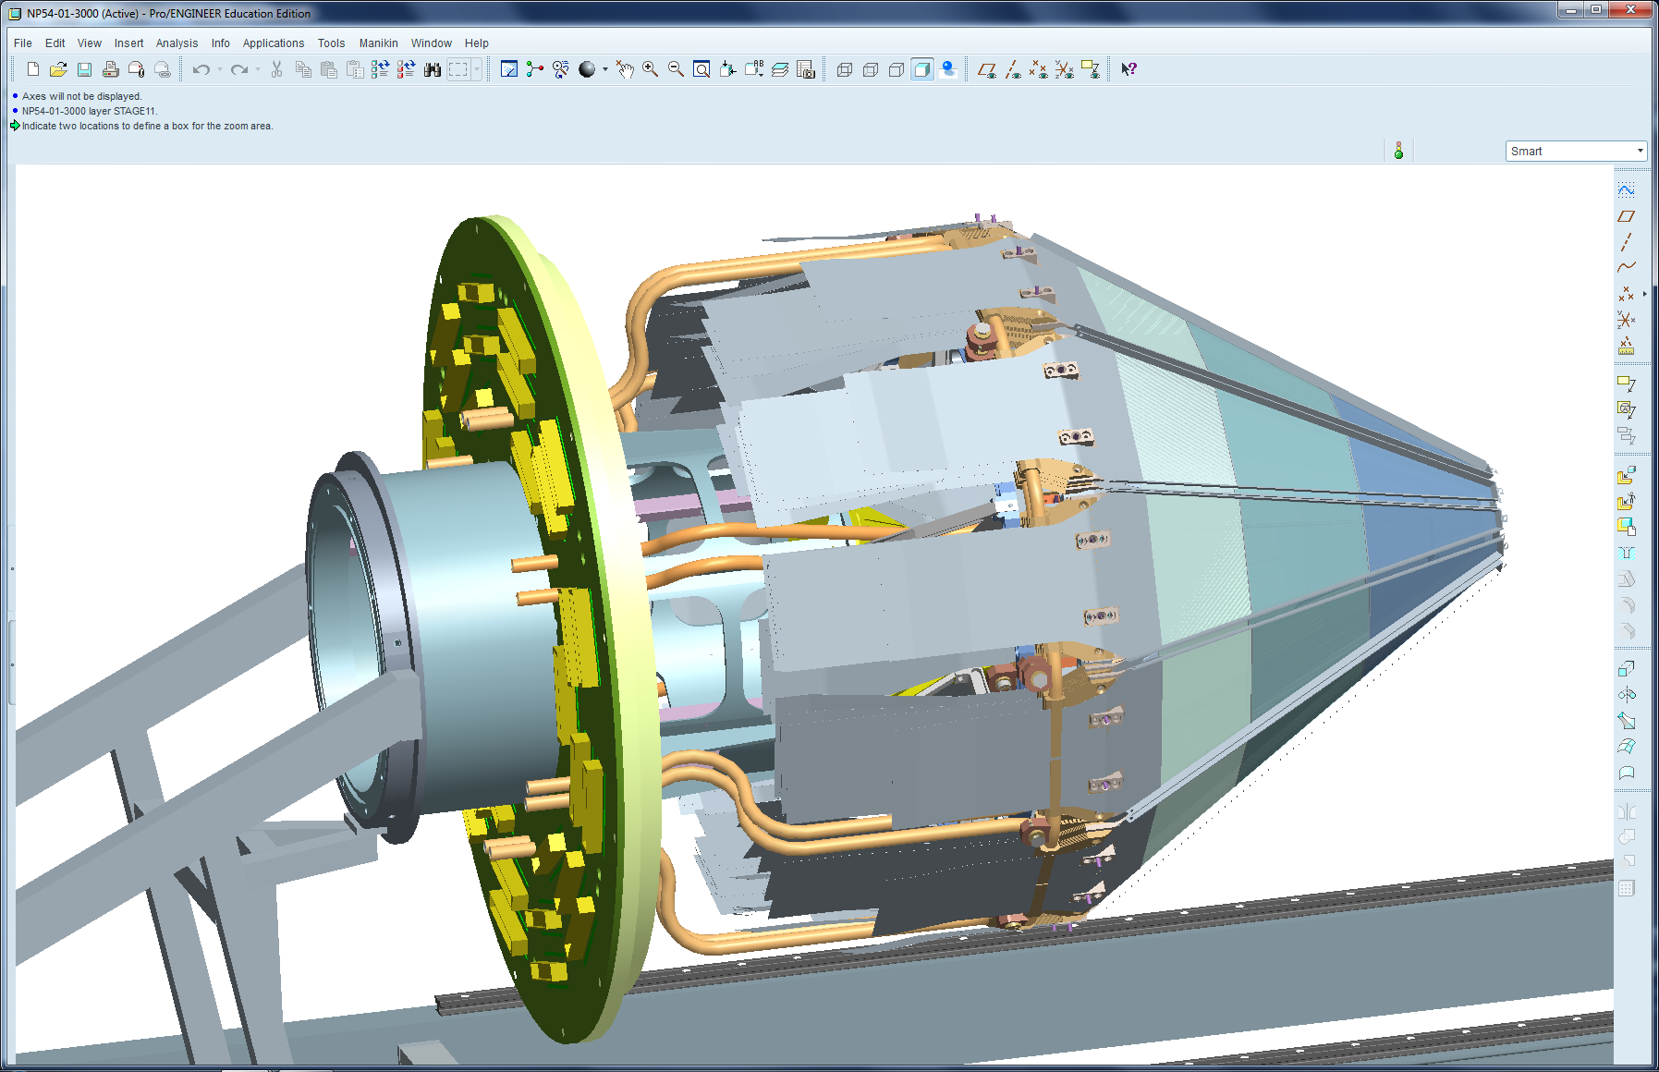
LOCATING OF BULKHEAD PLATE
AND FEEDTHROUGH BOARD INTO FINAL POSITION

Slide 45
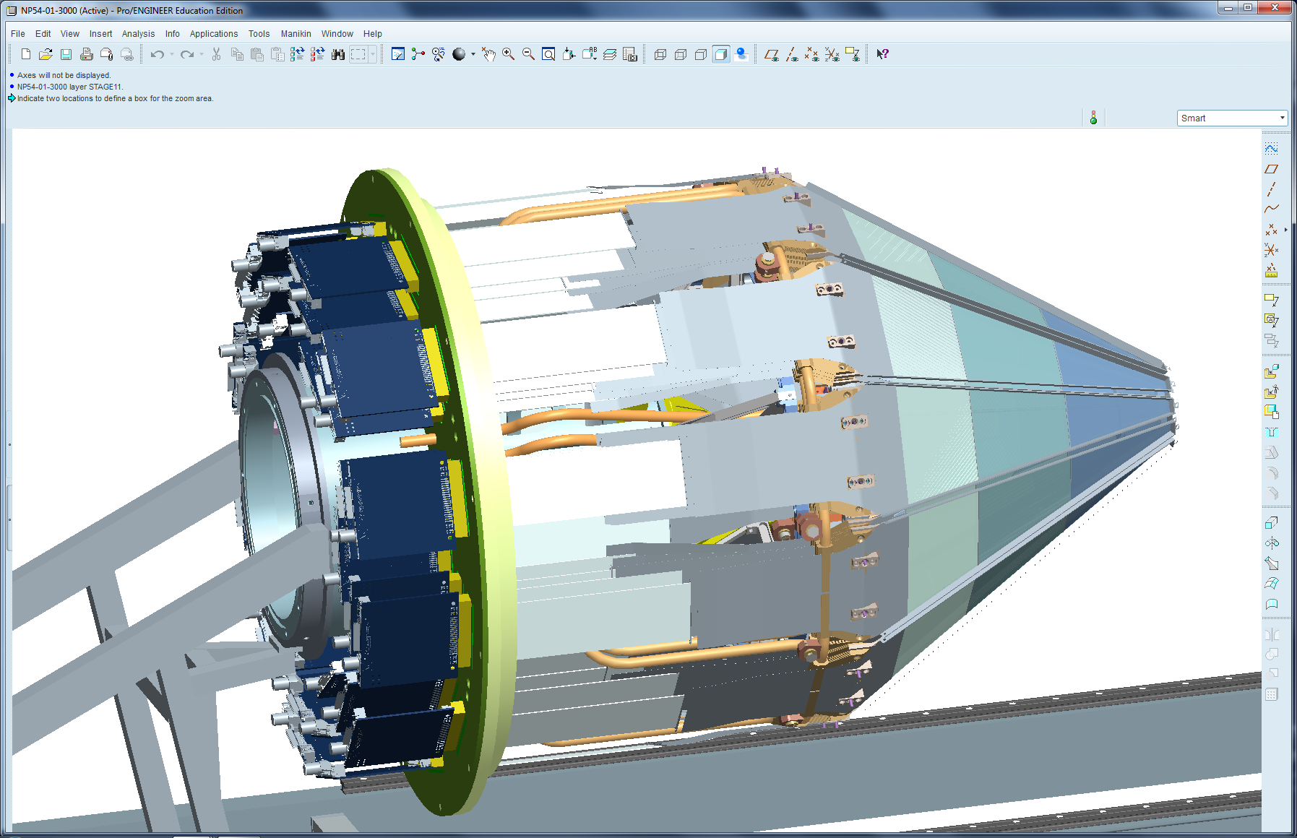
ASSEMBLY OF INNER AND OUTER
CIRCUIT BOARDS

Slide 46
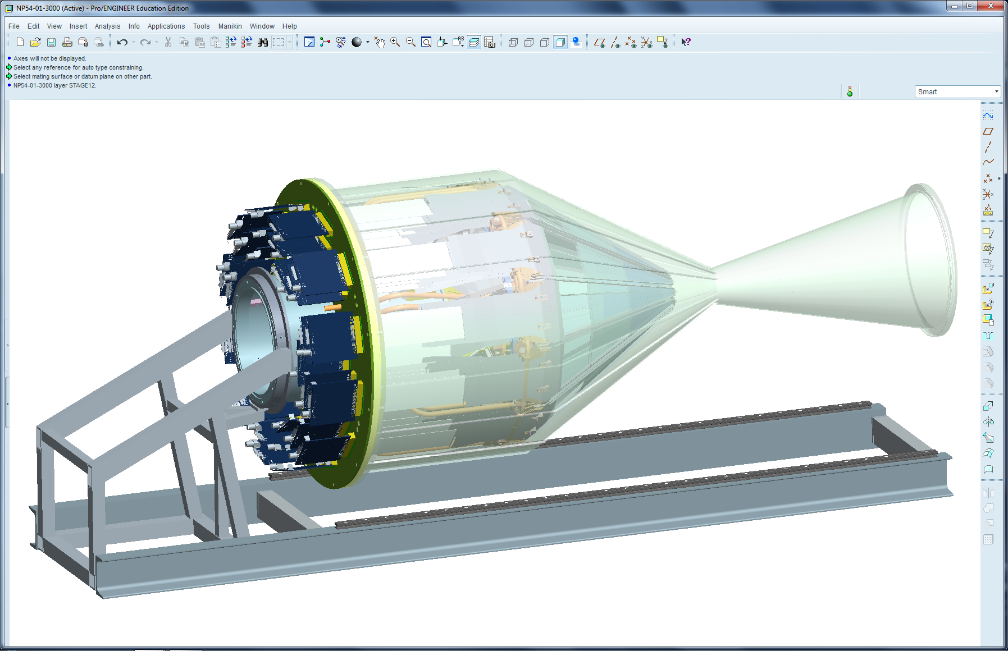
ASSEMBLY OF ALUMINIUM CHAMBER
(CURRENT WALL THICKNESS 2 mm)

Slide 47
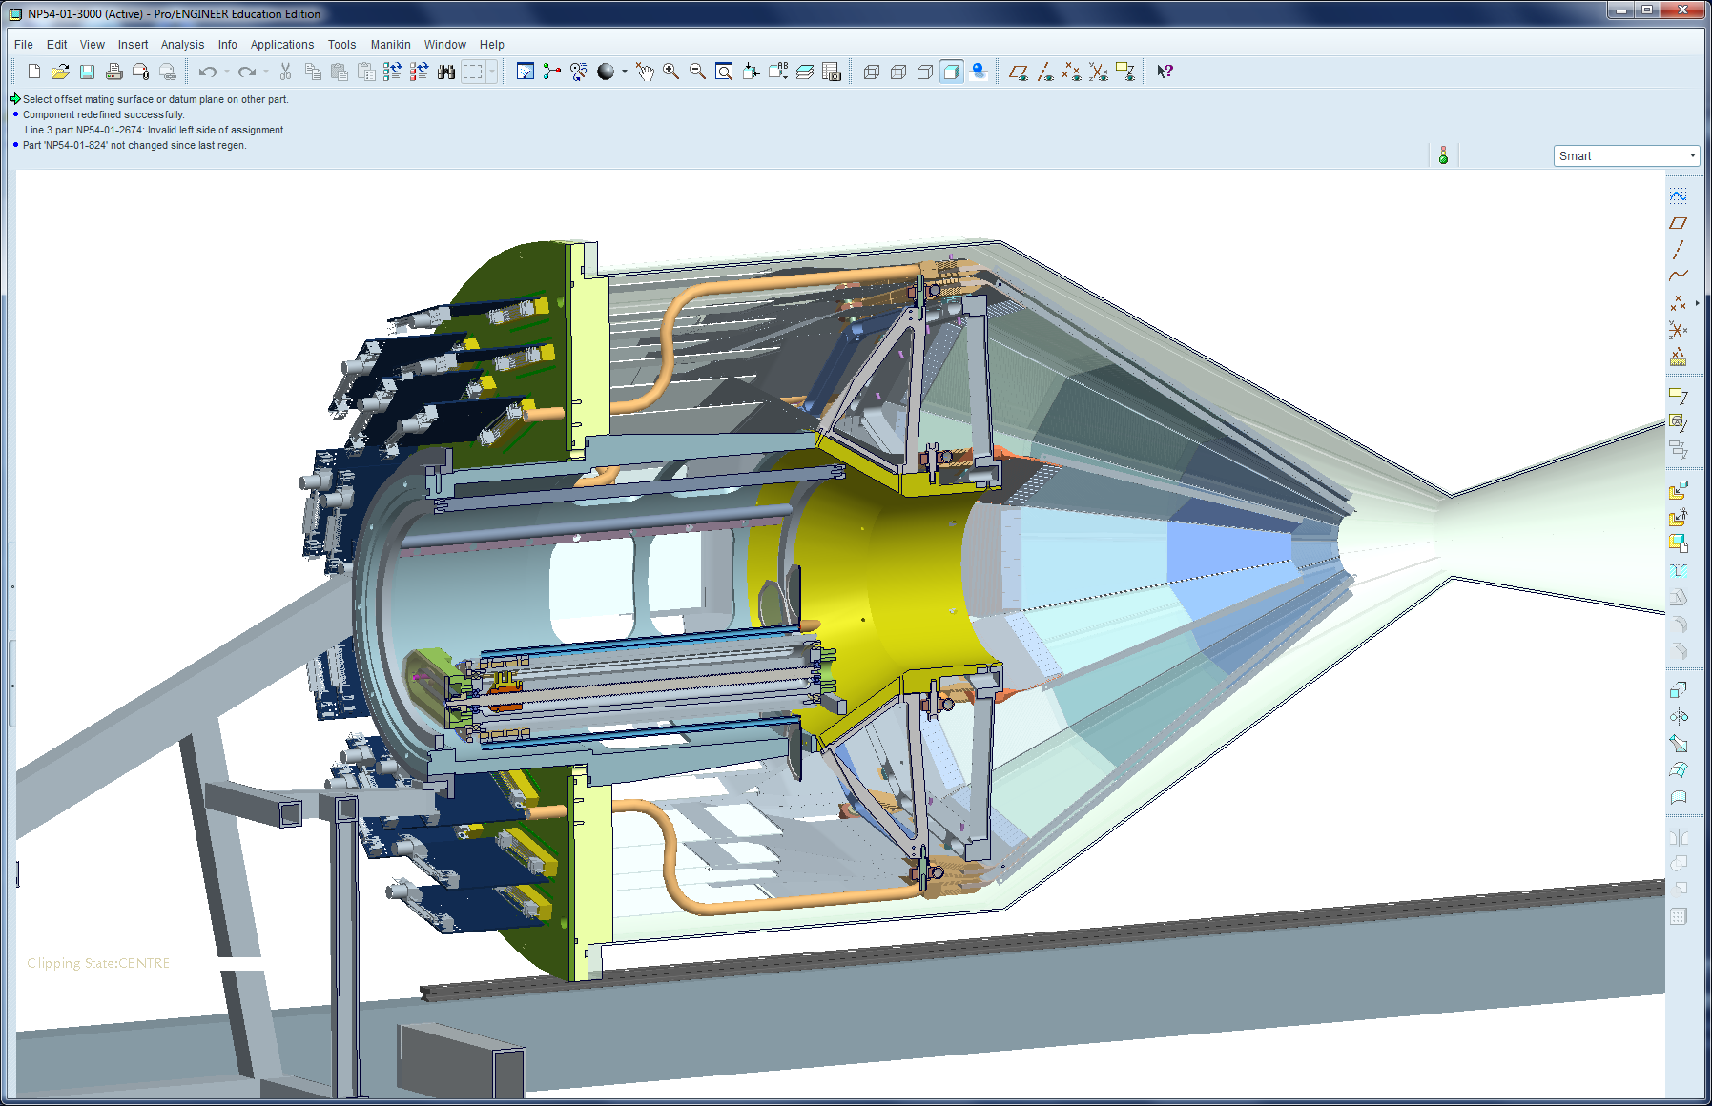
TARGET MECHANISM LOCATED IN ITS “IN BEAM” POSITION

Slide 48
Reactions with relativistic radioactive beams (R³B)
Successful test at GSI, autumn 2014
Has validated:
Si ladder construction techniques
ASIC readout
DAQ scheme
coupling to MBS merge
Mechanics & cooling
shipping

Slide 49
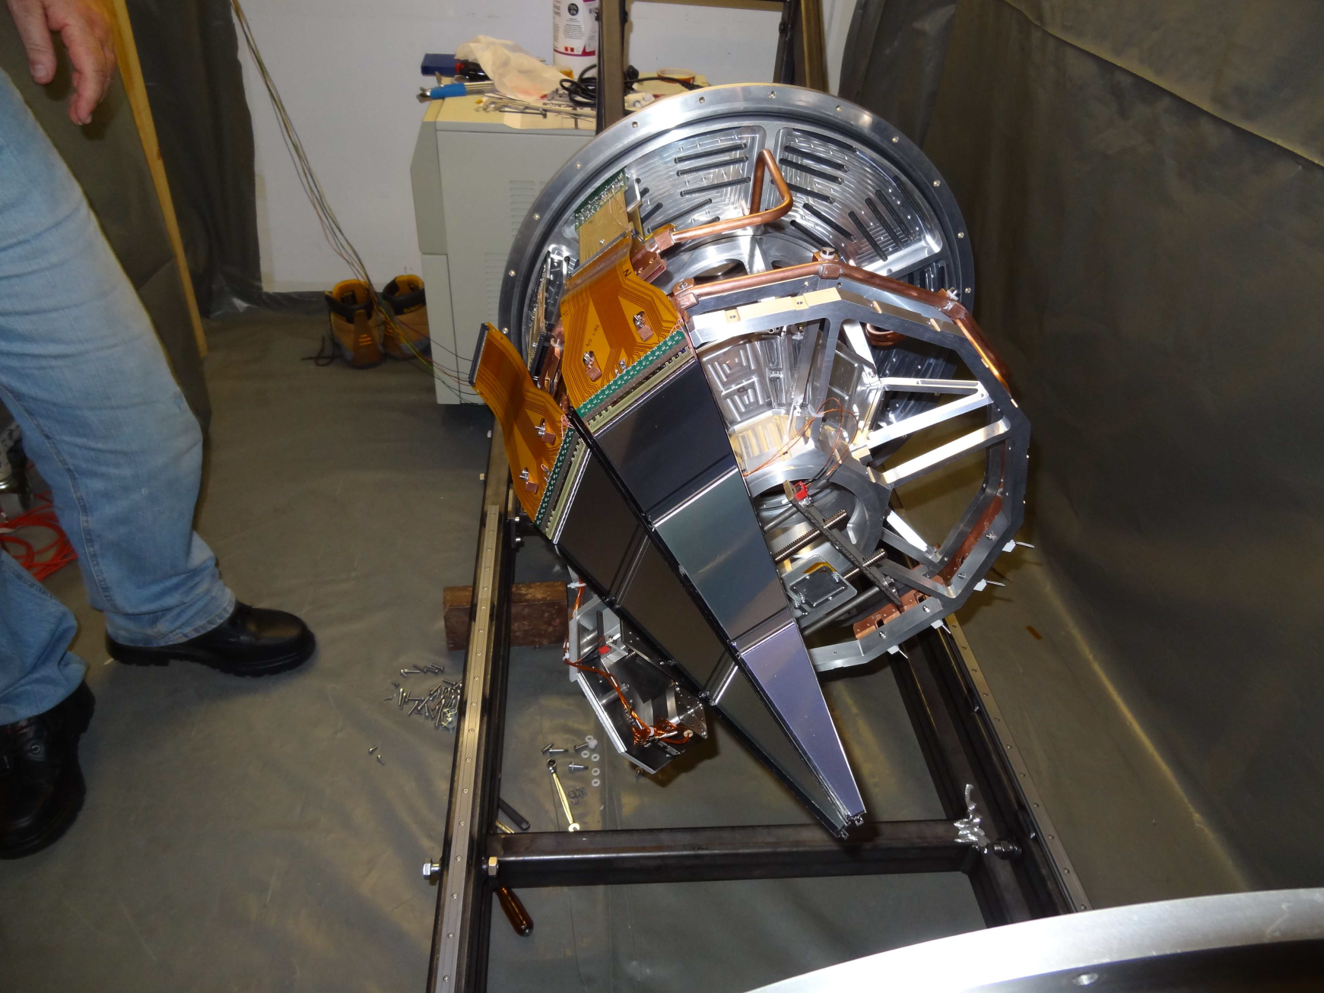
Delays, up to one year, due to:
-slow Si detector delivery
first 100 μm detectors delivered end of last year
-third ASIC iteration needed

Slide 50
31 LaBr3(Ce) + electronics delivered; mechanics ready
(additional 5 ordered)
Detectors used in
-Bucharest (light ions) 34P, 188W, 138Ce etc published
-ILL (induced fission and n,gamma) 196Pt published
-RIKEN (fragmentation beam)
Plans:
-Jyvaskyla
-Argonne (252Cf source, …)
-GANIL (with AGATA)
-Birmingham
-etc.
~20 publications
A LaBr3:Ce fast-timing array for DESPEC at FAIR,O.J.Roberts et al, NIM A748, 91 (2014)

Slide 51
Summary
First FAIR beams 2021
GSI beams from 2017 (?)
Low-energy branch building?
R3B first in-beam test in 2014
delayed, should be ready by April 2016
depends on availability of cross-community experts!
HISPEC practically finished
isotopic separation is now possible with LYCCA
AGATA campaigns at GSI
DESPEC needs commissioning of EDAQ
detectors in use in several labs
UK is associate member of FAIR

Slide 52
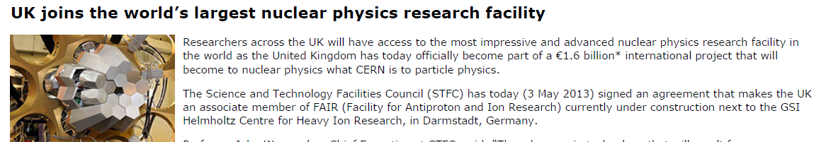
3rd of May 2013
Photo: G. Otto (GSI)

Slide 53


Slide 57
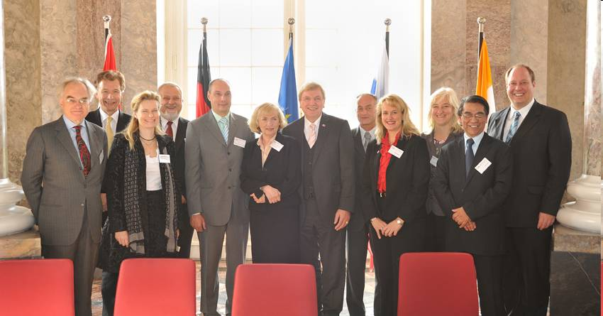
FAIR established: 4th of October 2010
nine countries signed the international agreement on the construction of the
accelerator facility FAIR. Signed:
Germany, Finland, France, India, Poland, Romania, Russia, Slovenia and Sweden.
Others expected within one year (Spain etc. needs ratification before signing
within one year.).
First OSC meeting; Oct. 2010

Slide 59
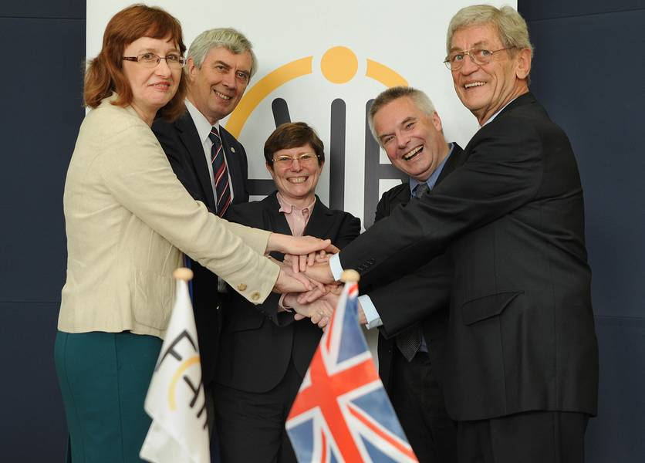
Dr. Janet Seed (STFC), Prof. Boris Sharkov (FAIR)
Dr. Beatrix Vierkorn-Rudolph (FAIR-Council, German Reseach Ministry),
Prof. John Womersley (STFC) Prof. Günther Rosner (FAIR) (Photo: Gaby Otto for FAIR)

Slide 60
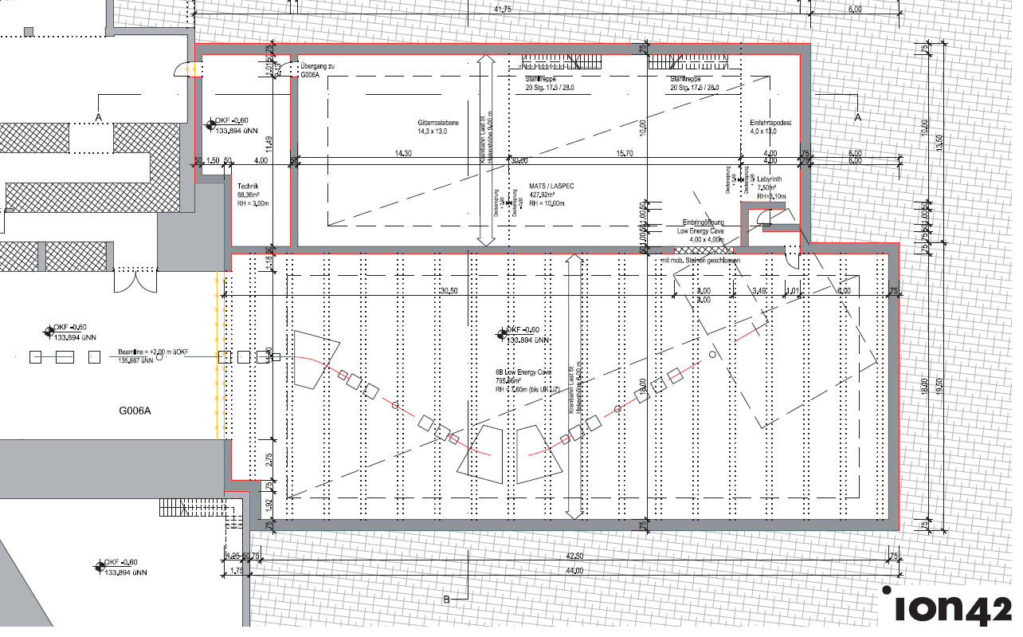
Result of new architect study
(2nd architect study – Feb 2014)

Slide 61
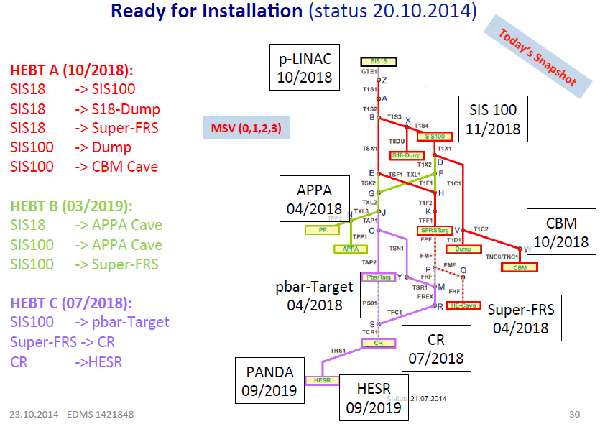
Latest plans; under discussion

Slide 62
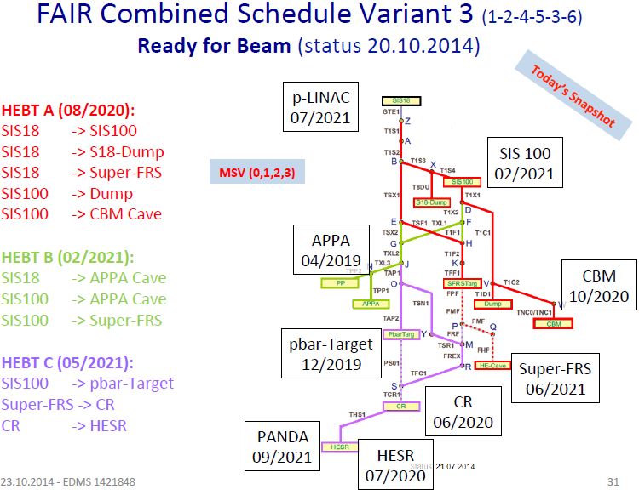
Latest plans; under discussion

Slide 63
High-resolution in-flight spectroscopy (HISPEC)
February-April 2014: AGATA+LYCCA campaign at GSI
LYCCA mechanics is in Daresbury
LYCCA will go to Cologne (Tandem accelerator) in 2015
To identify heavy (A>100) nuclei:
LYCCA after a dipole
Needs simulations
Diamond -> plastic
saved £143k
WA: 12 months PDRA: 40k

Slide 65
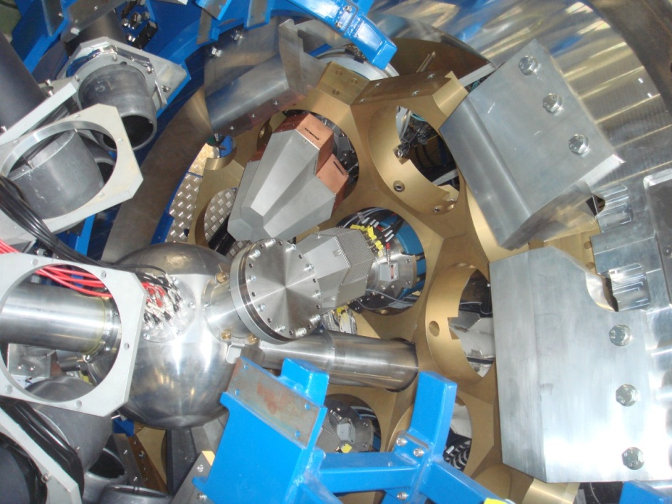
HISPEC
-AGATA at GSI commissioning, 136Xe and 238U beams: done April-June 2012
-Nine more days in September
-Experiments: Oct-Nov 2012 and
Oct 2013-March 2014;
2UK led exps. approved
Secondary
target
DSSD
Diamond or Plastic
DSSD
CsI
RIB vom FRS
LYCCA
(x, y)
Time-of-Flight
(ΔE, x, y)
(E)

Slide 66
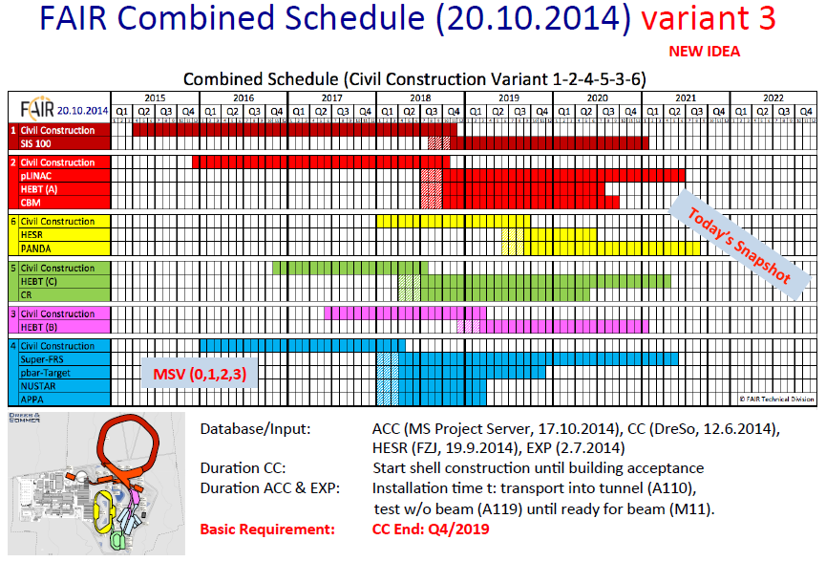

Slide 67
Overview of construction cost
Category (cost group) | Description | Cost (MEUR 2014)
KG 200 | Preparation and development | 0.100
KG 300 | Edifice (building, incl. pillars) | 4.434
KG 400 | Edifice (technical infrastructure) | 1.921
KG 500 | Outdoor facilities (e.g. road work) | 0.583
KG 700 | Ancillary cost (cost for planning, fees, permits, ...) | 1.228
 | Total cost estimate | 8.266
6.5 MEUR
in 2005 cost

Slide 68
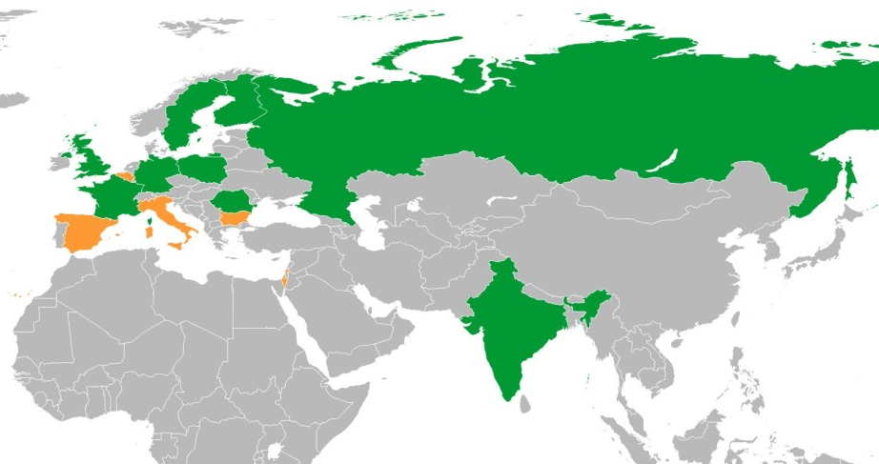
Institutes/countries participating in LEB
Country | % experiment funding (June 2014)
Belgium | 0.8
Bulgaria | 1.2
Finland | 5.1
France | 1.1
Germany | 24.9
India | 15.4
Israel | 0.1
Italy | 0.3
Poland | 2.6
Romania | 9.2
Russia | 1.0
Spain | 20.3
Sweden | 5.2
UK | 12.8
Countries to contact in order to form a consortium:
FAIR partner countries and Spain

