Slide 1
F_{L} and F_{L}^{C} @ EIC
M. Lamont, S. fazio and E.C. Aschenauer

Slide 2
Kinematics
EIC √s=141 GeV y < 0.95
EIC √s=45 GeV y > 0.01

Slide 3
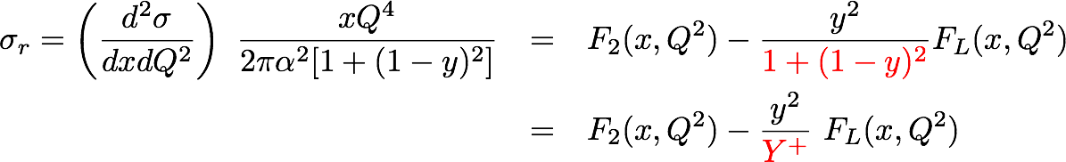
Measuring FL with the EIC (I)
quark+anti-quark
momentum distributions
gluon momentum distribution
In practice use reduced cross-section:
How to extract F_{L}
  Need different values of y²/Y⁺
  FL slope of σr vs y²/Y⁺
  F2 intercept of σr vs y²/Y⁺ with y-axis
  σr
  y²/Y⁺
0
Notes:
\begin{eqnarray*}\sigma_r = \left( \frac{d^2 \sigma}{dx dQ^2}\right)\ \frac{x Q^4}{2 \pi \alpha^2 [1 + (1-y)^2]}
&=& F_2(x, Q^2) - \frac{y^2}{\color{red}{1+(1-y)^2}} F_L(x, Q^2) \\
{} &=& F_2(x, Q^2) - \frac{y^2}{{\color{red}Y^+}} \ F_L(x, Q^2) \\\end{eqnarray*}

Slide 4
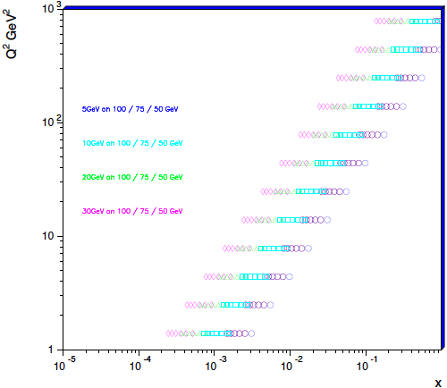

Measuring FL with the EIC (II)
In order to extract F_{L} one needs at least two measurements of the inclusive cross section with “wide” span in inelasticity parameter y (Q² = sxy)
F_{L} requires runs at various √s
Current kinematics chosen to overlap with eA
can extend x-range by going to
20 GeV x 250 / 200 / 150
Need sufficient lever arm in y²/Y⁺
Limits on y²/Y⁺:
At small y:
detector resolution for e’
At large y:
radiative corrections and charge symmetric background
EIC studies:
Statistical error is negligible
in essentially whole range
Systematical Error
Calibration
Normalization
Experiment
Radiative Corrections
Cuts:
Bin in Q² (12 bins logarithmic ) and y (10 bins linear)
with fixed x for each bin
  Lowest √s y-bins Δy= 0.1
  Higher √s Δy gets smaller by ratio of √s₁ / √s₂
  3 points in Y⁺ for each Q²-bin
  0.01 < Y⁺ < 0.95 → ΔY⁺ > 0.1
Notes:
Lowest value of x and Q2 :
y y2/Y+ proton p
0.7 0.44 100
0.54 0.24 130
0.28 0.28 250

Slide 5
Extract the F_{L} structure function
Method:
fit the slops of Y⁺ for different √s at fixed x, Q²
Total simulated event sample L = 10 fb⁻¹
Simulation:
e+p: simulated using PYTHIA
5(20) x 50 → ∫L = 2 fb⁻¹
5(20) x 75 → ∫L = 4 fb⁻¹
5(20) x 100 → ∫L = 4 fb⁻¹
Statistical uncertainties irrelevant
all dominated by 3% systematics

Slide 6
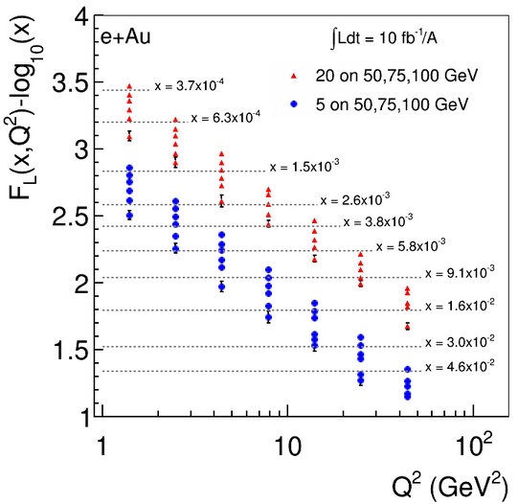
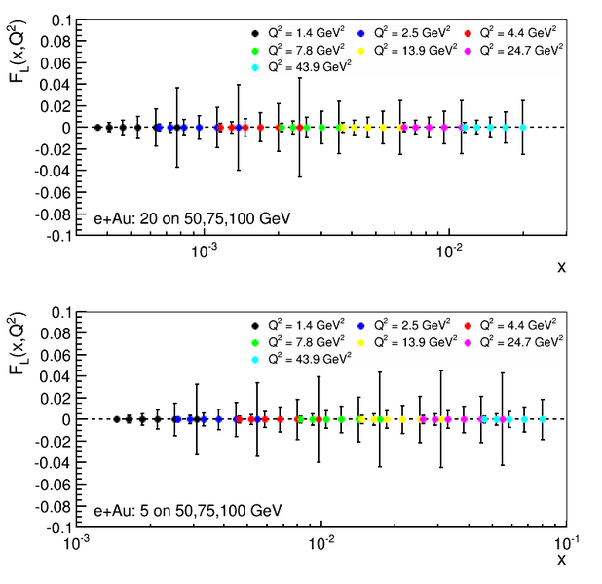
F_{l} and its uncertainties
e+p
These points are where we have
LEVER ARM (three points, y+ > 0.2)
e+p:
Physically meaningful measurement
Model dependent!
e+p:

Slide 7
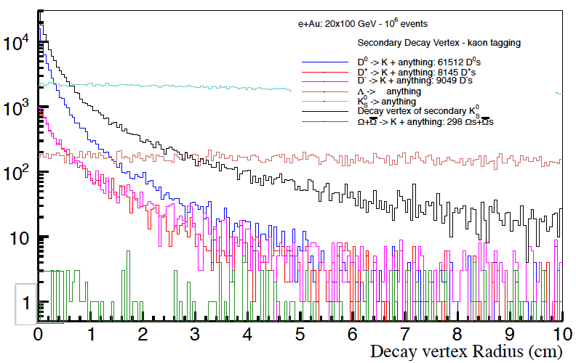
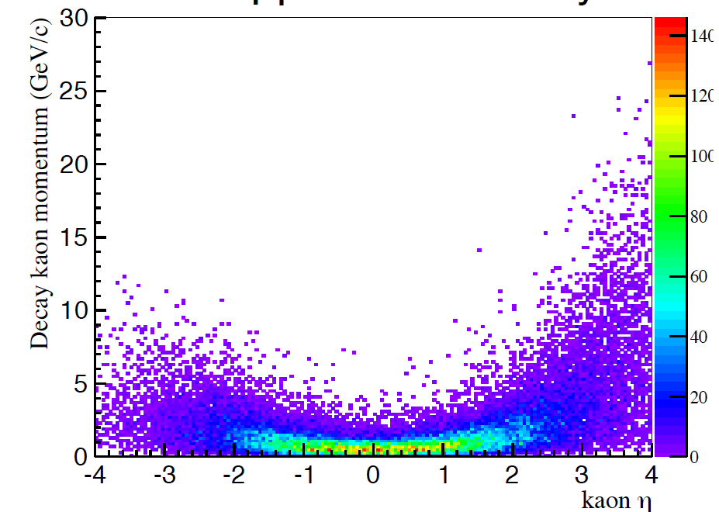
F_{L}^{C}
We tag charm by displaced kaons in the final state
0.01 cm < |VTX| < 3 cm → Cut on the Decay Vertex
Particle ID for Kaons:
CENTRAL DETECTOR (-1 < Eta < 1):
dE/dx -> 0.2 GeV < P < 0.8 GeV
RICH -> 2 GeV < P < 5 GeV
FORWARD (1 < Eta < 3.5):
RICH -> 2 GeV < P < 40 GeV
REAR (-3.5 < Eta < 1):
RICH -> 2 GeV < P < 15 GeV
same sample as for F_{L}
but increased systematic uncertainty 7%

Slide 8
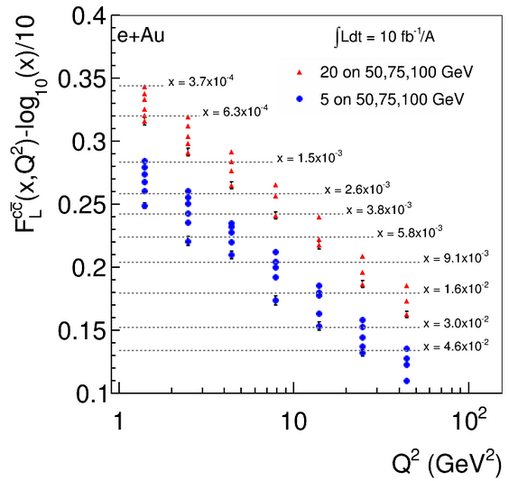
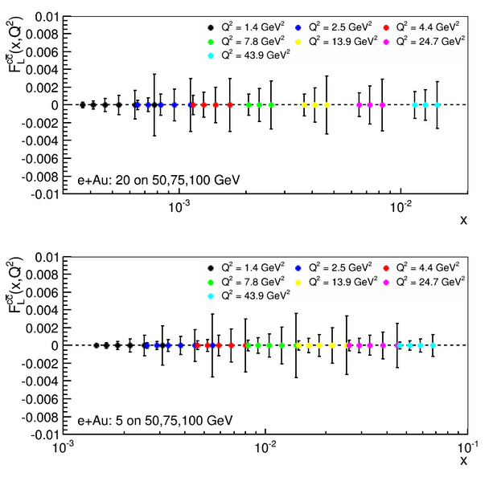
F_{l}^{c} and its uncertainties
e+p
These points are where we have
LEVER ARM (three points, y+ > 0.2)
e+p:
Physically meaningful measurement
Model dependent!
e+p:

Slide 9
Background
We look at background from DIS events with kaons that pass the whole selection but are not coming from a charm decay
We study the fraction of background events over signal as:
Background fraction [Background/Signal] (selected_bkd_events/selected_Charm_Events)
5 GeV x 50 GeV (10M events simulated)
Total number of selected events (charm in acceptance and with a kaon detected): 18822
Total number of background events (in the final selection) = 179
Background fraction [Background/Signal] = 0.95%
5 GeV x 100 GeV (10M events simulated)
Total number of selected events (charm in acceptance and with a kaon detected): 26273
Total number of background events (in the final selection) = 258
Background fraction [Background/Signal] = 0.98%
20 GeV x 100 GeV (10M events simulated)
Total number of selected events (charm in acceptance and with a kaon detected): 39624
Total number of background events (in the final selection) = 460
Background fraction [Background/Signal] = 1.16%
Conclusion:
The B/S fraction is expected in the order of ~1% with a slight energy dependence
What about kinematical dependence?

Slide 10
Background – kinematical dependence
The errors on the B/S fraction are calculated with the binomial formula
for correlated values

Slide 11
Charm efficiency
We look at the selection efficiency for charm events
We study the charm selection efficiency as:
Charm efficiency = selected_charm_Events / charm_Events_inAcceptance
5 GeV x 50 GeV (10M events simulated)
Total number of selected events (charm in acceptance and with a kaon detected): 18822
Total number of events with a charm in kinematical acceptance: 67544
Charm efficiency = 27.9%
5 GeV x 100 GeV (10M events simulated)
Total number of selected events (charm in acceptance and with a kaon detected): 26273
Total number of events with a charm in kinematical acceptance: 91930
Charm efficiency = 28.6%
20 GeV x 100 GeV (10M events simulated)
Total number of selected events (charm in acceptance and with a kaon detected): 39624
Total number of events with a charm in kinematical acceptance: 138672
Charm efficiency = 28.6%
Conclusion:
The charm selection efficiency is expected in the order of ~28% with no significant
energy dependence
What about kinematical dependence?

Slide 12
Charm Selection efficiency – kin. dependence
The errors on the efficiency are calculated with the binomial formula
for correlated values

Slide 13
Summary
EIC can measure F_{L} over a wide range in x-Q²
EIC can measure for the first time F^{C}_{L} over a wide range in x-Q²
We have done studies on radiative corrections as well, not presented here (➔ time)
Any F_{L} and F_{L}^{C} measurement will be systematic limited
  we can work on reducing the systematic uncertainties, but for this we need a more definite design of the detector
  some details of the current simulations can be discussed
Should investigate how well F_{L} can be determined combining HERA and EIC data of the reduced cross section
EIC has nice access to high x at high Q2 through CC, see backup

Slide 14


Slide 15
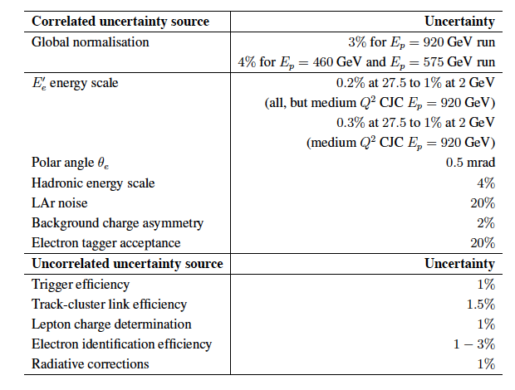
HERA: σ_{r} and F_{L}
H1

Slide 16
CC kinematic coverage
For details see: arXiv:1309.5327 PRD 88 (2013) 114025

Slide 17

CC Cross Section @ EIC

Slide 18
Polarized CC cross section

Slide 19
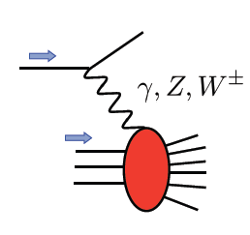
Polarized EW PHYSICS
ν
e
W^{+/-}
Complementary to SIDIS:
very high Q2-scale
extremely clean theoretically
No Fragmentation function
best way to measure at very high x
QCD
fit

