Slide 1
Large (non small) x at the eic october 4th , 2016 Jefferson Laboratory
Simonetta Liuti
University of Virginia

Slide 2
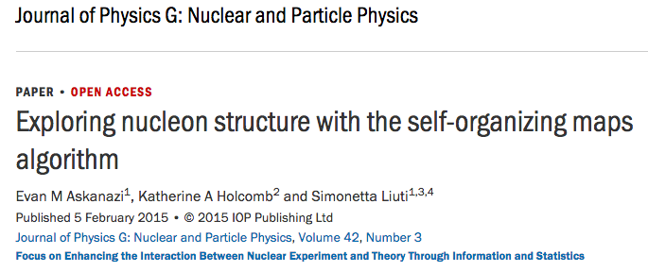
Based on

Slide 3
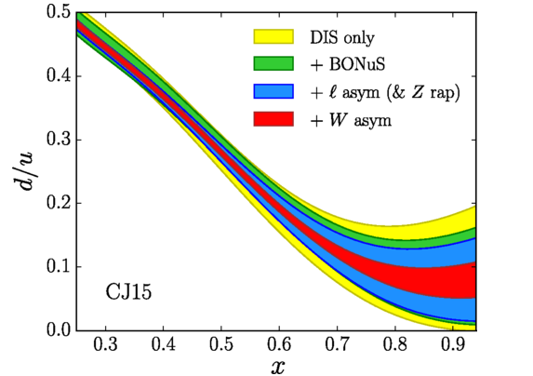
d/u ratio
SU(6)
Helicity conservation
Accardi et al., PRD93(2016)
Counting rules

Slide 4
Large x_{Bj} at fixed Q² and the continuation of the pQCD curve into the resonance region
TMC
Large x structure of
PQCD evolution equations
Main question: how to continue pQCD curve? What defines the pQCD curve?
NNLO and higher…
Higher Twists
Nuclear corrections
(for neutron)

Slide 5
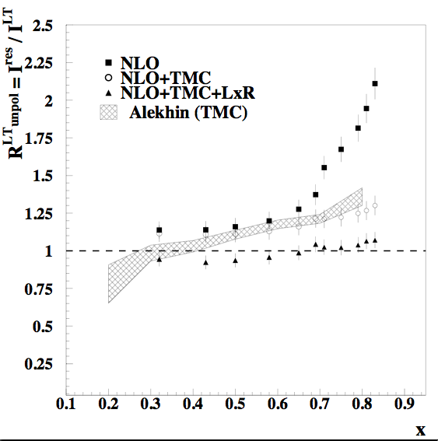
An initial study
Ratio of “Jlab +SLAC” data in resonance region ( W²<4 GeV²) over pQCD curve
TMC
Large x Resummation
Bianchi, Fantoni, S.L. (PRD 2003)

Slide 6
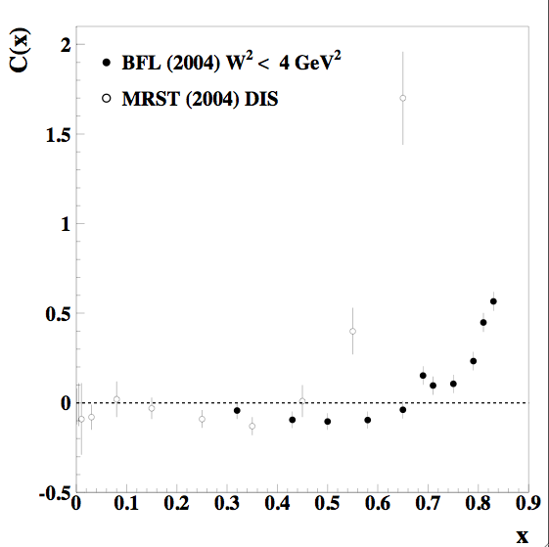
Because of large x resummation the size of HTs is reduced

Slide 7
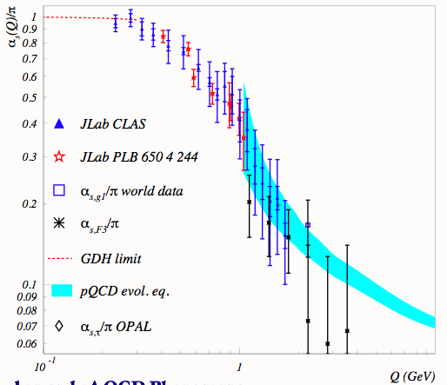
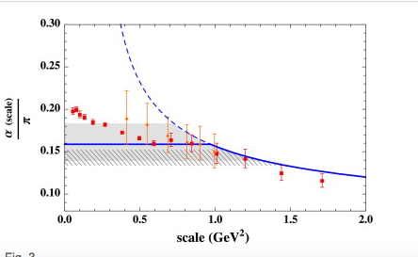
In addition …. α_{S}needs to be continued at very low Q²
J.P. Chen and A. Deur
GDH analysis
A. Courtoy and S.L., PLB726 (2013)
Use this “positively” to
Extract α_{S} at low scale

Slide 8
In conclusion we have developed a neural network which is specific for addressing the problems of fitting PDFs, SOMPDF.
Given an appropriate manpower one could run it and extract quantitative results

