Slide 1
Medium to High-x at EIC
Rik Yoshida
Jefferson Lab
Not Low-x Meeting
October 4, 2016

Slide 2
Introduction
EIC Users Group meetings at Berkeley and Argonne.
Discussion and encouragement to think about topics so-far not highlighted in the whitepaper
Some of us thought about high-x (or not low-x) physics.
A lot of work has been and is being done in some areas of high-x physics for EIC
e.g. Ch. Weiss’ group on eA/gluons via charm, previous work at BNL, …
Seemed that there were plenty of other high-x physics areas none-the-less.
Some of us did a quick study of the effect of EIC high-x measurement on PDFs. Presented at the Argonne meeting. (see talk by R. Ent)
Prospect for measurements of pion and kaon structure function measurements also revisited and presented at Argonne meeting (see talk by T. Horn)
These ideas led to some corridor discussions.
No particular framework for starting these discussions exist.
Didn’t feel ready for a formal workshop
Decided to have an ad-hoc one day workshop to start thing off.
Not meant to cover all relevant topics (we can have further meetings)
Arbitrarily decided to cover mainly inclusive measurements for this time.
Emphasize discussions rather than presentations (try to keep it small)
Look for promising directions of effort—physics studies, detector explorations.
Try to end up with a list of concrete next steps
Eventually interface with EIC UG organizations..
When we started to send emails around, were happy to get a lot of responses quickly.

Slide 3
Agenda
Some questions
What would be the effect of high precision high-s measurements on HL-LHC?
Experience from LHeC studies (Paul)
Current status of EIC high-x inclusive measurement studies. (Alberto)
Can we measure FL at relatively high-x? What would be their impact
HERA measurement (Mandy)
EIC studies (Elke)
What can we further learn from high-x measurements at EIC?
Higher Twist (Simonetta)
Charge Symmetry Violation (Ross, Seamus)
Are Pion and Kaon structure functions measurable at an EIC? Can we get to a PDF study of them? (Wally, Tanja)
Some comments on measurability and detector requirements =>

Slide 4
High-x parton uncertainties
From PDF4LHC recommendations for LHC run 2

Slide 5
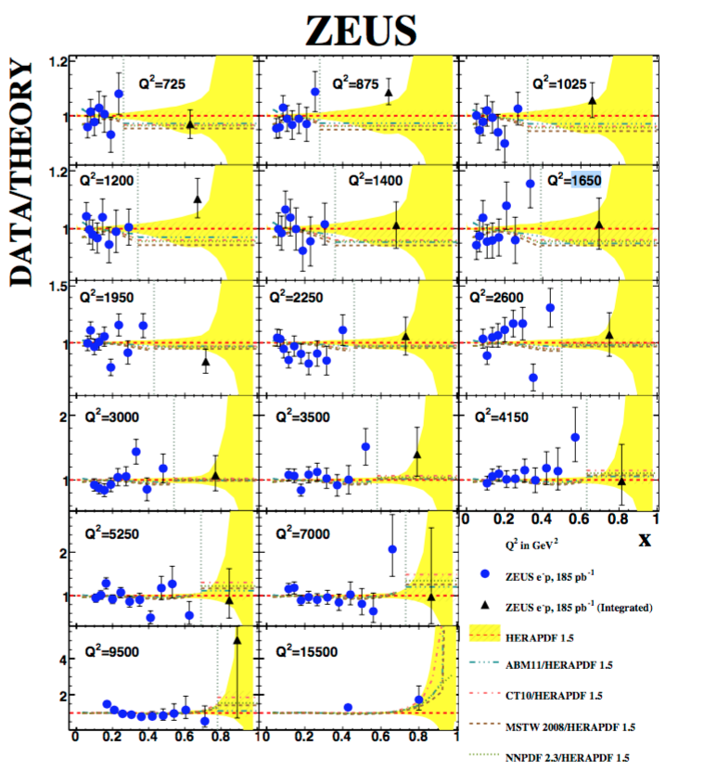
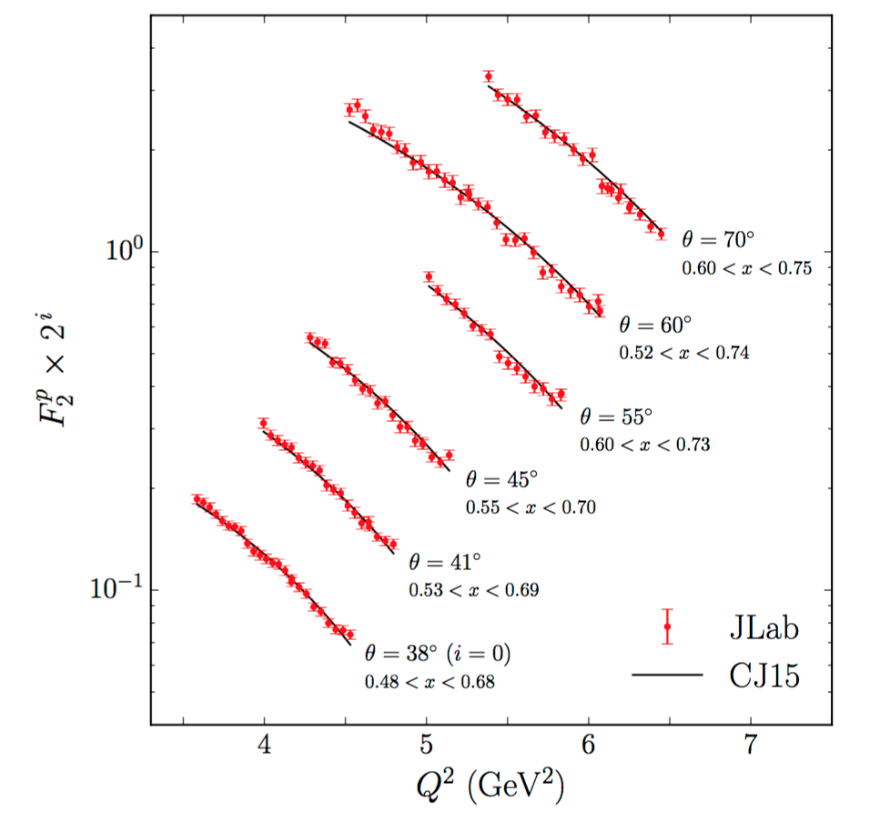
Existing High-x measurements
JLAB 12 measurements will push
to higher Q² but…
Could EIC fill the
high Q² (10-1000 GeV²)
high-x (>0.5) gap in the data with precision measurements?

Slide 6
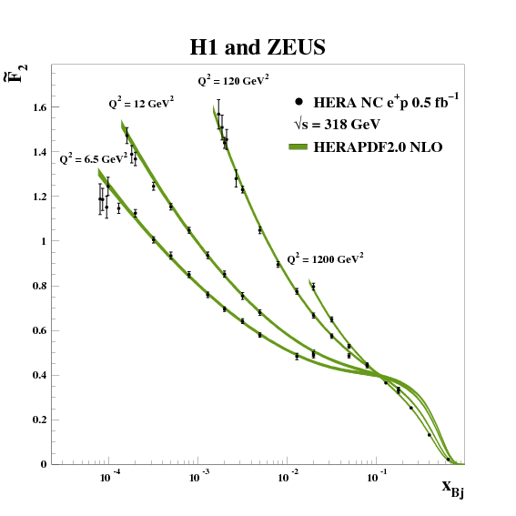
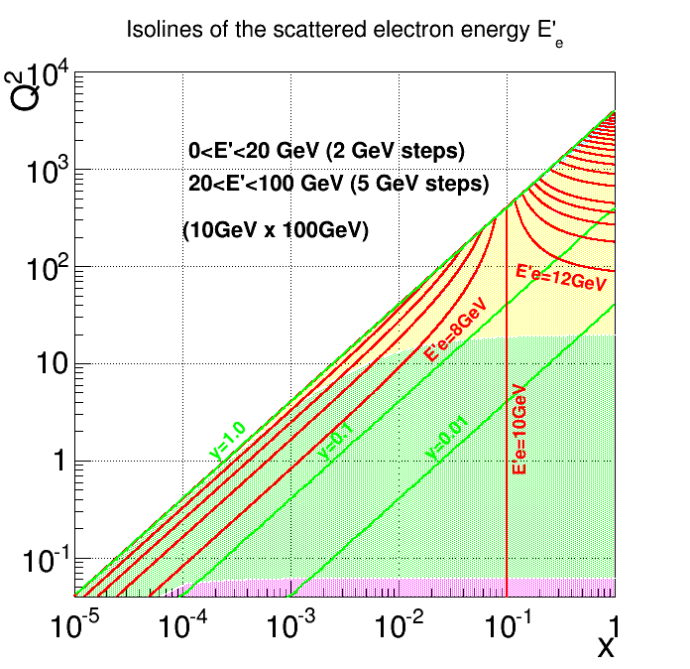
Cross-sections
1/Q⁴
~(1-x)³
Best statistics at lower Q² (but must be “high enough”) ➔ Low y

Slide 7
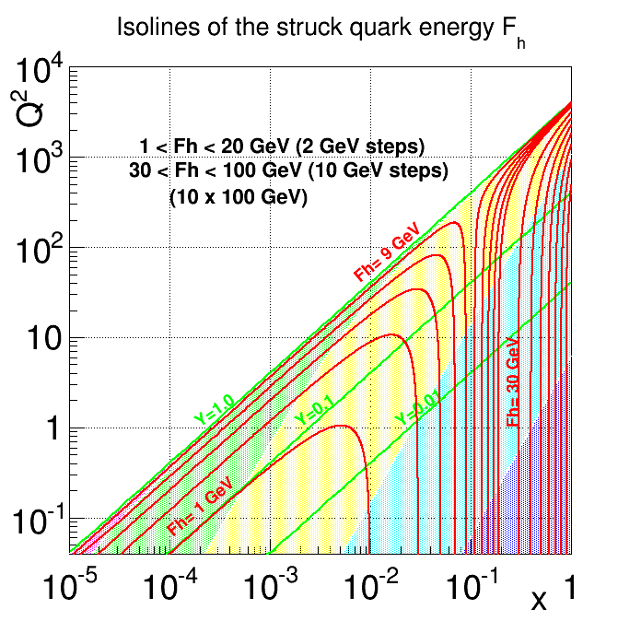
Resolutions

Slide 8
Resolutions
Say, Q² = 20 GeV², x= 0.7 (y=0.01)
if dE/E = 1%, then dx/x = 100%
if dF/F= 10% then dx/x = 10.1%
.. need jet energy resolution of ~85%/√F
Need to measure jet energies (forward calorimeters)?
How precisely?
Lower E_{p}?

Slide 9
Questions you might ask..
What is the measurable range?
What are the resolutions really needed?
How low in the jet angle can we measure?
What is the relation between
Luminosity available
Acceptance
Optimum beam energies (more than one?)
Measurement technique
What is the right detector technology for this measurement?
Can we optimize for the high-x and also for other measurements at the EIC with the same detector?

