Slide 1
Coherent elecroproduction of neutral pion off a helium-4
Bayram Torayev

Slide 2
Outline
Physics Motivation
Experimental Setup
Particle Identification
Coherent Event Selection
Results
Summary

Slide 3
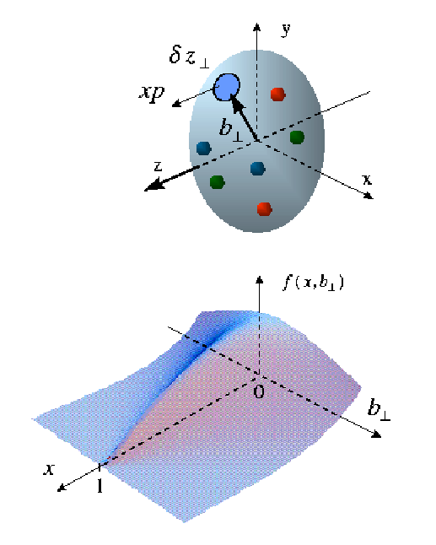
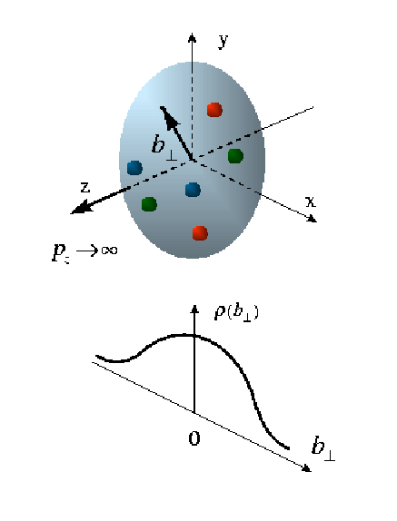
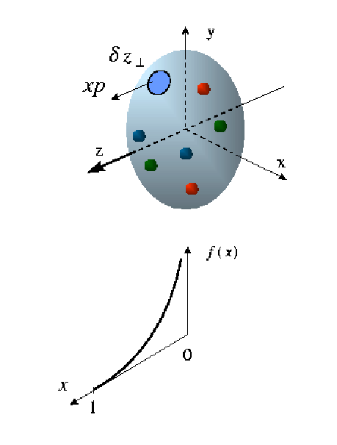
Electron Scattering Processes
Elastic Scattering Nucleon form factors
transverse charge & current densities
Deep Inelastic Scattering
Structure functions
quark longitudinal
momentum (polarized and unpolarized) distributions
Deep Exclusive Scattering
GPDs
fully-correlated
quark distribution in
both coordinate and
momentum space

Slide 4
Generalized Parton Distributions (GPDs)
At leading twist, the partonic structure of the nucleon is described by 4 quark helicity conserving (chiral even) GPDs.
Factorization proven only for longitudinally polarized virtual photons for meson production.
DA
Factorization
GPDs
p
p’
conserve nucleon helicity
flip nucleon helicity
Vector mesons
(ρ, ω, φ)
Pseudoscalar
mesons (π, η)
In the forward limit (t → 0), H GPD’s reduce to the forward parton distributions.
E GPD’s, which involve nucleon helicity flip, do not have a DIS equivalent.

Slide 5
Deeply Virtual Meson Production (DVMP)
Deeply virtual exclusive reactions: access to the structure of the nucleon
Varying Q² (size of the probe) and t (transverse size of the target object)
Explore transition between hadronic and partonic mechanisms
Asymmetry arises due to interference LT’
π⁰
e’
φ
e
leptonic plane
p’
hadronic
plane

Slide 6
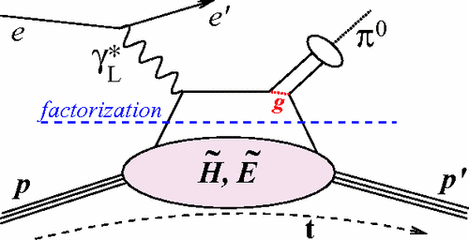
Neutral pion electroproduction off a helium-4 in CLAS
Coherent electroproduction of pion has been studied in deep exclusive regime:
CLAS detector was used to detect electrons
IC was used detect low angle photons
RTPC was used to detect low momentum recoil helium-4

Slide 7
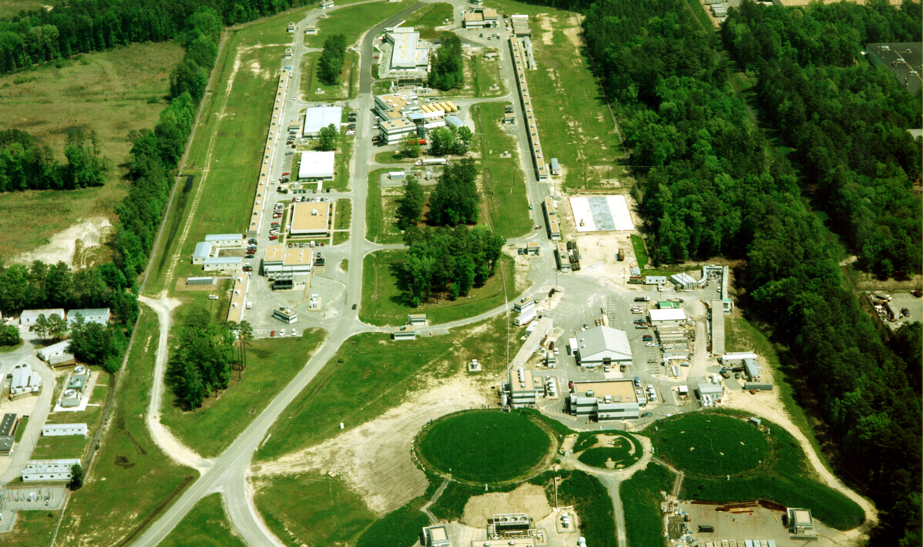
The 6 GeV Electron Accelerator
Hall-A
Hall-B
CLAS
Hall-C

Slide 8
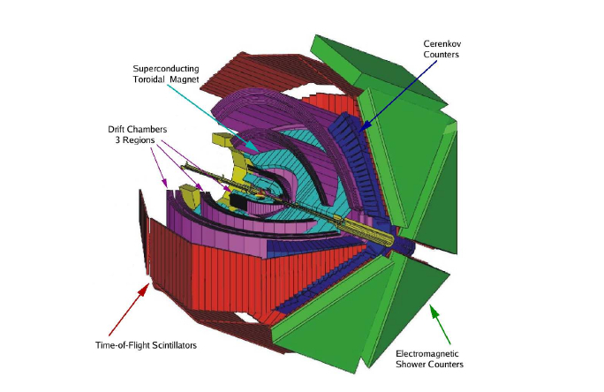
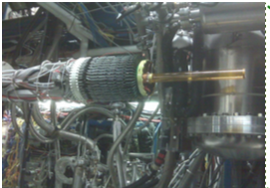
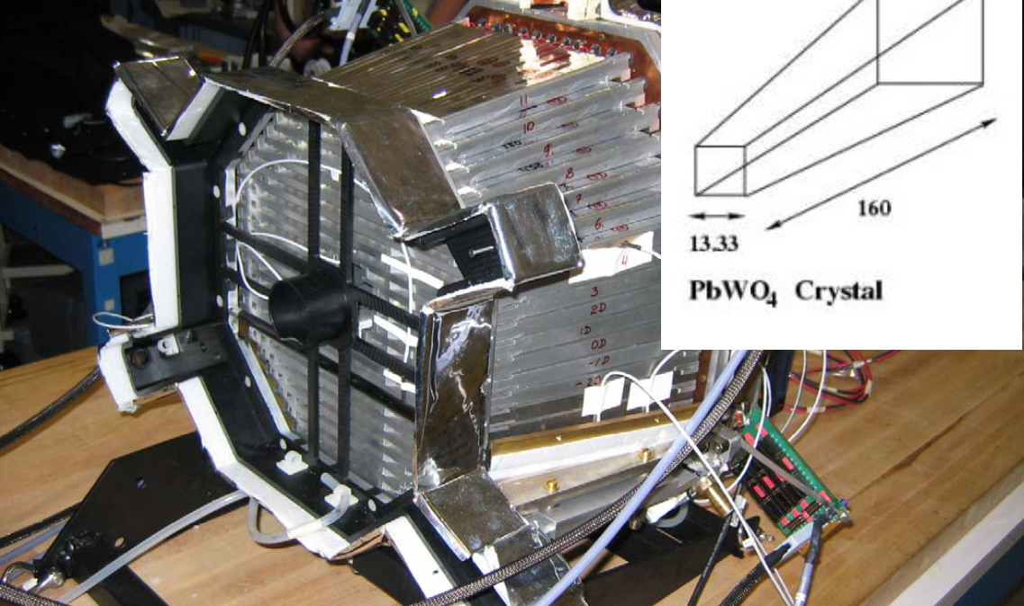
CEBAF Large Acceptance Spectrometer CLAS
CLAS Detector divided into 6 sectors
  Torus Magnet used to bend charged particles
  Drift Chambers consist of 3 regions and used to measure momentum of the charged particles
  Cherenkov counters to separate electron/pion
  Time Of Flight Counters
  Electromagnetic calorimeters to detect neutral particles and electrons
Superconducting
Torus Magnet
Cherenkov Counters
Drift Chambers
3 Regions
Time Of Flight
Counters
Electromagnetic
Calorimeter
Radial Time Projection Chamber (RTPC)
Inner Calorimeter
Notes:
----- Meeting Notes (10/31/16 14:41) -----
Torus Magnet

Slide 9
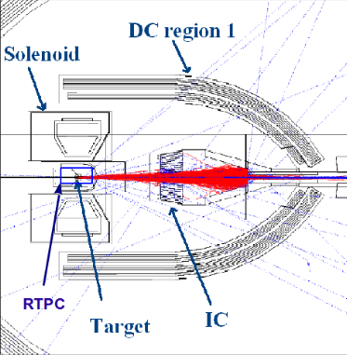
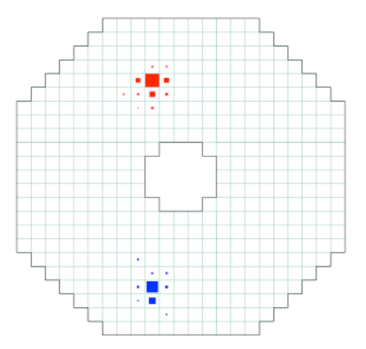
Inner Calorimeter and Solenoid Magnet
Solenoid Magnet
  Provides shield for Moller electrons.
  Used to measure RTPC momentum.
Inner Calorimeter
  424 PbWO₄ crystals, 16 cm long
  High resolution calorimeter to detect photons at small angles.
  When a high energy particle interacts with a crystals, it produces. electromagnetic shower and deposits its energy.
  Reconstructions of clusters will give information about position and energy of the particle.

Slide 10
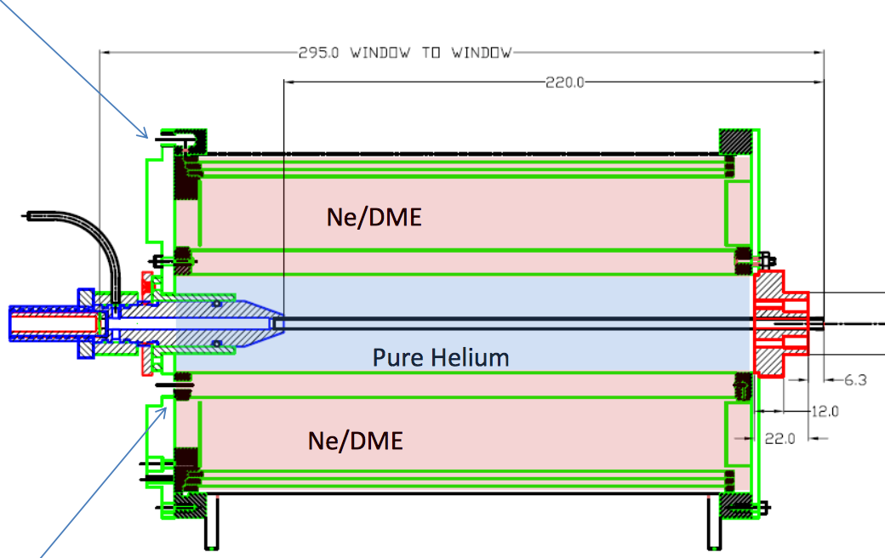
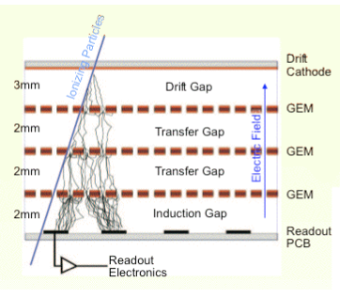
Radial Time Projection Chamber
Detection of low momentum recoil helium-4.
Design of the RTPC
  RTPC has cylindrical shape.
  20 cm long, 15 cm in diameter.
  Azimuthal coverage is %80.
  It consists three concentric GEMs with radii 60 mm, 63 mm and 69 mm.
  There are 3200 pads in the readout electronic surface.
Gas Inlet
Gas Outlet
Working principle
  Charged particles ionize gas along the path
  Electrons directed to GEM foils.
  Electron avalanche by GEM layers.
  Charge collected by readout recorded in ADCs and time in TDCs.
Gas Target
  The thickness of wall is 27μm
  The length of target cell is 30 cm
  The pressure of target is 6 atm.

Slide 11
Construction of RTPC

Slide 12
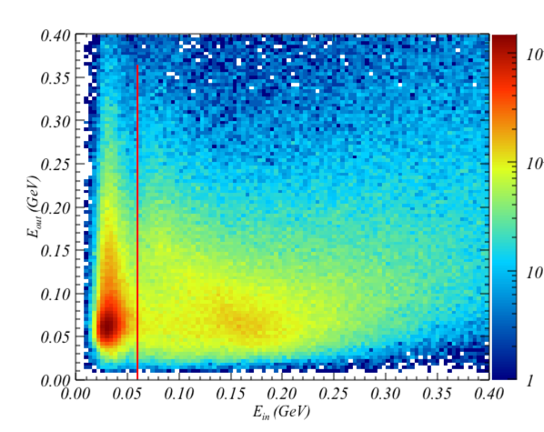
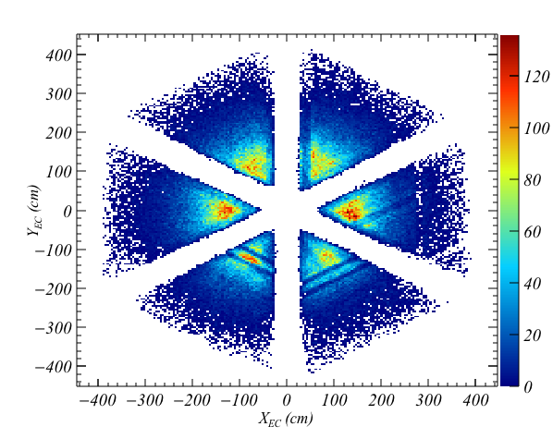
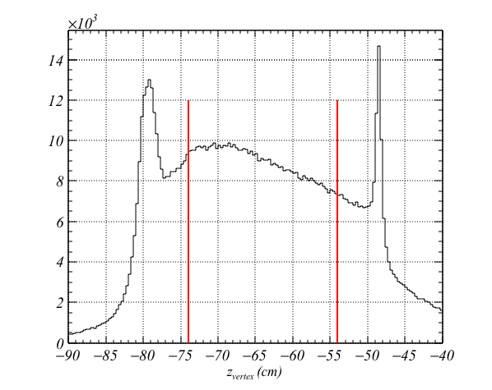
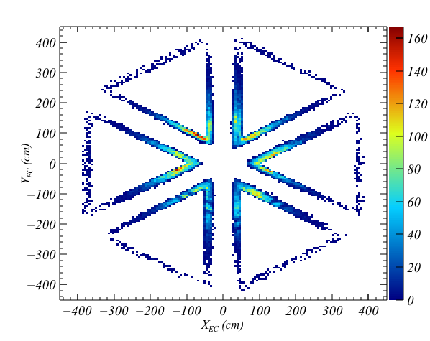
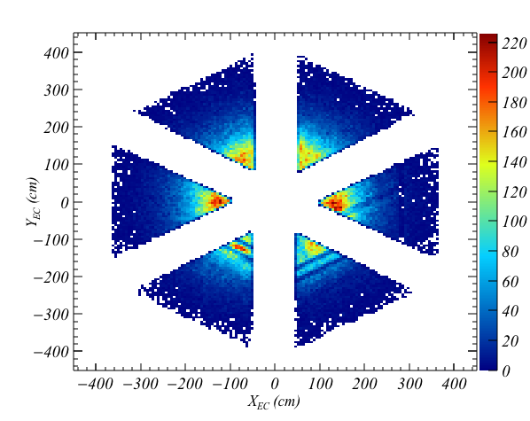
Electron Identification
Minimum momentum in DC (p > 0.65 GeV).
Vertex cut to reject events from target windows and match drift region of RTPC [-74 cm, -54 cm]
Energy deposit in inner layer of EC (E_{inner} > 0.06 GeV)
EC fiducial cut (60 cm < U <390 cm, V < 360cm and W<390 cm )

Slide 13
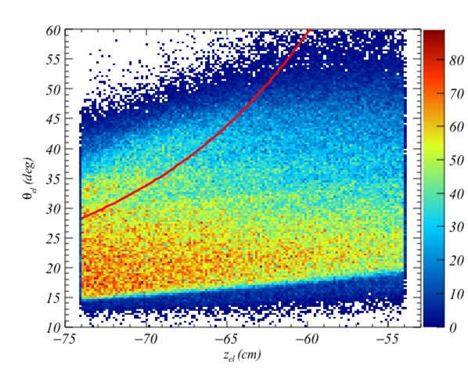
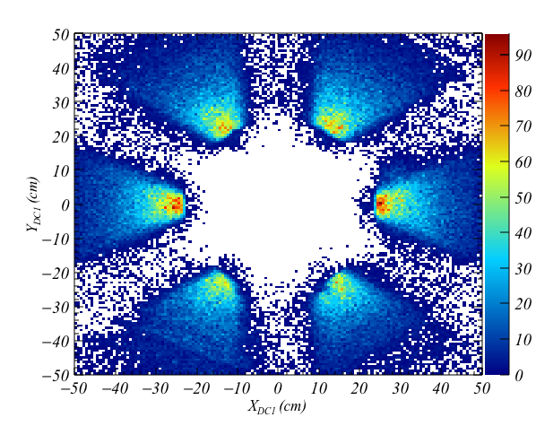
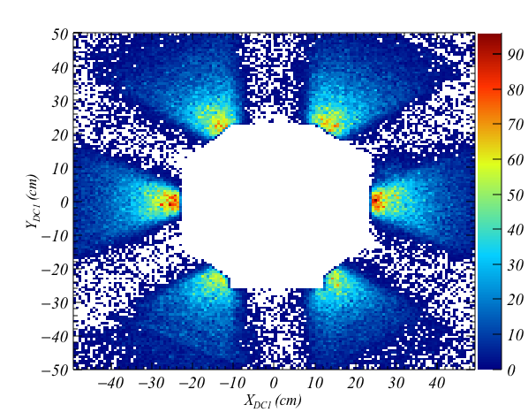
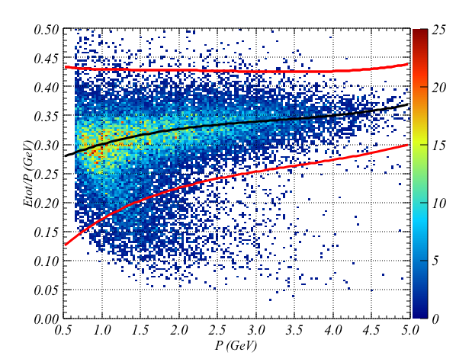
Electron Identification
Vertex dependent polar angle cut: Reject electrons that interact with solenoid magnet or its structure.
IC Shadow cut: Reject electrons that interact with IC or its structure.
Momentum dependent sampling fraction cut

Slide 14
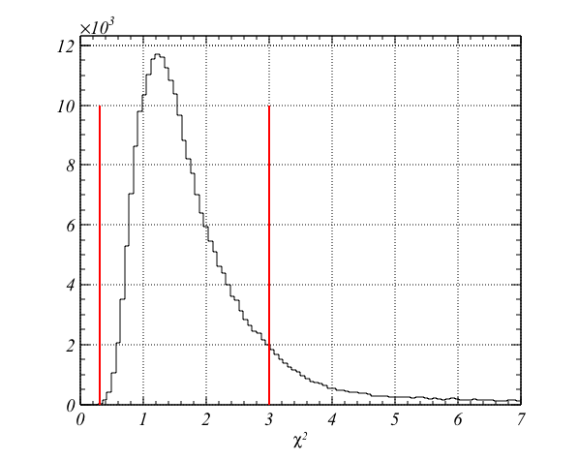
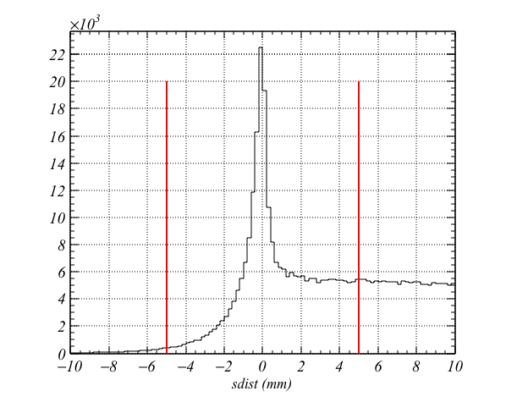
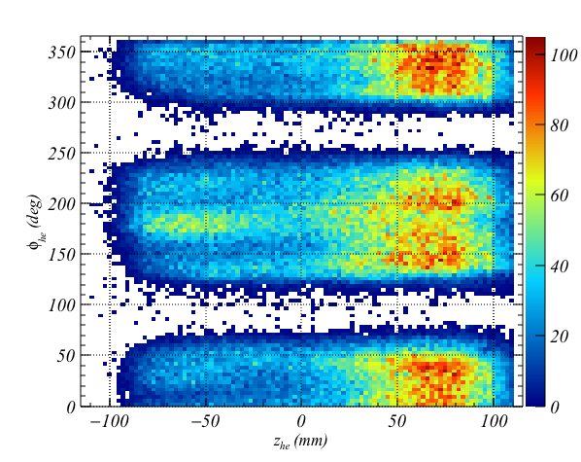
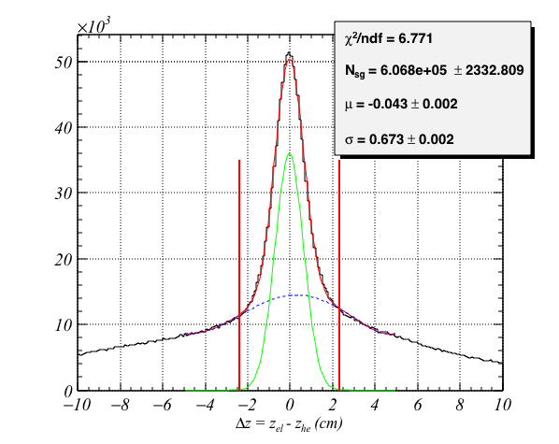
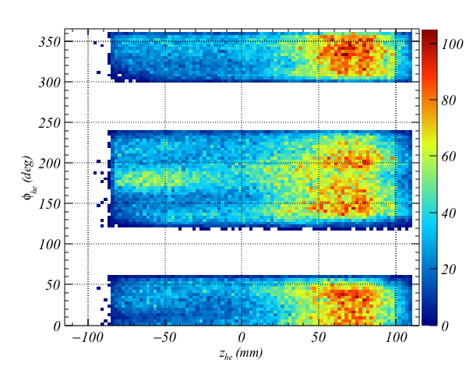
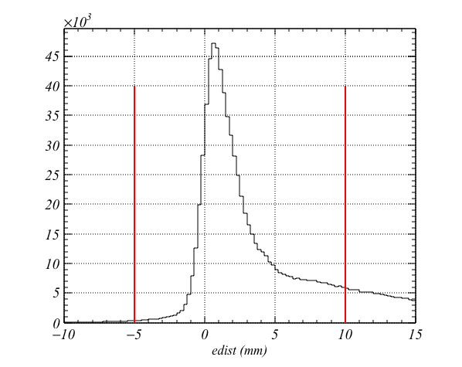
Helium-4 Candidate Selection
Number of pads (#>3)
Positive Curvature
The distance of the first ionization from cathode (edist)
The distance of the last ionization from cathode (sdist)
Helix path fit quality
Polar angle cut [20⁰, 80⁰]
Fiducial cut
Vertex matching

Slide 15
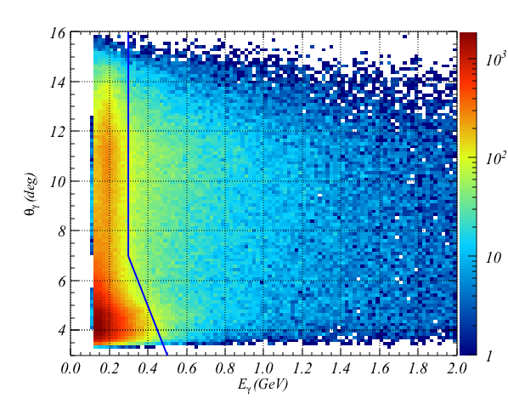
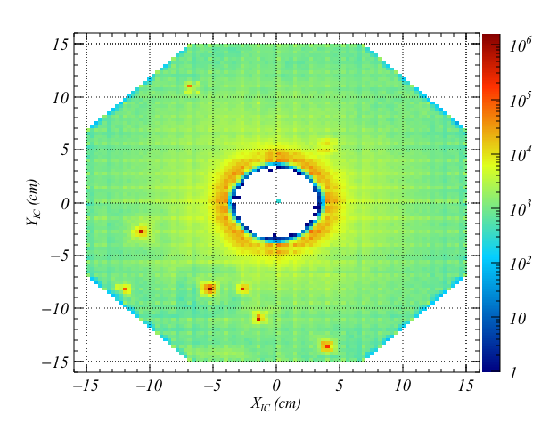
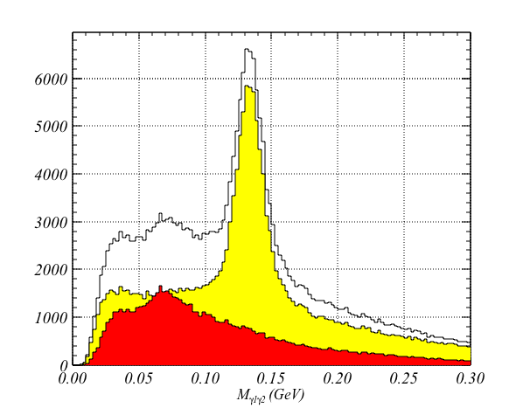
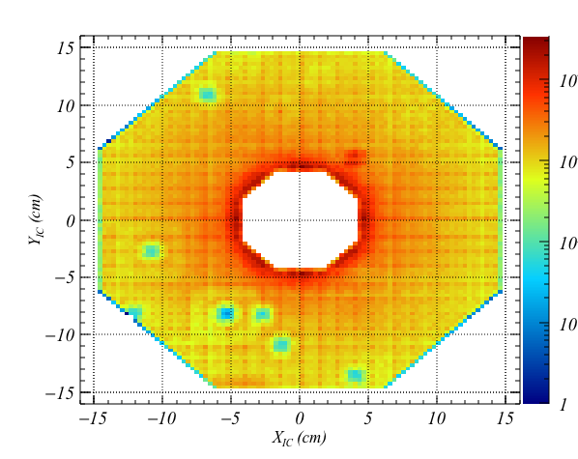
Photon Selection in IC and Pion Reconstruction
Number of clusters > 3
Minimum Energy deposit in IC (E>0.3 GeV)
Moller electron reduction
Fiducial cut and rejection of hot channels
Eliminating clusters that has no time information

Slide 16
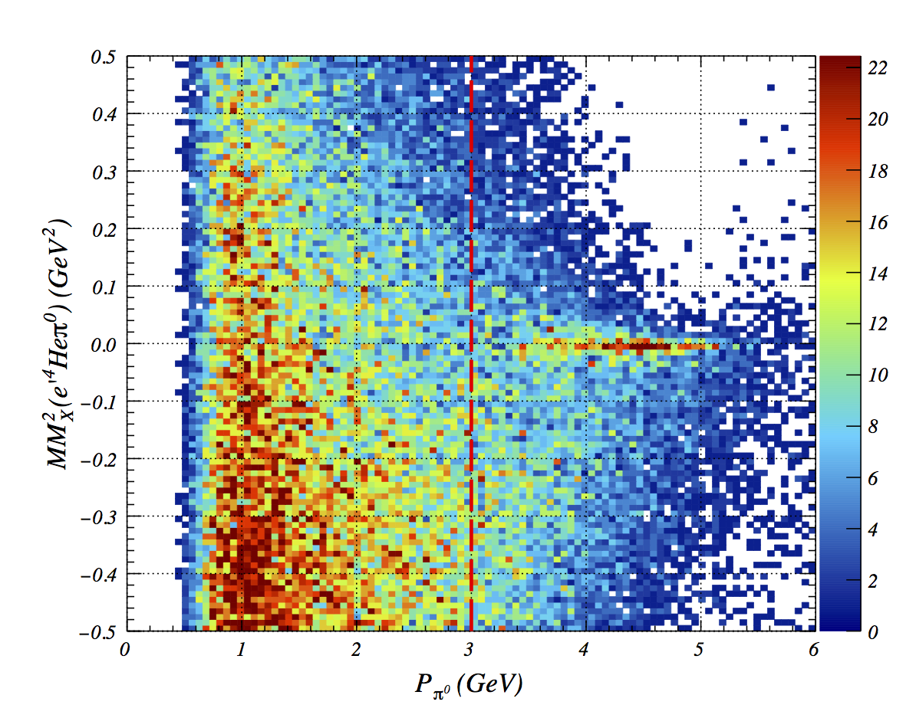
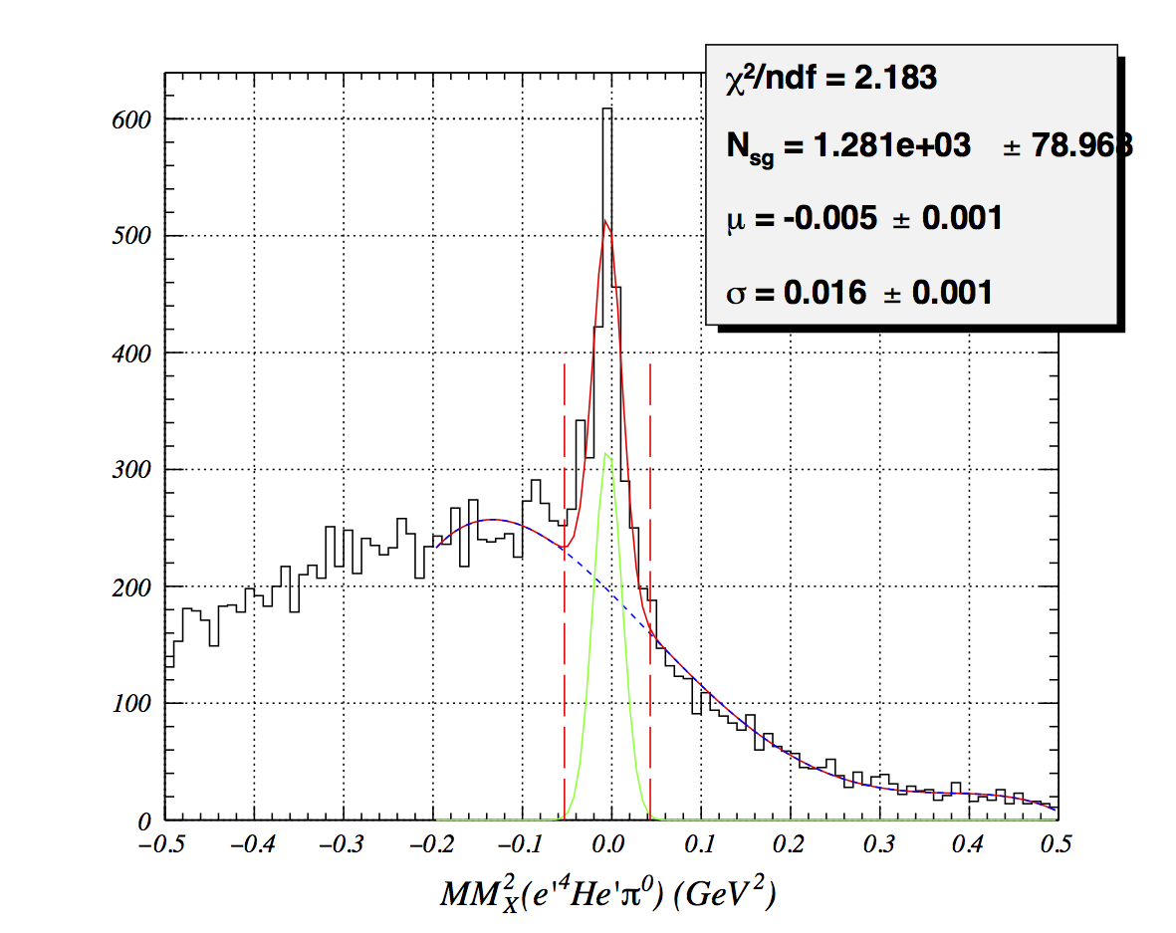
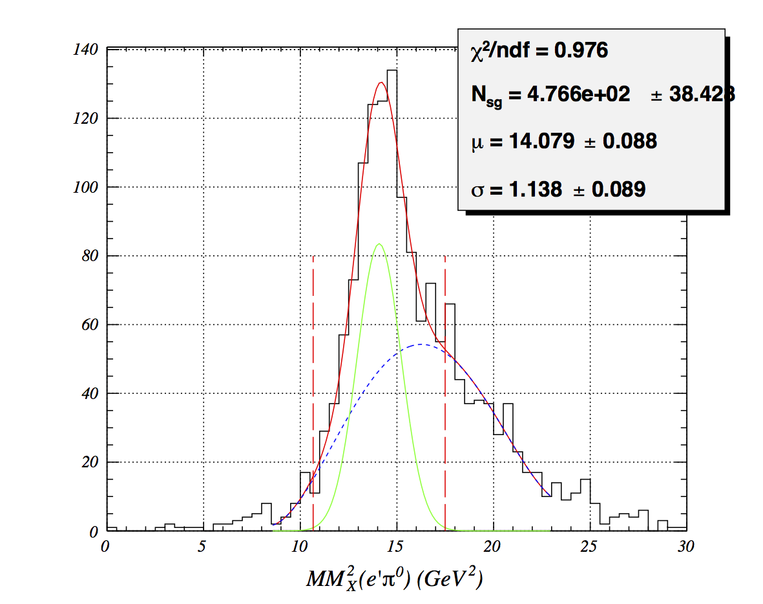
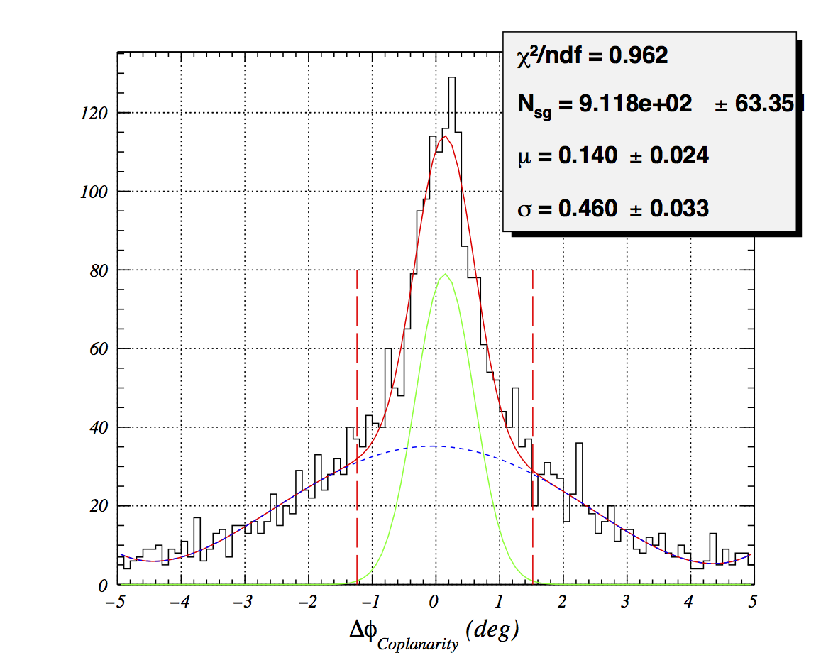
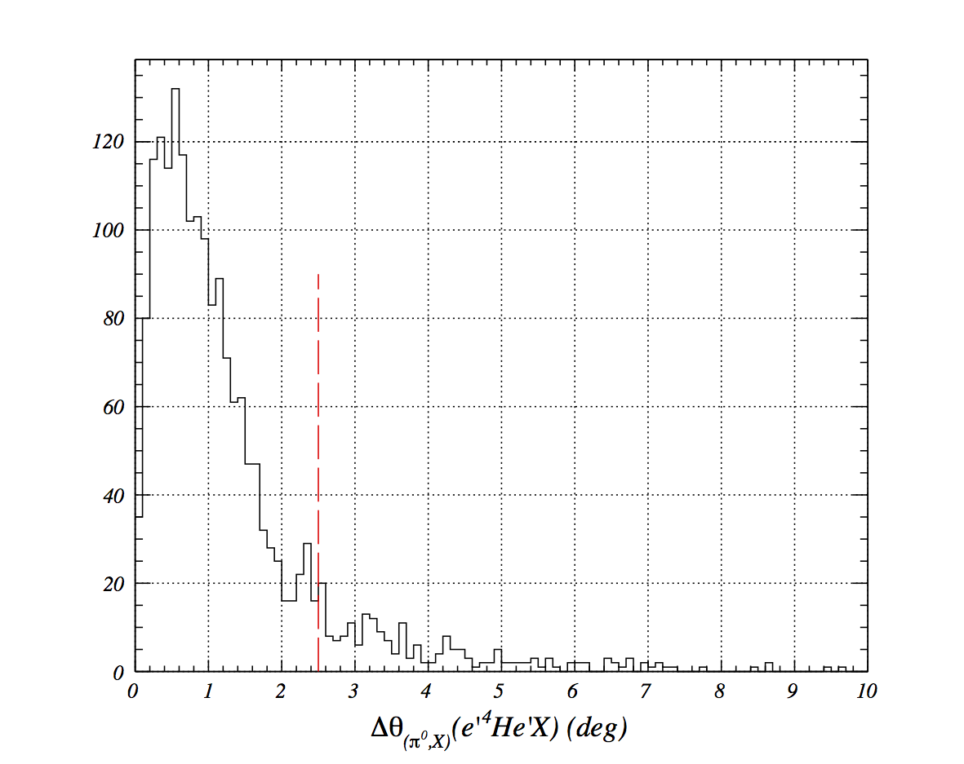
Coherent Selection
Coherent events
Pion momentum cut
Squared Missing Mass cut
Coplanarity
Cone angle between missing pion and detected one
Squared Missing Mass of helium-4

Slide 17
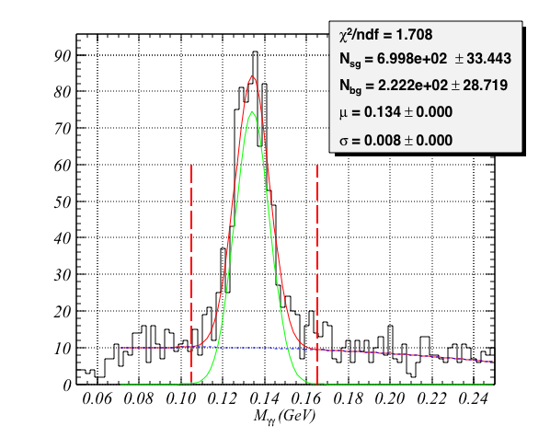
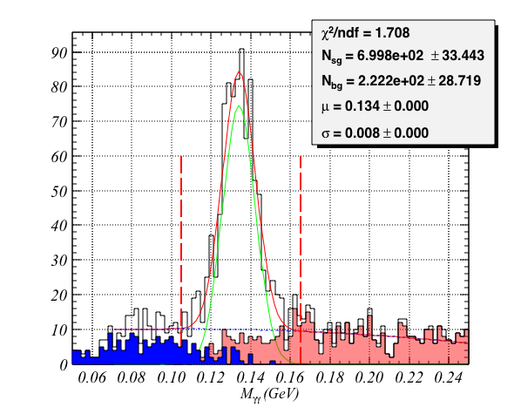
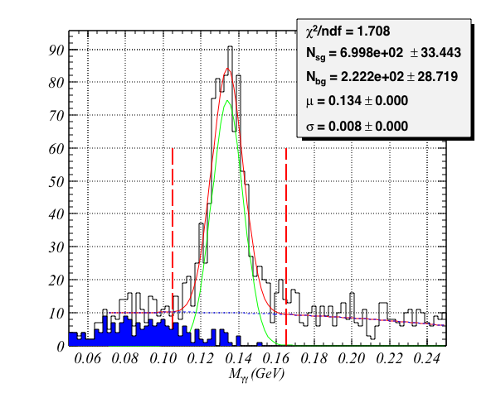
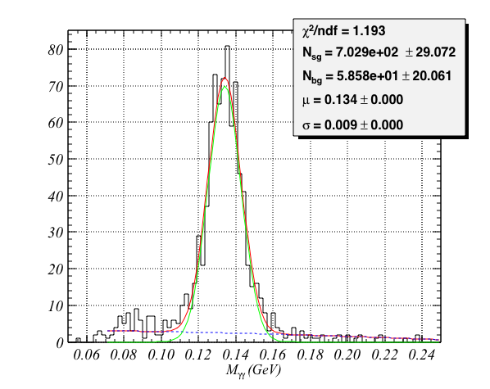
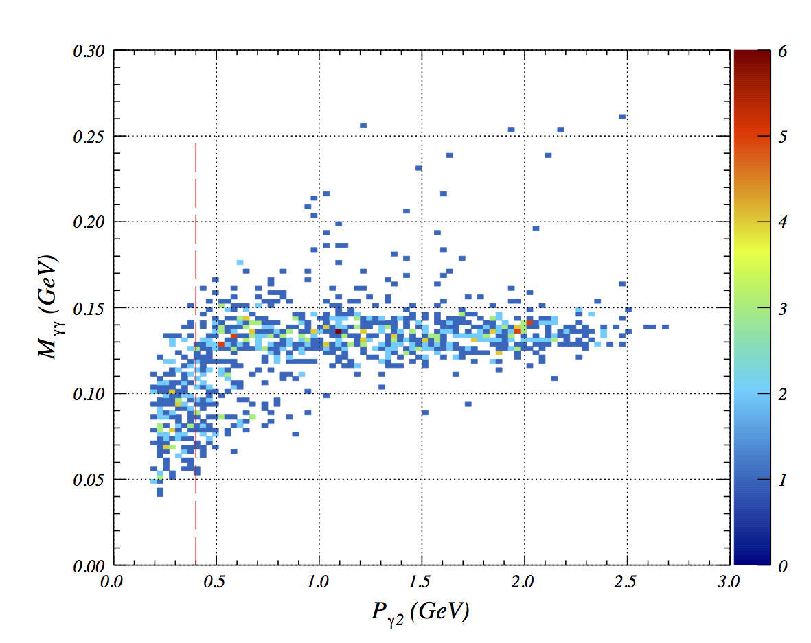
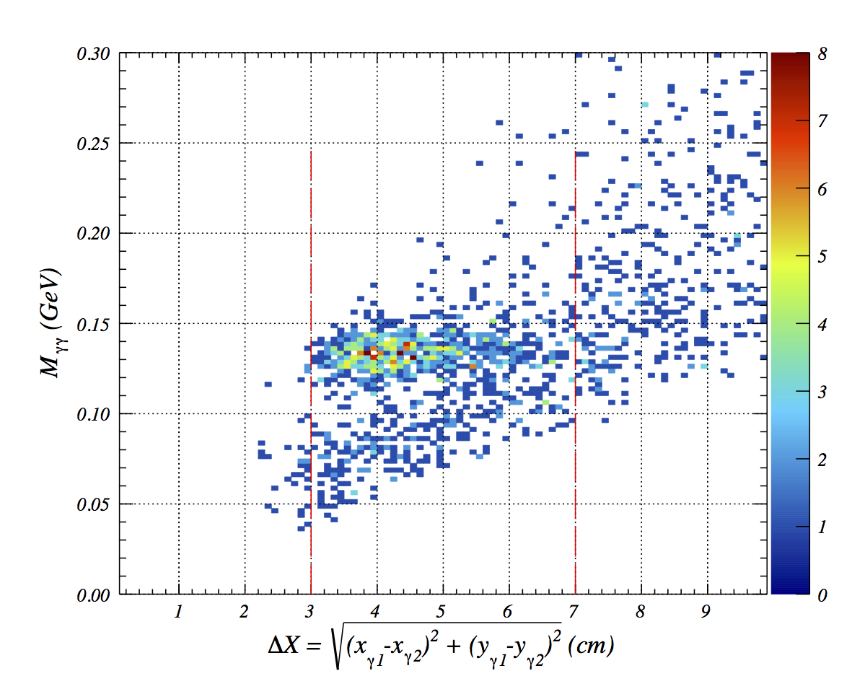
Suppressing background
After applying exclusive cuts, one third of the events are background
Events with photon energy smaller that 400 MeV are rejected
The distance between two photons in IC needs to be smaller than 7.0 cm.

Slide 18
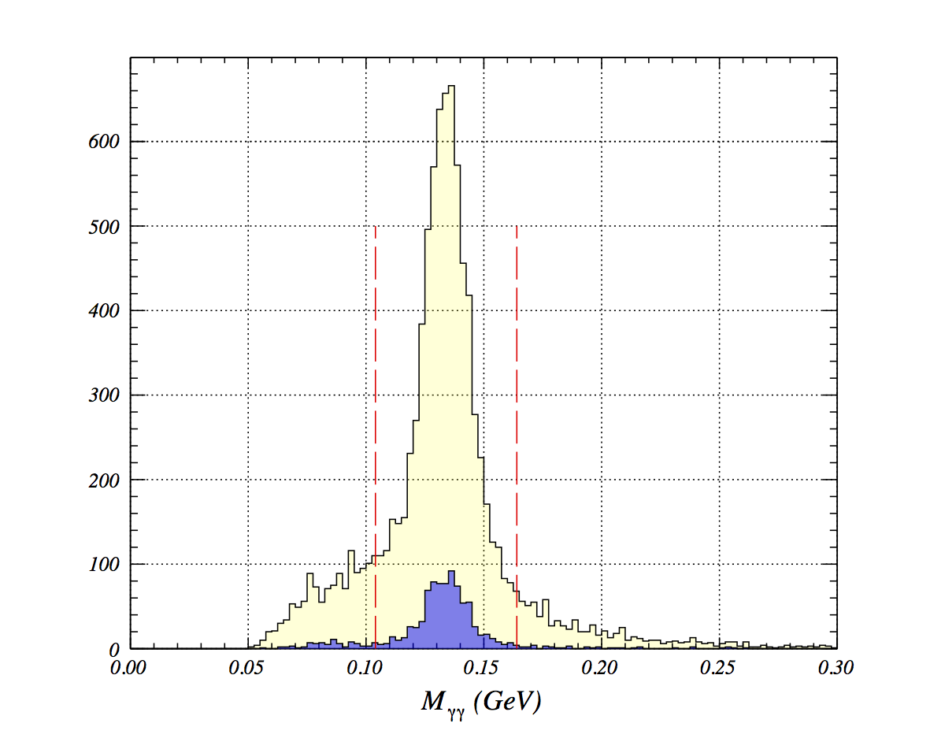
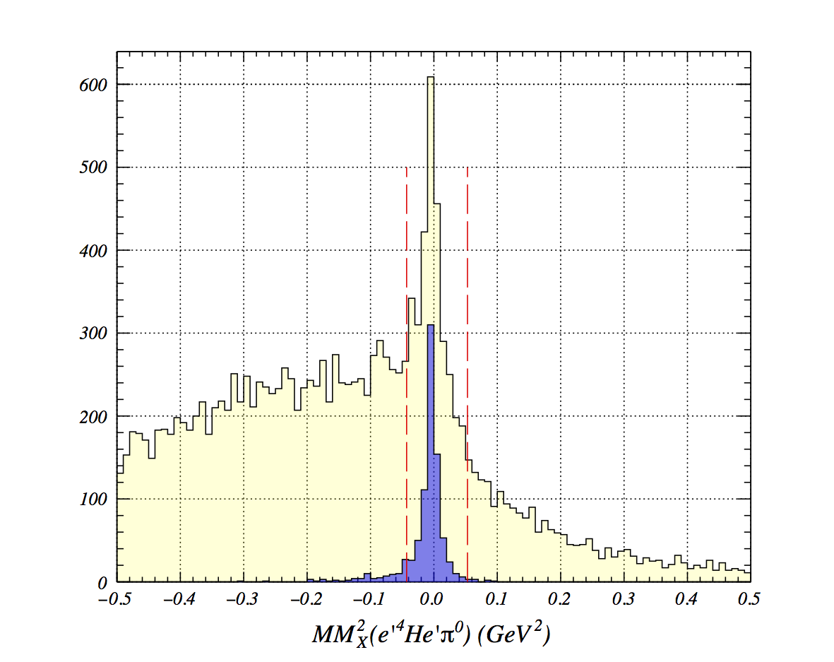
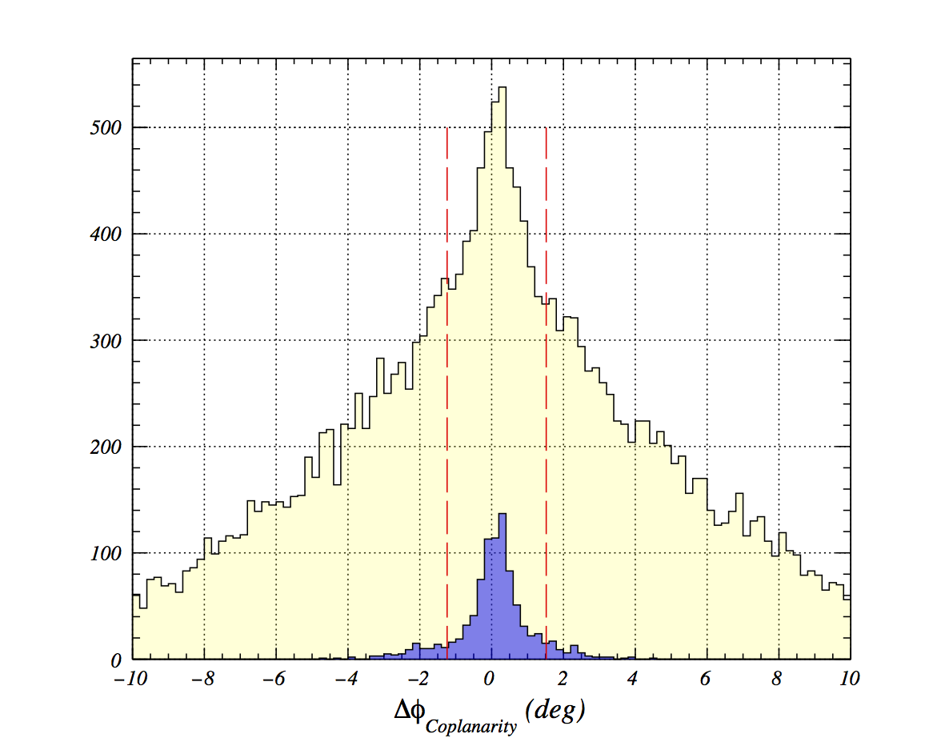
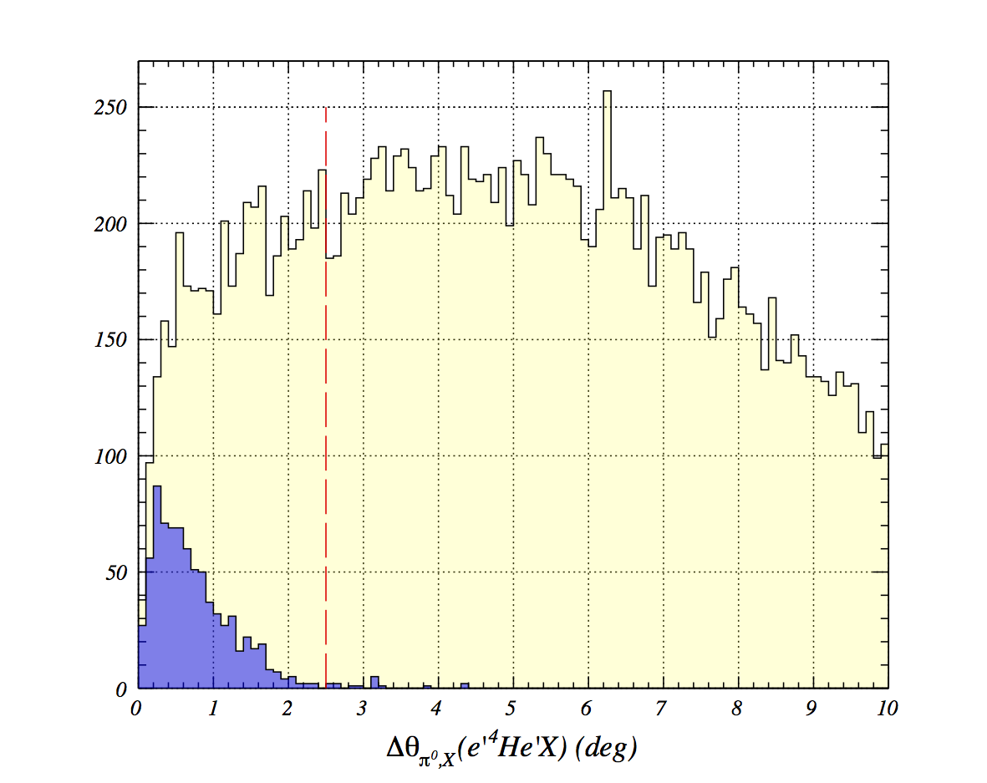
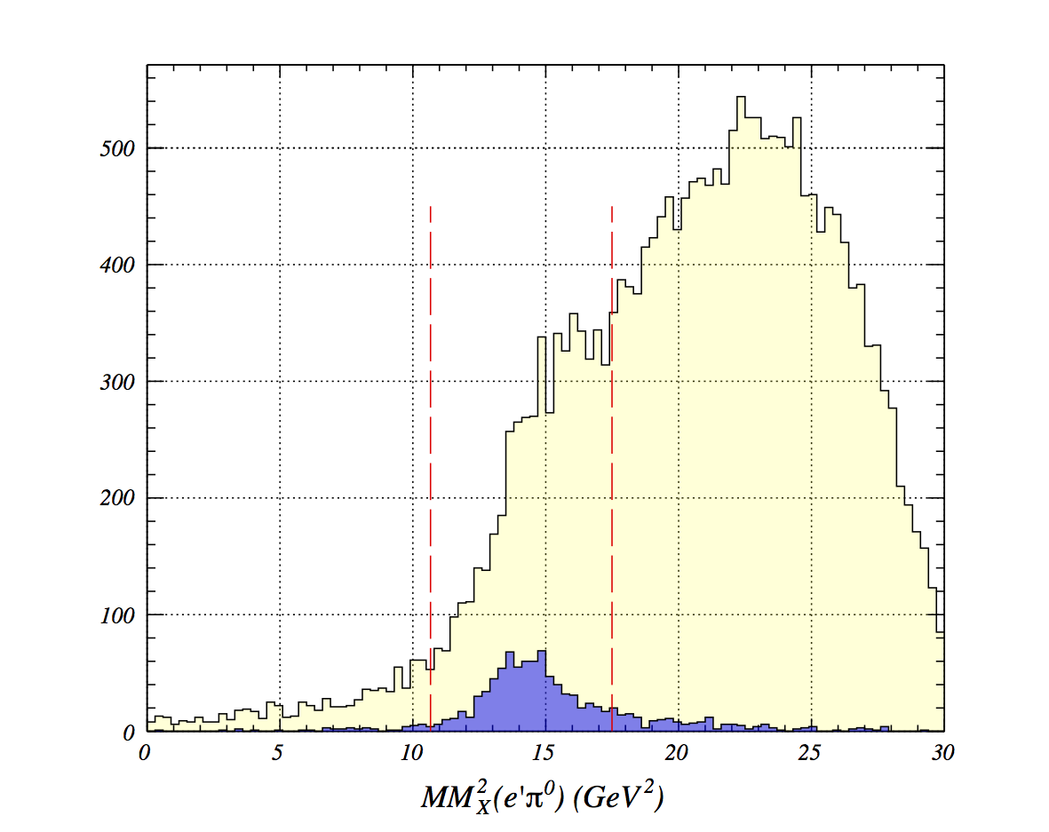
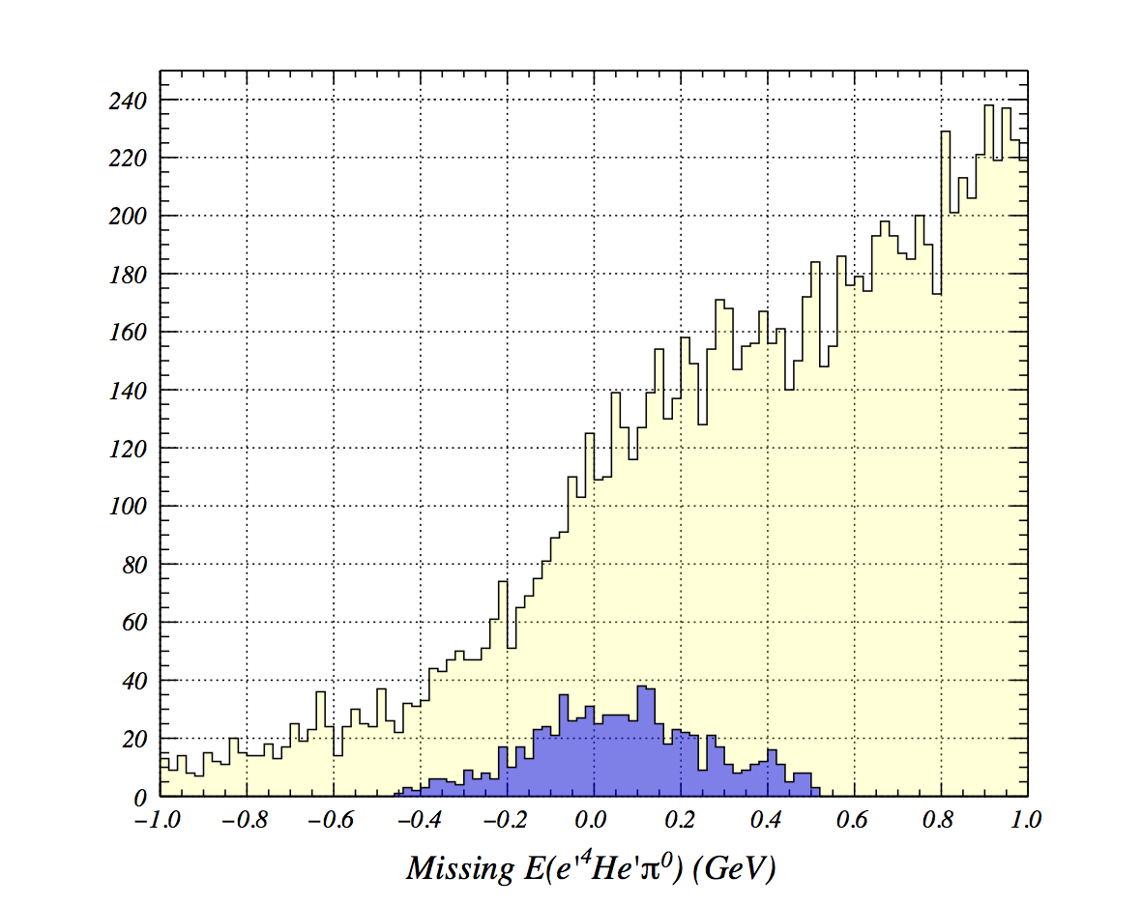
Summary of Coherent Event Selection

Slide 19
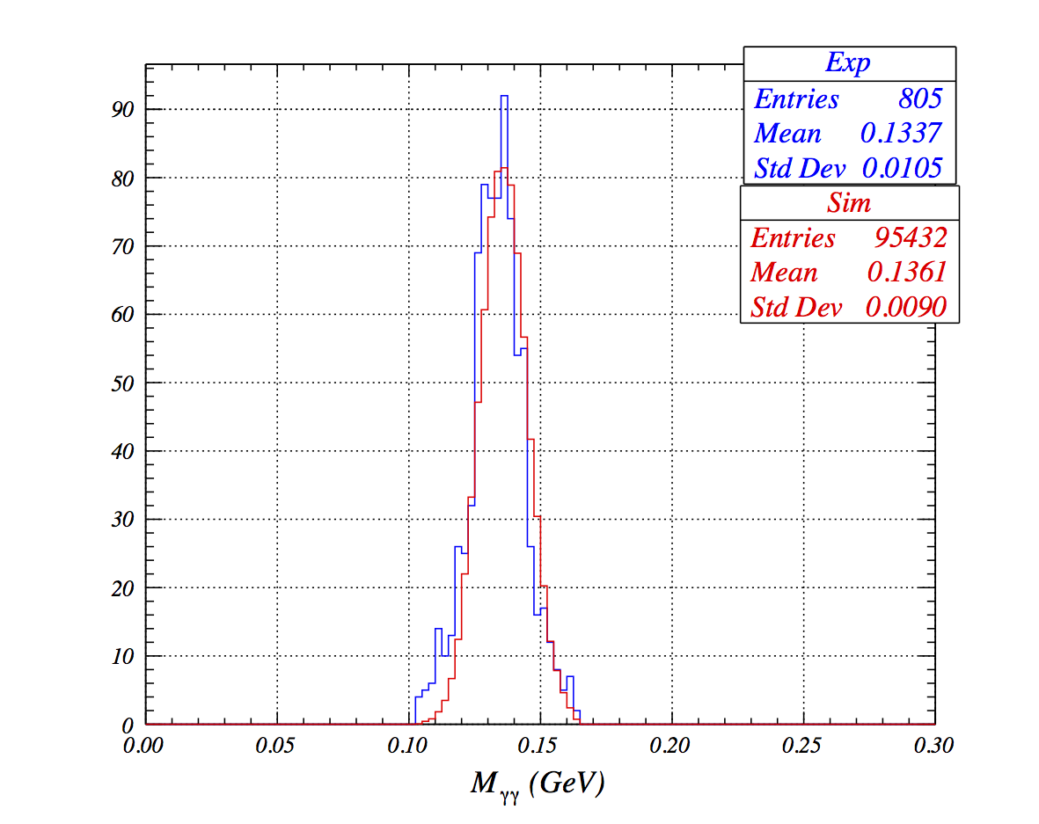
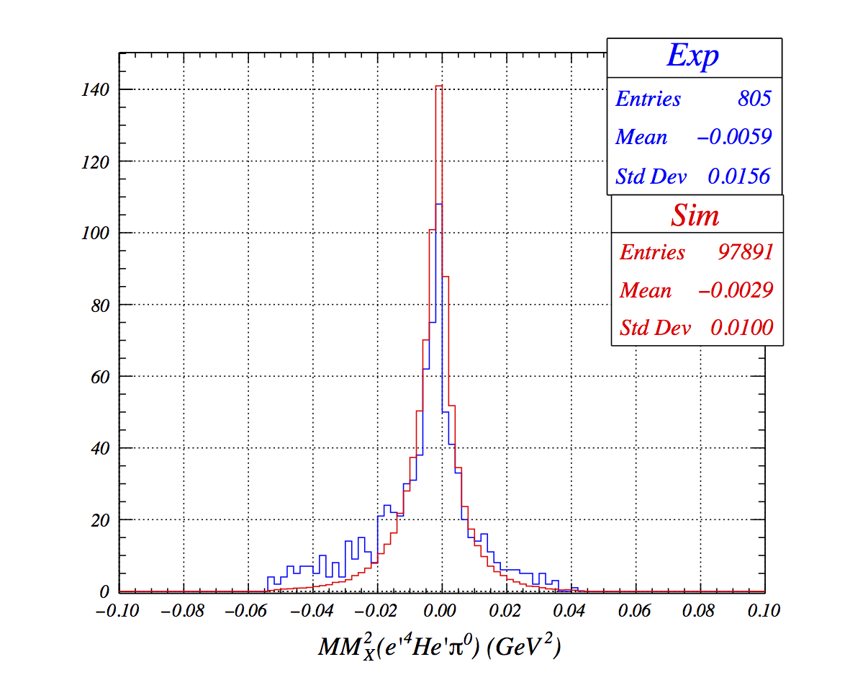


Simulation
Event Generator: (e’ π⁰ ⁴He) events are generated
GSIM: simulates detectors responses to particles
Smearing (GPP): energy, position and time are smeared to make more realistic
RECSIS: reconstruction code (ADCs, TDCs) -> ->physical quantities
fastMC: Simulates RTPC.

Slide 20

Extraction of BSA and Statistical Uncertainty
Beam-Spin Asymmetry is the ratio of the cross-sections of different helicity states.
Data points fitted with αsin(φ) to extract the asymmetry

Slide 21


Systematic Uncertainties
The variables directly proportional to cross-sections will cancel each other in asymmetry measurements. However, some sources can contribute to systematic uncertainty:
Coherent event selection cuts: Asymmetry calculated again by varying the exclusive cuts.
Beam polarization: Global estimated error for Hall-B Moller polarimeter is 3.5% which is taken as a systematic uncertainty.
Fitting Method: The dataset has been fitted with un-binned likelihood method and difference between least square fit method has taken as systematic uncertainty.

Slide 22
Un-binned Maximum Likelihood Fitting Method
Definition of Likelihood
  For convenience the negative log of the Likelihood is often used
Parameters are estimated by maximizing the Likelihood, or equivalently minimizing –log(L)
Functions used in likelihoods
must be Probability Density Functions:

Slide 23

Beam Spin Asymmetry extracted by un-binned likelihood method
Asymmetry extracted by minimizing ->

Slide 24
Summary of Systematic Uncertainties
Sources of Systematic Uncertainty
Squared Missing Mass | 6.7%
Minimum Energy of Photon | 4.5%
Distance between photons | 20.0%
Beam polarization | 3.5%
Fitting method | 14.6%
Total | 26.3%

Slide 25




Results
Proton
Helium-4
M. Hattawy
M. Hattawy
The beam spin asymmetry has same sign in both coherent and incoherent DVCS process on a helium-4 target.
The beam spin asymmetry of coherent pion electroproduction on helim-4 has opposite sign than the asymmetry measured for pion production on the proton
De.Masi et al. CLAS Collaboration

Slide 26


Regge-based model, JML
- Black dotted line: Regge poles only.
- Black dash-dotted line: unitary cuts contribution only Charge Exchange (CEX) and Vector meson cut
- Red dash-dotted line: Vector meson cut alone (J=0).
-: This work: Coherent pion production of helium-4

Slide 27
Summary
The beam spin asymmetry of neutral pion on helium-4has been measured for the first time
Beam spin asymmetry has opposite sign compared to pion production on a proton target
More work on theoretical models need to compare their calculations with the experimental results.

Slide 28

Gas Electron Multiplier (GEM) foils
GEM is made of thin Kapton film covered on both sides with copper layers.
GEM consists high density of holes.
Holes are made by chemical etching.
Gain is obtained by applying potential differences on conductive layers.
Electric field lines in GEM holes

Slide 29

Reconstruction of charged particles in CLAS

Slide 30




Photon Selection in EC and Pion Reconstruction
Neutral particle cut (q=0)
Minimum energy deposit in EC (E_{EC} > 0.3 GeV)
EC fiducial cut

Slide 31





Coherent Event Selection
Neutral pion decays into two photons each of which can be detected either in EC or IC which results in 3 different combinations to reconstruct the pion.
EC-EC
EC-IC
IC-IC

Slide 32
Comparison between χ² and likelihood method
χ² fit is fastest, easiest
  Works fine at high statistics
  Gives absolute goodness-of-fit indication
  Make (incorrect) Gaussian error assumption on low statistics bins
  Has bias proportional to 1/N
  Misses information with feature size < bin size
Un-binned Likelihood
  No Gaussian assumption made at low statistics
  No information lost due to binning
  Gives best error of all methods (especially at low statistics)
  Has bias proportional to 1/N
  Can be computationally expensive for large N

