Slide 1
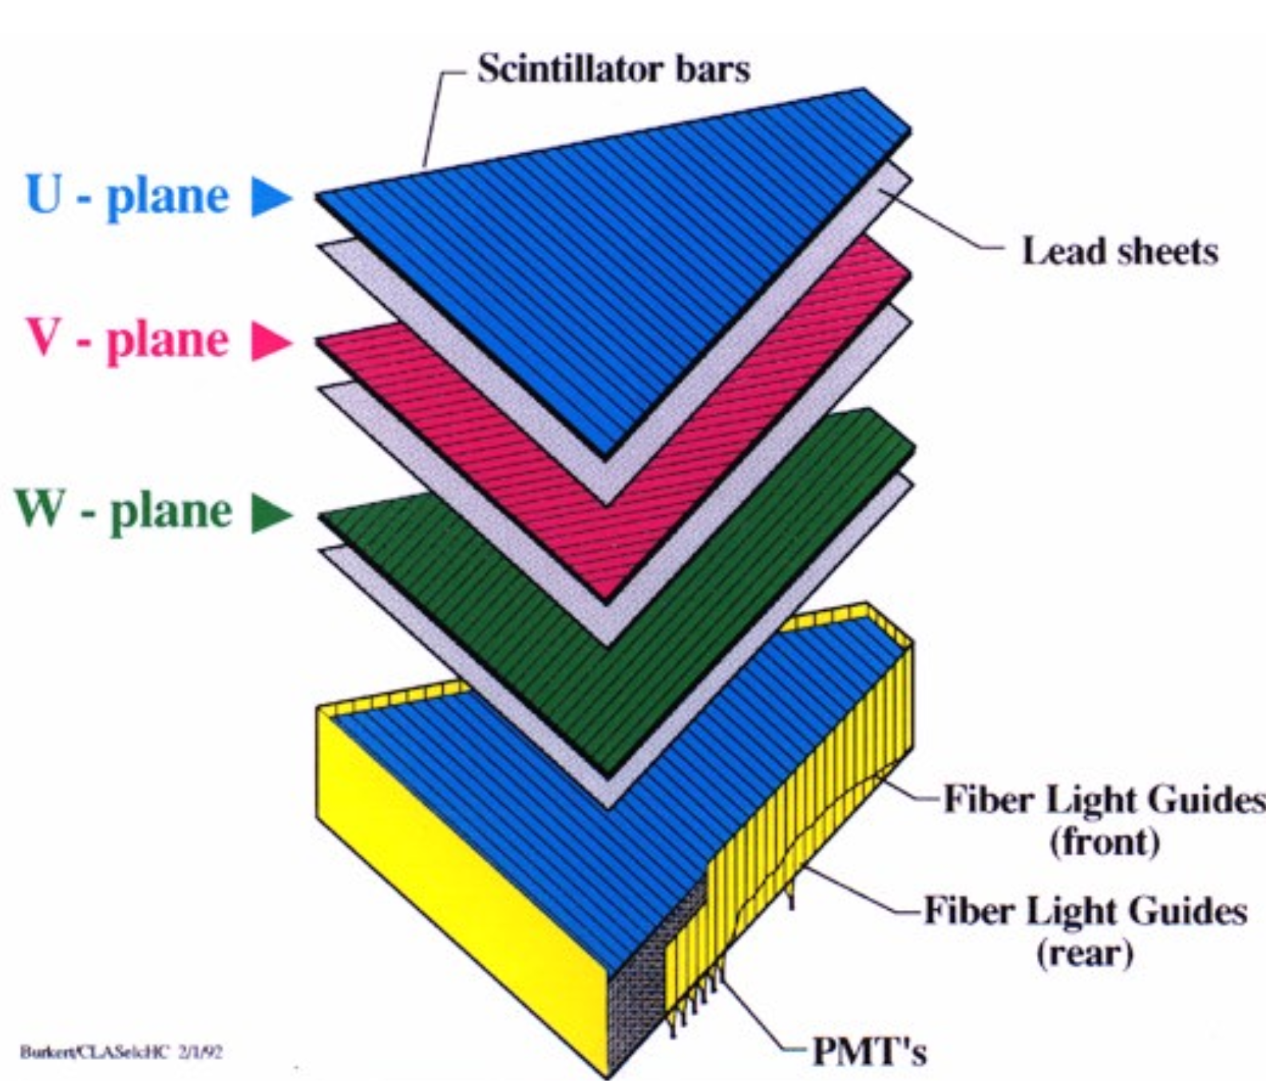
EG6: EC Calibration
Using reconstructed π⁰ and η to calibrate for energy and position of individual photons
Frank Thanh Cao
UConn
Notes:
Meson production of eta, pi0

Slide 2
Shifted π⁰_{ECEC} Invariant Mass
When identifying the π⁰, which are reconstructed by two EC photons, the invariant mass is shifted by ~ 20%.
Notes:
The first step was to break this down by run number to see if there is any particular run that is shifting this mass to be larger…

Slide 3
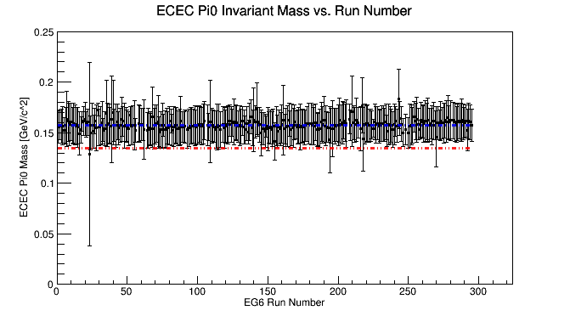
π⁰_{ECEC} Breakdown by Run Index

Slide 4
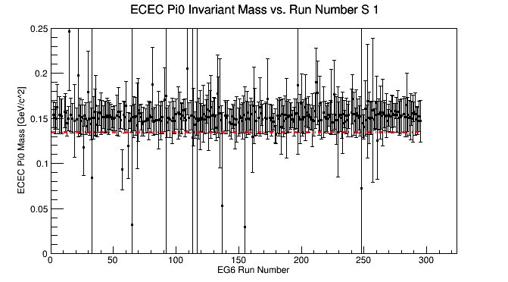
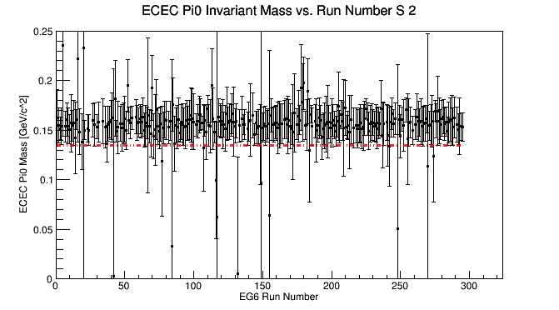
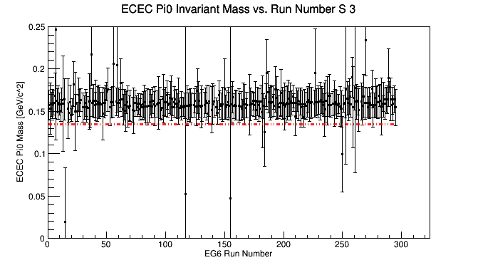
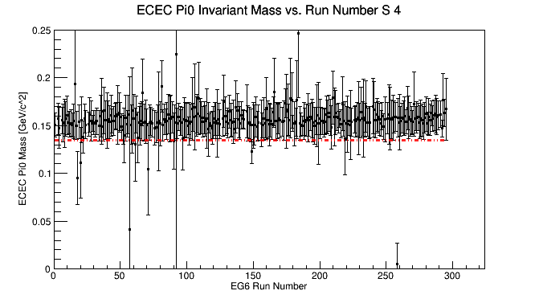
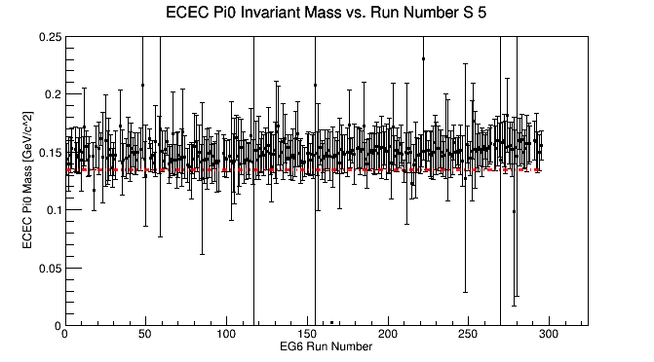
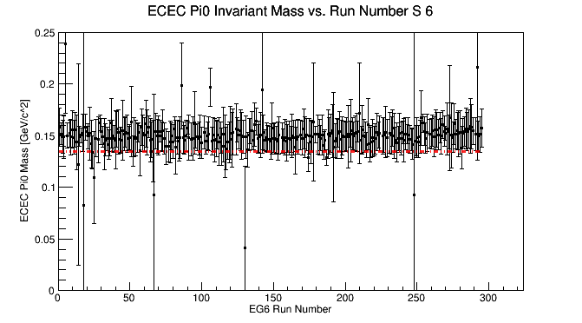
π⁰_{ECEC}: Inv. Mass vs. Run Number by Sector
Notes:
After trying to figure this out and meeting with Kawtar, Whit, and Mohammad, we concluded that the best person was to talk to was Cole Smith. We exchanged emails and I was reminded that there is an EC sampling fraction correction made. The fraction of the energy deposited should not vary in time, but it does due to experimental imperfections. I was also reminded that Nathan did an extensive analysis on this and Mohammad had given me this some time ago...

Slide 5
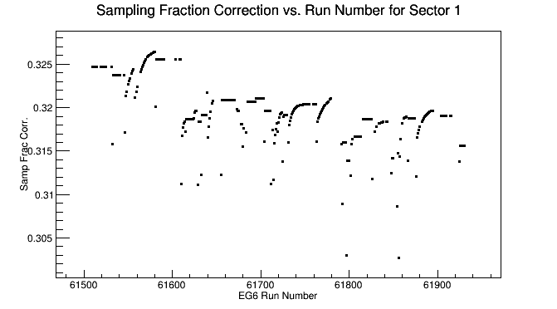
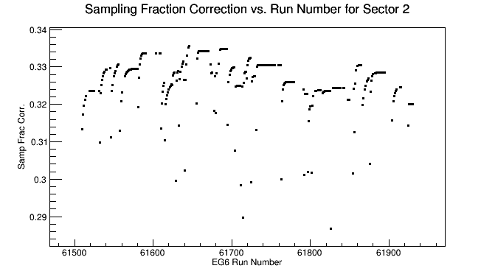
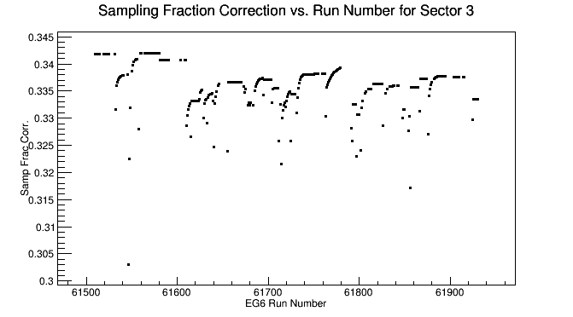
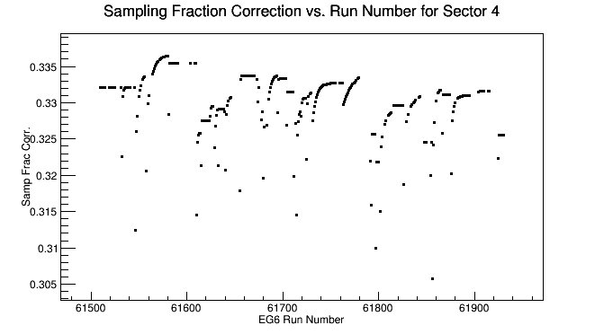
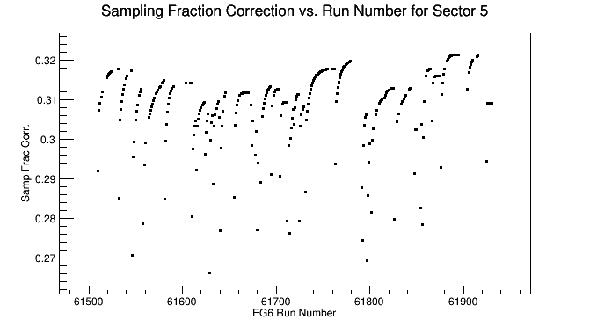
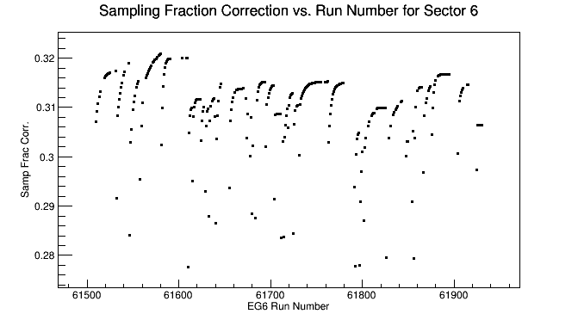
EG6 Sampling Fraction Correction vs. Run Number by Sector
(from Nathan Baltzell)
Notes:
Since the EC is a sampling calorimeter, only energy in the scintillators are

Slide 6
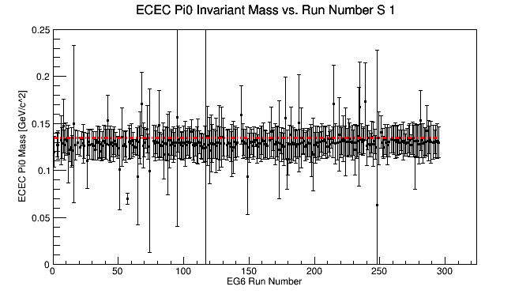
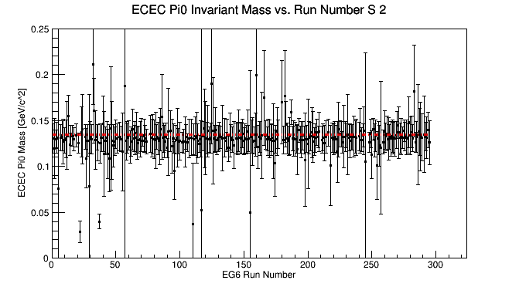
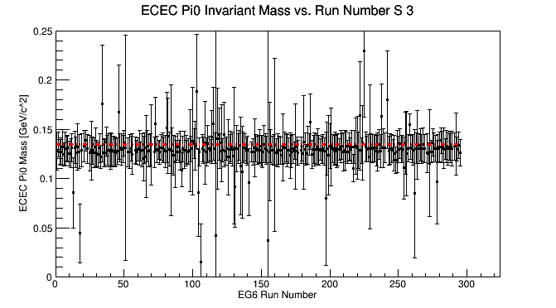
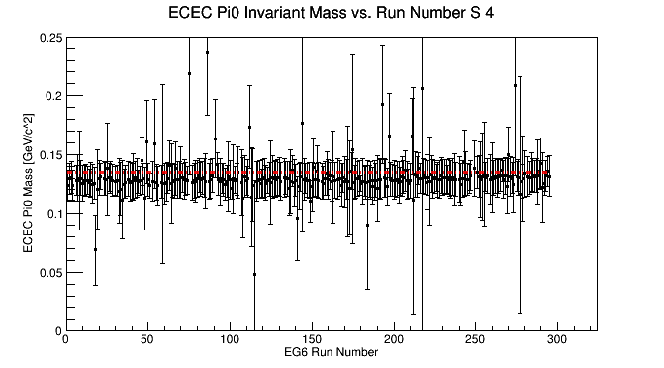
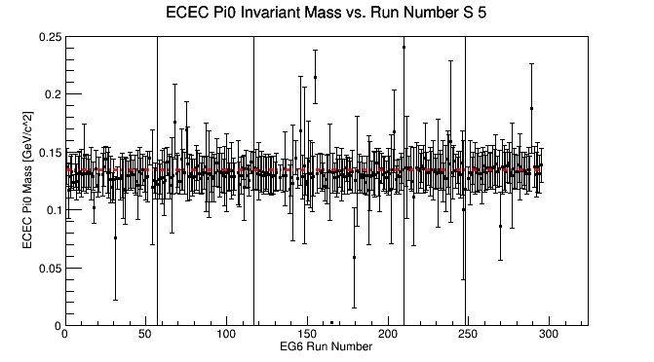
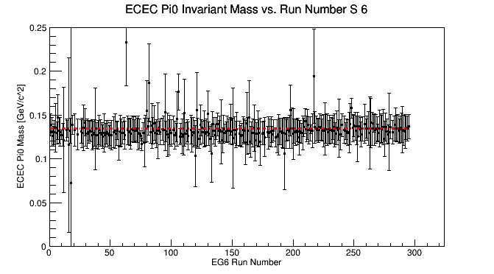
π⁰_{ECEC}: Inv. Mass vs. Run Number by Sector After Corrections

Slide 7
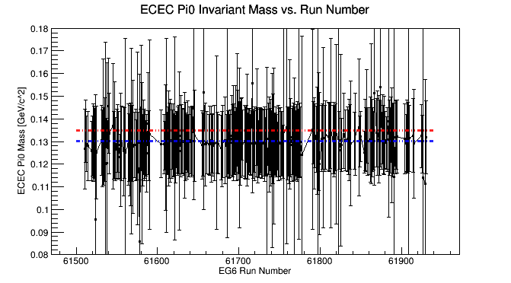
π⁰_{ECEC} Closer Look
Can this be improve?

Slide 8
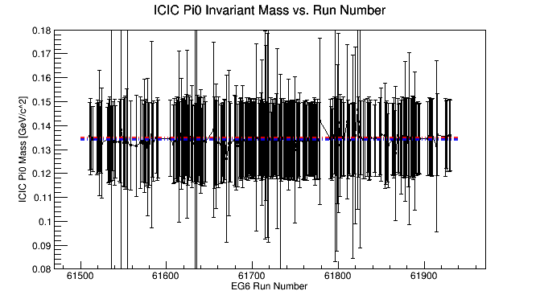
π⁰_{ICIC} Closer Look

Slide 9
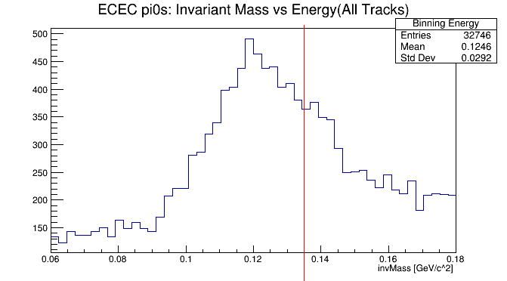
π⁰_{ECEC} Mass Changes with Energy
https://userweb.jlab.org/~fcao/images/invMassByBin.gif

Slide 10
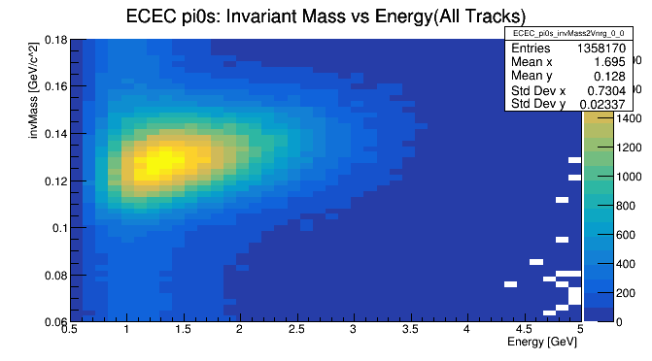
π⁰_{ECEC} Mass Changes with Energy

Slide 11
Scaling Factor
The correction to the photon energy is
If we take the symmetric case, where E₁ ~= E₂ =: E, and solve for c_{SF} , in terms of the energy of the reconstructed π⁰ , we have
With
Notes:
Assuming that the position is well calibrated

Slide 12
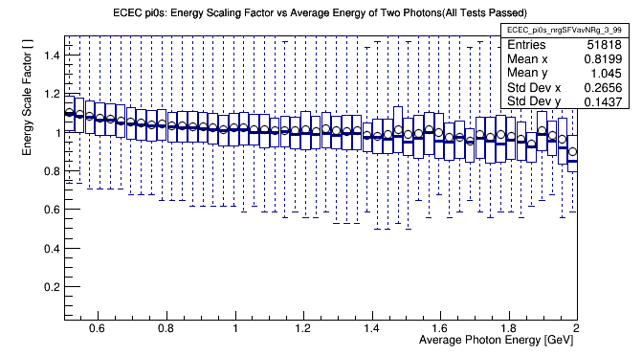
Scaling Factor vs. Average Photon Energy
Notes:
Explain Candleplot

Slide 13
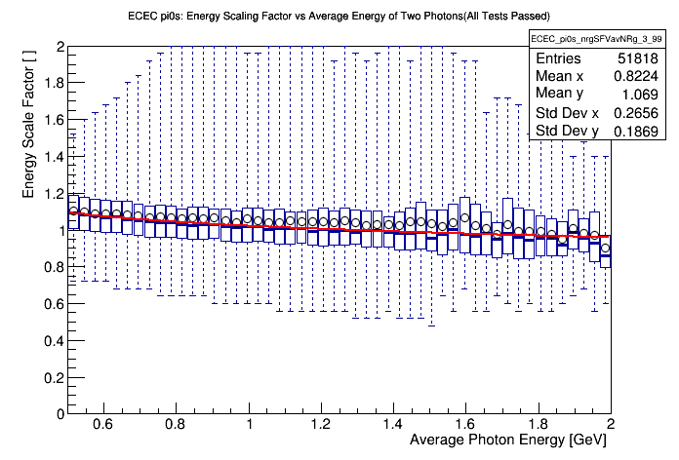
Scaling Factor Correction

Slide 14
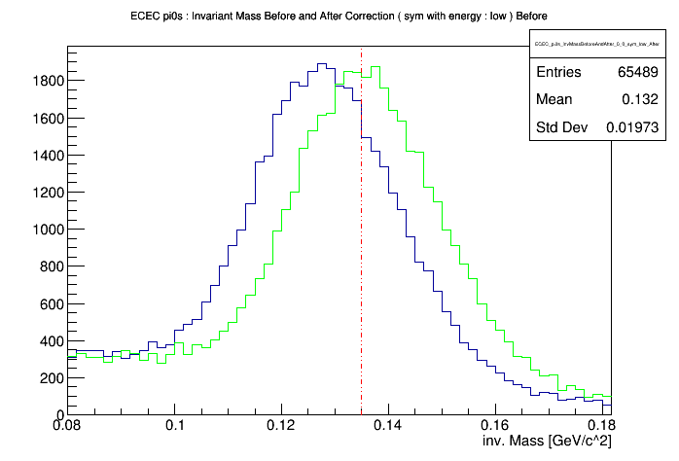
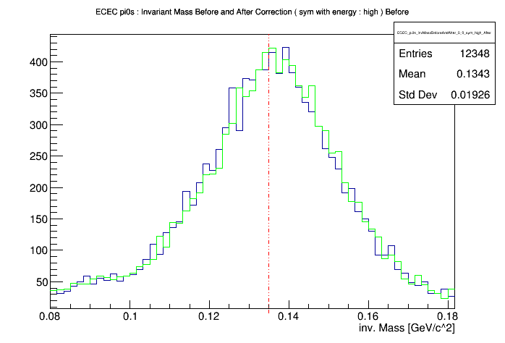
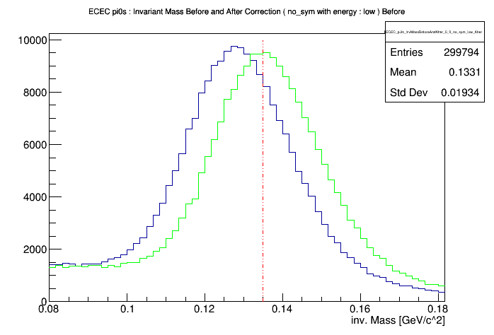
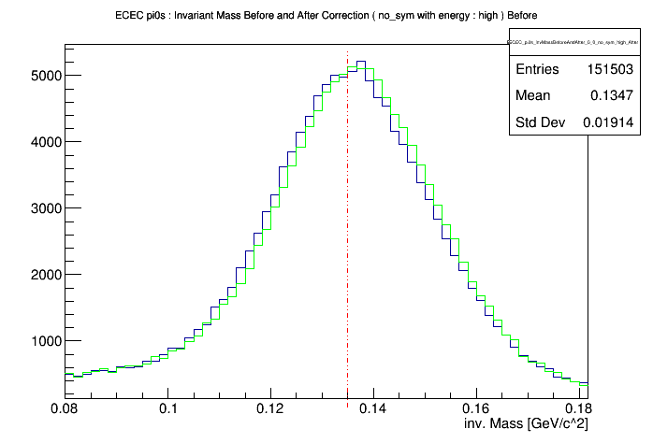
Scaling Factor Results
Low Energy (E ≤ 1.8 GeV)
High Energy (E > 1.8 GeV)
With Symm. Cut
No Symm. Cut

Slide 15
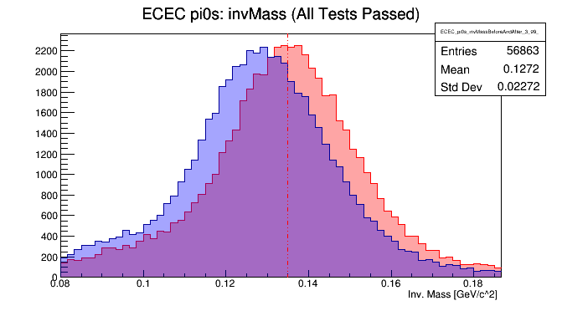
Scaling Factor Results

Slide 16
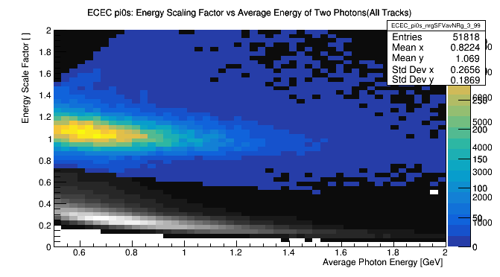
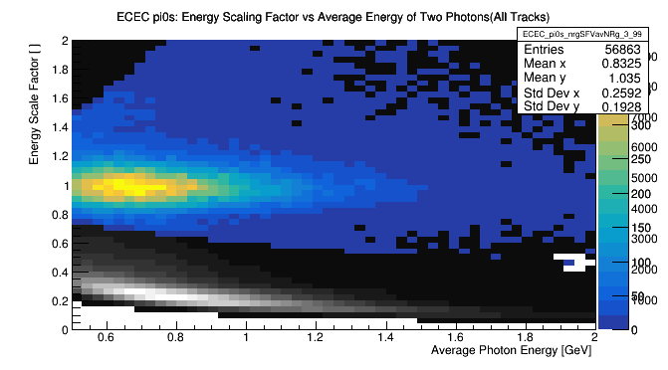
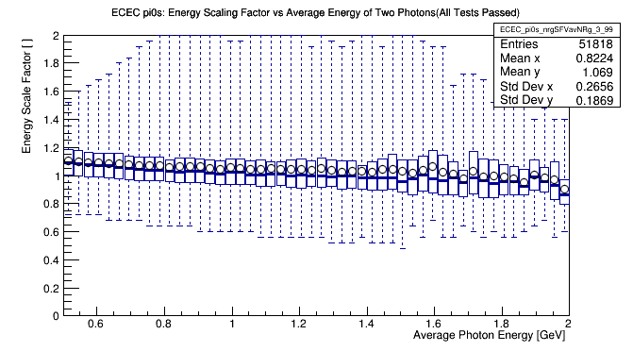
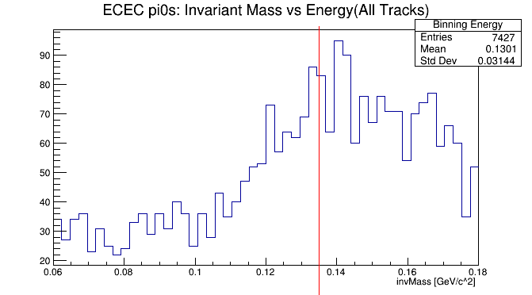
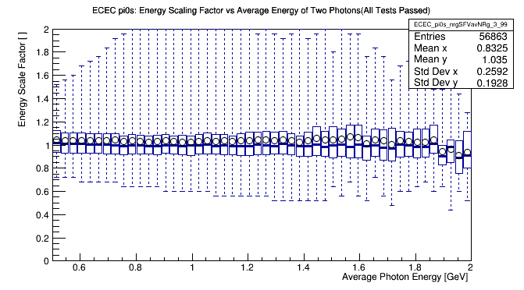
Scaling Factor Results
Before
After
Scale Factor Vs. Energy
Scale Factor Vs. Energy
https://userweb.jlab.org/~fcao/

Slide 17
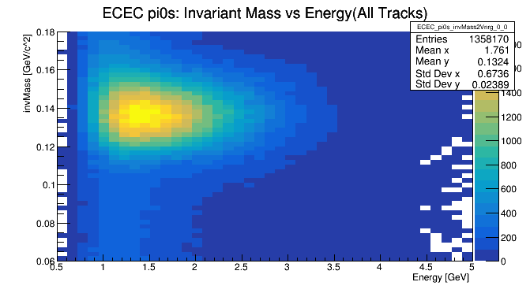
Scaling Factor Results
Before
After
Mass vs Energy
Mass (Stepping
through Energy)
https://userweb.jlab.org/~fcao/images/invMassByBin.gif
https://userweb.jlab.org/~fcao/images/invMassByBin_After.gif

Slide 18
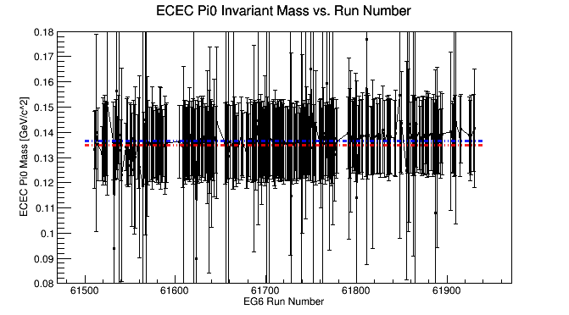
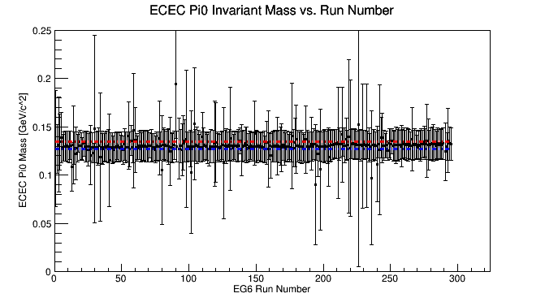
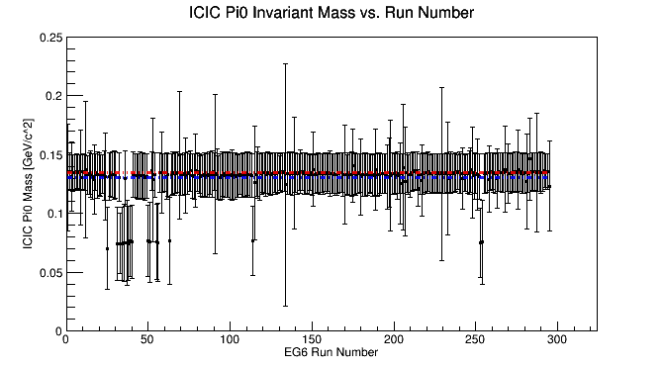
π⁰_{ECEC} Results
Before
After
The π⁰_{ECEC} invariant mass is much closer to where it should be and photon energies in the EC have been corrected.
Ultimately, with a better handle on the EC photon, we can have more confidence in reconstructing both π⁰ and η in the EC.

Slide 19
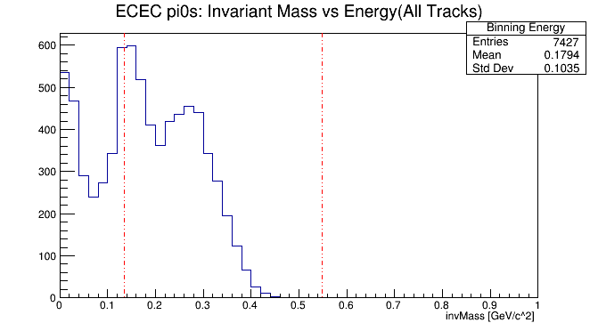
Invariant Mass of EC Photon Pairs
https://userweb.jlab.org/~fcao/images/invMassByBin_fullRangeAfter.gif

Slide 20
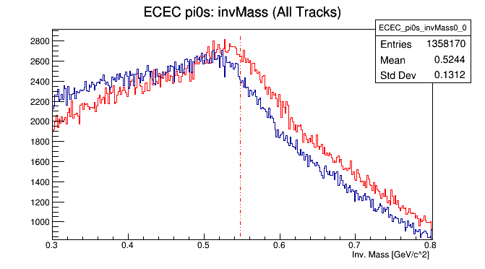
η_{ECEC} Dominated by Background

Slide 21
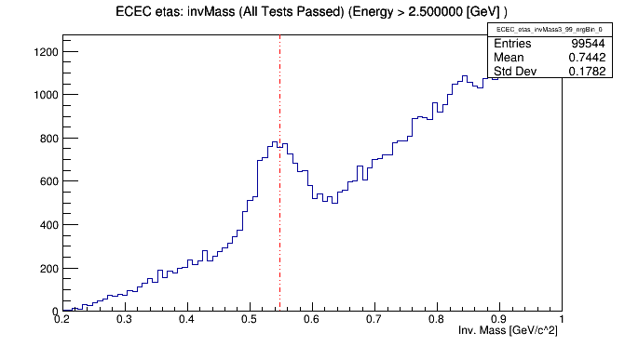
η_{ECEC} with Energy Cut

Slide 22
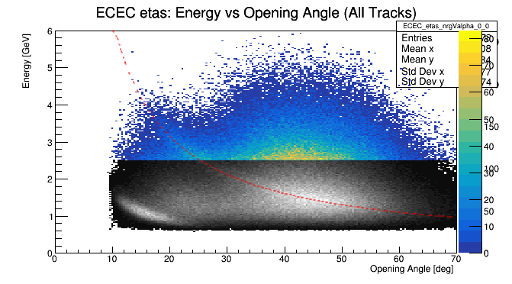
Statistics Lost with Energy Cut

Slide 23
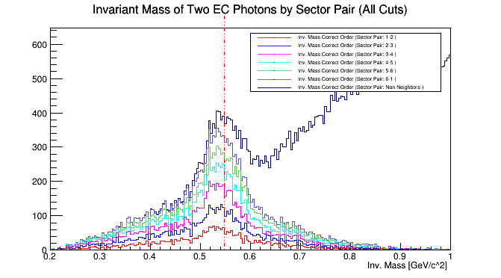
η_{ECEC} Breakdown

Slide 24
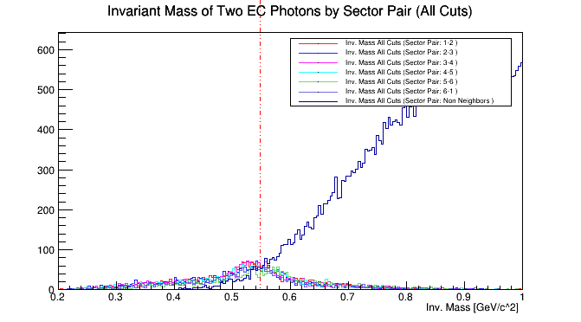
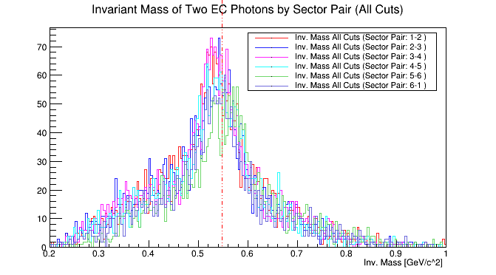
η_{ECEC} Breakdown

Slide 25
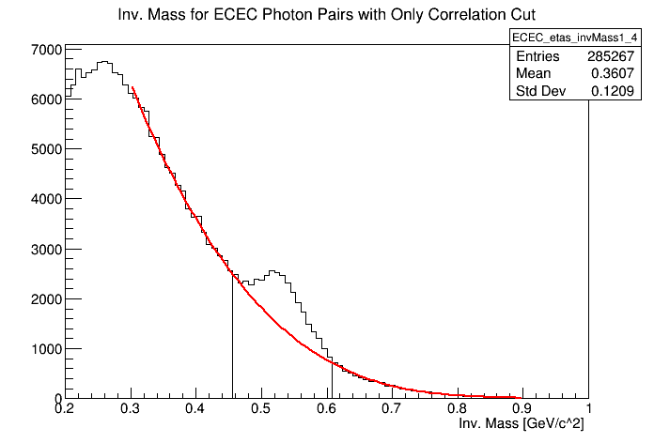
Without Energy Cut, With Correlation Cut

Slide 26
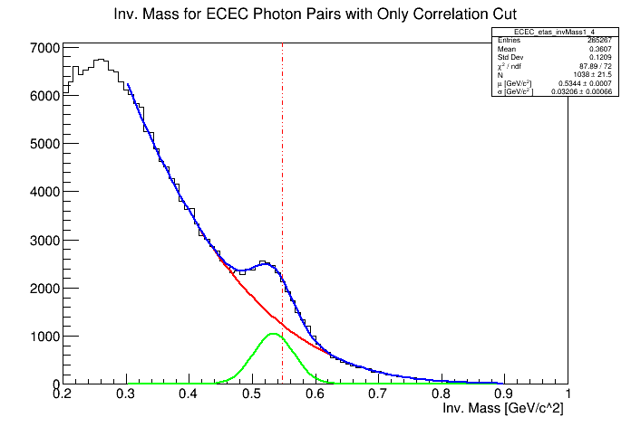
Without Energy Cut, With Correlation Cut

Slide 27
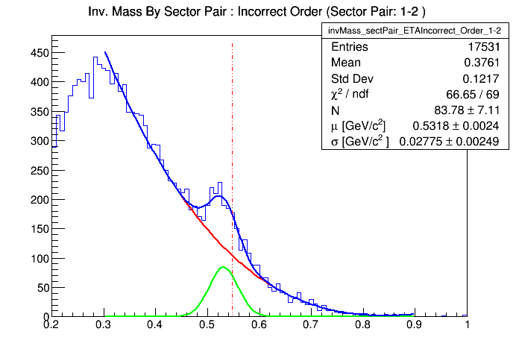
η_{ECEC}: Invariant Mass Distribution for E_{η} > 1.0 GeV

Slide 28
η_{ECEC}: Invariant Mass Distribution for E_{η} > 1.5 GeV

Slide 29
η_{ECEC}: Invariant Mass Distribution for E_{η} > 2.5 GeV

Slide 30
η_{ECEC}: Signal to Background Vs. Energy Threshold

Slide 31
Conclusion and Outlook
Using reconstructed π⁰ and η, we set constraints on the reconstructed photons in the EC
With a good handle on the photons in the EC we have added statistics to DVCS and DVMP processes
Signal to Noise Ratio studies hint at using an energy threshold for η reconstruction
We plan to use exclusivity cuts to further improve our confidence in π⁰ and η candidates and further improve the EC calibration

Slide 32
Backup Slides
Because you never know what questions you’re going to get
Notes:
Meson production of eta, pi0

Slide 33
Scaling Factor vs. Average Photon energy

Slide 34
Photon Pair Opening Angle

Slide 35
Correlation Cut Only

Slide 36
Sector Pair with Leading Energy
https://userweb.jlab.org/~fcao/

Slide 37
Exclusivity Studies
Coherent Channel:
DVCS
pi0
Eta
Incoherent Channel:
DVCS
pi0
eta

